Slide 1
Bolometers Based on Co/AlOx/Al/EuS Tunneling Junctions

Slide 2
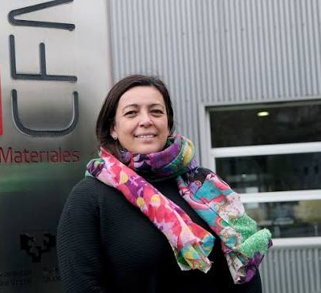






C. Rogero
F.S. Bergeret
M. Ilyn
Materials for Quantum Technologies group

Slide 3
What’s new in the bolometers Based on Co/AlOx/Al/EuS Tunneling Junctions?

Slide 4
What’s new in the bolometers Based on Co/AlOx/Al/EuS Tunneling Junctions?
Cryogenic thermoelectric element

Slide 5
What’s new in the bolometers Based on Co/AlOx/Al/EuS Tunneling Junctions?
Cryogenic thermoelectric element
Self-powered sensor

Slide 6
What’s new in the bolometers Based on Co/AlOx/Al/EuS Tunneling Junctions?
Cryogenic thermoelectric element
Self-powered sensor
Thermoelectric detector of X-ray radiation
  NEP of 1..10 aW/(Hz)**1/2
  energy resolution of 2 eV at 6 keV
  pulse decay times down below 100 μs.
Thermoelectric detector of THz (here, 100 GHz to 1.5 THz) radiation
  NEP of 1..10 aW/(Hz)**1/2
  time constant below 100 ps.

Slide 7
How does it work?
Sebastián Bergeret
Tero Heikkilä
“Predicted Very Large Thermoelectric Effect in Ferromagnet-Superconductor Junctions in the Presence of a Spin-Splitting Magnetic Field”, Phys. Rev. Lett. 112, 057001 (2014)

Slide 8
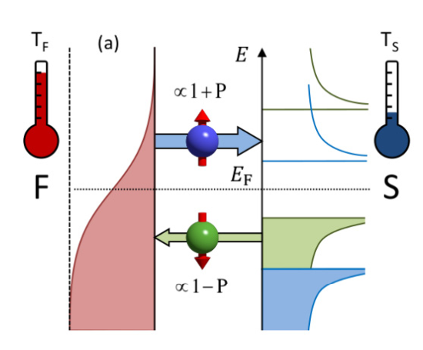
How does it work?
Kolenda S, Sürgers C, Fischer G and Beckmann D Phys. Rev. B 95, 224505 (2017)
Sebastián Bergeret
Tero Heikkilä
“Predicted Very Large Thermoelectric Effect in Ferromagnet-Superconductor Junctions in the Presence of a Spin-Splitting Magnetic Field”, Phys. Rev. Lett. 112, 057001 (2014)

Slide 9
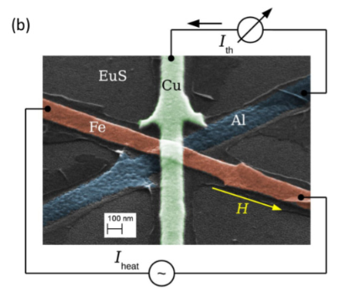
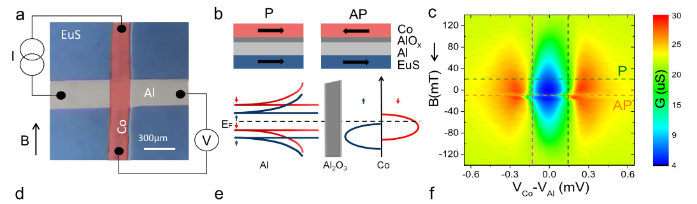
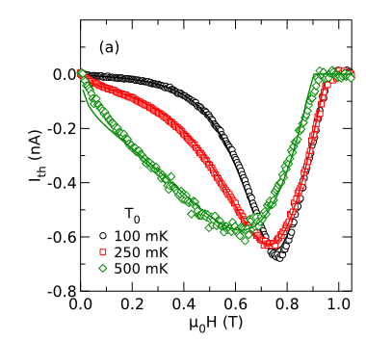
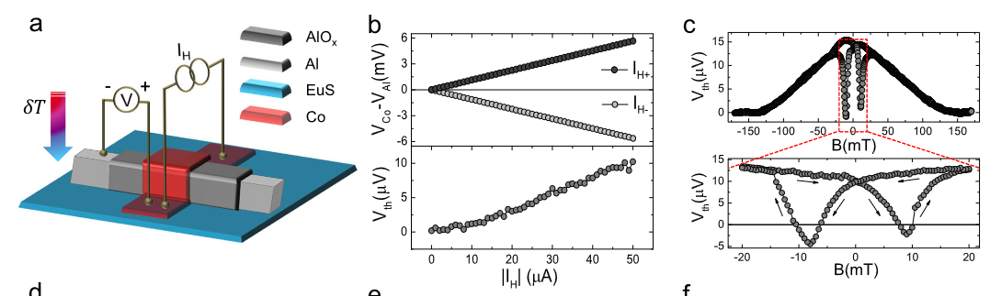
Does it work?
Kolenda S, Sürgers C, Fischer G and Beckmann D
Phys. Rev. B 95, 224505 (2017)
Araujo, C. I. L. de; Virtanen, P.; Spies, M.; González-Orellana, C.; Kerschbaumer, S.; Ilyn, M.; Rogero, C.; Heikkilä, T. T.; Giazotto, F.; Strambini, E. Superconducting Spintronic Heat Engine.
Nat Commun 2024, 15 (1), 4823

Slide 10
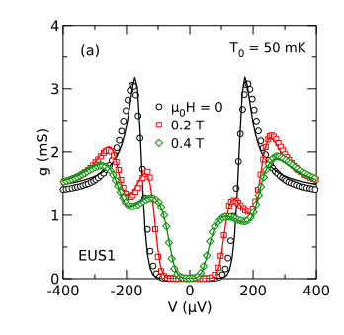
Beckmann´s results

Slide 11
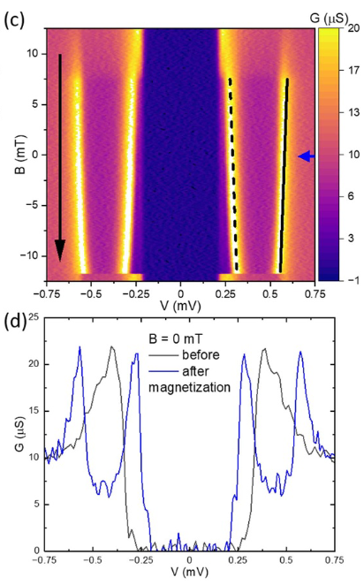
Beckmann´s results
Our Al/AlOx/Al/EuS

Slide 12
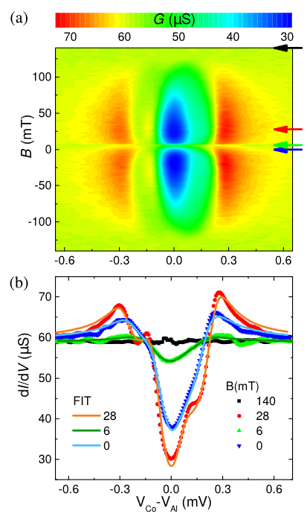
Beckmann´s results
Our Al/AlOx/Al/EuS
Our Co/AlOx/Al/EuS

Slide 13
X-Ray sensor Ilari Maasilta (ilari.j.maasilta@jyu.fi )
Geng Zhuoran (zhuoran.z.geng@jyu.fi )
THz sensor Alessandro Monfardini (alessandro.monfardini@neel.cnrs.fr)

Slide 14
X-Ray Calorimeter

Slide 15
X-Ray Calorimeter
When a photon hits the superconducting absorber, it generates a population of quasiparticles which is proportional to the released energy.
These quasiparticles travel through the superconducting layer of the transducer towards the junction.

Slide 17
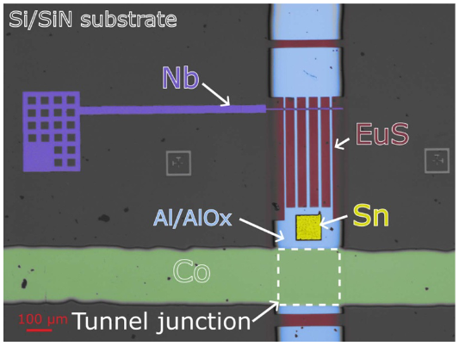

Slide 18
• Thickness determines the absorption efficiency of the incoming
X-rays (also known as stopping power). In principle, thicker layers
are better for this task, as each photon interacts through a
greater length with the material, transferring its energy to it.
• Area determines the rate of the X-ray events (cross
section). A larger area increases the number of
absorbed photons.
• Volume determines the heat
capacity, which dictates
the peak signal and the
ultimate energy resolution.
Larger volume reduces the signal
level and degrades the resolution.

Slide 19
Crossover from amplifier limited NEP (dashed line) to detector limited NEP at high T
The energy resolution and (b) time constants of a SFTED X-ray calorimeter with the different
SQUID options.
“Thermoelectric Radiation Detector Based on Superconductor-ferromagnet Systems”
Phys. Rev. App.. 10, 034053 (2018).

Slide 20
THz Calorimeter

Slide 21
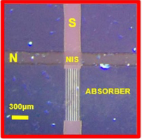
THz Calorimeter

Slide 22
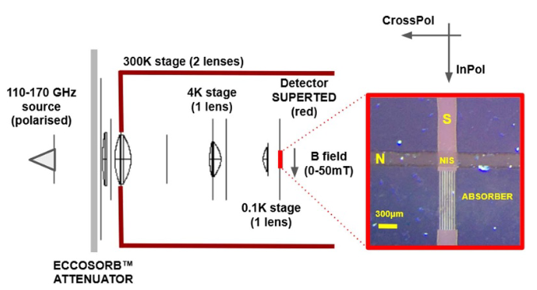
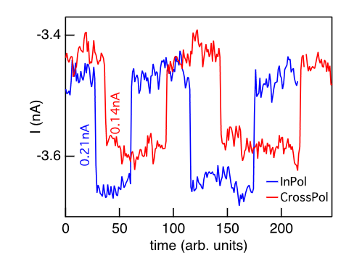
Zero bias current flowing into the N electrode as a function of the 150 GHz illumination conditions (polarisation, and ON/OFF). H = 20 mT along the direction of the superconductor (S) and T = 120 mK.
Geng, Z.; Hijano, A.; Ilić, S.; Ilyn, M.; Maasilta, I.; Monfardini, A.; Spies, M.; Strambini, E.; Virtanen, P.; Calvo, M.; González-Orellána, C.; Helenius, A. P.; Khorshidian, S.; De Araujo, C. I. L.; Levy-Bertrand, F.; Rogero, C.; Giazotto, F.; Bergeret, F. S.; Heikkilä, T. T.
Superconductor-Ferromagnet Hybrids for Non-Reciprocal Electronics and Detectors.
Supercond. Sci. Technol. 2023, 36 (12), 123001

Slide 23
Bolometer integrating Tiebow antennas for detection of radiation in the THz range
A nearby capacitor is used to create a resonator.
The feed line on top of the image is used to read the changes in amplitude and phase of a bias signal.
Antenna is fabricated from theSC material with bigger bangap

Slide 24
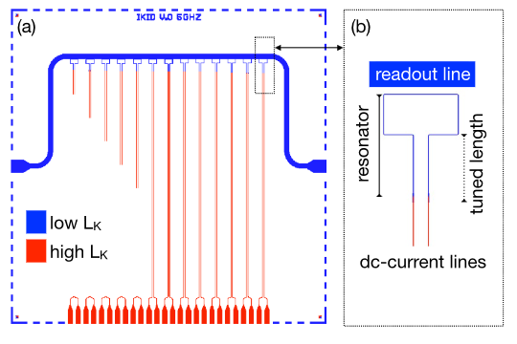
Design of the iKID readout scheme with two different materials design (a) Resonators (in blue) are to connect to the detectors (not shown) via the dc-current lines (in red). The blue horizontal line is a readout line to monitor the resonance frequencies. (b) Zoom on a resonator.
Geng, Z.; Hijano, A.; Ilić, S.; Ilyn, M.; Maasilta, I.; Monfardini, A.; Spies, M.; Strambini, E.; Virtanen, P.; Calvo, M.; González-Orellána, C.; Helenius, A. P.; Khorshidian, S.; De Araujo, C. I. L.; Levy-Bertrand, F.; Rogero, C.; Giazotto, F.; Bergeret, F. S.; Heikkilä, T. T.
Superconductor-Ferromagnet Hybrids for Non-Reciprocal Electronics and Detectors.
Supercond. Sci. Technol. 2023, 36 (12), 123001

Slide 25
What’s new in the bolometers Based on Co/AlOx/Al/EuS Tunneling Junctions?
Cryogenic thermoelectric element
Self-powered sensor
Thermoelectric detector of X-ray radiation
  NEP of 1..10 aW/(Hz)**1/2
  energy resolution of 2 eV at 6 keV
  pulse decay times down below 100 μs.
Thermoelectric detector of THz (here, 100 GHz to 1.5 THz) radiation
  NEP of 1..10 aW/(Hz)**1/2
  time constant below 100 ps.

Slide 26
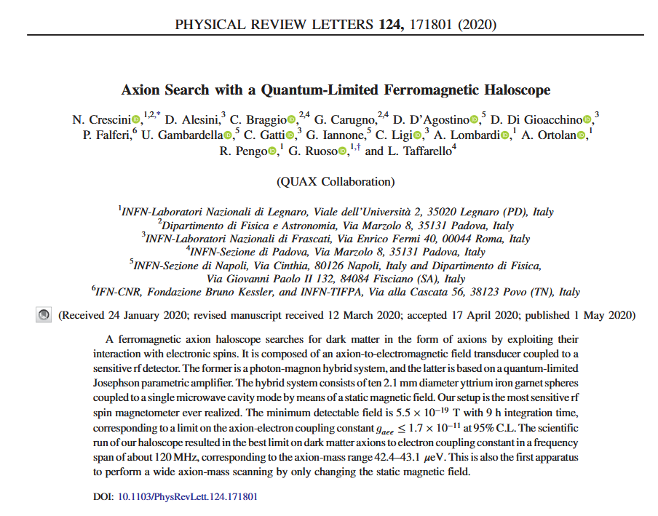

Slide 27
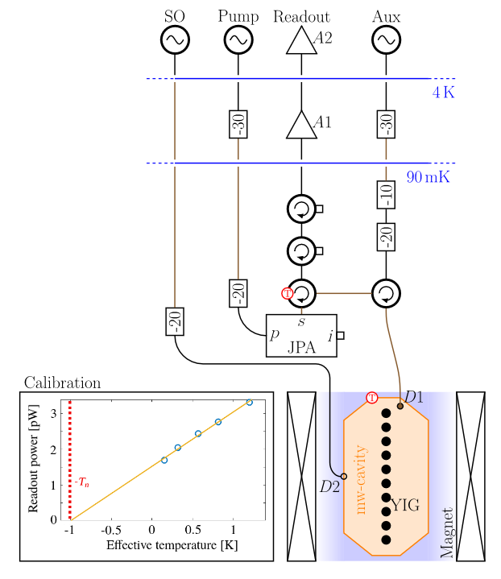
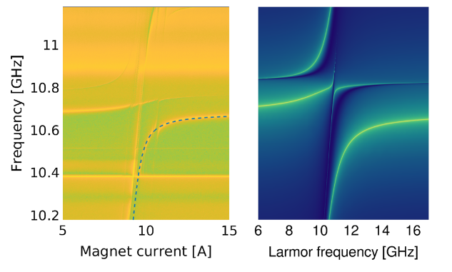
Measured (left) and modeled (right) transmission func-
tions of the HS. The right plot is the function f(ω), based
on the second quantization of coupled harmonic oscillators, while
the left one is a SO-to-readout (see Fig. 2) transmission measure-
ment with the JPA off, performed at 90 mK. Color scales are in
arbitrary units (brighter colors correspond to higher amplitudes).
The dashed line in the left plot identifies the low-frequency hybrid
mode, having resonant frequencies ω1 and linewidths γ1.

Slide 28
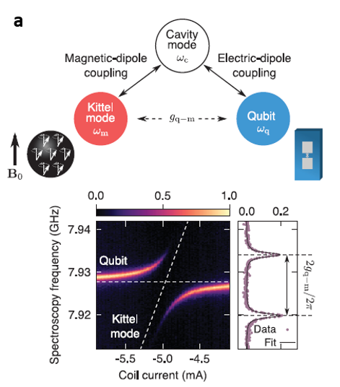
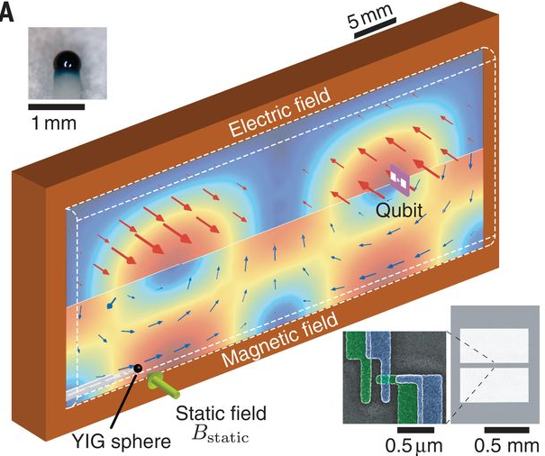
(1)Tabuchi, Y.; Ishino, S.; Noguchi, A.; Ishikawa, T.; Yamazaki, R.; Usami, K.; Nakamura, Y. Coherent Coupling between a Ferromagnetic Magnon and a Superconducting Qubit. Science 2015, 349 (6246), 405–408. https://doi.org/10.1126/science.aaa3693.
(2)Lachance-Quirion, D.; Tabuchi, Y.; Gloppe, A.; Usami, K.; Nakamura, Y. Hybrid Quantum Systems Based on Magnonics. Appl. Phys. Express 2019, 12 (7), 070101. https://doi.org/10.7567/1882-0786/ab248d.
(3)Lachance-Quirion, D.; Wolski, S. P.; Tabuchi, Y.; Kono, S.; Usami, K.; Nakamura, Y. Entanglement-Based Single-Shot Detection of a Single Magnon with a Superconducting Qubit. Science 2020, 367 (6476), 425–428. https://doi.org/10.1126/science.aaz9236.
(4)Clerk, A. A.; Lehnert, K. W.; Bertet, P.; Petta, J. R.; Nakamura, Y. Hybrid Quantum Systems with Circuit Quantum Electrodynamics. Nat. Phys. 2020, 16 (3), 257–267. https://doi.org/10.1038/s41567-020-0797-9.

Slide 31
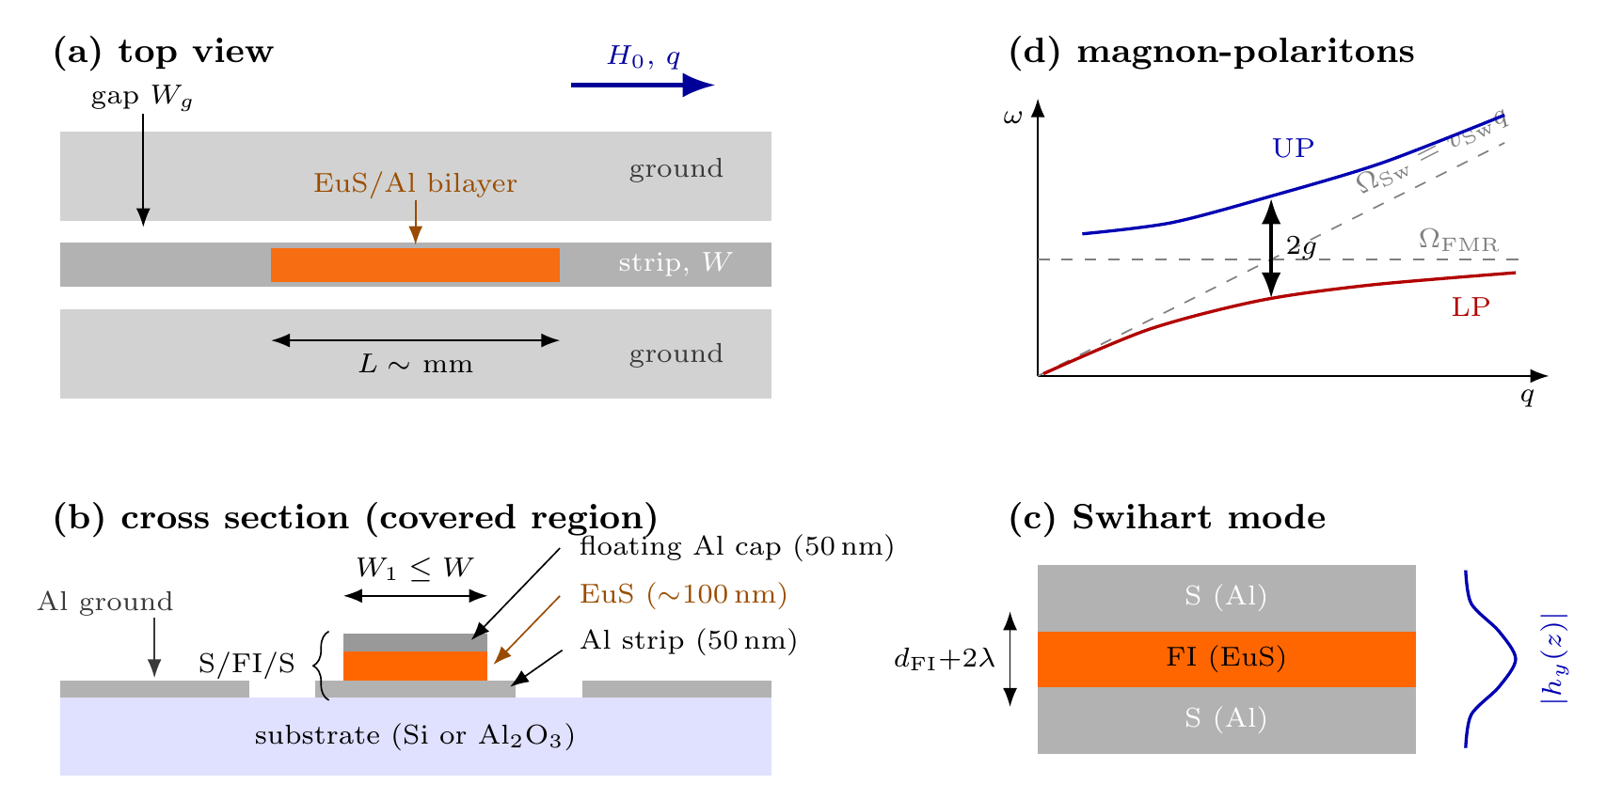
S/FI/S sandwich on the CPW strip = slow-wave cavity; EuS magnons hybridize with its Swihart modes
Al CPW driven in transmission — we measure S21(f, H0) with a VNA
EuS/Al bilayer on the strip forms a vertical Al/EuS/Al = S/FI/S stack
Microwave field squeezed into dFI + 2λ ≈ 0.5 µm → slow Swihart modes (vSw ≈ 0.13c)
Kittel magnons in EuS anticross the Swihart standing waves → magnon-polaritons
Large EuS moment (µ0Ms ≈ 1.5 T) → coupling can be ultrastrong (g → ΩFMR/2)

Slide 32
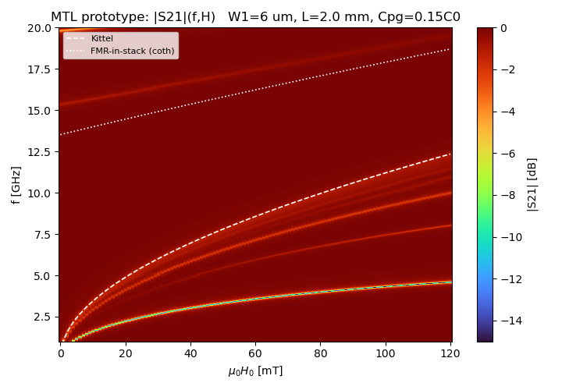
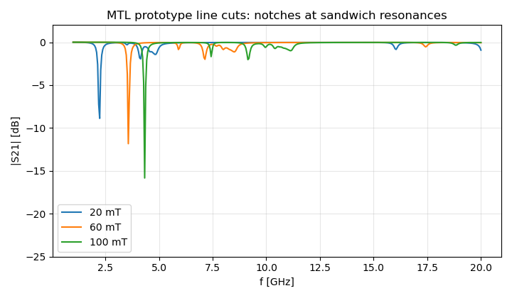
Floating plate ⇒ open–open sandwich resonator ⇒ comb of field-tunable notches, not a bulk stopband
Baseline stays high: the loading is set by the small plate–ground fringing Cpg — the key electrostatic unknown
The two levels bracket what the VNA will show — the data will pick the picture

Slide 33
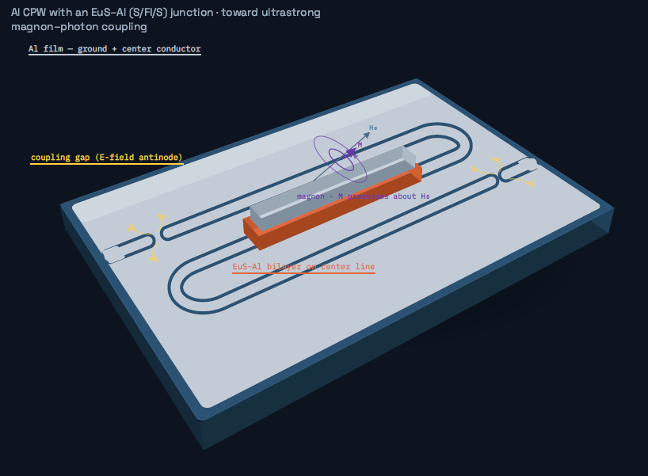

Quantum Magnonics in Planar Devices

