Slide 1

IFMIF-DONES: Status and Overview of a Next-Generation High-Current Accelerator Facility for Fusion Materials Qualification
J. Maestre on behalf of the DONES Integrated Programme Team
Red Española de Futuros Colisionadores
20/10/2026

Slide 2
Outline
Description of IFMIF-DONES core
Summary
Intro to IFMIF-DONES
Accelerator Systems
DONES- Experimental Capabilities
Lithium Systems
Test Systems

Slide 3
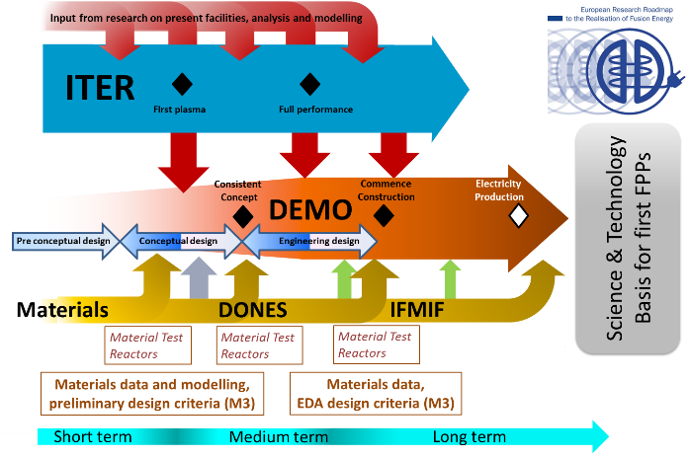
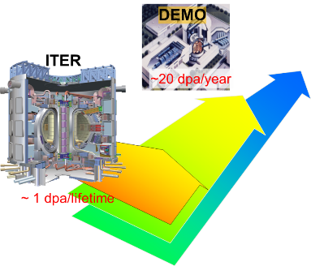
Why IFMIF-DONES ?
One of the main differences between ITER and DEMO is the radiation dose: at DEMO more than
two orders of magnitude higher
20-50 dpa/lifetime
1-3 dpa/lifetime

Slide 4
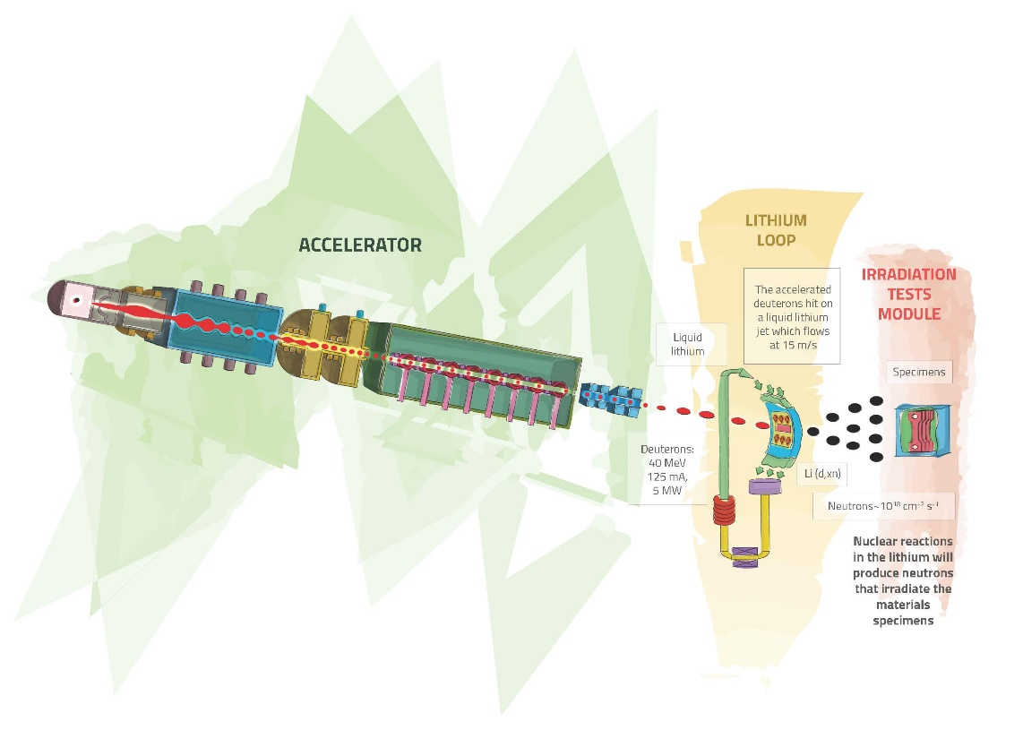
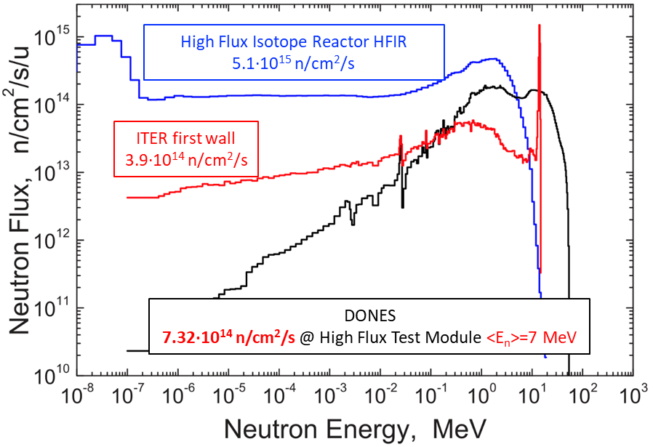
What is IFMIF-DONES?
An accelerator based fusion-like neutron source
to be used for the qualification of the materials to be used in the DEMO Reactor
High Flux Test Module requirements
Dpa | 20 dpa_{NRT} (<2.5 years, 300 cm³) 50 dpa_{NRT} (<3 years,100 cm³)
Temperature | Controlled 250 – 550 C
Dpa gradient | <15% (gauge volume)
Temperature gradient | <3% (gauge volume)
Stripping reaction
15
A neutron flux of ~5 10¹⁴ n/ cm²/s
is generated with a neutron spectrum up to 55 MeV energy
Heat removal by high velocity Li flux
Facility able to irradiation multiple irradiation modules simultaneously

Slide 5
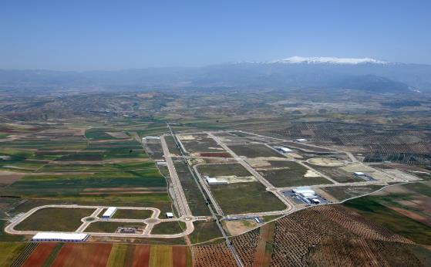

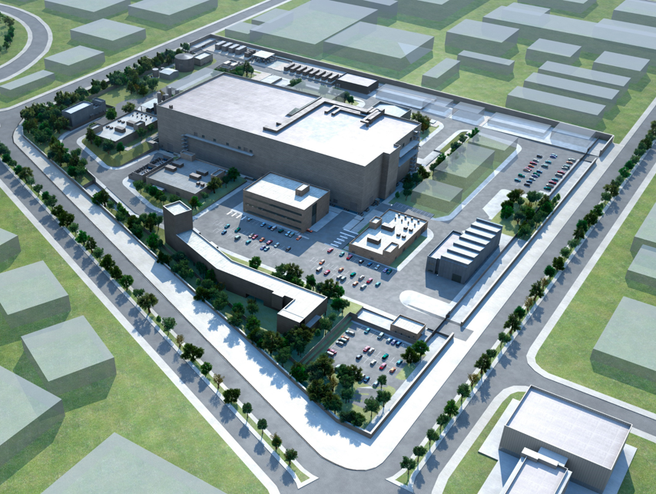


IFMIF-DONES Facility
The site is located at Escúzar -18 km southwest from Granada city- Spain
European Strategic Facility RI Project
High priority facility in the EU Fusion Roadmap

Slide 6
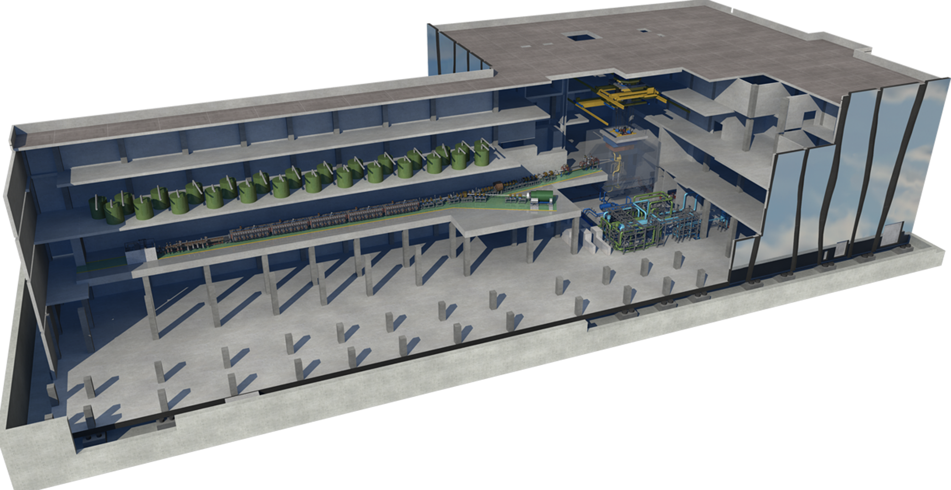
IFMIF-DONES Facility
70% Availability
30 years Operation
Access Cell
Test Cell
(Target + Test Systems)
3.2- Main Building
TIR
RF area
Site, Building & Plant Systems
Accelerator Vault
Complementary experiments area
CICS
Lithium Systems

Slide 7






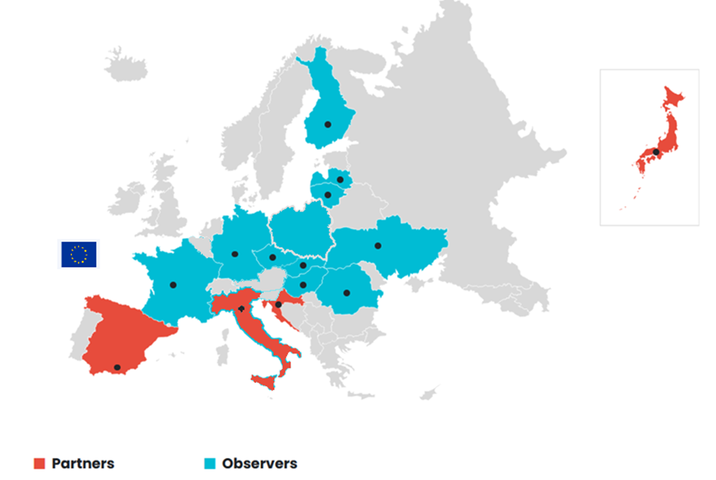



DONES Programme Governance
Current Parties
  F4E
  IFMIF-DONES España (Host)
  INFN
  QST
  RBI
Signature of the
Multilateral International DONES Agreement
MIDA
21st November 2025
  Observers:
  Czech Republic
  Finland
  France
  Germany
  Hungary
  Latvia
  Lithuania
  Poland
  Romania
  Slovakia
  Ukraine

Slide 8
Outline
Description of IFMIF-DONES core
Summary
Intro to IFMIF-DONES
Accelerator Systems
DONES- Experimental Capabilities
Lithium Systems
Test Systems

Slide 9
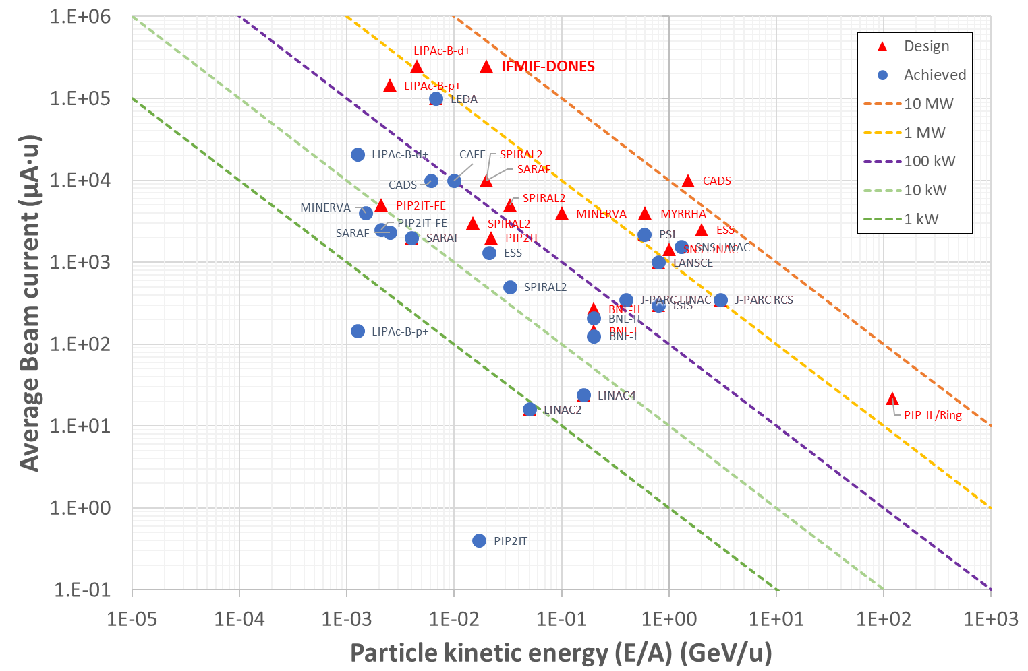
The 5 MW deuteron LINAC
40 MeV / 125 mA CW / 5 MW SC LINAC
Highest D⁺ current LINAC
One of the highest average beam power & perveance
Top H⁺ & D⁺ Injector performance
Longest RFQ
High Beam loading in resonant cavities
Record of light hadrons current through SC cavities
Facility (Accelerator, target…) design considering feasibility upgrading to 10 MW!

Slide 10
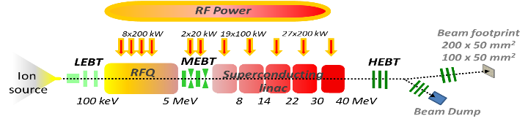
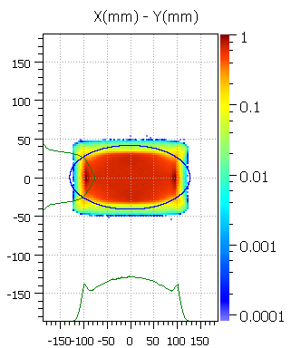
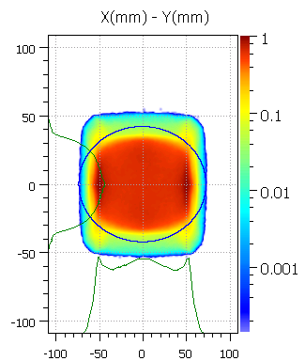
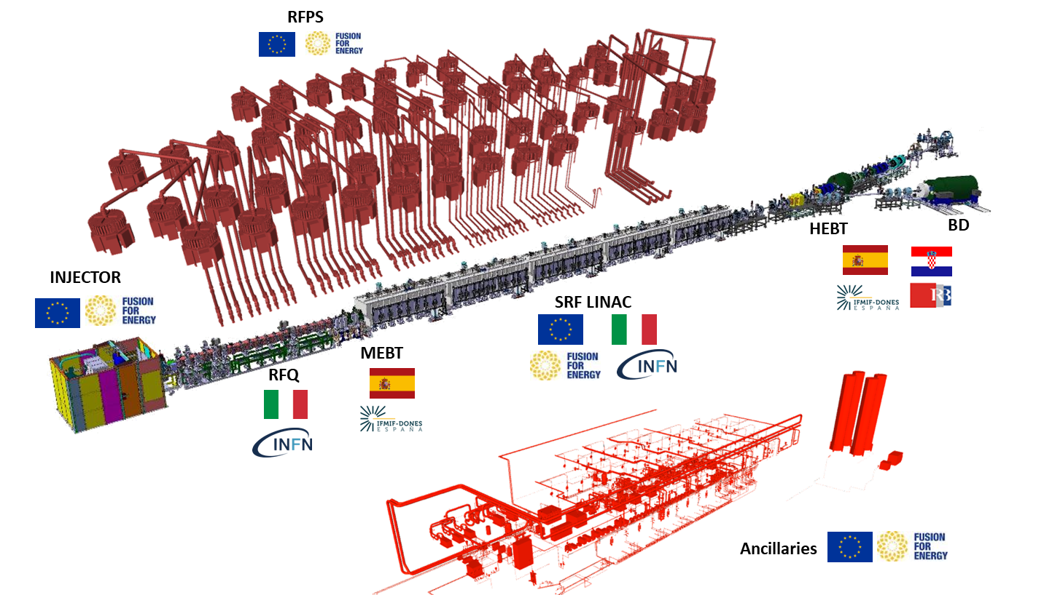
Accelerator Systems: parameters
Beam footprint @ target
175 MHz SSPA RF Stations
Ancillaries
Vacuum, Cryogenics, Water cooling,
Gas and electric distribution…
20x5 cm² footprint
(reference)
10x5 cm² footprint
(optional)
D+ CW 175 MHz SC LINAC
125 mA / 40 MeV → 5 MW
Total length of ~100 m
Windowless liquid Li target
, 87% availability
Hands-on maintenance (<1 W/m)
Target-beam at 9° angle →
possibility to upgrade
with 2nd mirror accelerator (10 MW)
Independent EMC mesh
embedded into the Building

Slide 11
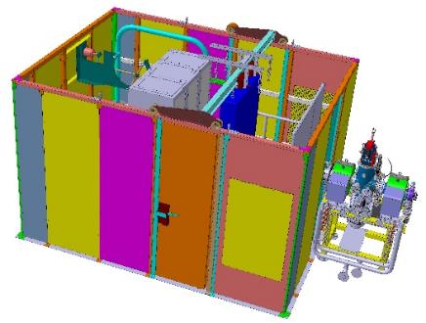
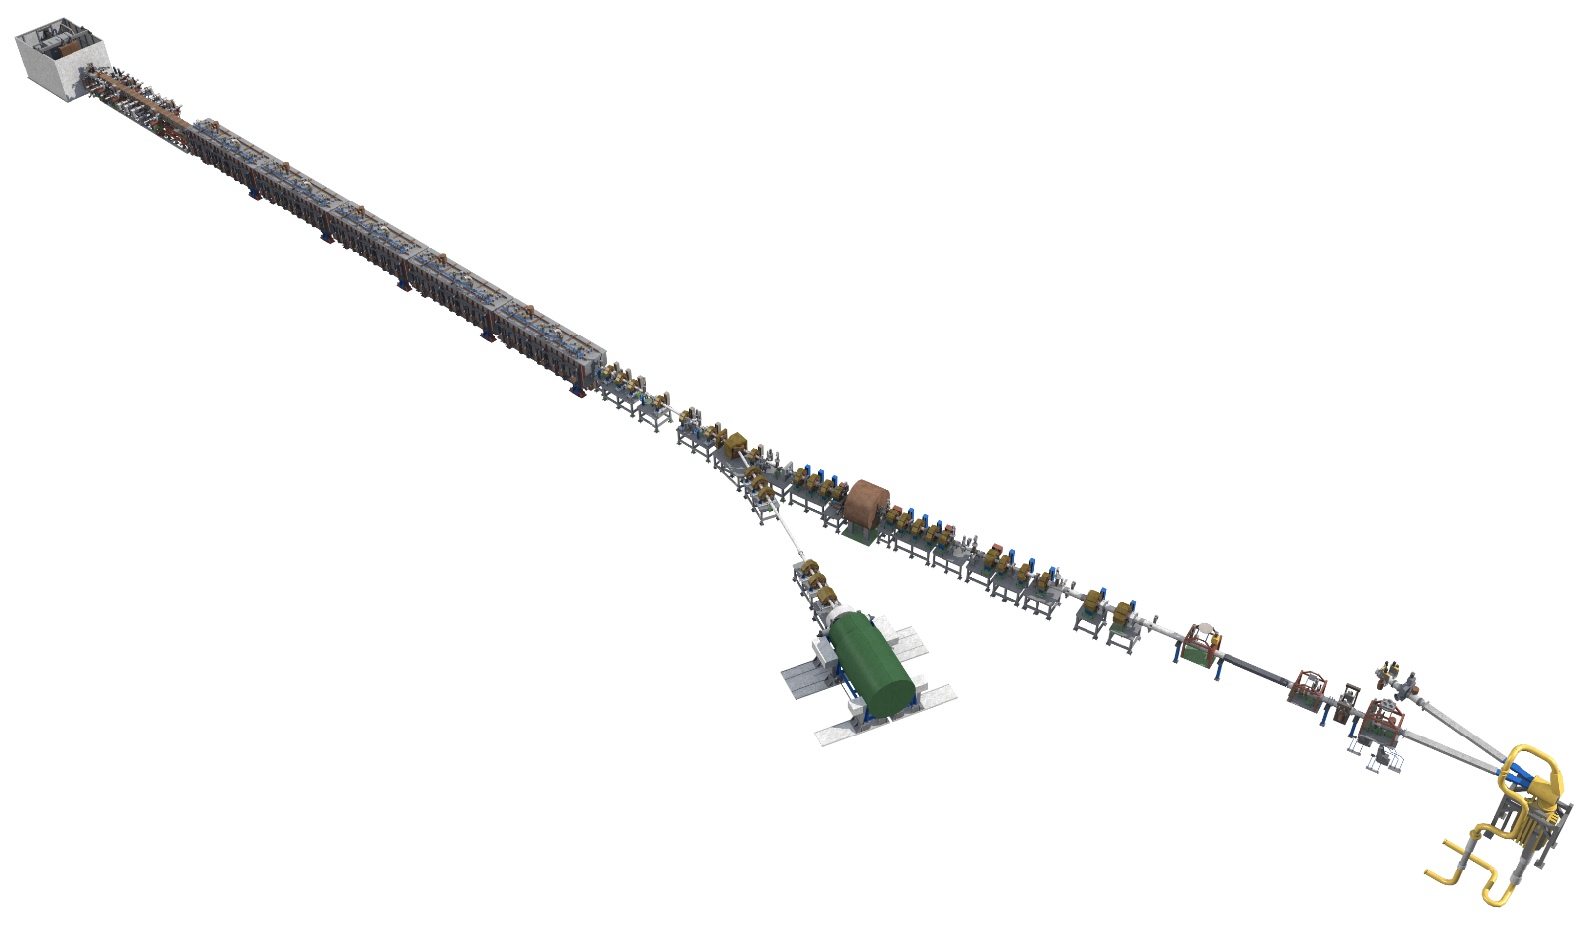
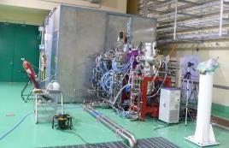


Accelerator Systems: description
INJECTOR / LEBT
RFQ
MEBT
SRF LINAC
HEBT
EXTRACTED BEAM
ION SOURCE
BEAM AT RFQ
100 keV / 140 mA
2.45 GHz ECR
125 mA
DC design point
Deuterium plasma
Nominal accelerator current
Main functions
Generate D⁺ ions; extract and accelerate them to 100 keV; focus and match the beam transversely to the RFQ. Diagnostics support tuning of current, profile and emittance.
ECR ion source – SILHI type
Validated in LIPAc at nominal CW current
Chopper for high intensity pulsed D⁺ beam
Beam operation: continuous-wave (CW) nominally; injector/LEBT can support commissioning and pulsed modes.

Slide 12


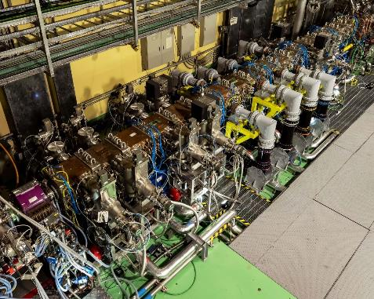
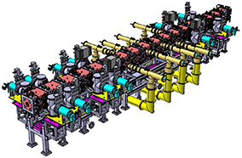
Accelerator Systems: description
INJECTOR / LEBT
RFQ
MEBT
SRF LINAC
HEBT
FOUR-VANE COPPER CAVITY
Bunching + acceleration + transverse focusing
RF FREQUENCY
ENERGY GAIN
STRUCTURE LENGTH
BEAM CURRENT
BEAM POWER AT EXIT
175 MHz
0.1 → 5 MeV
≈ 9.7 m
125 mA
625 kW
CW operation
Deuterons
Four-vane copper RFQ
Nominal output
5 MeV × 125 mA
Main functions
The RFQ simultaneously bunches, focuses and accelerates the high-current beam
RF design and validation
One of the longest and highest power RFQ
Loss control: High-current CW operation makes beam loss a major activation and reliability concern. The RFQ uses careful field shaping and cooling to control thermal loading.
Optimization from LIPAc feedback

Slide 13
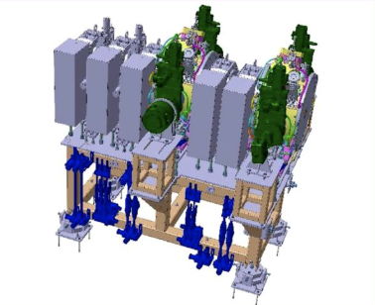
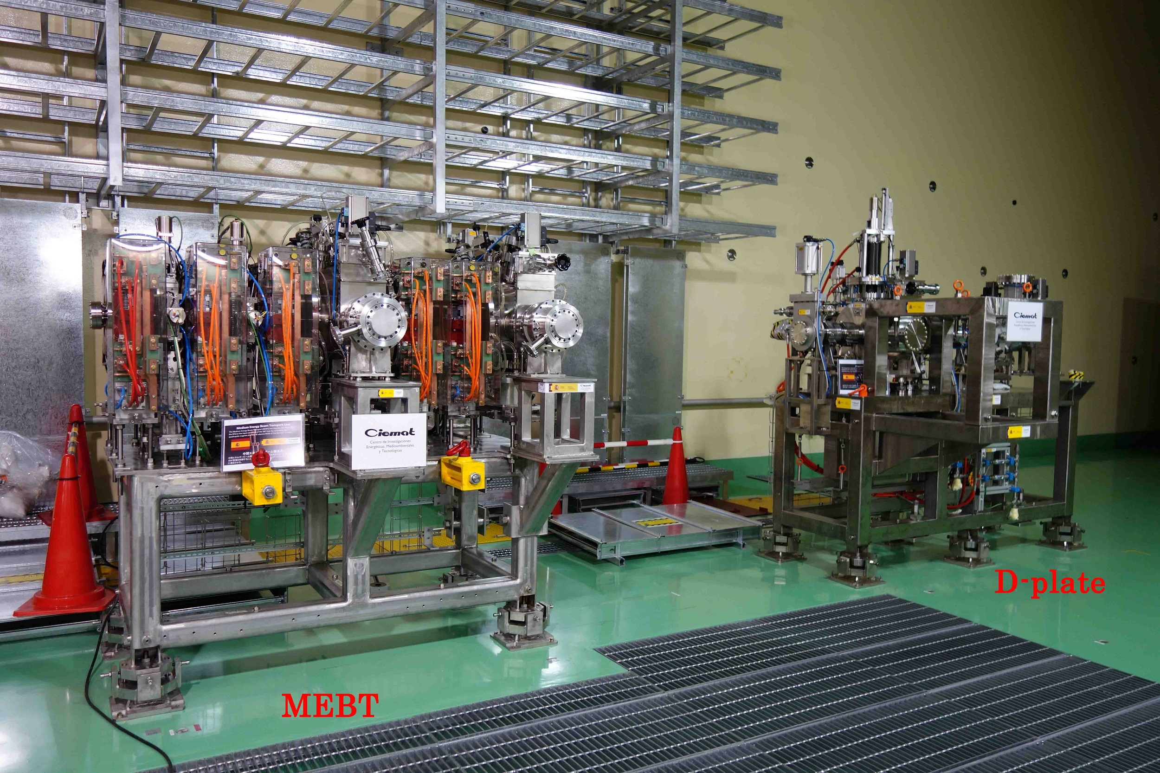

Accelerator Systems: description
INJECTOR / LEBT
RFQ
MEBT
SRF LINAC
HEBT
BEAM ENERGY
BEAM CURRENT
BEAM-DYNAMICS LENGTH
RE-BUNCHER VOLTAGE
TRANSMISSION TARGET
5 MeV
125 mA
≈ 2.35 m
up to 350 kV
> 99.9%
RFQ output
CW
Nominal design
Effective voltage
MEBT input to output
Quadrupole magnets transport and match the beam envelope. Scrapers intercept halo and particles outside the accepted phase space. Two five-gap re-buncher cavities adjust bunch phase and energy spread for efficient capture by the superconducting cavities.
Optimization from LIPAC feedback: Improvement on maintenance and beam diagnostics; rad-hard and low activation materials.
Main functions
MEBT design and validation
Match the RFQ output beam to the longitudinal and transverse acceptance of the SRF linac.
VATIAC Validator under manufacturing
First operational tests on-site in 2028
Status

Slide 14
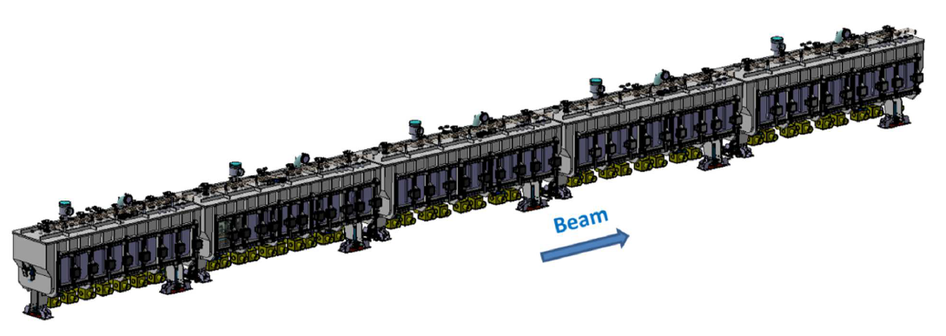
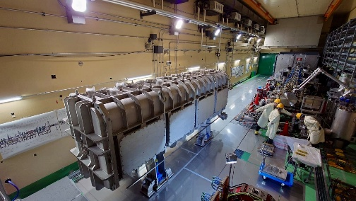
Accelerator Systems: description
INJECTOR / LEBT
RFQ
MEBT
SRF LINAC
HEBT
SUPERCONDUCTING HWRs
CM1
CM2
CM3
CM4
CM5
HWR
HWR
HWR
HWR
HWR
5 MeV
40 MeV
FINAL ENERGY
BEAM CURRENT
OUTPUT BEAM POWER
CRYOMODULES
OPERATING TEMPERATURE
40 MeV
125 mA
5 MW
5
≈ 4.5 K
Deuterons
CW nominal
40 MeV × 125 mA
Warm sections between
Liquid-helium cooled
Main functions
SRF design
Accelerating structures
Niobium half-wave resonators (HWRs), two types: 19 x low-β and 27 x high- β
Focusing & cryogenics
Superconducting solenoids provide focusing. The cryostat maintains cavities at cryogenic temperature and provides thermal and magnetic shielding
Five cryomodules provide the main acceleration from 5 to 40 MeV
Validation: Assembly of the LIPAc Cryomodyule ongoing → first beam expected in 2027

Slide 15
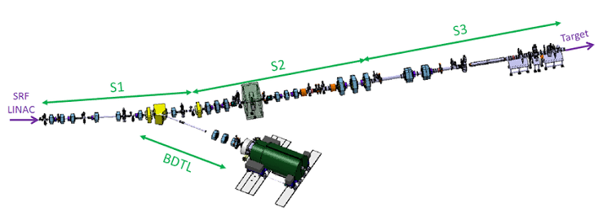

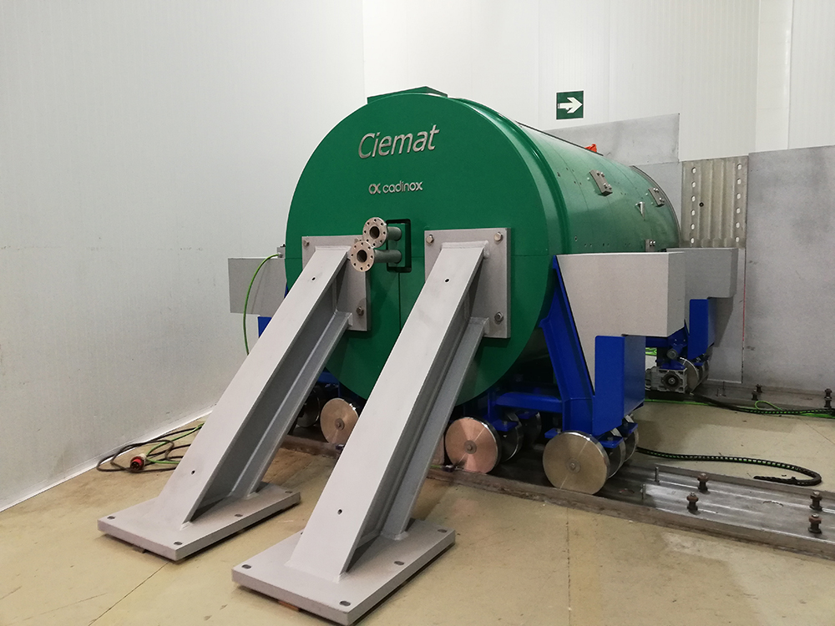

Accelerator Systems: description
INJECTOR / LEBT
RFQ
MEBT
SRF LINAC
HEBT
INPUT ENERGY
NOMINAL CURRENT
BEAM POWER
FOOTPRINT RANGE
TARGET INCIDENCE
40 MeV
125 mA
5 MW
10–20 cm × 5 cm
≈ 9°
From SRF linac
CW
High-power transport
Horizontal × vertical
On lithium jet
FROM SRF
DIPOLES / QUADS
SCRAPERS & DIAGNOSTICS
TARGET / HPBD
Status
VATIAC Validator under manufacturing
First operational tests on-site in 2028
Main functions
Transport, shape and deliver the 5 MW beam to the lithium target — or to the beam dump
HEBT design
Beam shaping
Magnetic elements and scrapers shape the beam into a quasi-rectangular footprint on the lithium free surface; the footprint is adjustable to support commissioning and operation.
Commissioning
The line transports the beam to the lithium target in normal operation and can direct it to the high-power beam dump (HPBD) during commissioning or when target operation is unavailable.
Some features
Multipole magnets (oct/dodec) for rectangular shape
High Power Beam Dump for commissioning and tuning (1% DC)
Safety-credit module containing Fast valves
Aluminium beampipe to minimize the activation
Water-cooled RH Scraper
He-cooled RH Collimator at TIR
Beam diagnostics for all beam modes
Secondary beamline for 2nd accelerator with target diagnostics

Slide 16
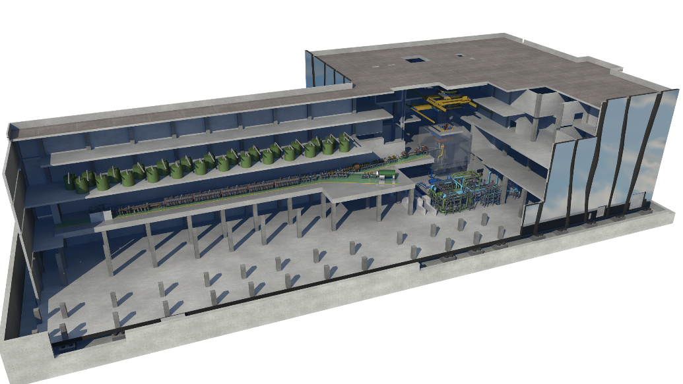
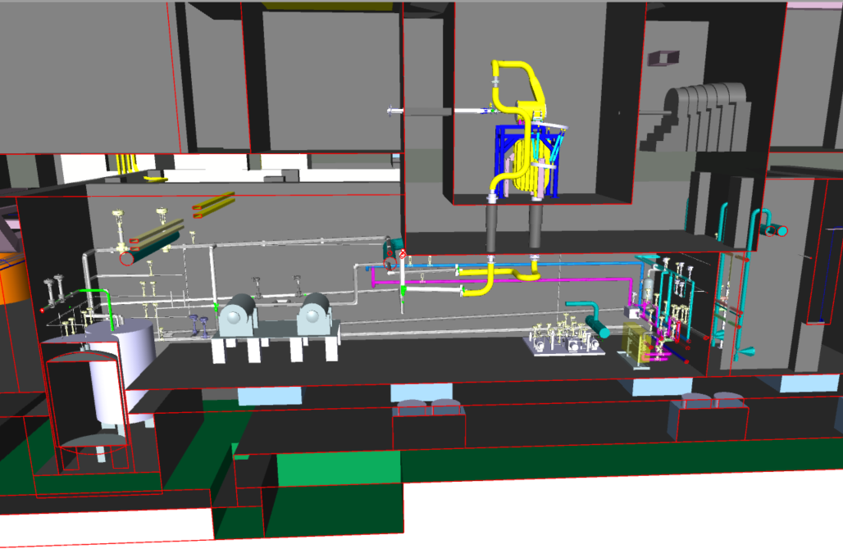
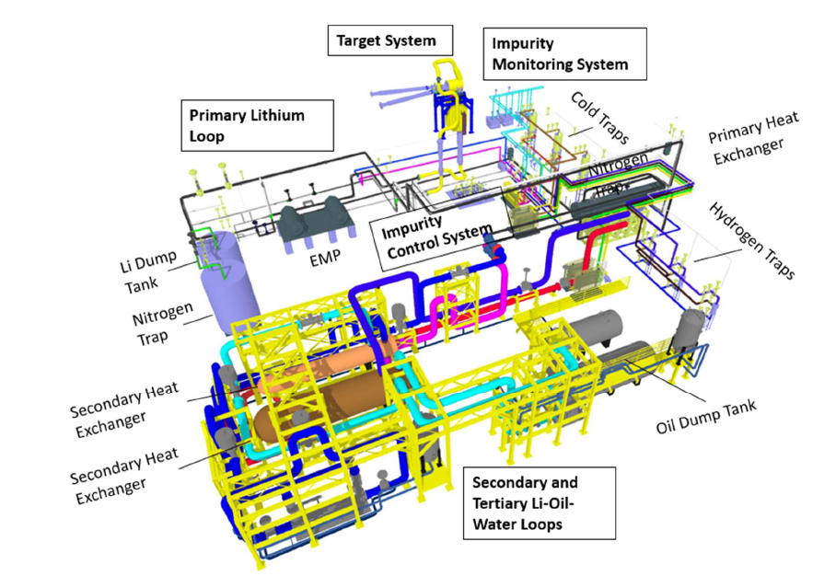
Lithium Systems
HEBT
TARGET
beam
Main functions
To generate a stable liquid lithium target for enabling D-Li stripping reaction and producing an adequate neutron flux to properly irradiate
LS design
Target System: To provide a continuous Li jet whose interaction with D+ beam generates the Neutron flux.
Heat Removal Loop: To remove the energy deposition on the Lithium.
Impurity Control System: To localize and control the impurities in the Lithium.
BEAM POWER
FOOTPRINT RANGE
TARGET FLOW
TARGET JET VELOCITY
5 MW
10–20 cm × 5 cm
100 L/s
15 m/s
High-power transport
Horizontal × vertical
lLithium Loop
On lithium jet

Slide 17
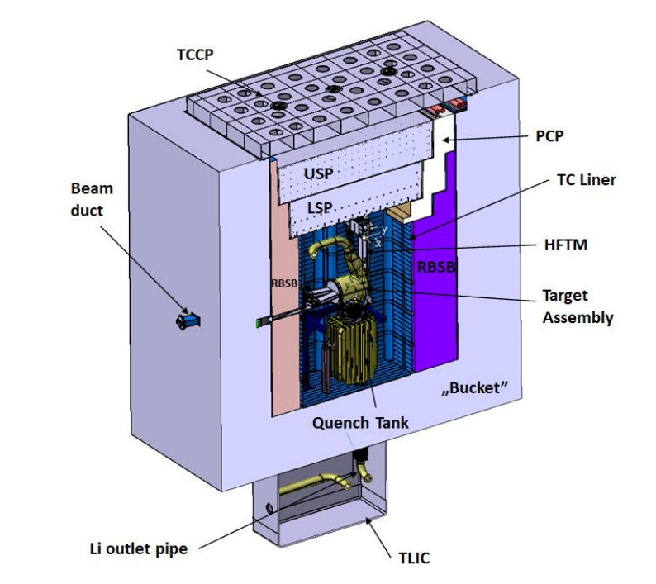
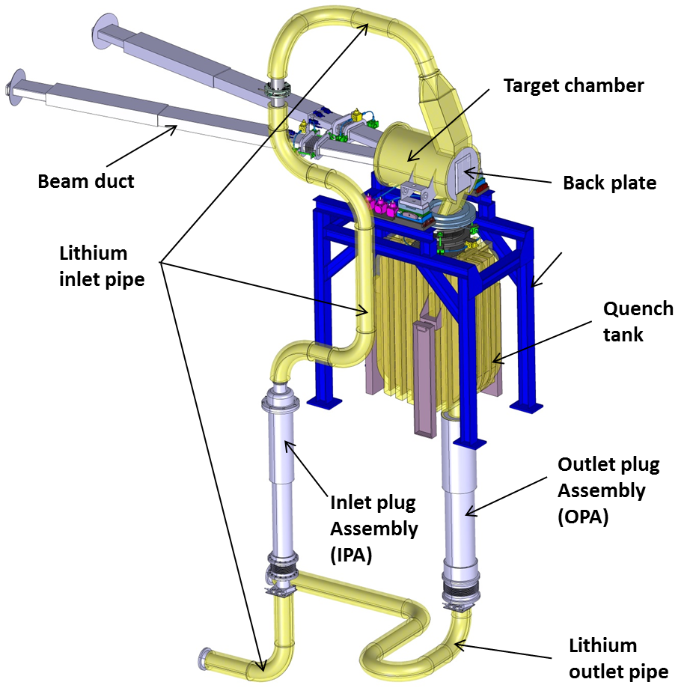
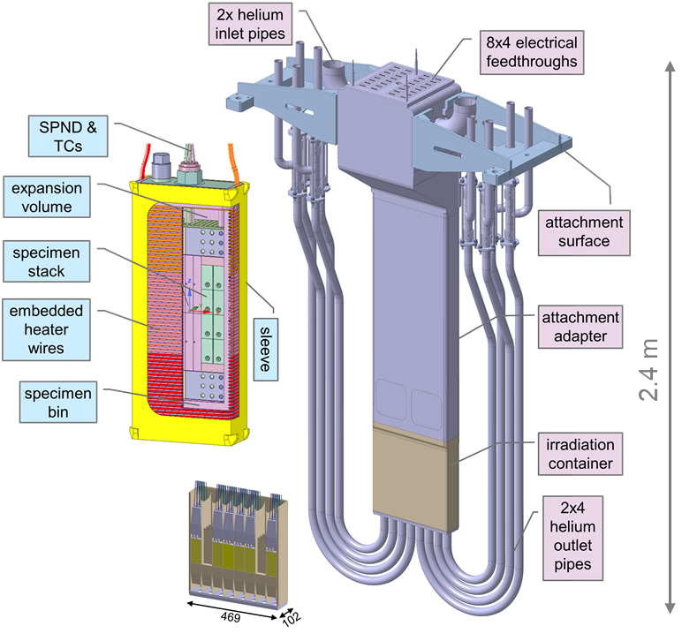



Test Cell & Target
Beam
F. Arbeiter (KIT)
Heat flux: 100 KW/cc
Jet thickness: 25 ± 1 mm
Li inlet T: 300 °C
Li velocity: 15 m/s
Chamber pressure: 10⁻² Pa
HFTM assembly
(316LN)
SSTT specimens
TEST CELL
Target System is allocated inside Test Cell, concrete cell covered by a stainless-steel liner under a controlled environment (He or Ar).
The TC confine the neutron source and allocate the different irradiation modules
TARGET
Converts the high-power deuteron beam into an intense neutron field
Liquid metal target
Windows-less
Under vacuum (10^-4 mbar)
Irradiation Modules (HFTM)
Irradiation device positioned immediately behind the lithium target. It houses small specimens of candidate fusion-reactor materials in dedicated irradiation capsules, exposing them to a high-intensity neutron field

Slide 18
Outline
Description of IFMIF-DONES core
Summary
Intro to IFMIF-DONES
Accelerator Systems
DONES- Experimental Capabilities
Lithium Systems
Test Systems

Slide 19
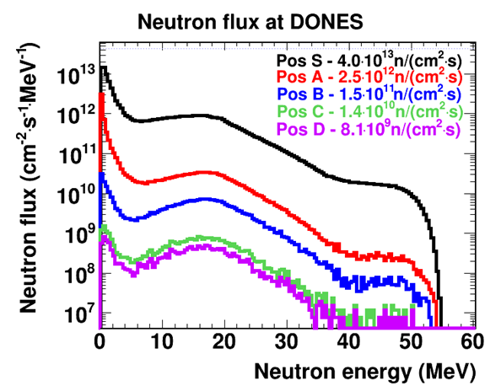
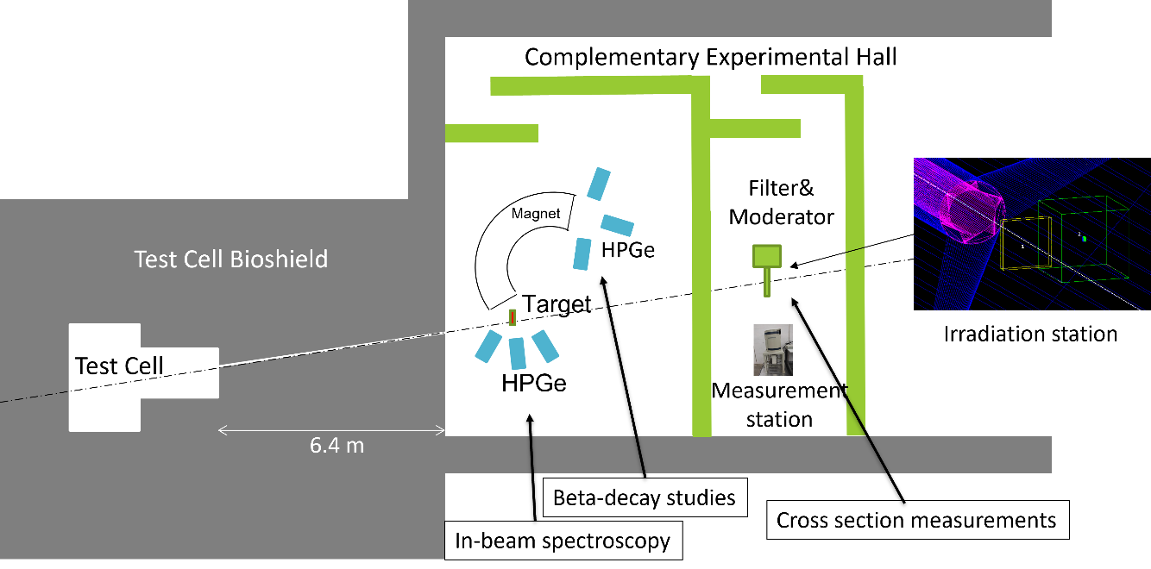

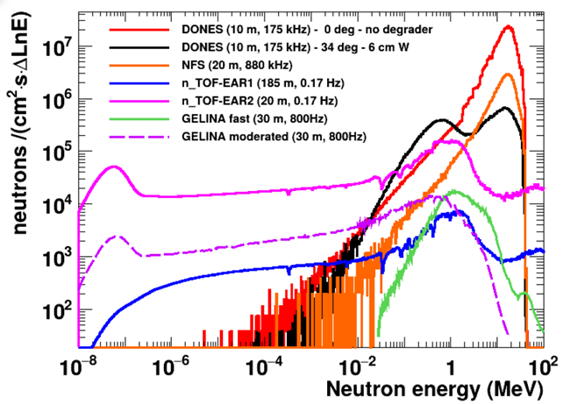
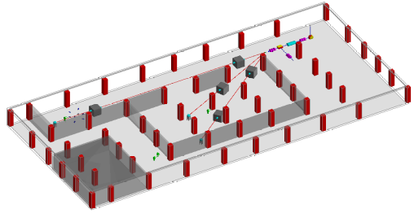


Facility & users
Three main experimental areas – First Experimental Programme to be presented this year
Test cell – Main neutron experimental area (fusion users)
Area for complementary experiments with continuous neutron beam
Design of TOF DONES ready (CIEMAT/NFUS)
Area for complementary experiments with deuteron beam
Neutron Beam Tube and Shutter connected to the Target Area (Test Cell)
>10¹⁰ n/cm²-s
WS DONES Users – CIEMAT- Madrid – 13-15 October
Fusion users (materials, breeding blankets,…)
Nuclear physics
Astrophysics
Medical applications
Industry, safety
Societal applications
< 2 ns microbunches
Challenge → 40 MeV extraction system based on meander kickers
https://indico.ifmif-dones.es/event/92/

Slide 20
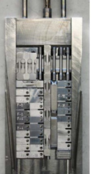
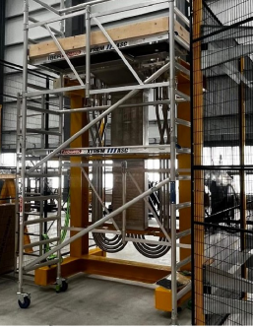
Test cell – High Flux Irradiation Module
Baseline focused on High Flux Test Module (HFTM): high-priority structural materials irradiation.
Two mature module designs: one exposes material specimens; the other characterizes the neutron/radiation field.
HFTM
STUMM
High Flux Test Module
Start-up Monitoring Module
• Mission: irradiate small structural-material specimens, initially Eurofer (9% Cr steel).
• Peak neutron flux: up to 5 × 10¹⁴ n·cm⁻²·s⁻¹.
• Controlled specimen temperature: 250–550 °C (target spread about ±3%).
• Damage objective: 13-35 dpa/fpy up to 300 cm³ (22-50 dpa/fpy with two accelerators)
10-15 appm He / dpa, 45-55 appm H / dpa.
F. Arbeiter (KIT)
• Mission: map radiation fields behind the target, especially during commissioning.
• Diagnostics cover neutron flux and radiation-field characteristics.
• Designed for transient and steady-state monitoring.
• STUMM-PROTO development includes ~35 m coaxial cables to emulate remote electronics.
Samples:
Steel Eurofer 97: First Wall Fusion Structural materials
Copper: divertor heat sink
Tungsten: Armor
Sensors:
Micro-fission Chambers: fast neutrons
Ionization Chambers: they help separate the neutron contribution from the combined neutron–gamma signal
(SPNDs: Alternative or complementary detectors for thermal and epithermal neutron flux
Gamma thermometers: Measures nuclear heating
SSTT specimens

Slide 21
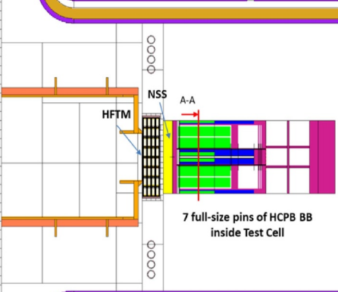
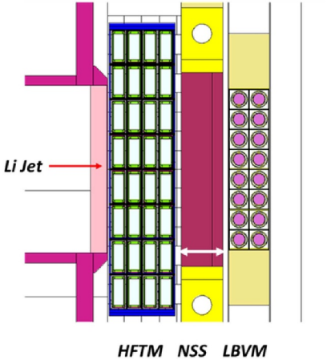
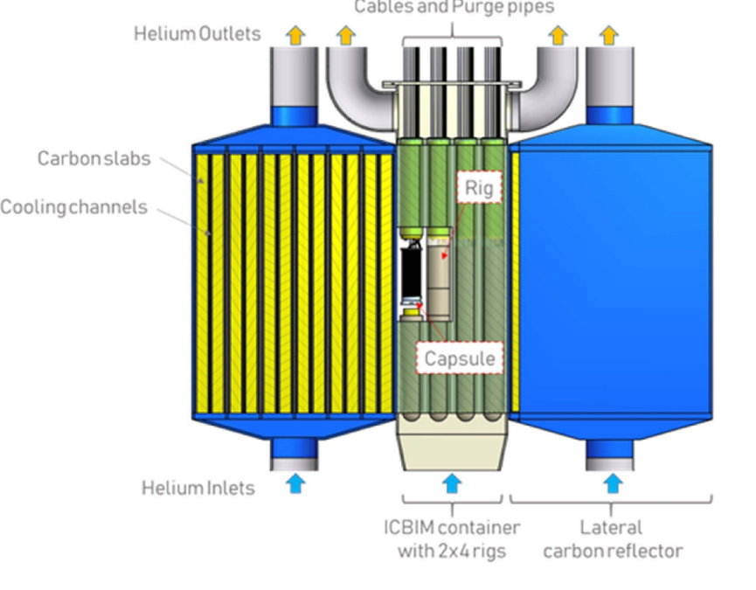
Test cell – Other Irradiation Modules
BLUME • LBVM • TRTM: not yet explicitly part of the facility baseline
Three complementary concepts target functional materials and blanket sub-systems beyond the baseline high-flux structural-material programme.
BLUME
LBVM
TRTM
Blanket Functional Material Module
Liquid Breeder Validation Module
Tritium Release Test Module
• Representative section of the Helium-Cooled Pebble-Bed (HCPB) blanket breeder zone.
• Focus: blanket functional materials and integrated unit-size structures.
• Helps assess blanket technology under fusion-like neutron exposure.
• Targets liquid-breeder R&D, especially PbLi and associated functional materials.
• Can investigate anti-corrosion / anti-permeation barriers.
• Concept links to liquid PbLi blanket concepts, including WCLL.
• Designed for lithium-ceramic pebble beds associated with the HCPB blanket.
• Measures/validates tritium release behaviour under irradiation.
• Concept also includes neutron-multiplier materials such as beryllides.
CONCEPTUAL DESIGN
CONCEPTUAL DESIGN
CONCEPTUAL DESIGN
Figures extracted from: Arbeiter, Frederik, et al. "The IFMIF-DONES irradiation modules." Nuclear Fusion 65.12 (2025): 125001.

Slide 22
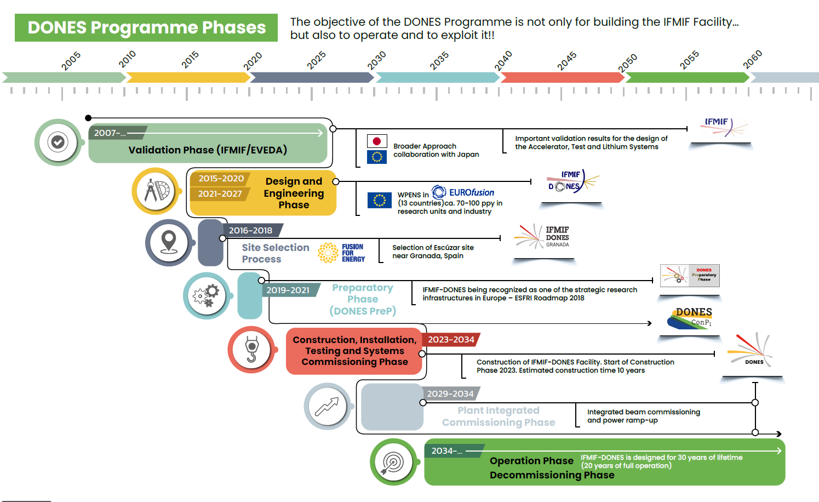

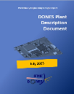
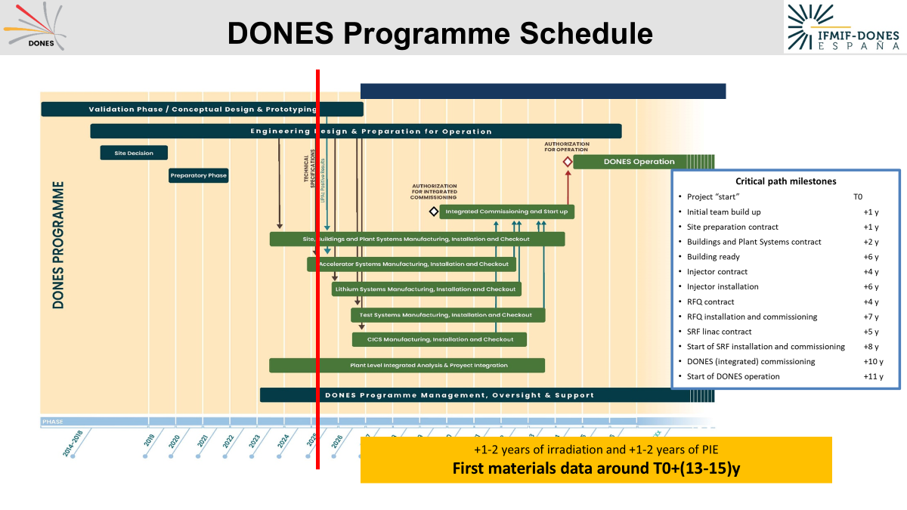
DONES Timeline

Slide 23
Outline
Description of IFMIF-DONES core
Summary
Intro to IFMIF-DONES
Accelerator Systems
DONES- Experimental Capabilities
Lithium Systems
Test Systems

Slide 24
Summary
IFMIF-DONES is a key step towards reducing material-related uncertainties and enabling the development of reliable fusion energy
IFMIF-DONES will provide a unique accelerator-based neutron irradiation facility for both fusion but also non-fusion applications
IFMIF-DONES is an international Facility right now under Construction Phase
Procurement of the LINAC and Test Cell are ongoing with several systems under final design and manufacturing

Slide 25
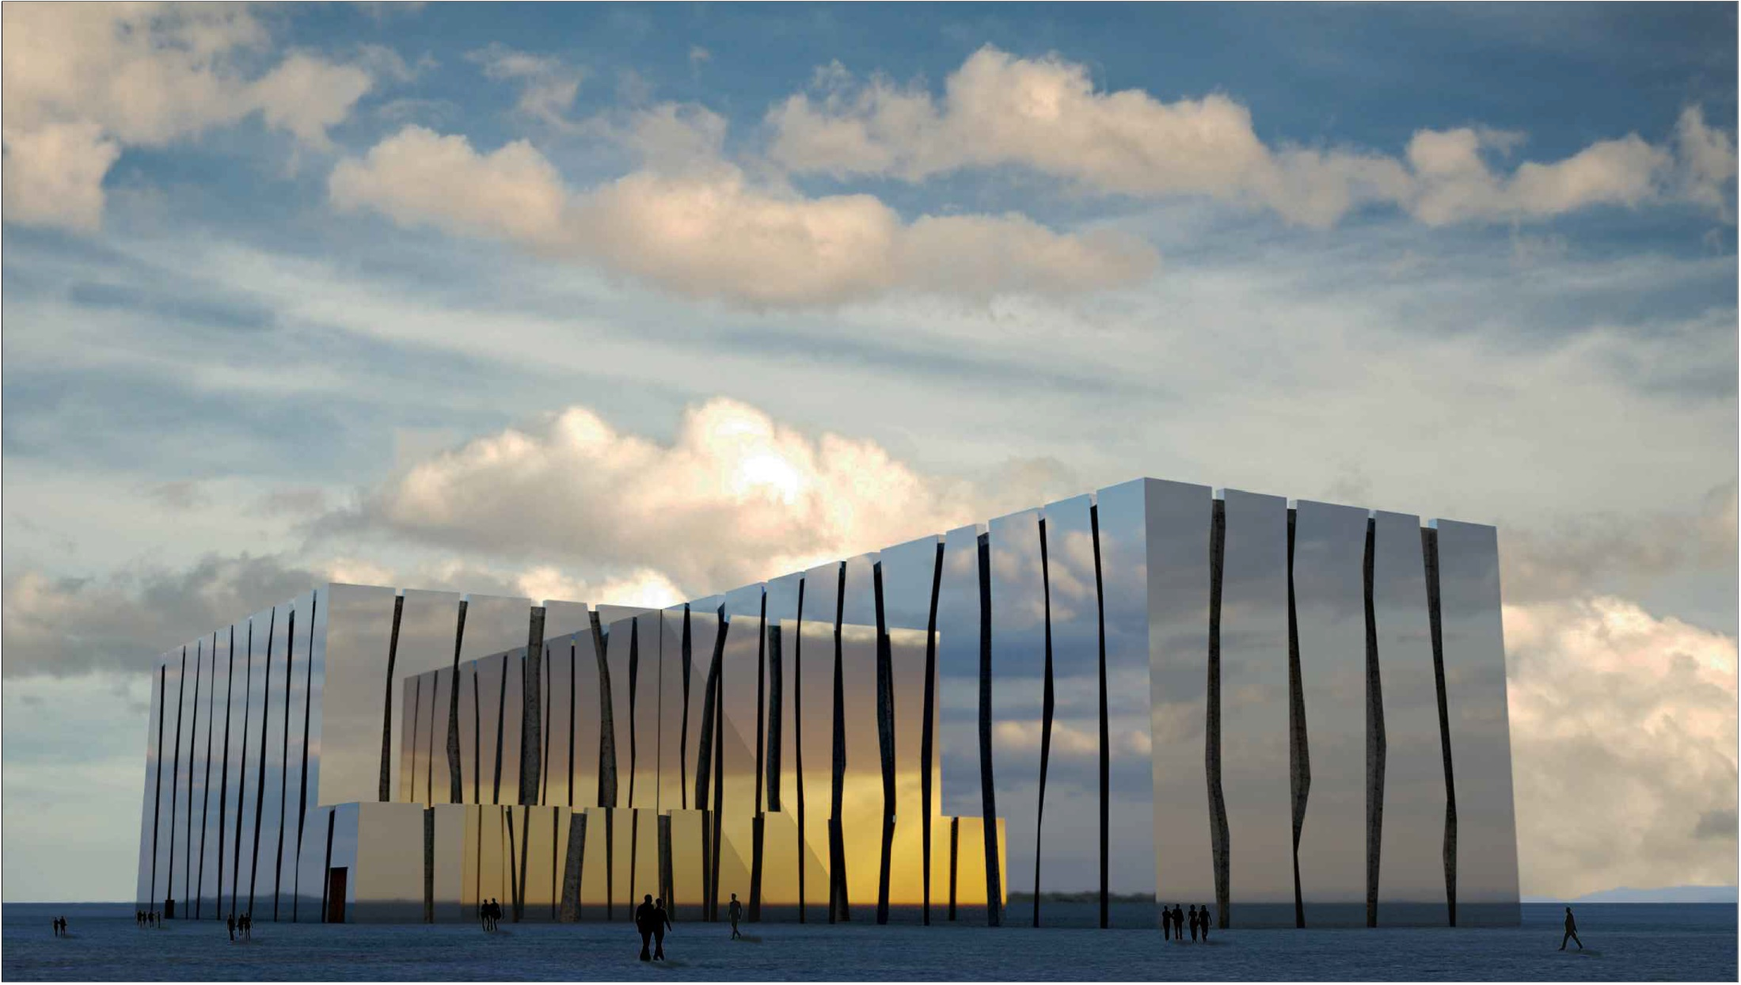







Thank you for your attention…
www.ifmif-dones.es

