Slide 1
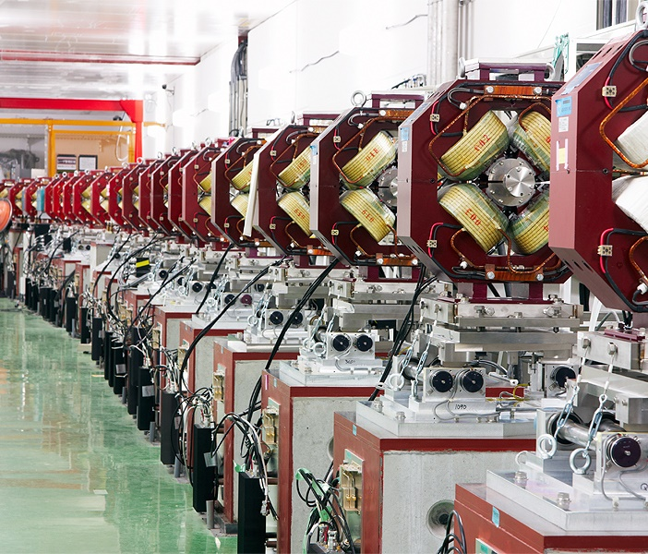



AITANA (IFIC) FCC plans
Daniel Esperante Pereira ¹
on behalf ot the IFIC-AITANA accelerators group
¹ IFIC (UV, CSIC)

Slide 2
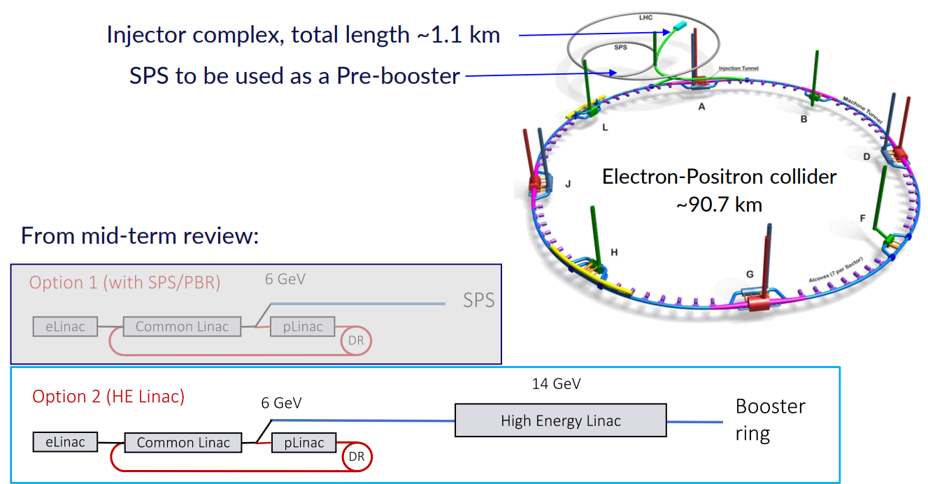
FCC complex: Injector linacs
We have a primary interested in this part of the accelerator complex,
though other contributions are not discarded:
cBPMs
Linac RF
Presentation: THE FCC-ee INJECTOR COMPLEX: Status of the injector parameters for the booster, CERN, March 5, 2024

Slide 3
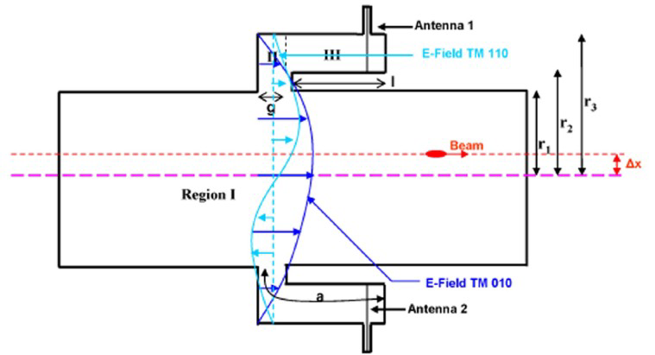
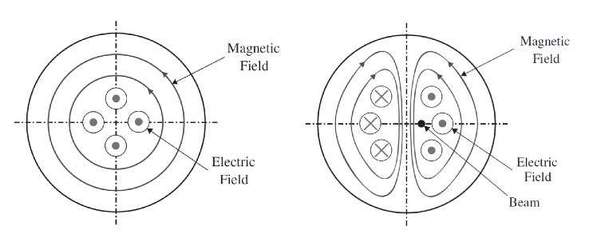
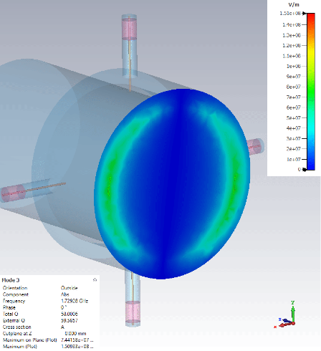
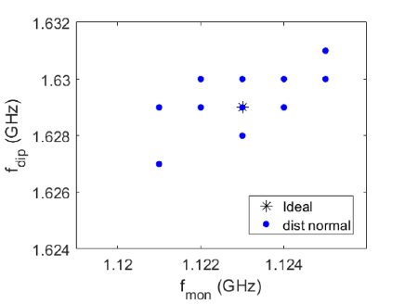
Beam position monitoring system
Development of a re-entrant cavity BPM for linear colliders with single bunch resolution < 1 μm for cryogenic temperatures
Cavity BPMs are resonant systems crossed by the beam pipe. EM modes are induced on the cavity by the beam and beam position measurement depends on their amplitude
  Vposition(t) = Vout,0 sin(ω110t + φ)exp (−t /τ)
Develop the know-how to design new cavity BPMs and readout:
  Use commercial vacuum feedthroughs
  Multiparametric design
  Tolerance analysis to in order to reduce fabrication costs
  Complex readout with mixing electronics and fast ADC
  Complex data processing: DDC, IQ demodulation
Now we have the capability to adapt the design to different beam pipe sizes, operational frequencies, understand mechanical fabrication, optimal manufacturing cost
The Monopole mode TM₀₁₀ , f₀₁₀ = 1.25 GHz gives the reference signal:
V_{TM010} ∝ q_{bunch}
The Dipole mode TM_{110,} f₀₁₀ = 1.72 GHz
gives the position information:
V_{TM110} ∝ q_{bunch} × δx
Manufacturing tolerances with = 50 μm 20 cases with different variations in all parameters simultaneously

Slide 4
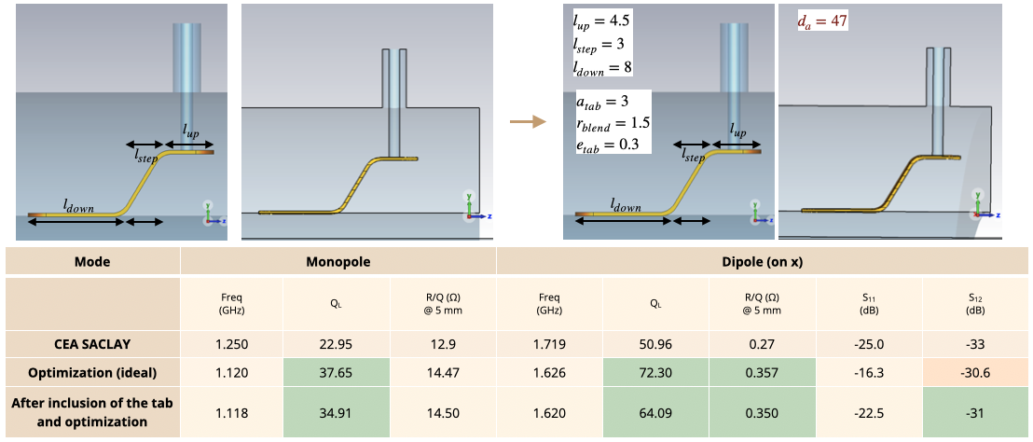
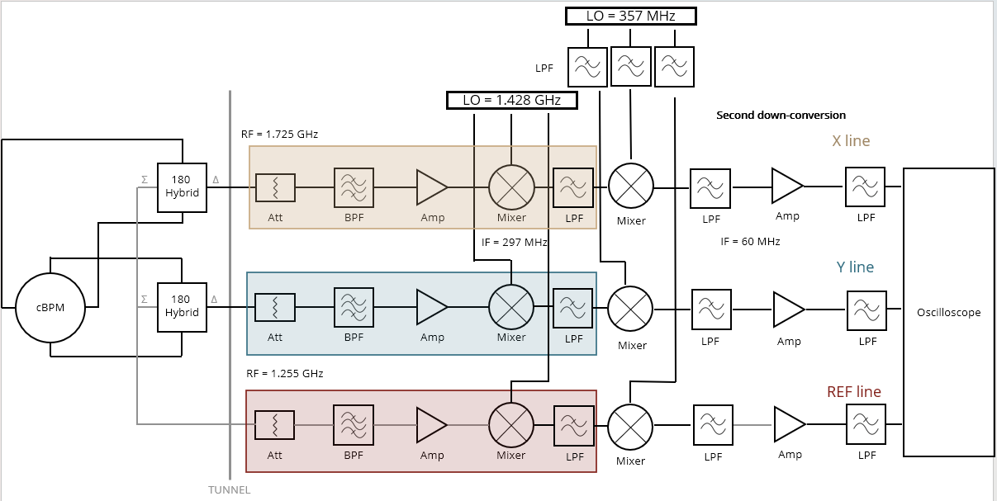
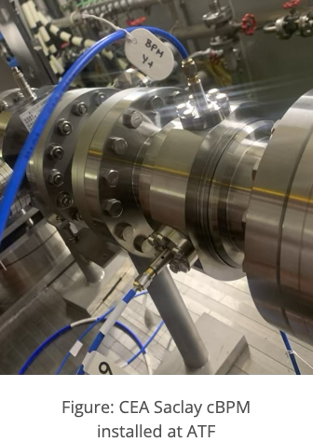
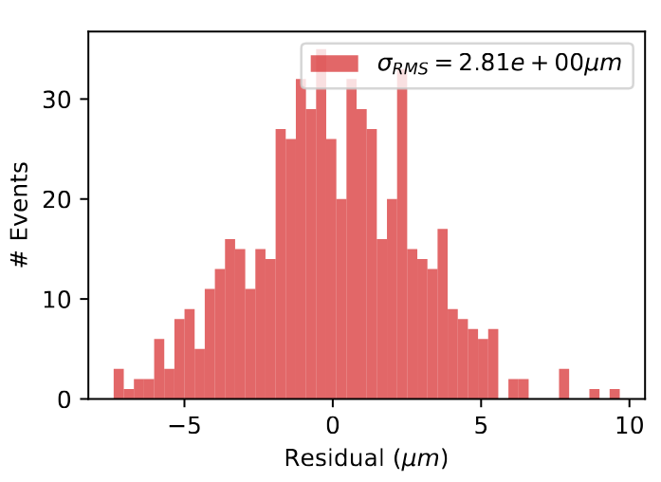
Beam position monitoring system
  Design and construction of a new cBPM in close collaboration with industry:
    Built a new cBPM with Neptury Technologies, now under characterization at IFIC and to be tested in June 2026 at KEK
  New DAQ system to process data accurately and consistently:
    Beam-tests at KEK (Japan) with prototype readout and processing algorithms with cBPM from CEA Saclay shows a resolution <3μm
    Data processing, analysis and beam test conditions to be improved
    New beam tests in May 2026
  But FCC baseline design is based on button BPMs
    They are cost-effective solution
    Less technical problems with wakefields, port heating with respect cBPMs

Slide 5
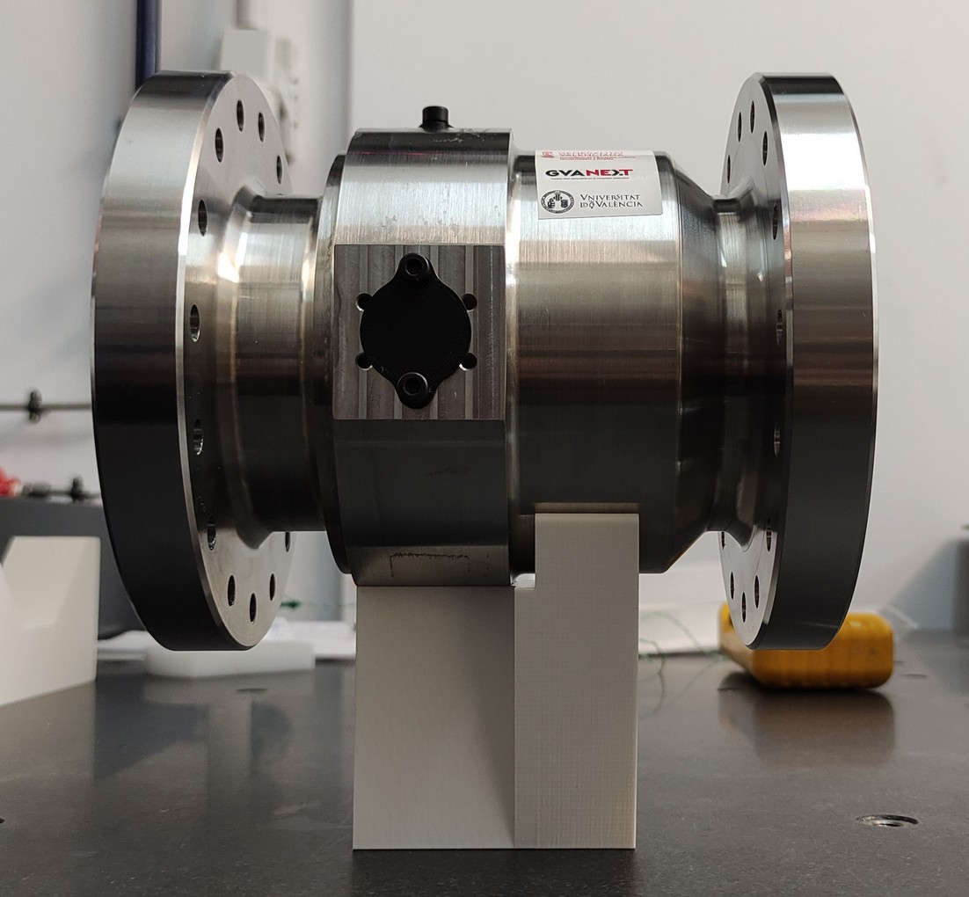
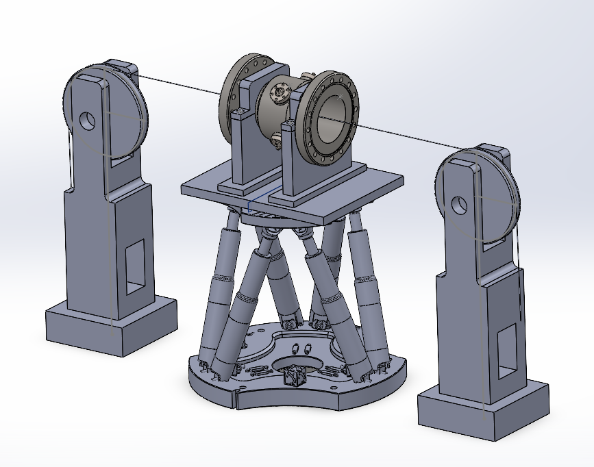
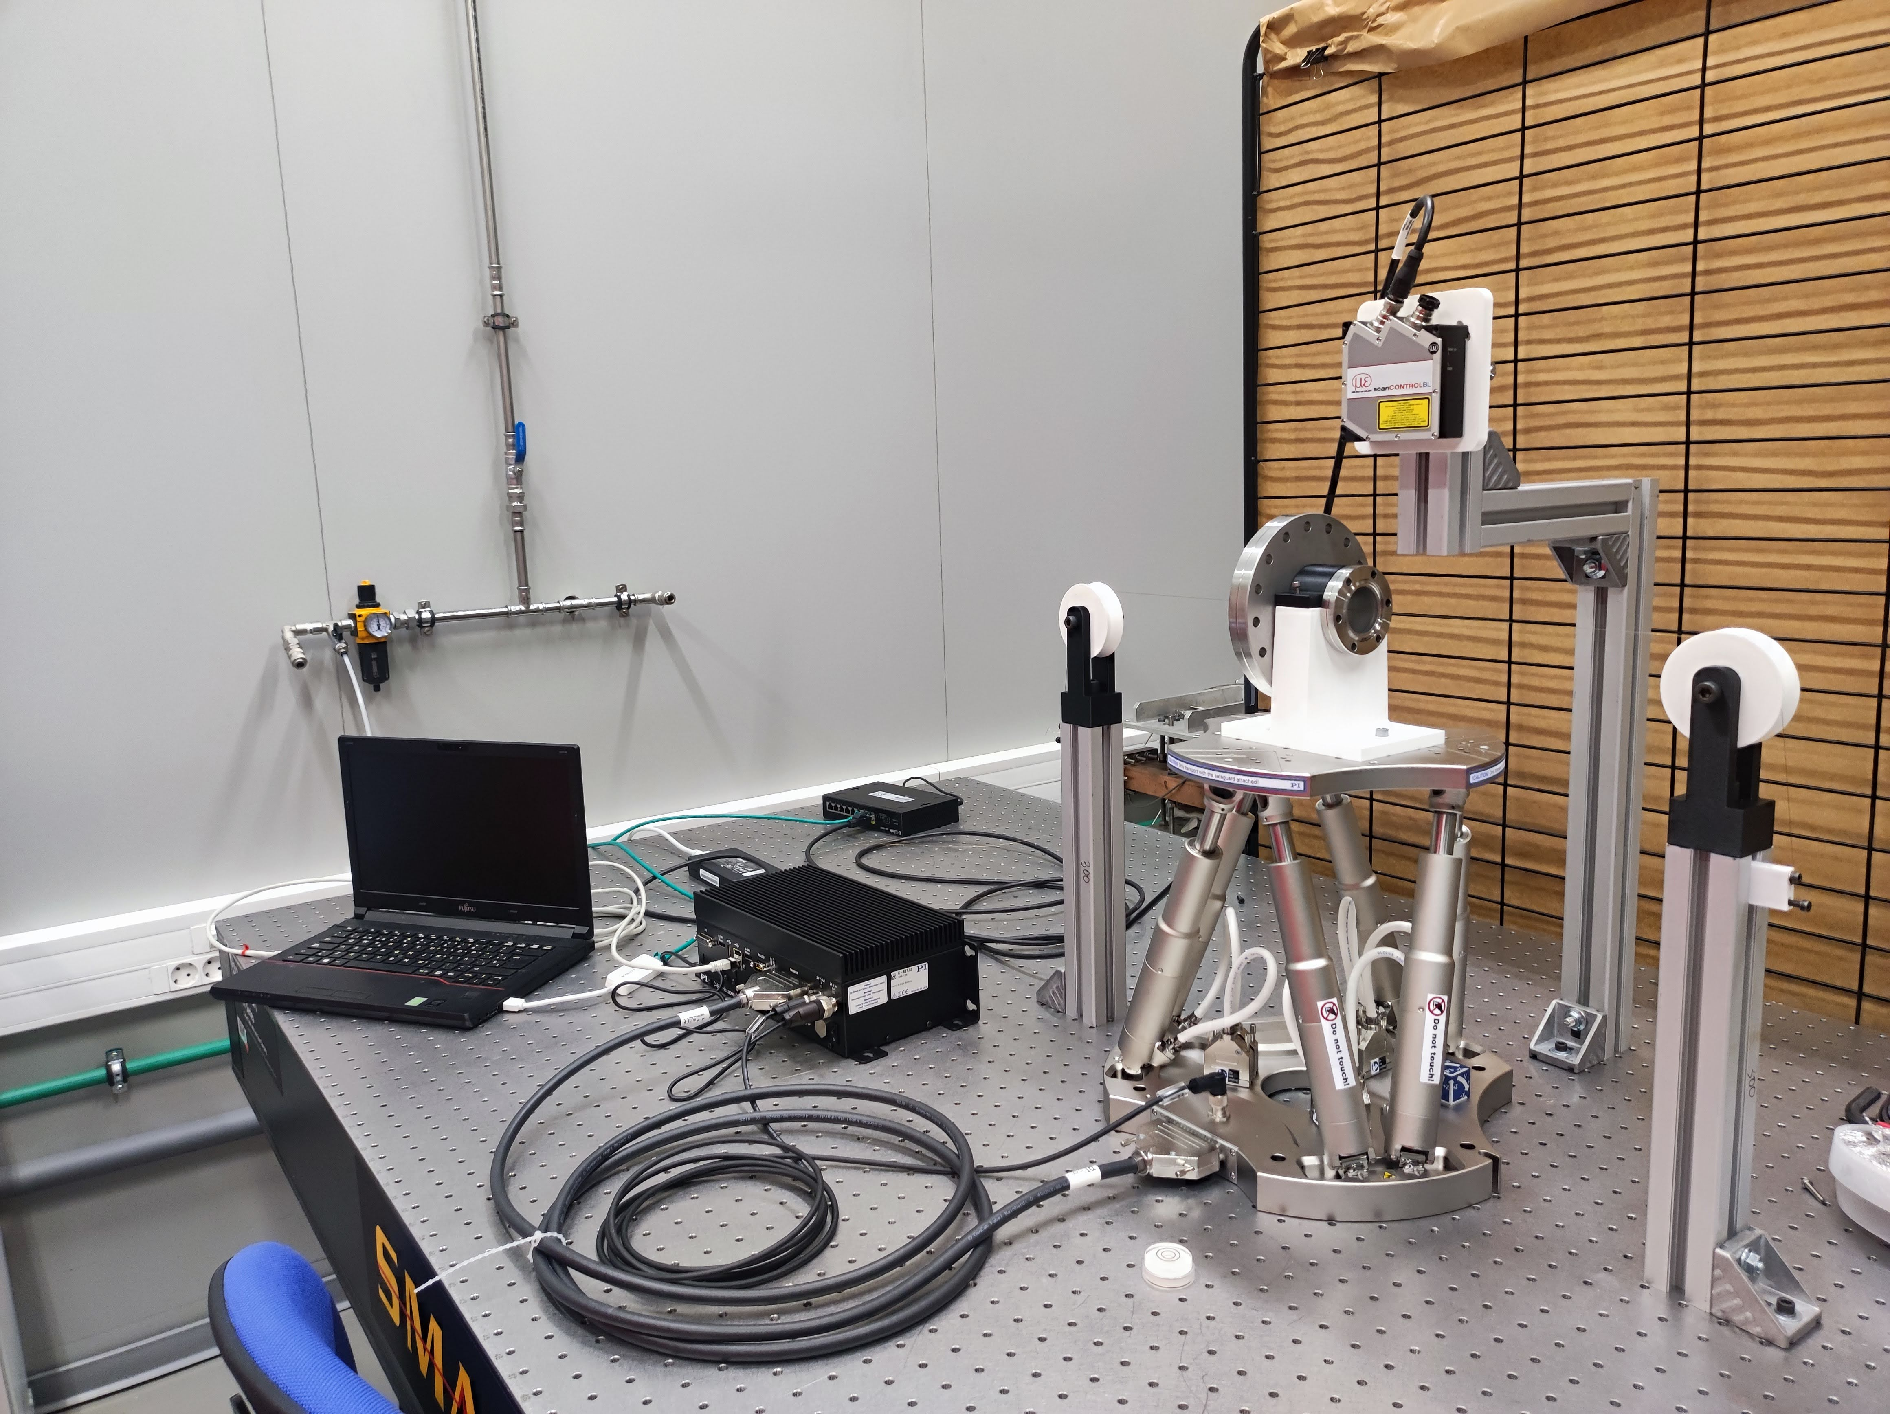
Beam position monitoring system
cBPMs may be interesting for other parts of the FCC complex other than the storage and booster rings:
  Injector transfer lines and matching/injection sections.
  Particularly in: damping ring extraction, compressor section inputs/outputs, matching to the booster, and areas where “beam jitter” must be separated from optical errors
  A cavity BPM at strategic points can provide better diagnostics of: pulse-to-pulse stability, residual offsets after correctors ...
In collaboration with Frank Zimmermann (FCC Deputy Study Leader) and Thibaut Lefevre (Head of the CERN Beam Instrumentation group) we have agreed in carrying out feasibility studies together with FCC collaboration:
  Study potential locations: Injector or HE linac
  Requirements: bunch-by-bunch measurements (to be integrated in feedback systems)
  Challenges: beam impedance, heating and impact in beam dynamics
  Activities: performance to cost evaluation and comparison among different technologies (needs to be re-evaluated as it was done many years ago)
Also, a system to calibrate BPMs where we can measure the geometrical center with respect to the electrical center was a common interest

Slide 6
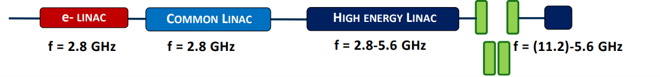
RF accelerator
Injector complex, total length ~1.1 km
We have experience in RF systems and RF cavity design, Photo-injector designs and testing at X-Band and S-Band frequency for different projects (CLIC, IFIC RF laboratory, XLS-CompactLight)
Contacted FCC-ee injector responsible Alexej Grudiev and have agreed in looking for potential interests and contributions:
  Groups currently involved: CERN, PSI, IJCLab, INFN-LNF, SLAC
  IFIC contribution to be studied with FCC responsibles
    RF R&D: S-Band design
    Multipactor expertise
  This contribution may have a potential involvement of Spanish Industry
    Cavity construction
    RF sources (power modulators)
    Magnets

Slide 7
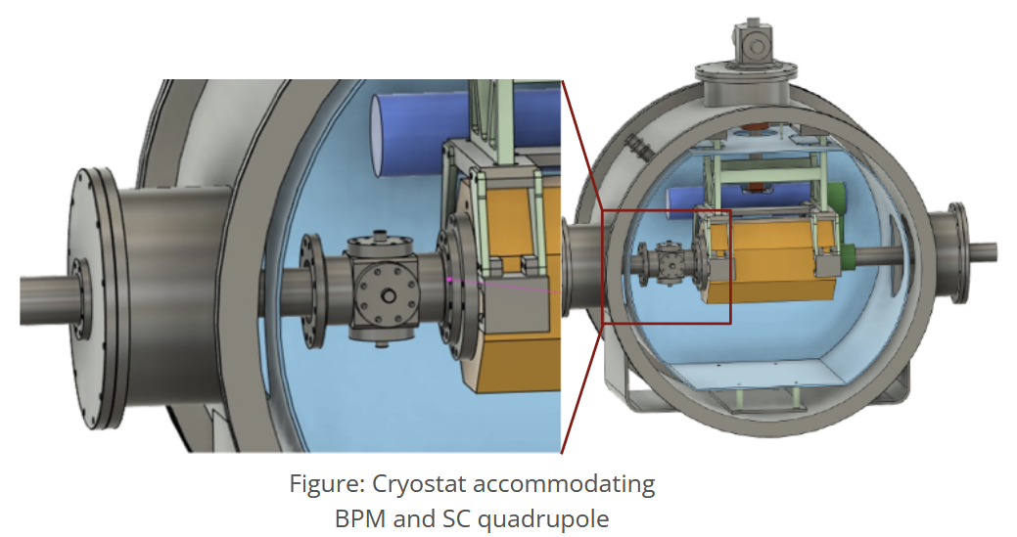

Ongoing work, plans and funding
In development:
  Development of BPM electronics readout and data processing system
  Study potential integration of cBPM in FCC
  Develop a new BPM calibration system
  Beam tests of BPM
  Tests on cryogenic conditions with KEK colleagues
Funding:
  ASFAE/2022/013, “RF technologies for beam monitors in accelerators and for dark-matter axion detectors.”
  S8A, PhD student Laura Pedraza Motavita
  PROMETEO CIPROM/2021/073: PhD student Juan Carlos Fernandez
  Plan nacional: PID2021-122134NB-C21, PID2024-158190NB-C21
  Participants of the European project (Marie Curie Action - SE): EAJADE (Europe-America-Japan Accelerator Development Exchange) Program. Stays in KEK for the beam test of the BPM.
  Requested a continuation project, GEAR-NG, more focused on FCC accelerator activities

Slide 8
Thank you
Daniel Esperante Pereira
Daniel.esperante@ific.uv.es

Slide 9
Conclusions
Our group has a solid background:
  RF design and simulation (CST, HFSS, Superfish)
  Particle accelerators electronic systems
    Low Level RF systems
    Embedded systems (FPGA, MPSoC, microTCA, PXI…)
    Electronics instrumentation
  Beam diagnostics
    cBPMs, BPMs
    Test setups
  Non-linear RF phenomena: multipactor and RF-breakdows
  Beam dynamics
    Lattice design, collimation, collective effects
  Theoretical developments

Slide 10


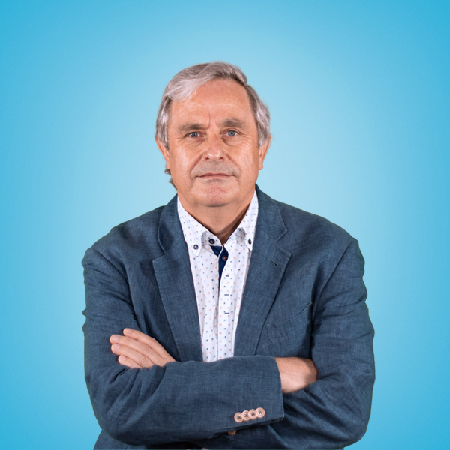
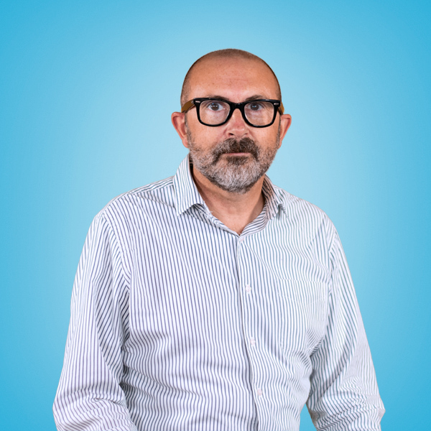
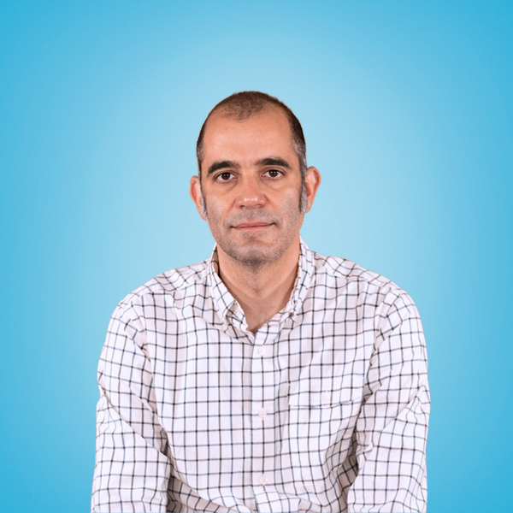
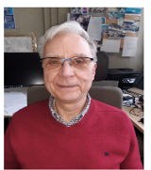
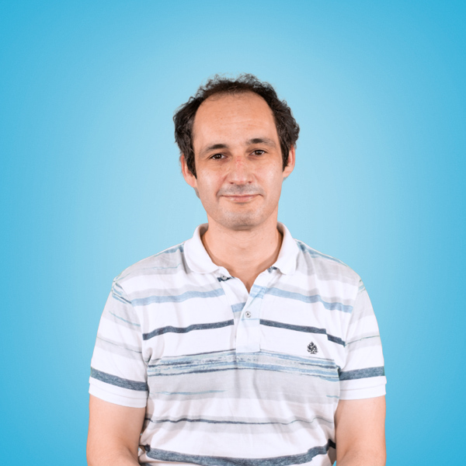
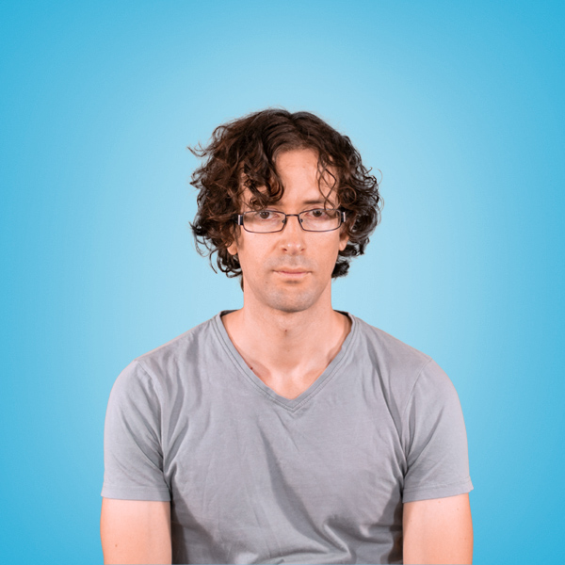
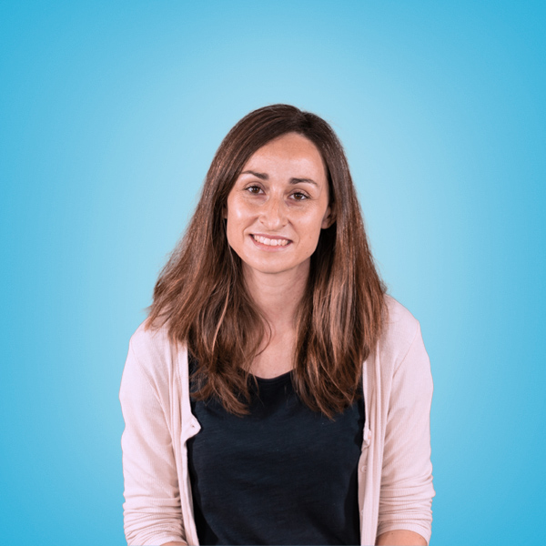
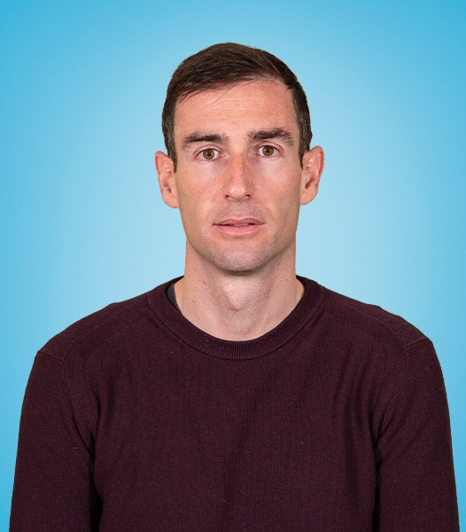
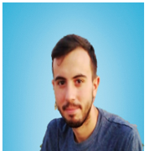
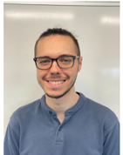
Accelerator physics and technology team
Team members:
  Juan Fuster Verdú: juan.fuster@ific.uv.es
  Benito Gimeno Martínez: benito.gimeno@uv.es
  Daniel Esperante Pereira: daniel.esperante@ific.uv.es
  Santiago Noguere Puchol: Santiago.Noguera@ific.uv.es
  Cesar Blanch Gutiérrez: cesar.blanch@ific.uv.es
  Daniel González-Iglesias: daniel.gonzalez-iglesias@uv.es
  Nuria Fuster Martínez: nuria.fuster@ific.uv.es
  Marça Boronat Arevalo: boronat.arevalo@ific.uv.es
  Carlos Orero Canet: carlos.orero@ific.uv.es
  Abraham Menéndez: Abraham.menendez@uv.es
  Pablo Martín Luna: pamarlu@ific.uv.es
  Javier Olivares Herrador: javier.olivares.herrador@cern.ch
  Juan Carlos Fernández: juancarlos.fernandez@ific.uv.es
  Eduardo Martínez López: Eduardo.martinez@ific.uv.es
  Laura K. Pedraza: laura.pedraza@ific.uv.es
  José Reina Valero: jose.reina@ific.uv.es
Within the AITANA group: https://aitanatop.ific.uv.es/aitanatop/

