Slide 1

CIEMAT and SHIP
Introduction, activities, interests
Cristina Fernández Bedoya (CIEMAT)
Spain@SHIP opportunities
Valencia, May 5th, 2026

Slide 2
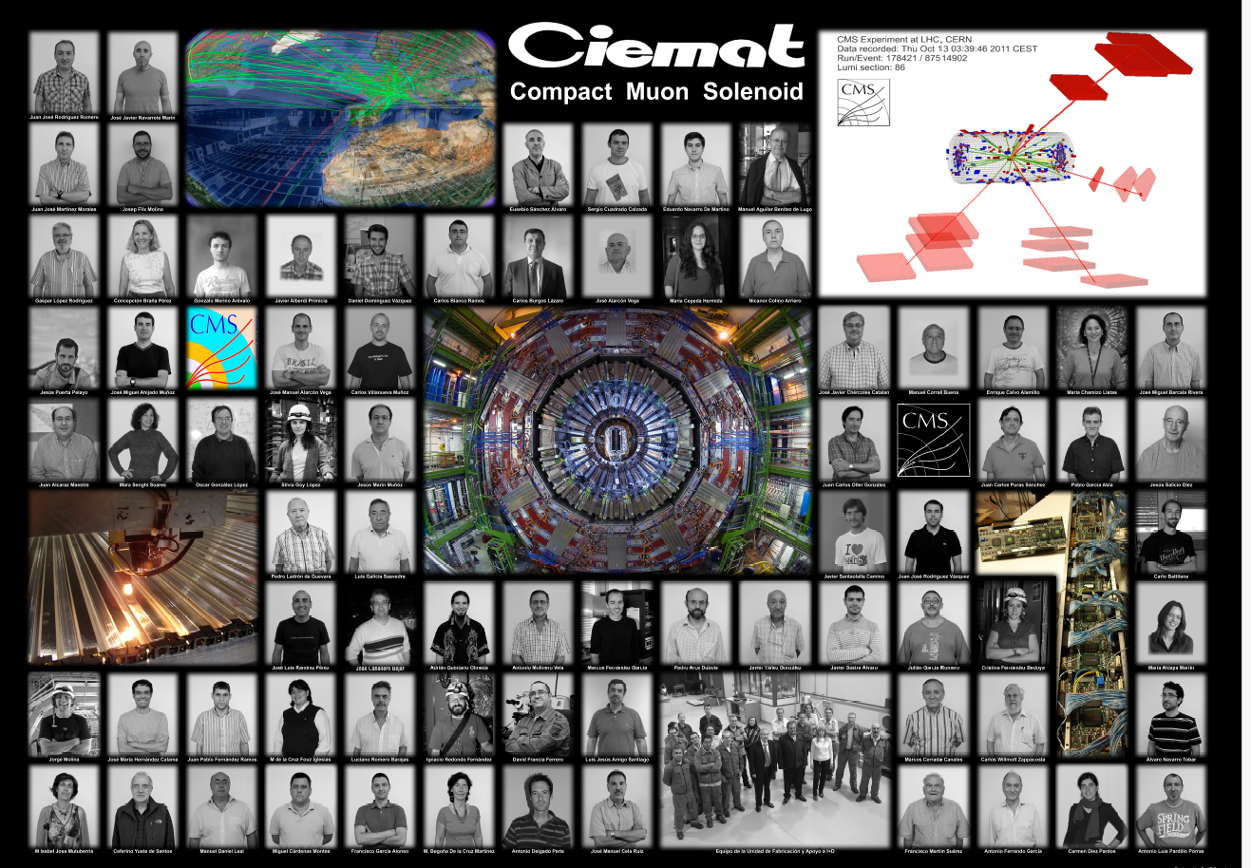
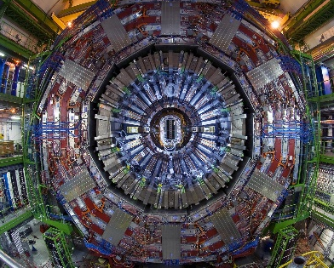


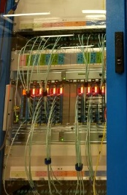
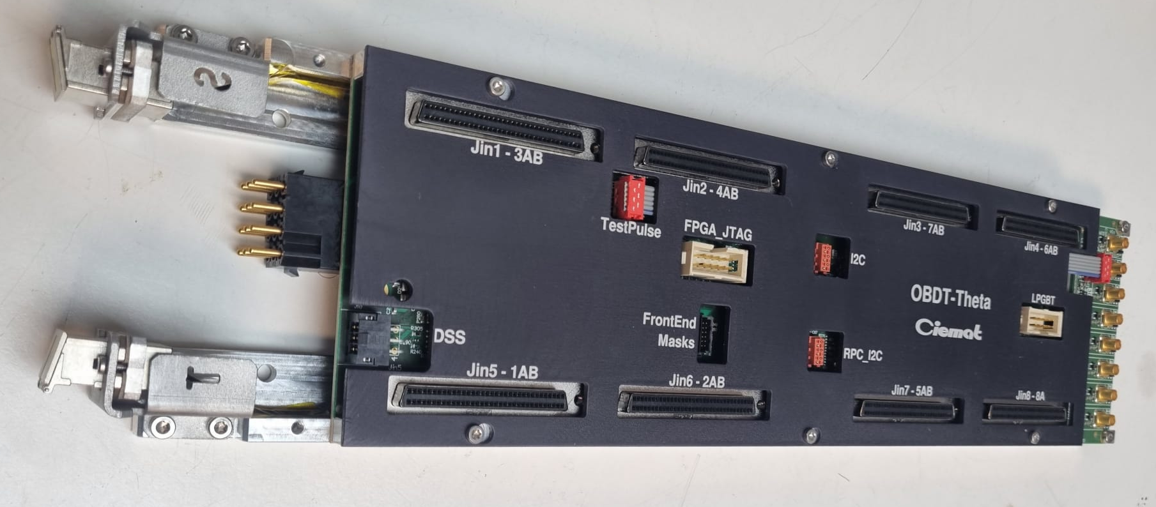
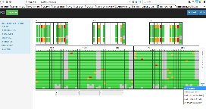
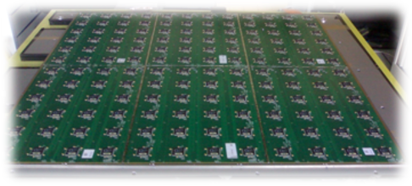
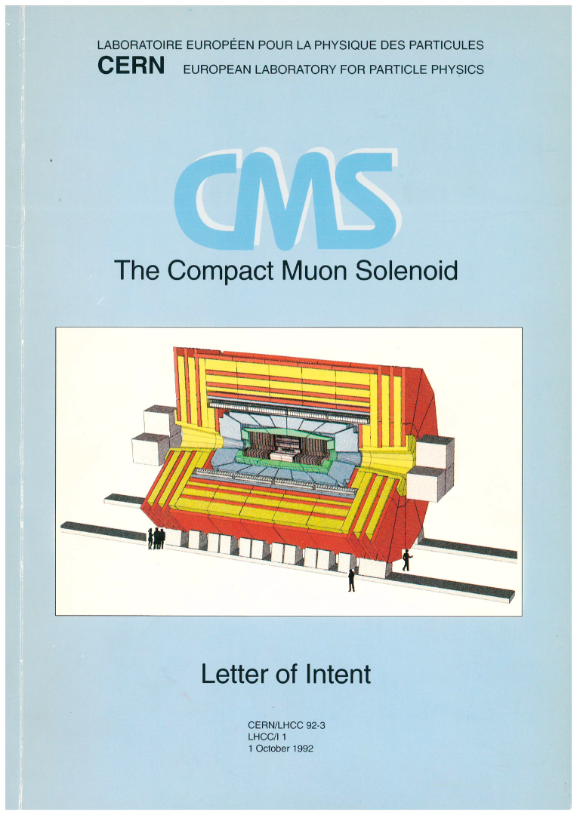
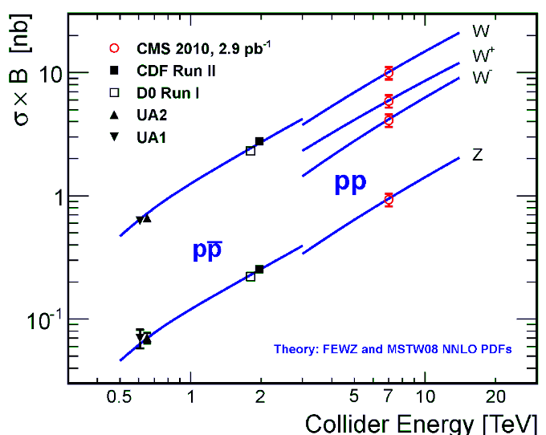
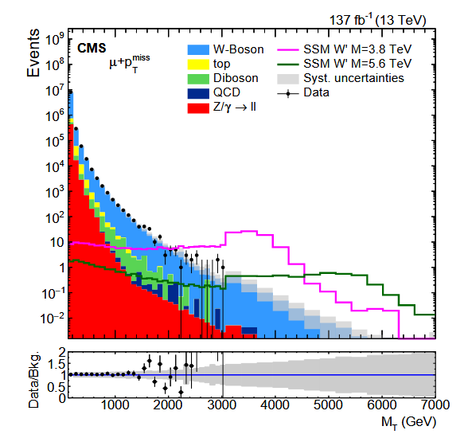
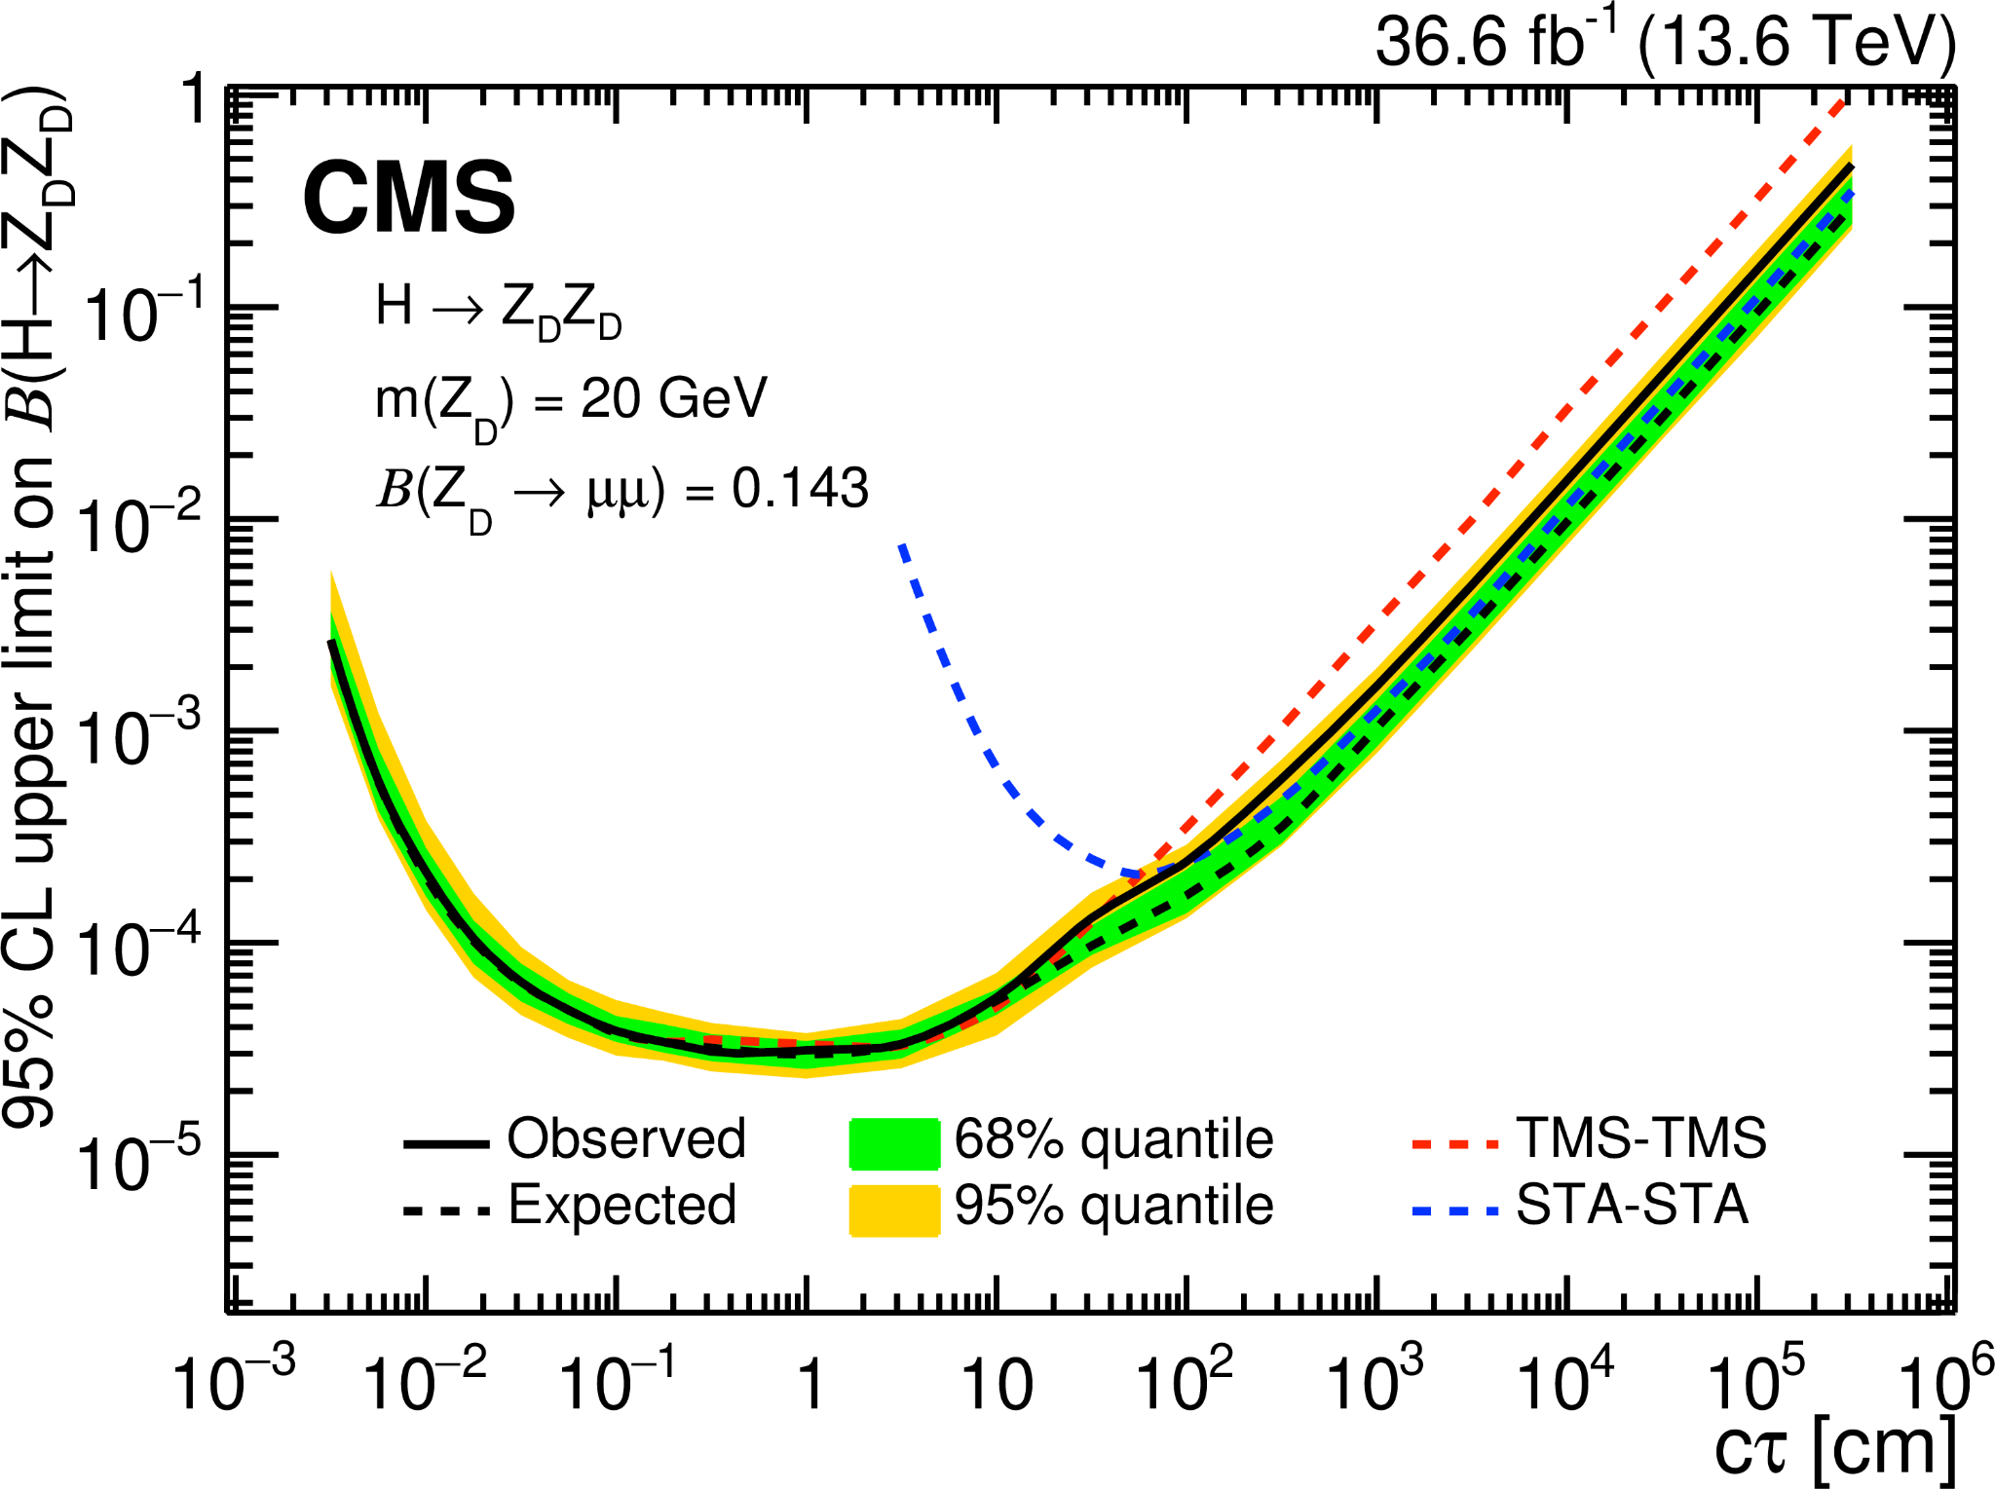
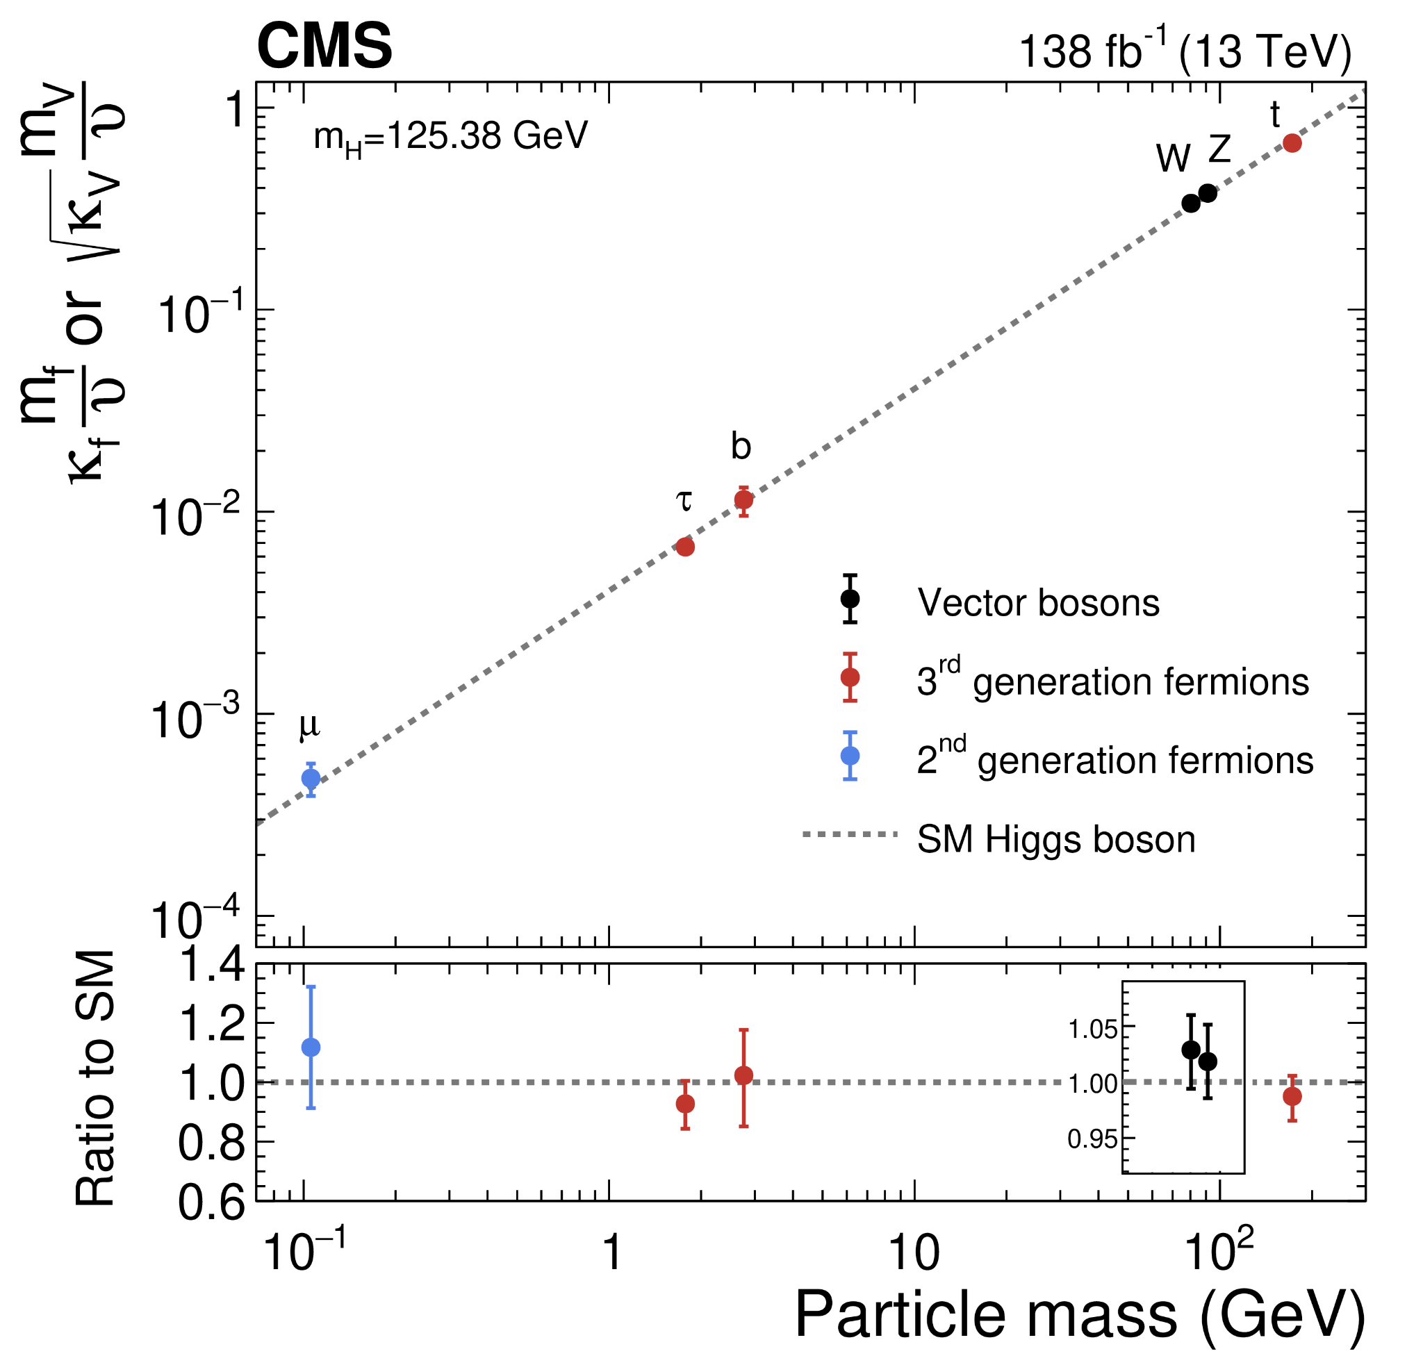

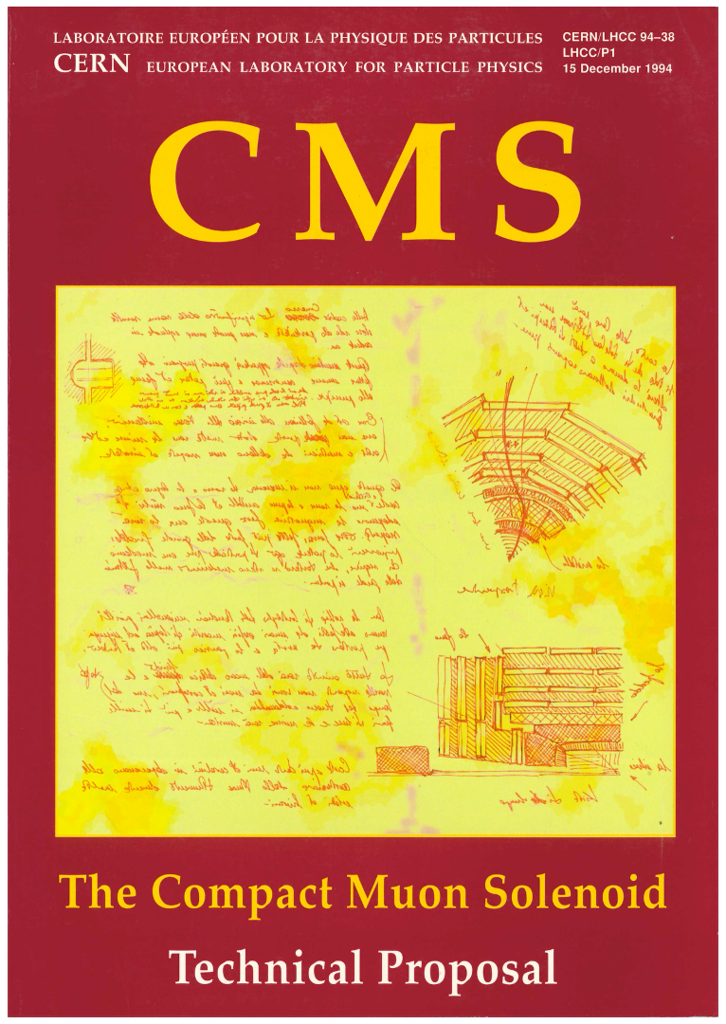
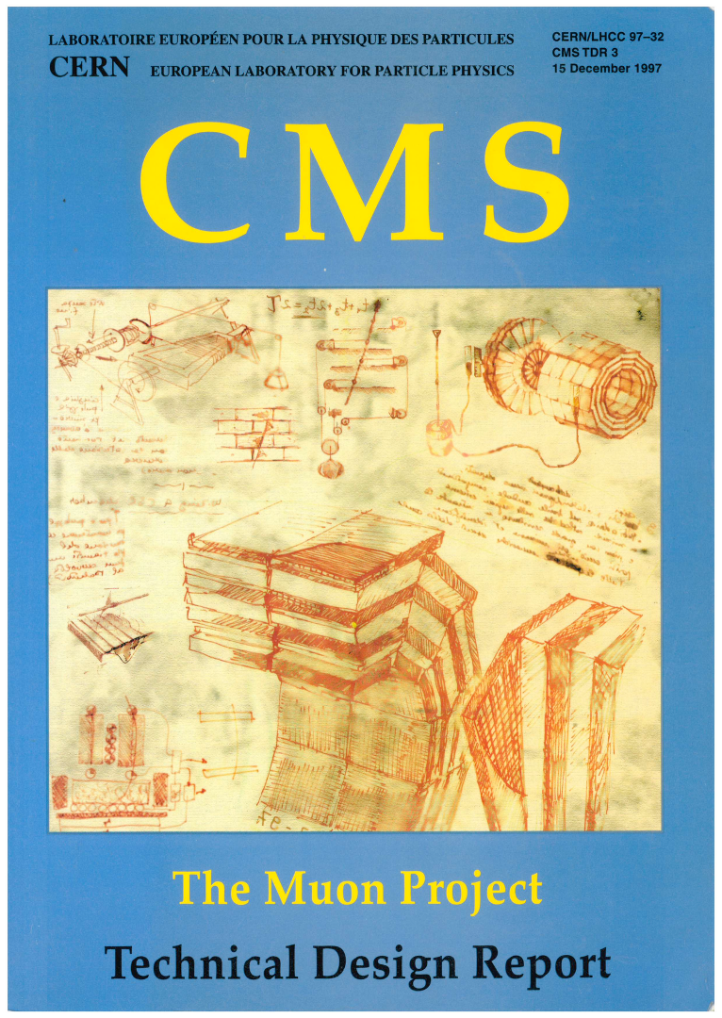
CIEMAT at Colliders
Continued participation of CIEMAT at highest energy colliders since decades
Critical LHC contributions since early days.
Involvement in future colliders simultaneous to LHC and HL-LHC
2009
LHC start
Higgs boson
Phase 1 upgrade
1000 papers
HL-LHC construction
70 DT chambers
Readout and alignm.
LHC
Fw & Sw
Upgrades
HL electronics
Future Calorimeters
Design
Construction
Run1
2010-12
Run2
2015-18
Run3
2022-25
HL-LHC
2030-41
Future Colliders
Long Lived Searches
Higgs couplings
Search for W’
TDRs
1996/7
W and Z
cross sections
LoI
1992
European Strategy
Notes:
CIEMAT has been working very actively in colliders since many decades and our contribution to LHC dates back to the R&D phase. We were heavily involved in the construction of the CMS (compact muon solenoid) detector and during the years we keep maintaining a very active role in all the fronts from physics studies to operation or building the different upgrades, including the nearby High Luminosity LHC. In parallel we have pursued a line of R&D on future colliders

Slide 3

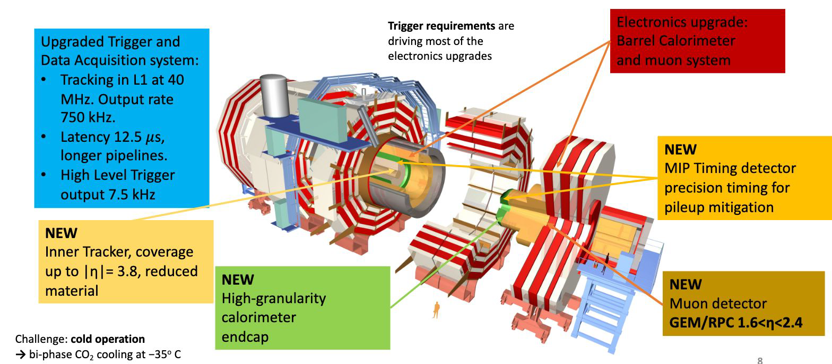

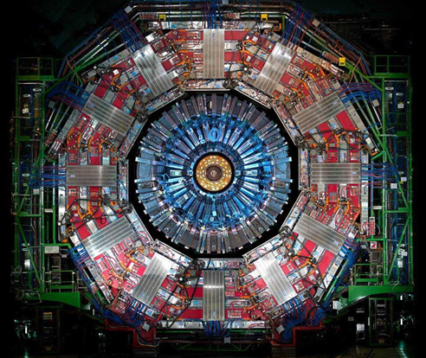
COMPACT MUON SOLENOID
TRIGGER
MUONS
HGCAL
CIEMAT SHIP – May 5st, 2026
Notes:
Contextualizar upgrade and

Slide 4
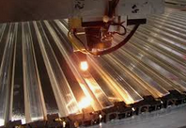
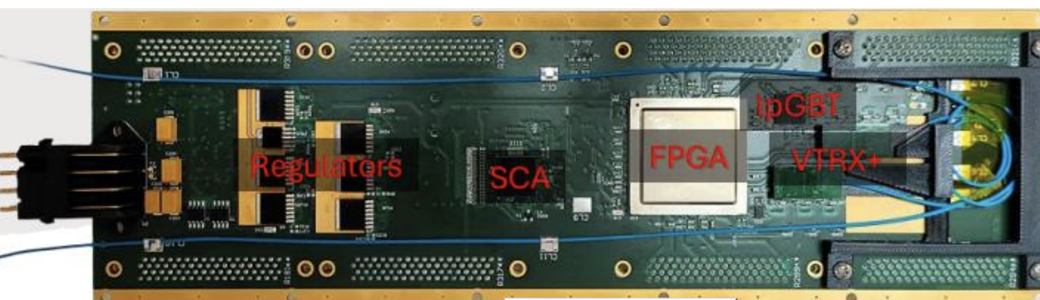
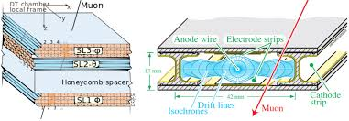
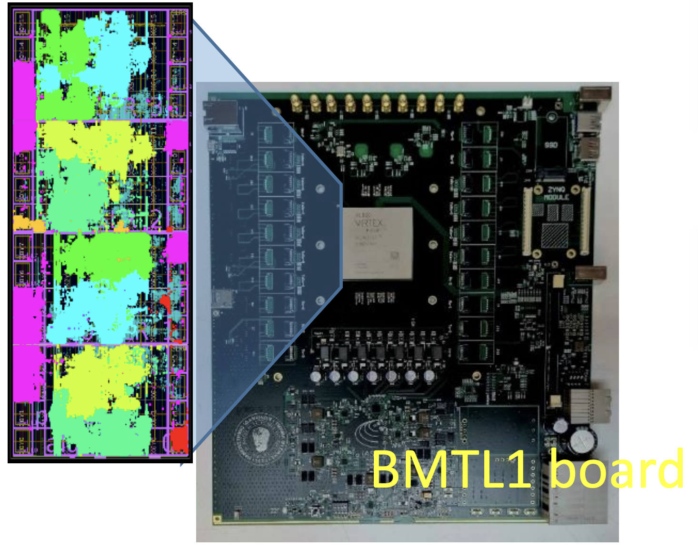
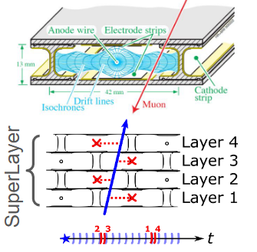
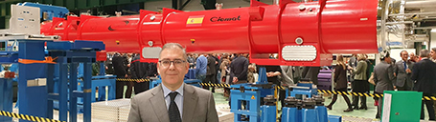
Expertise at CIEMAT´s Colliders group
Gaseous Detectors
Trigger systems and algorithms
Digital Electronics design
Designed and built the readout electronics of the original CMS Drift Tube chambers (two layers of electronic boards)
Designed electronics for all the upgrade phases (SC relocation, phase 1 upgrade)
Now designed electronics for Phase 2
Designed systems for time measurement, high throughput, flexible readout systems
Worked also with various photodetection systems
Contributed to the CMS Trigger at several levels (HLT, Level 1)
Designed complex algorithms (track fitting at DT: 4D reconstruction)
Building Phase 2 system, expertise in FPGA firmware development
Built CMS Drift Tube chambers (25%)
Operated them for over 20 years: reparations, maintenance
Longevity studies at GIF++ in the last 10 years
Timing
Calorimetry
Long standing participation in CALICE
Now contributing to HGCAL
Magnets
Different department at CIEMAT (Technology, instead of Basic Research)
In good contact with them. Actually very busy building correction superconducting magnets for HL-LHC (in the inner triplets).
CIEMAT SHIP – May 5st, 2026

Slide 5
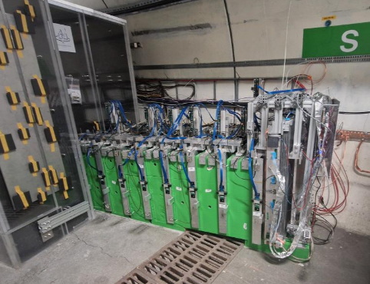
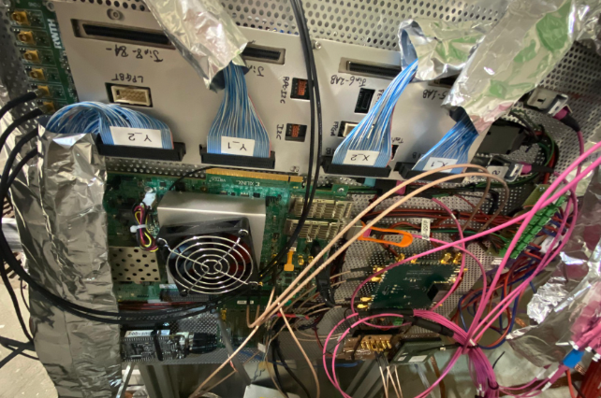
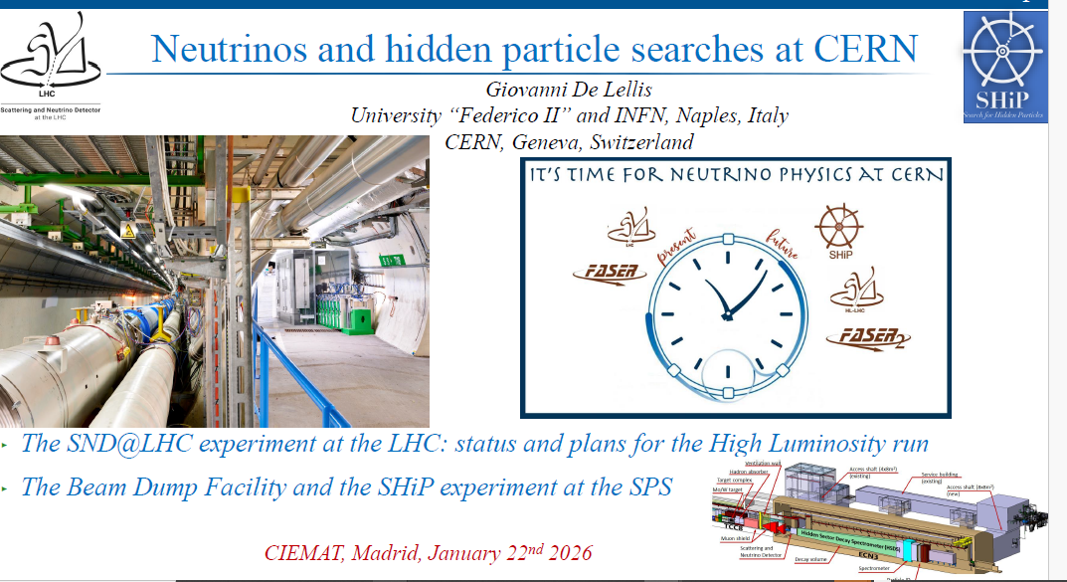
CIEMAT at SND (Scattering and Neutrino Detector)
Detect and study very forward LHC neutrinos and other feebly interacting particles
Muon tagger was added in the last stage at the end of 2024 to improve the resolution of the muons
One OBDT-theta system (CIEMAT) has been taken data in the last year in the muon tagger
Collaboration with INFN Bologna
SND experiment
d
OBDT-theta
Backend system
Based on AMD eval board
Custom fw adapted to DAQ
Seminar from Giovanni de Lellis at CIEMAT in January 2026
Custom designed electronics to interface with the LHC clock
CIEMAT SHIP – May 5st, 2026

Slide 6
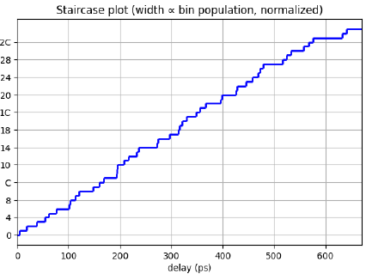
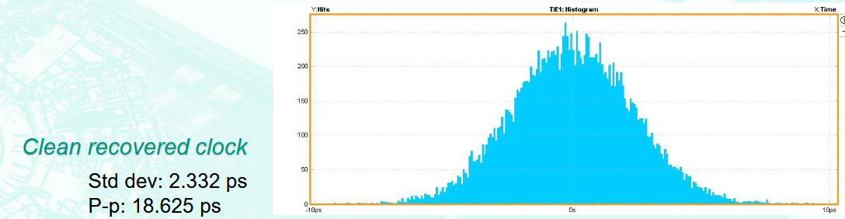
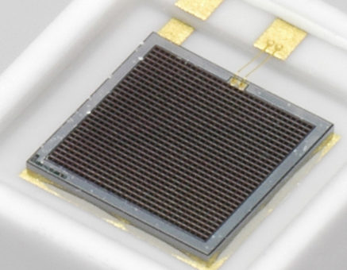
An advanced and flexible readout board:
OBDT-theta
Programmability and flexibility of the OBDT-theta board allows it to be repurposed to other experiments.
Present use in other setups:
  SND@LHC
  DRD 1 : readout electronics for gas detector
  DRD 7.3. Timing applications
  R&D of new detectors for
future colliders
Programmable
Radiation tolerant
228 channels @ 0.7 ns
~50 Gpbs throughput
DRD collaboration (R&D for Future Experiments)
DRD7.3 timing applications
OBDT-theta for MPPC (Multi-Pixel Photon Counter) readout chain
Collaboration with IFIC on the ATENEA project
Validated the timing distribution reliability (jitter recovered clock 𝝈 ~ 2.3 ps)
At present implementing time digitization inside the OBDT-theta with ~40 ps resolution
Notes:
SND: Muon tagger, instalado en navidades, en operación ahora mismo
Timing: no todos los detectores van a necesitar el mismo nivel de timing. Estudio de timing en la OBDT-Theta, centrado en el jitter. Resultado del test: se puede usar para distribuir el reloj. Presentado en Junio. Además, estudio actual muestra que se puede usar para medir tiempo (método de línea de retardo / delay chain): 40 ps. Esto supone aún más versatilidad / sinergia para otros experimentos.
DRD1 : se ha ofrecido la OBDT-theta para otros detectores, que no sean cámaras de deriva. De momento poco avance por falta de personal, se podría hacer mucho mas.

Slide 7
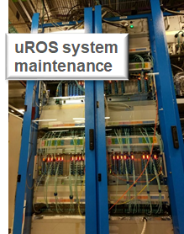
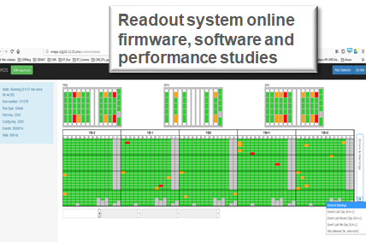
CMS decommissioning
Several parts of the CMS detector will be decommissioned in June 2026.
For instance the second level of trigger and readout
uTCA boards and crates (uROS system (30 boards), TwinMux system (60 boards))
Optical fiber inputs, ipbus connection
Some interface to CMS DAQ and Timing and Control system to be discussed
FPGAs could be reprogramed for different purpouse (now they receive GBT links, some boards may be modified for lpGBT readout (TwinMux)
CIEMAT SHIP – May 5st, 2026

Slide 8
Summary
We acknowledge the strong scientific interest of the SHiP program, which explores a region of the BSM phase space complementary to that covered by CMS.
Our involvement in SND@LHC has also contributed to strengthening connections between the scientific communities engaged in these initiatives, fostering synergies across experiments.
CIEMAT is currently playing a key role in the CMS Phase 2 upgrade program and is actively involved in the FCC R&D activities, both of which represent major strategic commitments for the Unit.
At present, significant scheduling constraints limit our capacity to engage in additional large-scale projects such as SHiP, as our resources are fully allocated until the HL-LHC enters operation.
The planned decommissioning of several CMS subsystems may open opportunities for the identification and exploitation of potential synergies.
Nevertheless, we remain open to future discussions, particularly in areas where our contribution could be targeted and complementary rather than core to the project.
CIEMAT SHIP – May 5st, 2026

Slide 9
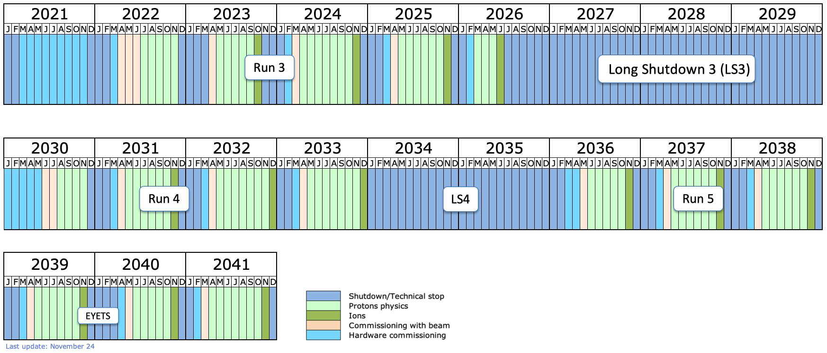
HL-LHC
Notes:
Let me go briefly through some of the most important contributions from our group on the scientific exploitation of CMS.

Slide 10


Trigger and DAQ activities @CIEMAT
EXPERTISE
Long expertise in design and development of digital electronics for TRIGGER and DAQ:
  In the last 25 years: CMS DT readout and upgrade: SC relocation and uTCA migration
  Large expertise in FPGAs (AMD, Microchip) and large throughput communication
  HL-LHC: new on-detector electronics for CMS Drift Tubes : OBDT-theta design
    >200 TDC readout based on rad tolerant FPGAs and high speed links
HL-LHC: new ATCA backend for the CMS Barrel Muon Trigger and Readout:
    BMTL1 production, firmware implementation and emulator development
Developed the Muon trigger algorithm (emulator, firmware) for CMS at HL-LHC:
    Analytical Method for DT primitives, performance monitoring of muon triggers, menus

