Slide 1

Comentario de resultados
Masterclass Hands on Particle Physics
Mariam Tórtola
26 de marzo de 2026

Slide 2
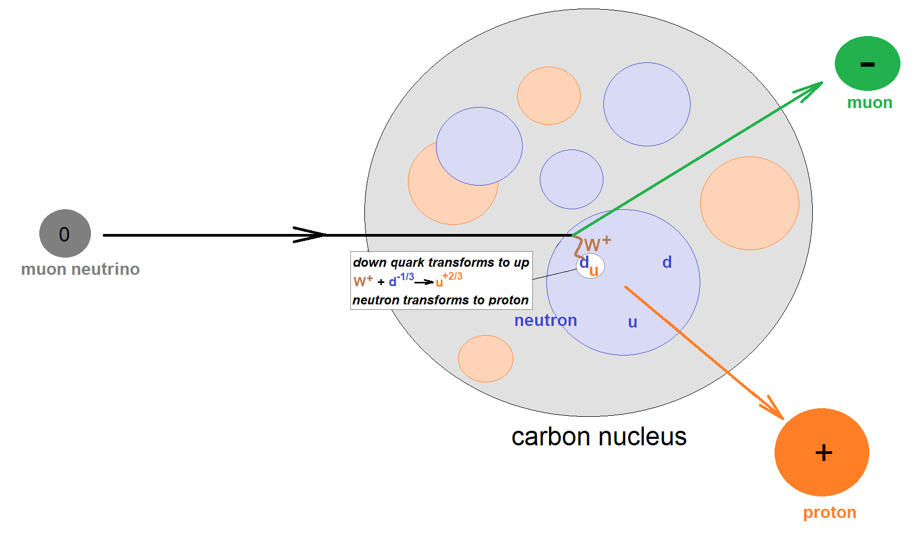
    Signal and background events
There are both background and signal events
In each signal event, a neutrino penetrates a nucleus in carbon target and undergoes a weak interaction with a neutron in that nucleus
  The neutrino interacts with the neutron to become a muon, causing the neutron to
  become a proton!
Background event: any other event type

Slide 3
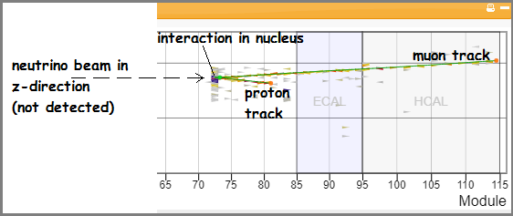
    Interaction kinematics
While MINERvA cannot directly detect the neutrino, it detects and measures the kinematics of both the muon and the proton that emerge from the interaction
You can find this kinematic information with Arachne, the MINERvA event display that you will use to visualize the events.
You will then put this information into a spreadsheet which applies conservation of momentum to give the momentum of the system prior to the interaction in three dimensions.

Slide 4
MINERvA’s Principal Interaction
Of Interest (What we see)
υ_{μ}
p⁺
n⁰
μ⁻
Scintillating Target Material

Slide 5
MINERvA’s Principal Interaction
Of Interest (What we see)
A proton and muon “appear” out of nowhere
in the scintillating target
υ_{μ}
p⁺
n⁰
μ⁻
Scintillating Target Material

Slide 6
MINERvA’s Principal Interaction
Of Interest (Revealed)
neutrino + neutron → proton + muon
ν_{μ-} + n⁰ → p⁺ + μ⁻
p⁺
υ_{μ}
n⁰
μ⁻
Scintillating Target Material

Slide 7
What’s Going On?
A neutrino with kinetic energy strikes a neutron at ‘rest’ in the nucleus of an atom…
Which causes one of the neutron’s down quarks to flip “up” (udd) to (uud) … transforming it to a proton!
Simultaneously, a muon is generated as the neutrino annihilates
p⁺
udd —> uud
υ_{μ}
n⁰
μ⁻
Scintillating Target Material

Slide 8
What’s Going On?
p⁺
υ_{μ}
n⁰
μ⁻
Also, there is a net gain of mass & a loss of energy during the interaction (E = Δmc²)
Some of the neutrino’s pre-collision kinetic energy changes into new mass (the muon) and some is transferred to the kinetic energies of the muon and proton.

Slide 9
Masterclass objectives
Determine which events are signal events (from which effective measurements may be made) and which events are background (that cannot be used for measurements).
Apply conservation of momentum and energy to measure the approximate energy of a neutrino beam from the Fermilab accelerator complex.
Apply conservation of momentum and energy to measure the properties of neutrons in nuclei of atoms in the target of a neutrino beam.

Slide 10
Momentum Conservation
At the position and time
of the interaction only!
Momentum is
conserved in
all 3 axes
p⁺
υ_{μ}
n⁰
μ⁻
Before Collision
After Collision
p_{neutrino} + p_{neutron}
= p_{proton} + p_{muon}

Slide 11
Momentum Conservation
The beam is aimed so that neutrinos only have momentum in the z-axis!
p⁺
υ_{μ}
n⁰
z-axis
μ⁻
p_{neutrino} + p_{neutron} = p_{proton} + p_{muon}
In the z-axis: p_{neutrino} = p_{proton} + p_{muon}

Slide 12
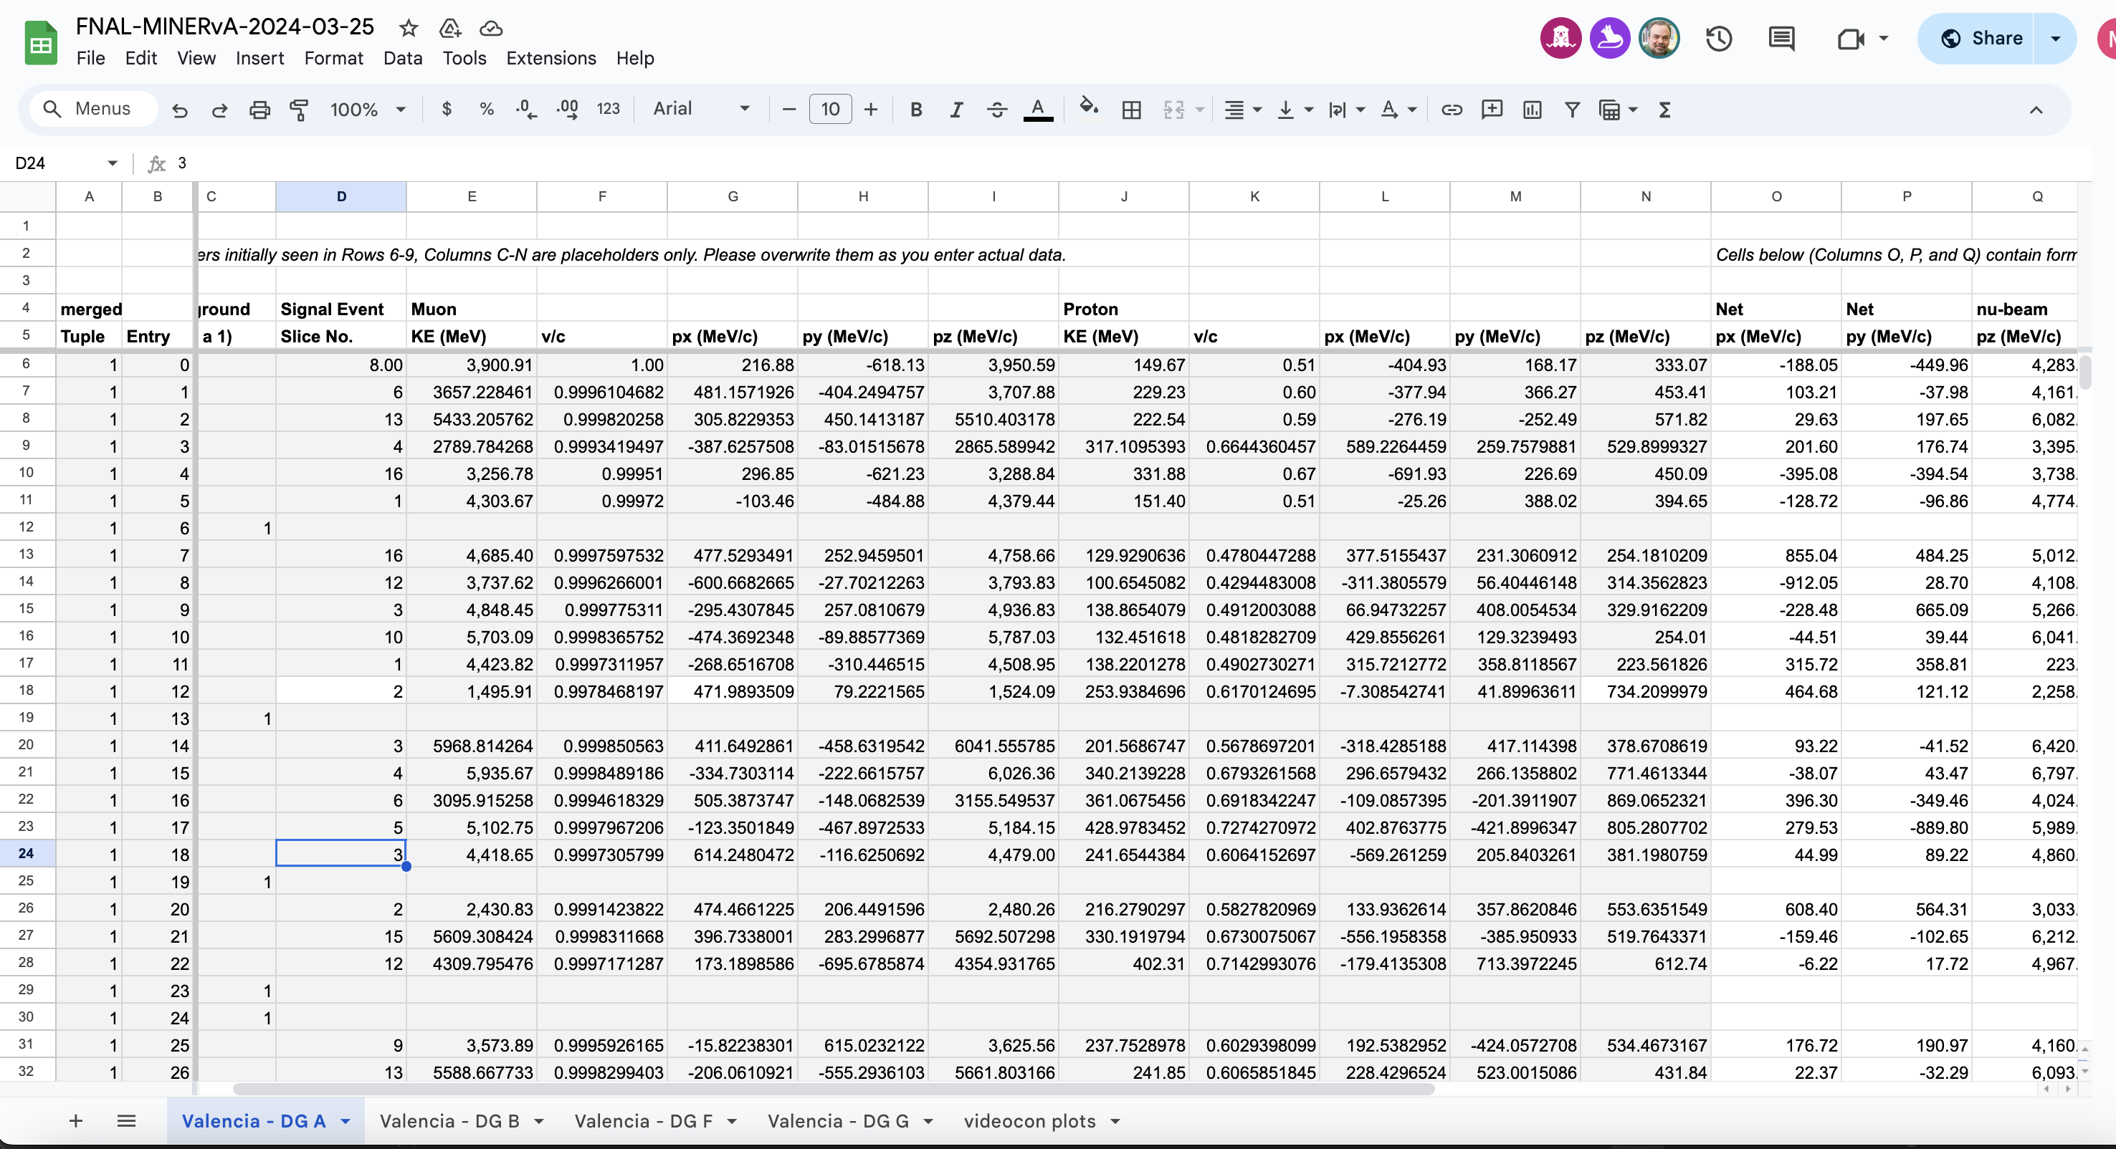
Momentum Conservation
In the z-axis: p_{neutrino} = p_{proton} + p_{muon}
http:/go.uv.es/mamtor/minerva_hoja

Slide 13
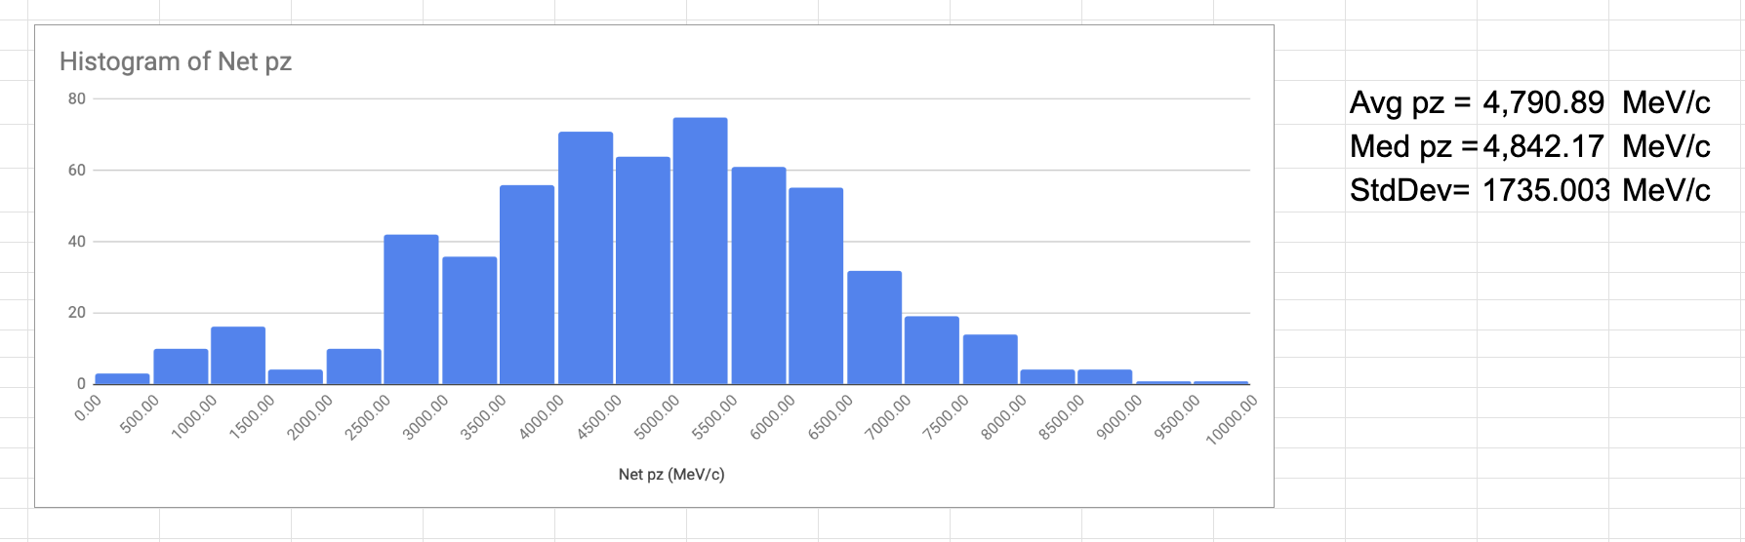
Momentum Conservation
In the z-axis: p_{neutrino} = p_{proton} + p_{muon}

Slide 14
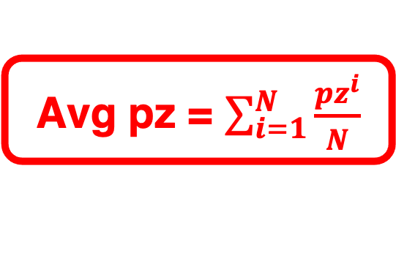
Momentum Conservation
In the z-axis: p_{neutrino} = p_{proton} + p_{muon}
Avg pz = $\sum_{i=1}^{N}{\frac{{pz}^{i}}{N}}$
StdDev = standard deviation
Med pz = median
Average or mean value
central value in a distribution
dispersion of the data

Slide 15
Momentum Conservation
In the z-axis: p_{neutrino} = p_{proton} + p_{muon}
⇒ We can reconstruct the initial neutrino momentum
E² = p²c² + m²c⁴
For neutrinos: pc >>mc²
initial neutrino
energy
⇒
E_{beam} = p_{neutrino} c
⇒

Slide 16
Momentum Conservation
υ_{μ}
p⁺
z-axis
n⁰
μ⁻
z-axis: p_{neutrino} = p_{proton} + p_{muon}
If the target neutron is totally at rest…
… then in the x-axis & y-axis
p_{proton} + p_{muon} = 0

Slide 17
Momentum Conservation
υ_{μ}
p⁺
z-axis
n⁰
μ⁻
z-axis: p_{neutrino} = p_{proton} + p_{muon}
If the target neutron has motion…
… then in the x-axis & y-axis
p_{proton} + p_{muon} ≠ 0

Slide 18
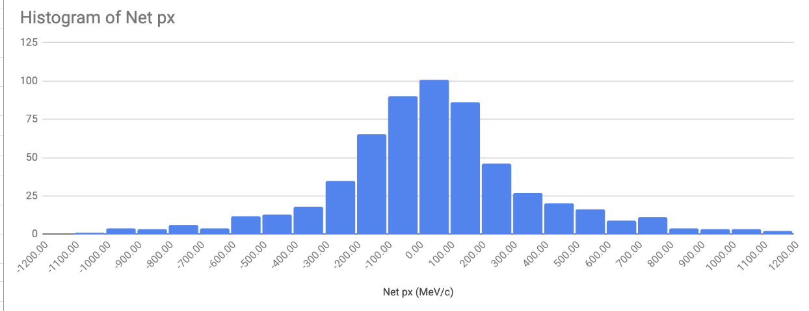
Momentum in x-y directions
x-y axis: p_{neutron} = p_{proton} + p_{muon}
p_{proton} + p_{muon} ≈ 0
Histograms net p_{x}
⇒ distribution centered in 0
Δp_{x} = 336.7 MeV/c
⇒ width of the distribution of p_{x} : Δp_{x}

Slide 19
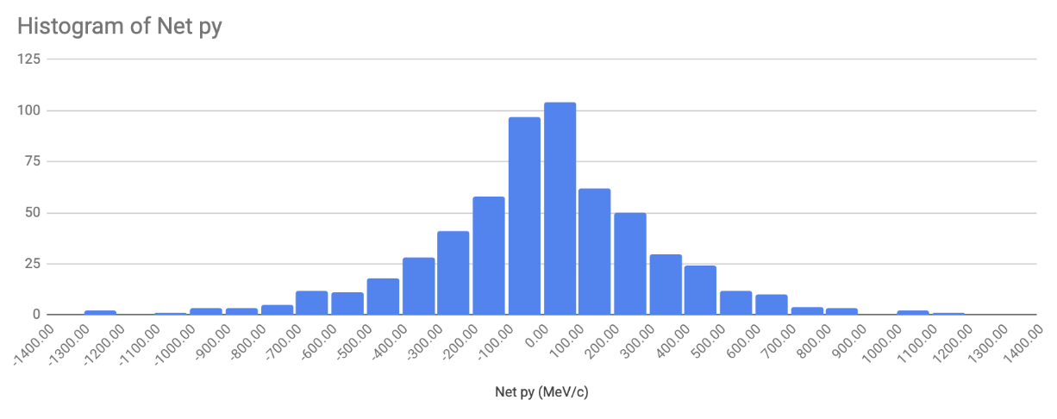
Momentum in x-y directions
x-y axis: p_{neutron} = p_{proton} + p_{muon}
p_{proton} + p_{muon} ≈ 0
Histograms net p_{y}
⇒ distribution centered in 0
Δp_{y} = 323.6 MeV/c
⇒ width of the distribution of p_{y} : Δp_{y}

Slide 20
Momentum in x-y directions
x-y axis: p_{neutron} = p_{proton} + p_{muon}
p_{proton} + p_{muon} ≈ 0
Histograms net p_{y}
⇒ distribution centered in 0
But: neutron at
rest!!
⇒ width of the distribution of p_{y} : Δp_{y}

Slide 21
Origin of neutron momentum ?

Slide 22
Origin of neutron momentum ?
1) Classical thermal equilibrium of neutrons with atoms in the scintillator
Too small!!

Slide 23
Origin of neutron momentum ?
1) Classical thermal equilibrium of neutrons with atoms in the scintillator
Too small!!
2) Heisenberg uncertainty principle and neutron confinement in the nucleus
Δp_{x} Δx ≥ h/4π → Δp_{x}= (100 Mev*fm/c)/ Δx
Better, but still small
Δx = 2*R = (1.25 fm) A^{1/3} = 5.7 fm
→ Δp_{x} ≥ 18 MeV/c

Slide 24
Origin of neutron momentum ?
1) Classical thermal equilibrium of neutrons with atoms in the scintillator
Too small!!
2) Heisenberg uncertainty principle and neutron confinement in the nucleus
Δp_{x} Δx ≥ h/4π → Δp_{x}= (100 Mev*fm/c)/ Δx
Better, but still small
Δx = 2*R = (1.25 fm) A^{1/3} = 5.7 fm
→ Δp_{x} ≥ 18 MeV/c
3) Pauli exclusion principle applied to neutrons confined in the nucleus
Typical value of
transverse moment
in MINERvA

Slide 25
Origin of neutron momentum ?
1) Classical thermal equilibrium of neutrons with atoms in the scintillator
Too small!!
2) Heisenberg uncertainty principle and neutron confinement in the nucleus
Δp_{x} Δx ≥ h/4π → Δp_{x}= (100 Mev*fm/c)/ Δx
Better, but still small
Δx = 2*R = (1.25 fm) A^{1/3} = 5.7 fm
→ Δp_{x} ≥ 18 MeV/c
3) Fermi gas: exclusion principle applied to neutrons confined in the nucleus
Typical value of
transverse moment
in MINERvA

Slide 26

Estimation of the radius of the nucleus
The results on transverse momentum of the neutron can be used to estimate the size of the carbon nuclear radius.
⇒ We can compare our results with the average radius of a nucleus with A nucleons:
R = R₀ A^{1/3} = (1.25 fm) A^{1/3} → R(C, A=12) = 2.9 fm

Slide 27
Estimation of the radius of the nucleus
The results on transverse momentum of the neutron can be used to estimate the size of the carbon nuclear radius.
⇒ We can compare our results with the average radius of a nucleus with A nucleons:
R = R₀ A^{1/3} = (1.25 fm) A^{1/3} → R(C, A=12) = 2.9 fm
1) Heisenberg uncertainty principle:
Δp_{x} Δx ≥ h/4π → Δx= (100 Mev*fm/c)/ Δp_{x}
Estimation of R

Slide 28
Estimation of the radius of the nucleus
The results on transverse momentum of the neutron can be used to estimate the size of the carbon nuclear radius.
⇒ We can compare our results with the average radius of a nucleus with A nucleons:
R = R₀ A^{1/3} = (1.25 fm) A^{1/3} → R(C, A=12) = 2.9 fm
1) Heisenberg uncertainty principle:
Δp_{x} Δx ≥ h/4π → R ≈ Δx= (100 Mev*fm/c)/ Δp_{x}
Estimation of R
2) Fermi gas approximation: neutrons must obey the exclusion principle
Estimation of R₀

Slide 29
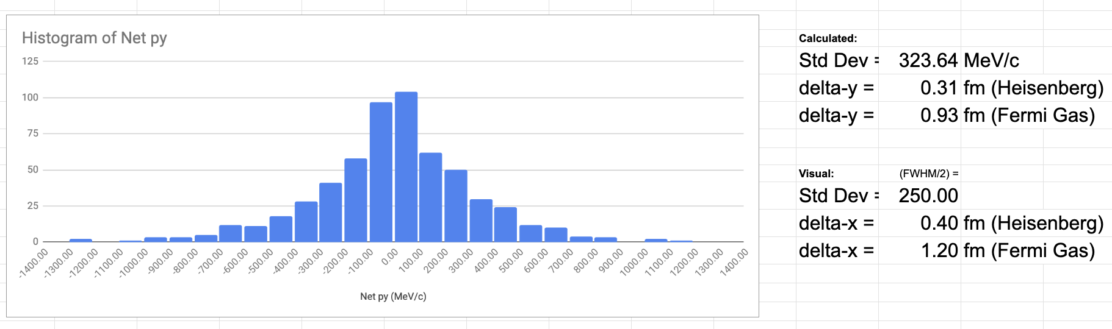
Momentum Conservation in x-y
Estimation of C
nuclear radius R and R₀
Δp_{x}, Δp_{y} ⇒ Δx, Δy
R = R₀ A^{1/3} = (1.25 fm) A^{1/3} → R(C, A=12) = 2.9 fm
R₀ = 1.25 fm
http:/go.uv.es/mamtor/minerva_hoja

Slide 30

Videoconferencia
Masterclass Hands on Particle Physics
https://go.uv.es/mamtor/videoconf

