Slide 1

Meeting BPM IFIC
Project meeting - 27th of January 2026
Juan Carlos Fernández Ortega, Laura Karina Pedraza, Daniel Esperante, Nuria Fuster Martínez, Marçà Boronat, César Blanch, Benito Gimeno, Daniel González
juancarlos.fernandez@ific.uv.es

Slide 2
01
Introduction
02
Double downconversion
TABLE OF CONTENTS
03
FPGA+ADC progress
04
Hardware improvements
05
Future work

Slide 3
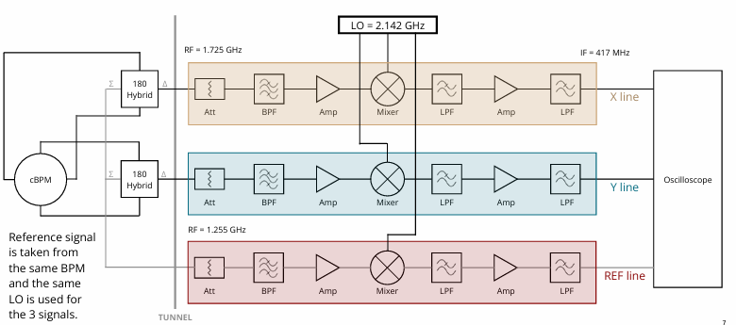

1. Introduction
May design
2. Local Oscillator Generator
1. Downconversion
system
O. Friar, Building, Optimising and Measuring the Performance of Downconverting electronics using X-Microwave Modules, Major Project Report, 2022

Slide 4




2. Double downconversion
µC
RF = 1.725 GHz
TUNNEL
CLK = 714 MHz
LO = 2.142 GHz
Oscilloscope
LPF
Splitter 1:4
PLL
Amp
BPF
Splitter 1:3
Mixer
Local Oscillator input is 714 MHz from ATF RF slave signal generator and generates the necessary frequency multiples for synchronization between our system and ATF bunch repetition rate.
Microcontroller programs the PLL via the SPI protocol to ensure accurate frequency control.

Slide 5
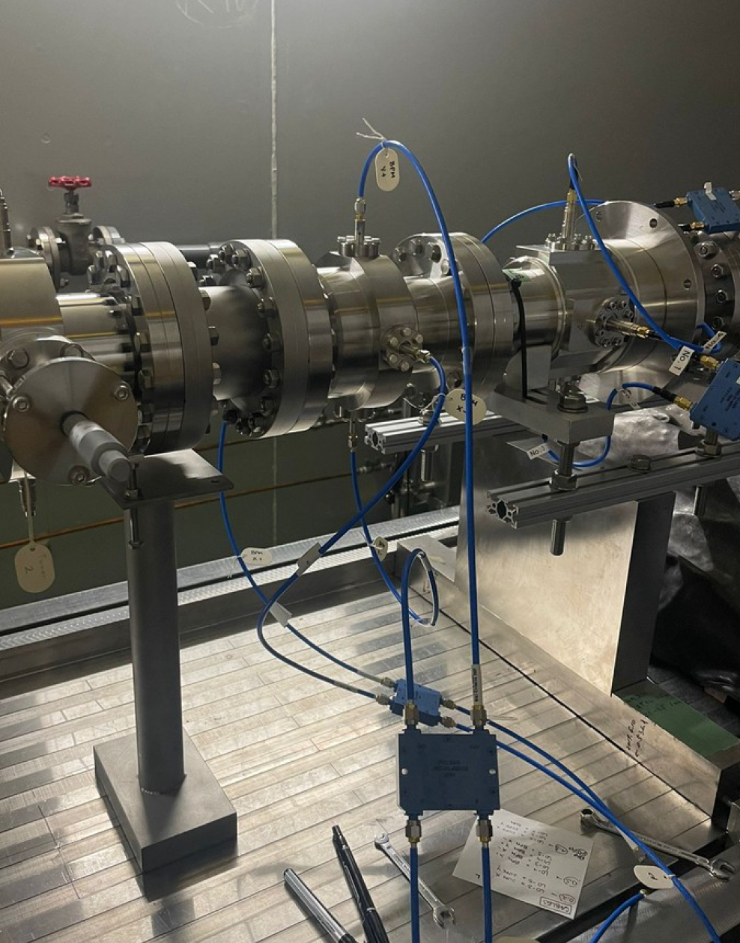
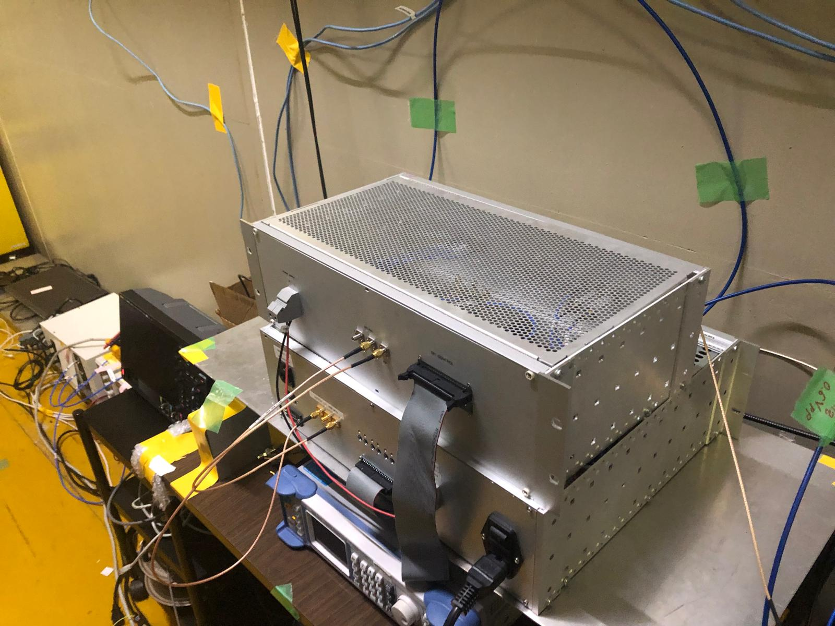
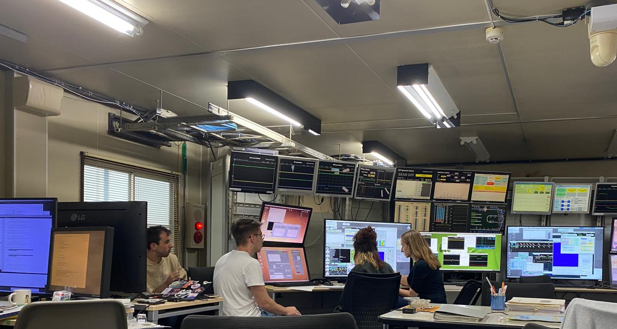
2. Double downconversion
Resolution measurement
DDC algorithm for
signal processing
cBPM
Downconversion
system
LO signal generator
I
N
S
I
D
E
TUNNEL
C
O
N
T
R
O
L
R
O
O
M
Calibration procedure
of the cBPM
Hybrid coupler
Oscilloscope
NEXT TO TUNNEL

Slide 6

LO = 357 MHz
New implementation for December shifts
LPF
LO = 1.428 GHz
Second down-conversion
RF = 1.725 GHz
IF = 297 MHz
X line
IF = 60 MHz
Σ
180
Hybrid
Δ
Att
BPF
Amp
Mixer
LPF
Mixer
LPF
Amp
LPF
Oscilloscope
Y line
cBPM
Σ
180
Hybrid
Δ
Att
BPF
Amp
Mixer
LPF
Mixer
LPF
Amp
LPF
RF = 1.255 GHz
REF line
Att
BPF
Amp
Mixer
LPF
Mixer
LPF
Amp
LPF
TUNNEL
O. Friar, Building, Optimising and Measuring the Performance of Downconverting electronics using X-Microwave Modules, Major Project Report, 2022

Slide 7
2. Double downconversion
June design (Local Oscillator generator)
µC
1st downconversion
RF = 1.725 GHz
TUNNEL
LO = 2.142 GHz
CLK = 714 MHz
Different mixers
2nd mixer needs a lower input power.
PLL
Amp
BPF
Splitter 1:3
Mixer
2nd downconversion
µC
RF = 297 MHz
TUNNEL
LO = 357 MHz
CLK = 714 MHz
Oscilloscope
PLL
LPF
Splitter 1:3
Mixer

Slide 8
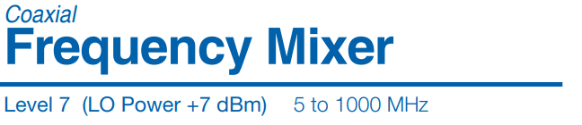
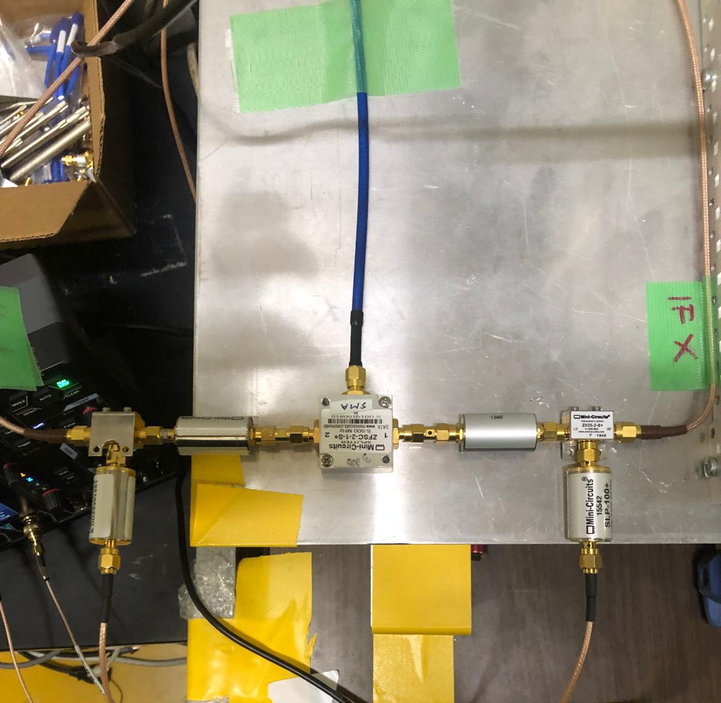
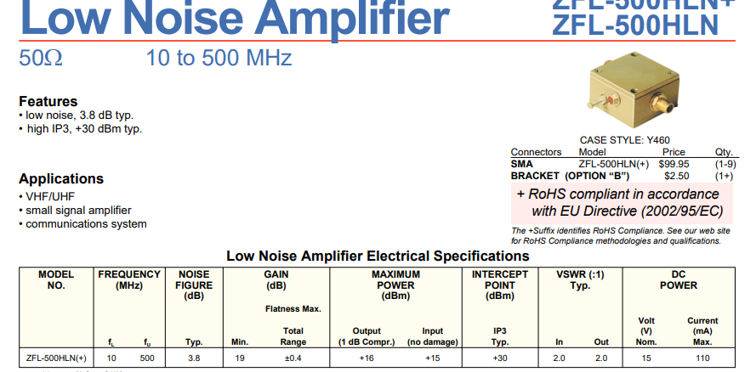
Amplifier of ATF.
Possible saturation…
Need of similar amplifier.
Splitter 1:2
Mixer
LPF
LPF
Mixer
LPF
LPF

Slide 9
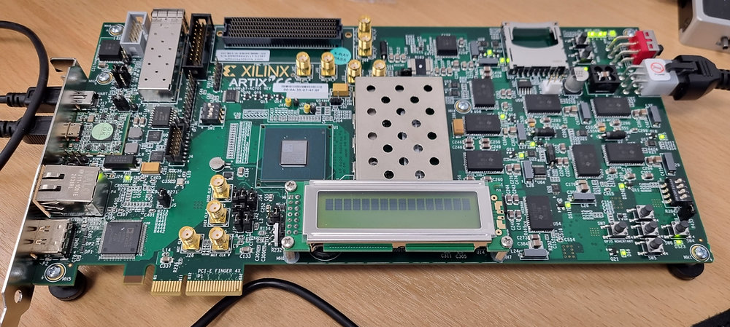
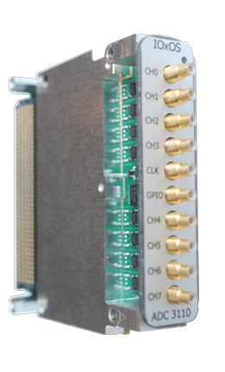
3. FPGA + ADC
A) FPGA and ADC Project Status
FPGA (first tests)
Artix 7 – AC701 for testing, probably will change to a FPGA manufactured by IOXOS company.
FPGA+ADC manage data position information in real-time signal processing.
ADC: 16 bit, 250 Msps, 8 channels.
BUT... if 60 MHz double-downconversion finally works fine:
Considering this ADC: 16 bit, 250 Msps, 8 channels.

Slide 10
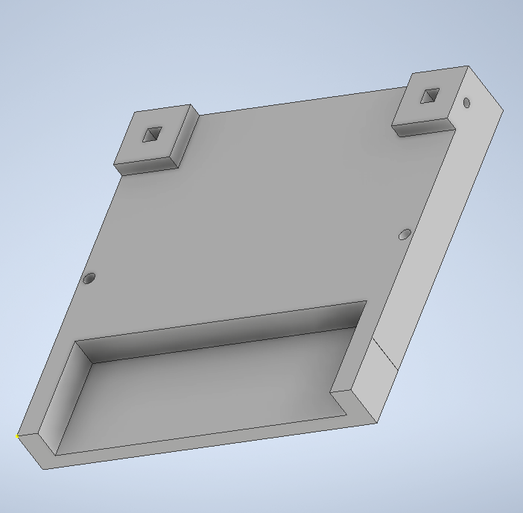
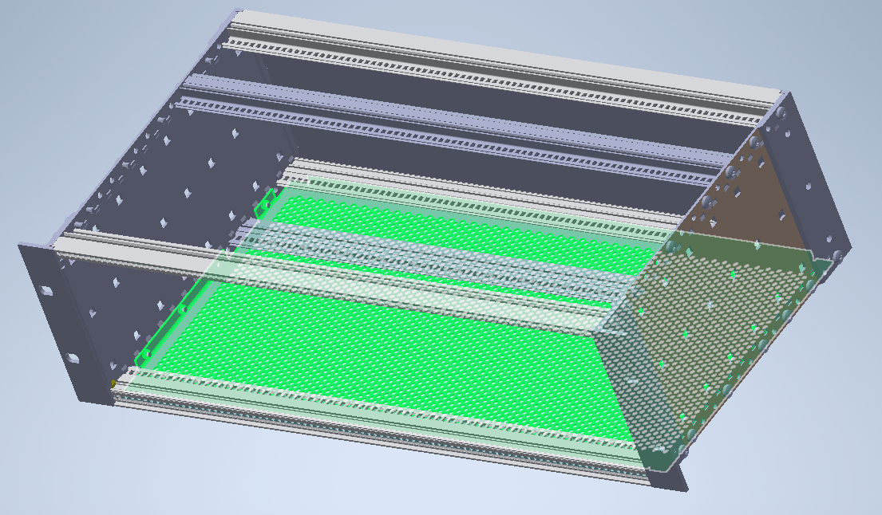
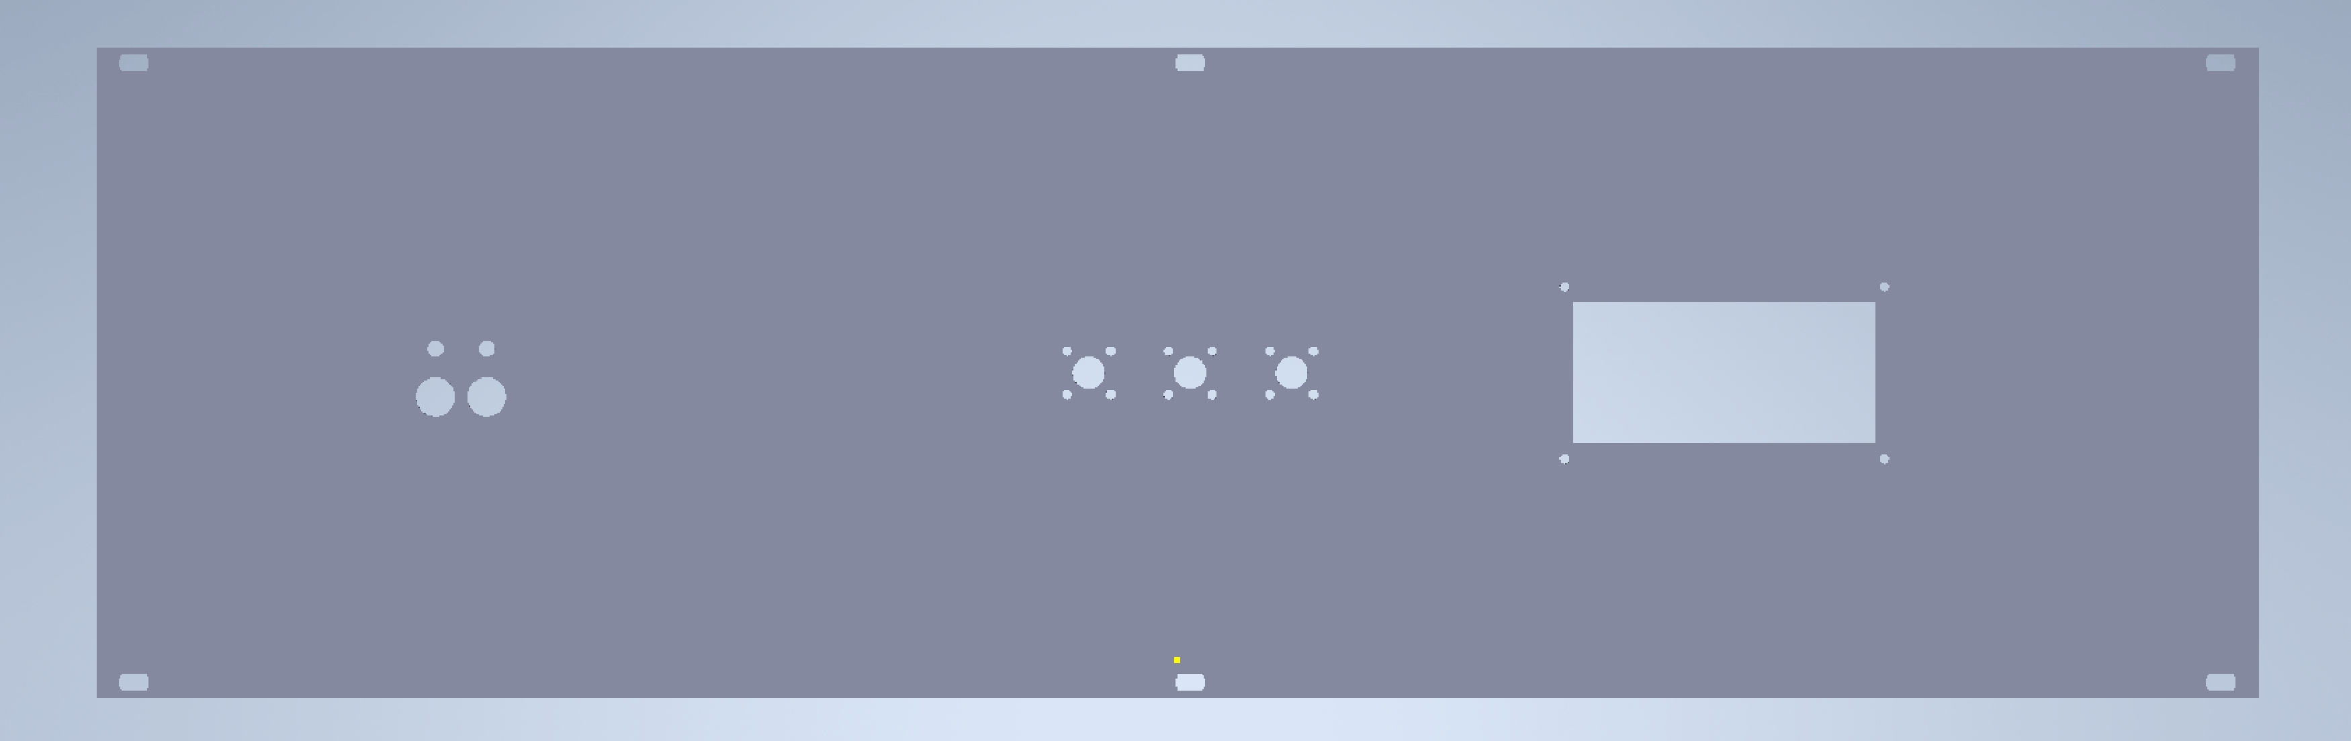
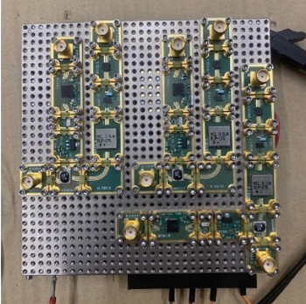

4. Hardware improvements
Make more compact system and reliable.
Change of frequency output due to problem of synchronization with ATF (resolved in May Shifts). However, we have changed some components in this set of shifts.
Preparing all these changes done during July-November in Valencia.
These changes have been performed in the last two weeks of November at ATF.
Set analog down-conversion system inside new crate,
  similar crate that Local-Oscillator signal.
Front panel
Back panel

Slide 11
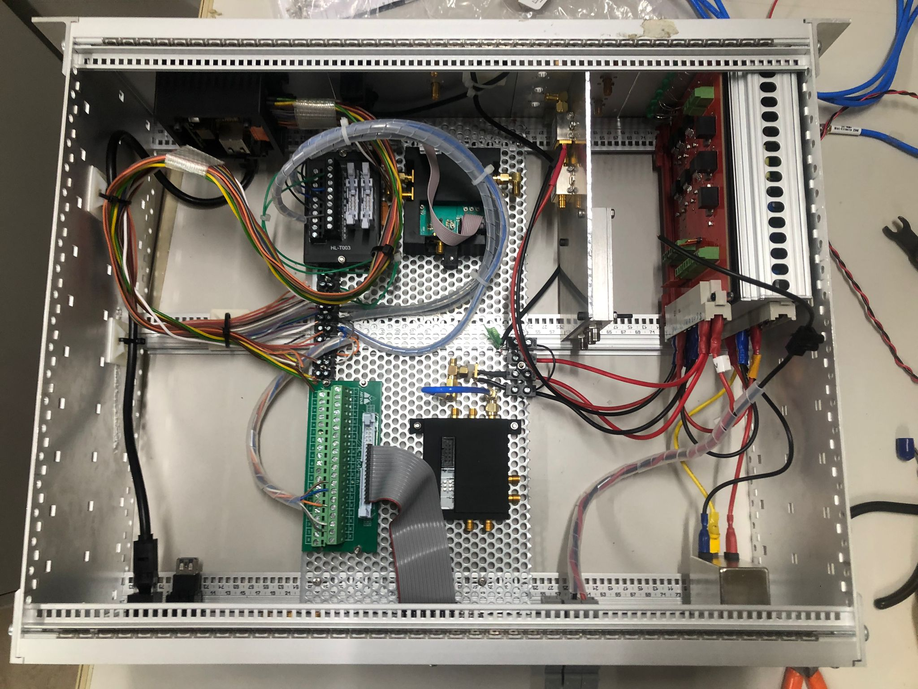
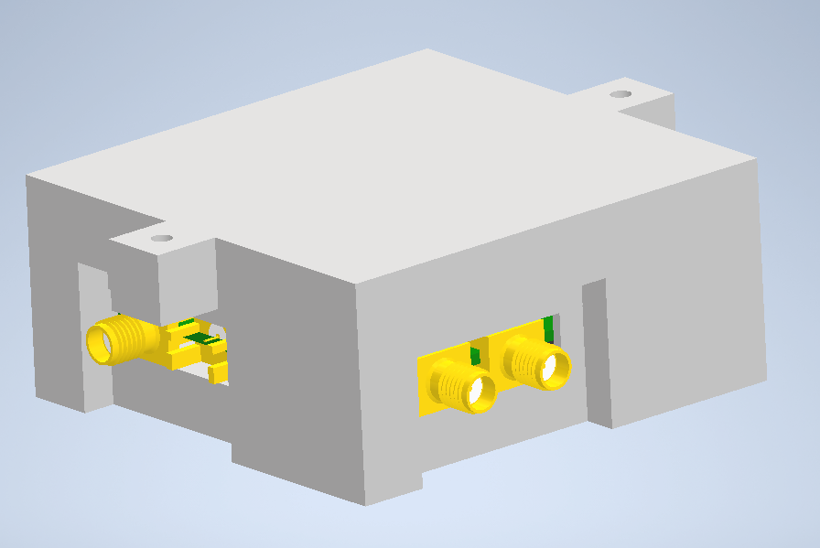
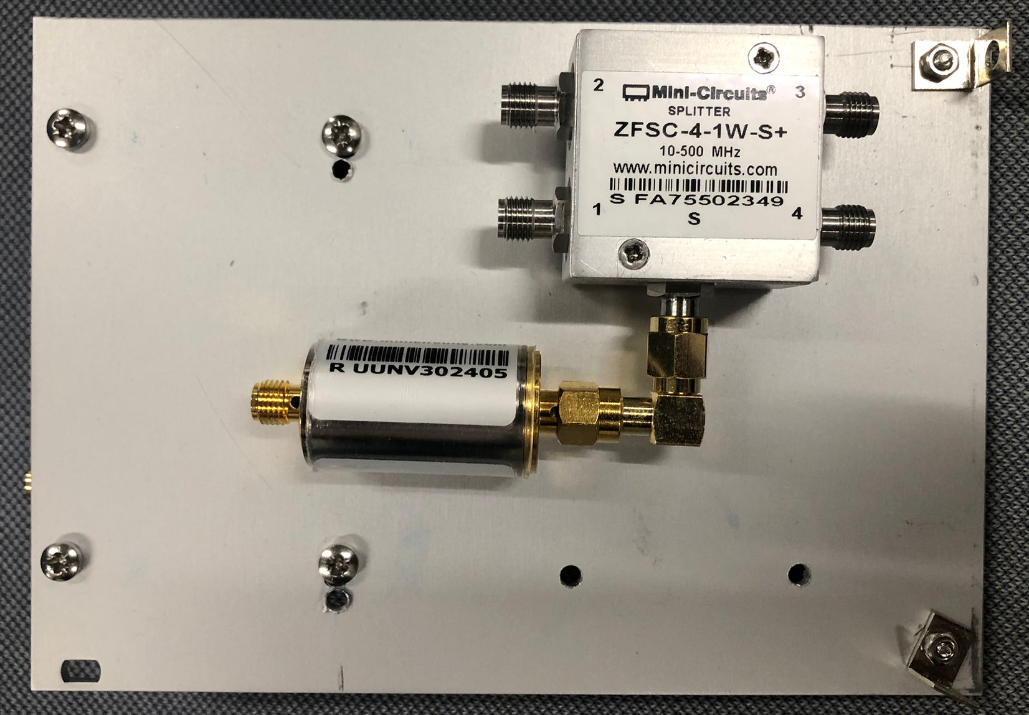


4. Hardware improvements
B) Hardware improvements
Make more compact system and reliable.
Change of frequency output due to problem of synchronization with ATF (resolved in May Shifts). However, we have changed some components in this set of shifts.
Preparing all these changes done during July-November in Valencia
These changes have been performed in the last two weeks of November at ATF.
Set new holders for PLL inside Local Oscillator crate and set new aluminum plates for analog components.

Slide 12
5. Future work
A) Plan
 | 2025 | 2026 |  | 2027
 | Oct - Dec | Jan - Jun | Jul - Dec | Jan - Jun | Jul - Dec
Finalize CEA BPM performance characterization
Test with beam the new cavity BPM
Develop and test the partially o fully digital DAQ system
Investigate how to evaluate the BPM-spQM alignment accuracy
Mechanical design of dummy model BPM-flanges-beam pipe
Construction of dummy model BPM-flanges-beam pipe
Test dummy model at test cryostat at KEK

Slide 13
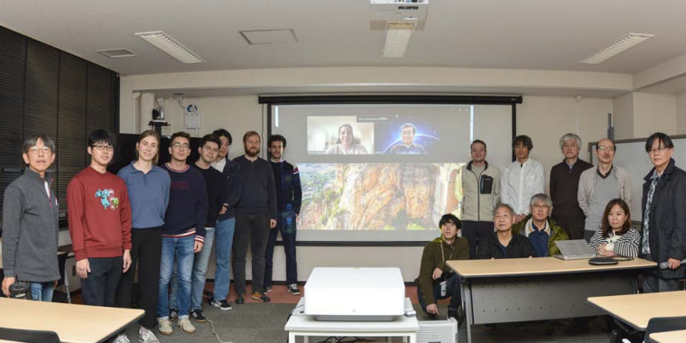
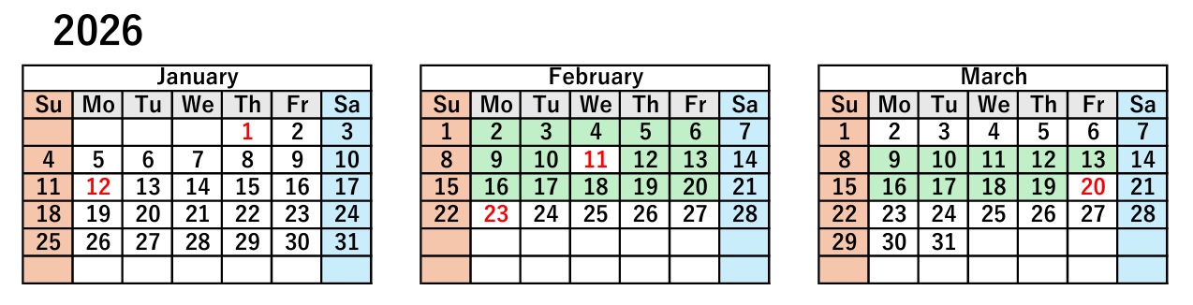
5. Future work
    Beam time along 2025, 2026 and 2027 (once or twice per year)
    Installation of new prototype in 2026 adding it to the LINAC at ATF.
    Test new cavity BPM performance at ATF.
    Develop the DAQ system based on µTCA and try to implement at ATF.

Slide 14
Meeting BPM IFIC
Project meeting - 27th of January 2026
Juan Carlos Fernández Ortega, Laura Karina Pedraza, Daniel Esperante, Nuria Fuster Martínez, Marçà Boronat, César Blanch, Benito Gimeno, Daniel González
juancarlos.fernandez@ific.uv.es

