Slide 1
Temperature Readout Electronics Status
Xavier Pons – CERN – 04/11/2025

Slide 2
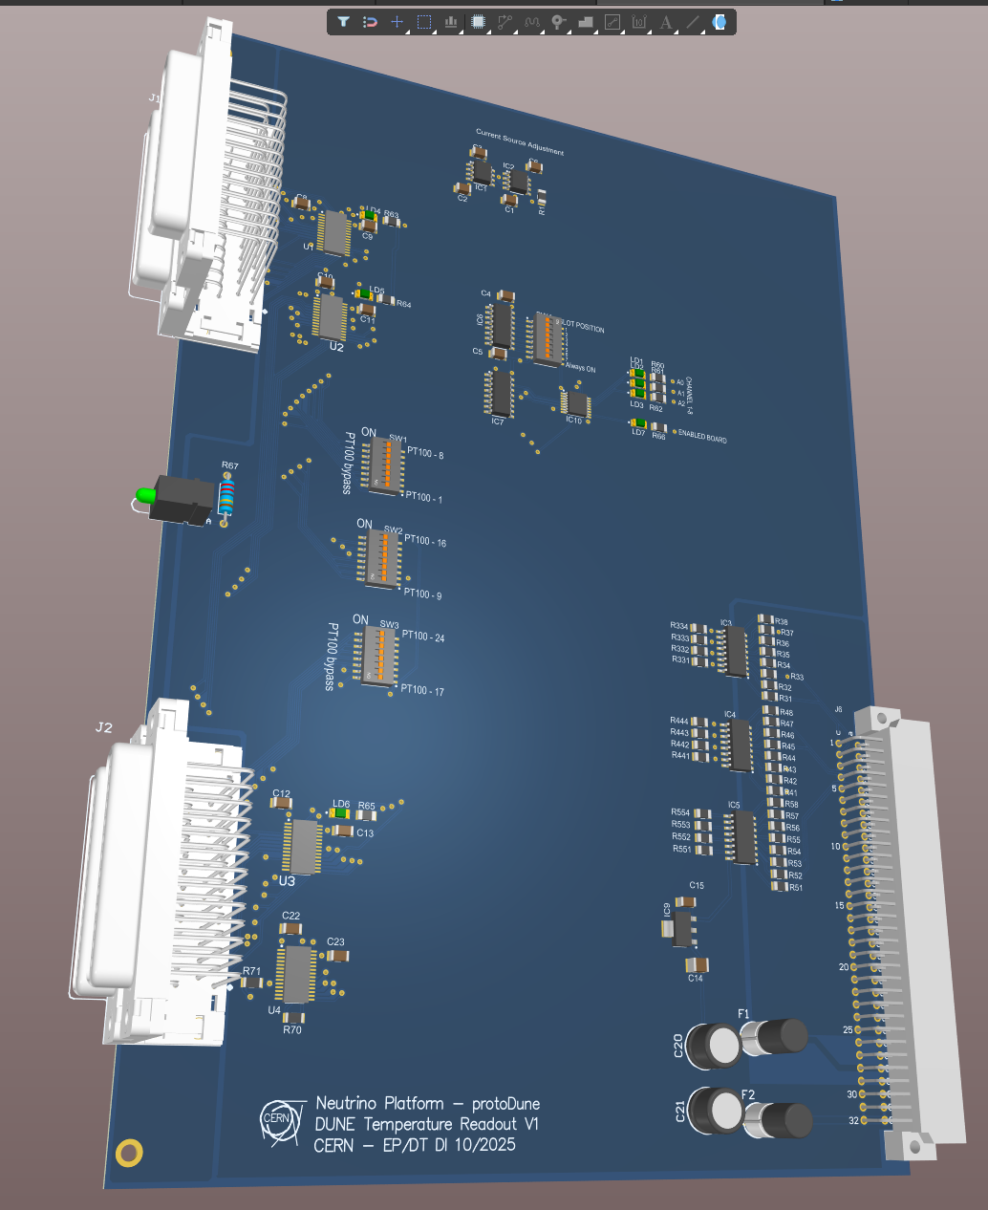
Main readout board
Similar to NP04 readout board
6U crate size (Standard CERN, ATOS crate manufacturer)
24 channels connected to same current source
With 4 connectors Sub-D 25 pin
6 PT100 / connector with same pinout as NP04
Possibility to by bypass sensor (current source by the DIP switch)
Detector ground connection continuity from connector shell to crate chassis
Simplified input
Improved noise and accuracy
Contains one fixed resistor 100 Ohms 0.01% to measure the current source stability
Contains a common current source located in the backplane to the other circuits of the crate
Removed the power connectors
Only one connector, in the bottom
Power supply +15V/-15V
Ordered 30 circuits (400 EUR)
To order the components, for how many circuits?

Slide 3
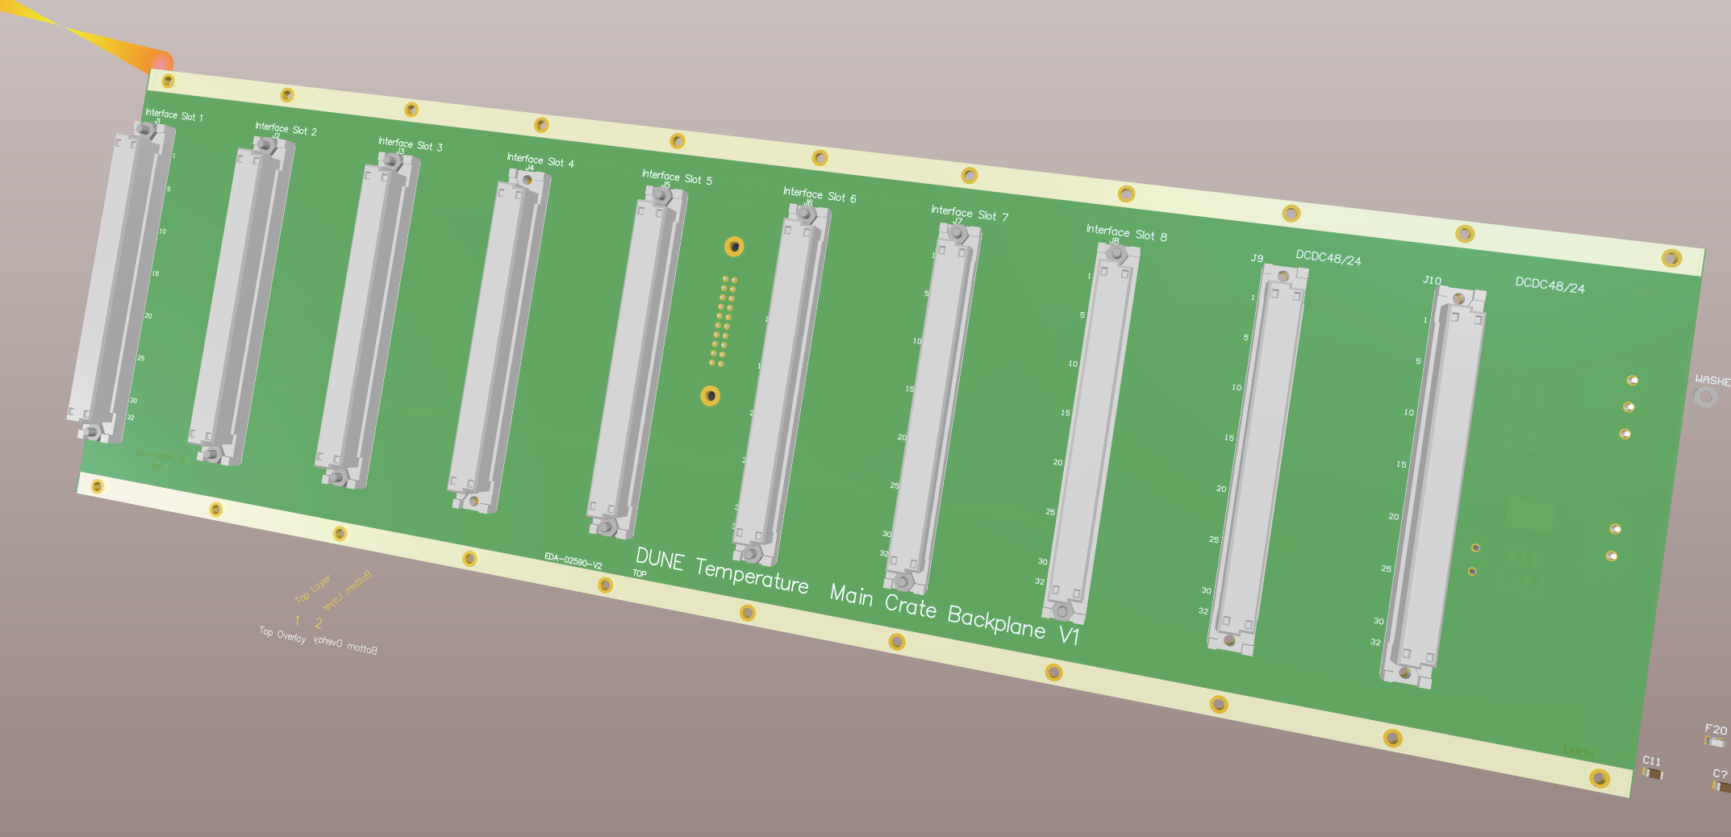
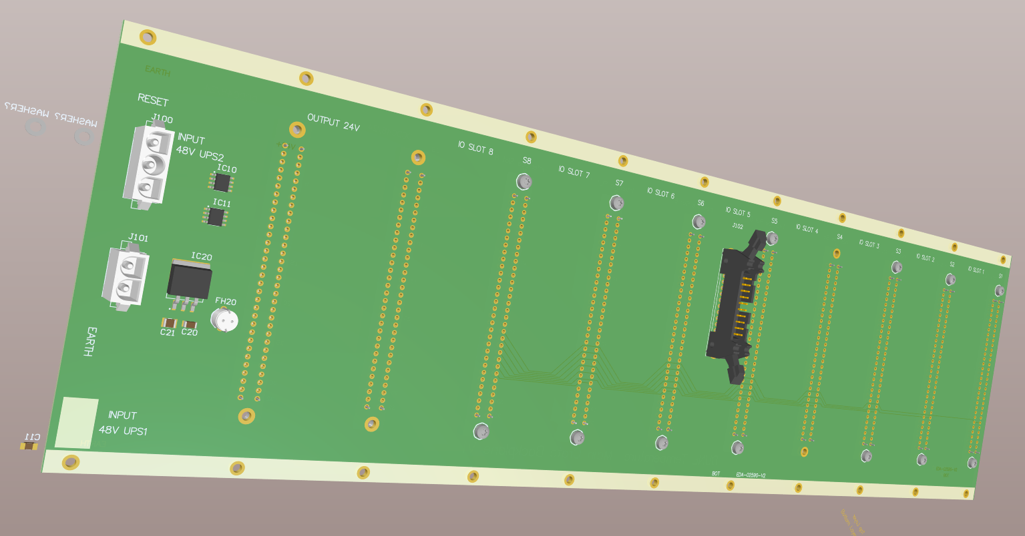
Backplane
6U crate size (Standard CERN, ATOS crate manufacturer)
10 boards => 240 channels
Standard Harting DIN connector or the circuits
Power supply +15/-15 V and possibility of 24V only (common with cRIO)
Contains and LDO from 24V to 15V, unipolar signals
Signal output of the boards after mux in a single 20 pin 3M connector
Will include a circuit to boost the control bits for all the boards
Includes a current source circuit common to all the boards with the possibility to bypass with a jumper in case of empty slots

Slide 4
Miscellaneous
Needed the configuration of the sensors in FD
For the APA the connectors have 4 sensors and it will require a patch panel to adapt and concentrate the signals
War cable configuration, layout?

