Slide 1
Medical applications with laser accelerators
Jornadas PROMESA
30 October 2025, Valencia, Spain
Jose Benlliure
Instituto de Física Corpuscular (CSIC – Univ. Valencia), Spain
Notes:
1
1

Slide 2
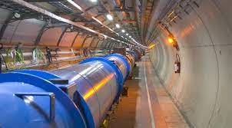
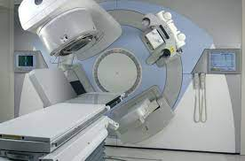
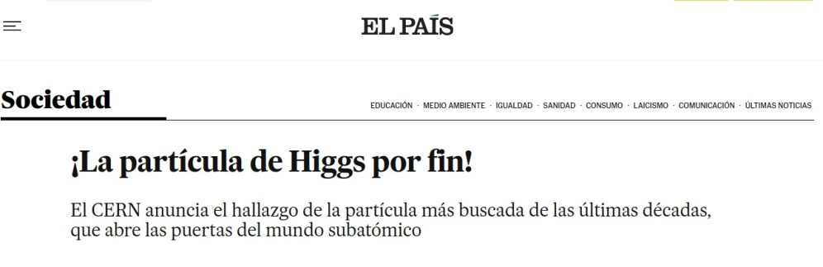
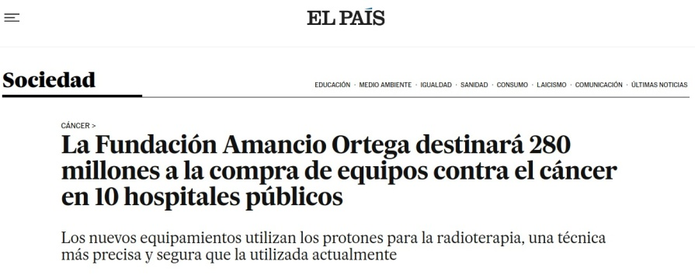
The societal impact of particle accelerators
Particle accelerators have evolved from a research tool to a technology with a major societal impact.
José Benlliure
2
Jornada PROMESA, 30 de October de 2025

Slide 3
The societal impact of particle accelerators
Some numbers
There are about 35,000 accelerators in operation worldwide.
34% medical applications (~10000 e-, ~ 1400 protons, ~14 ions).
34% ion implantation (~12000)
28% industrial sterilisation (~10000 e-)
6% fundamental research (~200 ).
The market for accelerators dedicated to medical and industrial applications exceeds $5000M per year and is growing at more than 8% annually.
Some 250 accelerators are in operation in Spain.
231 electron accelerators for radiotherapy.
17 cyclotrons for the production of PET radioisotopes.
2 cyclotrons for proton therapy (11 more soon).
3 accelerators for fundamental and applied research (CNA-Sevilla, CMAM-
Madrid y ALBA-Barcelona).
José Benlliure
3
Jornada PROMESA, 30 de October de 2025

Slide 4
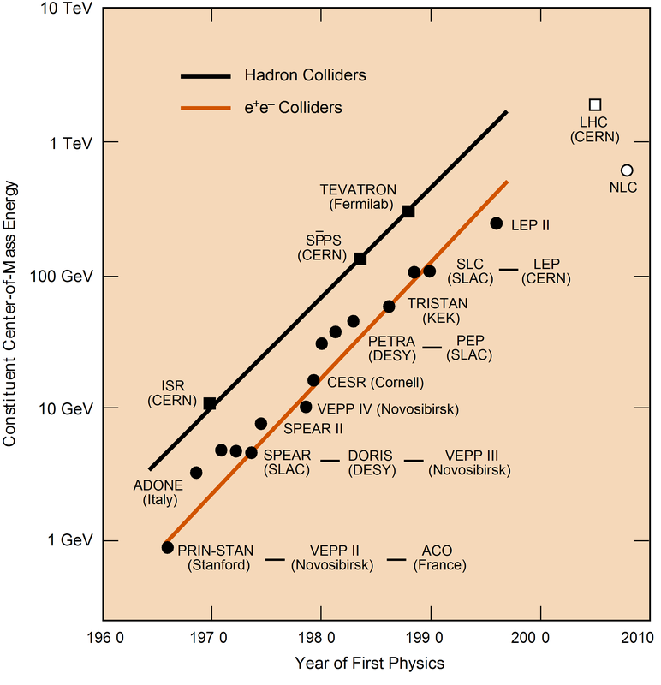
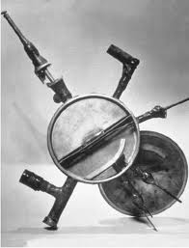
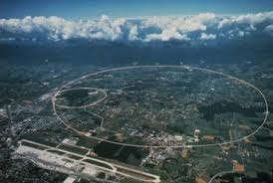
RF particle acceleration technology
Mature technology facing some challenges
Accelerator technology made great strides during the 20th century.
1931
2010
10 cm
MeV
TeV
4.5 Km
But in the 21st century it has encountered two main limitations:
Difficult to increase the acceleration gradient with RF technology ~10⁷ V/m.
Energy can only be increased with length (future circular collider e-e+ 100 TeV ~100 km)
The cost of accelerators increases with the physical space they occupy.
Accelerator shielding (concrete) costs more than the accelerator itself.
José Benlliure
4
Jornada PROMESA, 30 de October de 2025

Slide 5
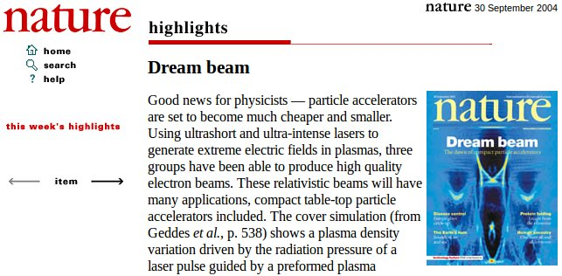

A new technology for particle acceleration
2004
2018
Laser-plasma accelerators rely on the Chirped Pulse Amplification invented by Mourou and Strickland.
José Benlliure
5
Jornada PROMESA, 30 de October de 2025

Slide 6
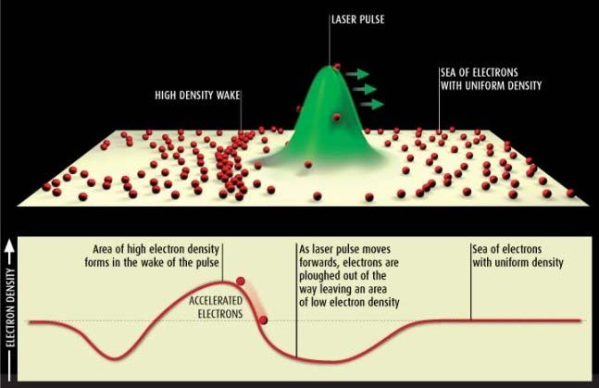
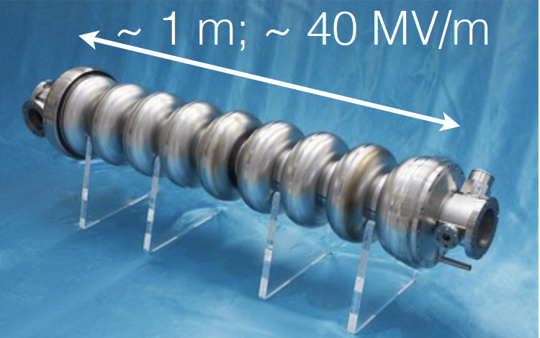
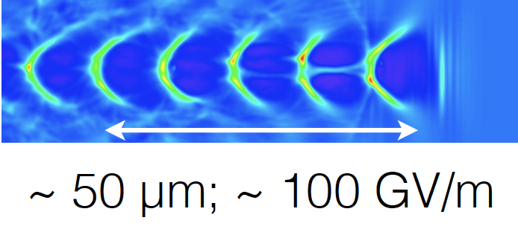
Laser-plasma acceleration in a nutshell
Electron acceleration
A section of RF cavity
Ultra-intense and ultra-short laser pulses with power densities above 10¹⁸ W/cm² , traversing an electron plasma, create a charge separation which can build up to a charge-density wave (wakefield) of the order of TV/m. Electrons entering this wakefield are accelerated to relativistic energies.
A plasma wave
José Benlliure
6
Jornada PROMESA, 30 de October de 2025
Notes:
6
6

Slide 7
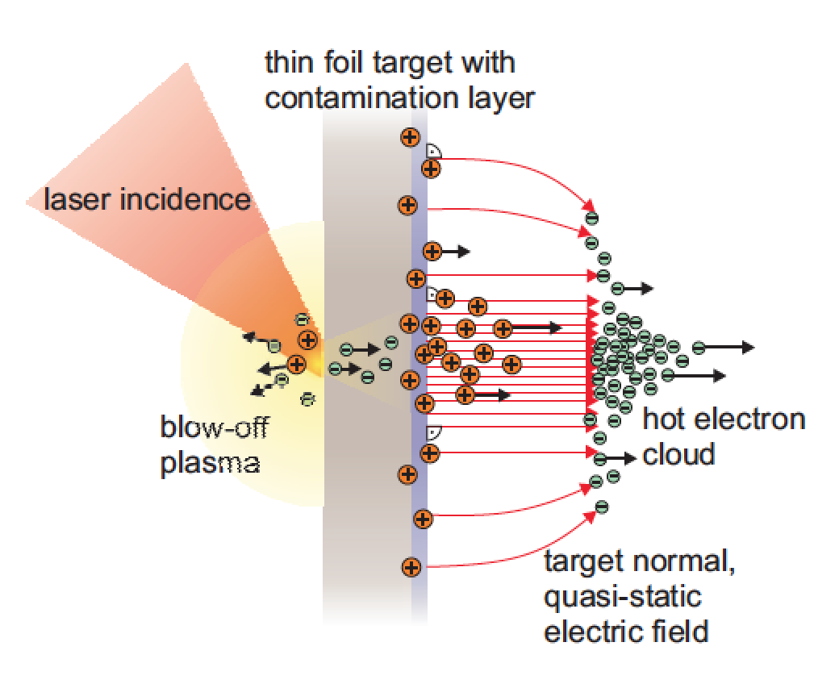
Laser-plasma acceleration in a nutshell
Electron acceleration
Ion acceleration
Ultra-intense and ultra-short laser pulses with power densities above 10¹⁸ W/cm² , traversing an electron plasma, create a charge separation which can build up to a charge-density wave (wakefield) of the order of TV/m. Electrons entering this wakefield are accelerated to relativistic energies.
The cloud of accelerated electrons leaves the target material, ionizing its rear surface and forming a charge-separation field, also of the order of TV/m. Such fields accelerate the ions, normal to the surface.
José Benlliure
7
Jornada PROMESA, 30 de October de 2025
Notes:
7
7

Slide 8
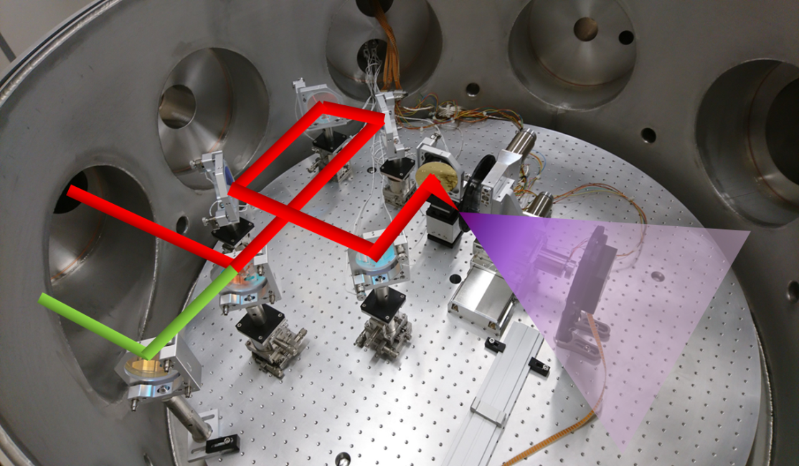
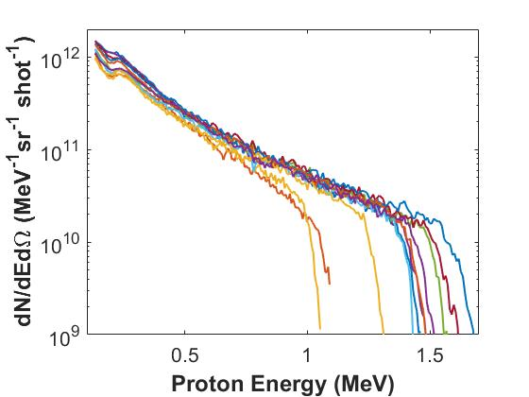
Laser-plasma acceleration in a nutshell
IR beam
~20 cm³
~10 μm
Pros
Cons
Extremely high acceleration gradients (~TV/m).
Compactness and portability.
Lower cost (laser and shielding).
Flexibility in particle species.
Ultra-short ion bunches.
High beam currents (~10¹² ions/pulse).
Energy spread and poor beam quality.
Limited reproducibility.
Relatively low maximum energies (~150 MeV).
Target replenishment and debris.
Low repetition rate (< 100 Hz).
José Benlliure
8
Jornada PROMESA, 30 de October de 2025
Notes:
8
8

Slide 9
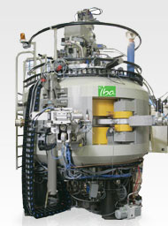
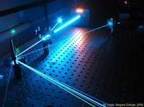
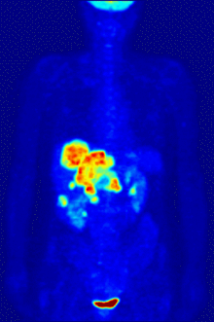
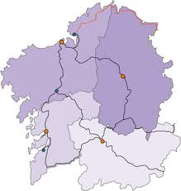


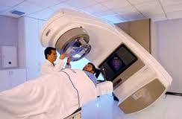
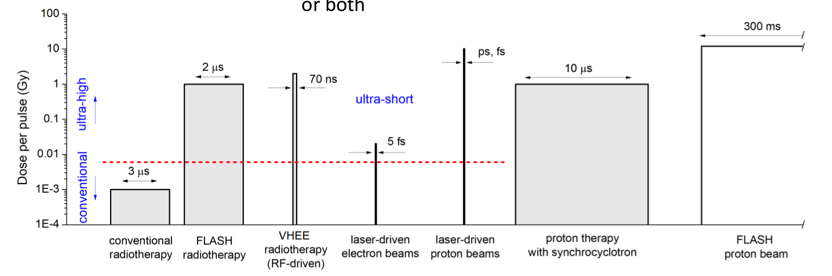

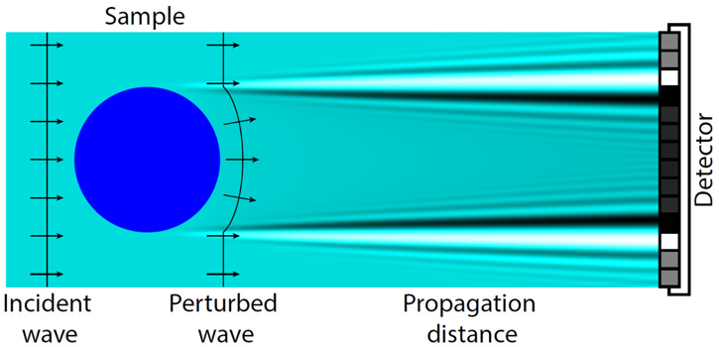
Medical applications with laser-accelerated ions
Radioisotope production
LPA could be the enabling technology to produce in-house on-demand doses of PET probes of interest at low cost, in an automated, user-friendly device (short-lived, i.e. ¹¹C).
UHDR (Flash) radiobiology
Laser accelerators naturally produce ultra-short particle pulses that meet the requirements of flash radio-therapy. Moreover, they do not require a gantry.
Michael Seimetz
Phase-contrast X-ray imaging
For materials with low absorption (e.g. biological matter) the phase shift can gives orders of magnitude stronger contrast than absorption.
Laser-induced X-ray sources fulfill the conditions for phase-contrast imaging: small size sources (~10 μm) and high fluxes.
José Benlliure
9
Jornada PROMESA, 30 de October de 2025
Notes:
9
9

Slide 10
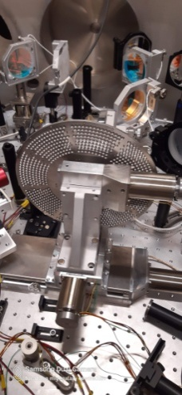
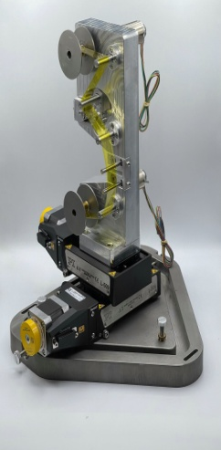
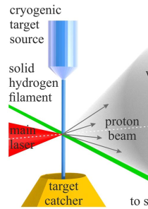
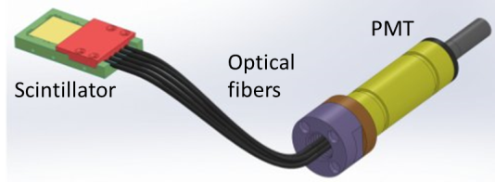
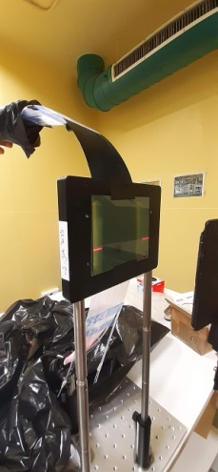
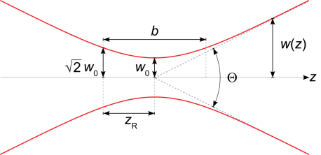
Key technologies in laser acceleration at IFIC
High repetition rate targets
New diagnostics
The target material used to accelerate the ions (~ 1 μm) has to be replaced and positioned with an accuracy better than 10 μm every 100 ms (10 Hz).
The detection of laser-accelerated particles faces two major challenges:
Huge particle fluxes (~10¹² ions in t < 1 ps).
Large electromagnetic noise.
Integral measurements with quasi-optical detectors:
Scintillating plastics or gases.
Photo-sensors decoupled with optical fibers.
Plastic scintillators
Scintillating
fibers
15 minutes operation.
1 hour operation.
Continuous
operation.
Optical PPAC
fibra
óptica
gas
centelleador
foto
sensor
~10 μm
José Benlliure
7
Jornada PROMESA, 30 de October de 2025
Notes:
10
10

Slide 11
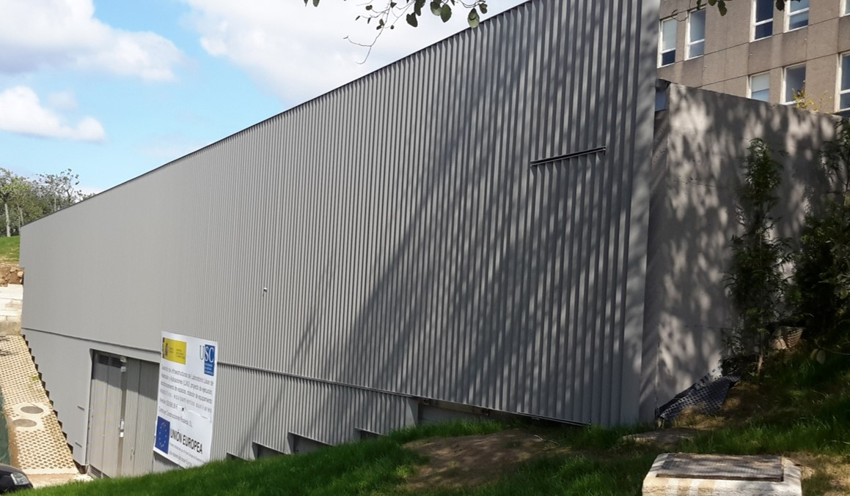
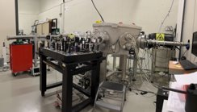

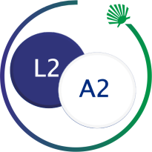
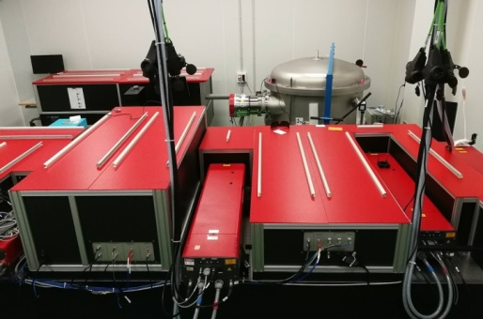
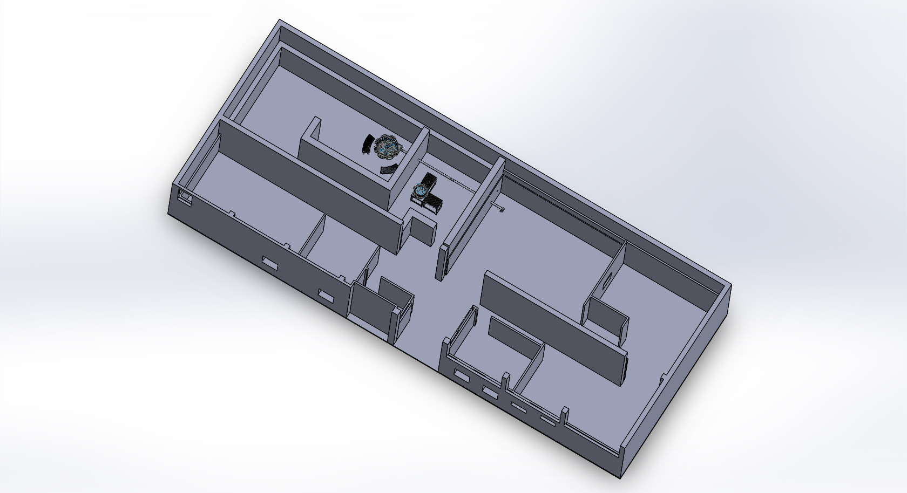




Laser Laboratory for Acceleration and Applications
Radioprotected
area
Facilities:
- Alpha 10/XS laser from Thales.
- Clean room.
- Radioprotected acceleration area.
- Instrumentation and laser labs.
proton
Exp.
X-ray
station
Instrumentation lab.
Laser
clean room
Micro-machining
lab.
Control
room
Control
room
Two laser lines:
- 1 mJ, 1 kHz, 35 fs for X-ray generation
- 1 J, 10 Hz, 25 fs for proton acceleration
Laser lab.
José Benlliure
11
Jornada PROMESA, 30 de October de 2025
Notes:
11
11

Slide 12
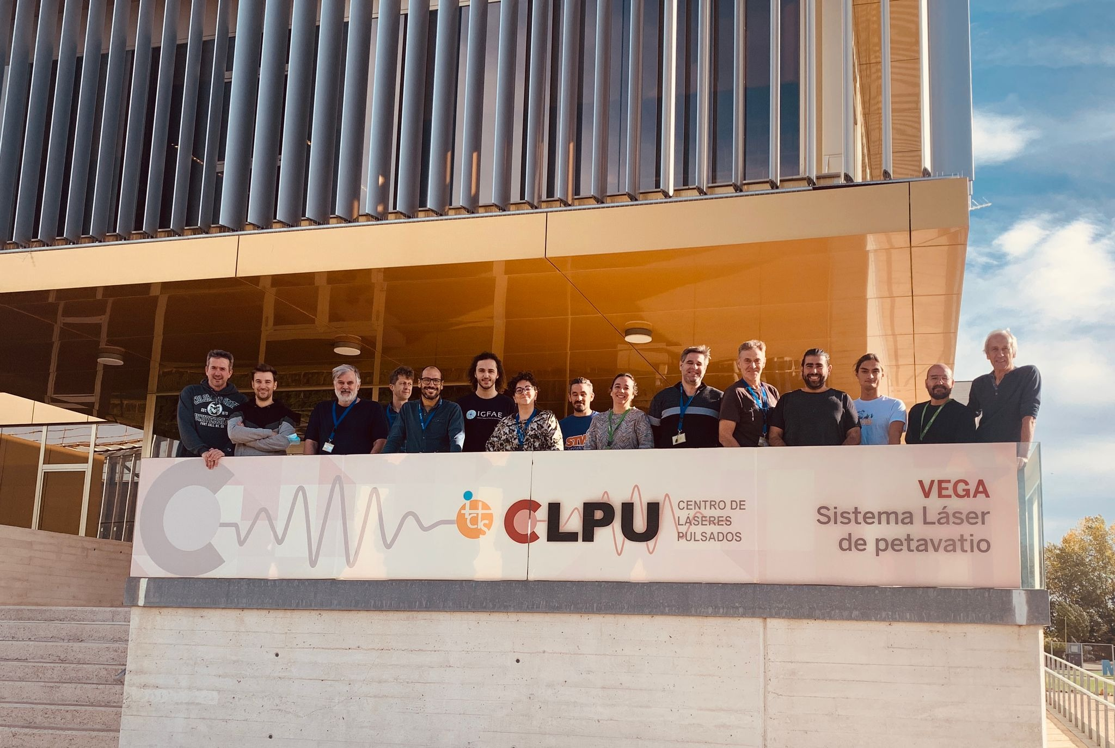
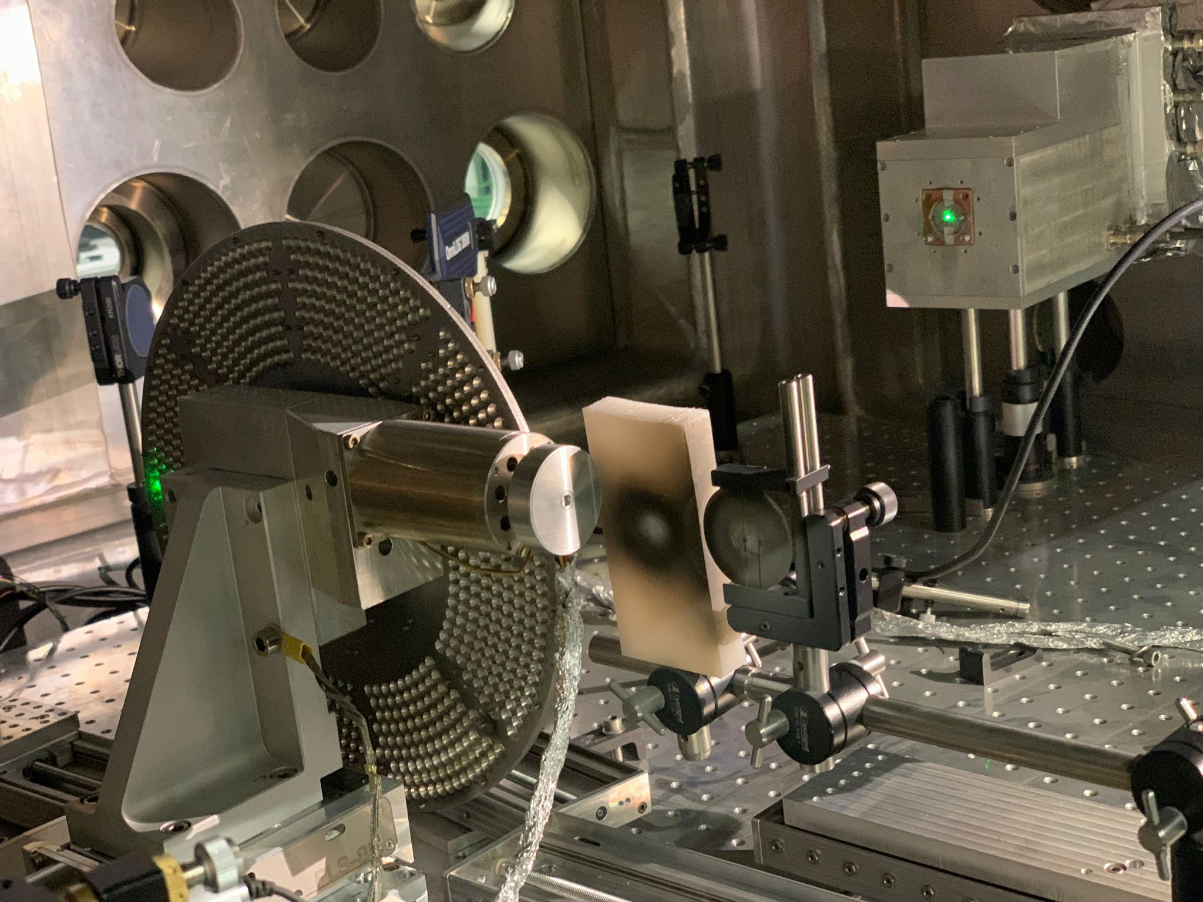
Laser-accelerated ions at CLPU
Beam times at CLPU (October 2022, May 2024):
Laser-induced neutron generation.
Ion acceleration with the L2A2 wheel target.
¹¹C production with a 1 PW laser system.
José Benlliure

Slide 13
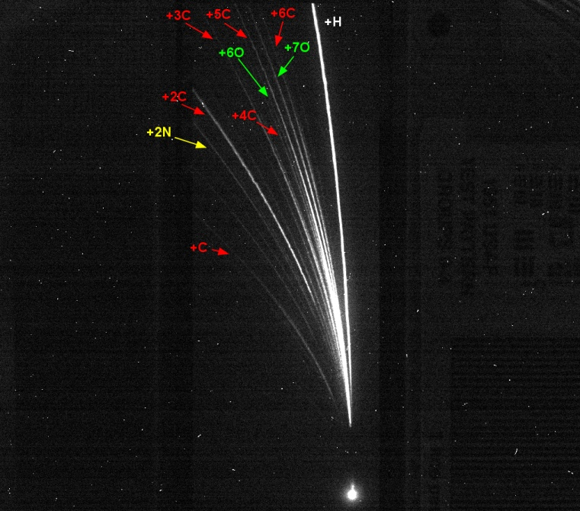
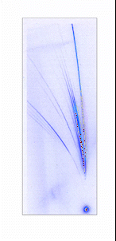
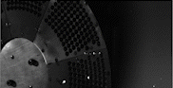
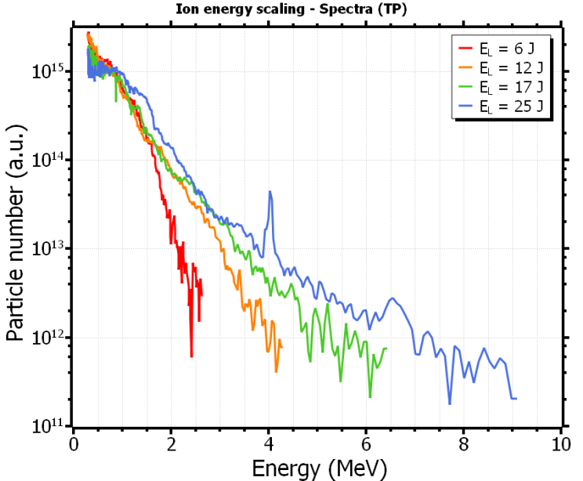
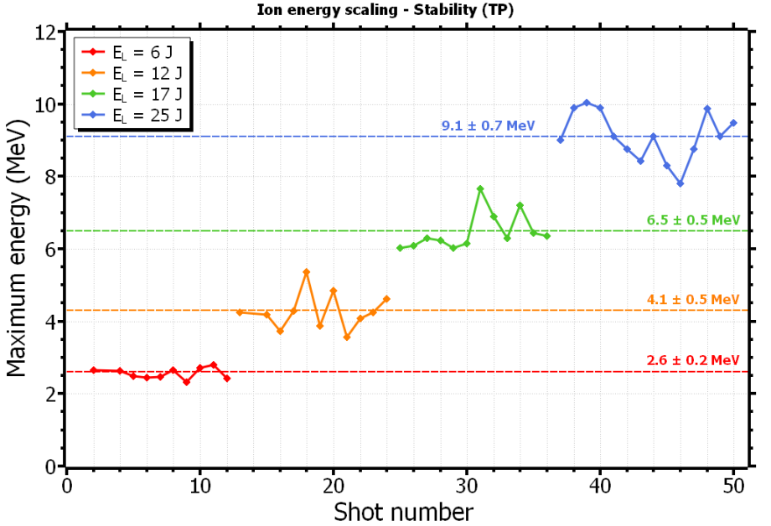
Laser-accelerated ions at CLPU
Multi-shot ion acceleration.
José Benlliure
13

Slide 14
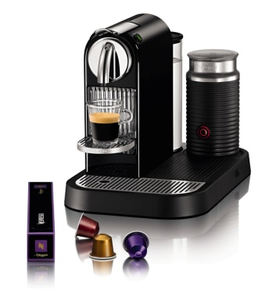
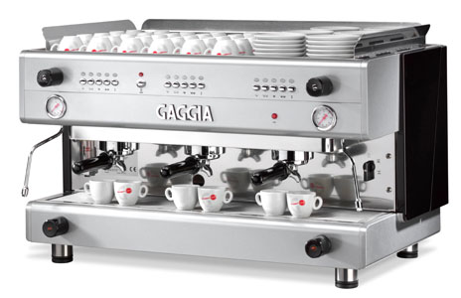
Radioisotope production for PET-imaging
Laser-plasma acceleration could be the enabling technology to produce in-house on-demand doses of PET probes of interest at low cost, in an automated, user-friendly device. The compact size of laser-plasma accelerators would reduce the capital cost of the accelerator and the required infrastructures, in particular radiation shielding.
Similar arguments are also valid for the production of radio-nuclides of interest for medical applications other than PET, e.g. ²²⁶Rd(γ,n)²²⁵Rd-->²²⁵Ac
José Benlliure
14
Jornada PROMESA, 30 de October de 2025

Slide 15
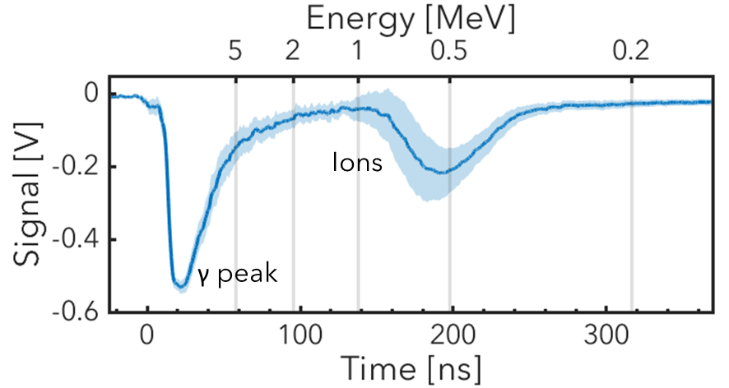
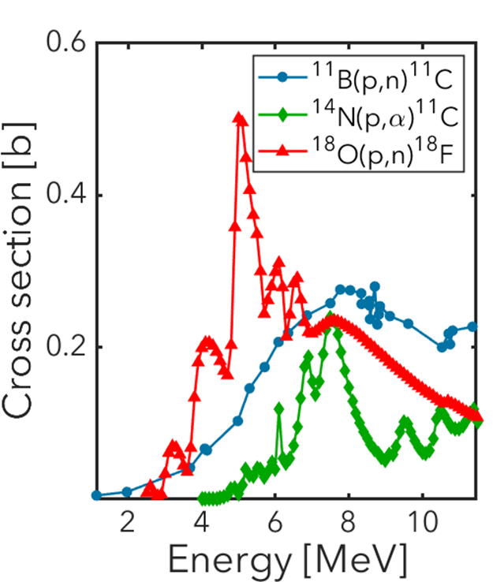
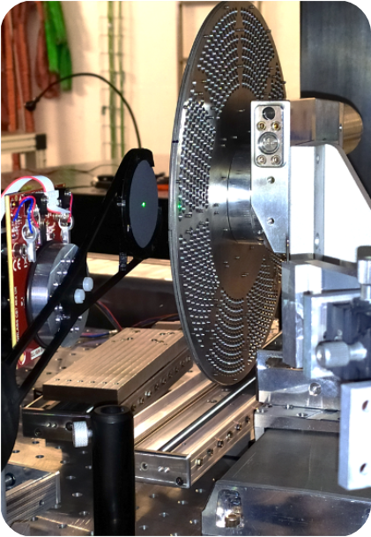
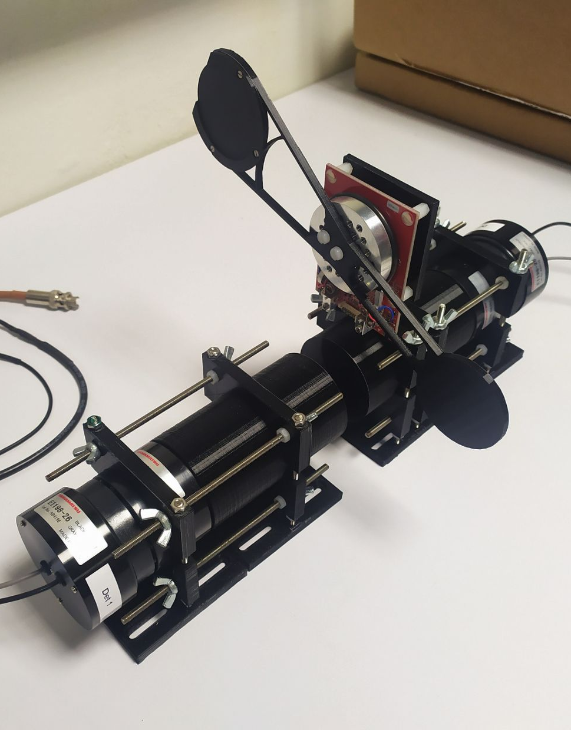
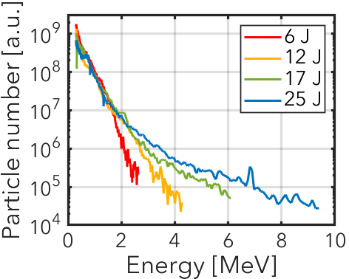
Production of ¹¹C at CLPU
¹¹C isotope production
Activation measurements
Using the 1PW VEGA system, energies are sufficient to produce ¹¹C through proton-induced reactions on Boron, ¹¹B(p,n)¹¹C.
A compact setup was developed to enable irradiation of an activation sample and measure its activity in vacuum conditions (no need for let-up).
Measurements based on coincidence detection (only measurements of β⁺ decays).
L2A2
^{nat}B
CLPU
CsI
José Benlliure
15
Jornada PROMESA, 30 de October de 2025

Slide 16
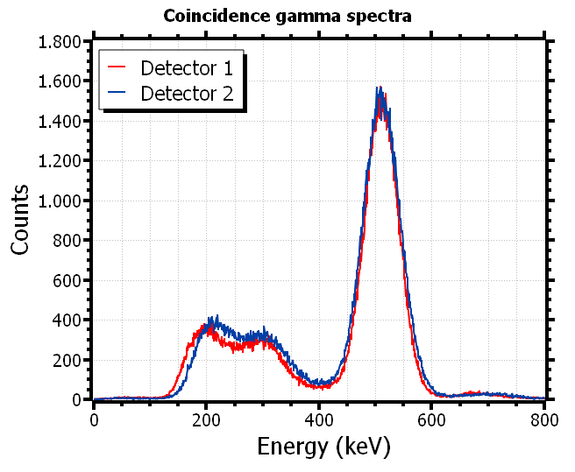
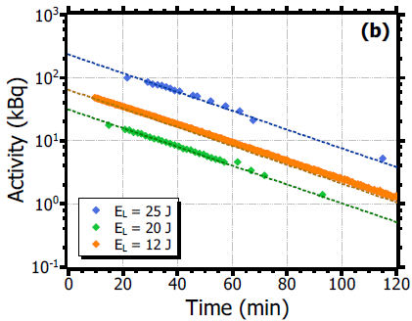
Production of ¹¹C at CLPU
Experiment 2022
Demonstrated continuous ¹¹C production in multi-shot operation (series of 20 shots at 0,1 Hz).
Reproducing the decay curve and half-life of ¹¹C.
Achieved activities above 10 kBq per shot.
T_{1/2} = 1221,8 s
J. Peñas et al., Scientifc Reports, 14, 11448 (2024)
Laser energy [J] | Repetition Rate [Hz] | # shots | Activity per shot [kBq] | Total activity [kBq]
12 | 0,2 | 40 | 1.8 | 68.6
20 | 0,1 | 10 | 3.2 | 31.5
25 | 0,1 | 20 | 12.4 | 233.8
On the path to generate pre-clinical activity levels using laser-driven sources
José Benlliure
16
Jornada PROMESA, 30 de October de 2025

Slide 17
Production of ¹¹C at CLPU
Target operation @ 1Hz, 1PW
Experiment 2024: laser-driven proton source @ 1 Hz, 1 PW
Continuous activation over long series of shots (~800) was achieved.
At 1 Hz the heating of the optics reduces the proton energy and then the final activities.
At 0,2 Hz the laser optics have time to cool between shots.
Expected 1 Hz
> 4MBq!
0,2 Hz
1 Hz
The present bottle-neck for a continuous proton source driven by PW laser systems is the heating of the optics.
José Benlliure
17
Jornada PROMESA, 30 de October de 2025

Slide 18
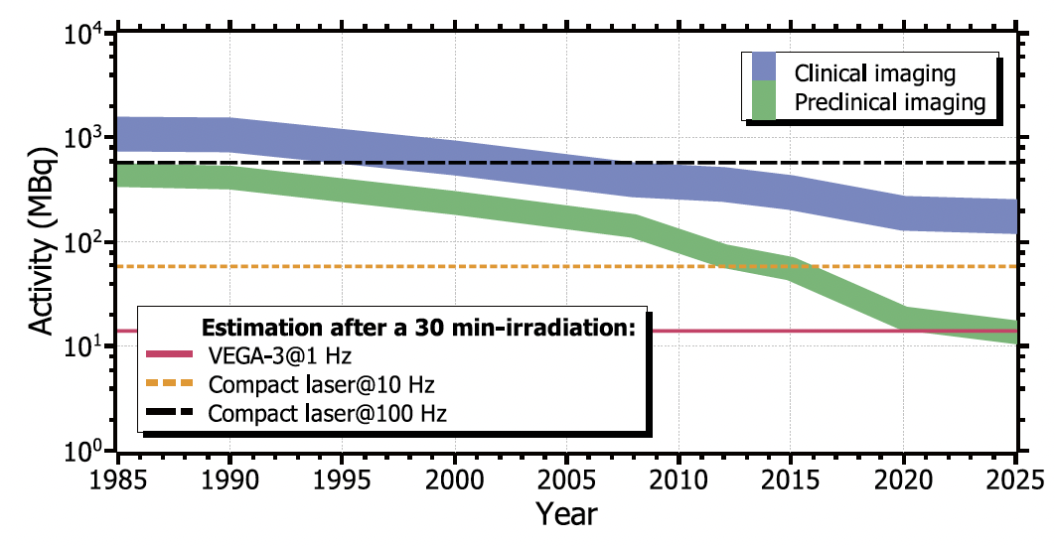
Perspectives for the laser production of ¹¹C
Target operation @ 1Hz, 1PW
PW laser systems are probably not the most cost efficient solution for the production of ¹¹C.
Compact ~100 TW systems at 100 Hz could represent a good option.
José Benlliure
18
Jornada PROMESA, 30 de October de 2025

Slide 19
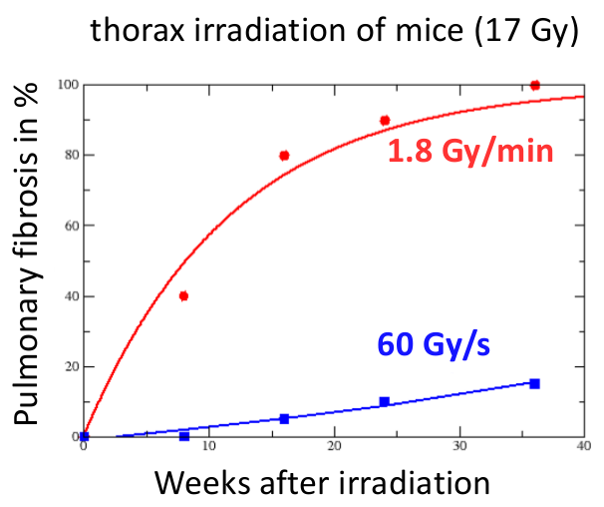


Radiobiology studies with laser accelerated particles
In-vitro studies of flash effect
Numerous studies have demonstrated the efficacy of the use of high dose rates in reducing radiotoxicity in healthy tissues.
 | Total dose | Dose rate
Conventional therapy | 1-10 Gy | 1 Gy/min
Flash therapy | 1-10 Gy | > 10 Gy/s
Laser accelerators naturally produce ultra-short particle pulses that meet the requirements of flash radio-therapy and do not require a gantry.
Michael Seimetz
Ana Vega
José Benlliure
José Benlliure

Slide 20
Radiobiology studies with laser accelerated particles
In-vitro studies of flash effect
The benefit of flash radio-therapy seems to be accepted but, there are still many parameters that should be optimised:
Type of radiation: electrons, protons, …
Dose rate (> 10 Gy/s).
Pulse duration and number:
→ 100 pulses of 0,1 Gy in 1 ms: 10 Gy with 10² Gy/s.
→ 1000 pulses of 0,01 Gy in 1 μs: 10 Gy with 10⁴ Gy/s.
Time between pulses.
Michael Seimetz
Ana Vega
José Benlliure
José Benlliure

Slide 21







Radiobiology studies with laser accelerated particles
In-vitro studies of flash effect
Proof of concept with X rays at L2A2, Nov. 2021:
Cell culture and transport.
Dose determination.
Irradiation protocol.
Analysis procedures.
Irradiations with protons at CLPU, Oct. 2023:
Selection of the proton energy.
Precise determination of the dose.
Human lung adenocarcinoma cells
Michael Seimetz
Ana Vega
A. Reija: PhD USC (prev. 2025).
José Benlliure
José Benlliure
21
Notes:
21
21

Slide 22



Phase contrast imaging
Objects exposed to a radiation field not only cause radiation absorption, but also a phase shift.
$$n=1 −δ+iβ$$
β: absorption refraction index.
δ: phase shift refraction index.
For materials with low absorption (e.g. biological matter) the phase shift can gives orders of magnitude stronger contrast than absorption.
Information on the phase shift can be retrieved from the intensity variations due to the interference pattern created by the refraction produced by the phase shift. However, a X-ray source with high transverse coherence is required.
$$l_{t}=\frac{λR}{σ}>\frac{\sqrt{λD}}{2\sqrt{2}} with D=\frac{zd}{z+d}$$
σ: source size
R: source-detector distance
d: source-sample distance
z: sample-detector distance
Transverse coherence can be obtained with small size sources or large source-to-sample distance (Fresnel approximation).
Laser-induced X-ray sources fulfill the conditions for phase-contrast imaging: small size sources (~10 μm) and high fluxes.
Tomographic image of anatomical features of a live mouse.
José Benlliure
22
Jornada PROMESA, 30 de October de 2025
Notes:
22
22

Slide 23




Phase contrast imaging
A compact kHz X-ray source running on air.
Laser parameters: ~ 1 mJ, 35 fs, 1kHz.
Target material: 100x100x1 mm³ copper plates, beam focus σ_{xy}~2 μm.
Target replenishment: shot-by-shot moving plate along concentric circles of impacts (two linear and one rotating stages).
A. Coathup: PhD USC (prev. 2025).
José Benlliure
23
Jornada PROMESA, 30 de October de 2025

Slide 24





Laser-induced X-ray 2D phase-contrast imaging
Phase-contrast imaging provides a better contrast compared to amplitude imaging.
Amplitude Retrieval
Phase Retrieval
Phase retrieval algorithm
- Propagation-based phase-contrast imaging.
- Single image at one source-to-object distance.
Assumptions:
- Not negligible absorption
- δ and μ are proportional
- Fresnel approximation
Dried insect material:
- Chitin ( C₈H₁₃NO₅)
- µ = 7,015 mm⁻¹ δ = 1.38 x 10⁻⁵
- Magnification = 1,21
- d = 62 mm z = 13 mm
$$n=1 −δ+iβ$$
$$μ=π\frac{4π}{λ}β$$
José Benlliure
24
Jornada PROMESA, 30 de October de 2025
Notes:
24
24

Slide 25

Contribution to the next PROMETEO proposal
Objective
Construction and commissioning of advanced target assemblies for the continuous operation of laser accelerators to be used in compact generators of medical radio-isotopes and advanced systems for phase-contrast X-ray imaging.
15 minutes operation.
1 hour operation.
Continuous
operation.
José Benlliure
25
Notes:
25
25

Slide 26
Contribution to the next PROMETEO proposal
Working plan
Phase 1: Commissioning of the tape-drive target existing at L2A2.
Phase 2: Construction of a target characterization system.
Phase 3: Design, construction and commissioning of a liquid-jet target.
Phase 4: First experiments with the targets: X-ray and 11C production.
José Benlliure
26
Notes:
26
26

Slide 27
Contribution to the next PROMETEO proposal
Funding request
We intend to set up a new laboratory at IFIC to develop key laser-plasma acceleration technologies relevant for medical applications. Our needs are as follows:
Equipment:
- Vacuum chamber and associated pumping system: 75 k€ (other call)
- Target characterization system: 20 k (this call)
- Liquid-target assembly: 25 k€ (this call)
Consumables: 15 k€ (another call)
Personnel
- 3 years PhD contract: 75 k€ (this call)
Travels: 15 k€ (this call)
José Benlliure
27
Notes:
27
27

Slide 28




Laser-accelerated ions at L2A2
Intensity on target 0.1 – 1.5 x 10 ²¹ W/cm²
Time-of-flight detector
IR beam
OAP F/2
Alingment beam
Proton beam
Target holder
TOF signals
Proton Spectra
José Benlliure
28
Notes:
The first peak appearing in the TOF signals is the gamma flash, which englobes all the radiation produced in the interaction, and marks the zero time.
The second peak represents the protons arrival some ns after the interaction, with the time and space we can obtain the energy of the protons.
Moreover, the calibrated TOF detector give us also de number of proton per shot in an online configuration.
The first experimental results at the L2A2 are 10^10 protons per shot up to 1.5 MeV obtained not with best parameters possible.
Working with suitable laser and target parameters the L2A2 facility should produce 10^12 protons per shot up to 10 MeV.

Slide 29



High power laser systems
Ultra intense laser pulses (I>5 10¹⁸ W/cm²):
Lasers are pulsed with relatively low frequency: large peak power and modest average power.
The intensity of the pulses depends on three parameters: energy, time and surface.
Two approaches are used to produce ultra intense laser pulses:
High energy laser systems:
E ~ 1 KJ - 1 MJ, t ~ 1 ps, A~0.1 mm²
Ultra-short laser pulses:
E ~ 1 J - 10 J, t ~ 10-100 fs, A~1 μm²
José Benlliure
29

Slide 30




High-repetition rate targets
Replenishing and positioning of the acceleration target
The target material used to accelerate the ions (~ 1 μm Al) volatilises after each impact of the laser pulses and has to be replaced and positioned with an accuracy better than 10 μm every 100 ms (10 Hz).
~10 μm
3D mapping of impact positions on the target enables an accurate positioning.
15 minutes operation.
1 hour operation.
Continuous
operation.
J. Peñas: PhD USC (2023).
J. Peñas et al., HPLE 11, e22 (2024)
José Benlliure
30
Notes:
30
30

Slide 31





Production of ¹¹C at CLPU
Target operation @ 1Hz, 1PW
Experiment 2024: laser-driven proton source @ 1 Hz, 1 PW
Several improvements on the wheel to minimize impact of EMP.
Relay system to physically disconnect the motors and controller during the shots.
A continuous reduction of the proton energy is observed.
Electromagnetic
pulse (EMP)
The operation of the target is stable at 1 Hz but the laser cannot keep up at such rates because of the heating of the optics.
José Benlliure
31

