Slide 1
Model-Based Dose Calculation in Brachytherapy: Current Status and Future Directions
Gabriel Paiva Fonseca

Slide 2
Summary
TG43
TG186
TPS commissioning
Reference database
Clinical results

Slide 3
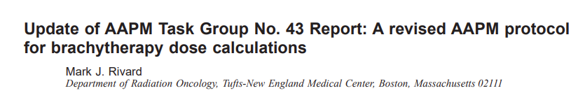
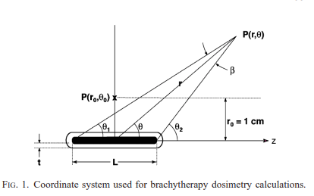

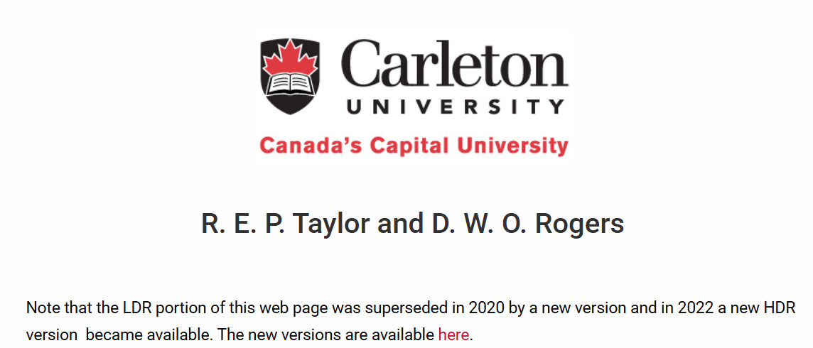
TG43
Simple formalism
Tabulated data
Easy to implement

Slide 4
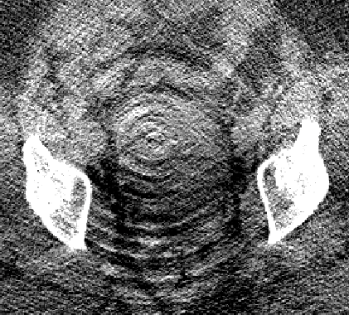
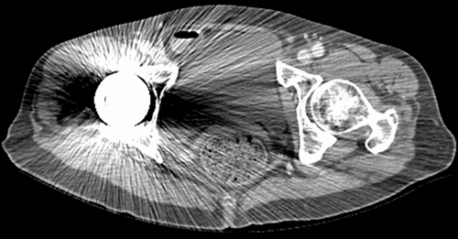
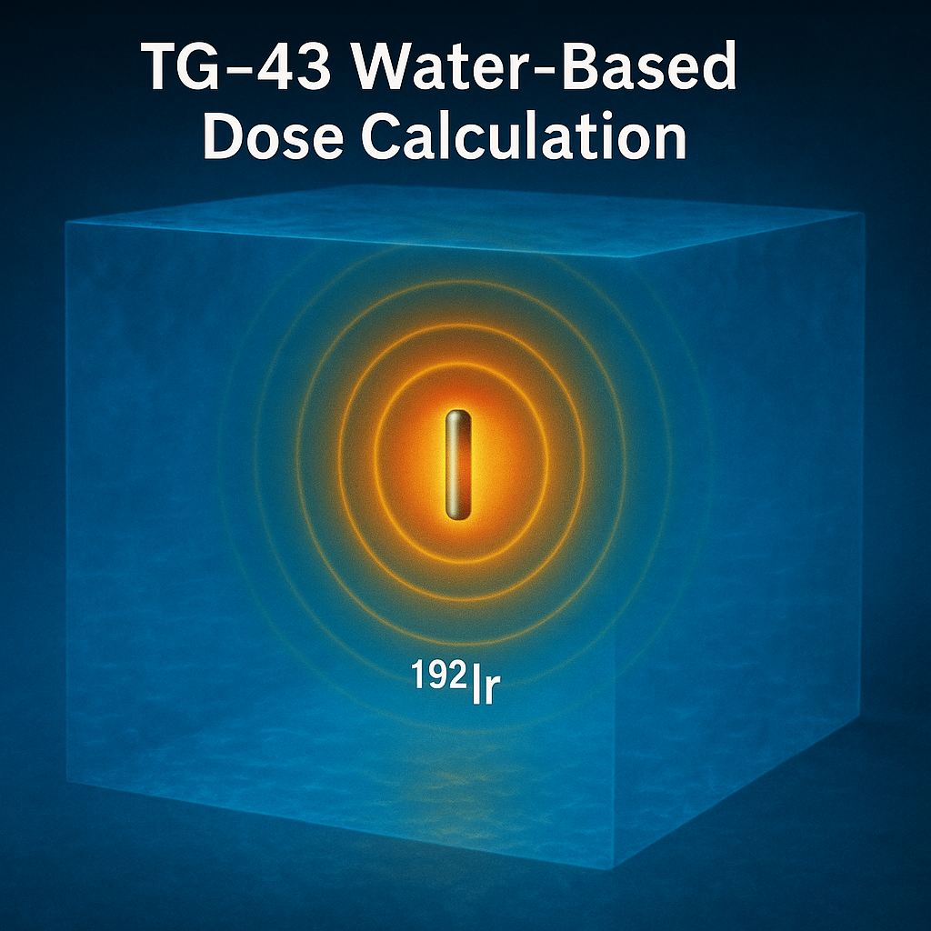
TG43
Robust … can handle bad images
Robust … but a bit insensitive

Slide 5
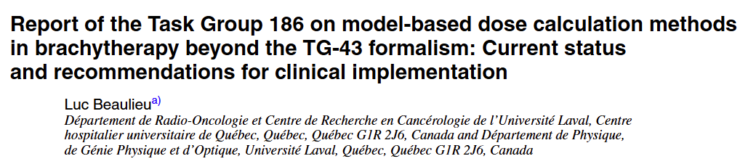
TG186
This report addresses three major issues associated with the advent of MBDCAs, namely,
Choice of dose speciﬁcation medium (Sec. III), because there are energy-dependent differences even when non water materials are included in the radiation-transport model depending on whether dose is speciﬁed to a water reference medium or the local tissue medium.
Voxel-by-voxel cross-section assignment, as neither conventional single-energy CT nor ICRU/ICRP tissue composition recipes are de facto accurate guides for the task (Sec. IV).
Commissioning procedures for MBDCAs (Sec. V).

Slide 6
Dose Speciﬁcation Medium

Slide 7
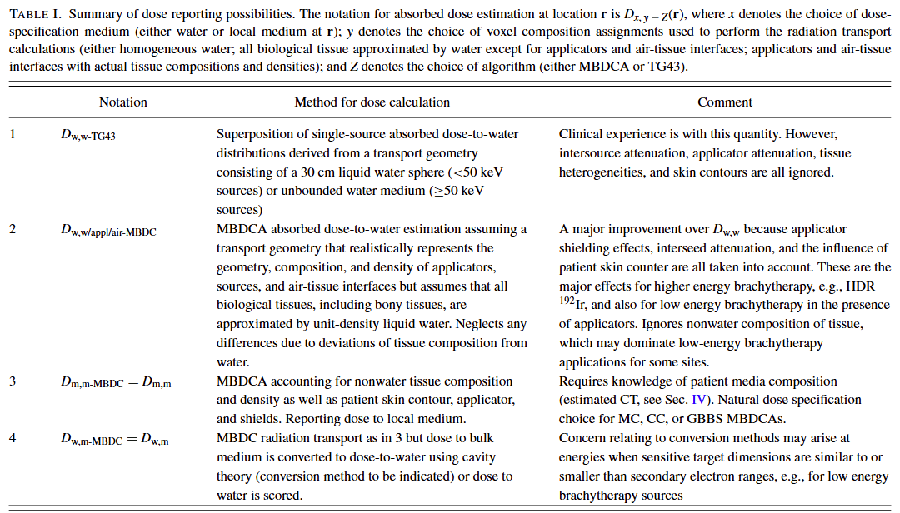
Dose reporting

Slide 8
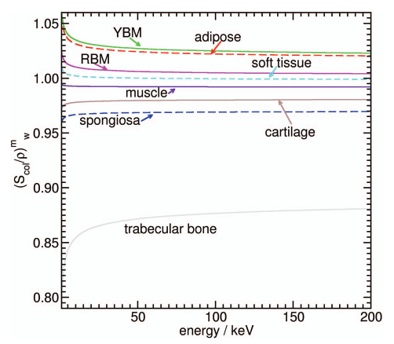
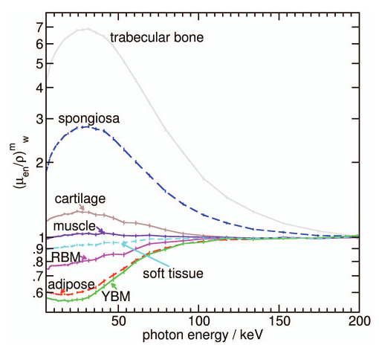
Dose reporting
How should we convert D_{m,m} to D_{w,m} ?
It depends on the volume of interest

Slide 9
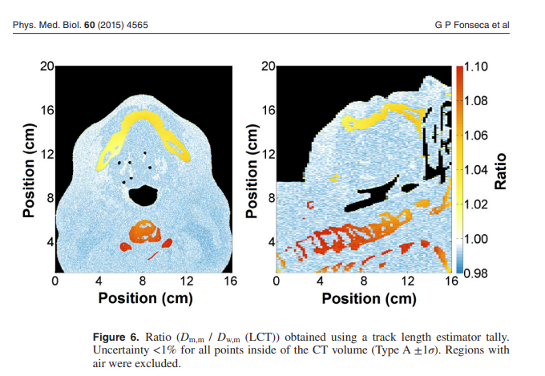
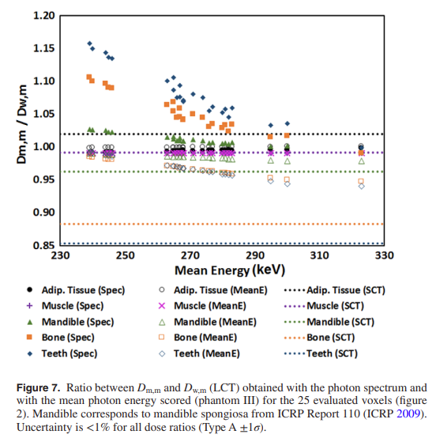
Dose reporting
Even for 192Ir it can be relevant

Slide 10
Voxel-by-voxel cross-section assignment

Slide 11
Mat. Characterization and segmentation
Material characterization
CT/CBCT/DECT/Spectral segmentation
CT artefacts
Calcifications … Applicators … etc.
Contrast
Not common in brachytherapy … additional steps

Slide 12
Commissioning TG186 and beyond

Slide 13
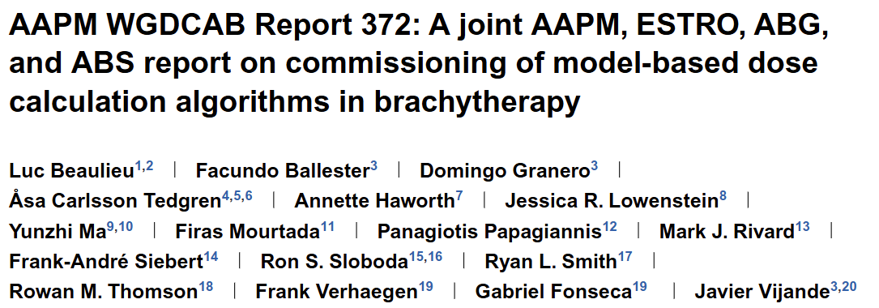

The TG-186 report introduced two levels of commissioning:
Level 1 pertains to the veriﬁcation of the algorithm in reference conditions for the dosimetric characterization of a source according to TG-43. Tolerances < 2% (in dose or dose rate) are expected at clinically relevant distances.
Level 2 pertains to the comparison of the end-user’s MBDCA results with corresponding reference data in speciﬁc virtual phantoms mimicking clinical scenarios

Slide 14
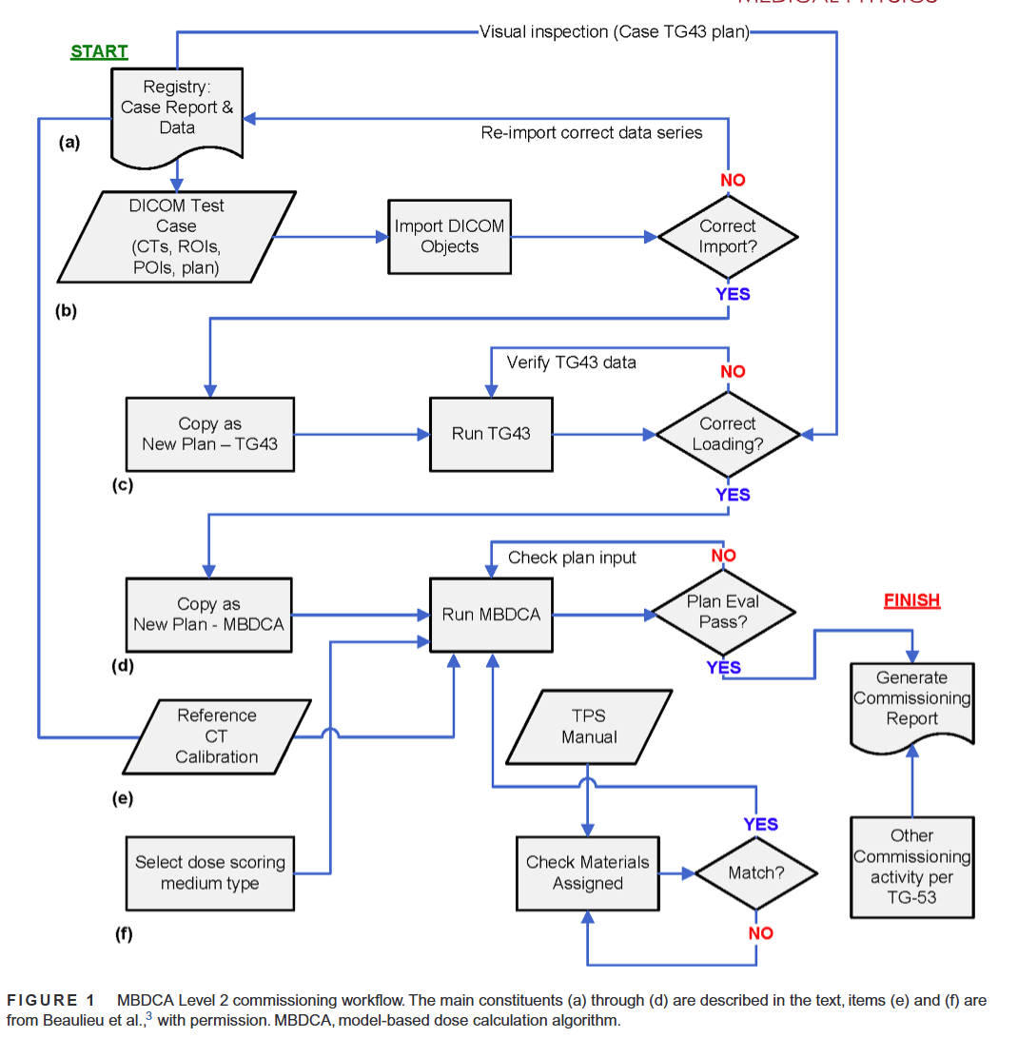
Workflow
Based on reference data
User most know limitations of the model

Slide 15
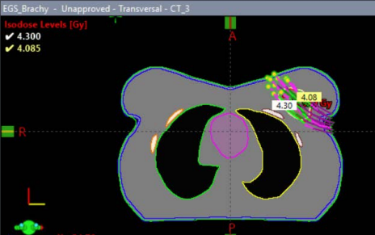
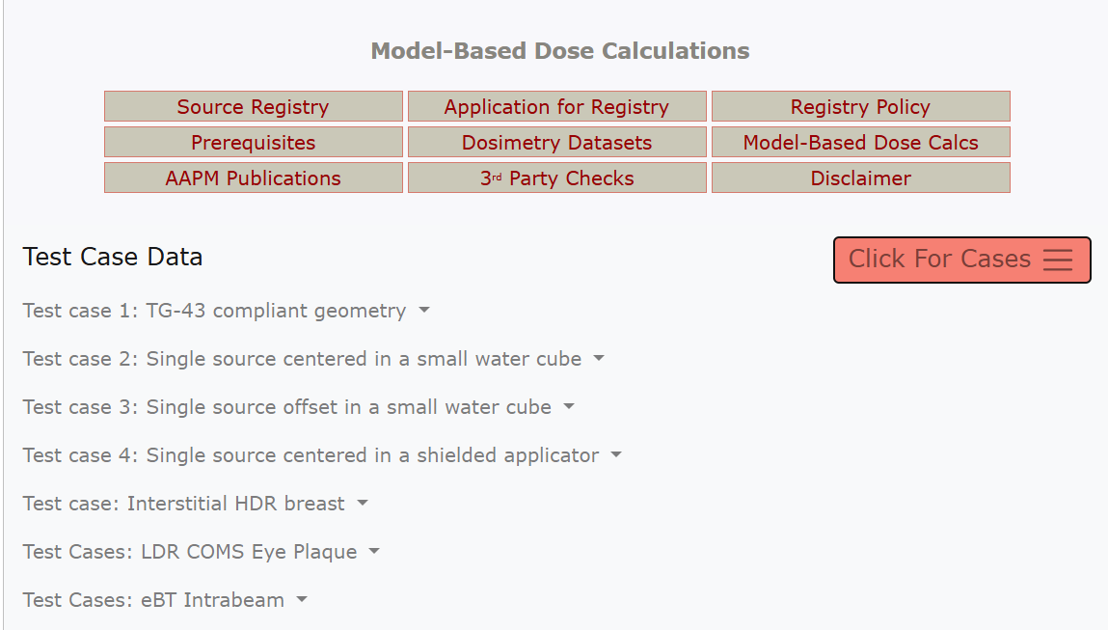
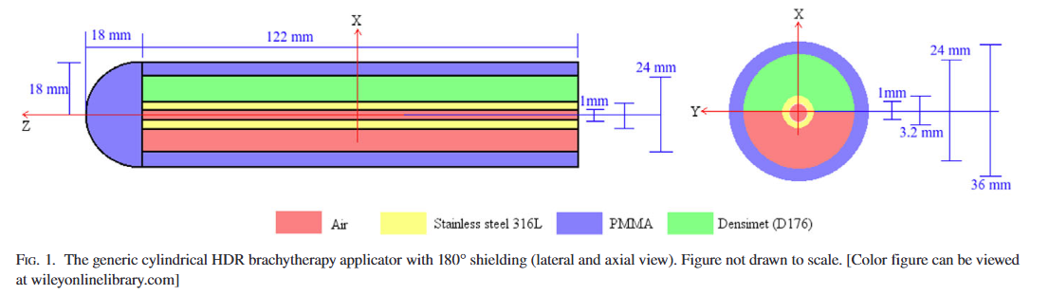
What about now …
Moving to Zenodo soon

Slide 16
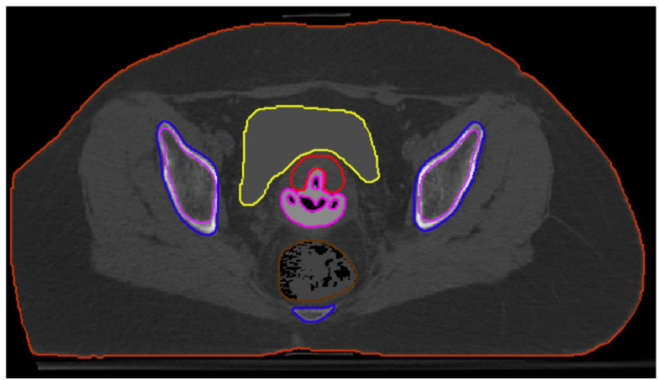
GYN case
Coming:
Head and Neck
Prostate Iodine
In-preparation:
Valencia/Leipzig
Skin
Neuro – Gamma tile
60Co - Gyn
Case not intended to proof clinical relevance, but to provide a reference for a wide variety of scenarios

Slide 17
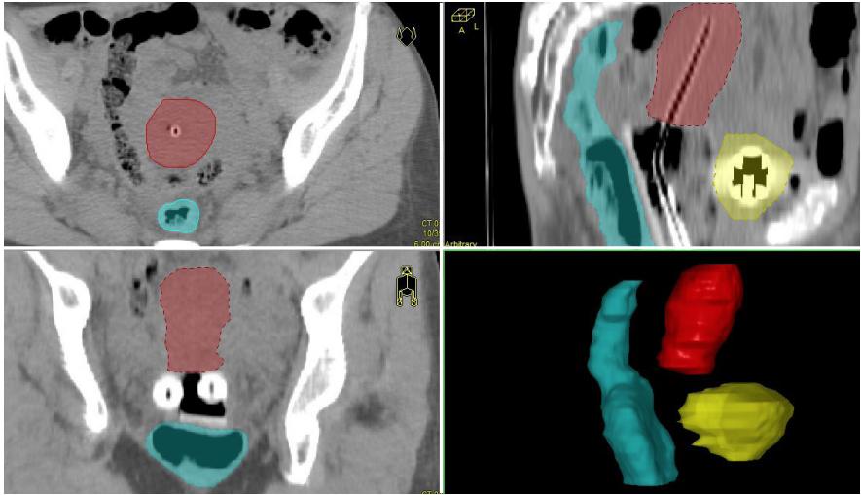
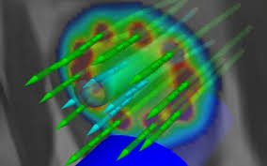
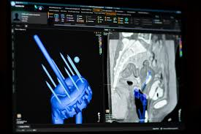
Clinical use
Available TPS
Oncentra ACE – Collapse cone
BrachyVision – AcurosBV Deterministic approach
RayStation - MC
Mostly in research setting
Very slow clinical adoption

Slide 18
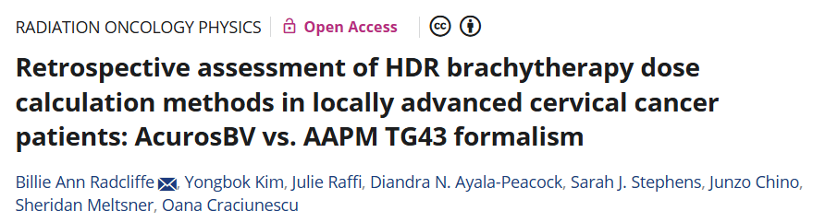
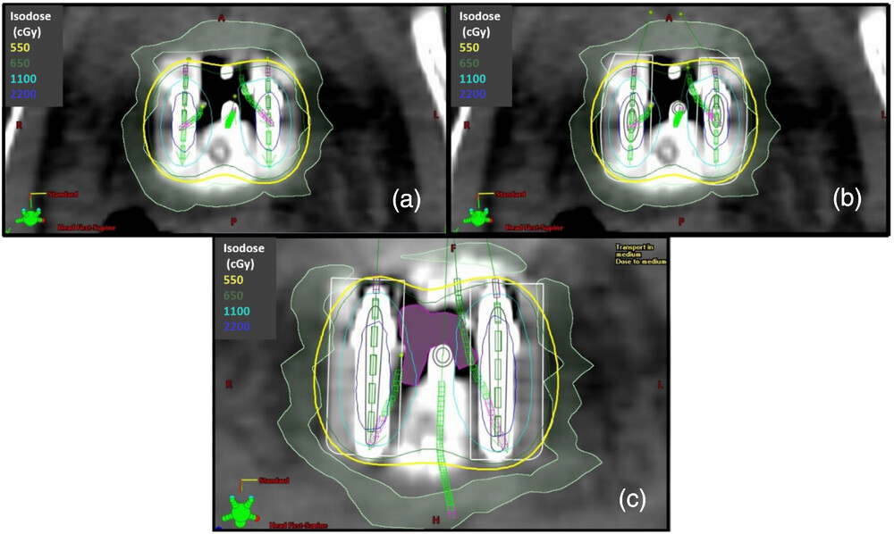
GYN
This study includes 32 patients with a total of 156 fractions treated with T&O applicators with titanium interstitial needles. ... The AcurosBV calculated doses are always lower than TG43 calculated dose. The average dose reduction was 4.20 % for target and 5.90 % for OARs. The maximal dose reduction was 9.68% for target and 29.03% for vaginal wall OAR.
Clinical implementation of a MBDCA AcurosBV style algorithm is challenging due to both logistical complexities and strain on computational resources. The results of this study do not present enough clinical dosimetric change to warrant using an MBDCA approach for the primary algorithm for HDR 192Ir T&O gynecological treatments. However, MBDCA approach could be utilized as a supplemental check or verification tool. Due to calculation speed, TG43 could be utilized as the primary algorithm with AcurosBV calculated dose as a second verification check.

Slide 19
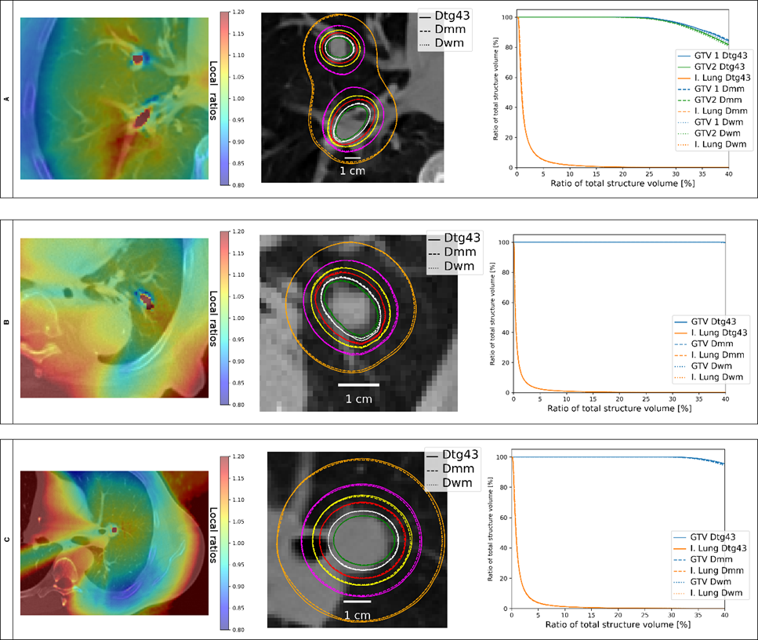
Lung
Lung – to be submitted
Large differences in low dose regions

Slide 20
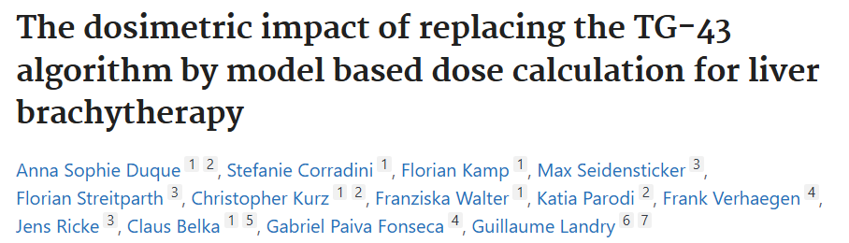
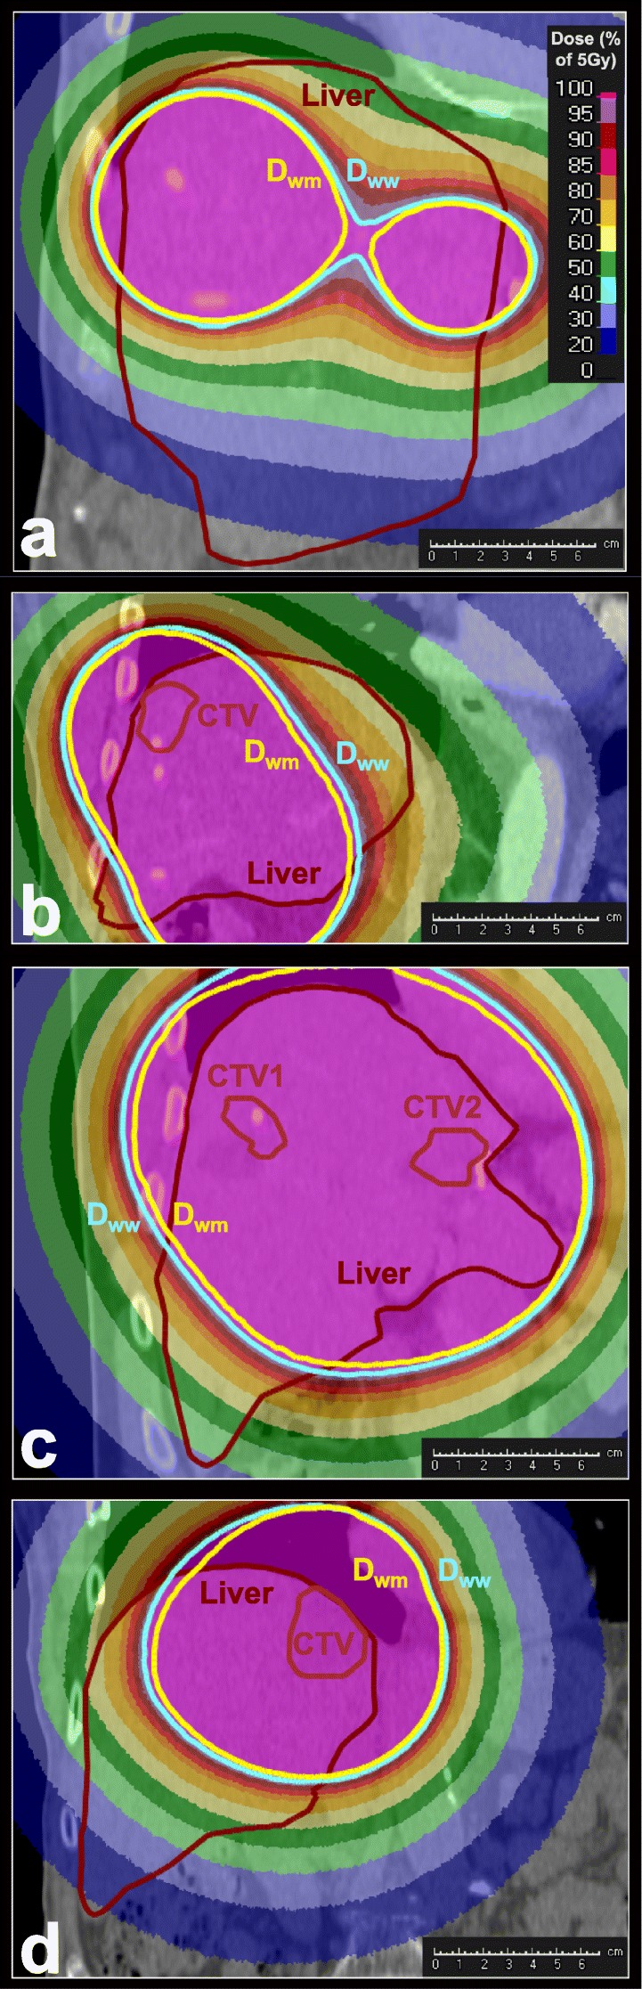
Liver
Up to ~7% V5Gy
Similar CTV coverage

Slide 21
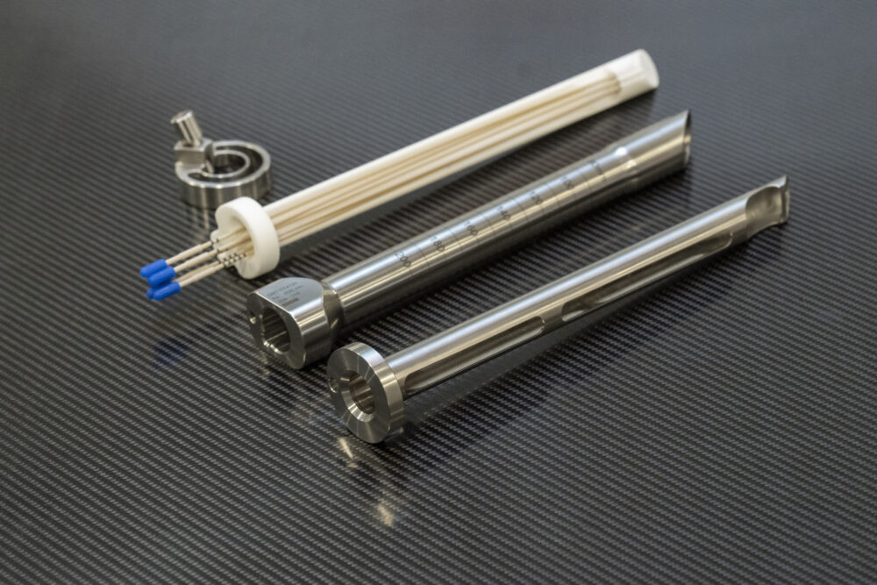
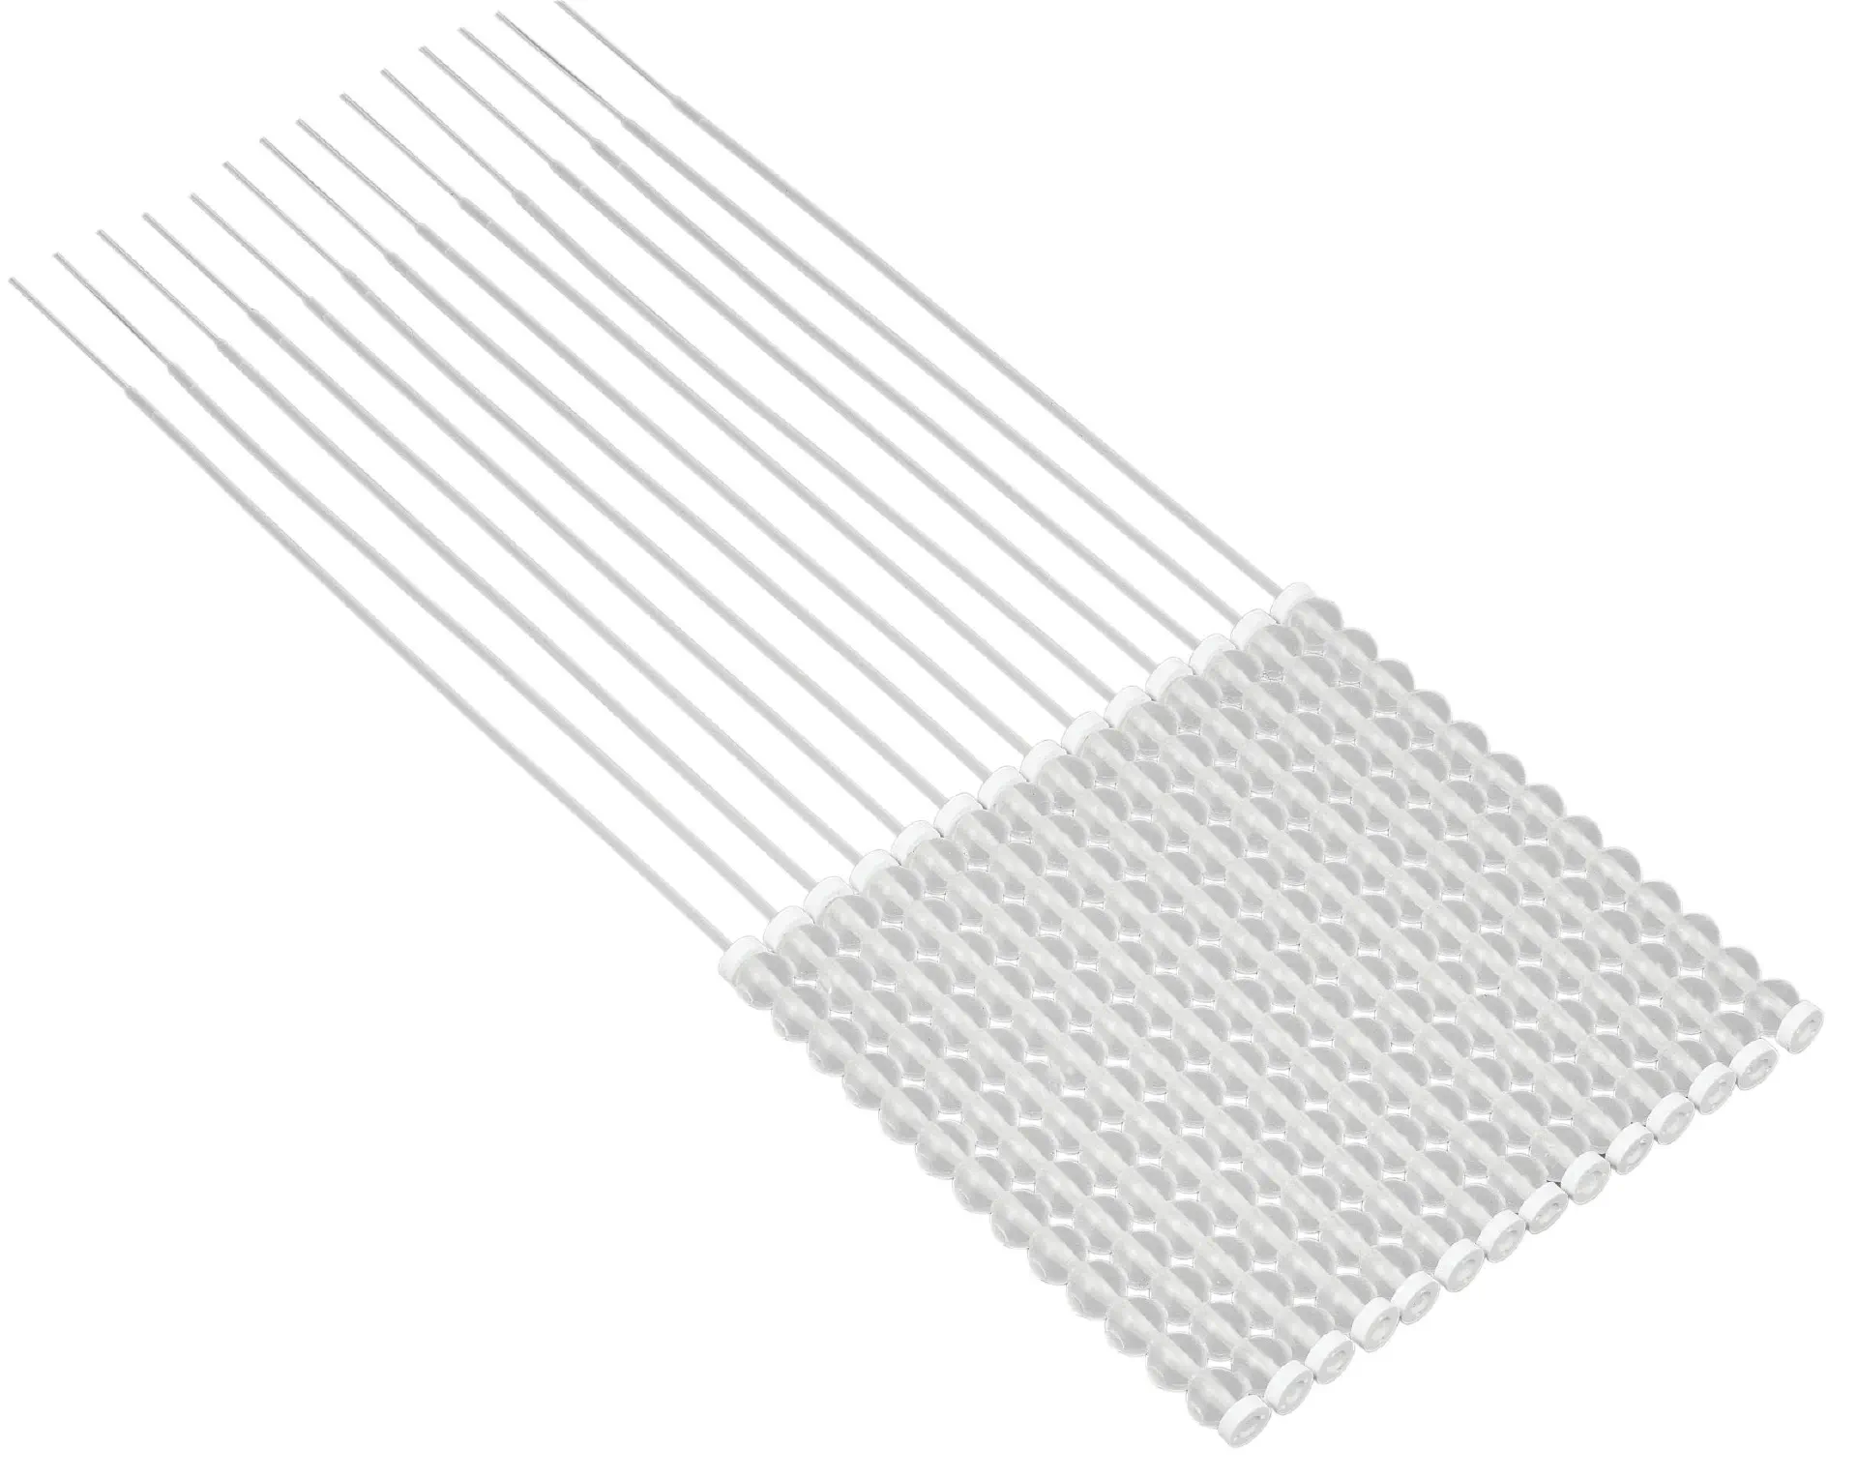
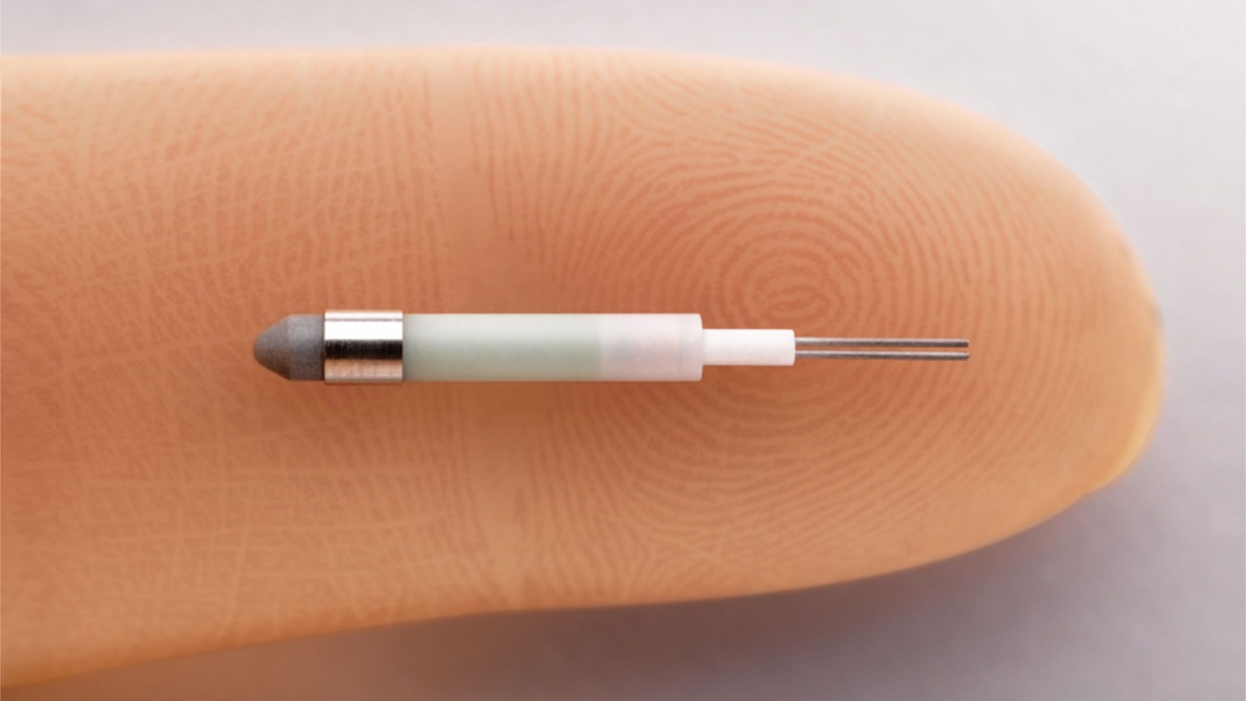
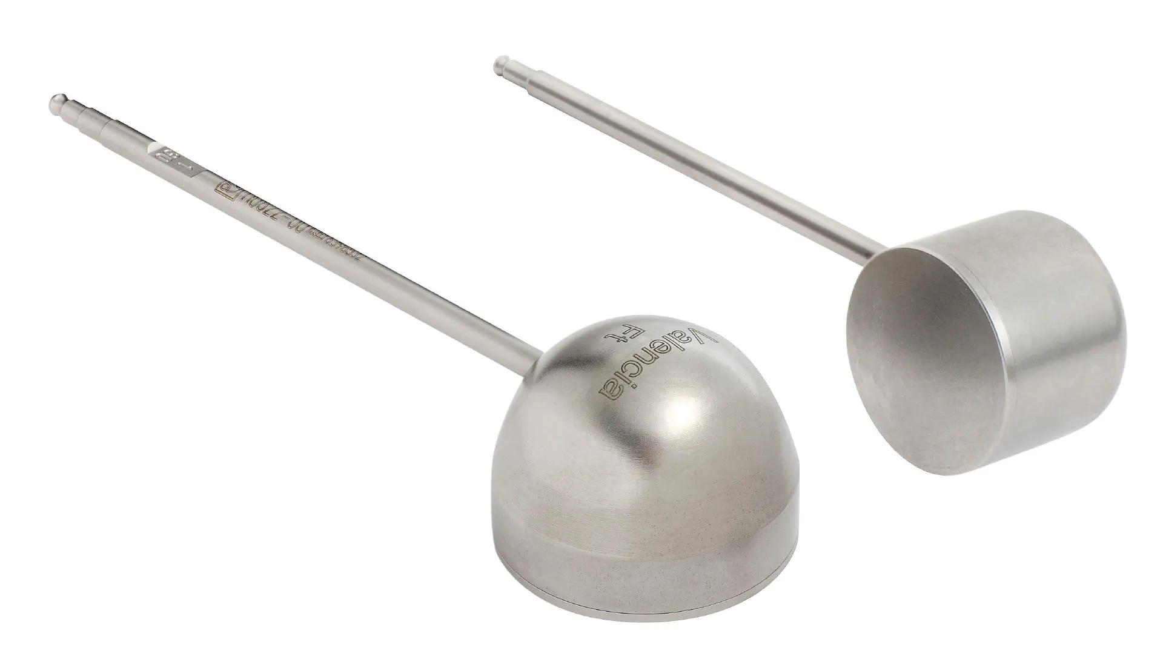
Where can it be more important ?
Skin and shielded applicators
Needs to be added to the TPS library
Low energy – Lacking TPS

Slide 22
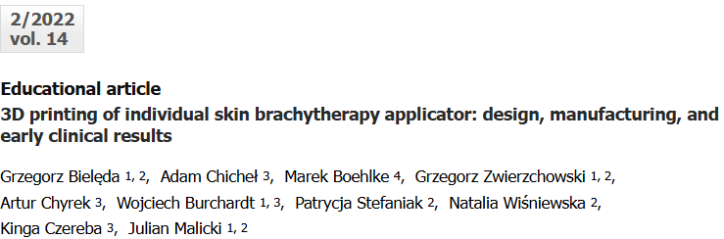
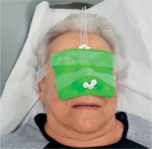
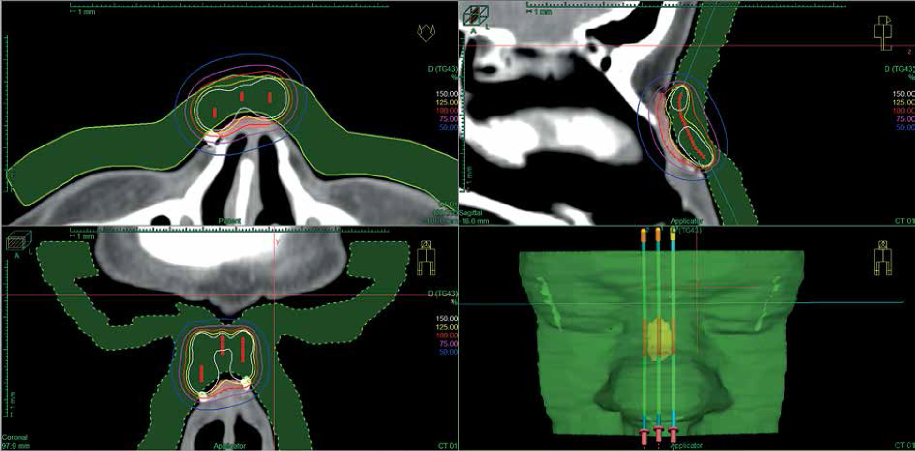
3D printed applicators

Slide 23
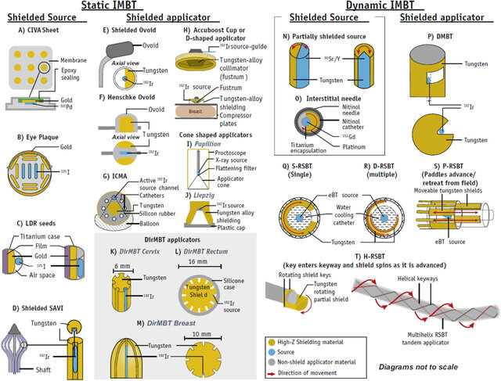
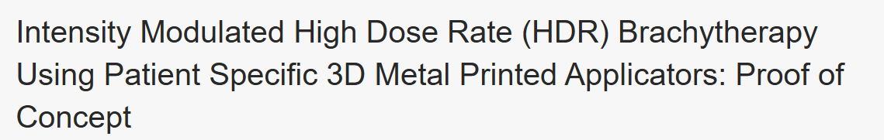
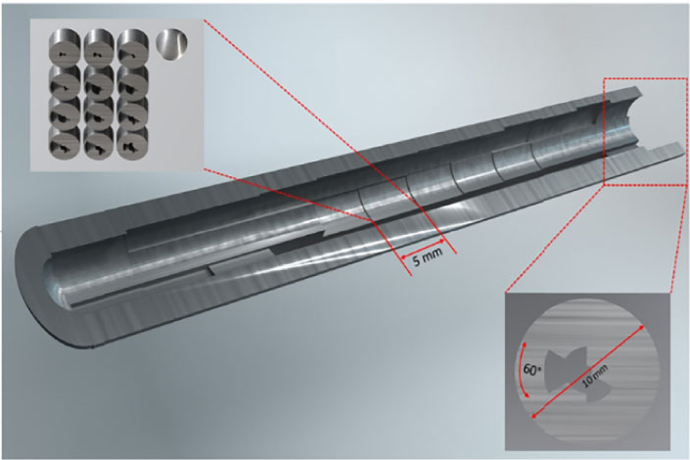
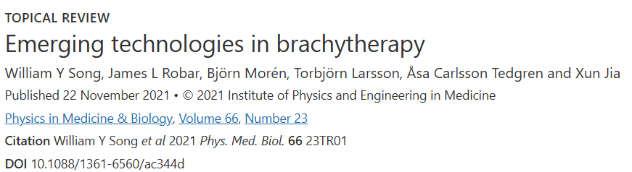
Where can it be more important ?

Slide 24
Conclusion
Clinical data needed
TPS adoption is very slow ($$$)
Limited possibility in TPS for customization
New possibilities including for dosimetry (e.g.g energy correction)

Slide 25
Thank you !

