Slide 1

IMAS: a Total-Body PET system with TOF and DOI capabilities
Álvaro Anreus, Marta Freire, David Sánchez, Santiago Jiménez-Serrano, Edwing Y. Ulin-Barreño, Jorge Álamo, Julio Barberá, Neus Cucarella, Andrea González-Montoro, Alfonso Ríos, Irene Torres, Luis F. Vidal, Marc Gil, José M. Benlloch and Antonio J. González
Institute for Instrumentation in Molecular Imaging, i3M
Valencia, October 27th 2025
V Jornadas RSEF / IFIMED de Física Médica
contact: aanrval@i3m.upv.es

Slide 2

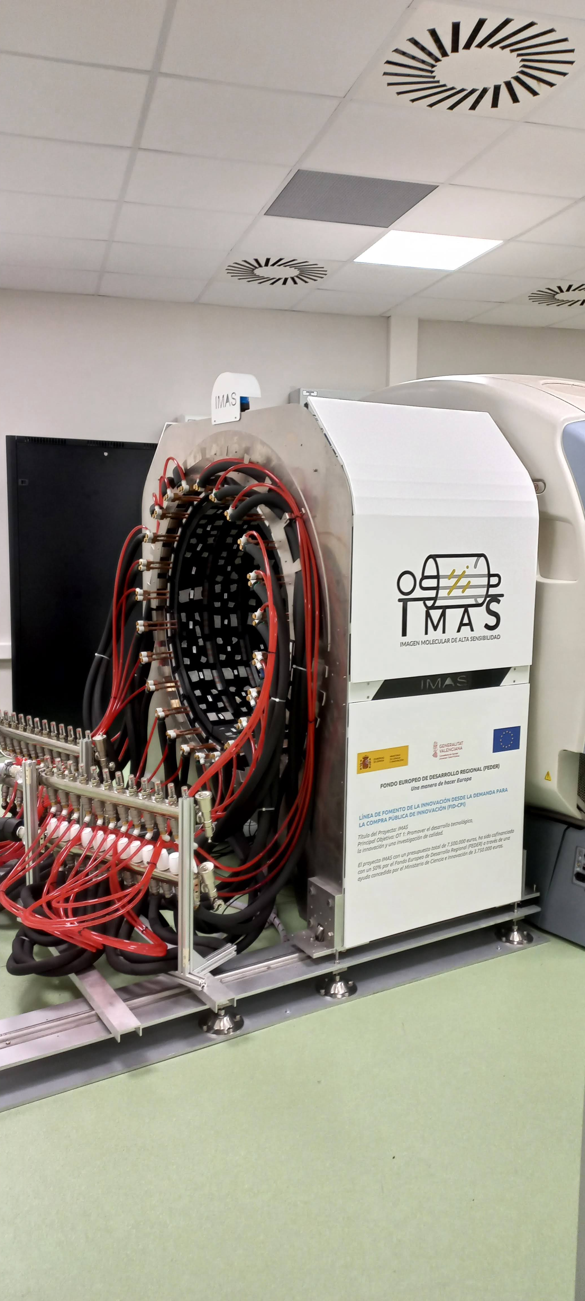

Overview
Total Body PET: High Sensitivity Molecular Imaging (IMAS) project
Materials and Methods
System Performance
Conclusions and next steps

Slide 3
Overview
Total Body PET: High Sensitivity Molecular Imaging (IMAS) project
Materials and Methods
System Performance
Conclusions and next steps

Slide 4
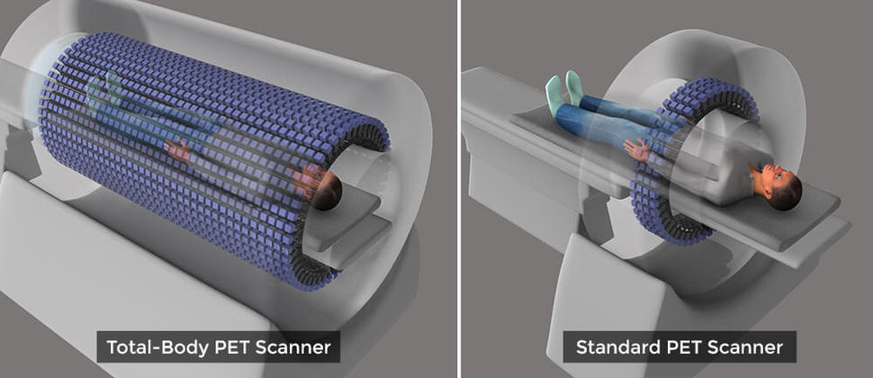
PET systems
PET is a non-invasive, highly sensitive molecular imaging technique → functional information at the molecular level
But these studies are still limited by statistics, radiation dose and efficiency geometry
Total Body PET increases axial coverage and sensitivity.
Current PET scanners only collect about 1% of the emitted signals. TB-PET can increase sensitivity around x20.

Slide 5
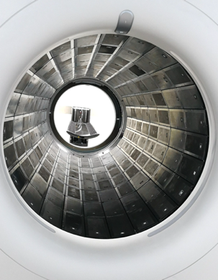
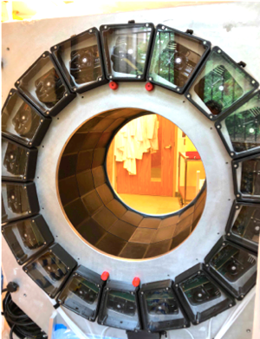
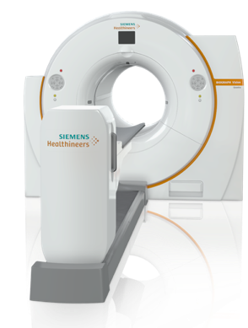
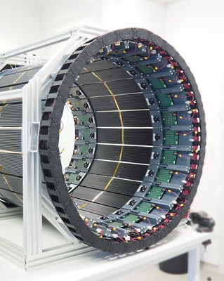
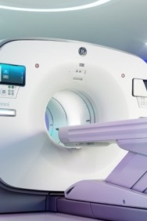
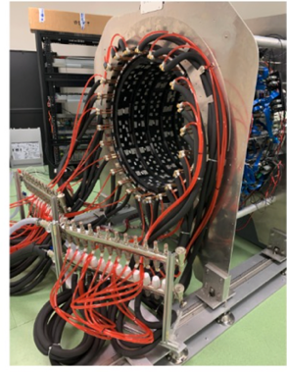
Total Body PET system
United Imaging uEXPLORER
PennPET EXPLORER
Siemens Quadra
J-PET
GE Omni
IMAS
Highest sensitivity,
400 ps
2 m long
United imaging Healthcare
Pixels, no DOI
SiPM On-Semi
$$$$
TOF 250 ps
70 - 140 cm long
Philips technology platform
Pixels, no DOI
dSiPM Philips
$??
TOF <214 ps
1.06 m long
Siemens Vision tech
Pixels, no DOI
SiPM Hama
$$$
TOF impact
70 cm
Plastic scintillator
DOI
32 cm -> 96 cm
GE Omni
BGO
Pixels, no DOI
$$
DOI
TOF 450 ps
71 cm long
Semi-monolithic LYSO
DOI
SiPM Hama
$$
On the market

Slide 6
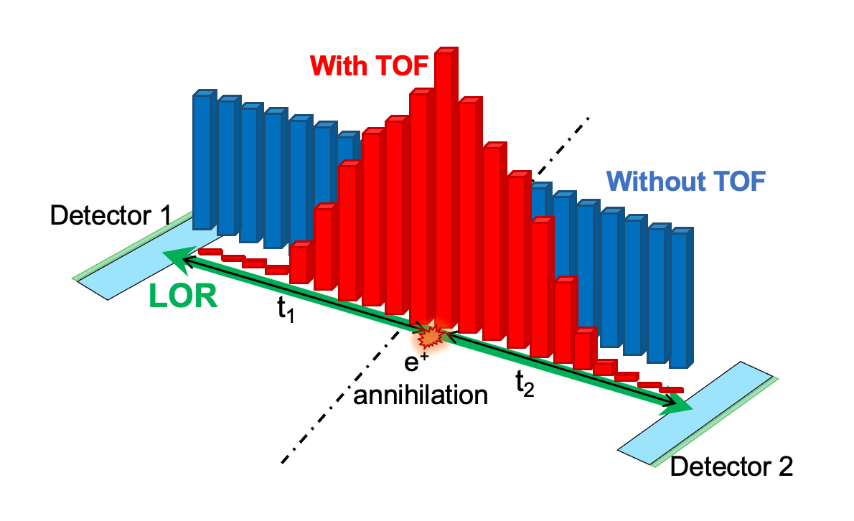
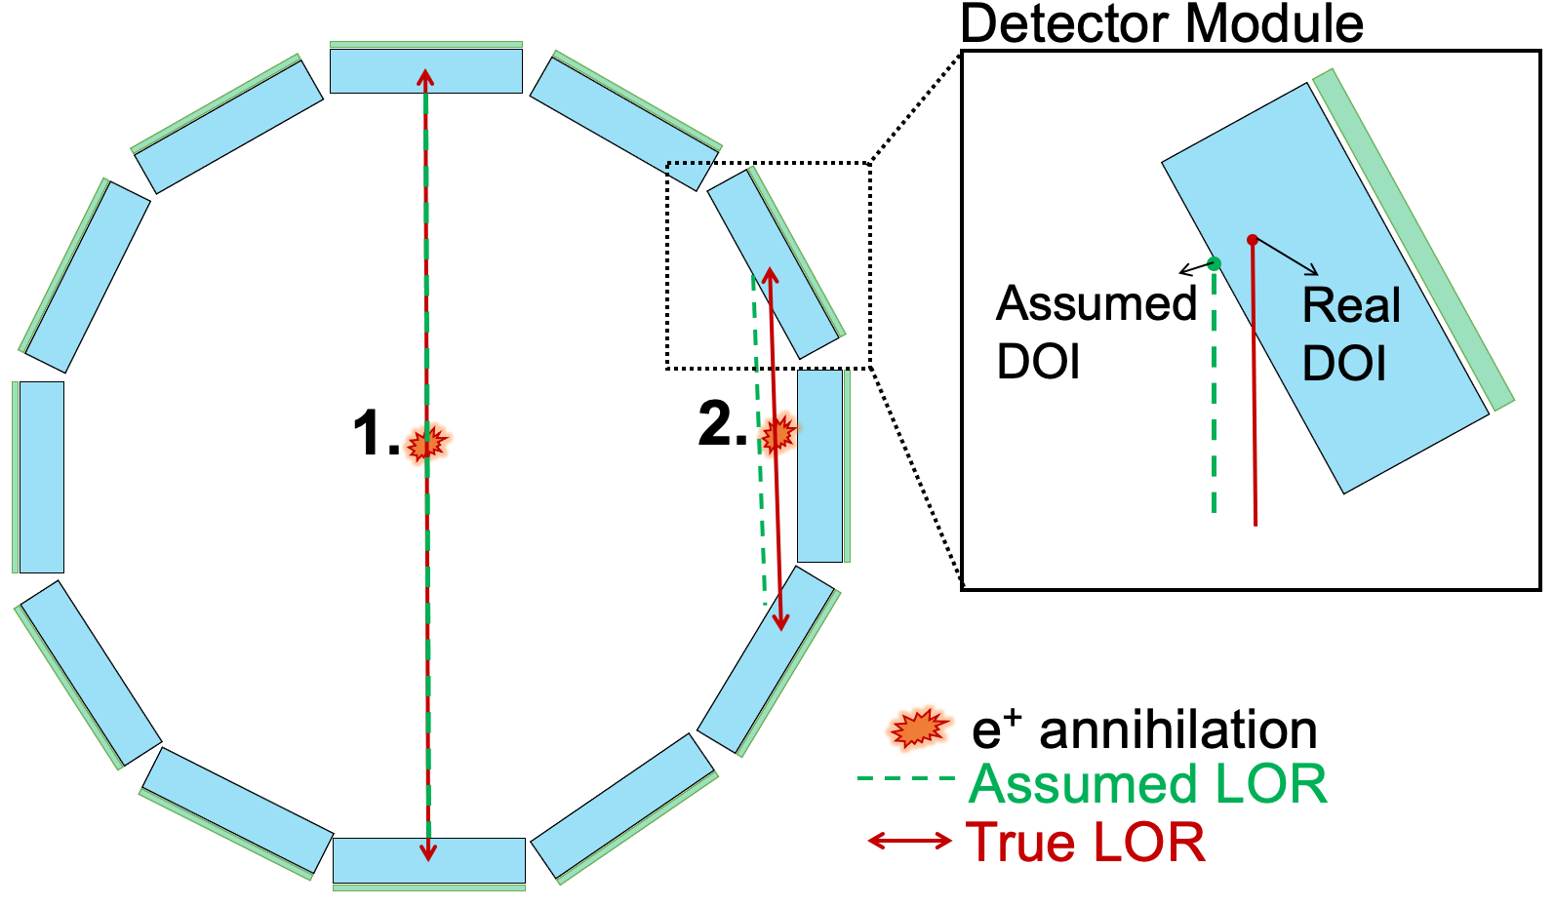
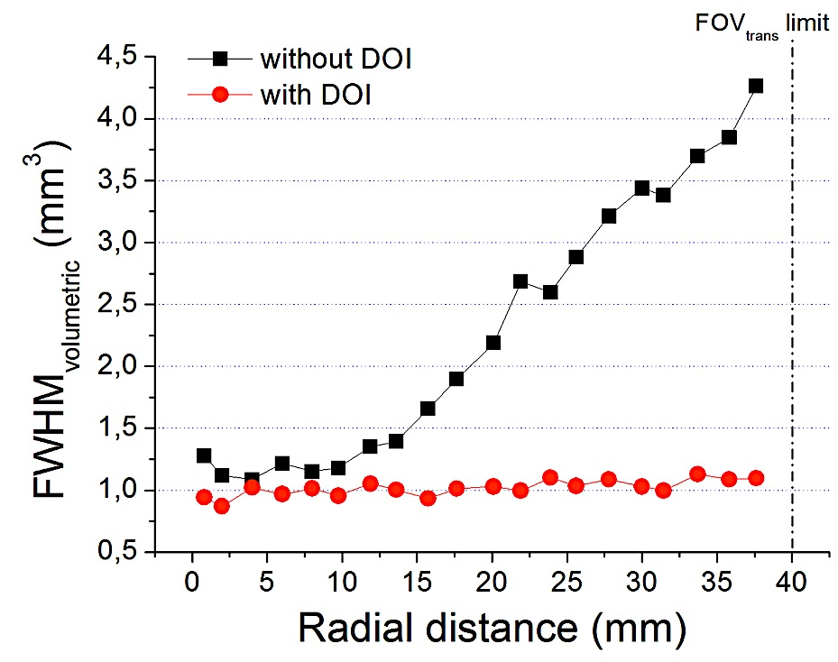
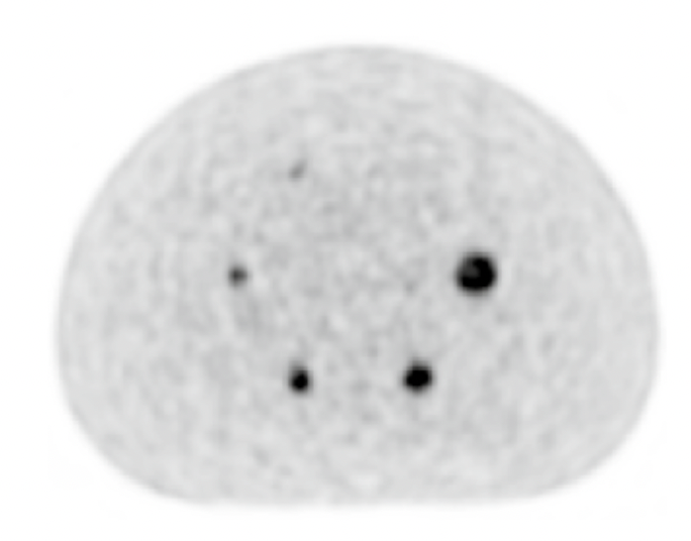
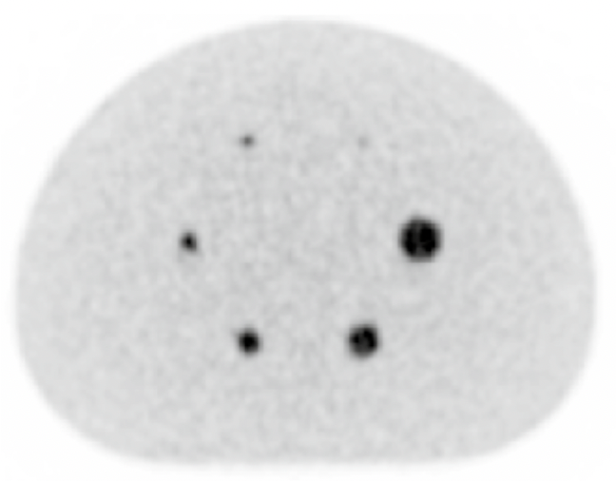
Total Body PET with DOI and TOF
Role of DOI
Role of TOF
DOI (Depth of Interaction) is the depth at which the annihilation photon interacts within the detector.
TOF (Time of Flight): the difference in the arrival time of the two annihilation photons
1.
With TOF: better localization of the true annihilation point along the LOR
TOF information → increases the image Signal to Noise Ratio (SNR)
Non TOF
With DOI: the true Line of Response (LOR) is determined
TOF (210 ps)
DOI information →provide homogeneous
spatial resolution across the entire Field of View (FOV)

Slide 7


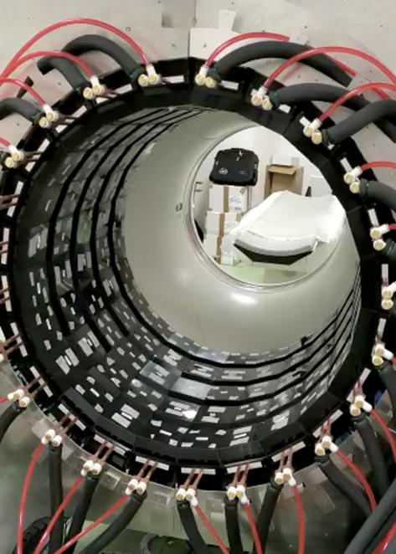
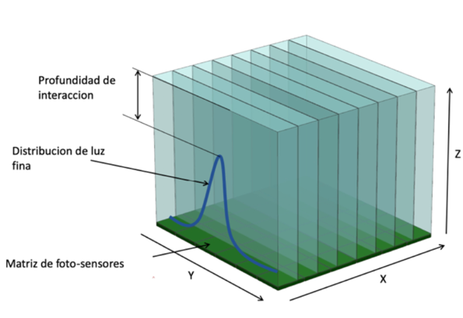
Total Body PET: High Sensitivity Molecular Imaging (IMAS) project
IMAS, Imagen Molecular de Alta Sensibilidad
Construction of a TB-PET system:
Long axial coverture (71 cm), 5 rings with a diameter of 82 cm and axial length of 10 cm each, separated by 5 cm between rings.
Without a high-cost impact: using semi-monolithic crystals and a signal reduction readout that significantly reduces the cost.
Detector technology with DOI and TOF capabilities: semi-monolithic crystal

Slide 8
Overview
Total Body PET: High Sensitivity Molecular Imaging (IMAS) project
Materials and Methods
System Performance
Conclusions and next steps

Slide 9

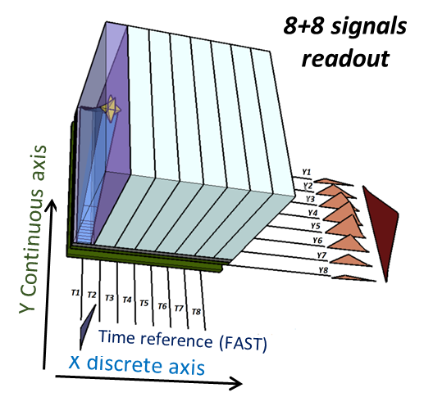
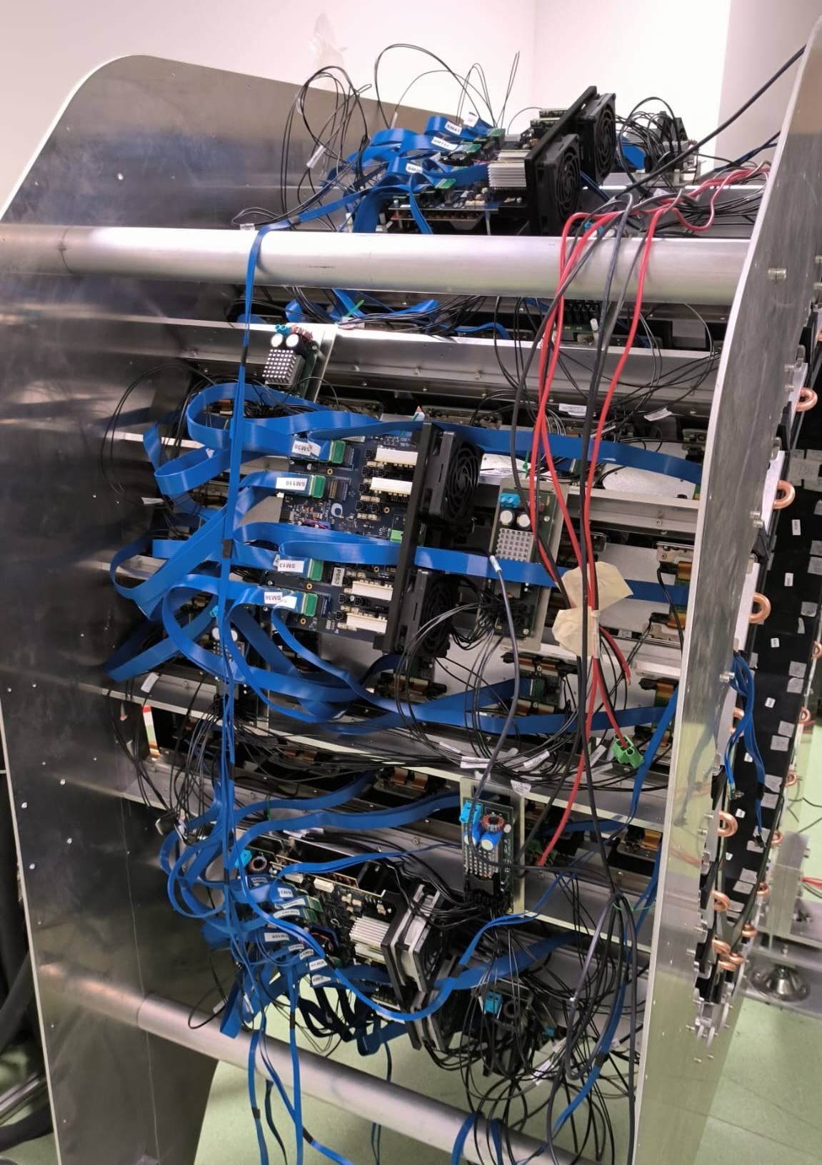
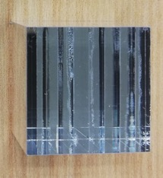
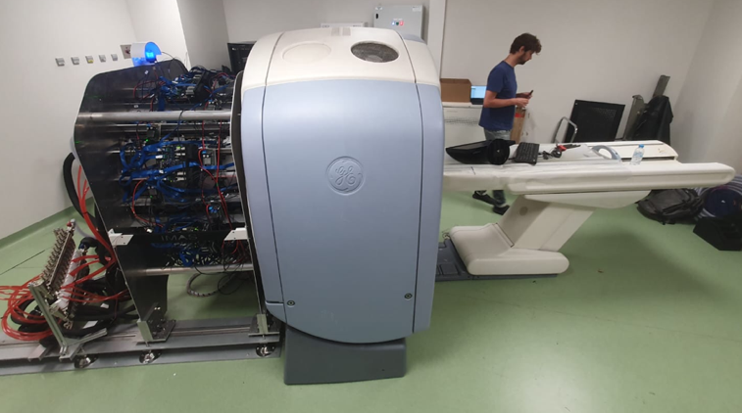
Materials
Mini-Module (MM):
LYSO semi-monolithic coupled to 8x8 SiPM matrix
Reduction readout
PETsys electronics
IMAS scanner
FEM256
25.8 mm
25.8 mm
FEB/D 8k
System components:
16 x MM → 1 Super-Module (SM), readout by 1 x FEM256
24 x SM → 1 Ring
IMAS PET system → 5 Rings: Axial length of 71 cm (5 cm gap)
  122 880 SiPMs
  30 720 channels
  15 360 slabs
Water cooling for temperature stabilization
Installation on May-June 2023
CT
PET

Slide 10
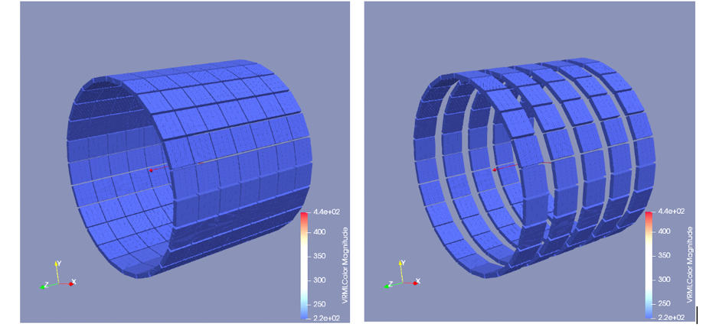
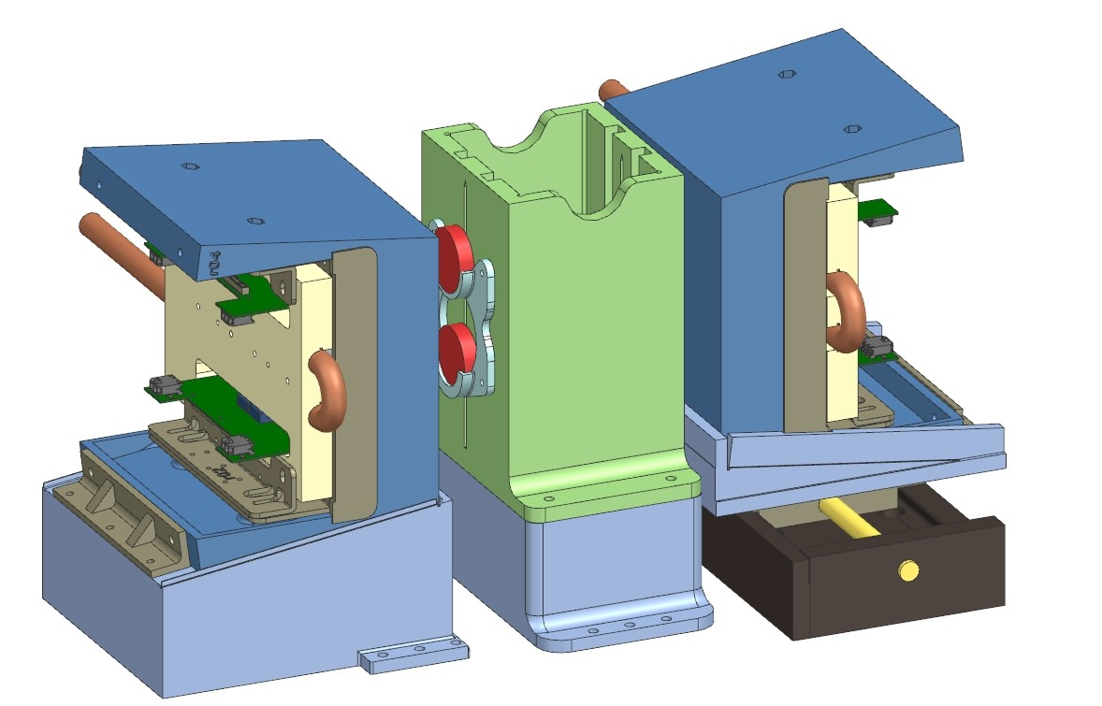
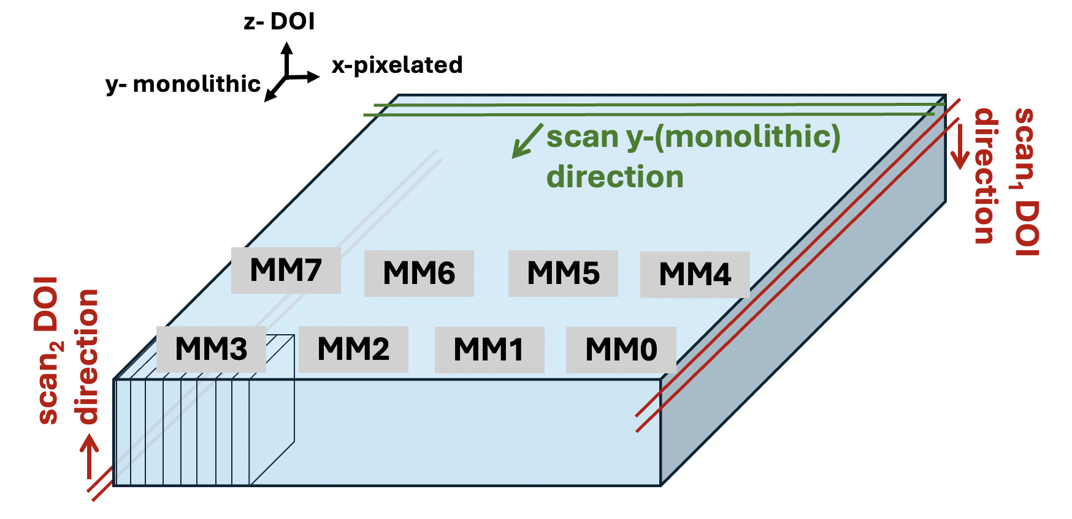
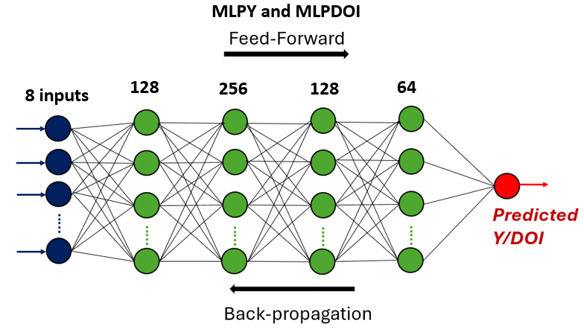
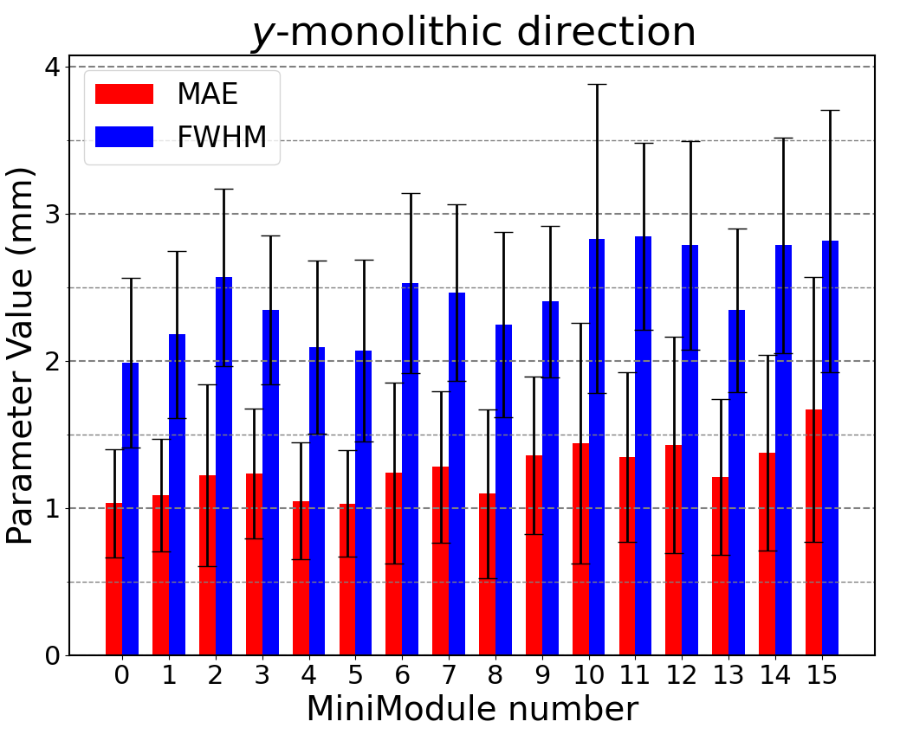
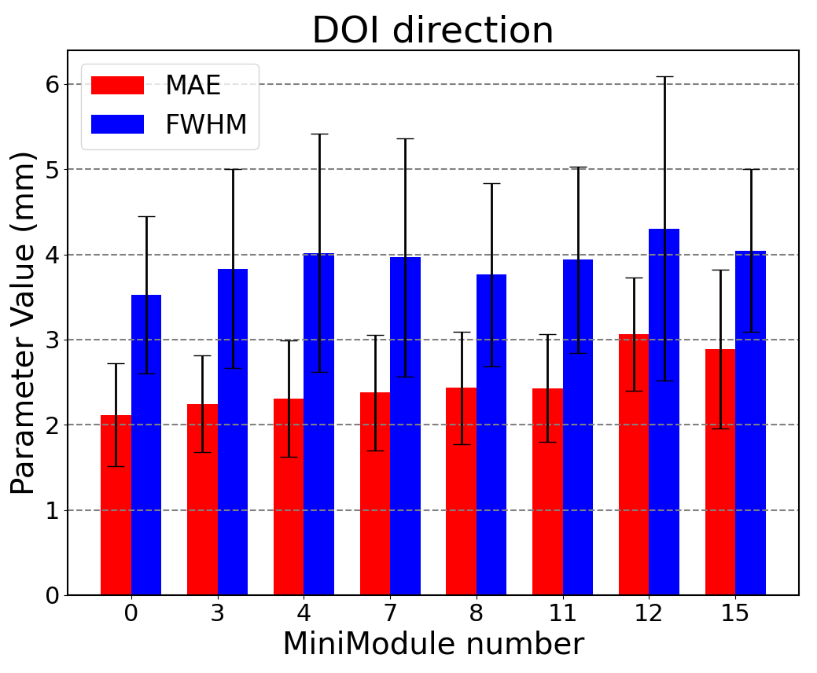
IMAS Calibration
Experimental set-up
Reference SM
Reference SM
²²Na point sources
Reference SM
SM for coincidences
Slit collimator
Motor
Neural Network
Spatial performance for the reference SM
→ The trained NN are used to estimate the impact position in y-monolithic and DOI direction in all the SM of the IMAS system

Slide 11
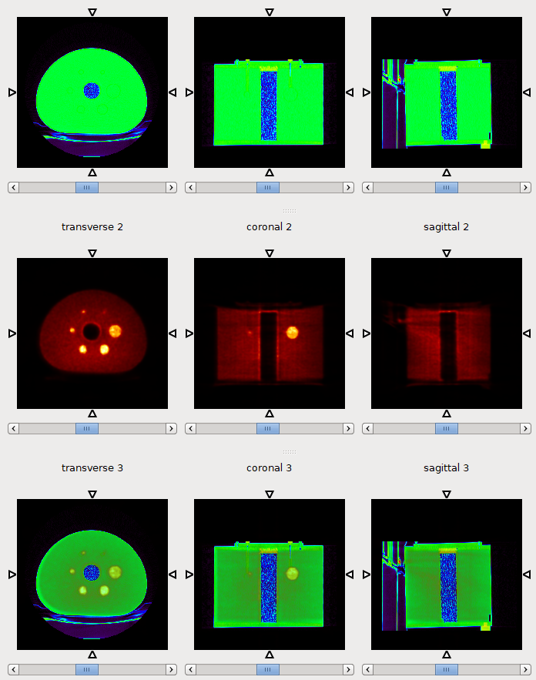
Methods
Raw data PETsys
LM
Reconstructed image
MLEM or OSEM
Normalization correction
Attenuation correction
x- coordinates are estimated
y- and DOI coordinates are calculated using NN
Energy calibrated
DOI information included for correcting parallax errors

Slide 12
Overview
Total Body PET: High Sensitivity Molecular Imaging (IMAS) project
Materials and Methods
System Performance
Conclusions and next steps

Slide 13
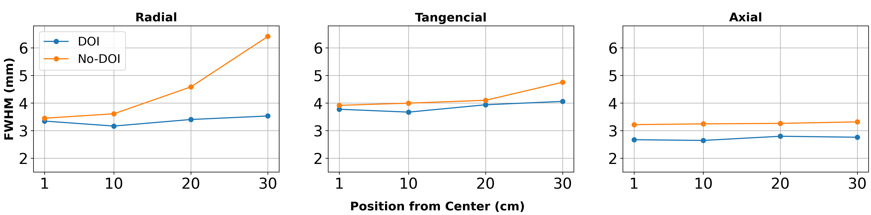
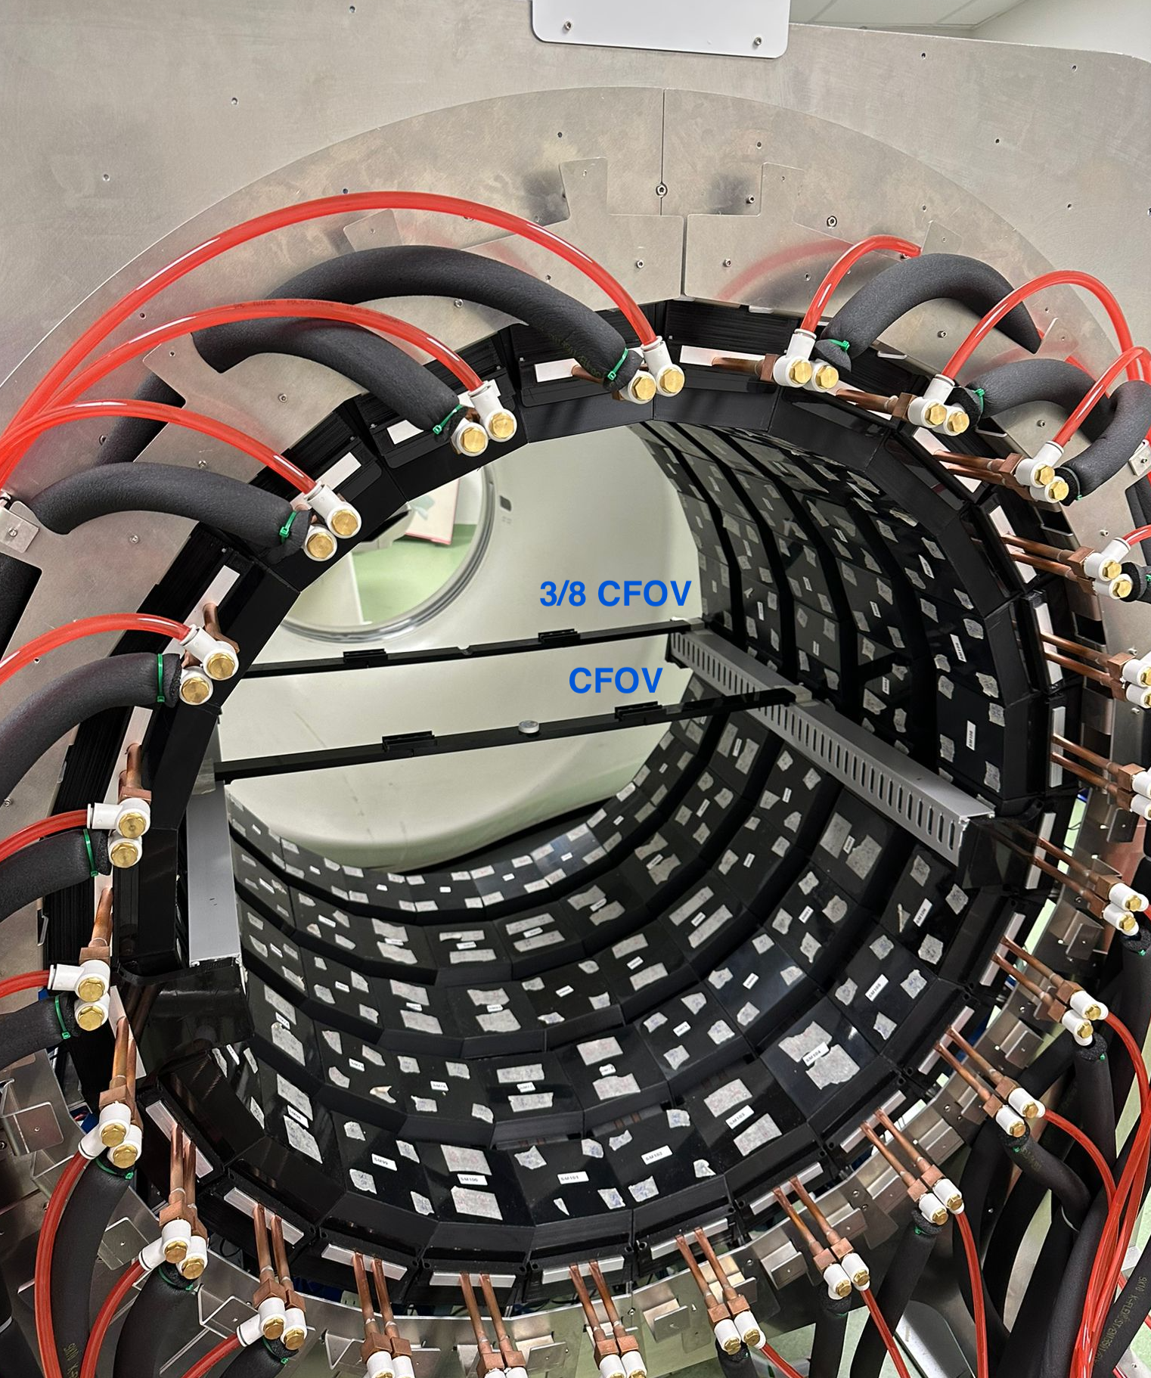
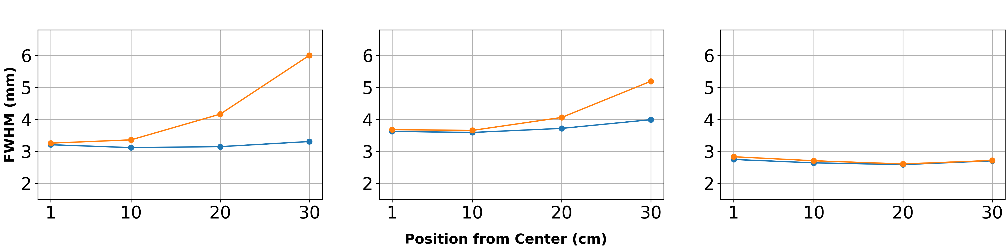
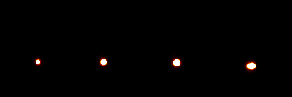
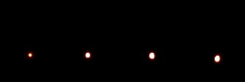
Spatial resolution
Point sources
Point source ²²Na, activity 6.2 µCi and 1 mm active diameter
MLEM reconstruction, 15 iter
cFOV
3/8 FOV
No-DOI
DOI

Slide 14
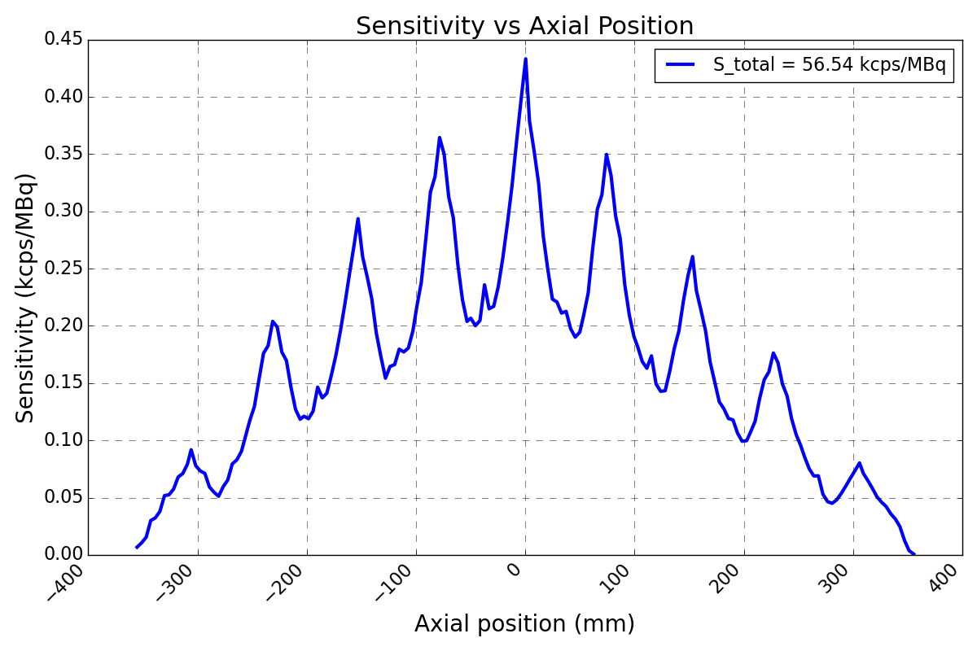
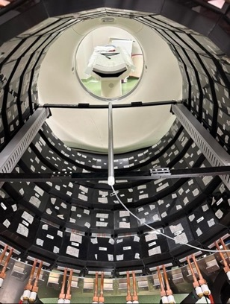
Sensitivity NEMA 2018
Sensitivity phantom
Pipe filled with FDG
Initial activity of 15.5 MBq
Total Sensitivity:
56.5 kcps/MBq
Sensitivity (kcps/MBq)
Axial position (mm)

Slide 15
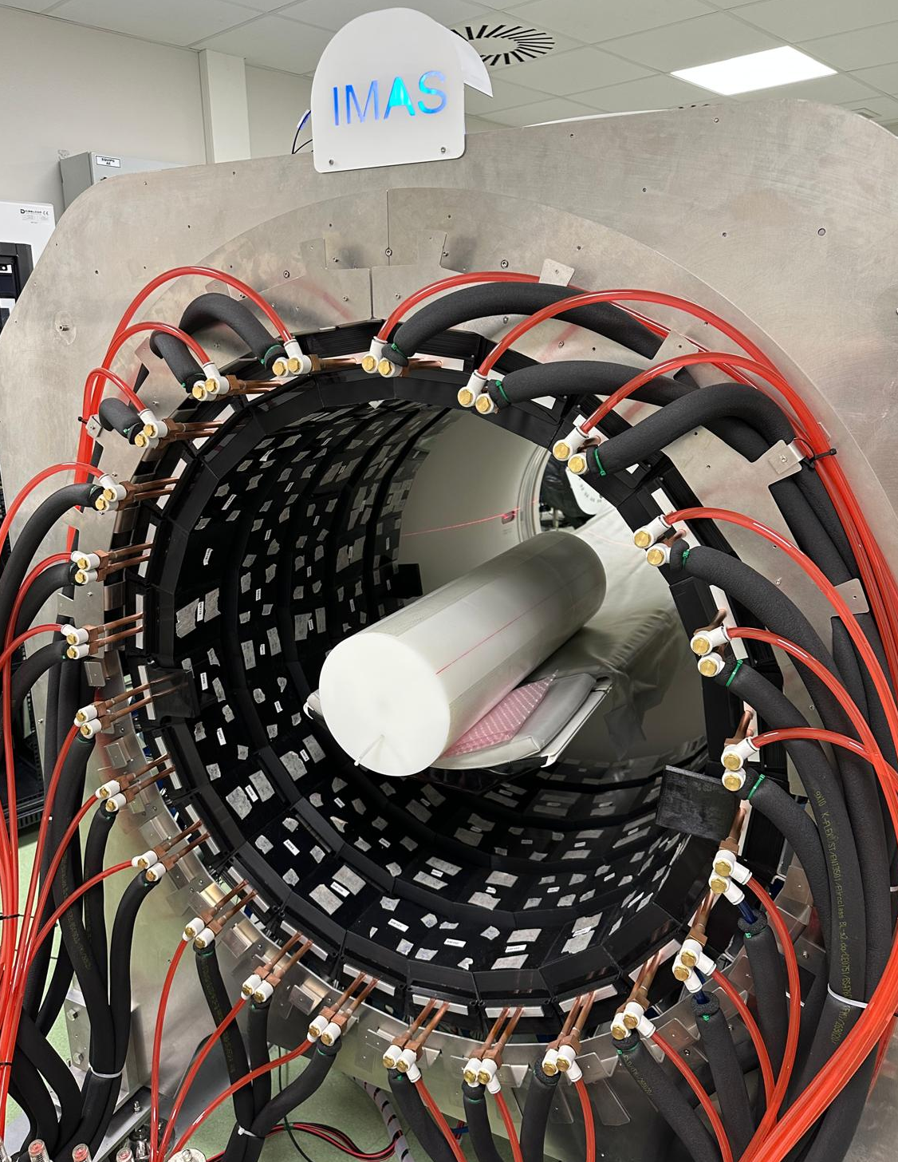
Count rate performance
2023
2024
2025
Loss counts at:
~9.3 MBq
Loss counts at:
~28 MBq
Loss counts at:
~44 MBq
Improvements 2024:
Installation of a second DAQ
SW/FW writing into disk performance increased: writing at 3 Gb/s into disk
FW implementation of a threshold on the minimum number of hits: remove noise events
Improvements 2025:
FW implementation of a threshold on the minimum energy: remove low energy events
2026
Future improvements:
Improve write performance into disk:
limit is found at 6 Gb/s
Reduce coincidence window
→ We are in discussions with PETsys to improve rate performance

Slide 16
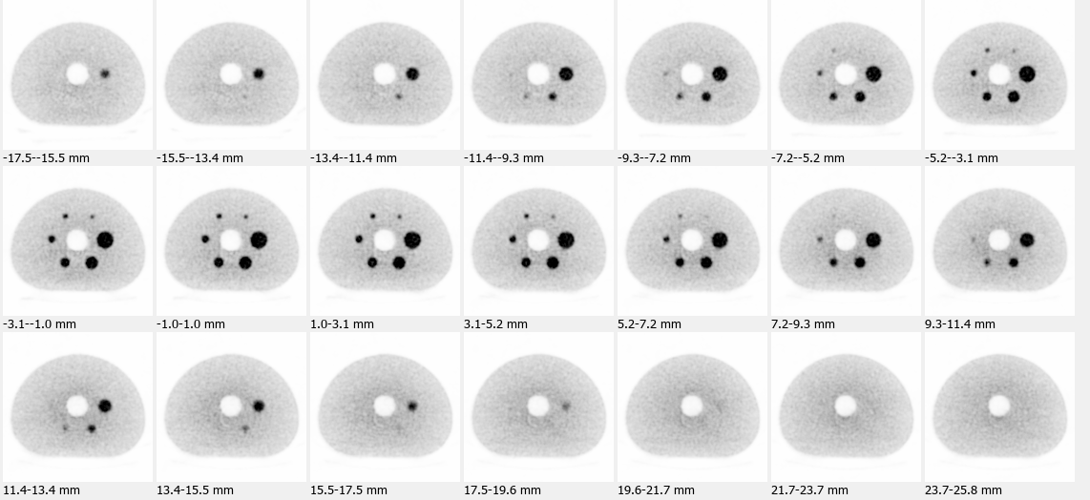
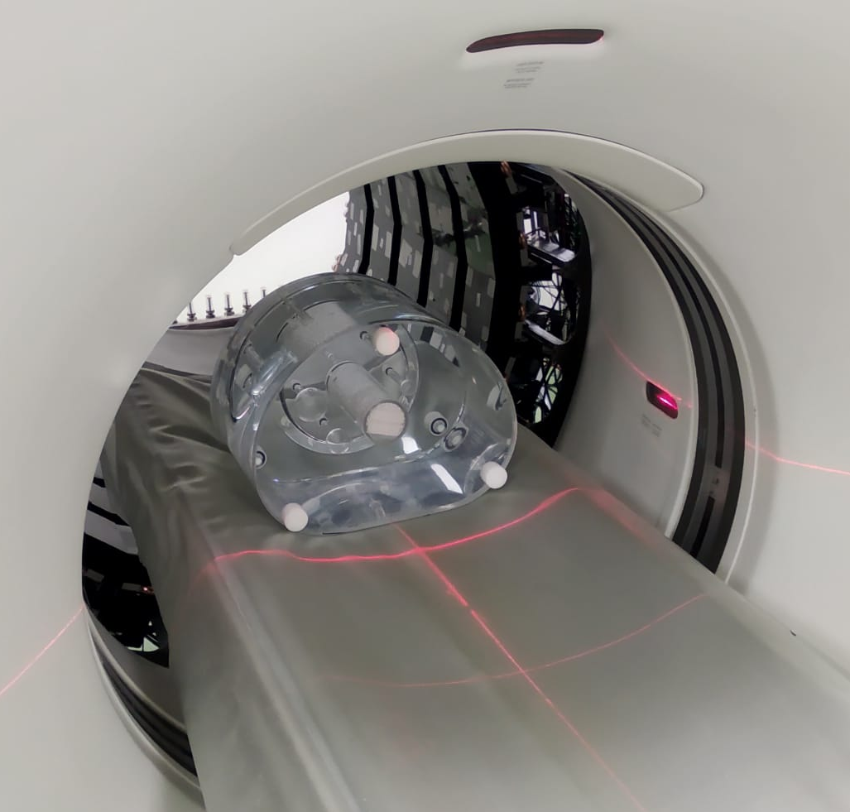
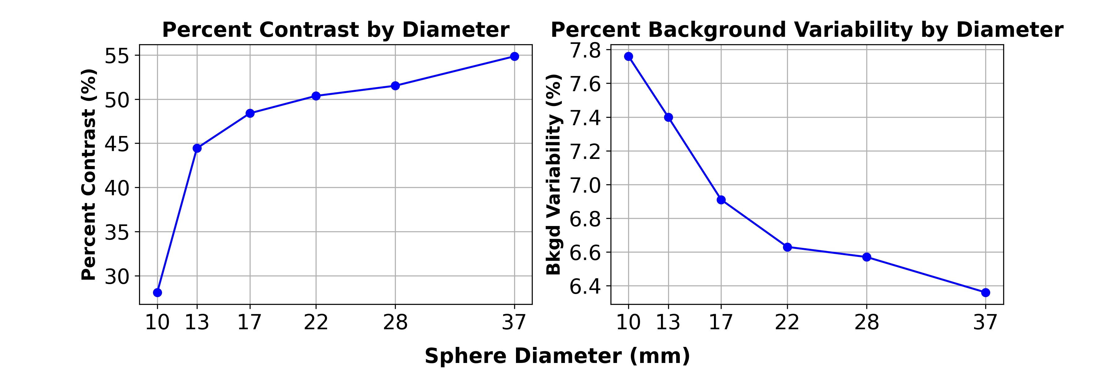
Images: Torso NEMA 2018
Torso Phantom:
Ratio 1:10 FDG
OSEM reconstruction, 10 iter + 5 subset
Normalization applied
Attenuation corrected using CT

Slide 17
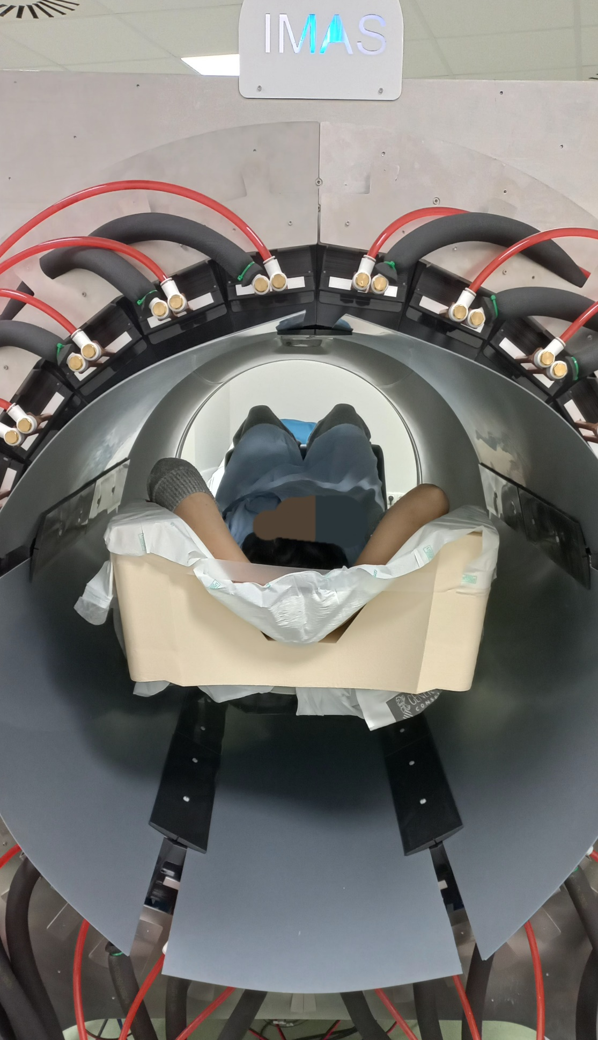

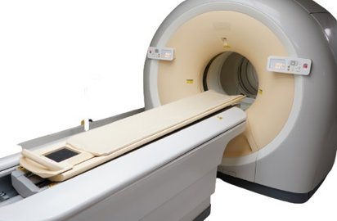

Patients
Ethics committee approval September 2024. Room approval to use FDG February 2025.
Protocol is very “wide” allowing all recruited patients for conventional PET/CT to be asked for an IMAS PET/CT
Patient Protocol at Hospital La Fe
Patient injection
WB-PET/CT from La Fe
Patient consent obtained
TB-PET IMAS (no CT)

Slide 18
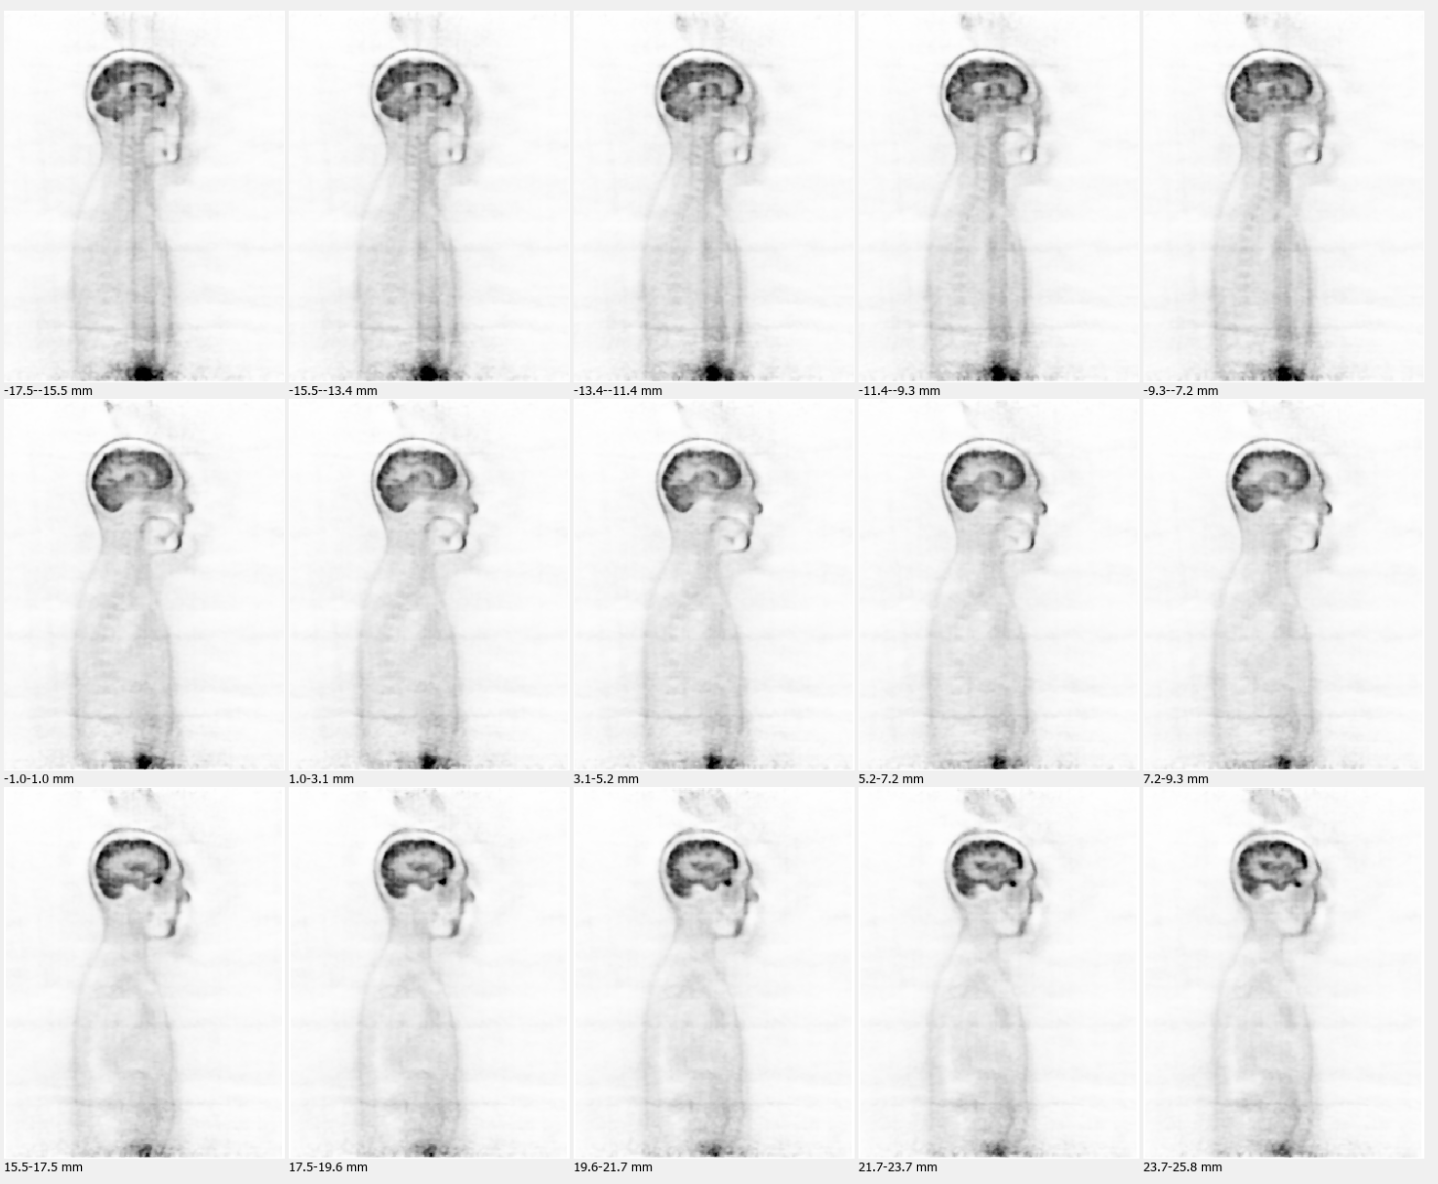
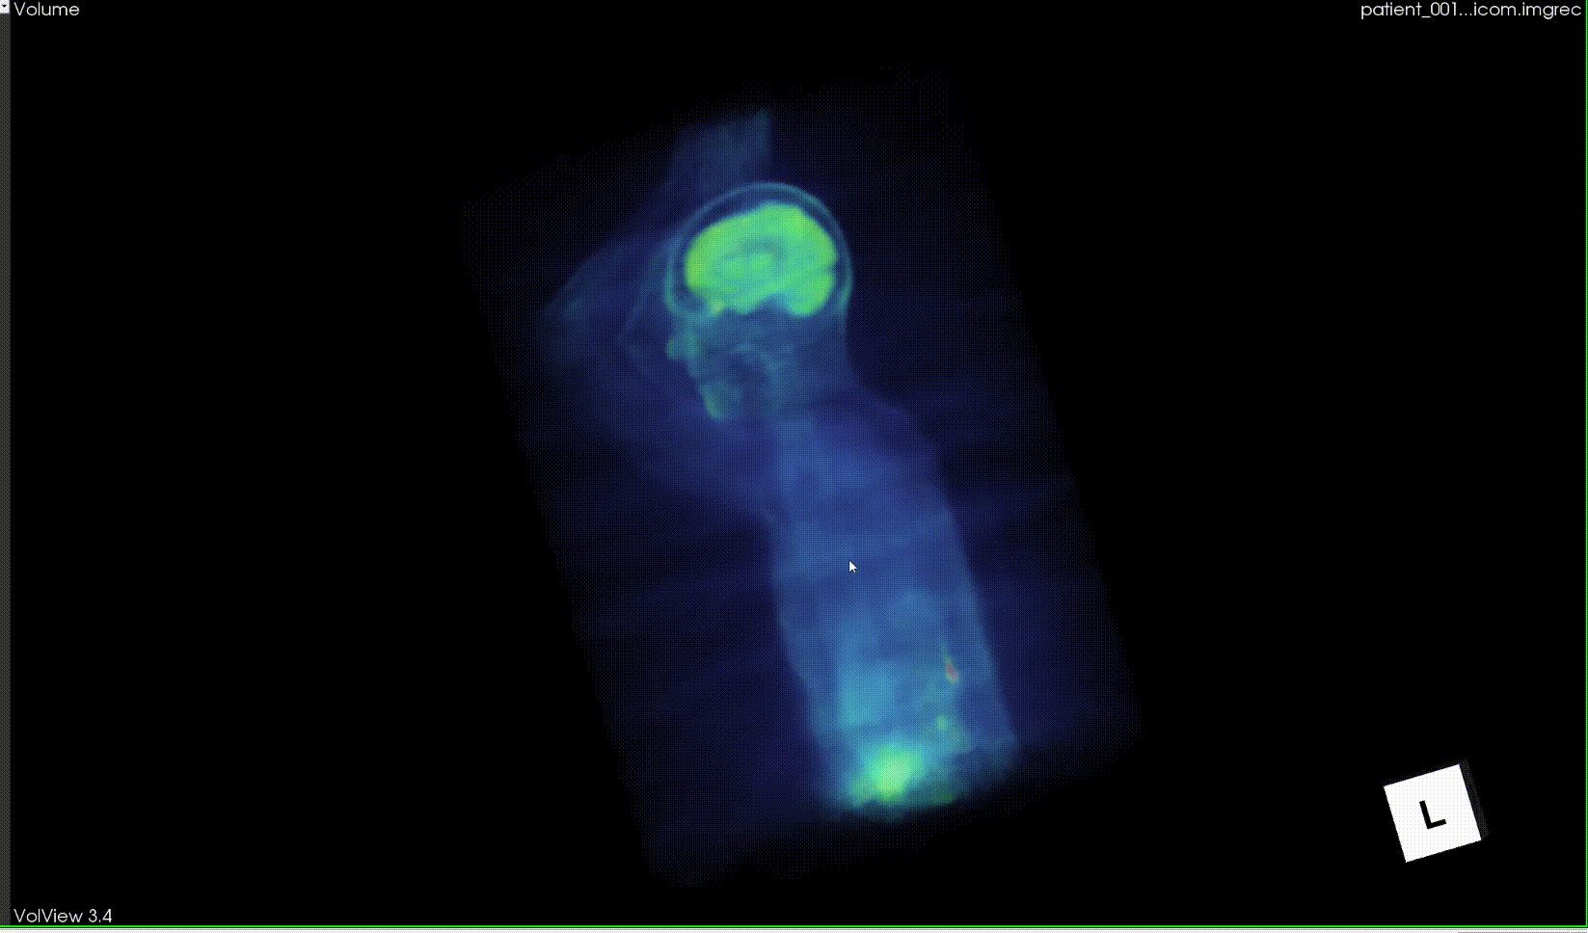
Patients
RESULTS IMAS Patient 01 – 14/03/2025
Activity 3.59 mCi (FDG)
Time acquisition 800s

Slide 19
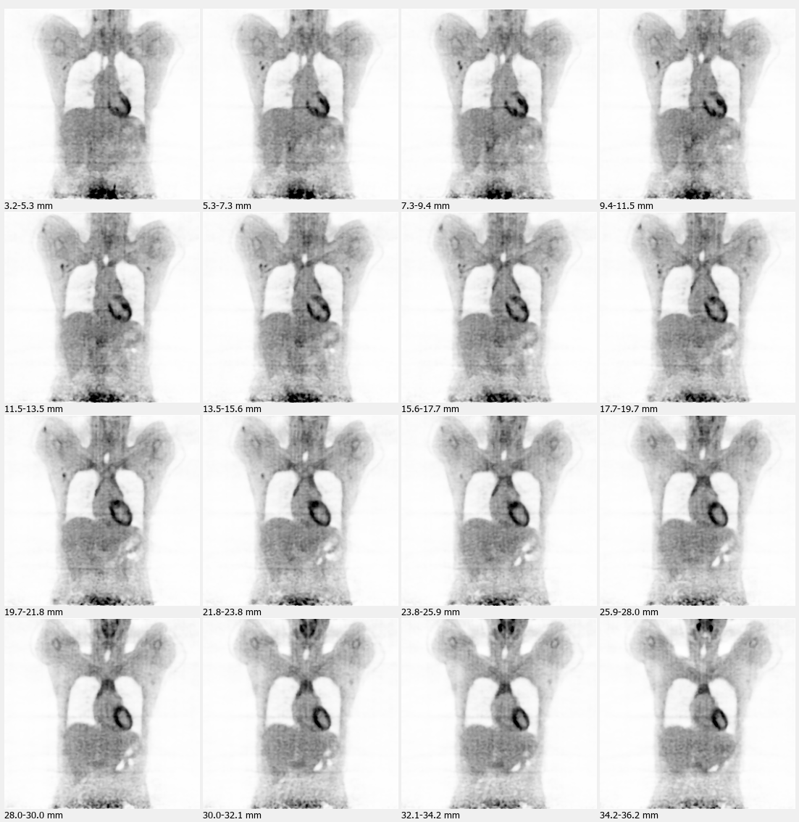
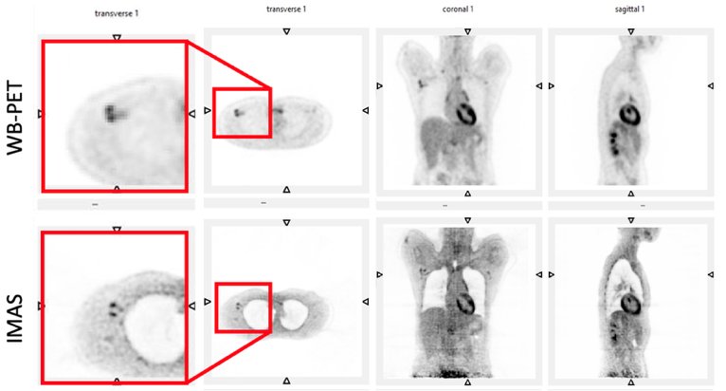
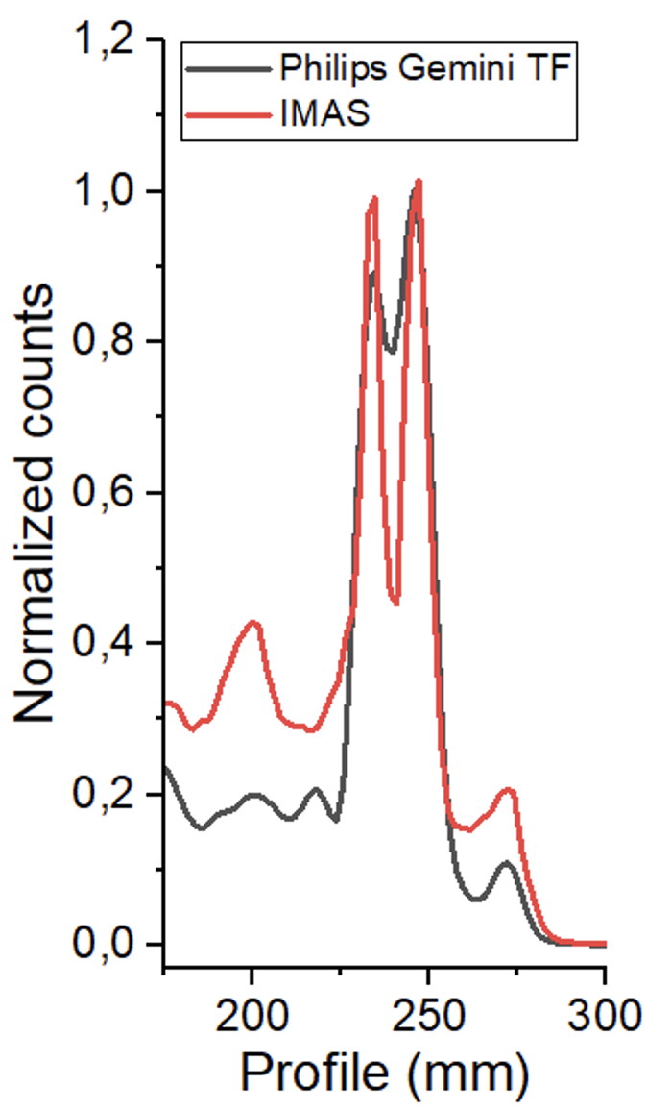
Patients
RESULTS IMAS Patient 02 – 03/04/2025
Activity 3.41 mCi (FDG)
Time acquisition 1200s

Slide 20
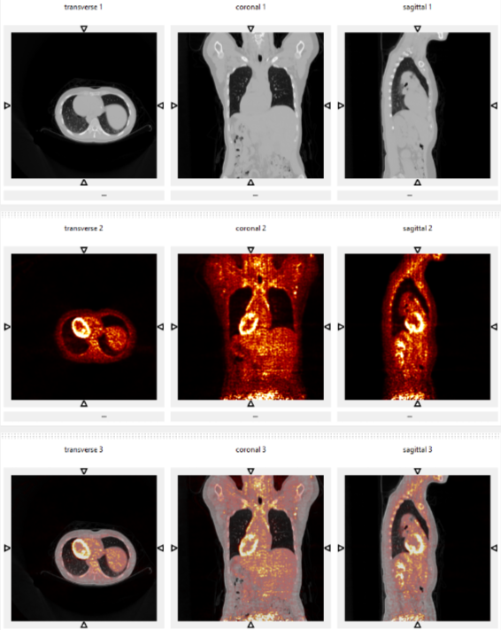
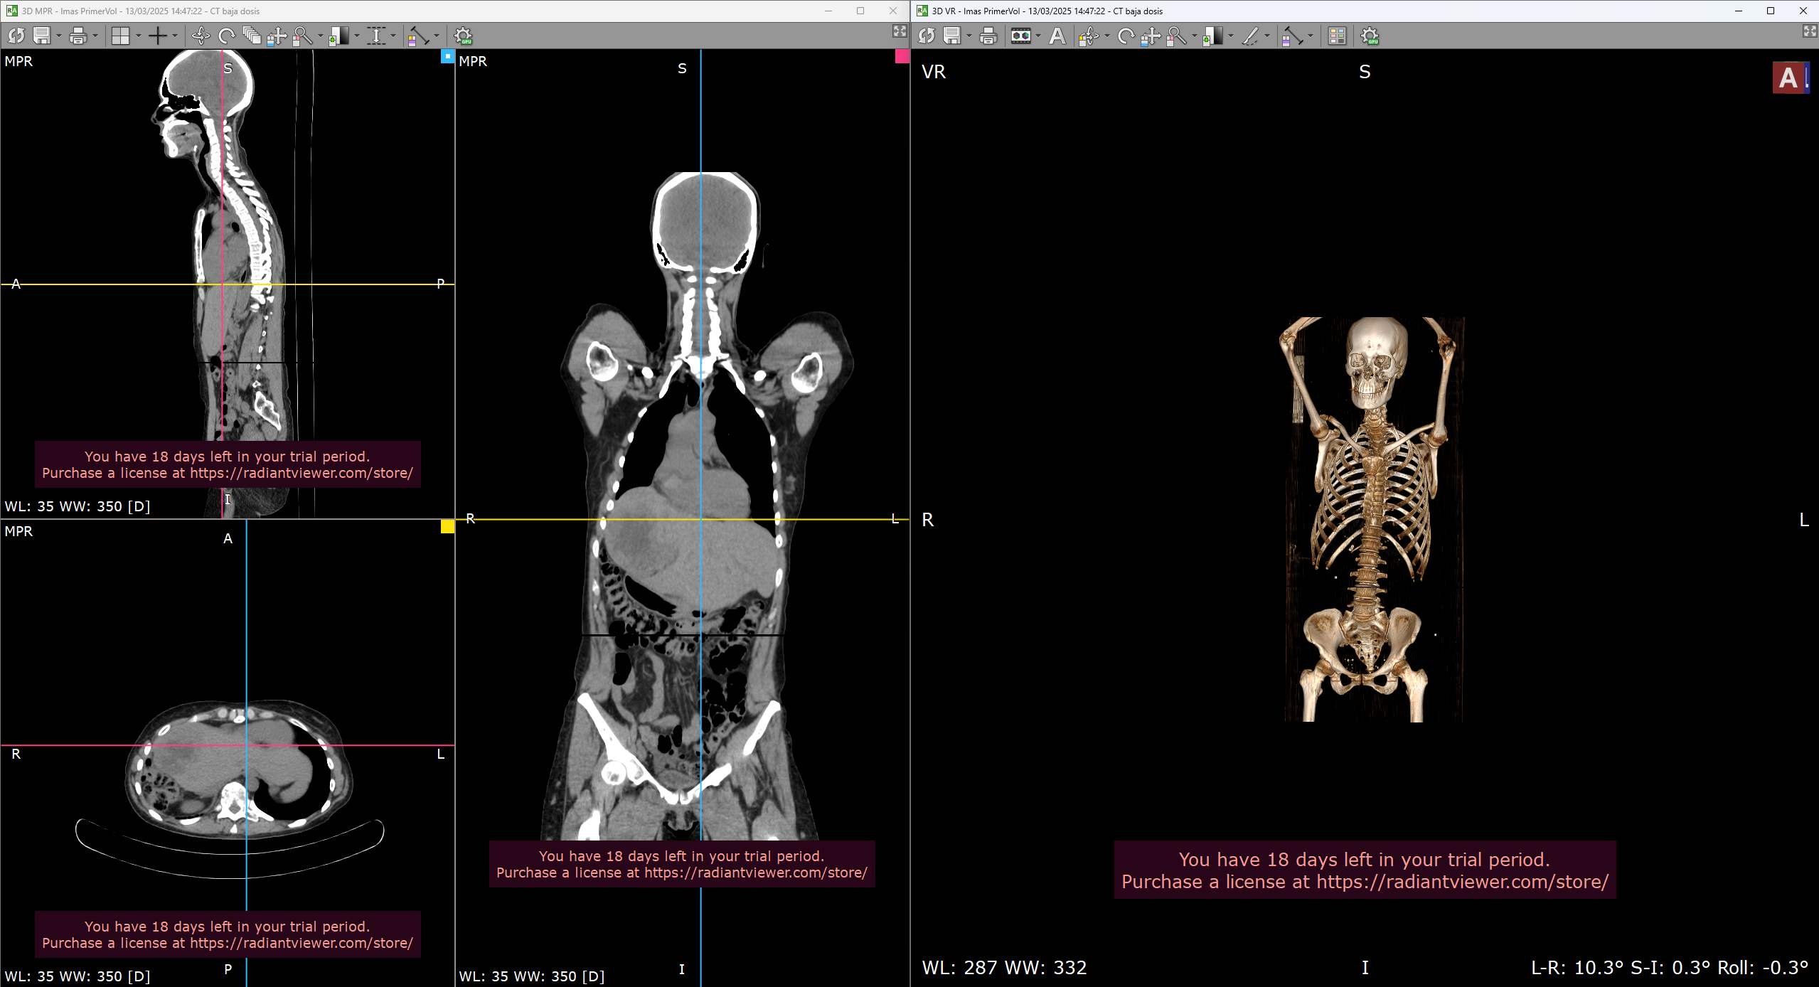
Patients: CT co-register
RESULTS IMAS Patient 02 – 03/04/2025
CT Philips -Radiant DICOM Viewer
CT Philips
PET IMAS
CT Philips + PET IMAS

Slide 21
Overview
Total Body PET: High Sensitivity Molecular Imaging (IMAS) project
Materials and Methods
System Performance
Conclusions and next steps

Slide 22
Conclusions
Spatial resolution along the center of FOV of scanner is around 3 mm with DOI correction, whereas without DOI correction it increases exponentially in the radial direction.
Sensitivity of the IMAS is around 56 kcps/MBq.
NECR performance is below expected, due to count rate limitations at the DAQ level and some limitations of the system design. The system currently loss counts at activity of 44 MBq.
Significant efforts are being made in collaboration with PETsys into data transmission bottle neck and rate capabilities of the system (a lot of events/s due to high sensitivity of the device).
First patient images acquired with IMAS system demonstrate excellent image quality and confirm the expected performance.
System | Axial FOV (cm) | Detector design | FWHM @20 cm (mm)
uExplorer¹ | 200 | Pixel | 4.7 (BP)
PennPET² | 140 (no gaps) | Pixel | 5.6 (OSEM)
Siemens Quadra³ | 106 | Pixel | 5.83 (BP)
IMAS | 70 (with gaps) | Semi-monolithic | 3.2 (MLEM)
¹Spencer, B. A., et al., Journal of Nuclear Medicine, 62(6), 861-870,
²Dai, Bing, et al., Physics in Medicine & Biology 68.9 (2023): 095007,
³Prenosil, George A., et al., Journal of nuclear medicine 63.3 (2022): 476-484
Nest steps
Apply TOF in reconstructions
More patients

Slide 23
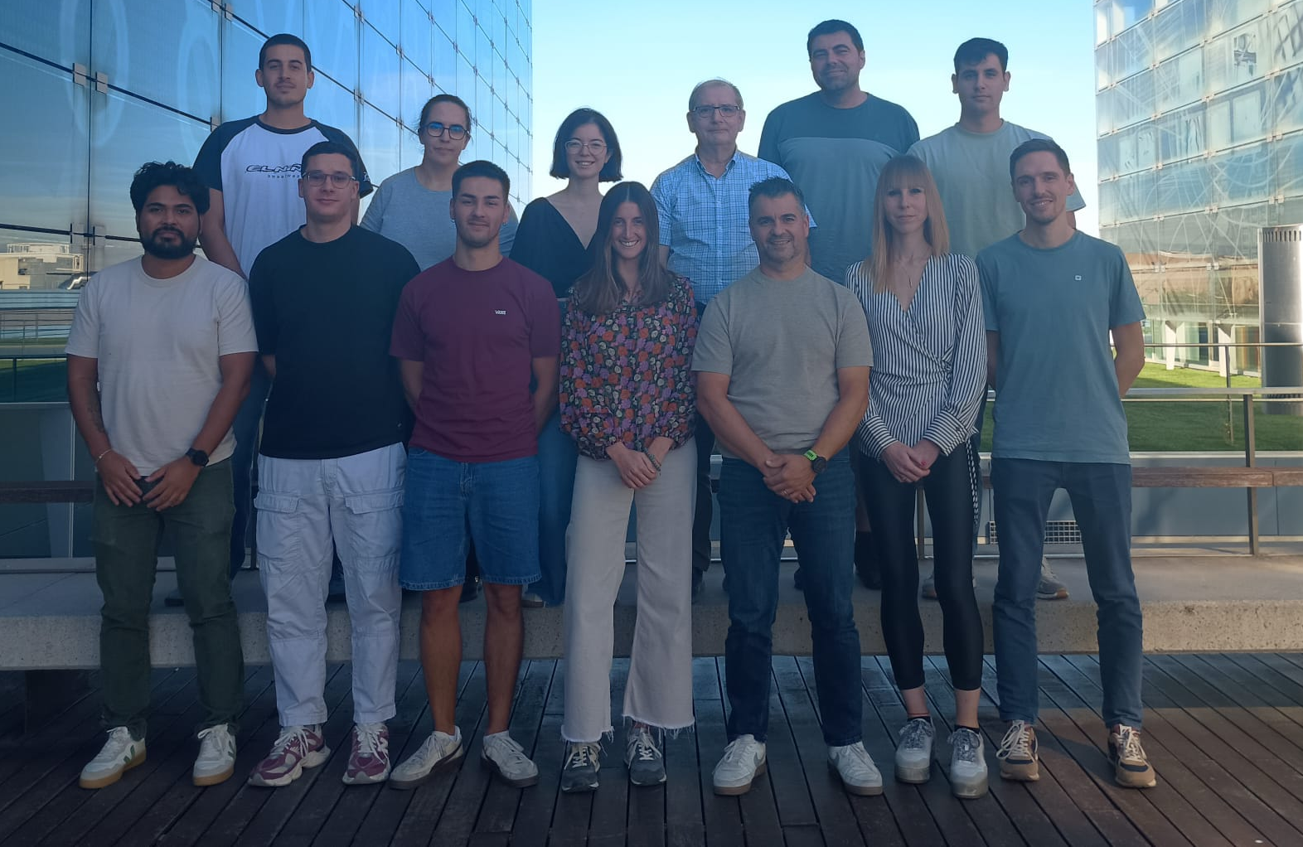
Thank you for attention!
Institute for Instrumentation in Molecular Imaging, i3M
contact: aanrval@i3m.upv.es

