Slide 1


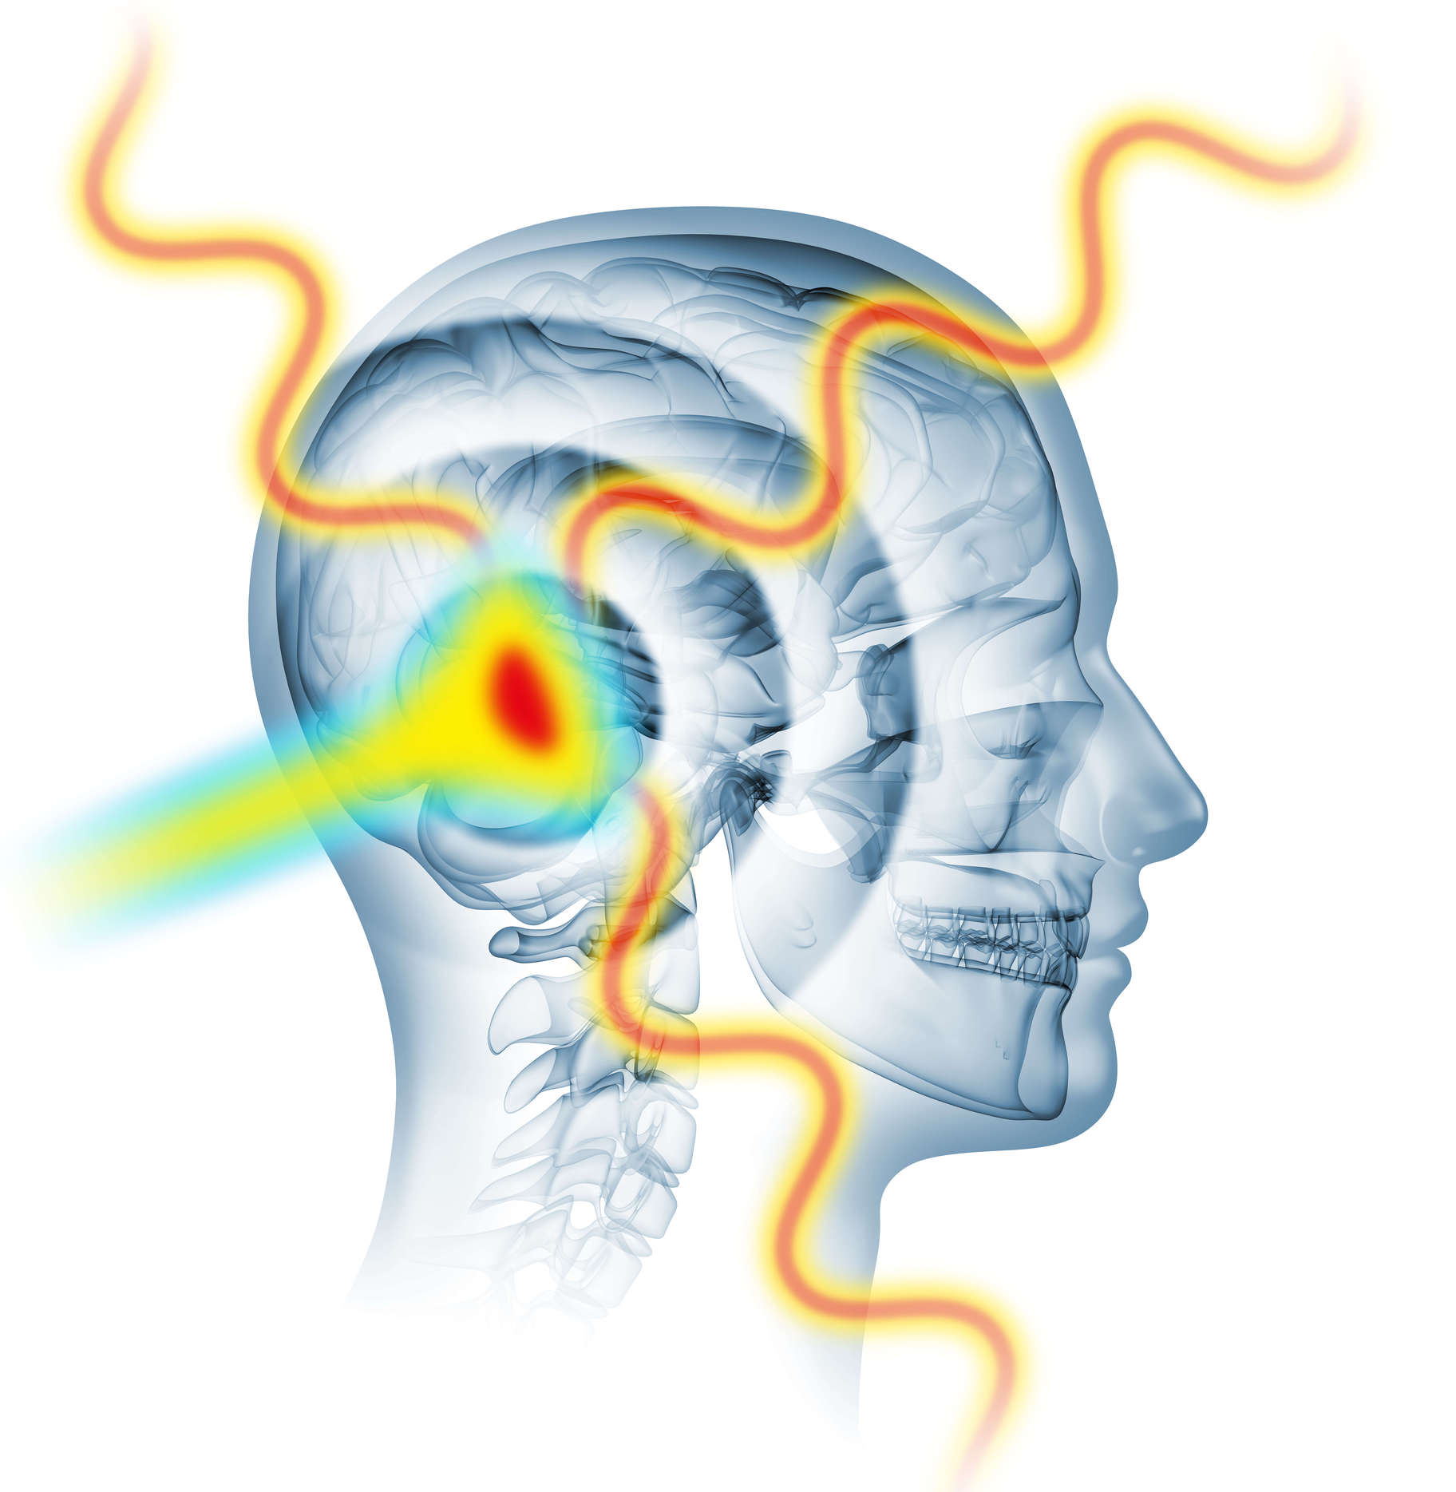
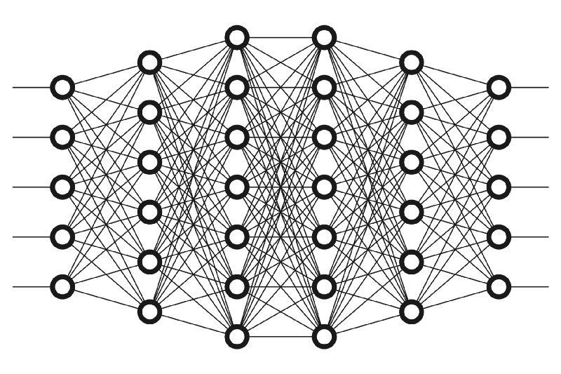
PROTOTWIN:
PET Imaging and AI to Improve Proton Therapy
Pablo Cabrales Miró-Granada (pcabrale@ucm.es)

Slide 2
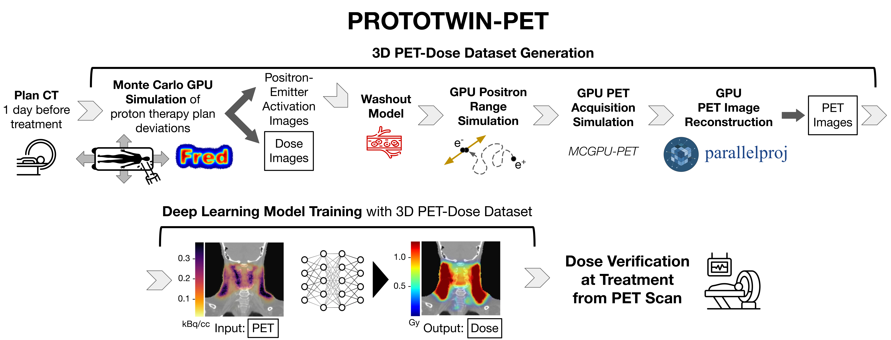
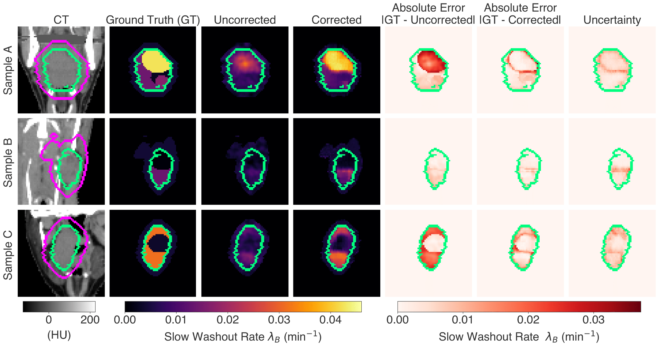
How can PET and AI improve proton therapy?
Providing clinicians crucial information to:
Part 1: Verify the treatment
Part 2: Adapt the treatment
Physical information (dose) from static PET
Biological information (tumor status) from dynamic PET
Washout
Rate
?
min⁻¹
Enabling more personalized and effective patient treatment
Why now?
Greater sensitivity (e.g. time-of-flight) and AI enhance PET
But let’s start with an introduction…
Notes:
With better PET (improved time-of-flight) and AI you can improve PET beyond what was possible; PET had been studied for proton therapy in the past but it is still not widely used

Slide 3
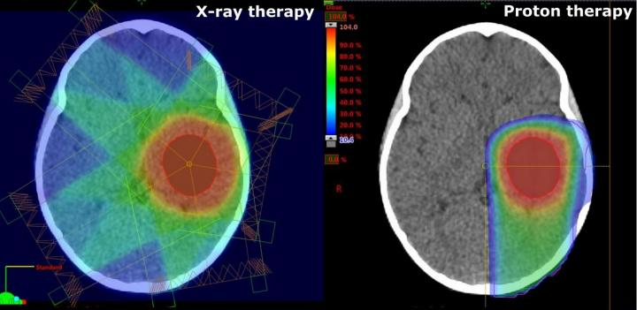
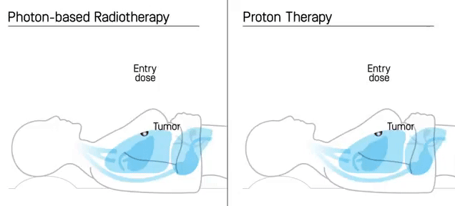
Proton therapy targets tumors more precisely than photon-based radiotherapy
Protons deliver most of their energy within the tumor (Bragg Peak🎯)
Photon-based radiotherapy
Proton therapy
X-rays
Credit: IBA
Notes:
Delivers most of their energy within the tumor, as opposed to photons, due to the interaction between protons and the patients bodies

Slide 4
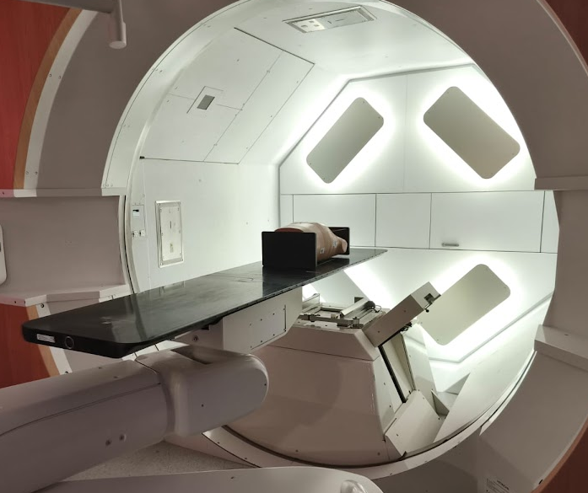
Proton therapy keeps improving and growing
Advances in treatment delivery, adaptation, optimization [Mohan, Prec. Radiat. Oncol., 2022]
Cumulative evidence: clinical trials for head-and-neck, brain, pediatric…
Proton facility at Clínica Universidad de Navarra
Source: ptcog.site
Notes:
- Proton therapy, has been growing in terms of numbers of patients treated (>500k) and number of clinical facilities
- Since the five year survival rate for cancer is at approximately 70%, a priority is minimizing secondary effect, e.g. cognitive decline in pediatric pediatric CNS patients or xerostomía in head and neck patients

Slide 5


Part 1 of 2:
PROTOTWIN-PET:
A Deep Learning and GPU-Based Workflow
for Dose Verification in Proton Therapy with PET
Pablo Cabrales^{1,2}, Víctor V. Onecha³, David G. Izquierdo³, José Manuel Udías^{1,2},
Luis Mario Fraile^{1,2}, and Joaquín L. Herraiz^{1,2}
(1) (2) (3) (4)
📜 Published in IEEE TRPMS (2025)

Slide 6
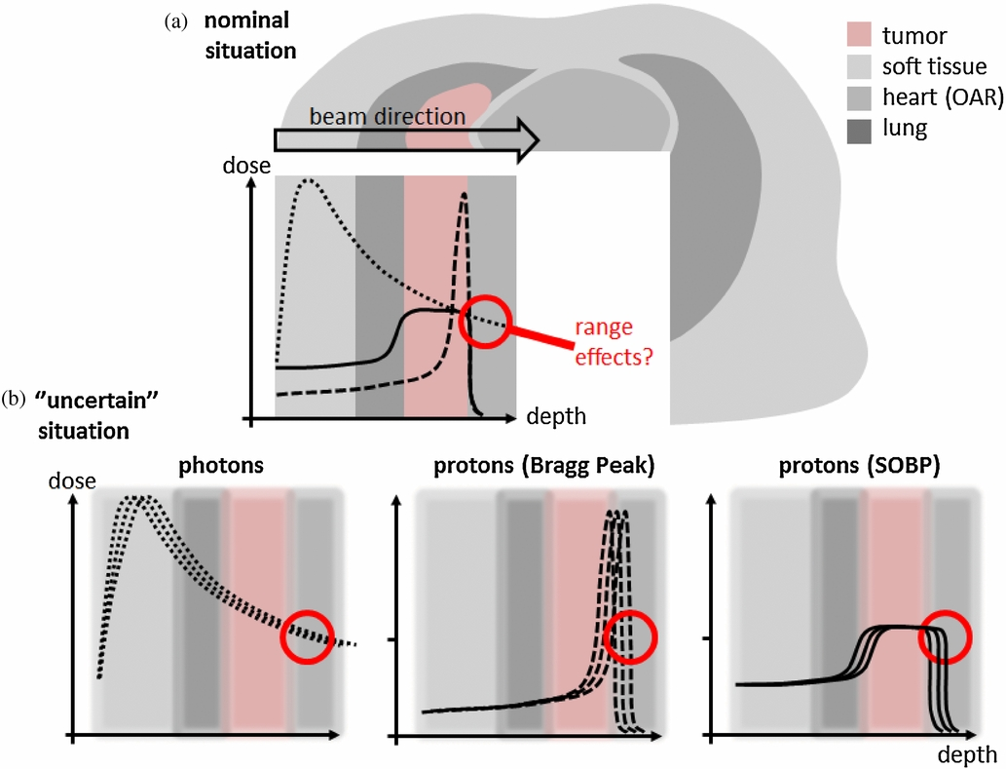
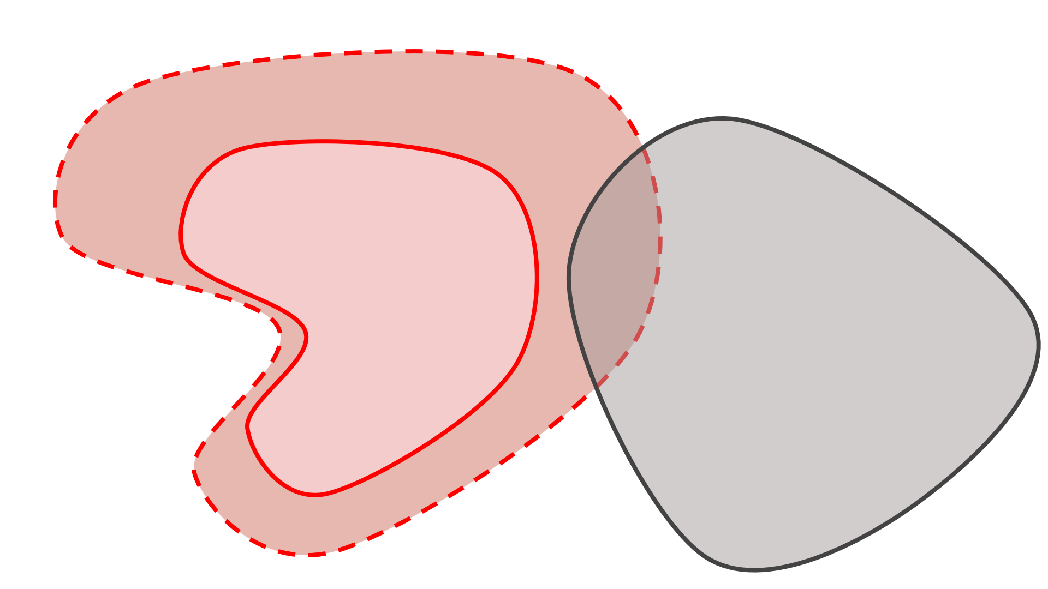

Treatment uncertainties limit proton advantage
Protons can be very precise, but the real world is messy: treatments are sensitive to uncertainties
Patient setup
Organ motion
Tissue properties
Dose
Photons
Dose
Protons
Tumor
Tumor
Organ-at-risk
Organ-at-risk
Adapted from:
Knopf, Lomax,
Phys. Med. Biol.,
2013
Irradiation margins
Irradiation margins are introduced to ensure tumor coverage, damaging organs-at-risk
Tumor
Organ-at-risk
Notes:
- treatment are very sensitive to uncertainties due to the highly localized dose delivery make the
Margins are introduced in the planning target volumen to ensure that there is no cancer recurrence

Slide 7
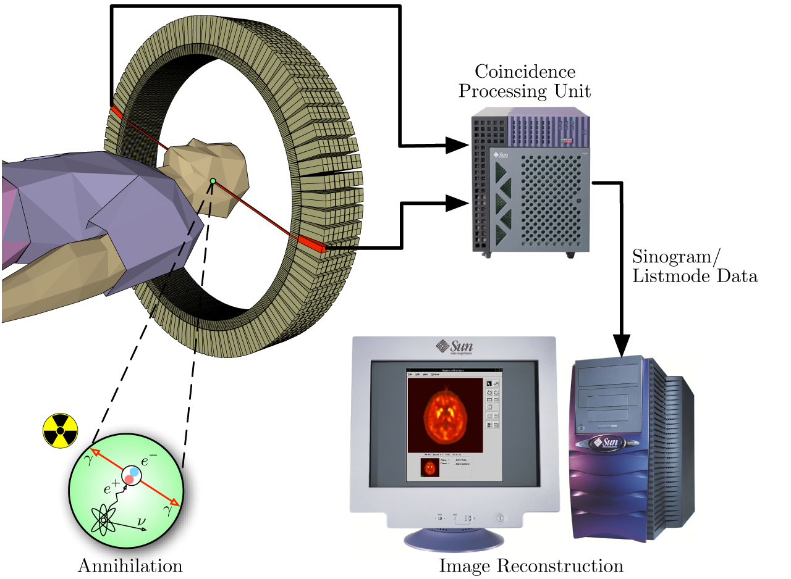
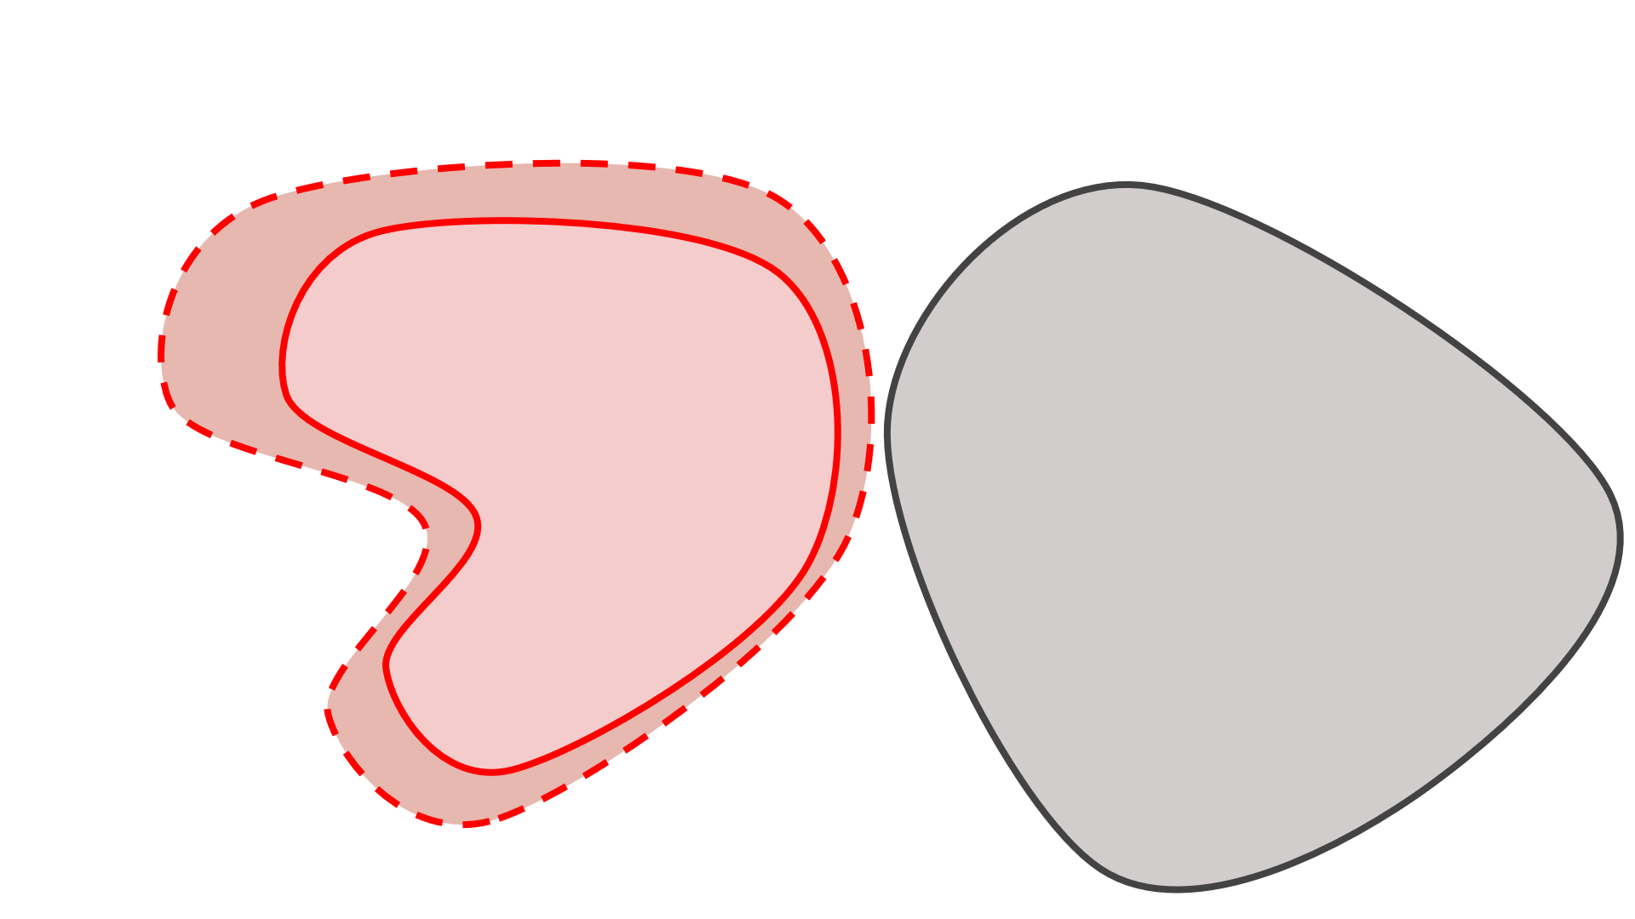

Treatment verification can improve efficacy
How can we know if we have hit (or missed)
the target? Treatment verification
γ
Secondary emissions like acoustic waves, prompt gamma photons, positron-emitting isotopes ¹¹C, ¹³N, ³⁸K → Positron Emission Tomography (PET)
p⁺
γ
Credit: LMU and Jens Maus
Irradiation margins
Detecting deviations enables adaptation and reducing margins
Tumor
Organ-at-risk
Notes:
Since protons stop inside the patient, dose delivery verification relis on secondary emissions
Positron Emission Tomography has been studied the most and the approach I consider in my work
We need to know where the radiation, which is usually called radiation dose, or dose is delivered to know if treatment has gone as planned or if we have damaged healthy tissue and underdosed the tumor. Since radiation therapy treatments are spaced across around 30 sessions, dose delivery errors in one session can be corrected in following sessions

Slide 8
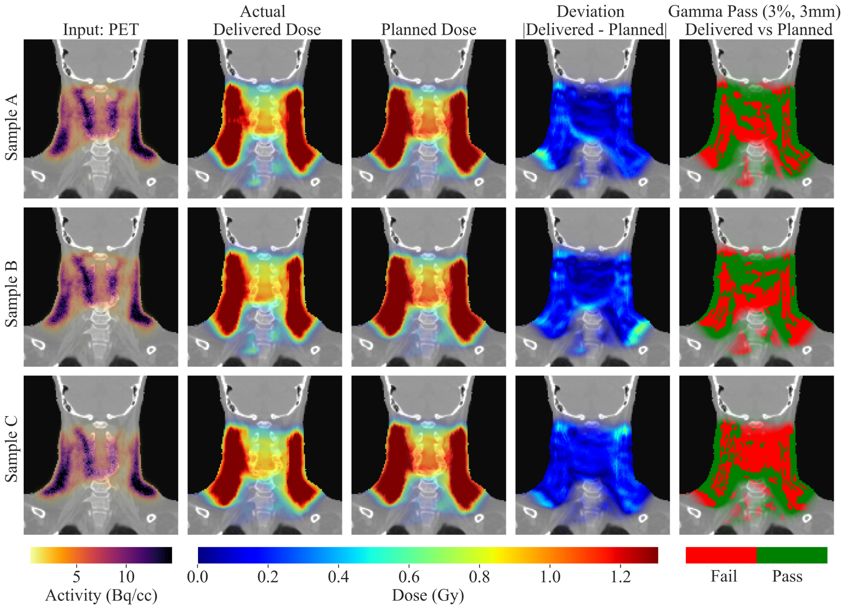
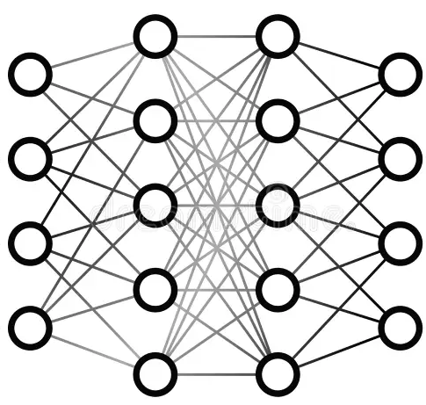
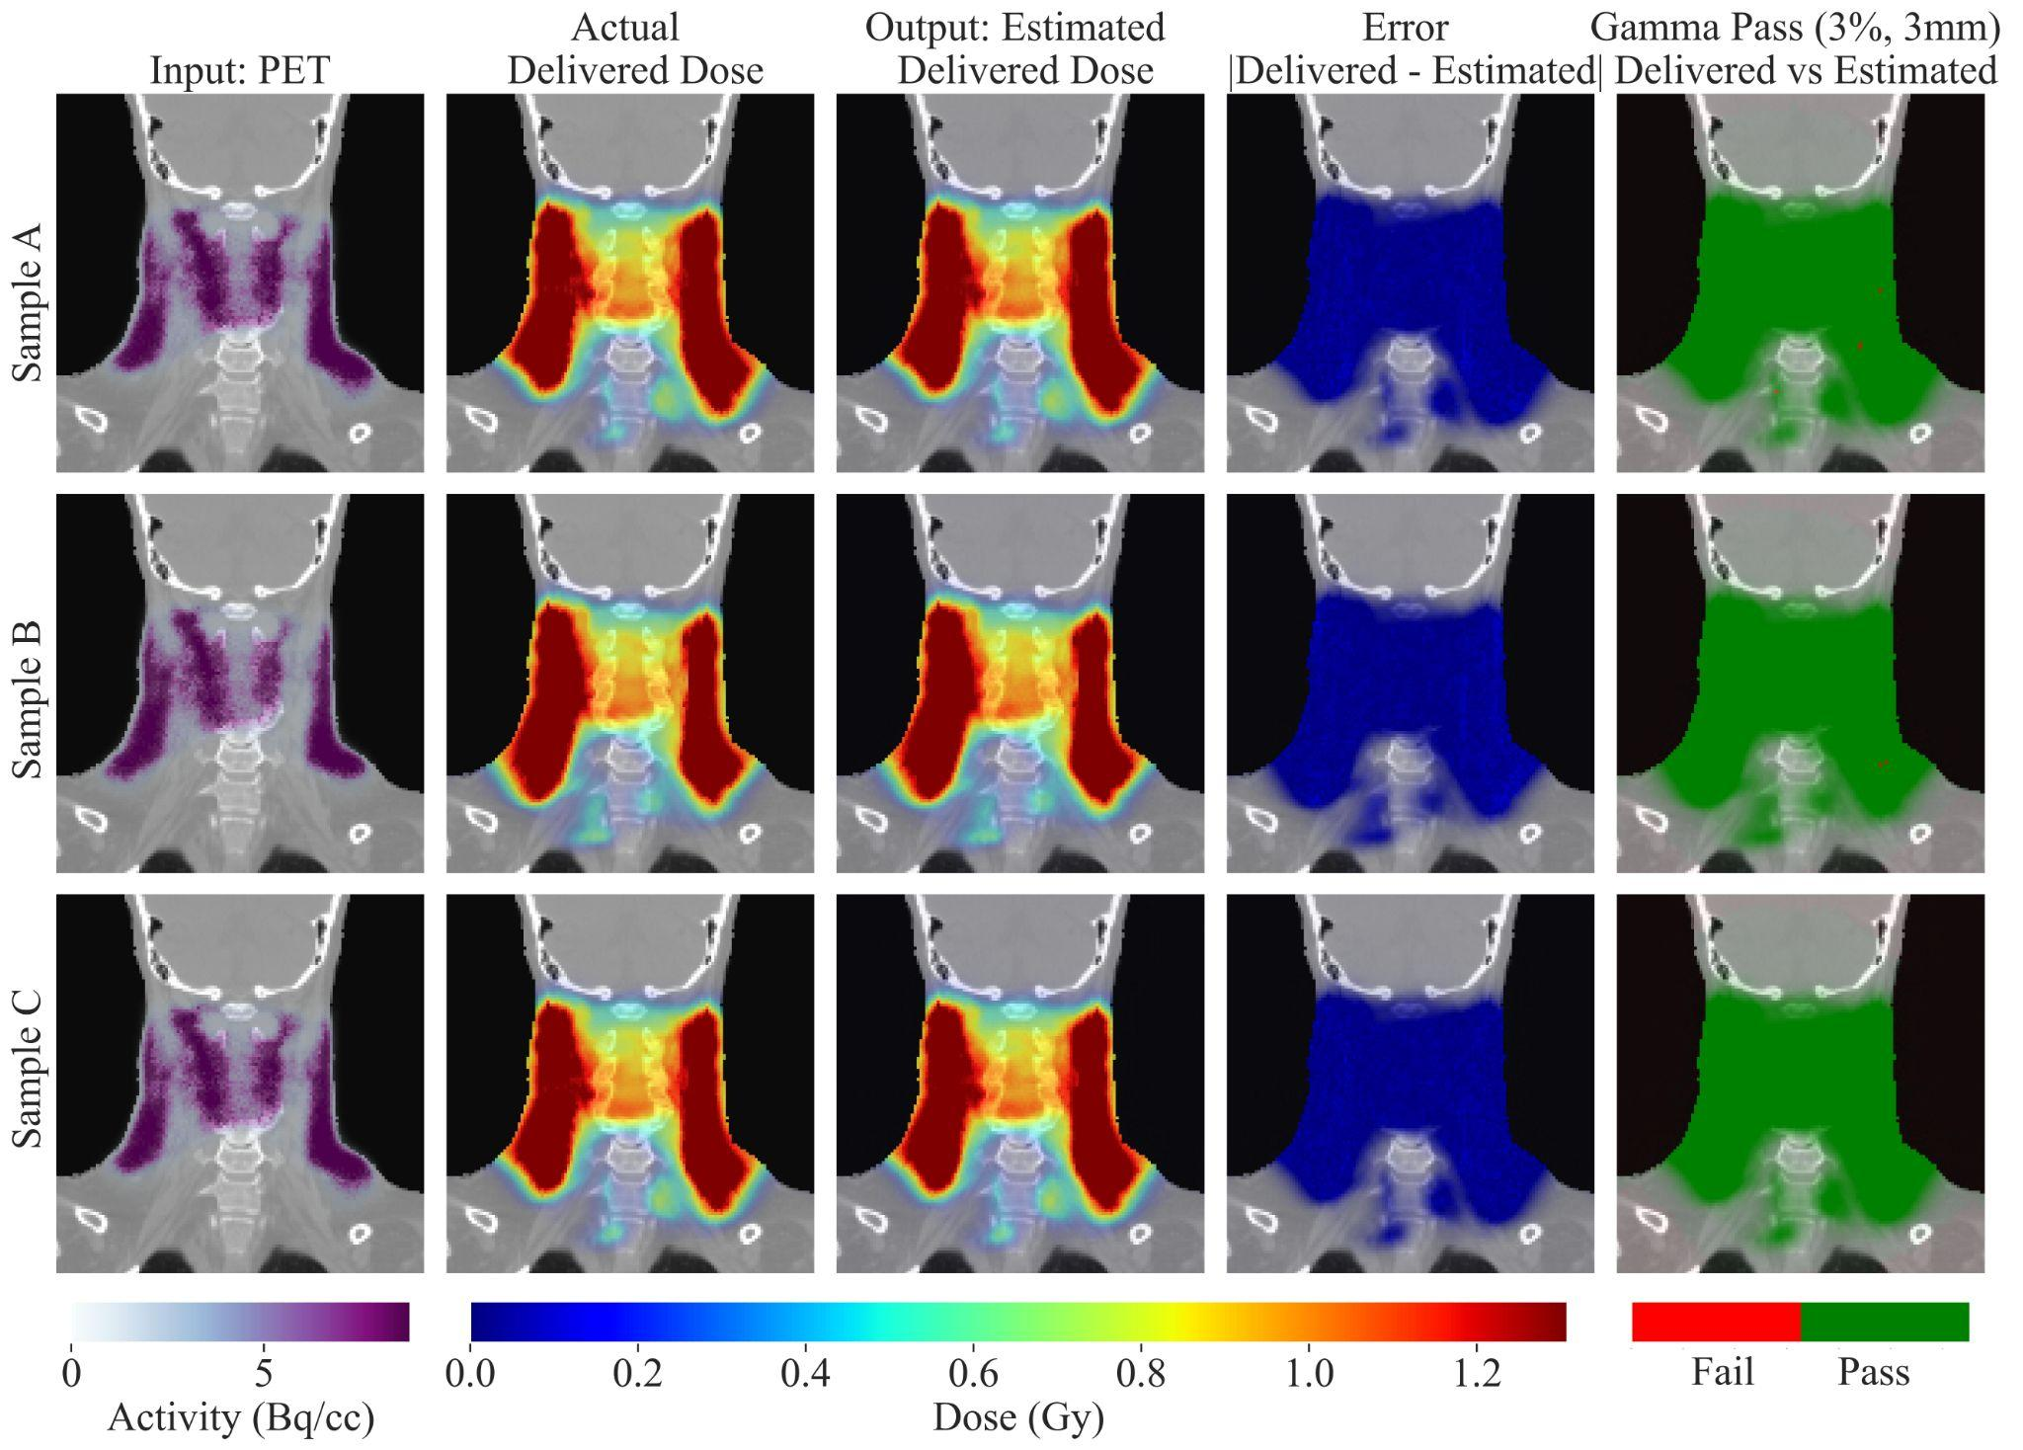


PET-based verification requires fast and accurate end-to-end workflows
Produced Positron Emitters
Deep Learning (DL)
Estimated Radiation Dose
Protons
PET
kBq/cc
Gy
Challenging! Different processes, noisy PET images (low counts, washout)
Current DL approaches [Peng et al., IEEE TRPMS 2023]:
Unrealistic training data (missing PET simulation, clinical uncertainties) and CPU-based tools (slow)
Lack end-to-end workflows
Notes:
We can compare obtained and expected PET distributions, but it is not as insightful
the conversion from PET to dose is not straightforward because, while dose depositions are related to interactions between protons and the atomic electrons, destroying the cell dna, PET activations correspond to nuclear interactions, and thus take place at different energies and are not directly correlated. unrealistic datasets do not consider effects that will appear in the clinical practice and that our model needs to be shown in training so that it can work in the clinical practice
Made key advancements

Slide 9


Proposed Workflow for Improved Verification
github.com/pcabrales/prototwin-pet
doi.org/10.1109/TRPMS.2025.3531536
Notes:
Treatment deviations reflect how treatment might go wrong

Slide 10
Proposed Workflow for Improved Verification
github.com/pcabrales/prototwin-pet
doi.org/10.1109/TRPMS.2025.3531536
Notes:
Treatment deviations reflect how treatment might go wrong

Slide 11
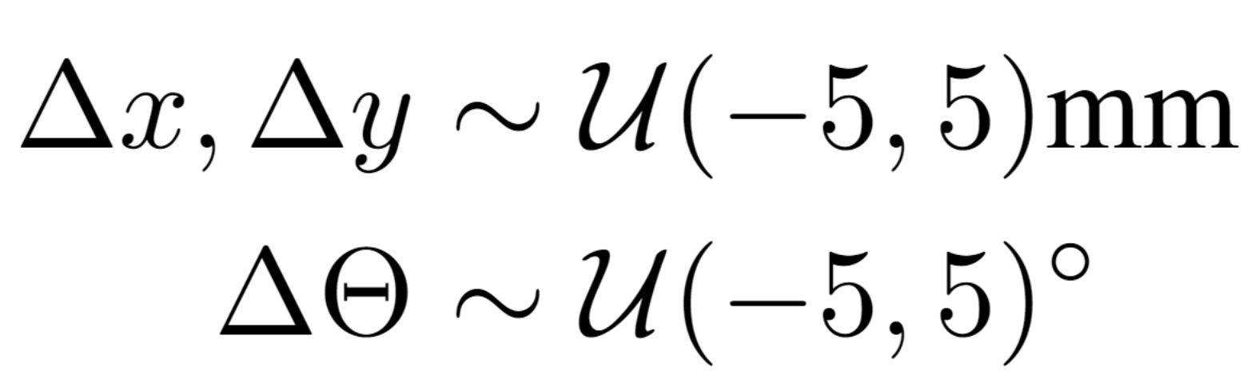
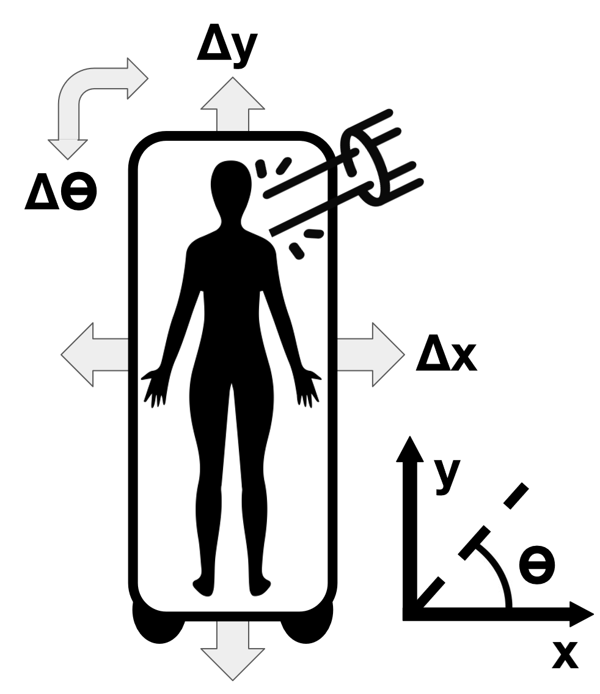
Realistic dataset is generated for training
Each 3D PET-Dose pair reflects a realistic treatment deviation
Patient setup
Physical parameters (tissue density and ionization energy, up to 10%)
Model training with >100 PET-dose pairs
Details at github.com/pcabrales/prototwin-pet
Notes:
Displacements in the directions parallel to the couch

Slide 12
Proposed Workflow for Improved Dose Verification
github.com/pcabrales/prototwin-pet
doi.org/10.1109/TRPMS.2025.3531536

Slide 13
Proposed Workflow for Improved Dose Verification
github.com/pcabrales/prototwin-pet
doi.org/10.1109/TRPMS.2025.3531536

Slide 14
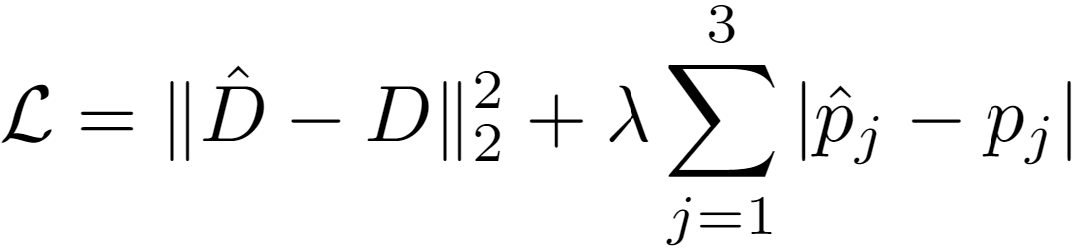
Model is trained to simultaneously estimate dose and setup errors from the PET image
Notes:
CT is provided for anatomical context Unet-like models extract high and low level features; attention captures relationships between distant parts of the image
Extra:
DPB starts at penultimate encoder layer because the spatial representation was potentially overly compressed at the bottleneck and information was lost before that
Lambda is a hyperparameter that was tuned experimentally

Slide 15


Proposed Workflow for Improved Dose Verification
Dose Verification from PET Scan
Enables online
and offline
github.com/pcabrales/prototwin-pet
doi.org/10.1109/TRPMS.2025.3531536
Notes:
For anyone that want to take a look at it and maybe try it out

Slide 16
Workflow is validated in silico
150 training PET-Dose pairs for oropharyngeal cancer patient (2.2 Gy, 2 fields)
Generated in < 20 hours, model trained in 3 hours (RTX 4080 GPU)
Offline verification: 10 minutes post-irradiation,
30-minute Siemens Biograph Vision PET scan
Input: PET and CT
Output: Dose
kBq/cc
Gy
Notes:
Let’s see how this would work for a patient: they have a tumor …, the treatment might have gone wrong due to unexpected patient motion
Offline only requires a convenional PET

Slide 17
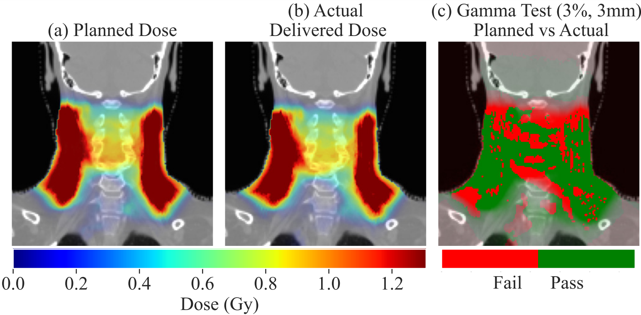
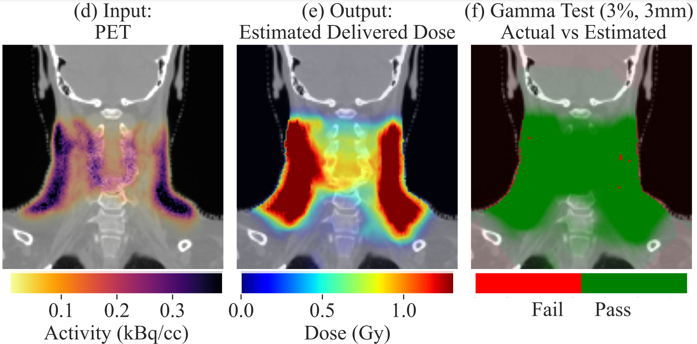

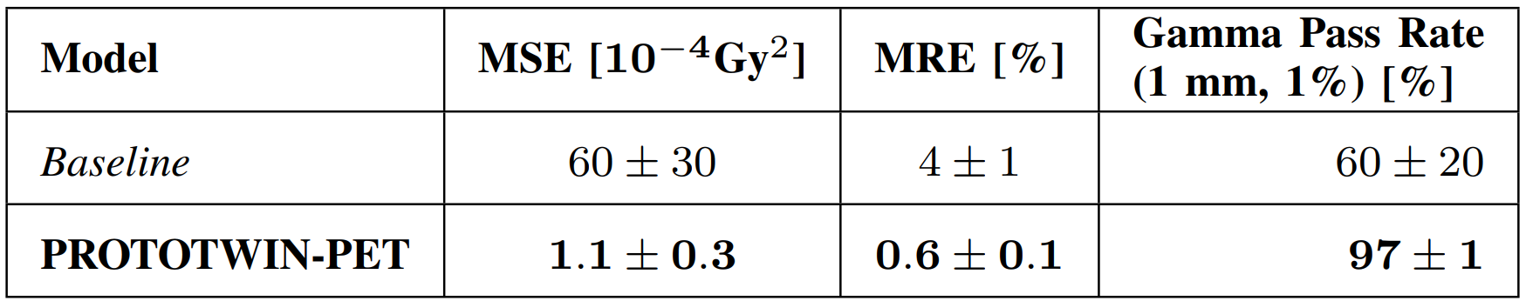
Trained model accurately estimates delivered dose for clinically significant deviations
Test Case
PROTO-
TWIN-
PET
30 ms
Reference: Planned vs Actual
Actual vs Estimated
Previous works: ~1.5
PROTO-
TWIN-
PET
[Ma et al., Med. Phys. (2020),
Rahman et al., Phys. Med. Biol. (2022)]
Notes:
It’s a test sample
- en diferentes métricas mejora bastante respecto al caso en que no se estima la deposicion de dosis y se considera que es igual a la planeada
Without prototwin-pet, we would not be aware of the difference between the planned and actual delivered dose; with it, we can correct it in following sessions

Slide 18
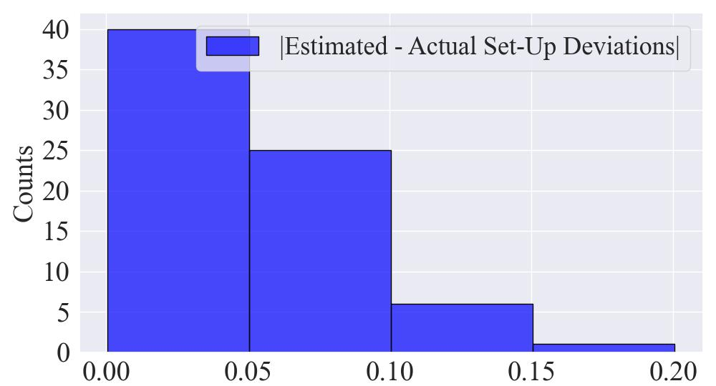
Trained model detects setup errors with submillimetric accuracy (in silico)
Across 50 test cases (MRE < 2%):
|Δx_{estimated} - Δx_{actual}| = 0.04 ± 0.07 mm
|Δy_{estimated} - Δy_{actual}| = 0.03 ± 0.05 mm
|Δθ_{estimated} - Δθ_{actual}| = 0.05 ± 0.07 º
Setup Deviation Error (º or mm)
Notes:
Submillimetric precision in silico, in our simulation, in reality we would have to see how accurate we can be

Slide 19
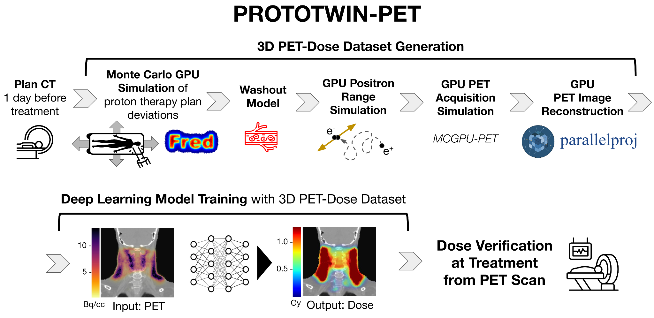

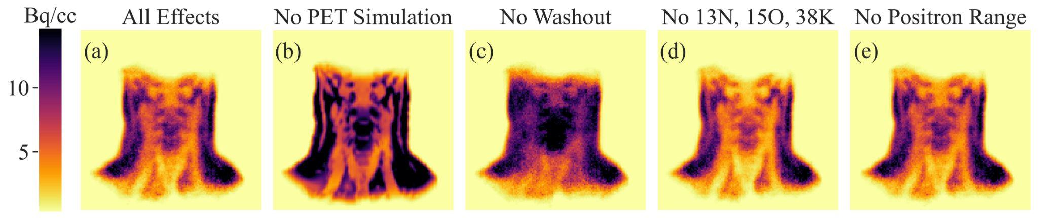
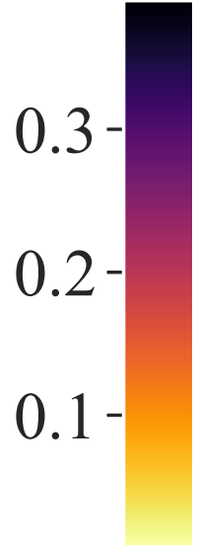
Ablation Study: How does training models with unrealistic PET inputs impact performance?
Notes:
One may wonder: this workflow is complicated, but how necessary is including the steps to make the PET image realistic

Slide 20
Ablation Study: How does training models with unrealistic PET inputs impact performance?
Gaussian blurring
instead

Slide 21
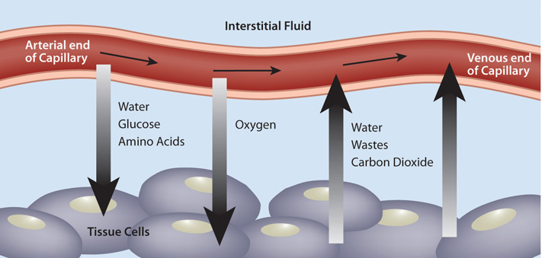
Ablation Study: How does training models with unrealistic PET inputs impact performance?
Capillary
Blood Cells
C¹¹

Slide 22
Ablation Study: How does training models with unrealistic PET inputs impact performance?

Slide 23
Ablation Study: How does training models with unrealistic PET inputs impact performance?

Slide 24
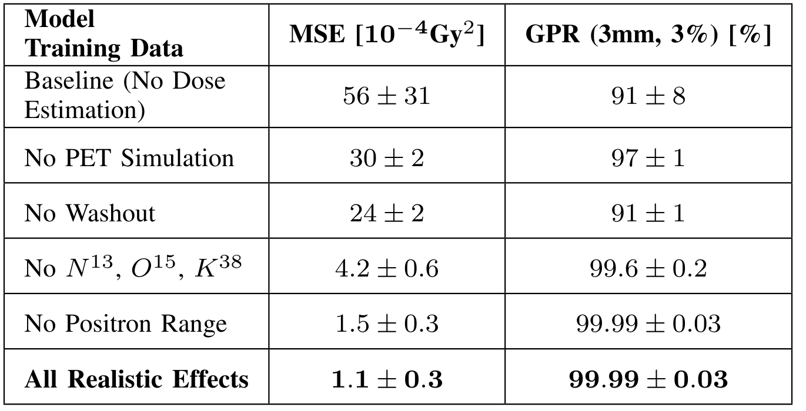
Ablation Study: training models with unrealistic PET inputs significantly degrades performance
PET simulation and washout are critical for reliable dose estimation
Notes:
The performance downgrade is most significant for models trained without the realistic PET acquisition simulation and washout effects. In contrast, the impact is less severe when only 11C activations are considered and the positron range is omitted. This outcome is expected since positrons emitted from activated isotopes have relatively low energies, and 11C is the most uniformly and abundantly contributing isotope

Slide 25
Conclusions: PROTOTWIN-PET accurately verifies dose delivery in milliseconds
Potential to shrink margins and minimize healthy tissue damage
Limitations: uncertainty remains in interaction cross-sections, PET-CT registration, or biological washout parameters
Validation in real scenarios is essential: Clínica Universidad de Navarra (CUN) and Massachusetts General Hospital (MGH) …

Slide 26

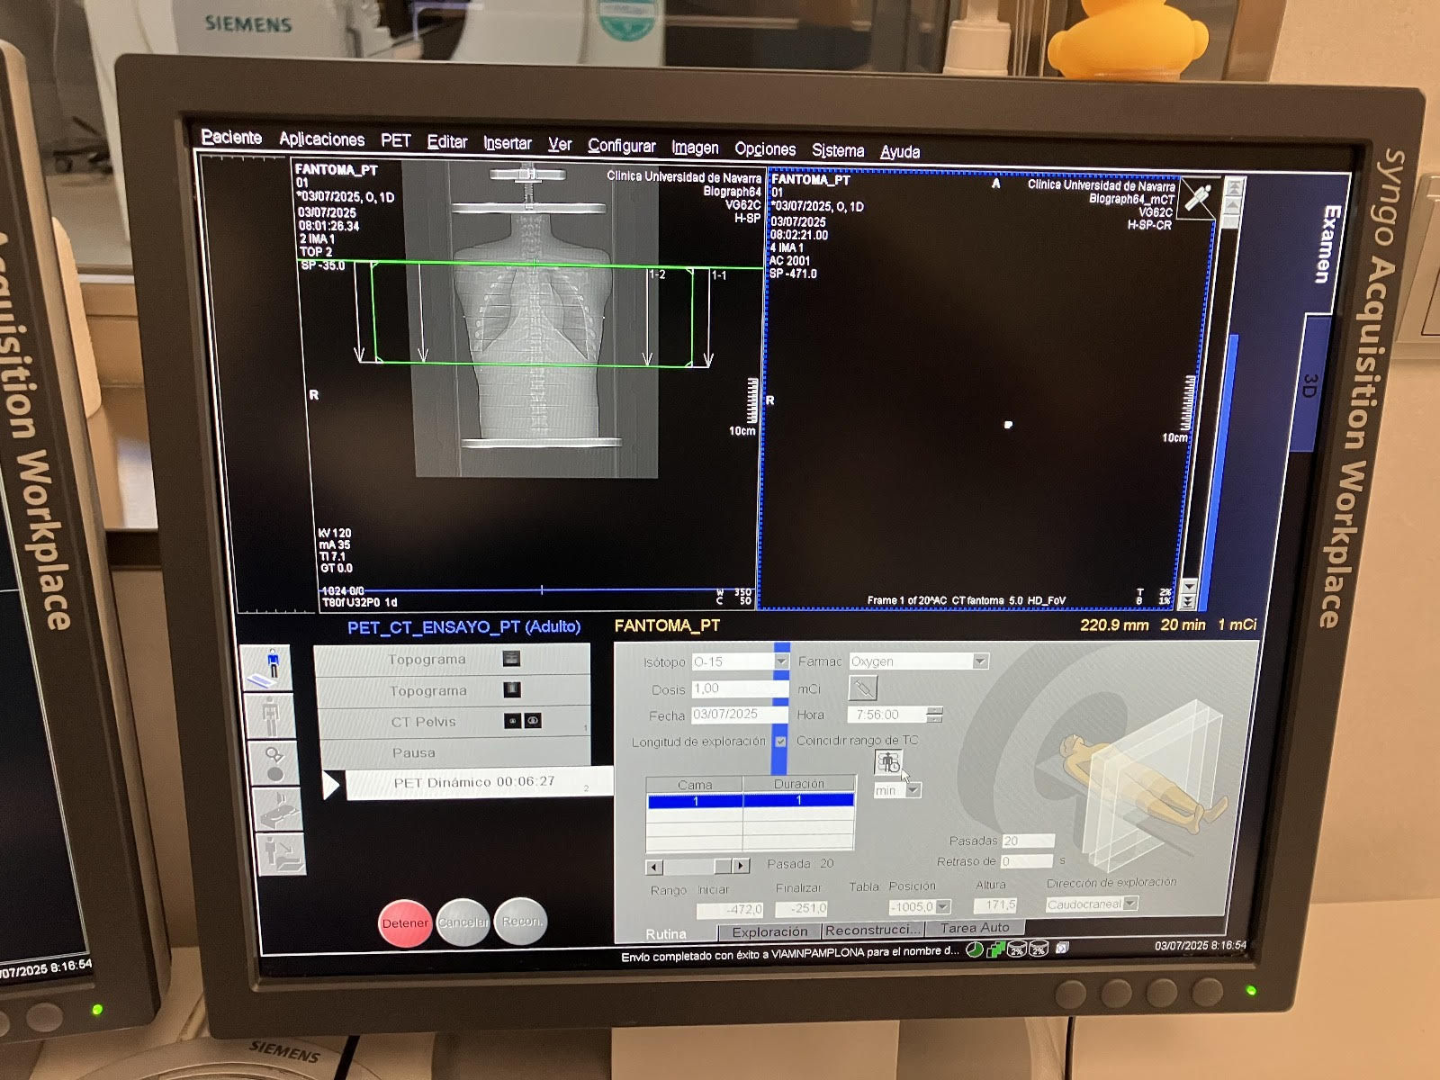
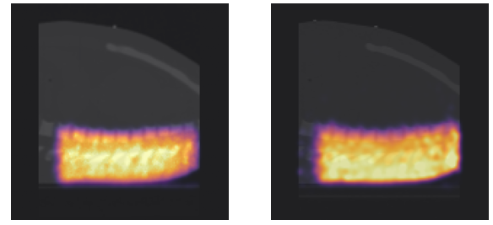
Experiments at CUN aim to validate simulations and AI models
July 2025
Simulated PET
Real PET
Proton
Therapy
PET
Activity (A.U.)
Thanks to Dr. Diego Azcona, Dr. Ana García Sanz, Dr. Edgar Guillén, Lucía Meijón

Slide 27

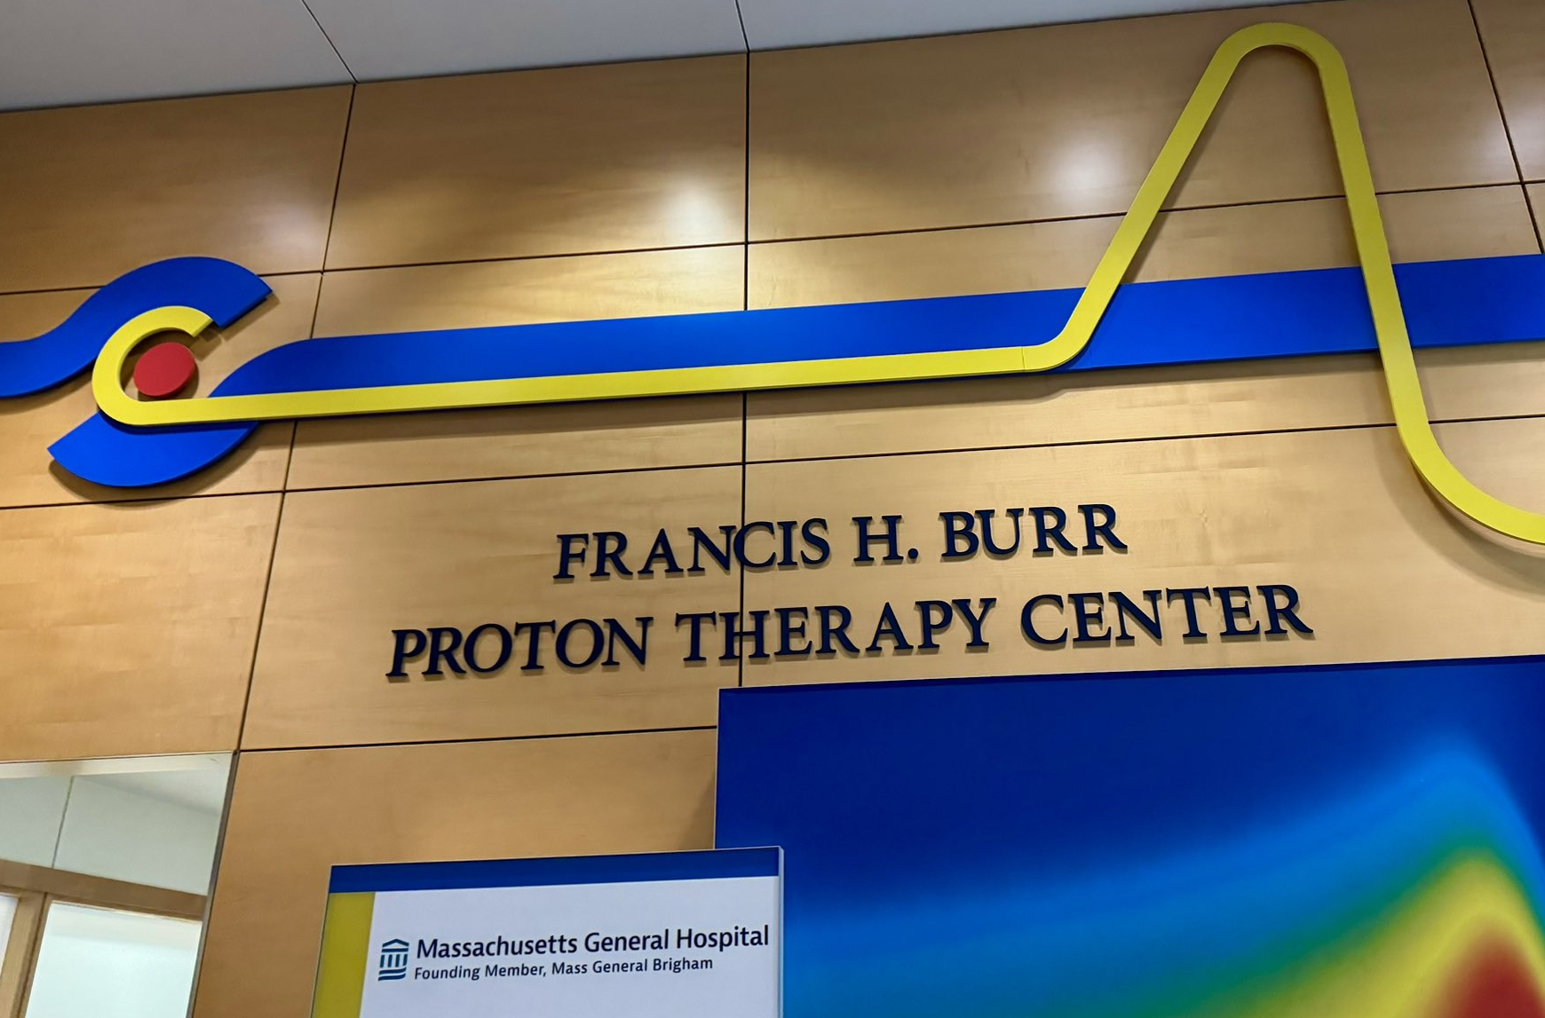
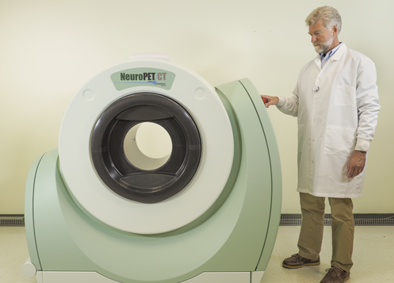
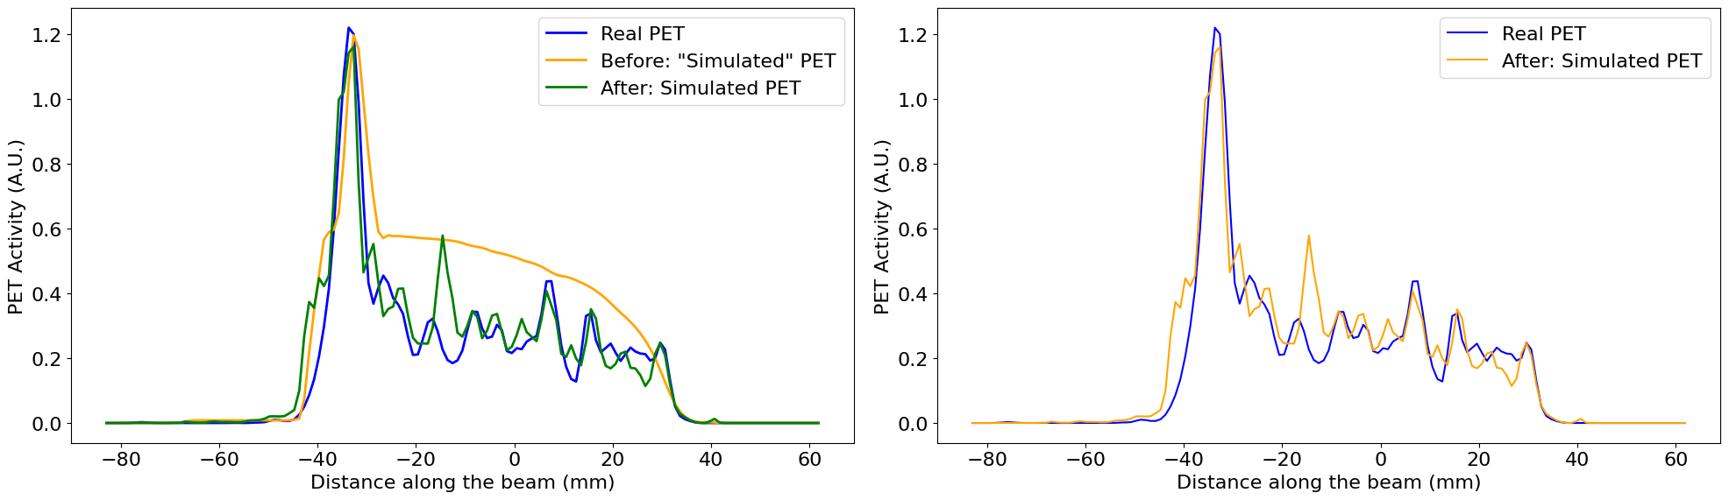
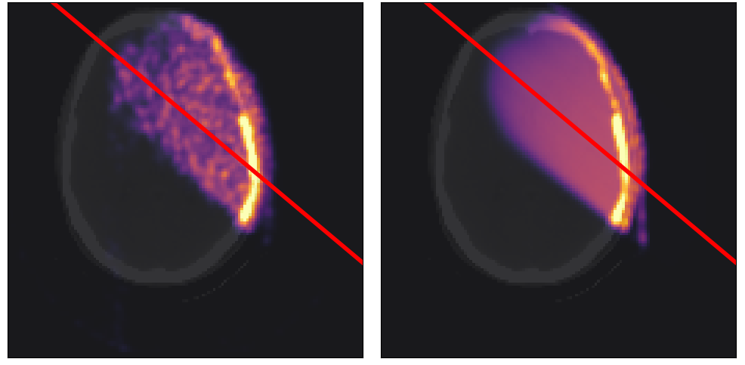
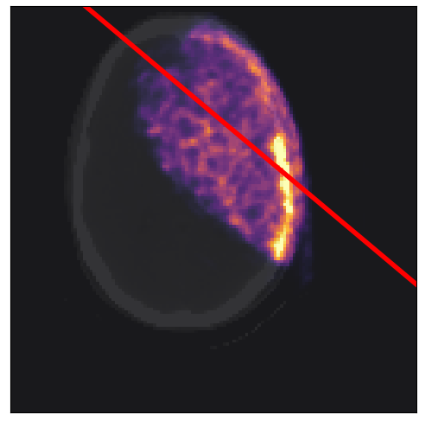
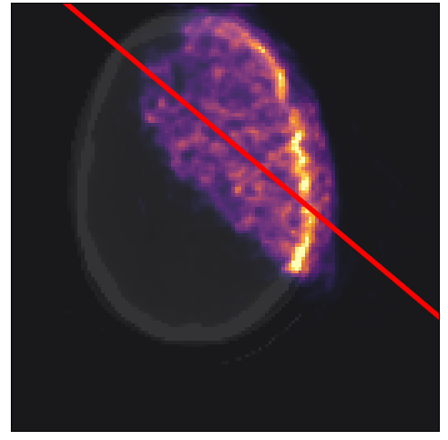
Analysis of MGH data reveals the importance of PET simulation
>70 post-proton therapy PET scans (2014 to 2020)
Real PET
Before: “Simulated” PET
After: Simulated PET
* Red line = beam direction
Thanks to Dr. Helen A. Shih, Dr. Kira Grogg, Dr. Xuping Zhu
Notes:
_{Data infrautilized}
_{Massachusetts general hospital}

Slide 28
Part 2 of 2:
Mapping Intratumoral Heterogeneity Through
PET-Derived Washout After Proton Therapy
Pablo Cabrales^{1,2}, David G. Izquierdo³, Víctor V. Onecha³, Mailyn Pérez-Liva,
José Manuel Udías^{1,2}, Luis Mario Fraile^{1,2}, and Joaquín L. Herraiz^{1,2}
(1) (2) (3) (4)
📜 Preprint in arXiv (2025)
Notes:
Can we get any more information: Dynamic PET to extract biological insight

Slide 29
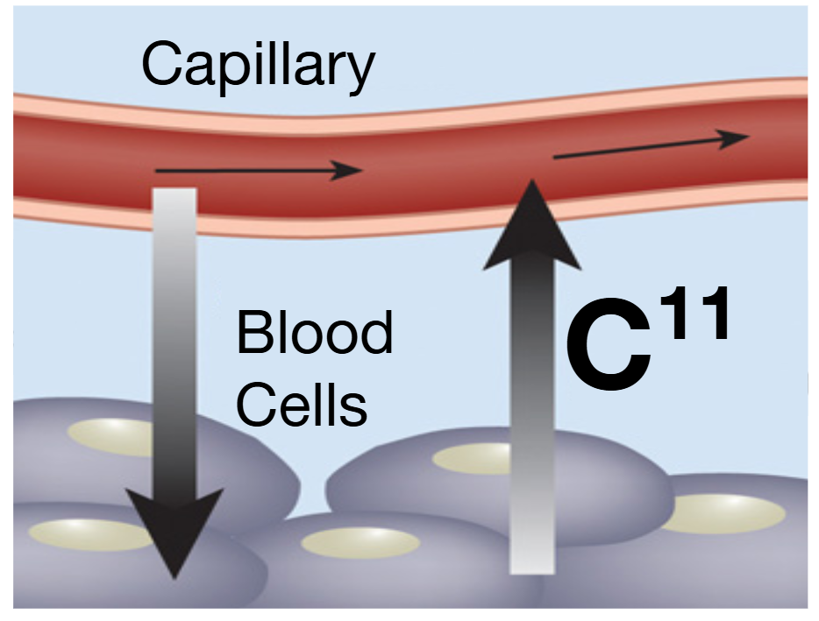
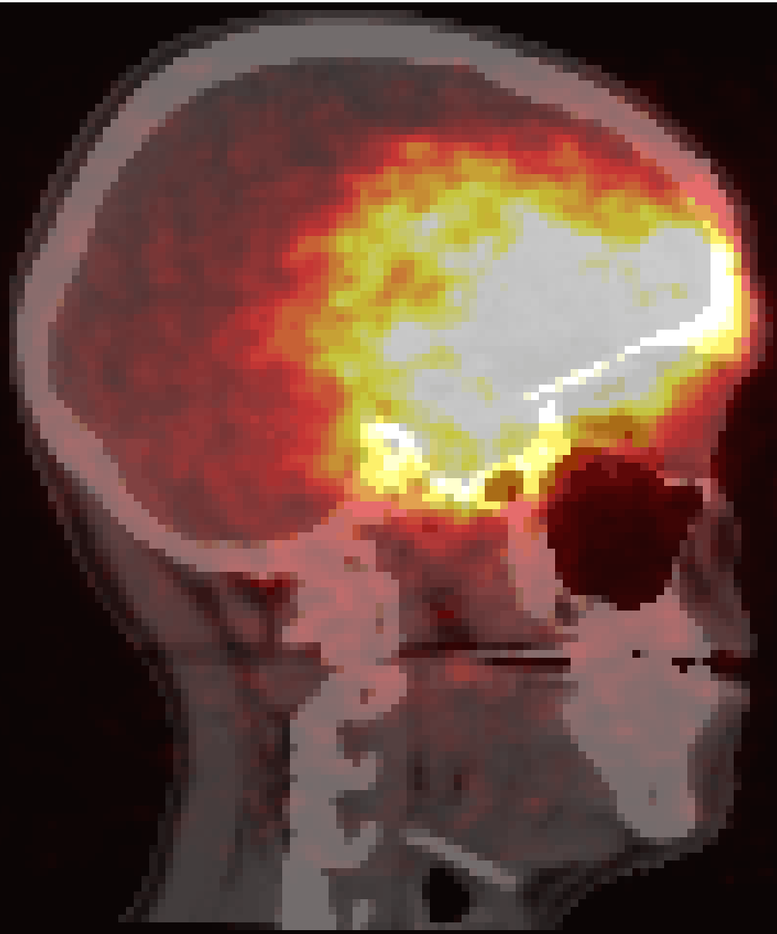
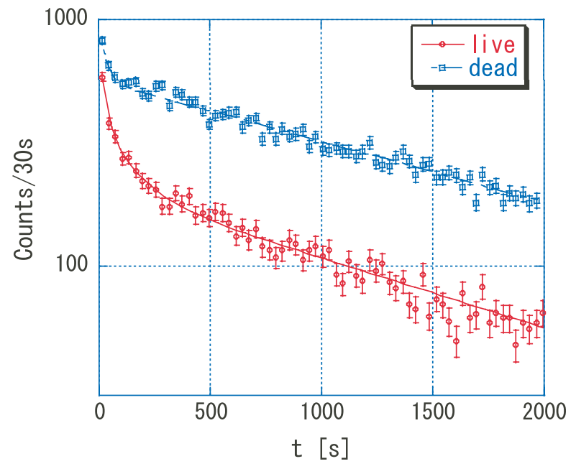


Biological washout:
problem or opportunity?
Dynamic, complex, tissue-dependent processes displacing proton-produced positron emitters and reducing PET image SNR
kBq/cc
λ_{B}: Biological Washout Rate
Dynamic post-proton therapy
PET at MGH
Credit: Mizuno et al 2003 Phys. Med. Biol.
Notes:
- like perfusion and cellular metabolism
- refer back to the first part (treatment verification)

Slide 30
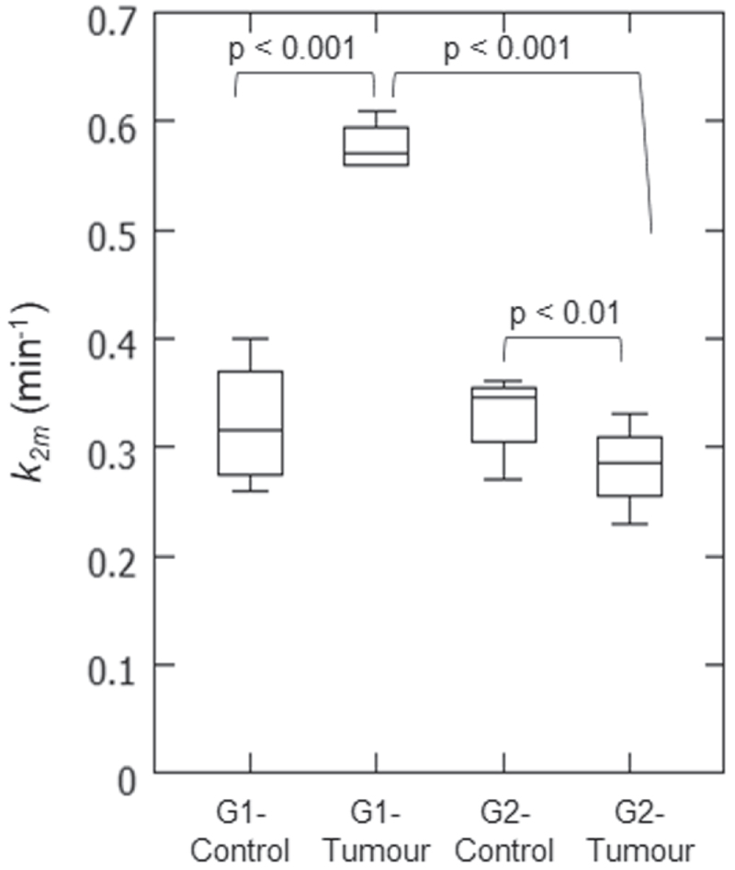
Biological washout:
problem or opportunity?
Washout can be estimated with dynamic PET post-treatment to correct it and inform tumoral status (vascularity, tissue response*)
Perfused
But low SNR limits washout estimation (approximate, tumor-wide)
Hypoxic
Washout Rate
Can accurate washout mapping at intratumoral scales provide clinically relevant information?
* Toramatsu et al., Phys Med Biol, 2022
Fiedler et al., Acta Oncologica 2010
Notes:
Higher washout rates mean that the tumor is more perfused
with DCE-MRI and histological analysis

Slide 31
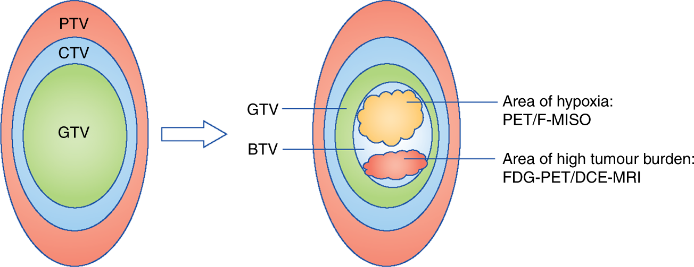
Heterogeneous tumors respond worse
Intratumoral heterogeneity relates to tumor progression and survival: surrogate marker to improve risk stratification, tumor assessment, and personalized treatment [Zhao et al., Eur J Nucl Med Mol Imaging, 2022]
Currently: tracers (>2000$*), + radiation, may not reach regions
Beaton et al., Br J Cancer, 2019
*www.martinos.org/core-services-fee-chart
Notes:
(e.g. finding aggressive regions)
Extra:
Normal-tissue exposure from a full external-beam radiotherapy course (beam leakage/scatter): 300 mSv
Additional radiation due to PET imaging: ~5 mSv

Slide 32
Can we accurately map washout to reveal intratumoral heterogeneity non-invasively?
Challenge: direct estimation from dynamic PET after proton therapy is noisy and blurred due to low counts
?
Washout Rate
Cluster 1
min⁻¹
Cluster 2
Cluster 3
Cluster 4
Notes:
(e.g. finding aggressive regions)
To overcome the low SNR, we develop a deep learning workflow

Slide 33
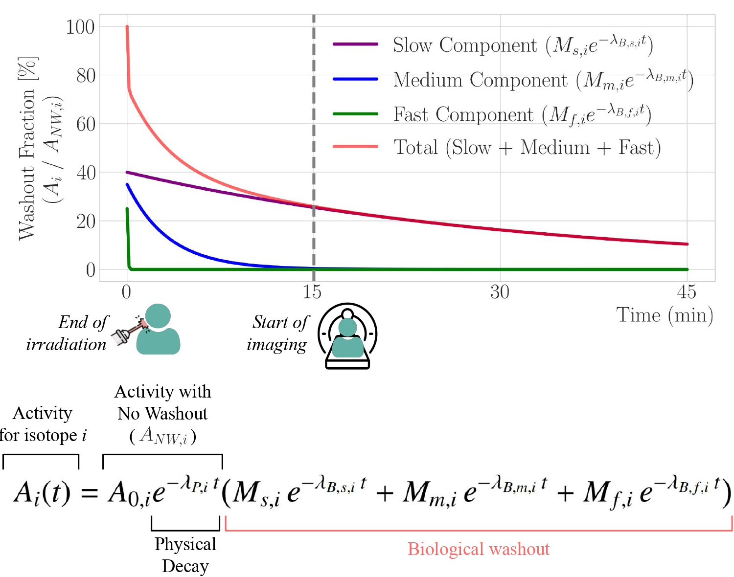

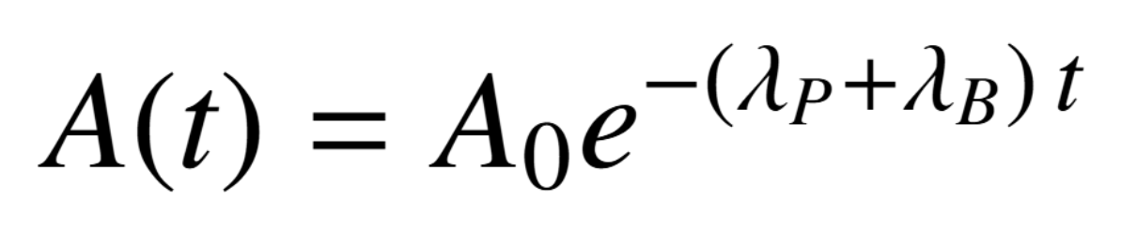


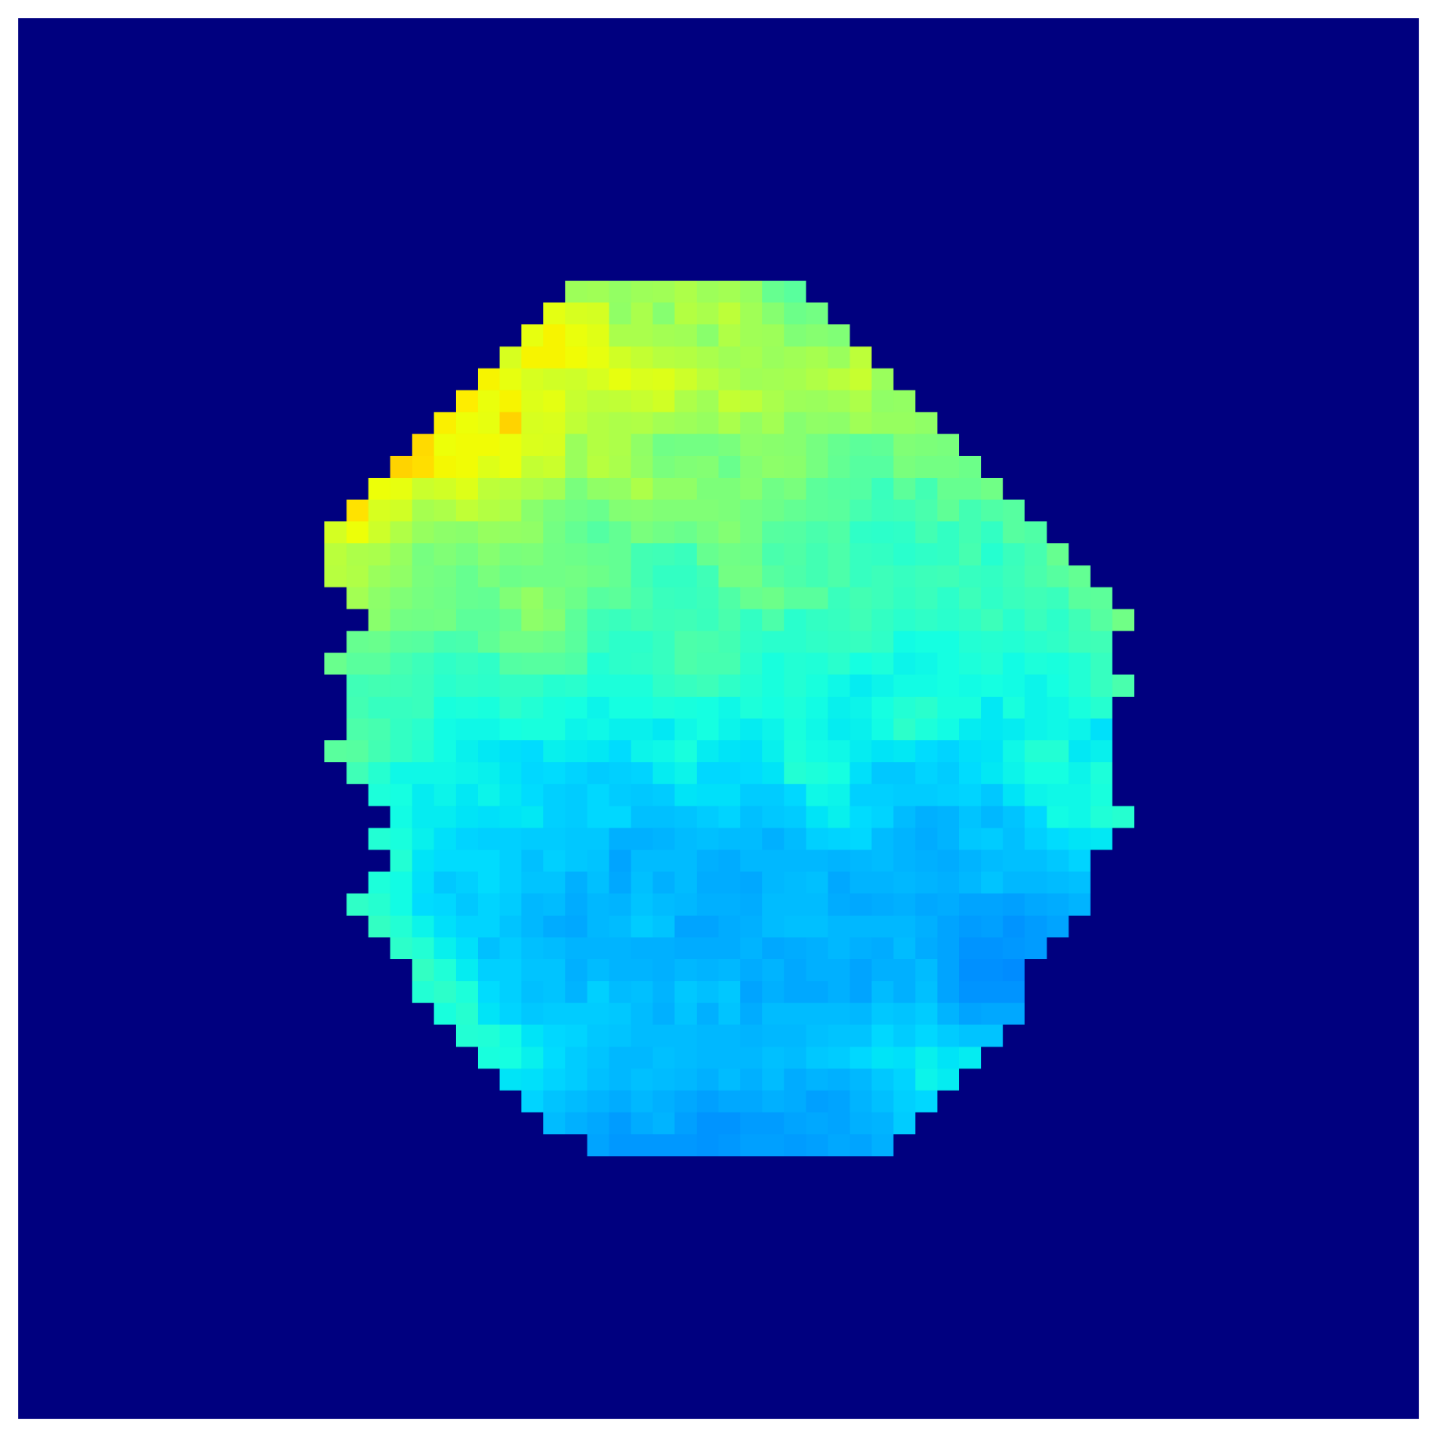

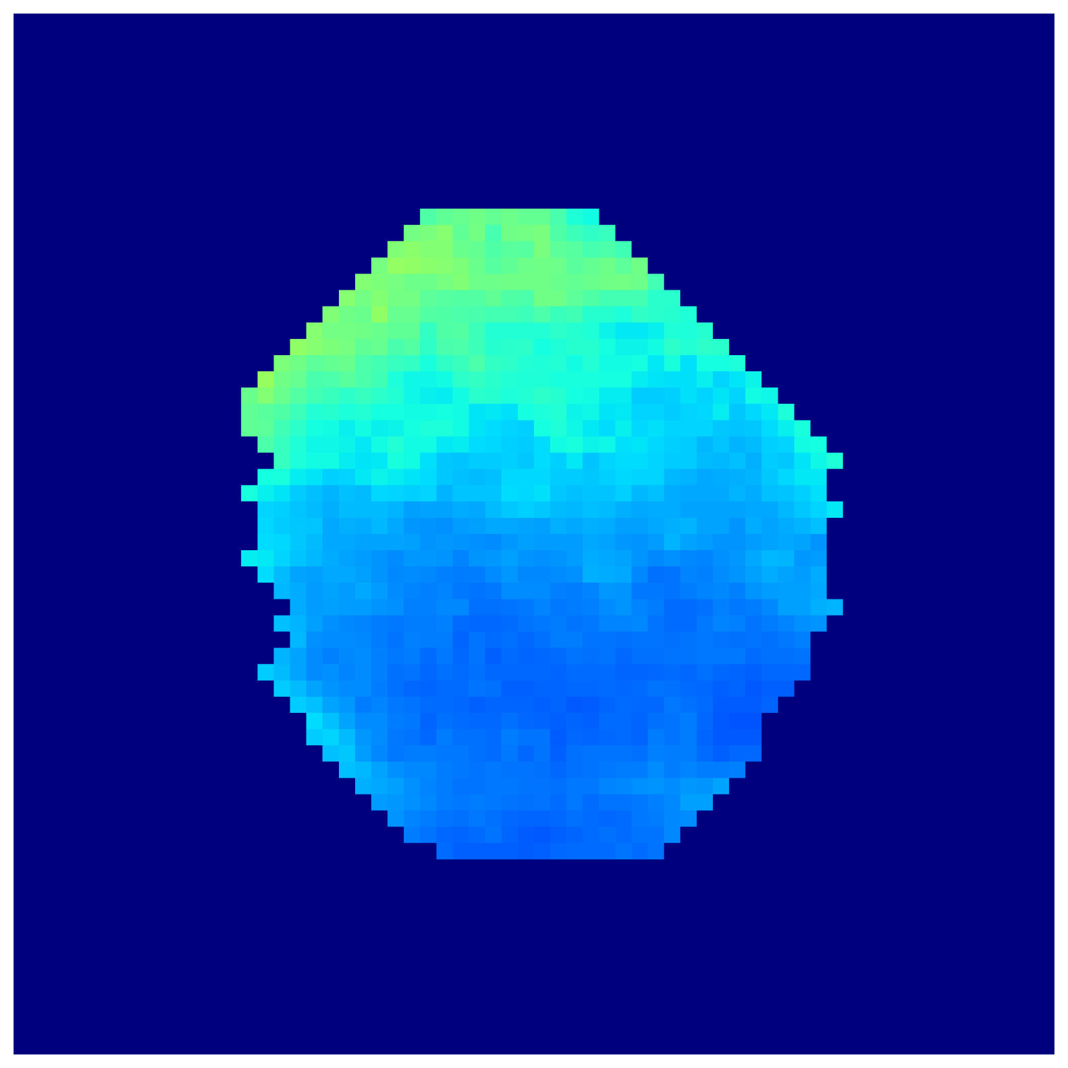


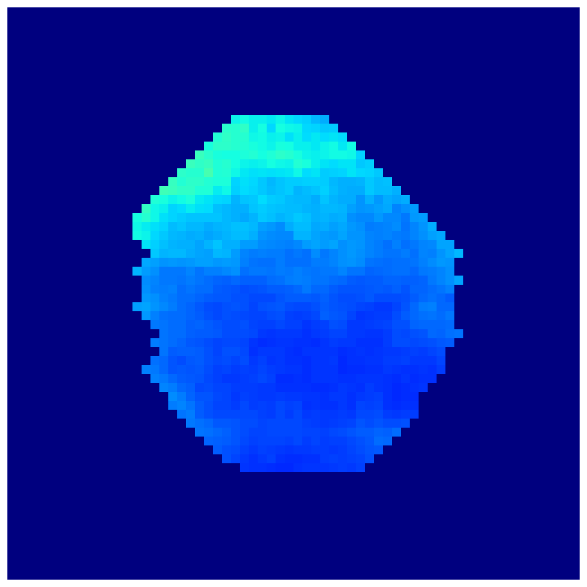

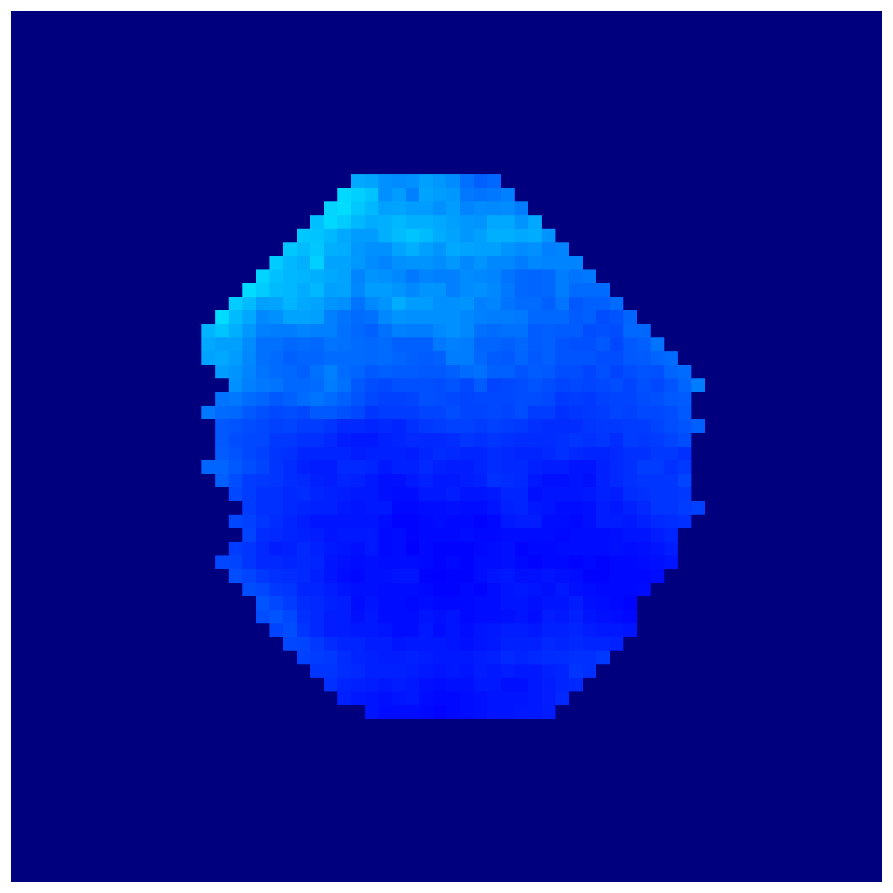


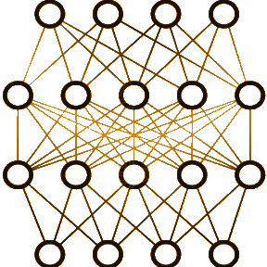
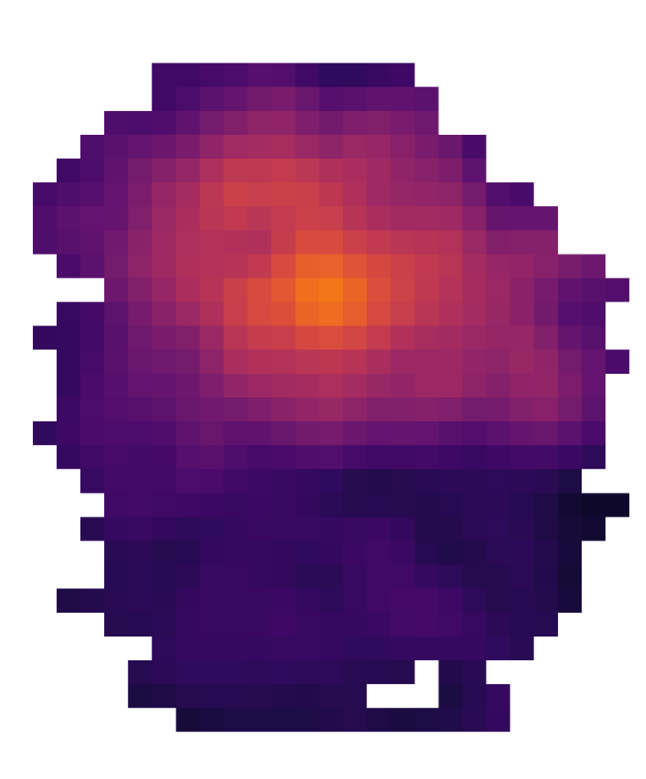

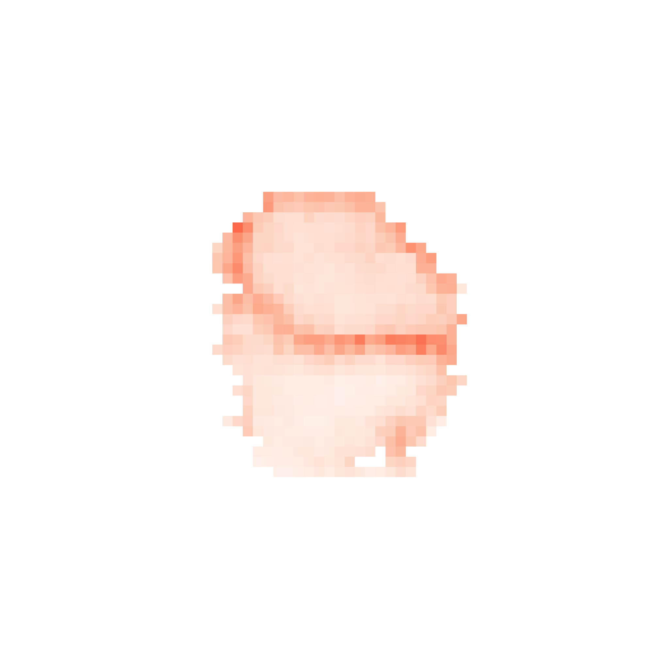
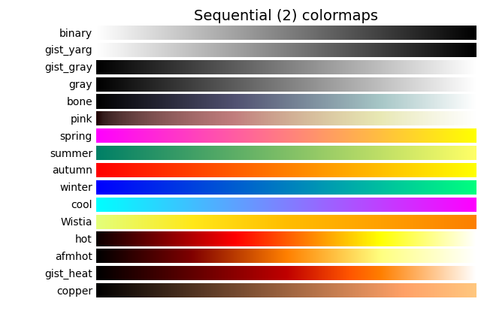
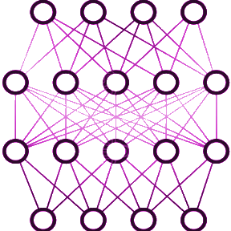

Proposed Workflow for Improving Washout Mapping and Revealing Heterogeneity
(A) Patient Selection
(B) Treatment Planning
(C) Proton
Therapy
Simulation
(D) Introducing
Tumor Heterogeneities
(E) PET acquisition
simulation
(F) Dynamic PET
reconstruction
(G) Voxel-wise
activity fit
Vascularized
Dataset Generation
A
…
Head and neck
cancer
Necrotic
t (min)
Ground Truths
(75 digital twins)
15 min delay,
30 min scan
λ_{B} : Biological Washout Rate
Uncorrected
Washout Rate Map (λ_{B})
with Uncertainty*
λ_{B}
A_{o}
(H) Fit Correction
Model Training
min⁻¹
kBq/cc
15 min delay
~80% is ¹¹C
(I) Direct Estimation
Washout Mapping after Proton Therapy from PET Scan
min⁻¹
min⁻¹
*[Kendall et al., NeurIPS Proceedings, 2017; Seitzer et al., arXiv:2203.09168, 2022]
https://github.com/pcabrales/ppw
Notes:
- WE WANT TO TURN THIS PROBLEM OF WASHOUT INTO AN OPPORTUNITY FOR BIOLOGICAL TUMOR ASSESSMENT. This is how we do it
For each patient’s digital twin we introduce heterogeneities inside the tumor, áreas with different washout rates
At imaging times, activity Will be governed by the slower components of 11C washout. We are focusing on the washout rate but we have developed another way to include the faster components, look at the preprint
- * Uncertainty = Aleatoric (intrinsic noise; learned β−NLL loss) +
Epistemic (model stability; Monte Carlo Dropout)

Slide 34
Trained models help reveal heterogeneity
High uncertainty aligns with higher errors ✓
Notes:
Let’s see the tumors of some patients….; how would it help the patient/oncologist?
Uncorrected maps suffer from spillover effects
Uncertainty estimates align with regions of higher error (also made a sparsification error plot)
You activate regions that you would not reach with blood flow (conventional radiotracer)
Extra:
(Epistemic uncertainty was low compared to aleatoric, reflecting that most
Techniques which can be applied to Dynamic low-dose PET

Slide 35







Trained models improve washout maps
Models generalize across
Trained
Models
PET scanners
Anatomical regions
PET acquisition timings
***
***
***
***
***
***
***
***
***
***
Trained models enable separating intratumoral regions larger than 5 mL
[Toramatsu et al., Phys Med Biol, 2022]
Notes:
As expected, higher error for smaller regions
- Differences between hypoxic and control and perfused and control regions are close to 0.01

Slide 36
Conclusions: non-invasive, robust washout estimation and heterogeneity assessment
Potentially enabling:
Tumor response evaluation and risk stratification
Treatment adaptation (e.g. dose painting)
Improved PET-based treatment verification [Cabrales et al., IEEE TRPMS, 2025]
min⁻¹
Washout Rate
Validation in real patients is essential: Massachusetts General Hospital (MGH) and Clínica Universidad de Navarra (CUN)…
Notes:
Non-invasive because it leverages intrinsic radioactivity

Slide 37

Analyzing MGH study data
>70 post-proton therapy PET scans (2014 to 2020)
In progress: assessing if regions observed with PET match those from other modalities after applying our framework
PRELIMINARY
Thanks to Dr. Helen A. Shih, Dr. Kira Grogg, Dr. Xuping Zhu
Notes:
_{Data infrautilized}
_{MGH, USA}
Introducing our framework to enhance separation of washout in different tissues
-e.g. are hypoxic regions also hypoxic in the obtained washout maps?
_{Count rate: 10k/second}
_{Randoms rate: 0.05%}

Slide 38







Acknowledgements
Supported by Spanish MCIN/AEI/10.13039/501100011033 and the European Union NextGenerationEU/PRTR under grants TED2021-130592B-I00 PROTOTWIN, PID2021-126998OB-I00 FASCINA, and PDC2022-133057-I00 3PET; by Comunidad de Madrid (Spain) under projects ASAP-CM P2022/BMD-7434 and TAU-CM PR47/21 (PRTR), and by Grupo de Física Nuclear (910059) at Universidad Complutense de Madrid. Additionally, Pablo Cabrales acknowledges support from the Complutense University Predoctoral Fellowship (CT15-23), funded by the Universidad Complutense de Madrid and Banco Santander, as well as from the Ayuda para estancias breves fellowship (EB33/24), funded by the Universidad Complutense de Madrid.

Slide 39


Pablo Cabrales Miró-Granada
pcabrale@ucm.es
Questions? Thank you
Published in
IEEE TRPMS, 2025
Code is available on GitHub
github.com/pcabrales/ppw

Slide 40
Additional material

Slide 41

Questions? Thank you
Pablo Cabrales Miró-Granada
Grupo de Física Nuclear @ UCM
pcabrale@ucm.es
Code is available on GitHub
github.com/pcabrales/ppw

Slide 42
Questions? Thank you
This work:
Washout Rate (min⁻¹)
Pablo Cabrales Miró-Granada
Grupo de Física Nuclear @ UCM
pcabrale@ucm.es
Code is available on GitHub
github.com/pcabrales/ppw

Slide 43

Role of the Vision Transformer: nnUnet vs nnFormer
Vision transformers may improve results by capturing correlated effects through the image
nnFormer also outperformed (and is lighter) than UXNet, SwinUNETR, TransBTS, attention UNet, vanilla UNet

Slide 44



Role of the Vision Transformer: nnUnet vs nnFormer
(For biomedical image segmentation)
[Wald et al., 2025
arXiv:2503.01835]
Vision transformer role is greater in nnFormer than other CNN + transformer architectures, may indicate that it is the differential factor for our task (image translation: PET → Dose) where long-term spatial correlations are significant
Notes:
Question may be: why is nnFormer outperforming other models?

Slide 45
Deep Learning Training
Protons leave correlated effect through image
CNN + Vision Transformers (nnFormer) better than
pure CNN (nnUnet)?
Compared architectures (detailed later)
Images are 3D and large (128⨯96x128) for GPU
Batch size = 1, accumulated gradients (4 batches) for stability
AdamW (learning rate = 0.001) and cosine annealing scheduling
600 epochs with early stopping (patience = 50 epochs)
Patient position is important: no spatial (e.g. rotation) data augmentation

Slide 46



Model Architecture and Uncertainty Estimation
Trustworthiness in medical AI is key: know what the model doesn’t know
$${ Total Uncertainty= (Aleatoric}^{2}+{Epistemic}^{2})^{0.5}$$
Aleatoric uncertainty
Reflects intrinsic noise in PET data
Estimated by the model
Output A = $\hat{μ},\text{Output} \text{B}\text{ = }\hat{σ}$
Epistemic uncertainty
Reflects lack of model knowledge and stability
Std dev of 20 MC dropout passes with 20% dropout rate
[Kendall et al., NeurIPS Proceedings, 2017;
Seitzer et al., arXiv:2203.09168, 2022]
$$L=0.9 \text{β}\text{−}\text{NLL}\text{ +}0.1 \text{SSIM}$$

Slide 47

MGH study data analysis
- Post-proton therapy PET scans conducted from 2014 to 2020 (>30 patients, >70 scans, MRIs)
- Analysis in progress: already seeing the importance of PET simulation
Thanks to Dr. Helen A. Shih, Dr. Kira Grogg, Dr. Xuping Zhu
Notes:
_{Data infrautilized}

Slide 48
Questions? Thank you
This work:
Washout Rate (min⁻¹)
Pablo Cabrales Miró-Granada
Grupo de Física Nuclear @ UCM
pcabrale@ucm.es
Code is available on GitHub
github.com/pcabrales/ppw

