Slide 1
Time resolution measurements of our SiPM tile with the C3 amplification board
Carlos Benitez, Justo Martín-Albo, Raheema Hafeji
NDGAr Project Meeting
IFIC-IGFAE-Vigo
Monday 23rd June 2025

Slide 2
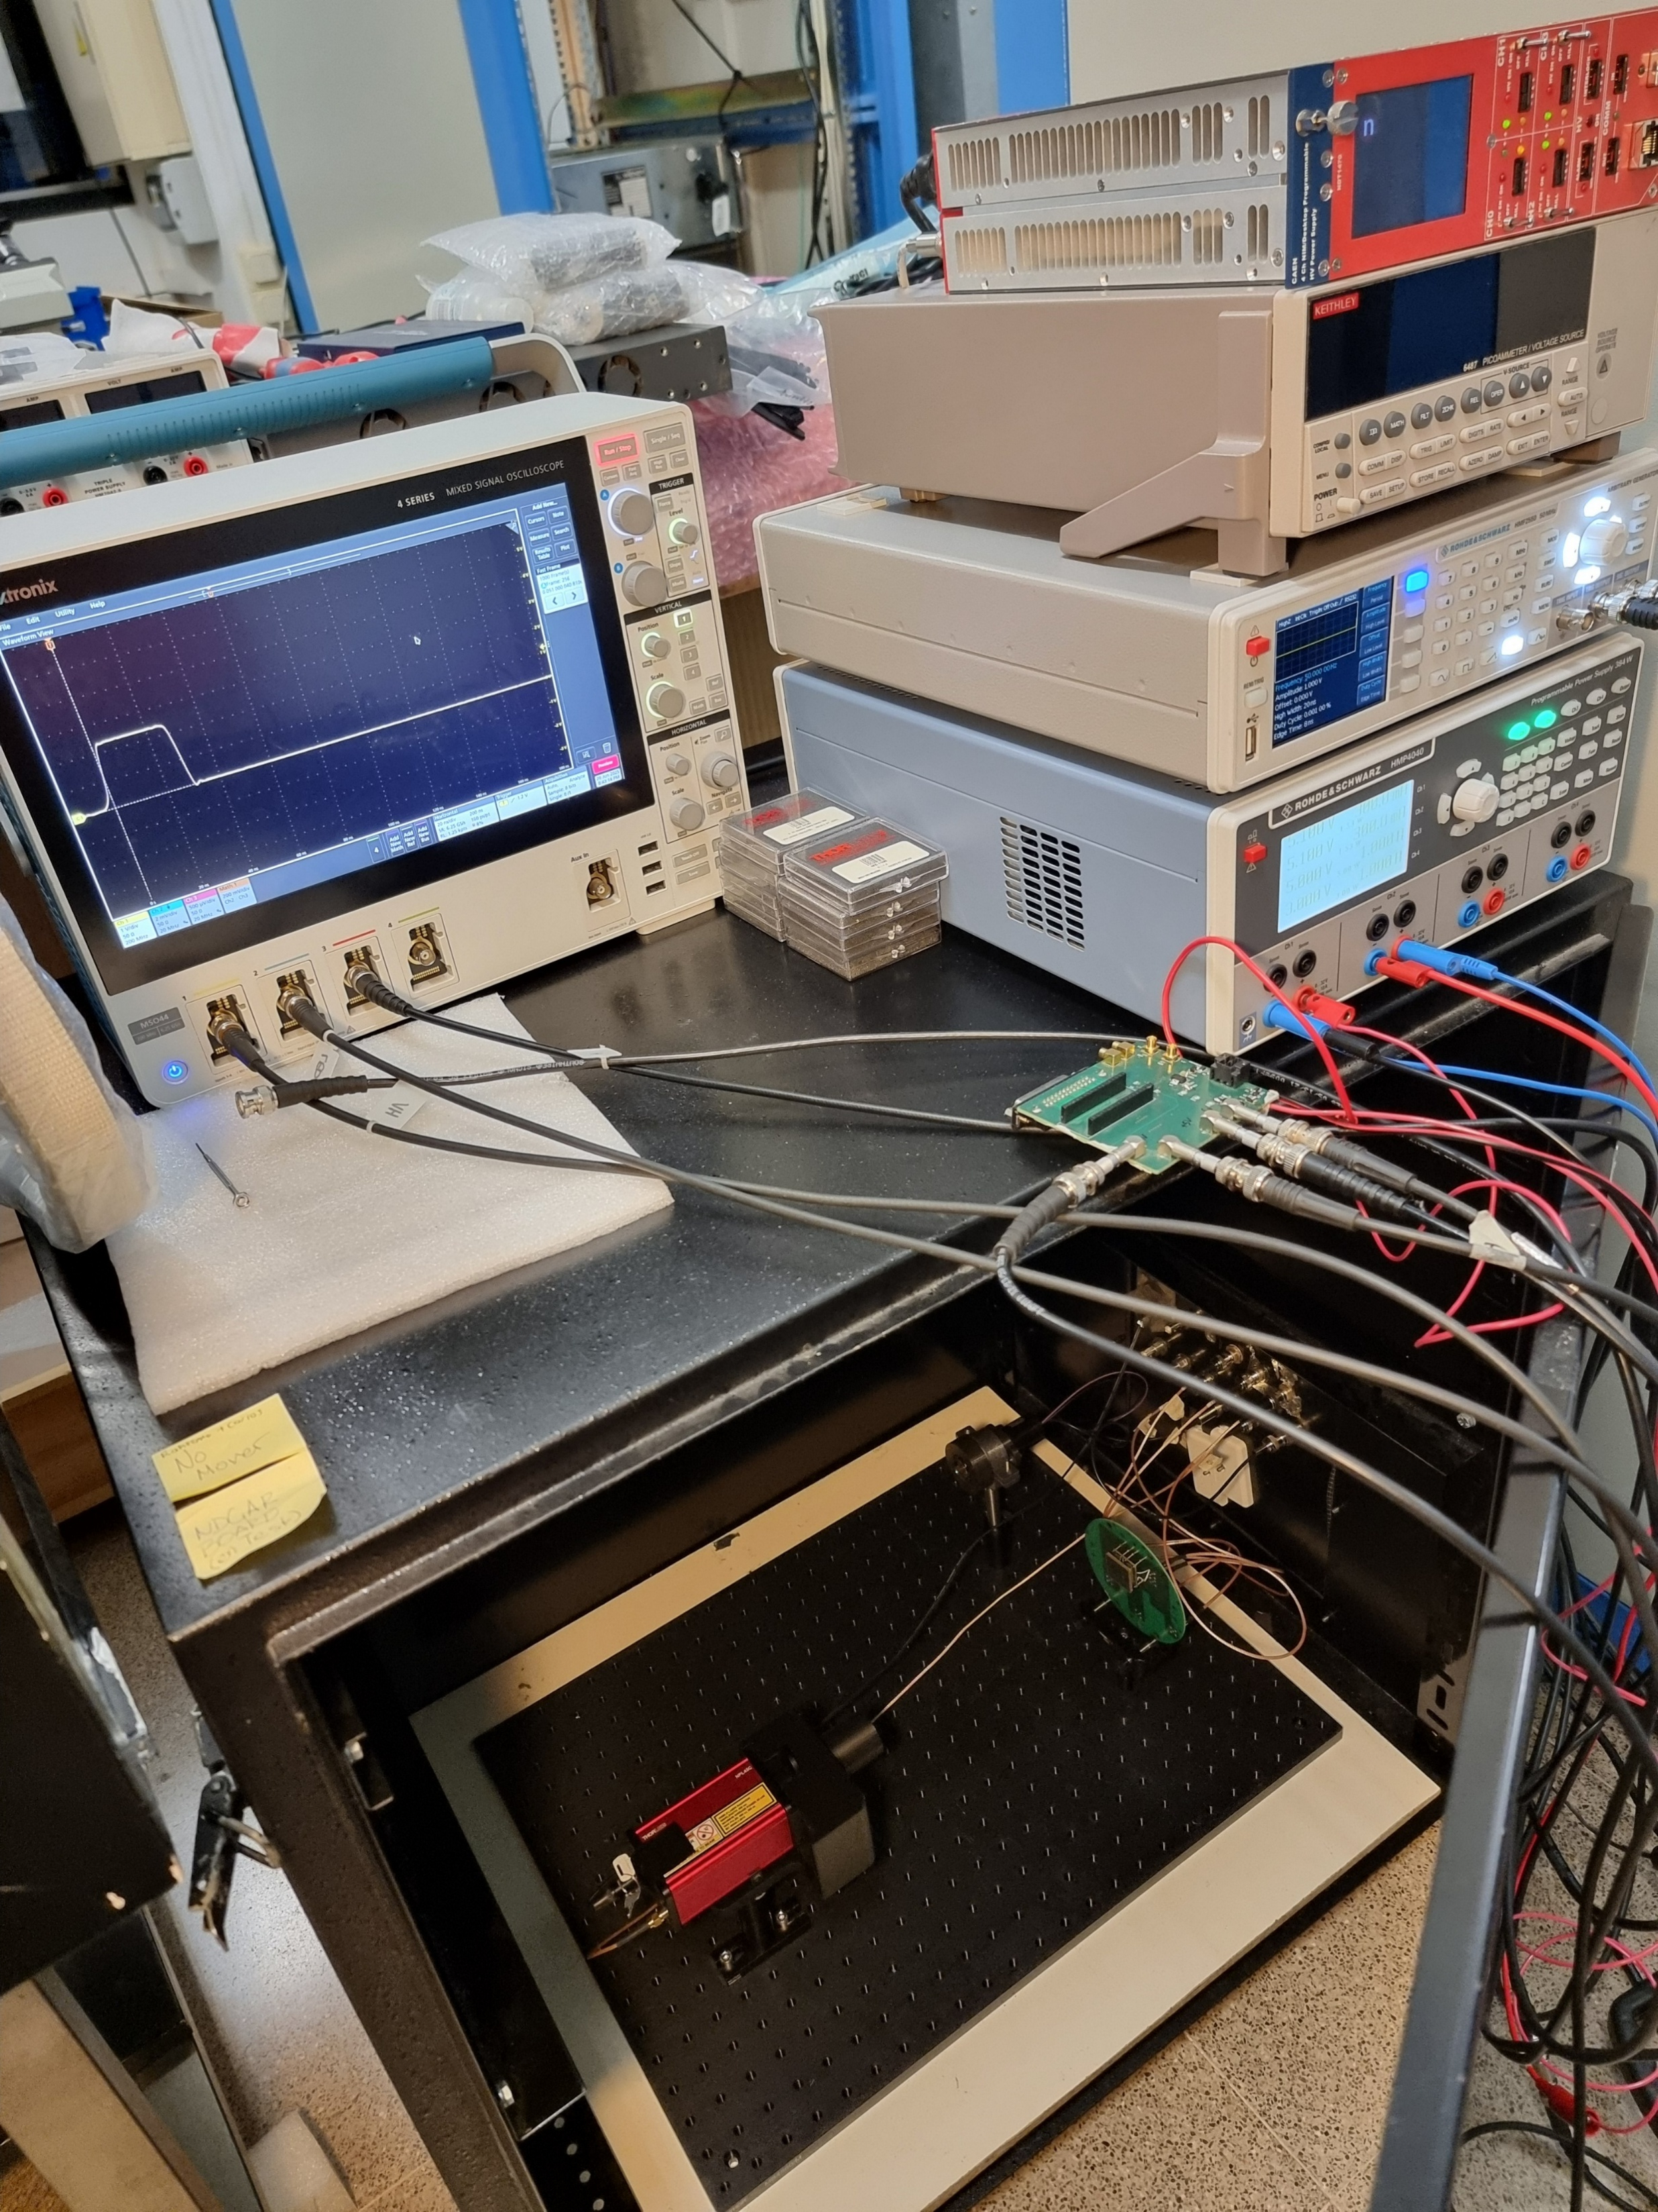
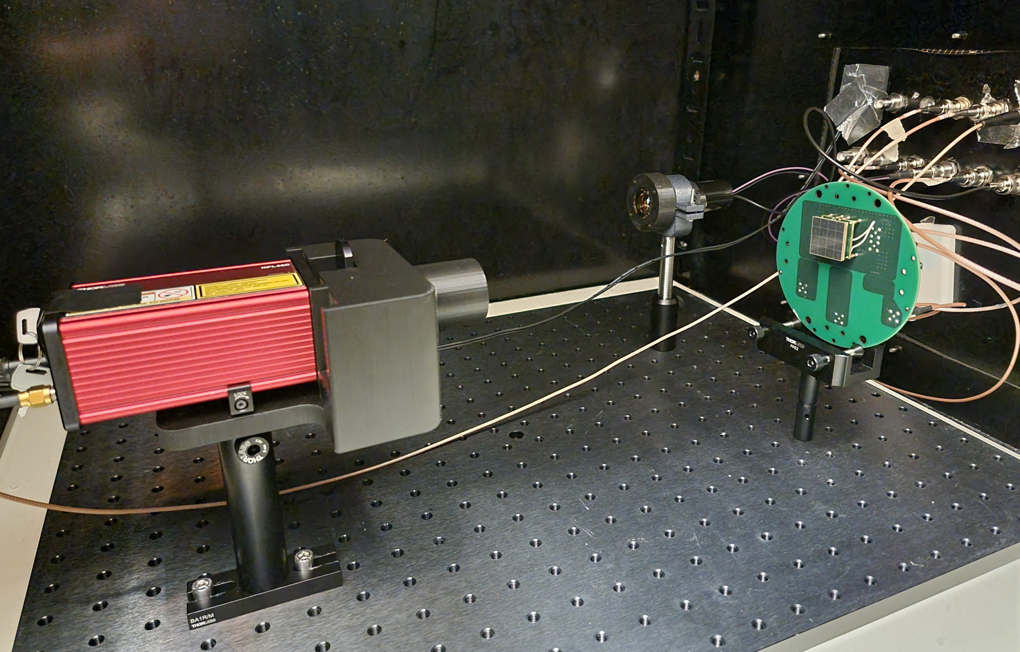
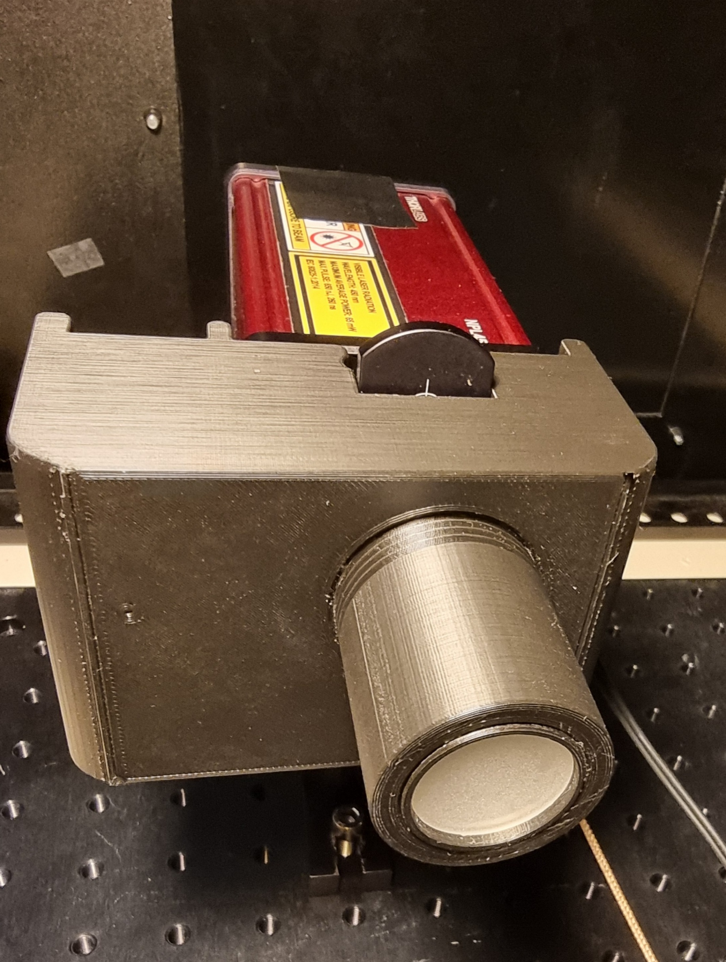
Experimental setup
Measurements carried out at 22.5 °C in a light-tight optical box.
E2924 PMT, operated at 1000V.
S14161-6050HS-04 SiPM tile + C3 board, operated at 2V/3V/4V OV.
29 cm between collimation hole and SiPM surface.
A holder allowing Thorlabs Neutral Density filters and a Thorlabs diffuser to be placed in series in front of a collimated laser beam (diffuser facing photosensor).
1000 waveforms
6.25 kpts RL
3.125 Gs/s SR
320 ps/pt
12 bits
Oscilloscope triggered on laser output signal at 50% (1.12 V).
Thorlabs NPL45C 450 nm laser, set to FWHM 6 ns and externally triggered with the R&S HMF2550 function generator at (mainly) 50 Hz with 1V input voltage, 20ns high width and 8ns edge time pulses.

Slide 3
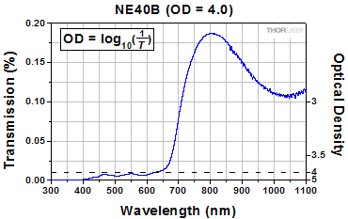
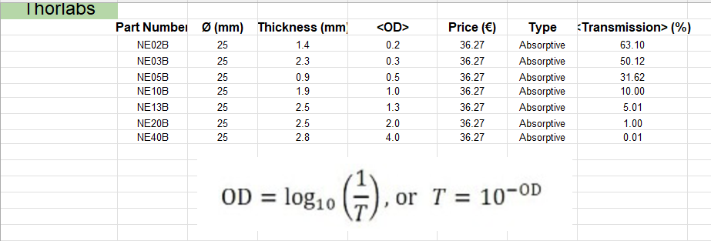
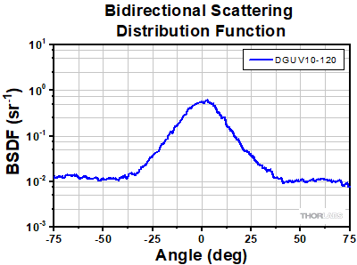
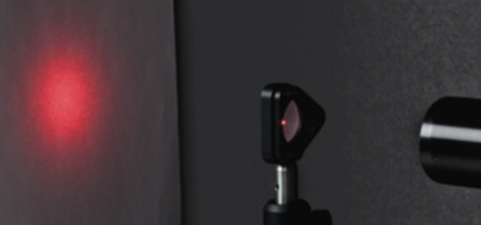
Thorlabs filters: attenuators and diffuser
The filters were stacked in series, to reach the required levels of attenuation.

Slide 4
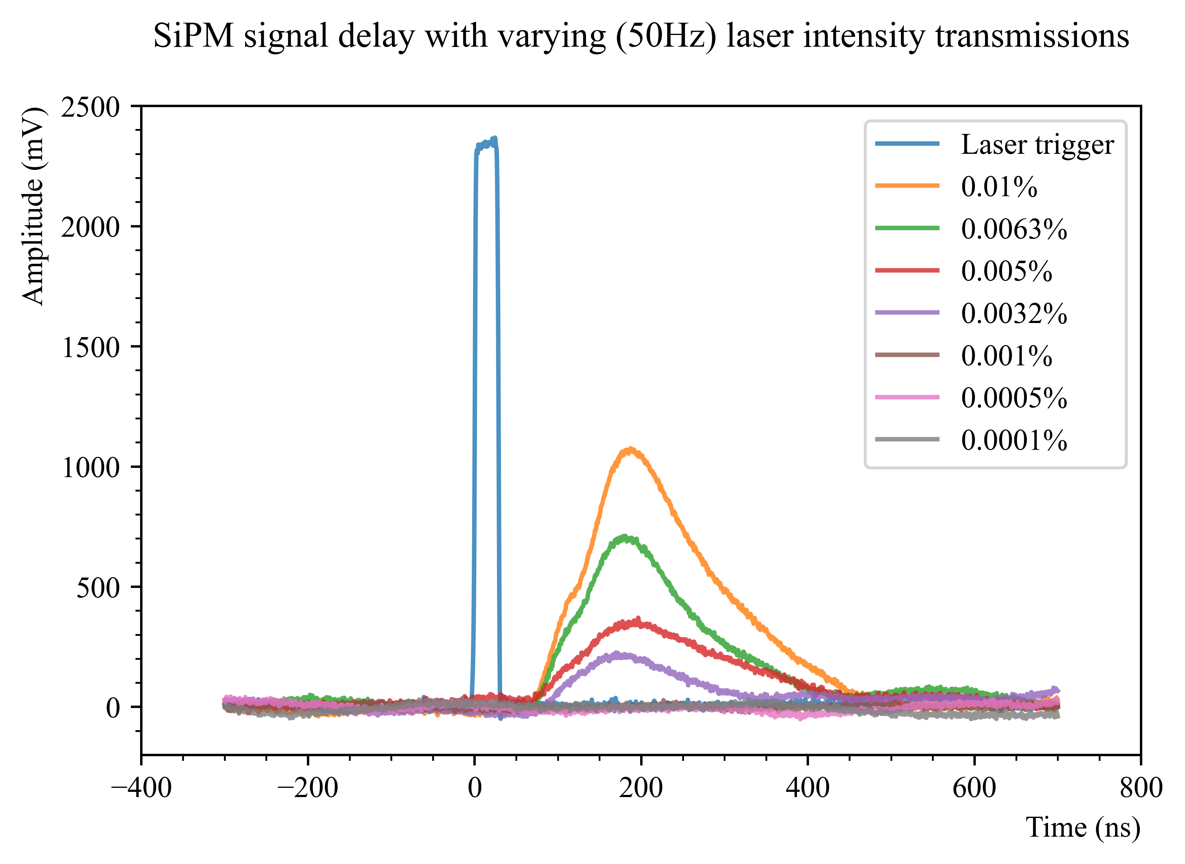
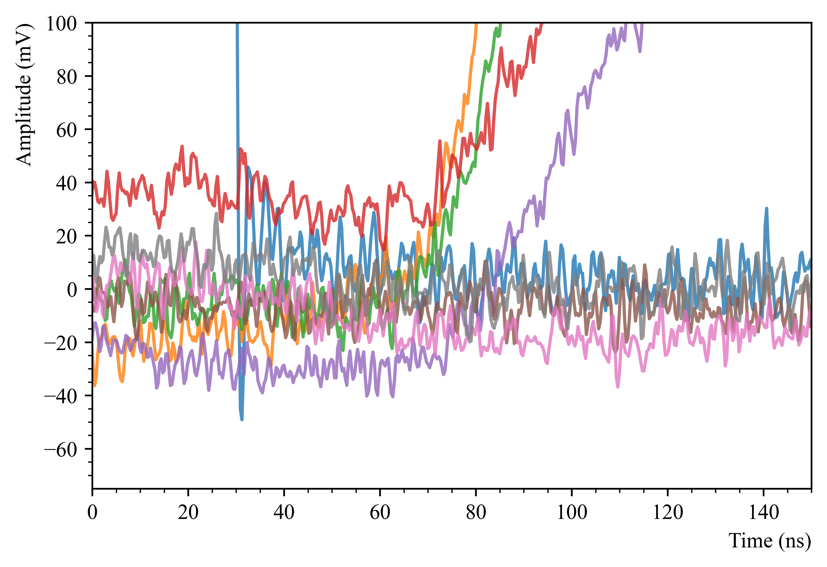
Time resolution measurements
Measurements for the time resolution were carried out, with light intensities ranging from 0.000005% to 1% transmission.
There doesn’t appear to be something groundbreaking happening, from this initial cursory inspection.
Although no detailed analysis has yet been carried out, the time delay with the SiPMs (~40ns from end of laser trigger) seems similar to what is seen with the PMT (see next slide).
To measure the photosensor signal delay:
>The ‘start’ point is the time of the laser trigger.
> What leading edge threshold of the photosensor signal should be used to determine the ‘stop’ time?
Zoomed view

Slide 5
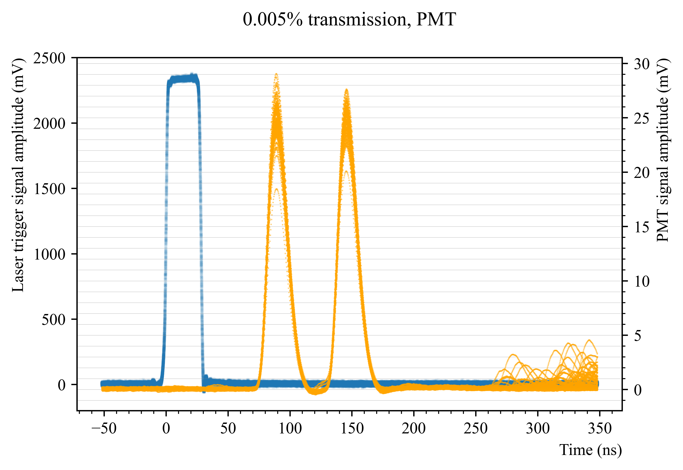
PMT signal delay
The PMT signal delay, which was being used to characterise the acquisition chain, also appears to be around ~40ns (more light intensity measurements shown in the extra slides)

Slide 6
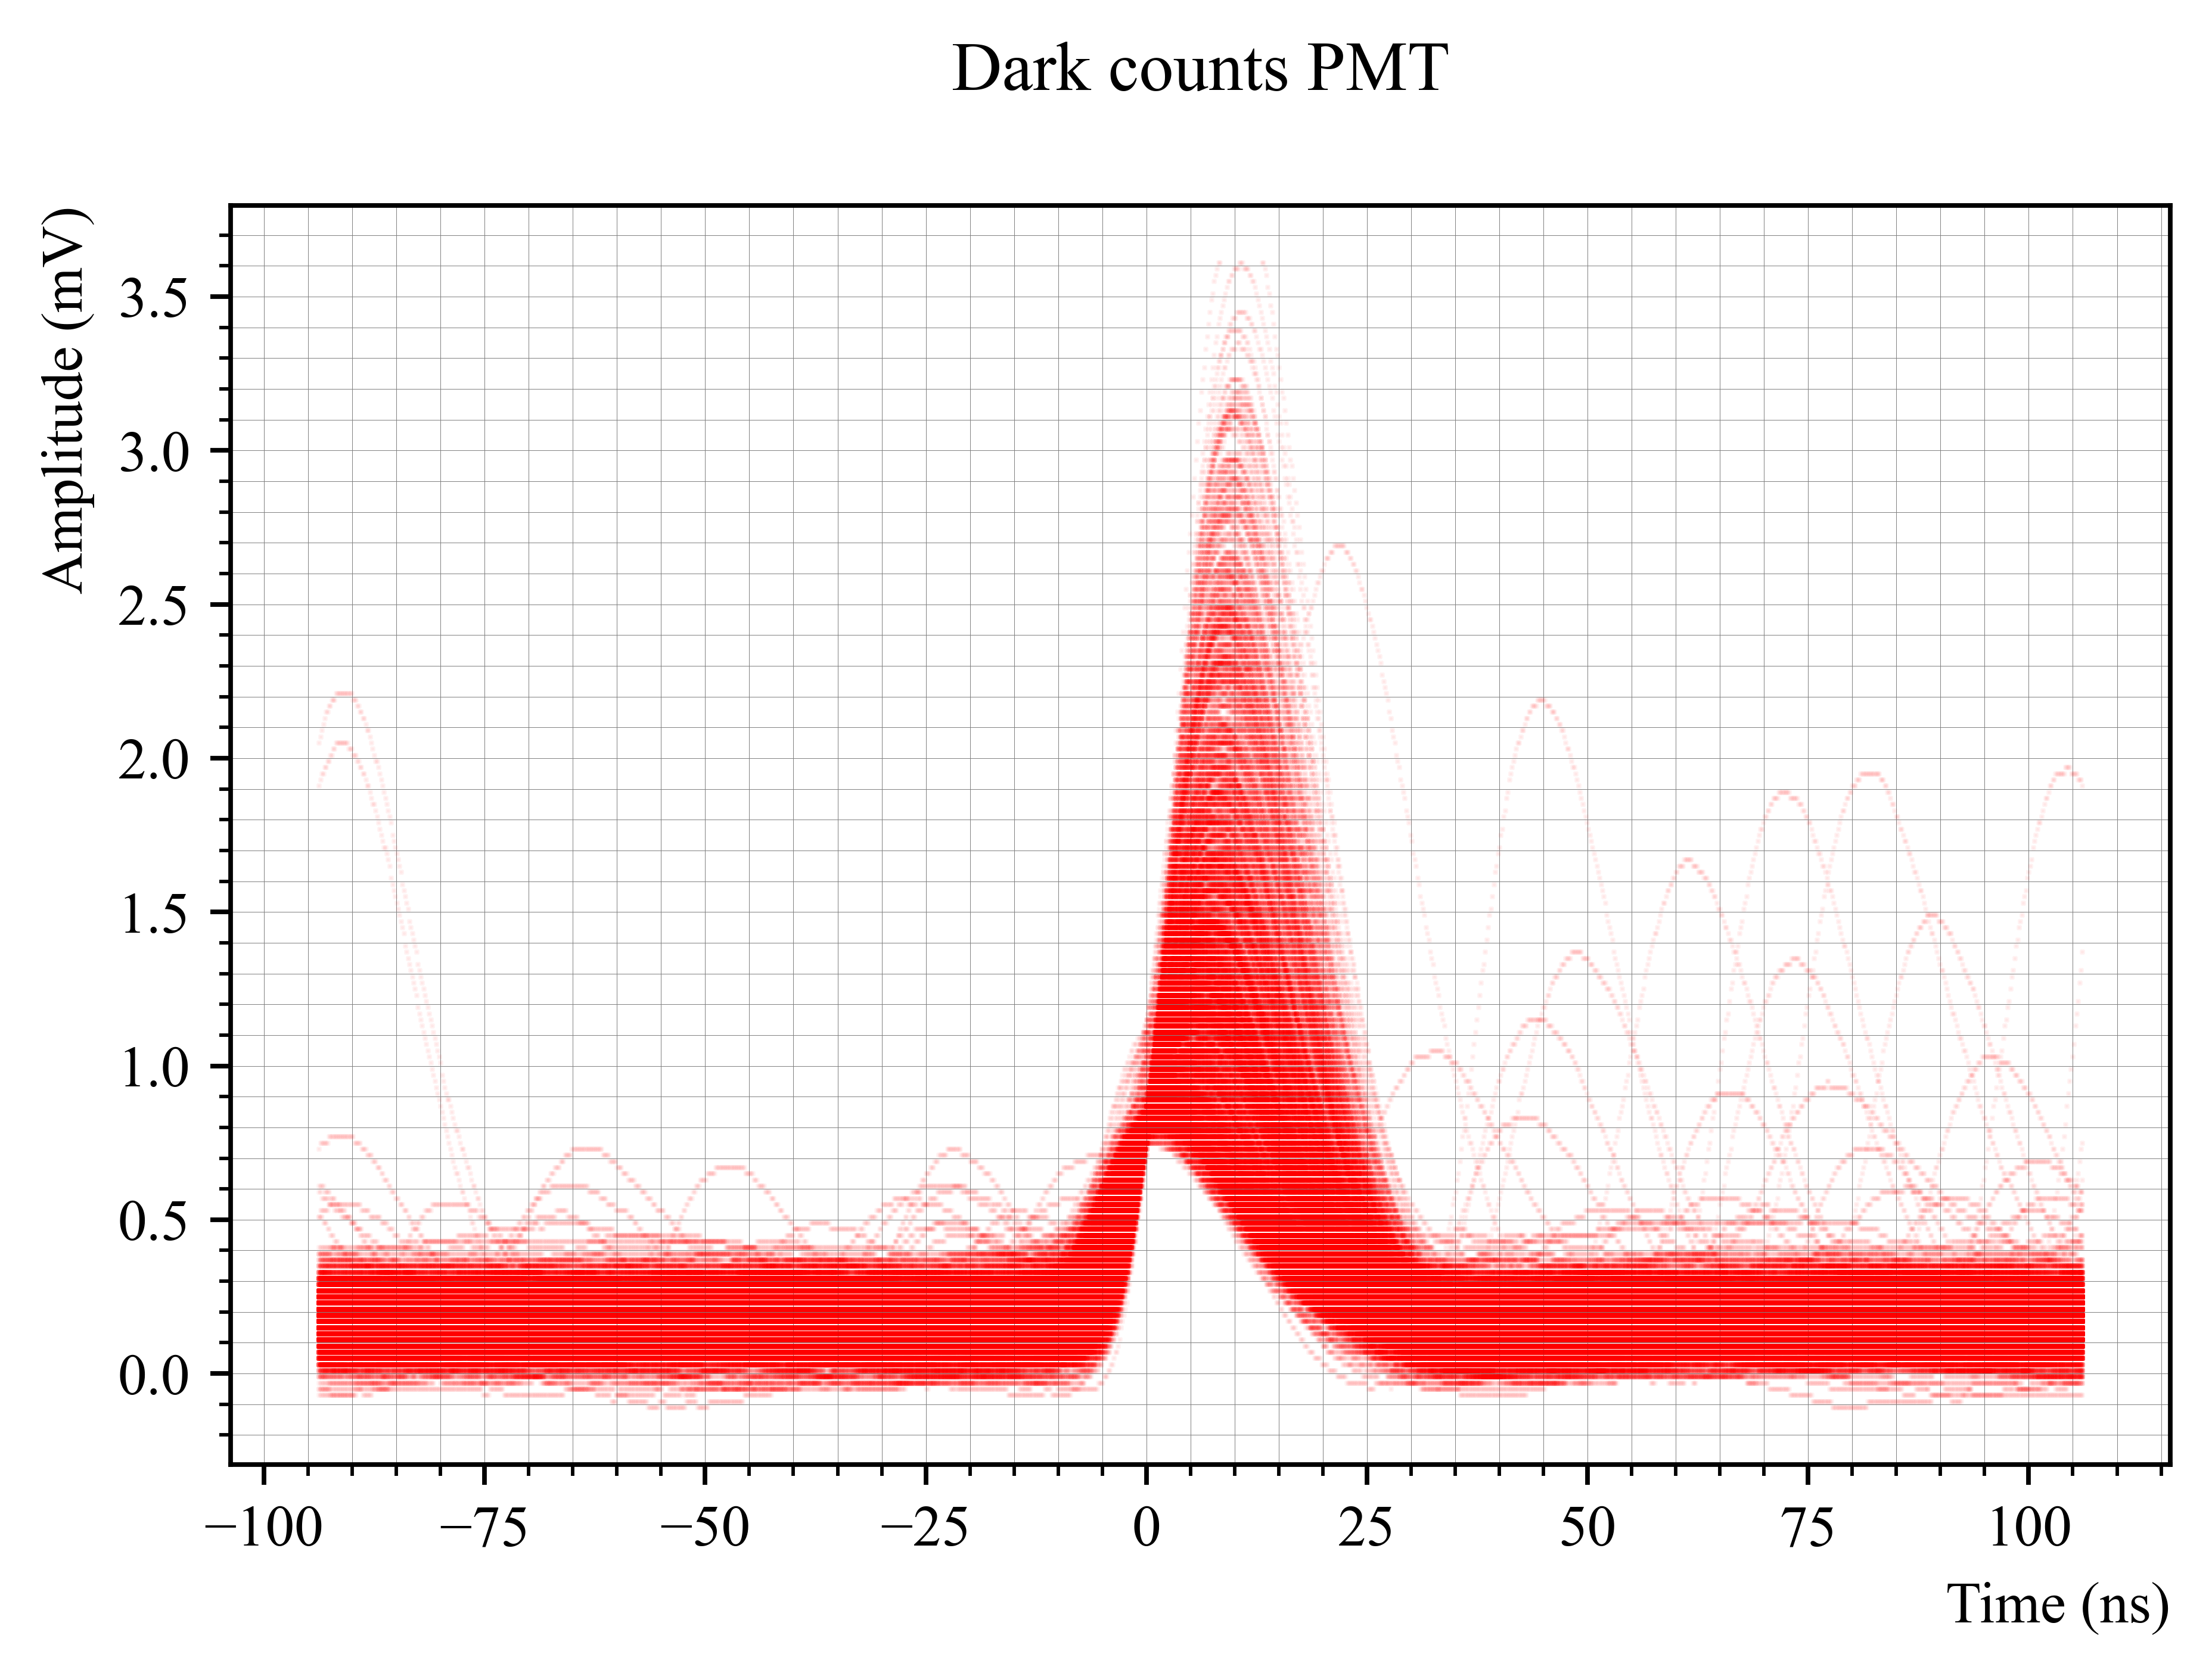
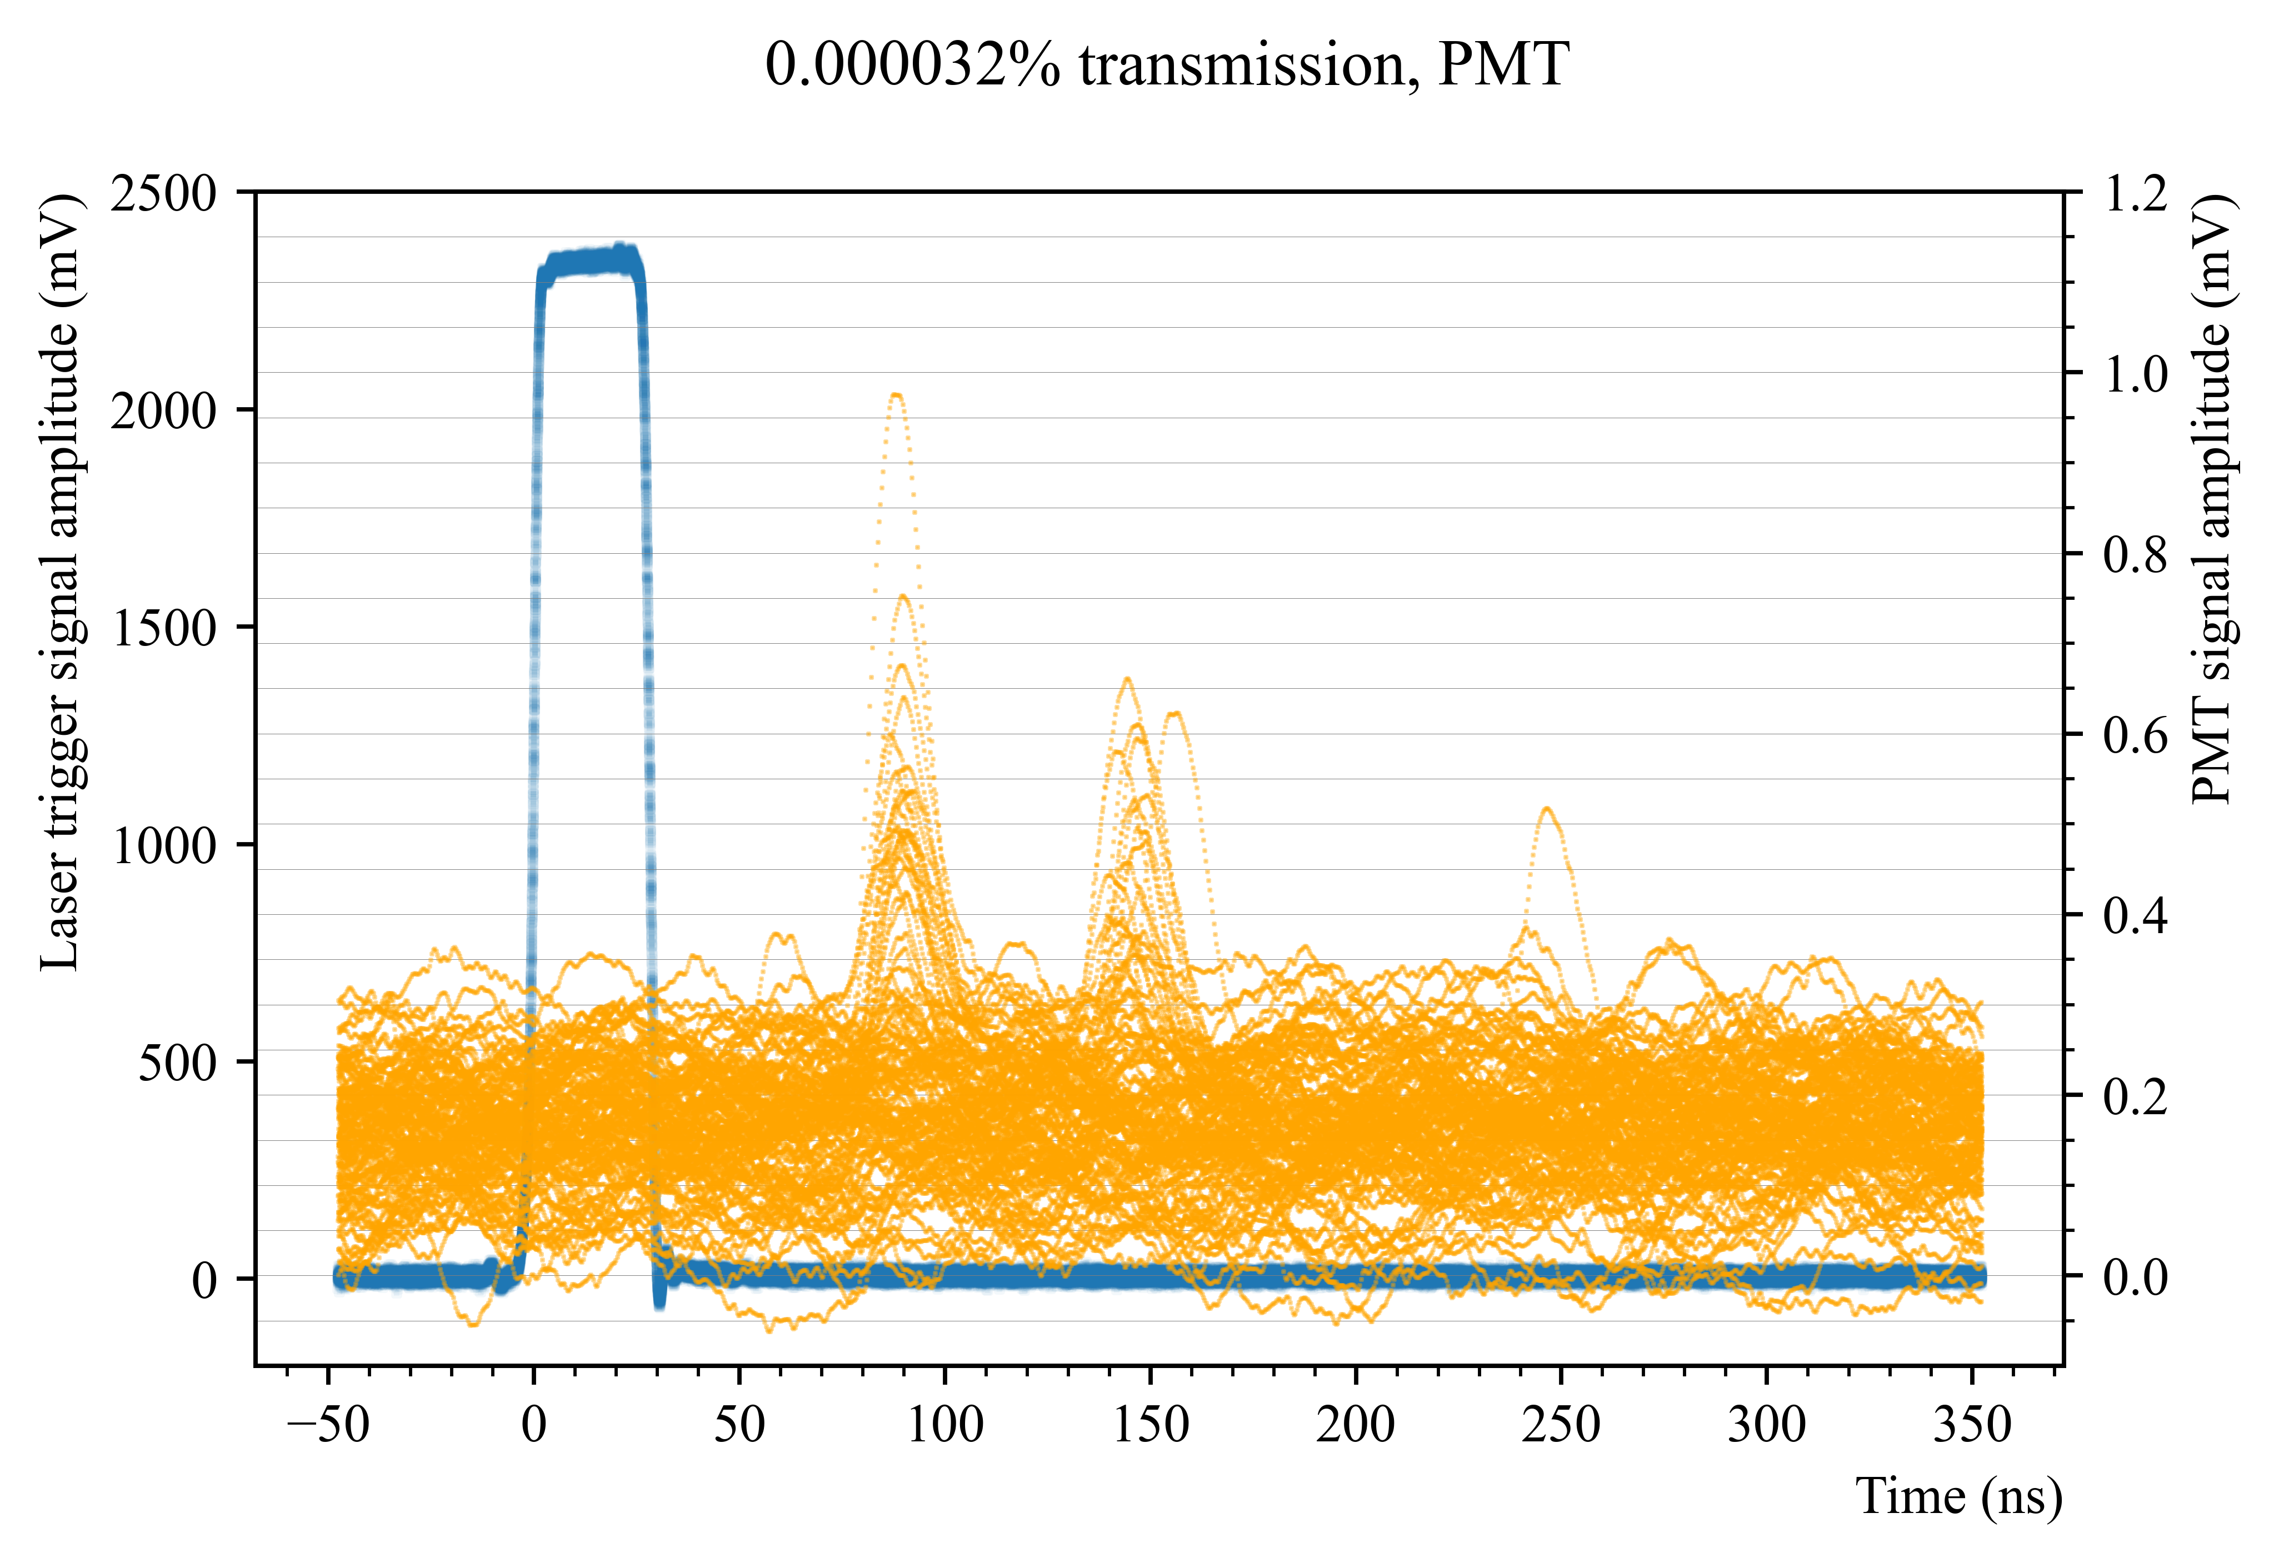
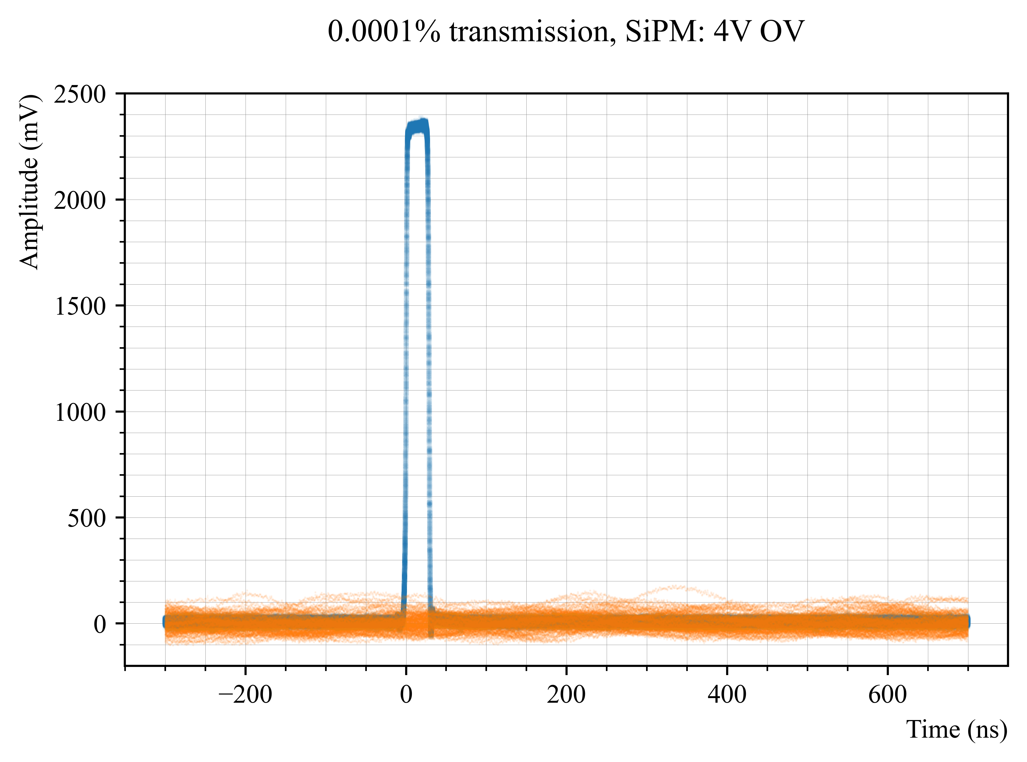
Determining the level of laser attenuation needed to reach single photon level
By looking at the dark counts of the PMT, the PMT single photon level was determined to be 0.5 mV (see red plot).
I found that the nearest level of laser light attenuation, with our available filters, needed to reach a PMT signal at 0.5 mV for single photon level was a reduction in the laser transmission to 0.000032% (see bottom left plot).
So I assumed that attenuating the laser light to 0.000032% will also give me single photon level detection in the SiPM.
However, the SiPM signal from the laser disappears into the DCR band well before this level of transmission. It is already no longer possible to discriminate external light from DCR at 0.001% transmission (see bottom right plot, more detailed views in extra slides).

Slide 7
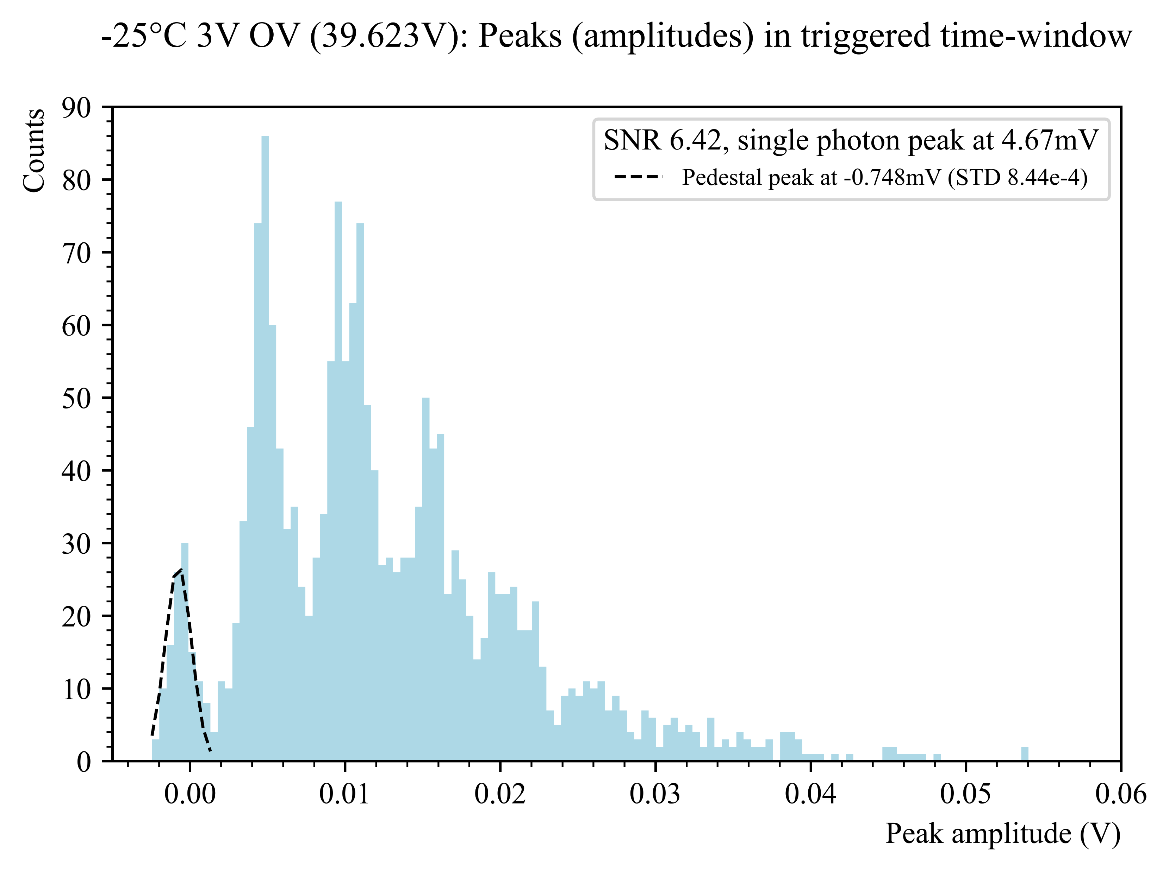
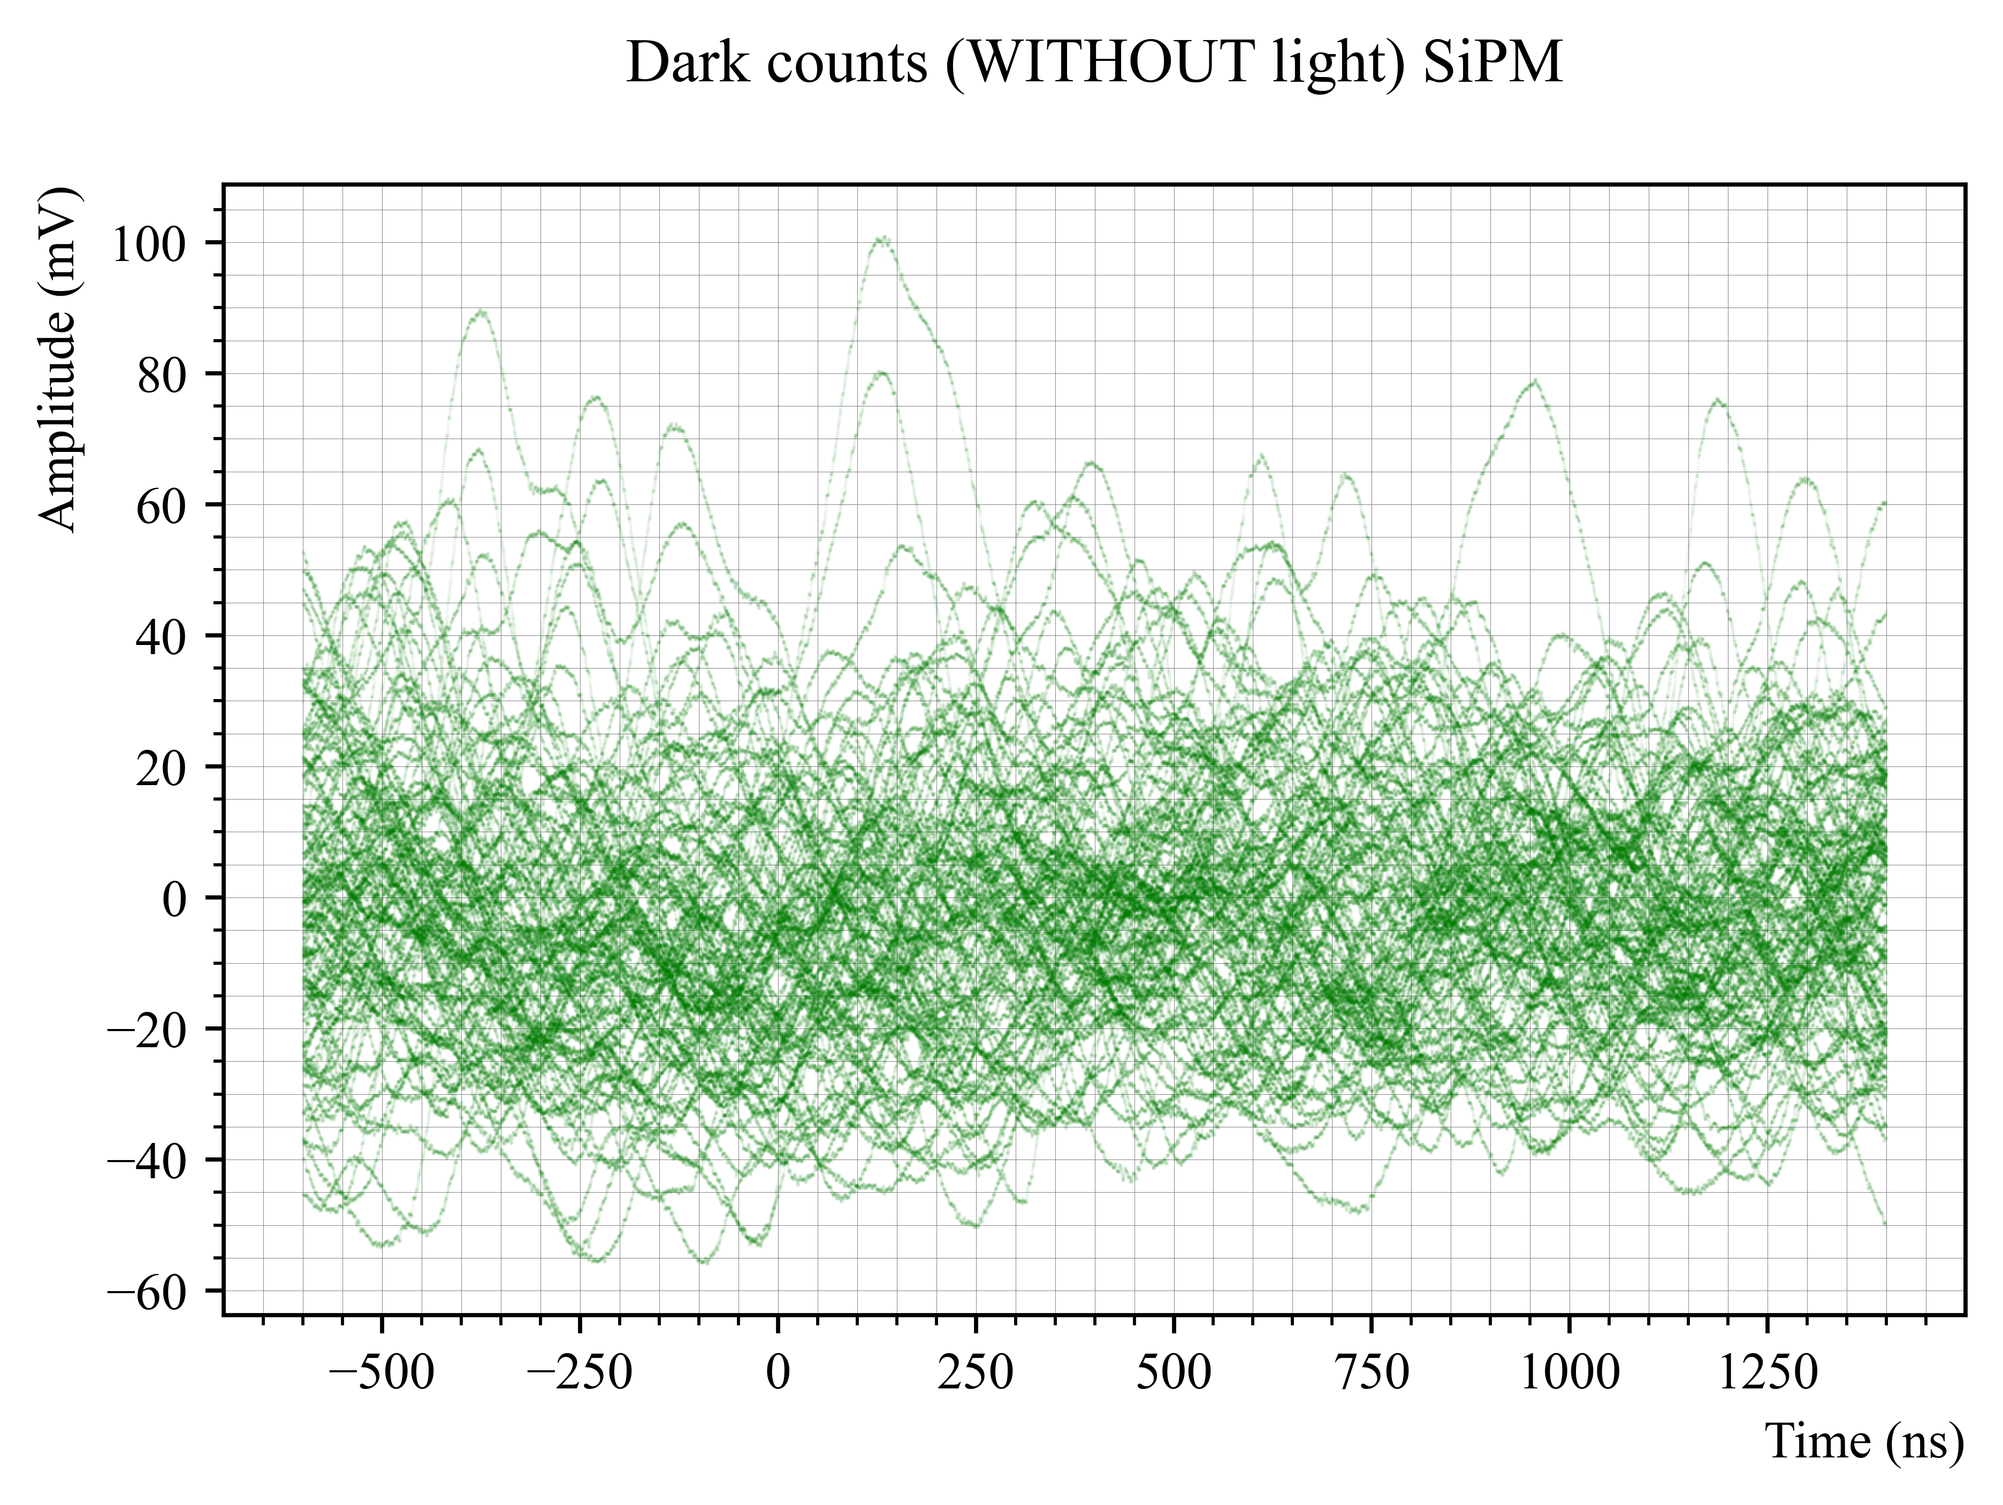
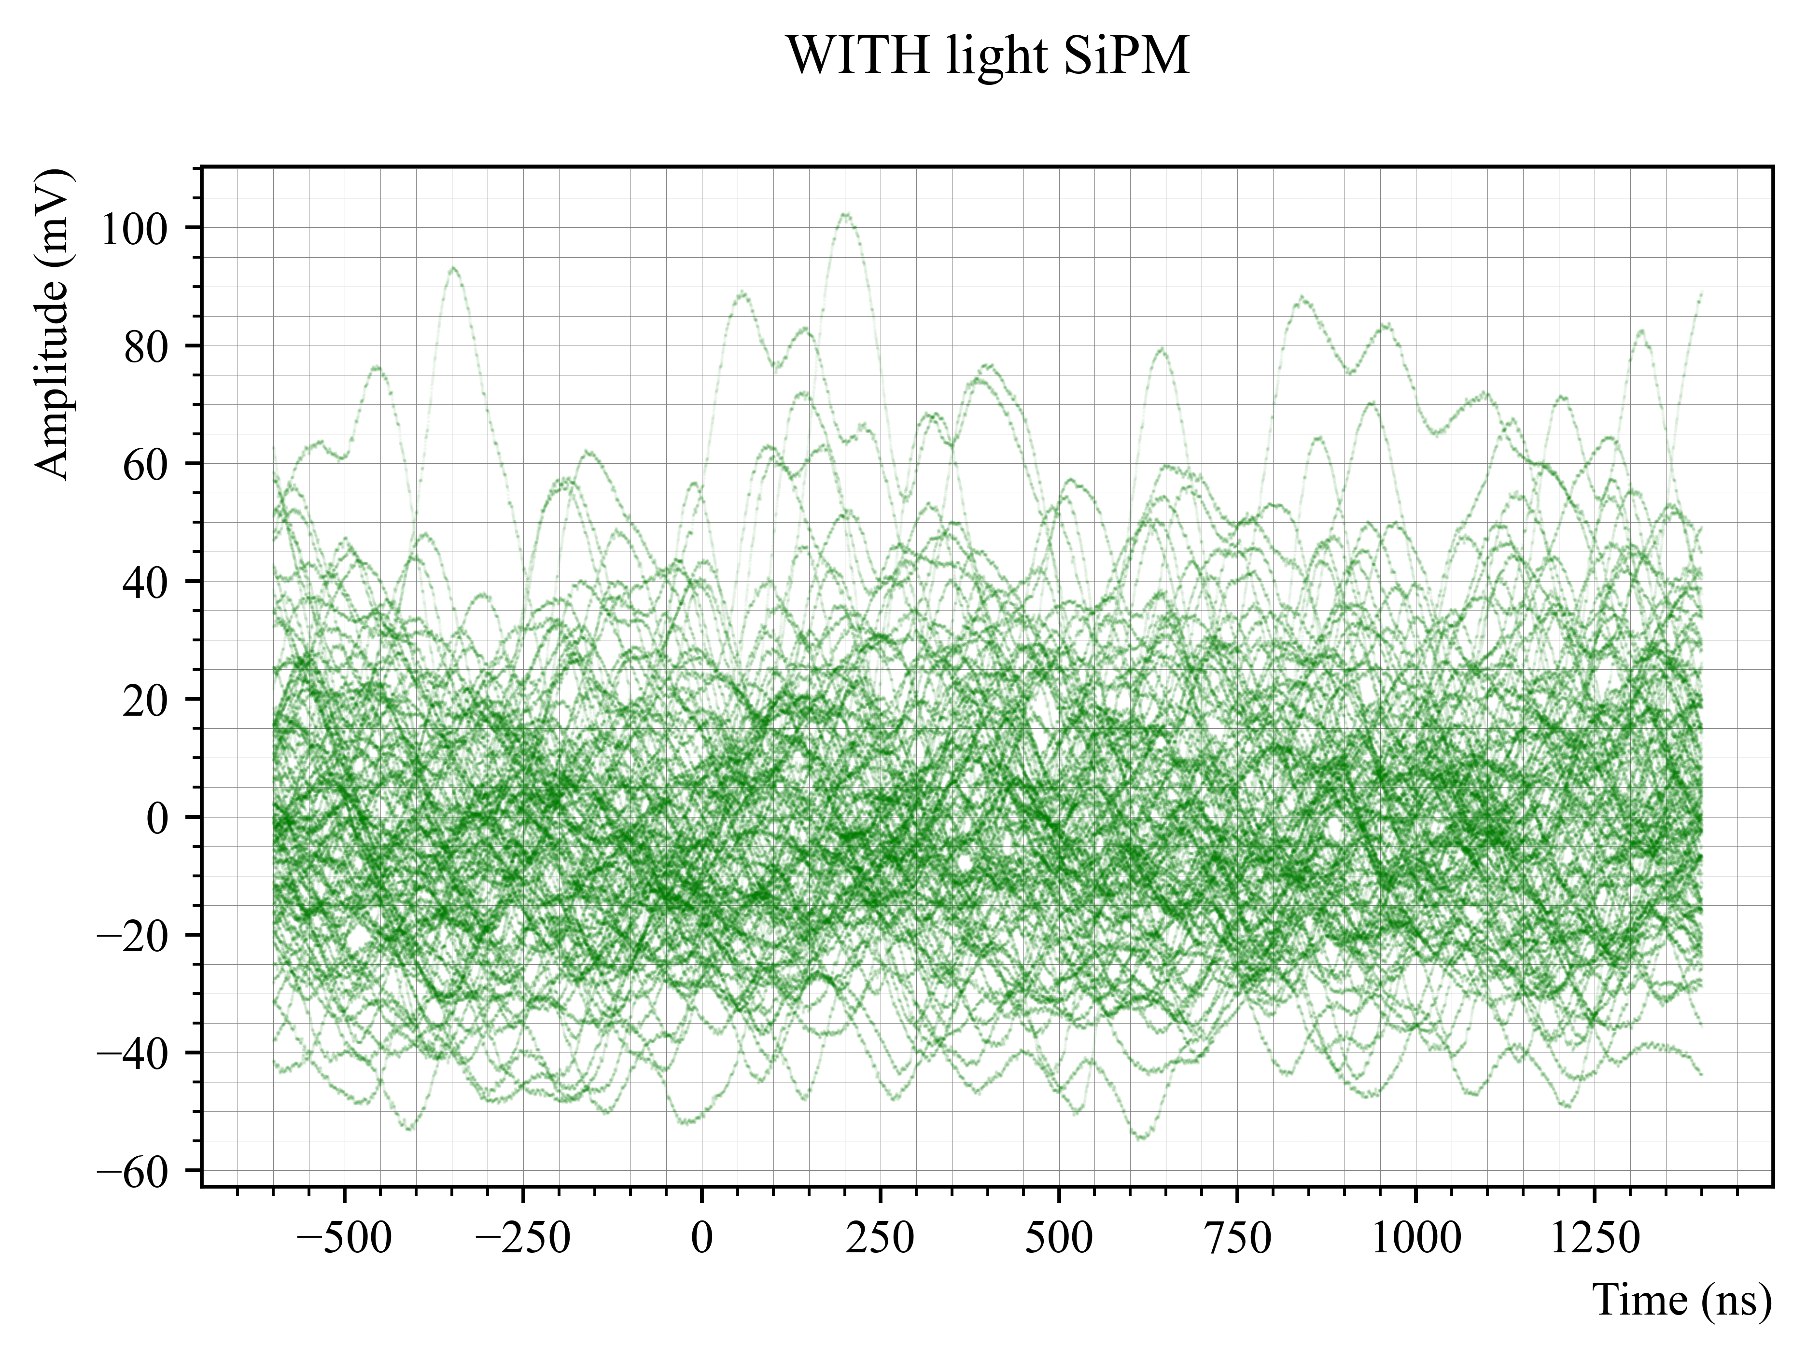
Looking at it from another angle: can we discriminate between SiPM external single photon signals and the DCR band at room temperature?
From my old analysis, I know that the SiPM single photon level is at 5 mV (see blue plot).
At room temperature, the SiPM dark counts band reaches 40 mV (see left green plot).
It was not possible, at room temperature, to discriminate between SiPM single photon signals that are at 5 mV, as they are hidden in the dark counts band which reaches 40 mV (see right green plot).
SP level

Slide 8
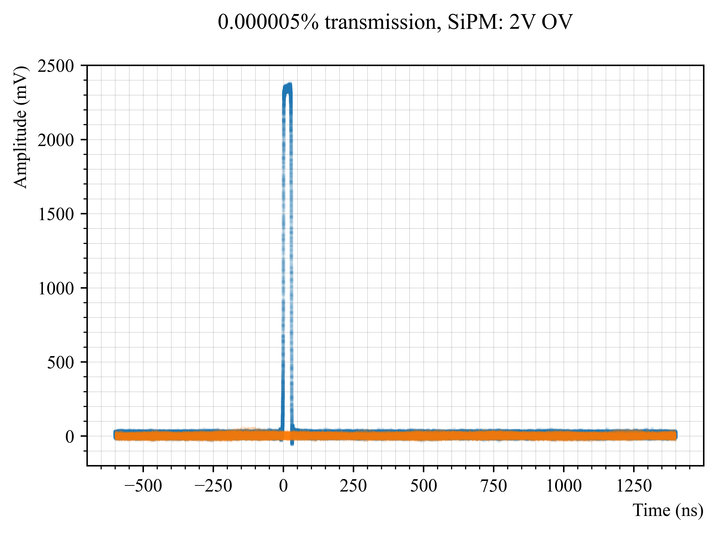
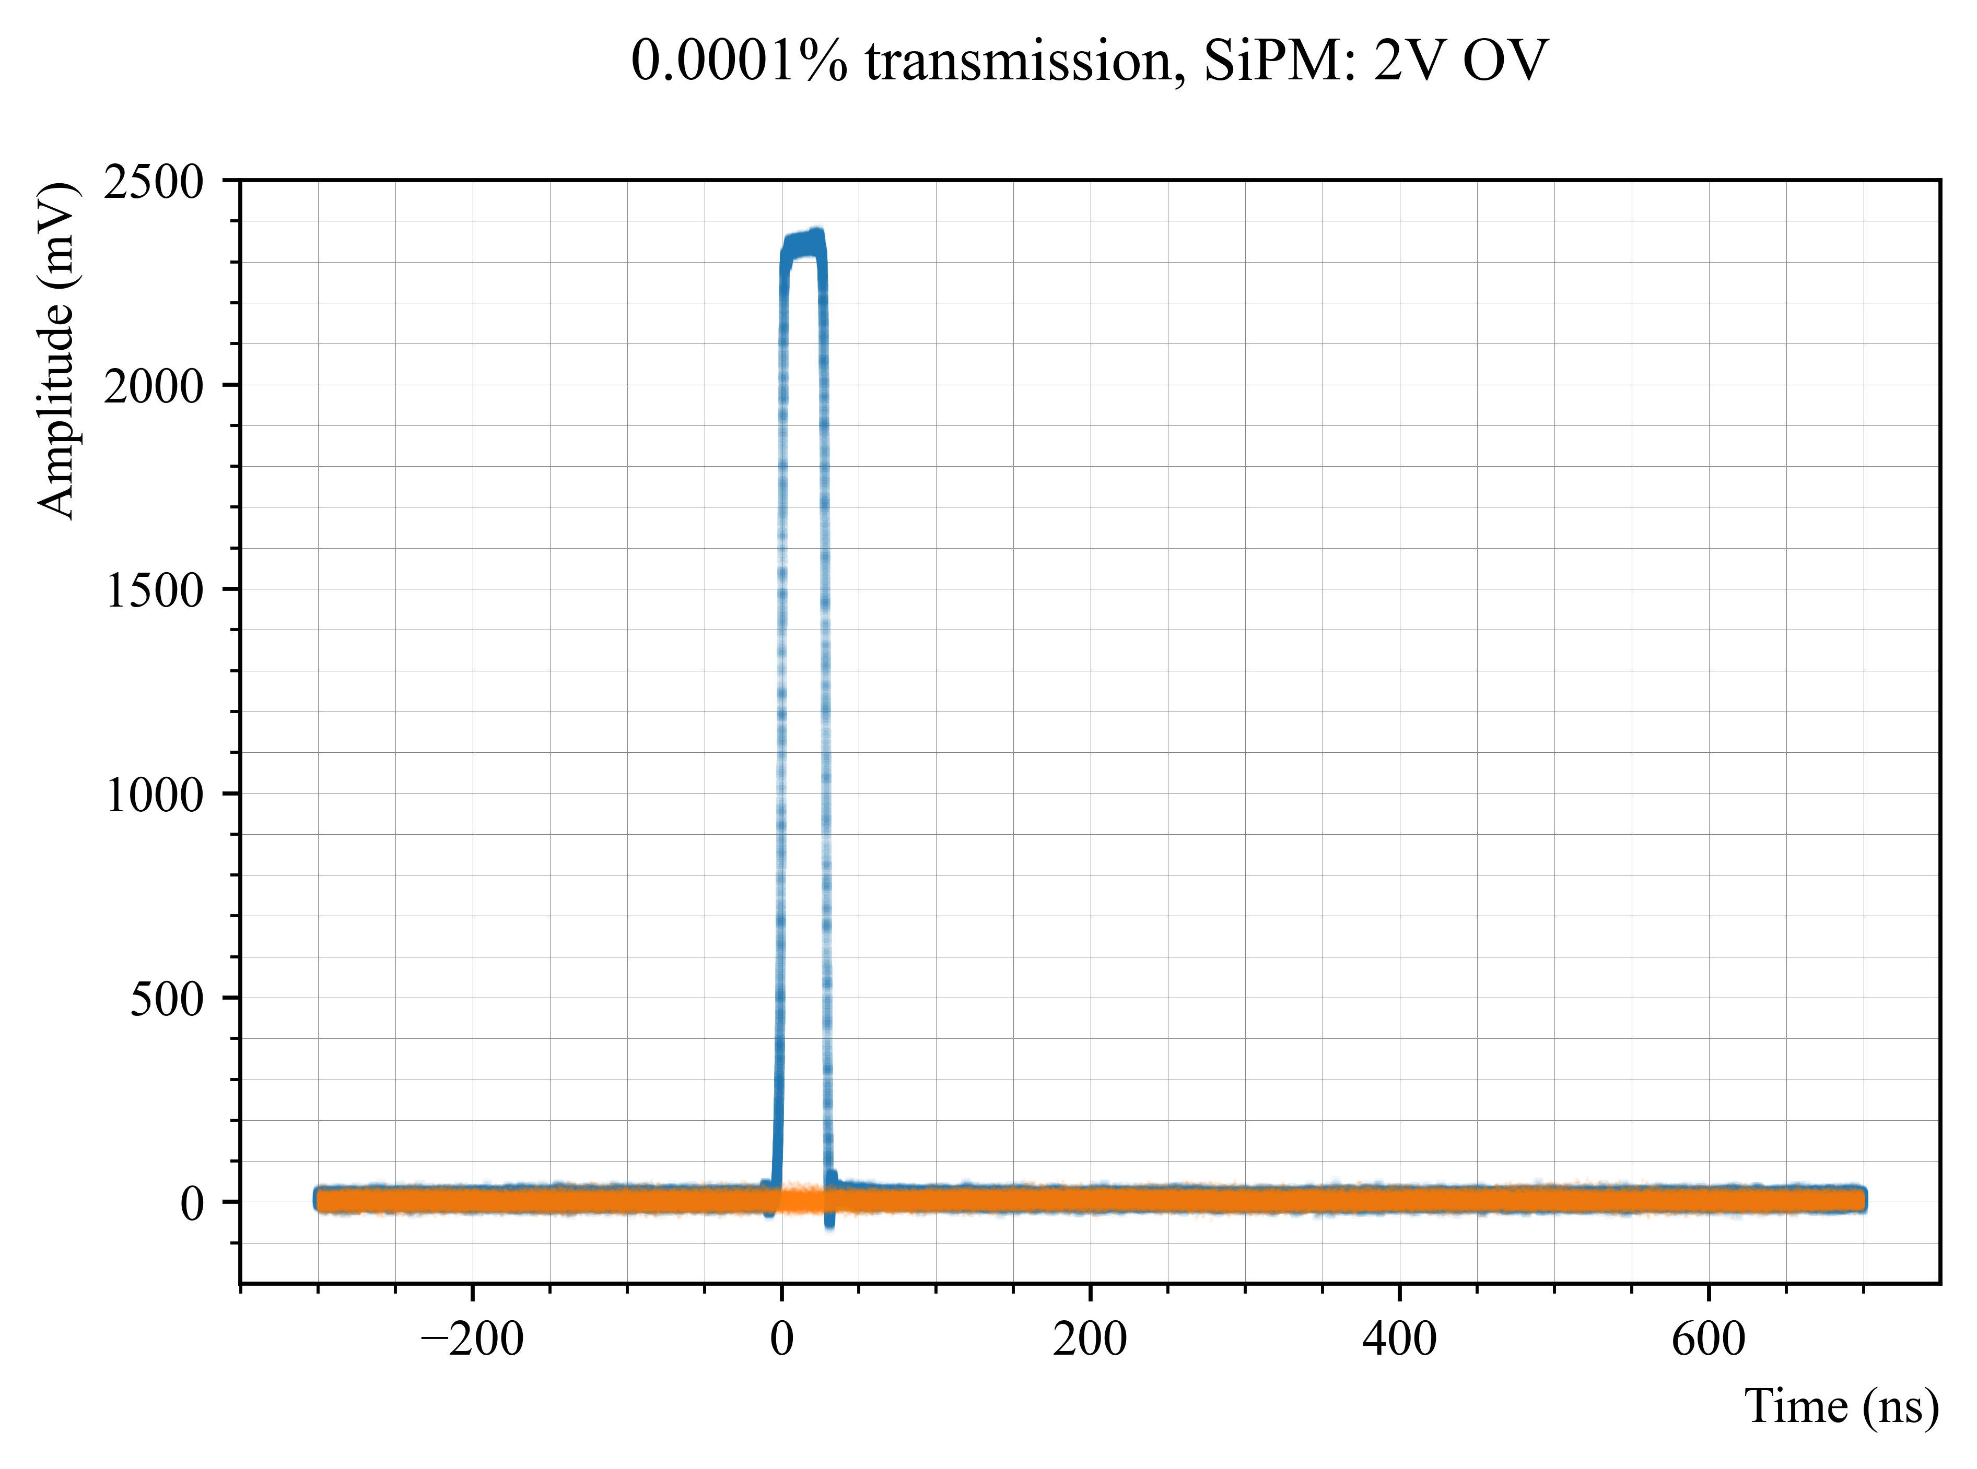
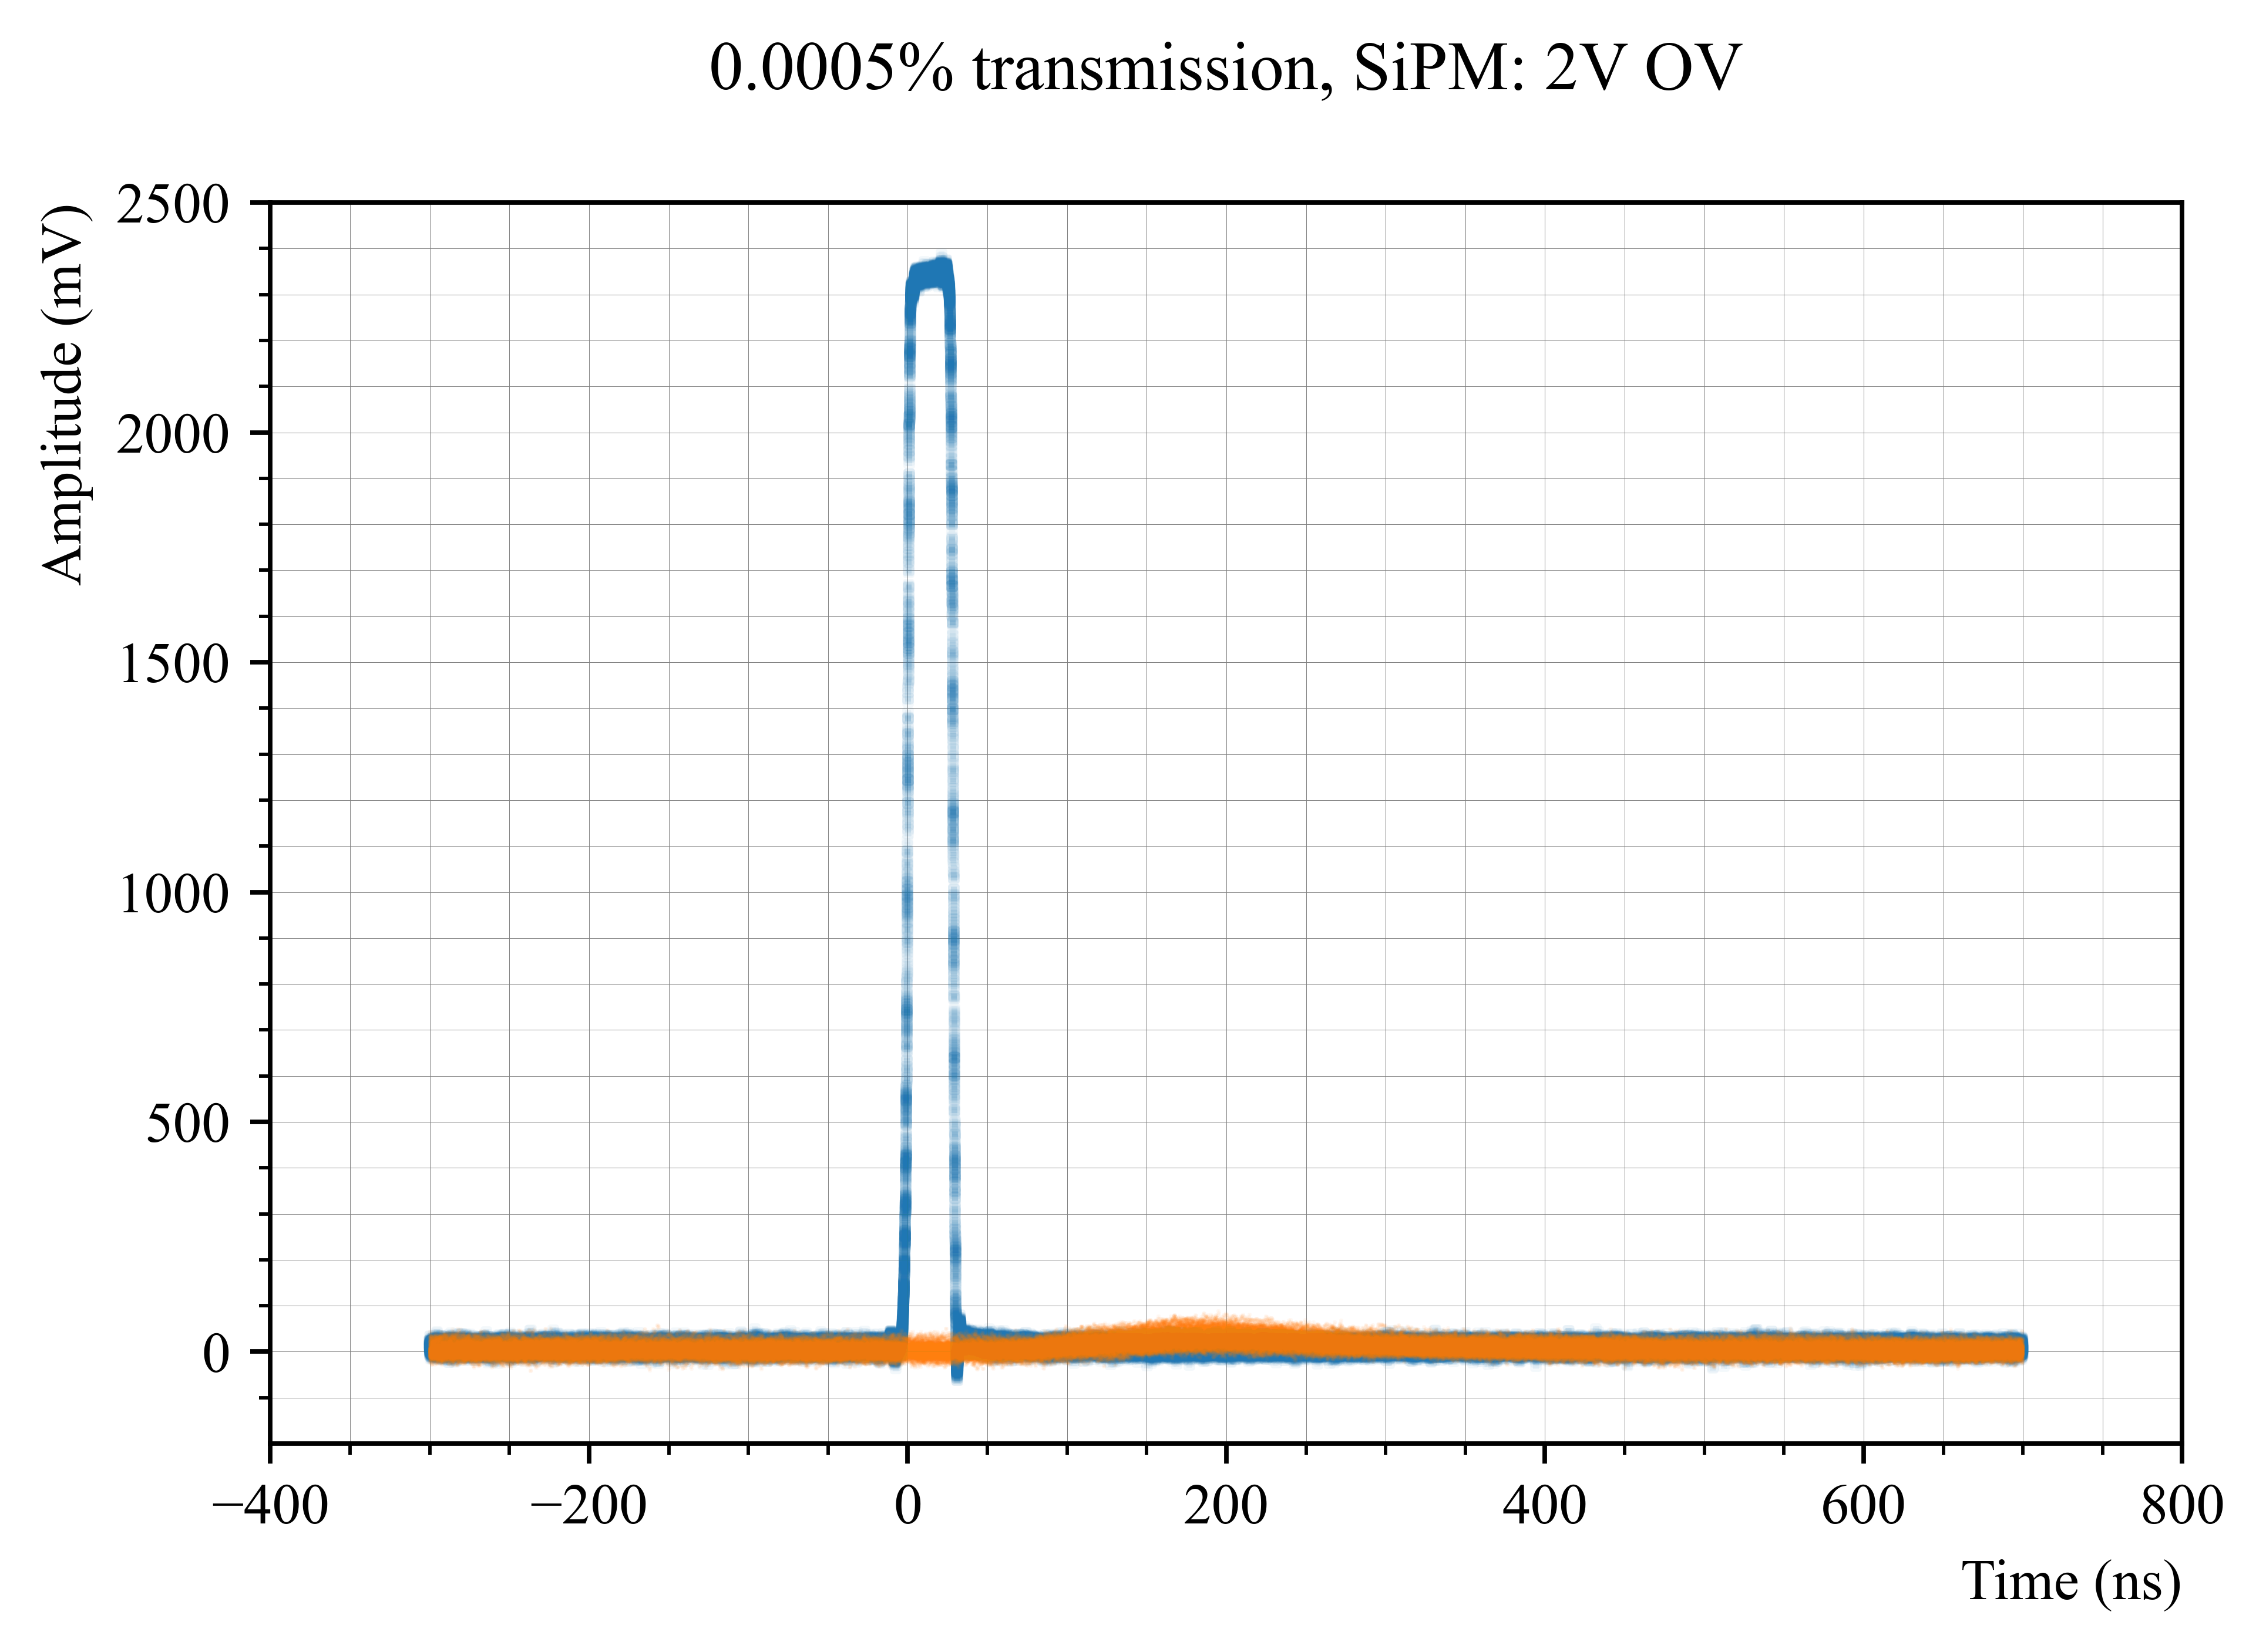
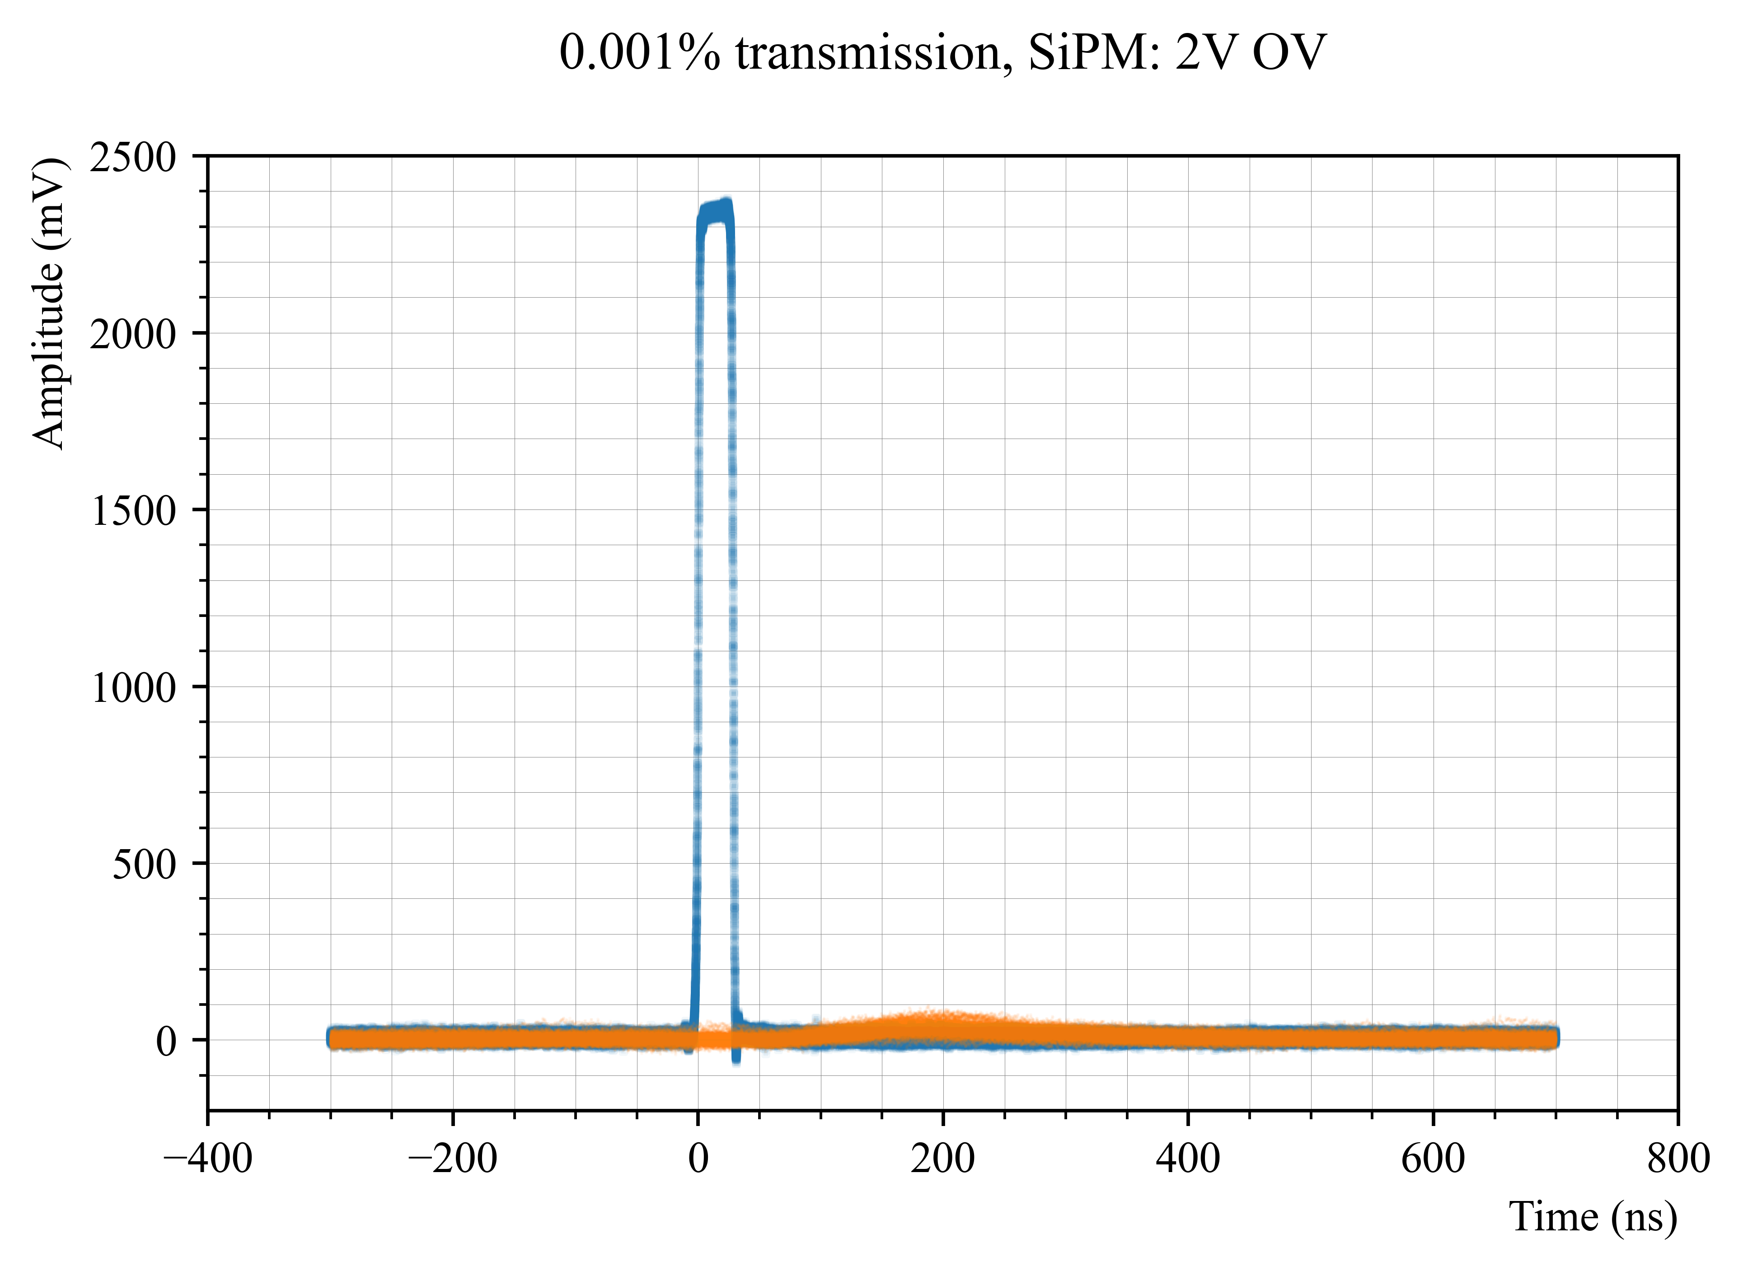
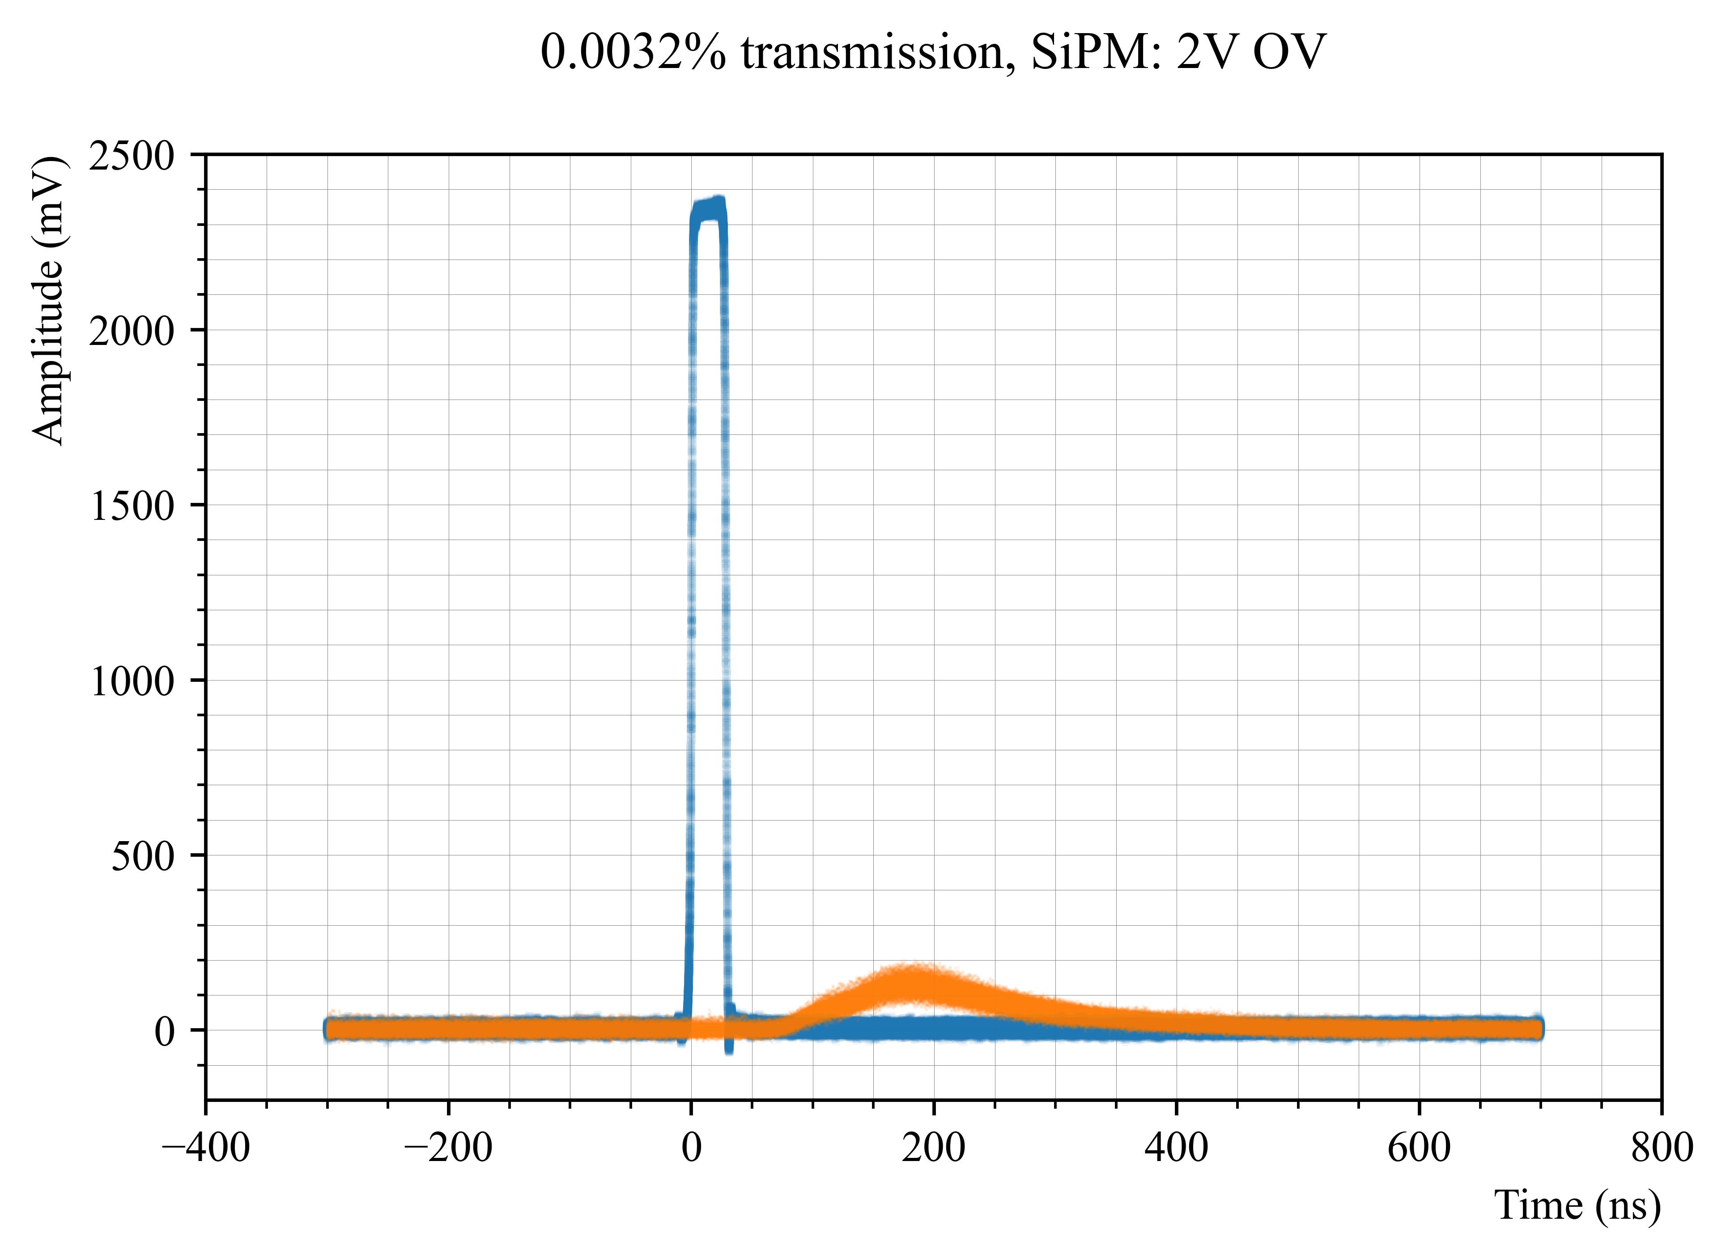
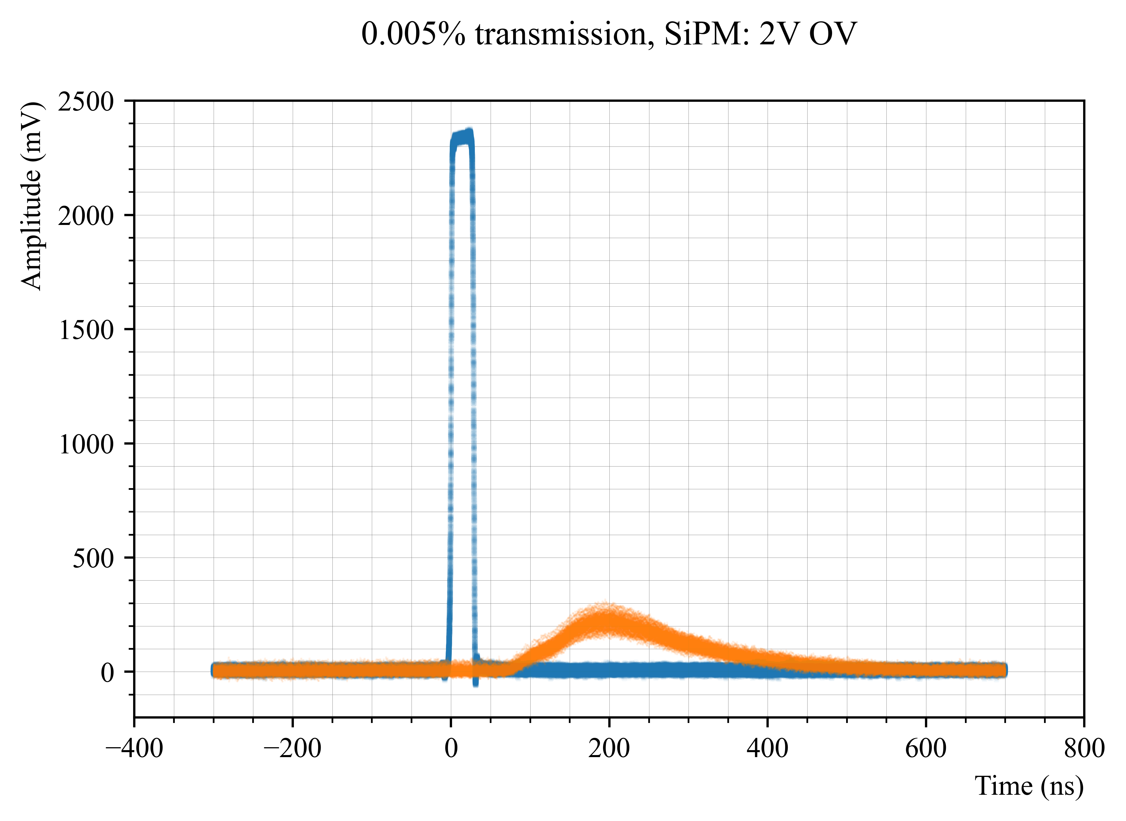
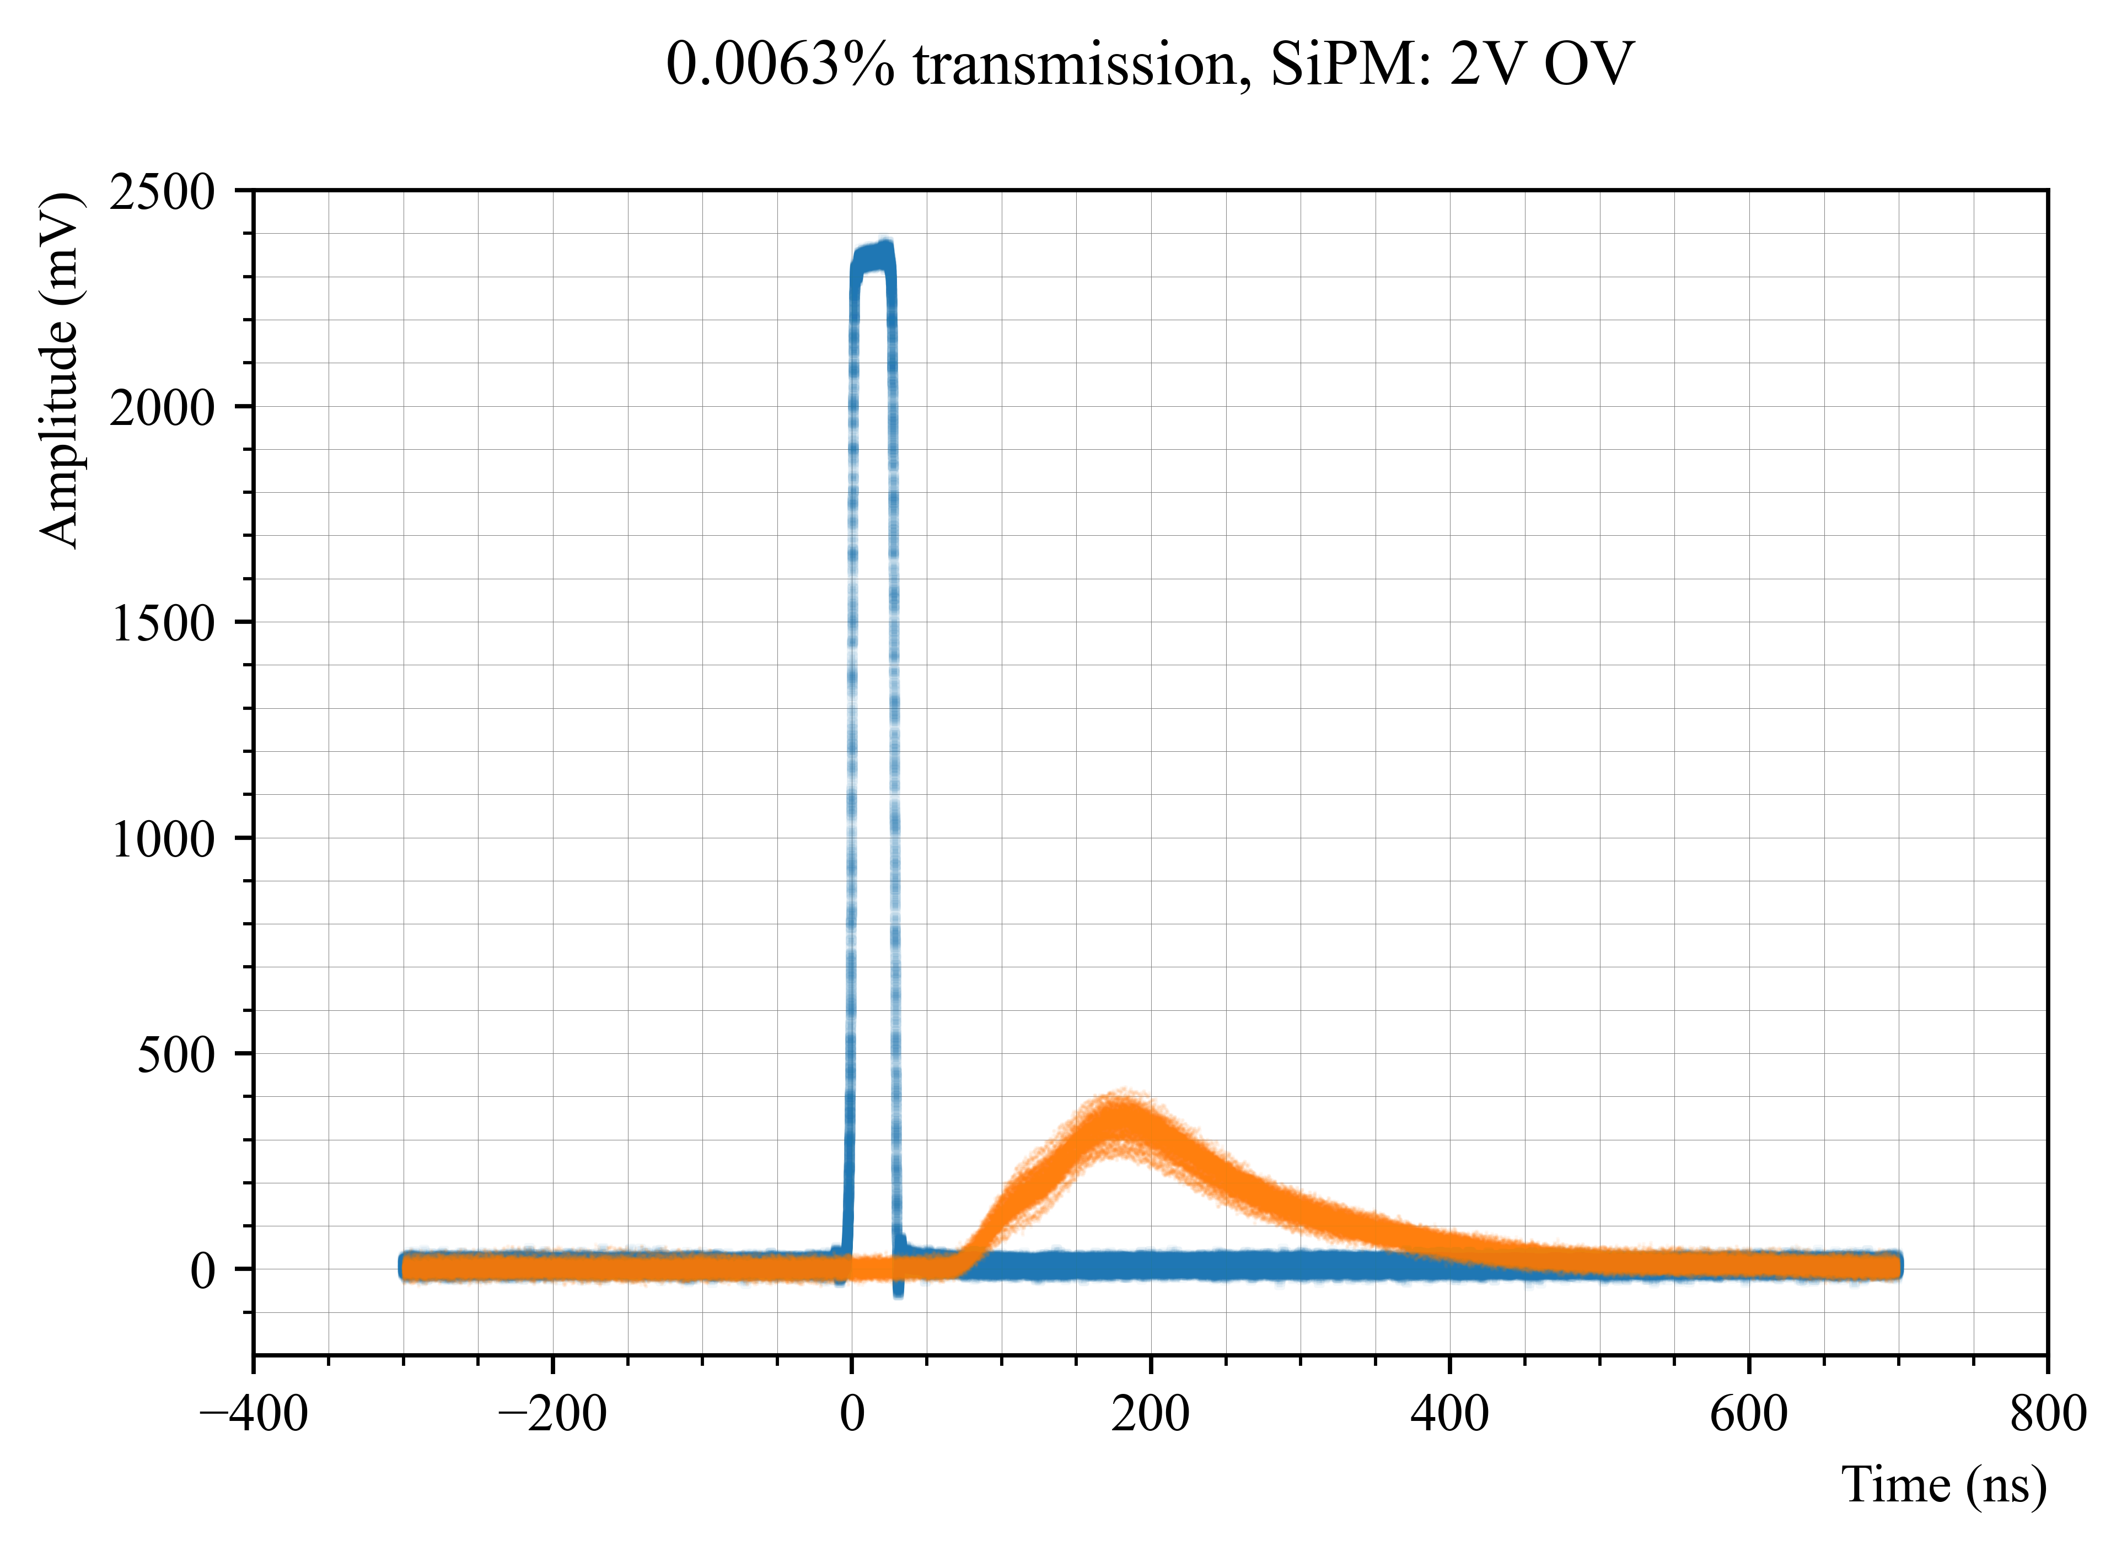
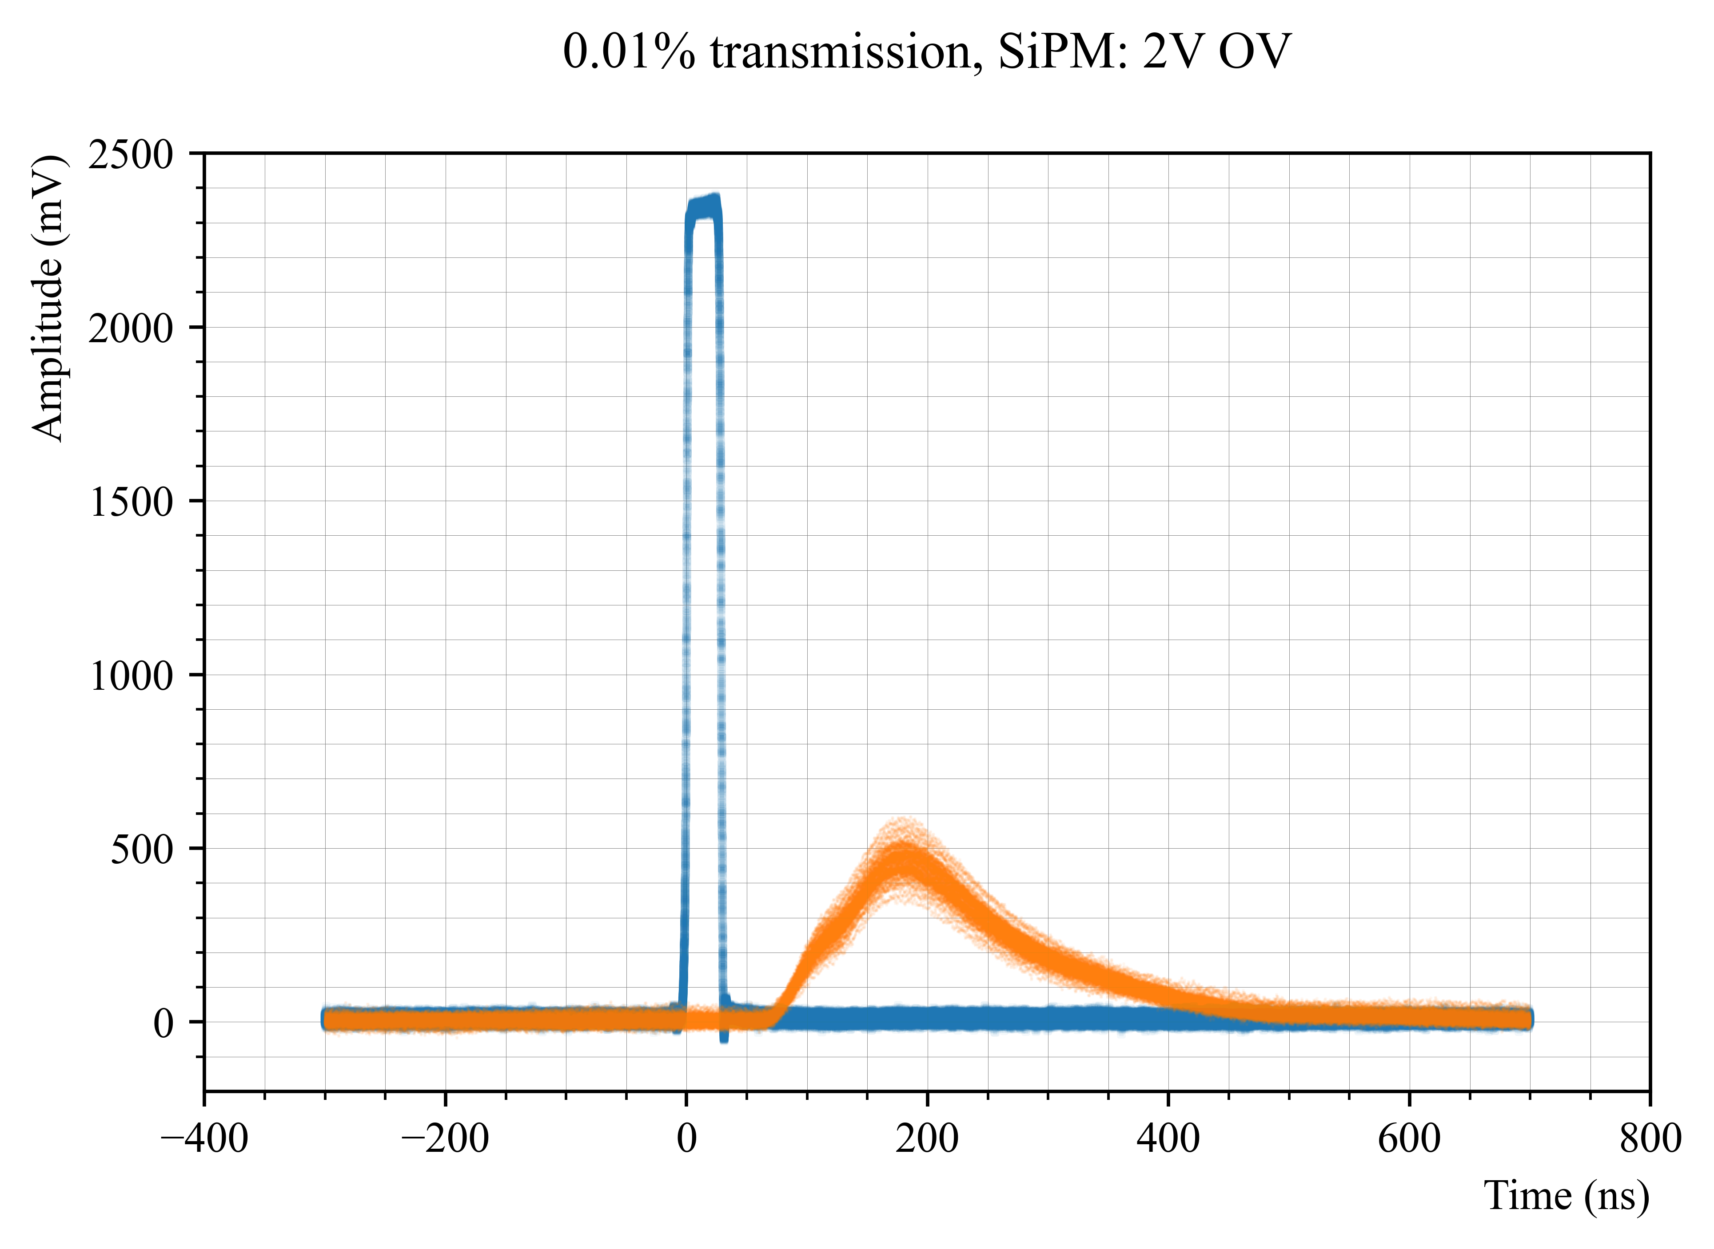
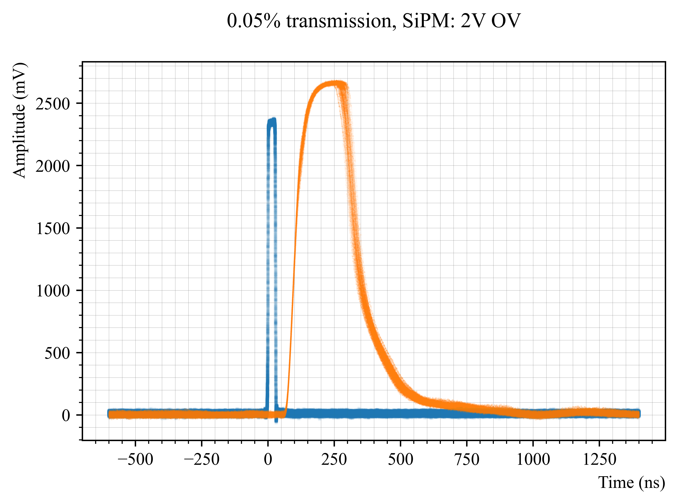
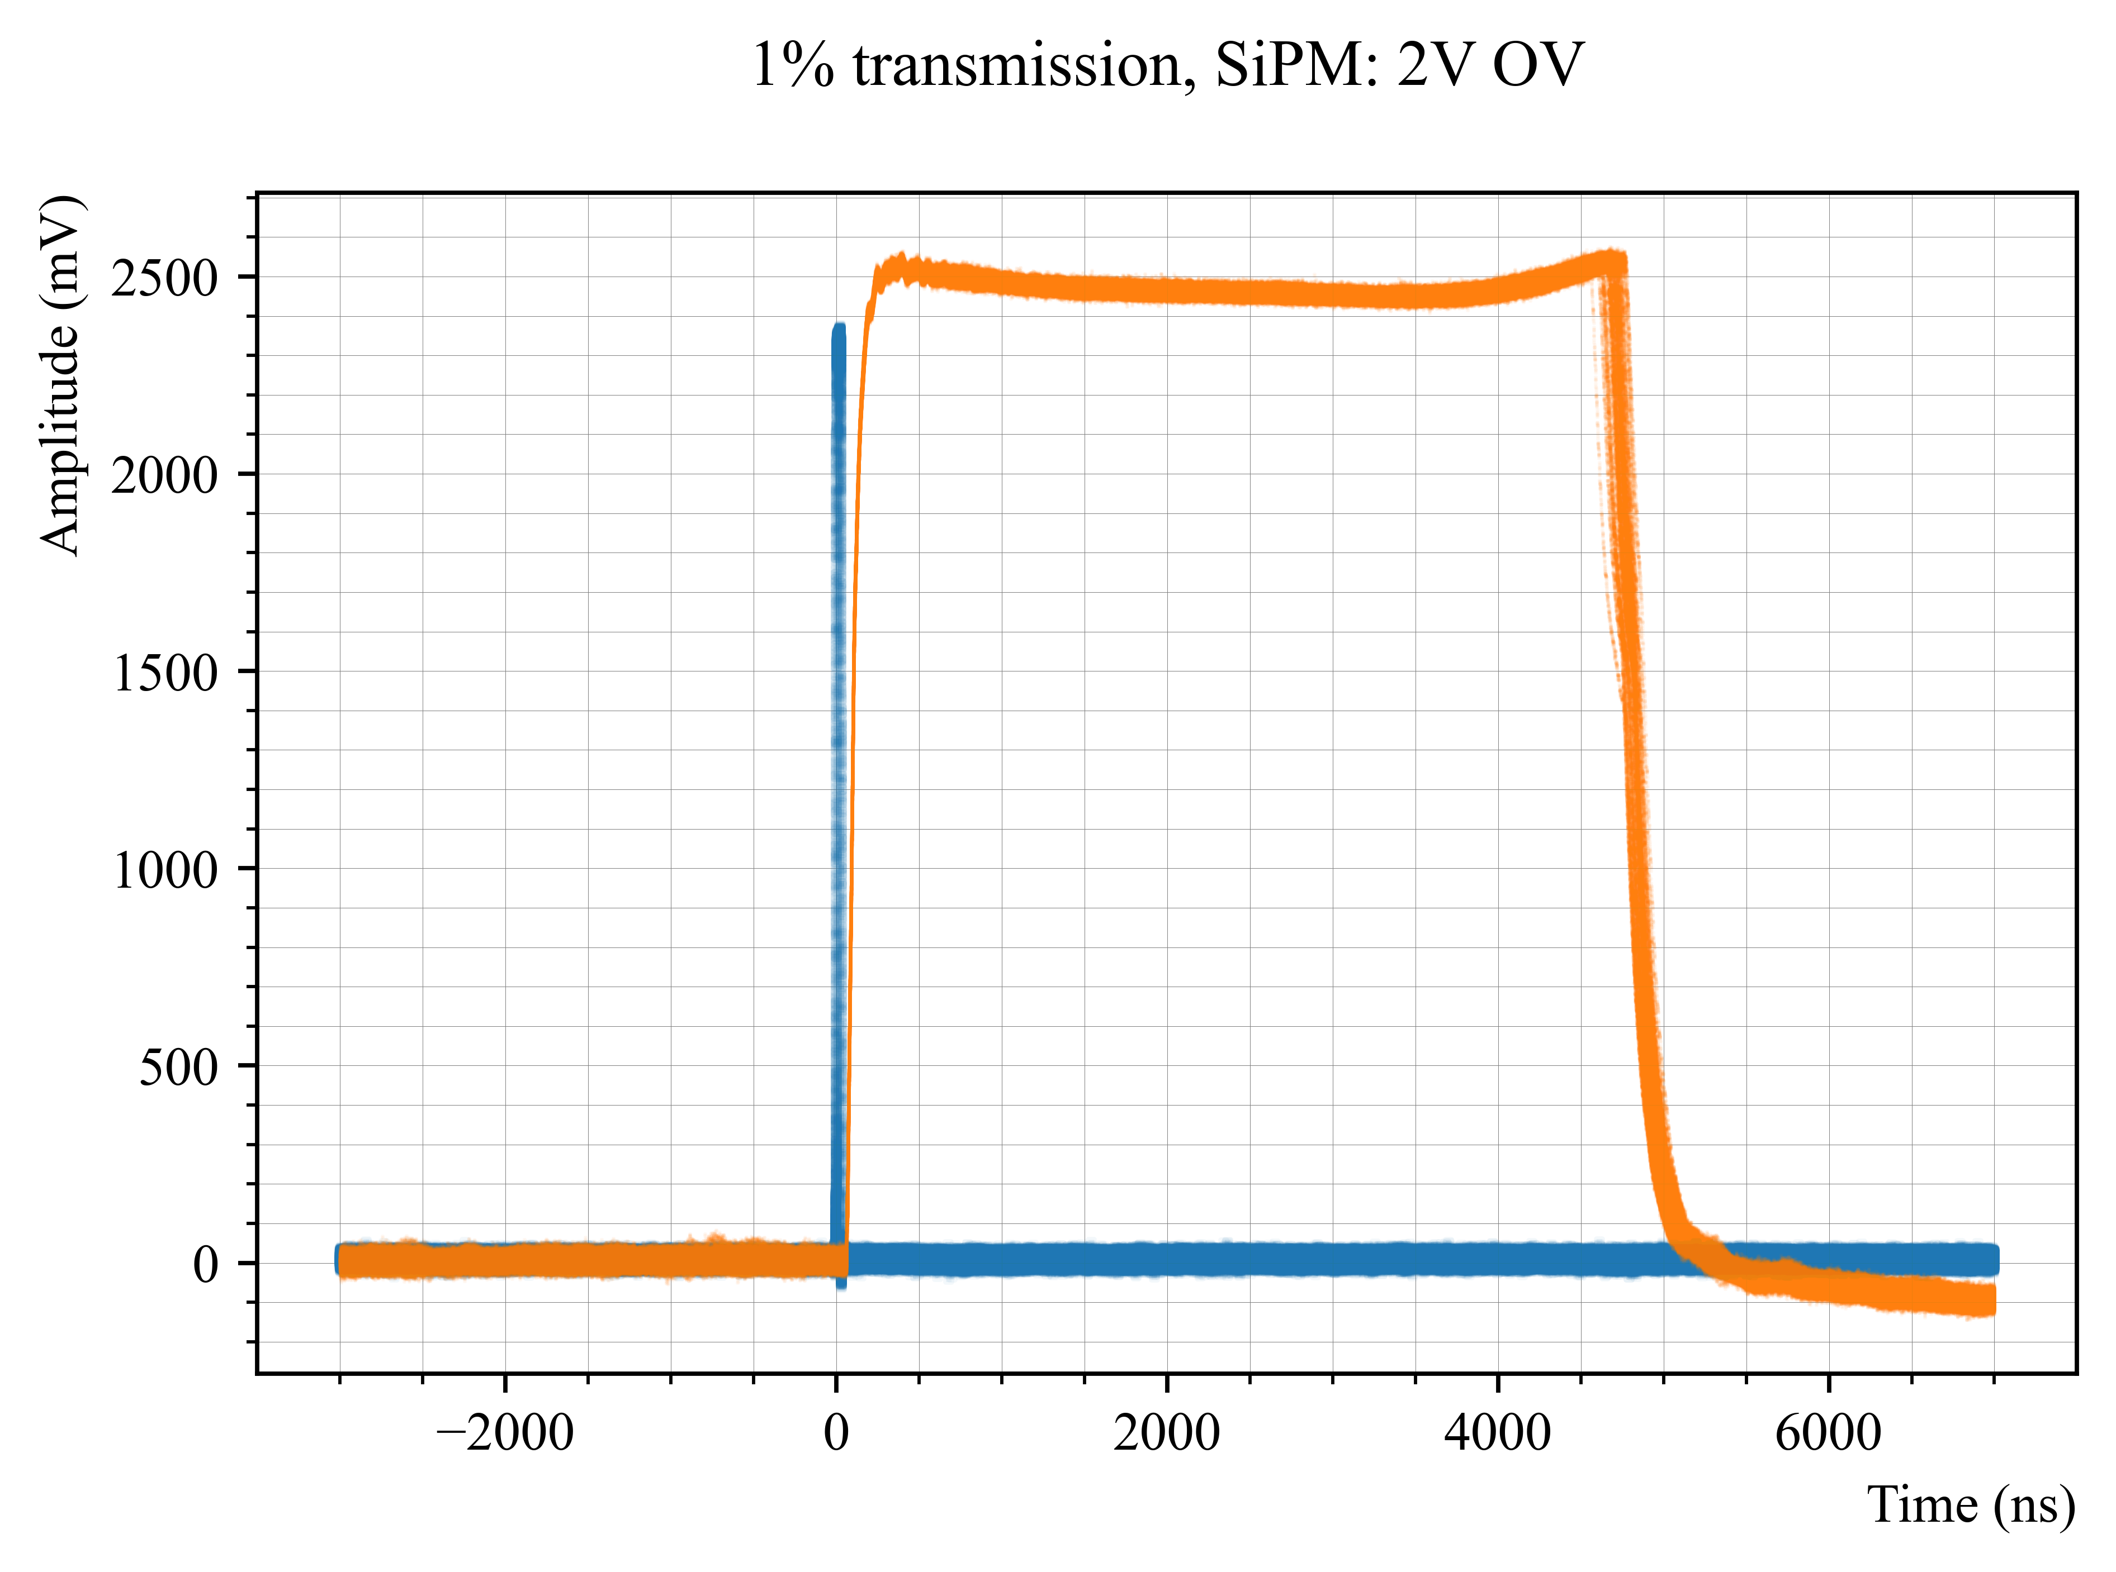
SiPM: 2V overvoltage

Slide 9
Extra slides

Slide 10
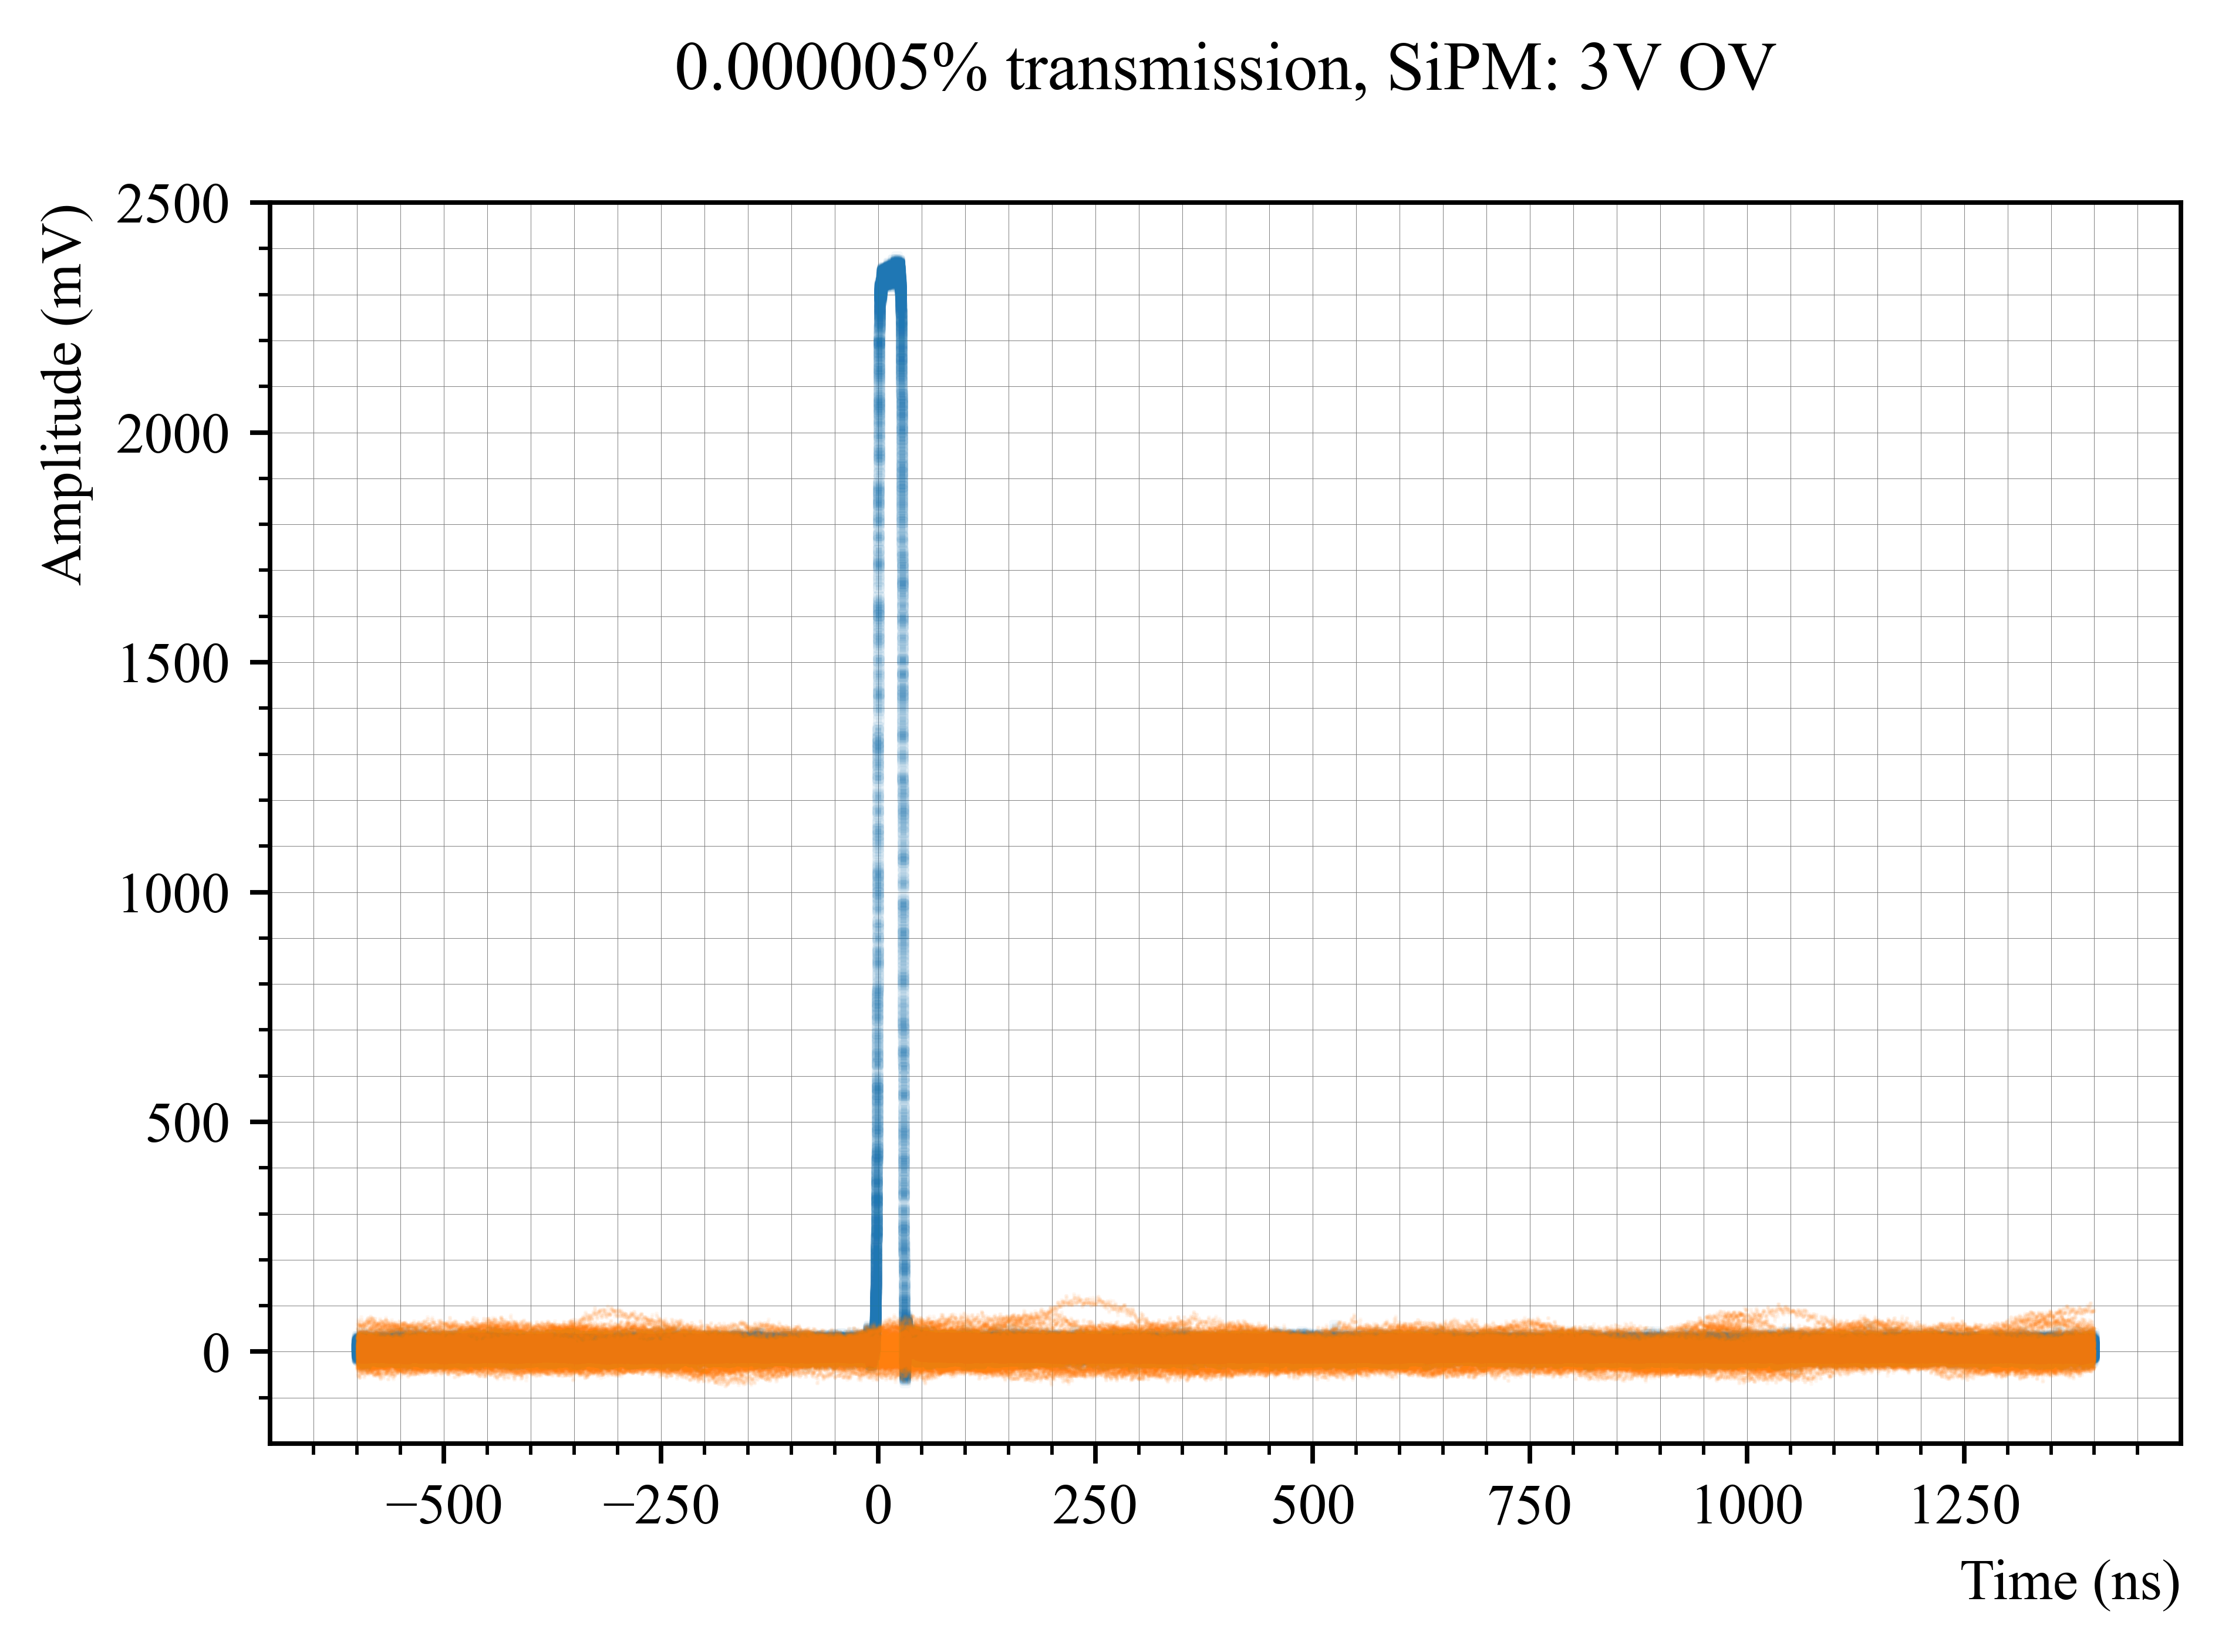

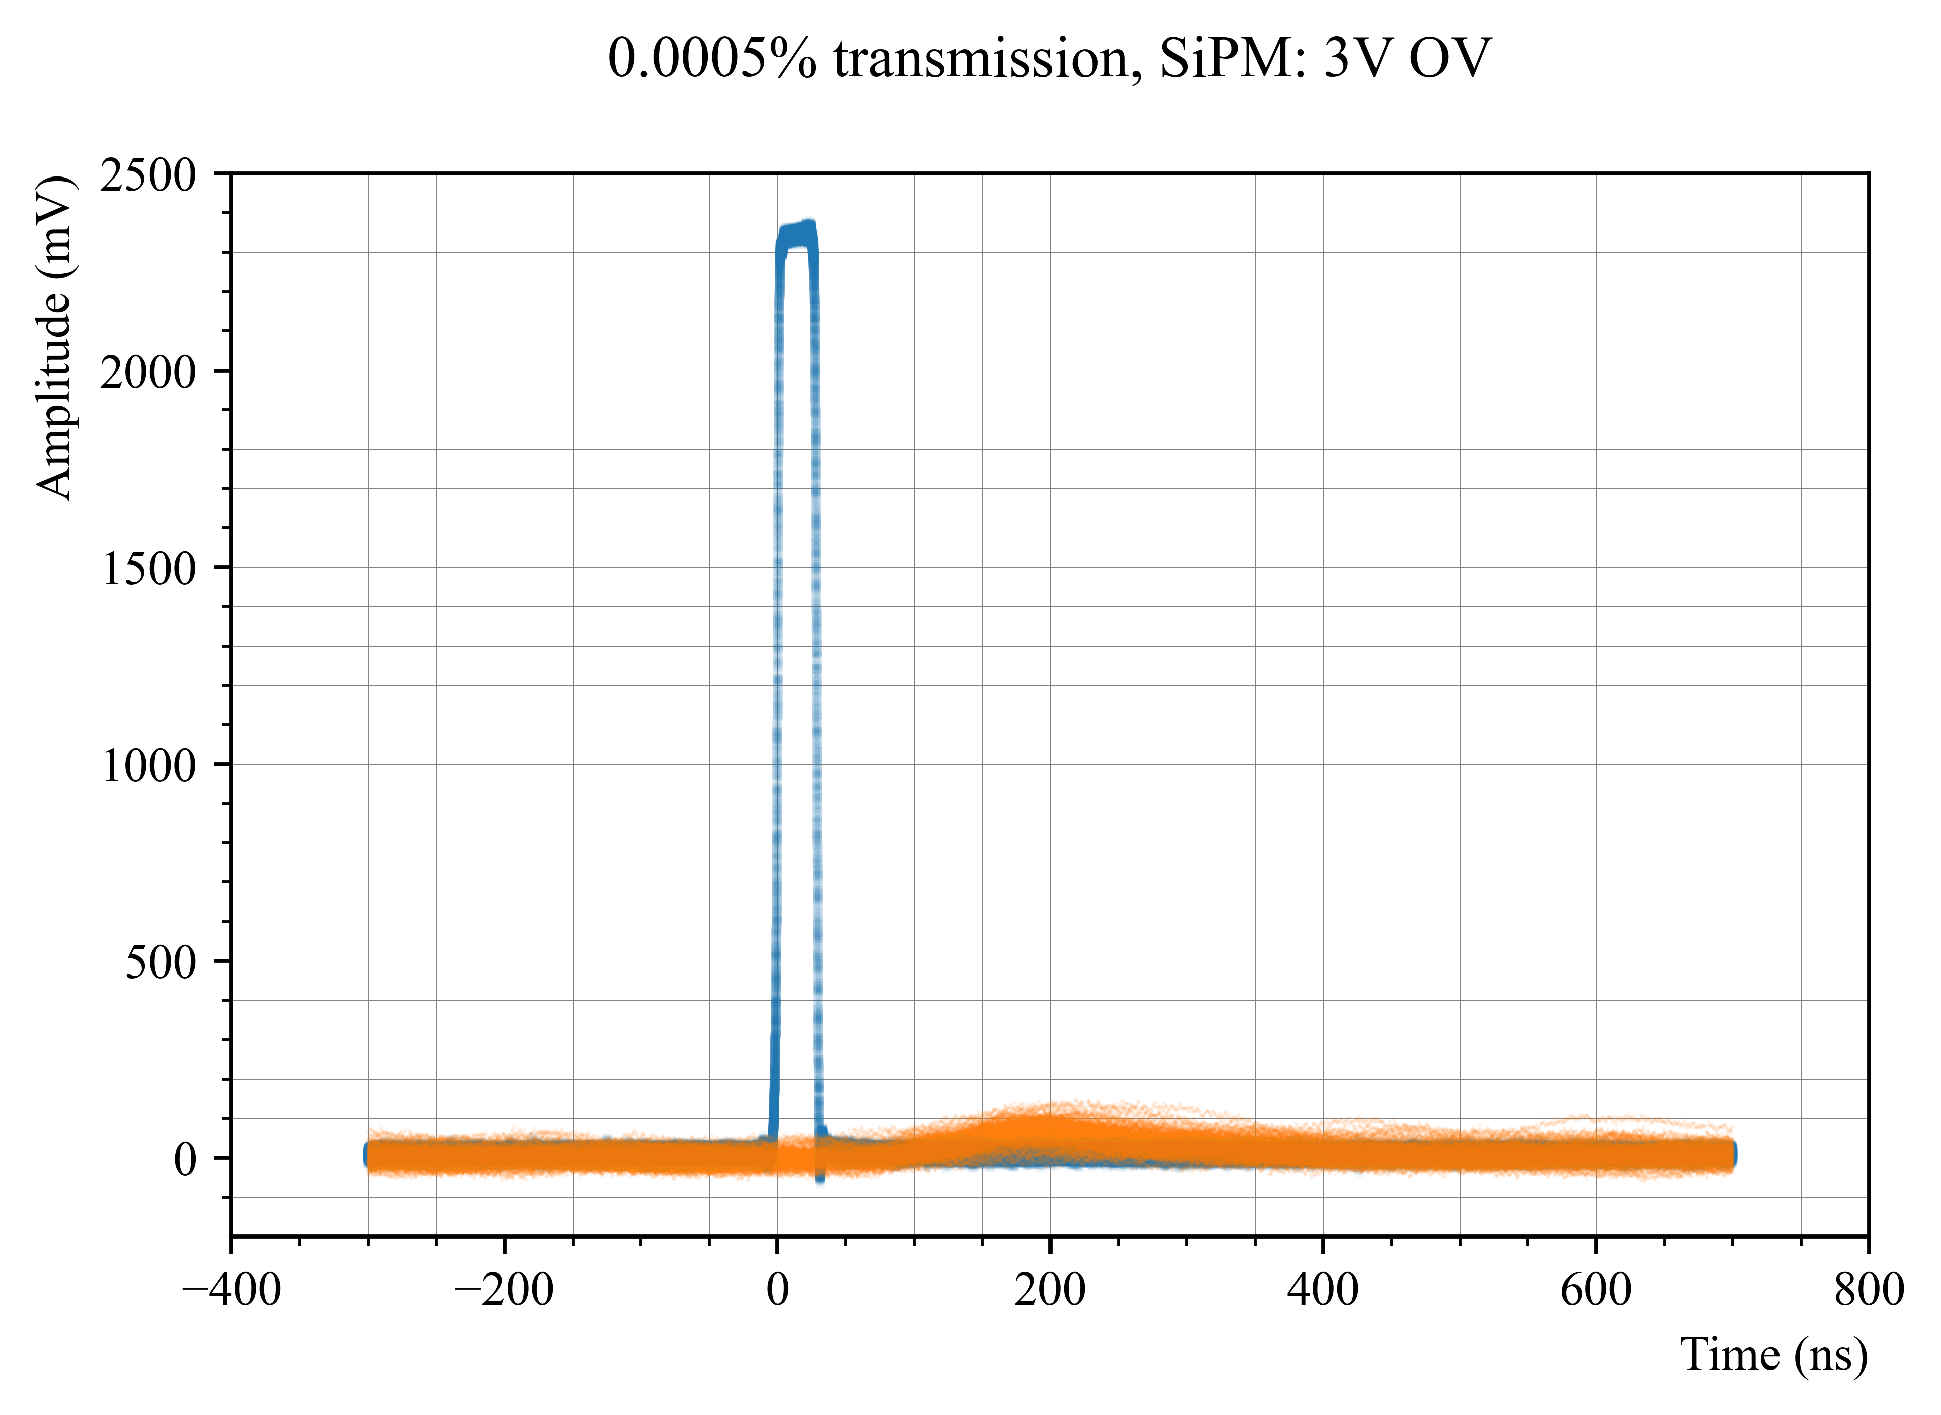

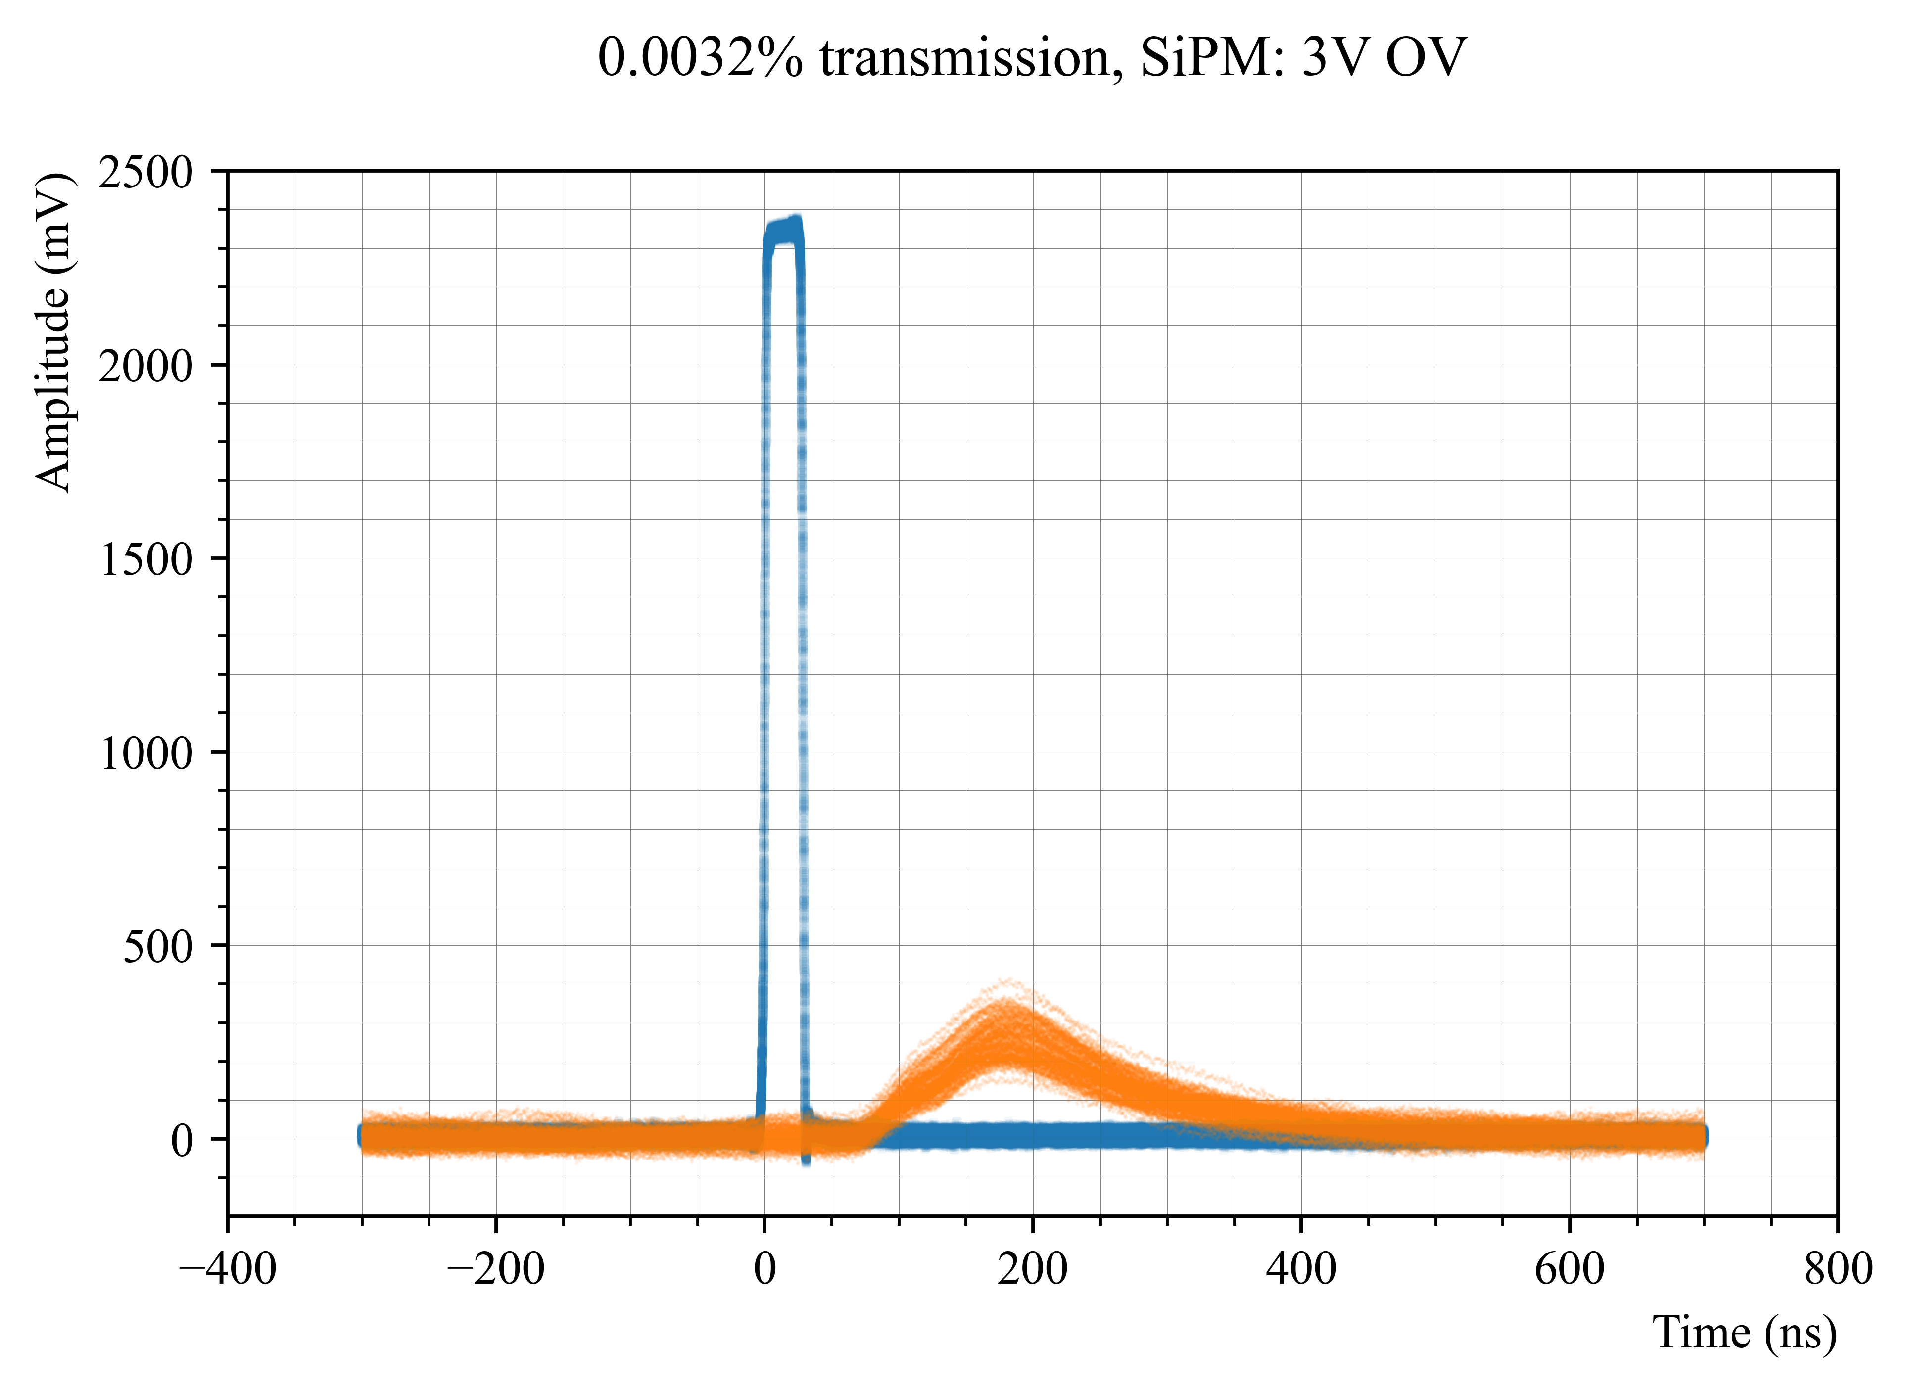
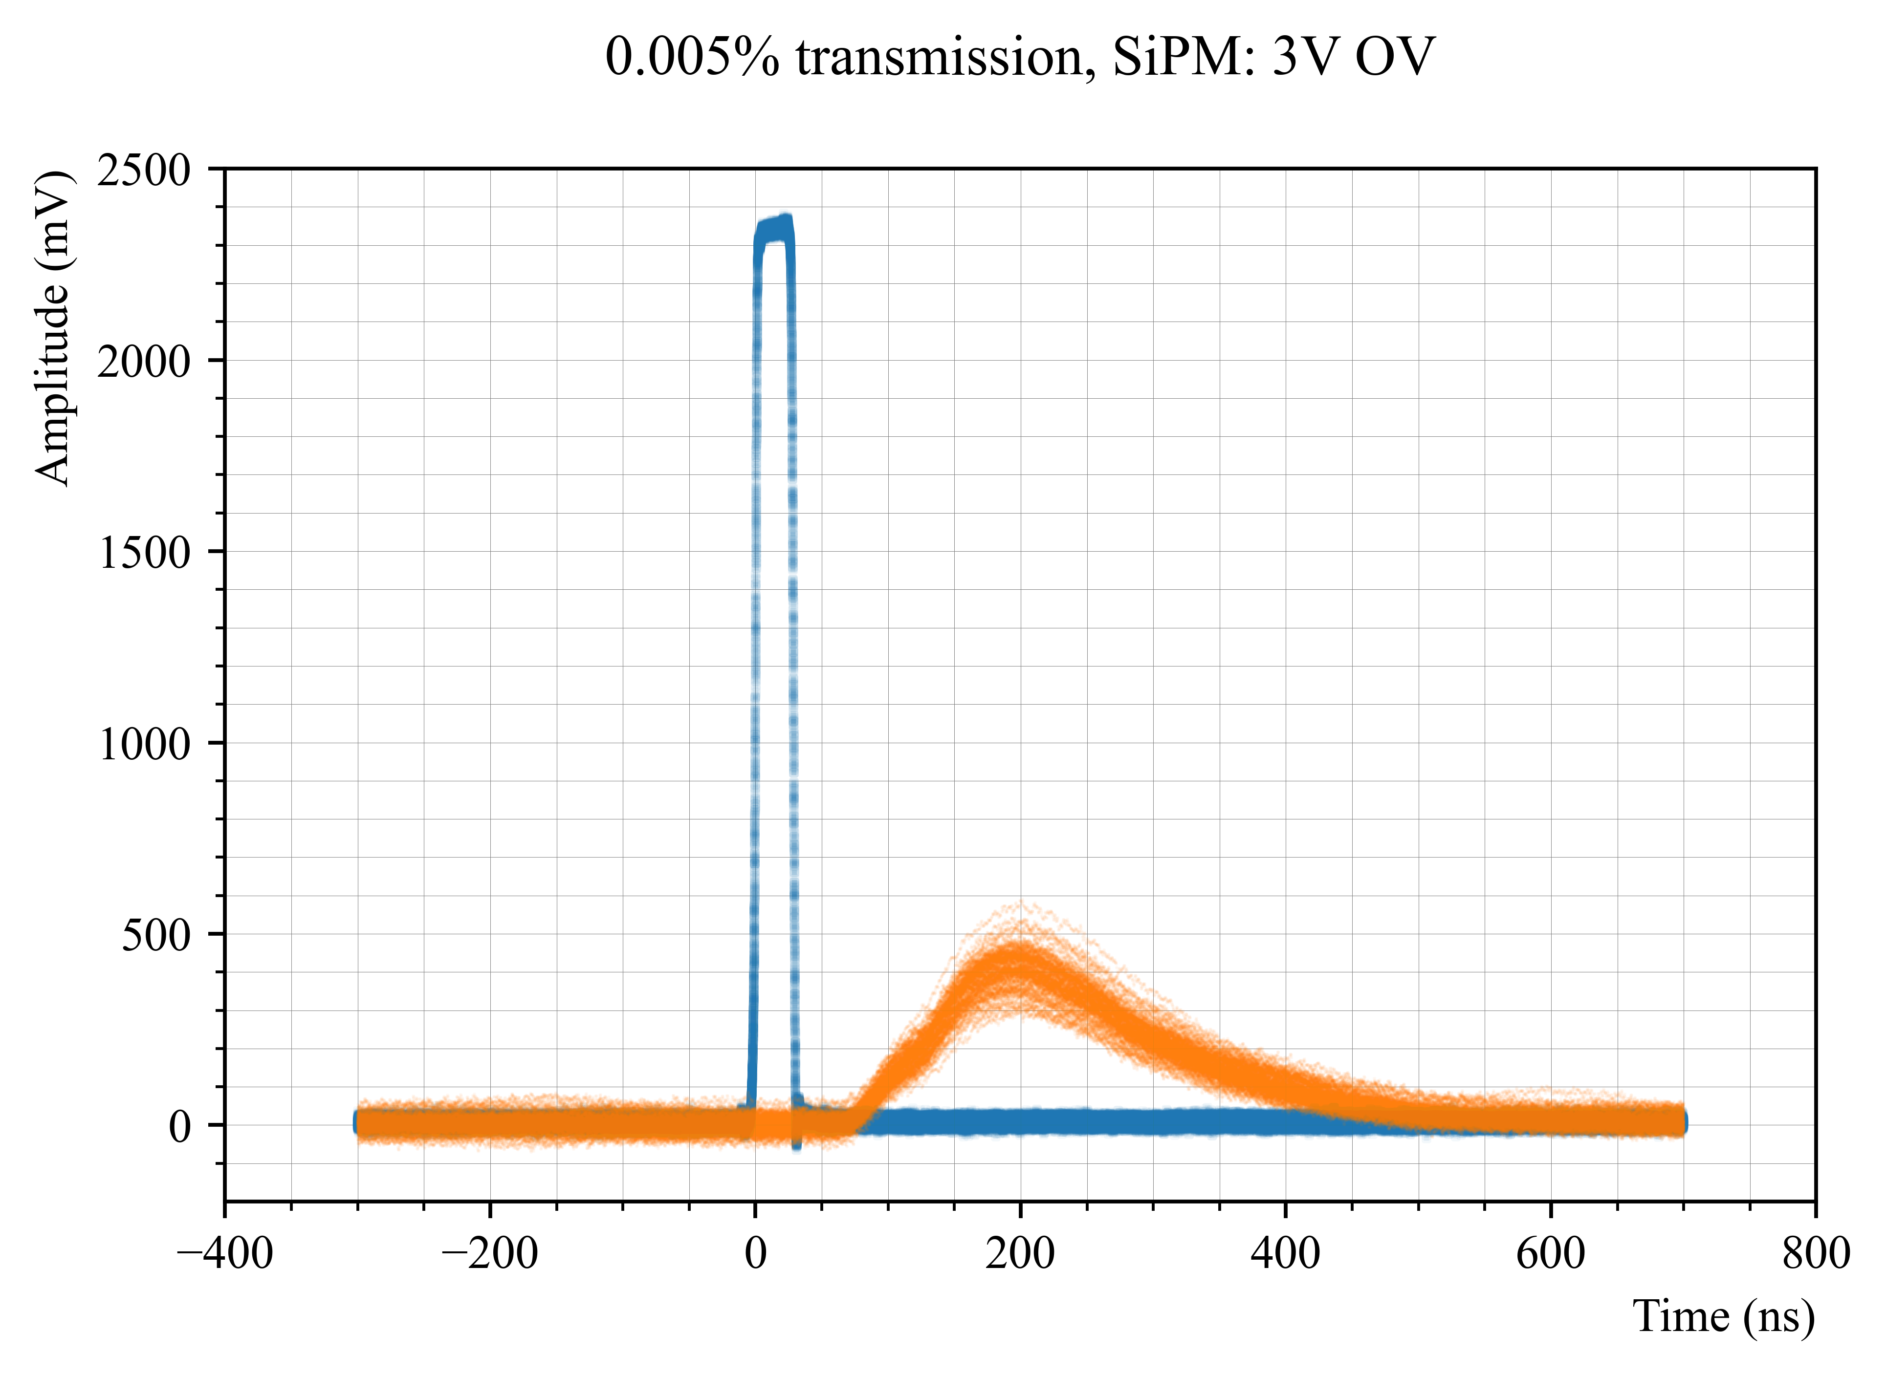
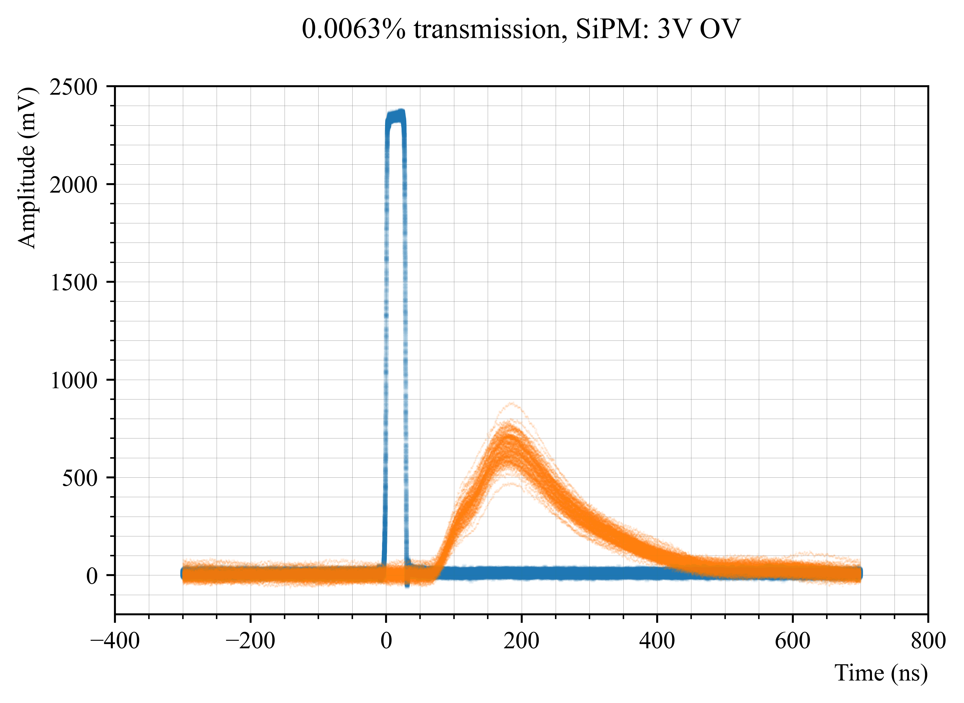
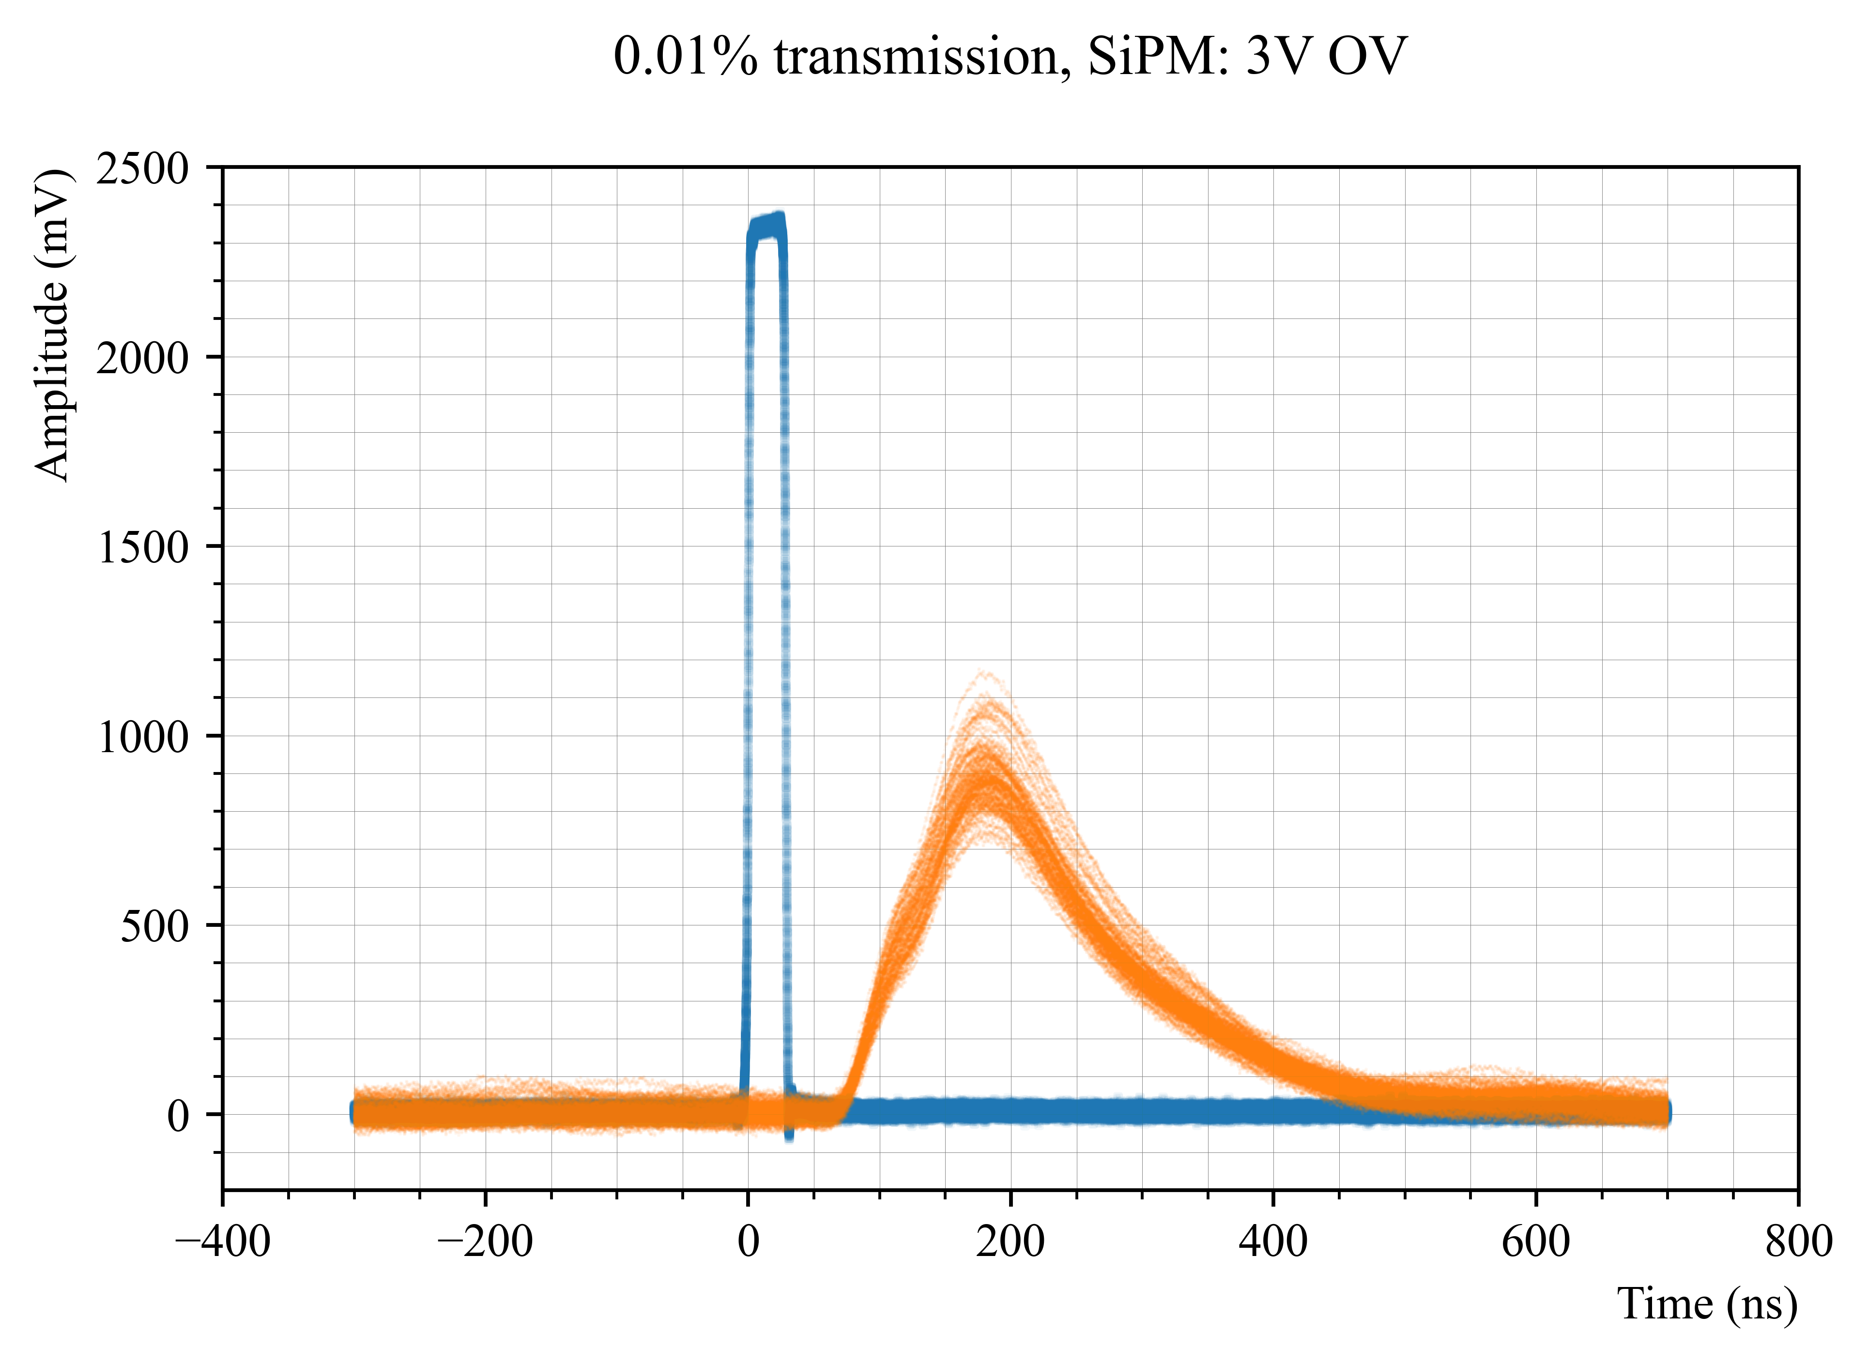
SiPM: 3V overvoltage

Slide 11
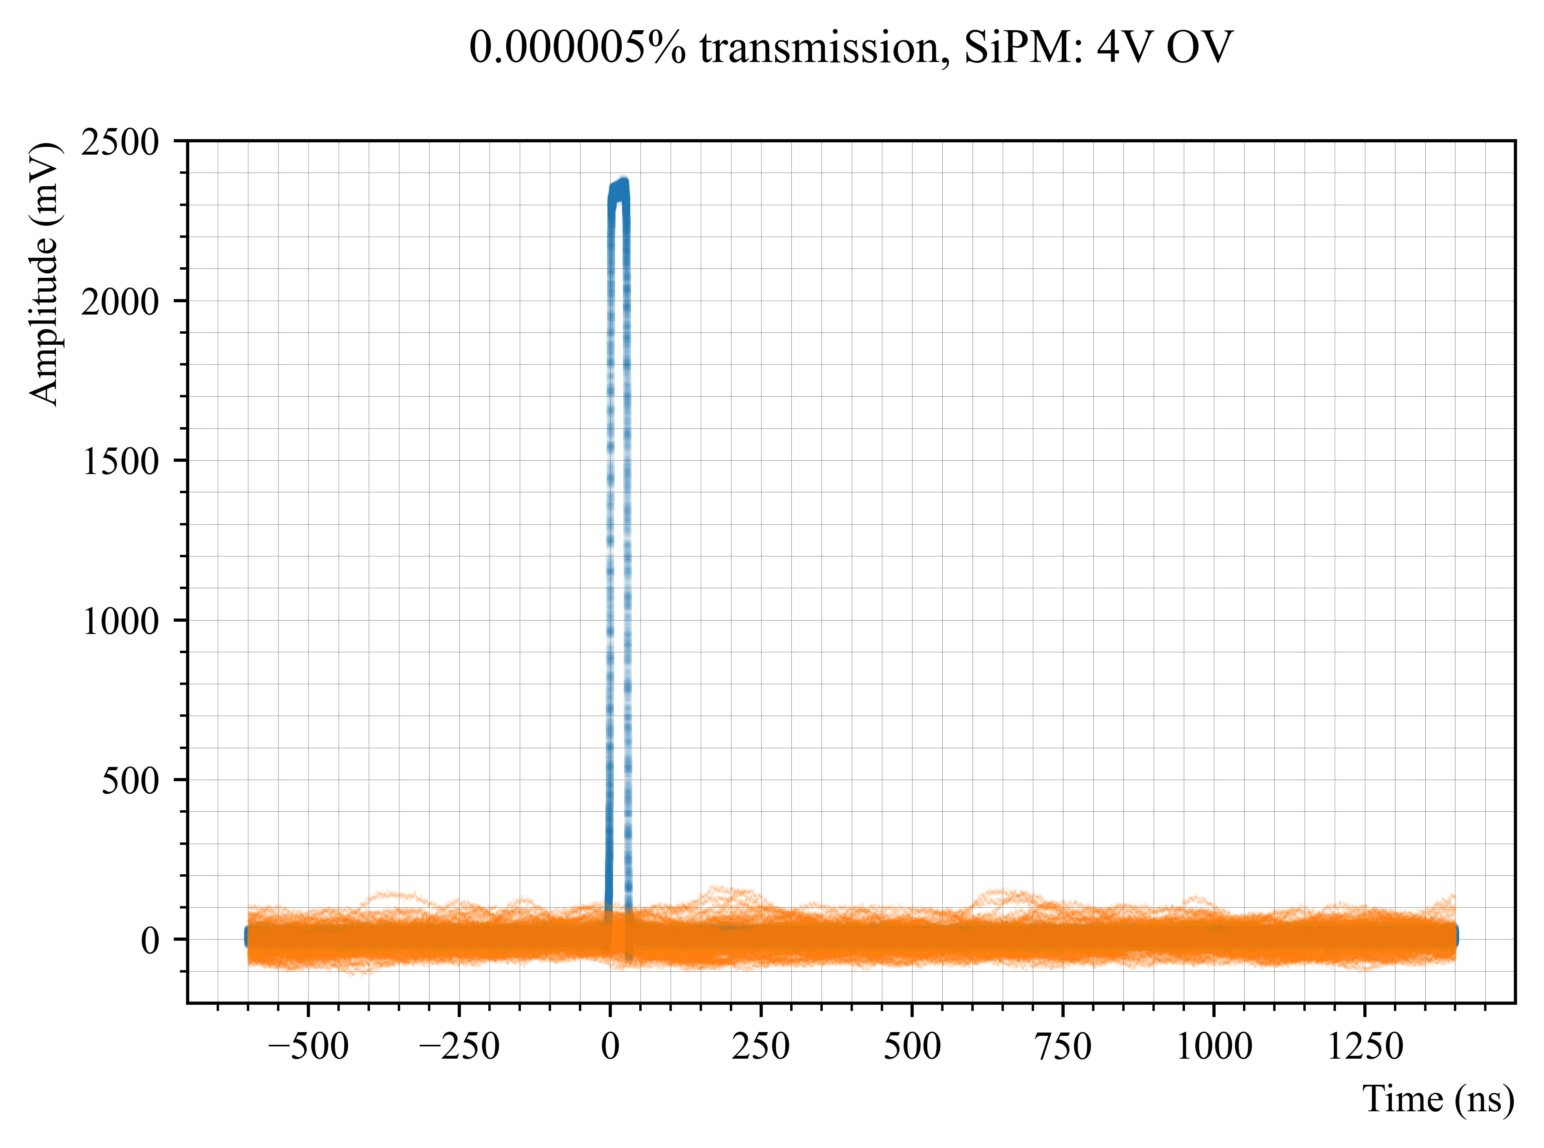
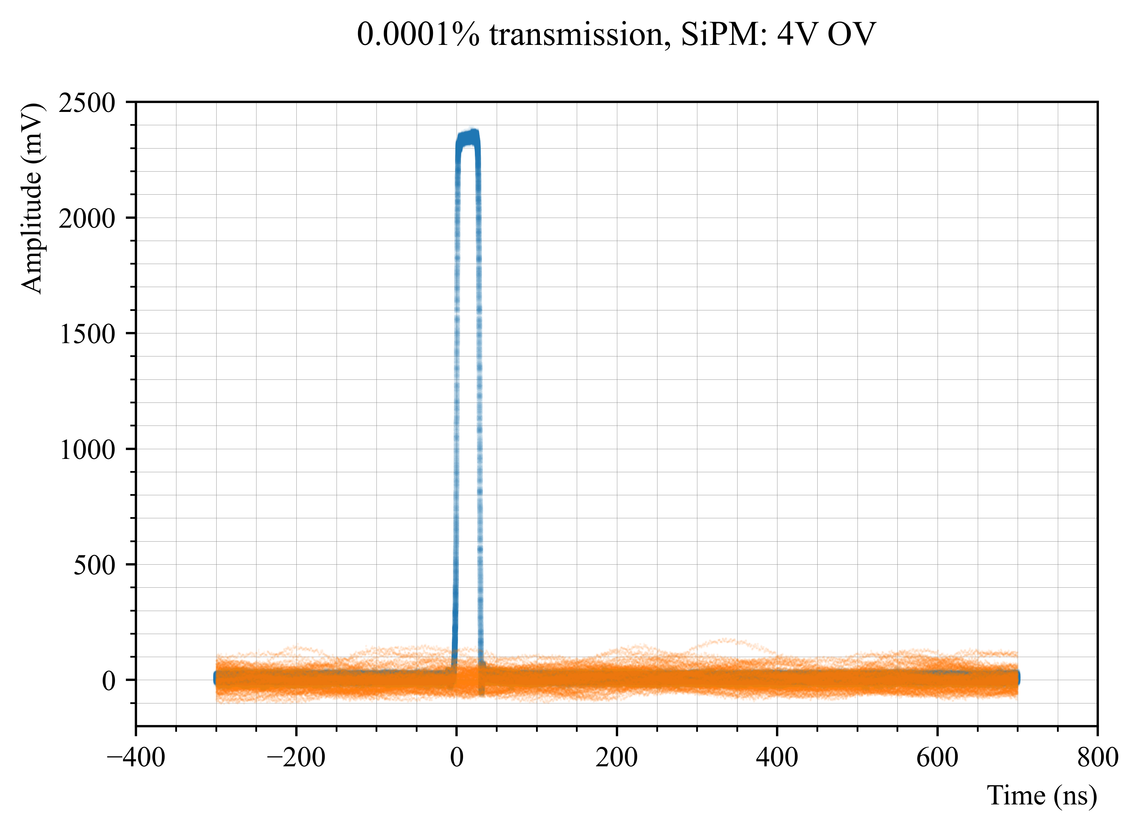

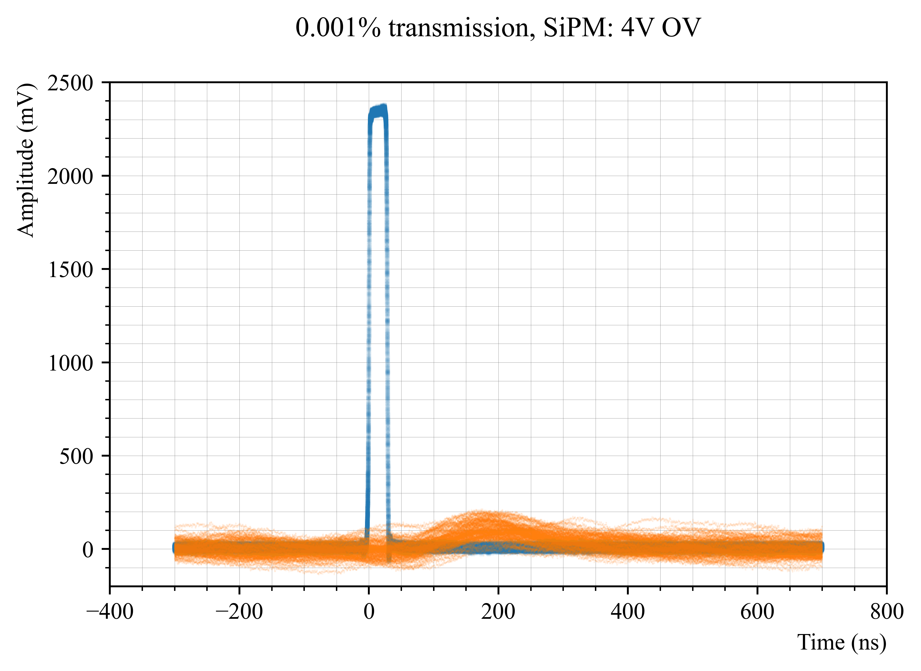
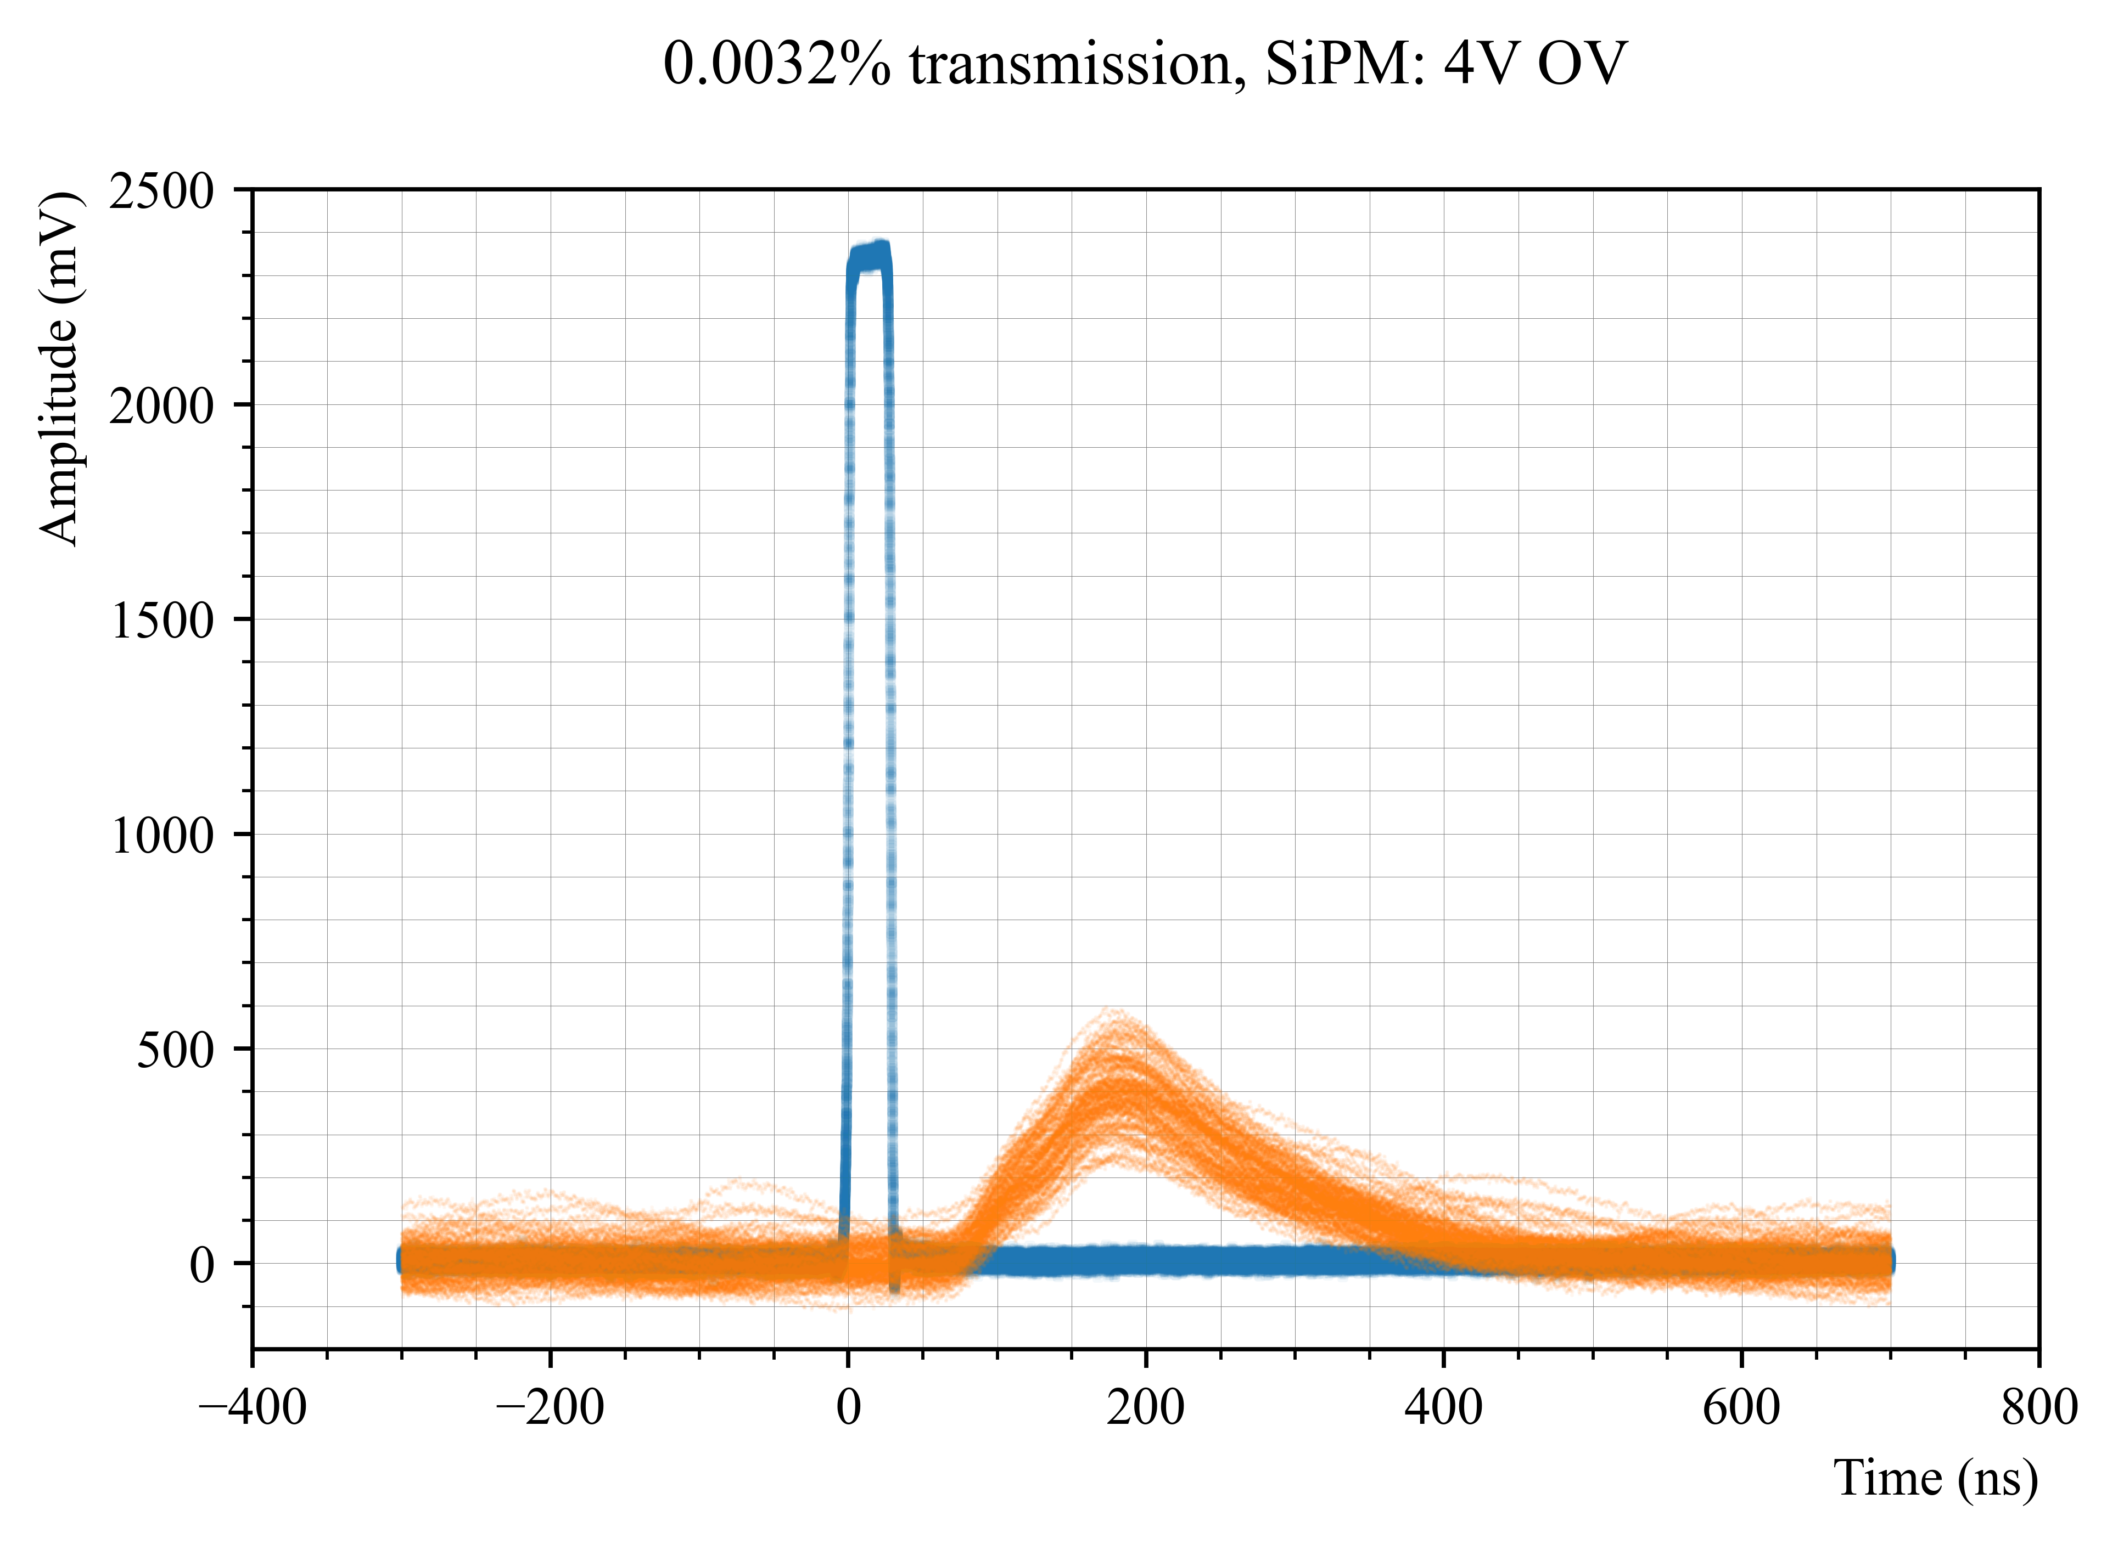
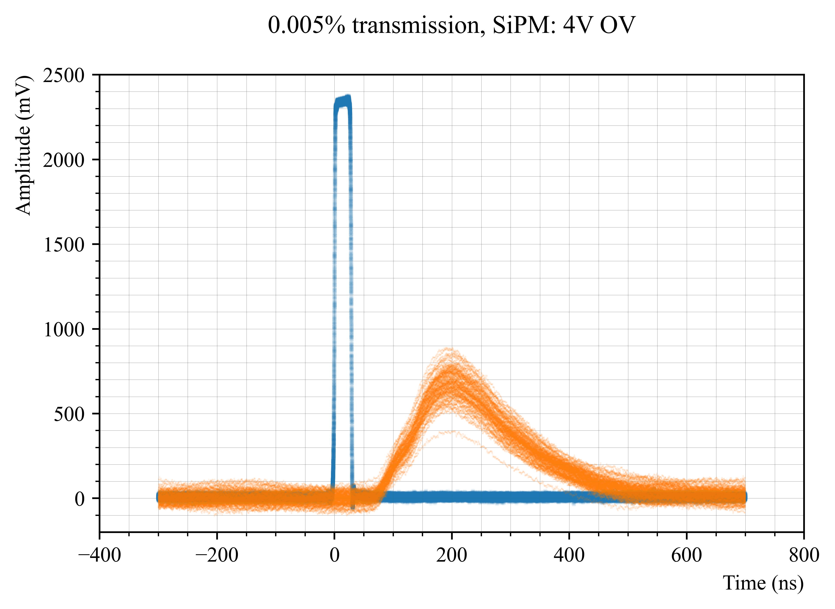
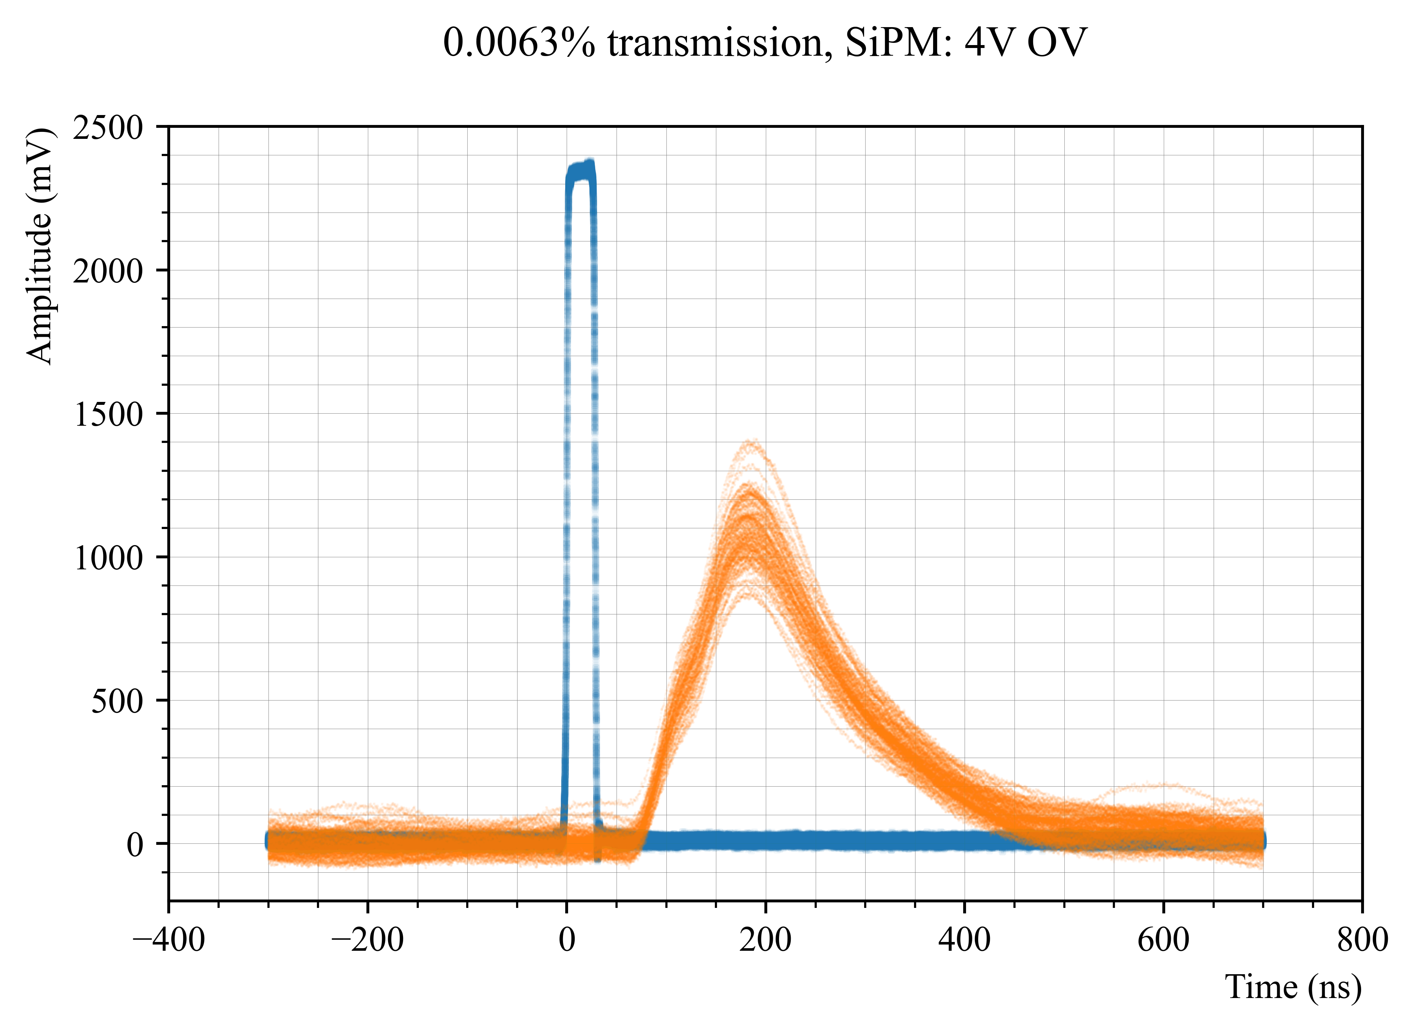
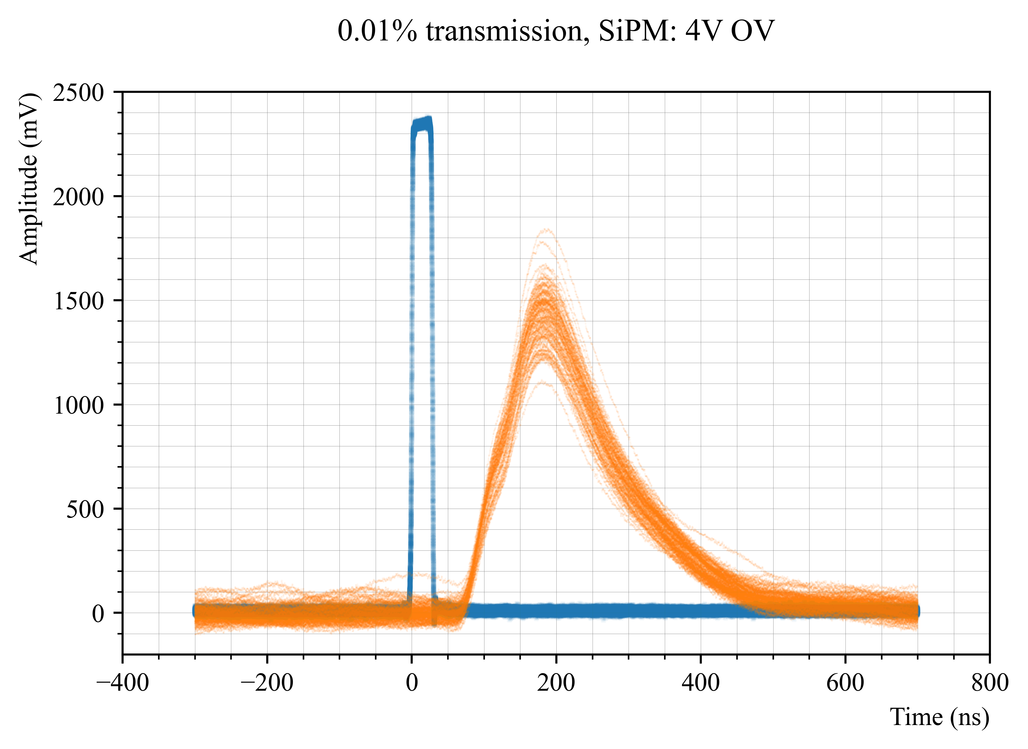
SiPM: 4V overvoltage

Slide 12
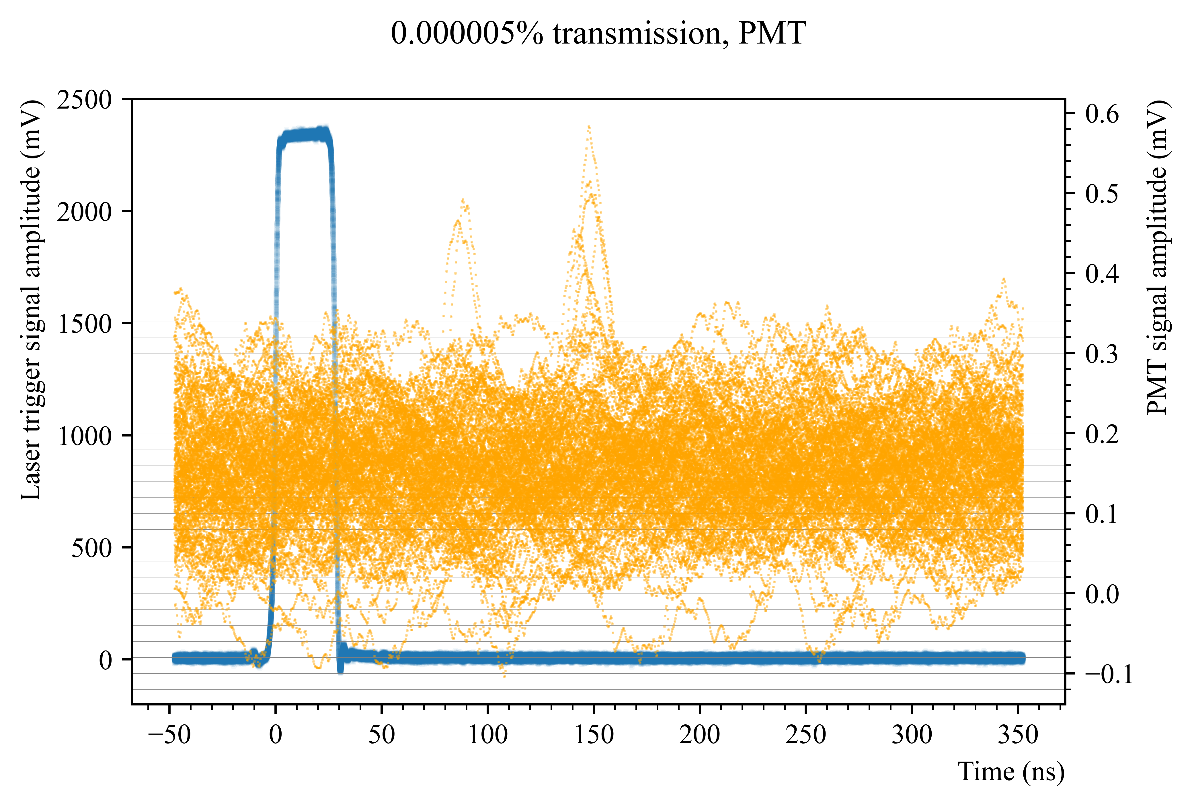
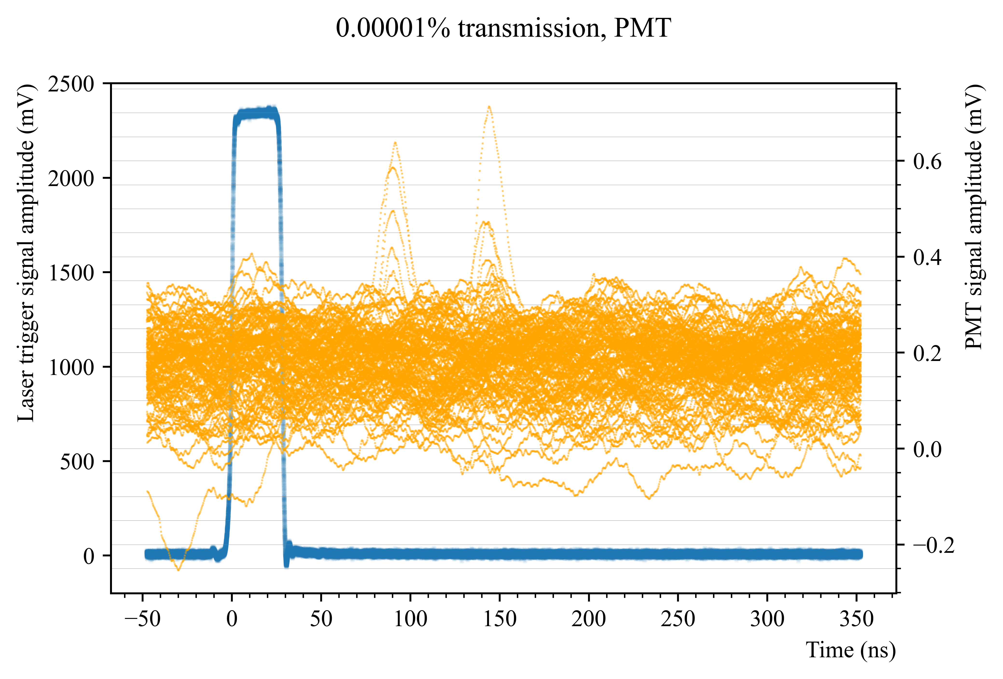
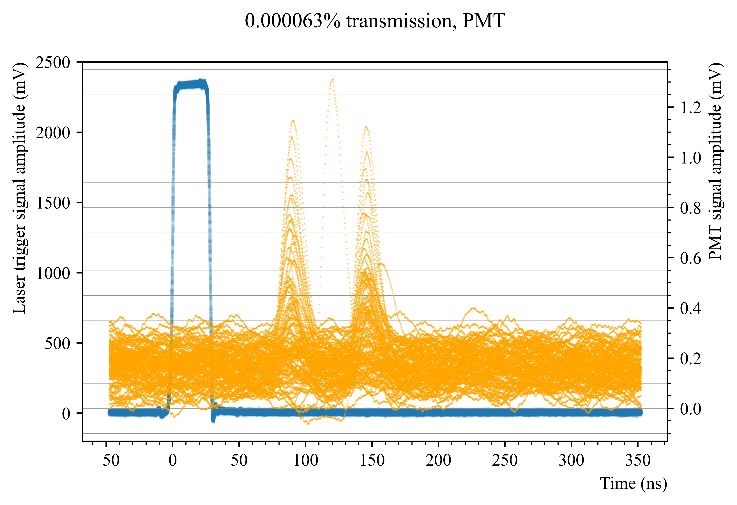
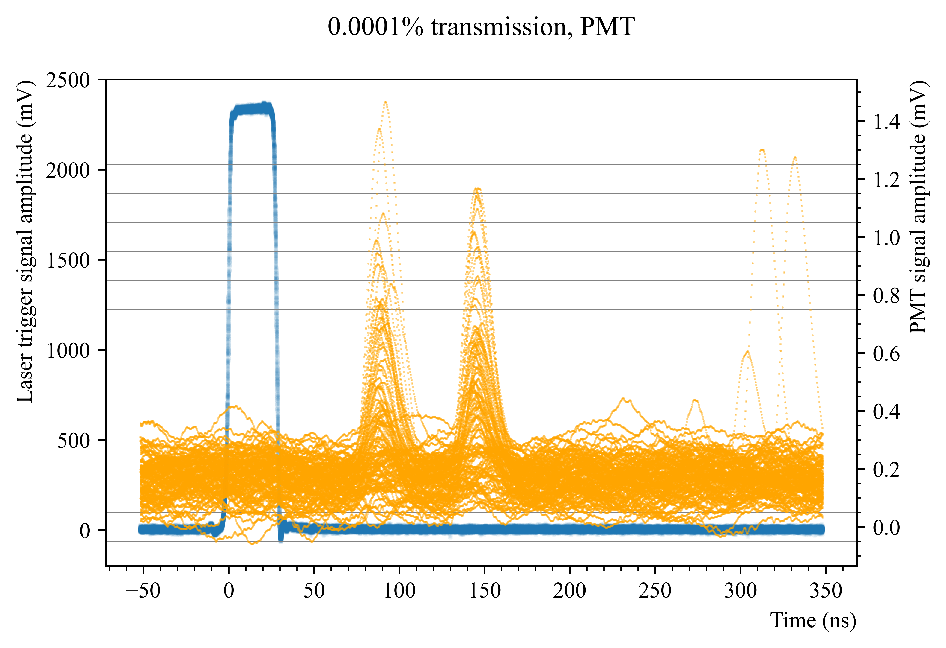
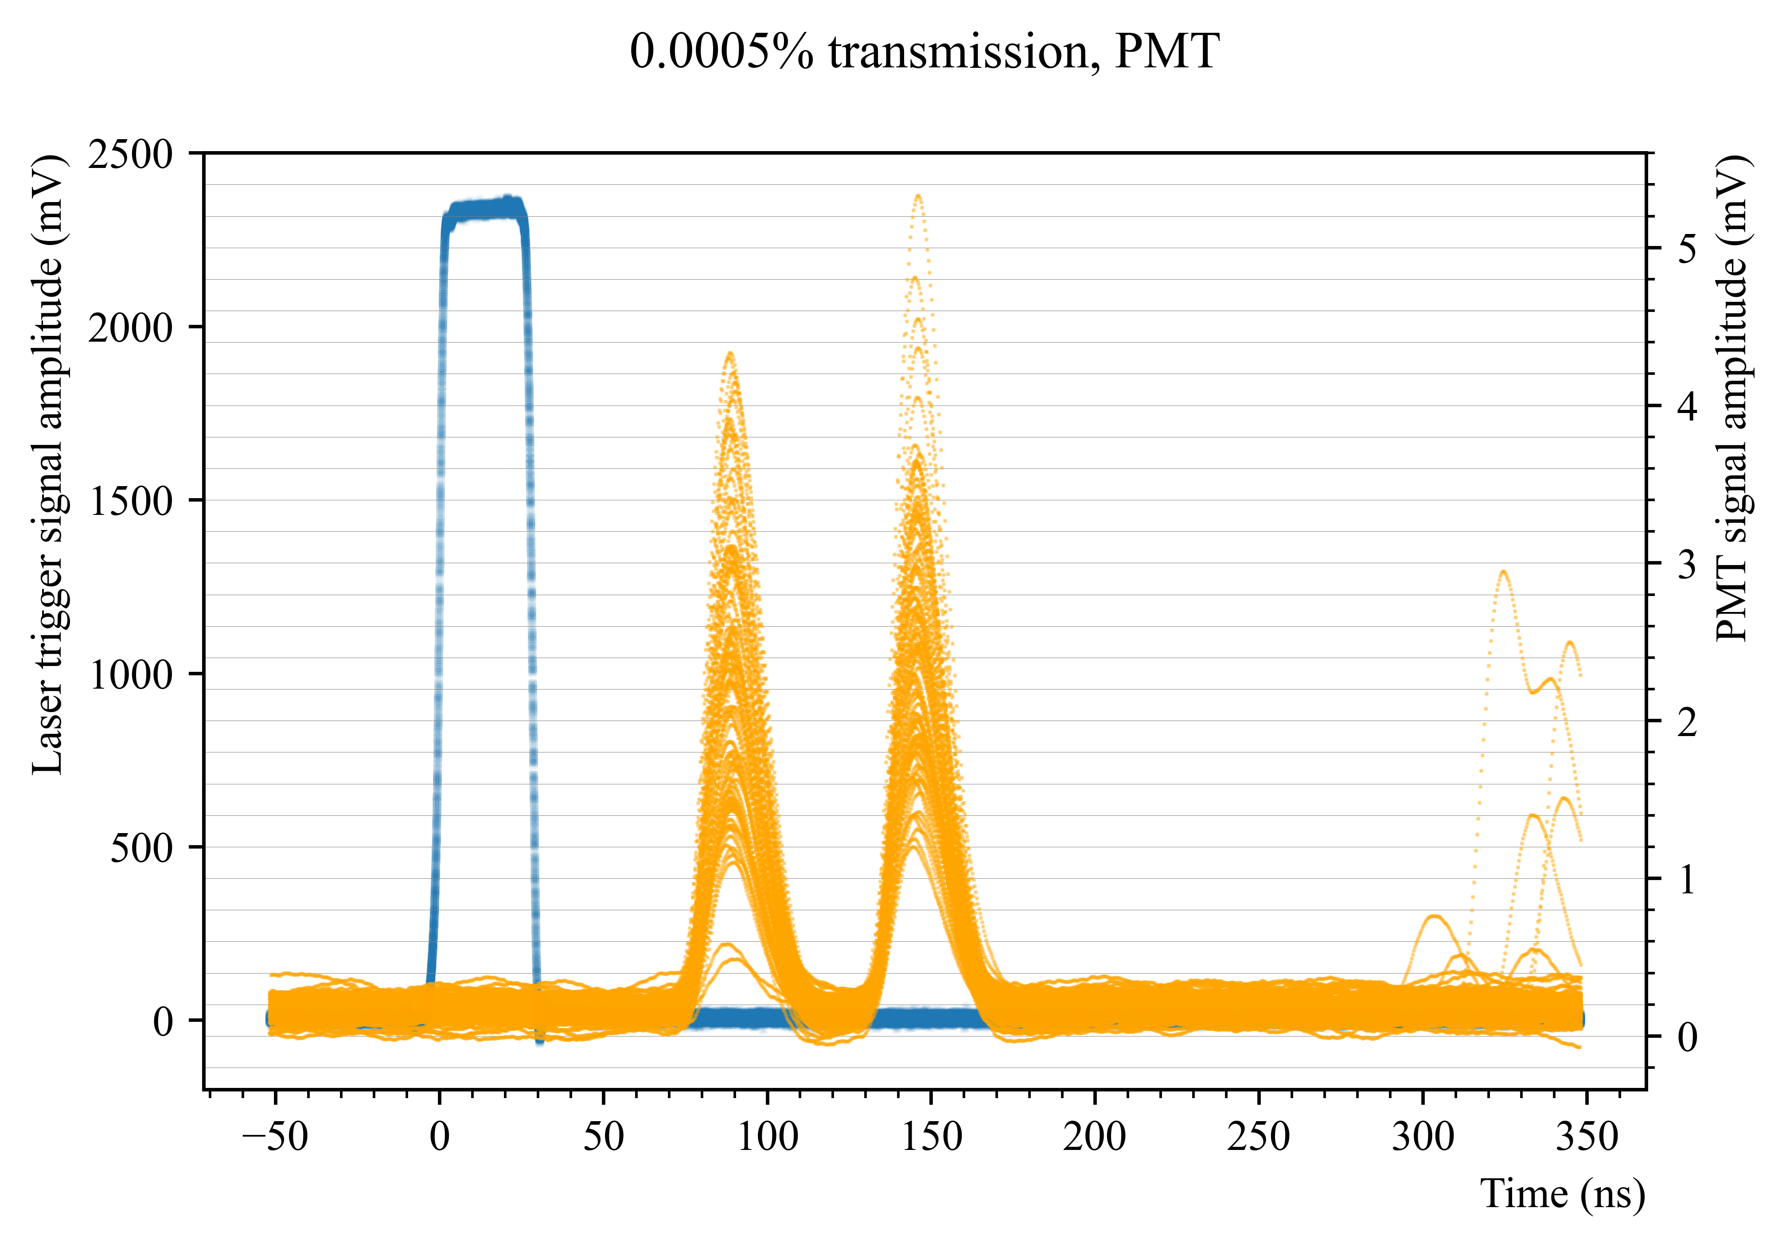
PMT

Slide 13
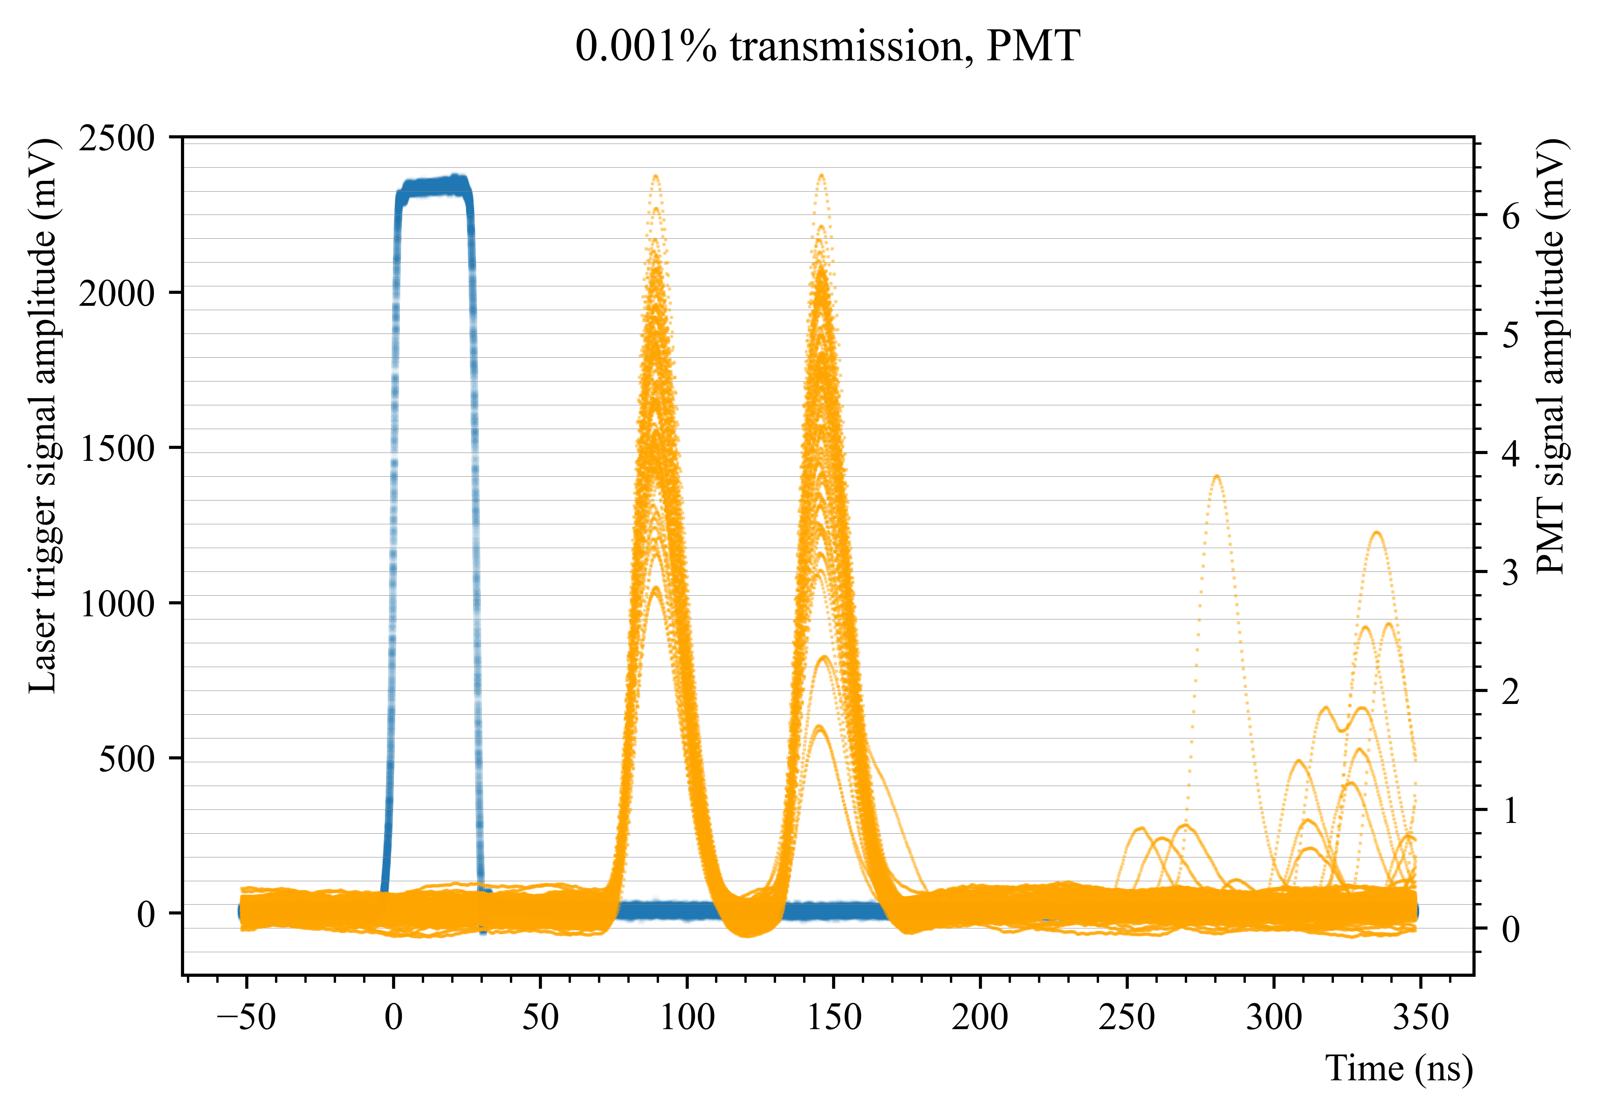
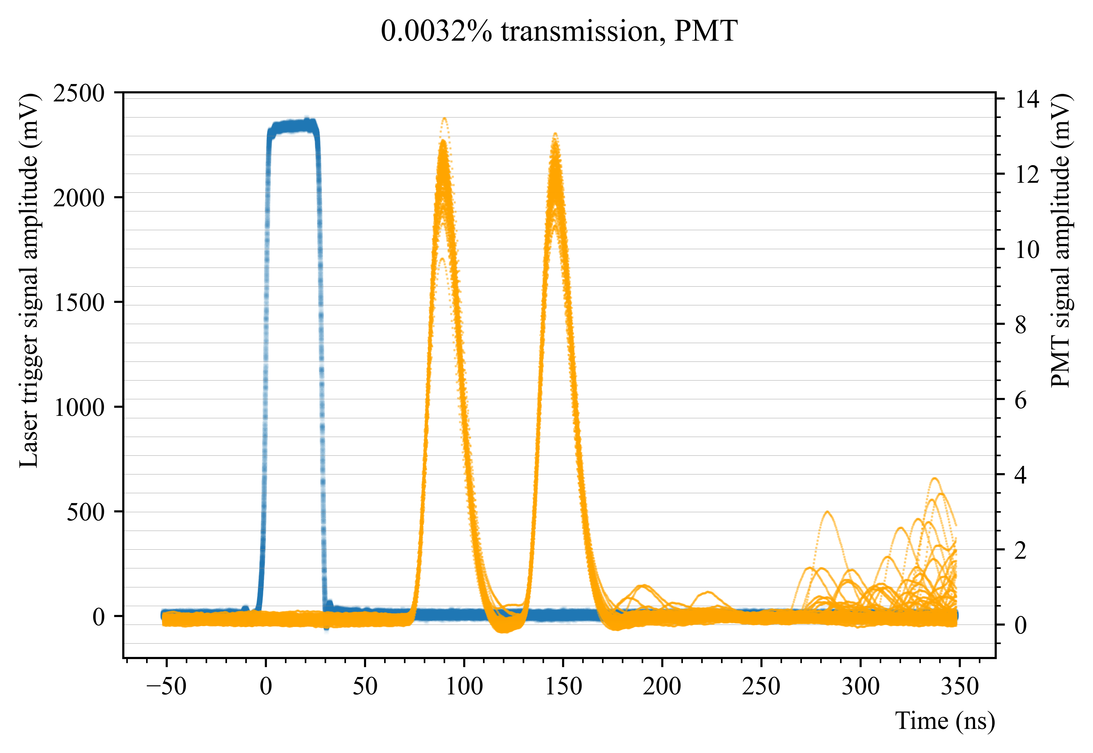
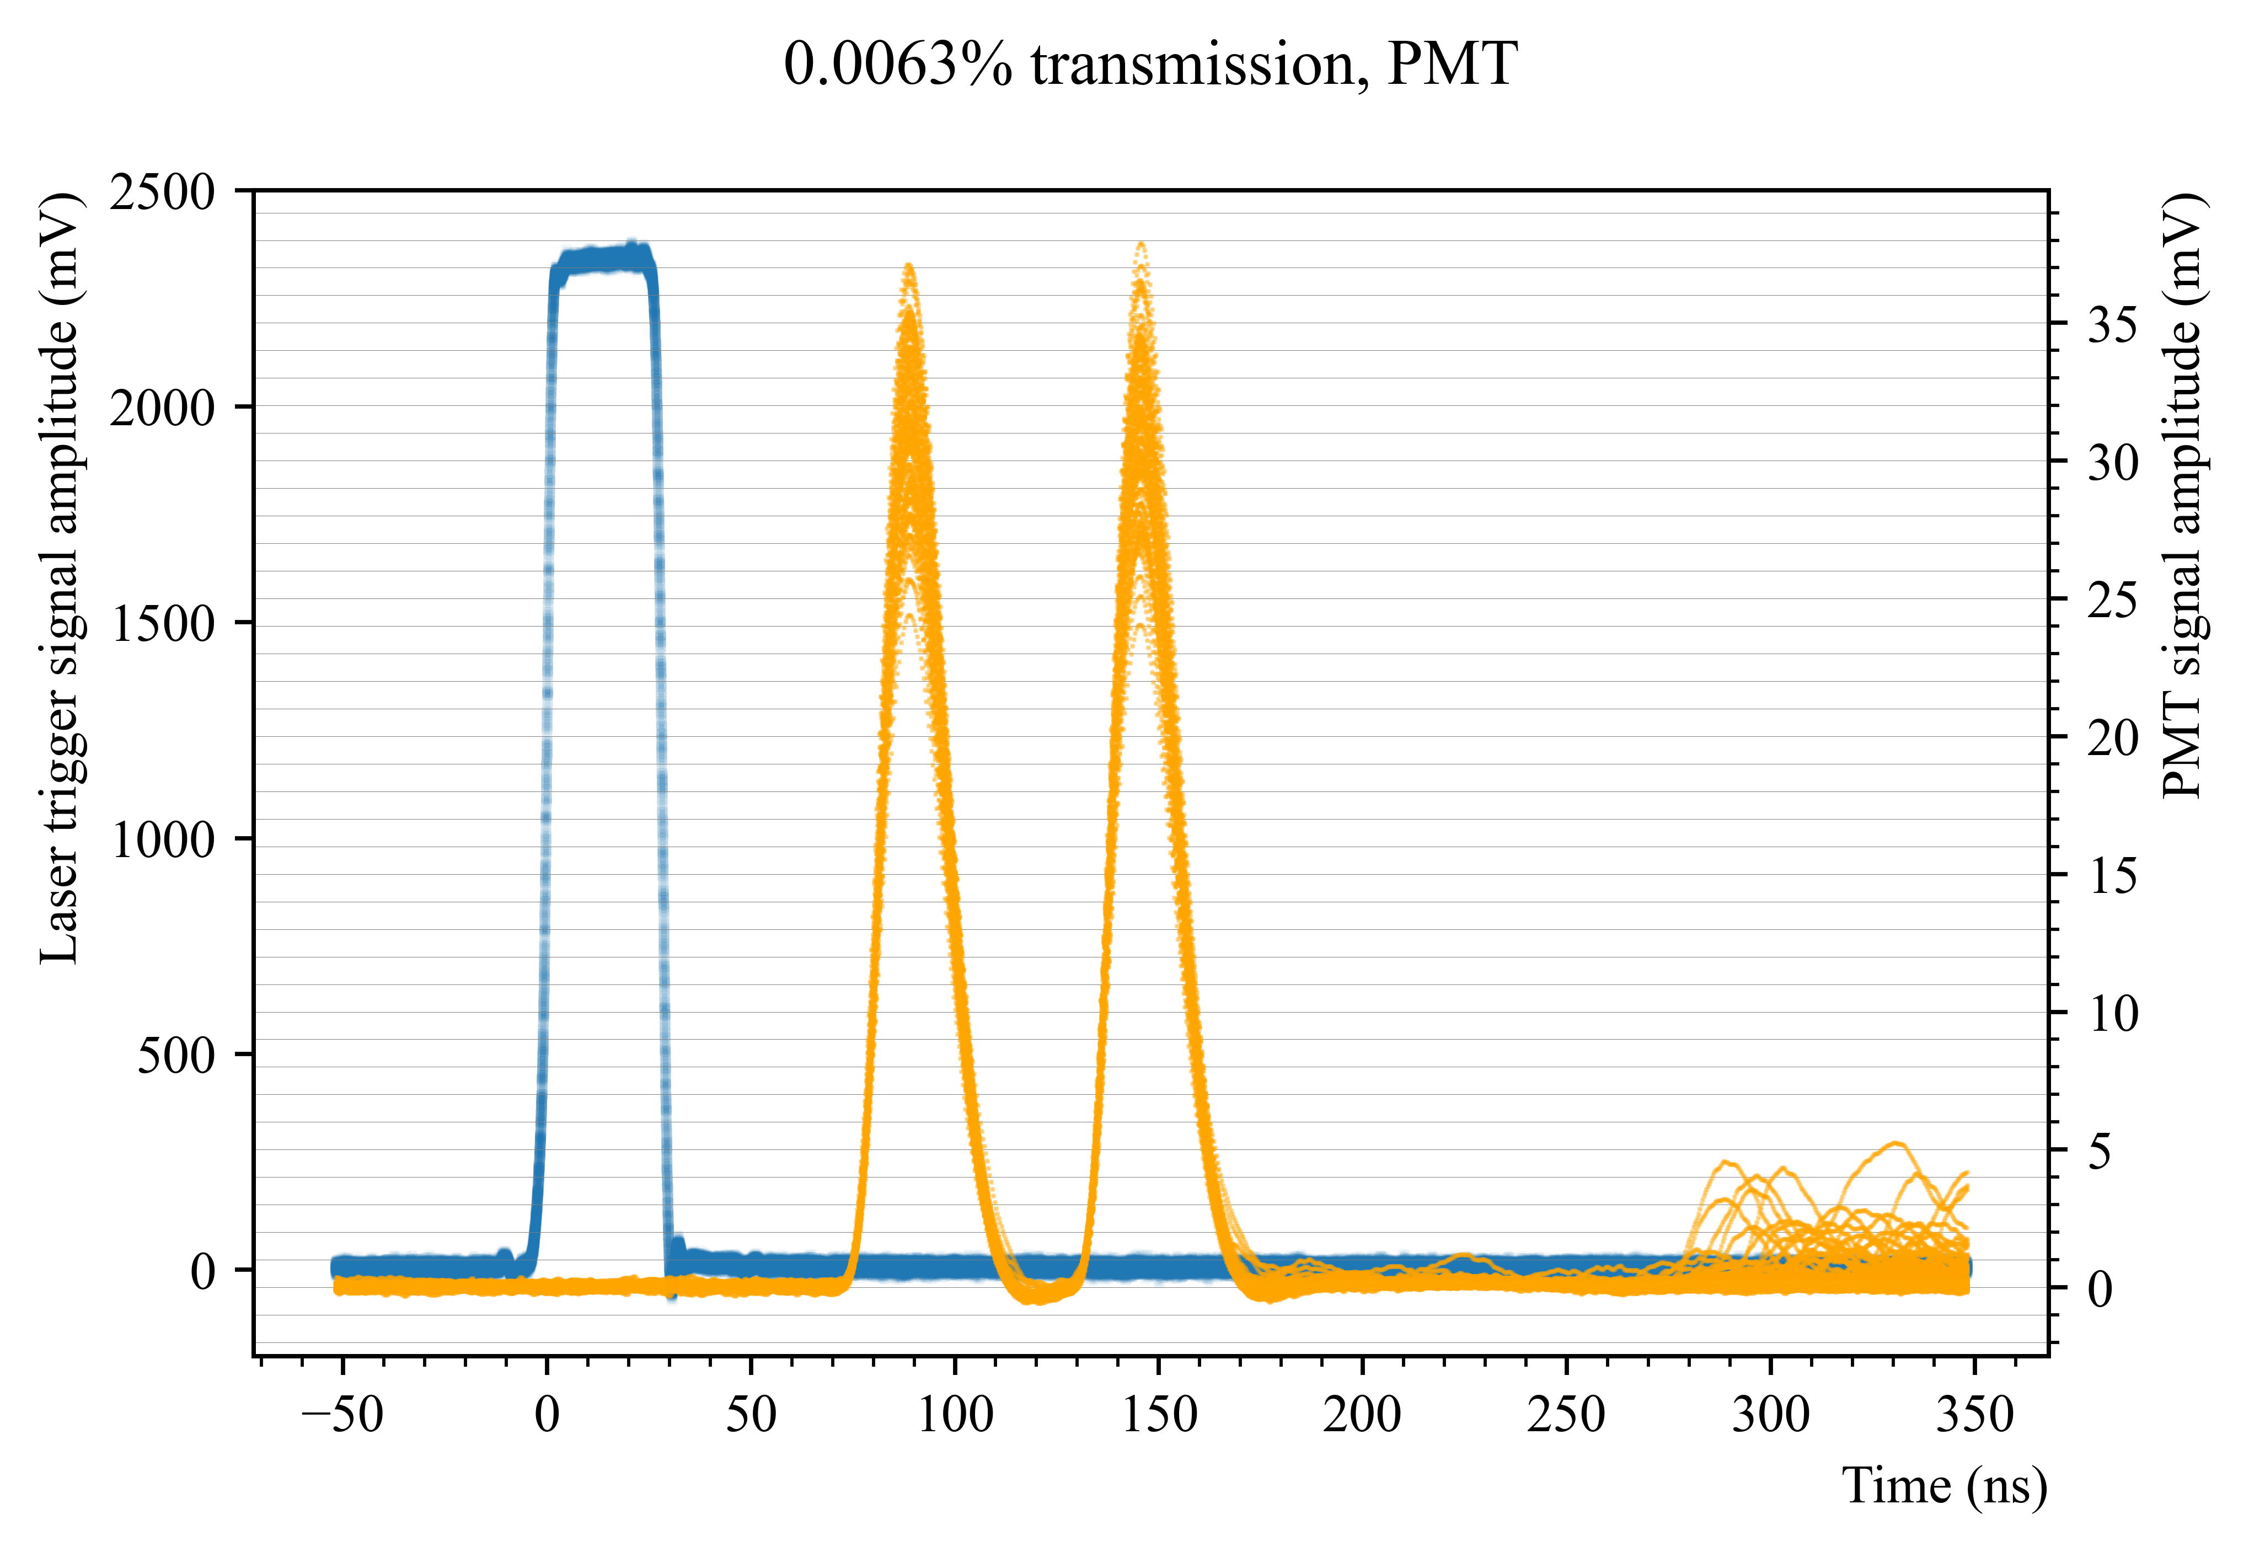
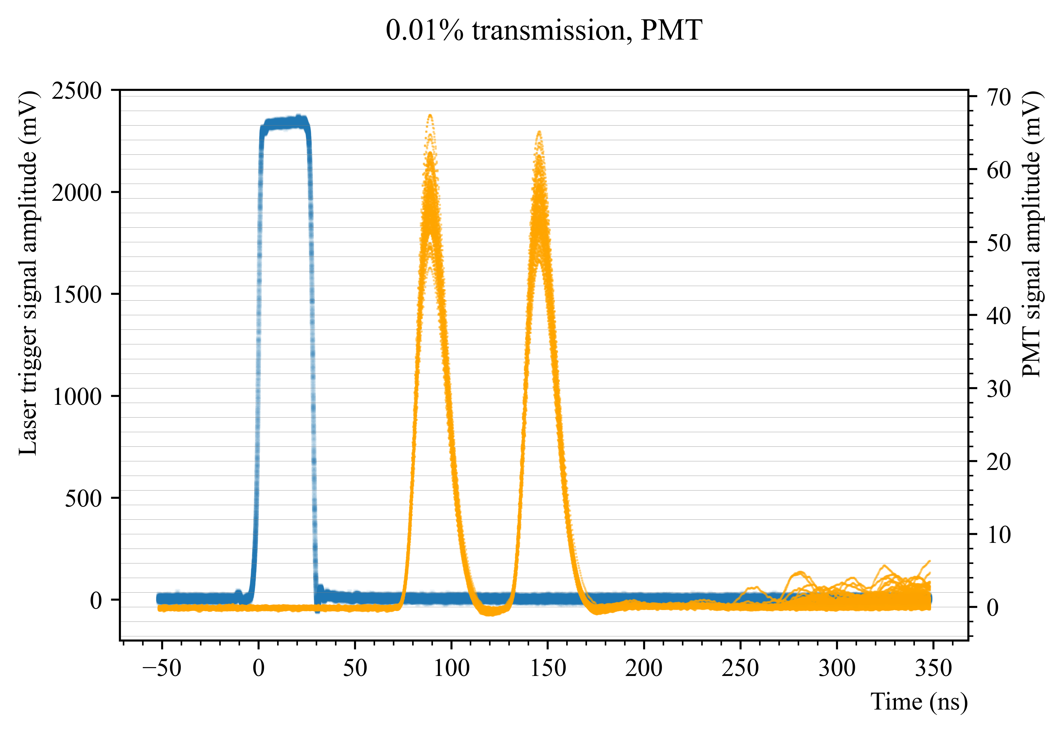
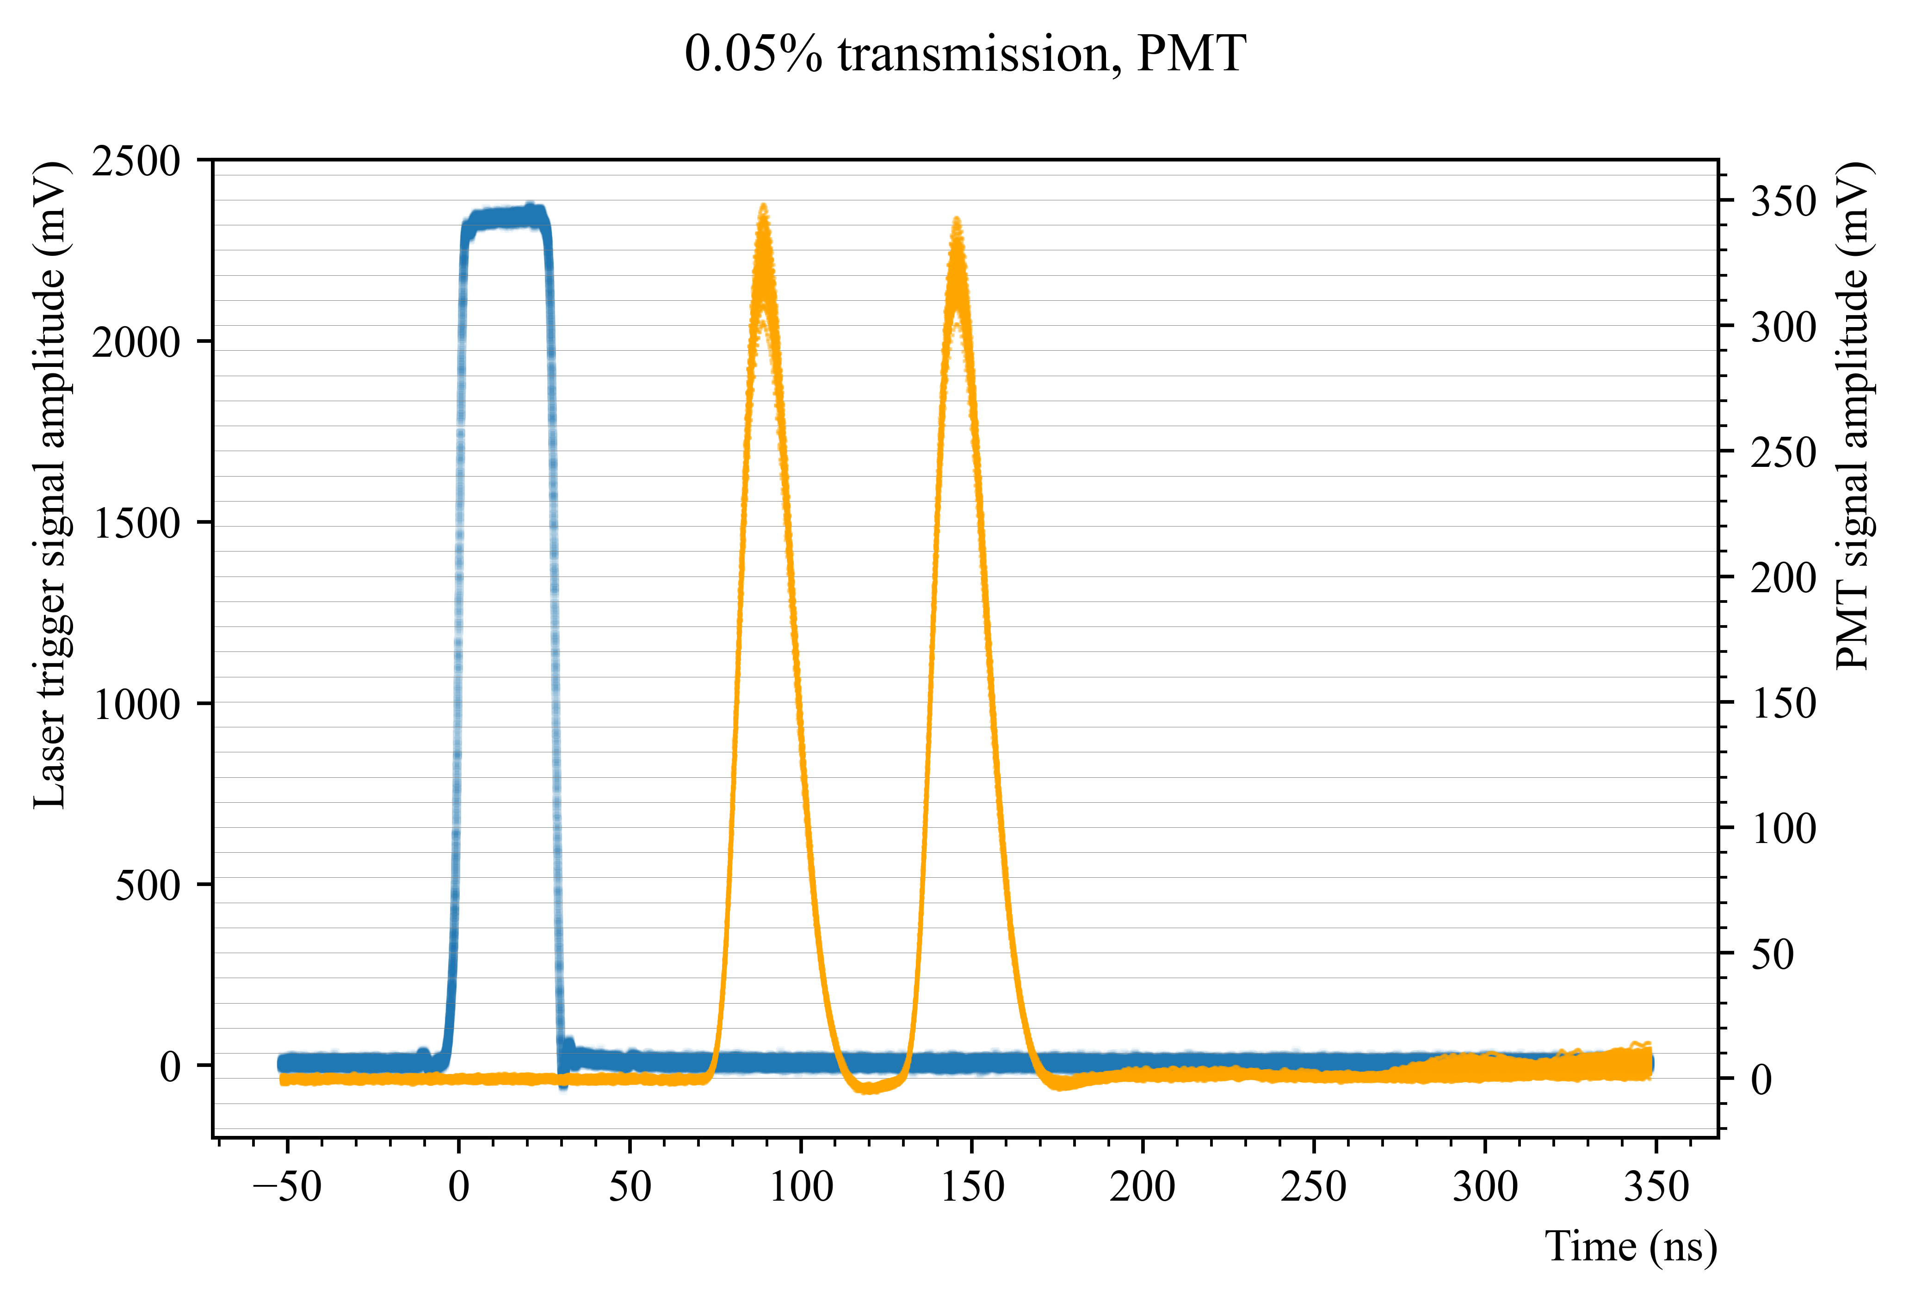
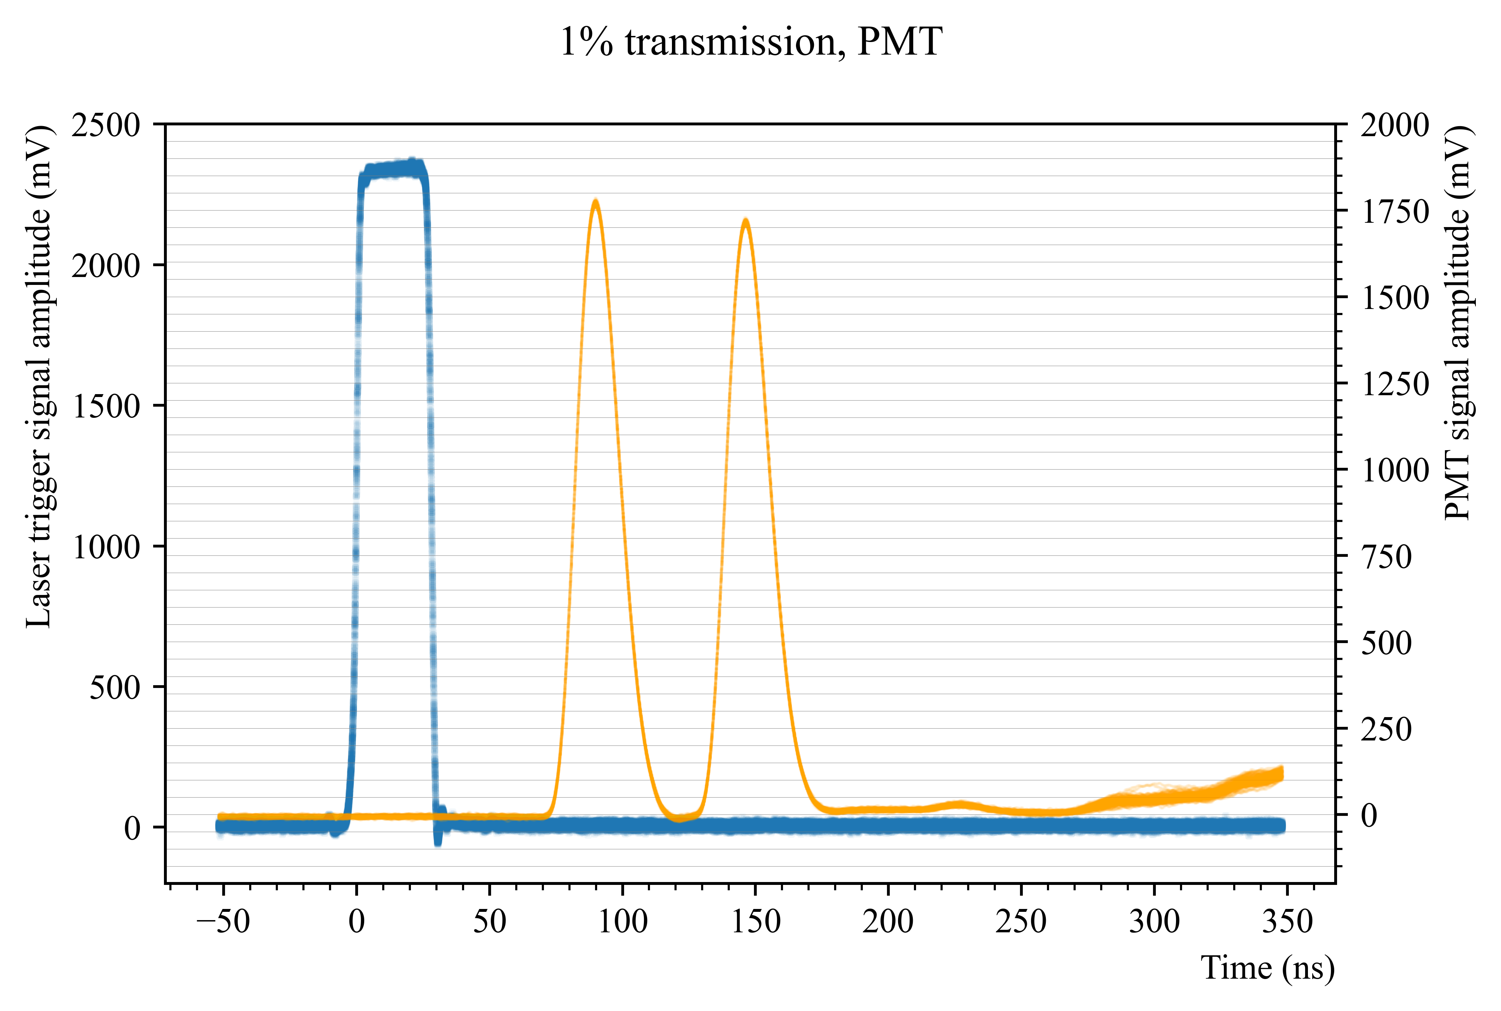
PMT

Slide 14




Different frequencies

Slide 15




Different frequencies

