Slide 1



CMS Phase-II Pixel Upgrade: Challenges and Solutions in Power Distribution
Dr. Javier Galindo, Dr.Alvaro Pradas, Dr.Claudio Rivetta, Dr.Mateo Iglesias, Alberto Arcusa and Dr. Fernando Arteche

Slide 2

OUTLINE
01 Introduction
02 Serial powering
03 Transients
04 Noise control
05 HDI design
06 Summary

Slide 3
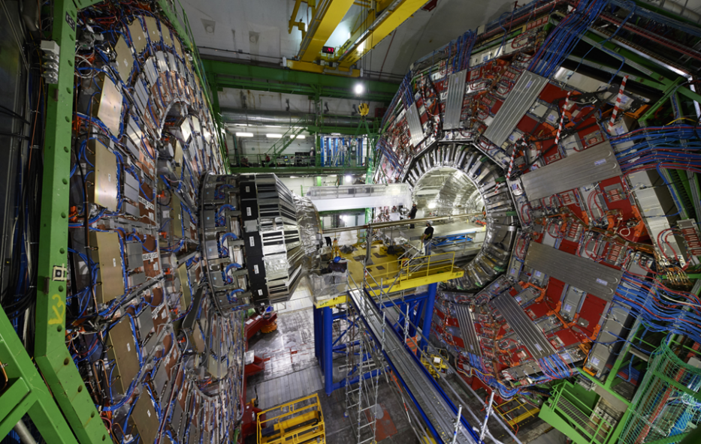
1. Introduction
1er Encuentro Aragón - Comunidad Valenciana
28-29 mayo 2025, Galáctica , Arcos de las Salinas, Teruel
CMS – Compact Muon Solenoid
It is one of the 4 HEP experiments of the LHC
Dimensions
  Weight – 15000t
  Diameter – 15m
  Length – 22m
It is divided in several sub-detectors
  PX,TK,ECAL, Muon, 4T Solenoid
Operates synchronously at 40 MHz

Slide 4
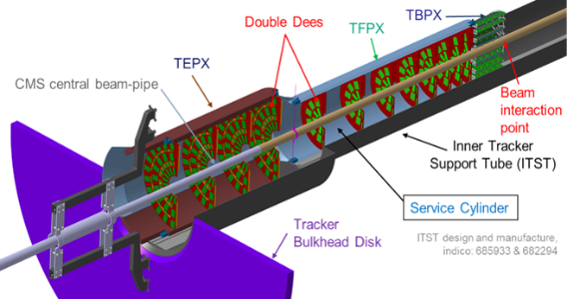
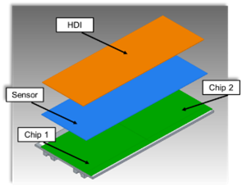
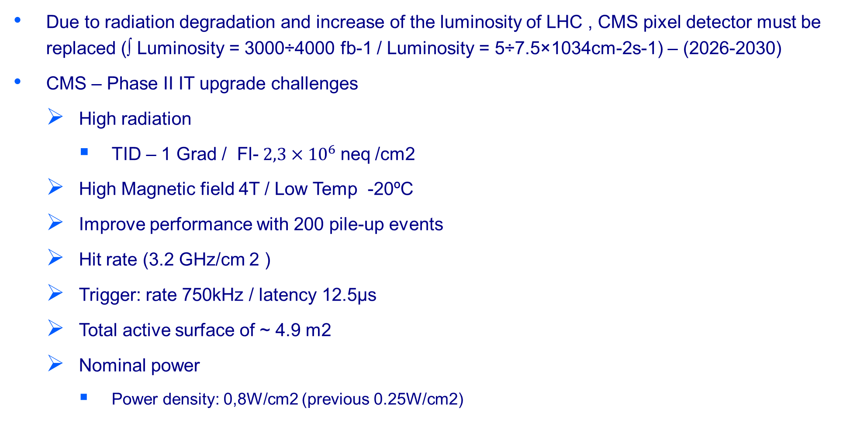
1. Introduction
1er Encuentro Aragón - Comunidad Valenciana
28-29 mayo 2025, Galáctica , Arcos de las Salinas, Teruel
Due to radiation degradation and increase of the luminosity of LHC , CMS pixel detector must be replaced (∫ Luminosity = 3000÷4000 fb-1 / Luminosity = 5÷7.5×1034cm-2s-1) – (2026-2030)
CMS – Phase II IT upgrade challenges
  High radiation
    TID – 1 Grad / Fl-$2,3×{10}^{6}$neq /cm2
  High Magnetic field 4T / Low Temp -20ºC
  Improve performance with 200 pile-up events
  Hit rate (3.2 GHz/cm 2 )
  Trigger: rate 750kHz / latency 12.5µs
  Total active surface of ~ 4.9 m2
  Nominal power
    Power density: 0,8W/cm2 (previous 0.25W/cm2)

Slide 5
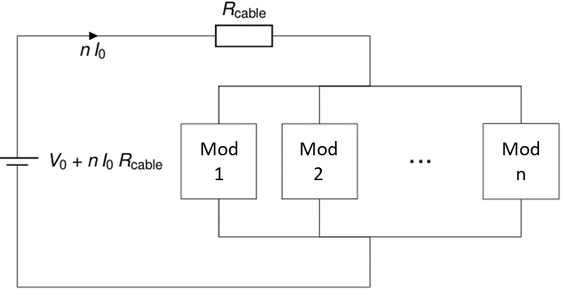
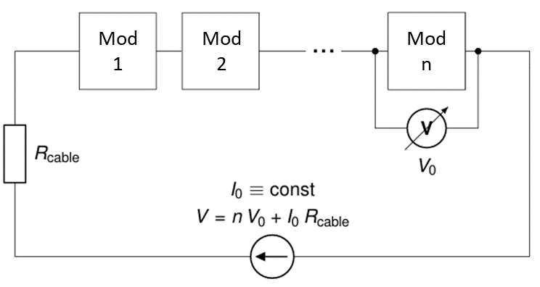
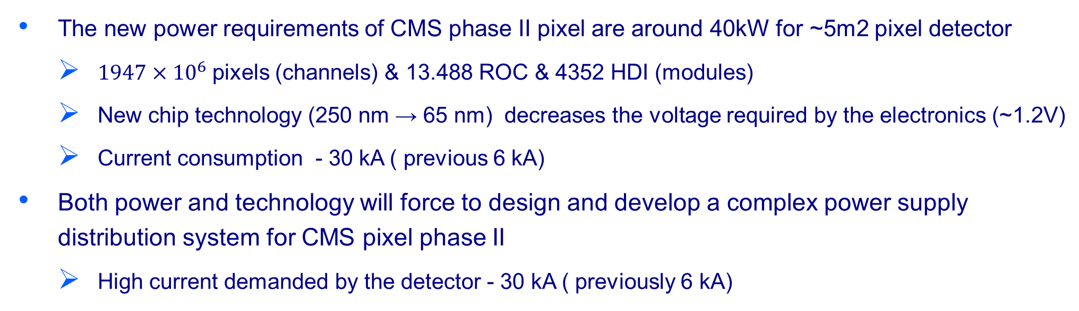
1. Introduction
1er Encuentro Aragón - Comunidad Valenciana
28-29 mayo 2025, Galáctica , Arcos de las Salinas, Teruel
The new power requirements of CMS phase II pixel are around 40kW for ~5m2 pixel detector
  $1947×{10}^{6}$pixels (channels) & 13.488 ROC & 4352 HDI (modules)
  New chip technology (250 nm → 65 nm) decreases the voltage required by the electronics (~1.2V)
  Current consumption - 30 kA ( previous 6 kA)
Both power and technology will force to design and develop a complex power supply distribution system for CMS pixel phase II
  High current demanded by the detector - 30 kA ( previously 6 kA)
Serial
Parallel

Slide 6
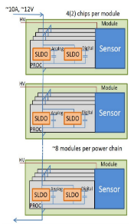
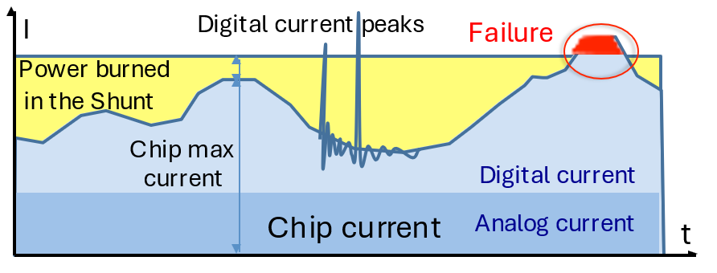
2. Serial Powering
1er Encuentro Aragón - Comunidad Valenciana
28-29 mayo 2025, Galáctica , Arcos de las Salinas, Teruel
Serial powering is the baseline choice for CMS pixel upgrade.
Power system based on DC-DC conv.
  LV – Current source (30m or 100m)- Serial
  Bias or HV – Voltage source (100m)- Parallel
Key component: on chip Shunt-LDO, (RadHard) – Integrated in the ASIC

Slide 7
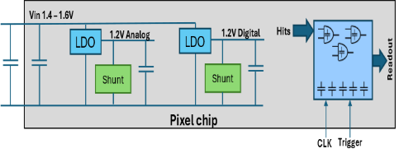
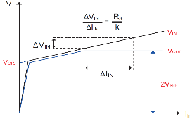
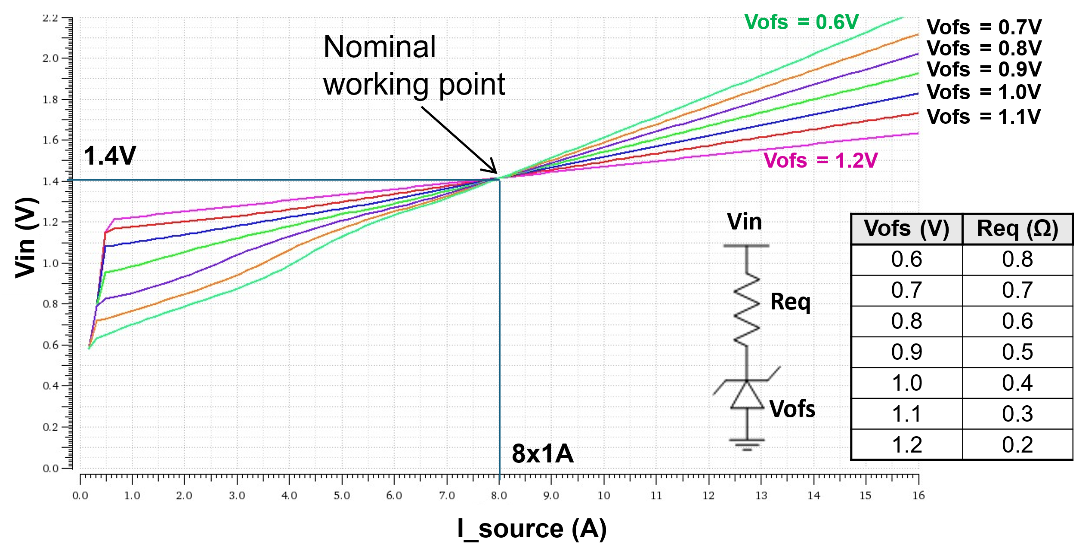
2. Serial Powering
1er Encuentro Aragón - Comunidad Valenciana
28-29 mayo 2025, Galáctica , Arcos de las Salinas, Teruel
LDO part is a very fast voltage regulator that gives a nominal 1.2V at the output.
Shunt part is the key of the regulator. It acts as a current by-pass with 2 main goals:
  Assure constant current consumption to allow serial powering topologies
  From input point of view it behaves as a resistor -> allows parallel connection with balanced current sharing
Two SLDO per chip (digital and analog)
It is configurable through external resistors
  Vofs / Requ

Slide 8
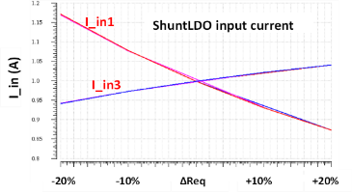
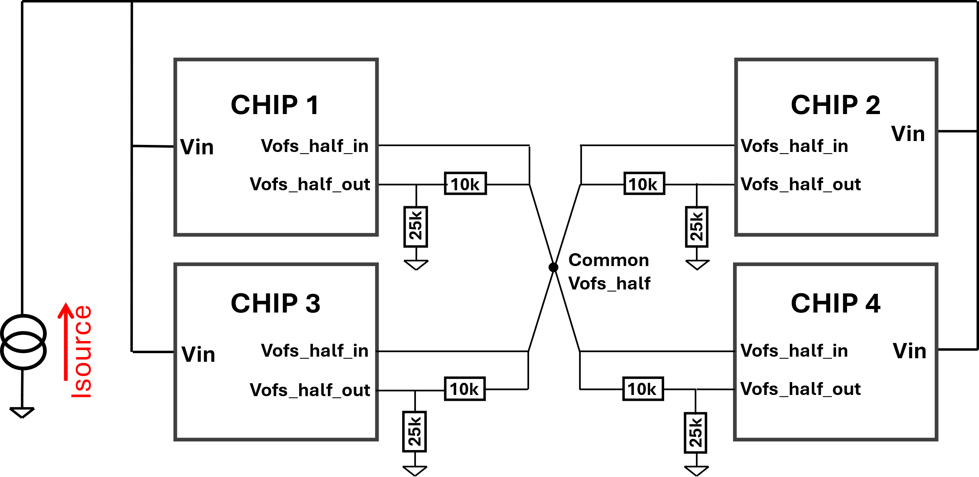
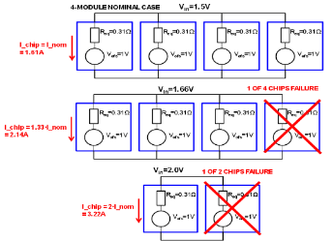
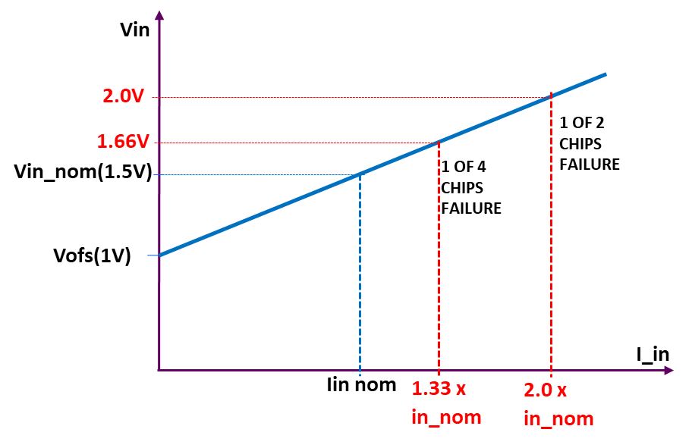
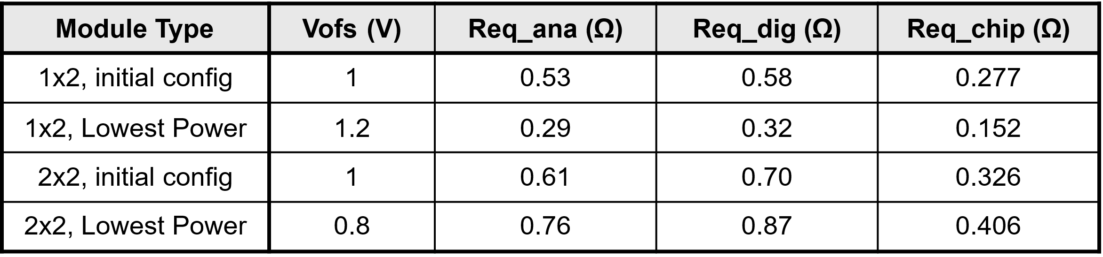
2. Serial Powering
1er Encuentro Aragón - Comunidad Valenciana
28-29 mayo 2025, Galáctica , Arcos de las Salinas, Teruel
The selection of the configuration points is crucial due to current distribution among ROCs located in the same module (tolerances & failure modes)
Tolerances
Failure modes
Configuration topology

Slide 9
3. Transients
1er Encuentro Aragón - Comunidad Valenciana
28-29 mayo 2025, Galáctica , Arcos de las Salinas, Teruel
Transients are one of the most critical aspects in power systems.
They can arise from:
  Load variations, System start-up, Faults or failures
These transients can significantly affect Inner Tracker operation, leading to:
  Oscillations
  Electrical noise
  Unreliable start-up behavior
Multi-level impacts across: Propagation aspects
  ROC level, Module level & System level
The presence of transients must be considered in system design to minimize their effects.
  Parasitic elements play a major role in shaping transient behavior.

Slide 10
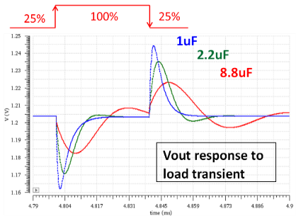
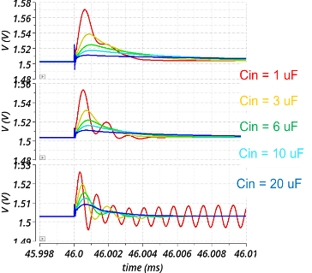
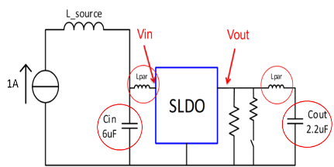
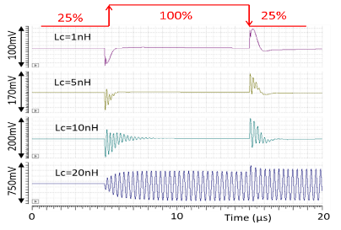
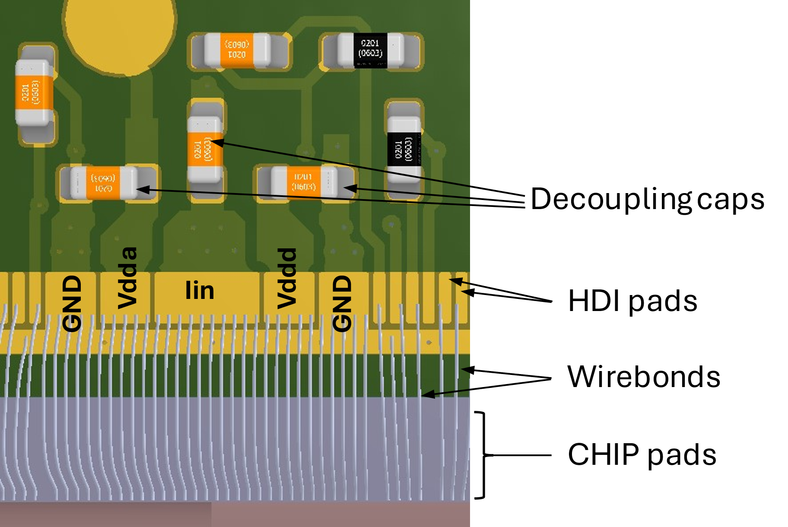
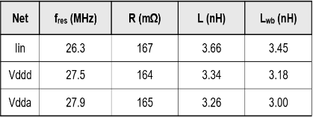
3. Transients – Load variations
1er Encuentro Aragón - Comunidad Valenciana
28-29 mayo 2025, Galáctica , Arcos de las Salinas, Teruel
Load variations: Lpar, Cout and Vofs
singleSLDO
ROC level
Cout
1chip
4chips
Lpar

Slide 11
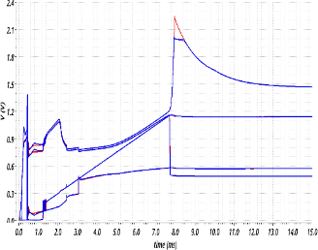
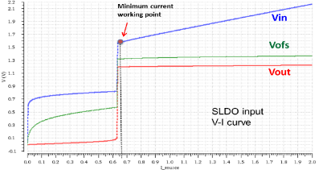
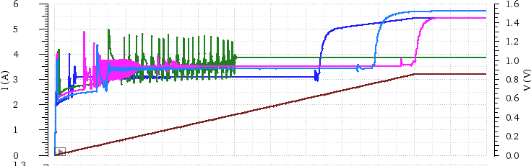
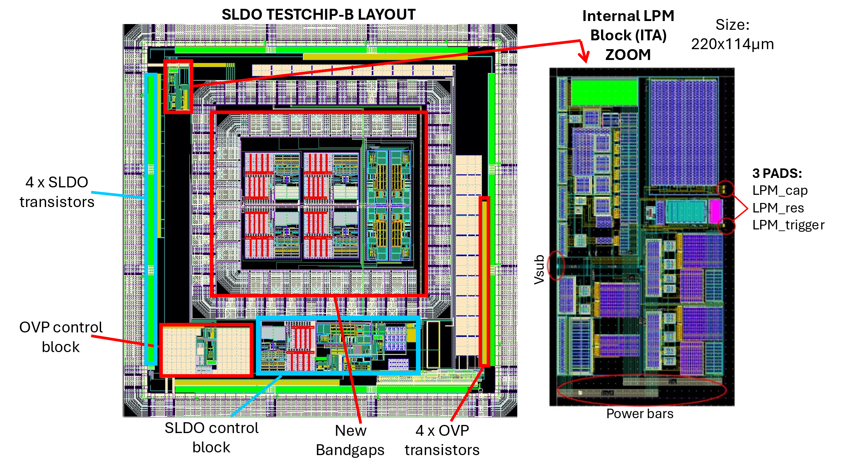
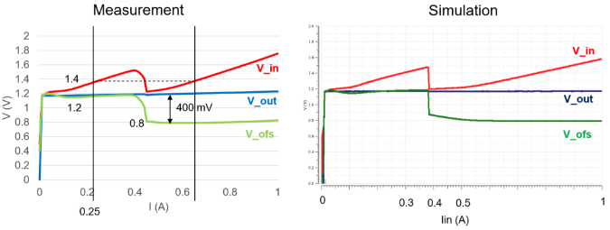
3. Transients – System start-up
1er Encuentro Aragón - Comunidad Valenciana
28-29 mayo 2025, Galáctica , Arcos de las Salinas, Teruel
BG effects at low temprature
Overvoltage - Protection
System start-up has been analyzed
Vin (sin protección)
Vin
ff
sf
fs
ss
Vin (con protección)
Iin
LPM – ITA`s circuit

Slide 12
4. Noise control - EMC
1er Encuentro Aragón - Comunidad Valenciana
28-29 mayo 2025, Galáctica , Arcos de las Salinas, Teruel
Electromagnetic noise control has been a key focus throughout the detector's development at CMS Phase II - IT.
The main goal of the EMC studies is to characterize the response of the CMS phase II pixel electronics to RF conducted disturbances:
  Noise risk assessment (Options evaluation)
  Identify critical elements in prototypes that could reduce the detector performance (grounding, routing, filtering, decoupling capacitors,…)
  Noise level limits required for the power supply units and other sub-detectors
Noise assessments were integrated at the early design stage to facilitate corrective action where required.
The studies were performed at ASIC (RD53/CROC) and system level

Slide 13
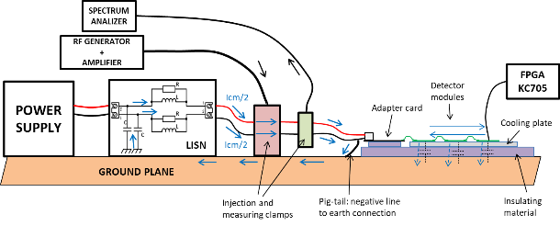
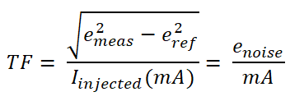
4. Noise control - EMC
1er Encuentro Aragón - Comunidad Valenciana
28-29 mayo 2025, Galáctica , Arcos de las Salinas, Teruel
The noise studies are based on RF noise susceptibility test
The idea of the RF noise susceptibility test is to inject a perturbing signal to the detector and evaluate the performance of RD53A
Iinj
Detector
emeas
Frequency range - 100 kHz up to 50 MHz
The performance of the detector has been evaluated via transfer functions

Slide 14
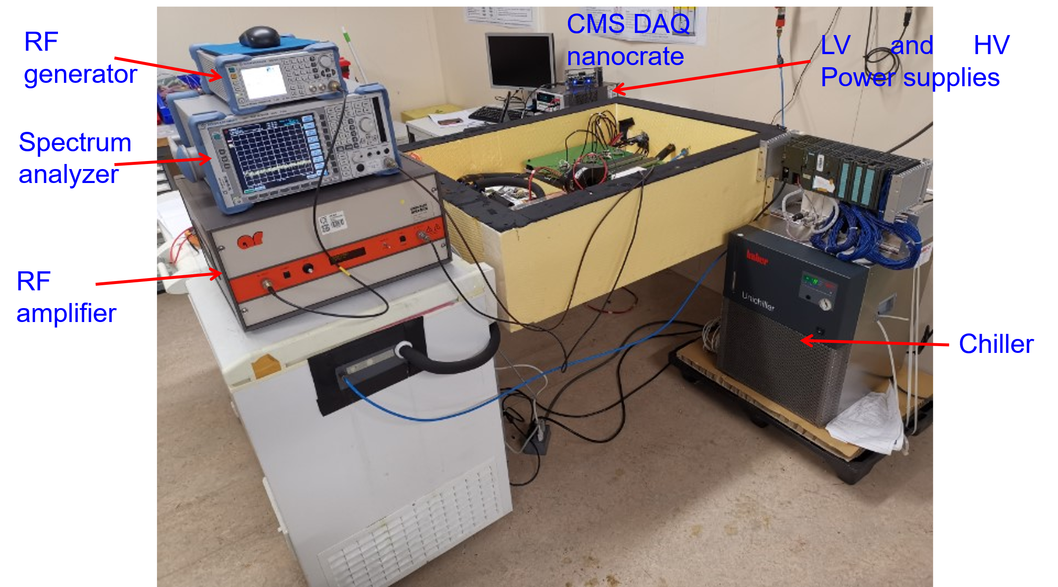
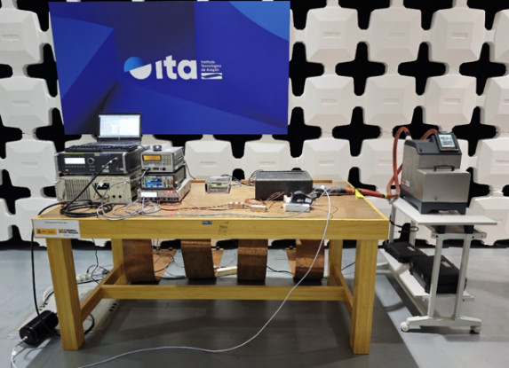
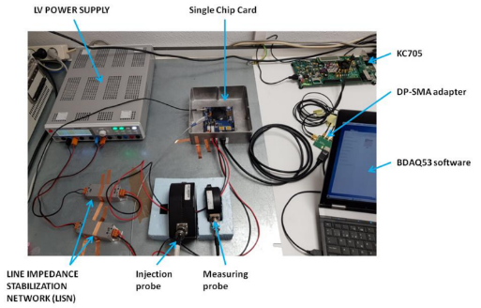
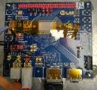
4. Noise control - EMC
1er Encuentro Aragón - Comunidad Valenciana
28-29 mayo 2025, Galáctica , Arcos de las Salinas, Teruel
Several set-ups has been used
SETUP AT CERN CMS LAB
SETUP AT ITA EMC LAB
SETUP AT ITA - ASICs

Slide 15
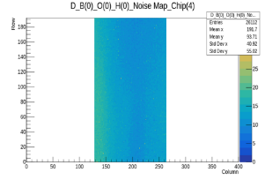
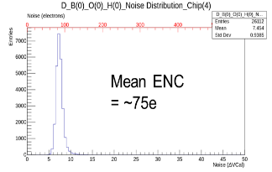
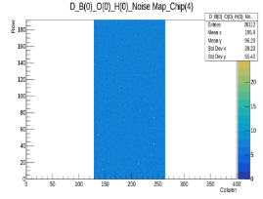
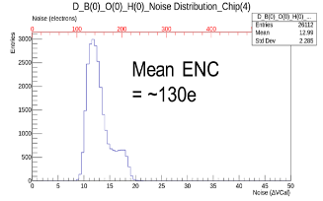
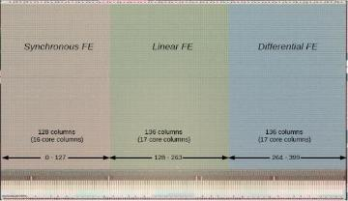
4. Noise control - EMC
1er Encuentro Aragón - Comunidad Valenciana
28-29 mayo 2025, Galáctica , Arcos de las Salinas, Teruel
Noise distribution
Noise at 3 MHz
No Noise
RD53A Lin FE and FEI4 noise sensitivity comparison
RD53 evaluation.
RD53A Front-End noise sensitivity comparison

Slide 16
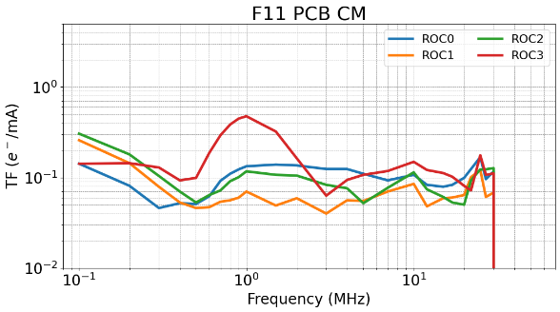
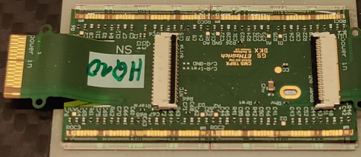
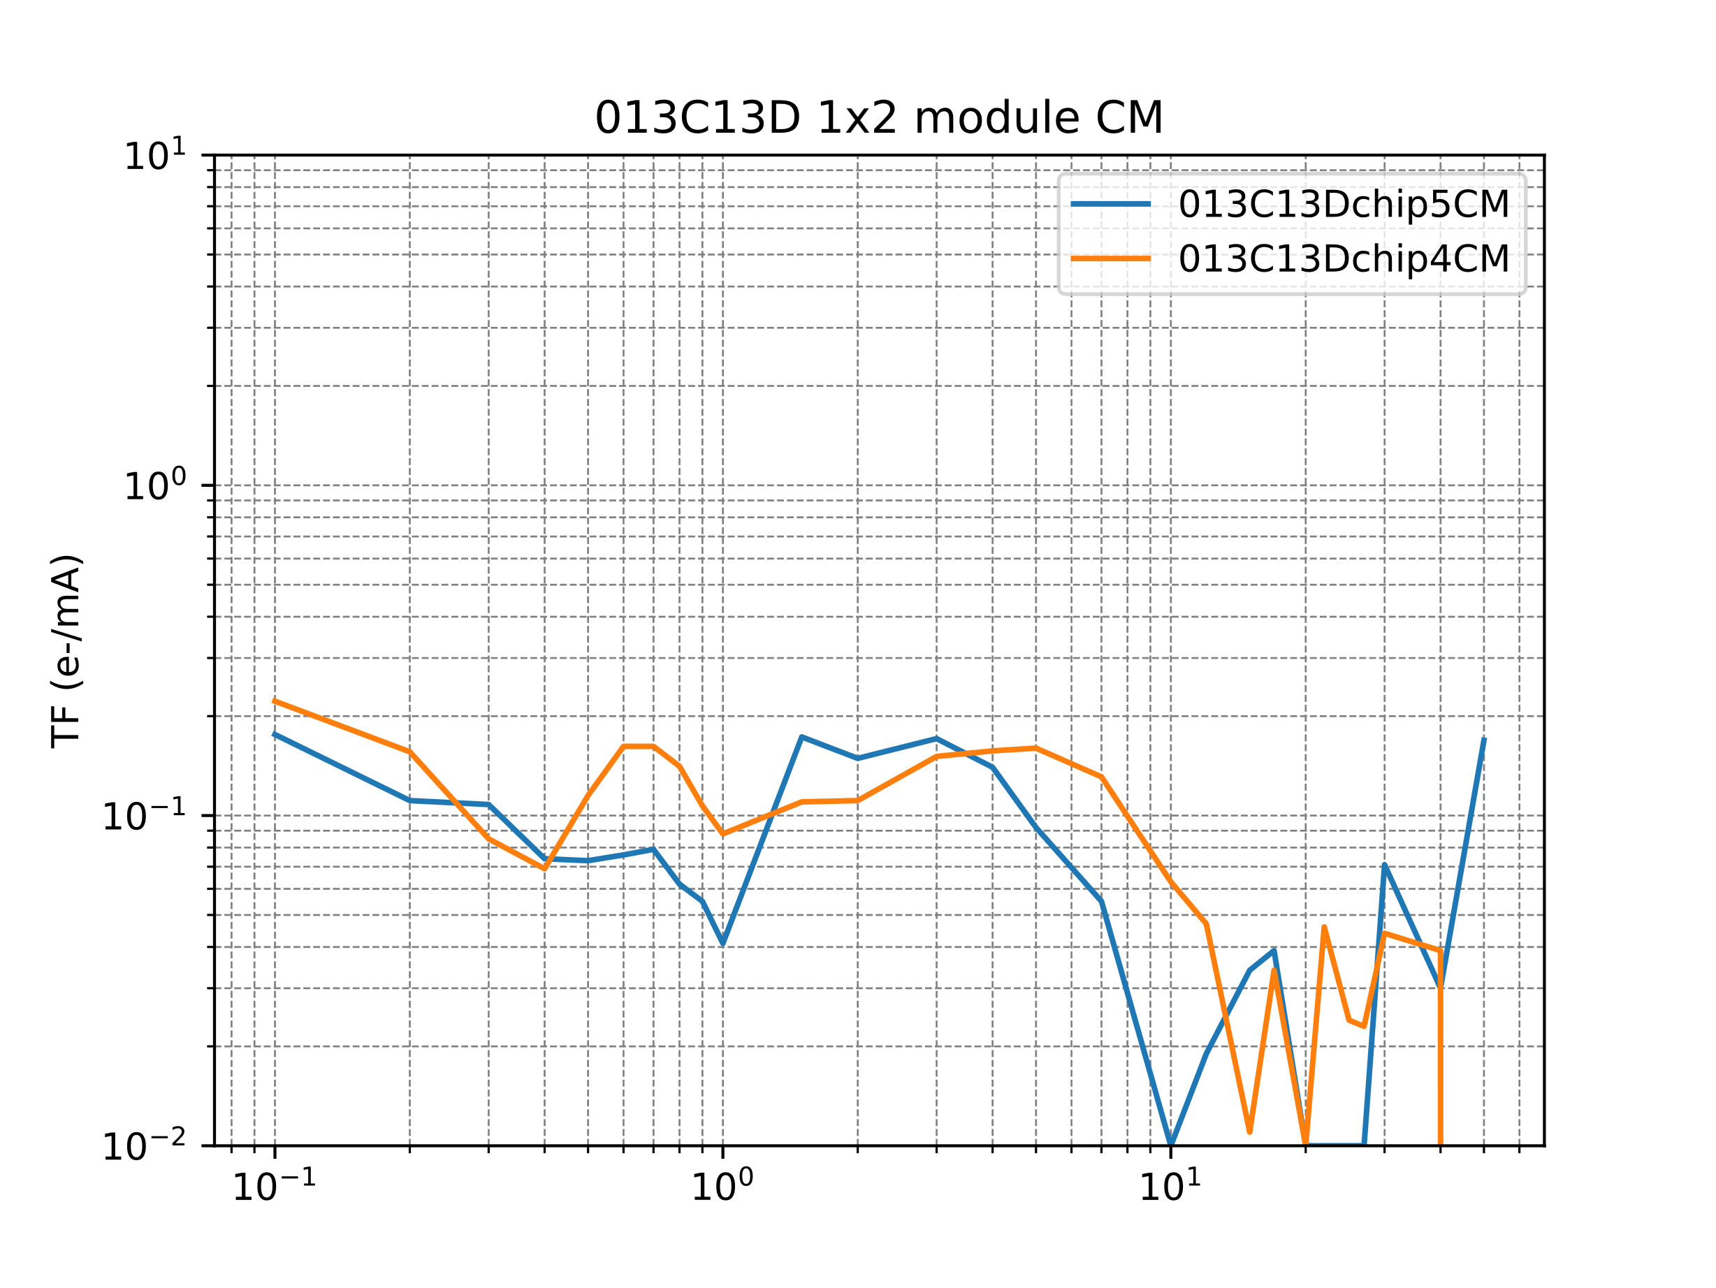
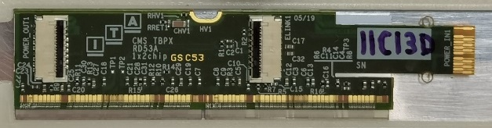
4. Noise control - EMC
1er Encuentro Aragón - Comunidad Valenciana
28-29 mayo 2025, Galáctica , Arcos de las Salinas, Teruel
Module evaluation.
ROC_2
ROC_3
HDI TBPX 2x2
ROC_1
ROC_0
HDI TBPX 1x2
ROC_5
ROC_4

Slide 17
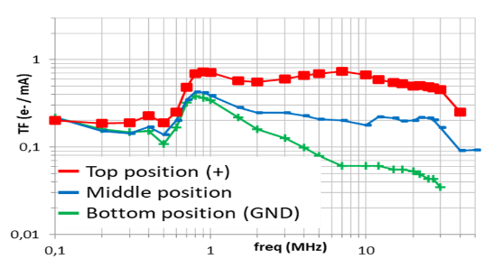
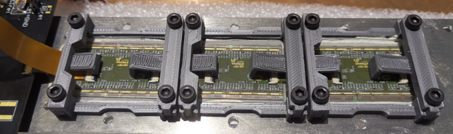
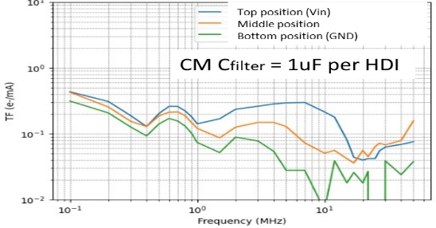
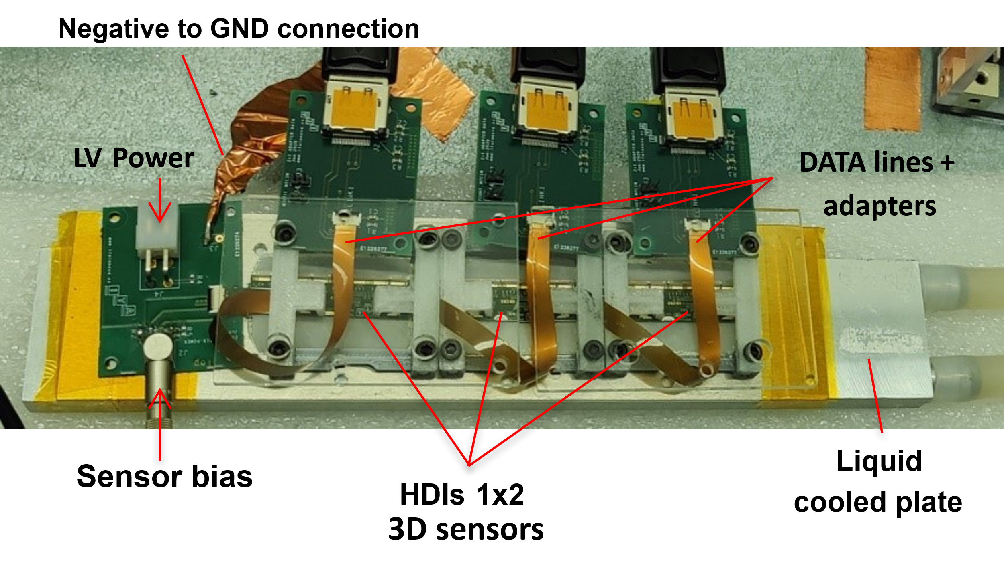
4. Noise control - EMC
1er Encuentro Aragón - Comunidad Valenciana
28-29 mayo 2025, Galáctica , Arcos de las Salinas, Teruel
Grounding and filtering topology evaluation
2x2 HDI
1x2 HDI

Slide 18
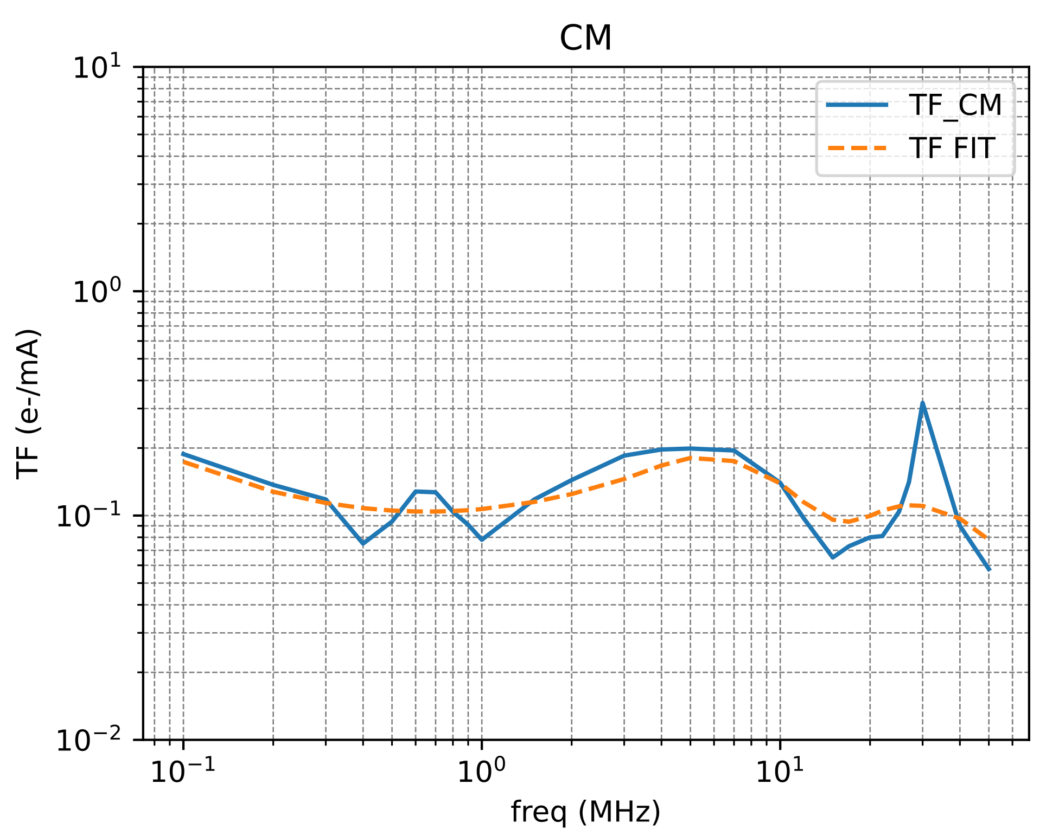
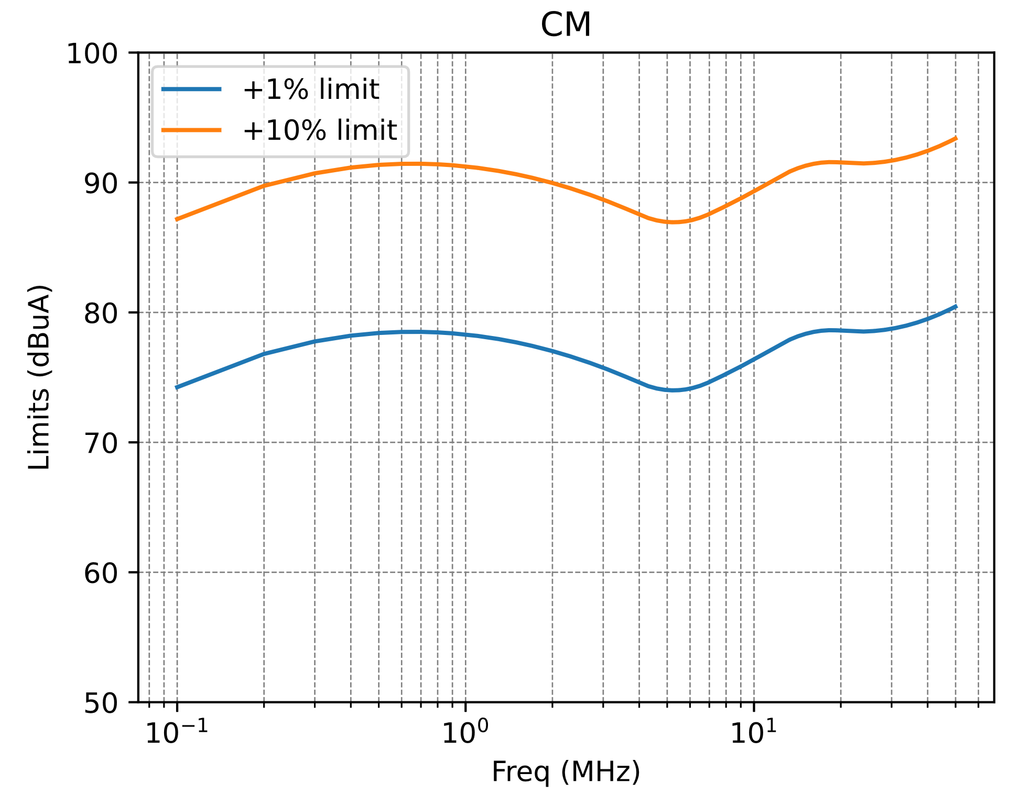
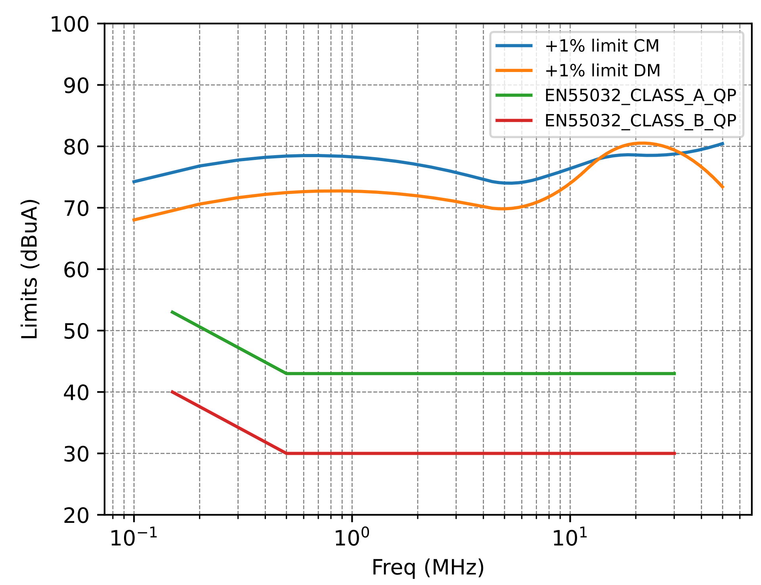


4. Noise control - EMC
1er Encuentro Aragón - Comunidad Valenciana
28-29 mayo 2025, Galáctica , Arcos de las Salinas, Teruel
Noise level compatible with CMS-ITK – Phase II
Noise limits
Noise limits

Slide 19



5. HDI design
1er Encuentro Aragón - Comunidad Valenciana
28-29 mayo 2025, Galáctica , Arcos de las Salinas, Teruel
HDIs are flexible PCBs that serve as the interface between chips/sensors and power/communication lines.
  Minimize material usage to the lowest feasible amount.
  Minimize energy dissipation to improve overall efficiency.
  Ensure signal integrity across communication lines.
  Design for low noise and minimal transient disturbances.

Slide 20




5. HDI design – Power dissipation
1er Encuentro Aragón - Comunidad Valenciana
28-29 mayo 2025, Galáctica , Arcos de las Salinas, Teruel
HDI has been design by simulation in order to minimized the amount of cooper
  Detail analysis of power routing & current balance
Power dissipation (~15%)
RD53A-TBPX-2x2 HDI V1
RD53A-TBPX-2x2 HDI V4
Current unbalance (< 1%)

Slide 21


5. HDI disign – Signal integrity
1er Encuentro Aragón - Comunidad Valenciana
28-29 mayo 2025, Galáctica , Arcos de las Salinas, Teruel
Data transmission - Impedance Matching
Module Input impedance

Slide 22






5. HDI disign – Signal integrity
1er Encuentro Aragón - Comunidad Valenciana
28-29 mayo 2025, Galáctica , Arcos de las Salinas, Teruel
Analysis of the contribution of wire bonds and the chip’s input stage.
The dominant source of signal distortion is the chip’s input capacitance (Cin), which acts as a parasitic element.
The impact of the wire bonds is negligible compared to that of Cin.
Eye diagram – Input chip
( Simulation)

Slide 23
6. Summary
1er Encuentro Aragón - Comunidad Valenciana
28-29 mayo 2025, Galáctica , Arcos de las Salinas, Teruel
A general overview of the design and development of the CMS-Phase II ITk power supply distribution system has been presented
  The design presents multiple challenges: transients, noise, power dissipation, and signal integrity
  All critical aspects must be addressed simultaneously
Early-stage analysis enabled the implementation of corrective actions
  EMC testing has been particularly relevant for system validation
  Development supported by simulation models for design refinement
Activities carried out within the framework of various projects
  Strong involvement of ITA in both national and european projects.
Very close collaboration with ETHZ, CMS-ITk–CERN , IFCA and IMB-CNM

Slide 24




1er Encuentro Aragón - Comunidad Valenciana
28-29 mayo 2025, Galáctica , Arcos de las Salinas, Teruel
¡Thank you!
This project has received funding from the CMSUPG project under Grant Agreements No PID2020-113705RB-C33. & Plan de Recuperacion Trasnformacion y resiliencia
This project has received funding from the European Union’s Horizon 2020 research and innovation programme under grant agreement No 101004761. (AIDAINNOVA)

