Slide 1

Characterization of a CLLBC pixelated crystal for dose monitoring in boron neutron capture therapy
S. Valladares¹, P. Torres-Sánchez¹, J. Lerendegui-Marco¹, J. Balibrea-Correa¹,
V. Babiano-Suarez¹, B. Gameiro¹, I. Ladarescu¹, A. Sanchis-Moltó¹,
C. Domingo-Pardo¹
¹ IFIC (CSIC-University of Valencia), Paterna, 46980 Spain

Slide 2

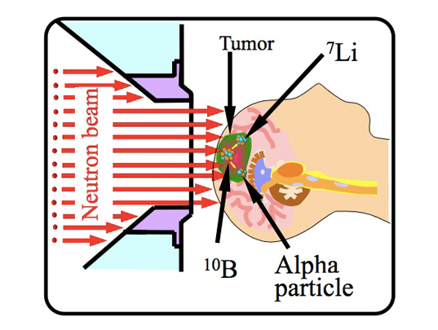
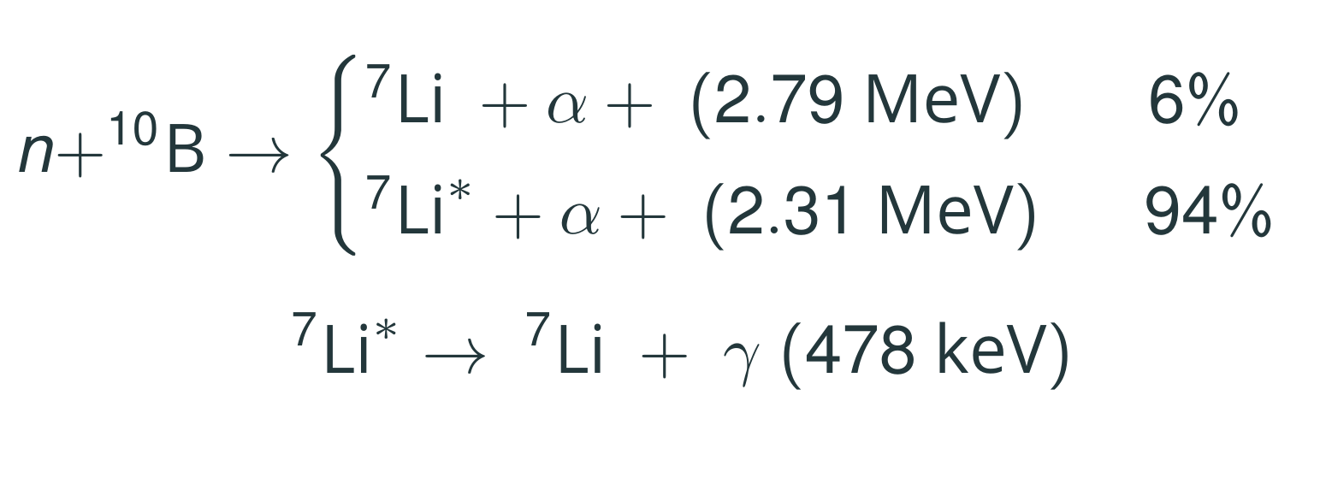
Motivation
Boron Neutron Capture Therapy (BNCT)
Experimental radiotherapy suitable for difficult-to-treat or resistant cancers.
For the treatment of head and neck cancers, lung cancers, and even breast cancers ¹.
Current Challenges: Measurement of boron concentration in vivo ¹.
BNCT treatment diagram
¹ International Atomic Energy Agency. Advances in Boron Neutron Capture Therapy. Non-serial Publications. IAEA, Vienna, 2023

Slide 3
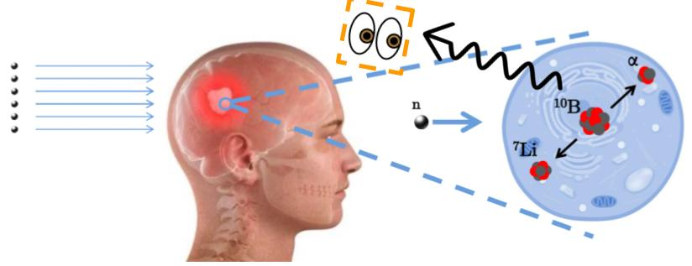
Motivation
Boron Neutron Capture Therapy (BNCT)
Current Challenges: Measurement of boron concentration in vivo.
Current control methods → measure the blood boron concentration.
Proposed strategies → SPECT or Compton Cameras. ^{2,3,4}
BNCT treatment diagram
² T Ferri et al. Design and validation of a spect prototype for treatment monitoring in BNCT and first experimental tomographic results. IEEE Transactions on Radiation and Plasma Medical Sciences, 2025.
³ Caracciolo Anita. Development of a gamma-ray detection unit for a SPECT system for real-time dose monitoring in BNCT. PhD thesis, Politecnico di Milano, 2025.
⁴ Chun-hui Gong et al. Optimization of the Compton camera for measuring prompt gamma rays in boron neutron capture therapy. Applied Radiation and Isotopes, 124:62–67, 2017.

Slide 4
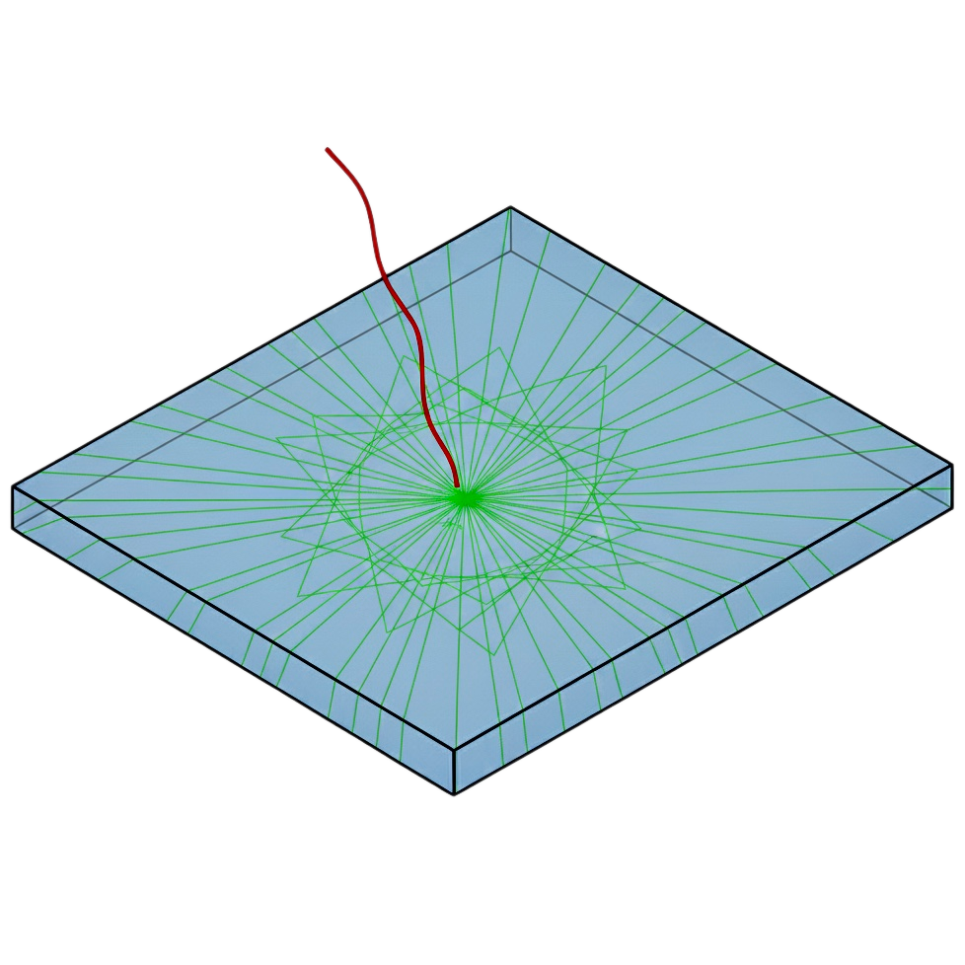
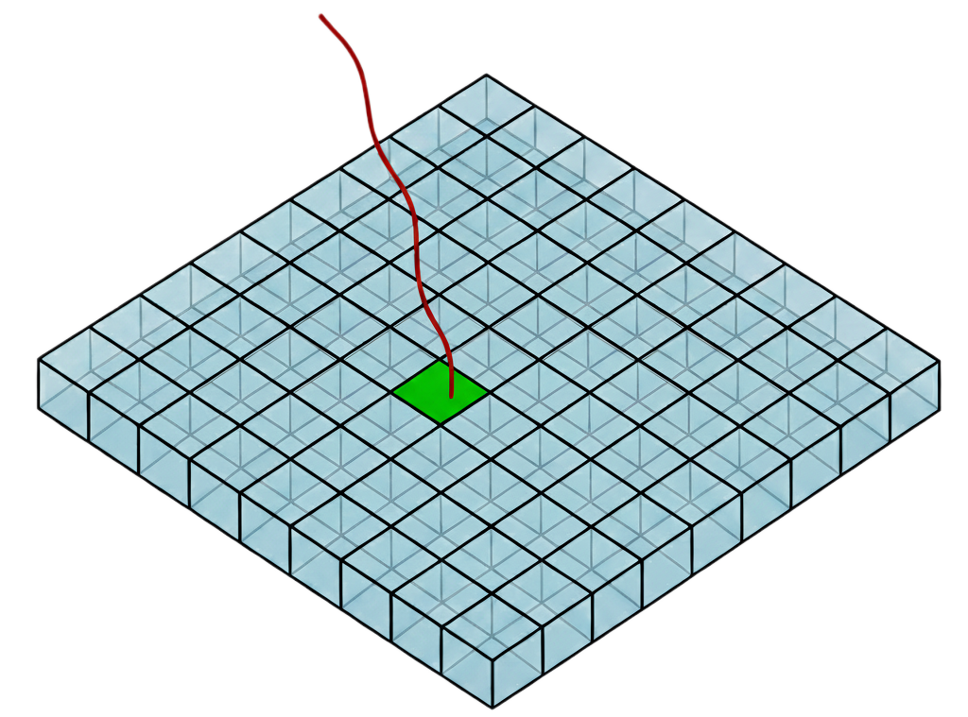
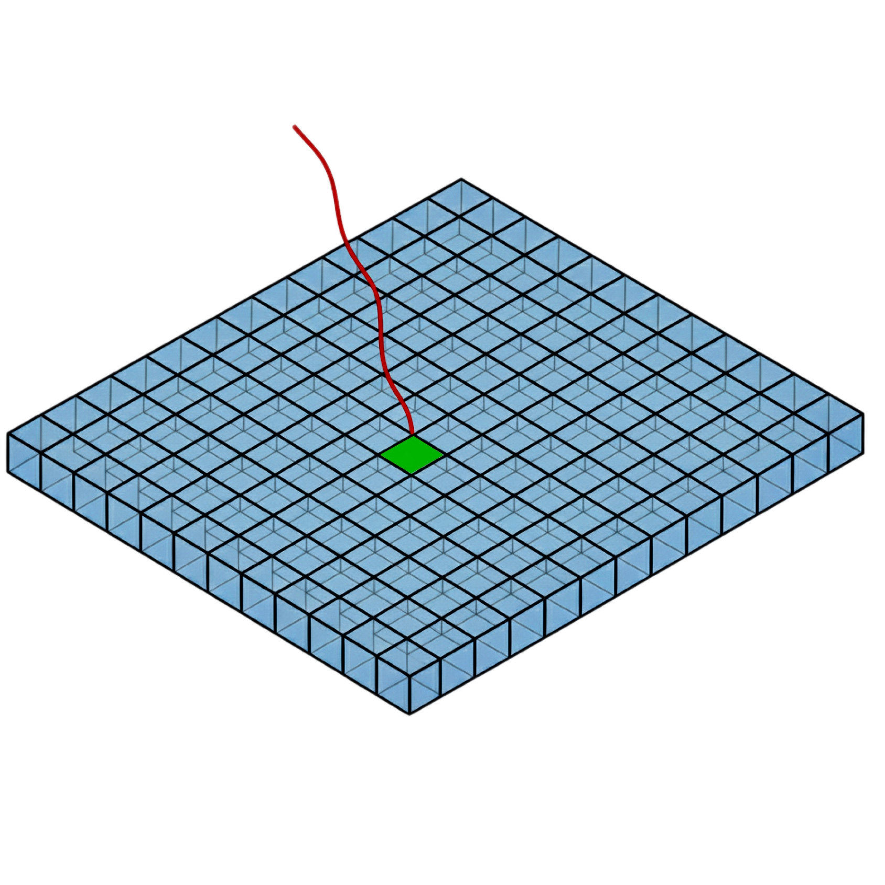
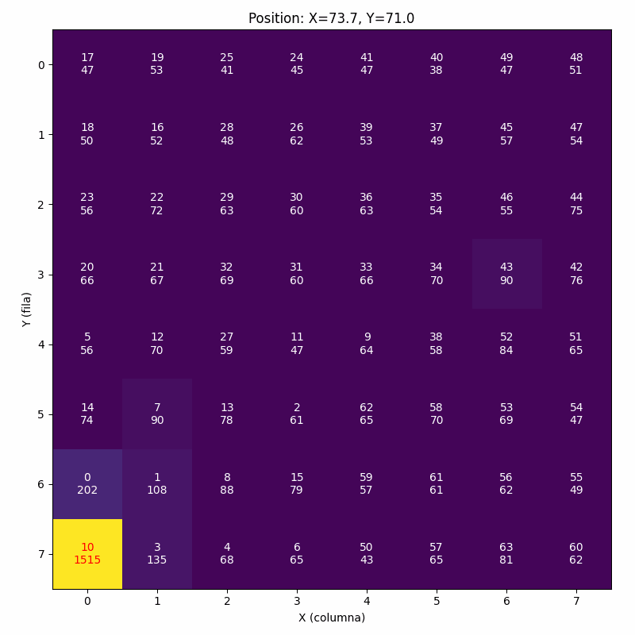
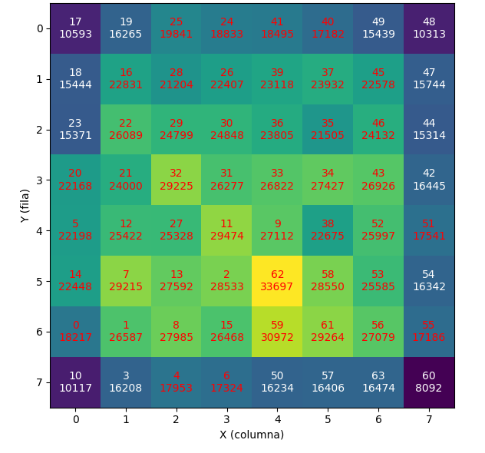
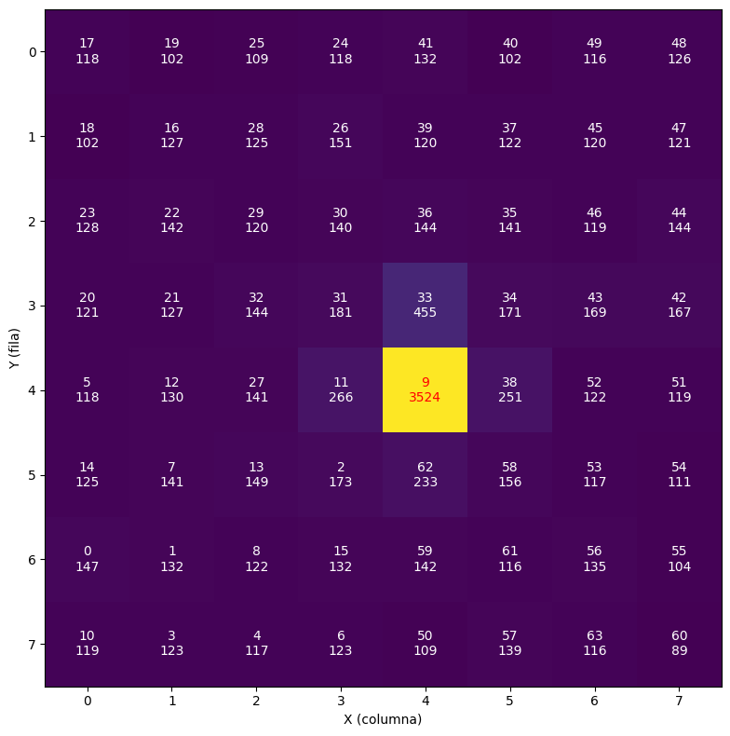
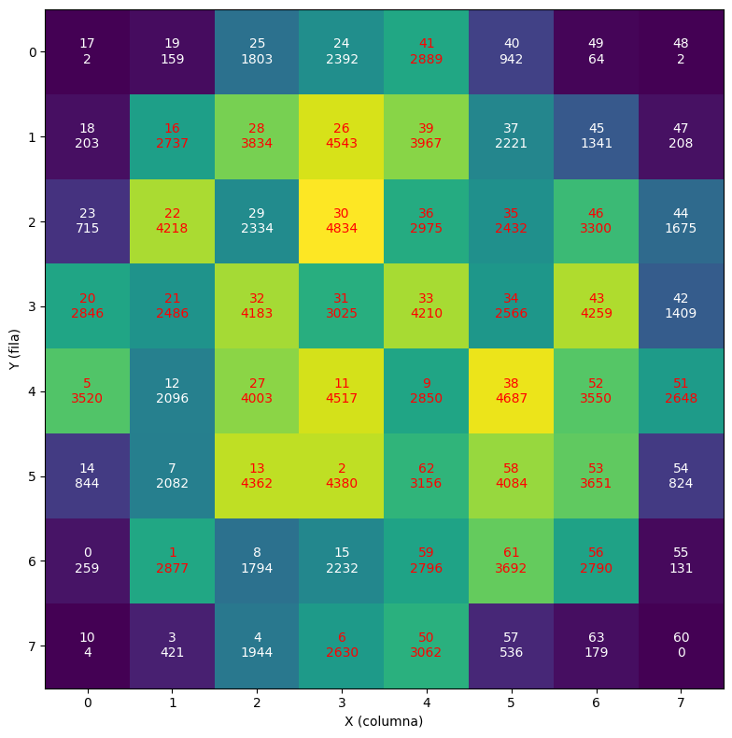
Monolithic vs Pixelated Crystals
Photon
Photon
Monolithic crystals → light spread in the whole crystal
Pixelated crystals → light confined in a single “pixel”
Pixelated crystal
Monolithic crystal
Marta Freire et al. Reducing calibration time in pet systems based on monolithic crystals. Frontiers in Medicine, 8:734476, 2021.

Slide 5
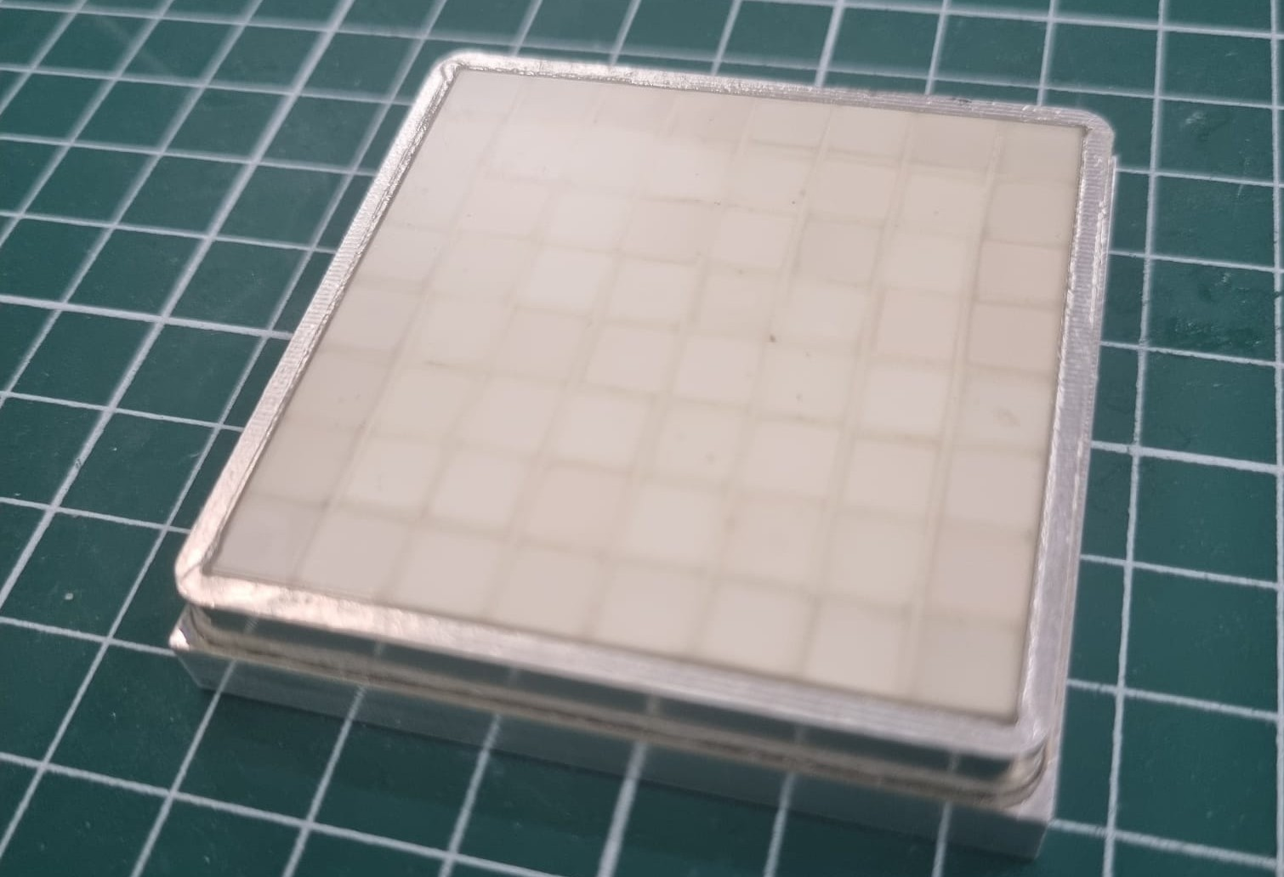
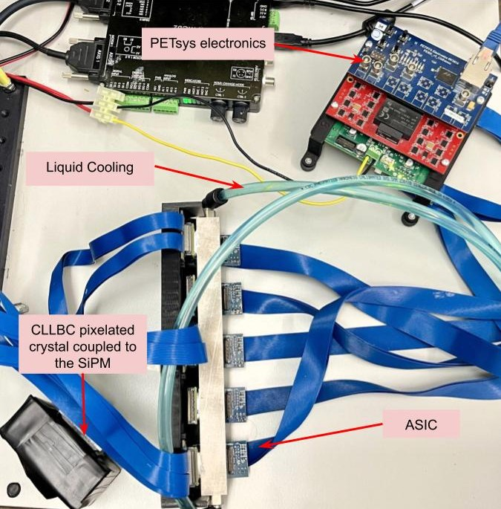
CLLBC segmented crystal
To work under higher count rates.
Light confined in individual pixels.
Segmented crystal used → 8x8 pixels, each 5.7x5.7 mm and a thickness of 6~mm.
CLLBC segmented scintillator crystal
Characterization setup
Andrea Sanchis Moltó. Gamma-neutron vision device: first tests of neutron imaging for bnct and development of the first prototype. Trabajo Fin de Máster, Universidad de Valencia, 2025.

Slide 6
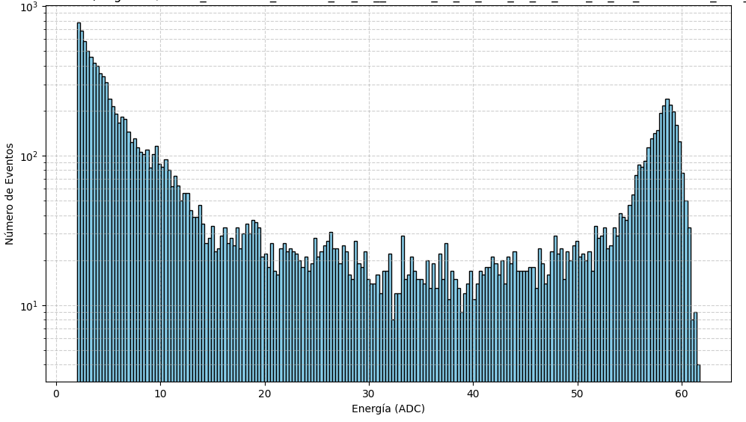
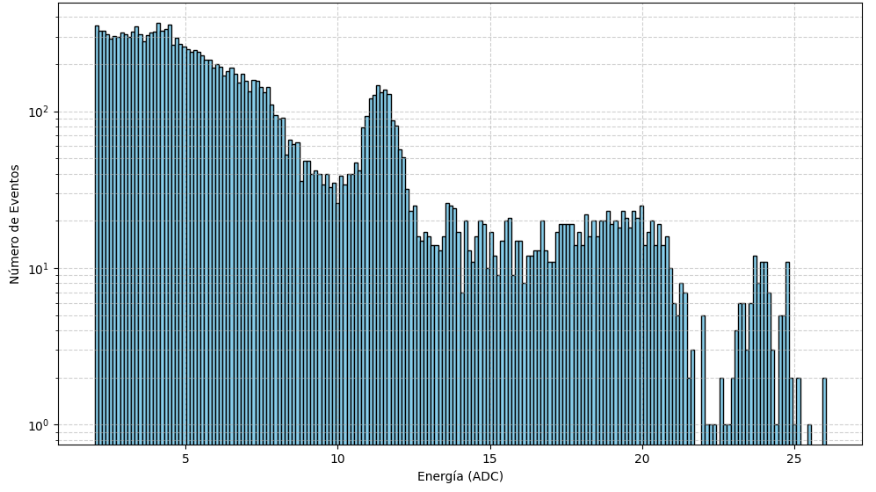
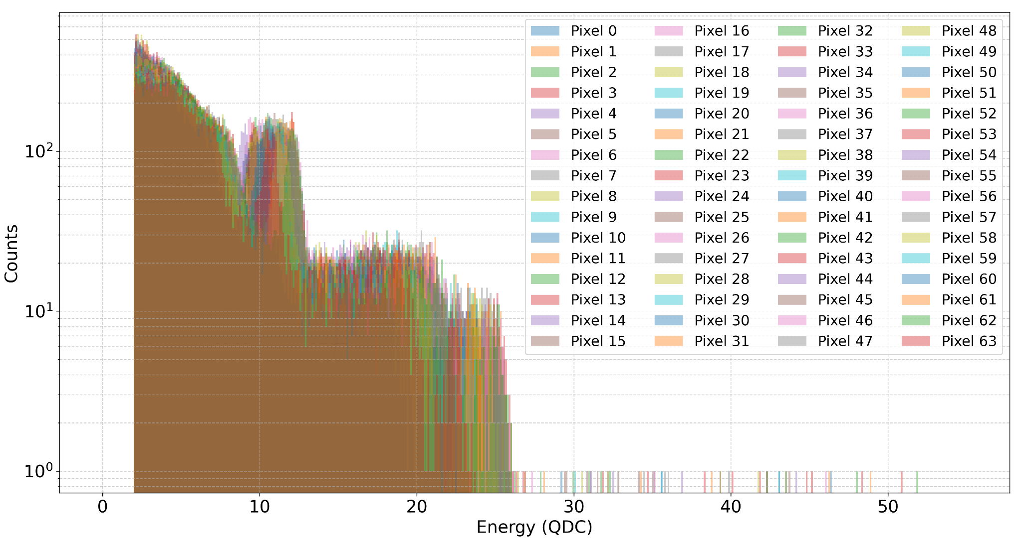
PETSys Calibration
Pixel 58 spectrum with default settings
Pixel 58 spectrum with optimized settings
PETsys settings optimization required! ⁵
Each pixel capable to produce an energy spectrum
Na-22 pixelated crystal spectrum (QDC)
⁵ PETsys Electronics. TOFPET2C/D SiPM Readout ASIC Datasheet. https://www.petsys-electronics.com, 2025

Slide 7
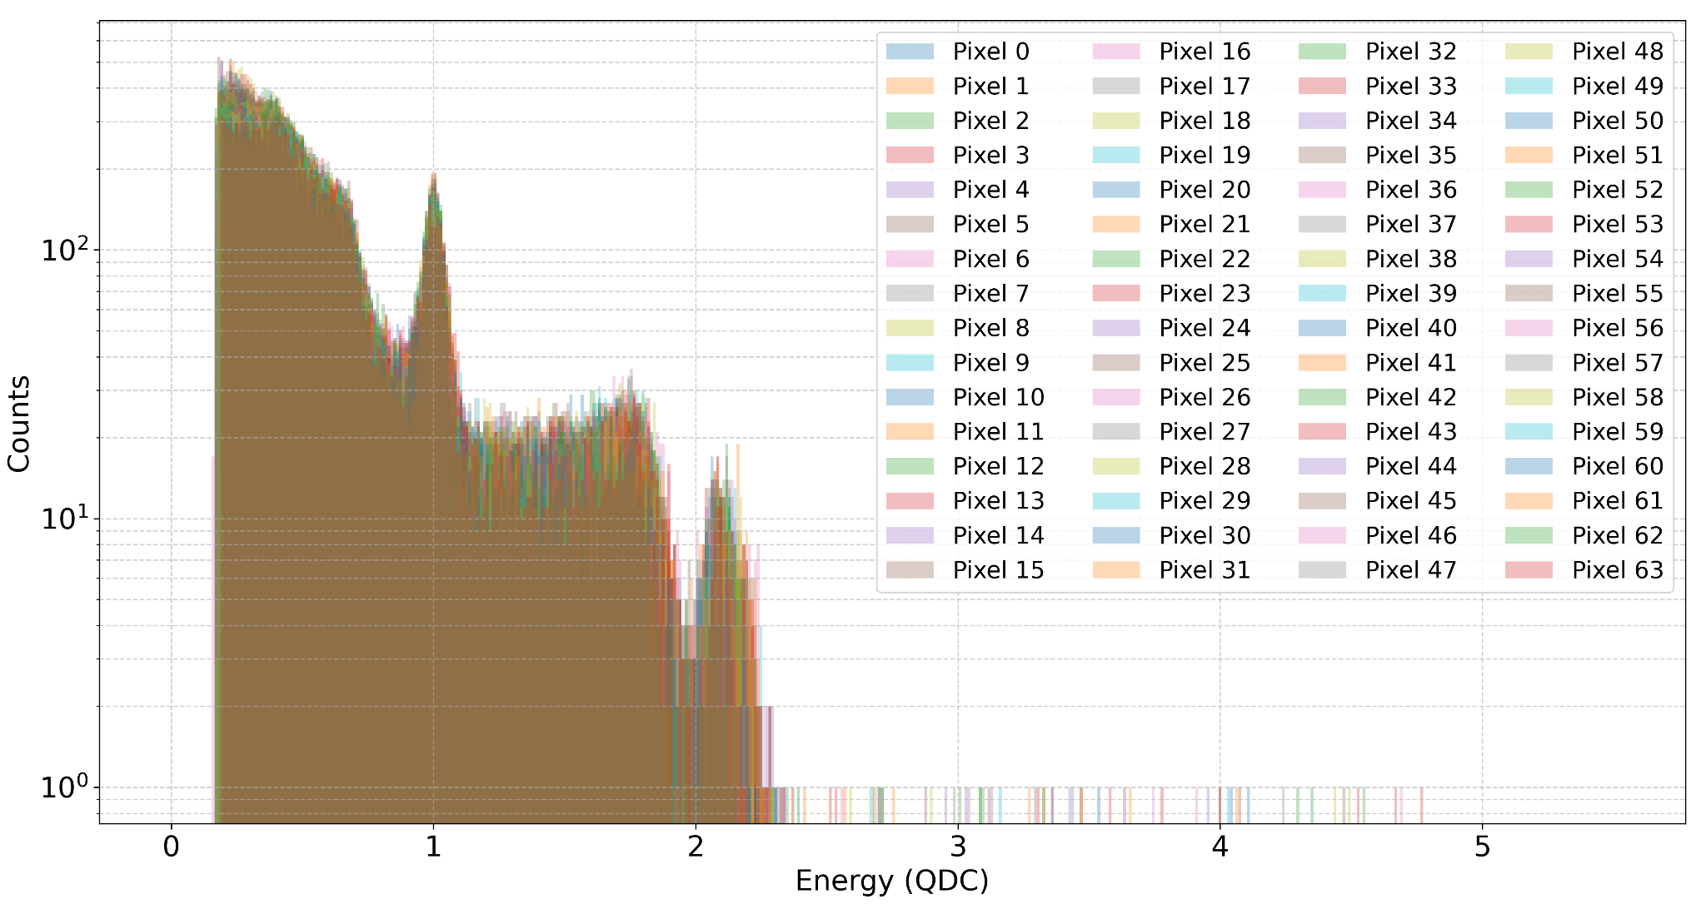
PETSys Calibration
Pixels not aligned
Pixels aligned
511 keV peak!
511 keV peak!
Each pixel capable to produce an energy spectrum
Each pixel has a different response → calibration required!
Na-22 pixelated crystal spectrum (QDC)
⁵ PETsys Electronics. TOFPET2C/D SiPM Readout ASIC Datasheet. https://www.petsys-electronics.com, 2025

Slide 8
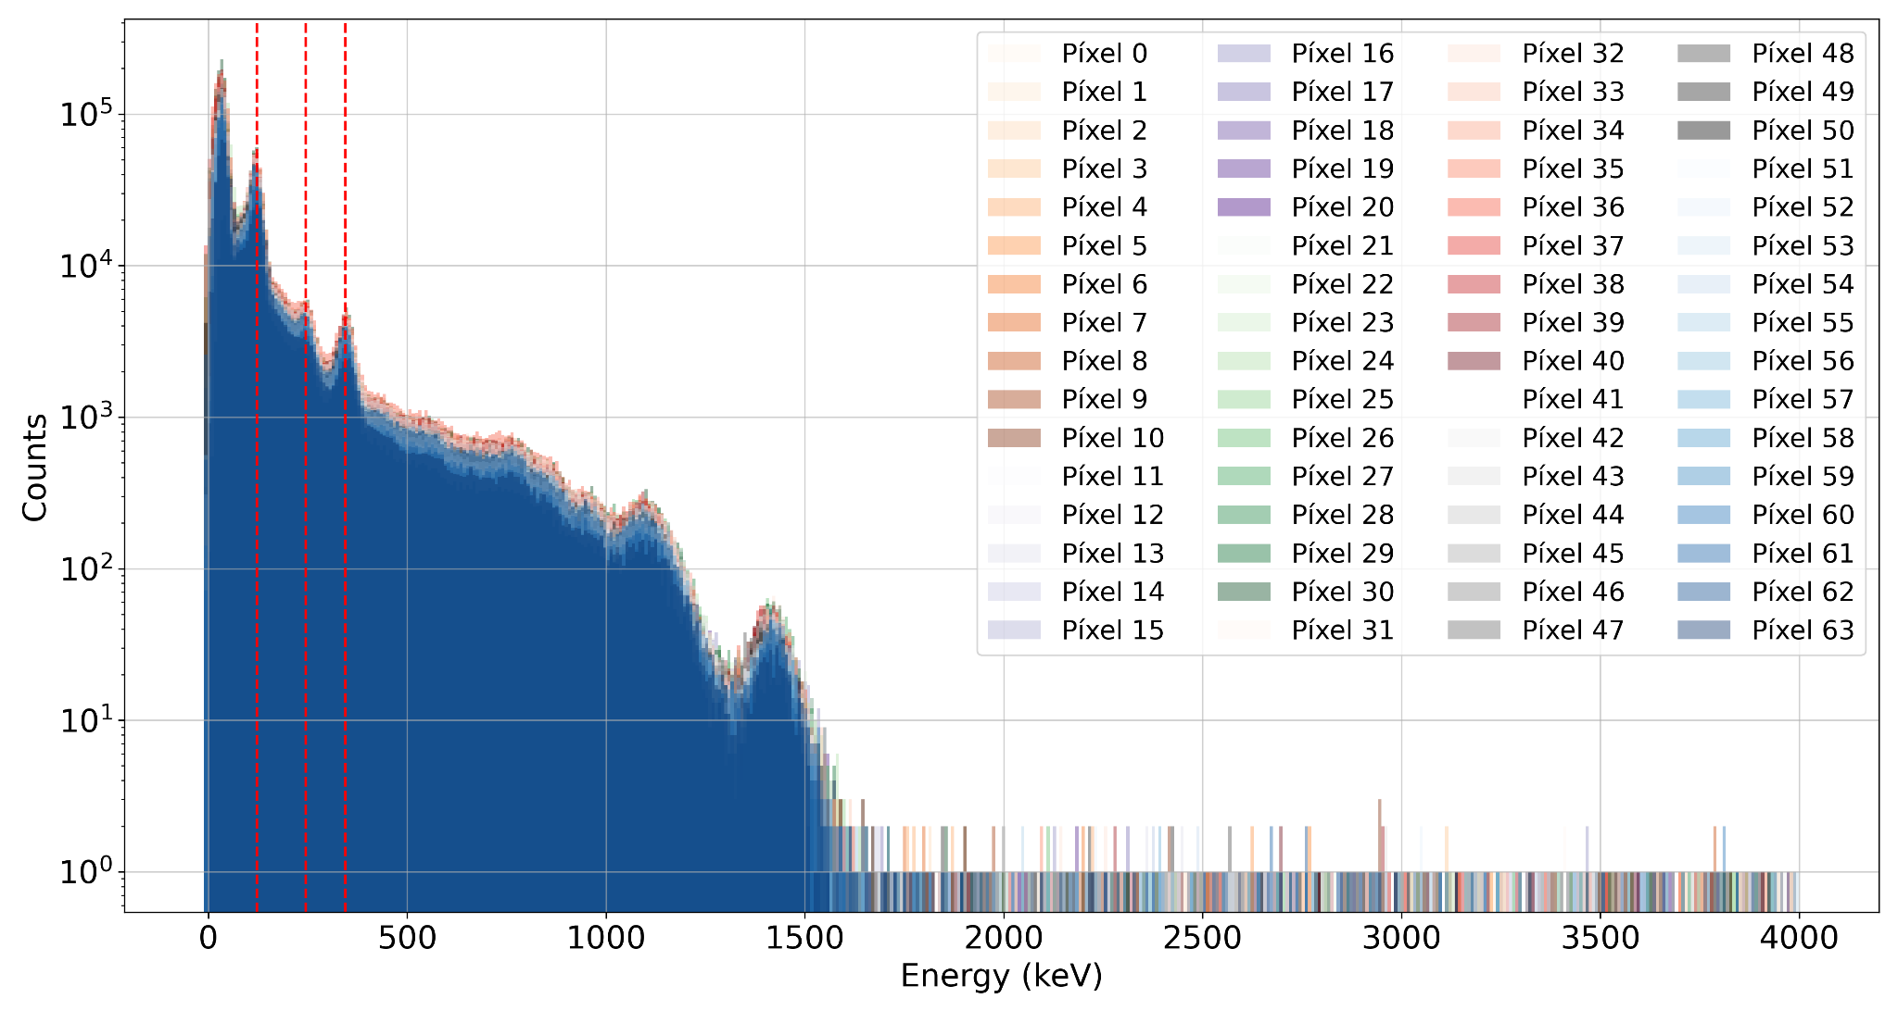
Energy calibration of individual pixels
¹⁵²Eu source for calibration.
Calibration performed pixel-by-pixel.⁶
Eu-152 pixelated crystal energy spectrum
⁶ ON Semiconductor. Linearity of the silicon photomultiplier. Application Note AND9776/D, Rev.2, ON Semiconductor, September 2018

Slide 9
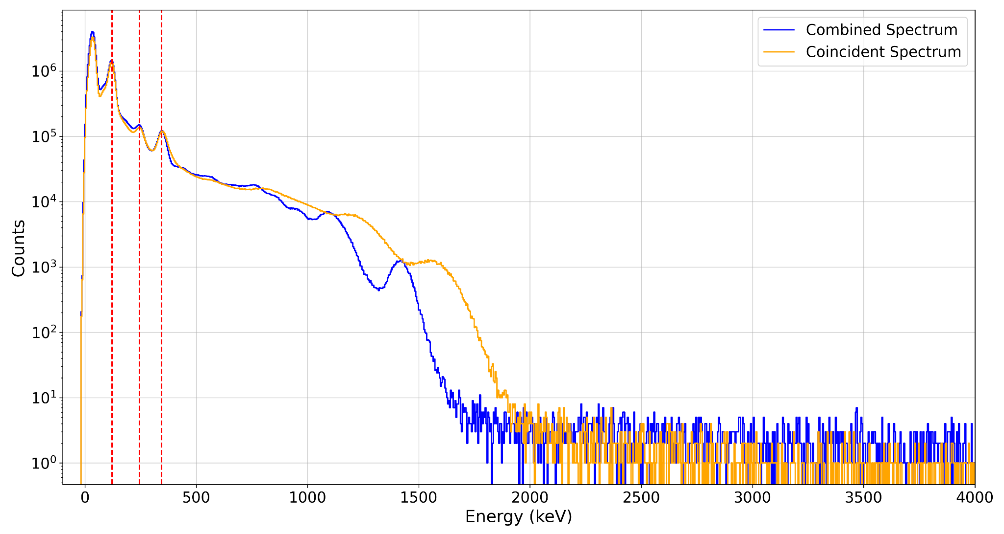
Energy calibration of individual pixels
Comparison between the coincident energy spectrum (orange spectrum) and the sum of the individual pixels energy spectrum (blue spectrum)
⁶ ON Semiconductor. Linearity of the silicon photomultiplier. Application Note AND9776/D, Rev.2, ON Semiconductor, September 2018

Slide 10
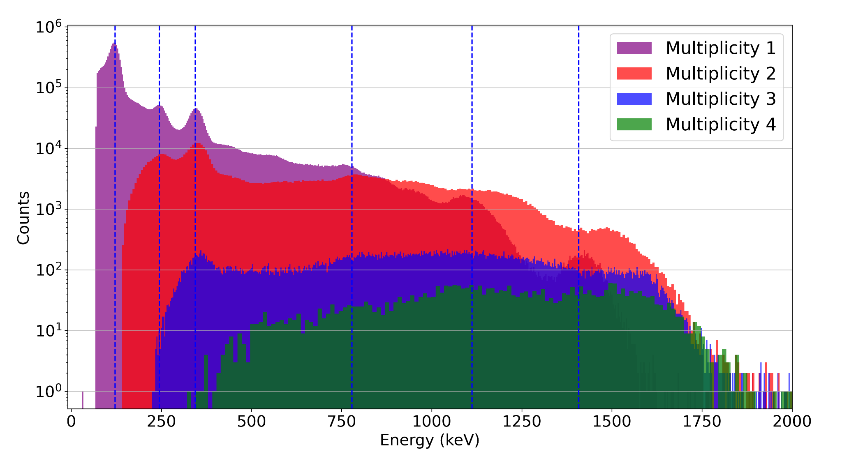
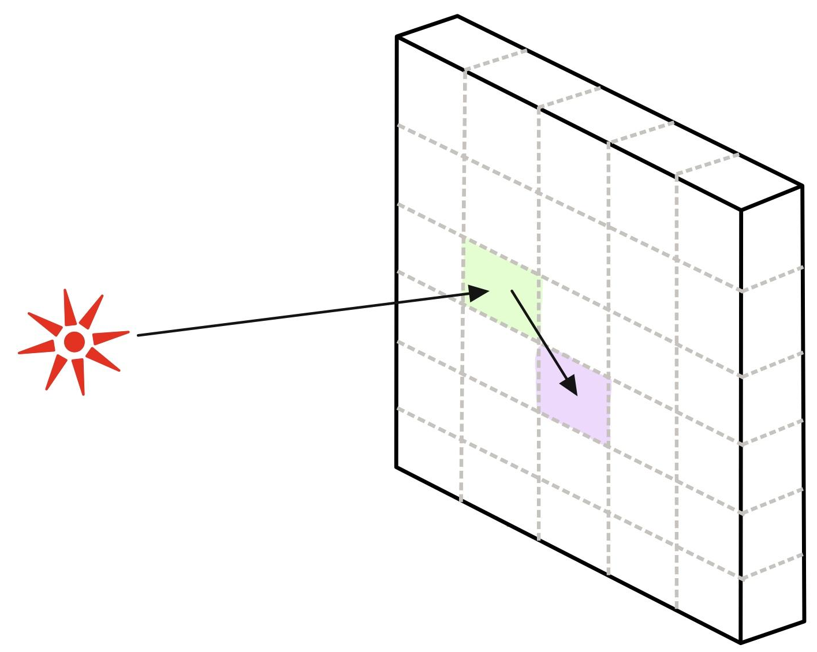

Energy response and pixel multiplicity
Ideally → one pixel per event.
Reality → > 90% events trigger one pixel.
Shift in coincidence spectrum → multiplicity >1 events!
Comparison of coincidence energy spectrum for different multiplicities

Slide 11
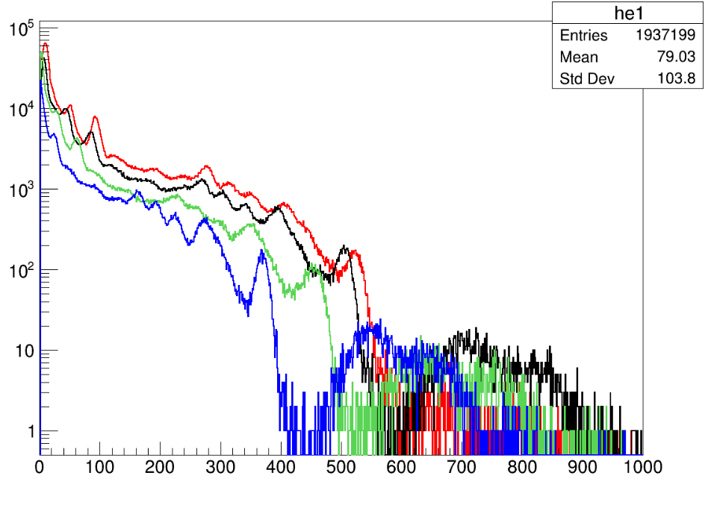
PETSys Calibration
Calibration merged manually
Pixelated config + Monolithic config
By checking the spectrum from all the absorbers → optimizations TBD.
RED → Absorber 1
BLACK → Absorber 2
GREEN → Absorber 3
BLUE → Absorber 4
Eu-152 spectrum of the four absorbers (QDC)

Slide 12
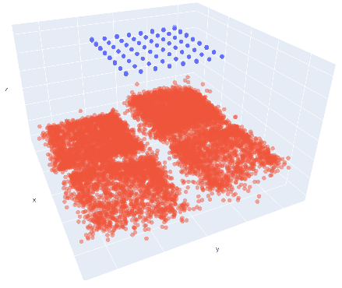
i-TED position reconstruction
Events position reconstruction i-TED
Scatterer plane → pixel center used as effective position
Absorbers plane → position reconstructed from the spatial charge distribution.⁷
i-TED events reconstruction
⁷ J Balibrea-Correa et al. Machine learning aided 3D-position reconstruction in large LaCl3 crystals. Nuclear Instruments and Methods in Physics Research Section A, 2021.

Slide 13
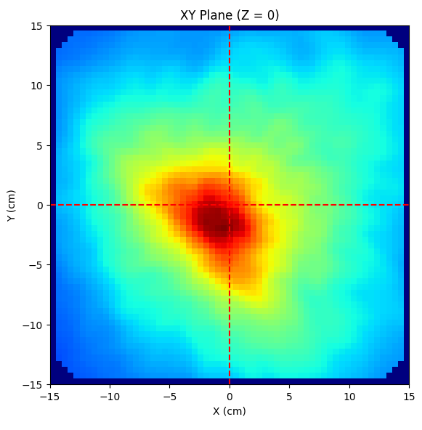
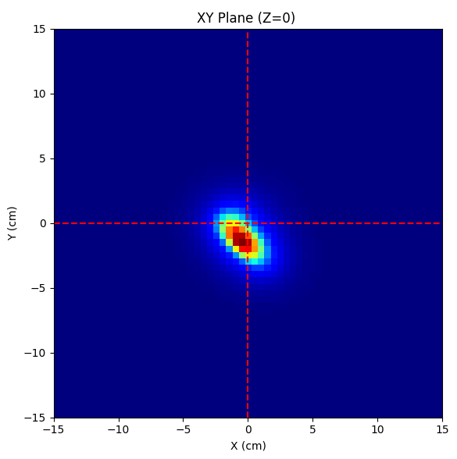
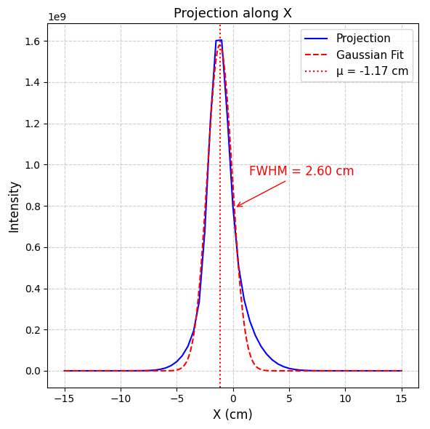
iTED-P Imaging
Backprojection
LM-MLEM
First imaging test with the pixelated crystal as scatterer
Detector resolution set to ~8.5% @ 662 keV
Still work to be done…
Na-22 source placed at ~0 cm in the x-axis.

Slide 14
Conclusions
BNCT current problem → high count rates.
Proposed solution → Pixelated crystal.
Reliable energy spectrum → Reducing the gain in the acquisition line.
Each pixel responds differently → Calibration of the 64 pixels.
Events with multiplicity > 1 → Distort energy spectrum.
First implementation of a pixelated crystal in an iTED module
Still work to be done…

Slide 15

Thank you for your attention!
Advanced imaging system for Medical Applications
(Grant No. 101137646)

Slide 16
Backup Slides
Advanced imaging system for Medical Applications
(Grant No. 101137646)

Slide 17
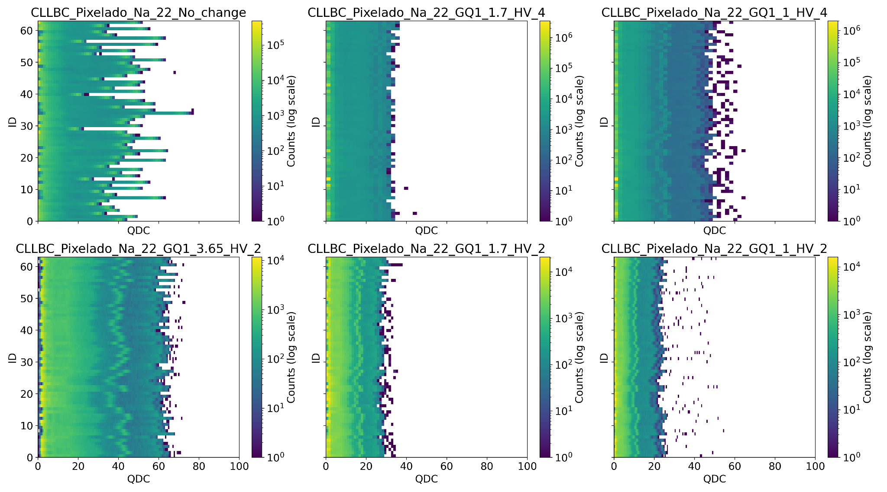
Pixelated Crystal configurations
Saturation!
2D histograms of detected events for ²²Na source with five minutes of acquisition time using a segmented CLLBC crystal. Each subplot shows QDC (horizontal) versus ID (pixel, vertical) for six different measurement configurations.

Slide 18
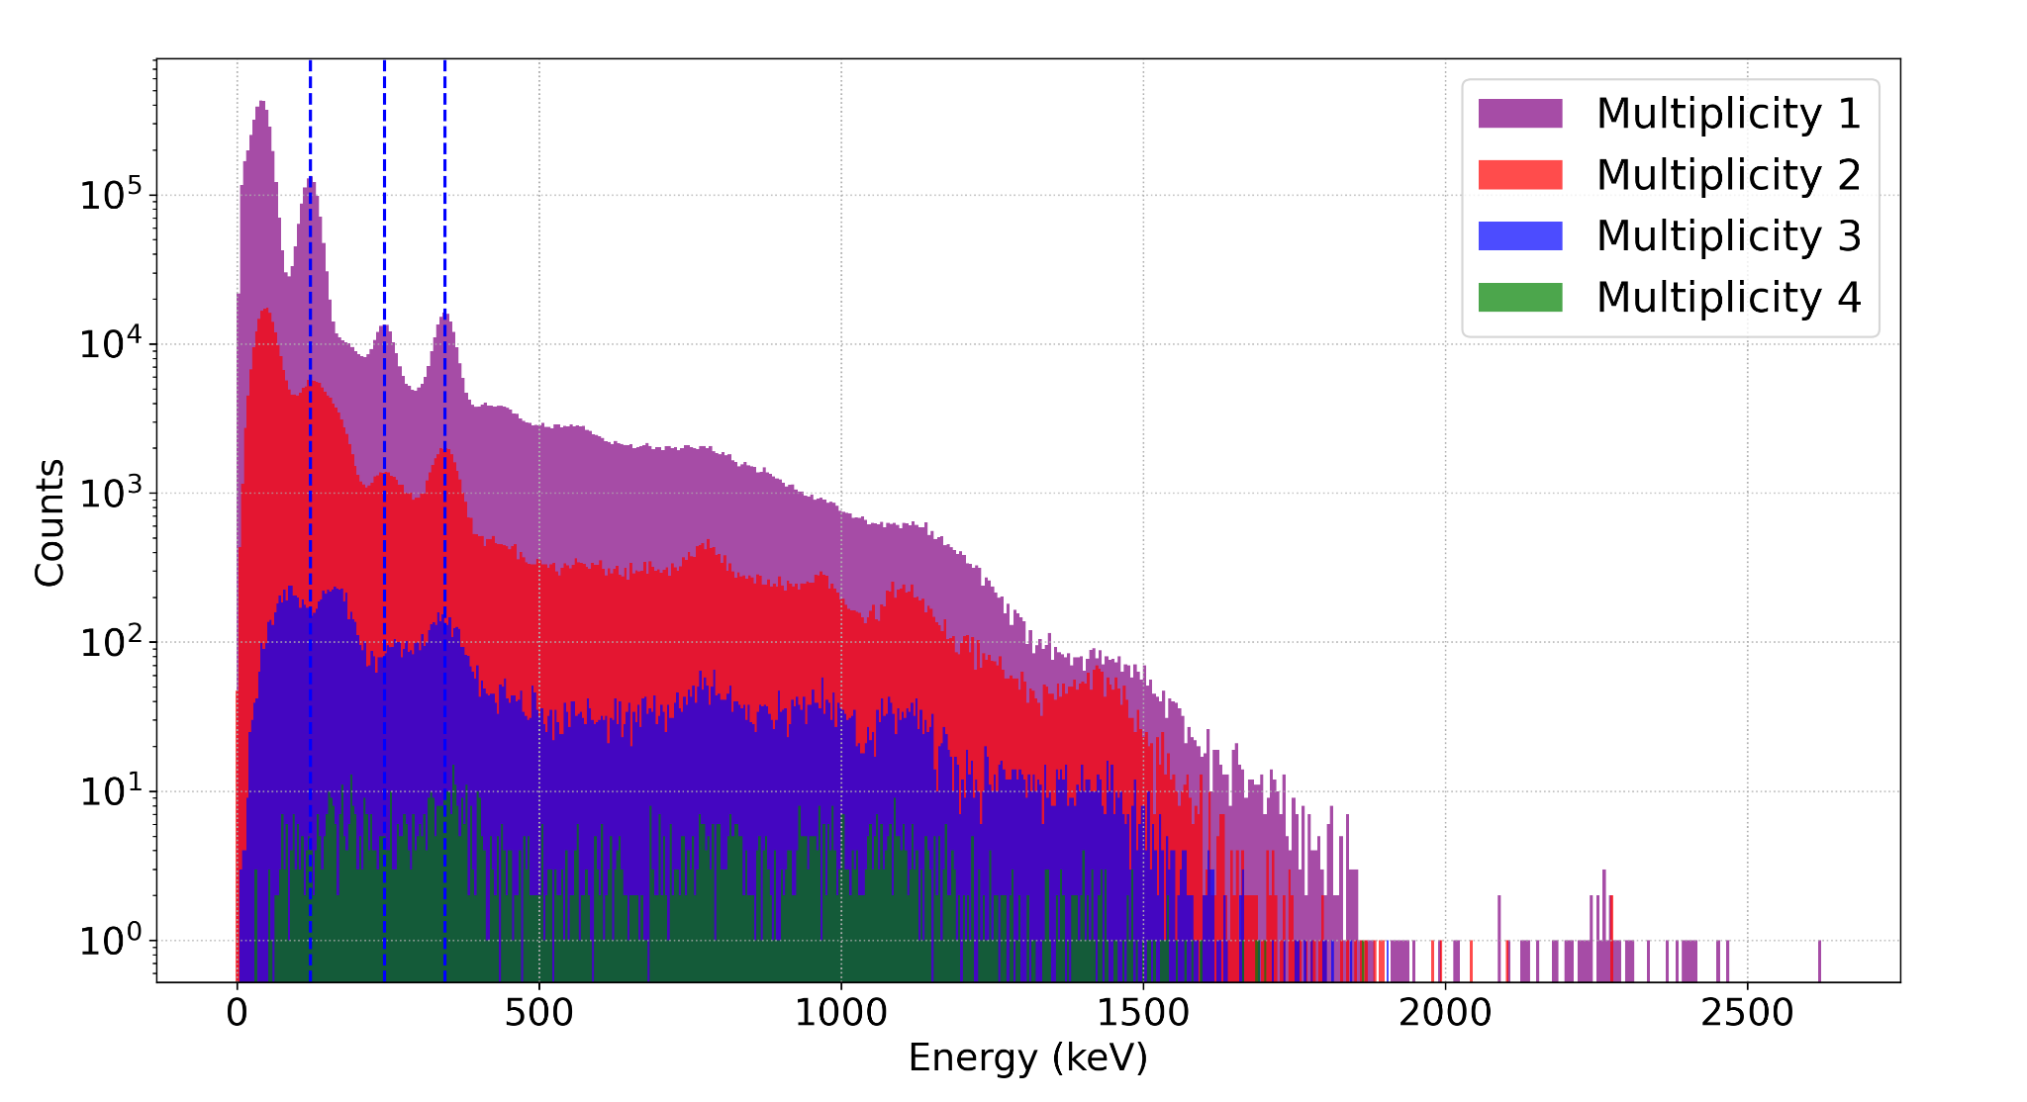

Multiplicity 2: Exp. vs Sim.
Experimental data
Simulation data
Ideally → one pixel per event.
Reality → > 90% events trigger one pixel.
Shift in coincidence spectrum → multiplicity >1 events!
No shift observed!
Effect independent from the energy calibration.
Comparison of coincidence energy spectrum for different multiplicities

Slide 19
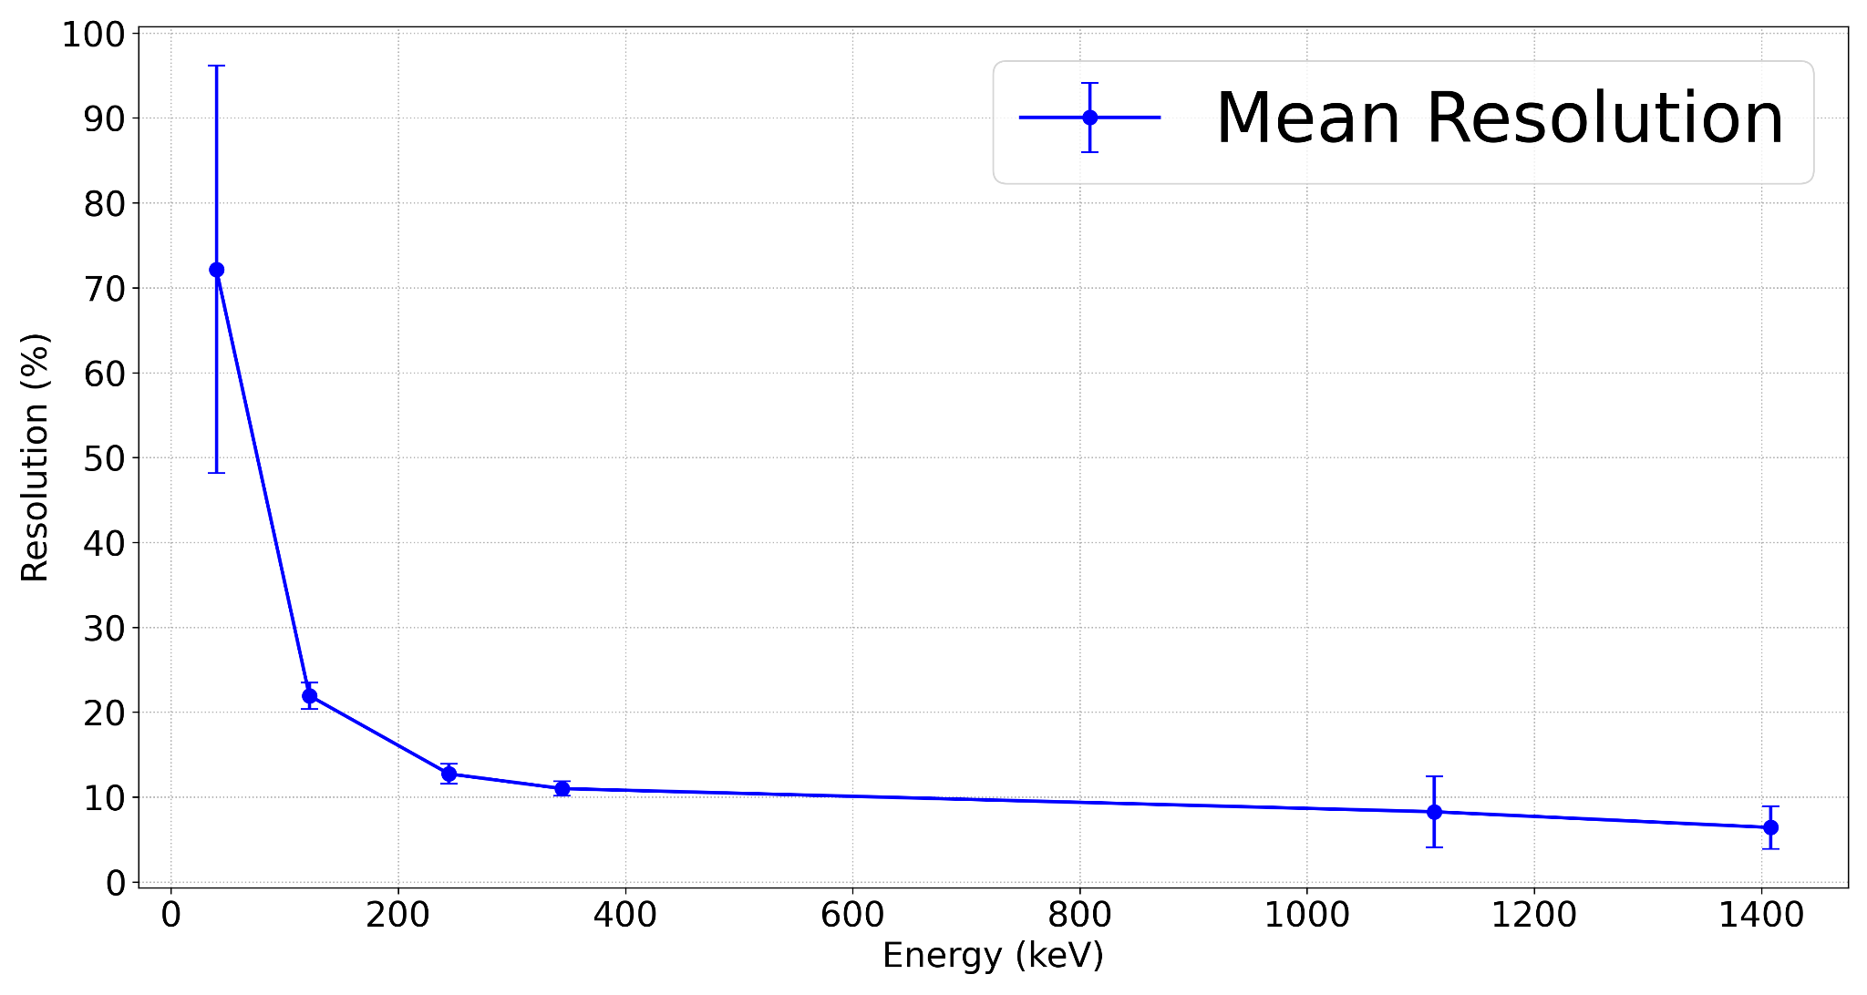
Energy Resolution
Mean energy resolution → 10% at 662 keV.
No optimization of electronics parameters
Mean energy resolution curve for the 64 pixels of the pixelated crystal.

Slide 20
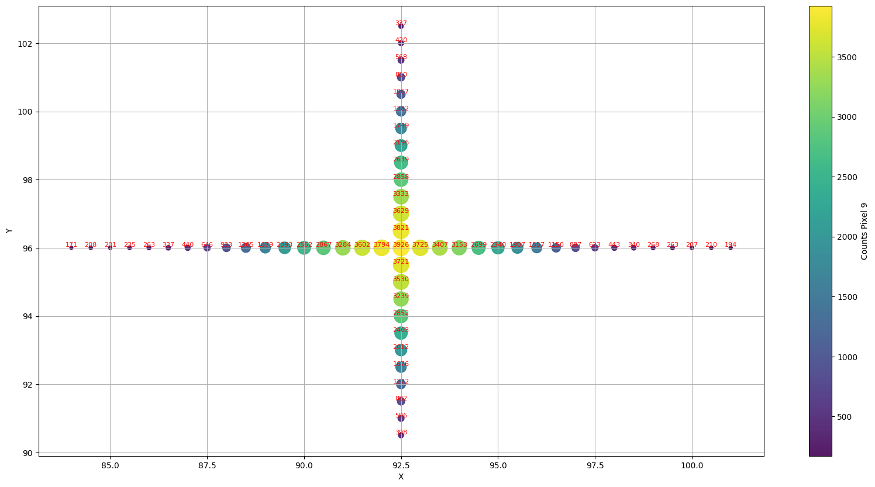
Scanning Pixel-by-Pixel
Scanning across the center of pixel 9

