Slide 1




Studying the Structure of Light Exotic Nuclei through Inverse-Kinematics Reactions
Sebastián Gómez García (IEM-CSIC)

Slide 2
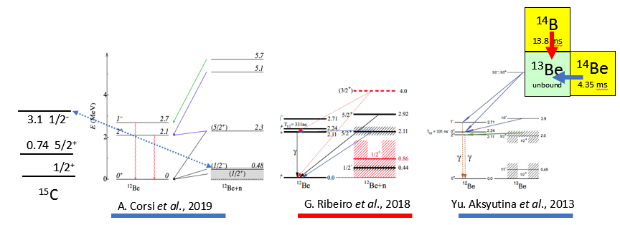
Motivation
Neutron-rich light nuclei present several interesting feature:
Halo nuclei (e.g. ¹¹Be, ¹¹Li, ⁶He)
Clustering (e.g. ⁸Be = α+α)
Molecular behaviour (e.g. ¹⁰Be = 2α+2n) )
Resonant continuum states (e.g. ¹³Be)
Why study ¹³Be?
¹³Be is interesting as subsystem of the 2-neutron halo nucleus ¹⁴Be.
¹³Be is critical to establish the ¹²Be-n interaction in the 3-body modelling of ¹⁴Be.
The relative positions of the 1/2⁺ and 1/2⁻ resonances are debated.
The 1/2⁻ state extracted from the breakup of ¹⁴Be breakup (¹³Be) appears at a surprisingly low energy compared with its analogue in ¹⁵C (¹⁴C+n).

Slide 3




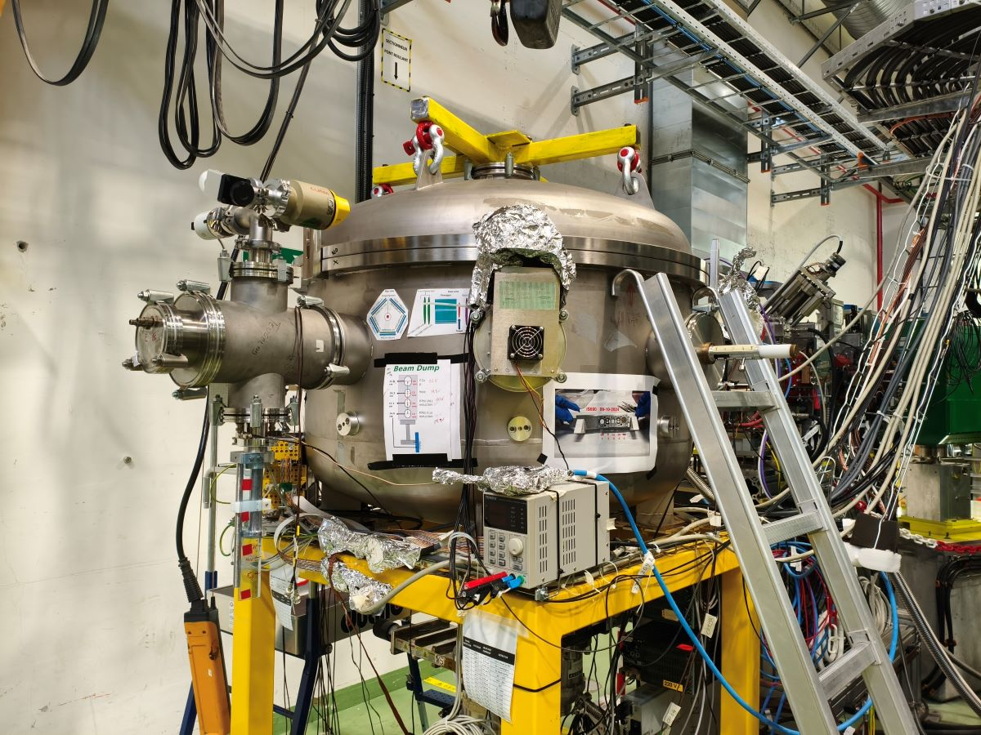

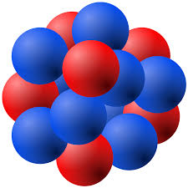

IS690 Experiment
5,4 MeV/u
P
n
ɣ
¹¹Be
³H/Ti foil
¹³Be
¹²Be*
The main target consists of a 12 × 5 mm, 1 µm-thick Ti foil loaded with tritium (³H/Ti ≈ 0.4).
The activity of the source is 3,38 GBq.
We aim to study the angular distribution of the proton and the gamma spectrum to characterize the high excited states.
Scattering Experiment Chamber (SEC) at ISOLDE (CERN)

Slide 4
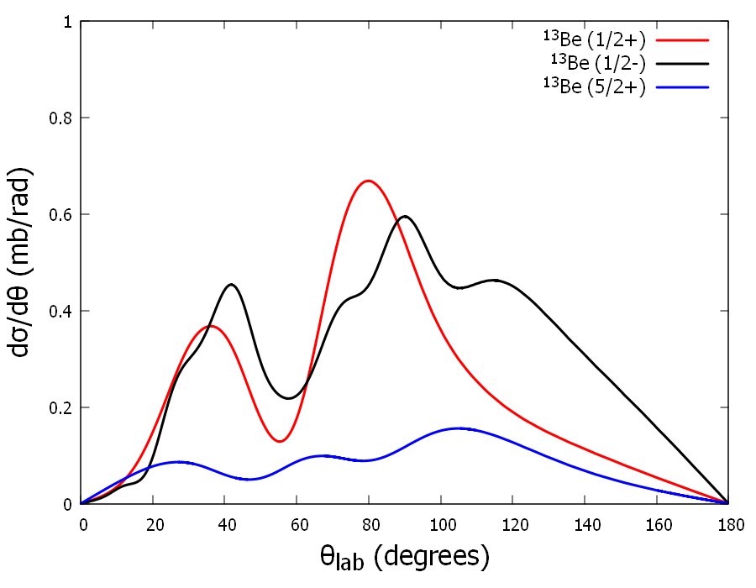
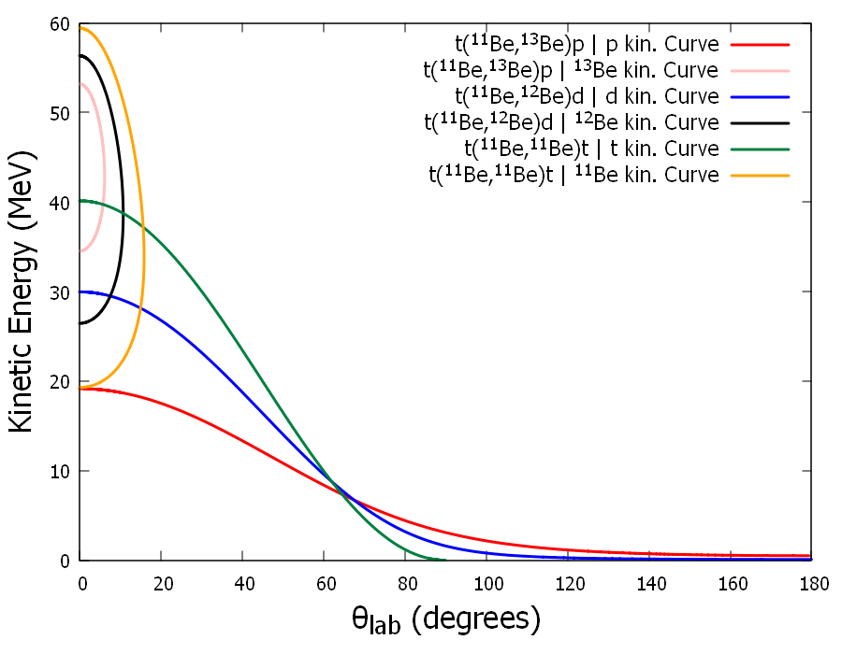
Set-Up Requirements
t(¹¹Be, ¹³Be)p @ 5.4 MeV/u
Cross sections calculations done by A. Moro and JA Lay
Kinematic Curves for two body reactions channels

Slide 5
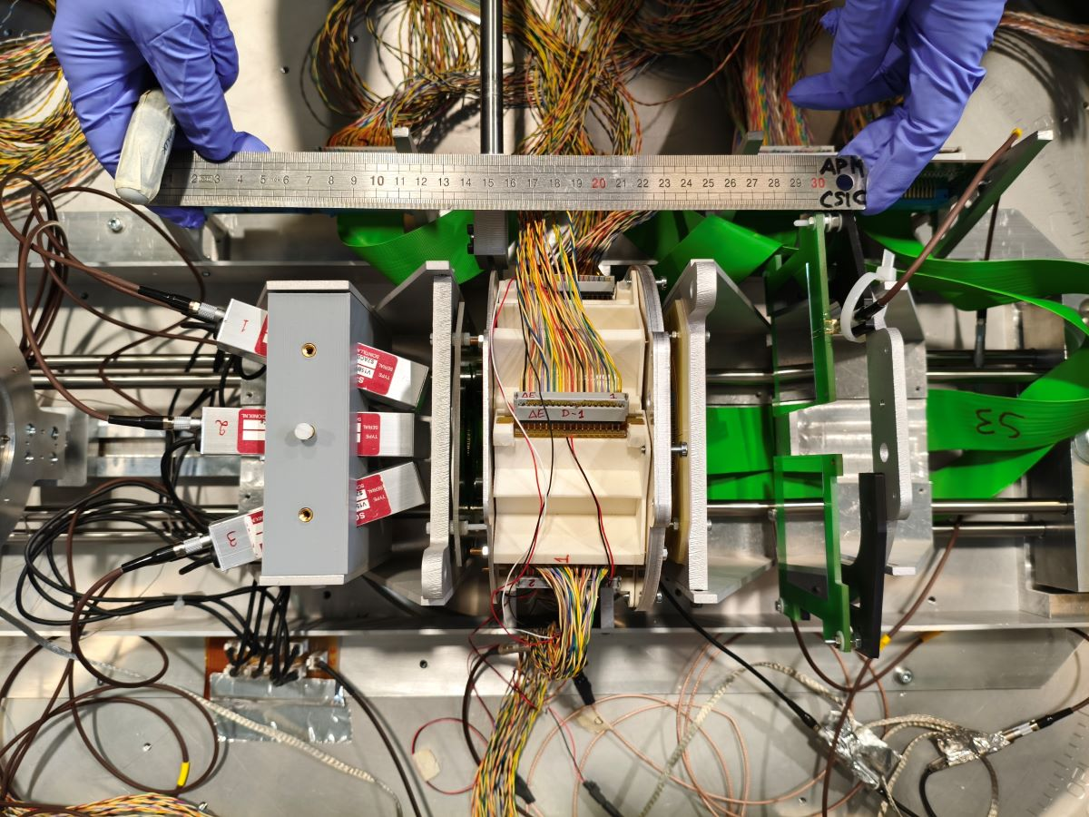
Set-Up
Target
11Be⁴⁺ @ 5,4 MeV/u
BeamDump
IS690 experimental Set-Up

Slide 6
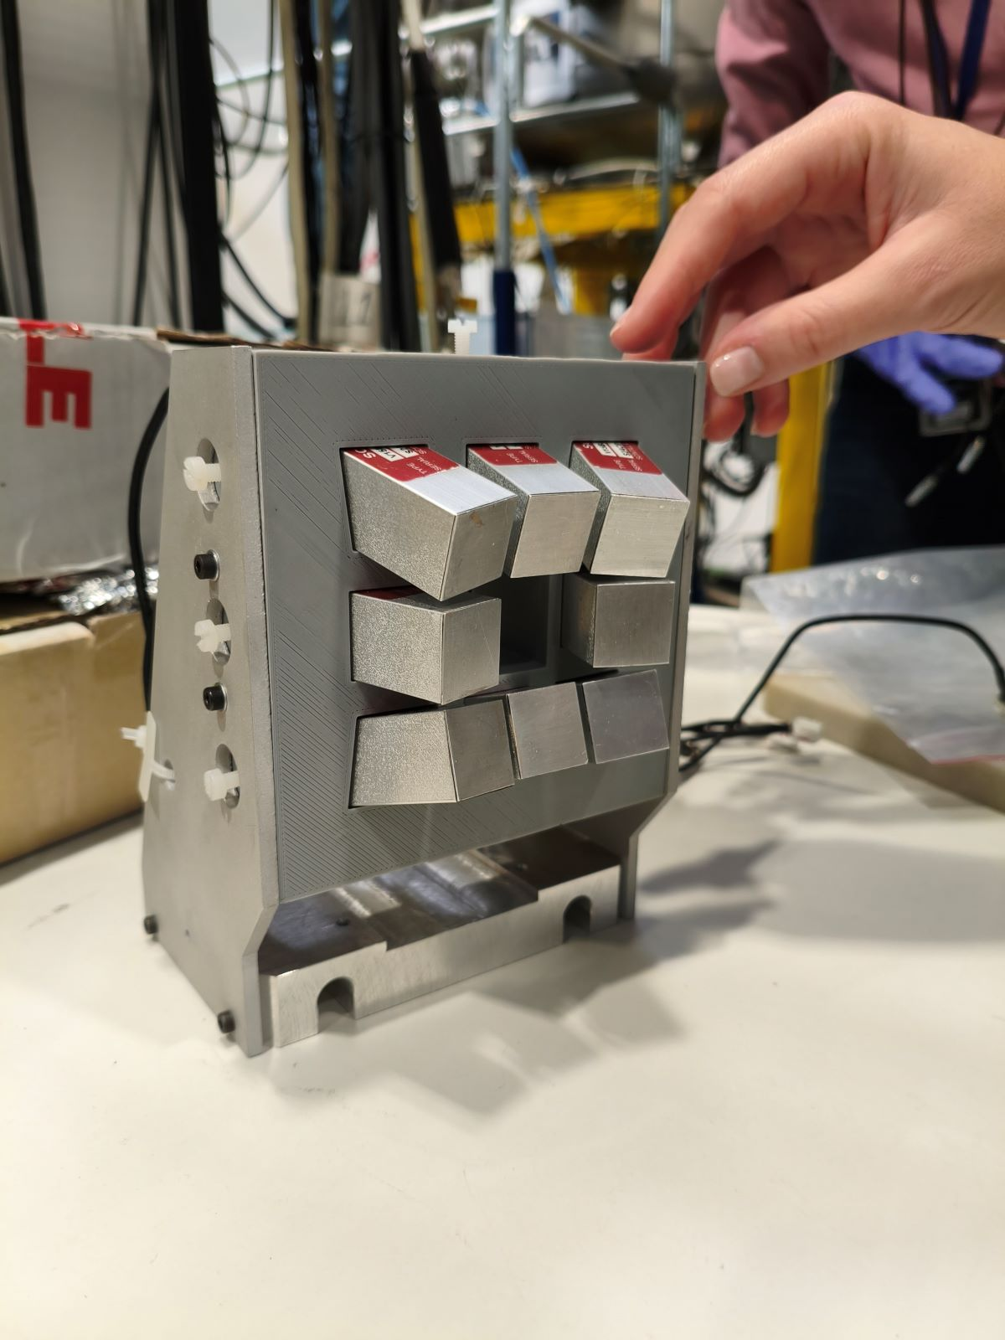
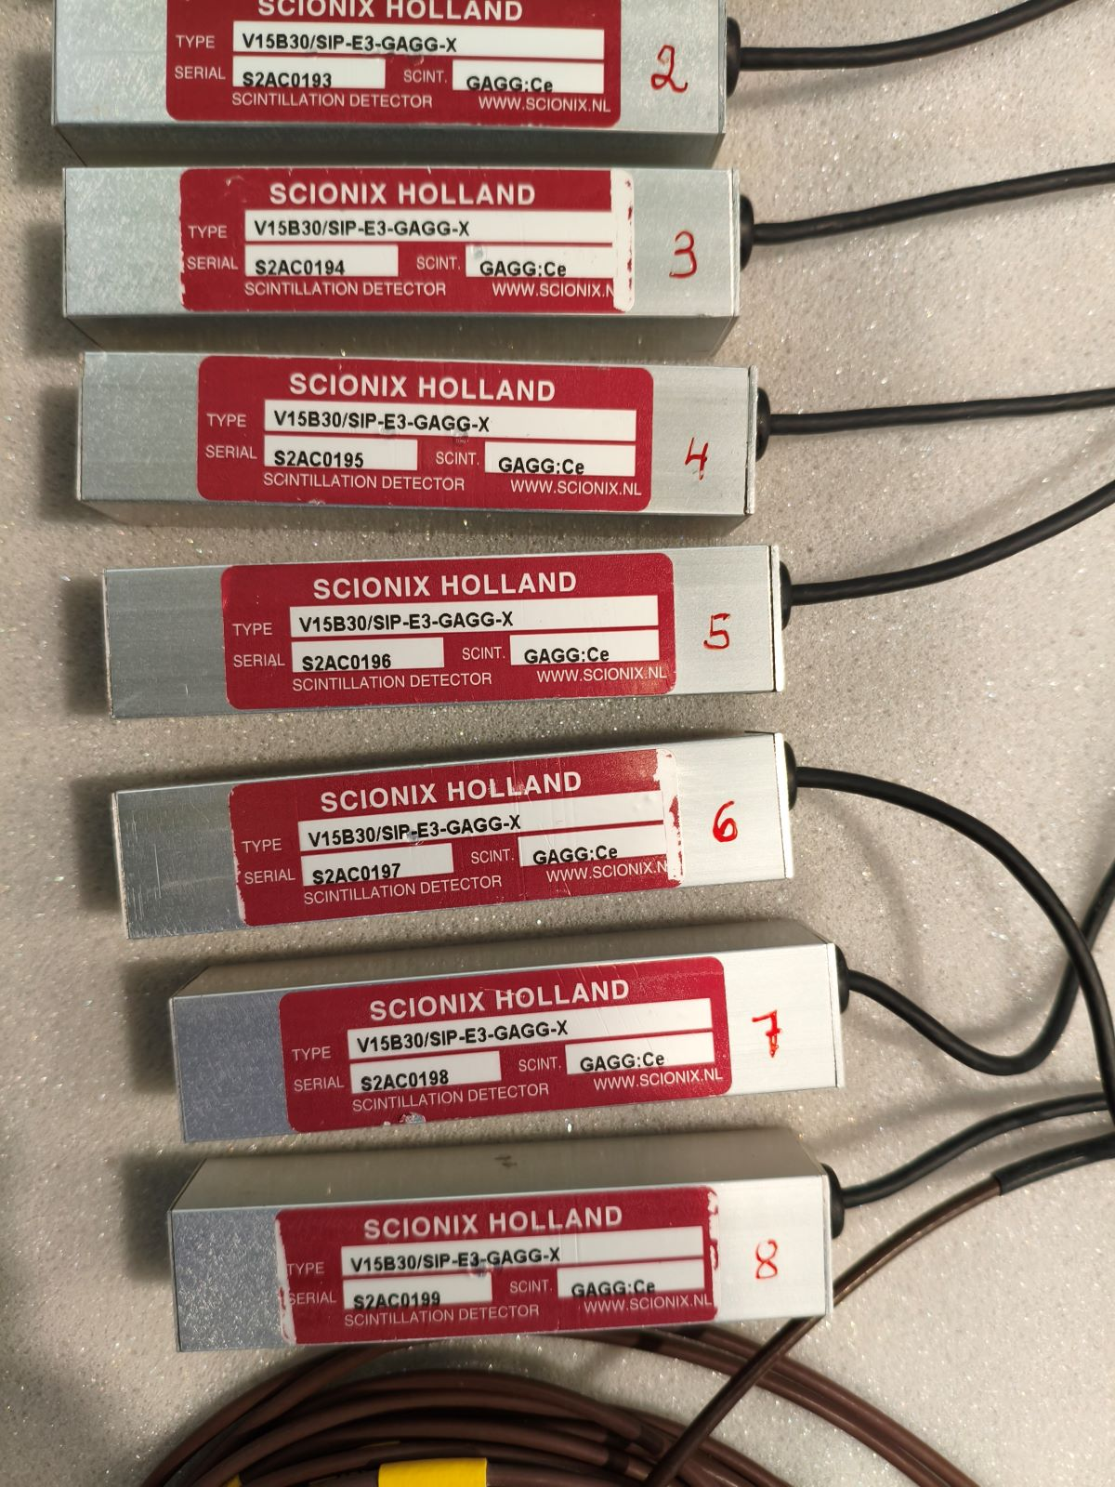
Set-Up GAGGs
GAGGs Formation
GAGGs Detectors
We used eight GAGG(Ce) scintillators [Gd₂Al₂Ga₃O₁₂:Ce] to detect the gamma-ray spectrum.
The beam passes through the center of the array, and the detectors are placed backwards at approximately θ ≈ 150°.
They are connected to an MDPP-16 Mesytec digitizer.

Slide 7
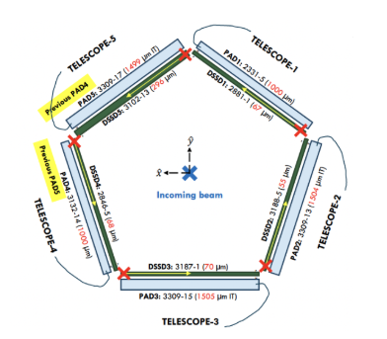
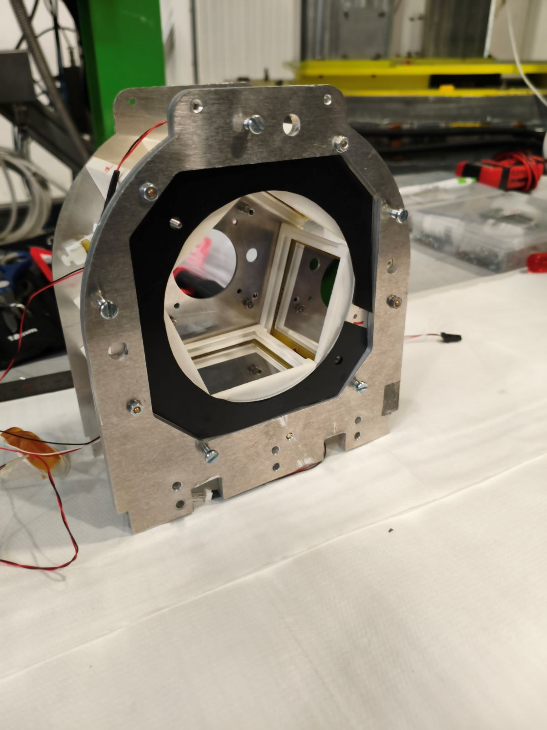
Set-Up Pentagon
Back side view of the Pentagon
Pentagon Drawing
The DSSDs are segmented silicon detectors with 16 strips on the front side and 16 perpendicular strips on the back side.
The pad detectors are non-segmented, single-sided silicon detectors.
Their purpose is to detect and identify the light particles produced in the reactions.
They cover angles from θ ≈ 36° to θ ≈ 76°.
The DSSDs are connected to a VMMR8 Mesytec module, while the pads are connected to an MDPP32 digitizer.

Slide 8
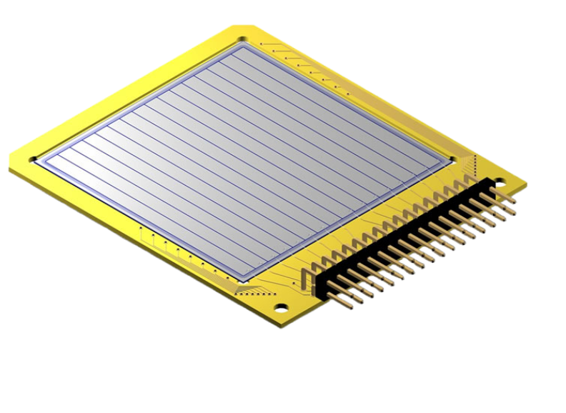
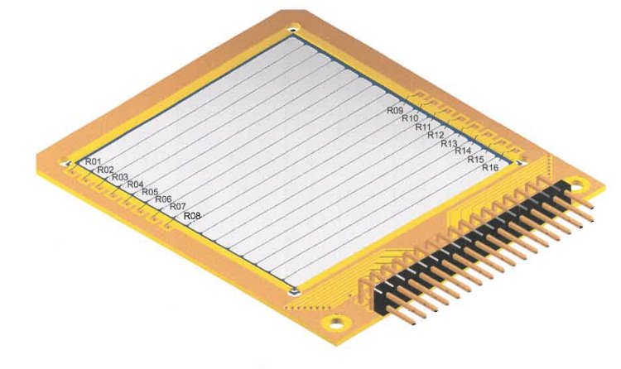
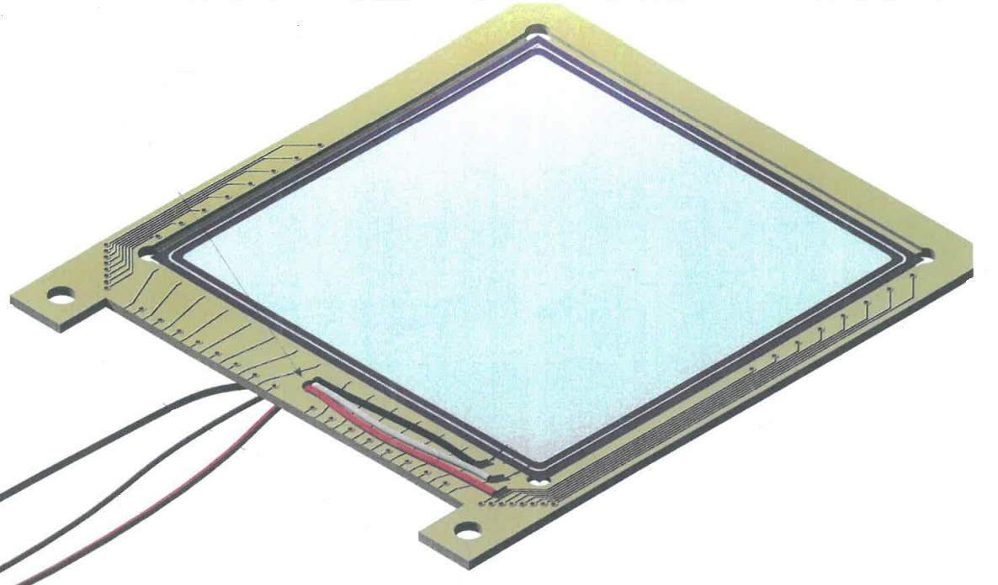
Set-Up Pentagon
Front side (left) and back side(right) of the DSSD
Front side of the PAD
Back side view of the Pentagon
Pentagon Drawing
The DSSDs are segmented silicon detectors with 16 strips on the front side and 16 perpendicular strips on the back side.
The pad detectors are non-segmented, single-sided silicon detectors.
Their purpose is to detect and identify the light particles produced in the reactions.
They cover angles from θ ≈ 36° to θ ≈ 76°.
The DSSDs are connected to a VMMR8 Mesytec module, while the pads are connected to an MDPP32 digitizer.

Slide 9
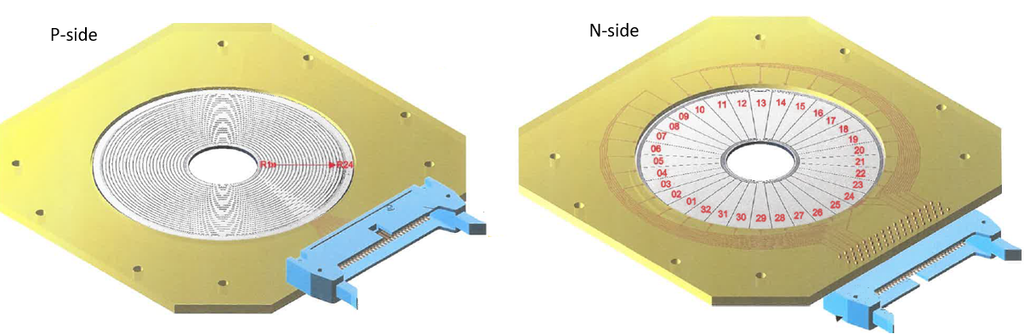
Set-Up S3
Both sides of the S3 detectors
Double-sided silicon detectors are segmented with 24 rings on the front side and 32 sectors on the back side.
Their purpose is to detect the heavy fragments from the reactions and to identify light particles at forward angles.
Each detector is 1000 µm thick, and they cover angles from θ ≈ 7° to θ ≈ 25°.
Both detectors are connected to a VMMR8 Mesytec module.

Slide 10
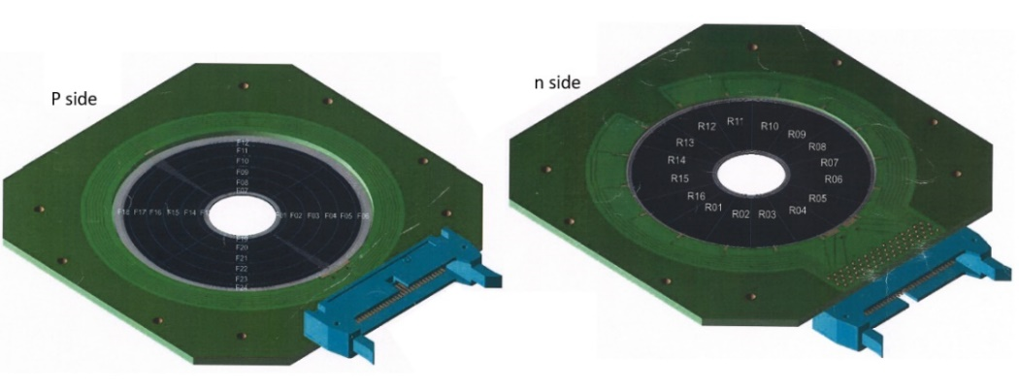
Set-Up S5
Both sides of the S5 detectors
Double-sided silicon detectors are segmented with 24 quarter rings on the front side and 16 sectors on the back side.
Its purpose is to detect light particles from the reactions at backward angles.
The beam passes through the central hole, and the detector covers angles from θ ≈ 110° to θ ≈ 140°.
Each detector is 300 µm thick.
It is connected to a VMMR8 Mesytec module.

Slide 11
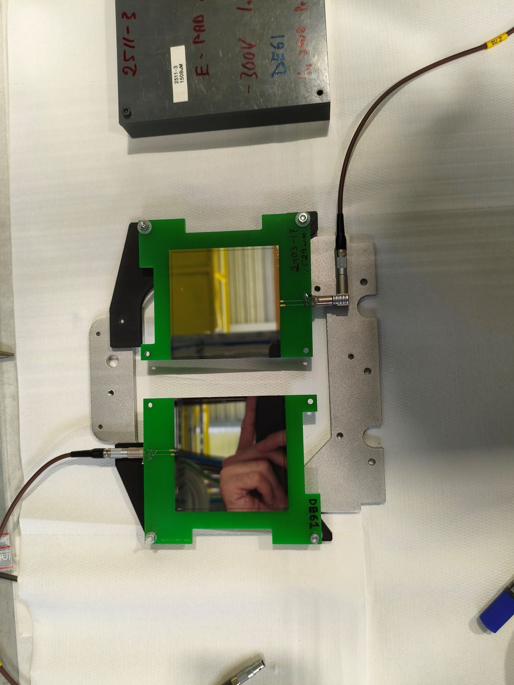
Set-Up BB7
BB7 detectors
Non-segmented, single-sided silicon detectors.
Their purpose is to assist the S3 telescope by fully stopping the light particles.
Each detector is 1500 µm thick.
They are connected to an MDPP32 Mesytec module

Slide 12
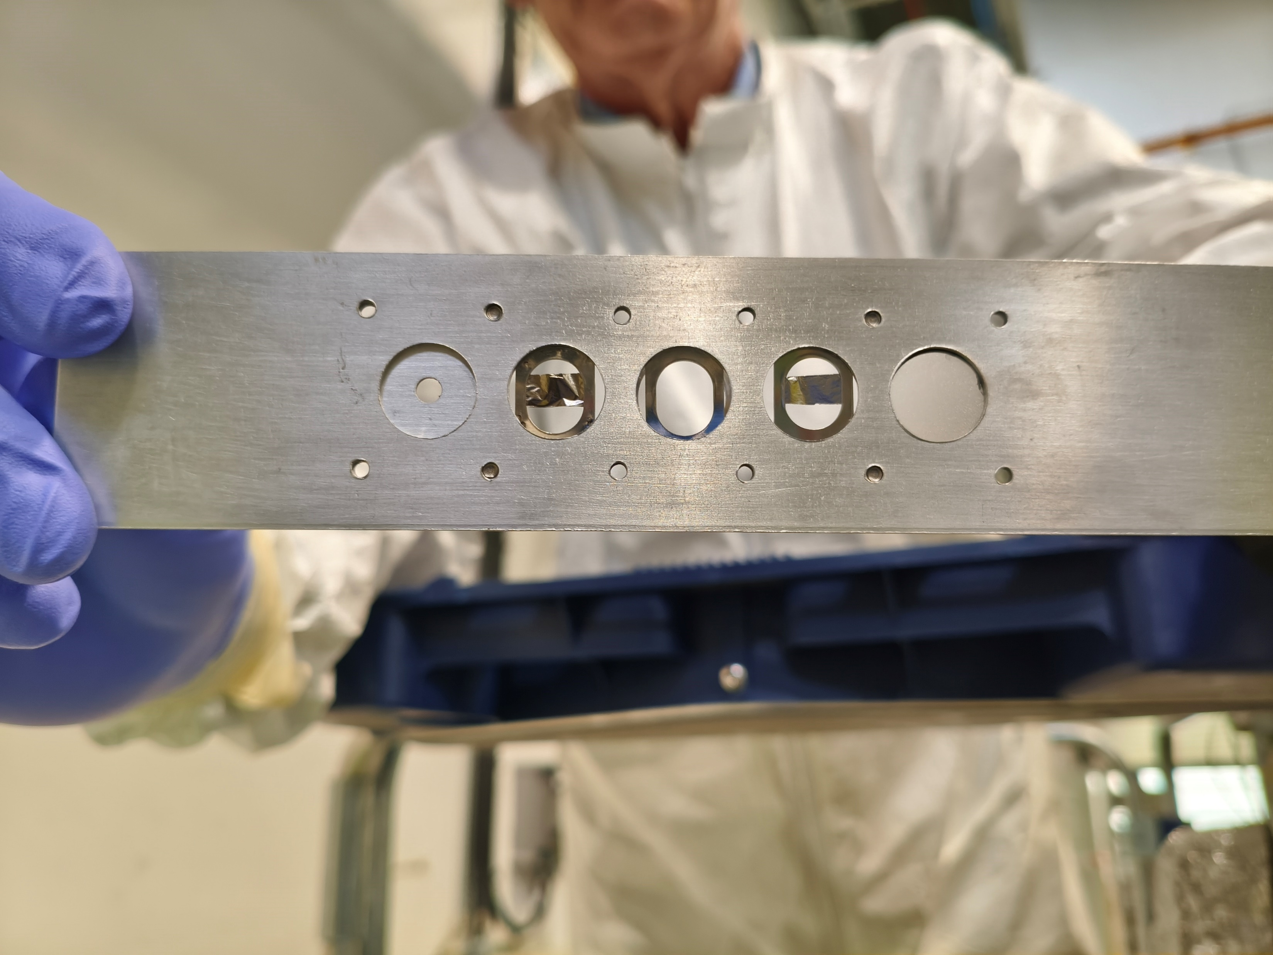
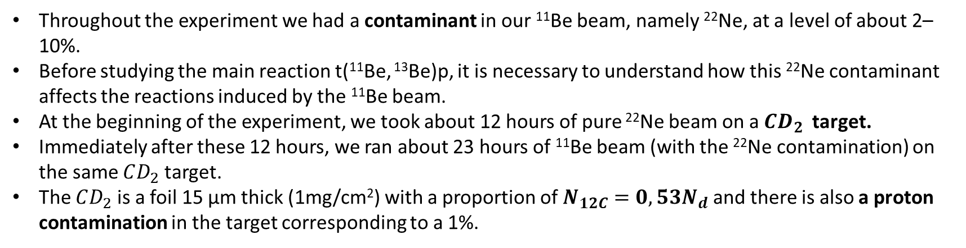
Reaction to study
Throughout the experiment we had a contaminant in our ¹¹Be beam, namely ²²Ne, at a level of about 2–10%.
Before studying the main reaction t(¹¹Be, ¹³Be)p, it is necessary to understand how this ²²Ne contaminant affects the reactions induced by the ¹¹Be beam.
At the beginning of the experiment, we took about 12 hours of pure ²²Ne beam on a $CD_{2}$target.
Immediately after these 12 hours, we ran about 23 hours of ¹¹Be beam (with the ²²Ne contamination) on the same $CD_{2}$ target.
The $CD_{2}$ is a foil 15 μm thick (1mg/cm²) with a proportion of $N_{12C}=0,53N_{d}$ and there is also a proton contamination in the target corresponding to a 1%.

Slide 13
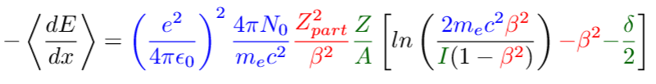

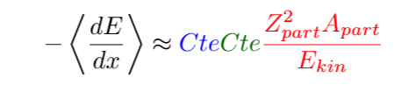




Particle Identification
We can identify different particles using a telescope of detectors. The energy deposited in a detector is described by the Bethe-Bloch formula:
Constants
Particle
Detector
If we consider the non-relativistic approximation β << 1 and
ΔE
E
ΔE
P
$$E_{kin,p}=E_{kin,d}$$
d
$${dE}_{p} \text{<}{ dE}_{d}$$
n
p
$$E_{kin}$$

Slide 14
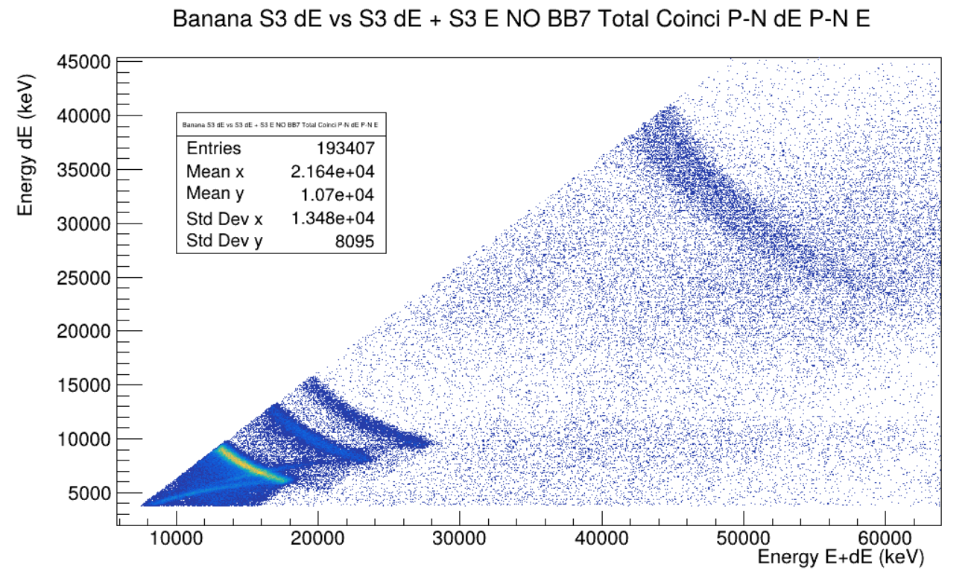
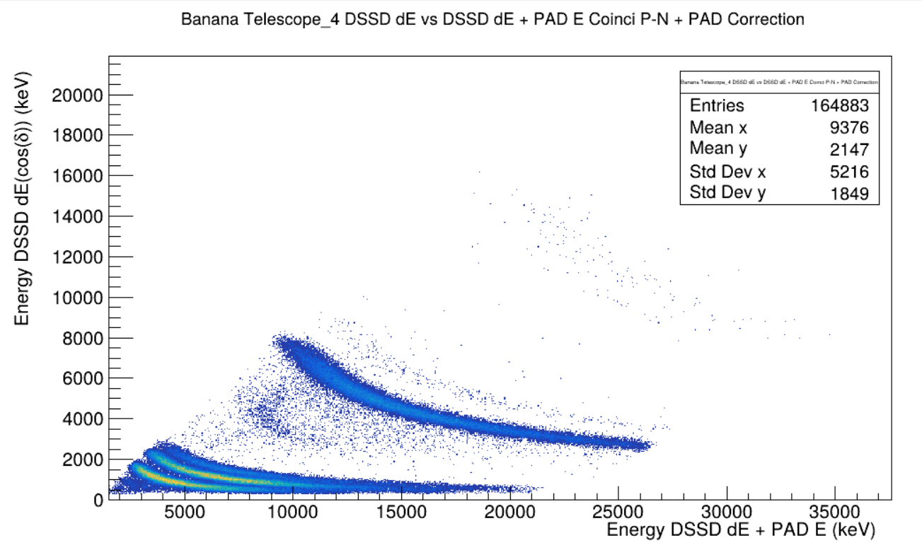
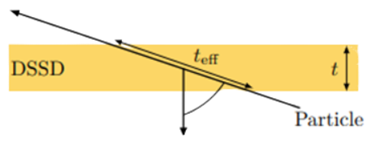





Particle Identification
Li
Alphas
4He
6 He
Deuterons
Tritons
Deuterons
Tritons
Protons
Protons
S3 Telescope Particle Identification
Pentagon Telescope Particle Identification
ΔE
$$E_{kin,p1}=E_{kin,p2}$$
1
P
$$t_{eff}cos⁡(\text{δ})=t$$
$${dE}_{p,1} \text{<}{ dE}_{p,2}$$
δ
$\text{Δ}E =\frac{dE}{dx}t_{eff}=\frac{dE}{dx}\frac{t}{cos⁡(\text{δ})}$ = $\frac{\text{Δ}\text{E}′}{cos⁡(\text{δ})}$
2
P
$\text{Δ}\text{E}′$ = Normal incident energy

Slide 15



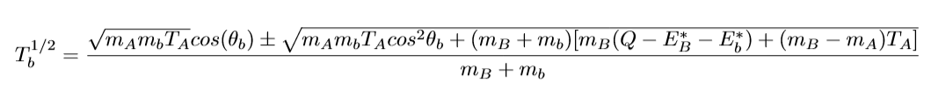
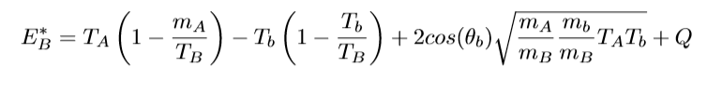

Reaction Identification
Now, the next step is to identify the reaction from which each of these particles is coming. First, we will study two-body kinematics, considering a beam A with kinetic energy $T_{A}$ impinging on a target a at rest. They interact and produce a recoil B and an ejectile b
Assuming both the projectile and the target are in the ground stat, by conservation of energy and momentum

Slide 16
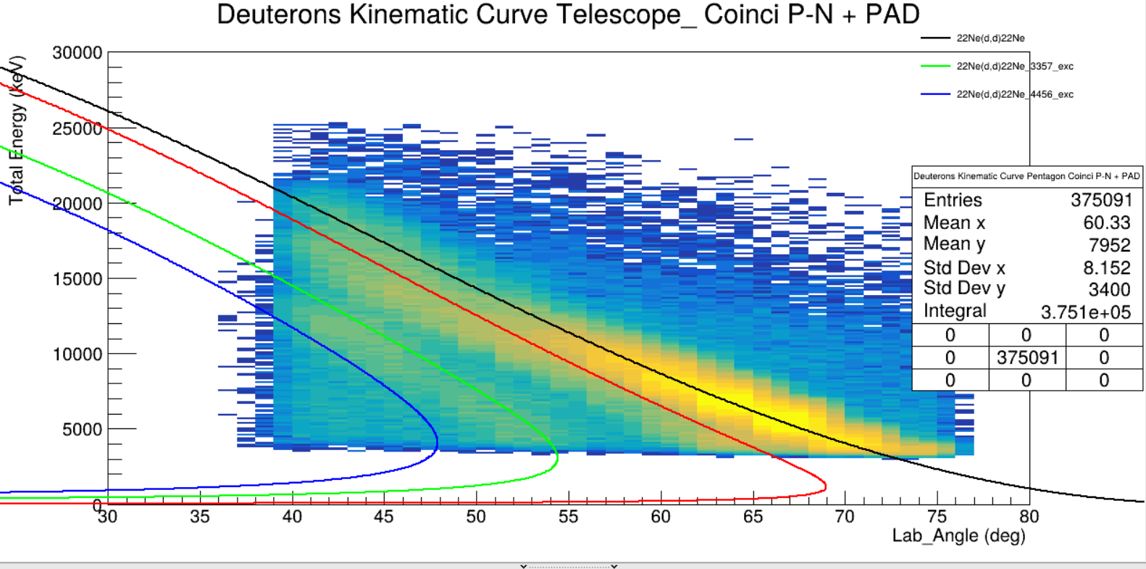
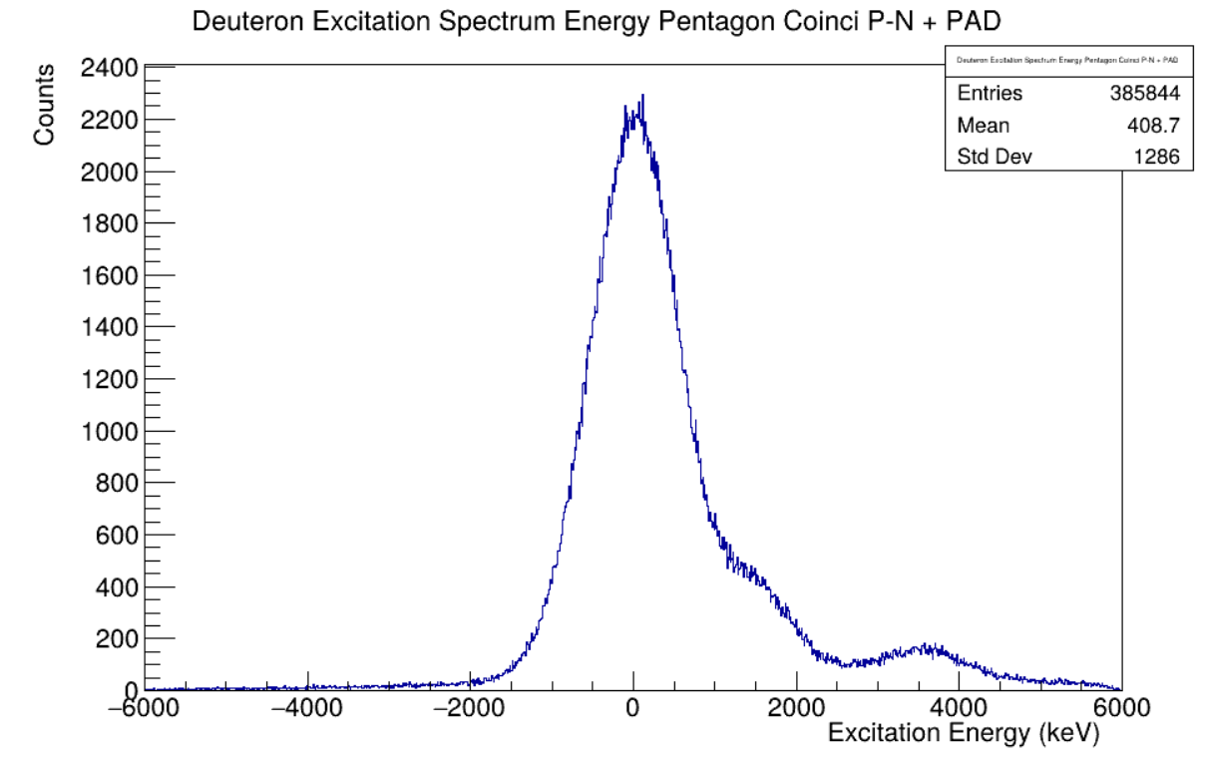
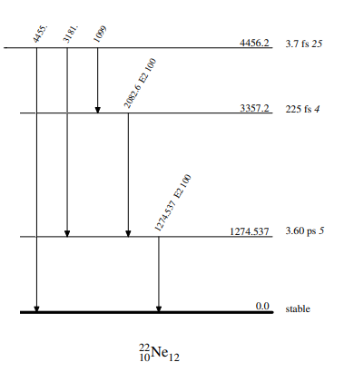
²²Ne + ²H -> ²²Ne * + ²H
²²Ne Excitation Spectrum
Deuteron Kinematic Curve
²²Ne(d,d) ²²Ne
²²Ne(d,d) ²²Ne* (1274,53 keV)
²²Ne(d,d) ²²Ne* (3357,2 keV)
²²Ne(d,d) ²²Ne* (4456,2 keV)
Energy levels of ²²Ne

Slide 17
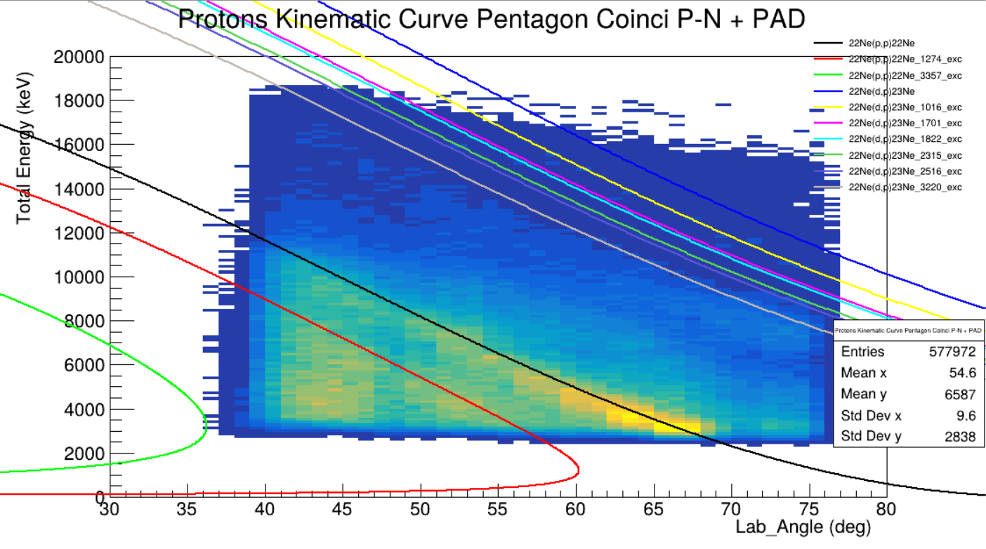
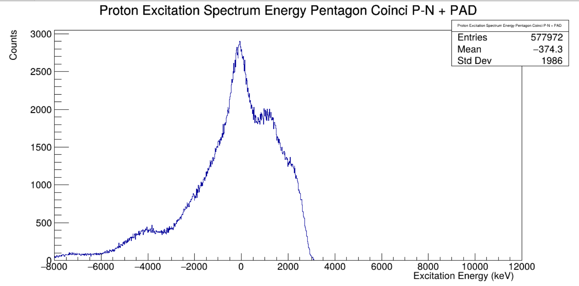
²²Ne + ¹H -> ²²Ne * + ¹H
22Ne Excitation Spectrum
Proton Kinematic Curve
²²Ne(d,d) ²²Ne
²²Ne(d,p) ²³Ne* (1274,53 keV)
²²Ne(d,d) ²²Ne* (1274,53 keV)
²²Ne(d,p) ²³Ne* (1822 keV)
²²Ne(d,d) ²²Ne* (3357,2 keV)
²²Ne(d,p) ²³Ne* (2315 keV)
²²Ne(d,p) ²³Ne
²²Ne(d,p) ²³Ne* (2315 keV)
²²Ne(d,p) ²³Ne* (1016 keV)
²²Ne(d,p) ²³Ne* (3220 keV)
Energy levels of ²²Ne

Slide 18

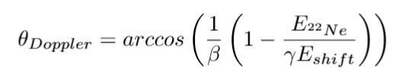

Doppler Shift
For the last step, we look at the GAGGs in coincidence with the protons and deuterons from the pentagon in order to recognize any gamma peak. We must take into account that in most cases that gamma is produced in flight.
$$Θ_{Doppler}$$
ɣ
Detector
We can determine the $Θ_{Doppler}$ using a known gamma peak, in this case, we can use the 1274,537 keV gamma ray for the 22Ne first excited.

Slide 19
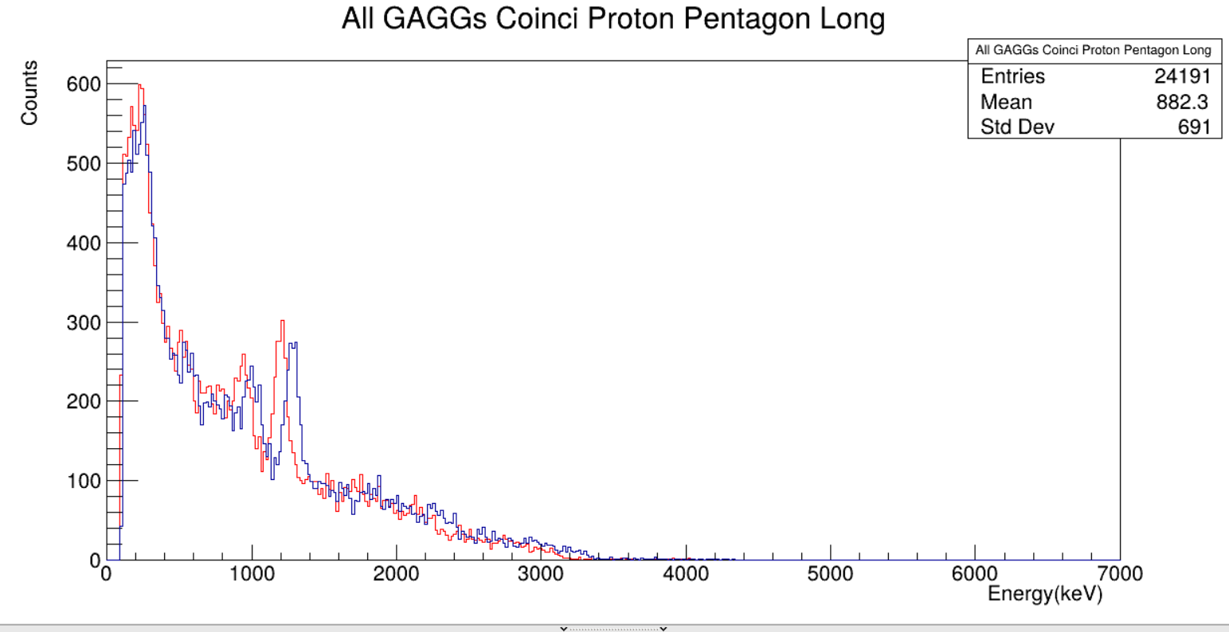
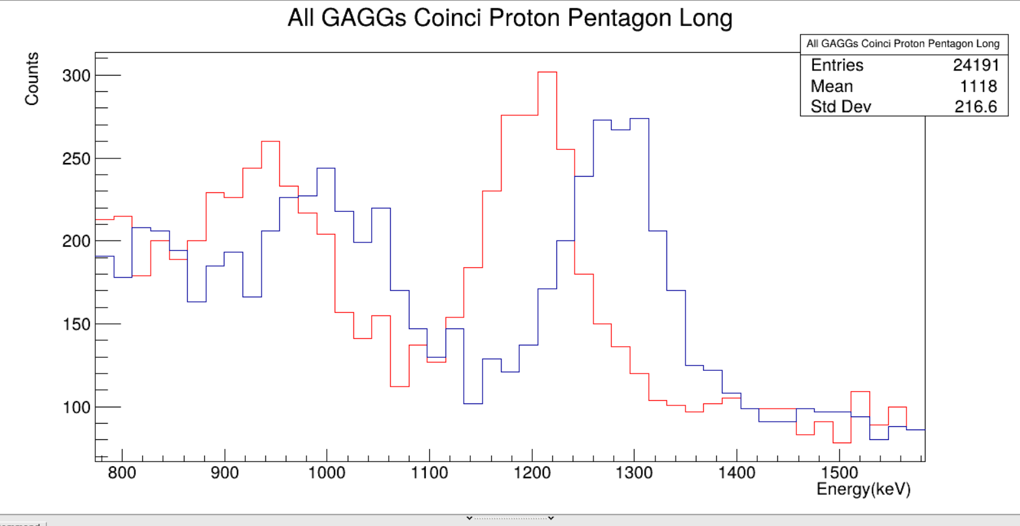

Doppler Shift
1016,926 keV 23Ne*
1274,537 keV 22Ne*
GAGGs spectrum in coincidence with Pentagon protons.
²²Ne and ²³Ne first excited gamma ray.
In red the shifted spectrum and in blue the corrected spectrum.
$θ_{Doppler}\text{≈}$ 125 º

Slide 20
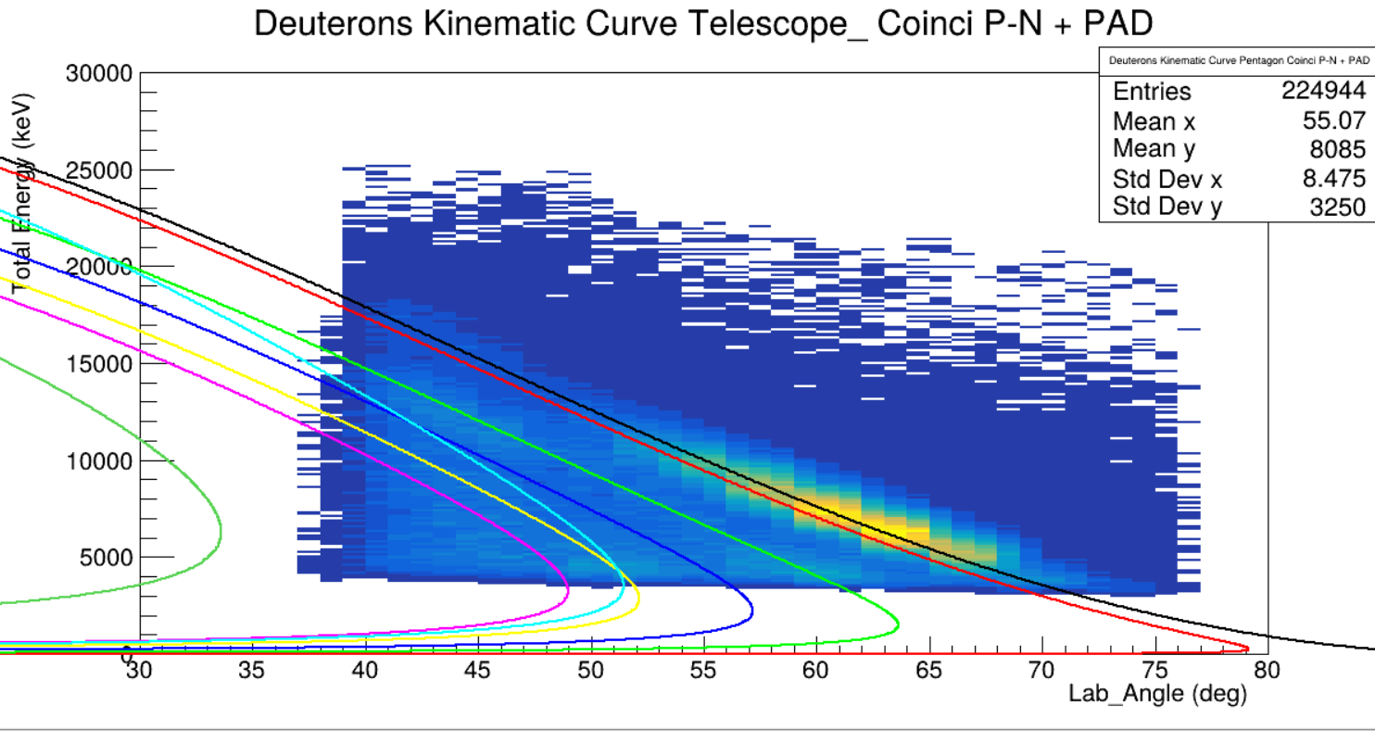
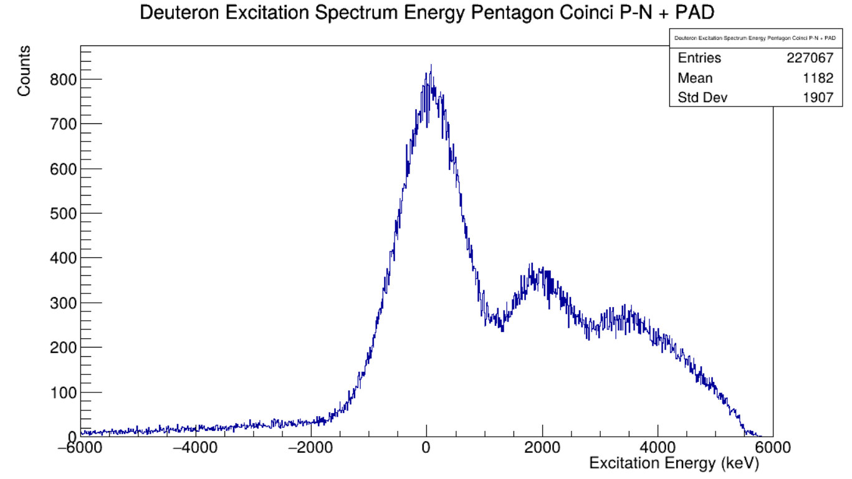
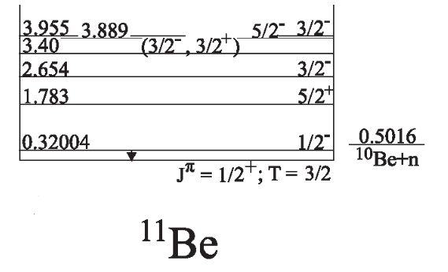
¹¹Be + ²H -> ¹¹Be * + ²H
Deuteron Kinematic Curve
11Be Excitation Spectrum
¹¹Be(d,d) ¹¹Be
¹¹Be(d,d) ¹¹Be* (3889 keV)
¹¹Be(d,d) ¹¹Be* (320 keV)
¹¹Be(p,d) ¹⁰Be
¹¹Be(d,d) ¹¹Be* (1783 keV)
¹¹Be(p,d) ¹⁰Be* (3368 keV)
¹¹Be(d,d) ¹¹Be* (2654 keV)
¹¹Be(d,d) ¹¹Be* (3400 keV)
Energy levels of ¹¹Be

Slide 21
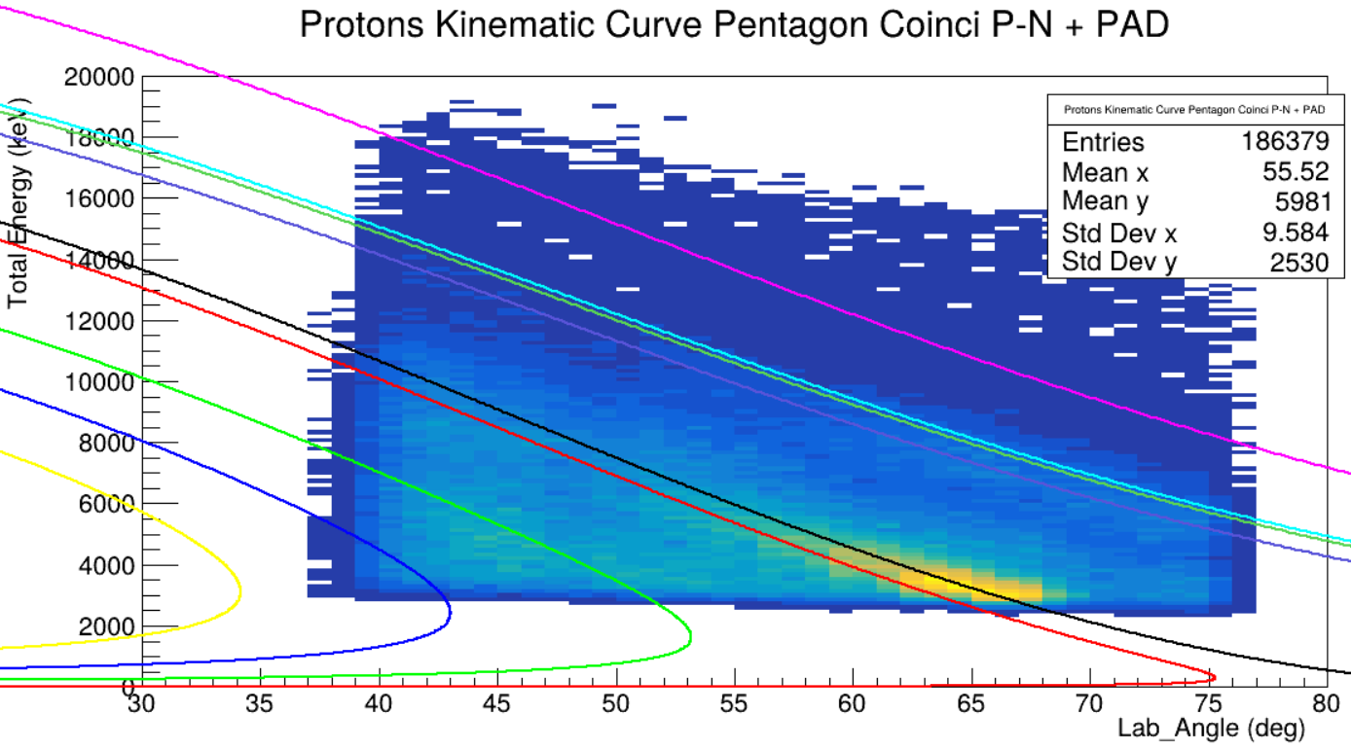
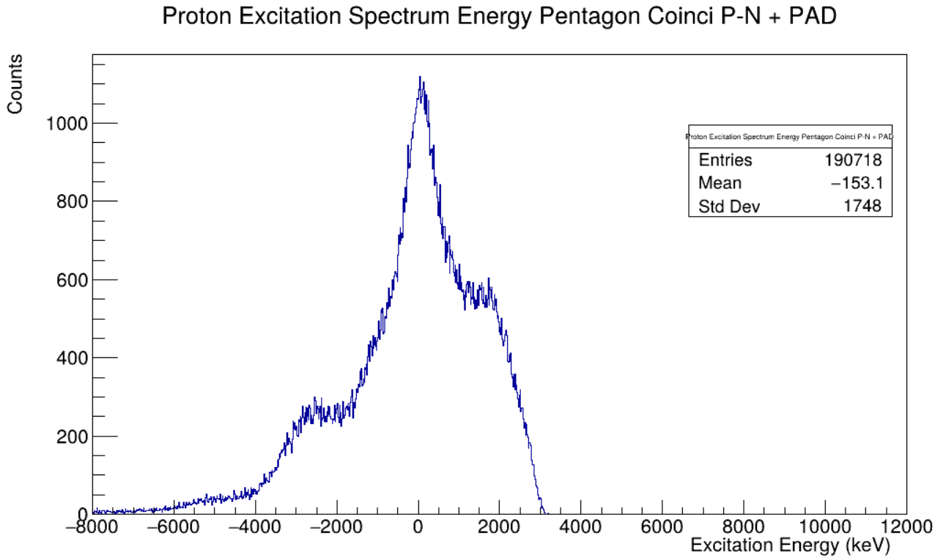
¹¹Be + ¹H -> ¹¹Be * + ¹H
11Be Excitated Spectra
Proton Kinematic Curve
¹¹Be(p,d) ¹¹Be
¹¹Be(d,p) ¹²Be
¹¹Be(p,d) ¹¹Be* (320 keV)
¹¹Be(d,p) ¹²Be* (2109 keV)
¹¹Be(p,d) ¹¹Be* (1783 keV)
¹¹Be(d,p) ¹²Be* (2251 keV)
¹¹Be(p,d) ¹¹Be* (2654 keV)
¹¹Be(d,p) ¹²Be* (2715 keV)
¹¹Be(p,d) ¹¹Be* (3400 keV)
Energy levels of ¹¹Be

Slide 22
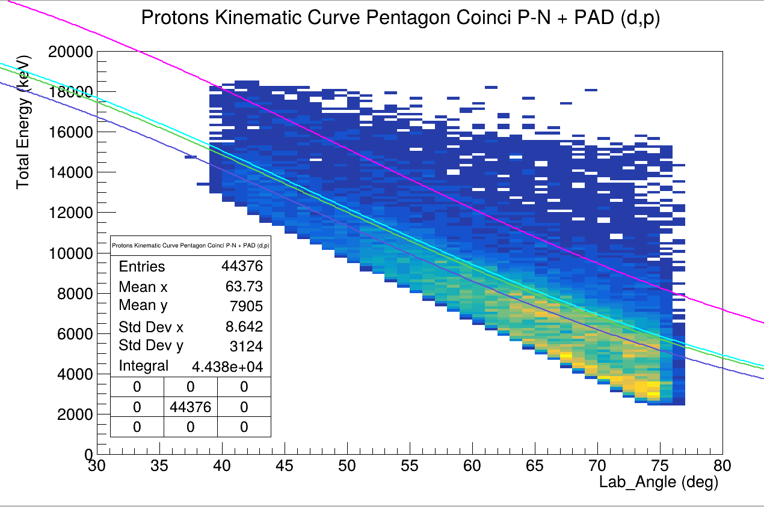
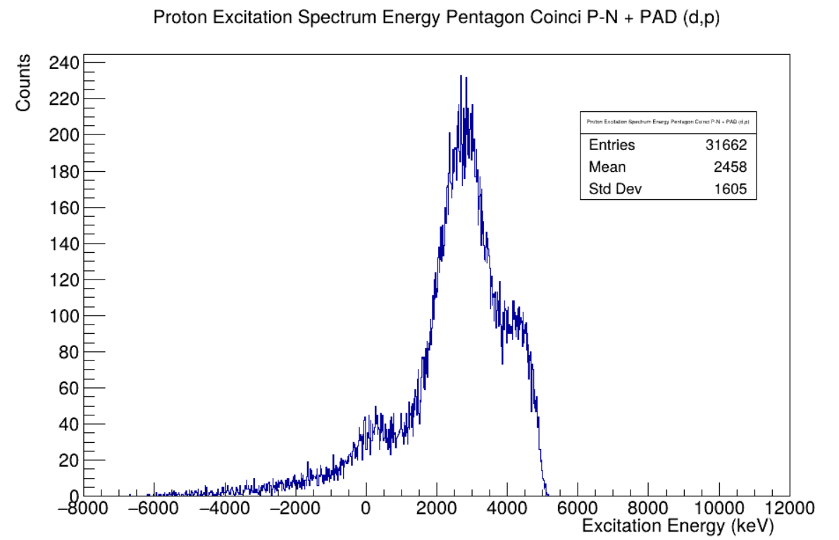
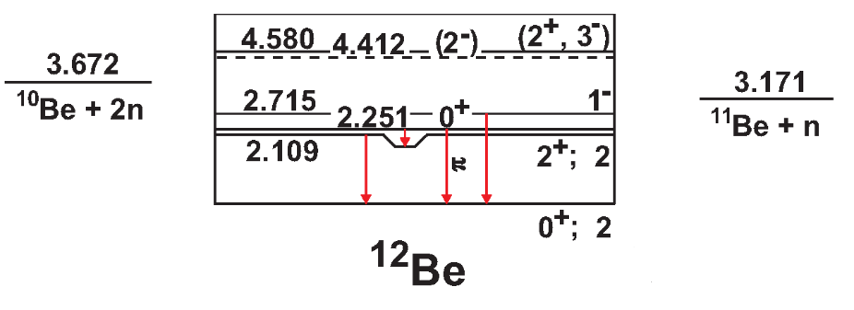
¹¹Be + ²H -> ¹²Be * + ¹H
Proton Kinematic Curve
12Be Excitated Spectra
¹¹Be(d,p) ¹²Be
¹¹Be(d,p) ¹²Be* (2109 keV)
¹¹Be(d,p) ¹²Be* (2251 keV)
¹¹Be(d,p) ¹²Be* (2715 keV)
Energy levels of ¹²Be

Slide 23
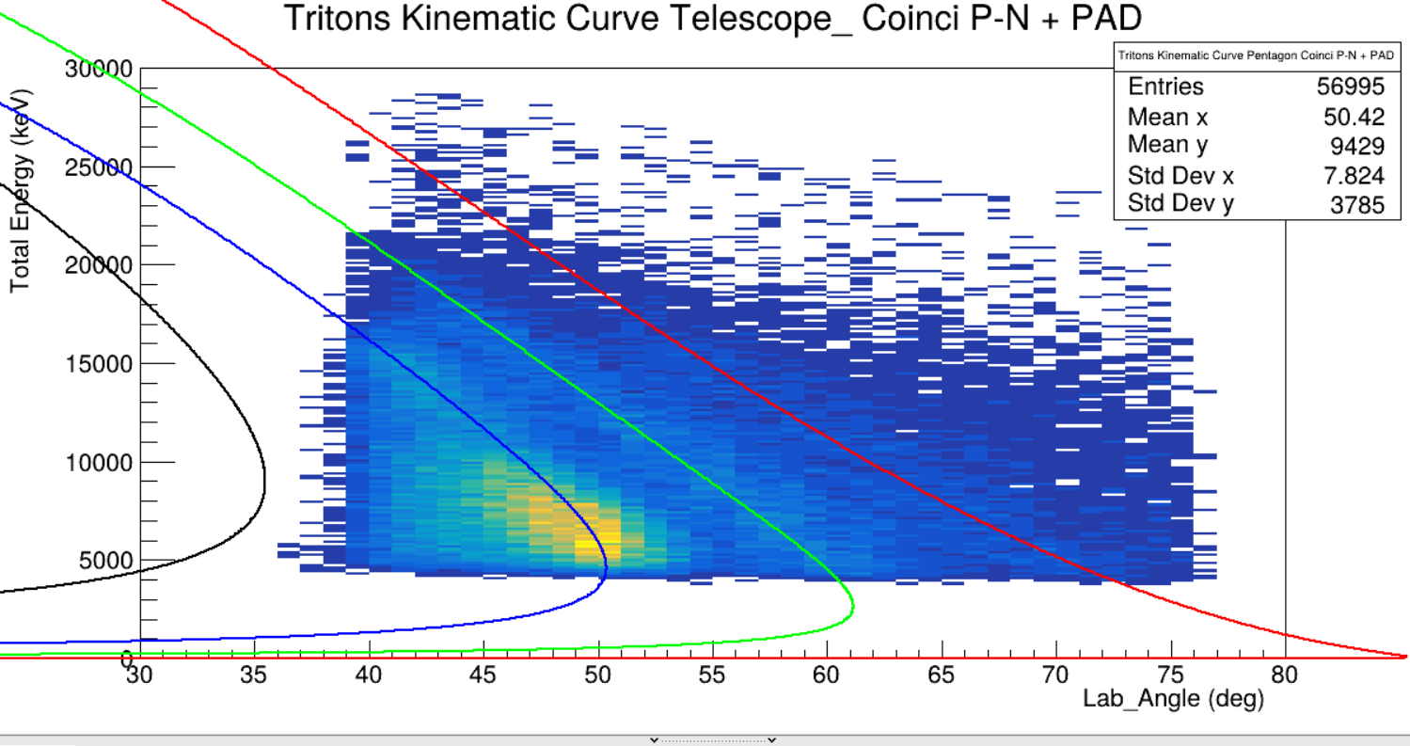
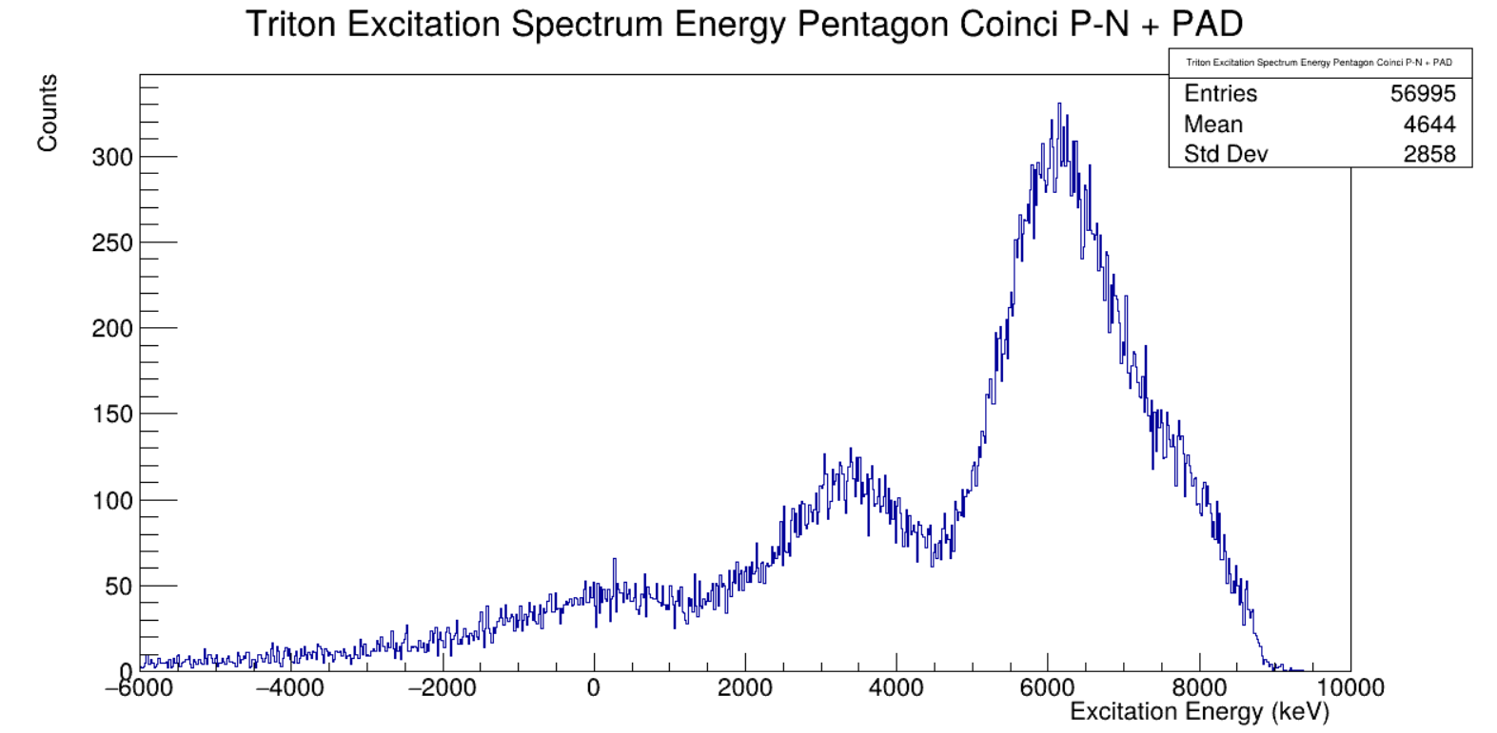
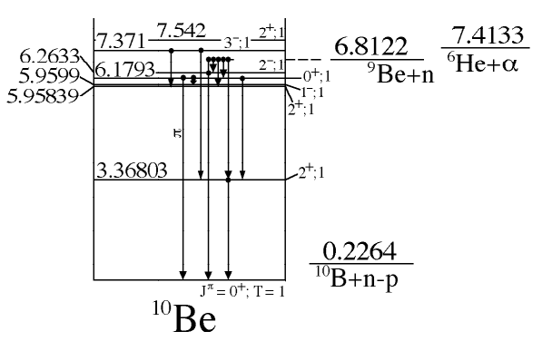
¹¹Be + ²H -> ¹⁰Be * + ³H
Tritium Kinematic Curve
10Be Excitated Spectra
¹¹Be(p,t) ⁹B
¹¹Be(d,t) ¹⁰Be
¹¹Be(d,t) ¹⁰Be* (3368 keV)
¹¹Be(d,t) ¹⁰Be* (5958 keV)
Energy levels of ¹⁰Be

Slide 24
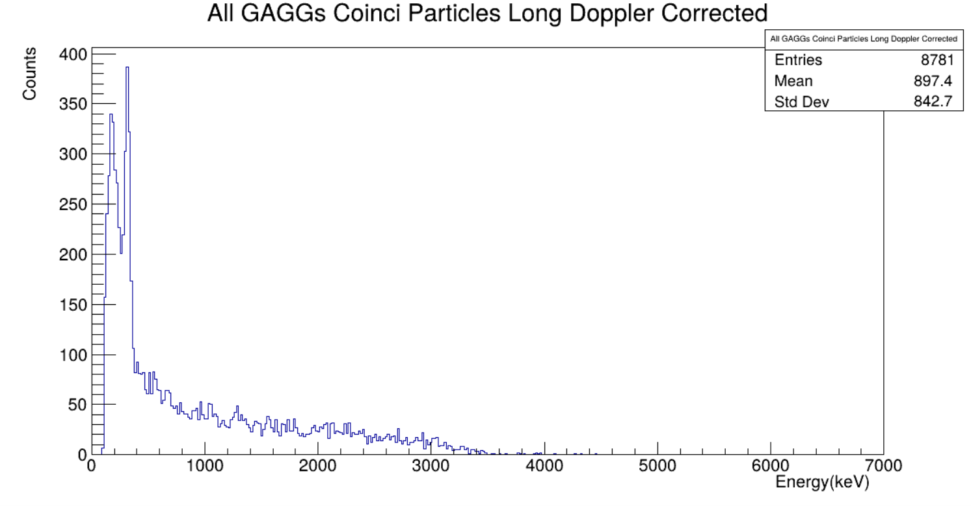
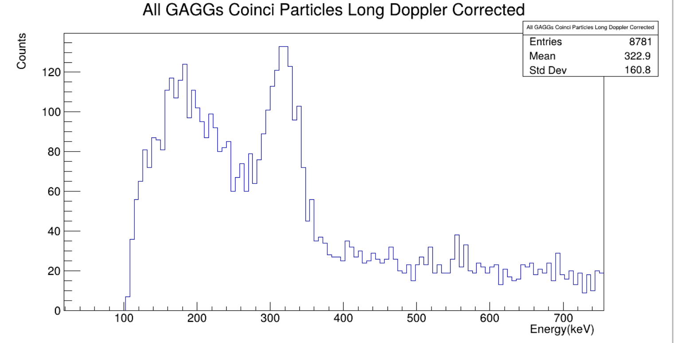
GAGGs ¹¹Be
GAGGs Spectrum in coincidence with the Pentagon
320 keV gamma ray from the 11Be first excited
We can clearly see the 320 keV first excited of 11Be

Slide 25

Summary and Outlooks
The detection system worked successfully for inverse kinematics reactions.
Inverse kinematics is a powerful tool to study weakly-bound light nuclei, including excited and resonant states.
The results obtained for the ²²Ne and ¹¹Be on the $CD_{2}$ establish a basis for exploring the ¹³Be structure.
The methodology used to obtain this results was succesfully validated, providing the confidence for its application with the ³H target.
Thank you for your attention!
Any questions?

