Slide 1
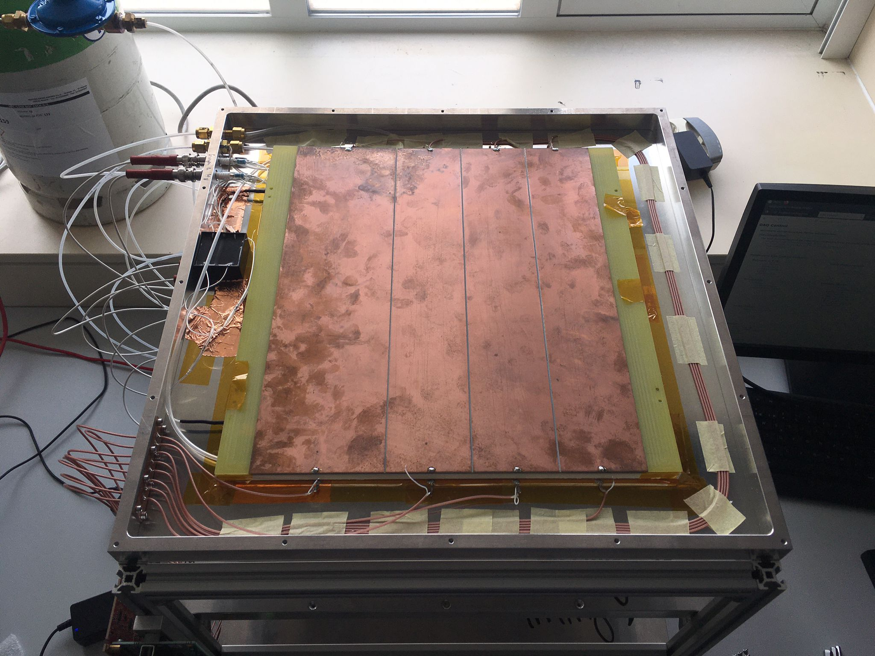
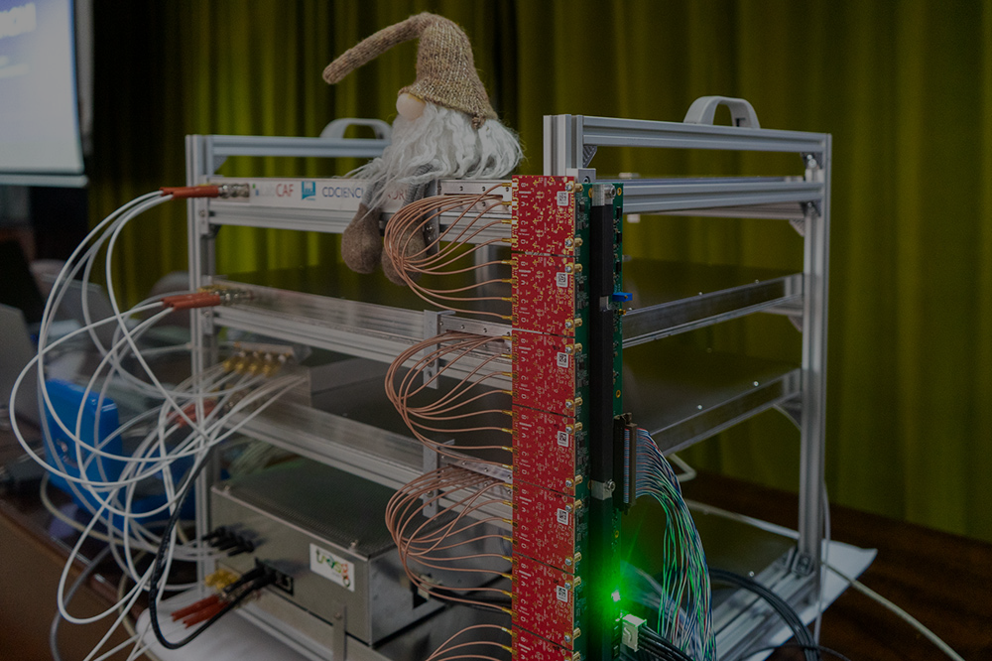






RPC readout optimization:
miniTRASGO as a path to a single-plane multiplexed timing system
November 19th 2025, Valencia
XVII CPAN Days
C. Soneira-Landín (csoneira@ucm.es), A. Blanco, L.M. Fraile, L. Lopes, J.M. Udías

Slide 2
Table of contents - A detector story
Introduction
Resistive Plate Chambers in miniTRASGO
More advanced versions
R3B prototype
Multiplexing: SHIP prototype
Next step
going for the single plane
Current stage!

Slide 3
Introduction
Resistive Plate Chambers in miniTRASGO

Slide 4
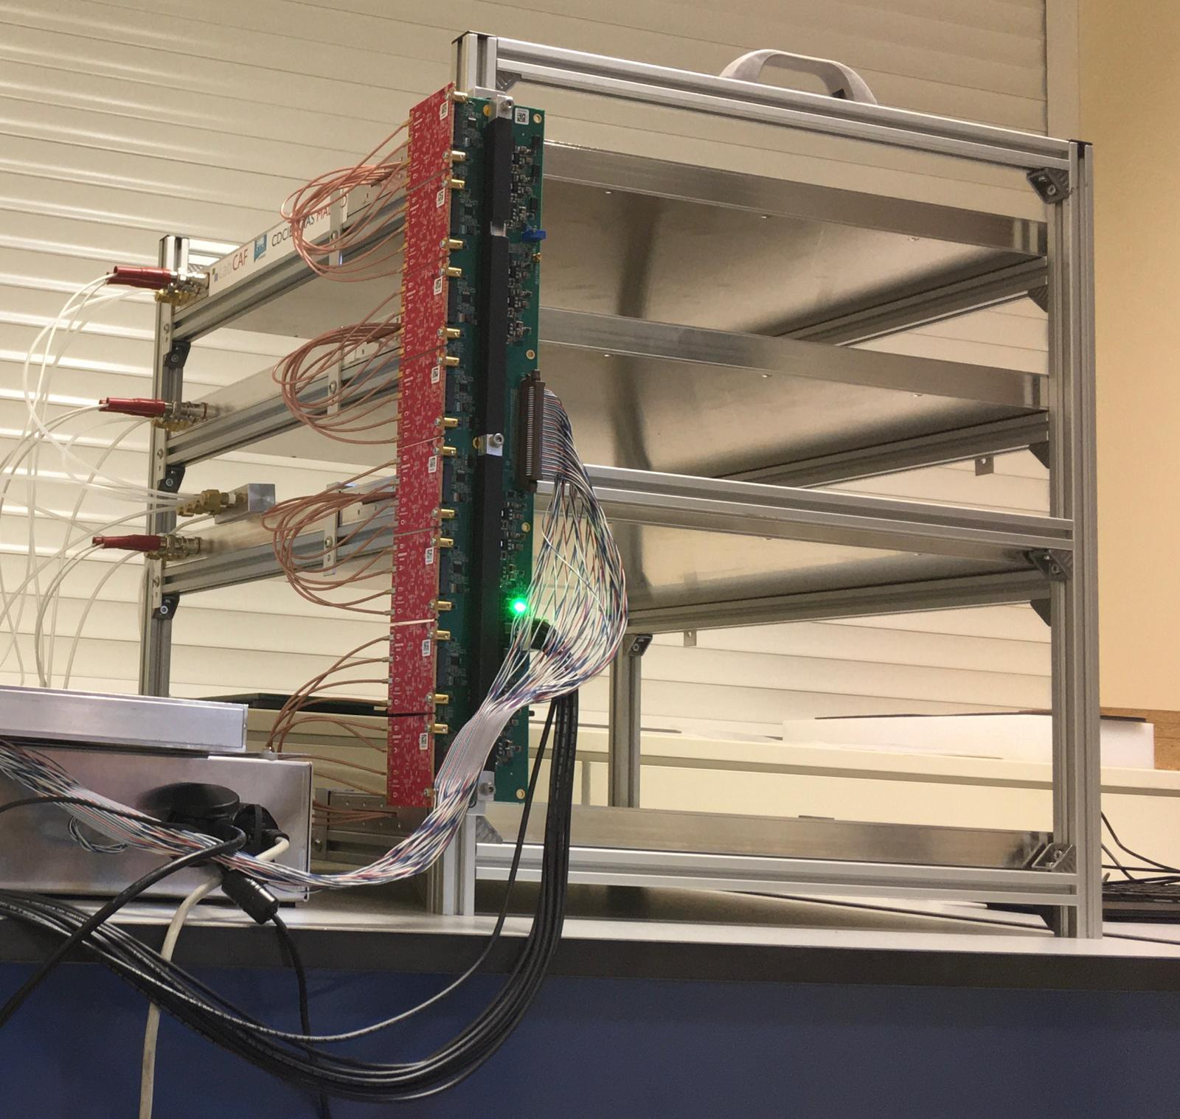
miniTRASGO:
RPC-based muon telescope
4 parallel 30x30 cm² Multigap glass Resistive Plate Chambers (MRPCs)
~400 ps timing
~3 cm spatial resolution
Gas: R134a, flux of <1 kg/month
C. Soneira-Landín et al., NIM A, 2025, https://doi.org/10.1016/j.nima.2025.170511
C. Soneira-Landín et al., Adv. Space Res., 2025, https://doi.org/10.1016/j.asr.2025.07.096
C. Soneira-Landín et al., PoS(ICRC2025)1368

Slide 5
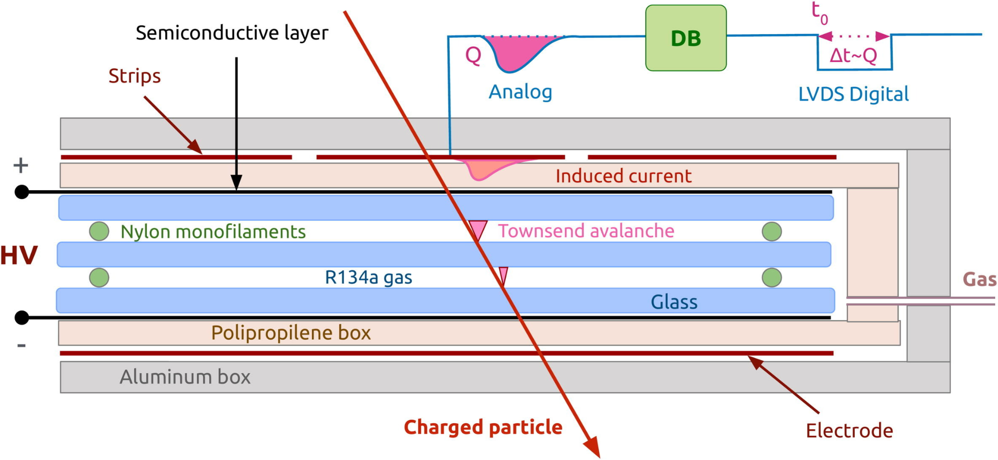
Every Multigap glass RPC has:
2 gas gaps → 1 mm/gap
3 glass electrodes → 2 mm/glass
Readout: wide strips (6-9 cm)
Resistive Plate Chamber layout

Slide 6
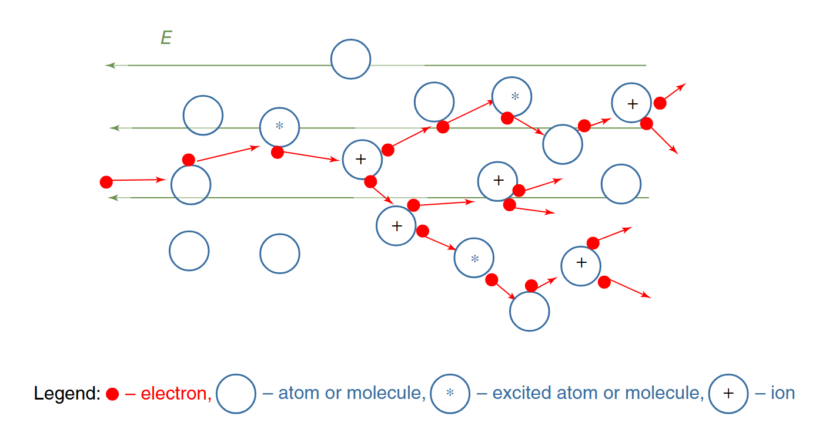
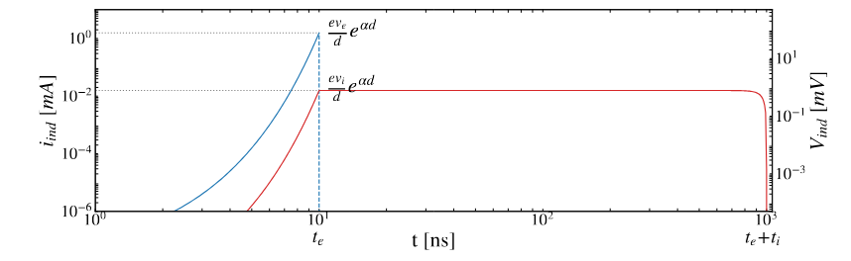
Signal induction in RPCs
Ionic signal
Electronic signal
Townsend avalanche
(from Abbrescia et al., 2018)
Integration window covers usually fast signal

Slide 7
Asymmetric parallel Cu strips read in Front and Back (32 channels)
Time and charge obtained

Slide 8
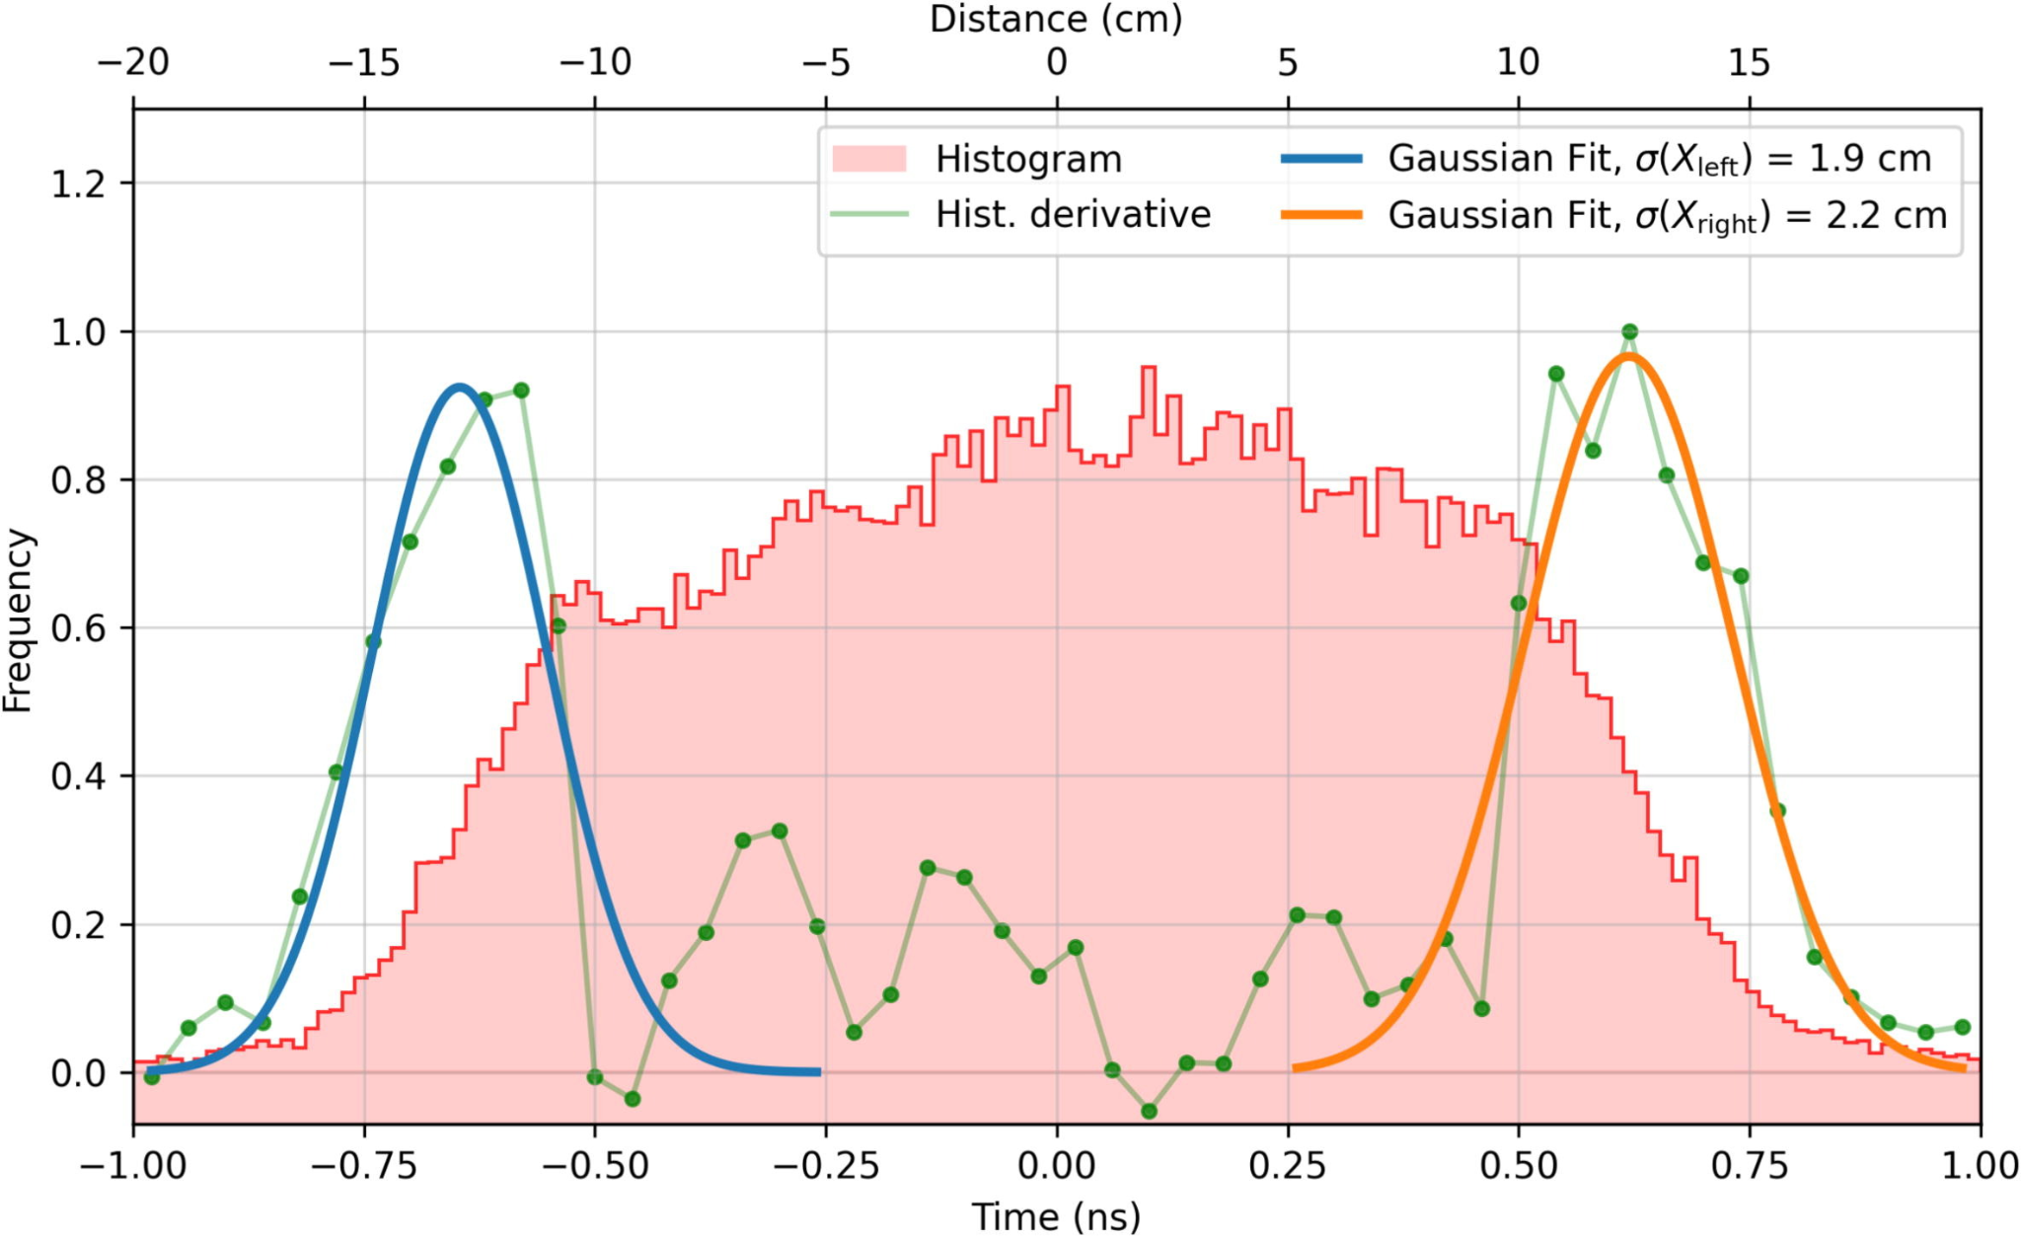
Estimated position uncertainty
Using the time difference in both sides of the strip the position of the event can be determined
C. Soneira-Landín et al., Adv. Space Res., 2025, https://doi.org/10.1016/j.asr.2025.07.096

Slide 9
More advanced versions
R3B prototype

Slide 10
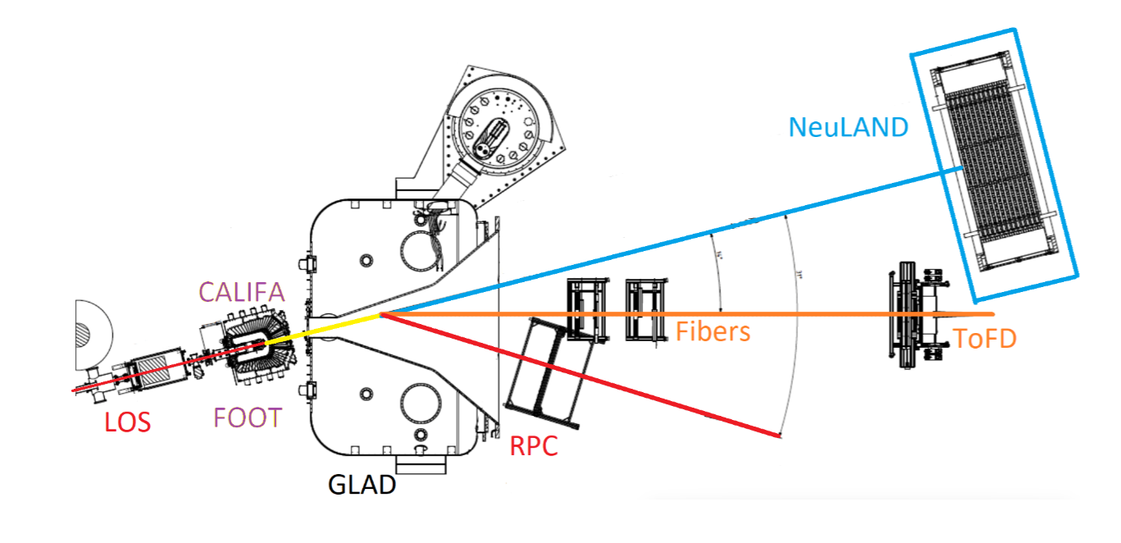
R3B prototype
2 m²
6 gaps x 2 chambers
3 cm pitch strips
The next step in the detector development is being used in R3B experiment at FAIR
Adapted from M. Xarepe et al., NIM A, 2023, https://doi.org/10.1016/j.nima.2023.168445

Slide 11
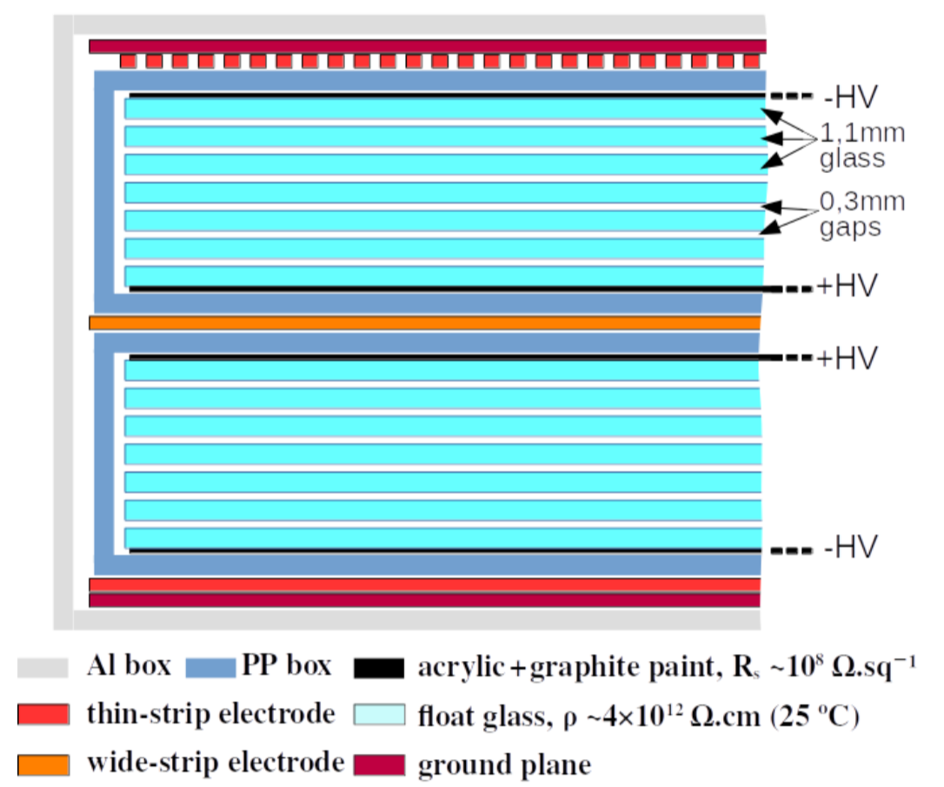
R3B prototype layout
2 multigap RPCs stacked
Thick readout strips are in the middle

Slide 12
Still measuring the fast signal
→ Faint (less efficient) and ballistic deficit (losing information)
Integration window covers fast signal
Still, using a double stack allows for 98% efficiency for MIPs

Slide 13
More advanced versions
Multiplexing: SHIP prototype

Slide 14
SHIP prototype
Charge induction sharing allows for improved position resolution
Townsend avalanche
electrons
Thin strips

Slide 15
Let’s take profit on the long signal
But combining readouts
Thin strips for slow signal → position
Thick strips for fast signal → timing
→ Robust (more efficient) and total charge collection

Slide 16
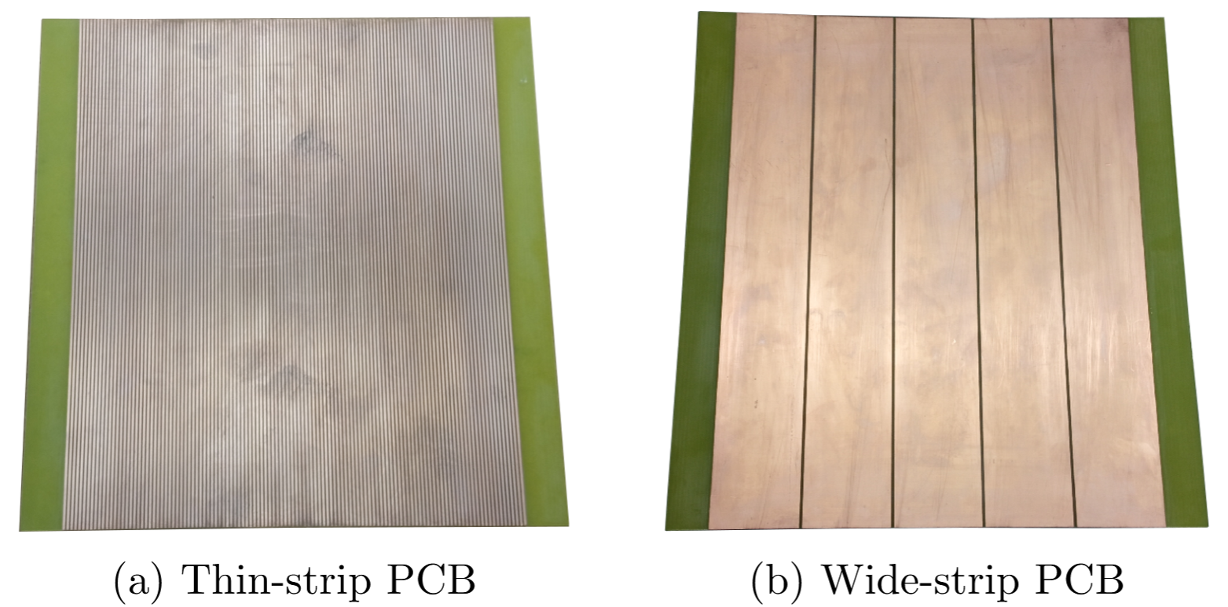
Readout electrodes
Pitch 61.0 mm
Interstrip 2 mm
Pitch 2.54 mm
Interstrip 1 mm

Slide 17
SHIP prototype

Slide 18
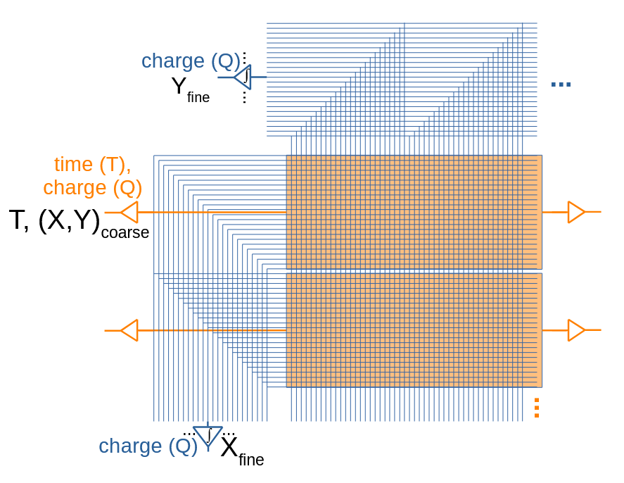
SHIP prototype
But this makes the channel count massive → high cost
Solution?

Slide 19
SHIP prototype
Multiplexing

Slide 20
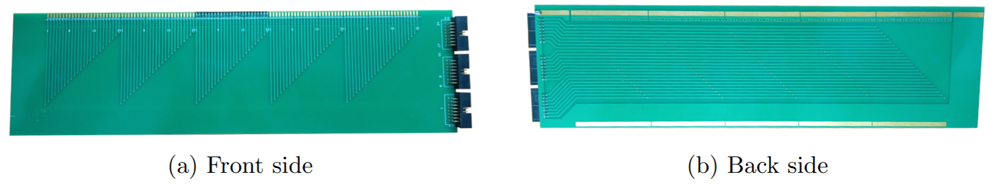
SHIP prototype
Multiplexing PCB
Front side
Rear side

Slide 21
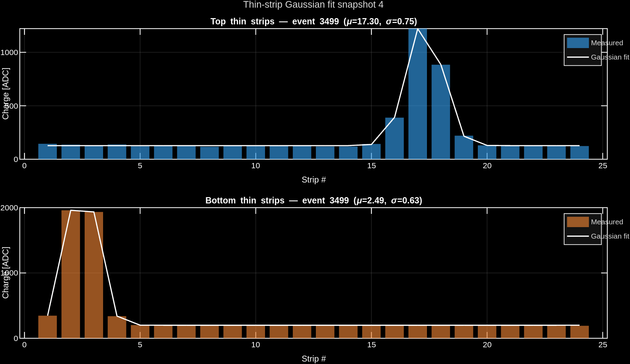

Slide 22
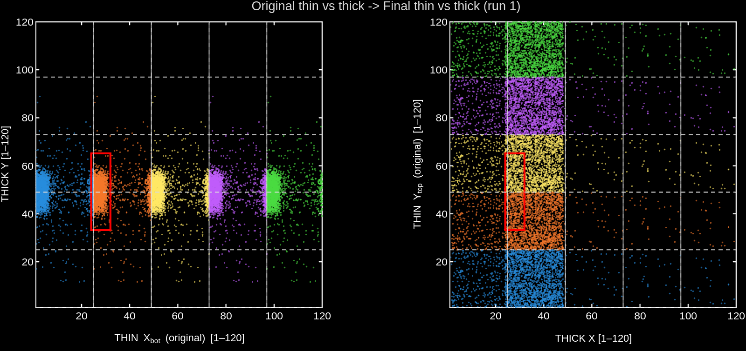
SHIP prototype
Ambiguities can be eliminated by combining information from different detector components

Slide 23
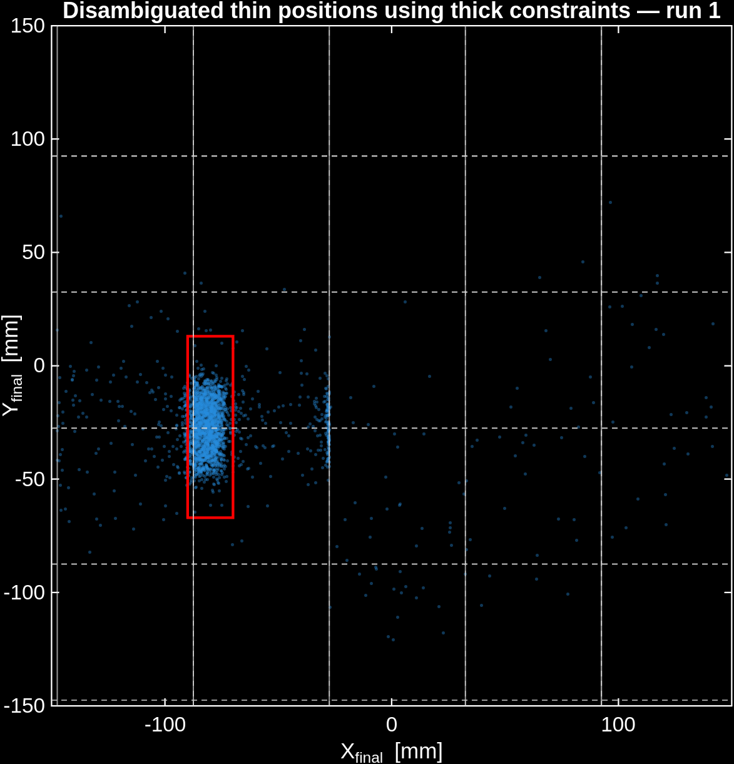
SHIP prototype
Unwrapped positions
(preliminary method, yet to be refined)

Slide 24
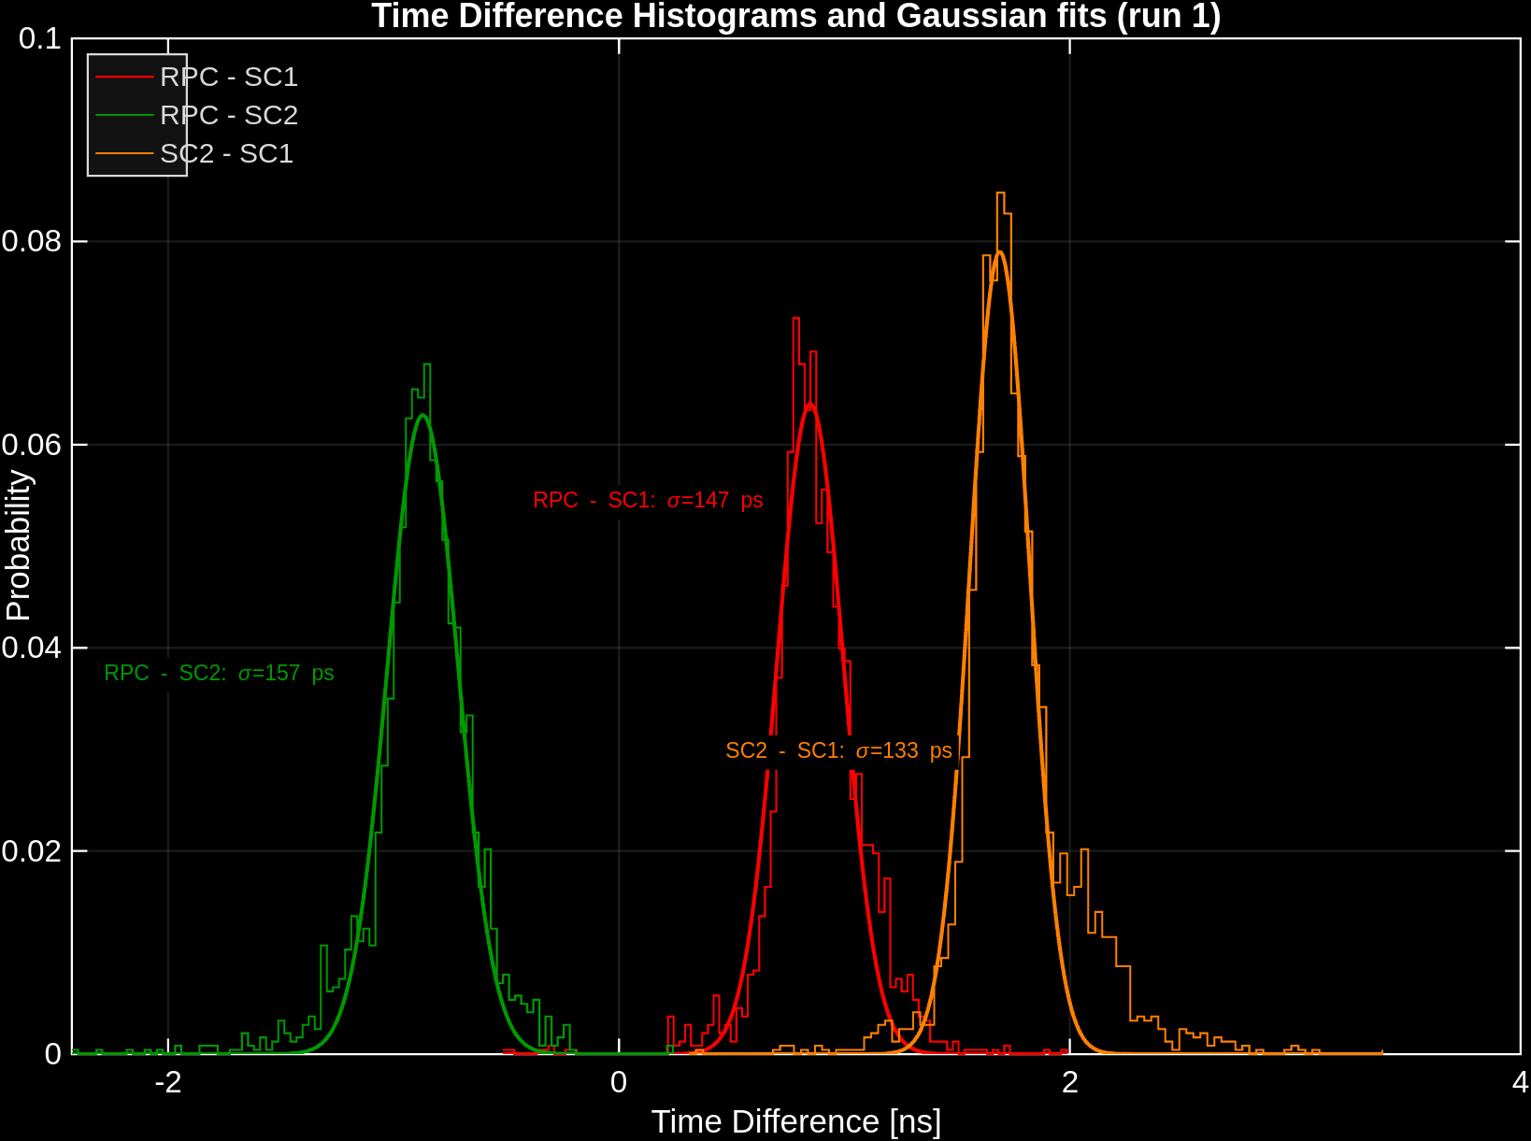
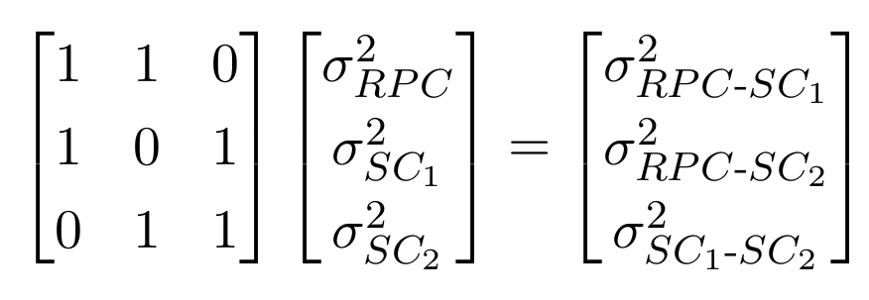
SHIP prototype
Time resolution (preliminary)
Time res. (equal-PMT assumption)
RPC → 119 ps (preliminary)
SC → 94 ps

Slide 25
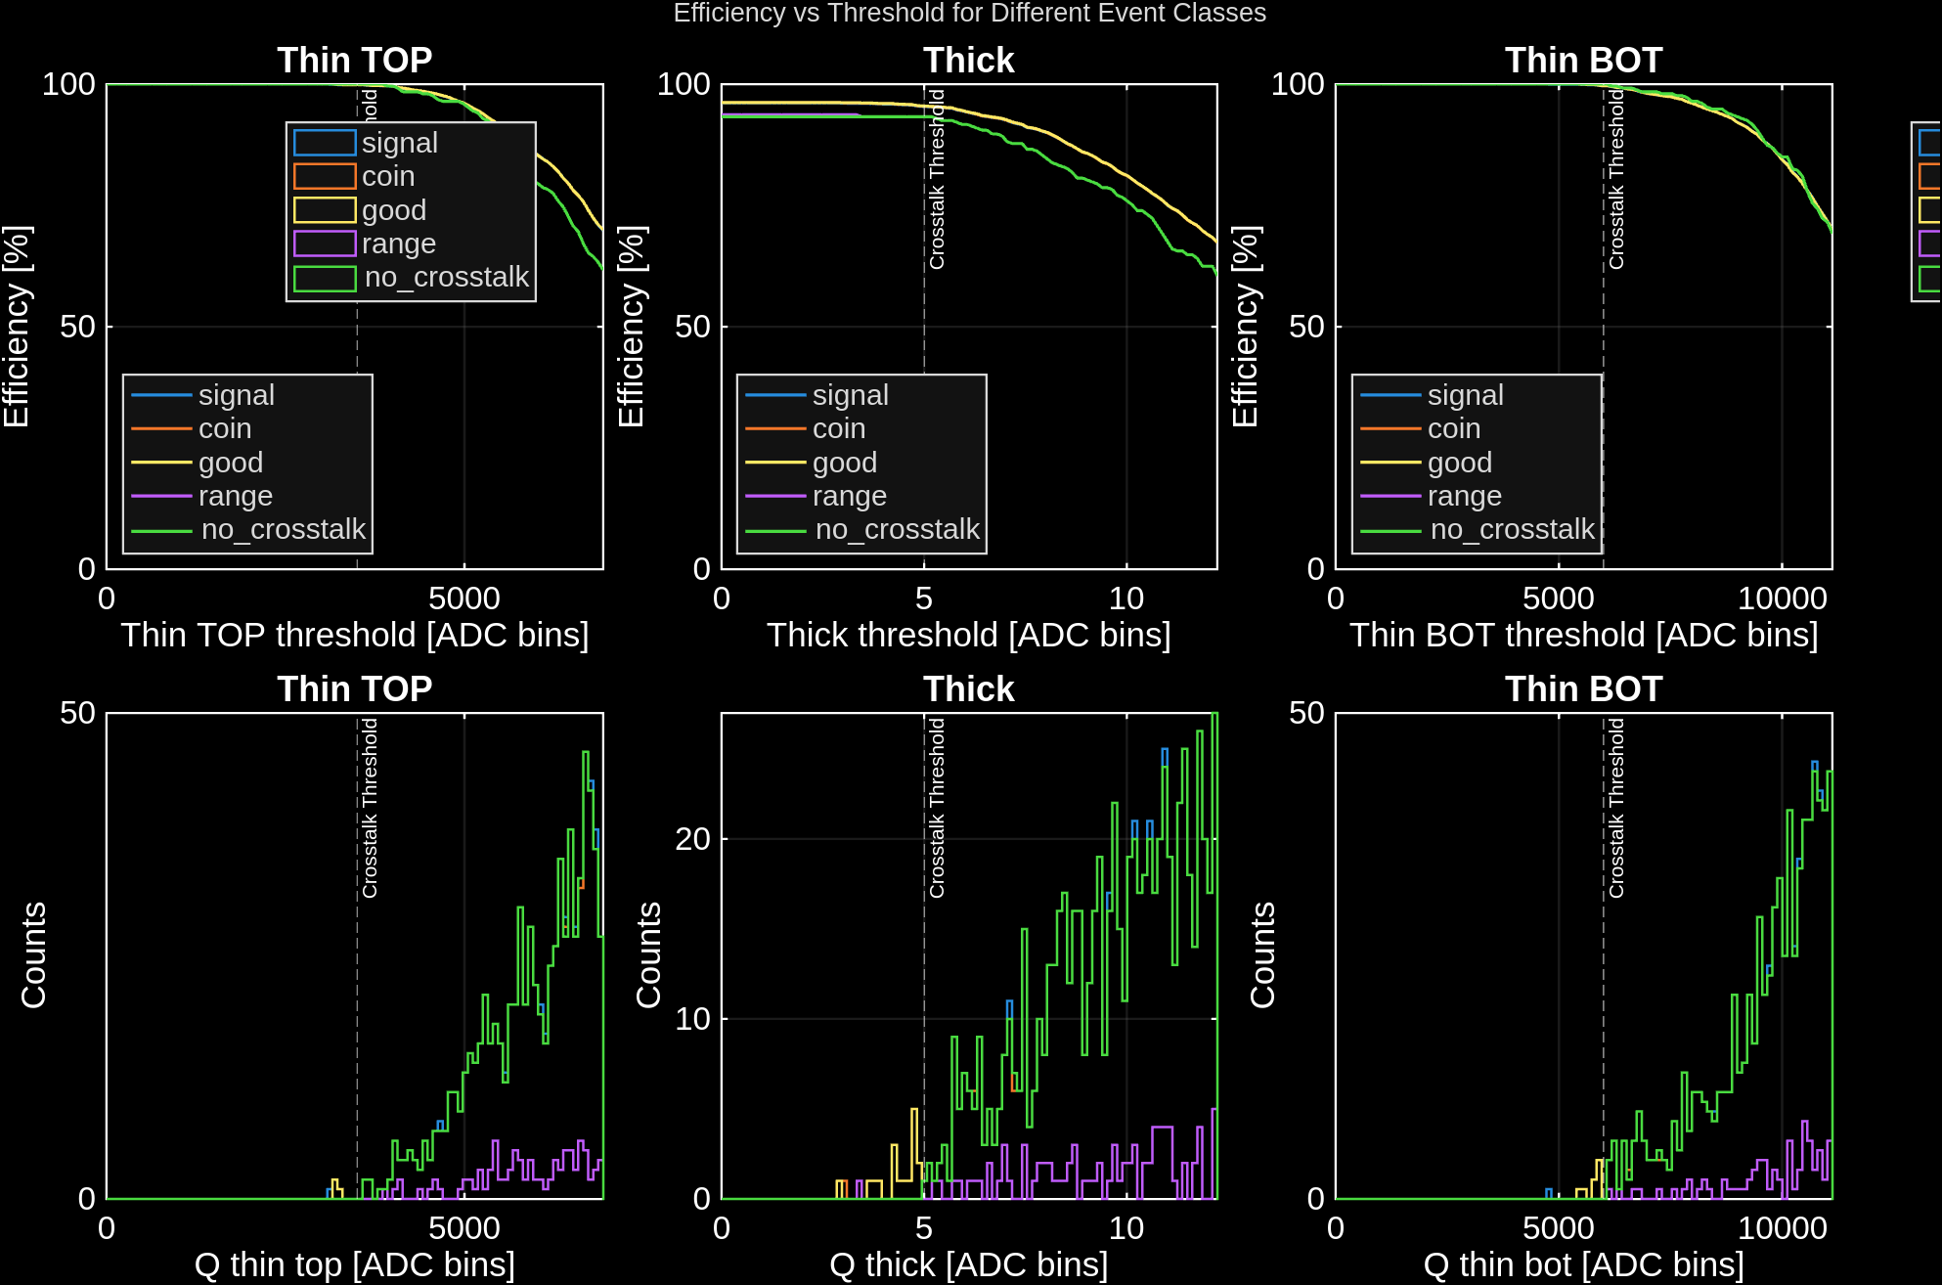
SHIP prototype
Efficiency (preliminary)
Using scintillators as reference
RPC | Efficiency [%]
Thin_top | 100.0 (2.8)
Thick_center | 96.2 (2.7)
Thin_bottom | 100.0 (2.8)

Slide 26
Next step
going for the single plane

Slide 27
Fewer channels, less electronics, less material
Single-plane prototype
Problem
Which readout for timing, which one for position?
Solution
Both of them!

Slide 28
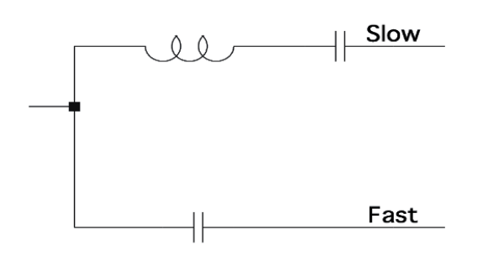
Single-plane prototype: signal separation
Signal collected fully on thin strips
Dedicated RC network to split fast and slow components
Tests (Joana Pinto @ LIP):
Emulation of a typical RPC pulse.
Capacitors scanned and optimal ratio found
C_fast : C_slow ≈ 1 : 10, with final values 560 pF (fast) and 5.6 nF (slow), avoiding saturation and keeping amplitudes.
→ Next step is plugging real RPC signals

Slide 29
Concluding
a summary of the story

Slide 30
Conclusions - A detector story
miniTRASGO
a good workspace for detector characterization
R3B prototype
→ double mRPC read in the middle
SHIP prototype
→ introducing thin strips and multiplexing
Single plane
→ thin strips only and fast/slow filter
We are here.

Slide 31
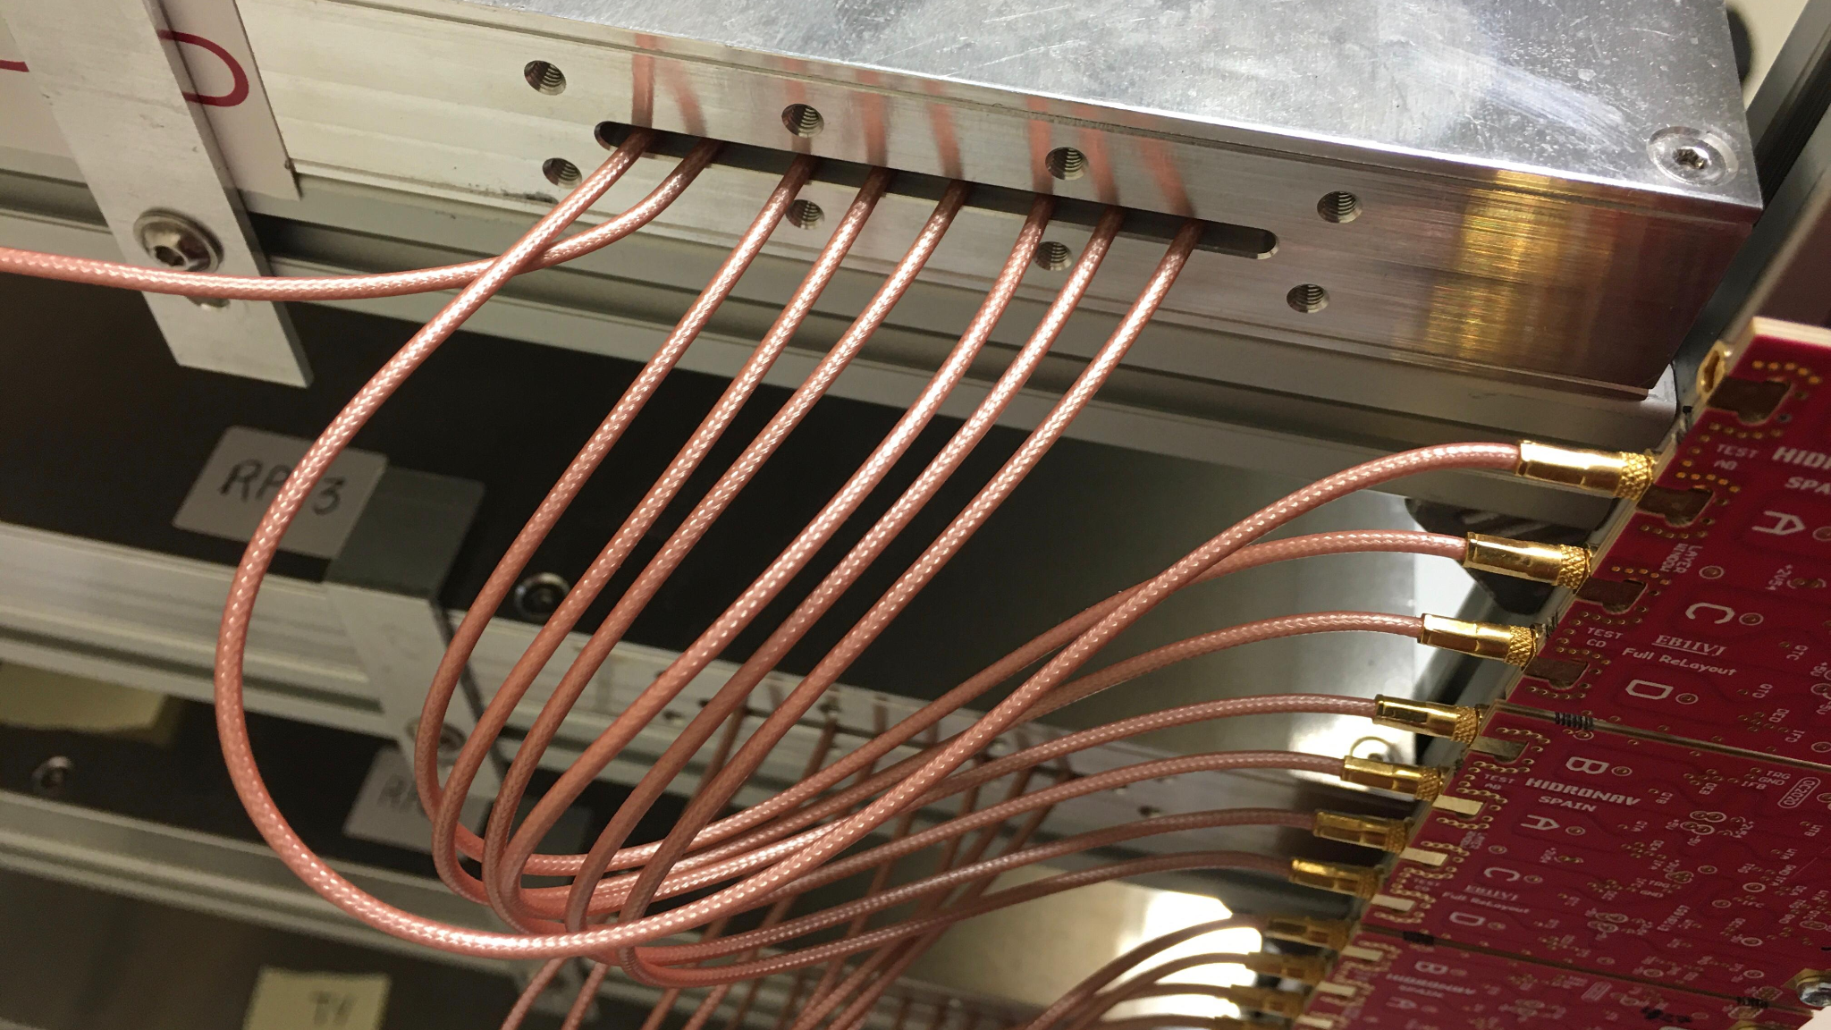
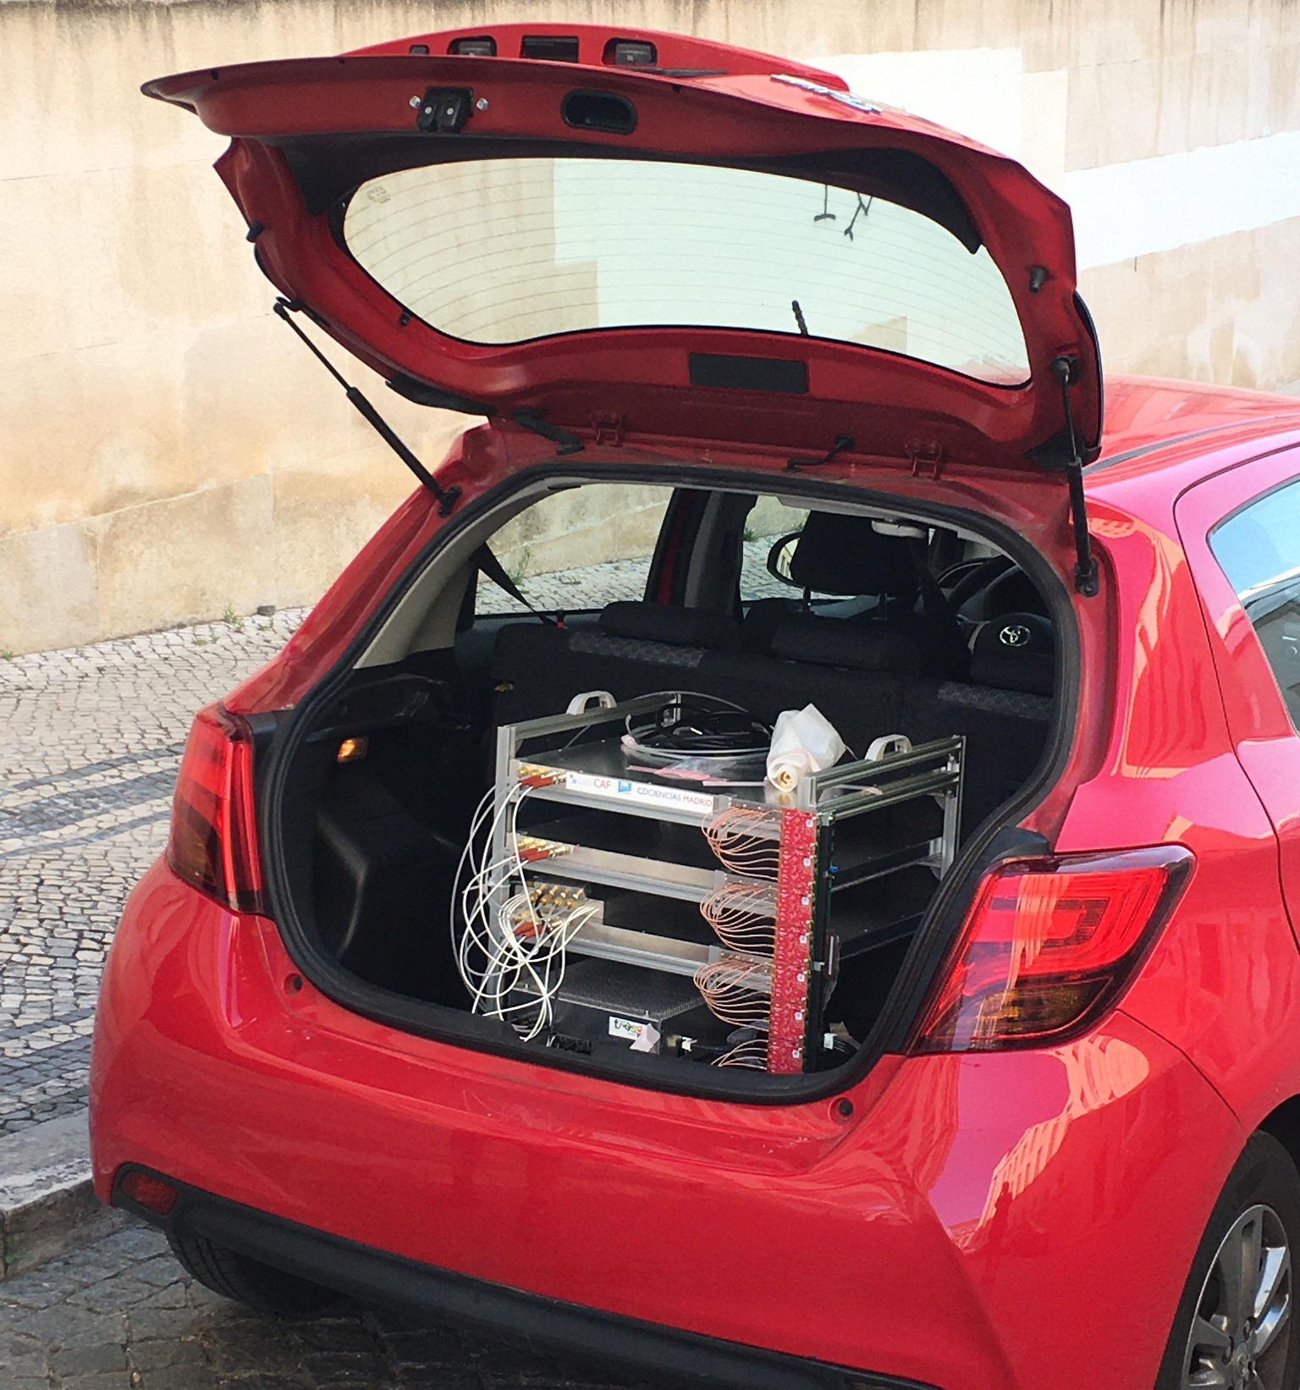
Thank you! Questions?
RPC readout optimization:
miniTRASGO as a path to a single-plane multiplexed timing system
csoneira@ucm.es
C. Soneira-Landín

Slide 32
Back-up slides
for those curious

Slide 33
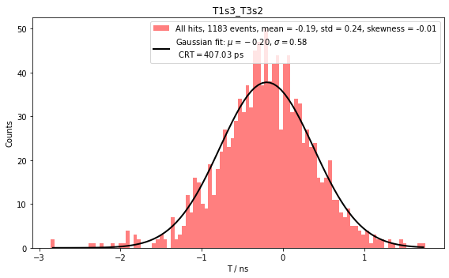

Slide 34
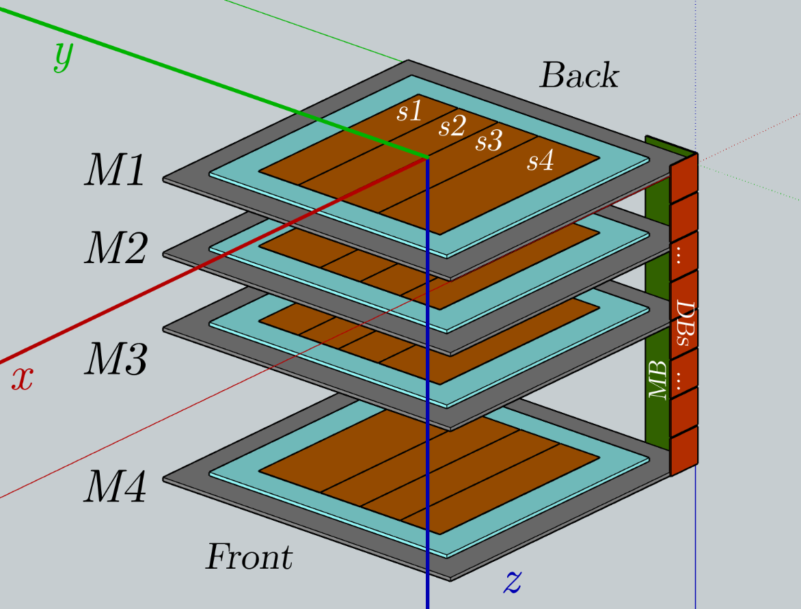
Not evenly spaced
(10 and 20 cm)
Trigger:
1-2, 1-3, 2-3, 3-4
Asymmetric parallel Cu strips read in Front and Back
32 channels

Slide 35
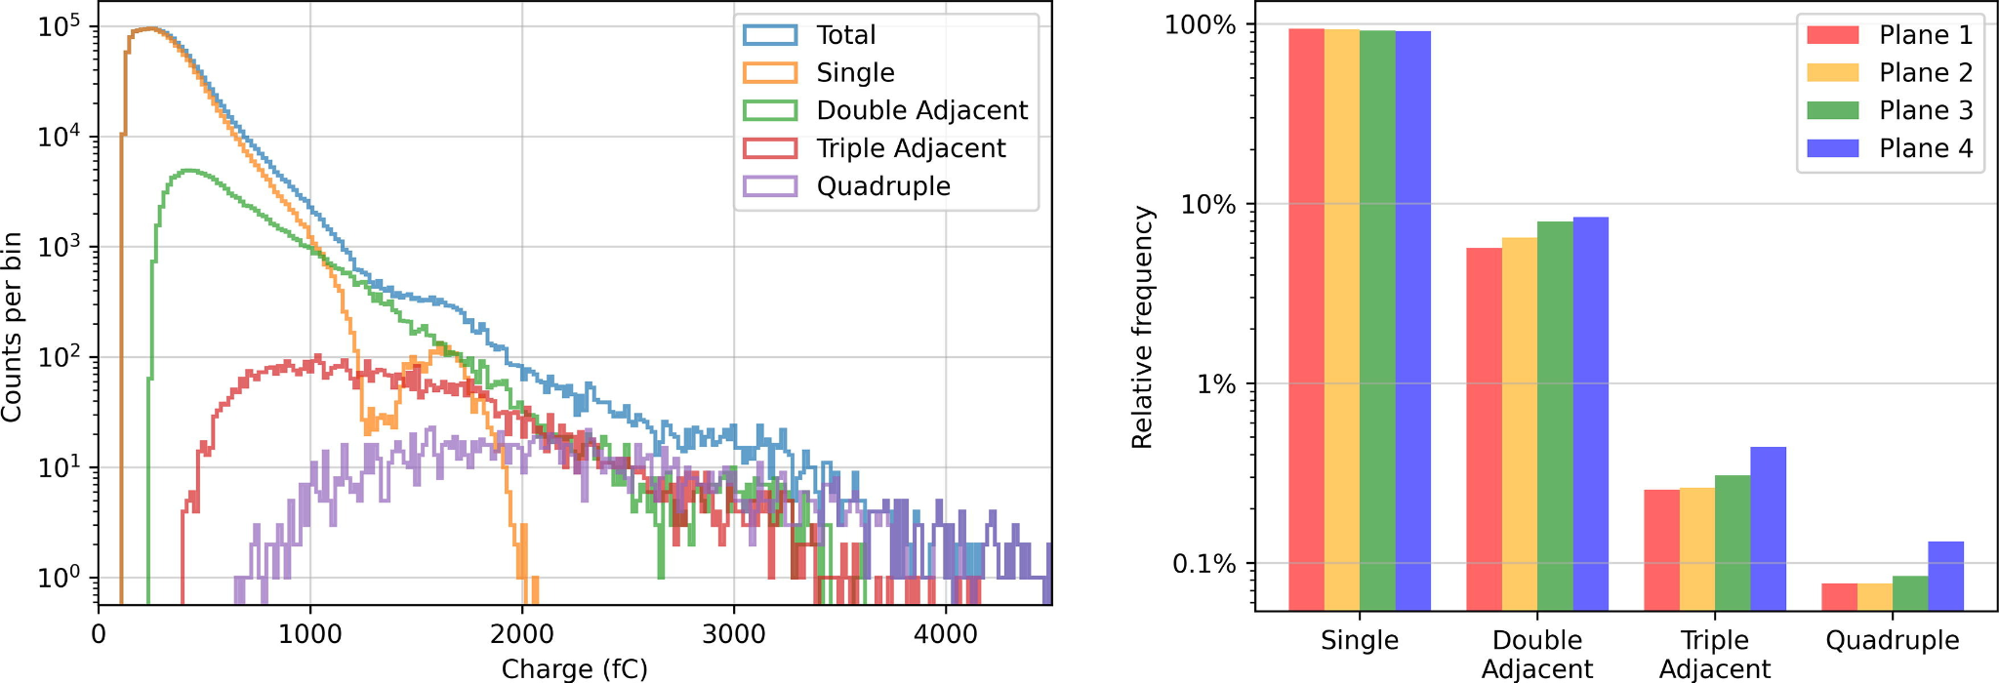

Slide 36
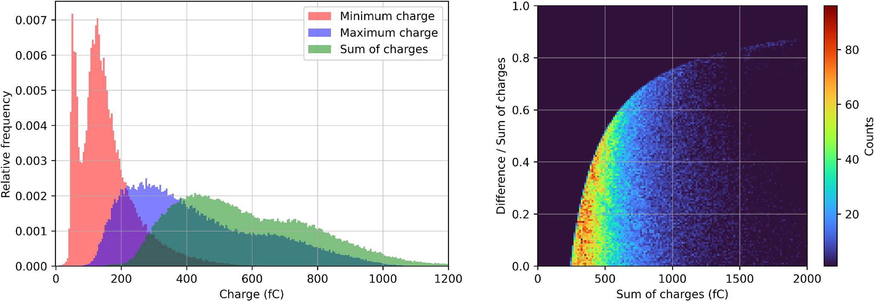

Slide 37
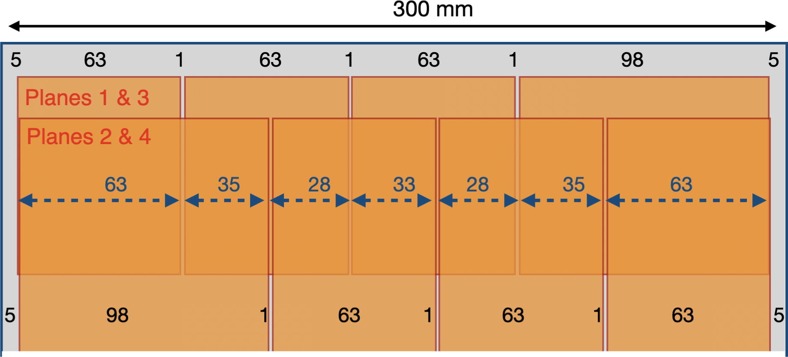

Slide 38
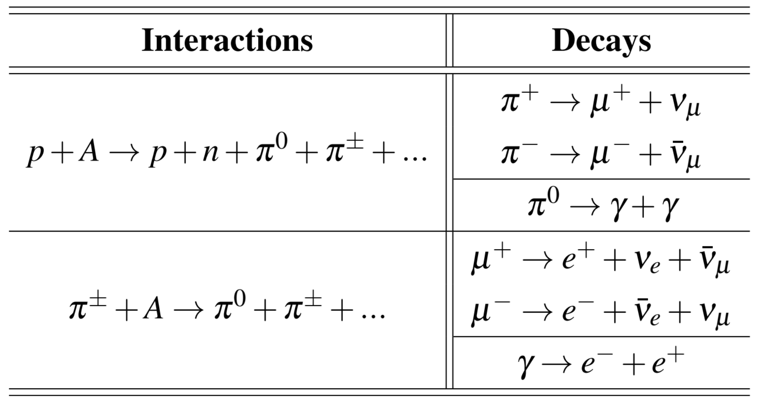
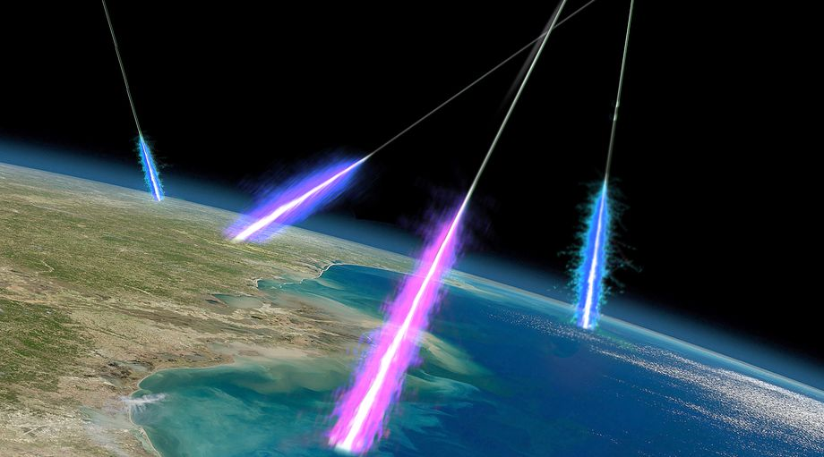
Nuclear reactions in the upper atmosphere
Javier Zarracina/Vox

Slide 39
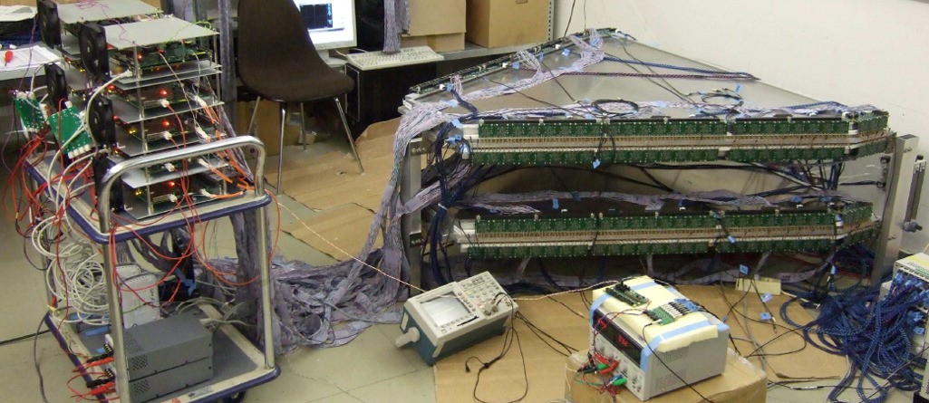
HADES Time-of-Flight Wall (commissioning)
D. Belver et al., TRASGO: A proposal for a timing RPCs based detector for analyzing cosmic ray air showers, NIM A, 2012, https://doi.org/10.1016/j.nima.2010.09.173
A. Blanco et al., RPC HADES-TOF wall cosmic ray test performance, NIM A, 2012, https://doi.org/10.1016/j.nima.2010.08.068
D. Belver et al., Analysis of the space-time microstructure of cosmic ray air showers using the HADES RPC TOF wall, JINST, 2012, 10.1088/1748-0221/7/10/P10007

Slide 40
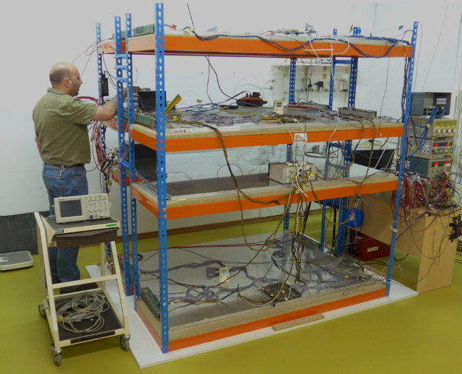
TRAGALDABAS
A Blanco et al., TRAGALDABAS: a new RPC based detector for the regular study of cosmic rays, JINST, 2014, DOI 10.1088/1748-0221/9/09/C09027
I. Riádigos et al., Revisiting the limits of atmospheric temperature retrieval from cosmic-ray measurements. Earth and Space Science, 2022, https://doi.org/10.1029/2021EA001982
I. Riádigos et al., Atmospheric temperature effect in secondary cosmic rays observed with a 2 m² ground-based tRPC detector. Earth and Space Science, 2020, https://doi.org/10.1029/2020EA001131

Slide 41
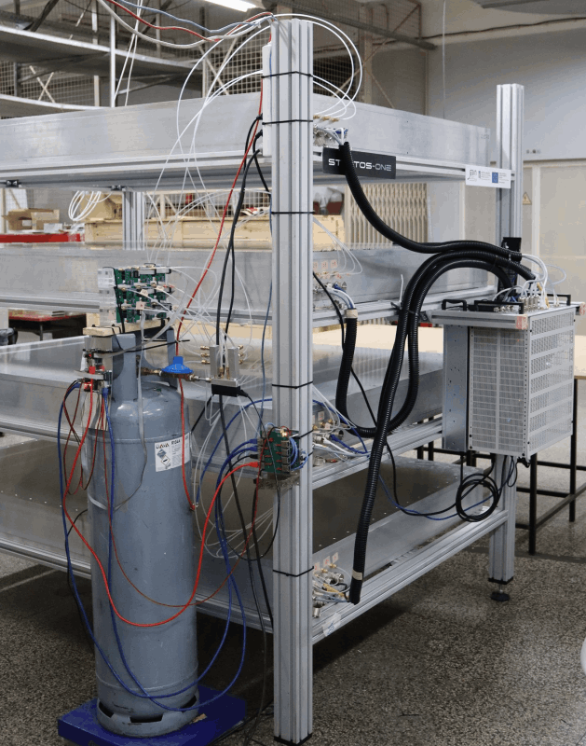
Logicmelt, Stratos DS – Stratospheric temperature prediction using artificial intelligence, Logicmelt – Use Cases, 2025, https://logicmelt.com/en/use-cases_eng/stratos-ds-prediction-of-the-stratosphere-temperature/
NAC-Intercom, Project STRATOS – Ground Station for Continuous Monitoring of the Stratosphere Temperature through Cosmic Ray Directional Flow, NAC-Intercom – Projects, 2025, https://www.nac-inter.com/en/content/30-project-stratos
STRATOS

Slide 42
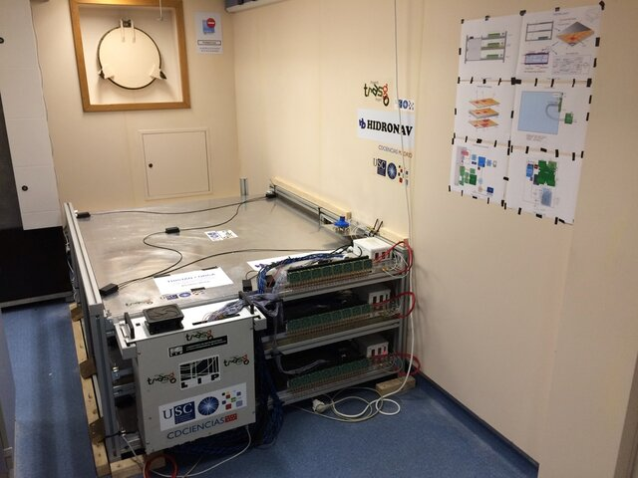
TRISTAN
J.P. Saraiva, et al., The TRISTAN detector—2018–2019 latitude survey of cosmic rays. Journal of Instrumentation, JINST, 2020, https://doi.org/10.1088/1748-0221/15/09/C09024

Slide 43
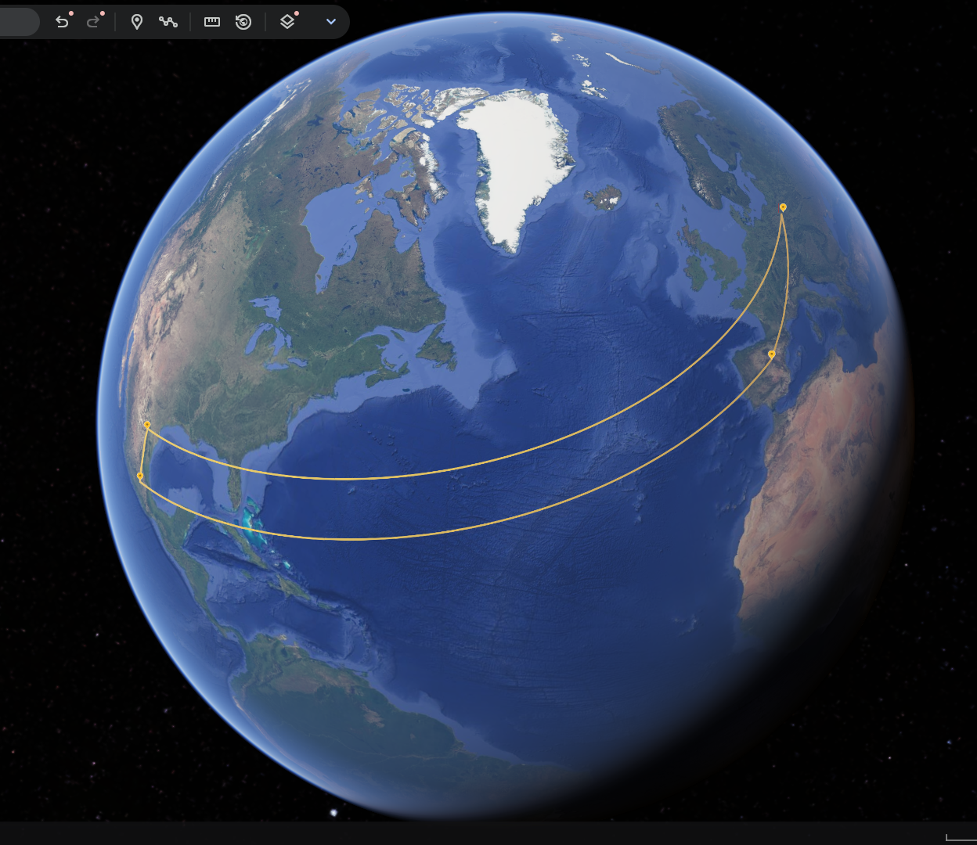
miniTRASGO network
Warsaw 🇵🇱
Madrid 🇪🇸
Puebla 🇲🇽
Monterrey 🇲🇽

Slide 44
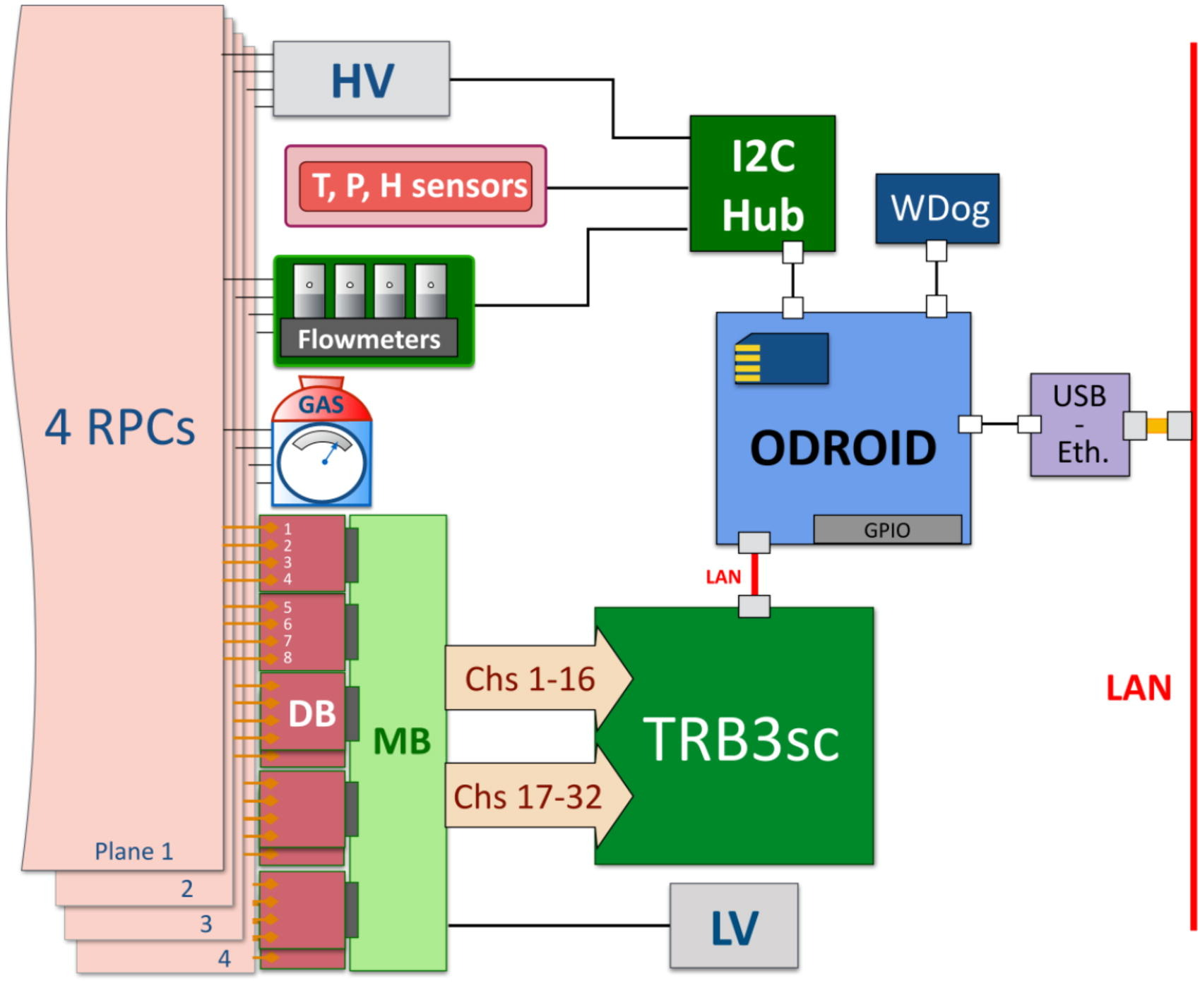
Compact and autonomous
Only three connections:
Power (standard plug)
Gas bottle (15 kg)
Ethernet (not required)
Includes:
environment sensors, flowmeters, DAQ and a PC for data analysis and storage

Slide 45
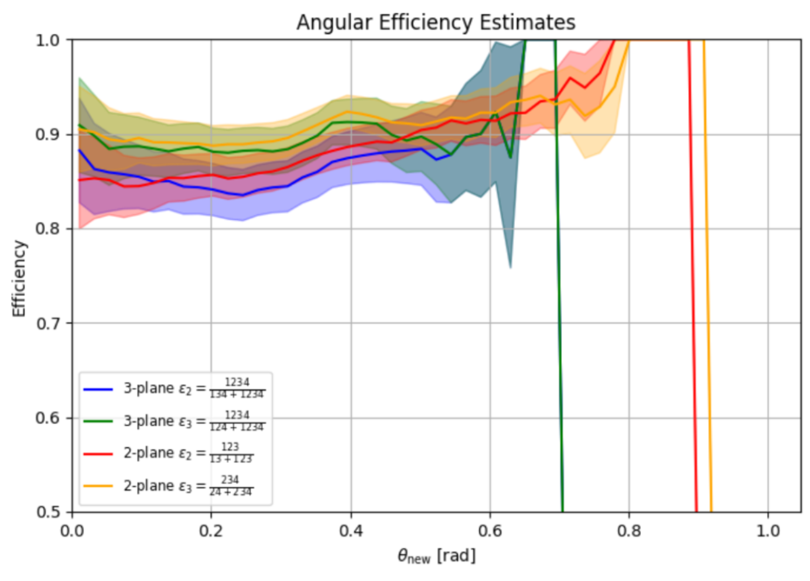
Efficiency vs. incident zenith muon angle
Oblique tracks spend more time in the active volume

Slide 46
Forbush Decrease
On March 2024

Slide 47
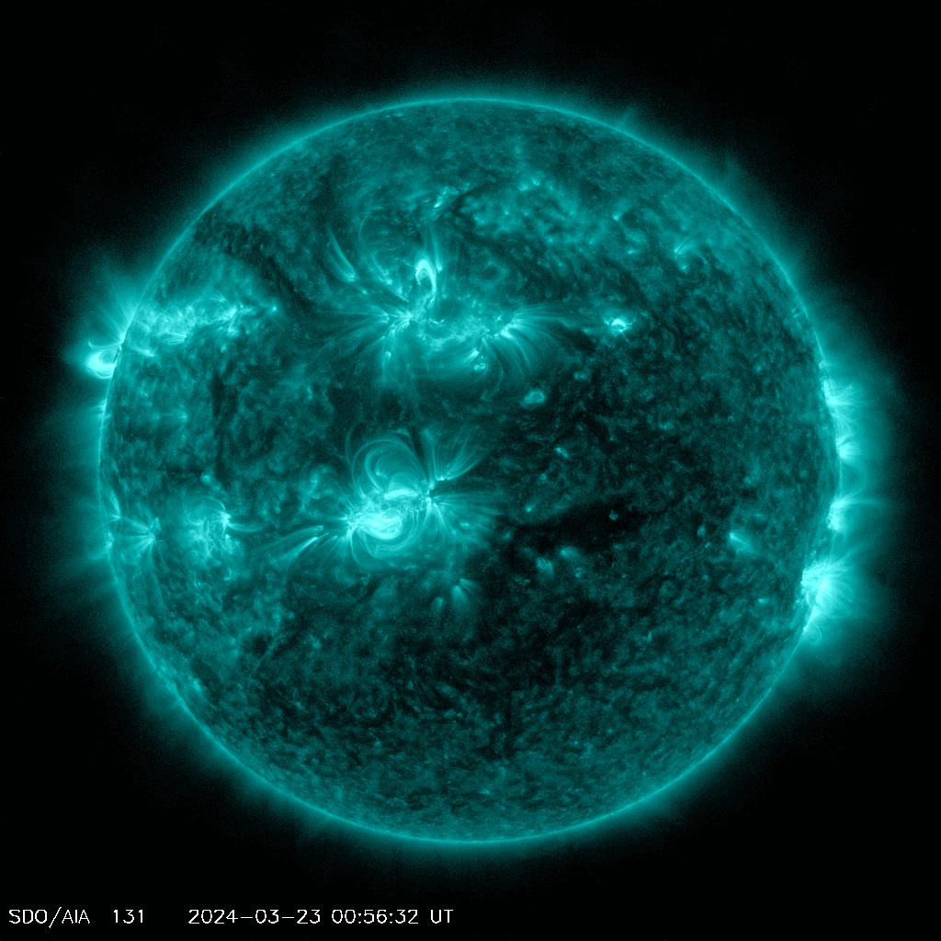
Two Sunspots exploded in tandem on March 23rd 2024 (03:30 CET)
8 hours later…
From Solar Dynamics Observatory, NASA

Slide 48
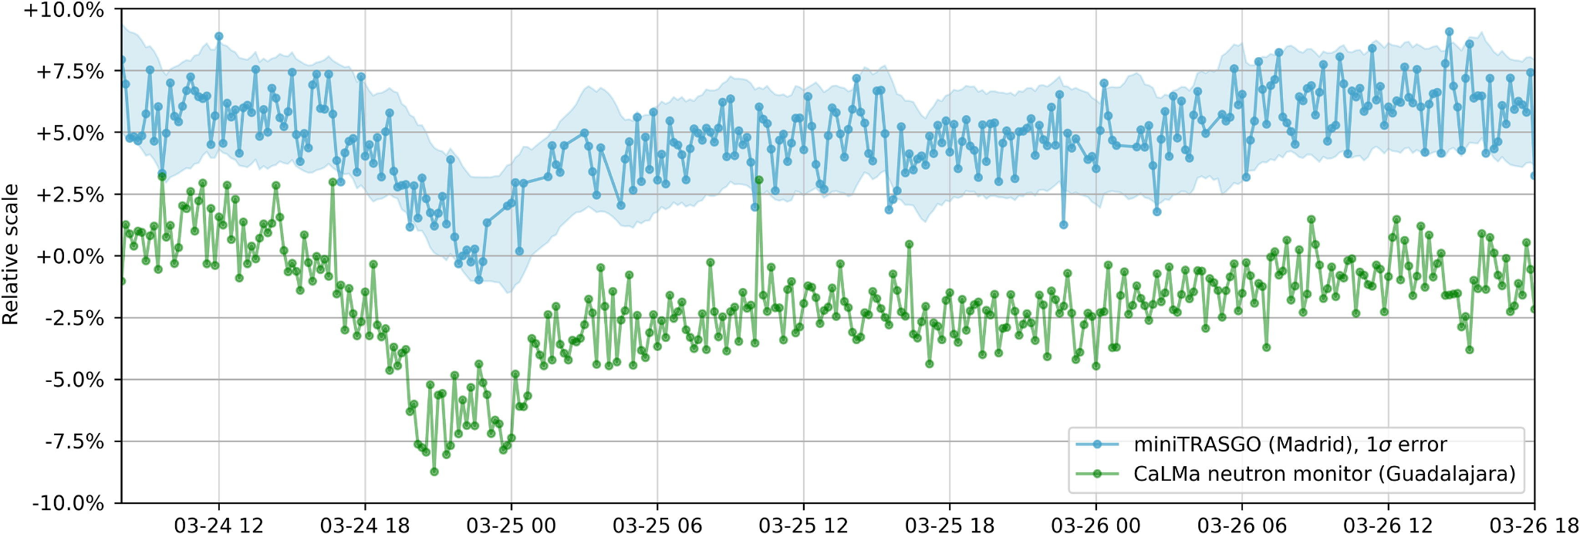
Eff. and pressure corrected rate
→ the Forbush Decrease can be seen

Slide 49
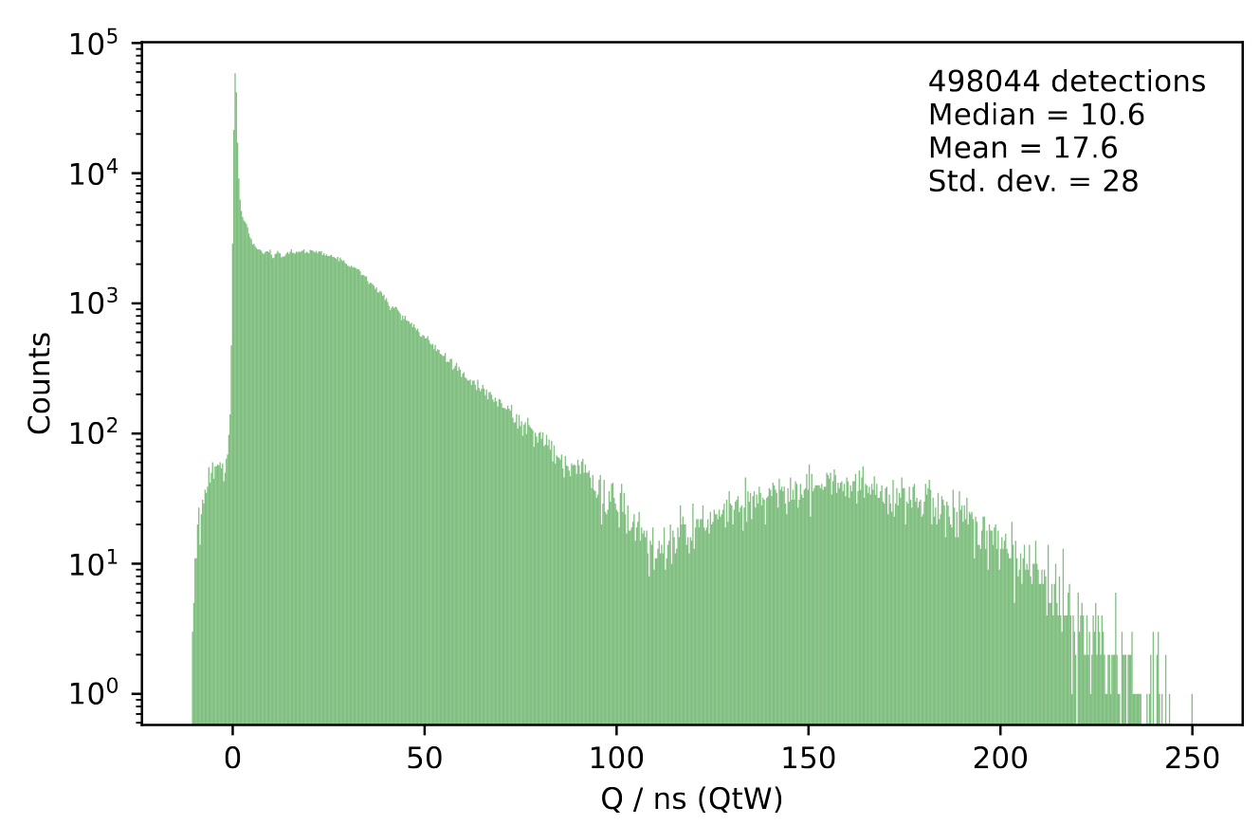
Measure: time and charge in F and B per strip
Cal. charge dist. for the B side of strip 2 of M3
Time sum → Incidence time
Time diff → Position
Charge sum → Total charge
Charge diff → Monitor

