Slide 1
Neutron energy measurements of (α, xn) reactions with MONSTER
José Llanes Gamonoso
jose.llanes@ciemat.es
MONSTER collaboration; MANY collaboration
Unidad de Innovación Nuclear
Departamento de Fisión Nuclear
CIEMAT
Avda. Complutense 40, 28040 Madrid – España

Slide 2
Table of contents
Introduction
Experimental setup
Data analysis
Results
Final remarks

Slide 3
Table of contents
Introduction
Experimental setup
Data analysis
Results
Final remarks

Slide 4
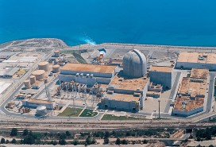
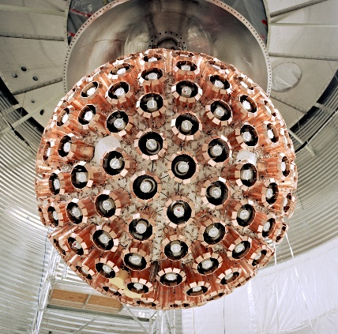
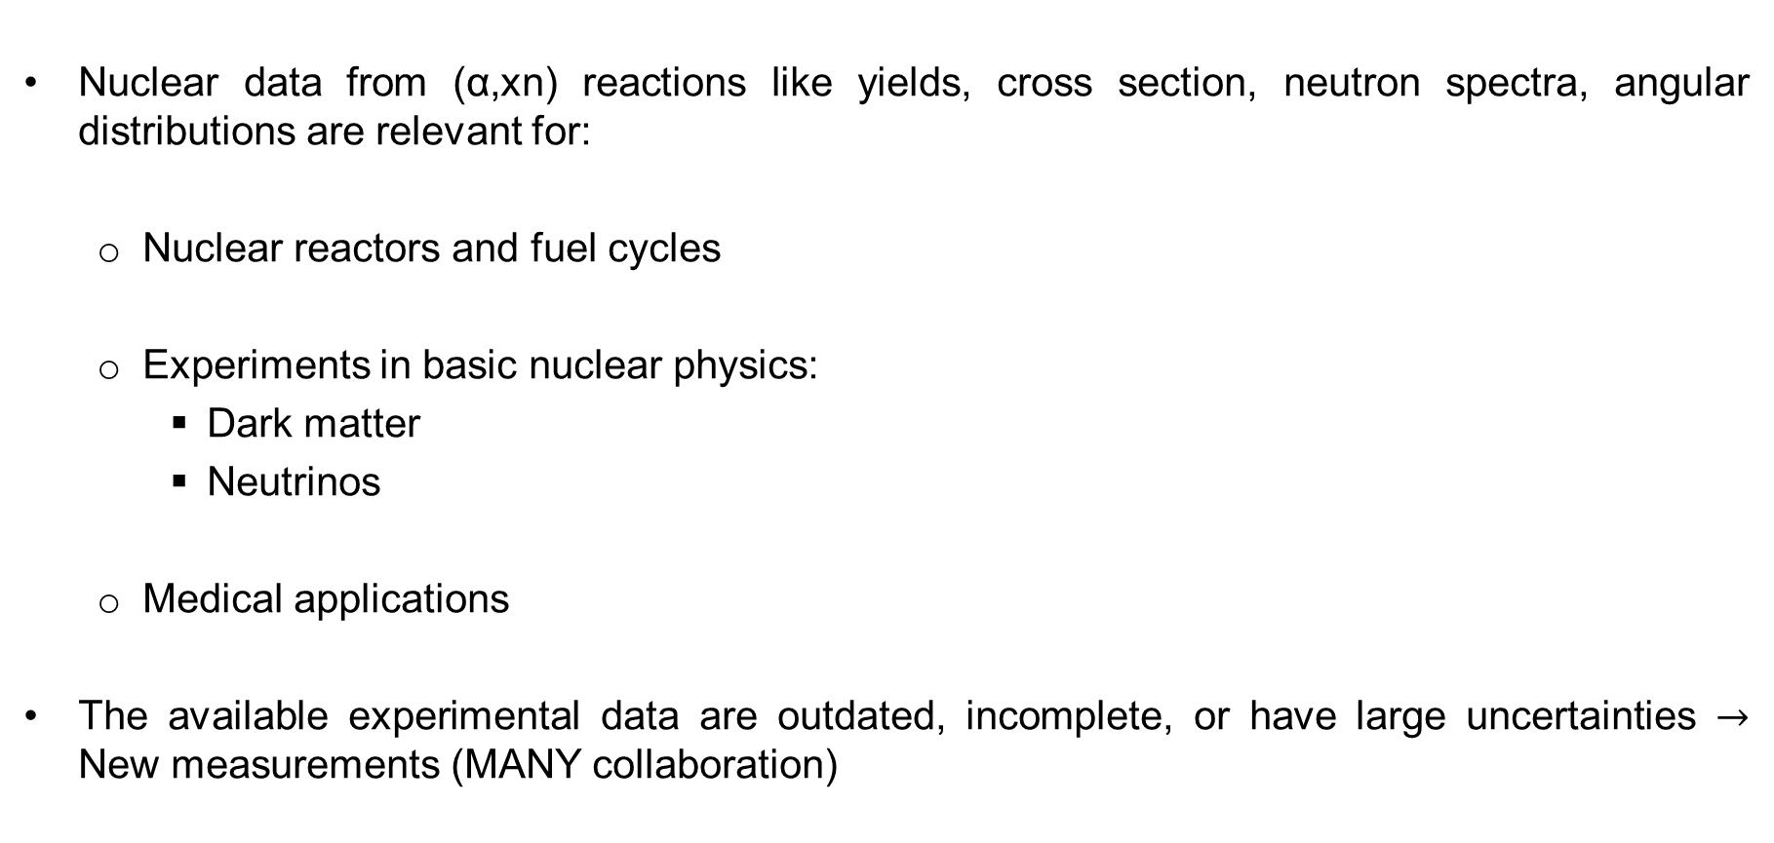
Motivation
Nuclear data from (α,xn) reactions like yields, cross section, neutron spectra, angular distributions are relevant for:
Nuclear reactors and fuel cycles
Experiments in basic nuclear physics:
Dark matter
Neutrinos
Medical applications
The available experimental data are outdated, incomplete, or have large uncertainties $→$ New measurements (MANY collaboration)
D. Cano-Ott et al., J. Phys. G: Nucl. Part. Phys., (2025)
S.S. Westerdale et al., Summary report of the Technical Meeting, 8-12 Nov 2021 (virtual event)

Slide 5






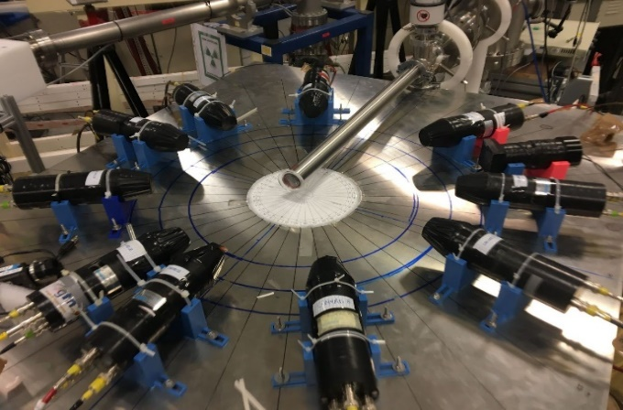

Measurement of Alpha Neutron Yields and Spectra (MANY)
Two Spanish facilities
Three Spanish detectors
LaBr₃ array
miniBELEN
GARY
miniBELEN

Slide 6
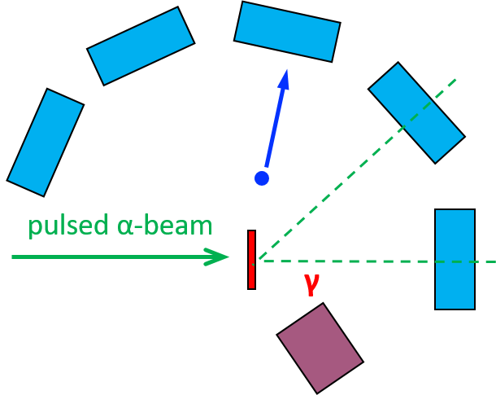
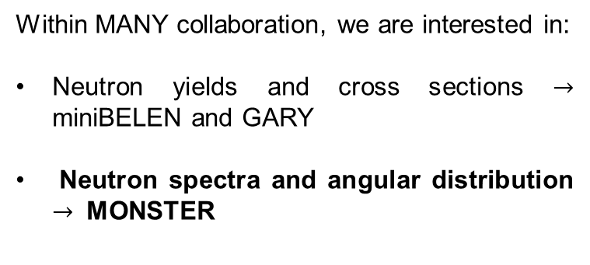
Measurement of neutron spectra in (α,xn) reactions
Within MANY collaboration, we are interested in:
Neutron yields and cross sections $→$ miniBELEN and GARY
Neutron spectra and angular distribution $→$ MONSTER
Our experimental setup
MONSTER
neutron detectors
(liquid/plastic scintillators)
TOF spectrometer:
Requires a pulsed α-beam.
Information for the eff correction ε_{n}(E_{n})
Measurements at different angles allows the study of angular distribution
Low efficiency (~ 1%)
Neutron/gamma discrimination and correlation with γ-rays

Slide 7
Table of contents
Introduction
Experimental setup
Data analysis
Results
Final remarks

Slide 8
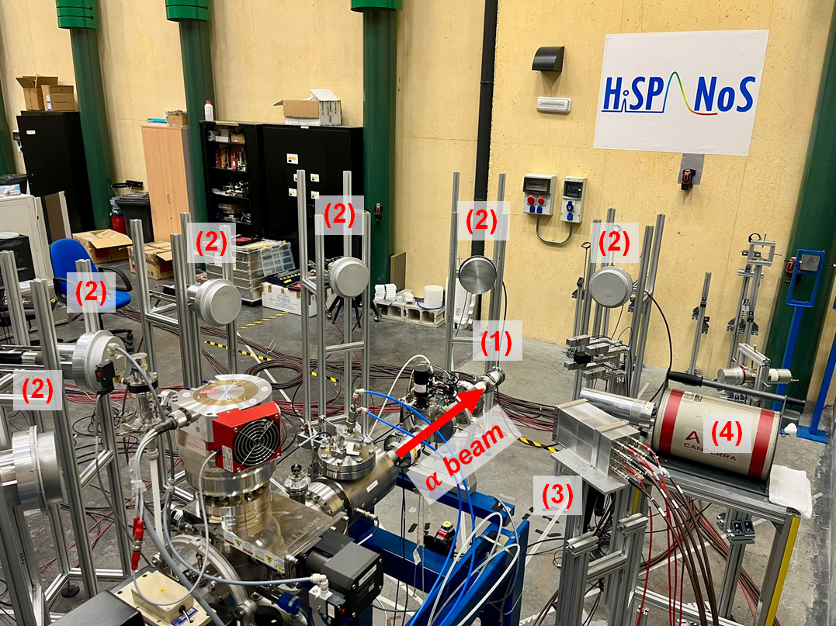
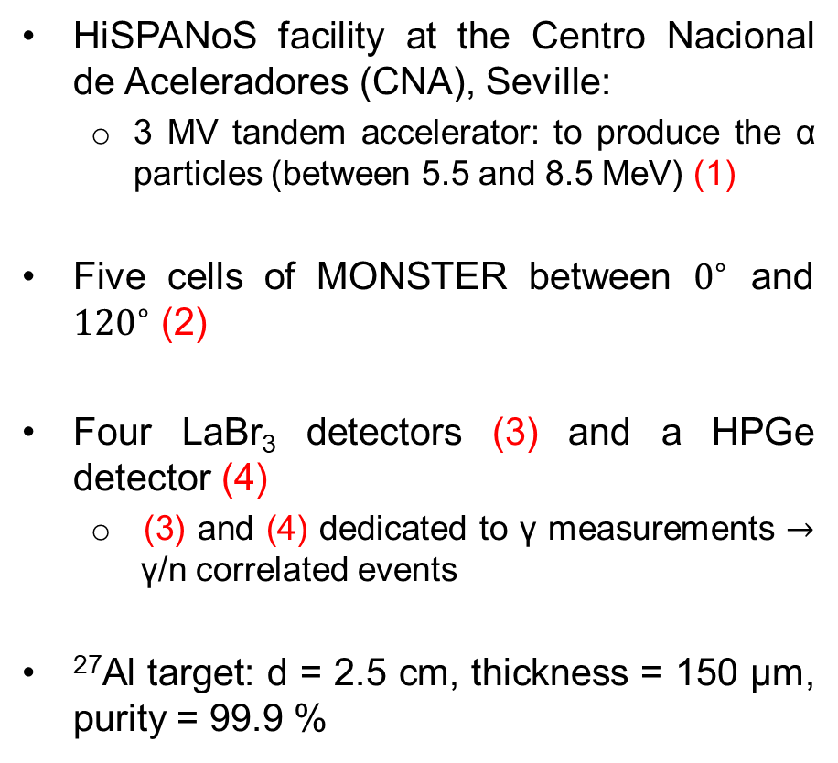
Experimental setup
HiSPANoS facility at the Centro Nacional de Aceleradores (CNA), Seville:
3 MV tandem accelerator: to produce the α particles (between 5.5 and 8.5 MeV) (1)
Five cells of MONSTER between $0^{∘}$ and ${120}^{∘}$ (2)
Four LaBr₃ detectors (3) and a HPGe detector (4)
(3) and (4) dedicated to γ measurements $→$γ/n correlated events
²⁷Al target: d = 2.5 cm, thickness = 150 μm, purity = 99.9 %
A.R. Garcia et al., Journal of Instrumentation, 7, (2012) C05012
T. Martínez et al., Nucl. Data Sheets, 120, (2014) 78-80

Slide 9
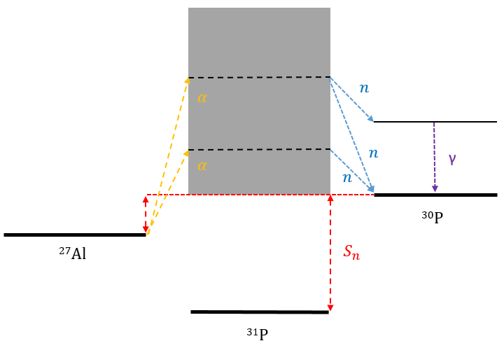
²⁷Al(α,n)³⁰P reaction
IAEA suggests the use of this reaction as a benchmark
Aluminum is a very common element in structural materials
There is available data for ²⁷Al(α,n)³⁰P reaction
The reaction mechanism is well-known:
β⁺ emission of ³⁰P allows the yield measurement
A. Junghans et al., INDC International Nuclear Data Committee (IAEA), (2023)
G.J.H. Jacobs & Liskien, Annals of Nuclear Energy, 10, (1983) 541-552

Slide 10
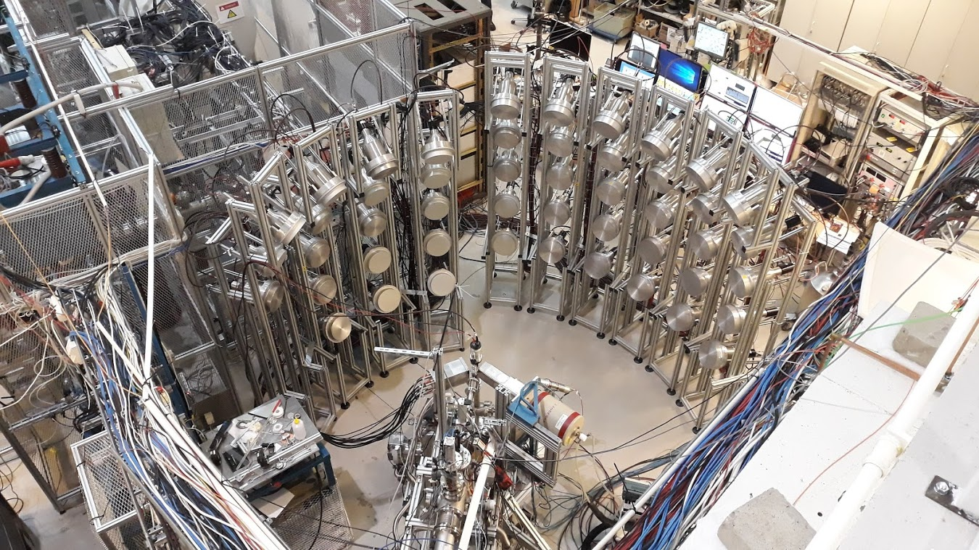
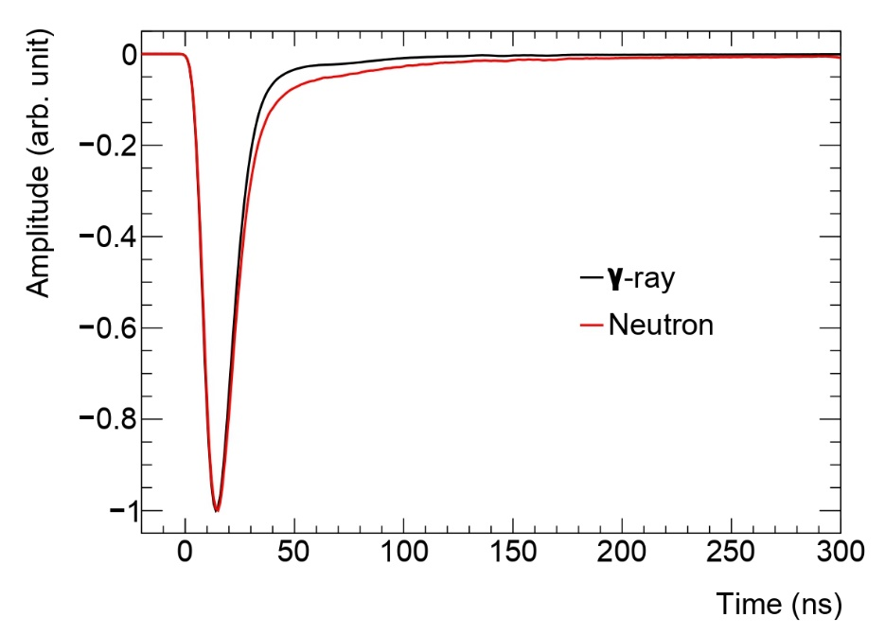
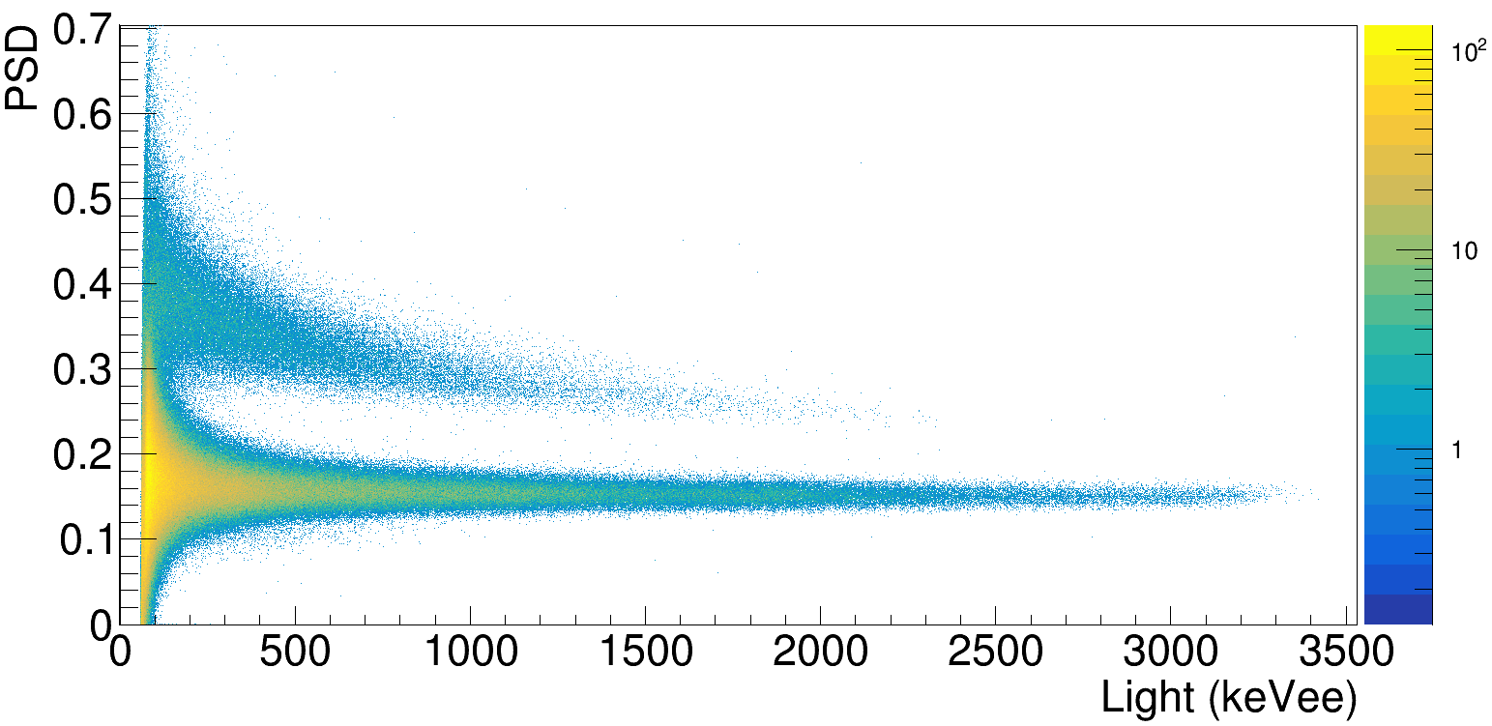
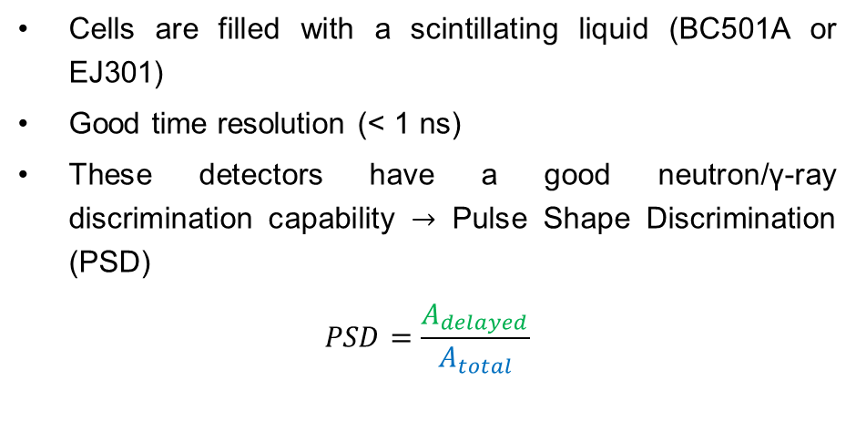

MONSTER spectrometer
Cells are filled with a scintillating liquid (BC501A or EJ301)
Good time resolution (< 1 ns)
These detectors have a good neutron/γ-ray discrimination capability $→$ Pulse Shape Discrimination (PSD)
$$PSD=\frac{A_{delayed}}{A_{total}}$$
t (CFD)
n
$$γ$$

Slide 11
Table of contents
Introduction
Experimental setup
Data analysis
Results
Final remarks

Slide 12
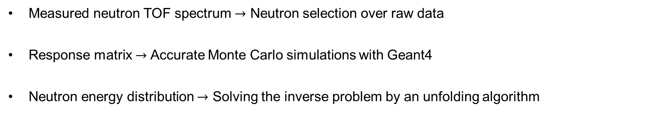

Inverse problem
$$TOF=R∙E_{n}$$
Measured neutron TOF spectrum
Response matrix
Neutron energy distribution
Measured neutron TOF spectrum $→$ Neutron selection over raw data
Response matrix $→$ Accurate Monte Carlo simulations with Geant4
Neutron energy distribution $→$ Solving the inverse problem by an unfolding algorithm
S. Agostinelli et al., Nucl. Inst. and Meth. A, 506, (2003) 250-303

Slide 13
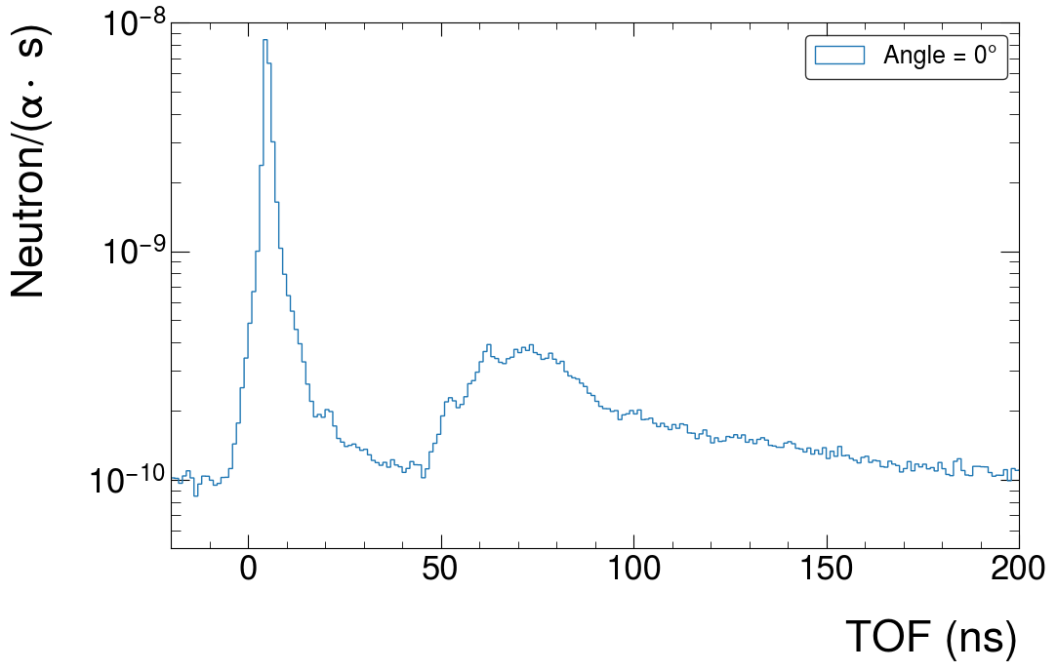
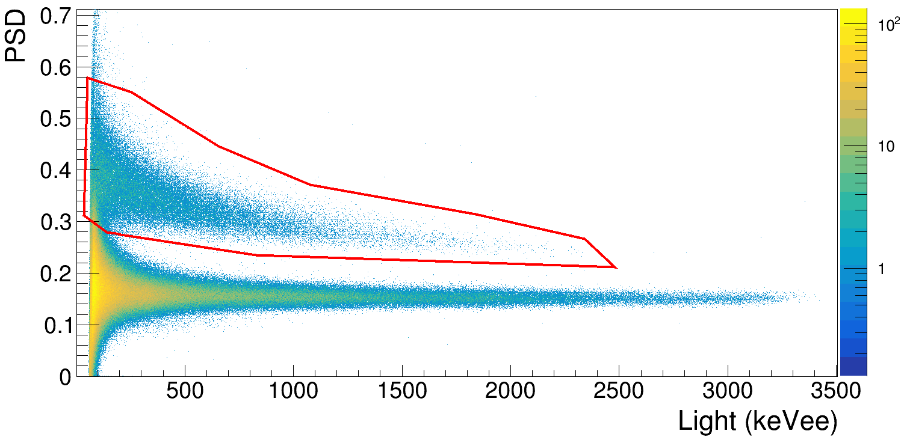



Neutron Selection
$E_{α}=8.5$ MeV
Raw TOF spectra
$γ$-peak
neutron structure
Neutron cut
$γ$uncorrelated background
Difficult to see the neutrons due to high $γ$contribution $→$ $γ$-peak and uncorrelated background $→$
$→$Necessity of a neutron cut

Slide 14
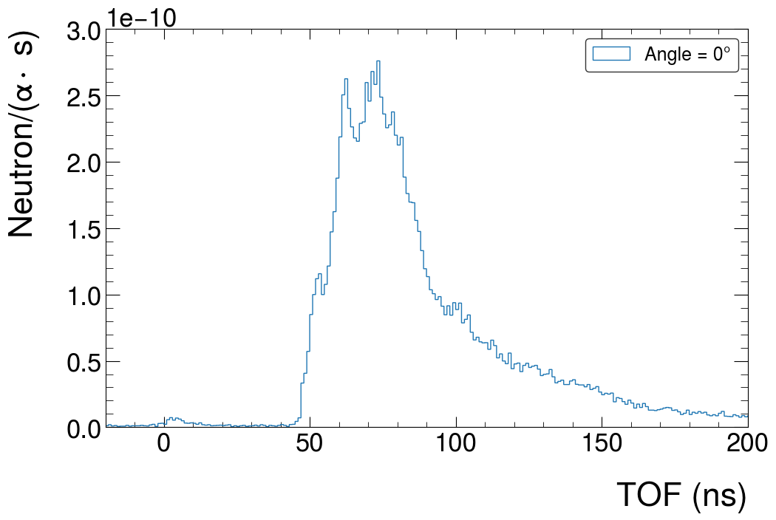
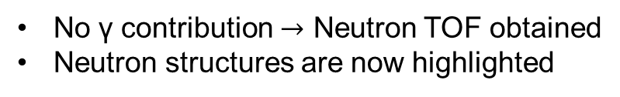
Neutron Selection
$E_{α}=8.5$ MeV
Raw TOF spectra
Neutron cut
No γ contribution $→$ Neutron TOF obtained
Neutron structures are now highlighted

Slide 15
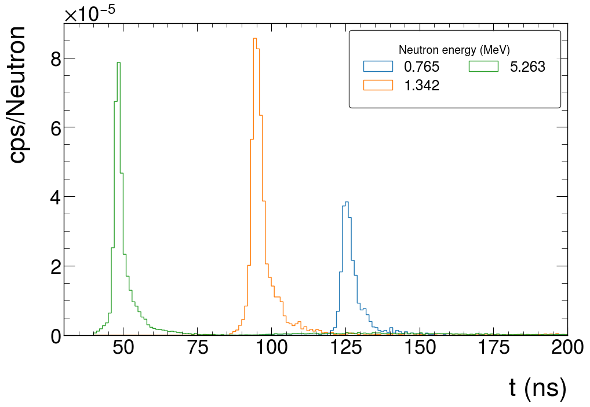
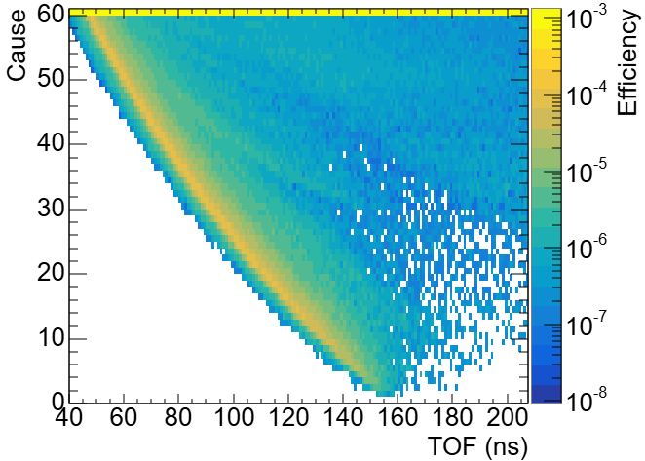
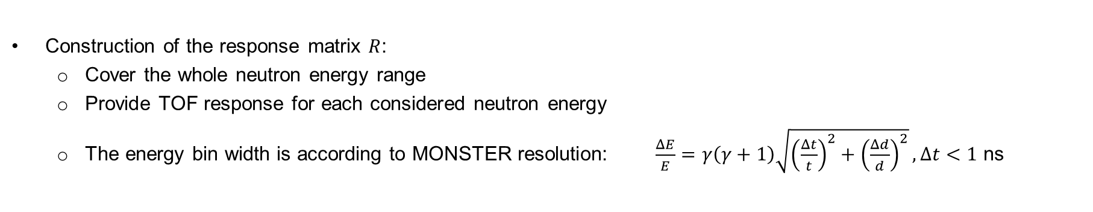
Response matrix
0º MONSTER cell
Neutron/(Source Particle)
Construction of the response matrix $R$:
Cover the whole neutron energy range
Provide TOF response for each considered neutron energy
The energy bin width is according to MONSTER resolution: $\frac{ΔE}{E}=γ\left(γ+1\right)\sqrt{{\left(\frac{Δt}{t}\right)}^{2}+{\left(\frac{Δd}{d}\right)}^{2}}, Δt<1$ ns
TOF (ns)

Slide 16
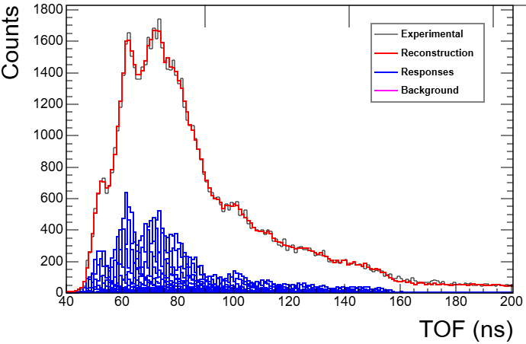


Response matrix and unfolding algorithm
Iterative Bayesian method :
Bayes formula
$$P\left(C_{i} | E_{j}\right)=\frac{P\left(E_{j} | C_{i}\right)P_{0}\left(C_{i}\right)}{\sum_{l=1}^{n_{C}}{P\left(E_{j} | C_{l}\right)P_{0}\left(C_{l}\right)}}$$
This methodology is validated with simulations (1) and real experiments (2)
G. D'Agostini, Nucl. Instrum. and Methods A, 362 (1995) 487-498
response matrix
initial guess
$E_{α}=8.5$ MeV, 0º MONSTER cell
independent causes
effects
Effects
Neutron/(Source Particle)
Causes
TOF (ns)
(1) A. Pérez de Rada Fiol et al., Rad. Phys. Chem. 226 (2025) 112243
(2) A. Pérez de Rada Fiol et al., Phys. Rev. C, 111, (2025), 044312

Slide 17
Table of contents
Introduction
Experimental setup
Data analysis
Results
Final remarks

Slide 18
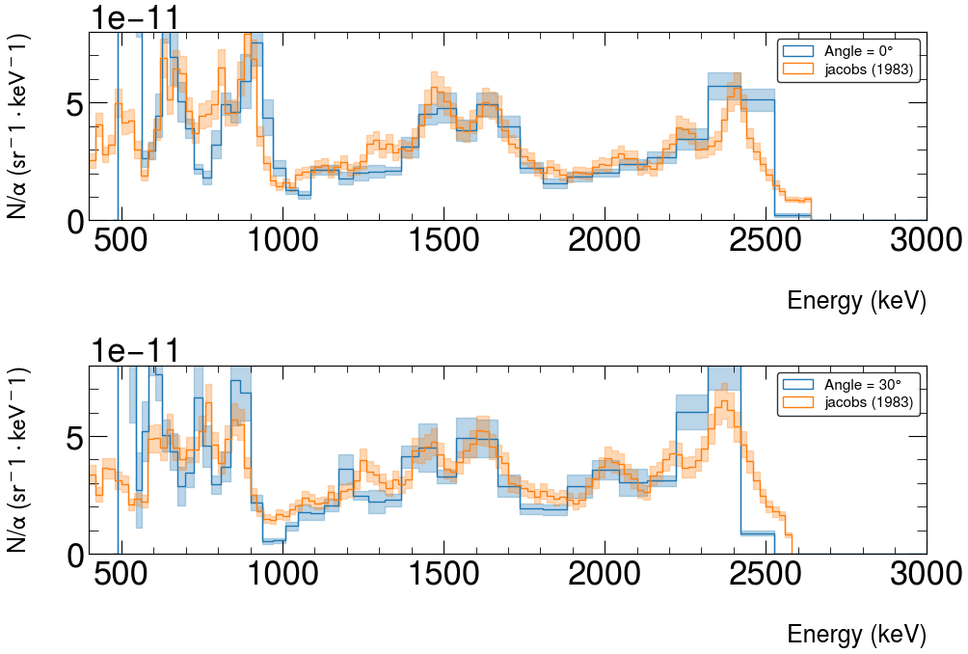
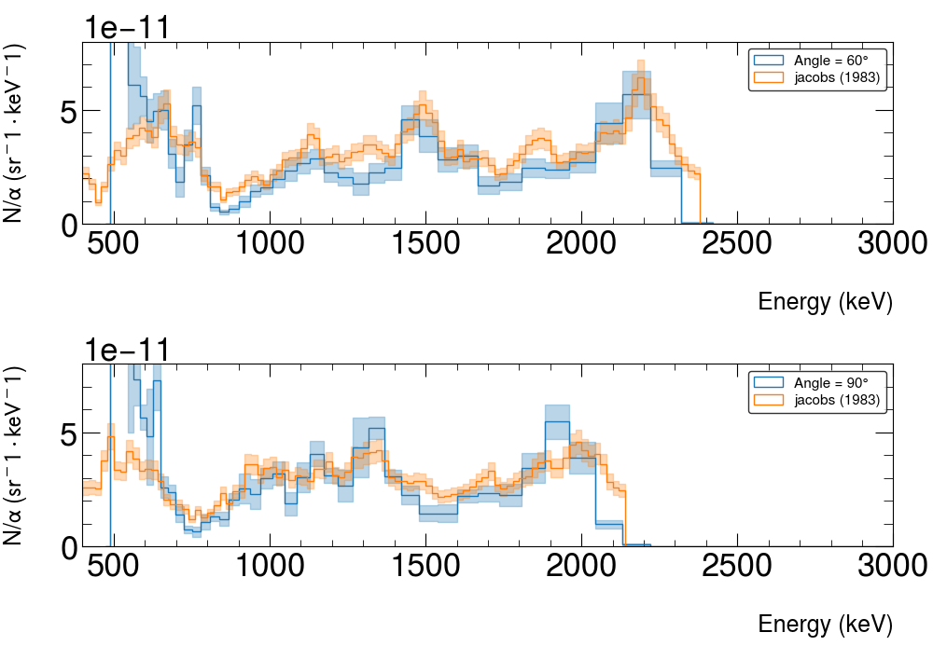




Neutron energy distributions: comparison with previous data ($E_{α}=5.5$MeV)
$$0^{∘}$$
$${60}^{∘}$$
$${30}^{∘}$$
$${90}^{∘}$$
Good agreement with previous data (within 10 %)
G.J.H. Jacobs & Liskien, Annals of Nuclear Energy, 10, (1983) 541-552

Slide 19
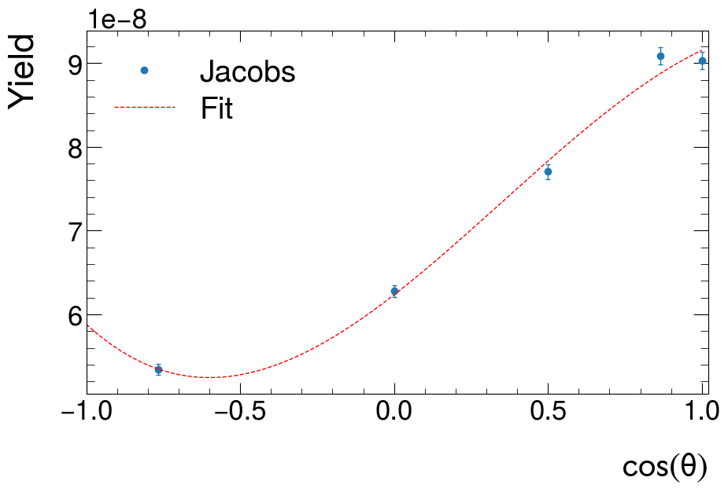
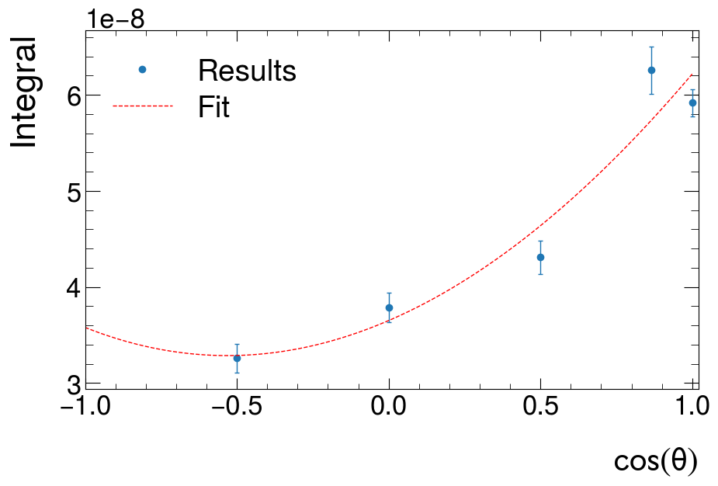
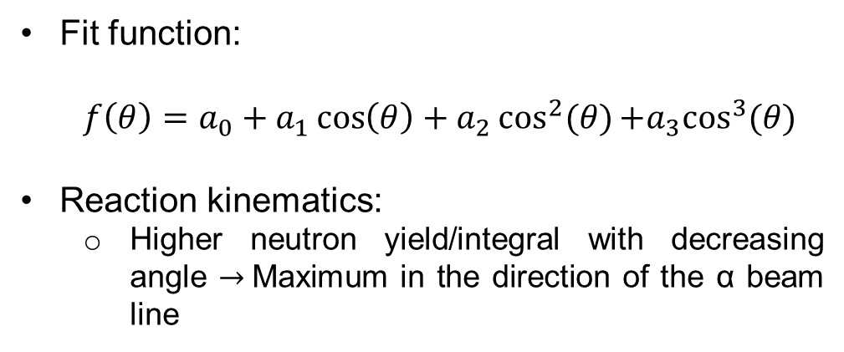
Angular distribution ($E_{α}=5.5$MeV)
Fit function:
$$f\left(θ\right)=a_{0}+a_{1}\cos\left(θ\right)+a_{2}\cos^{2}(θ){+a_{3}\cos^{3}(θ)}$$
Reaction kinematics:
Higher neutron yield/integral with decreasing angle $→$Maximum in the direction of the α beam line
R. M. Sealock, Nuc. Phys. A, 357, (1980) 279-292
0 °

Slide 20
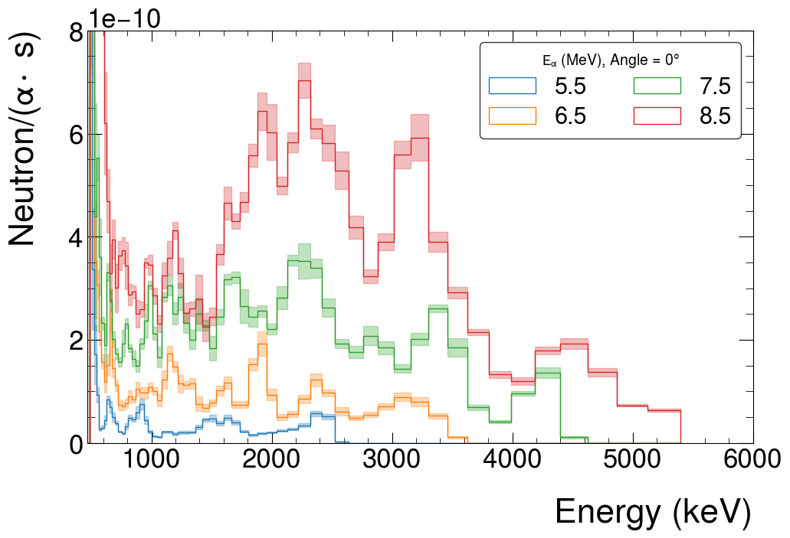
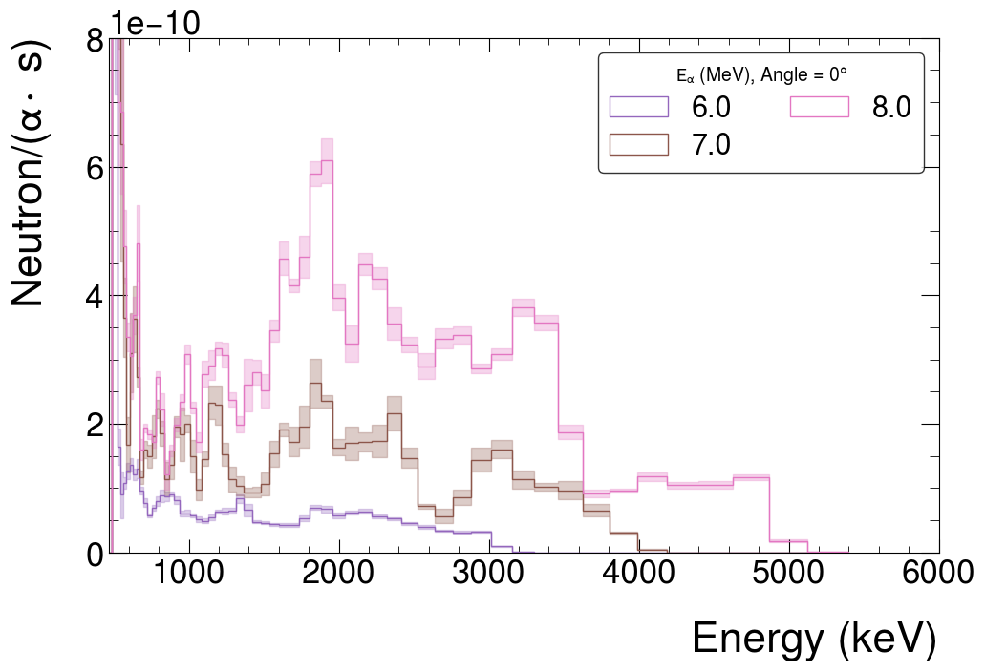
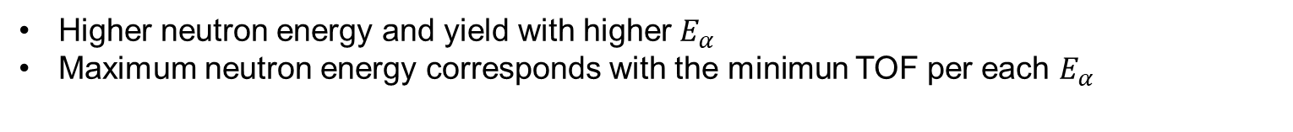
Neutron energy distributions: all energies (angle = 0º)
Higher neutron energy and yield with higher $E_{α}$
Maximum neutron energy corresponds with the minimun TOF per each $E_{α}$

Slide 21
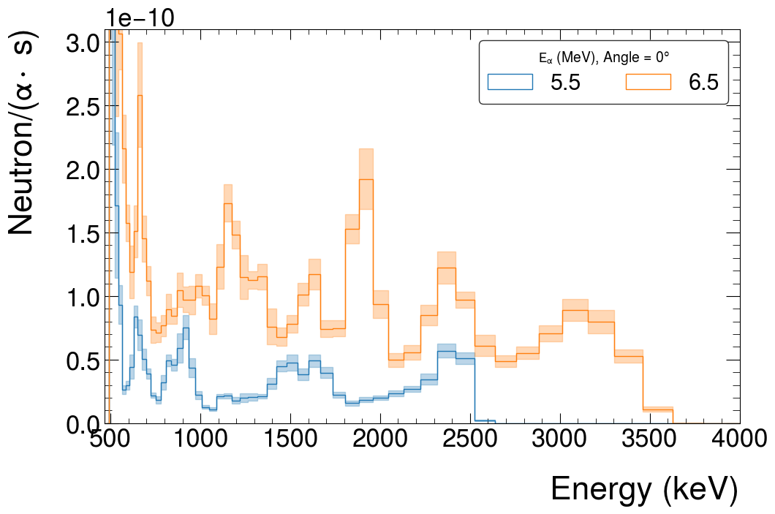
Neutron energy distributions: structures (angle = 0º)
Different structures due to the population of different excited states of ³⁰P for different $E_{α}$

Slide 22
Table of contents
Introduction
Experimental setup
Data analysis
Results
Final remarks

Slide 23
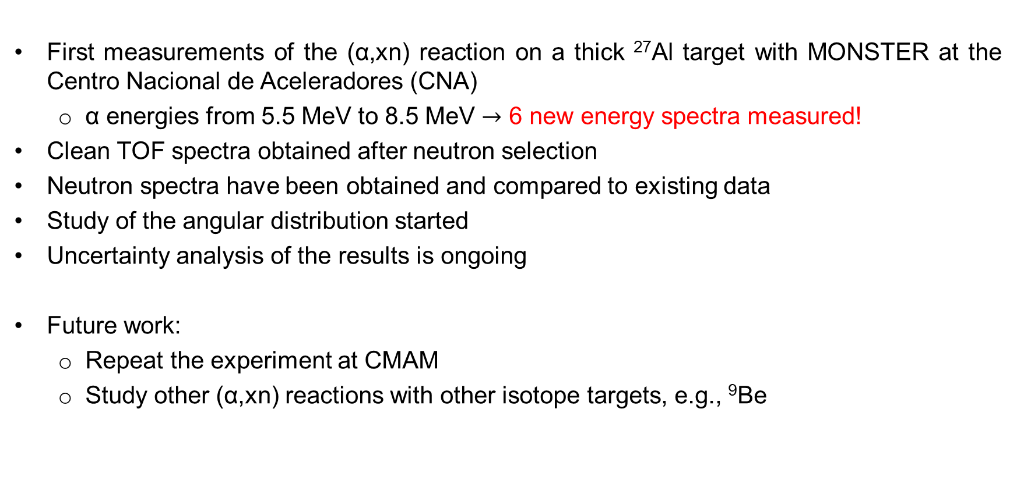
Final remarks
First measurements of the (α,xn) reaction on a thick ²⁷Al target with MONSTER at the Centro Nacional de Aceleradores (CNA)
α energies from 5.5 MeV to 8.5 MeV $→$ 6 new energy spectra measured!
Clean TOF spectra obtained after neutron selection
Neutron spectra have been obtained and compared to existing data
Study of the angular distribution started
Uncertainty analysis of the results is ongoing
Future work:
Repeat the experiment at CMAM
Study other (α,xn) reactions with other isotope targets, e.g., ⁹Be

Slide 24
Thanks for your attention
José Llanes Gamonoso
jose.llanes@ciemat.es
Acknowledgements
This work was supported in part by project PID2021-123100NB-I00 funded by MCIN/AEI/10.13039/501100011033/FEDER, UE and in part by the European Union’s HORIZON-EUROPE Research and Innovation Programme under grant agreement No. 101164596 (APRENDE, addressing priorities of evaluated nuclear data in Europe. WP2.). The support by the ENRESA-CIEMAT agreement 2023-2026 "Tecnologias disponibles para la transmutacion de radionucleidos de vida larga" is also acknowledged.
MANY collaborators
V. Alcayne⁶, A. Algora², O. Alonso-Sañudo³, G. Auñón^{7,8}, D. Bachiller-Perea⁶, J. Balibrea-Correa², J. Benito³, M. J. G. Borge^{5,4}, J. A. Briz³, F. Calviño¹, D. Cano-Ott⁶, G. Cortés¹, A. De Blas¹, C. Domingo-Pardo², A. Espinosa³, B. Fernández^{7,8}, L. M. Fraile³, G. Garcia⁴, R. García¹, V. García Tavora⁴, J Gómez-Camacho^{7,8}, E. M. González-Romero⁶, C. Guerrero^{7,8}, A. Illana³, J. Lerendegui-Marco², J. Llanes-Gamonoso⁶, M. Llanos³, T. Martínez⁶, V. Martínez-Nouvilas³, E. Mendoza⁶, N. Mont-Geli¹, J. R. Murias³, E. Nácher², A. Nerio Aguirre⁵, V. V. O. Onecha³, S. E. A. Orrigo², M. Pallàs¹, A. Perea⁵, A. Pérez de Rada Fiol⁶, V. Pesudo⁶, J. Plaza⁶, J. M. Quesada⁷, A. Sanchez-Caballero⁶, V. Sánchez-Tembleque³, R. Santorelli⁶, J. L. Tain², A. Tarifeño-Saldivia², O. Tengblad⁵, J. M. Udías³, D. Villamarín⁶, S. Viñals⁴
¹Institut de Tècniques Energètiques (INTE), Universitat Politècnica de Catalunya (UPC), E-08028, Barcelona, Spain
²Instituto de Física Corpuscular (IFIC), CSIC – Univ. Valencia (UV), E-46071, Valencia, Spain
³Grupo de Física Nuclear (GFN) and IPARCOS, Universidad Complutense de Madrid (UCM), E-28040, Madrid, Spain
⁴Centro de Micro-Análisis de Materiales (CMAM), Universidad Autónoma de Madrid (UAM), E-28049, Madrid, Spain
⁵Instituto de Estructura de la Materia (IEM), CSIC, E-28006 Madrid, Spain
⁶Centro de Investigaciones Energéticas, Medioambientales y Tecnológicas (CIEMAT), E-28040, Madrid, Spain
⁷Departamento de Física Atómica, Molecular y Nuclear, Universidad de Sevilla (US), E-41012 Sevilla, Spain
⁸Centro Nacional de Aceleradores (CNA) (Universidad de Sevilla (US) - Junta de Andalucía - CSIC), E-41092, Sevilla, Spain

