Slide 1
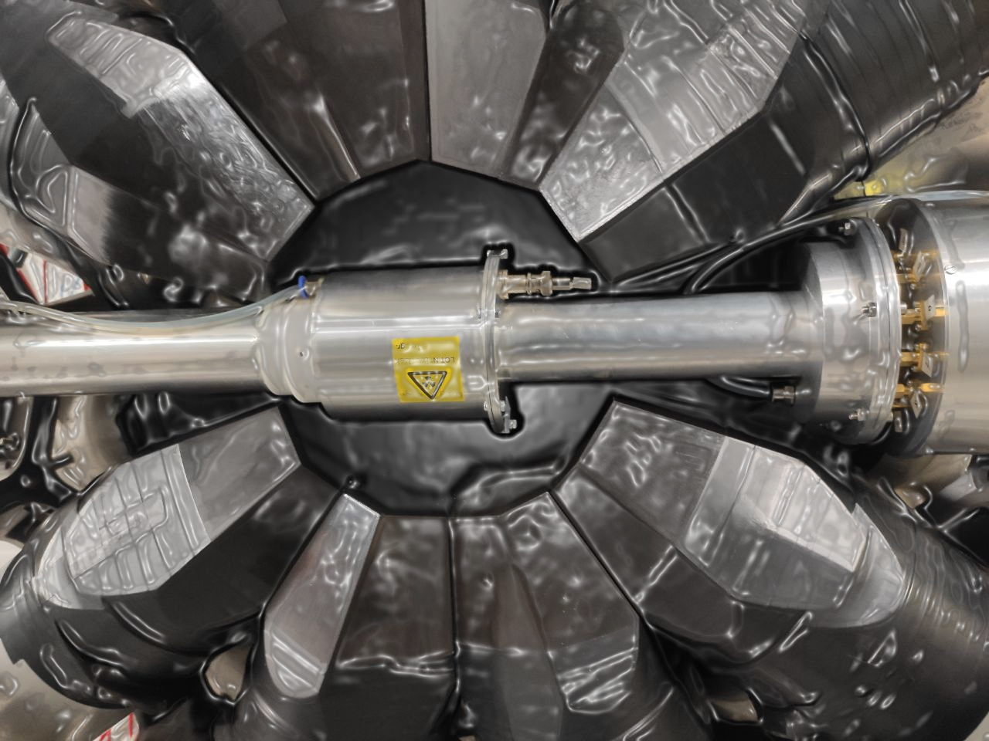




Final results of the ²³⁹Pu
neutron capture and fission cross-section measurements at n_TOF
Sanchez-Caballero¹, V. Alcayne¹, J. Andrzejewski², D. Cano-Ott¹, J. García-Pérez¹, E. Gónzalez-Romero¹, J. Heyse³, T. Martínez¹, E. Mendoza¹, J. Perkowski², J. Plaza del Olmo¹, A. Plompen³, P. Schillebeeckx³, G. Sibbens³
and the n_TOF collaboration
¹CIEMAT, Spain
²University of Lodz, Poland
³JRC-Geel, Belgium

Slide 2
Contents
Context and Motivation.
²³⁹Pu measurement at n_TOF. Experimental setup.
Final results.
Conclusions.

Slide 3
1
Context and Motivation

Slide 4
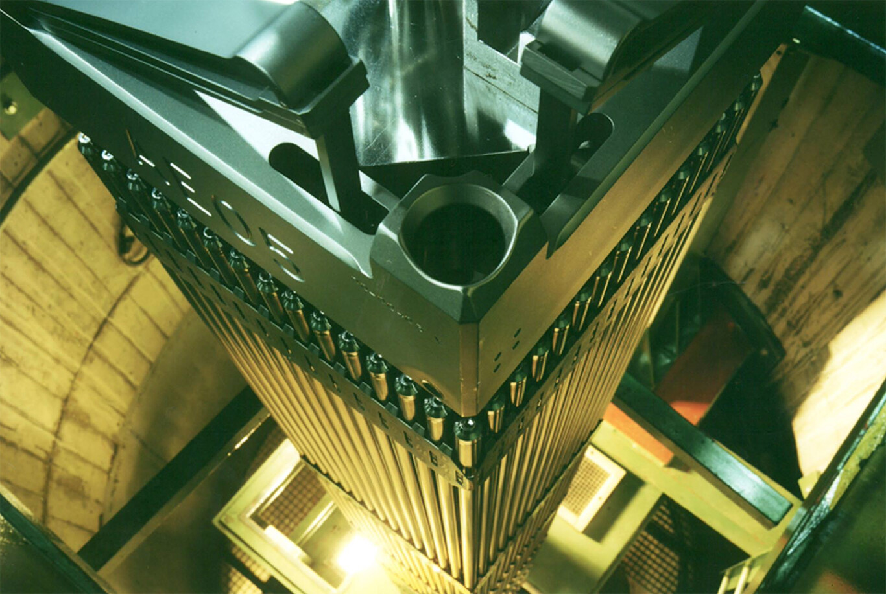
1. Context and Motivation
More precise ²³⁹Pu capture and fission cross-section data are required for:
Design of advanced nuclear devices (Gen IV reactors).
Optimization of nuclear waste management strategies of current reactors.
Operation of fast and thermal reactors that use MOX fuels.
Nuclear data evaluations for ²³⁹Pu(n,g) and (n,f)
Main evaluations for capture cross-sections show significant discrepancies.
Only two high-resolution measurements for ²³⁹Pu(n,g) cross-section exist, due to the intrinsic challenge of measuring a fissile sample.
Objective: to reduce the existing uncertainties of for ²³⁹Pu(n,γ) and (n,f) cross-sections.
²³⁹Pu capture and fission cross-sections are included in the NEA/OECD High Priority Request List.

Slide 5
2
²³⁹Pu measurement at n_TOF

Slide 6
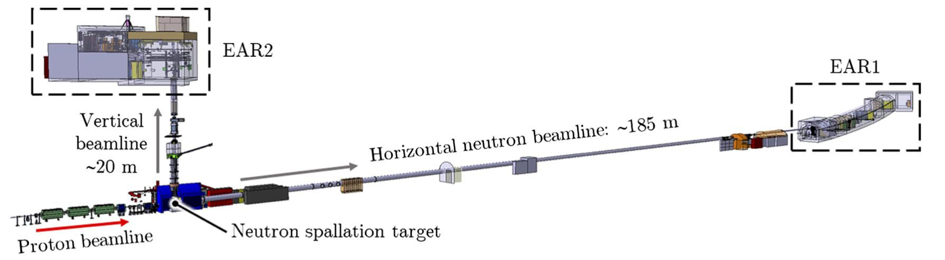
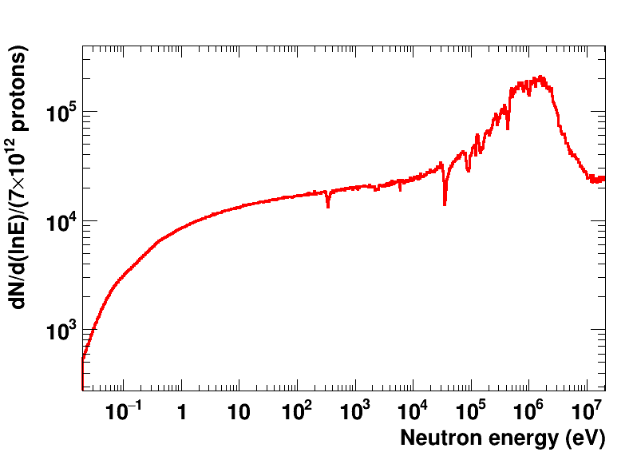
2. ²³⁹Pu measurement at n_TOF
n_TOF: a neutron Time-Of-Flight facility
A 185 m flight path (10 times larger than in previous ²³⁹Pu measurements) enables providing new data with higher energy resolution.
n_TOF neutron flux (185 m)
20 GeV/c protons impinging on lead target, produce neutron beam by spallation.
Low pulse repetition rate ~1 Hz; no overlapping pulses!
Broad neutron energy spectrum from meV to GeV.
High intensity neutron flux, ideal for radioactive samples.

Slide 7
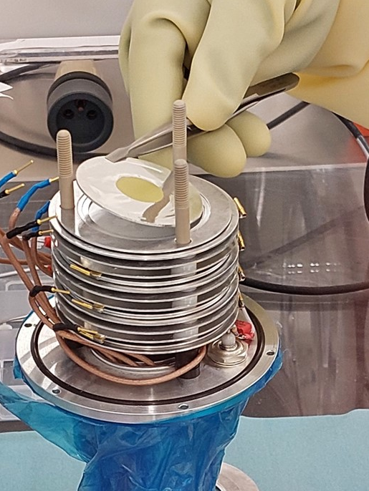
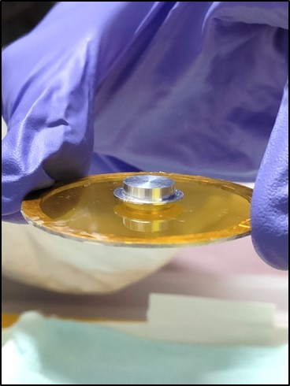
2.1 Overview of the experiment and samples
The experimental campaign was conducted in the last quarter of 2022, with 2 months of beam time (~5·10¹⁸ protons).
The campaign was divided in two different configurations:
The ²³⁹Pu targets
The PuO₂ (99.90% purity) 10 thin samples (~1 mg each) and the thick sample (~100 mg) were produced, deposited and encapsulated by JRC-Geel+SCK·CEN.
1. FC config.
2. TS config.
- 10 thin Pu samples (<10 mg total mass).
- Use FICH + TAC simultaneously.
- Measure fission and capture (up to 1 keV).
- 1 thick sample (~100 mg).
- Use only TAC.
- Measure capture above 1 keV.

Slide 8
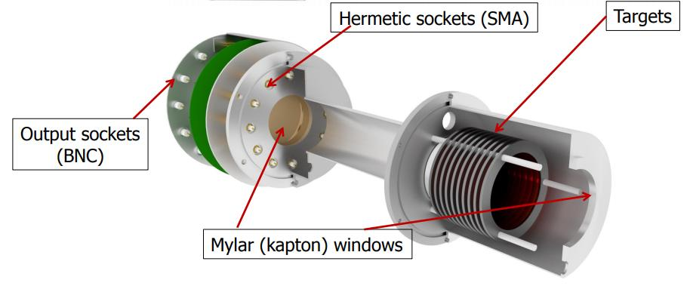
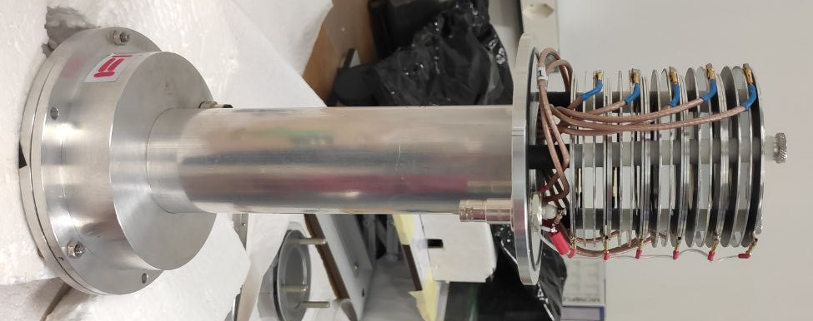
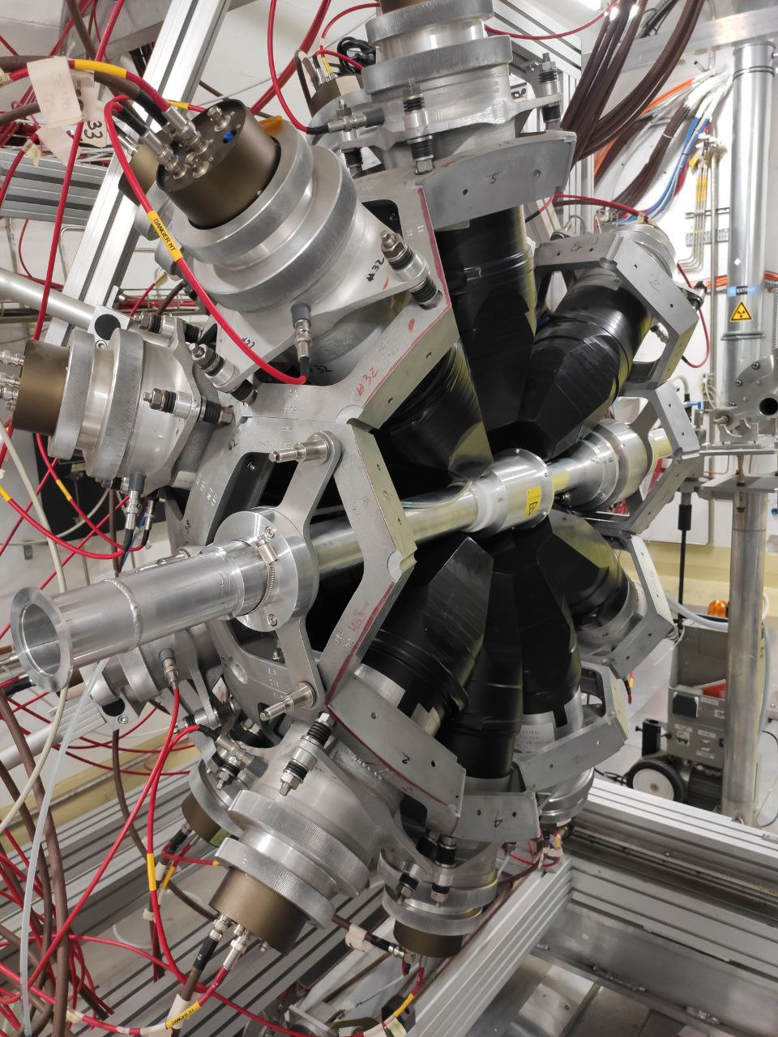
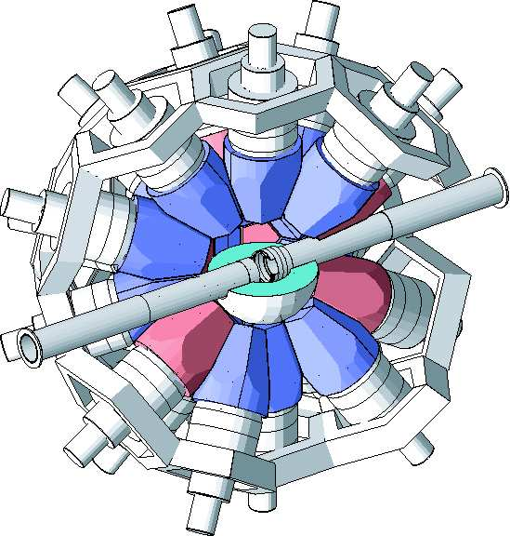
2.2 Main detectors
Fission Fragment Detector (FFD)
To perform fission tagging with the TAC and to measure fission cross-section.
Housing of 10 parallel targets of PuO₂ deposited in 10 µm aluminum backing.
Fast pre-amplifiers.
Filled with Ar+CF₄ gas. Efficiency of ~90%.
Silicon Flux Monitor (SiMon)
Four silicon detectors + LiF foil.
Measure neutron flux based on ⁶Li(n,α)³H reaction.
Total Absorption Calorimeter (TAC)
To measure capture by detecting γ-rays.
Composed of 40 BaF₂ crystals.
Fast response, high efficiency and low neutron sensitivity.

Slide 9
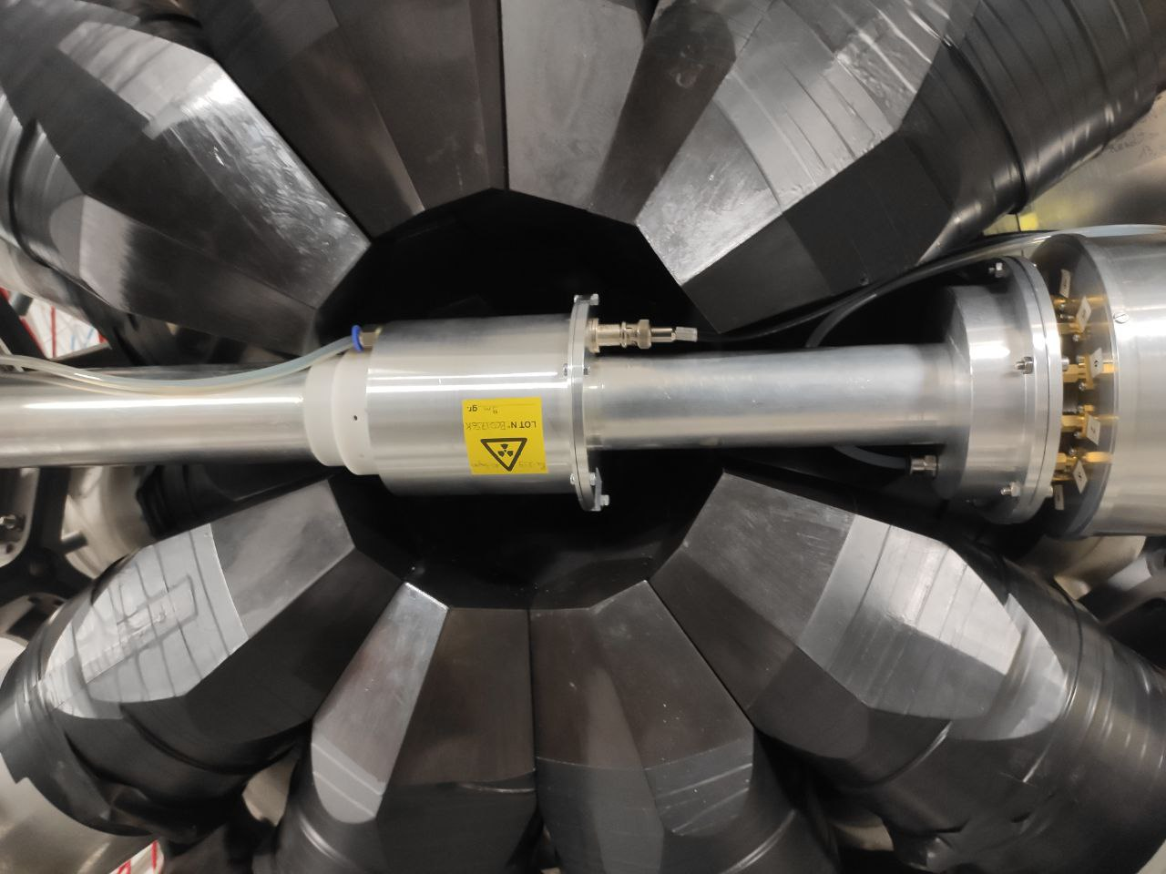
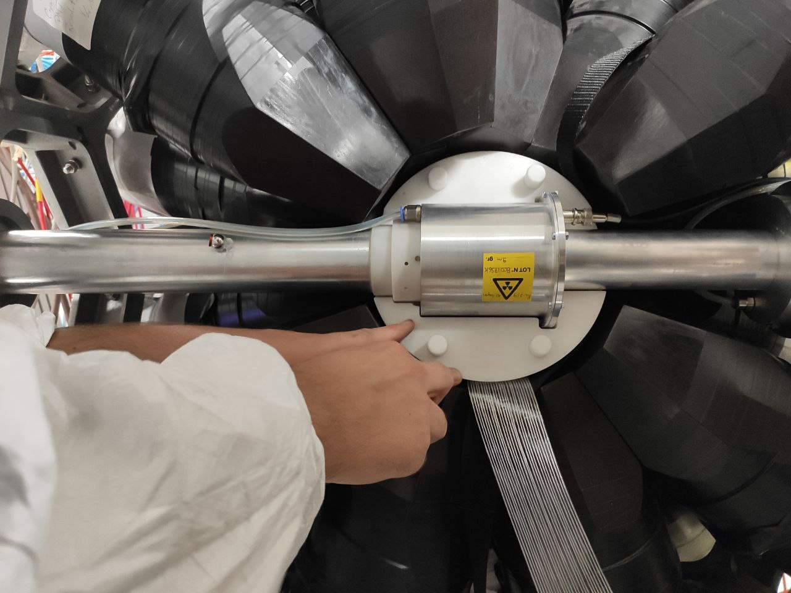
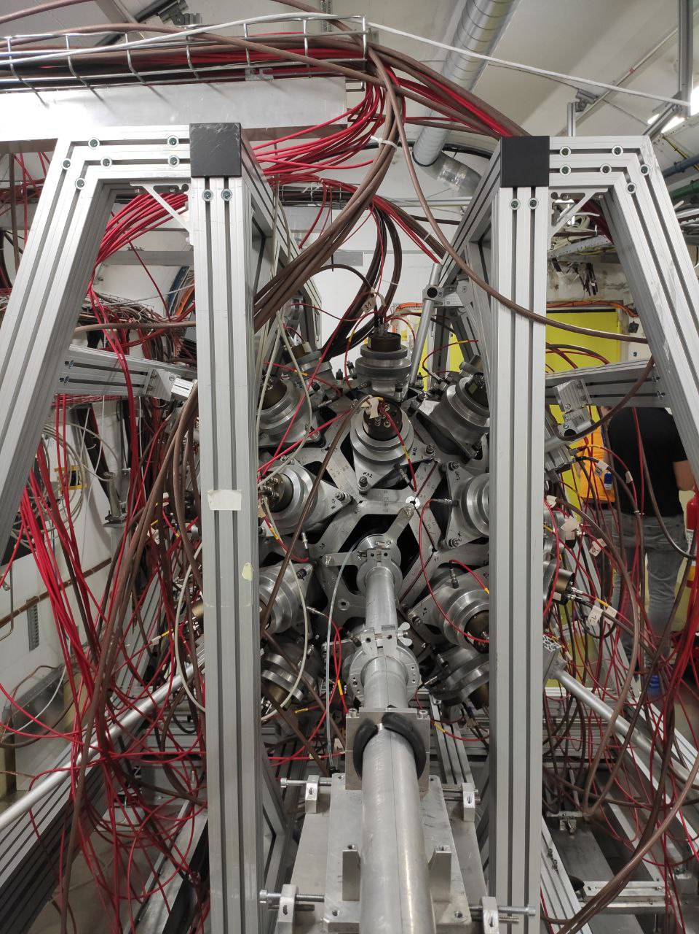
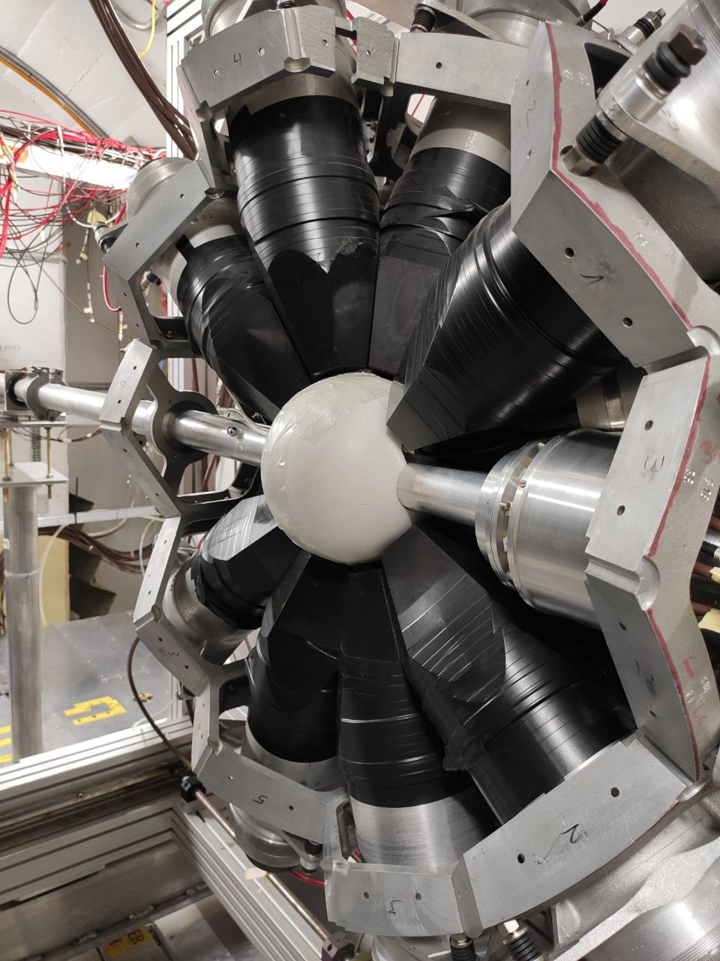
2.3 Experimental setup: mounting
The mounting procedure was similar in both experimental setups.
Li-doped polyethylene
5. TAC closed
1. The chamber is placed within the TAC
3. A neutron absorber is placed around the FFD.
UPSTREAM VIEW
4. Neutron absorber closed.
2. The TAC+FFD assembly is perfectly align with the neutron beam

Slide 10
3
Final results

Slide 11
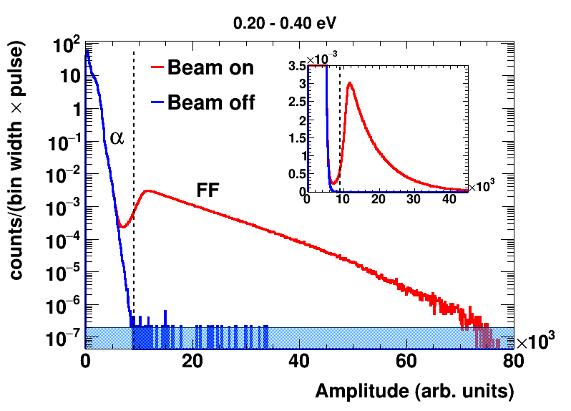
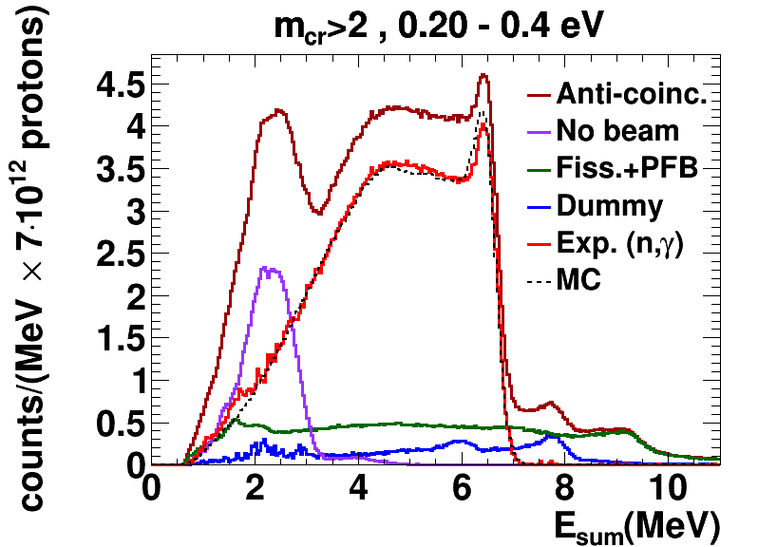
3.0 A glance at the Data Analysis
FFD
Amplitude spectra in the fast fission detector.
FF = Fission Fragment
Vertical line: selected α-FF threshold.
1 FF per >2000 alphas.
TAC
Sum energy spectra with the different background components, for the first resonance at 0.3 eV.
MC = Monte Carlo simulation of ²³⁹Pu(n,γ).
E. Mendoza et al. NuDEX: a new nuclear γ-ray cascade generator. EPJ Web of Conferences 239, 17006 (2020)
Access to code (github): https://github.com/UIN-CIEMAT/NuDEX
E. Mendoza et al. Study of photon strength functions of ²⁴¹Pu and ²⁴⁵Cm from neutron capture measurements. EPJ Web of Conferences 239, 01015 (2020)

Slide 12
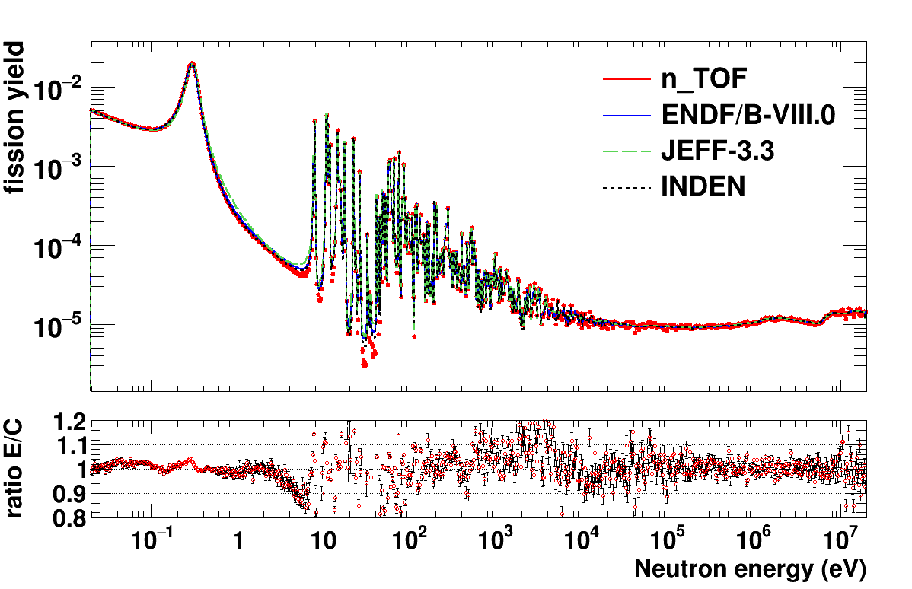
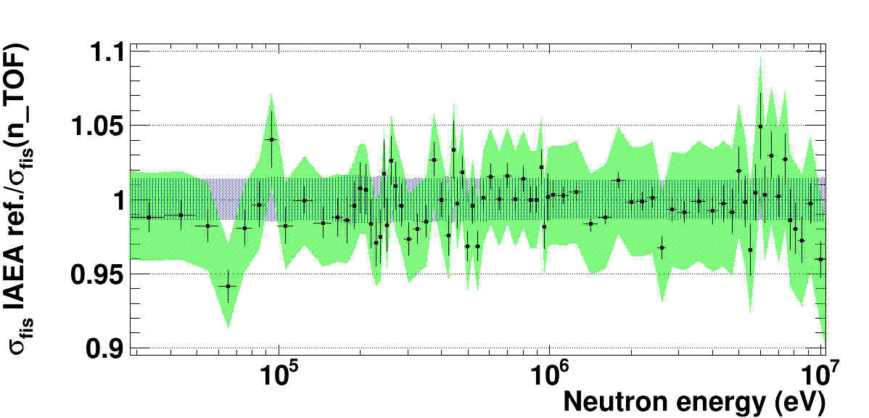
3.1 ²³⁹Pu fission results
Integrated fission yield: 100 bins per decade
Fission yield was normalized to an evaluation of the XS integral in the 9-20 eV range.
An overall good agreement with evaluations for 9 orders of magnitude in one-single-measurement!
(from thermal to high energy neutrons)
Our results are also compatible with the ²³⁹Pu(n,f) cross section reference (0.15-200 MeV) from the IAEA’s Neutron Data Standards (NDS).
Ratios calculated relative to INDEN
https://www-nds.iaea.org/INDEN/
1.5% unc. from eval.
²³⁹Pu(n,f) spectrum-averaged cross section (SACS) in the ²⁵²Cf(sf) reference neutron field. Total SACS uncertainties are reported.
Data | SACS
Derived, this work | 1802±65 (3.6%)
Derived, IAEA standard 2017¹ | 1798±23 (1.3%)
Mannhart evaluation² | 1812±25 (1.4%)
Capote et al. evaluation³ | 1826±19 (1.0%)
n_TOF sys. uncertainties
Sys. uncertainties of 2-4.5% in the whole range (20 meV to 10 MeV).
The new n_TOF ²³⁹Pu(n,f) data is being considered for the next evaluation of the NDS.

Slide 13

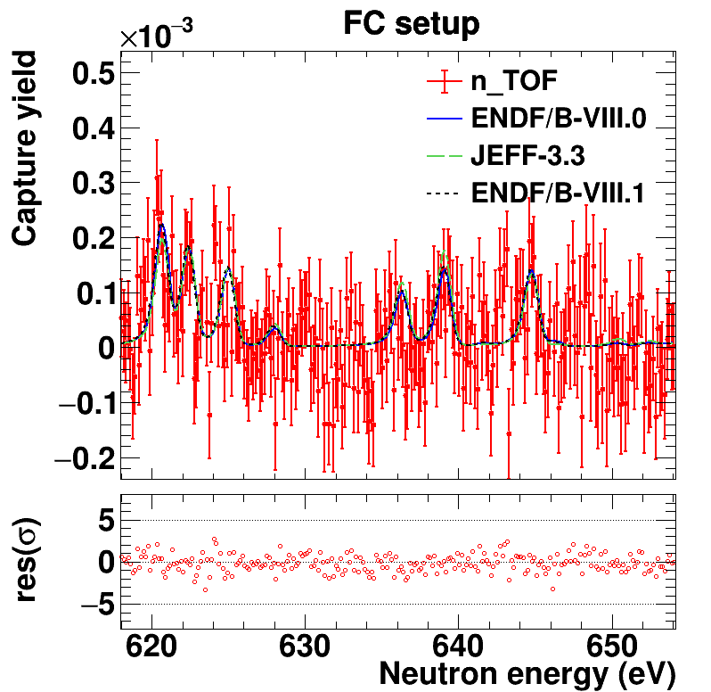
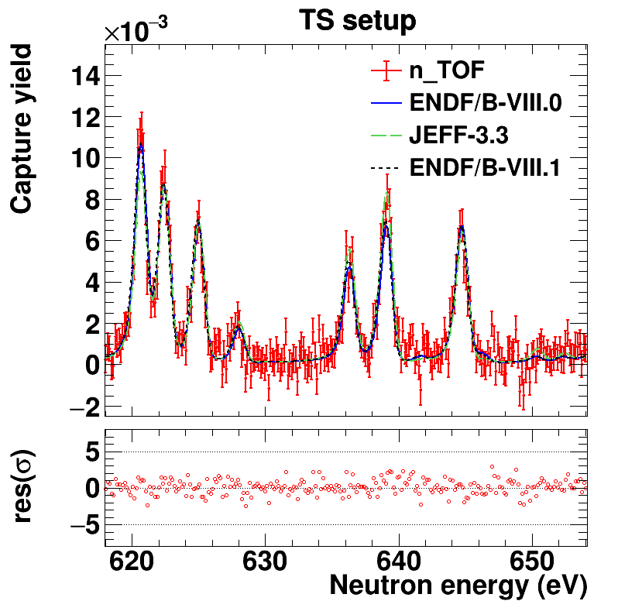
3.2 ²³⁹Pu capture results
The final capture cross section combines the data from both the FC and TS setup.
TS data extends the measurement to higher neutron energies and improves precision in small resonances with too low statistics in FC setup.
FC setup: limited statistics
A clear drop in statistics is observed above a few hundred eV.
TS setup: improved statistics
The larger sample mass provides sufficient statistics to resolve the resonance shapes.
<10 mg
~100 mg

Slide 14
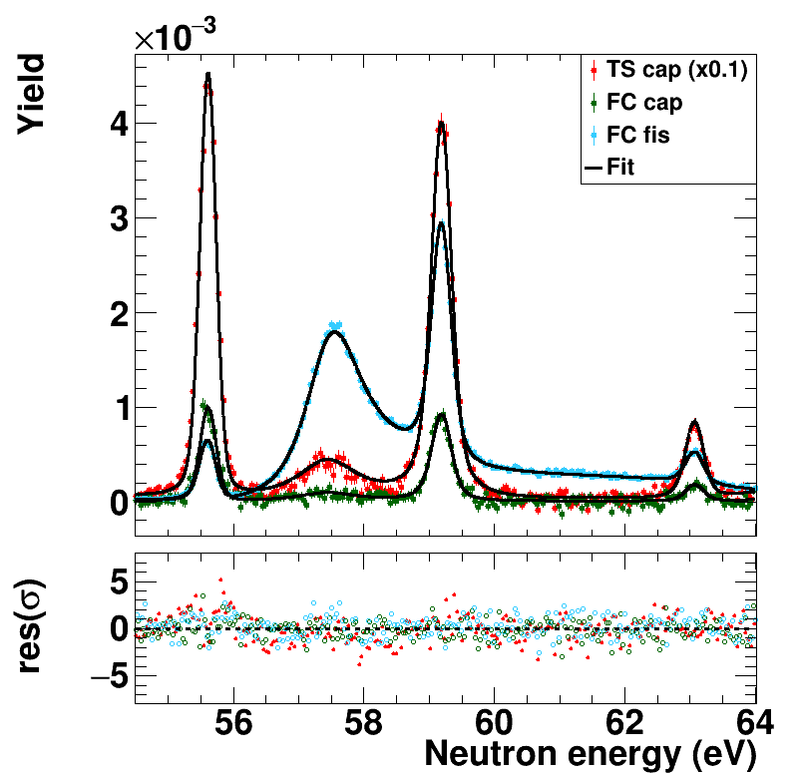
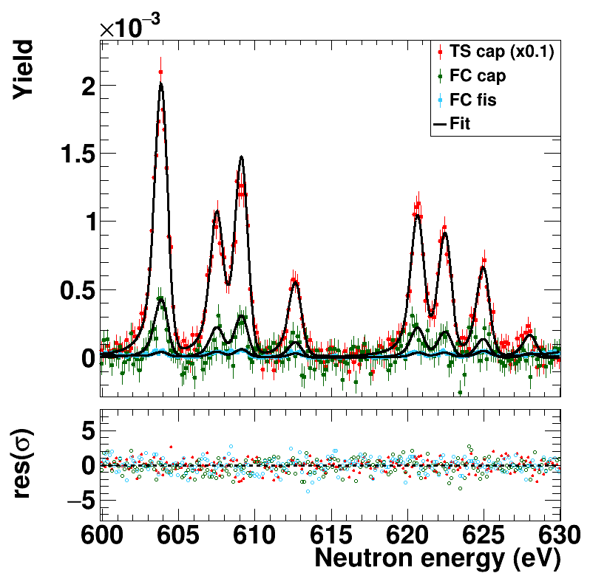
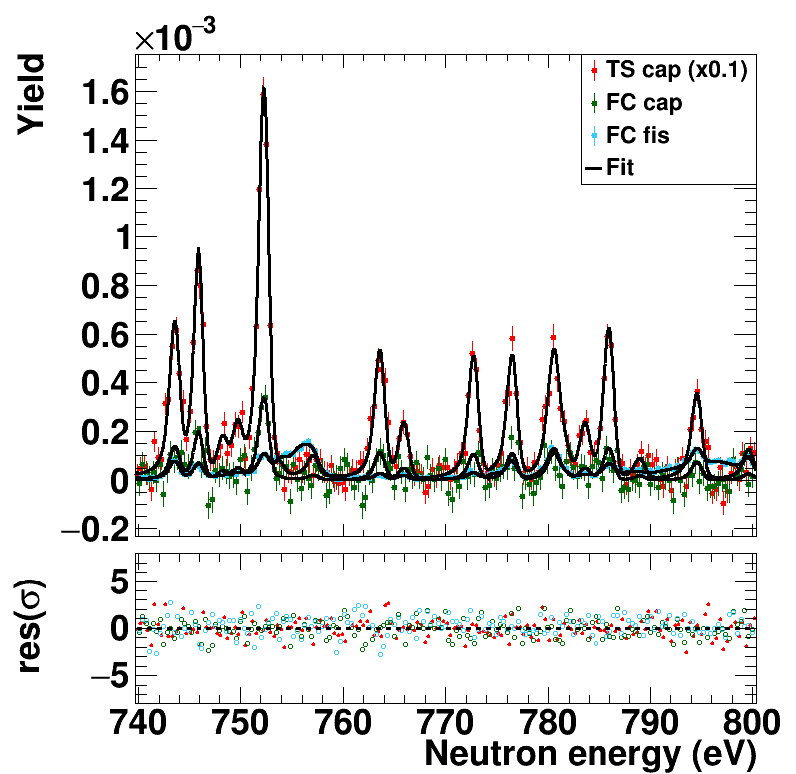
3.2 ²³⁹Pu capture results
The results from the FC setup was used to subtract the γ-ray fission background in the TS setup.
Resonance parameters (RPs) were extracted with SAMMY by fitting FC fission, FC capture and TS capture data. The final RPs set combines the results from FC and TS.
²³⁹Pu(n,f)
eV
0.02
10⁻¹
1
10
10²
10³
10⁴
10⁵
10⁶
10⁷
²³⁹Pu(n,γ) FC setup
²³⁹Pu(n,γ) TS setup
Examples of the SAMMY fit

Slide 15
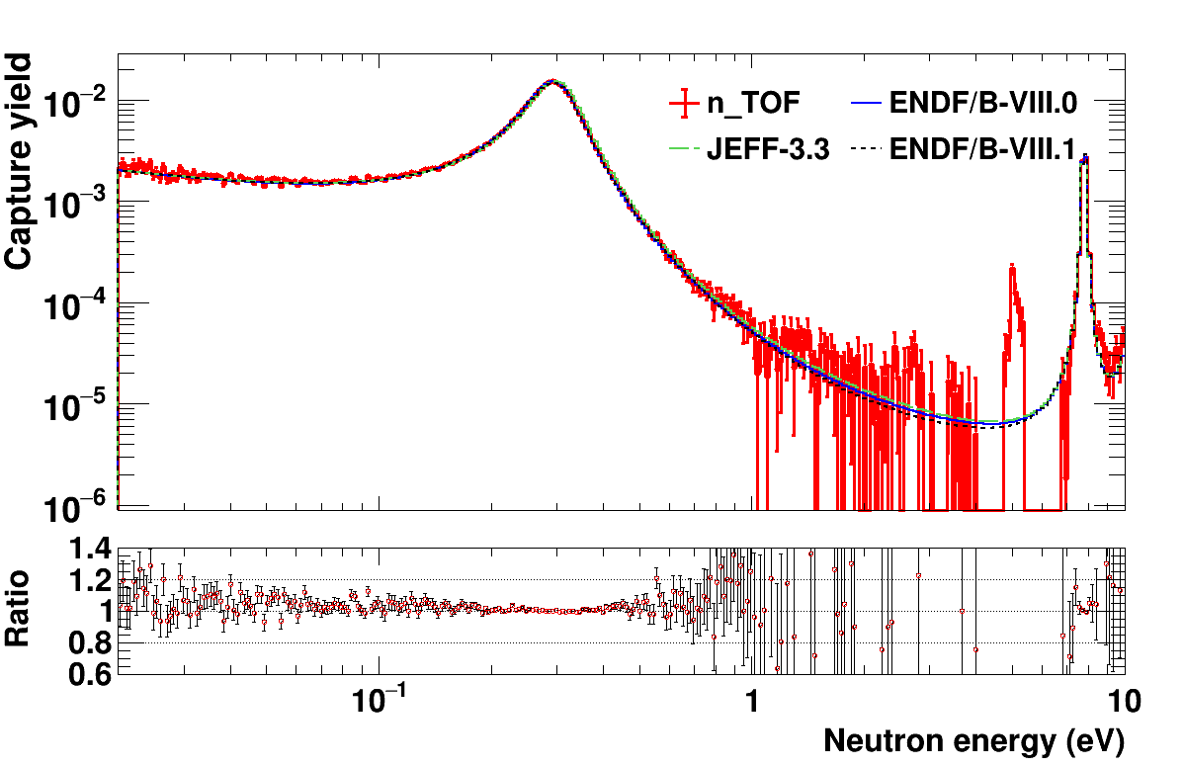
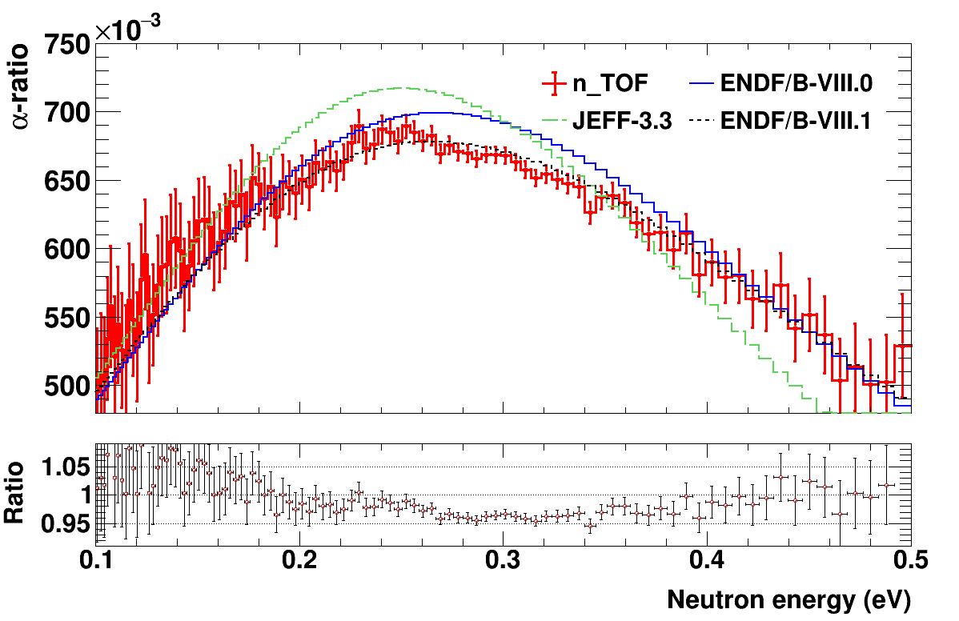
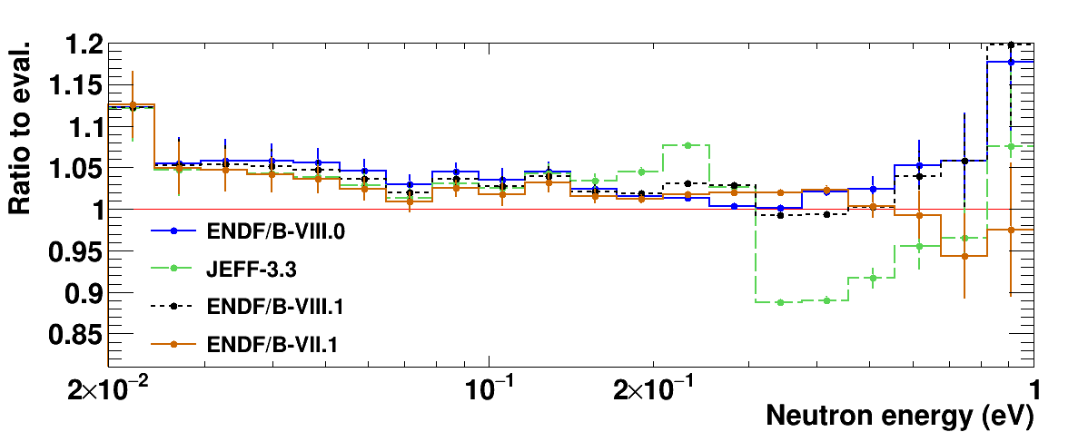
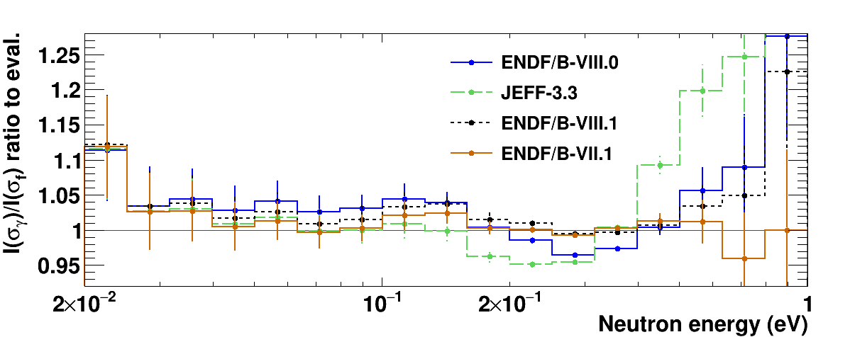
3.2 ²³⁹Pu(n,γ) vs. evaluations
Around the first, large resonance (@0.3 eV), relevant for thermal reactor calculations, the n_TOF data exhibit excellent agreement with ENDF/B-VIII.0, and the largest differences with JEFF-3.3.
²³⁹Pu α-ratio (capture-to-fission)
Larger statistical uncertainties.
Better agreement with E/B-VIII.1, and 3-4% below the other libraries. This deviation is driven by the difference in the fission cross section.
10 bins per decade

Slide 16
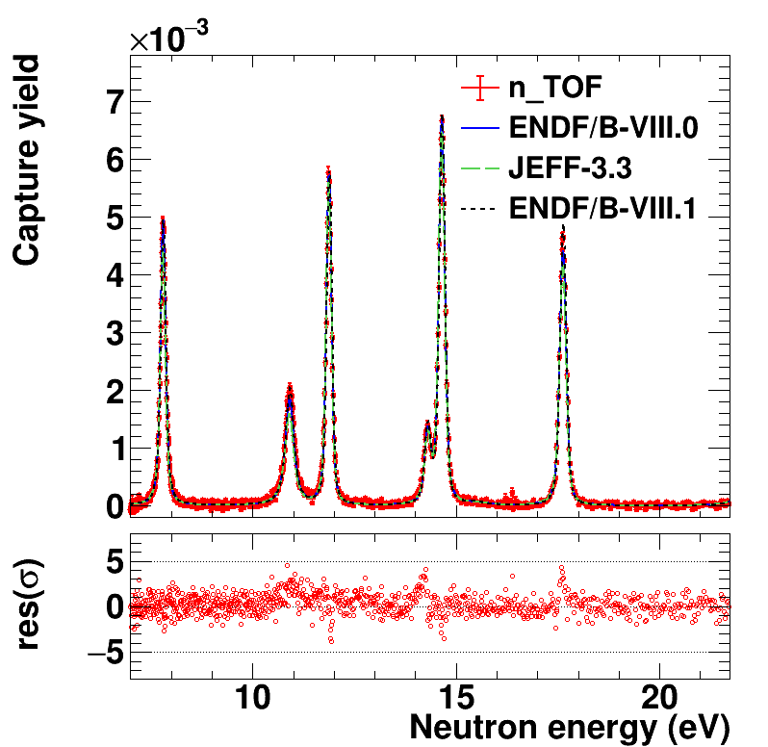
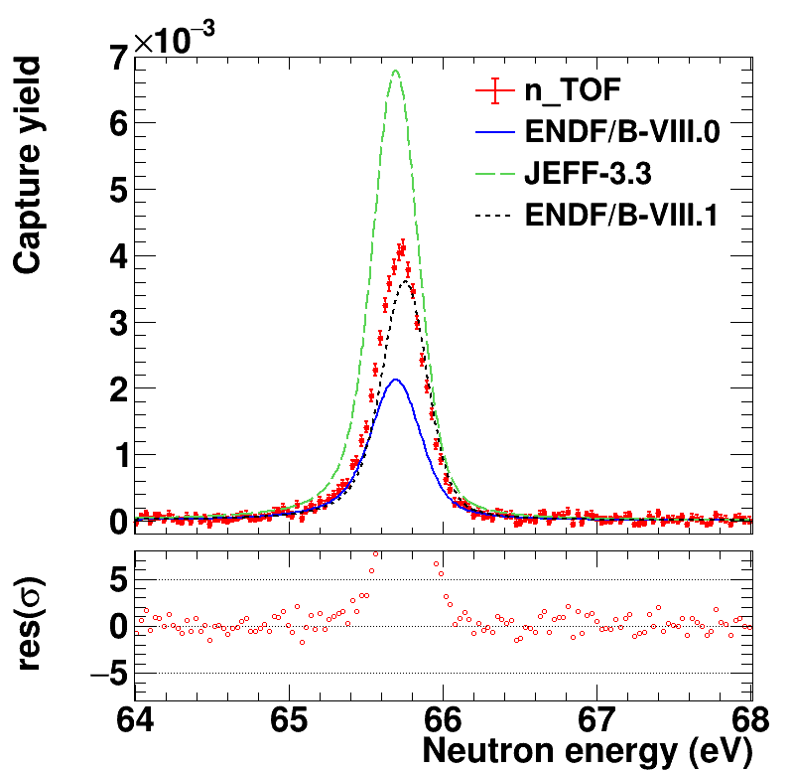
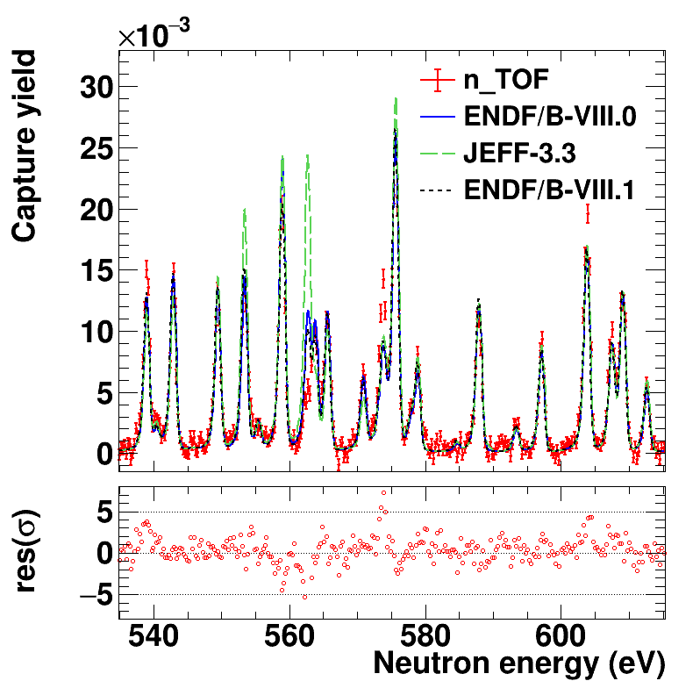
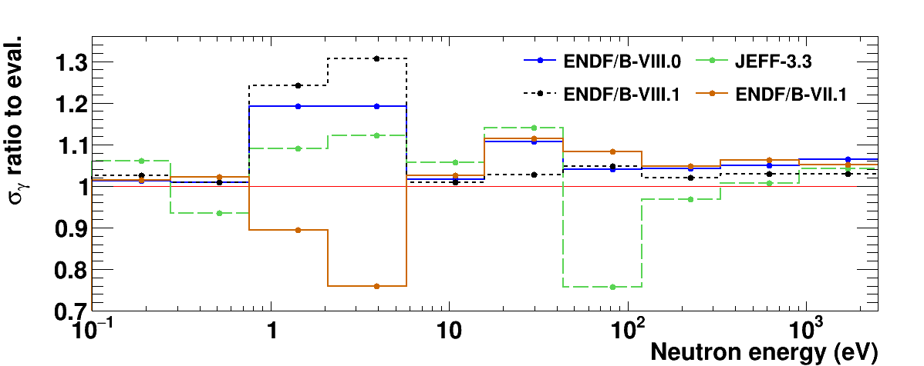
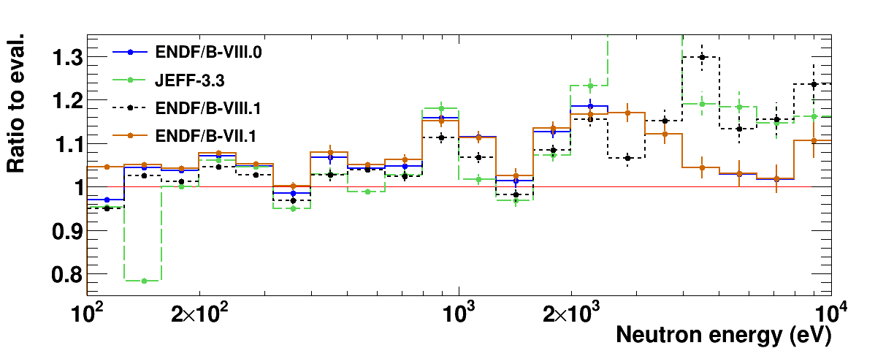
3.2 ²³⁹Pu(n,γ) vs. evaluations
10-100 eV, big discrepancies among evaluations. n_TOF closer to ENDF/B-VIII.1
E_{n}>100 eV: n_TOF systematically ~5% above evaluations. Larger diffs. above 1~keV, closer to E/B-VII.1.
2 bins per decade
10 bins per decade

Slide 17
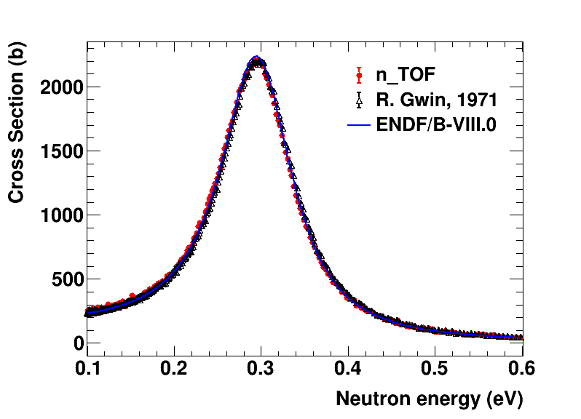
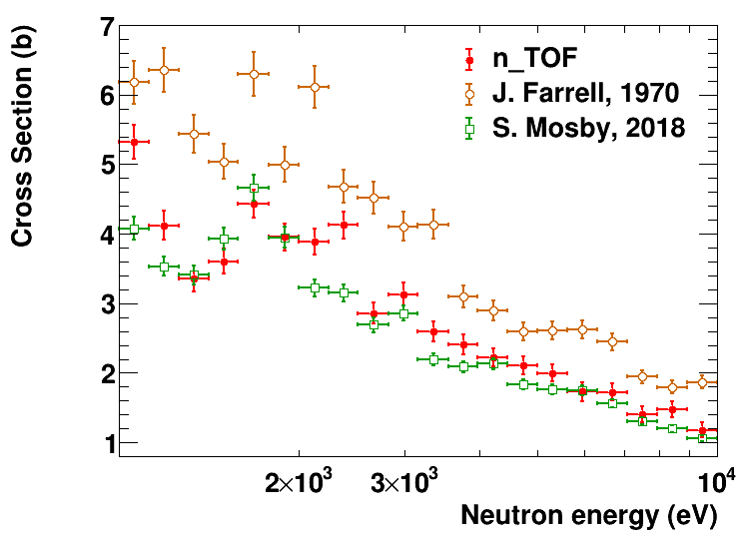
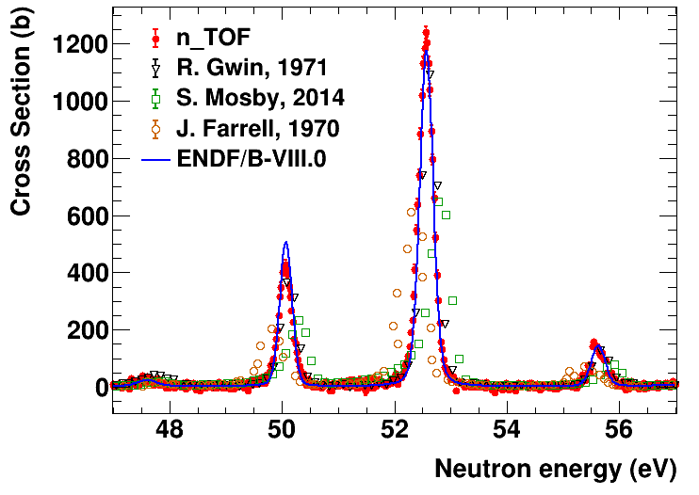
3.2 ²³⁹Pu(n,γ) vs. previous data
Scarcity of high-resolution ²³⁹Pu(n,γ) cross-section measurements. Two datasets in EXFOR (Gwin 1971, Mosby 2014/2018) mainly used for all evaluations.
@0.3 eV resonance: good compatibility with Gwin 1971 data.
At higher neutron energies, from 1 keV to 10 keV (TS setup), the n_TOF cross section integrals generally stays slightly above Mosby 2018 data.
Our capture data exhibit the highest neutron energy resolution among the existing experimental data.

Slide 18
4
Conclusions

Slide 19
4. Conclusions
The data analysis of the 2022 ²³⁹Pu experimental campaign at n_TOF has been completed, including:
Data reduction of fission and capture data and extraction of yields.
SAMMY fit of fission and capture yields, to obtain a final, combined set of resonance parameters.
The measured ²³⁹Pu(n,f) cross-section show excellent results in terms of low uncertainties, high energy resolution, and an unprecedented neutron energy coverage from 20 meV to 10 MeV with a single measurement.
The ²³⁹Pu capture cross-section measured from 0.1 eV to 10 keV, improving energy resolution of previous datasets with contained systematic uncertainties (2-5% with 5 bins per decade). Significant differences observed with the latest nuclear data libraries, suggesting the revision of some resonances in future evaluations.
Fission paper close to approval for publication.
Capture paper on writing stage.

Slide 20

Acknowledgments
This project has received funding from the Euratom research and training programme 2011-2018 under grant agreement No 847595 (ARIEL)
This activity is part of the scientific program approved by the European Commission H2020 Supplying Accurate Nuclear Data for energy and non-energy Applications – SANDA project (WP2, Task 2).
2021-1-RD EUFRAT-GELINA project funding for the stay at JRC-Geel.
Spanish national projects PGC2018-096717-B-C21, PID2021-123100NB-I00 and PDC2021-120828-I00.
 | EUROPEAN COMMISSION JOINT RESEARCH CENTRE Directorate G - Nuclear Safety and Security Standards for Nuclear Safety, Security and Safeguards

Slide 21
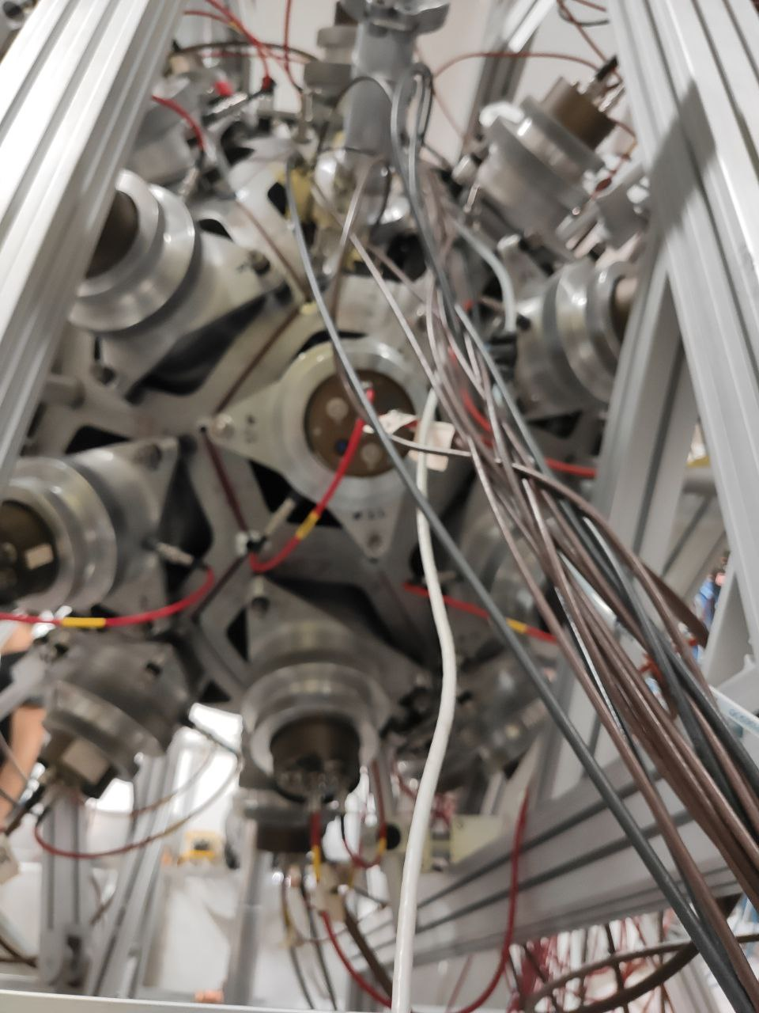
THANK YOU!

Slide 22
Extra slides

Slide 23
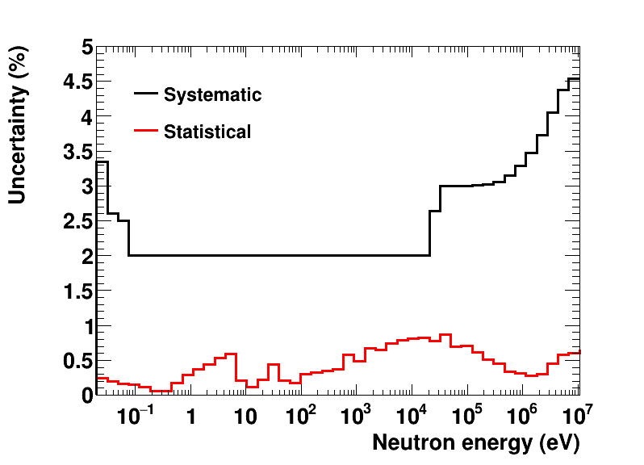
4.1 ²³⁹Pu(n,f) uncertainties
5 bins per decade

Slide 24
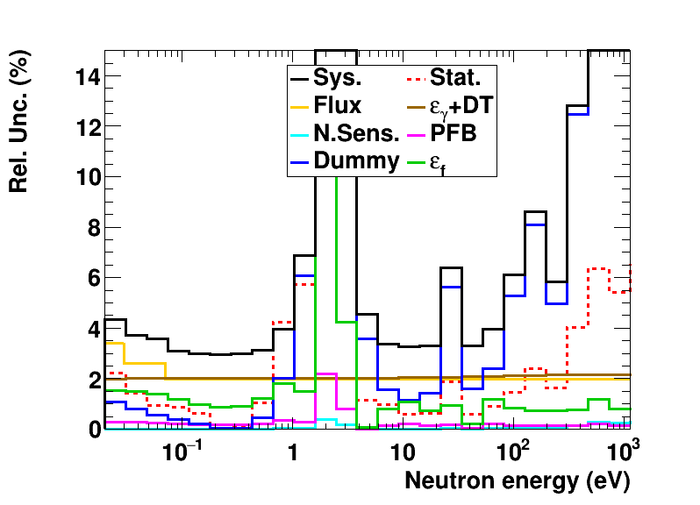

4.1 ²³⁹Pu(n,g) uncertainties
FC setup
Valley between resonances
DISCLAIMER:
Dummy uncertainties are overestimated in this plot, especially above 100 eV. Final values in the cross-section will be lower.

Slide 25
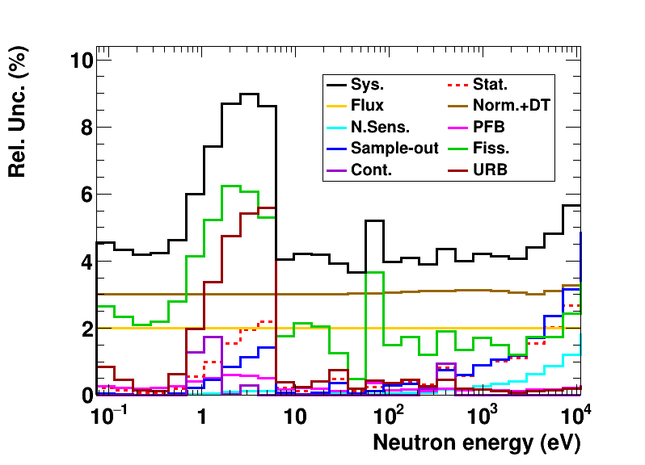
4.1 ²³⁹Pu(n,g) uncertainties
Target region of the TS setup
TS setup

Slide 26
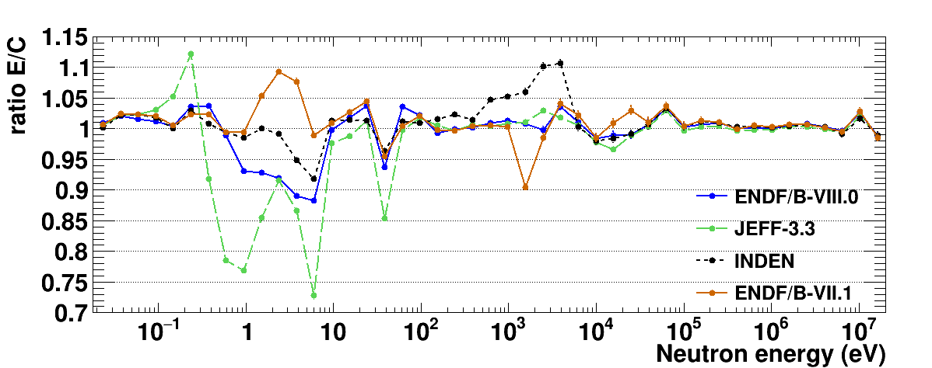
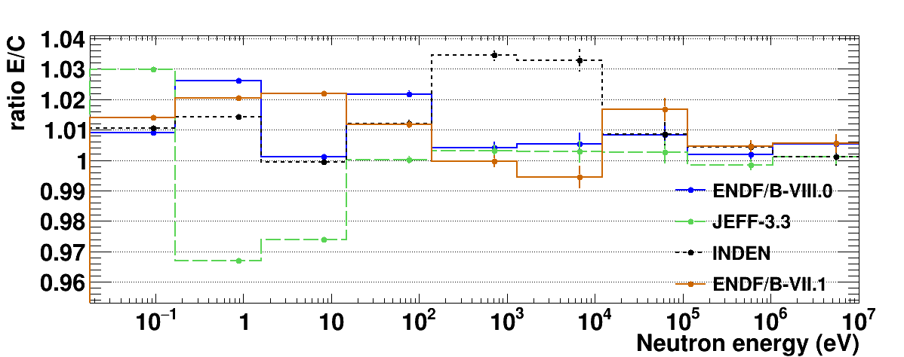
4.1 ²³⁹Pu(n,f) yield compared to evaluations
5 bins per decade
1 bin per decade

Slide 27
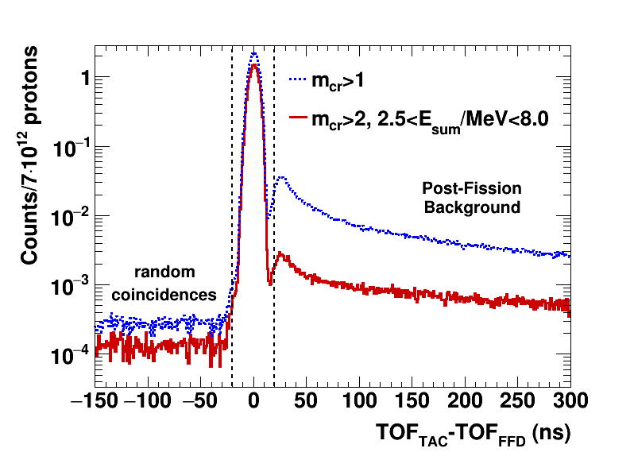
3.3 Coincidence analysis
Time coincidences between TAC events and fission chamber (FICH) signals in the energy region close to the 0.3 eV ²³⁹Pu resonance.
Coincidence window (-20,+20) ns.

Slide 28
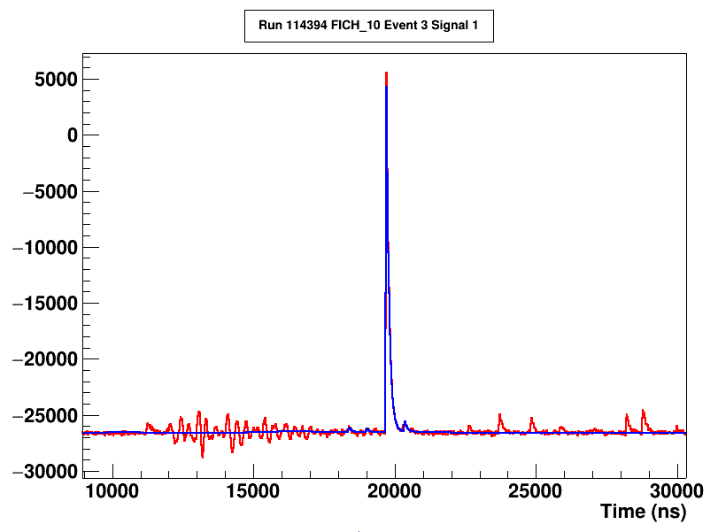
Max. E_{n} in fission yield
Inspecting the data buffers, we can estimate the width of the gamma flash, thus obtaining the maximum valid neutron energy for the fission yield that we could potentially reach.
Plot taken from file run114394_0_s1.raw.finished. The Tflash has been obtained from Baf2 #18 from the same pulse. TOFD = 185.59 m.
Start g-flash (11,196 ns)
Signal
Fit
Signal at 2.2 MeV
End g-flash (~18,000 ns)
3.3 MeV
Alphas
According to this, we could measure fission without being affected by the gamma-flash up to ~3 MeV.

Slide 29
Targets description
Number of electronic output from preamplifiers | Target position in the FC chamber | Pu-239 samples | Pu-239
Number of electronic output from preamplifiers | Target position in the FC chamber | TP number | Activity [μg/cm²] | Mass [μg] | Areal density [μg/cm²]
6 | 1 | 2020-006-15 | 2.24E+06 | 975 | 310
1 | 2 | 2020-006-02 | 2.22E+06 | 965 | 307
7 | 3 | 2020-006-04 | 2.20E+06 | 959 | 305
2 | 4 | 2020-006-06 | 2.09E+06 | 911 | 290
8 | 5 | 2020-006-14 | 2.81E+05 | 122 | 39
3 | 6 | 2020-006-07 | 1.94E+06 | 844 | 268
9 | 7 | 2020-006-08 | 2.19E+06 | 953 | 303
4 | 8 | 2020-006-10 | 2.11E+06 | 920 | 293
10 | 9 | 2020-006-12 | 2.09E+06 | 912 | 290
5 | 10 | 2020-006-13 | 2.25E+06 | 982 | 312

Slide 30
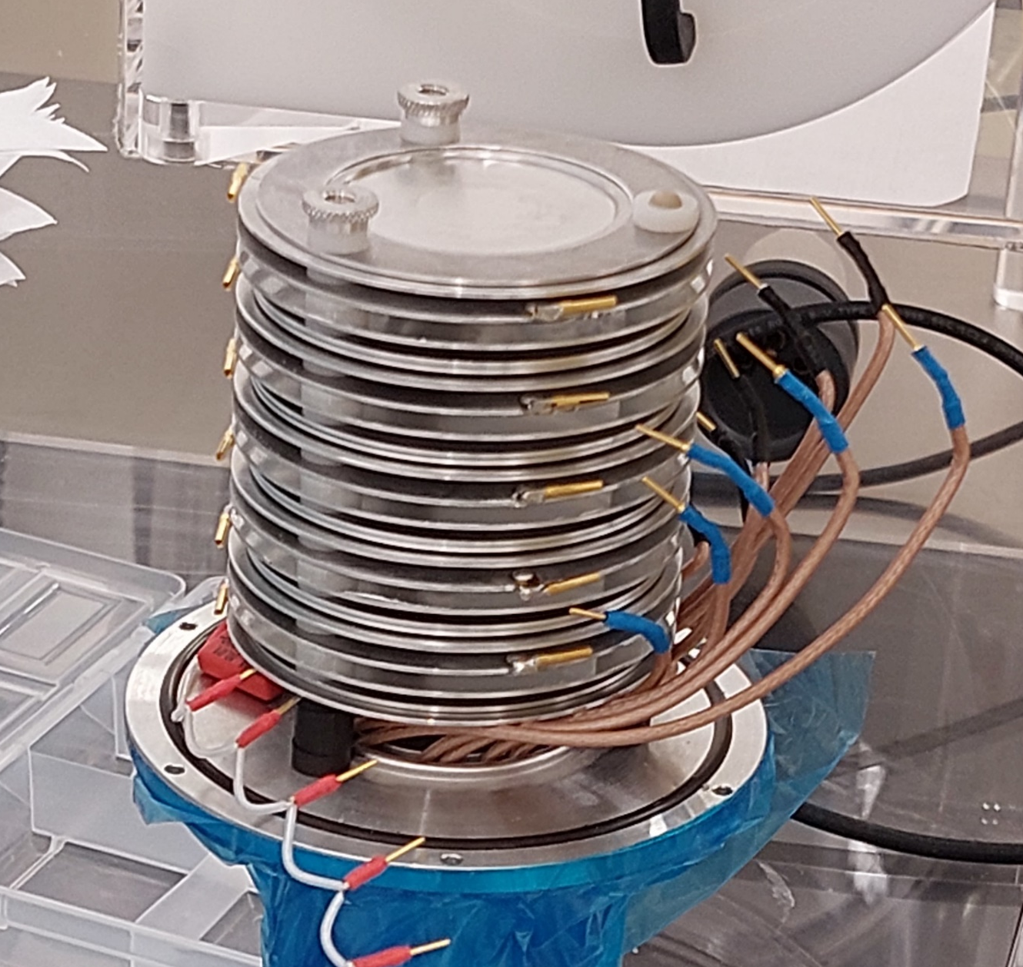
Targets description
CLOSER TO NEUTRON SOURCES
Target position-10
Target position-9
Target position-8
Target position-7
Target position-6
Target position-5
Target position-4
Target position-3
Target position-2
Target position-1

