Slide 1



Towards HL-LHC: Spanish contributions to the ATLAS, CMS & LHC-b upgrades
Manuel Lozano (On behalf of all Spanish Groups)
Manuel.lozano@csic.es

Slide 2
Aknowledgement
This is a presentation made of many contributions. Warm thanks to:
Cristina Fernández Bedoya, Ignacio Redondo
Sebastian Grinstein, Stefano Terzo
Carlos Lacasta, Fernando Martínez, Arantxa Ruíz
Gervasio Gómez
Santiago Folgueras
Miguel Ullán, Salvador Hidalgo, Giulio Pellegrini
Abraham Gallas
Eugeni Graugés
Diego Martínez Santos
Xavier Vilasís
Disclaimer:
Only detectors, no magnets, nor accelerator
Almost no Real Time Analysis
No personal names
Apologies:
It is almost impossible to present every contribution
Apologies for the missing parts

Slide 3
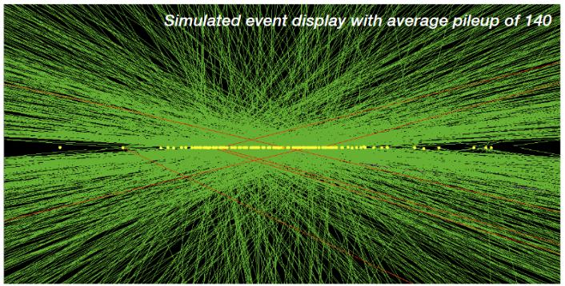
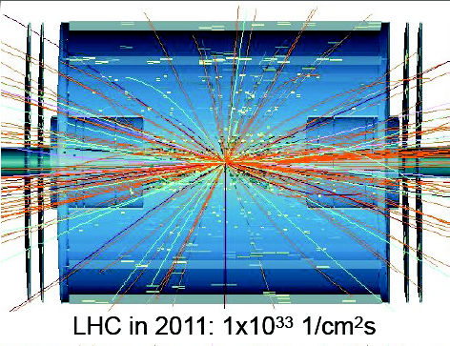
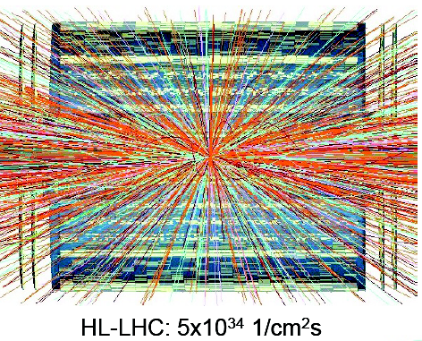
HL-LHC Upgrade
High Luminosity upgrade of the LHC accelerator
Provide ~ x10 increase in luminosity w.r.t LHC design value
Larger datasets → increase potential for discoveries after 2029
Physics motivation covered in other talks
Challenging operational environment requires major detector upgrades
From 20 to 200 collisions per beam crossing; track multiplicity from ~700 to 10.000
Radiation tolerant detectors and electronics to cope with unprecedented fluences
Increased granularity to cope with large occupancy and track multiplicity (large pileup)
Spain contributes to the upgrades of ATLAS, CMS and LHCb

Slide 4
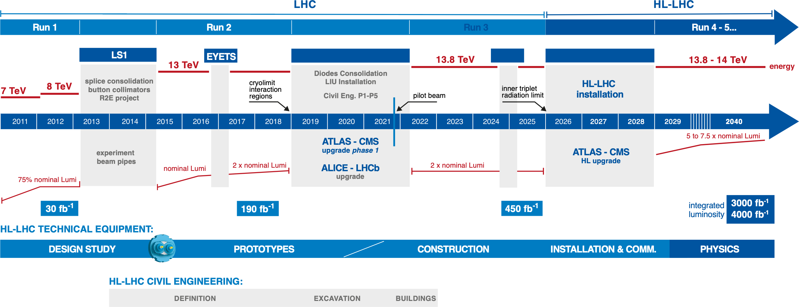
LHC / HL-LHC Plan
you are here
Situation at CPAN Days Nov. 2023 (Santander)

Slide 5
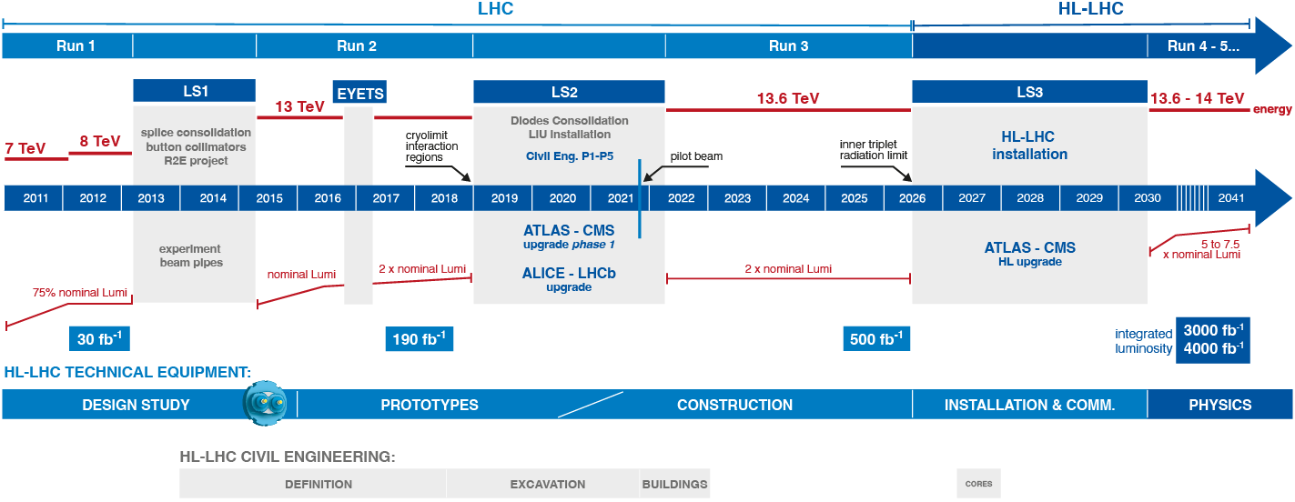
LHC / HL-LHC Plan
you are here
Update September 2024: “The decision to shift the start of the HL-LHC by approximately one year and increase the length of the shutdown reflects a consensus supported by our scientific committees.”
January 2025 figure

Slide 6
















The Spanish Team
TileCal
ITk-strips
ITk-pixels
HGTD
Muon DT
L1 trigger
HGCAL
IT pixels
MTD-ETL
ECAL
VELO
SciFi/Tk

Slide 7






The Spanish Team
Muon DT
L1 trigger
HGCAL
IT pixels
MTD-ETL

Slide 8
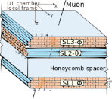


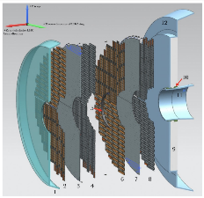
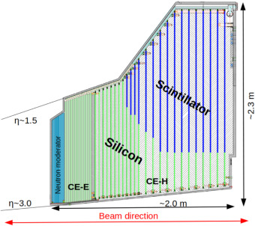
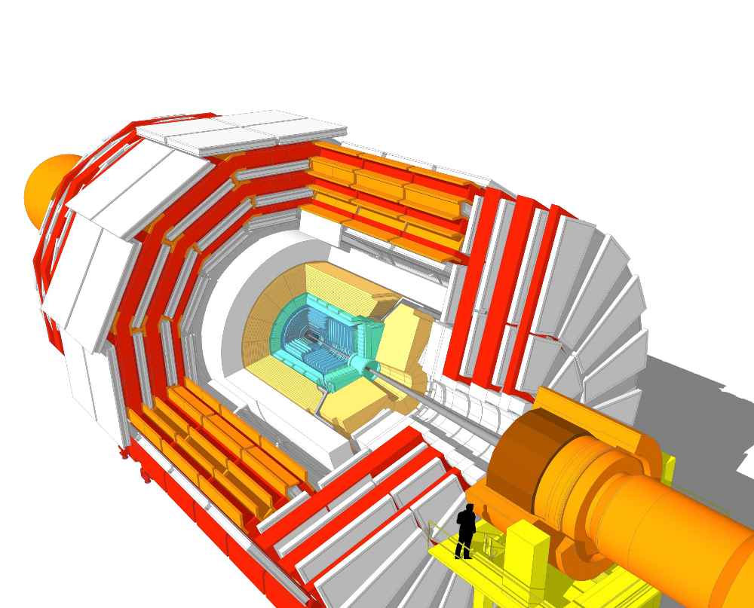
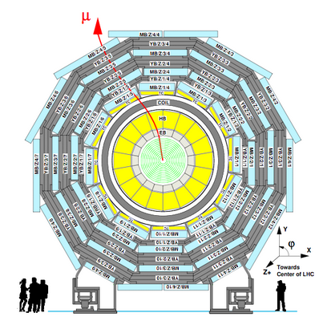





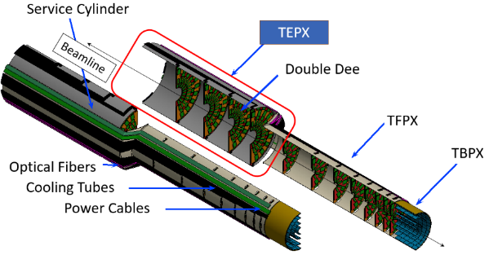


CMS Upgrade
ETL
HGCal
μ DTs + L1 Trigger
Inner Tracker

Slide 9
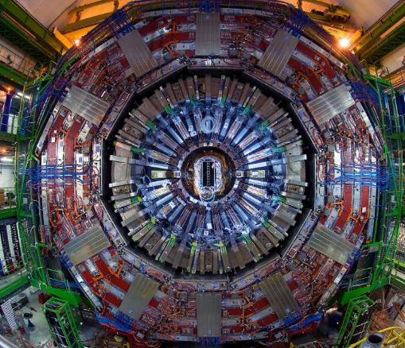

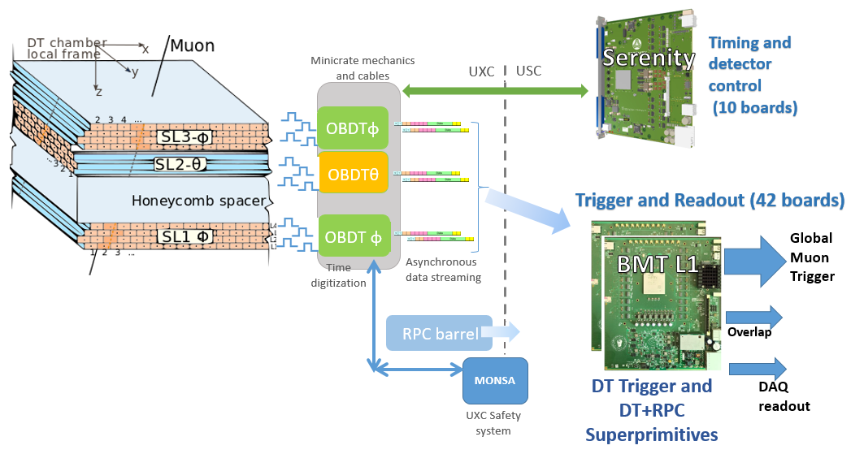






CMS Muon Drift Tube Upgrade
Drift tube chambers will not be replaced. Longevity: several years of radiation campaigns at GIF++ (Gamma Irradiation Facility) to validate its performance under HL-LHC. Efficiency loss should be acceptable
Full electronics needs to be replaced to stand: L1A rate, occupancy, radiation
Architectural change → to a full streaming of detector information
MINICRATES
250 chambers to be refurbished with new electronics:
Time digitization of the 172200 channels
Chamber interfaces, pressure ADCs, alignment forks, RPC interfaces, etc
830 boards embedded in the 250 Minicrates structures
Full refurbishment of backend electronics allows reaching ultimate detector performance in the trigger
-Electronics (theta view)
-Mechanics and cabling
-Backend and trigger algorithm
Collaboration with

Slide 10
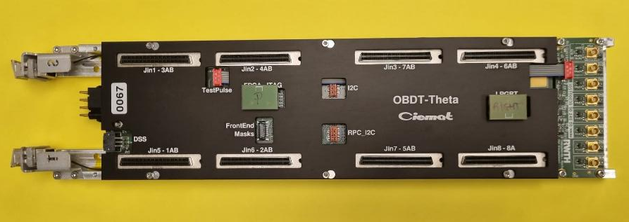
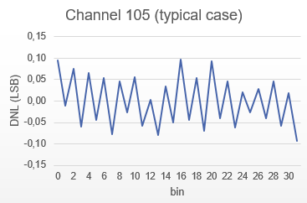
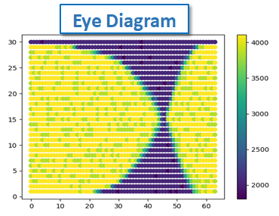
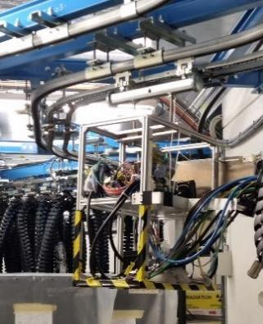
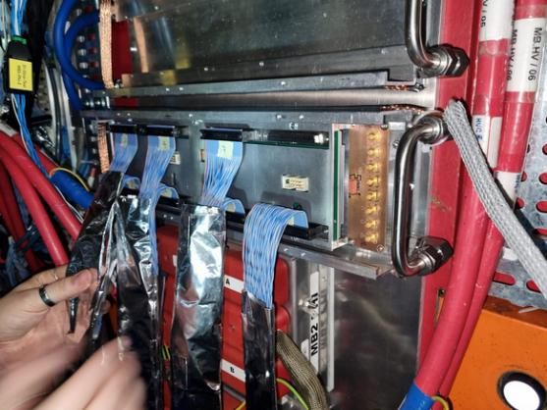
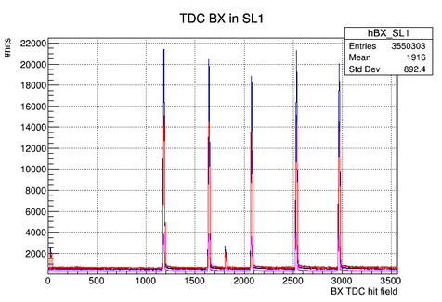



CMS Muon Phase 2: DT on detector electronics
Advanced and flexible readout board
OBDT-theta board: designed and produced at CIEMAT
Time digitization on the FPGA (228 channels/board) at 0.7 ns. Radiation tolerant FPGA Microsemi Polarfire
High speed optical communication (10 Gbps/link), total throughput available ~50 Gbps/board
Makes use of CERN ASICs: lpGBT (v1), SCA, VTRX
Halogen free, radiation tested
Automatic safety mechanisms embedded (temperature, current, voltage protections)
OBDT-theta board
Excellent performance of the board
Radiation tests performed at CHARM (100Gy)
Board validated with collisions in CMS (Slice Test)
OBDT time measurements of chamber hits coming from LHC collisions in CMS

Slide 11
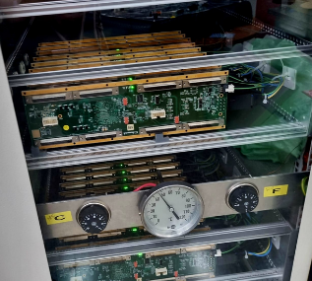
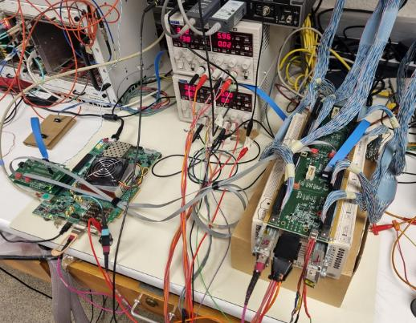
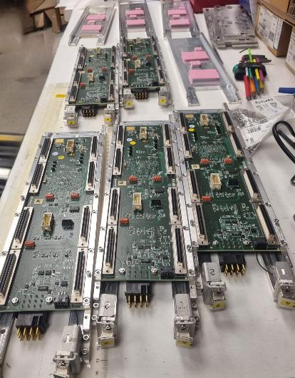
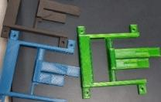
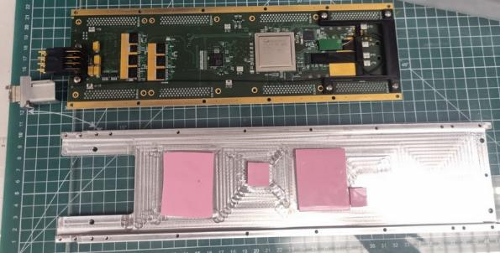
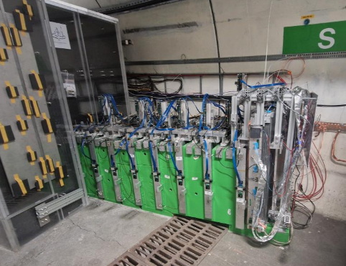
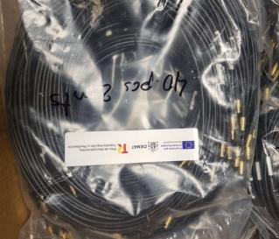
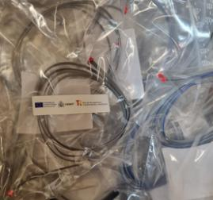
CMS Muon Phase 2: DT on detector electronics
Boards passed burn-in tests (2 weeks@50ºC) to discard infant mortality on components
Production on-going 88% completed
3D printing for fiber routing. Validation of plastics under radiation
Tests stand for production validation
SND experiment
Small mechanical pieces and cables production completed (~10 kunits)
d
Mechanical pieces for the OBDT frame assembly
OBDT-theta being used also in other experiments (SND@LHC)

Slide 12
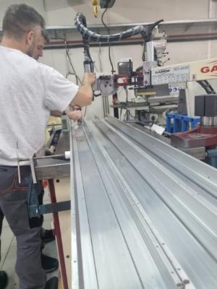
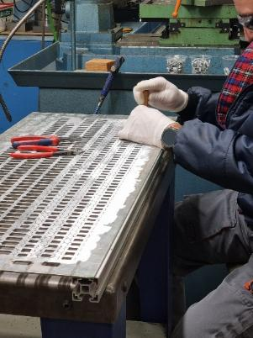
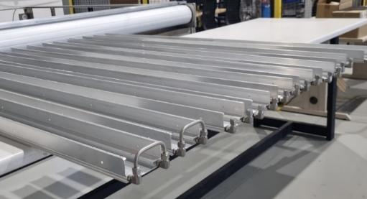
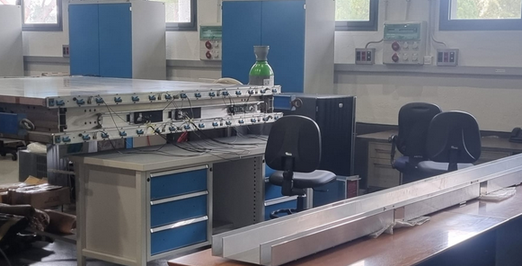
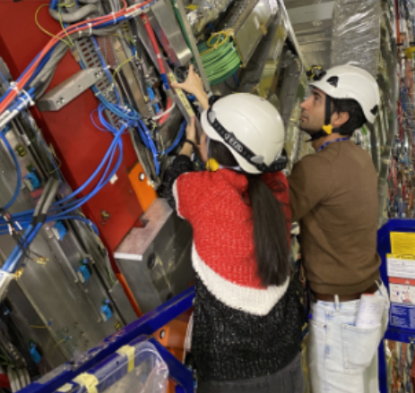
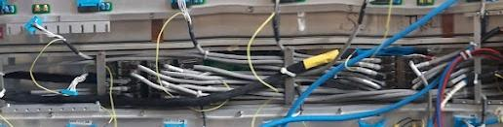
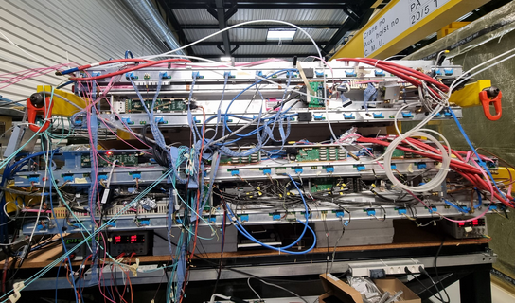
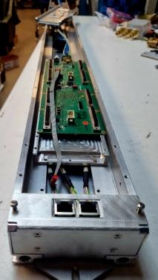
CMS Muon Phase 2: DT Minicrate mechanics, cables and assembly
Cooling validation
Minicrate assembly hall at CIEMAT
Mechanics fabrication
250 Minicrates ( 2 meters long)
+ 800 different pieces
Cabling and integration tests at SXA5 at CERN
Installation exercises at CERN
Slice Test: two CMS sectors working in parallel with upgrade electronics
Launching Minicrate assembly and testing at CIEMAT site

Slide 13
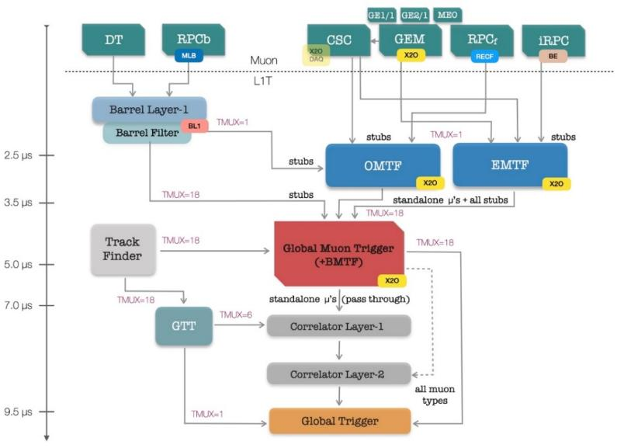
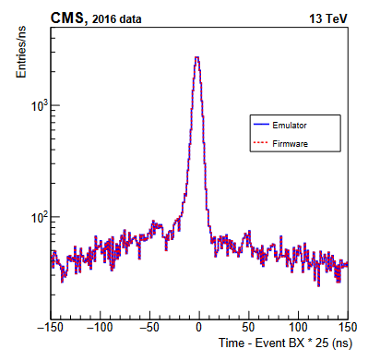
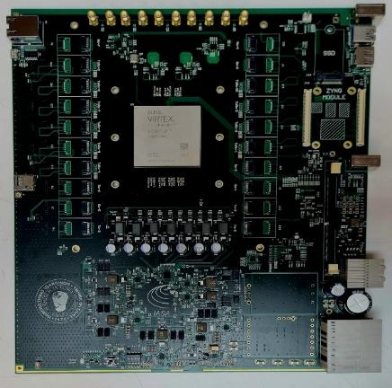
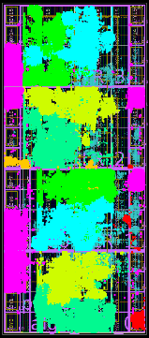
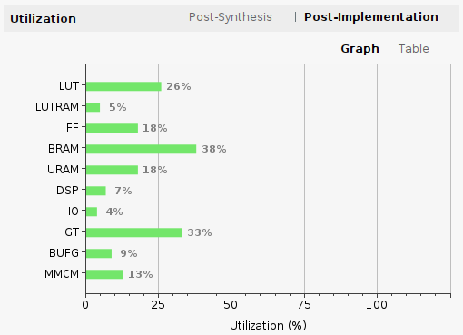
CMS Level 1 Trigger Phase 2 upgrade
CIEMAT is responsible of the CMS Muon Barrel Trigger primitive system for HL-LHC:
Algorithm development (complex muon track, combinatorial explosion, DT+RPC)
Firmware implementation for trigger and DAQ
Construction of the hardware system ATCA based in Spanish companies (installation and commissioning in 2027-2030)
Hardware backend
42 ATCA boards so called BMTL1
Ultra high performance FPGAS: AMD VU13P
Very high data throughput (3.8 Tpbs)
Collaboration with Univ. Ioannina (PCB), CIEMAT (design of the firmware)
Half of the production in Spanish industries
BMTL1 board

Slide 14
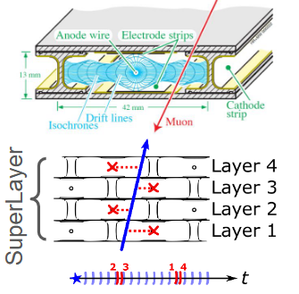

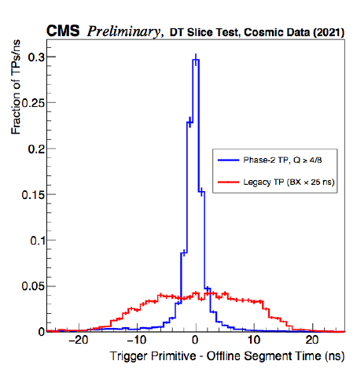
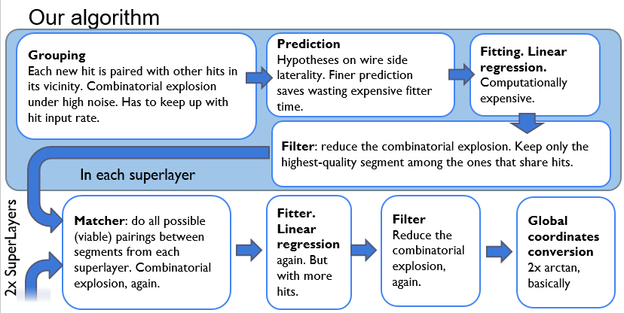
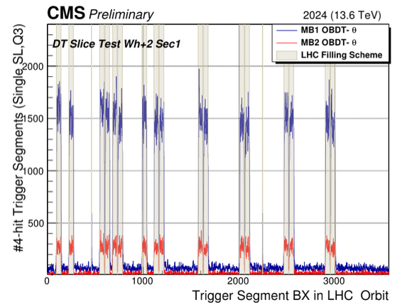
CMS Level 1 Trigger Phase 2 upgrade
Muon trigger algorithm development
Analytical Method has been developed to implement reconstruction of the barrel (DT+RPC) trigger primitives in HL-LHC
Accepts all generated DT data at maximum resolution and builds segments. Deals with combinatorial explosion and complicated Drift Tube logic (unknown time tag with 400 ns uncertainty (time drift). It can only be obtained from the fit.
Exploits maximum achievable resolution, bringing the hw system close to offline performance capabilities. [10.1016/j.nima.2023.168103]
➔ Enables HW trigger on exotic signatures: displaced muon triggers and showers
Validated with proton-proton collisions at the CMS slice test

Slide 15
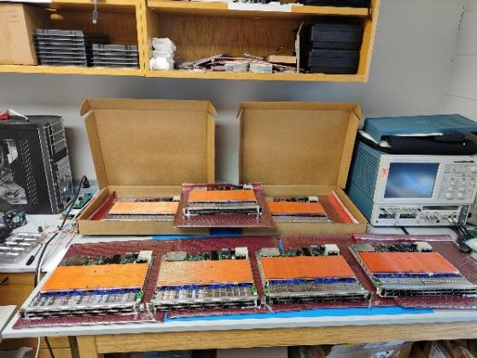
Level-1 Muon Trigger Upgrades
Operations and maintenance of the Level-1 Overlap Muon Track Finder (OMTF):
Software, firmware, and shifts (online and offline).
Collaborating with CIEMAT for Phase-2 Upgrade of the Barrel Muon Trigger (Layer-1 and Filter)
Software (theta view, integrating with CMSSW, Muon Shower tagging)
Firmware (Muon shower tagging).
Strong participation of Spanish community.
Contributing to the firmware and software development for the Phase-2 OMTF upgrade (collaboration with U. Warsaw); and to the manufacturing of the X2O boards (collaboration with UFL and UCLA).
Exploring alternative algorithms (i.e. GNN-based) for reconstructing LLPs using L1 muon trigger (using OMTF as a proof-of-concept).
Responsibilities:
Offline software coordinator
Phase-2 Muon DPG contact
Trigger Resources Manager
Trigger Editorial Board

Slide 16
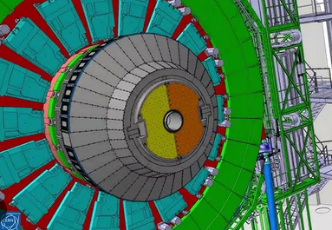
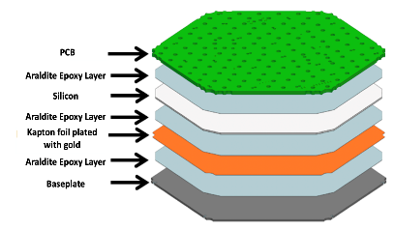
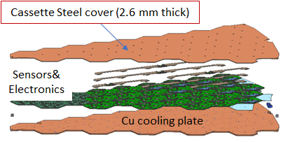

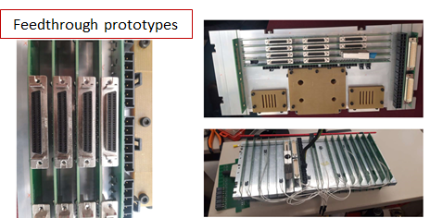
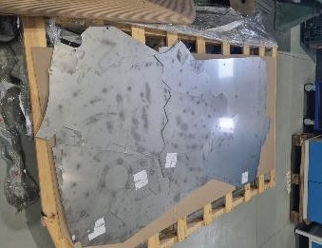

CIEMAT Contributions to CMS HGCAL (High Granularity Calorimeter)
Outer scintillator plastic
HGCAL - An innovative project deploying many silicon tracker technologies in a calorimetry environment
After Ukraine invasion, Russian institution collaboration with CERN and CMS in particular at risk: → Large participation from Russia on HGCAL.
CIEMAT joined efforts to ensure building this detector timely.
Therefore, several contributions taking place that involve Spanish industries
Si module
CuW baseplate
Inner silicon sensors
Machine ~1000 CuW thermal interface baseplates for HGCAL Si modules
Production of ~1200 PCBs allowing services cross the HGCAL thermal screen
Produce a fraction of steel protection covers of the CE-H HGCAL cassettes

Slide 17







CMS Inner Tracker Upgrade: 3D pixel activities
Characterization of 3D sensor radiation tolerance in TB campaigns
IT TBPX L1 to be implemented with 3D 25x100 μm pixel sensors
CNM: 100 mm SiSi wafers (150+200 μm)
8 CROC singles 25x100 (p-stop)
Efficiency at normal incidence: higher than 97% for all the modules after full depletion.
Modules tuned to average thresholds of 1000e- at T≃-30º
The efficiency plateau starts at around 90V
→ operation range: around 40V for CNM and 50V for FBK modules.
Efficiency*Acceptance vs bias voltage
TEPX
24 GeV protons
Φ ~ 1E16 n_{eq}/cm²
TBPX
TFPX
80V
150V
Efficiency map in the pixel cell
Runs 4+5 TBPX L1: Fluence 1.9E16 1 MeV n_{eq} & TID 1.0 Grad
IFCA coordinates CMS IT sensor group since 2018

Slide 18











CMS IT modules
IFCA will assemble:
~ 400 TEPX 2x2 modules (planar sensors)
So far: 26 pre-production modules assembled and tested
X-ray
Module QC
Pull tests on dedicated wire bond pads
Thermal cycles in cold box
CMS DAQ readout for system tests
X-ray tests for pixel hit map
Glue deposition via stamp
Micrometric precision using robot
Wire bonding: ~200 wire bonds / ASIC (~800 / module)
8x module cold box with peltiers
Semi-automatic
wire-bonding

Slide 19




FE, HDI, EMC, Serial Power
CROC simulation models & ETROC testing (ASICs)
CMS Pixel & ETL System prototyping & EMC
Parasitic layout inductance effects.
Output transient response – CROC simulation
Power dissipation - HDI 1x2 CROC
EMC test at -20ºC - CROC

Slide 20




CMS ETL: LGAD sensor R&D
Optimization of the Carbon dose to improve the radiation tolerance
Carbonated LGAD matching final sensor specifications for ETL manufactured at IMB-CNM
Full characterization carried out with Radioactive source and SPS test beam at CERN
Compliant with performance and ration tolerance requirements for the ETL
Q>8fC and σ_{t}<50 ps @ f = 1.5x10¹⁵ neq/cm²

Slide 21





ETL-ETROC2
Major project milestone : First version of a full fledged readout ASIC (ETROC2) arrived in March.
Bump bonding (IMB-CNM and Baretek) of first batch ETROC2 batch to 16x16 LGAD prototype sensors completed in August
Very low noise levels present, overcoming previous ETROC version major issue.
Test beam at the CERN North Area and laser testing at CERN SSD laser facility carried out in the second half of September
Fully self contained, self referential sensor+ETROC2 stack system at SPS TB.
Three sensor layers with accompanying master clock board and FPGA DAQ.
Fully functional ETROC2+sensor assembly (SSD laser facility) for dedicated jitter studies and ETROC2 performance
Very promising out-the-box performance: SPS beam profiling and track correlation observed.
Preliminary determination of the ETROC2 assembly jitter using the laser: < 30 ps.
beamspot
Signal amplitude (ToT)
Timewalk

Slide 22




ETL Module Assembly
IFCA will assemble ~900 (~10%) Endcap Timing Layer modules
Workflow established in collaboration with other sites (Nebraska, Fermilab and Torino)
Automated procedure based on a SCARA ROBOT to ensure precision
Integrate digital camera and AI recognition of fiducial mark positions
First mockup assemblies during first manual step using precision jigs
Waiting for LGAD+ETROC bare modules to start pre-production
Wire bonding and testing of modules performed on-site

Slide 23



MTD Geometry, Reconstruction and Physics Case
In charge of the Data Performance Group of the MTD (2019 – 2023)
Implementation and optimization of the detector geometry in CMSSW
Digitization and detector response (new ETL response model in progress)
Local reconstruction, 4D global reconstruction and 4D vertex building
Calibration procedures and alignment
New physics cases studied
Extension of searches for long-lived particles decaying into displaced jets
Use of timing information to estimate Particle ID (Time-Of-Flight-based Particle ID)
Strong impact on B physics analysis as it improves the particle tagging performances

Slide 24


IMB-CNM. CMS Activities
Fabrication of 3D sensors
Improve the fabrication yield of 3D pixel detectors to produce sensors for the CMS Inner Tracker upgrade
Production of 3D detectors based on the new 3D single side technology developed at IMB-CNM
3D Technology stabilization
3D-CROC First prototypes
Cell pitch: 50x50 µm2, 25x100 µm2
1 Electrode configuration (1E)
CMS selected the 3D sensors to instrument part of the Inner Tracker
CMS Market Survey and Tendering
IMB-CNM was qualified as a supplier of 3D detectors for CMS in the Market Survey
However, in the tendering process, FBK detectors were selected due to their lower price
Similar for ATLAS-ITk

Slide 25



IMB-CNM. CMS Activities
Fabrication of LGADs sensors
Detectors produced in 150 mm epitaxial wafers (50 µm active thickness)
16x16 matrix design (1.3x1.3 mm2 pad area)
Fabricated according to the CMS Market Survey specifications
LGADs on epitaxial substrates (6LG3, 15x15, 16x16, 15x30, 16x32 pixels)
LGADs with Carbon (6LG2, standard doping profile (15x15, 16x16), deep doping profile (16x16))
More resistant to radiation, more stable breakdown voltage and gain values
Temporal resolutions in the order of 35 ps
Prototypes irradiated with @ 1.5x10¹⁵ n_{eq}/cm² CC > 8 fC and a time resolution < 50 ps @ 12 V/µm (CMS technical requirements)
Large area prototypes (15x15 and 16x16 pixels, 2.5x2.5 cm2) show increasing yields (50%, 94%, and 99%) as manufacturing is repeated and stabilized
CMS selected the LGAD sensors to instrument the future End Cap Timing Layer
CMS Market Survey and Tendering
IMB-CNM fulfilled ETL specification but was not selected as supplier
HPK was selected for the outer layer of the ETL, with the inner layer awaiting accreditation from Lfoundry (Tendering)
For ATLAS IMB-CNM did not accomplished specifications

Slide 26




TileCal
ITk-strips
ITk-pixels
HGTD

Slide 27








ATLAS Upgrade
ITk-pixels
ITk-strips
TileCal
HGTD
Extended Long Extended barrel barrel barrel

Slide 28




Overview: Goals and Status
ITk Linear Pixel Triplet module
HGTD Module

Slide 29







ATLAS ITk Pixel Triplet Module Assembly
In the past we worked on pixel sensor R&D, prototyping & qualification
Finished qualification and pre-production
ITk 3D hybrid
25x100 um2 for linear triplet
Triplet flexible PCB
(3) Place hybrid on flex
(2) Align hybrids and flex
(1) Deposit glue on flex
Several metrology steps
Length, rotation, Flatness, Glue coverage
(5) Wire-bond
(6) Metrology
(7) Testing: Threshold tuning,
Detection with Sr90,
Thermal cycling, etc
N. Kakoty, https://doi.org/10.1088/1748-0221/20/06/C06028

Slide 30


ATLAS ITk Pixel Triplet Module Pre-production
✓
Linear triplet pre-production finished IFAE (11 shipped to CERN/SLAC)
Out of 11 pre-production triplets only 1 had critical failure (ASIC readout)
Production to start early 2026
Link to results here
Triplet production (final modules): 133 triplet modules for the innermost pixel layer (committed rate: 2 modules/week)
Also commitment to 3D sensor QA (with CNM)
We are ready for the production phase
Waiting for hybrids...

Slide 31








ATLAS HGTD Module Assembly
Worked on sensor R&D, ASIC design, hybridization, prototyping & qualification
IFAE completed prototype hybridization and assembly qualification for HGTD
Hybridization (in house)
Flex/hybrid alignment and gluing
Metrology
Contribution to ASIC design and LGAD development (CNM)
Final module testing
Wire-bonding and pull tests
Alvin readout
system developed at
IFAE (for lab & beam tests)
V. Gautram, https://doi.org/10.22323/1.463.0009

Slide 32




ATLAS HGTD Module Status
✓
Almost 200 hybrids produced, more than 50 modules assembled
Bump bonding at IFAE ongoing
Pre-production starting, ramping up, expect to do ~100 modules in 2026...
IFAE
IFAE commitment: about 1000 modules ie, 2000 hybrids
~2 years dedicated to assembly
Module assembly, six module jig operation started… (increase assembly rate)
Module loading: modules have to be loaded into Detector Units...
Setup being commissioned
Loading different system than assembly
.
.
.

Slide 33





ATLAS HGTD Module Characterization
Alvin DAQ developed by IFAE, used in labs and beam tests
E-L Gkougkousis, https://doi.org/10.1088/1742-6596/2374/1/012175

Slide 34
Conclusions
Situation:
IFAE’s contribution to ITk Pixel and HGTD in the form of modules
CNM contribution to sensor quality assurance
ITk Pixel:
IFAE responsible for assembly of innermost pixel layer
Pre-production completed, about to launch production (waiting for parts)
HGTD:
Prototyping and qualification completed, full detector assembly in-house
Pre-production about to be launched

Slide 35




IFIC @ ITk Strips
The ITk is the new ATLAS tracker for the HL-LHC.
IFIC-Valencia works in the ITk-Strip endcaps
Each endcap has 6 disks
Each disk 32 wedge-shaped carbon fiber supports (petals)
Each petal houses 18 (9 per side) silicon strip sensors.
Petal

Slide 36








ITk-Strip activities
Services
Petal loading
Petal
Modules
Cores + Bus tapes

Slide 37



Global Support Structure
Design structure with NIKHEF & DESY
The 2 endcaps already fabricated at at NIKHEF
Finite Element Analysis to optimize the structure

Slide 38




Services
Design of the service module bringing power, control signals and cooling to the petals.
Assemble and install the 16 service modules in the structure
First Service Module already installed in a structure

Slide 39
Petals and Modules
Sensors are glued on local supports (Petals). This is the building block of the EC system. It is a carbon fibre sandwich with integrated cooling and electronics.
Double sided object with 18 sensors, 70cm height, 10-20cm width
Bus tape to distribute power and signals
Each petal has six rings. One sensor shape per ring.
3 upper radius rings have 2 sensors.
In total, 18 modules, 9 on each side
IFIC has to populate 100 of those petals
Will assemble all the required R0 (200) and R5 (2x200) modules. In total 600 modules.
Will receive 200 R1, 200 R2, 2x200 R3 and 2x200 R4. In total 1200 modules.

Slide 40



Petals and Modules
A finished petal
4-row bonding in a module
Loading of a petal in the gantry
Built so far
19 R0 modules (97280 bonds)
15 R5 modules (69120 bonds)
7 petals

Slide 41



Strip sensor R&D and fabrication
ATLAS-ITK Strip Sensors
Strips implanted on p-type silicon bulk (n+-in-p)
Single Sided, AC coupled, by Hamamatsu (Japan)
Active thickness 300 μm, V_{FD} ~ 280 V
8 sensor geometries, 70 to 80 μm pitch
1 sensor per 6’’ wafer + Test Structures
Coordination of the Sensor Collaboration since 2017
Quality Control (QC)
Checks fulfilment of ATLAS specs with tests on actual main sensors
Quality Assurance (QA)
Monitors the fabrication process to detect deviations and predict tendencies of key parameters. On test structures
Tests can be destructive: irradiations
Status
Production is going on at a steady rate (~4.5 years now)
About 99% sensors received at this point.
21,553 accepted and ready for modules (89.8%)
Barrel target
EndCap target

Slide 42


Responsibility in Quality Assurance work for the Collaboration
Quality Assurance (QA)
Preventing defects during production, rather than identifying them after the fact. The QA procedures are applied to both un-irradiated and irradiated test structures
Monitor several device and technological parameters throughout production
8 test sites around the word
Ljubljana, KEK/Tsukuba, Prague, Birmingham, Toronto, Valencia, Barcelona, IHEP
Test pieces sampled from every production batch
Test Chip, Monitor Diodes (MD8), and minis
Proton, neutron, and gamma irradiations
2,576 QA pieces distributed for irradiations & tests
596 batches accepted, 6 batches rejected
Testchip developed at CNM and whole QA plan
All pre-irrad tests of QA samples done at CNM
Parameter extraction, analysis and DB upload software developed at CNM
Test chip
QA Test pieces
Example results
Post-neutron CCE
Pre-irrad interstrip resistance

Slide 43

Readout electronics
On-detector electronics transmits full digital data for every bunch crossing (40 MHz)
6,000 optical fibers (aggregated ~ 40 Tbps)
Off-detector PreProcessor
Real time signal reconstruction to obtain cell energy depositions
Provides digital trigger primitives to Level 0 Trigger Systems
Readout events after L0 Acceptance
LHC clock and control commands transmitted to on-detector electronics
Redundancy in data links and power distribution for improved system reliability
Mini-Drawer

Slide 44
Off-Detector Electronics
PreProcessor (PPr) : interface between the on-detector electronics and the ATLAS Global DCS, DAQ & Trigger systems
Signal reconstruction (trigger and DAQ), clock distribution, DCS interface, front-end control
Modular design
ATCA Carrier
TileCoM : System-on-Chip
IPMC: Health monitoring
GbE Switch : 16x1Gbe ports
Compact Processing Module(CPM): data processing
Trigger & DAQinterface(TDAQi) : trigger interface
Final designs approved
Now PreProduction
Upgrade of ATLAS Tile Hadronic Calorimeter for HL-LHC

Slide 45



Off-Detector Electronics
ATCA Carrier
TDAQi
CPM
Upgrade of ATLAS Tile Hadronic Calorimeter for HL-LHC

Slide 46



LHCb
ECAL
VELO
SciFi/Tk

Slide 47



LHCb Upgrade II
ECAL
VELO

Slide 48


Motivation
Upgrade I will not saturate precision in many key observables: a further upgrade is necessary to fully realise the flavour-physics potential of the HL-LHC.
Upgrade II
Original LHCb
Upgrade I
x7.5 increase in luminosity w.r.t. Run 3-4
L_{integ} > 300 fb⁻¹ during Run 5 and Run 6
The performance of Upgrade II must equal or surpass that of Upgrade I, with:
Pile-up reaching values of 40
200 Tb/s of data
Charged particle densities up to 1x10¹² / cm²
This is the intensity frontier! New, lightweight technologies with high granularity, fast-timing, radiation hardness and innovative data processing all necessary to go to L_{peak} ∼ 1x10³⁴ cm⁻²s⁻¹
Upgrade I installation finished
Ramping up developments for Upgrade II to be installed in LS4 (~2033)
Notes:
Actualizar la luminosidad al middle scenario de Peak luminosity ~ 1.5x 10^34 cm-2 s-1 a 1.0x 10^34 cm-2 s-1
Actualizar timeline

Slide 49






VELO II: the importance of timing
U-I conditions,
no pixel timing
±1000ps
U-II conditions,
with pixel timing
U-II conditions,
no timing
±15ps
Higher pile-up → PV separation from Upgrade I (4.2 mm) reduced to 1.5 mm in Upgrade II along the beam line.
Proton bunches overlap for a finite time (RMS ∼ 180 ps): in 1 ns window many overlapping collisions
Increasing the resolution to 20 ps only a few collisions and corresponding tracks remain
PV efficiency and IP resolutions will yield ~same signal selection performance IF timing resolution of 20 ps/track is achieved.
Notes:
CORRECT

Slide 50



Upgrade II VELO layout scenarios
Baseline:
Tracking Efficiency: >99% within LHCb Upgrade II acceptance (hits in at least 5 detector planes).
Sensor Technology: 3D silicon (150 μm thickness, 50 μm pitch) high spatial and temporal precision for the detector lifetime (> 300 fb⁻¹)
Spatial Resolution: < 10 μm single-hit
Timing: 50 ps per hit
Sensor Inner radius: 7,2 mm from the beamline to the closest detector element.
(Left) VELO detector layout in the Baseline scenario. (Right) Illustration of the VELO stations in one half of the detector, in the Baseline scenario
Scenarios @ reduced cost: Middle and Low
Reduction in Peak Luminosity 1.5 → 1.0 → reduction of data rates
Further reduction (Low): Thicker RF foil (a la UI) and 3D-printed metal alloy cooling interfaces instead of silicon microchannels → higher material budget and degradation of IP resolution → reduction in performance.
Conceptual design for a lightweight cylindrical RF-shield between the LHC beamline and the Upgrade II VELO modules
Notes:
According to LHCb Scoping document most likely will go with middle scenario and the parameters still to be defined Use Fig 42 Scoping document

Slide 51

Upgrade II VELO ASICs
Sensor R&D is closely matched to the ASIC development
 | VeloPix 1 | LA-PicoPix | IGNITE
Technology | 130 nm | 28nm | 28nm
Pixel size | 55 x 55 um | 50 x 50 um | 45 x 45 um
Pixel arrangement | 256 x 256 | 386 x 256 (not decided yet) | 320 x 256 (not decided yet)
Time resolution | 25 ns | ~30ps | ~16ps
Readout bandwidth | 20 Gbps | 100 Gbps | 100 Gbps
Ratiation hardness | 400MRad | 1 GRad | 1 GRad
Upgrade I based on VeloPix ASIC (130nm, from Medipix family). A new generation chip - Timepix4 has timing capability
Upgrade II requirements much more demanding still but could draw on similar concepts: LA-PicoPix, IGNITE demonstrator chips optimised for 3Ds sensors
Smaller pitch at larger r to maintain U-I resolution
Dose Achievable with 28nm TSMC CMOS
Innermost r: ~64 tracks per bx & 3.8 Ghits/s requires large b.w. Implementing data reduction on ASIC
Notes:
NEW SLIDE

Slide 52





Calorimeter Reconstruction
Towards a lightweight graph neural network for LHCb’s next-generation calorimeter
Creating a path towards HLT1 reco
ONNX format and Distilled versions actively being explored with even more promising initial results
To be tested with the Allen framework with PicoCal
Superior Energy resolution

Slide 53

PicoCal readout electronics
FRONT-END CRATES
ECAL
Photodetectors readout solution follows the same scheme as in current ECAL
Minimal light transport with PMT sensors near modules
Electronics in crates on top of the detector (reduced radiation)
Connection via analog link (coaxial 50Ω) up to 20m between modules and FEE (IFIC)
Aims at energy (12bit,ET≈40GeV) and time (σt≈10ps) measurements using different technologies (SpaCal/Shashlik, W/Pb, GAGG/Polystyrene)
ASICs using PMT signal under development in TSMC 65nm (V_{supply}=1.2V)
Separate energy and timing processing paths:
ICECAL65 designed by UB, IFIC and UPC
SPIDER designed by IJC Lab, LPC
PMT conditioning circuit for ASIC input range on base or front-end board (IFIC)

Slide 54
PicoCal: PMT Acquisition & Conditioning Circuit
COTS based two stage amplifier with intermediate divider/filter.
Several prototypes with different footprints for testing multiple OpAmps.
Commercial OpAmps force tradeoff among speed, stability and dynamic range (process 2ns t_{rise}/250MHz BW signal over 40mA/2V range with 50Ω conversion)
Intensive lab test to produce a configuration for each board compatible with SPIDER (v1) and ICECAL65 LG (v2 and v3) energy and voltage
Results show good linearity and <10% rise time loss in all cases
All boards tested at SPS, analysis and comparison to lab results ongoing

Slide 55
PicoCal: Energy ASIC
Two 11bit processing paths with factor 8 between their gains
Automatic internal selection of gain with fast comparator
Common acquisition and filtering per gain path with double time interleved switched section for integrator reset
Per channel clock phase selection to synchronize and set ADC sampling

Slide 56





Energy ASIC Analog Channel
Analog channel fulfills the specifications
HG and LG adjusted in the preamp
Precision for 11 bits (HG/LG)
Noise < 1 LSB
Shape the input signal to fit it within the 25 ns window for all SpaCal technos
< 1% variation for ±2 ns to adapt to arrival time fluctuations (Plateau)
Adjustable parameters for filtering and gain
Design status: blocks layout done
Pre-Amp
Shaper
Integrator
T&H
PREAMP
PZ FILTER
INTEGRATOR
TH
25 ns

Slide 57
Mighty SciFi readout electronics
Mighty SciFi
Fibres
Mighty Pixels HVCMOS
LS4 radiation levels require new detectors/electronics! (IFIC, UB, UPC)
Mighty Tracker: three stations with four layers each in XUVX configuration
CMOS MAPS (Si pixel) inner region / scintillating fibers + SiPMs outer region
PACIFIC (Upgrade I, current)
Mostly analog design
Multi-channel
Simple digitization
I2C slow control
PACIFIC++
Analog processing chain
Multi-channel
Complex digital: digitization/clustering/timing
IpGBT control/direct connection

Slide 58
PACIFIC++
SiPM readout ASIC with anode DC coupling and current mode input
Two processing paths with 10bit ADC and 6bit TDC respectively
Integrated digital processing (cluster) and Gbps serialized output
Double interleaved scheme for integrators to allow continuous operation
Low power single-ended and differential OTAs required for analog chain
(power 1-2mW; GBW 250MHz; SR 200mV/ns; noise 500μV)
Submission of 1st prototype by 2026

Slide 59







PMT studies at UB
Gain studies
Single Phe fit with 2 Gaussian or with Bellamy distribution
High N_{phe} statistical methode
Time resolution uniformity scan over photo- cathode and for different bias and light conditions
Grid of points, (laser)
PRELIMINARY
Hamamatsu R11187
Gain
Single Phe - Bellamy function fit
Arrival time uniformity over R11187
total std = 32 ps
Single Phe - Double Gaussian fit
1E+06
Large Number of Photoelectrons - Double
90
80
70
60
50
40
30
20
10
0
Time Resolution
Gaussian fit
R11187
Nominal Gain provided by the manufacturer
(expected between 600V and 800V)
R14755U-100
1E+05
σ_t (ps)
1E+04
500
550
600
650 700
Voltage (V)
750
300
500
700
900

Slide 60



FastRICH ASIC – Analog FrontEnd (Positive Input Stage)
FastRICH ASIC
65 nm tech
Based in FastIC
Specific for RICH
CFD, LED and TDC
included
Radiation Tolerant
HL-LHC Run 5 RICH system
Challenging rise in particle multiplicity and hit occupancy during HLLHC
The increased irradiation level
FPGAs → radiation-hard ASIC
in order to keep the high particle ID
→ time resolution of better than 100 ps
Upgrade to SiPM
Positive Input Stage (for SiPMs)
Designed at ICCUB
Current-mode with
Zin < 50Ω
Optimized for small area (1x1 mm² SiPMs)
Pseudo-differential output voltage

Slide 61






Spain@futureLHCbRTA
“The planning for the RTA and Online systems assumes that this underlying logic will continue in the Upgrade II period, albeit with new algorithms to make use of timing information.”
LHCb Upgrade II Scoping Document CERN/LHCC 2024-10
'Same with augmented Data Rates’
LHCB-FIGURE-2020-016

Slide 62

Spain@futureLHCbRTA
Assuming continuity
Calorimeter Reconstruction - GNNs (UB, LS-URL)
Tracking (Valencia, Corunha)
LLP trigger lines (Valencia)
Retina DWT– FPGA Velo Reconstruction (Valencia)
Neutral PID (LS-URL)
Trigger lines (all)
Flavour Tagging persistency (Corunha)

Slide 63

R&D
R&D

Slide 64

A word about the INTREPID project
INTREPID Project
Got funding from the ERC to explore alternative technologies and ideas which could not be otherwise investigated that could potentially lead to a significant breakthrough.
Project focuses on muons signatures, but ideas can be ported elsewhere and targets to expand the sensitivity to long-lived / displaced signatures.
For the HL-LHC and beyond:
Muon trigger for the HL-LHC (in collaboration with CIEMAT): expand existing low-latency algorithms to detect and trigger on non-standard signatures such as hadronic showers or slow charged particles.
GNN for real-time (O(μs)) muon reconstruction, using Versal ACAP and the AI engines.
Hardware/Setup:
Setting up a local test stand for benchmarking firmware.
Various devices available for testing: Xilinx Kintex, Virtex Ultrascale+, Versal 7nm AI.
Person power:
4 PhD students (full time), 1 postdoc (full time), 2-3 senior (0.5 FTE each)

Slide 65



What are the INTREPID goals?
LLP signals might be easily missed or misinterpreted in LHC data.
Optimizing the techniques within the current architecture to improve detection efficiency without requiring significant hardware upgrades.
Explore alternative technologies and ideas which could not be otherwise investigated that could potentially lead to a significant breakthrough.
Can we profit from using hit-level information?
Use of 7nm technology?

Slide 66










Technological Processes Developed @ IMB-CNM
Oblea de 100 mm de diámetro en la que se integran prototipos de detectores 3D-SS sobre substratos SiSi. Primera generación
Oblea de 100 mm de diámetro en la que se integran prototipos de detectores 3D-SS sobre substratos SiSi. Segunda generación, Nivel N+
Oblea de 150 mm de diámetro en la que se integran prototipos de detectores LGAD delgados sobre substratos epitaxiales y perfil original
Oblea de 150 mm de diámetro en la que se integran prototipos de detectores LGAD delgados sobre substratos Si-Si. Módulos 15x15 con perfil original
Oblea de 150 mm de diámetro en la que se integran prototipos de detectores LGAD delgados sobre substratos epitaxiales. Módulos 16x16 con perfiles original y profundo
Oblea de 100 mm de diámetro en la que se integran prototipos de detectores iLGAD de segunda generación con perfil original
Oblea de 100 mm de diámetro en la que se integran prototipos de detectores Trench iLGAD con diseño Timepix3
Oblea de 100 mm de diámetro en la que se integran prototipos de detectores Trench iLGAD con diseño Timepix4
Oblea de 100 mm de diámetro en la que se integran prototipos de detectores nLGAD de primera generación
Oblea de 100 mm de diámetro en la que se integran prototipos de detectores nLGAD de segunda generación

Slide 67




Current Detector development @ IMB-CNM
3D timing for future tracking. Atlas and CMS timing layers :
3D Technology stabilization (100mm → 150mm)
Devices for extremely harsh environments (>2×10¹⁵ n/cm²) :
Silicon 3D timing devices
Future timing layers based on 3D technology
LGAD timing for timing and tracking applications :
Inverse LGADs and Trenched iLGADs → 100% fill factor while maintaining precise tracking and timing information
Deep Junction LGADs
More radiation hard (<2×1015 n/cm2)
Technology Stabilization, increasing yield in 150mm wafers and large sensors
N-type LGAD development for DUV and soft X-ray detection
SiC detectors for Particle Physics and Nuclear Physics (IEM-CSIC):
Devices for extremely harsh environments:
Silicon Carbide (SiC) based devices
SiC diodes for X-ray detection and Beam monitoring
CMOS imaging sensor simulation (Imasenic and DRD3):
Development of a simulation framework for the production of HV-CMOS detectors

Slide 68





APECS Pilot Line @ IMB-CNM
Advanced Packaging and Heterogeneous Integration for Electronic Components and Systems
WP5 - Technology cooperation // T5.5 Collaborative projects with CSIC. Leader: CSIC. FMD-OFC, IZM
Hybrid assembly
Monolithic integration of cooling micro-channels
Task 5.5.1: Microchannel cooling
Integration of embedded microchannels with RDL in silicon interposers
Cooling microchannel fabrication in sensors or ASICs
Qualification of cooling concept
Miguel Ullán (IMB-CNM, CSIC)
Focus IZM: IO pitch reduction for hybrid assemblies
Sub-10µ-pitch
ASIC thermo-test chip fabrication
IO pitch reduction for hybrid assemblies
Heterogeneous integration
4µm pitch Au pillars
Services offered for (future) pilot-line customers:
Microchannel cooling for HPC and RF – Application
Hybrid Assembly Technologies for HPC – Application

Slide 69

Aladdin Experiment
In-vacuum fixed-target experiment for direct measurement of magnetic and electric dipole moments of charm baryons at the LHC. Ultimately explore 𝜏 lepton
Letter of Intent (LoI) in July 2024, endorsed by LHCC. Technical proposal by June 2026
Crystal 1 (TCCS): halo extraction of the LHC beam
Tungsten target - 2 cm
Crystal 2 (TCCP): spin precession of baryons with charm
Spectrometer: baryon reconstruction with a 1.9 Tm magnet
Particle identification detector – RICH (for p, K, p PID up to 1 TeV)
Strong synergy with LHCb physics program and LHCb Upgrade II technologies
VELO PicoPix, RICH, DAQ, Real Time Analysis
https://cds.cern.ch/record/2905467
https://aladdin.web.cern.ch/

Slide 70


Twocryst: Aladdin Proof-of-Principe at LHC IR3
Demonstrate:
Machine operation & achievable PoT
Detector setup & measurement of TeV regime channeling
Machine: beam manipulation using bent crystals
Bent crystals: Si with mechanical bending as baseline. Deflection of beam halo towards W target
Goniometers for precision bent crystal positioning
Magnet: compact spectrometer dipole magnet
Warm dipole magnet already available in situ (1.9 T m) as baseline (orbit corrector)
Detector: compact with high granularity, covers very forward region (η > 5)
LHCb VELO silicon pixel sensors & electronics inside Roman Pots (from ATLAS-ALFA)
https://twocryst.web.cern.ch

Slide 71

TWOCRYST contributions
Voltage Feedthrough Board (VFB)
Power Patch Panels
Power distribution system & 300 m cabling inside LHC tunnel
Flexible Front-End PCBs (RP)
Monitoring & control system (SCADA)
Installation & commissioning

Slide 72


TWOCRYST preliminary results
MDs 21-22 June 2025
https://www.home.cern/news/news/experiments/towards-new-physics-bent-crystals

Slide 73


Slide 74
Back Up Slides

Slide 75



Contribution from Oviedo to the Level-1 trigger upgrade

Slide 76
A word about the INTREPID project
Got funding from the ERC to explore alternative technologies and ideas which could not be otherwise investigated that could potentially lead to a significant breakthrough.
Project focuses on muons signatures, but ideas can be ported elsewhere and targets to expand the sensitivity to long-lived / displaced signatures.
For the HL-LHC and beyond:
Muon trigger for the HL-LHC (in collaboration with CIEMAT): expand existing low-latency algorithms to detect and trigger on non-standard signatures such as hadronic showers or slow charged particles.
GNN for real-time (O(μs)) muon reconstruction, using Versal ACAP and the AI engines.
Hardware/Setup:
Setting up a local test stand for benchmarking firmware.
Various devices available for testing: Xilinx Kintex, Virtex Ultrascale+, Versal 7nm AI.
Person power:
4 PhD students (full time), 1 postdoc (full time), 2-3 senior (0.5 FTE each)

Slide 77
What are the goals?
LLP signals might be easily missed or misinterpreted in LHC data.
Optimizing the techniques within the current architecture to improve detection efficiency without requiring significant hardware upgrades.
Explore alternative technologies and ideas which could not be otherwise investigated that could potentially lead to a significant breakthrough.
Can we profit from using hit-level information?
Use of 7nm technology?

Slide 78



Triggering on muon showers
Tag showers in the muon system to recover high-pt muons and to trigger on LLPs leaving hadronic showers in the muon system.
First version of the algorithm is ready and implemented in FW with less than 3K LUTS and less than 3K registers for each SuperLayer @480MHz
https://doi.org/10.22323/1.476.0930 (ICHEP 2024)
https://iopscience.iop.org/article/10.1088/1748-0221/20/03/C03024/pdf

Slide 79


GNN for real-time (O(μs)) muon reconstruction
GNN for classification of the muon stubs and for momentum regression.
Algorithm development
Firmware implementation (pytorch to HLS conversion)
Continuous integration for mixed (HLS+RTL) complex designs
Using the OMTF as a proof-of-concept but the algorithm can be ported elsewhere.
Next steps: Target displaced signatures

Slide 80






ATLAS ITk Module Characterization
IFAE Lab
Test-beams
DESY
CERN
S. Terzo, https://doi.org/10.3389/fphy.2021.624668

Slide 81






ATLAS: High Granularity Timing Detector
HGTD designed to improve ATLAS performance in the forward region in view of increased HL-LHC pile up
Timing based on LGAD sensors
Also provides luminosity information
Total active area about 10 m²
~8000 modules
IFAE making critical contributions:
LGAD Sensor R&D(with CNM)
ASIC design
(ALTIROC)
Hybridization, developed process
(in-house)
Module assembly and loading
Module testing
(Alvin Readout system developed at IFAE)

Slide 82





Slide 83




IMB-CNM Developments
IMB-CNM Activities for CMS High Luminosity Upgrades, Inner Tracker and Endcap Timing Layer
Notes:
Good afternoon. In this presentation I will summarize the current status of the 3D and LGAD productions at CNM for AidaInnova Project. Some of these works are also done in the framework of the CERN RD50 Collaboration.

Slide 84


Pre-production and Production of 3D sensors
Máscaras fotolitográficas para integrar, en obleas de 100 mm de diámetro, prototipos de detectores 3D-SS sobre substratos SiSi. Producción CMS. Run#18111
Oblea de 100 mm de diámetro en la que se integran prototipos de detectores 3D-SS sobre substratos SiSi. Pre-producción CMS
Oblea de 100 mm de diámetro en la que se integran prototipos de detectores 3D-SS sobre substratos SiSi. Producción CMS. Nivel columnas N+

Slide 85



LGAD sensors Pre-production and Production
Oblea de 150 mm de diámetro en la que se integran prototipos de detectores LGAD delgados sobre substratos epitaxiales y perfil original
Oblea de 150 mm de diámetro en la que se integran prototipos de detectores LGAD delgados sobre substratos epitaxiales. Módulos 15x15 con perfil original
Oblea de 150 mm de diámetro en la que se integran prototipos de detectores LGAD delgados sobre substratos epitaxiales. Módulos 16x16 con perfiles original y profundo

Slide 86



LGAD. Technological Processes Developed

Slide 87

Challenge I: Design and Fabrication at IMB-CNM
LGADs are (at the moment) one of the most complicated runs to develop at IMB-CNM clean room:
Big dice sizes
≈ 2.5x2.5 cm² (LGAD)
≈ 2.5x3.0 cm² (Timepix4)
≈10 Photolitographic steps
≈10 Thermal processes
5-6 Implantation steps
≈ 100 Fabrication steps
Single or double-sided processes
Timepix4 TiLGAD
16x16 LGADs
256 Pixels
To optimize the quality of the LGAD runs, IMB-CNM counts with TCAD Sentaurus to simulate the entire fabrication process and the electrical characterization of LGADs.

Slide 88

Challenge II: Large Scale Manufacturing Yield
IV measurements, at 20ºC, of IMB-CNM pixelated LGADs
Dispersion in V_{BD} was found higher tan desirable
Criteria set as I(100 V) < 200 nA for reliable pixels
4 tested devices
4 x 15 x 15 = 900 pixels
5 tested devices
5 x 16 x 16 = 1280 pixels
5% of pixels with
I(100V) > 200 nA
0.7% of pixels with
I(100V) > 200 nA

Slide 89


Challenge II: Large Scale Manufacturing Yield
IV measurements, at 20ºC, of IMB-CNM pixelated LGADs
Uniform leakage current but
Dispersion in V_{BD} was found higher tan desirable
CMS 6LG2-v2 16x16 pixels
(std LGAD)
ATLAS 6LG2-v1 15x15 pixels
(std LGAD)

Slide 90


Challenge III: Technology Reliability after Irradiation
6LG2-v1 Run
Single-pad diodes test
6LG3-v2 Run did not meet specifications after irradiation
6LG2-v1 run was tested before and after irradiation
After irradiation, CMS specifications were met at the voltage limit of 11 V/µm
6LG2-v2 run has to be tested
CMS
Irradiated (1e15 n_{eq}/cm²) @ -25ºC
V_{opMAX} | ≤ 11 V/µm = 540 V
V_{op} (CC = 8 fC) | 540 V (V_{op} = V_{opMAX})
I_{leak} | < 1 µA / single pad
CC (V_{opMAX}) | 8fC
σ (540 V) | < 50 ps

Slide 91





Challenge III: Technology Reliability after Irradiation

Slide 92






UBM & ETROC2 Dummies. Design and Fabrication
Under Bump Metallization (UBM)
LGAD and ETROC2 Interconnection Setup Definition
UBM Process Definition
Test Structures (LGAD with UBM)
Two Interconnection Test Processes (Common Run, ATLAS Samples)
Mechanical Test Structures (Dummies)
LGAD and ETROC2 Interconnection Test Structures
LGAD and ETROC2 Mechanical Emulators
Design and Fabrication
Electrical Characterization
Collaboration with Kansas University (EEUU)
Oblea de 150 mm de diámetro en la que se integran prototipos de pseudo sensores y estructuras de prueba mecánica para el ETROC
Vista de las estructuras de prueba mecánica tras el UBM
Detalle de uno de los pads de conexión eléctrica

Slide 93





Silicon Detectors for Timing and Tracking Applications
Trench iLGAD
Fabrication Steps Reduction (60%)
100 % Fill Factor
Pad and Pixelated devices
Timepix3,Timepix4
nLGAD
Low Penetrating Particles Detection
Simulation and Technological Process Optimization
Electrical and Technological Characterization
3D Timing
Radiation Hard Timing Detectors
Simulation and Technological Process Definition
Electrical Characterization
Future Applications
SiC diodes for X-ray detection and Beam monitoring

Slide 94



Silicon Detectors for Timing and Tracking Applications
Oblea de 100 mm de diámetro en la que se integran prototipos de detectores iLGAD de segunda generación con perfil original
Oblea de 100 mm de diámetro en la que se integran prototipos de detectores Trench iLGAD con diseño Timepix3
Oblea de 100 mm de diámetro en la que se integran prototipos de detectores Trench iLGAD con diseño Timepix4

Slide 95


Silicon Detectors for Timing and Tracking Applications
Oblea de 100 mm de diámetro en la que se integran prototipos de detectores nLGAD de primera generación
Oblea de 100 mm de diámetro en la que se integran prototipos de detectores nLGAD de segunda generación

Slide 96

nLGADs. Low Penetrating Particles Detection
TCT measurements, 20ºC, maximum power for every laser diode
Samples from both nLGAD runs measured under similar conditions have similar gain response

Slide 97

3D Radiation Hard Timing Detectors
3D detectors are great candidates for radiation hard timing detectors for future colliders
3Ds with n-on-n configuration have been studied
After substrate inversion, full depletion voltage should be lower
Irradiation campaign was done with sensors irradiated at equivalent fluence levels of
1E14, 1E15, 5E15, 1E16, 5E16 and 1E17 neq/cm2
DUTs
Pad diodes arrays of 50x50 pixels with pixel pitch of 50µm x 50µm
Test structures of 3x3pixels with pixel pitch of 55µm x 55µm
I-V and at low temperature (-20ºC)
C-V could not be performed → Noise is higher than a single pixel capacity
Breakdown voltage highly increase with fluence
Leakage current
Does not increase a lot with high fluence
Decreases after irradiation

Slide 98

SiC diodes for X-ray detection and Beam monitoring
Diodes designed and fabricated for a FLASH dosimetry project
P-N junction implanted diodes
4H-SiC, 100 mm wafers
3 µm high resistivity n-type doped epilayer
Technology based on our SiC power diodes
Looking at other applications
For example, being investigated for brachytherapy dosimetry in collaboration with IFCA
Requirements for X-ray BPMs:
Linearity: response signal proportional to beam intensity
Spatial uniformity: 2D flat response
Spatial resolution
Radiation hardness
Transmission >90-95% TBD (upcoming dedicated project)
IMB-CNM have performed several beam tests ALBA Synchrotron (Celeste) and Diamond Synchrotron (Jairo) to study the viability of SiC diodes as X-ray detectors and Beam Position Monitors
Notes:
In order to overcome the small signal, avalanche photo-diodes were proposed. In this case, a p-doped layer is diffused underneath the n+ to create a high electric region. Electron/hole pairs created in the bulk of the detector will pass through this region and they will be accelerated, creating more electron hole pairs and achieving the multiplication mechanism. Then, a higher signal is observed. Typically, these detectors have a gain of 100. The APD works in three different modes. Before the p-type layer is depleted there is no gain. Then, it works in linear mode until it reaches the breakdown and works in Geiger mode. For HEP is more interesting to work in linear mode. Gain is calculated by dividing the total charge of the APD between the charge of a PiN diode.
The drawback of this detector is the high noise produced by the high gain, so the signal to noise ratio is high.

Slide 99
Mighty SciFi readout electronics
Aiming at 99% hit efficiency with <100μm resolution with 250μm granularity
Waveform and delay depend on position
Shaper + integration to get charge
SiPMs not matched with fibres, clustering process required
Introduce <1ns time measurement

