Slide 1




Generative Surrogate Models for Differentiable Optimization of a Parallel-Plate Avalanche Counter with Optical Readout
María Pereira Martínez, Pietro Vischia, Xabier Cid Vidal
XVII CPAN Days, Valencia
November 20th 2025

Slide 2
1. Introduction

Slide 3

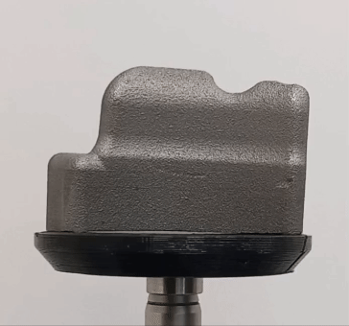
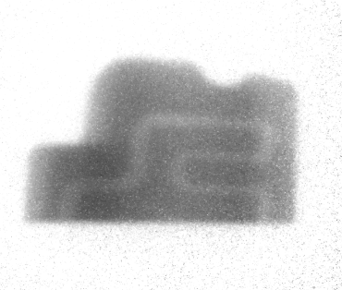

Tomography by emission and detection of neutrons for non-destructive tests. High penetration, effective for dense materials like metals and alloys. Metal industry, additive manufacturing, border security…
Neutron tomography
Images from Neutron Insights website

Slide 4
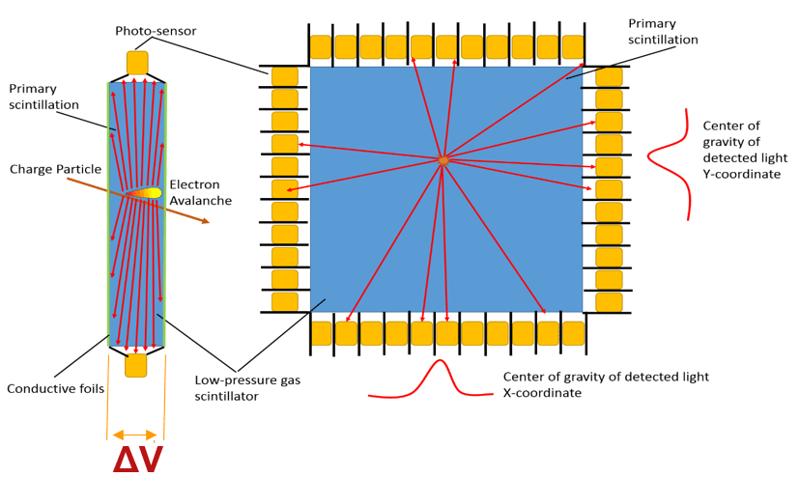
What do we want to do?
Optimize the neutron tomography system but… where do we start?
Optical Parallel-Plate Avalanche Counter
Parallel-plates filled with a high electroluminiscense yield gas (CF4).
Charged particles crossing active volume ionize medium and produce an avalanche.
Electroluminiscense light detected by 4 arrays of small, collimated silicon photomultipliers (SiPMs).
Image from 1808.05882

Slide 5
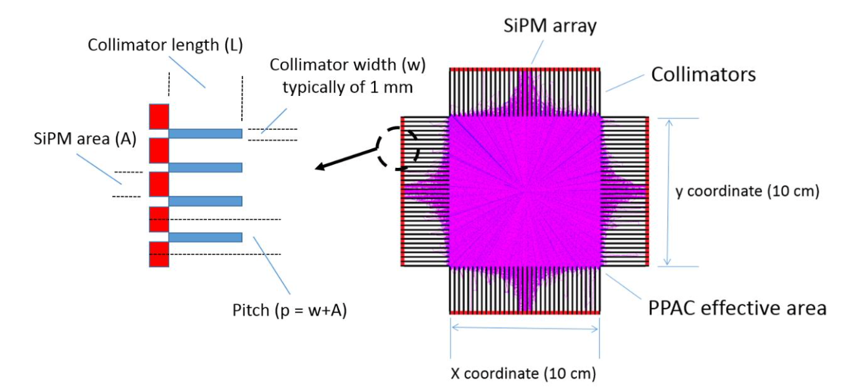
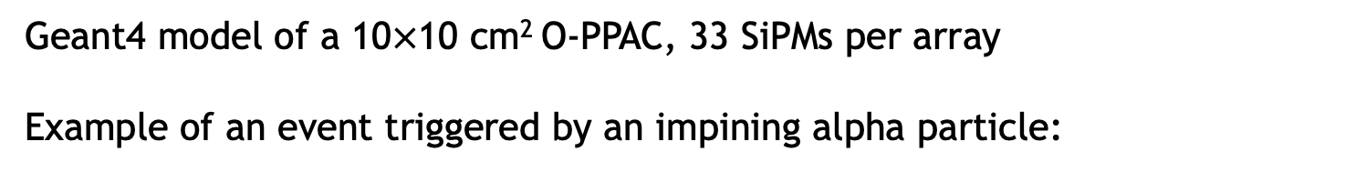
Optical Parallel Plate Avalanche Counter
Geant4 model of a 10$×$10 cm² O-PPAC, 33 SiPMs per array
Example of an event triggered by an impining alpha particle:
Image from 1808.05882

Slide 6
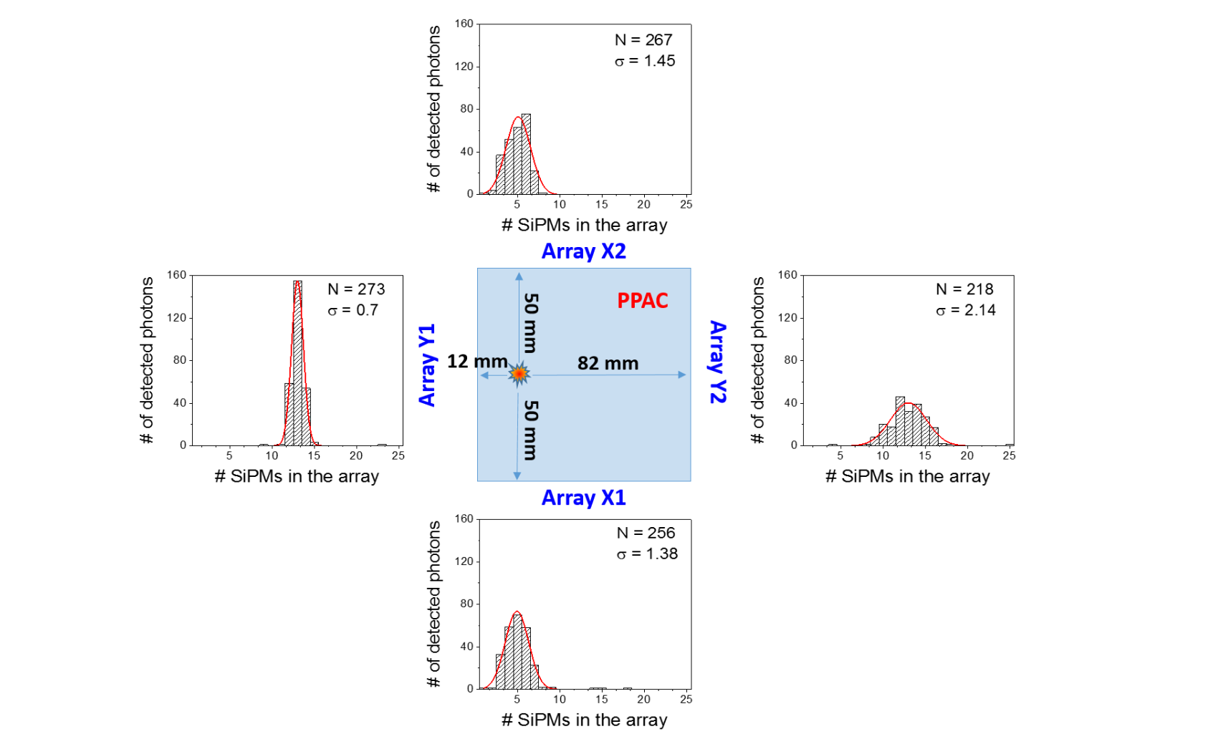
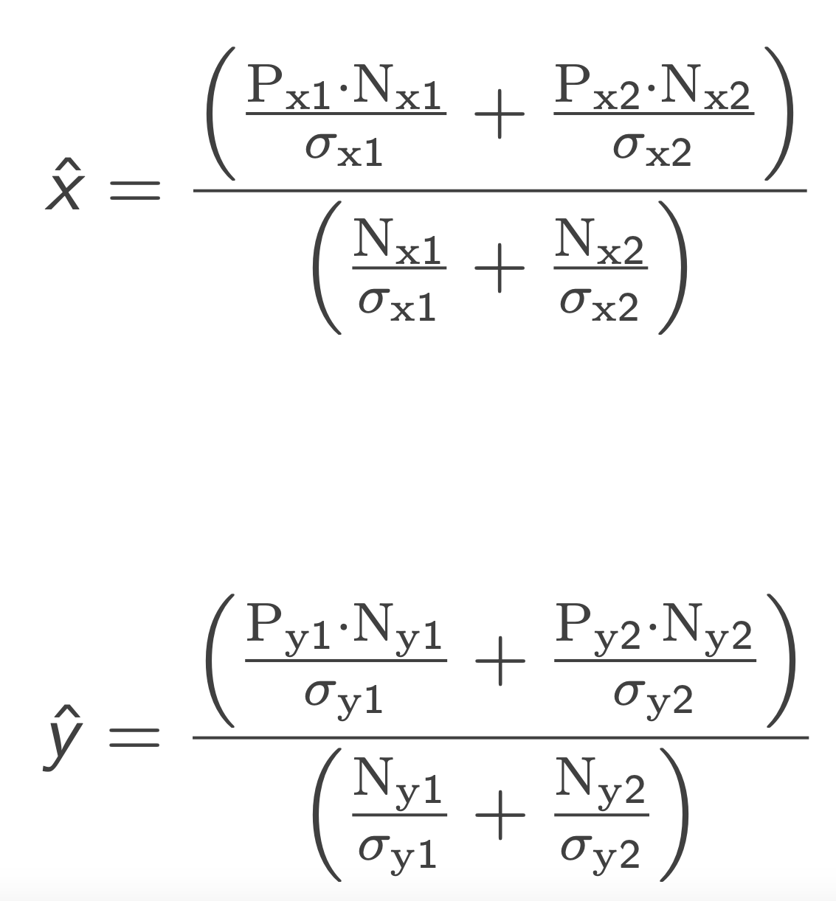
Reconstruction of the position
Reconstructed position ($\hat{x}, \hat{y}$) obtained from the number of photons detected in each SiPM
Weighted average
Image from 1808.05882

Slide 7
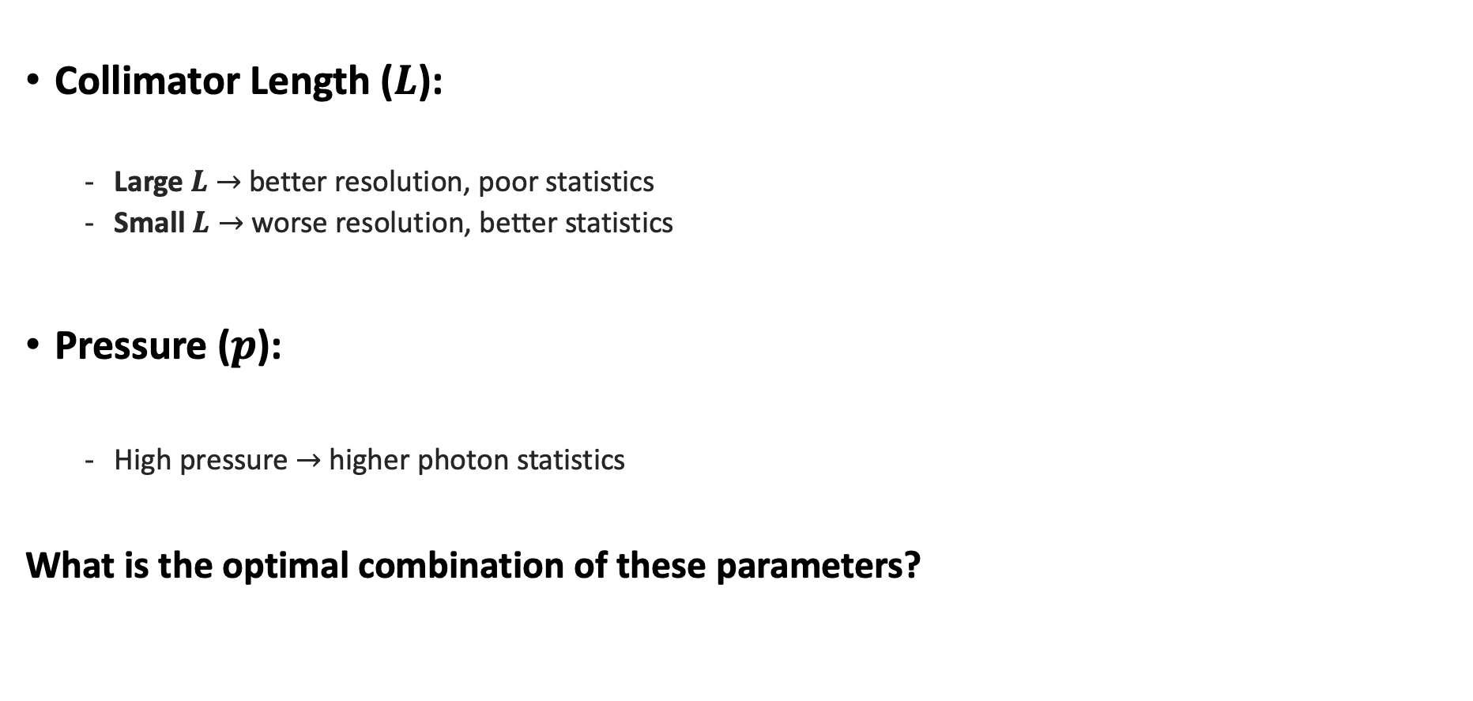
Parameters of interest
Collimator Length ($L$):
Large $L$ $→$ better resolution, poor statistics
Small $L→$worse resolution, better statistics
Pressure ($p$):
High pressure $→$higher photon statistics
What is the optimal combination of these parameters?
Image from 1808.05882

Slide 8
2. Differentiable programming for experiment design

Slide 9
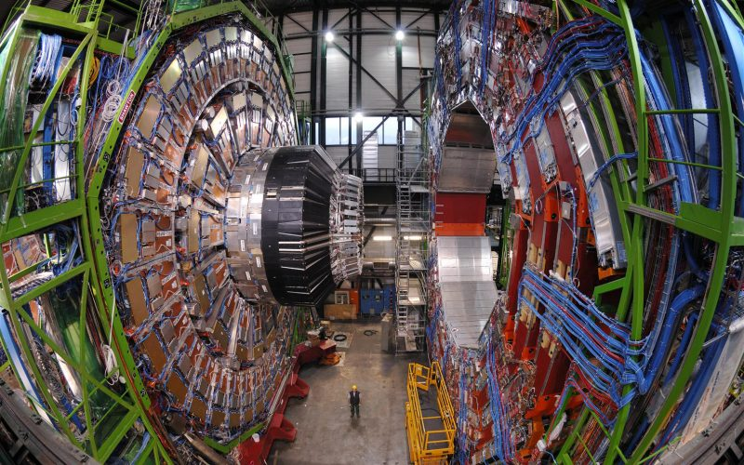
Differentiable programming for experiment design
Designing experiments is a challenging task.
- Number of parameters can be too high.
- Correlations between parameters can be non-trivial.
- Traditional approaches are computationally costly.
Development of deep learning techniques allows us to explore new approaches

Slide 10
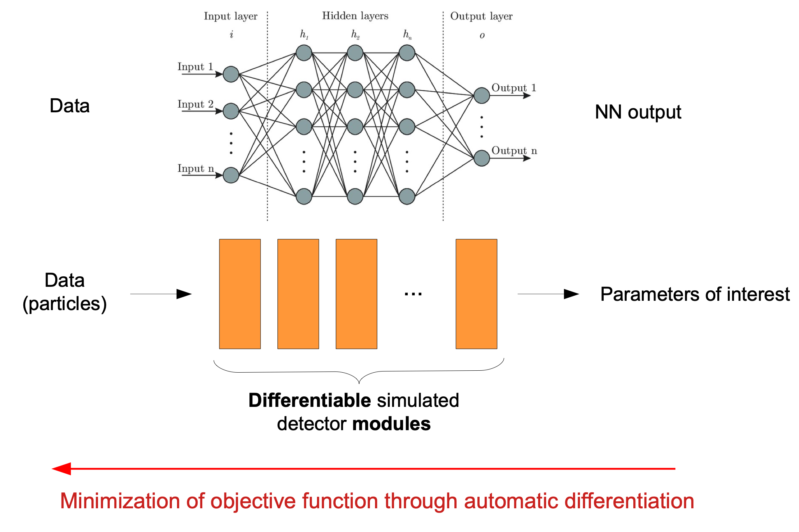
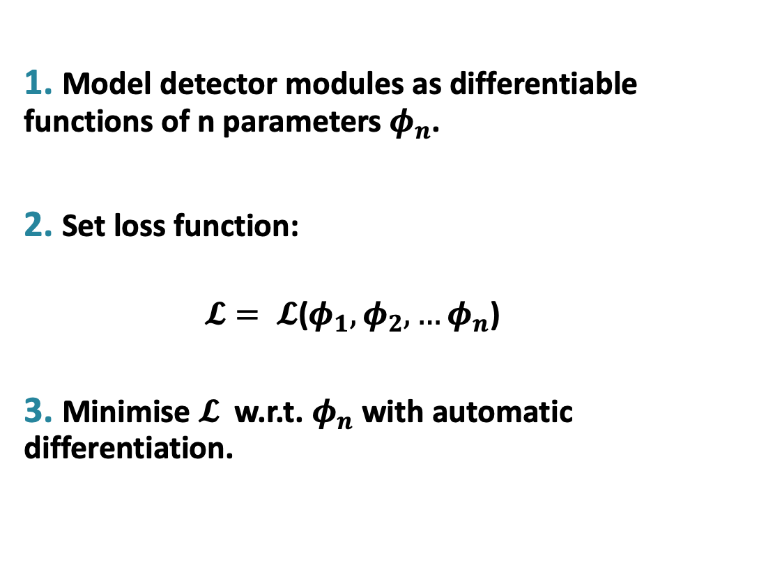
Differentiable programming for experiment design
1. Model detector modules as differentiable functions of n parameters $φ_{n}$.
2. Set loss function:
$𝓛= 𝓛$($φ_{1}, φ_{2}, …φ_{n}$)
3. Minimise $𝓛$w.r.t. $φ_{n}$with automatic differentiation.
Image from Julien Donini - Seminaire LPNHE - 14/02/2022

Slide 11
3. Automatic optimization of the O-PPAC detector

Slide 12


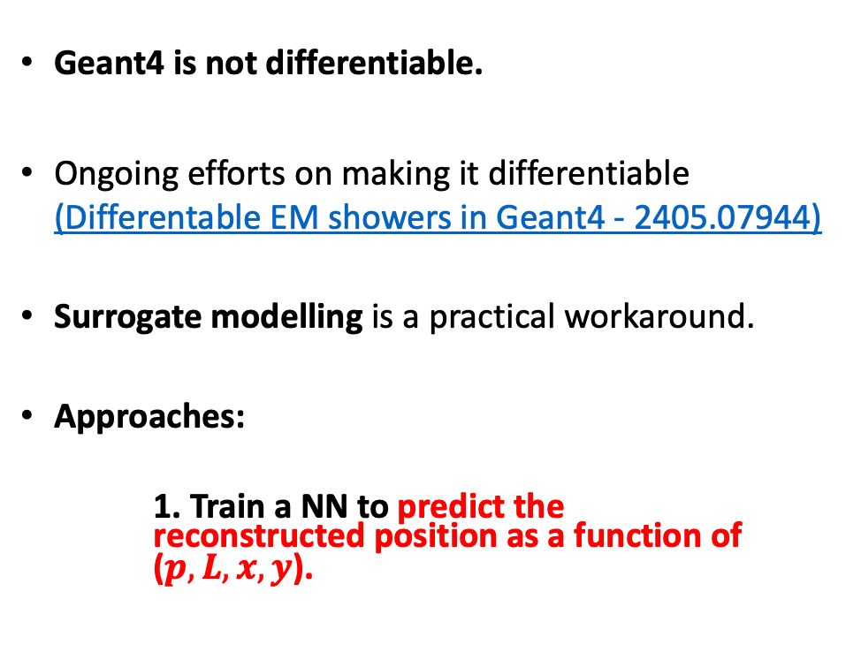

Automatic optimization of O-PPAC
Geant4 is not differentiable.
Ongoing efforts on making it differentiable (Differentable EM showers in Geant4 - 2405.07944)
Surrogate modelling is a practical workaround.
Approaches:
1. Train a NN to predict the reconstructed position as a function of ($p, L, x, y$).
$$(p, L, x, y)$$
Geant4
Reconstruction
($\hat{x}$, $\hat{y}$)
Features
Neural Network
Target
($\hat{x}′(p, L, x, y)$, $\hat{y}′(p, L, x, y)$)

Slide 13



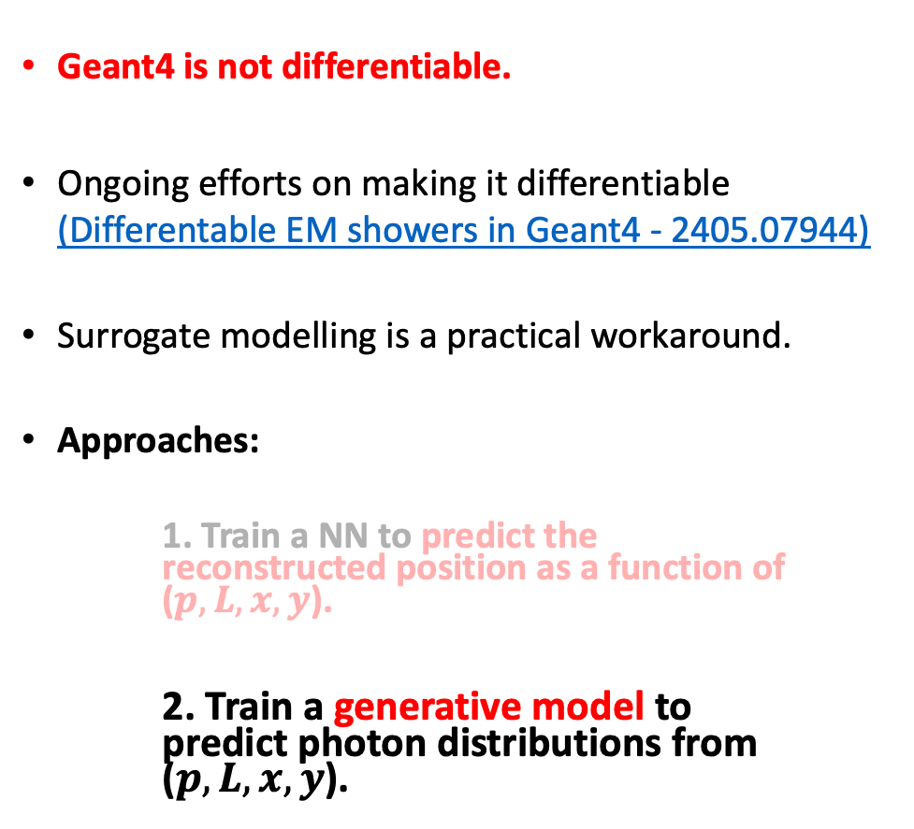
Automatic optimization of O-PPAC
Geant4 is not differentiable.
Ongoing efforts on making it differentiable (Differentable EM showers in Geant4 - 2405.07944)
Surrogate modelling is a practical workaround.
Approaches:
1. Train a NN to predict the reconstructed position as a function of ($p, L, x, y$).
2. Train a generative model to predict photon distributions from ($p, L, x, y$).
$$(p, L, x, y)$$
Geant4
($\hat{x}$, $\hat{y}$)
Features
Generative model
Target
$$n_{i}^{′}(p, L, x, y)$$

Slide 14
3.1. Neural Network Surrogate

Slide 15
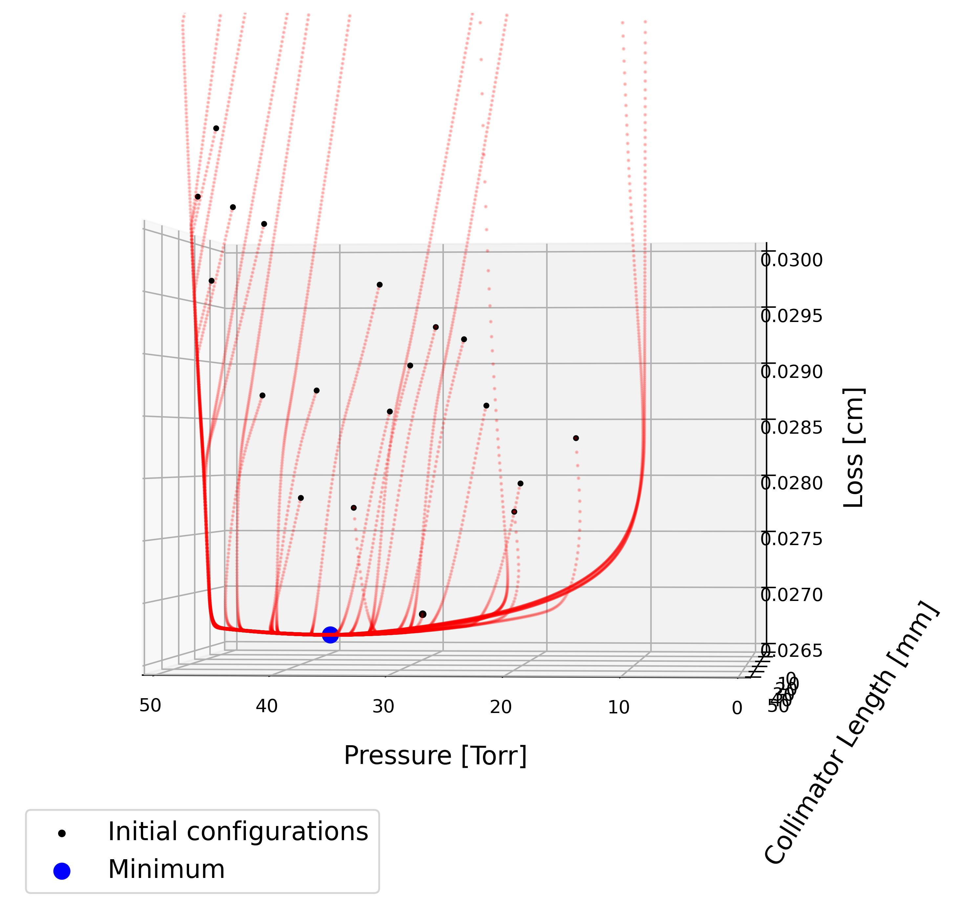
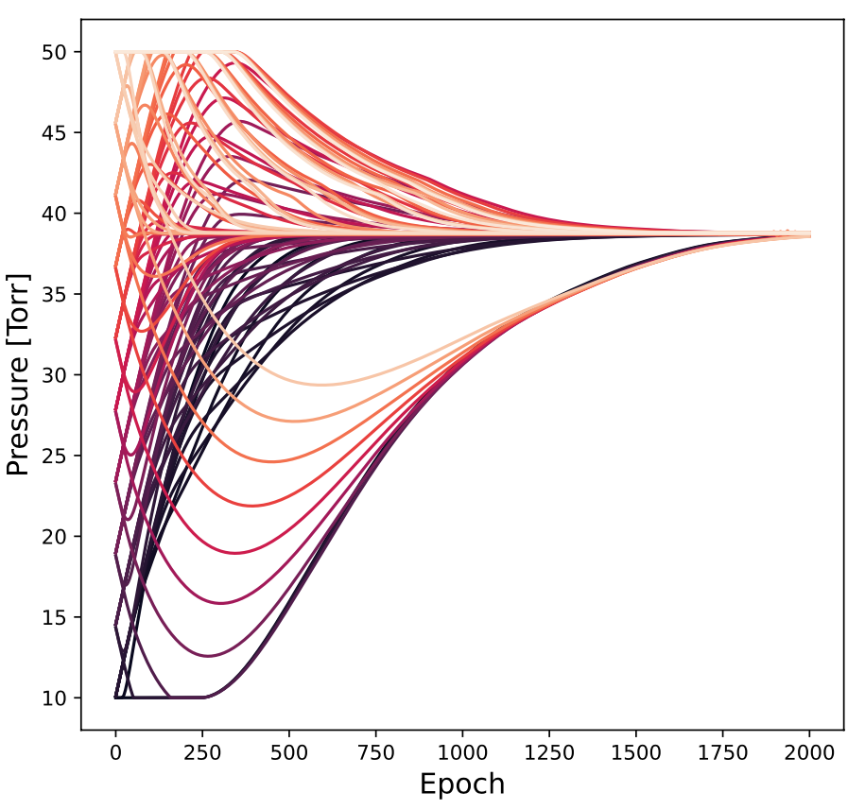
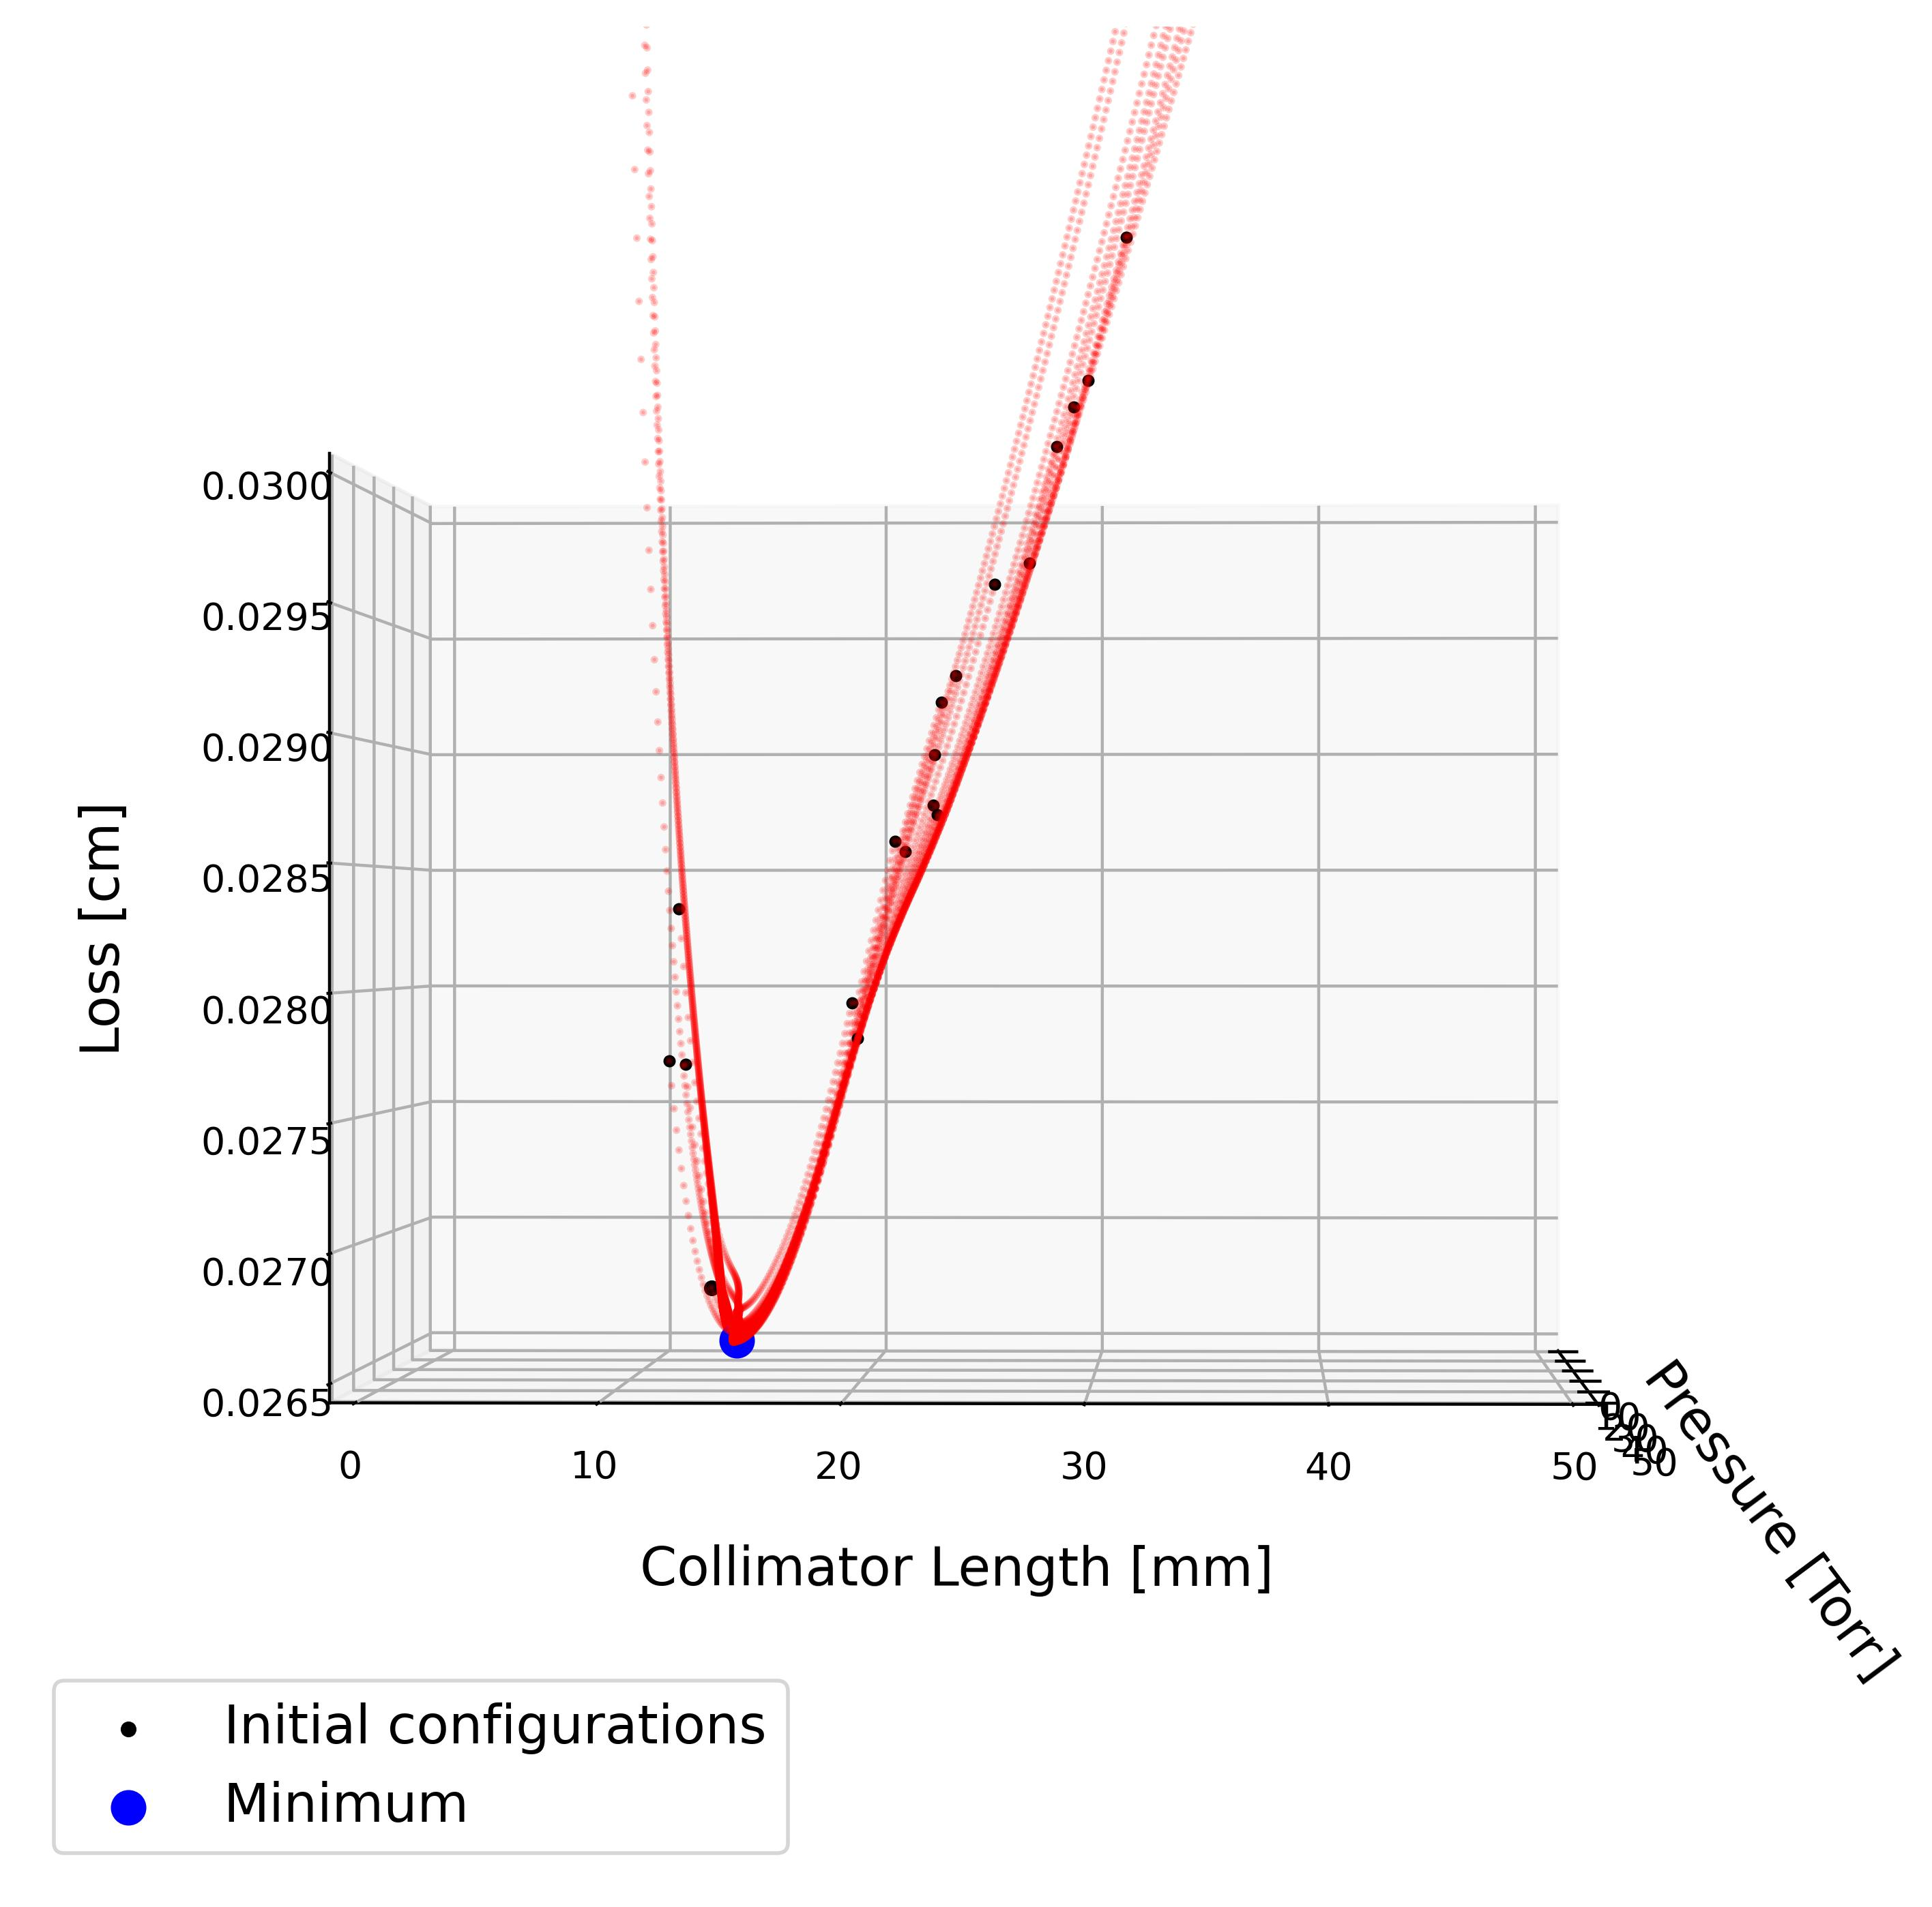
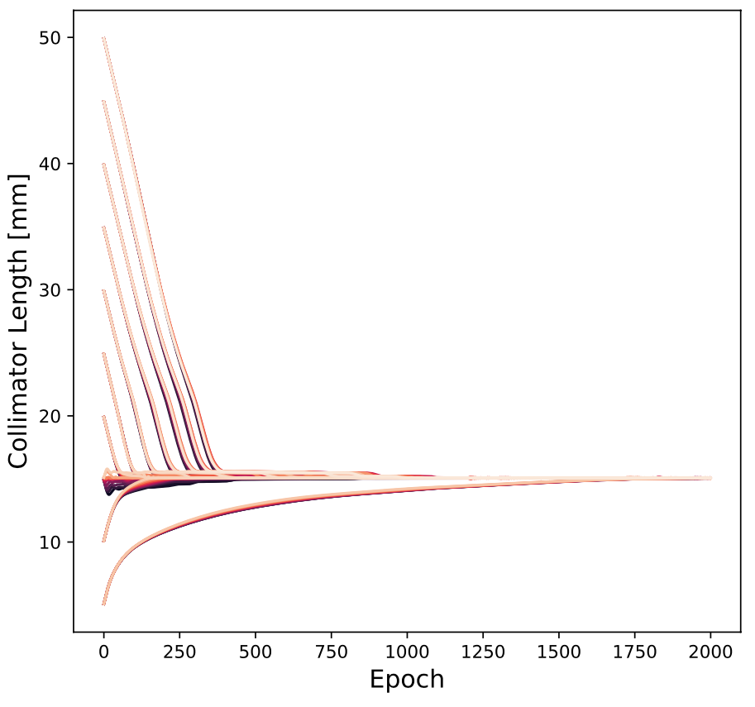
1. NN surrogate
Solution remarkably stable regardless of initial configuration
Results published in Particles 2025, 8(1), 26; https://doi.org/10.3390/particles8010026

Slide 16
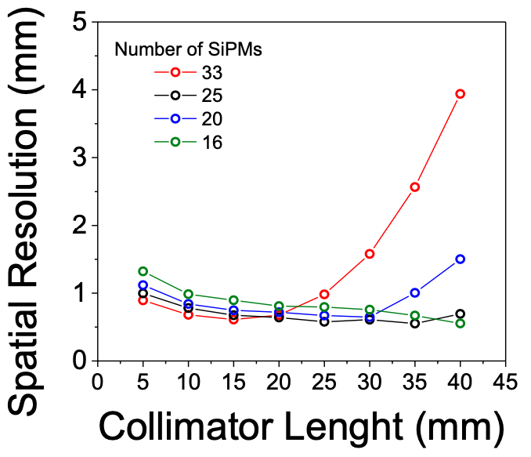
1. NN surrogate
Collimator length result matches the traditional approach: 10.1088/1748-0221/13/10/P10006
Results published in Particles 2025, 8(1), 26; https://doi.org/10.3390/particles8010026

Slide 17
3.2. Generative surrogate

Slide 18
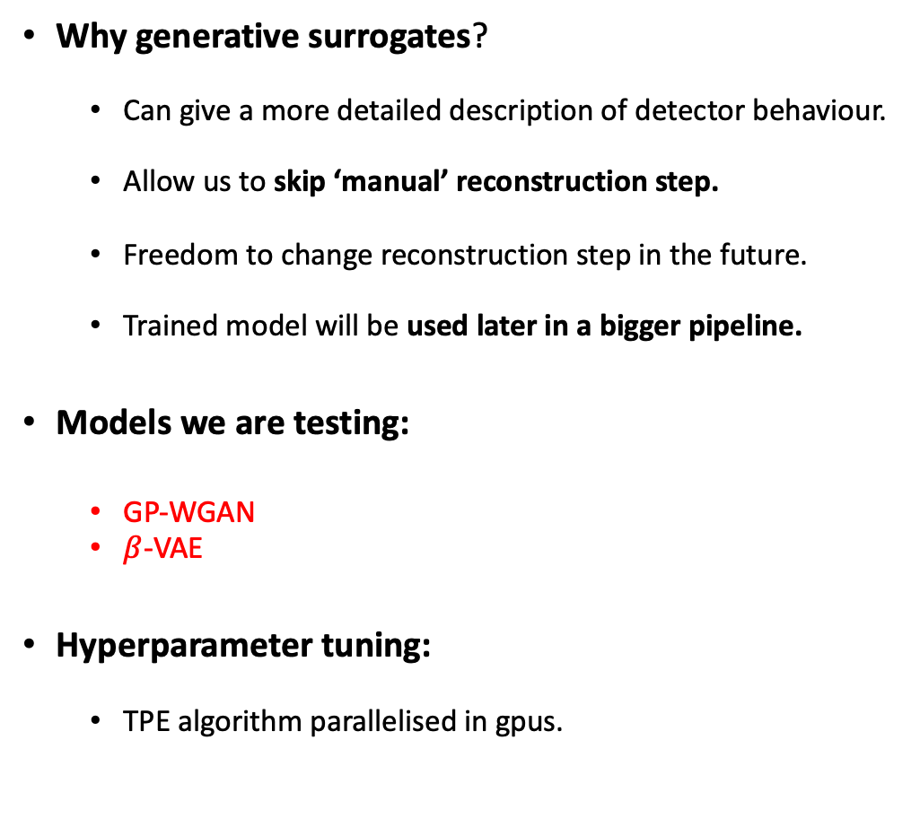
2. Generative Surrogate
Why generative surrogates?
Can give a more detailed description of detector behaviour.
Allow us to skip ‘manual’ reconstruction step.
Freedom to change reconstruction step in the future.
Trained model will be used later in a bigger pipeline.
Models we are testing:
GP-WGAN
$β$-VAE
Hyperparameter tuning:
TPE algorithm parallelised in gpus.

Slide 19

2. Generative Surrogate: Current status and challenges
Real events
GP-WGAN (RMSE = 5.2829)
$β$-VAE (RMSE = 5.2356)

Slide 20
2. Generative Surrogate: Current status and challenges
Behaviour is pretty uniform in x, y
but not so uniform in p, L
Proposed solutions:
- Train separate models for different regions.
- Penalize bad behaviour in this region through weights in loss function

Slide 21
2. Generative Surrogate: Current status and challenges
- Interesting parameter: error in reconstructed position
- $β$-VAE is better than GP-WGAN but there’s room for improvement.

Slide 22
Conclusions

Slide 23



Conclusions
Next steps
We are applying differentiable programming for the optimization of the O-PPAC detector.
With NN surrogate approach:
Solution independent of the initial configuration.
Collimator length result aligns with traditional methods.
With generative surrogate approach:
GP-WGANs and $β$-VAEs show comparable performance.
Behaviour is dependent on parameter region.
Improve generative surrogate response throughout the parameter space.
Try state-of-the-art models:
Diffusion models
Normalizing flows
Build pipeline for the full tomography system.

Slide 24
Thank you for your attention!
Questions?

Slide 25
Backup slides

Slide 26
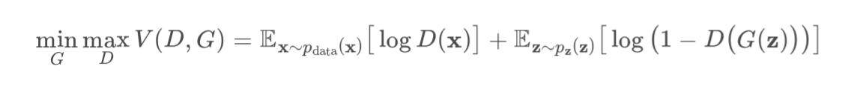
Vanilla GANs (2014) (https://arxiv.org/abs/1406.2661)
Discriminator tries to classify events as real or fake
Generator tries to fool the discriminator into thinking that generated events are real
Know problems:
- Training can converge without good results. Loss doesn’t give us information of the quality of the samples
-Inestability: D and G have to be very coordinated through architecture and learning rate. If not, convergence is not guaranteed.
- Mode Collapse: G learns to fool D producing the same event or very few events.
- Overtrained discriminator: if D is very good at classifying events, G cannot learn

Slide 27
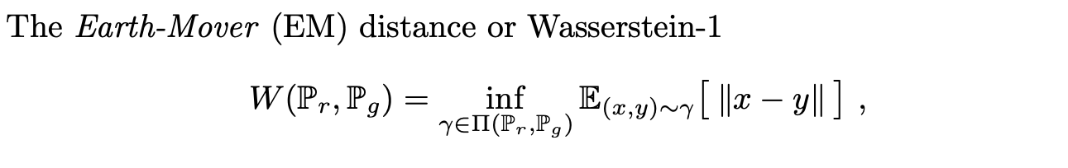
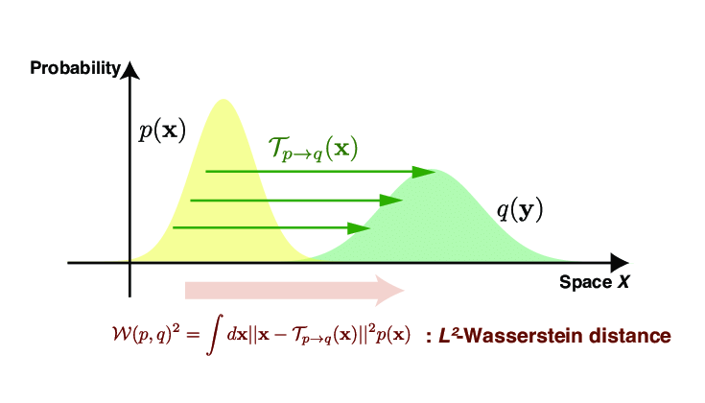
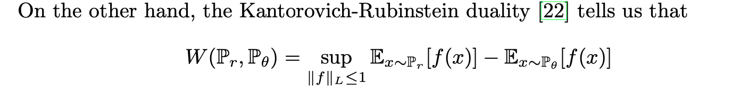
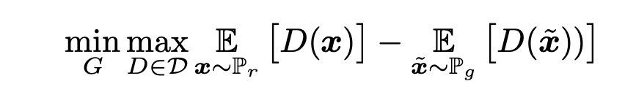

Wasserstein GANs (2017) (https://arxiv.org/pdf/1701.07875)
We can use the critic (old discriminator) function as an estimator of the W distance, while the generator tries to minimize it
K-Lipschitz constraint:

Slide 28
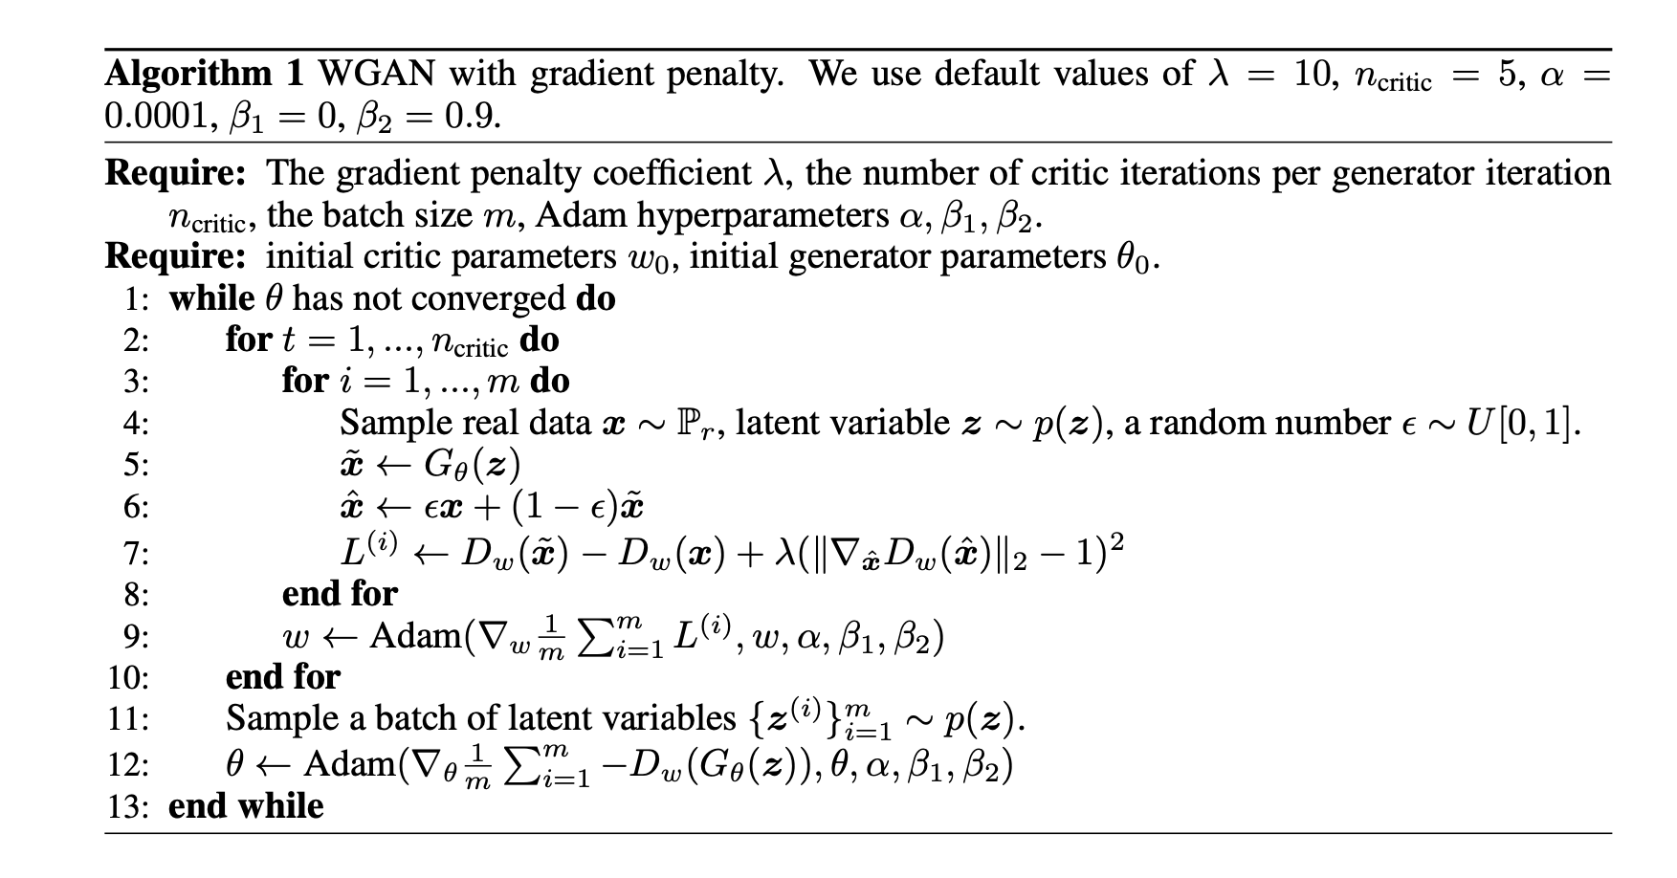
Wasserstein GANs: keys
Train the critic more often than the generator to have a good estimation of WD before updating G
Don’t use batch norm on the critic
Enforce the Lipschitz constraint. Two ways:
Gradient clipping (not ideal)
Gradient penalty (https://arxiv.org/pdf/1704.00028)

Slide 29
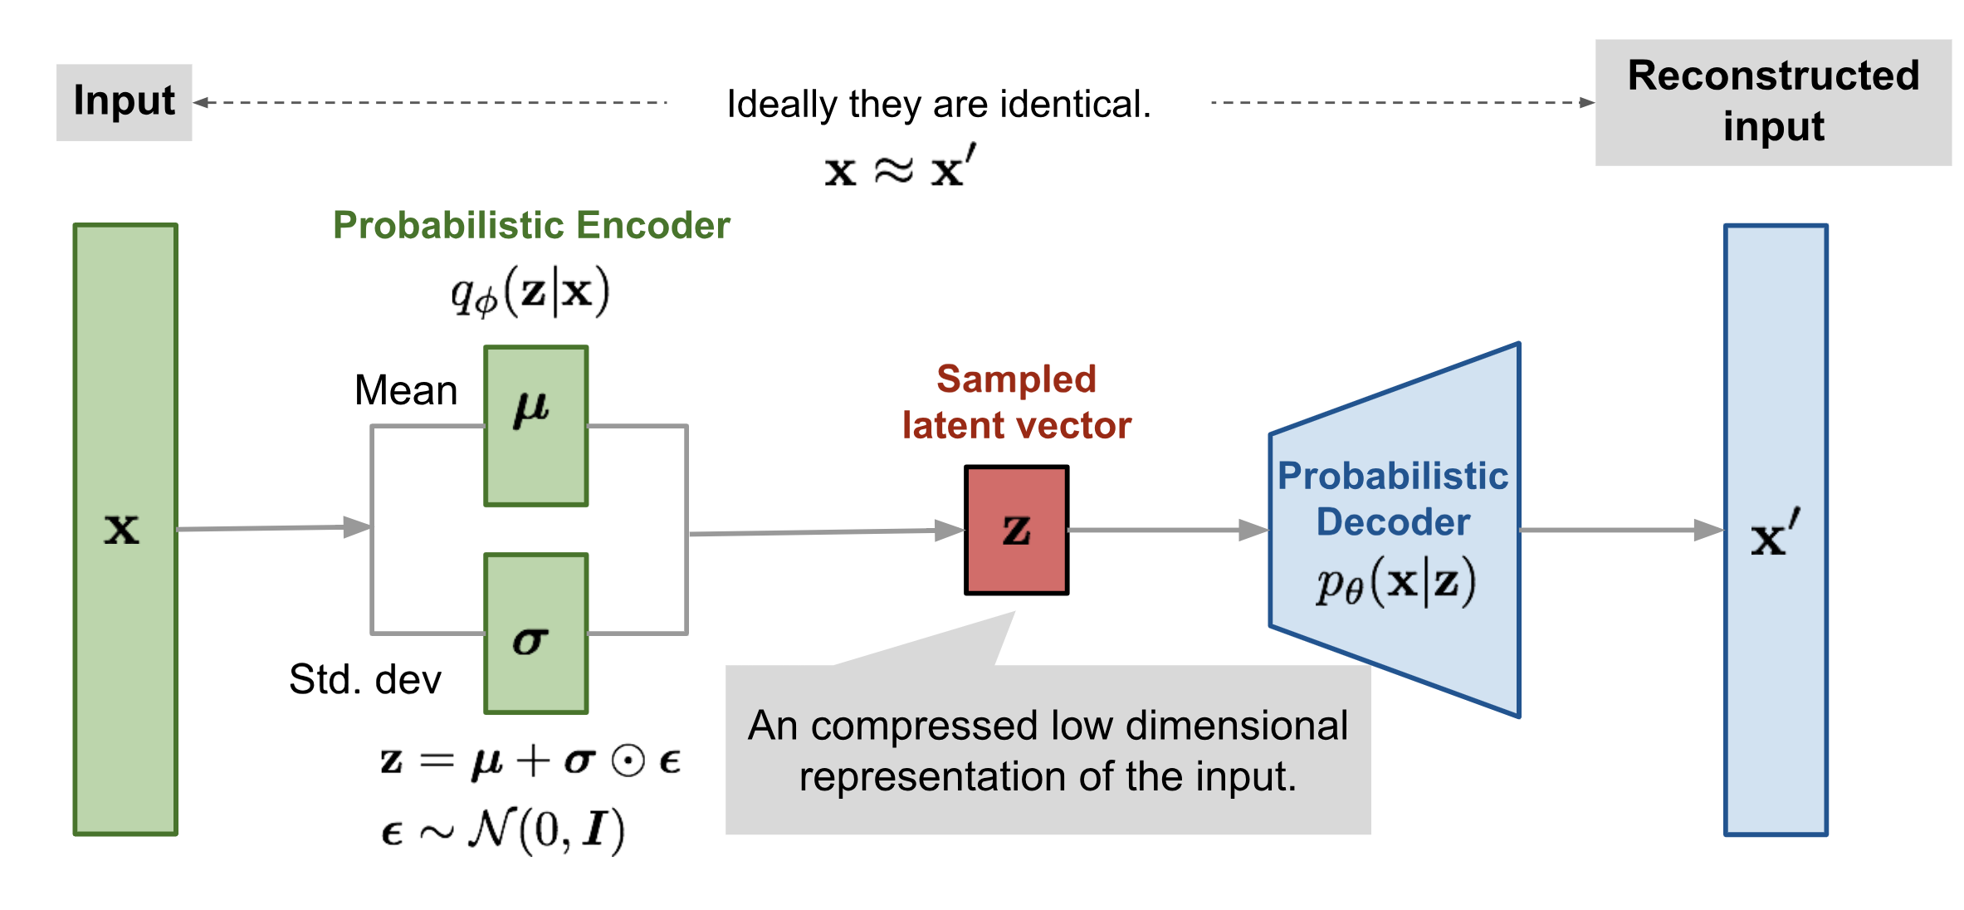
β-VAE
L = RMSE(input, output) + β KLD(p(z|x), gaussian)

