Slide 1

IRIS-HEP
G. Watts (UW/Seattle)
Deputy Executive Director of IRIS-HEP
For the IRIS-HEP Team
XVII CPAN Days
COMCHA Session
2025-11-19

Slide 2
What is IRIS-HEP?
IRIS-HEP is a software institute funded by the US National Science Foundation to contribute to a software upgrade for the High Luminosity LHC, in parallel to the large hardware (MREFC) investment.

Slide 3
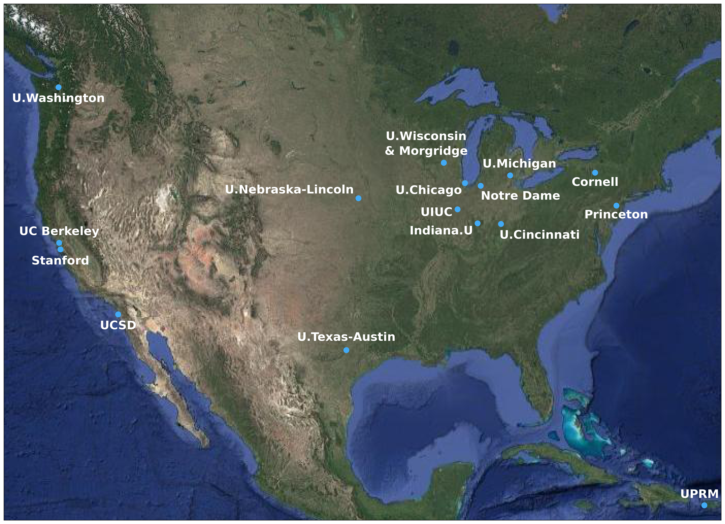
What is IRIS-HEP?
~30 FTE’s
60 People
16 Institutes

Slide 4
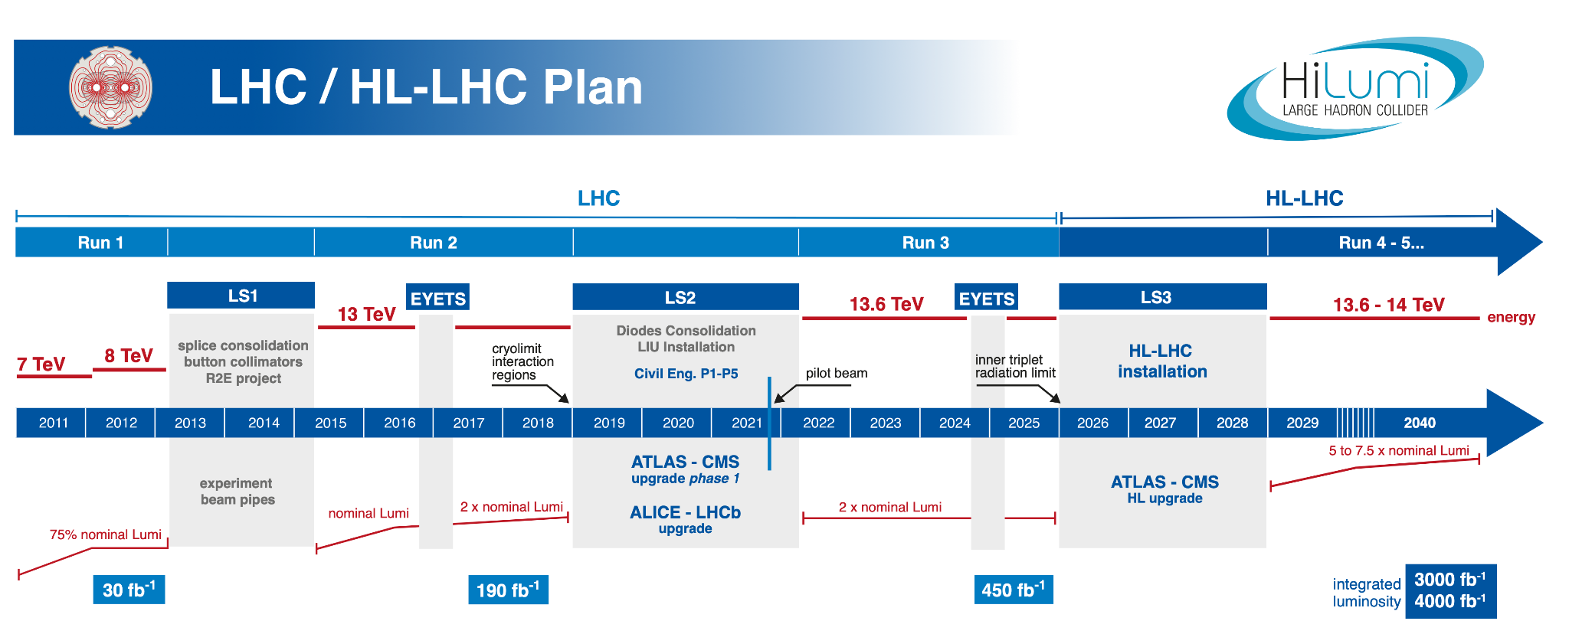
(January, 2022 version)
?
COVID
CTDR
IRIS-HEP Institute
IRIS-HEP Institute
(Phase 2)
S2I2-HEP
Institute Conceptualization and
Community White Paper Process
Design
Execution
Snowmass
U.S. HEP Community Planning Process

Slide 5


A Short History
NSF funded the S2I2-HEP Conceptualization Project (s2i2-hep.org/) in July 2016
Community charge from the Worldwide LHC Computing Grid in July 2016:
Anticipate a “software upgrade” in preparation for the HL-LHC
Identify and prioritize the software research and developments investments
to achieve improvements in software efficiency, scalability and performance and to make use of the advances in CPU, storage and network technologies
to enable new approaches to computing and software that could radically extend the physics reach of the detectors
to ensure the long term sustainability of the software through the lifetime of the HL-LHC

Slide 6
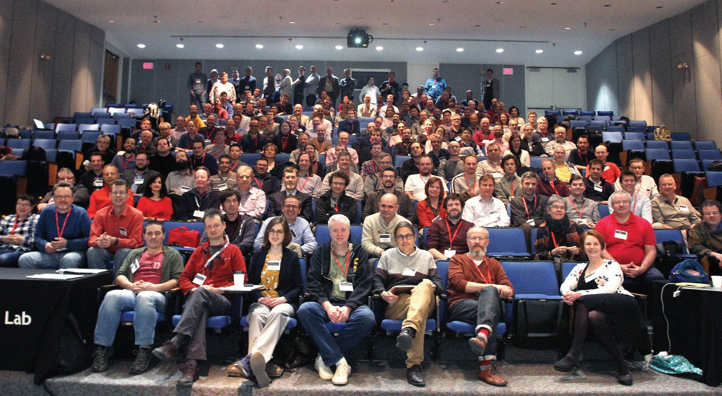
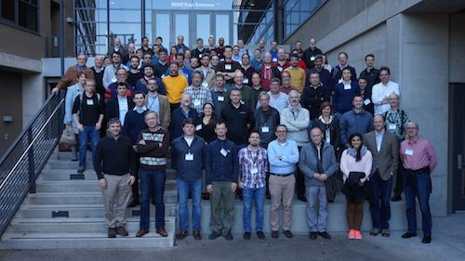
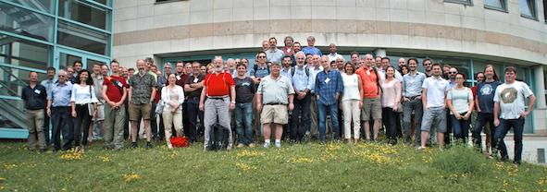
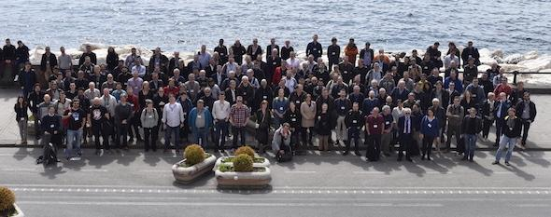
Growing a Global Collaboration
JLab
March, 2018
HSF/OSG/WLCG
UCSD/SDSC
January, 2017
HSF CWP
Naples
March, 2017
WLCG/HSF
Annecy
June, 2017
HSF CWP
Community White Paper: arXiv 1712.06592

Slide 7
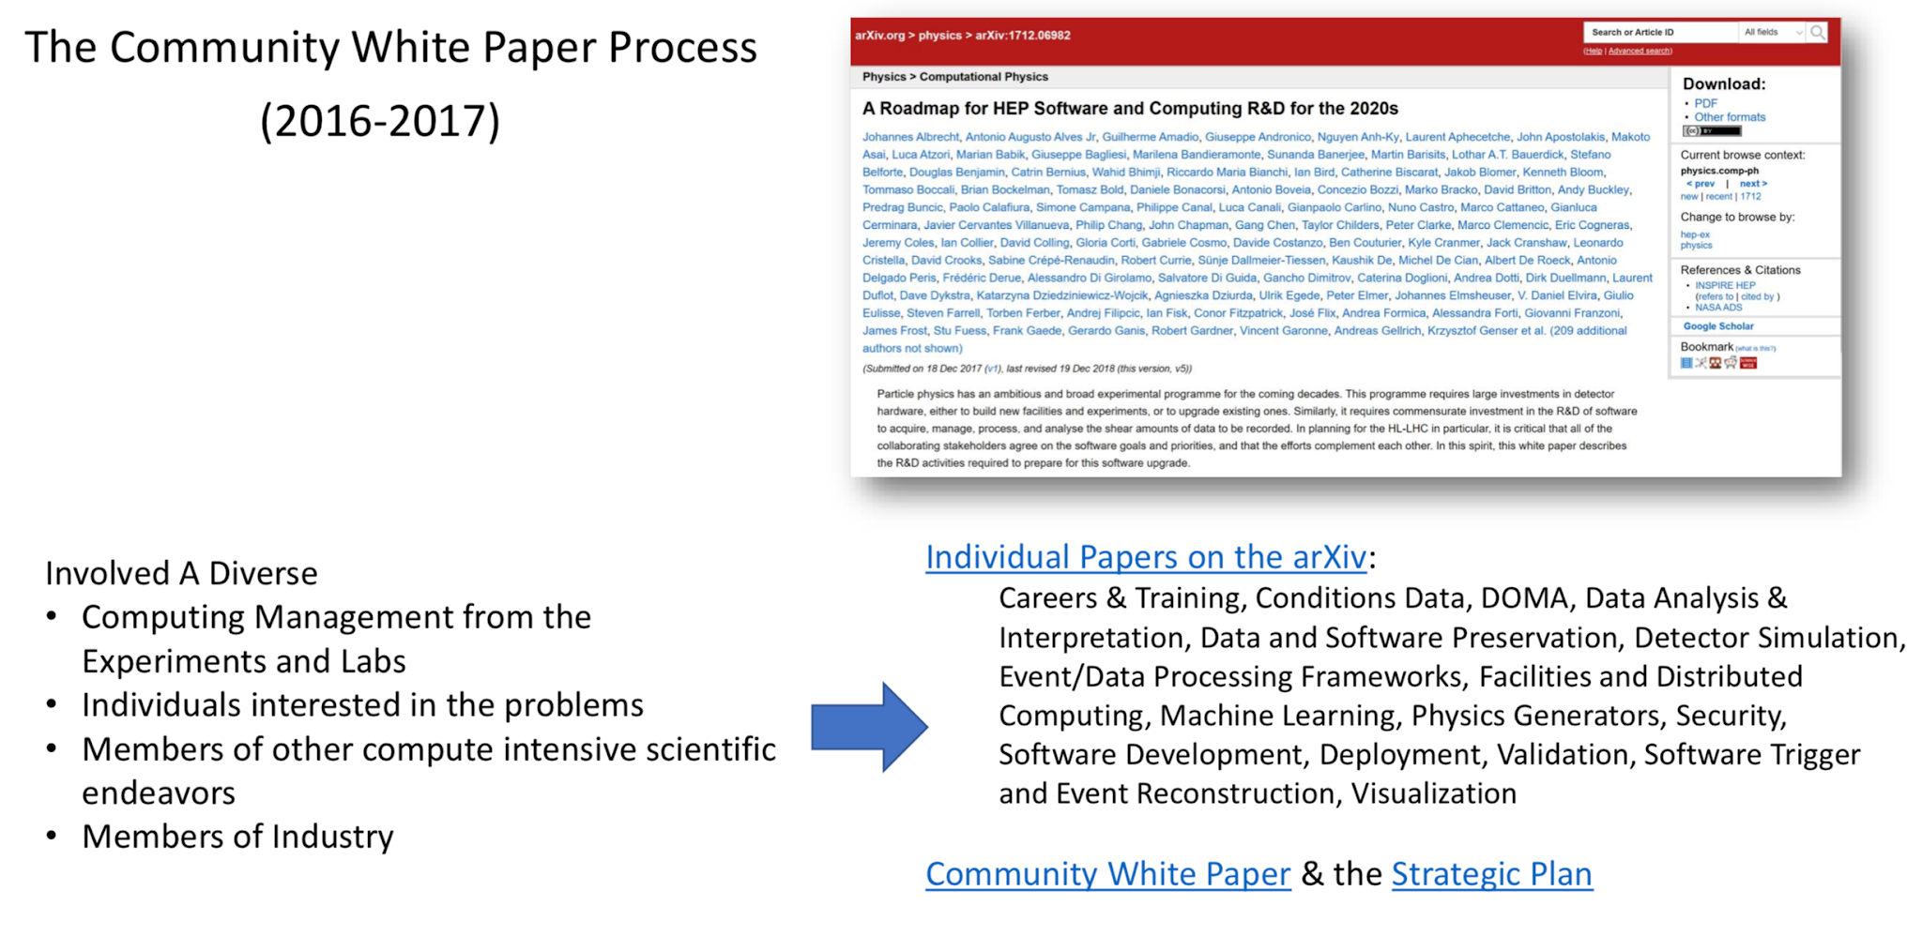
Grass Roots
Strategic Plan

Slide 8
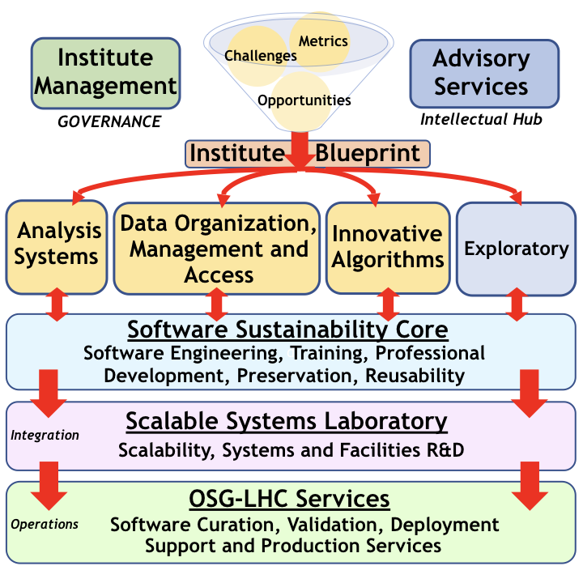
Main Areas of R&D
Training, Scaling, Production

Slide 9
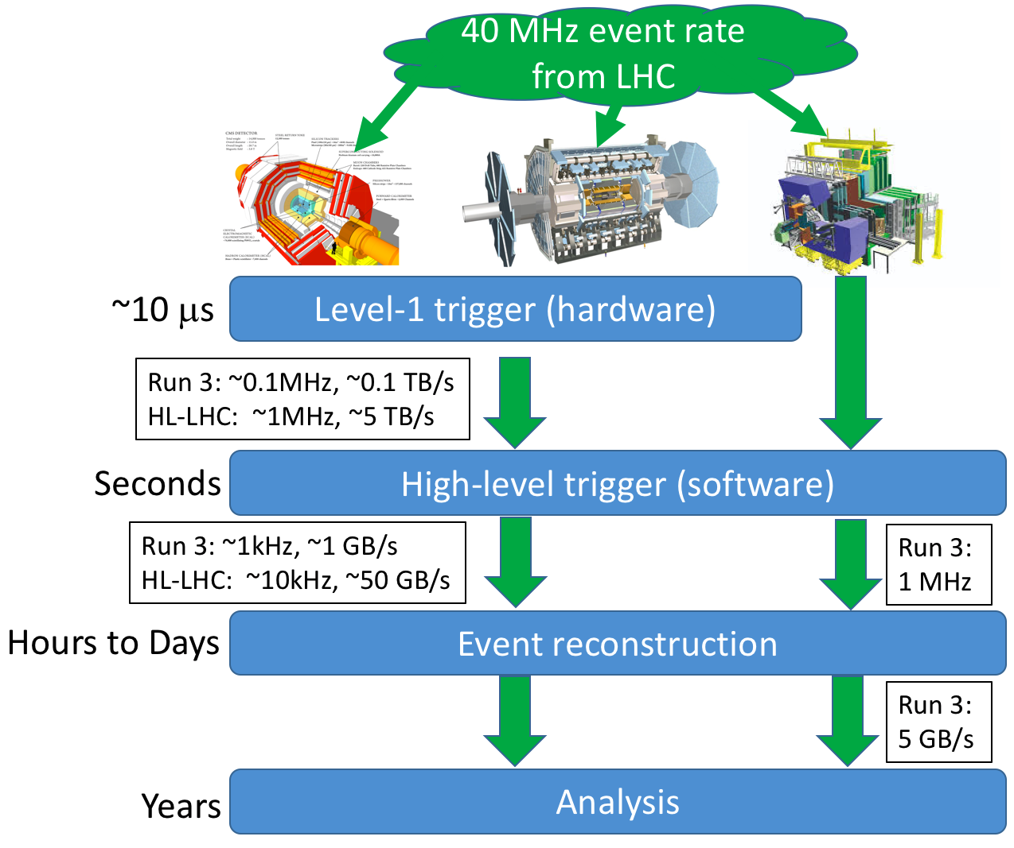
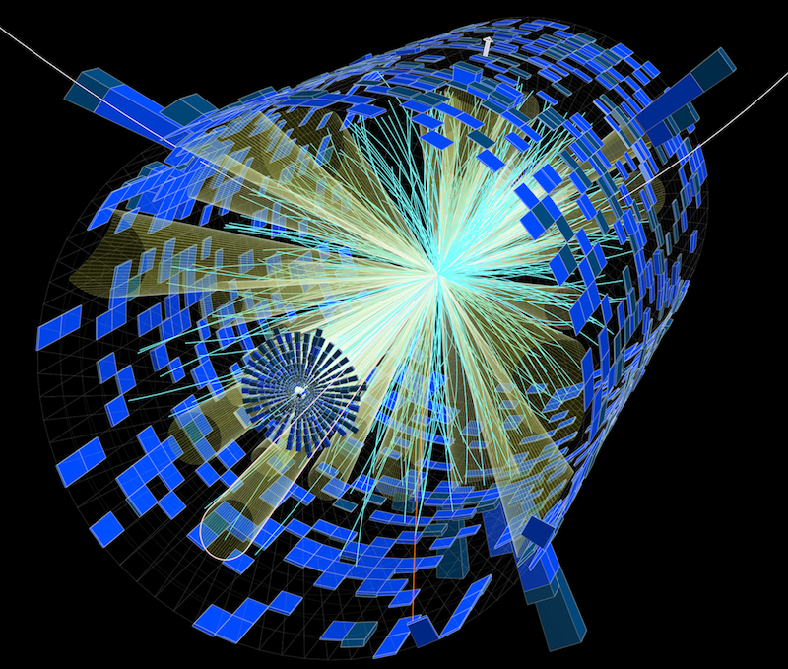
Innovative Algorithms - Trigger/Reconstruction
Full Project List
Algorithms for real-time processing of detector data in the software trigger and offline reconstruction are critical components of HEP’s computing challenge.

Slide 10
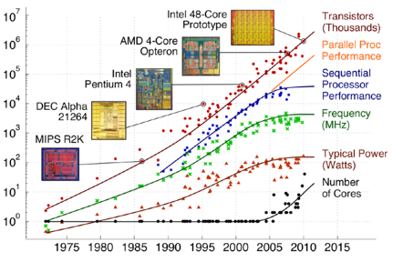
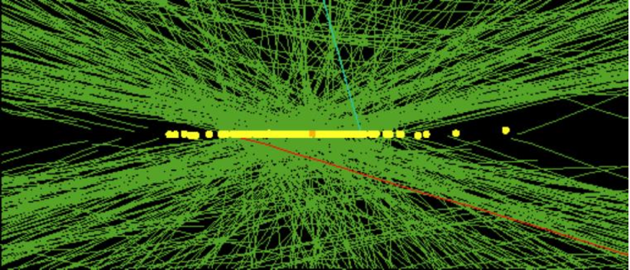
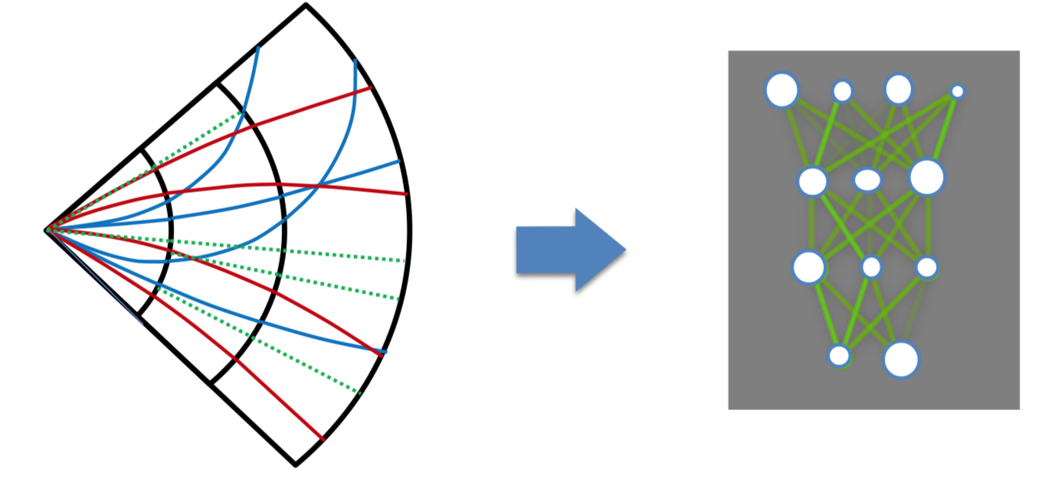
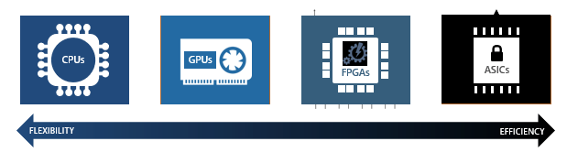
Groups are focused on answering 2 questions
How to make use of major advances in machine learning (ML)?
Use of ML in HEP may be a major opportunity
Capitalize on industry and data science techniques and tools
Could reduce CPU needs
Could lead to wider use of accelerators
IRIS-HEP investigations
New HEP applications of ML
Use of new ML techniques
ML on accelerators in realistic HEP apps
How to redesign tracking algorithms for HL-LHC?
Determination of charged-particle trajectories (“tracking”) is largest component of event reconstruction
IRIS-HEP investigations
More efficient algorithms
More performant algorithms
Use of hardware accelerators

Slide 11
Projects
Name | Focus Area(s) | Maturity | Description
Accelerated GNN Tracking | IA | Exploratory | accel-gnn-tracking
Accelerators and ML for reconstruction | IA | Archived | Accelerated calorimeter reconstruction using Machine Learning as a Service
ACTS | IA | Development | Development of experiment-independent, thread-safe track reconstruction.
GPU Trigger Project | IA | Testing | Allen: a GPU trigger for LHCb
Line-Segment tracking | IA | Development | Segment linking tracking for CMS
Machine Learning for jets | IA | Development | Machine learning for jets
mkFit | IA | Deployed | Modernizing Kalman filter tracking for CMS
PV-Finder | IA | Testing | CNNs to find primary vertices

Slide 12
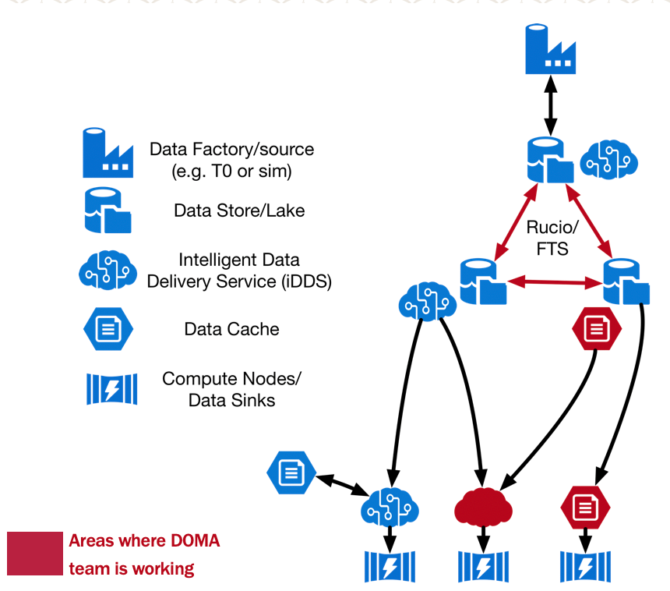
Data Organization, Management
and Access (DOMA)
Full Project List
The DOMA focus area performs fundamental R&D related to the central challenges of organizing, managing, and providing access to exabytes of data from processing systems of various kinds.
Data Organization: Improve how HEP data is serialized and stored.
Data Access: Develop capabilities to deliver filtered and transformed event streams to users and analysis systems.
Data Management: Improve and deploy distributed storage infrastructure spanning multiple physical sites. Improve inter-site transfer protocols and authorization

Slide 13
Projects
The Analysis Grand Challenge
Name | Focus Area(s) | Maturity | Description
200 Gbps Challenge | AS, DOMA | Testing | 200gbps
Analysis Grand Challenge | DOMA, AS | Development | Analysis Grand Challenge
Caching Data for LHC Analysis | DOMA, OSGLHC | Deployed | Cached-based placement of analysis datasets.
Coffea-Casa | DOMA, AS | Testing | A Prototype of Analysis Facility
Intelligent Data Delivery Service | DOMA | Deployed | Delivering Data. Better.
Modeling Data Workflows | DOMA, OSGLHC | Archived | Modeling HL-LHC Data flows
ServiceX | DOMA | Testing | Delivering columnar data on demand
SkyhookDM | DOMA | Development | Programmable Storage for Databases and Datasets
Third Party Copy | DOMA, OSGLHC | Deployed | Envisioning a new way to move LHC data

Slide 14
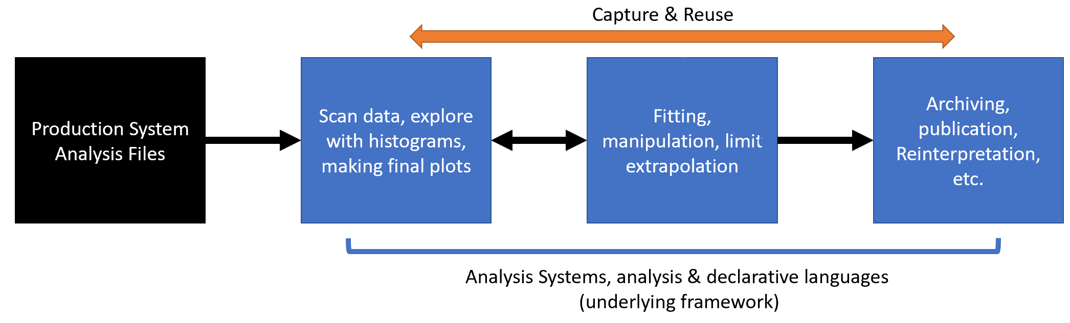
Analysis Systems
Full Project List
Develop sustainable analysis tools to extend the physics reach of the HL-LHC
create greater functionality to enable new techniques,
reducing time-to-insight and physics,
lowering the barriers for smaller teams, and
streamlining analysis preservation, reproducibility, and reuse.
Analysis Systems projects span all stages of end-user analysis.

Slide 15
Projects – Python Ecosystem
Name | Focus Area(s) | Maturity | Description
ADL Benchmarks | AS | Deployed | Functionality benchmarks for analysis description languages
Awkward Array | AS | Deployed | Manipulate arrays of complex data structures
Awkward-Dask | AS | Testing | Developing a new high-level Dask collection for Awkward Arrays
Columnar PHYSLITE | AS | Development | Columnar data analysis workflows with ATLAS PHYSLITE
Functional ADL | AS | Deployed | Functional Analysis Description Language
Histogram projects | AS | Deployed | Histogramming efforts
ROOT on Conda-Forge | AS | Deployed | Use ROOT in Conda through Conda-Forge
Scikit-HEP | AS | Deployed | Pythonic analysis tools
uproot | AS | Deployed | Read and write ROOT files in Python
Vector | AS | Deployed | Manipulate vectors

Slide 16
Projects - Statistics
Name | Focus Area(s) | Maturity | Description
abcd-pyhf | AS | Development | Likelihood-based ABCD method with pyhf
AmpGen | AS | Deployed | Generation and fitting for multibody hadron decays
cabinetry | AS | Deployed | Building and steering template fits
MadMiner | AS | Deployed | Likelihood-free Inference
ppx | AS | Deployed | Cross-platform Probabilistic Programming eXecution protocol
pyhf | AS | Deployed | Differentiable likelihoods
Along with other projects…

Slide 17
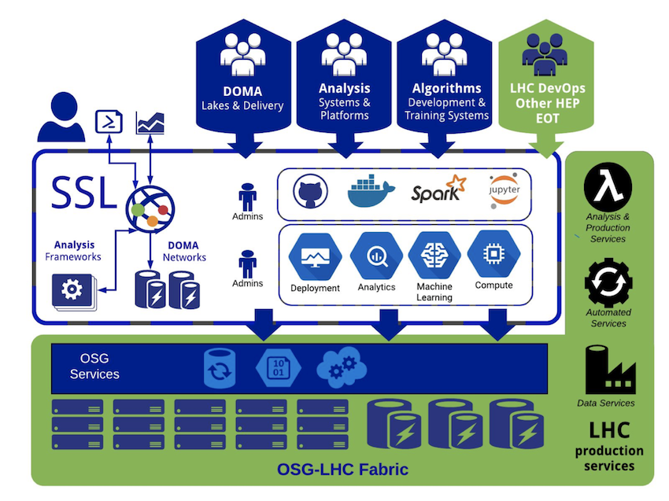
Scalable Systems Laboratory (SSL)
Full Information
Goal: Facilities Research
New paradigms for running facilities (e.g. k8s), distribution, etc.
Provides access to infrastructure and environments
Organizes software and resources for scalability testing
Does foundational systems R&D on accelerated services
Provides the integration path to the OSG-LHC production infrastructure

Slide 18
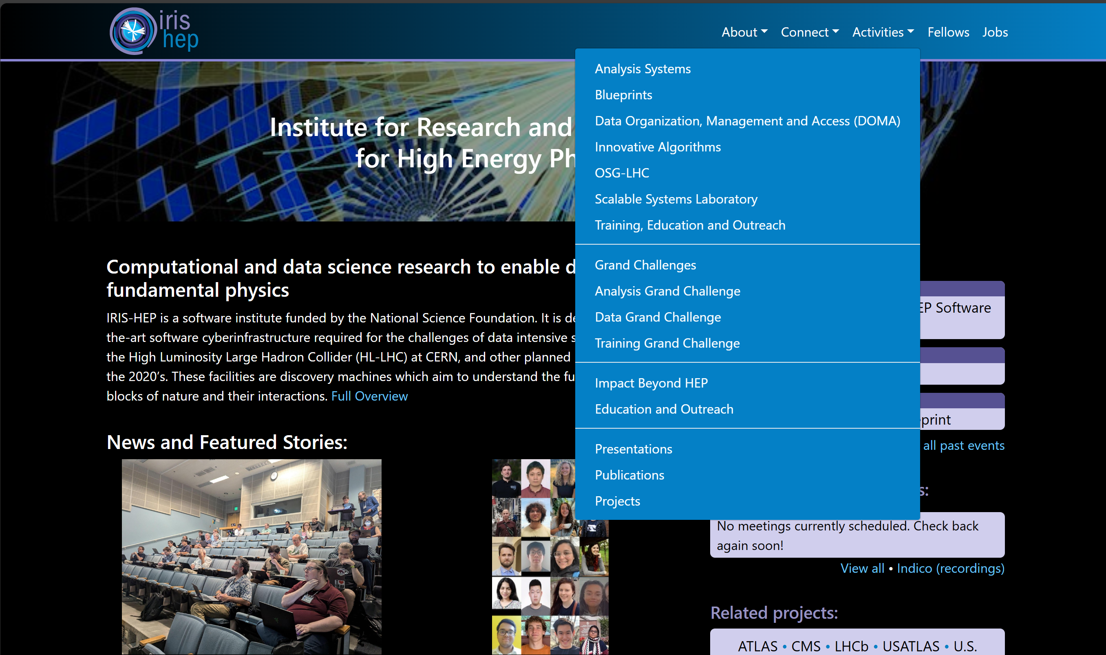
Finding Out More
Start with our Web Page:
https://iris-hep.org

Slide 19
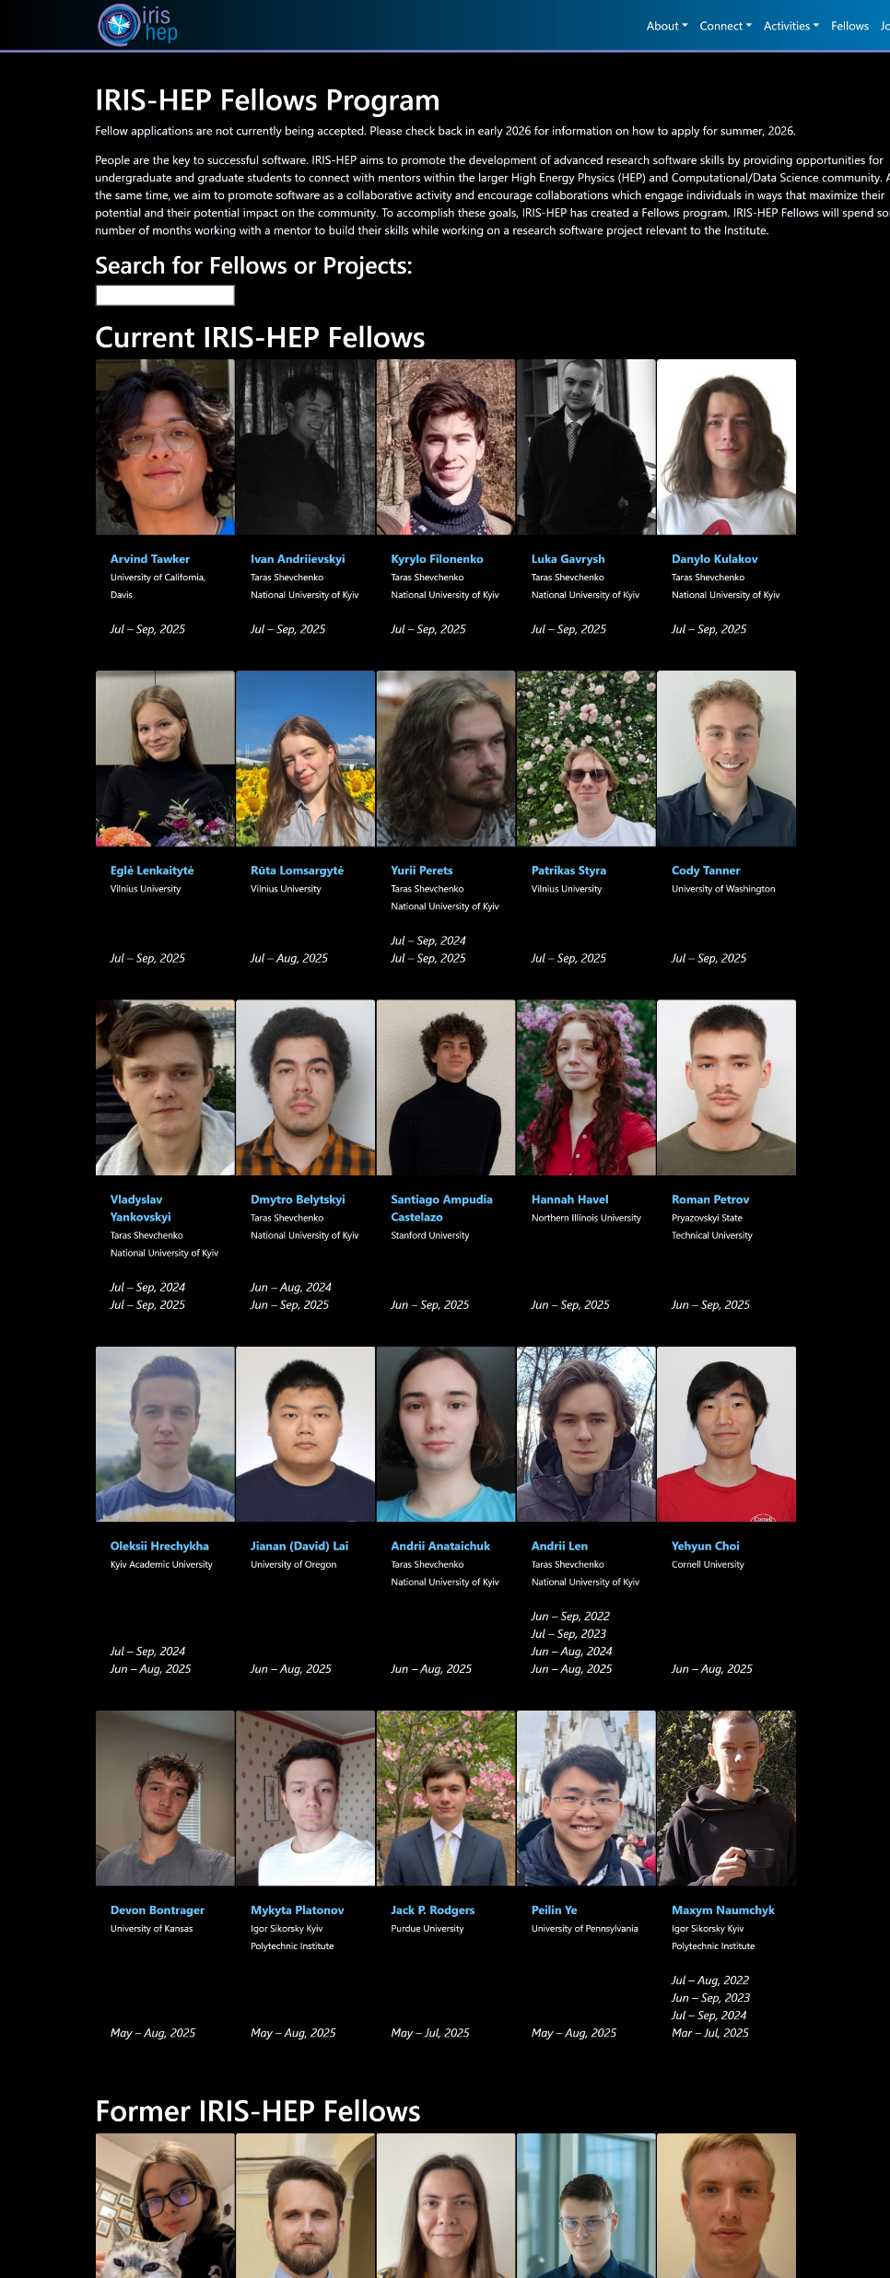
(Summer) Fellows Programs
Started as a Graduate Program
COVID turned it into an undergraduate program
This has been widely successful!
Gather projects from potential mentors in ~January
Student applications in March
Force interaction between potential students and mentors to draw up an application
Students must commit to 2 months of paid full-time work
Selection in late spring
Students work for 2 months over the summer

Slide 20
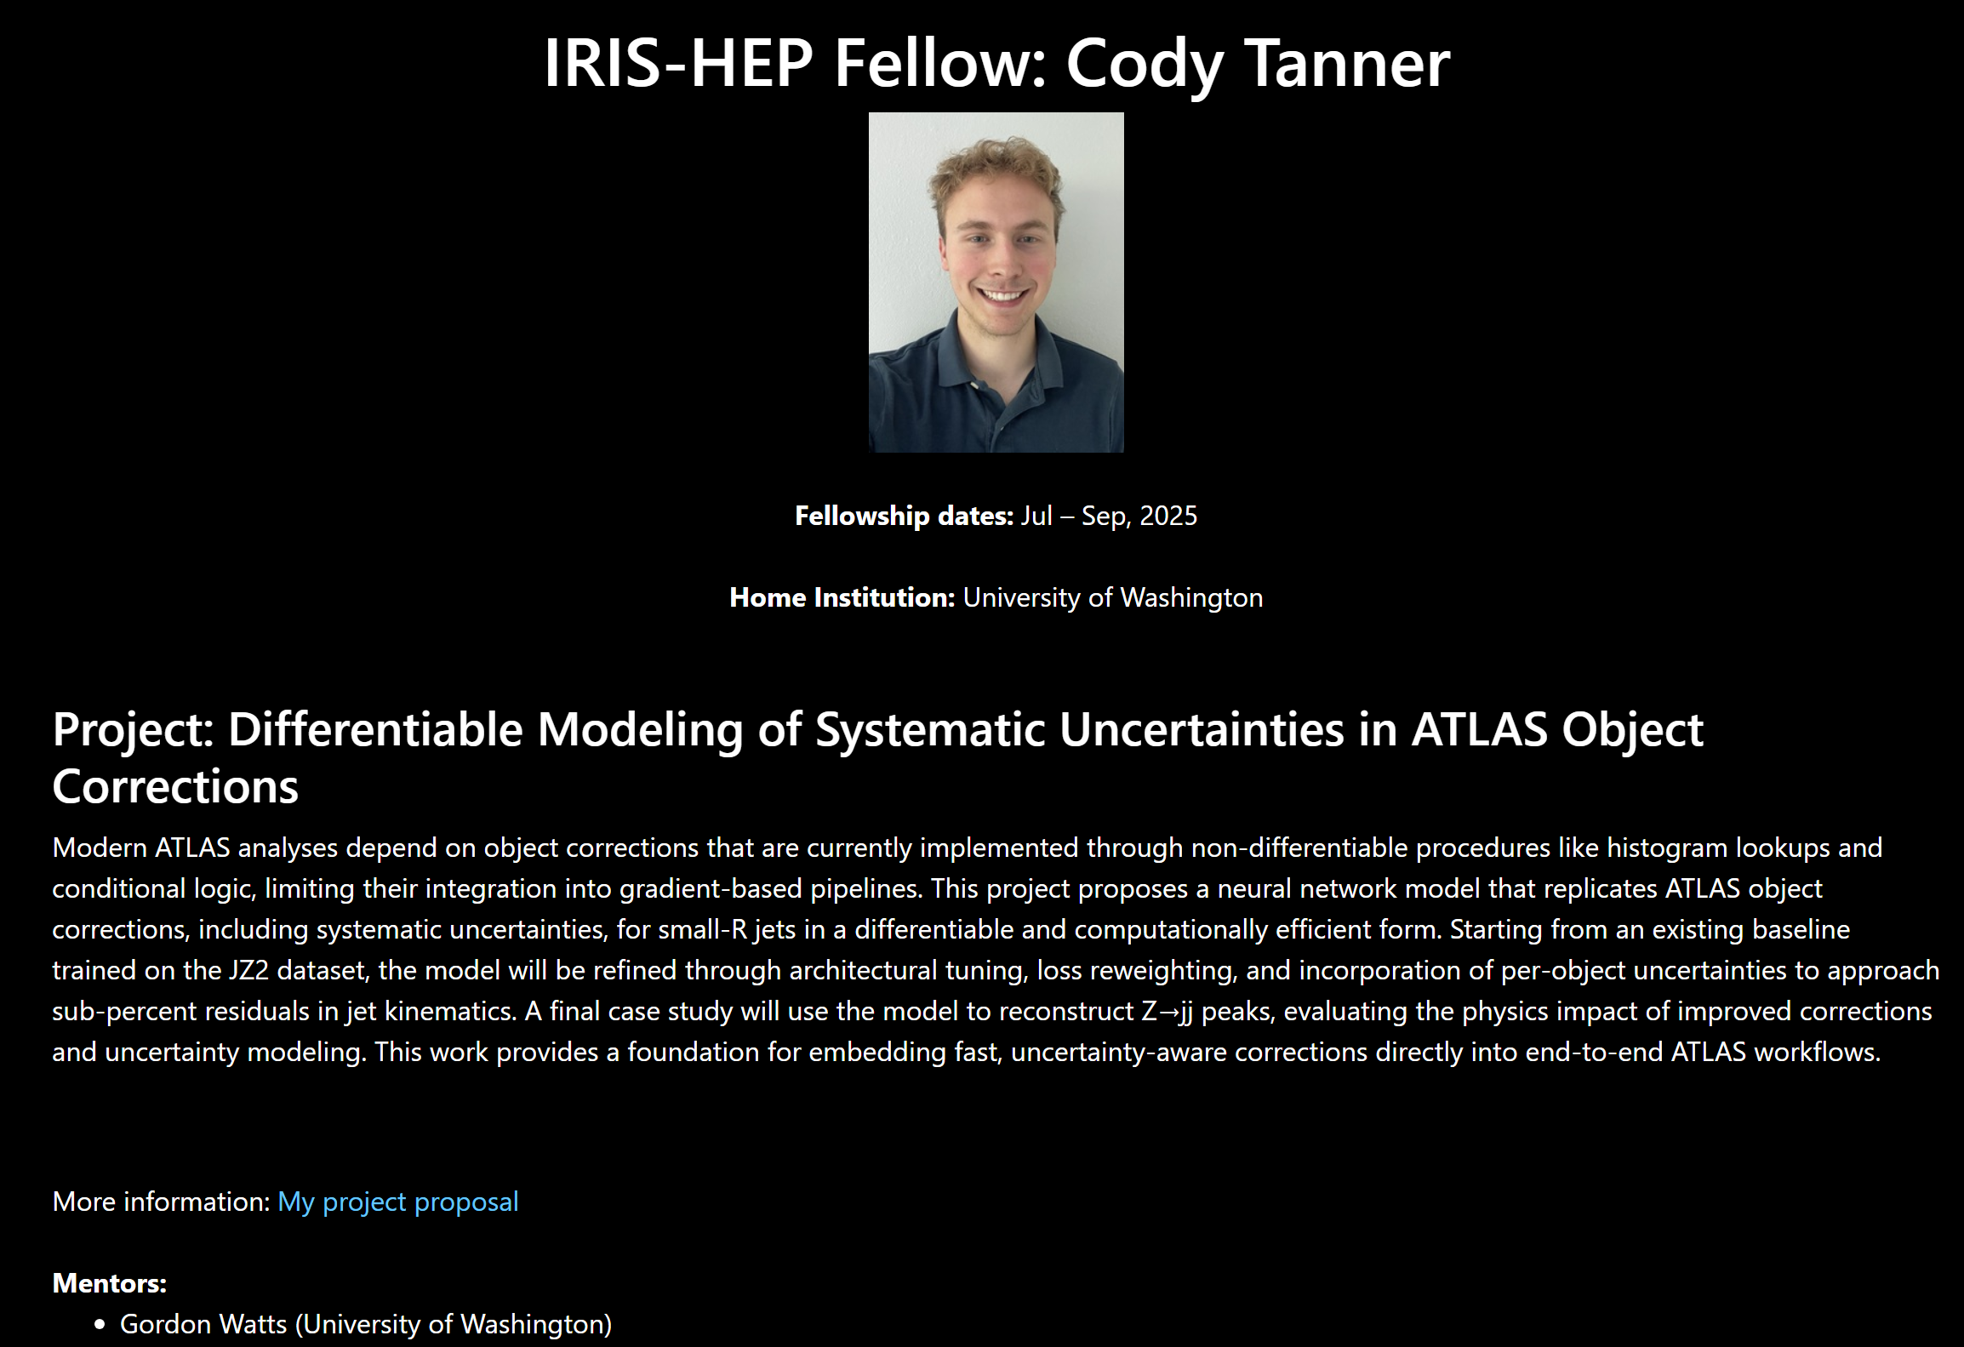
Example Project

Slide 21
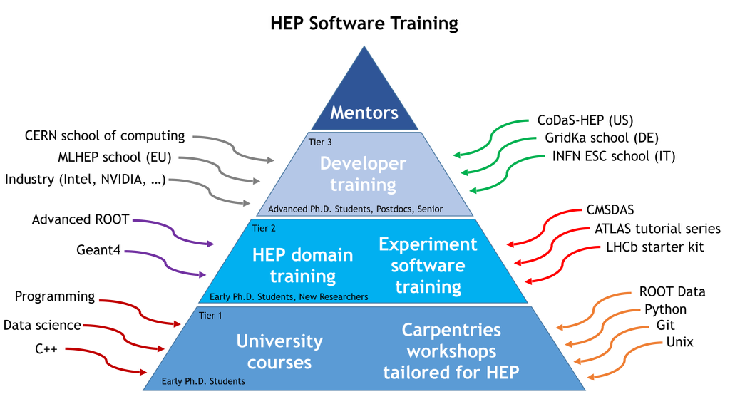
Training Events
We sponsor, collaborate, run, many training events!

Slide 22
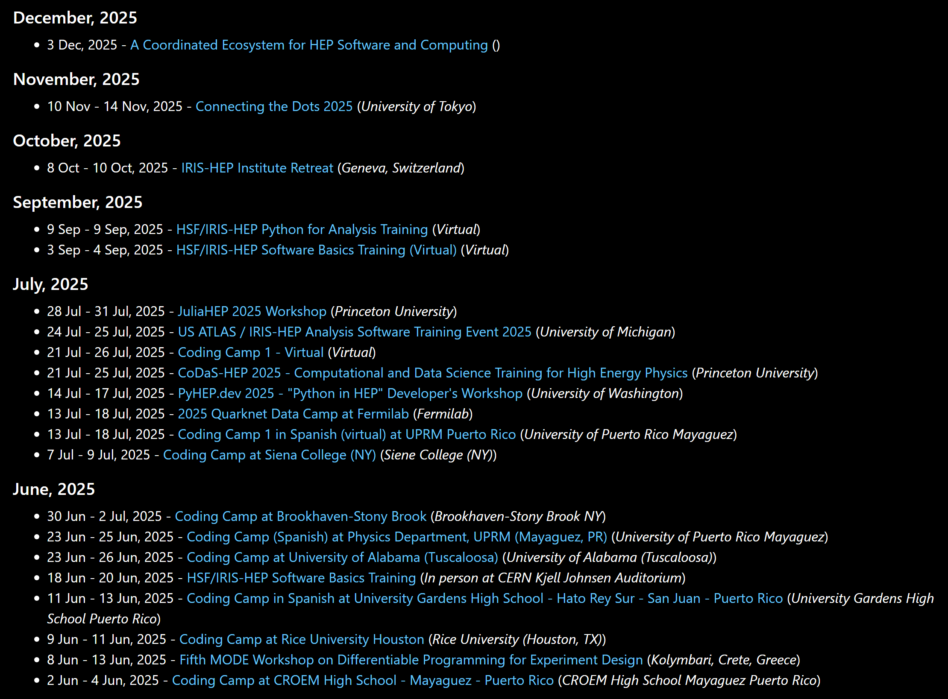
Events
Python Training
Software Carptentries Training
Co-located training at US ATLAS and US CMS summer meetings
CoDaS HEP
Coding Camps with Quarknet
Etc…

Slide 23
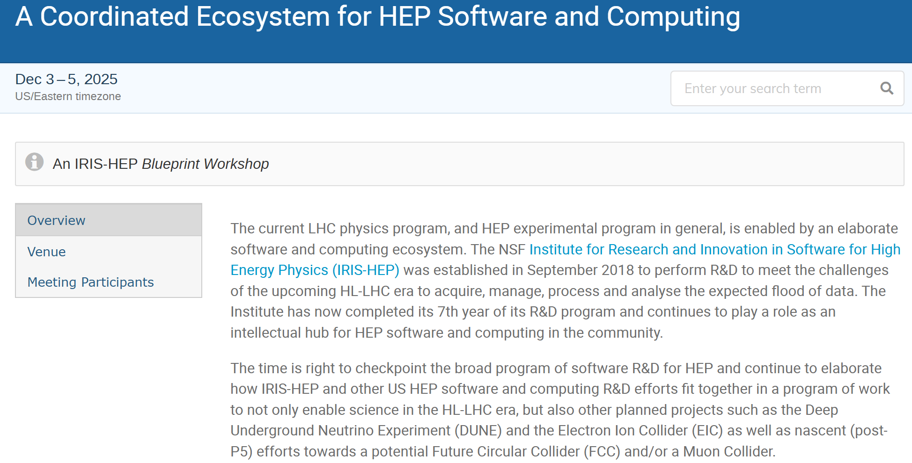
Intellectual Hub
We sponsor workshops and conferences
PyHEP
MODE
Connect the Dots
Etc.
We organize Blueprint Meetings
Blueprint Workshops
Gather experts inside and outside the field
Help set the direction of R&D in the future
Build field wide consensus

Slide 24

Conclusions
We are US based HL-LHC focused distributed Software Institute
We do work with others as well (EPIC/DUNE, etc.)
We collaborate with just about everyone on our projects!
Project pages have links of who to contact!
Subscribe to our announcements list
Meetings, blueprints, fellows program, etc.
Contact me with any questions!

