Slide 1



Multimessenger astrophysics synergies among particle physics, astronomy, cosmology
Maurizio Spurio, maurizio.spurio@unibo.it
Università di Bologna and INFN

Slide 2


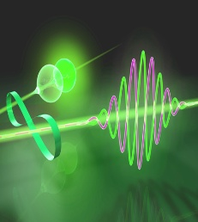
Multimessenger probes: three communities
2
Three large experimental branches
Gravitational waves (GWs), observed using laser interferometers
GWs
CR
Charged CRs
Antimatter
Neutrinos
γ−rays
p⁻ e⁺
γ
Individual quanta (CRs, antimatter, γ -rays, and ν), detected with experimental methods mainly developed for HE physics
The electromagnetic radiation, from radio to X-rays, with detection techniques developed by astronomers

Slide 3
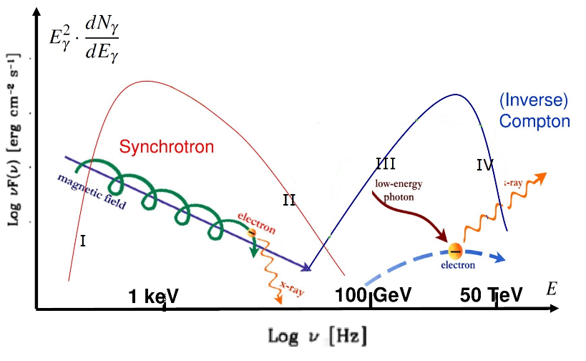
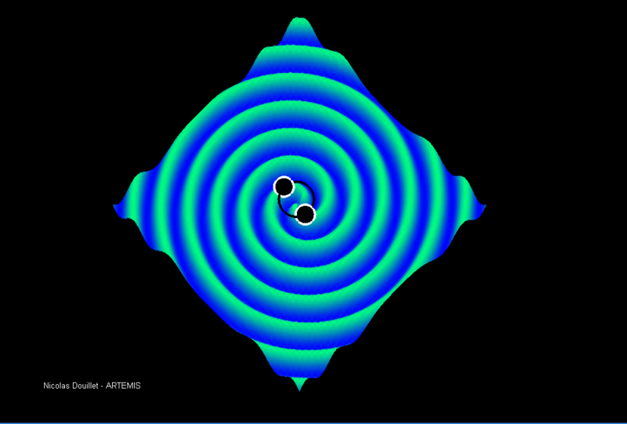
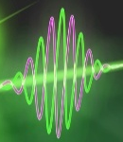
Multimessenger: different role of electrons/protons
3
electrons
hadrons
GWs
(F. Halzen)
CR
p⁻ e⁺
γ

Slide 4
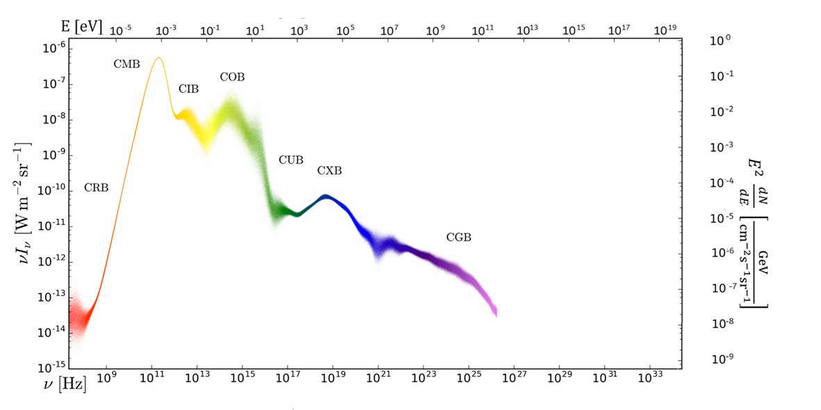
Energy density of probes
(Particle Data Group)
 R. Hill, K. W. Masui, & D. Scott, Appl. Spectroscopy 72, (2018) 663 (adapted)

Slide 5




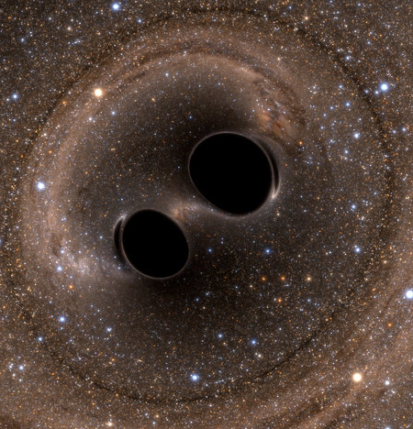
Connection among probes
Aart Heijboer
Weiwei Xu
CR
Jaime Álvarez-Muñiz
Irene Tamborra
Brian Reville
Simona Toscano
Marco Taoso
David Cerdeño
DM
Anita Reimer
Laura Lopez-Honorez
Cristiana Spingola
Chiara Caprini
Javier Redondo
Alicia López-Oramas
Christina Gao
γ
José Antonio Font
GW
Michela Negro
Alicia M. Sintes
Gabrijela Zaharijas
EM radiation
Gordan Krnjaic
Christian Byrnes
Andrei Mesinger
Anatoli Fedynitch
Ali Rida Khalife
Arianna Di Cintio
Katsuaki Asano

Slide 6
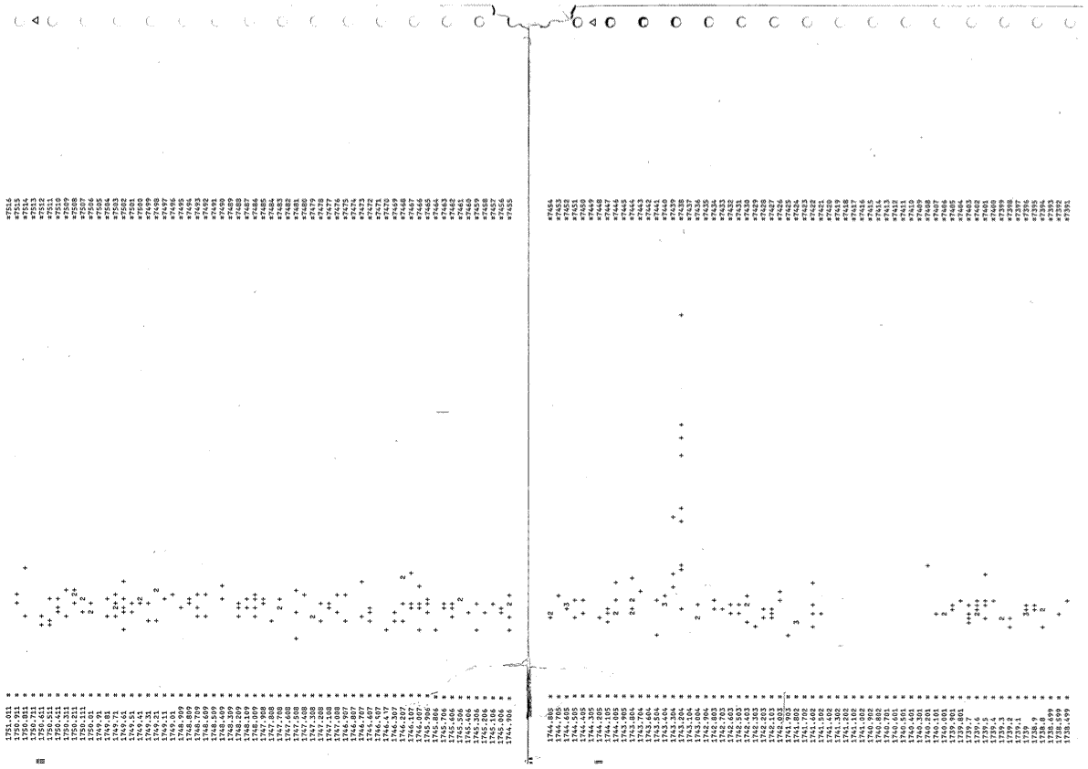
The SN1987A seen by KamiokaNDE
http://www-sk.icrr.u-tokyo.ac.jp/sk/news/2017/02/SN1987A-en.html
Printout of the data: x-axis shows time (one line as 10 s from right to left); y-axis shows the number of hit (proportional to the energy of the event). The peak is the signal of neutrinos from SN1987A. The blank period due to the detector maintenance was recorded a few minutes before the signal.
E
t (10 s/bin)

Slide 7
Multimessenger in 1987
On February 25, 1987, a Fax from the US informed us of the appearance of a supernova in the Large Magellanic Cloud.
News of this SN was quickly sent to the shift persons at Kamioka, and the data tapes until Feb. 25 were immediately sent to Tokyo using a ground transportation service.
Also: M. Koshiba, Phys. Rep. 220, 229 (l992)
Since the mine was closed on February 22 and 23, data were continuously taken during these days. It was lucky for the experiment, because from the end of February, it was planned a steel roof on the top of the detector tank….
On February 26, in order to search for the SN neutrino event, it was decided to look for events satisfying the following three criteria:…. (result: the plot in the previous slide)
The burst occurred at 16:35:35 23 February, 1987, JST, or at 7:35:35, 23 February, 1987, UT (±1 min) during a time interval of 13 s. The signal consisted of 11 electron events of energy 7.5 to 36 MeV.
The paper on this observation was ready by March 6. On March 7, …, a mistake in the calculation of both the right ascension and declination was found … A rewritten paper was resubmitted on March 9.
The error estimate of ±1 min was based on a check of the data-taking condition on February 21 through a computer terminal from Tokyo.

Slide 8
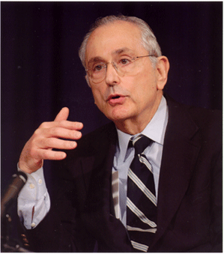
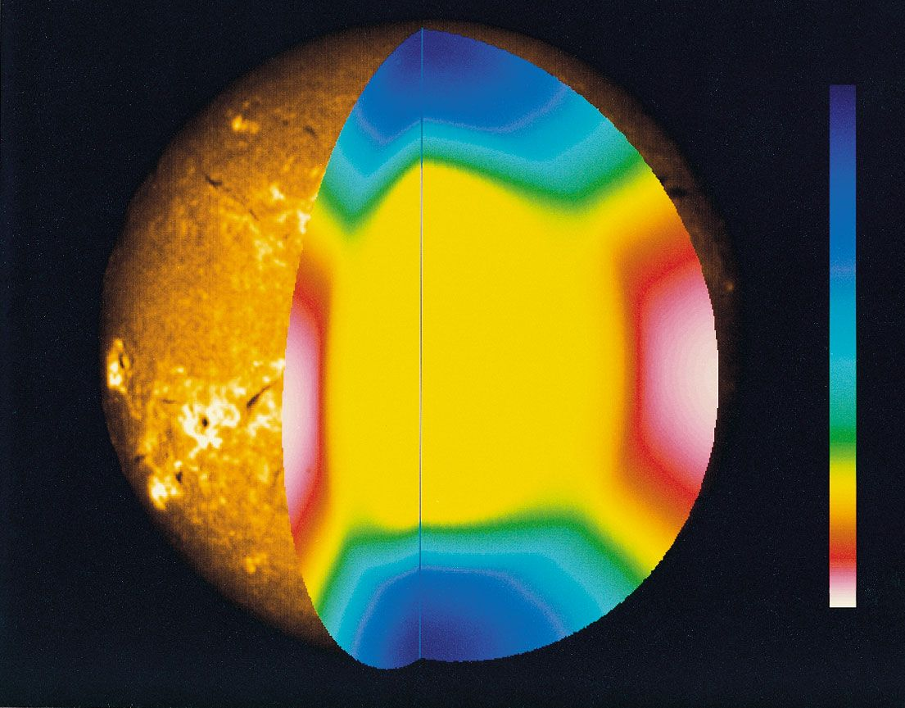
The Standard Solar Model (SSM)
Derived from the conservation laws and energy transport equations of physics, applied to a spherically symmetric gas (plasma) sphere
Input of the SSM:
Mass, Age, Luminosity, Radius
Assumptions of the SSM
Hydrostatic equilibrium
Spherical symmetry, no rotation, no magnetic field
Energy generation by H burning
Free parameters:
initial relative mass abundances:
X_{in} (H), Y_{in}(He), Z_{in}(metals)=1-X_{in} – Y_{in}
Tested by helioseismology
J. Bahcall: The initial author of the SSM

Slide 9
Solar neutrinos: astrophysics and particle physics
From the Particle Data Group (PDG):
Predicted ν spectrum vs. E
Results, after including ν oscillations
Table of solar neutrino experiments

Slide 10

2015: the newcomer
CR
DM
γ
GW
EM radiation

Slide 11
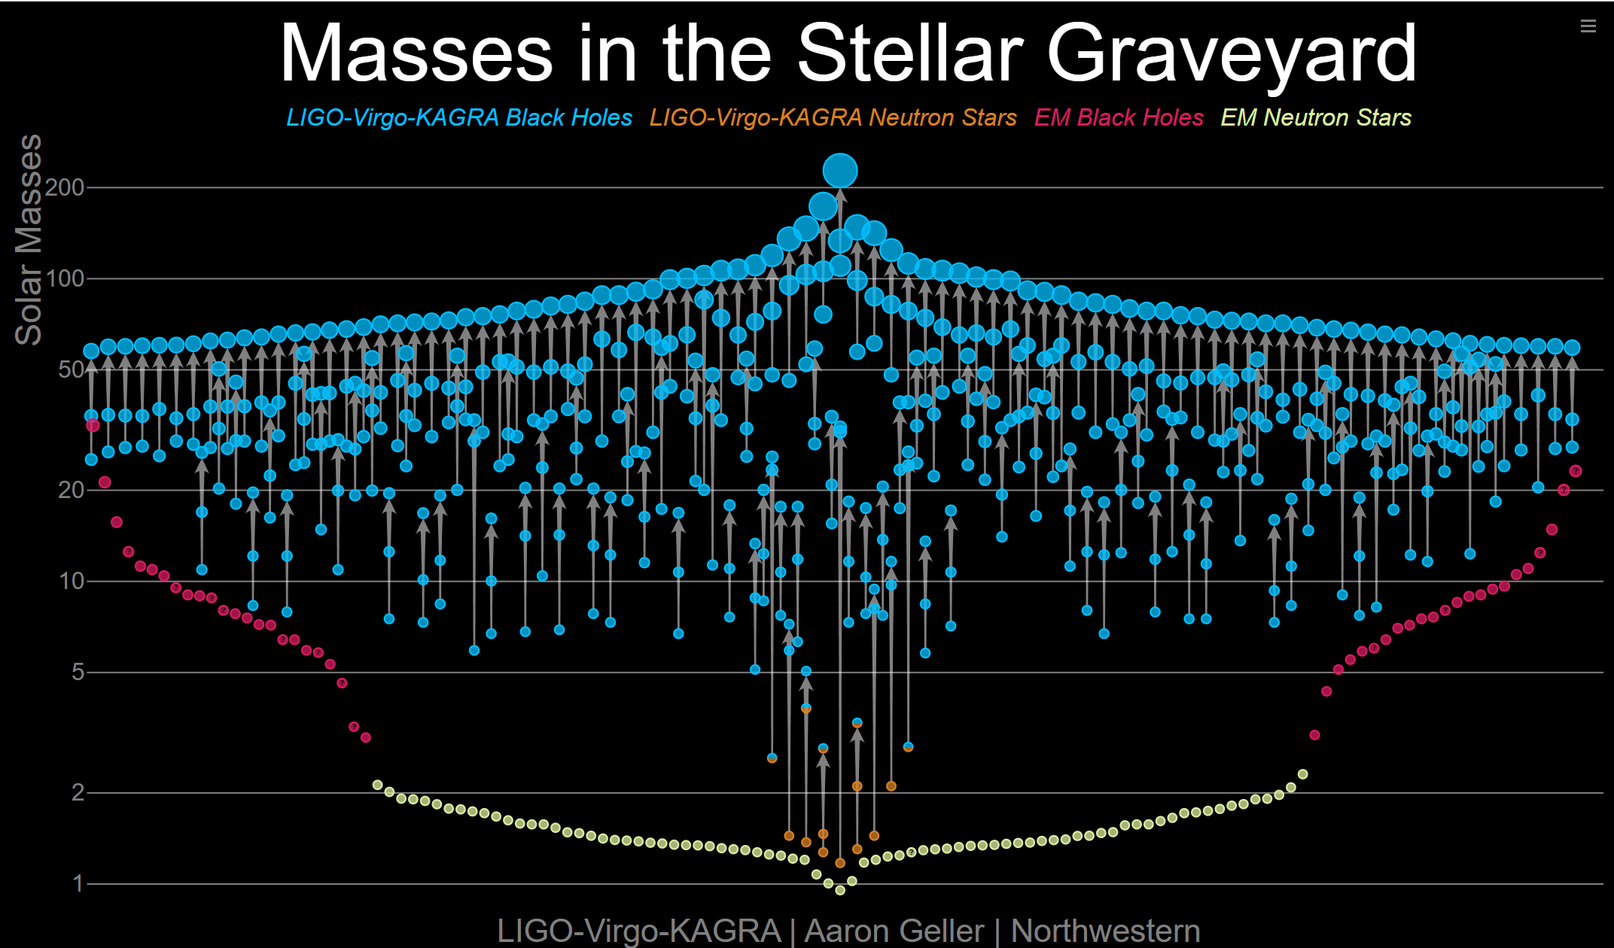
https://media.ligo.northwestern.edu/gallery/mass-plot

Slide 12
Astrophysics and cosmology with GWs
GW
The present: more than 200 detections, mostly BBH. Mass, spin, distance, distribution of binary systems
Astrophysical formation channels (stellar evolution with GWs): The binary black hole merger rate increases with redshift as S(z)=(1 + z)^{κ} with κ = 3−4, consistent with the cosmic star formation density.
there is no evidence of the mass spectrum evolving with redshift, the distribution of effective inspiral spin is found to broaden as redshift increases out to z ≈ 1.
Study of general relativity and beyond (gravity with GWs)
Local merger rates (i.e., at redshift z = 0) :
BNS: 7.6–250 Gpc⁻³ yr⁻¹
NSBH: 9.1– 84 Gpc⁻³ yr⁻¹
BBH: 14–26 Gpc⁻³ yr⁻¹
arXiv:2508.18083v2

Slide 13
GWs and multimessenger: GW170817
Fast: Real-time search for candidates
• Brokers to send rapid alerts!
X-ray afterglow
t₀+9 days
Sky-localization: rapid, to localize the signal
• Resources to characterize the transients
radio afterglow
t₀+16 days
Optical counterpart
t₀+10.87 hours
Short GRB
t₀+1.7s
No neutrinos
kilonova
GW merger t₀
Multi-wavelength
coverage!

Slide 14
More than 3500 authors
The 2° scientific paper for author number
M. Spurio - Astroparticle Physics - 13

Slide 15
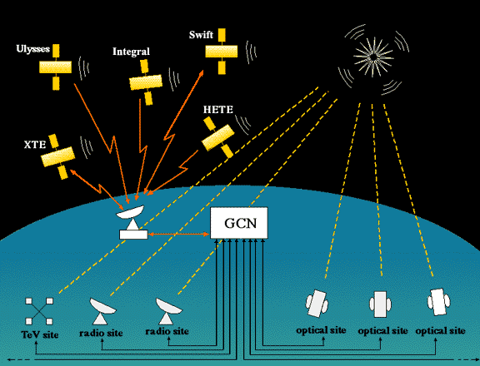
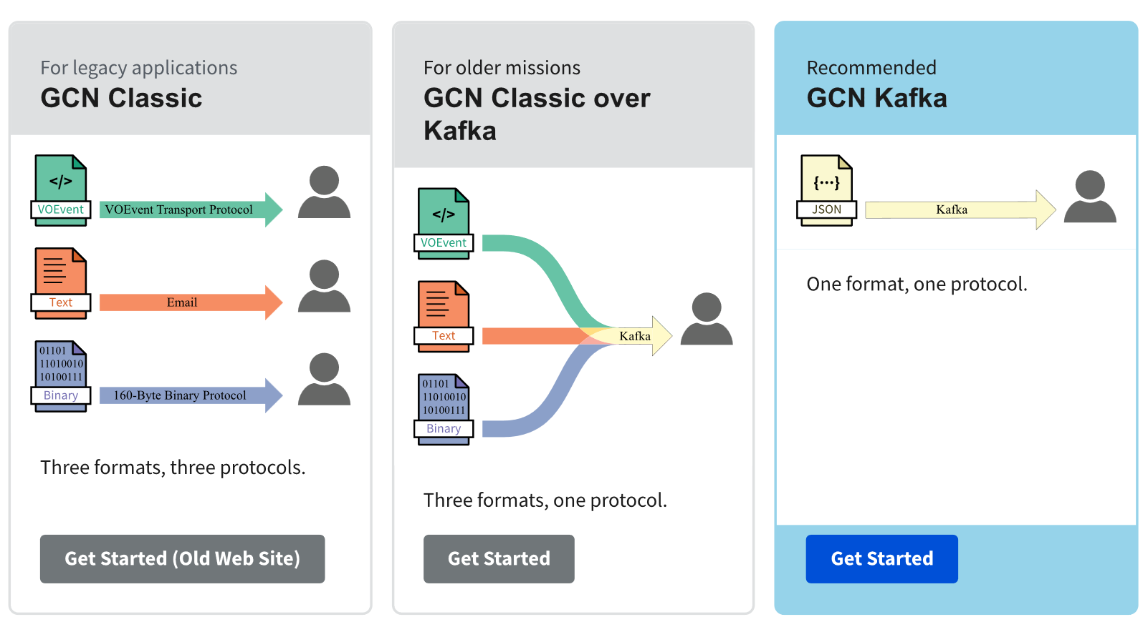
GCN and friends
https://nasa-gcn.github.io/gcn-presentation/
https://astro-colibri.science/

Slide 16
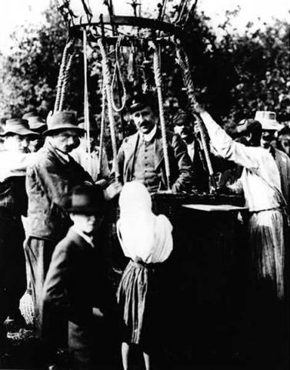
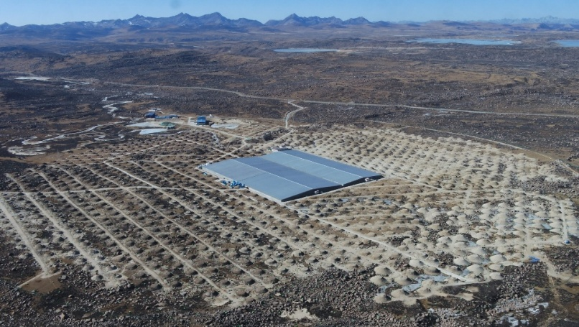
Connecting CR, gamma-rays and neutrinos
CR
DM
γ
GW
EM radiation

Slide 17
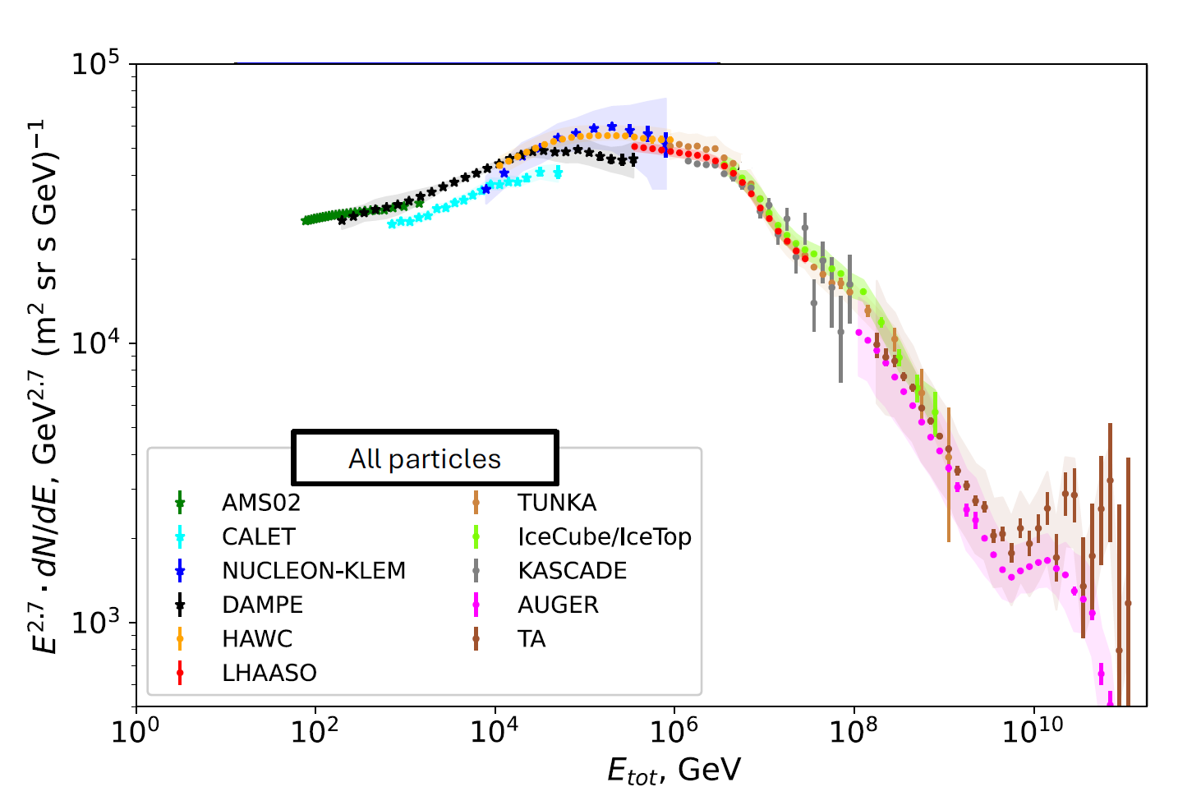
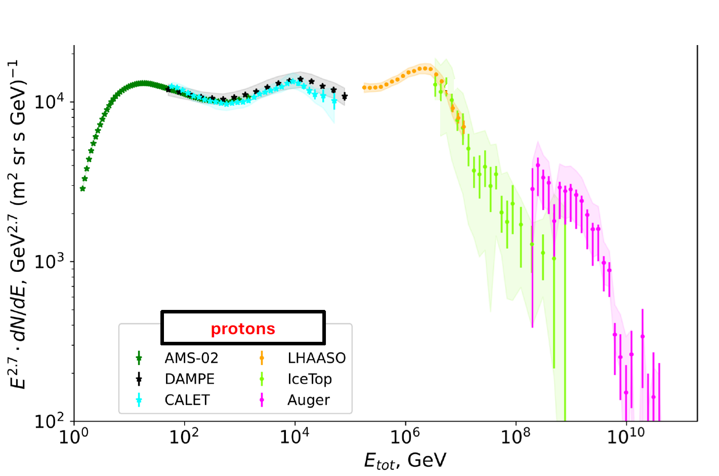
The longstanding CR problems
CR
Adapted from A. Neronov, NeuTel 2025
Which are the sources of Galactic CRs?
At what energy the extragalactic transition?
Extragalactic:
Composition
Origin of cut-off
Transition G/EG
Sources
….
About Galactic
Is the CR spectrum “universal” across the Galaxy?
What is the nature of the knee feature?
…and what that of new observed features: the sub-TeV “ankle”, the 10 TeV ”bump”
Are the features induced by changes of propagation of CRs in the interstellar medium?
…or from different source population?
Gamma-rays and neutrinos can help to disentangle the situation, as they are not affected by the (poorly known) Galactic magnetic field
Advection Diffusion Streaming
Escape
Pop A Pop B Pop

Slide 18
Fermi-LAT 4FGL-DR4: 7194 sources
From 50 GeV to 1 TeV
arXiv:2307.12546v4

Slide 19


The Galactic 𝛾-ray emission
γ
CR
CRs interact in the interstellar medium producing 𝛾-rays and ν’s.
Diffuse 𝛾-ray flux dominated (85%) by the π⁰ decay
Spectra of total/diffuse 𝛾- emission from the Galactic Plane measured from sub-GeV up to PeV:
Fermi-LAT arXiv:2508.18083, 1602.07246.
Tibet-Asγ arXiv:2104.05181
HAWC arXiv:2310.09117
LHAASO arXiv:2305.05372
and theoretical effort to model diffuse/source:
KRA_{𝛾}: arXiv:1504.00227
KRA_{𝛾}^{max}, KRA_{𝛾}^{min} arXiv:2209.10011, 2203.15759
DiffUSE arXiv:2107.14584, 2307.07451
CRINGE arXiv:2211.15607
…
and other interpretations, among which: arXiv:2412.08861, 2507.10823,…
arXiv:1602.07246v1
π⁰ decay
arXiv:2305.05372
Notes:
The signal is consistent with diffuse emission of neutrinos from the Milky Way but could also arise from a population of unresolved
point sources.

Slide 20


The Galaxy is not a neutrino desert
CR
γ
IceCube compared three diffuse emission models (based on ν production associated with CRs and γ-rays) from the Galactic plane to a background-only hypothesis
Three results produced on the flux integrated over the whole sky: a factor of x 4-6 difference @1 TeV.
 IceCube: DOI: 10.1126/science.adc9818
Integrated over the whole 4π sky
Notes:
The signal is consistent with diffuse emission of neutrinos from the Milky Way but could also arise from a population of unresolved
point sources.

Slide 21
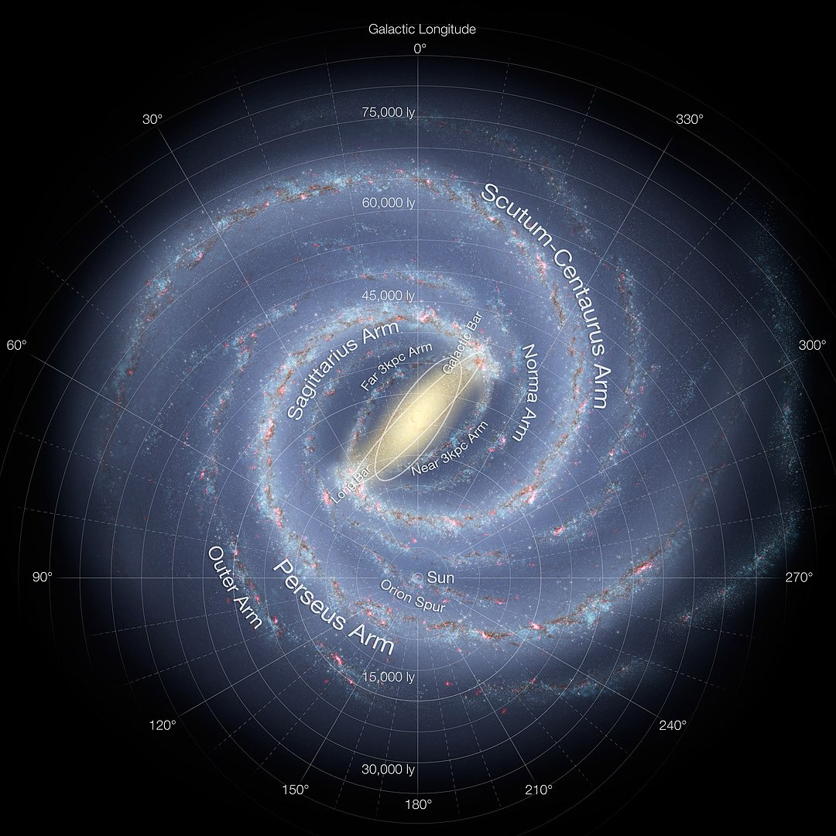
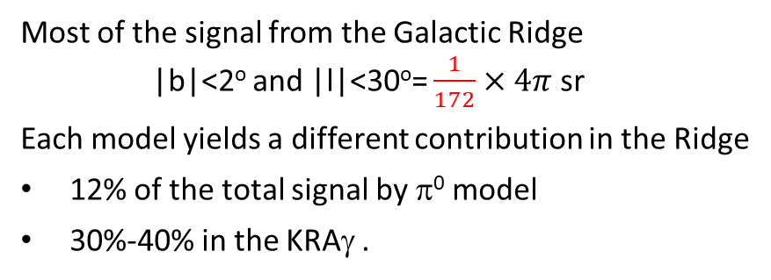
The Galactic ridge
CR
γ
Sun
Most of the signal from the Galactic Ridge |b|<2º and |l|<30º= $\frac{1}{172}×4π$ sr
Each model yields a different contribution in the Ridge
12% of the total signal by π⁰ model
30%-40% in the KRAγ .
Spectrum of 𝛾-ray emission from the Inner Galactic disk is harder (slope Γ ≃ 2.45) than the CR spectrum measured locally.

Slide 22
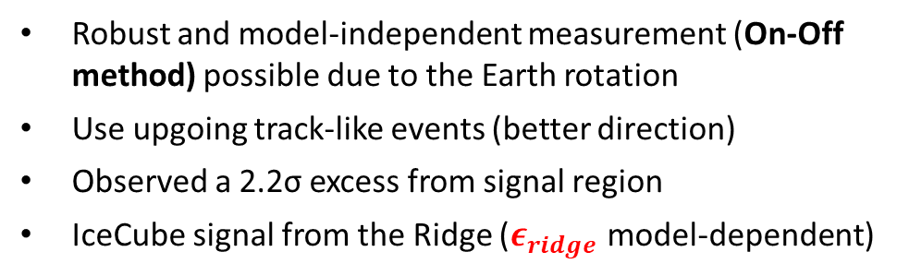
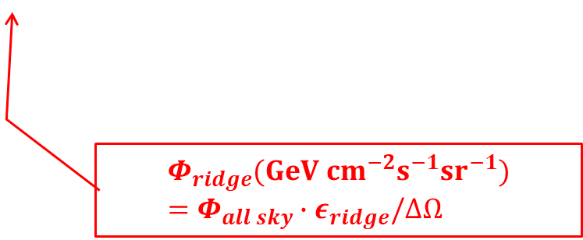
ANTARES as a «telescope»
CR
γ
ANTARES: PLB841 (2023) 137951
1 flavour
|b|<2º and |l|<30º
Robust and model-independent measurement (On-Off method) possible due to the Earth rotation
Use upgoing track-like events (better direction)
Observed a 2.2σ excess from signal region
IceCube signal from the Ridge ($ε_{ridge}$model-dependent)
$$Φ_{ridge}(GeV {cm}^{−2}s^{−1}{sr}^{−1})=Φ_{all sky}{∙ε}_{ridge}/∆Ω$$

Slide 23
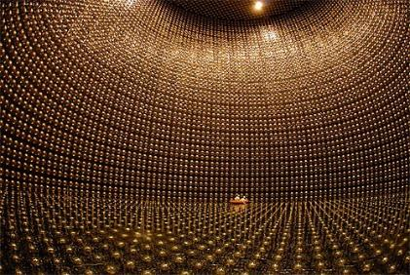
The weak neutrino
CR
DM
γ
GW
EM radiation

Slide 24
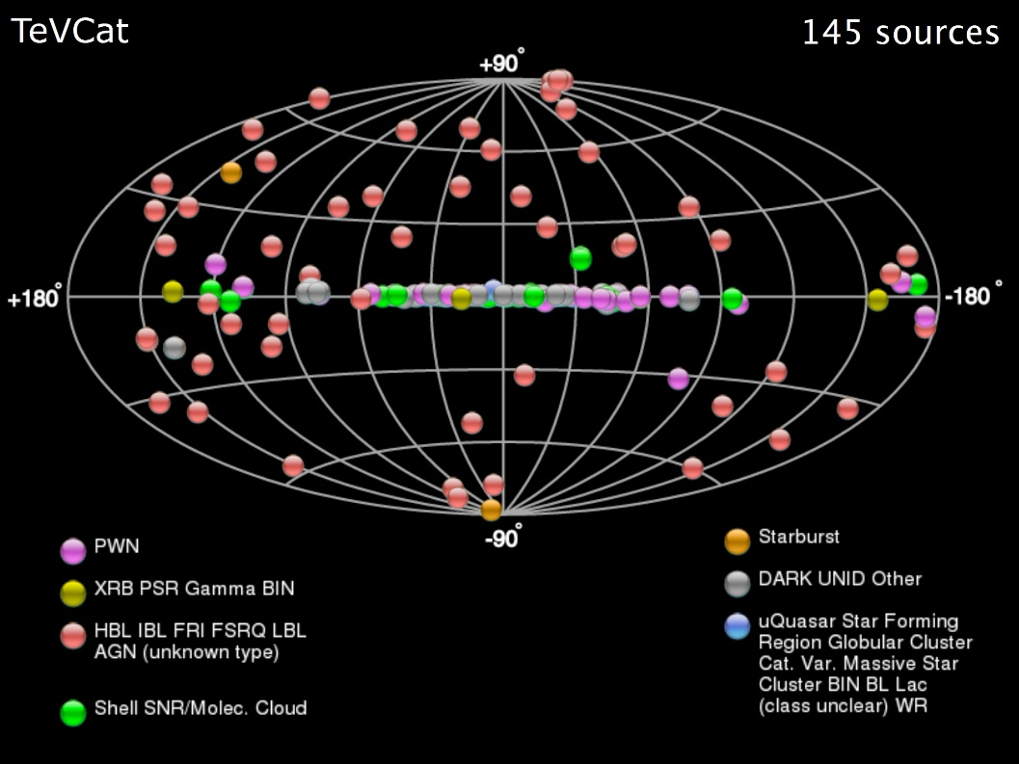
Point Sources: catalog of TeV γ-rays
http://tevcat.uchicago.edu/
Today: 344 objets
97 Galactic (<15 kpc)
85 with known z
Out of the Galactic Plane: AGN
24 AGN with 0.001<z<0.1
31 AGN with 0.1<z<0.2
20 AGN with 0.2<z<0.5
10 AGN with 0.5<z<1.1
7 GRBs (transient)
North sky
South sky
Mediterraneo

Slide 25

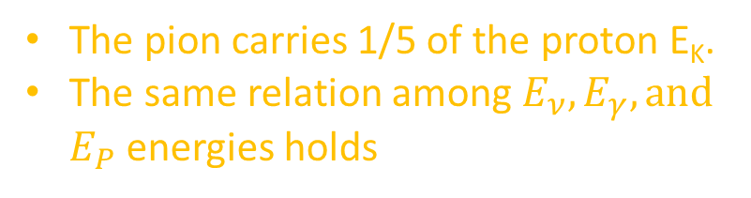

 Palladino+, Universe 2020, 6,30
electrons
The leading pion carries (on average) 1/5 of the proton E_{K}.
The 4 light (anti)leptons in π± decay carries ¼ of its energy:
$$E_{ν}\sim \frac{E_{γ}}{2}\sim \frac{E_{π}}{4}\sim \frac{E_{p}}{20}$$
protons, nuclei
The pion carries 1/5 of the proton E_{K}.
The same relation among $E_{ν},E_{γ},and$ $E_{P}$energies holds
4 ν/ 2 γ
$$n→p+e^{−}+{\overline{ν}}_{e}$$

Slide 26
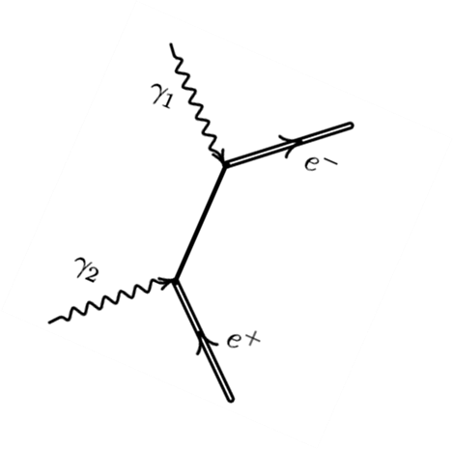
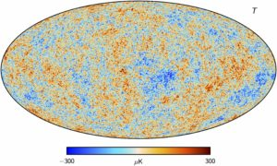
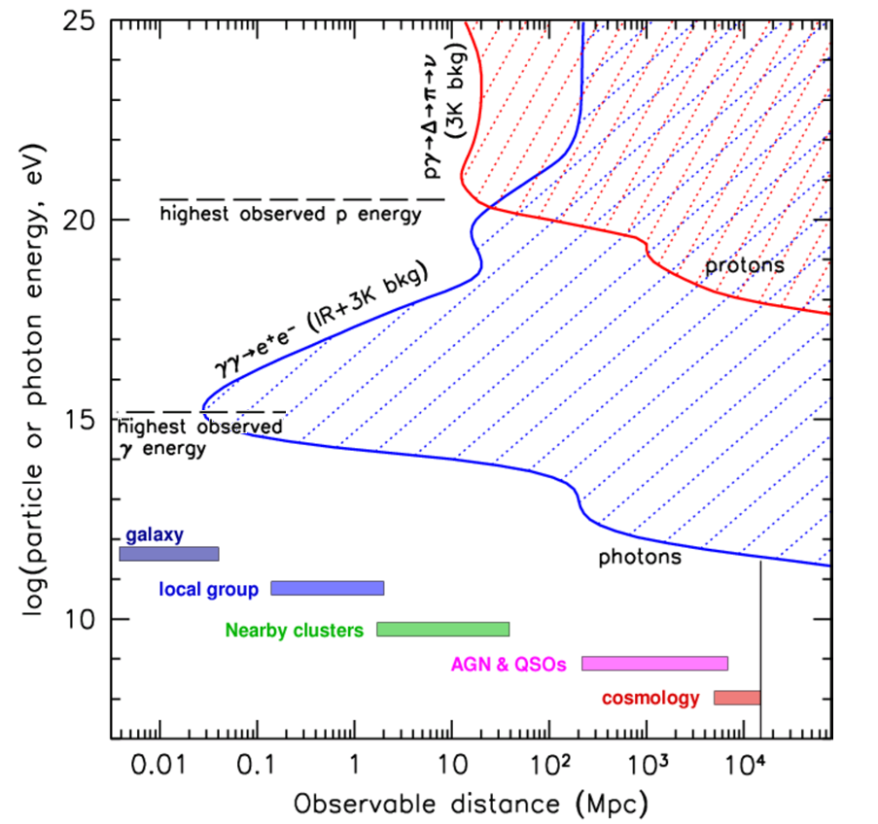
The visible Universe
γ
CR
Sources may not be γ-ray transparent. In photo-hadronic collisions, the dense target of is also a target for γγ interaction and subsequent cascading
Attenuation in propagation. If γ-rays escape the source, at 𝐸_{𝛾}≳1 TeV are strongly attenuated by γγ interaction with the CMB and the Extragalactic Background Light (EBL).

Slide 27
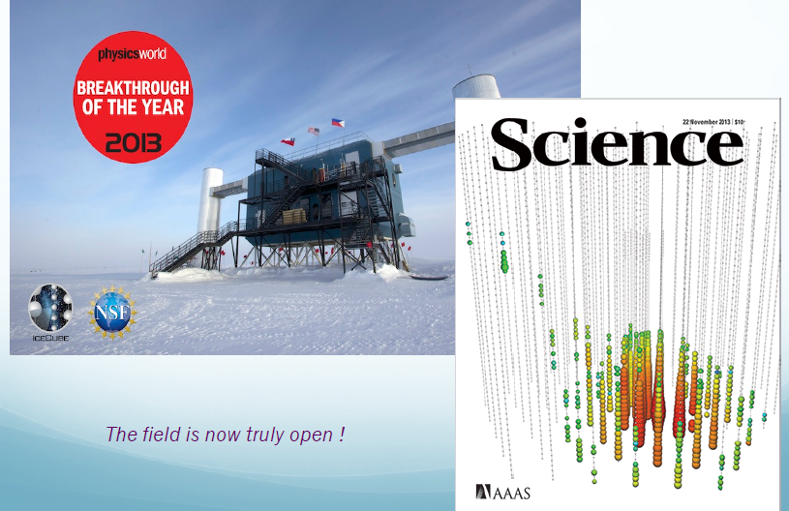
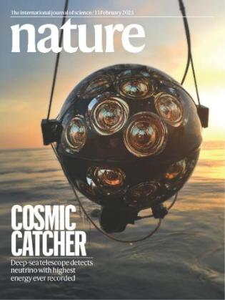
Observation of cosmic neutrinos
ν_{τ}

Slide 28
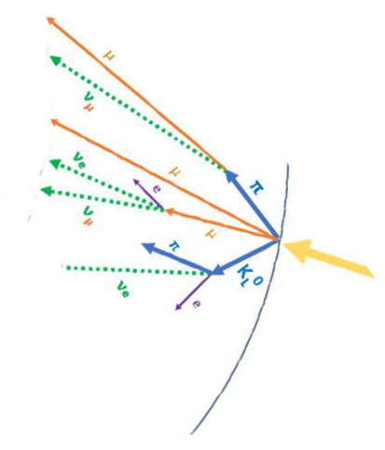

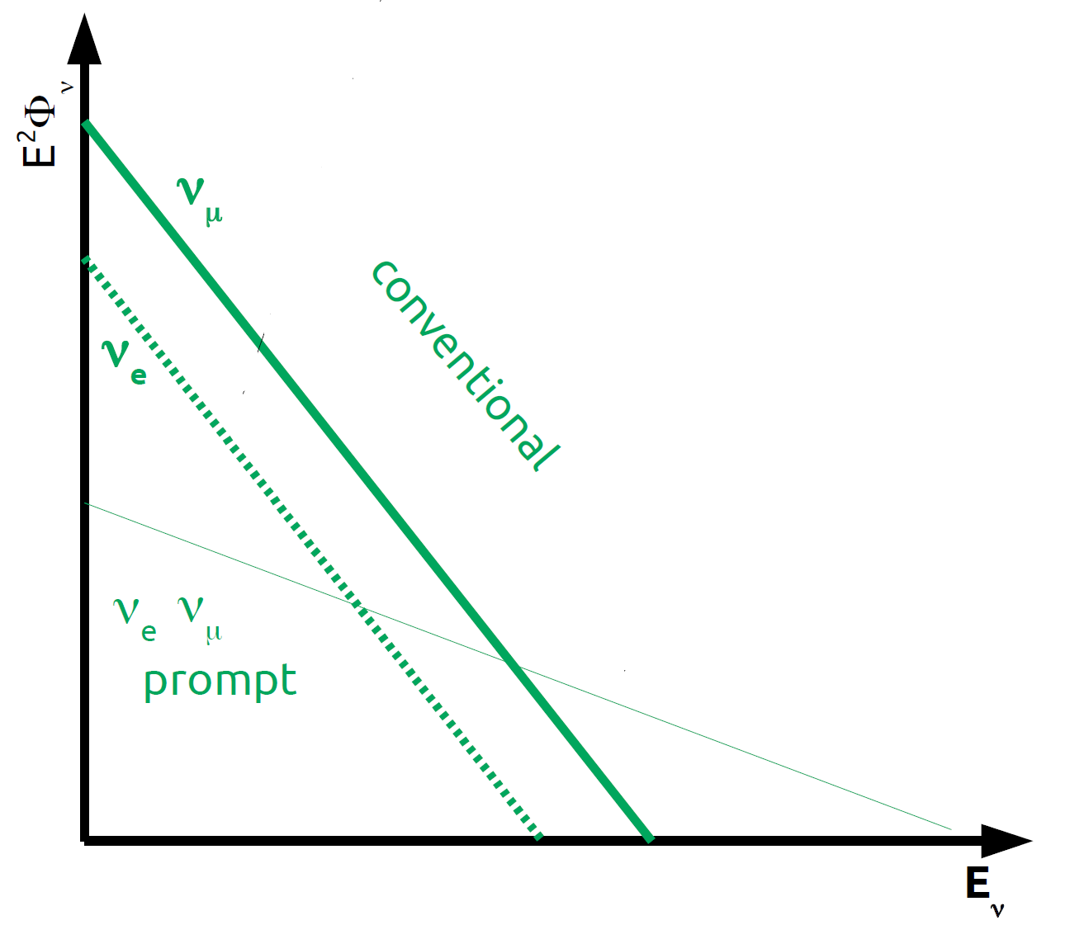
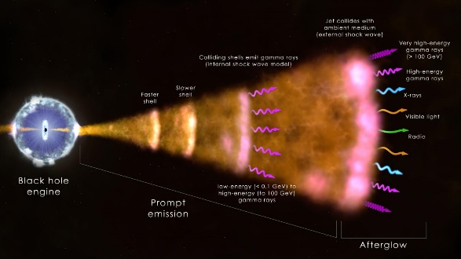
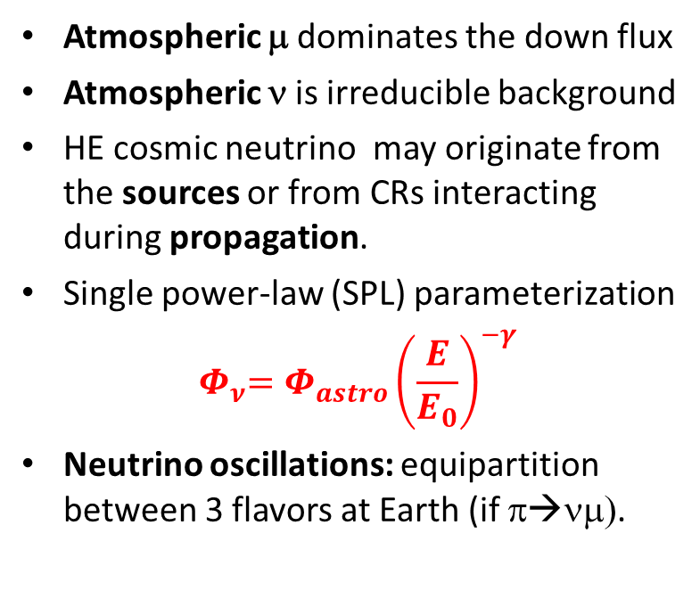
Background of atmospheric μ and ν
Atmospheric μ dominates the down flux
Atmospheric ν is irreducible background
HE cosmic neutrino may originate from the sources or from CRs interacting during propagation.
Single power-law (SPL) parameterization
$${ Φ}_{ν}=Φ_{astro}{\left(\frac{E}{E_{0}}\right)}^{−γ}$$
Neutrino oscillations: equipartition between 3 flavors at Earth (if π→νμ).
μ dominated
ν dominated
Cosmic

Slide 29
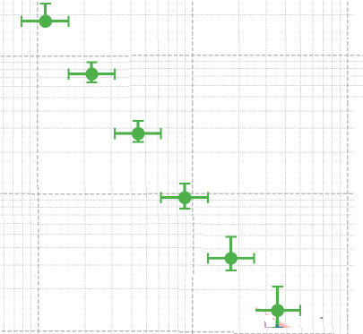
Diffuse cosmic neutrino fluxes: IceCube results
Atmospheric
+ cosmic
PoS(ICRC2025)1199
Cosmic
PHYSICAL REVIEW D 110, 022001 (2024)
arXiv:2507.22233v2

Slide 30
Small tensions in the TeV-PeV?
90% c.l.
PoS(ICRC2025)1031
68% c.l.
Baikal-GVD
Different IceCube event selections yield somewhat different indices for simple power law
IC reported clear evidence for departure from single power law with hardening below ∼ 30 TeV
Tension between Baikal-GVD and other IceCube results (possible reasons: systematics, ν sky anisotropies, Galactic ν, etc.)
ANTARES [JCAP08(2024)038]: upper limits
99.7% c.l.
95% c.l.
arXiv:2507.08421

Slide 31
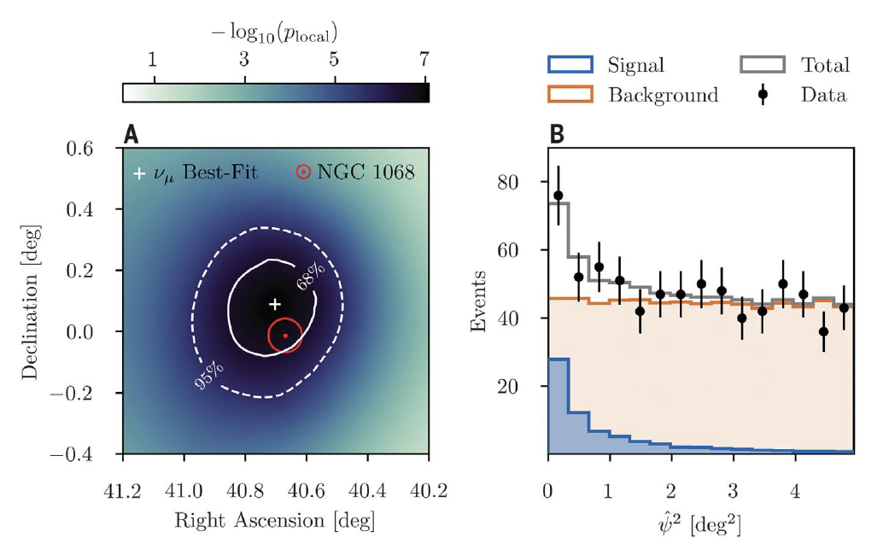
Catalog of ν-sources
Plot to fill with ν sources
North sky
South sky
Mediterraneo
 IceCube:Science 361 (2018)eaat1378
 IceCube:Science 361 (2018)eaat2890
NGC 1068
 IceCube:DOI 10.1126/science.abg3395 (2022)

Slide 32
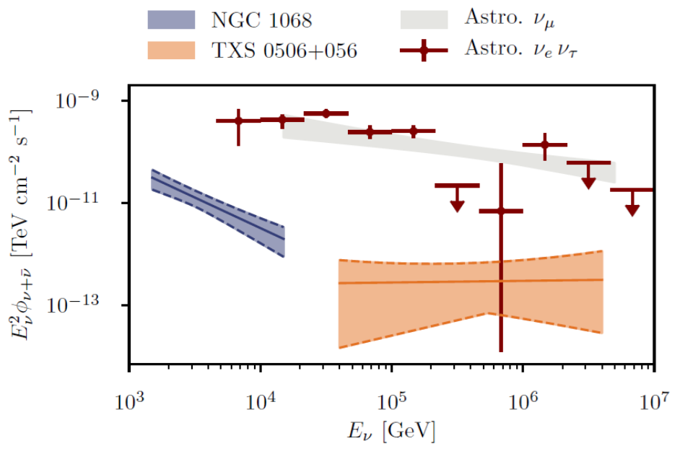
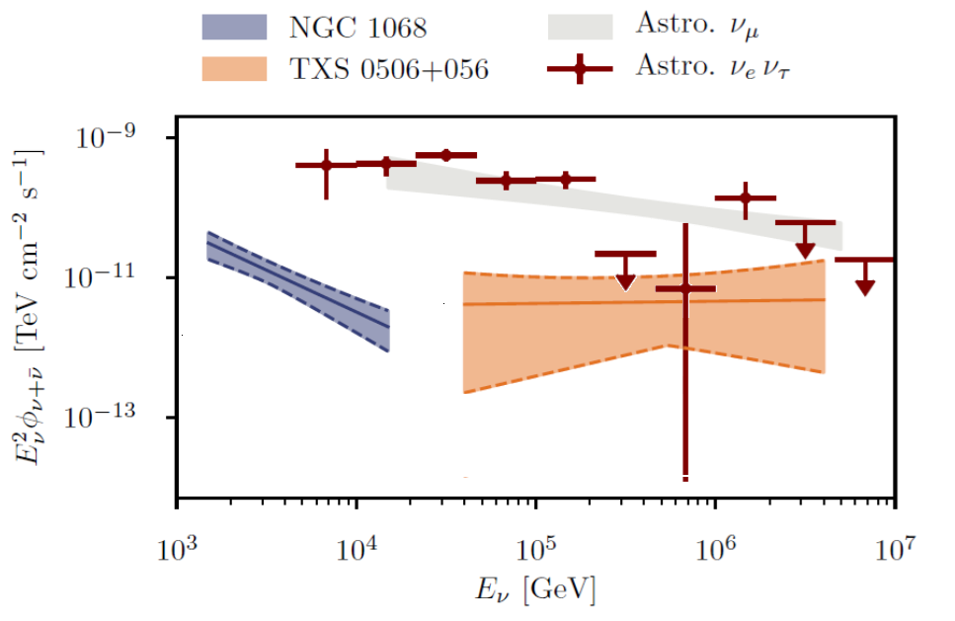
Results of neutrino sky map
NGC 1068: neutrino energies in a range not well measured with the diffuse flux.
Best-fit spectral index of γ = 3.2±0.2, softer than the diffuse flux
Spectral Energy Distribution of IC diffuse flux and of NGC and TXS sources.
TXS 0506+056 is >100 times farther away than the near NGC 1068: there are at least two populations of neutrino sources that differ in luminosity by orders of magnitude.
The TXS 0506+056 time-integrated emission in 10 y has pre-trial of 3.5 σ (i.e. n_{s}=5).
The Science 2018 result provided evidence for transient emission with n_{s} = 13±5 in 6 months.
If the TXS 0506+056 findings are both corrects, the population of HE (100 TeV range) ν’s could be significantly influenced by transients
My estimation, assuming the flux of transient flare
 IceCube:DOI 10.1126/science.abg3395 (2022)

Slide 33

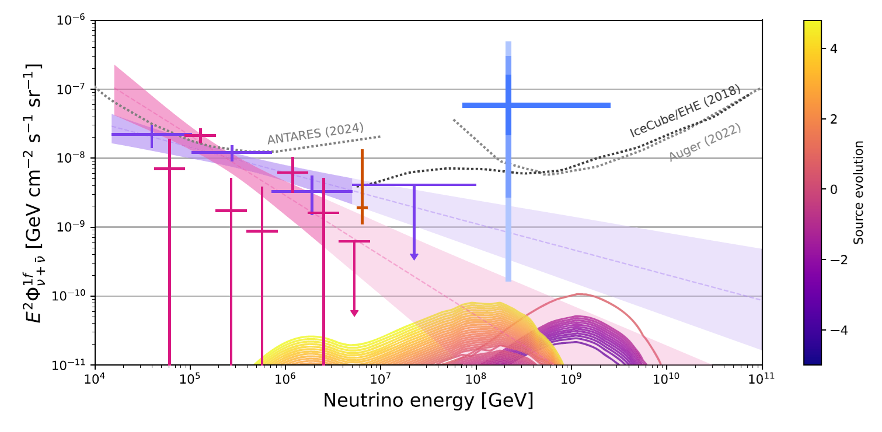
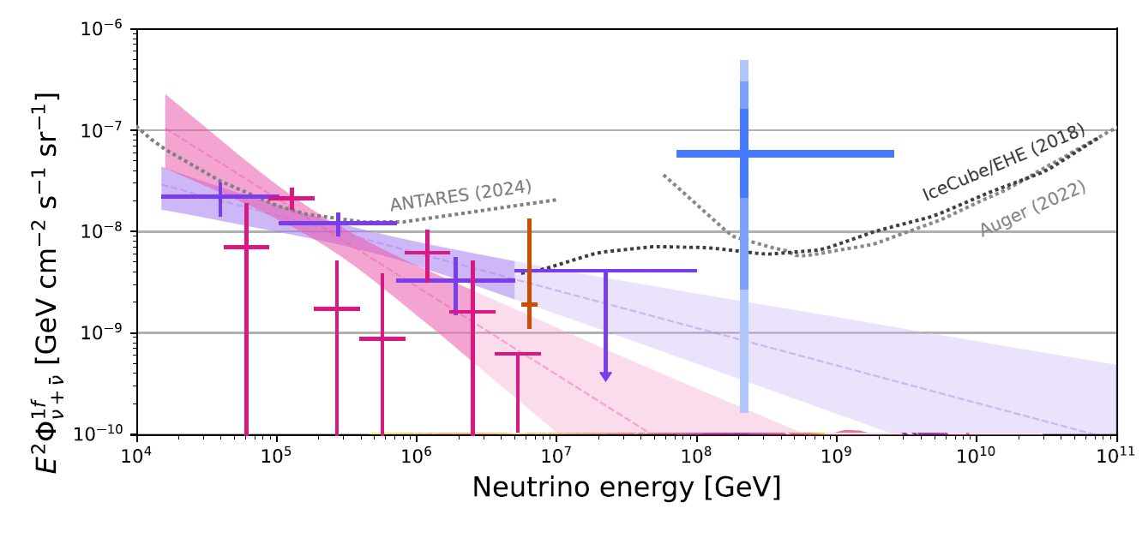
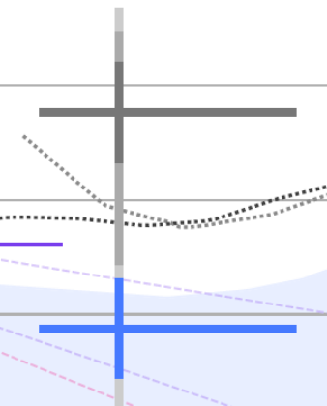
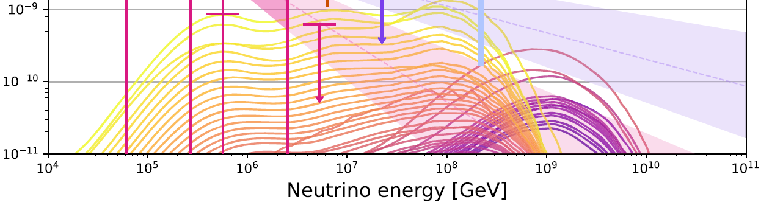
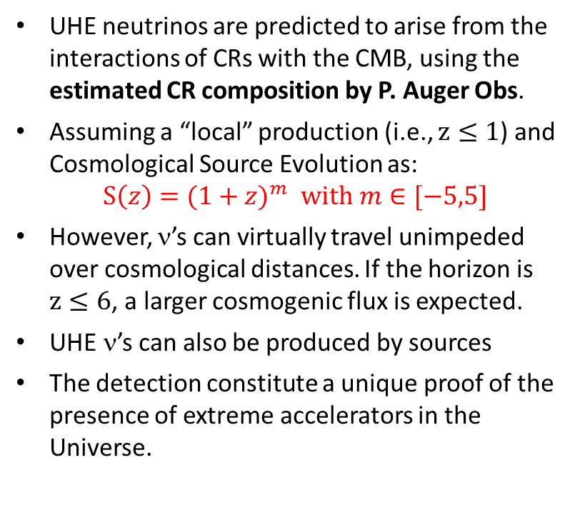

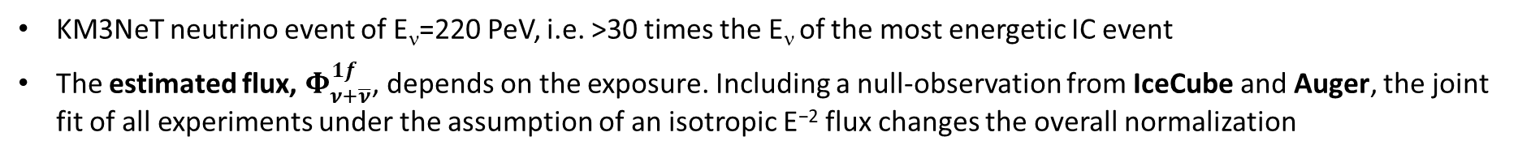
The 200-PeV KM3NeT neutrino
CR
KM3NeT neutrino event of E_{ν}=220 PeV, i.e. >30 times the E_{ν} of the most energetic IC event
The estimated flux, $Φ_{ν+\overline{ν}}^{1f}$, depends on the exposure. Including a null-observation from IceCube and Auger, the joint fit of all experiments under the assumption of an isotropic E⁻² flux changes the overall normalization
$$m$$
UHE neutrinos are predicted to arise from the interactions of CRs with the CMB, using the estimated CR composition by P. Auger Obs.
Assuming a “local” production (i.e., $z≤1$) and Cosmological Source Evolution as:
$$S\left(z\right)=(1+z)^{m} with m∈[−5,5]$$
However, ν’s can virtually travel unimpeded over cosmological distances. If the horizon is $z≤6$, a larger cosmogenic flux is expected.
UHE ν’s can also be produced by sources
The detection constitute a unique proof of the presence of extreme accelerators in the Universe.
 KM3NeT:Nature 638, 376–382 (2025)
z_{max}=6
z_{max}=1
 KM3NeT:Phys. Rev. X 15, 031016 (2025)
 KM3NeT: ApJL 984:L41, 2025
 KM3NeT: 2502.08484 [astro-ph.HE]

Slide 34
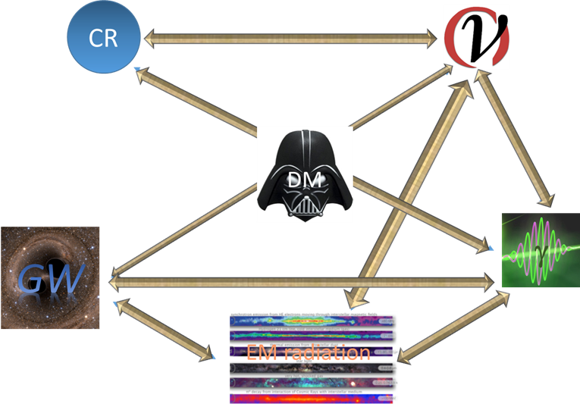
Multimessenger studies
{
Multimessenger Astronomy is a simple idea, but it is not easy ! It uses information from instruments (close) to the technology limits
Very small for EM radiation. Few deg² for IACT. Few sr for other γ-tel. Half-sky for ν-tel (sub-degree resolution). All-sky for GW interferometers
Experiments
Field-of-view
Angular resolution
Effective area
Visibility conditions
Duty cycles
Time response
Fraction of the sky
Universe Horizon (z)
Background
….
Order of magnitude differences from EM radiation and individual quanta (sub-degree). Very poor for GWs
Depends on the probe cross-section with apparatus. E.g., order of magnitude difference for ν-tel and γ-tel
Critical: optical, IACTS, fluorescence. Irrelevant: satellites, charged CRs, GWs, ν-tel
Critical for almost all without a very large field-of view and duty cycle.
Less than 50% for most observatories. 50% for ν-tel. Almost 100% for Fermi-LAT, GWs experiments
Visible, IR telescopes. ν-tel. Limited for CRs. HE γ-tel
Large for ν-tel

Slide 35
Multi-messenger synergies
35
X-ray telescopes: Swift,SVOM, ATHENA, (Theseus)…
- Provide transient triggers (GRB, AGN, Novae…)
- ToO program
Plot from S. Gao et al. arXiv:1807.04275v3,
only for illustrative purpose
γ-ray telescopes: Fermi-LAT+?
- All-sky complete monitoring
- Provide also transient triggers
Optical telescopes: TAROT, MASTER, LCOGT, ZTF, LSST…
Easy access follow-up
large error box
Characteristation of potential counterpart with spectroscopy (nature, redshift…)
VHE γ-ray telescopes:
HAWC, LHAASO…
- All-sky monitoring
- Provide triggers
HESS, MAGIC, CTA…
- Follow-up (not easy access)
Neutrino telescopes: IceCube, KM3NeT, GVD…
Cosmic ν observation
Mutual follow-up
Confirmation of sources, improve significance
Radio telescopes: Parkes,
MWA, Lofar, Nenufar, ASKAP, SKA, VLBI…
- Provide triggers (FRB…)
- Follow-up

Slide 36
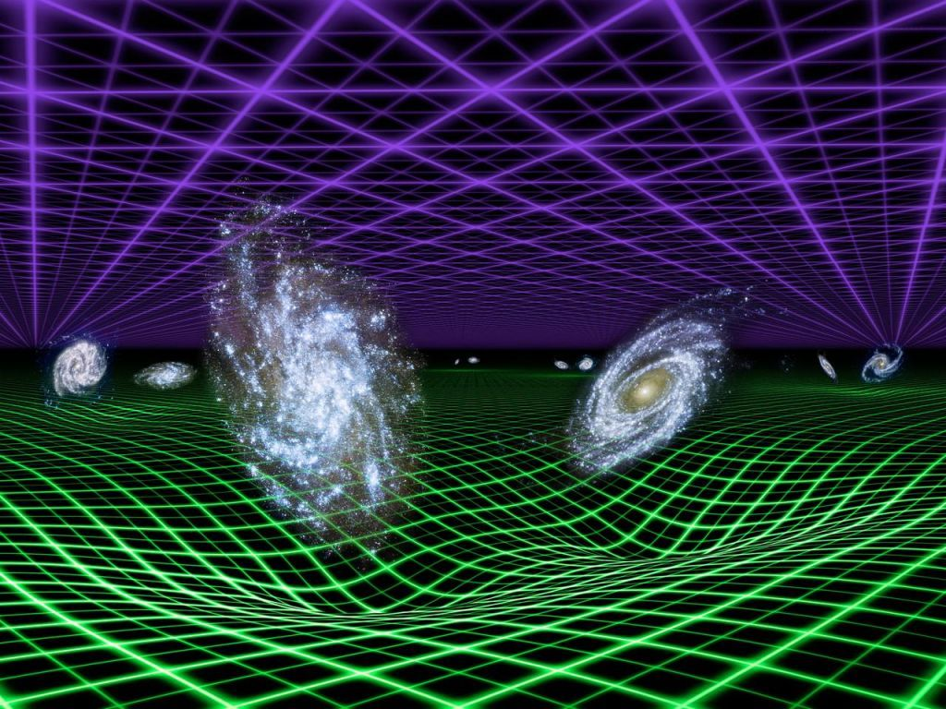
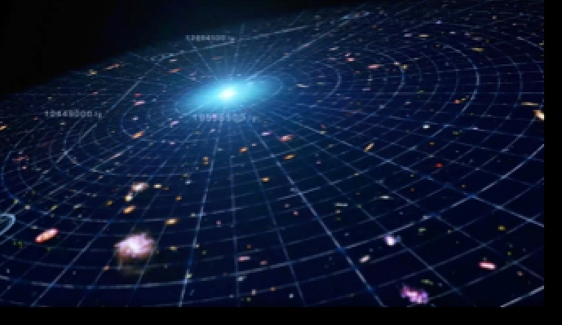
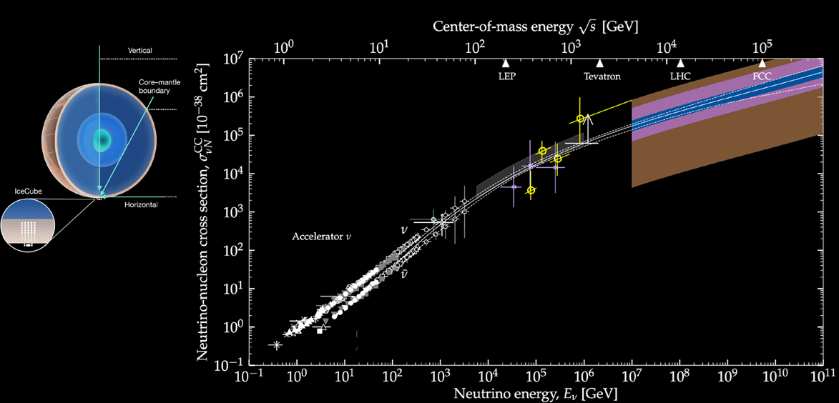
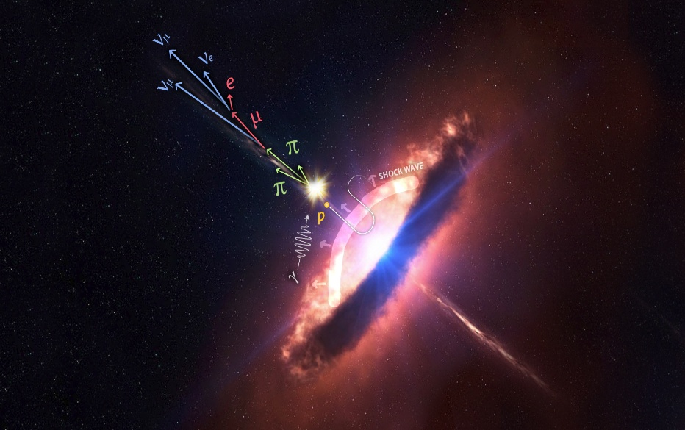

High energy physics, cosmology, astrophysics
Fundamental Physics
Speed of neutrinos
Speed of gravity
General Relativity tests
Lorentz Invariance Violation
“Vacuum” properties
Quantum gravity (space time structure of vacuum)
…
Cosmology
Cosmic evolution
Ladder scale (new)
Measure H₀
Test of ΛCDM
Formation of binary systems
Accretion of black holes
Dark energy
…
Astrophysics
Energy in stars
Stellar core collapse
Accretion disks and jets
Transients (GRBs, FRBs)
EBL
Galactic and extragalactic B
…
Nuclear and Particle Physics
Cross section @Energies $≫$ LHC
Neutrino oscillations and properties
EoS of nuclear matter
Quark-gluon plasma
“Glashow”, GZK, and other resonances
Heavy elements production sites (r-process)
Particle acceleration
Particle radiation mechanisms
Dark matter, axions
…
Astroparticle Physics:
Particle acceleration & production,
Propagation of CRs
Origin of galactic CRs
UHECRs
Chemical composition
Antimatter
…

Slide 37

Conclusions
37
Multimessenger astrophysics is the joint effort to understand HE phenomena using CRs, γ-rays, neutrinos, gravitational waves, in addition to EM radiation.
Multimessenger is a difficult task due to the differences in the experiments (visibility, duty cycles, sensitivity, time response,…). Information brokers are of fundamental importance.
Electrons and hadrons originate EM radiation and other probes with different weights.
The energy budget on Earth is dominated below the GeV by EM radiation induced mostly by moving electrons, and by hadrons and its secondaries above the GeV
In the extreme universe more energy seems emitted in neutrinos than in γ-rays
Neutrinos seems to be produced in sources obscured to HE γ-rays: this is unexpected and represents a great opportunity for a “new” astronomy.
New actors (LHAASO, CTA,KM3NeT, IceCubeGen2,…) will play a fundamental role for this
Today, astroparticle physics with multimessenger probes is paving the way for the future of particle physics, after the next generation of collider.
Only knowing the beams (=accelerators) and target (=space medium), we will have the opportunity to study the underlying properties of particles and interactions @ UHE

Slide 38
Spares

Slide 39
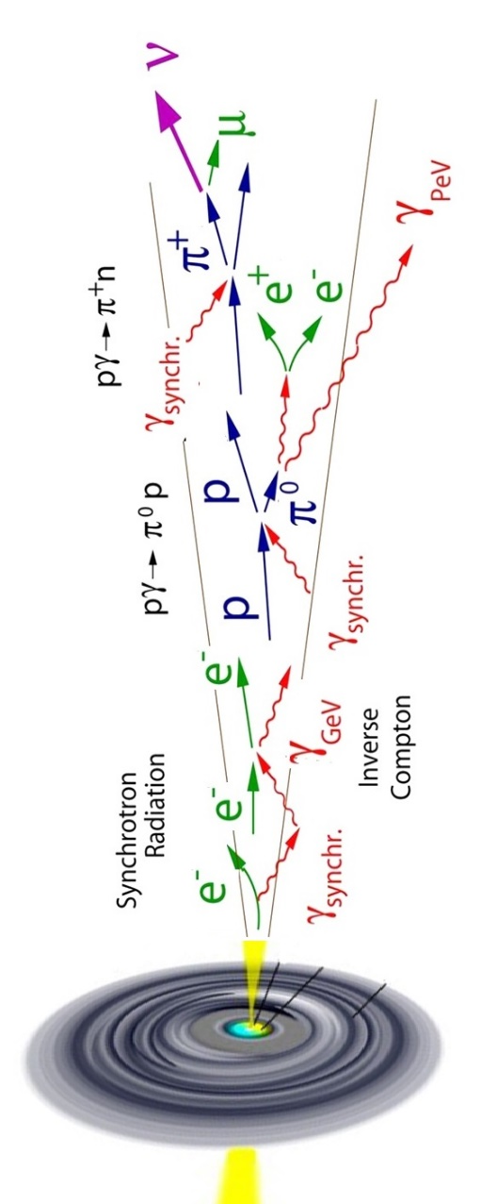
Open problems with the identification of sources
Public catalogues have also been used by many authors in >>377 refs
Positive correlations (also >3σ) between ν and selected catalogues have disappeared or significantly reduced after a new release of ν candidates appears.
The ν catalogs released by Collaborations are “work in progress” as they can be improved in the future
The accuracy of reconstruction of the ν properties is limited by systematics: new refined statistical analysis, improved reconstruction/ calibration can lead to a significant improvements in ν direction/energy.
The reduction of “>3σ” is true also for the TXS 0506+056 burst (arXiv:2307.14559)
Analysis of data of independent experiments, with uncorrelated systematic errors, could be recommended to reduce incorrect associations
Warning for young researchers: the machine learning involves a training dataset with characteristics based on MC simulations can be affected by the medium properties (water is more homogeneous that ice, but it needs calibrations)

Slide 40
Origin of the (diffuse) extragalactic ν’s
For a recent review: see the 377 refs in
 Fiorillo, Universe 2024, 10, 149
To identify ν sources, different strategies are adopted in IceCube, ANTARES, Baikal-GVD and KM3NeT:
searches for multiplets of events from close directions in the sky
searches for temporal and spatial correlations with transients
cross-correlation of ν angular distribution with catalogs
the analysis of the neutrino angular power spectrum
 Becker Tjus, Merten, Phys. Rep. 872 (2020) 1
Sources candidates
AGNs jets: about 1-10% of the AGNs. Blazars=jets towards the Earth. TXS 0506+056
AGNs cores (Seyfert,…): ν produced in an optically thick region that absorbs γ−rays. NGC 1068
GRBs (or choked/low-luminosity GRBs)
Starburst galaxies
Tidal Disruption Events (TDEs)
Clusters of galaxies
Galaxy & Galaxy Cluster mergers
Beyond the Standard Model (BSM)
…

Slide 41
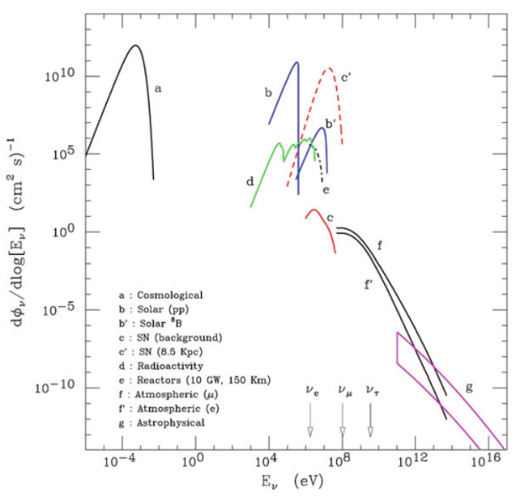

Where 99% of the energy is?
Theory of core collapse: ∼99% of the gravitational binding energy of the resulting remnant is converted to ν’s.
Stirling A. Colgate, Richard H. White, "The Hydrodynamic Behavior of Supernovae Explosions" ApJ, 143 (1966) 626
SN1987A in the LMC

Slide 42

GW interferometers

