Slide 1


  Axion Like Particles
a guided tour, a touristic panflet
Javier Redondo 6 Nov, TeVPa 2025, Valencia, SP
Notes:
Hello I am Javier Redondo from Zaragoza U.
and I am going to be your guide in this tour de force of the ALPs
fasten your backpack belts and let us go!
It is going to be tough to get an overview in 25m but I hope the views and panoramas compensate!

Slide 2
Convergence of many other potential observables
-definition
- motivation
- ALP dark matter
- Smoking guns
- some Highlights
- Conclusions
outline

Slide 3
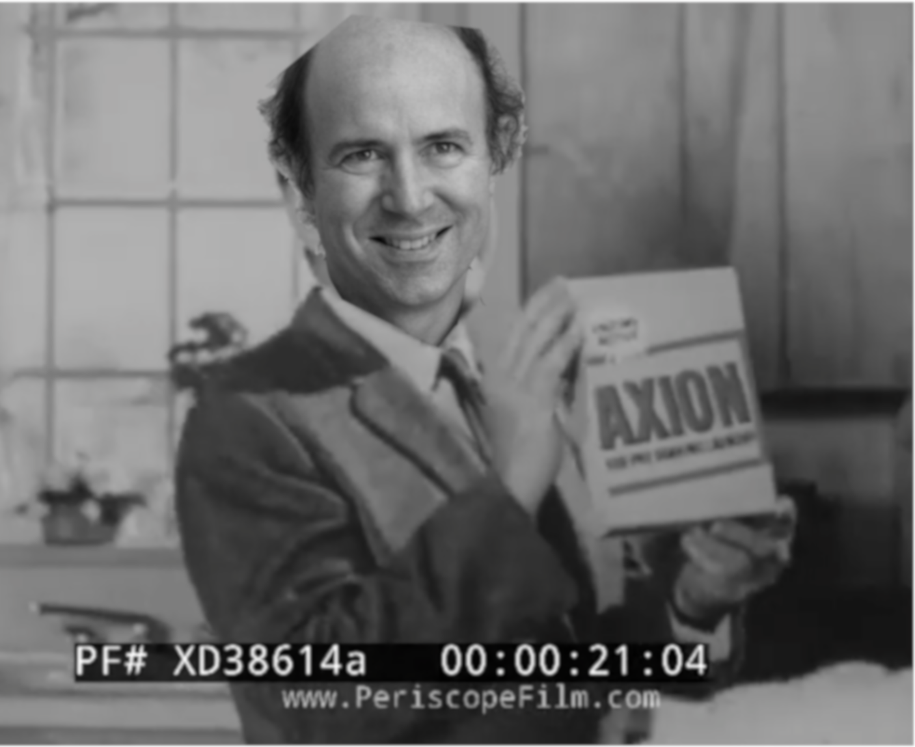
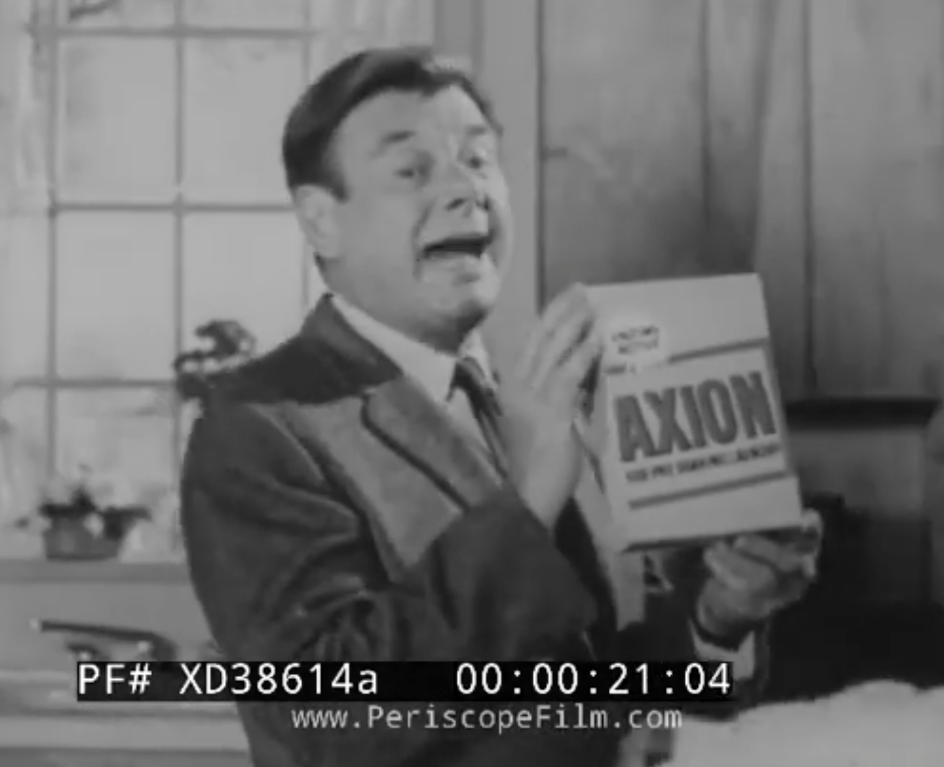






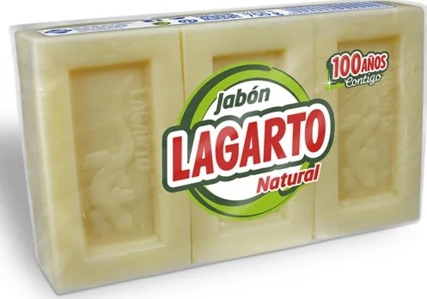
Convergence of many other potential observables
- QCD axion:
hypothetical O⁻ pseudo Nambu-Goldstone boson of an axial, color-anomalous global symmetry, spontaneously broken at a large energy scale fA
what is an axion-like particle?
Strip unobserved EDMs from Strong Interactions!
- Axion -like particles: anything resembling the above

Slide 4
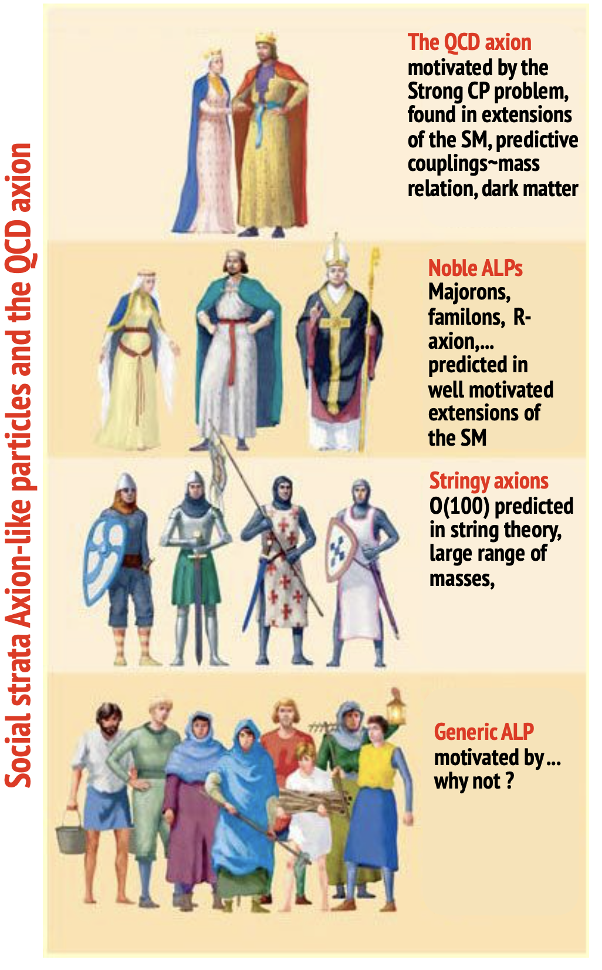
Convergence of many other potential observables
- QCD axion:
hypothetical O⁻ pseudo Nambu-Goldstone boson of an axial, color-anomalous global symmetry, sponteously broken at a large energy scale fA
what is an axion-like particle?
- Axion -like particles: anything resembling the above

Slide 5


Convergence of many other potential observables
- More fields, more symmetry at HE
- Learn about new scales in physics
                SUSY, GUT , Planck... what else?
- Dark matter and dark energy
- Explain some low E anomalies
- Learn the known by exploring the unknown
theoretical motivation
ST
GUT
SUSY
SM

Slide 6



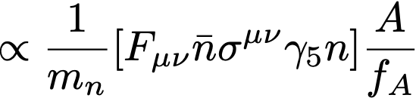
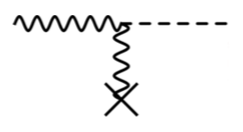
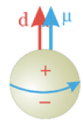

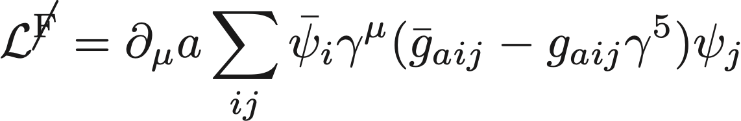

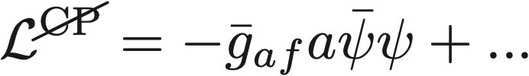


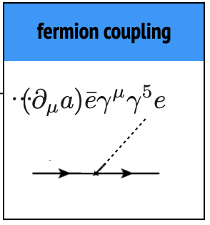
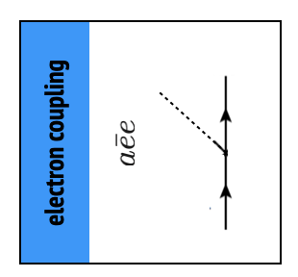
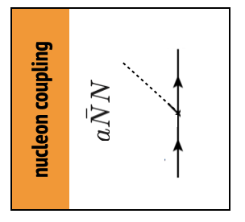
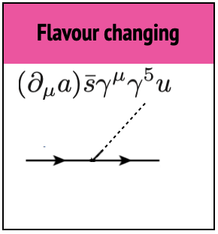
photon coupling
electron coupling
nucleon coupling
CP Neutron electric dipole
X
Axion Low energy theory
Flavour changing
nucleon coupling
electron coupling
Notes:
Axion couplings with colour code for plots

Slide 7
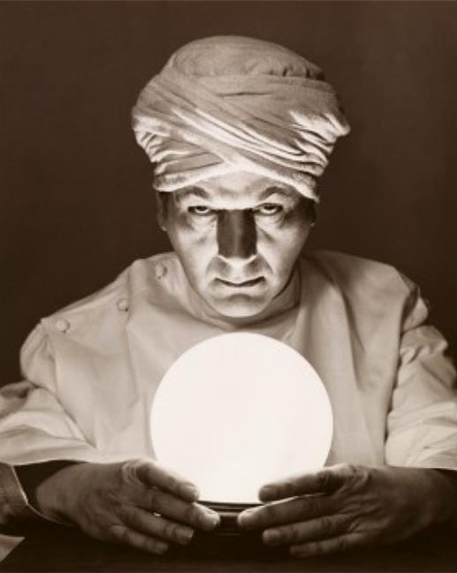
Predictions

Slide 8

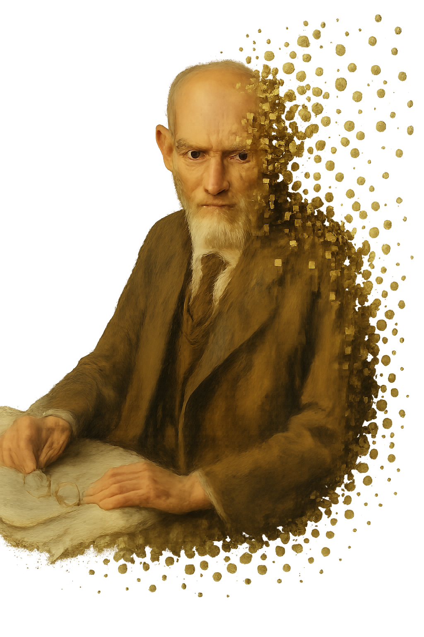
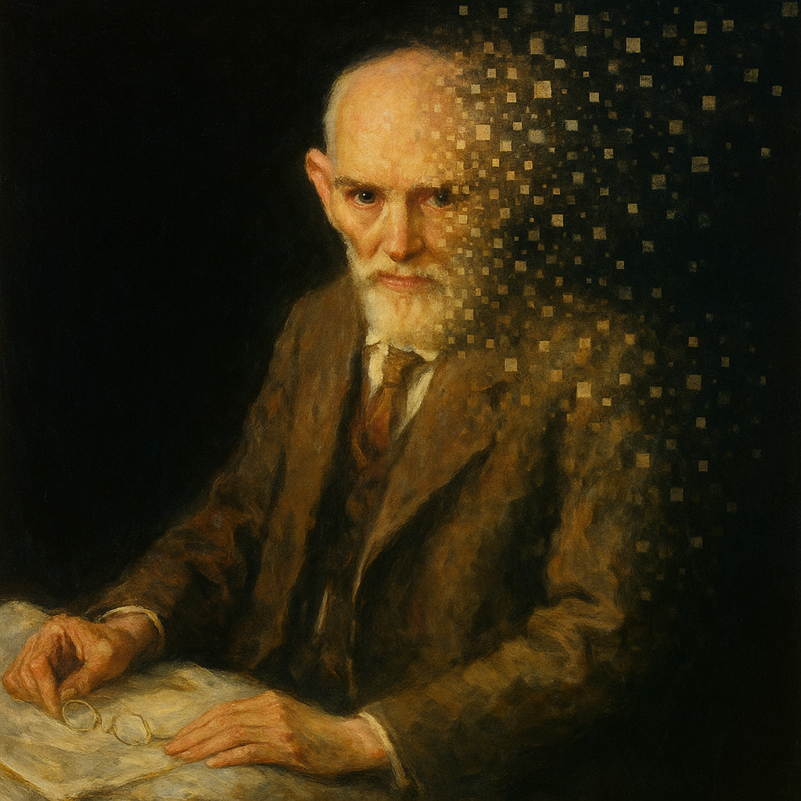
- Quantum gravity
- de Sitter vacua are INCONSISTENT with QG, θ-vacua must be eliminated by axion Dvali18
predictions
The remarkable success of string theory may have led to the misunderstanding that any quantum eld theory that appears consistent without gravity can be coupled to quantum gravity with string theory serving as the bridge. This expectation cannot be further from the truth. As we currently understand, only a few special quantum eld theories emerge as the low energy limits of string theory. Essentially no generic quantum eld theories can emerge, and only very special ones do! That may sound unnatural from the viewpoint of e ective eld theory but that is the lesson string theory is teaching us Vafa
https://chatgpt.com/backend-api/estuary/content?id=file_00000000a99071f49477e59b05d74b9e&ts=489546&p=fs&cid=1&sig=ebe6a0eb3291cc9fa540674efb2fa6a418f0752273366a695a6a74da0f5a6f7b&v=0
Notes:
Add a bit of GUT, Majoron

Slide 9
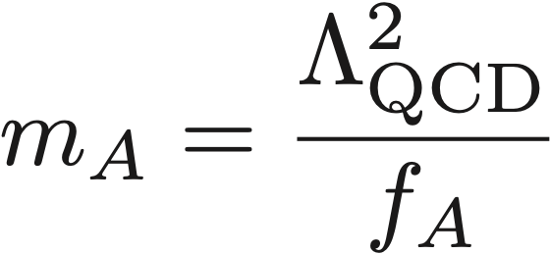
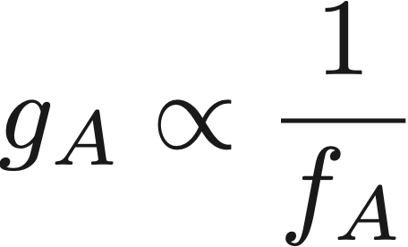
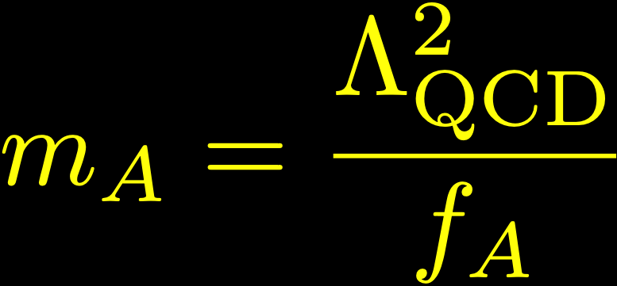
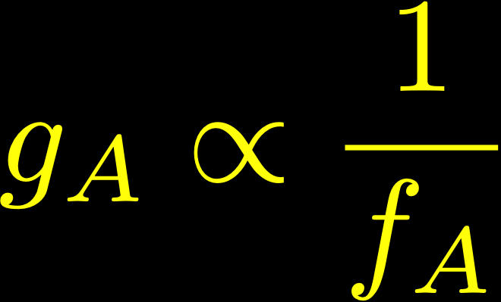
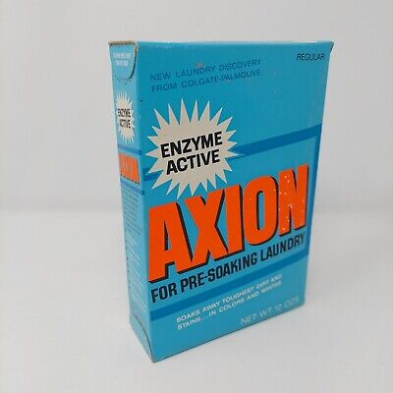
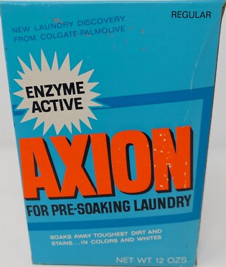
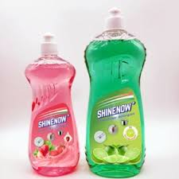
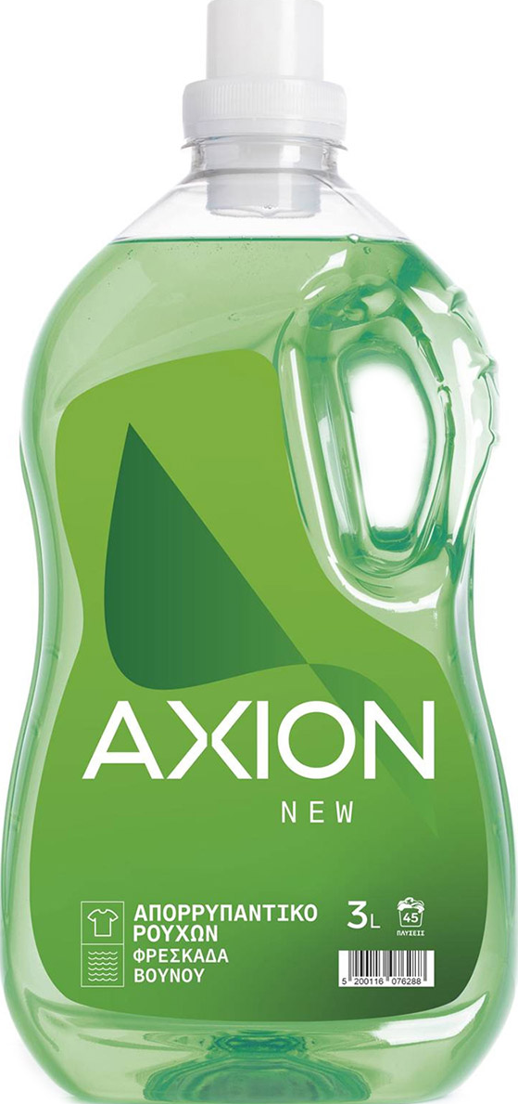
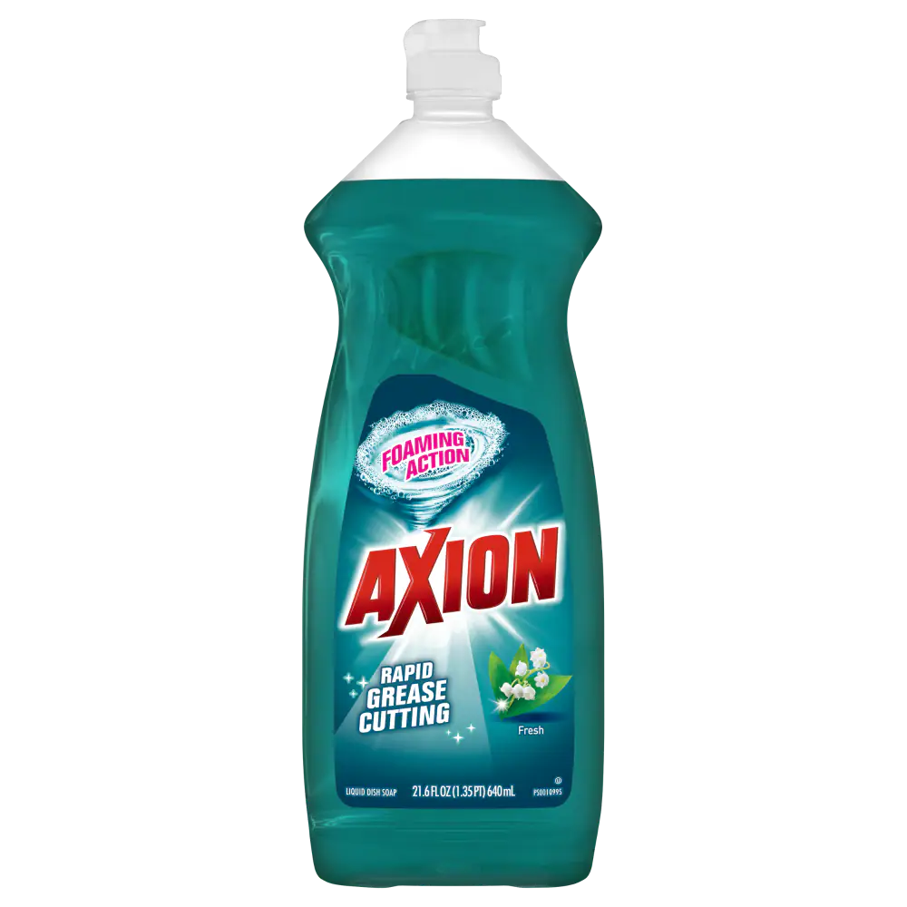

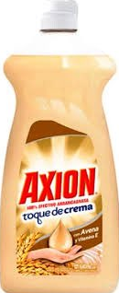
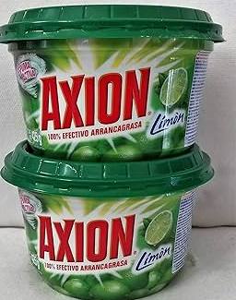
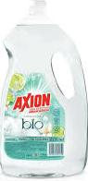
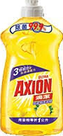
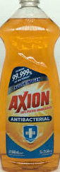
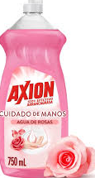
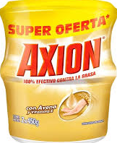
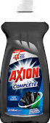
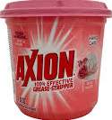
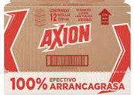
- Quantum gravity
- QCD axion
- Axial, Color-Anomalous SSB, explains smallness of Strong CP violations (strong CP problem)
- Color-Anomaly breaks Sym -> mass term!
- Couplings and mass related by QCD
- Some model dependency, See Di Luzio 22
predictions
Notes:
Add a bit of GUT, Majoron

Slide 10
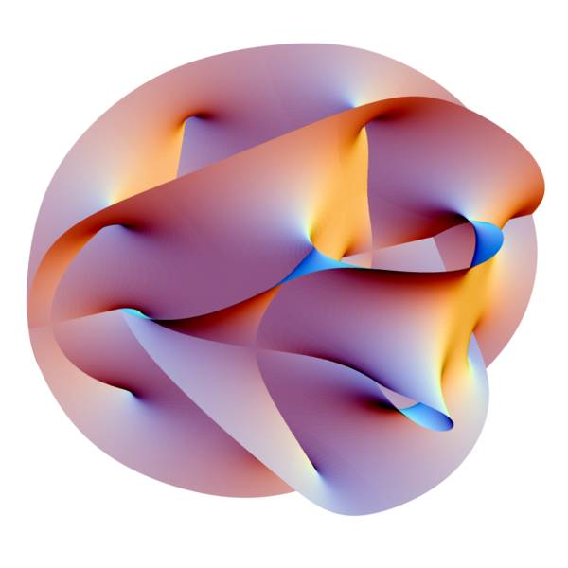
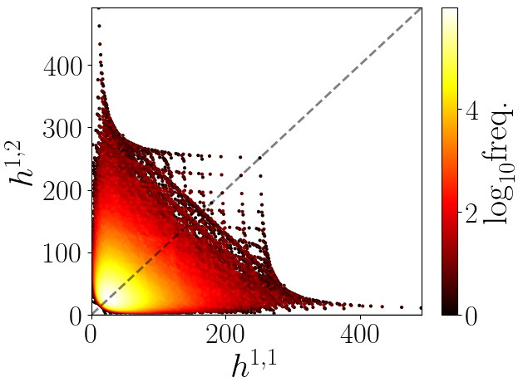

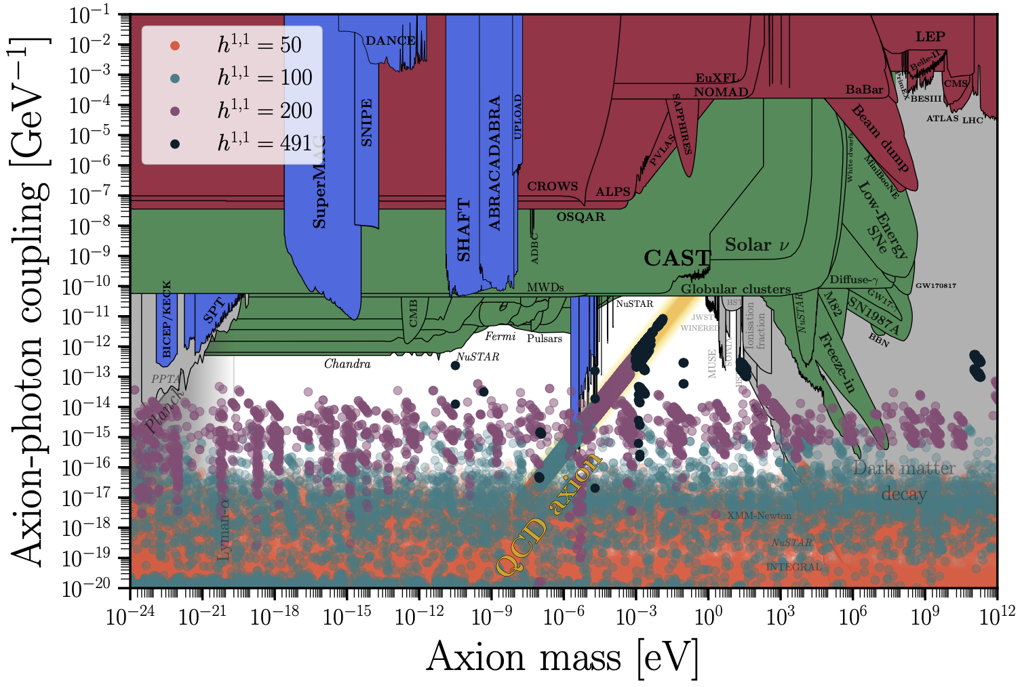
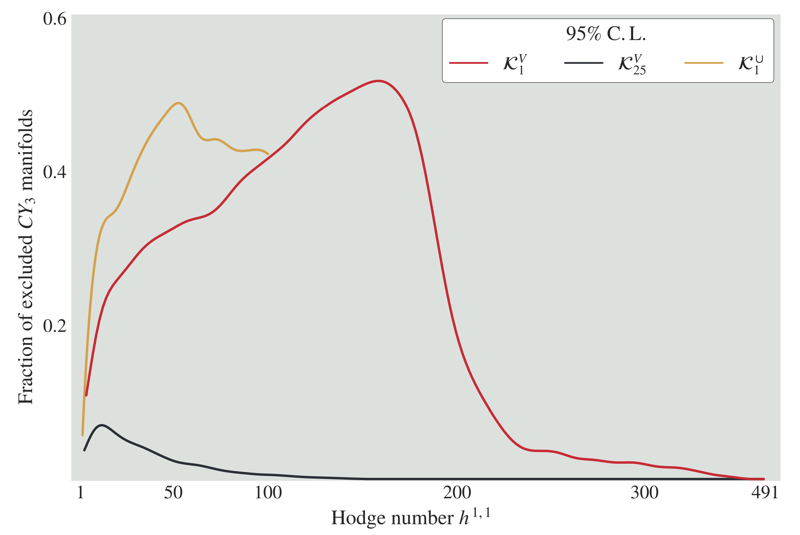
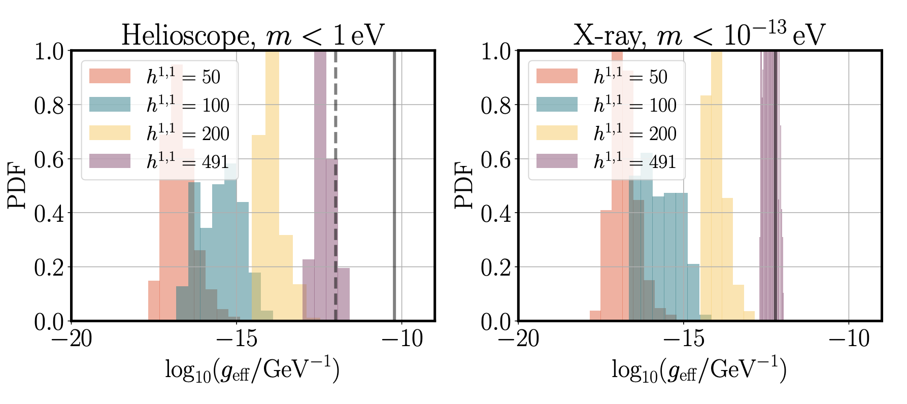
- Quantum gravity
- QCD axion
- String Theory
Axiverse ...
- O(100) Axions from TIIB 10D p-Form gauge fields
- Hodge number h11 = number of axions,
- All 4x10⁸ CYs known
- Recent predictions: See Marsh 21-25
    - EFT controlled > fa < GUT!
    - Many CYs excluded by BH spin
    - Fuzzy DM
    - Decaying DM, See Visinelli's talk
predictions
Notes:
Add a bit of GUT, Majoron

Slide 11
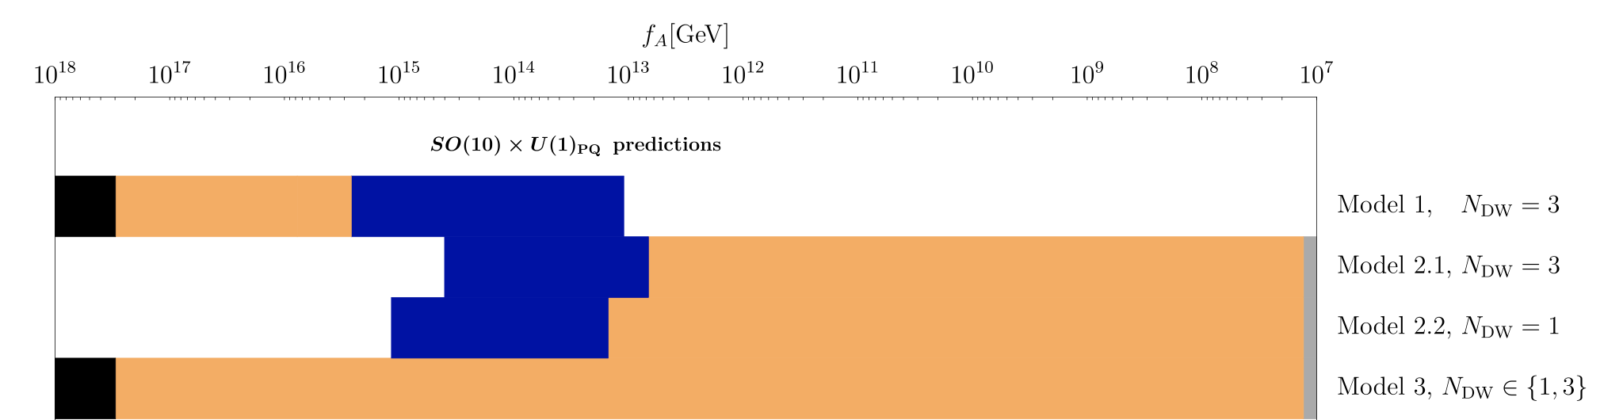
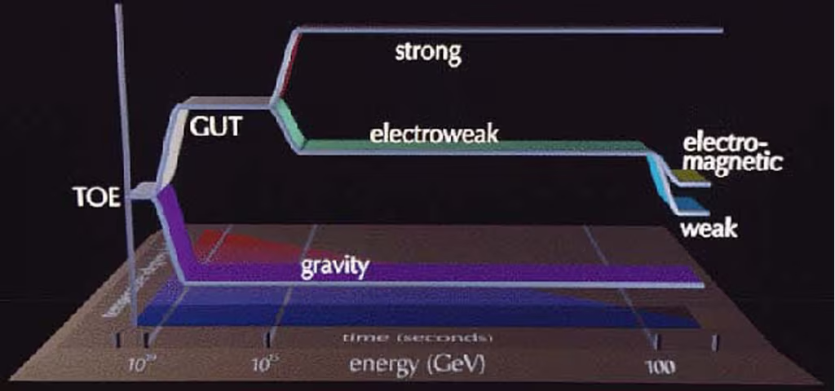
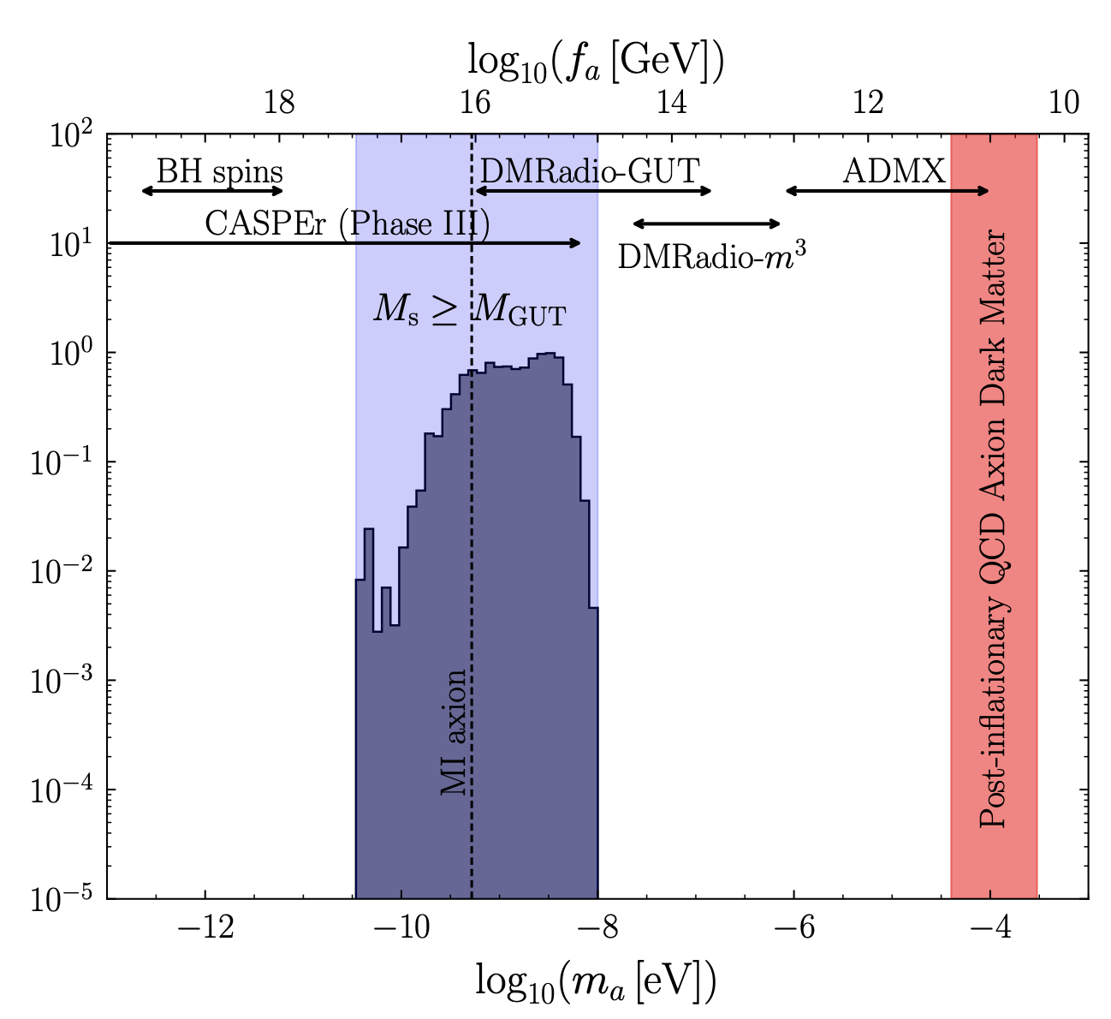
- Quantum gravity
Ernst18
- QCD axion
- String Theory
Axiverse ...
Benabou25
predictions
- GUT
- Flavour
- Majorons
- R-axion
- Axiverse, Imposing GUT Unification, safe proton decay
Notes:
Add a bit of GUT, Majoron

Slide 12

- Quantum gravity
- QCD axion
- String Theory
Axiverse ...
predictions
- GUT
- Flavour
- Majorons
- R-axion
- Flavour
- Majorons
- R-axion
- Flavour violating decays, K->pi a, many models
- Coupling to nu's, leptons, many models
- Mass related to SUSY breaking
Notes:
Add a bit of GUT, Majoron

Slide 13
- Quantum gravity
- de Sitter vacua are consistent with QG, θ-vacua must be eliminated by axion Dvali18
- QCD axion,
- Axial, Color-Anomalous SSB, explains smallness of Strong CP violations (strong CP problem)
- Color-Anomaly breaks Sym -> mass term!
- Couplings and mass related by QCD
- String Theory
Axiverse ...
- O(100) Axions from TIIB 10D p-Form gauge fields
- Hodge number h11 = number of axions,
- All 4x10⁸ CYs known, LE EFT calculable*
- Recent predictions: Marsh 21-25
predictions
- GUT
- fA ~ MGUT,
- KS GUTaxiverse
Ernst18
Benabou25
- Flavour
- Majorons
- R-axion
- Flavour violating decays, K->pi a, many models
- Coupling to nu's, leptons, many models
- Mass related to SUSY breaking
Notes:
Add a bit of GUT, Majoron

Slide 14







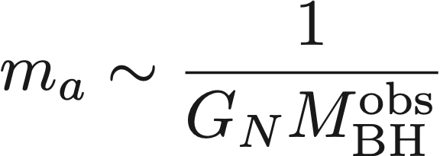

Laboratory
Stars
No Spinning BHs
Landscape
QCD axion predictions
Late Cosmology
Dark ...
Radiation, Matter, Energy
Notes:
Animations
Light and not so weakly interacting ALPs can be discovered at normal HEP experiments,
some extremely sensitive experiments apply to specficic ALPs, like those mediating flavour decays, or long-range forces
Weaker ALPs can still accelerate stellar evolution beyong ST predictions -> MASS<T
ALPs can steal AM from SBHs, but we dont->exclusion!
Relic ALPs can affect cosmology, decay spoils late cosmology predictions -> either too early decay or too slow
The rest of the parameter space is open for DM, DR, DE

Slide 15
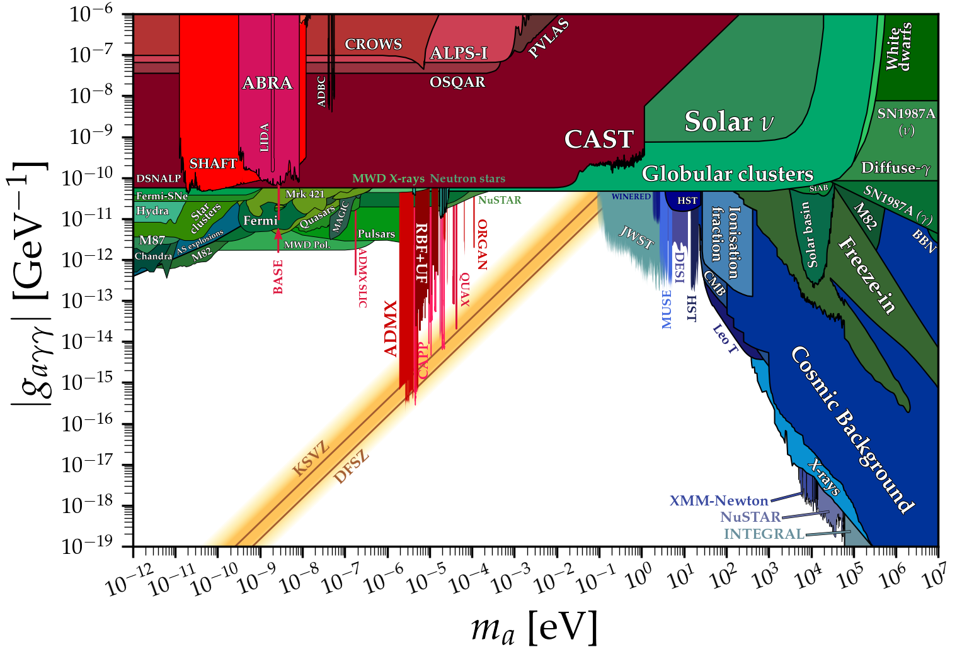
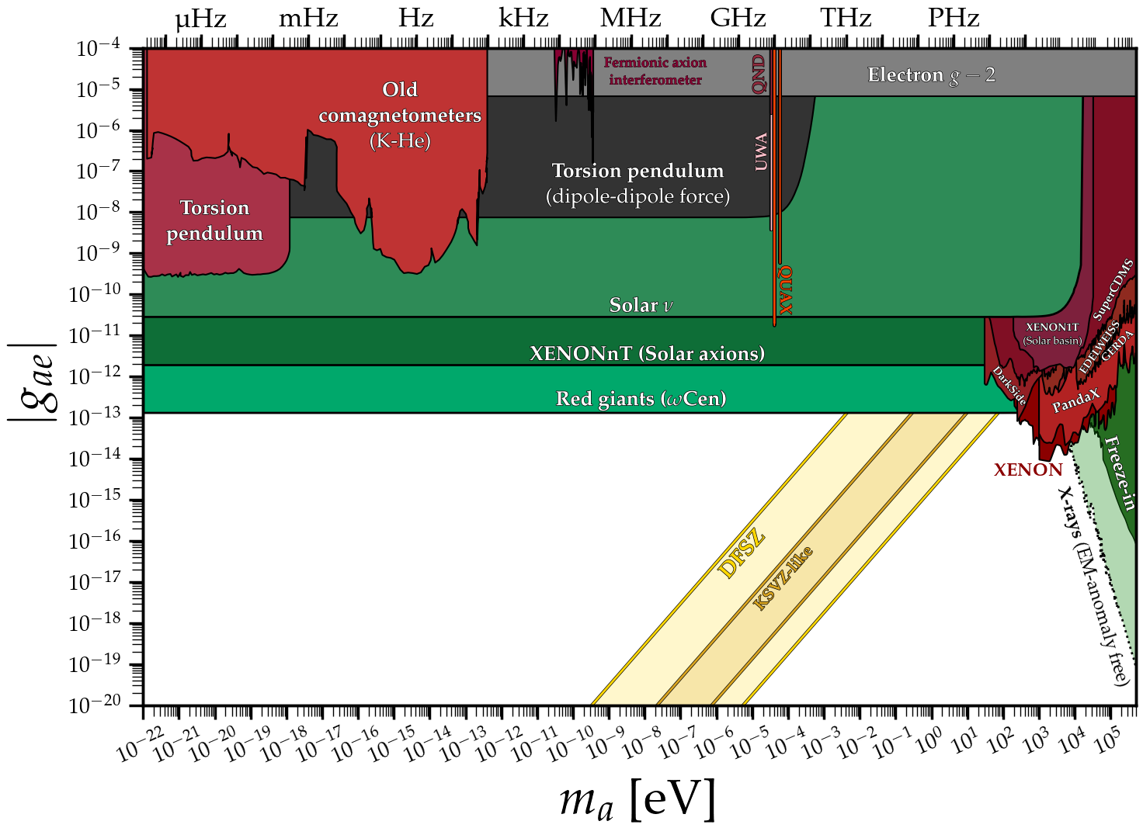
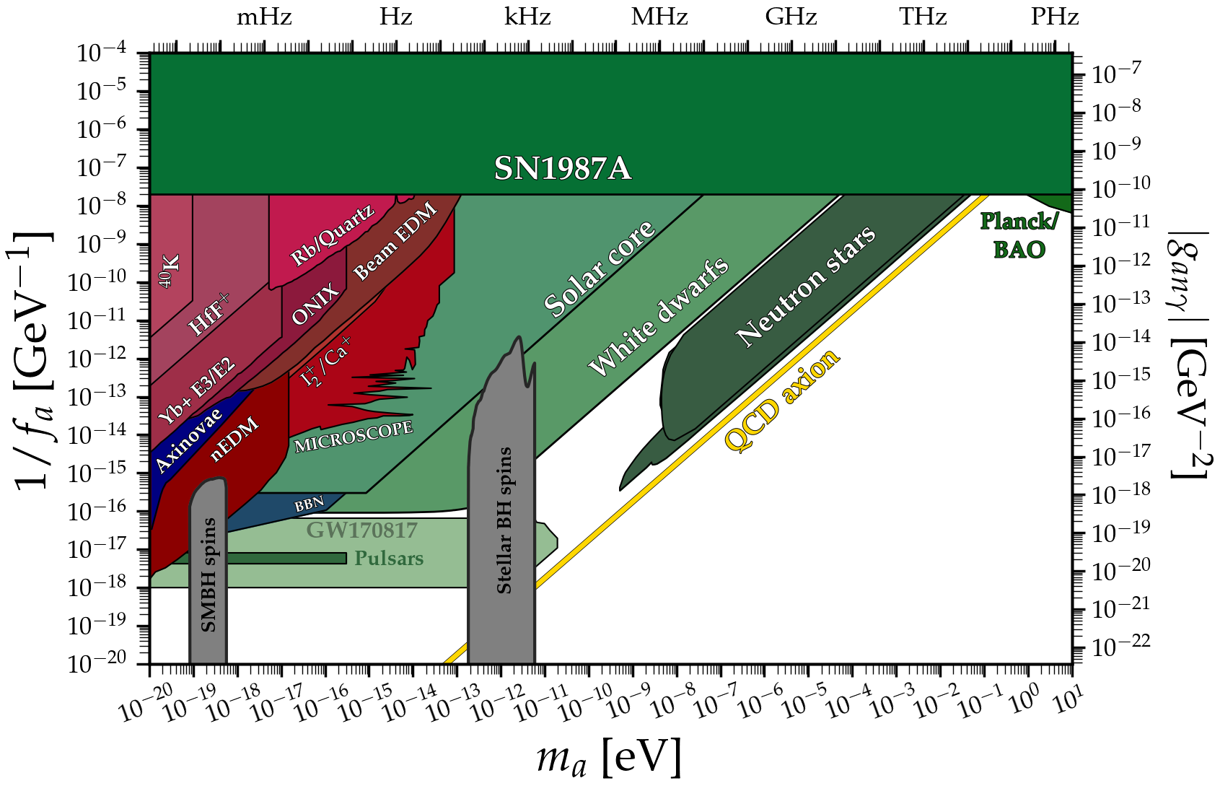
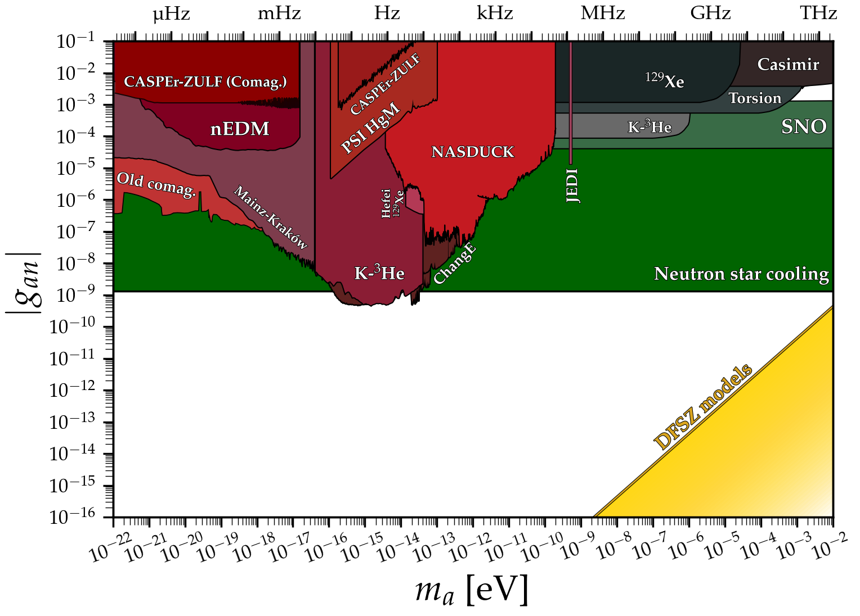
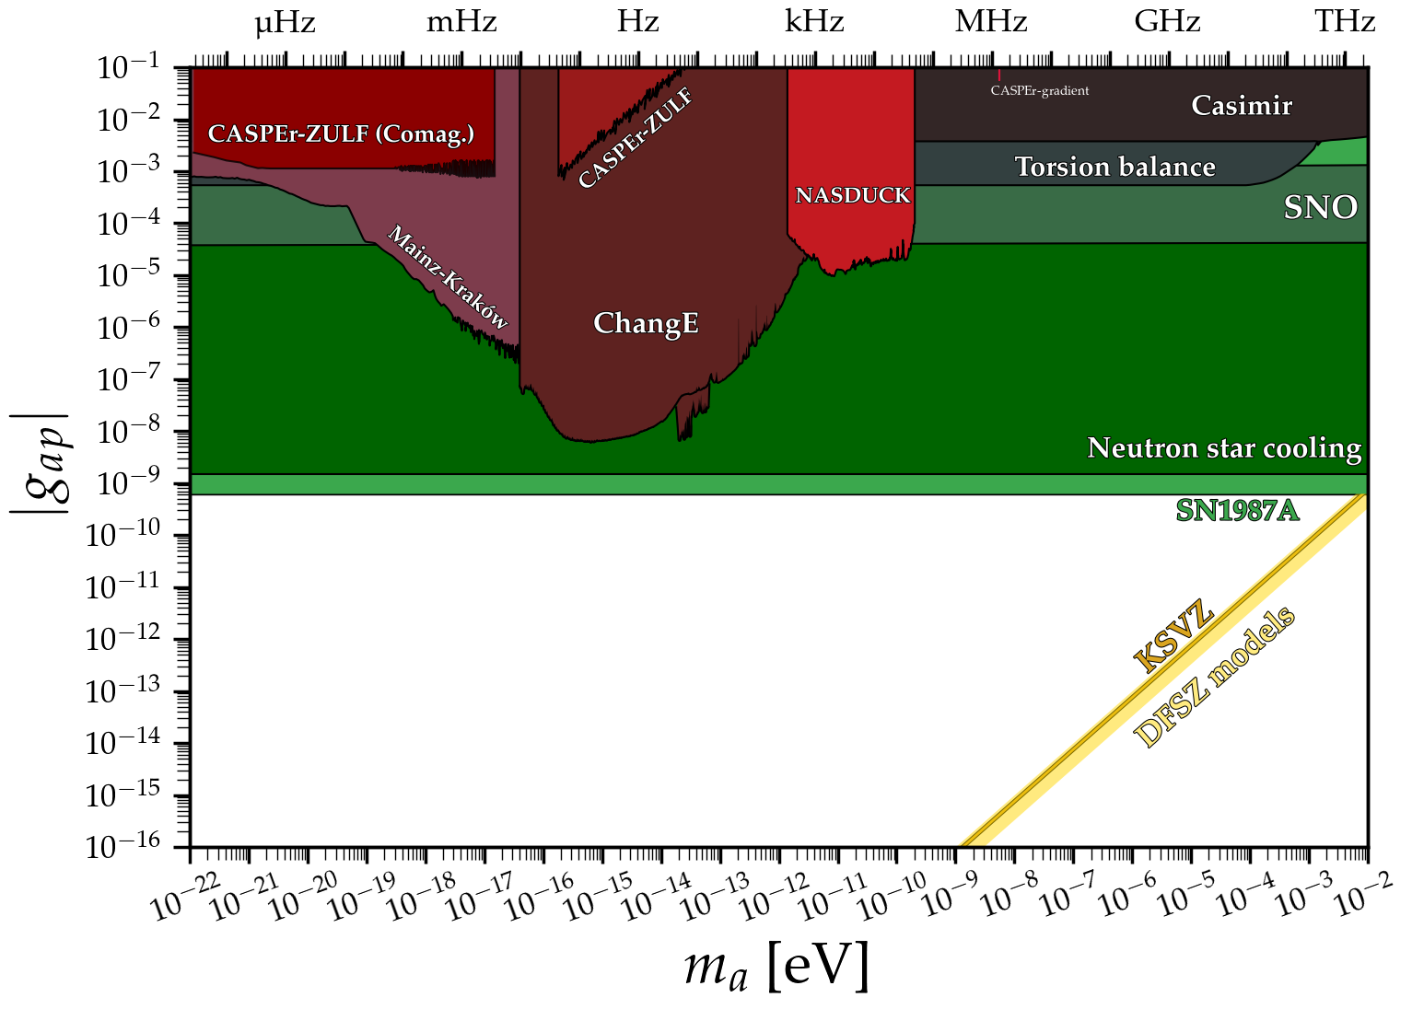
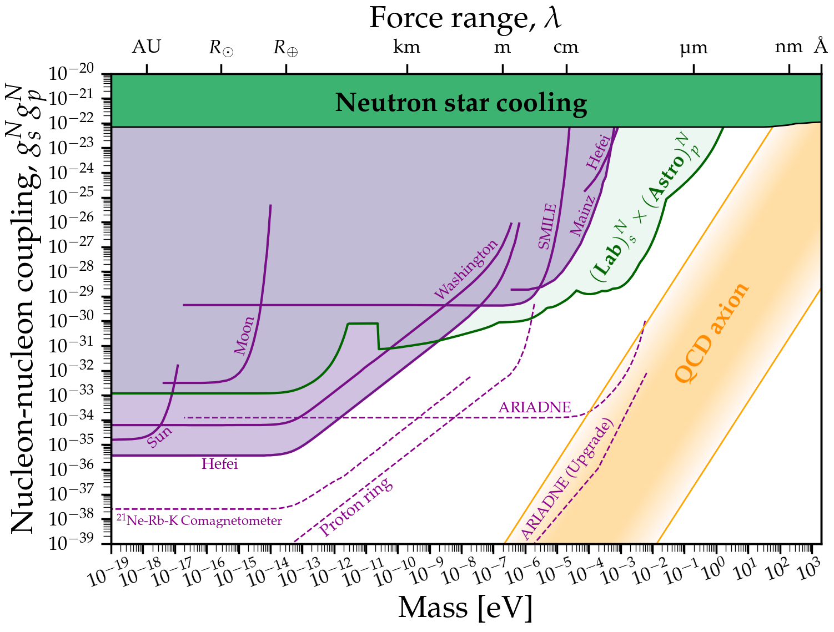


bounds
Notes:
Acknowledgements

Slide 16




bounds
Notes:
Acknowledgements

Slide 17
bounds
Notes:
Acknowledgements

Slide 18
bounds
Notes:
Acknowledgements

Slide 19
bounds
Notes:
Acknowledgements

Slide 20


Thanks to Ciaran O'Hare
https://cajohare.github.io/AxionLimits/
"ALP cartographer royal"
Notes:
ALPs can be DM by thermal and non-thermal processes resulting in DR, HDM, CDM within a broad range of parameters

Slide 21















Thermal
Moduli decays
Dark matter
Vacuum misalignment
Kinetic mis.
String Radiation
Notes:
ALPs can be DM by thermal and non-thermal processes resulting in DR, HDM, CDM within a broad range of parameters

Slide 22
Thermal
Moduli decays
Dark matter
Vacuum mislignment
Kinetic mis.
String Radiation
Notes:
ALPs can be DM by thermal and non-thermal processes resulting in DR, HDM, CDM within a broad range of parameters

Slide 23




- Some Neff, HotDM unavoidable
D'Eramo 24
- Miniclusters
Smoking GUNs: ALP DM is different
Badziak 25
- Fuzzy DM
- CMB Isocurvature
Eramo22
Notes:
They can be very different from ordinary CDM.
Miniclusters (cites), Sikivie stuff, Fuzzy DM, Isocurvature constraints
Topological, Gravitational Waves ...

Slide 24












- Neff, HotDM
Predictions from numerical simulations
O'Hare22
Pierobon23
- Bound fraction 80%
- NFW profiles
- ALP MCs fluffier and smaller
- Minivoids >8%
- Galactic disruption efficient
- Local DM > 80%
- Encounters rate
- MIcrolensing hard
QCD
QCD
- Miniclusters
ALP
Smoking GUNs: ALP DM is different
O'Hare24
- Fuzzy DM
- CMB Isocurvature
Notes:
They can be very different from ordinary CDM.
Miniclusters (cites), Sikivie stuff, Fuzzy DM, Isocurvature constraints
Topological, Gravitational Waves ...

Slide 25




- Neff, HotDM
Fuzzy DM has additional pressure and granularity
- Miniclusters
Smoking GUNs: ALP DM is different
- Fuzzy DM
- CMB Isocurvature
Notes:
They can be very different from ordinary CDM.
Miniclusters (cites), Sikivie stuff, Fuzzy DM, Isocurvature constraints
Topological, Gravitational Waves ...

Slide 26




Inflation, axion ALP CDM isocurvature at observable scales
- Neff, HotDM
Limits on HI
1%DM
10%DM
- Miniclusters
100%DM
Smoking GUNs: ALP DM is different
Low scale inflation seeds DM
  - Stochastic Axion scenario (Scherlis 2018)
- Fuzzy DM
- CMB Isocurvature
Notes:
They can be very different from ordinary CDM.
Miniclusters (cites), Sikivie stuff, Fuzzy DM, Isocurvature constraints
Topological, Gravitational Waves ...

Slide 27












- Tiny oscillating field with long coherent length and time
frequency
coherence time
coherence length
- Detectable if coupled to suitable resonator, scan in frequency!
Dark matter experiments
@ Strong B-field
NOISE
+signal
Axion-induced E-field
Tune a Resonant device to
Notes:
Axion Haloscopes (Ciaran's plot)

Slide 28




Dark matter experiments
https://cajohare.github.io/AxionLimits/
Notes:
Axion Haloscopes (Ciaran's plot)

Slide 29












- We can predict the axion dark matter mass ~ 0.1-0.4 meV
Benabou,Gorghetto,Moore,many more...
Post-inflationary axions
- Dedicated experiments on their way: MADMAX, ALPHA, ... RADES, CADEx, DALI
a
Notes:
Clear target, Simulations of axion decay predict axion mass*
Minicluster simulations predict
100-400 ueV, MADMAX, ALPHA, BREAD, Mention also DALI, CADEX

Slide 30



- Stellar evolution (speed limited by energy loss)
H
He
CO
...
time
Stellar evolution
- Axions emitted from stars accelerate stellar evolution (strong bounds ... some hints)
He
CO
...
H

Slide 31










- Solar axions can be detected by the International Axion Observatory
See Physics book 1904.09155, 2504.00079
IAXO concept
babyIAXO
2030?-
- Axions from Giant stars too
Stellar ALP experiments
Candon 24
- Next Galactic SN too
Carenza25
Notes:
IAXO
GALAXIS,

Slide 32


- Solar axions can be detected by the International Axion Observatory
See Physics book 1904.09155, 2504.00079
IAXO concept
babyIAXO
2030?-
Stellar ALP experiments
- Next Galactic SN too
Carenza25
- Next galactic SN axions could be detected by ... GALAXIS?
(Galactic Axion Instrument for Supernova)
Notes:
IAXO
GALAXIS,

Slide 33








- Long range forces
Wilzcek84, ARIADNE Axion Resonant InterAction DetectioN Experiment @ Northwestern U. Geraci14, 1st Results 25
Pure lab experiments
- Flavoured axion decays
model dependent coefficient
(NA62, ORKA, KOTO improvement by ~ 70 on BR )

Slide 34



EXCLUDED
Astrophysics
ARIADNE
FLAVOUR
- Strong CP no problem
- Axion Dark matter (1-10%)
- New scale in physics!
- Miniclusters
- Stellar cooling
- Solar axions
- SN axions
- Direct Detection!
- Flavour and new CP violating observables!
meV frontier
WD cooling hint?
ALPHA
GALAXIS?
ALPHA
MADMAX

Slide 35
- I hope you enjoyed your tour
- ALPs are wild!
- ALP are well motivated, worth studying
- Search well, you can find Dark Matter, radiation, new astro phenomena
- New sources of CP violation, guidance to solve the flavour puzzle?
- Hints of new energy scales in physics?
- We are measuring ... Axion DM could be found any day now
Welcome back!
Thanks for your attention
Notes:
- We are measuring ... Axion DM could be found any day now

