Slide 1


High Mass Dark Matter Searches With the High Speed LMC
Andrew Buchanan

Slide 2
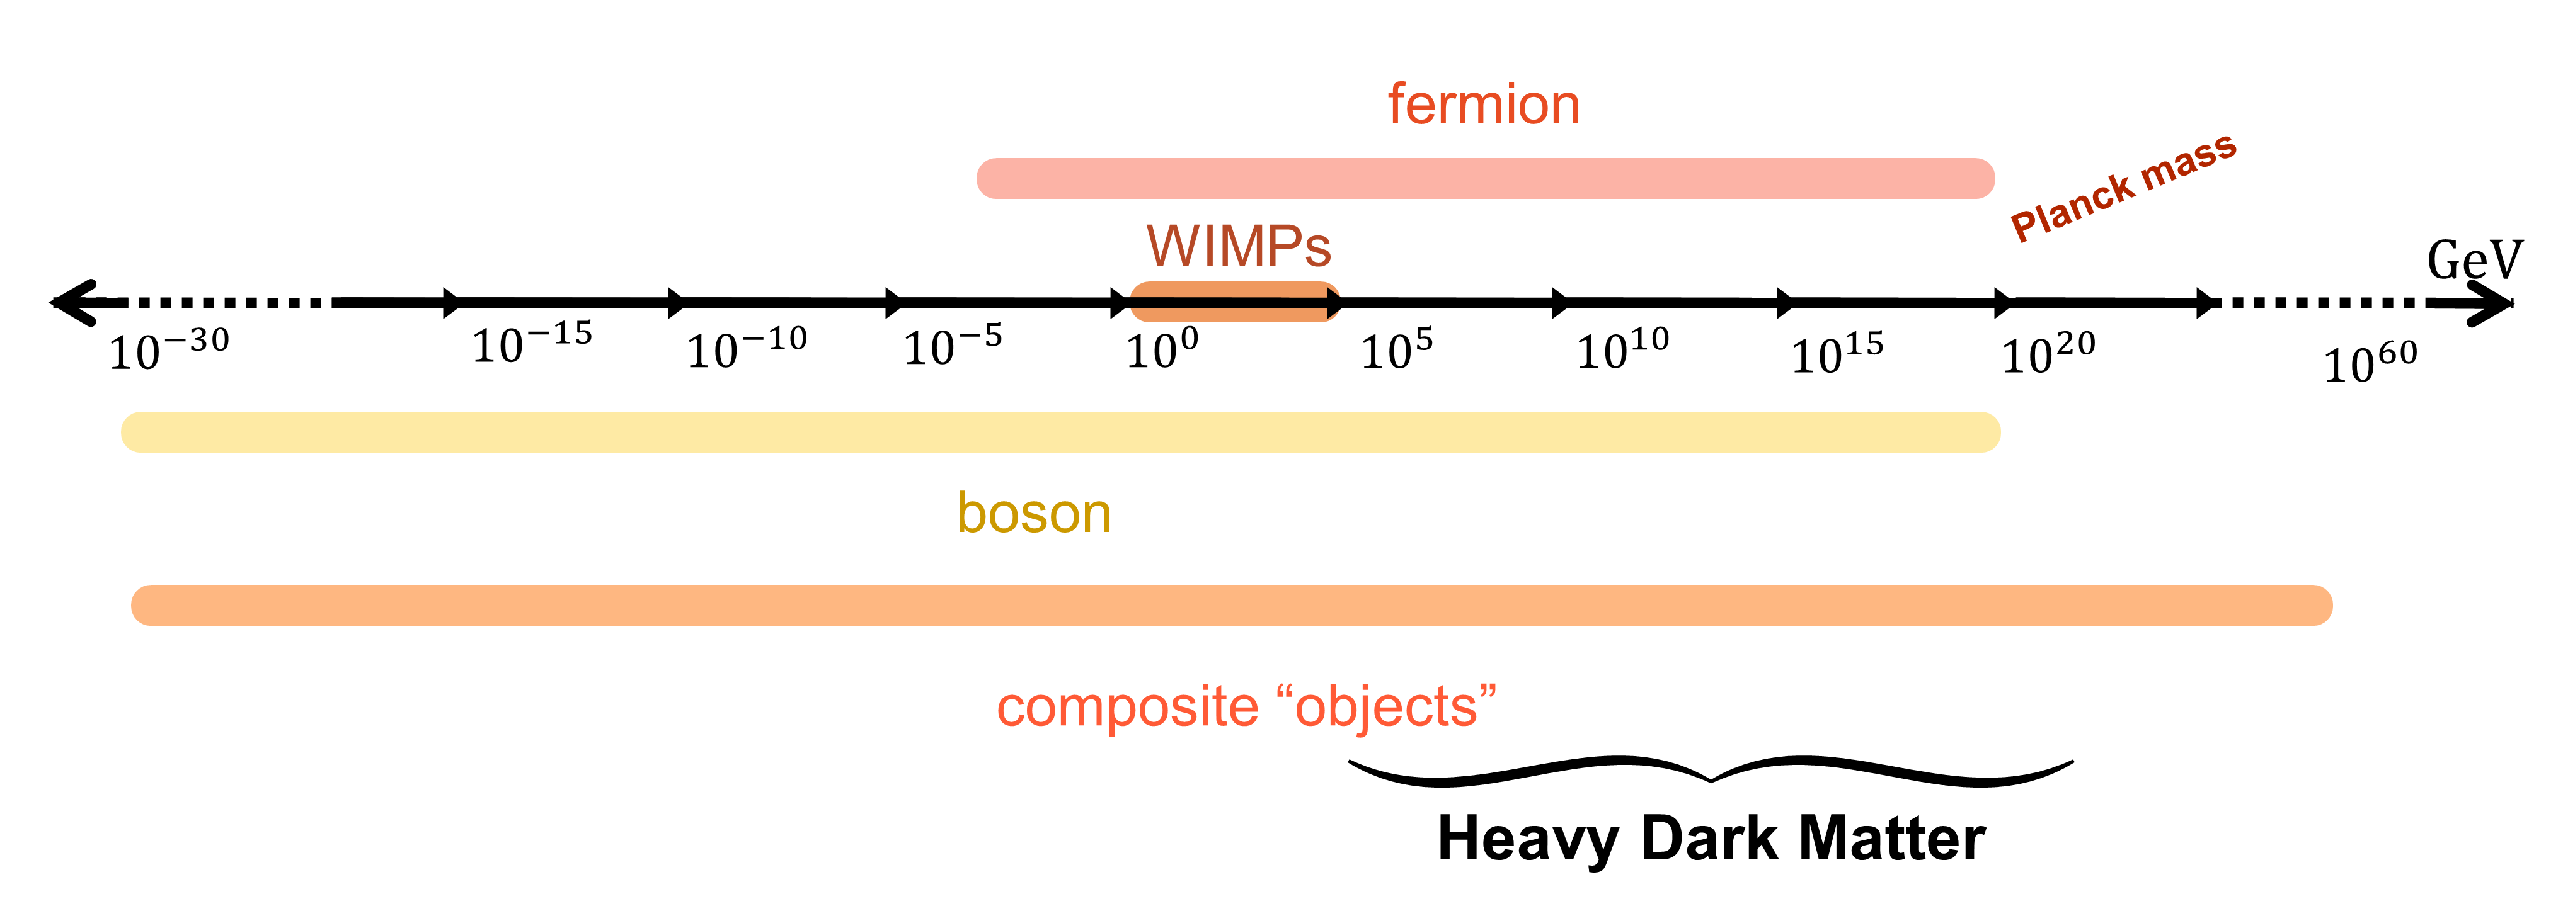
Heavy Dark Matter
Boukhtouchen ‘24

Slide 3
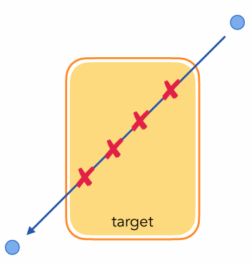
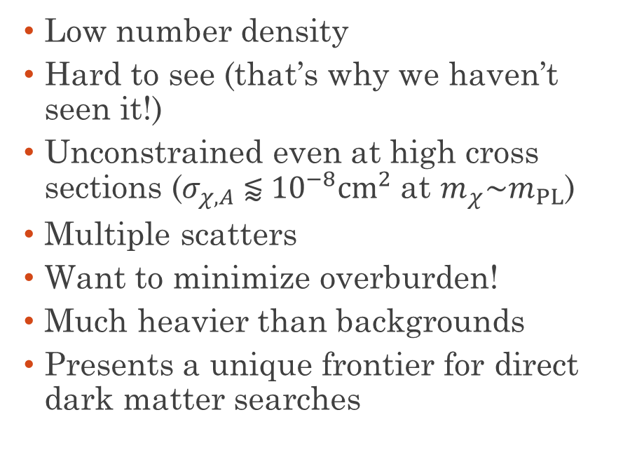
Why Heavy Dark Matter?
  Low number density
  Hard to see (that’s why we haven’t seen it!)
  Unconstrained even at high cross sections ($σ_{χ,A} \text{⪅} {10}^{−8}{cm}^{2}$at $m_{χ}\sim m_{PL}$)
  Multiple scatters
  Want to minimize overburden!
  Much heavier than backgrounds
  Presents a unique frontier for direct dark matter searches
Boukhtouchen ‘24

Slide 4
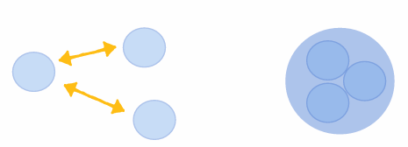
How Can Heavy Dark Matter Form?
Dark Nucleosynthesis
Boukhtouchen ‘24

Slide 5
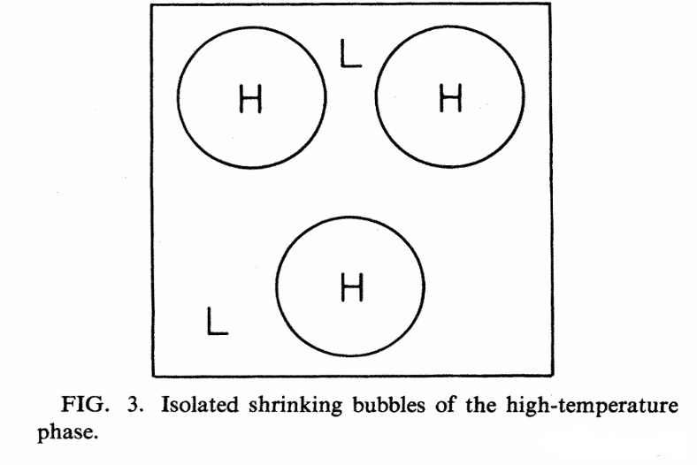
How Can Heavy Dark Matter Form?
Production from False Vacuum Bubbles
Dark Nucleosynthesis
Witten ‘84
Boukhtouchen ‘24

Slide 6
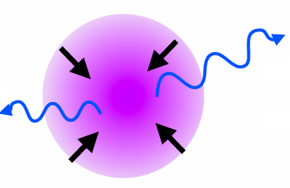
How Can Heavy Dark Matter Form?
Production from False Vacuum Bubbles
Dark Nucleosynthesis
Dissipative Processes
Witten ‘84
Boukhtouchen ‘24
Bramante et al ‘24

Slide 7
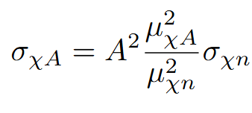
Heavy DM Interactions with Nuclei
Per-Nucleon
  Realistic for large loosely-bound composite DM
  Each DM constituent interacts coherently with whole nucleus

Slide 8

Heavy DM Interactions with Nuclei
Per-Nucleon
Contact
  Realistic for large loosely-bound composite DM
  Each DM constituent interacts coherently with whole nucleus
  Realistic for large single particles or tightly-bound composite DM
  DM interacts with each nuclei with the same strength

Slide 9
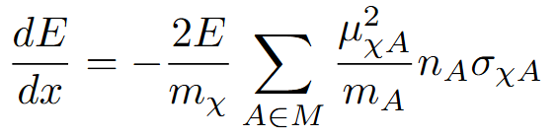

Heavy DM and the High Velocity Tail
  For multiple scatters, energy deposition is proportional to initial energy $∝v_{0}^{2}$

Slide 10
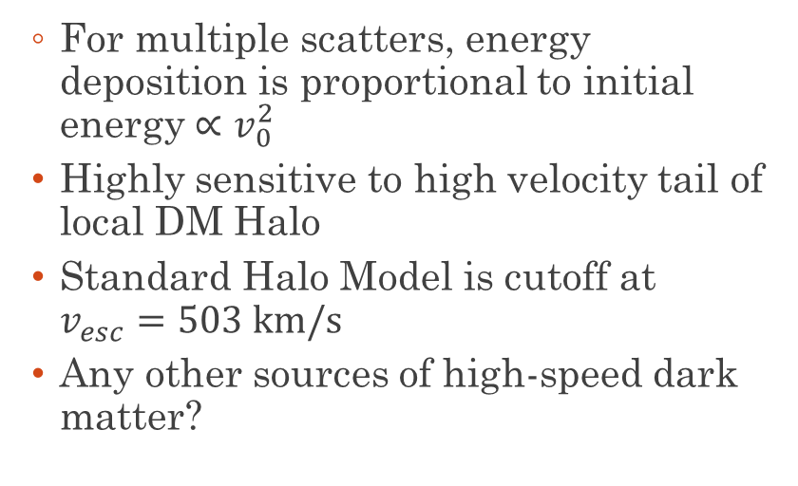
Heavy DM and the High Velocity Tail
  For multiple scatters, energy deposition is proportional to initial energy $∝v_{0}^{2}$
  Highly sensitive to high velocity tail of local DM Halo
  Standard Halo Model is cutoff at $v_{esc}=503 km/s$
  Any other sources of high-speed dark matter?

Slide 11
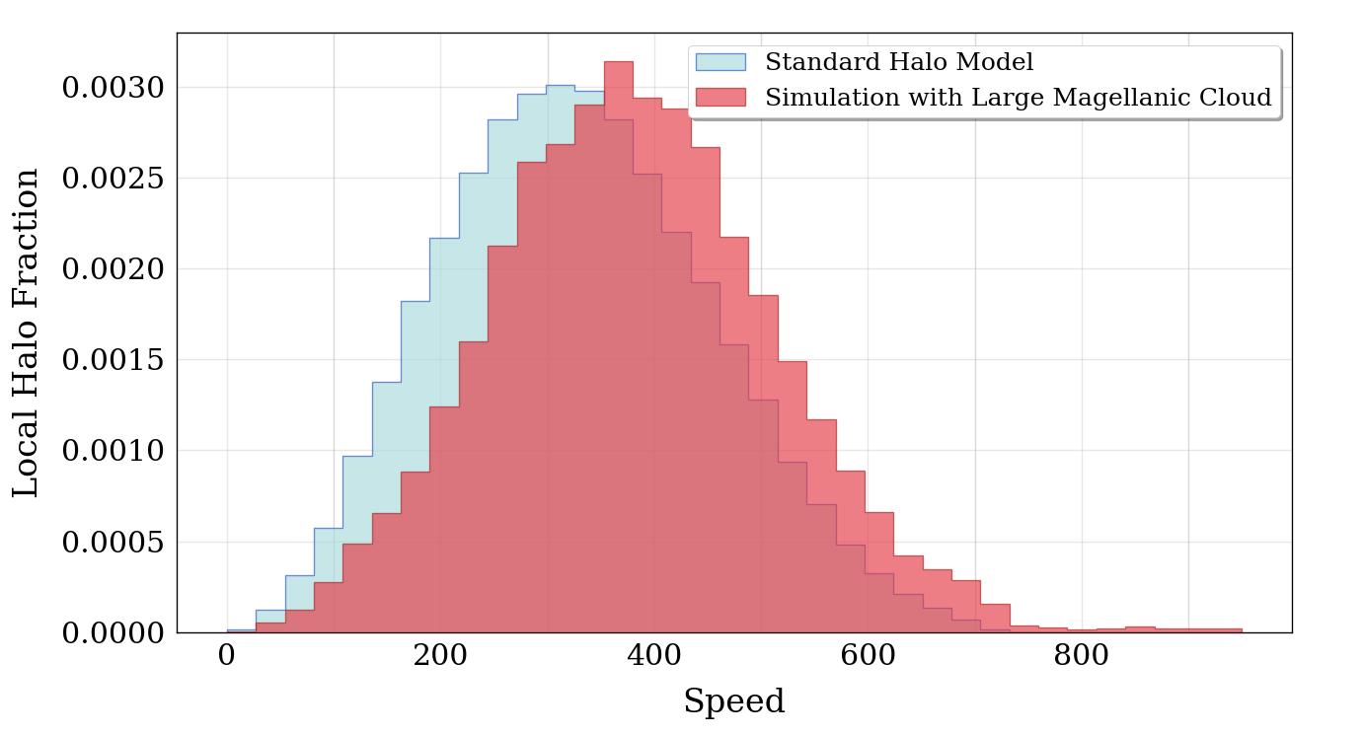
The Large Magellanic Cloud
  Satellite galaxy of Milky Way with its own halo
  Use simulated velocities of MW LMC analogues from Auriga cosmological simulations
Local Speed Distribution

Slide 12
The Large Magellanic Cloud
  Satellite galaxy of Milky Way with its own halo
  Use simulated velocities of MW LMC analogues from Auriga cosmological simulations
  Shifts peak of speed distribution
Local Speed Distribution

Slide 13
The Large Magellanic Cloud
  Satellite galaxy of Milky Way with its own halo
  Use simulated velocities of MW LMC analogues from Auriga cosmological simulations
  Shifts peak of speed distribution
  Increases high speed tail
Local Speed Distribution

Slide 14
The Large Magellanic Cloud
  Satellite galaxy of Milky Way with its own halo
  Use simulated velocities of MW LMC analogues from Auriga cosmological simulations
  Shifts peak of speed distribution
  Increases high speed tail
  Can improve heavy DM bounds with strong velocity dependence
  Use plastic etch detectors as a case study
Local Speed Distribution

Slide 15
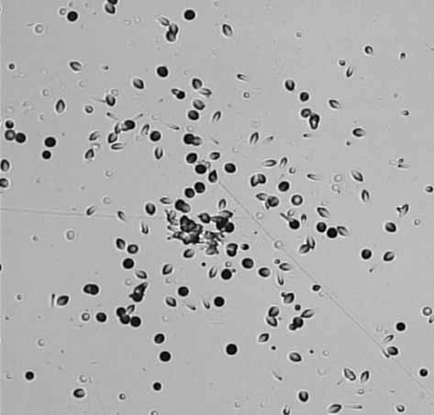
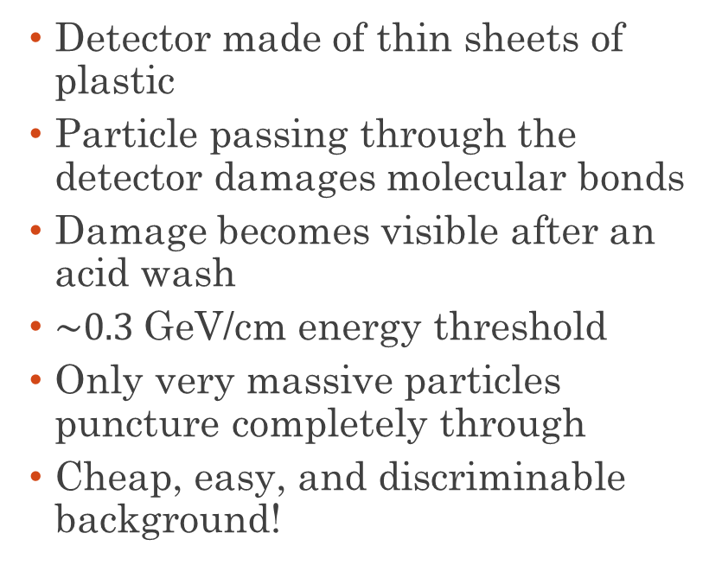
Plastic Etch Detectors
  Detector made of thin sheets of plastic
  Particle passing through the detector damages molecular bonds
  Damage becomes visible after an acid wash
  $\sim 0.3$GeV/cm energy threshold
  Only very massive particles puncture completely through
  Cheap, easy, and discriminable background!
El-Badry et al ‘07

Slide 16
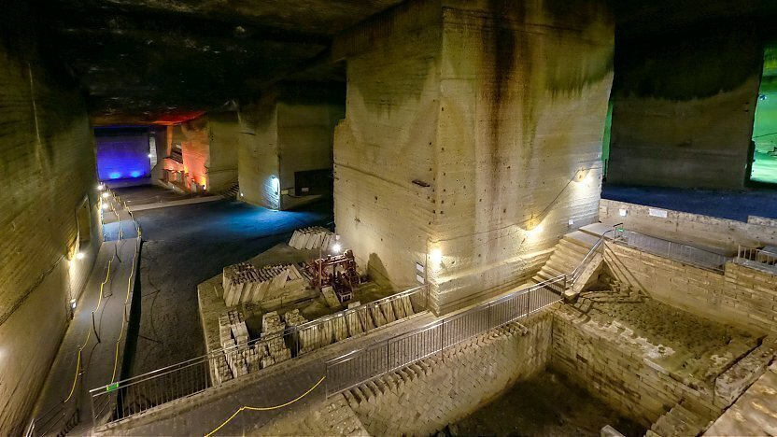
Plastic Etch Experiments
Ohya Quarry
  Search for magnetic monopoles at the Ohya underground mine north of Tokyo in the 1990s
Ohya History
Museum

Slide 17
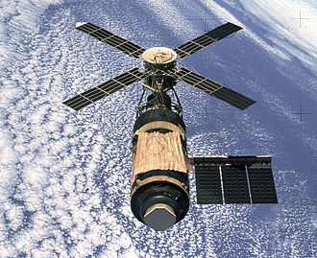
Plastic Etch Experiments
Ohya Quarry
SKYLAB
  Search for magnetic monopoles at the Ohya underground mine north of Tokyo in the 1990s
  Search for highly charged cosmic rays (Z > 60) at Skylab, the ISS predecessor in the 1970s
Ohya History
Museum
NASA
  Both detected nothing above background.

Slide 18
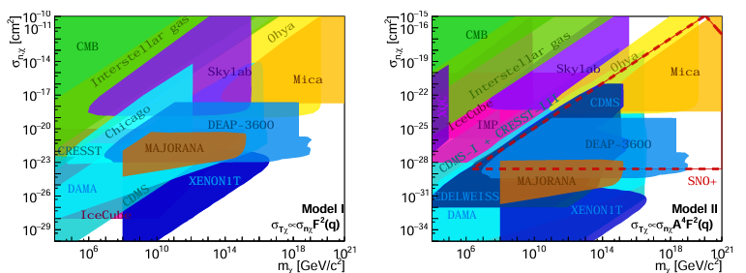
Existing Bounds
  In 2020, my colleagues used the Skylab and Ohya data to derive heavy DM bounds for contact and per-nucleon interactions (hep-ph 2012.13406)
  Useful test case for the effect of LMC
Per-Nucleon
Contact
Snowmass2021

Slide 19


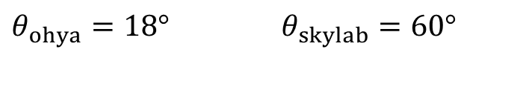
Directionality Matters
  Detector is planar and has acceptance angle $θ_{tol}$
$$θ_{tol}$$
$θ_{ohya}=18°$ $θ_{skylab}=60°$

Slide 20
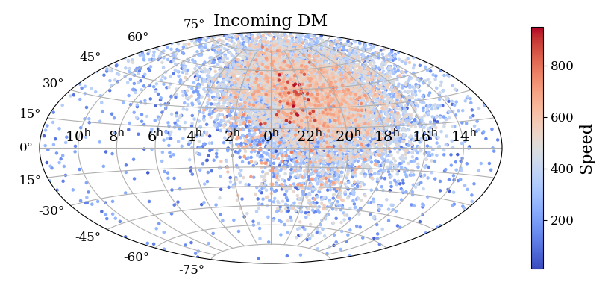
Directionality Matters
  Detector is planar and has acceptance angle $θ_{tol}$
  DM Wind from Sun’s motion
  LMC’s effects are concentrated in a small region of the sky
$$θ_{tol}$$
$θ_{ohya}=18°$ $θ_{skylab}=60°$

Slide 21

Dealing with Detector Orientation
OHYA
  Daily oscillation in orientation with respect to solar system frame
  $T=2.1$ yrs
  Average over sidereal day

Slide 22
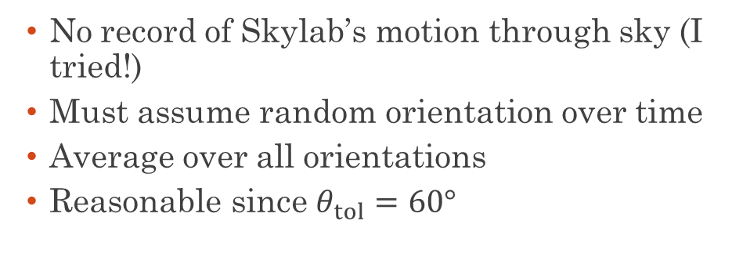
Dealing with Detector Orientation
OHYA
SKYLAB
  Daily oscillation in orientation with respect to solar system frame
  $T=2.1$ yrs
  Average over sidereal day
  No record of Skylab’s motion through sky (I tried!)
  Must assume random orientation over time
  Average over all orientations
  Reasonable since $θ_{tol}=60°$

Slide 23
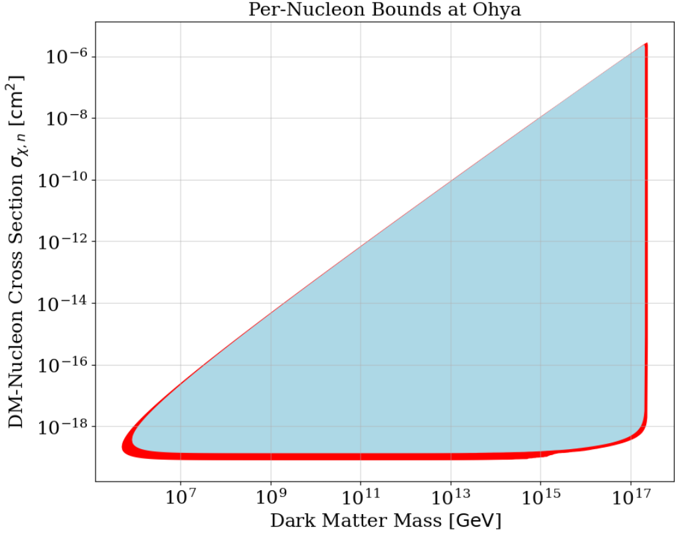
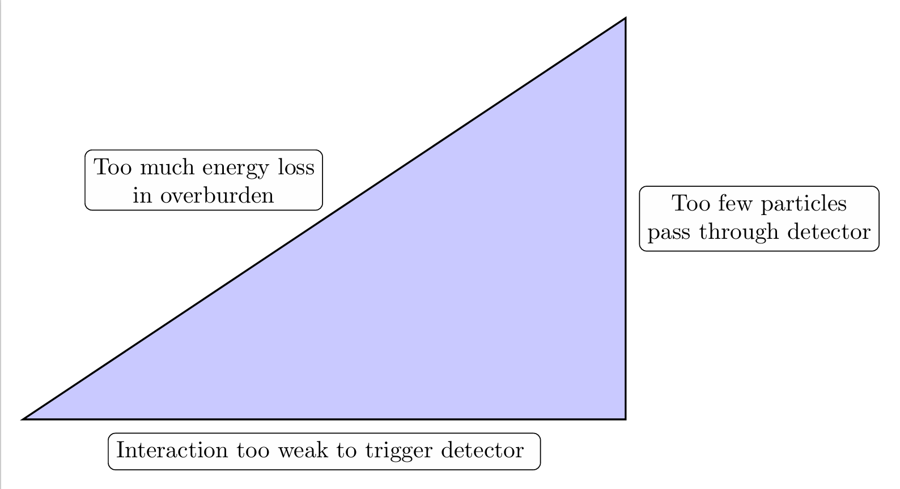
Halo Model vs Halo + LMC

Slide 24
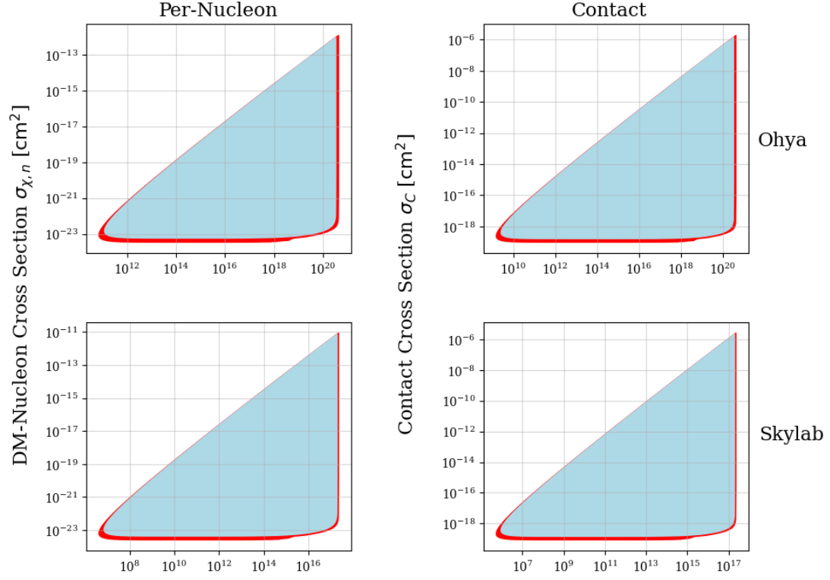
Halo Model vs Halo + LMC

Slide 25
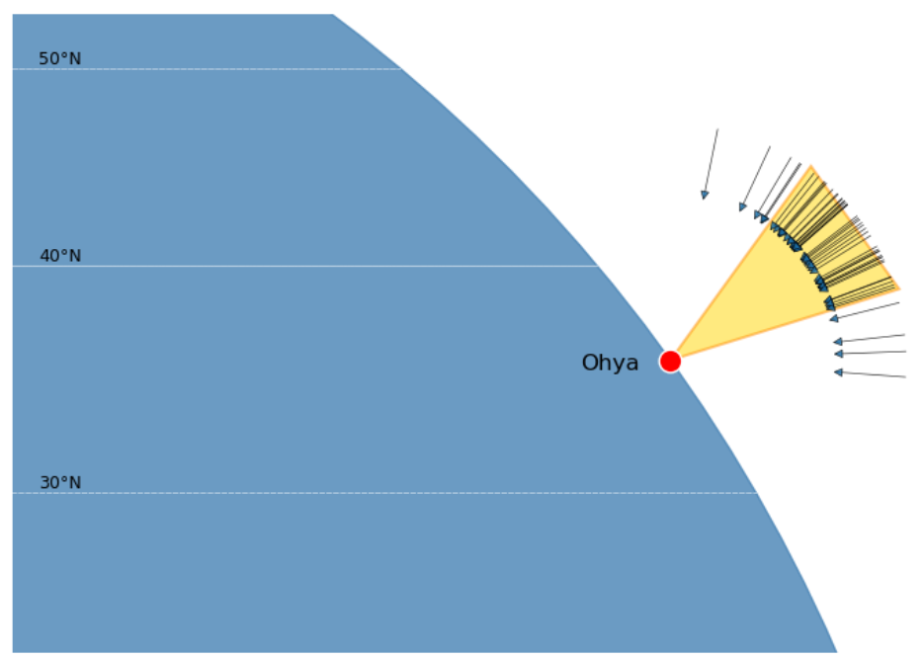
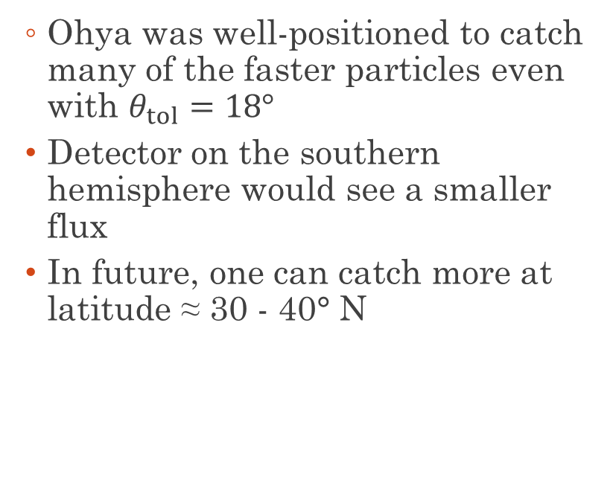
Catching the LMC Wind
  Ohya was well-positioned to catch many of the faster particles even with $θ_{tol}=18°$
  Detector on the southern hemisphere would see a smaller flux
  In future, one can catch more at latitude ≈ 30 - 40° N
Particles faster than 750 km/s

Slide 26
Conclusion
  Can improve bounds for heavy dark matter with fast dark matter due to the Large Magellanic Cloud
  Improvements can be applied straightforwardly to any multi-scattering heavy DM search
  Better bounds for free!
  Motivates more precise modelling of the effect of the LMC on the local dark matter distribution
  Choice of detector positioning can improve heavy DM detection prospects by a factor of 2!

Slide 27
Backup Slides

Slide 28
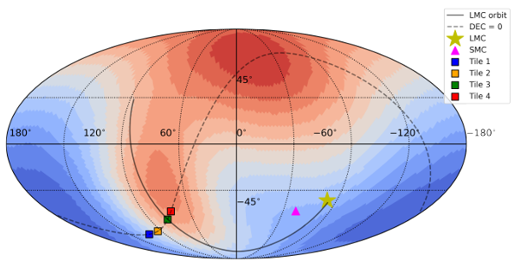
The LMC over Time
LMC is in southern sky
Incoming LMC DM is from northern direction
Why?
Cavieres et al ‘25

Slide 29
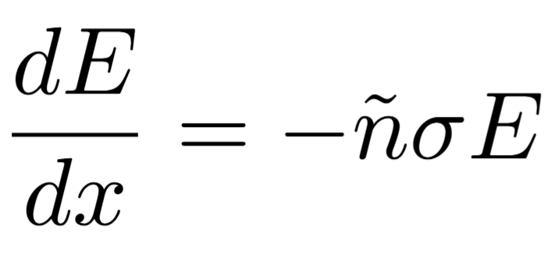
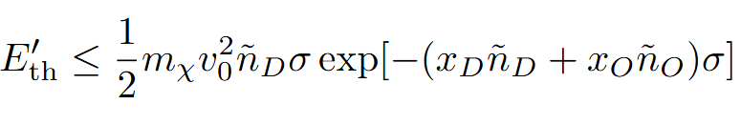
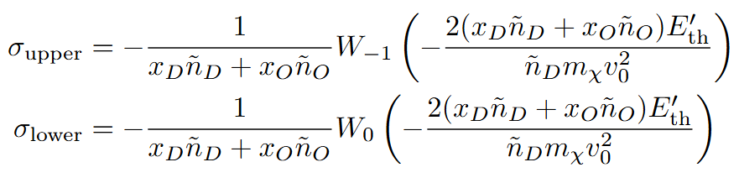

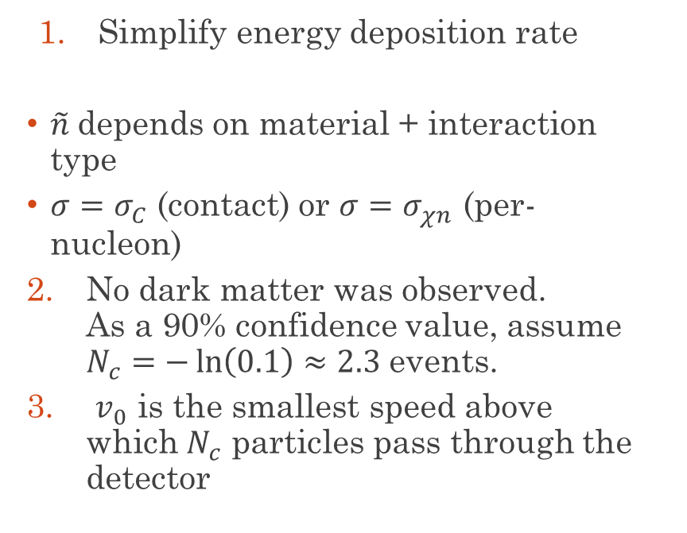
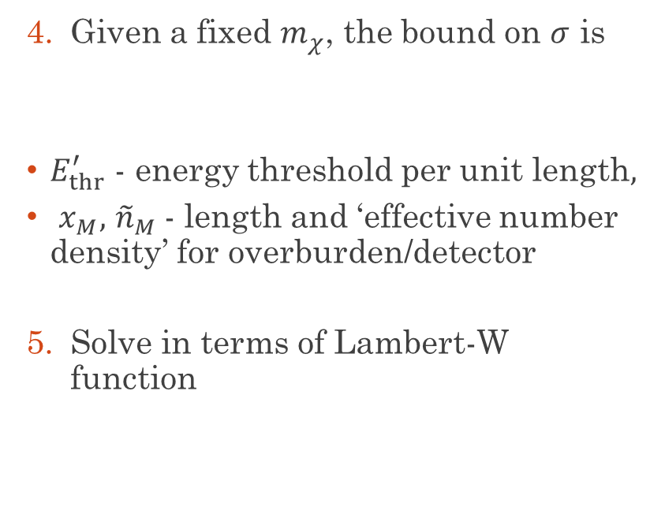
Deriving The Bound
  Simplify energy deposition rate
  $\tilde{n}$depends on material + interaction type
  $σ=σ_{C}$ (contact) or $σ=σ_{χn}$ (per-nucleon)
  No dark matter was observed.
  As a 90% confidence value, assume $N_{c}=−\ln\left(0.1\right)≈2.3$ events.
  $v_{0}$ is the smallest speed above which $N_{c}$ particles pass through the detector
  Given a fixed $m_{χ}$, the bound on $σ$ is
  $E_{thr}^{′}$ - energy threshold per unit length$,$
  $x_{M},$ ${\tilde{n}}_{M}$- length and ‘effective number density’ for overburden/detector
  Solve in terms of Lambert-W function

Slide 30
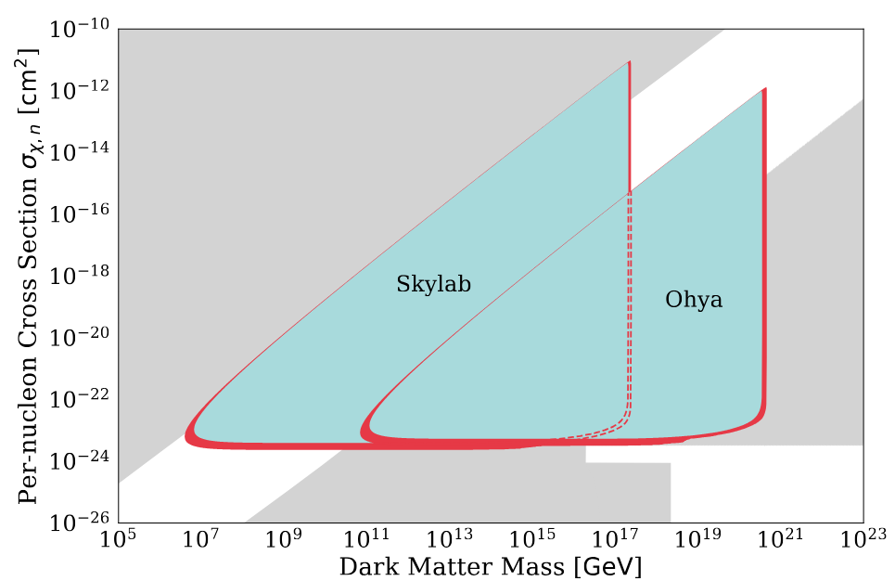
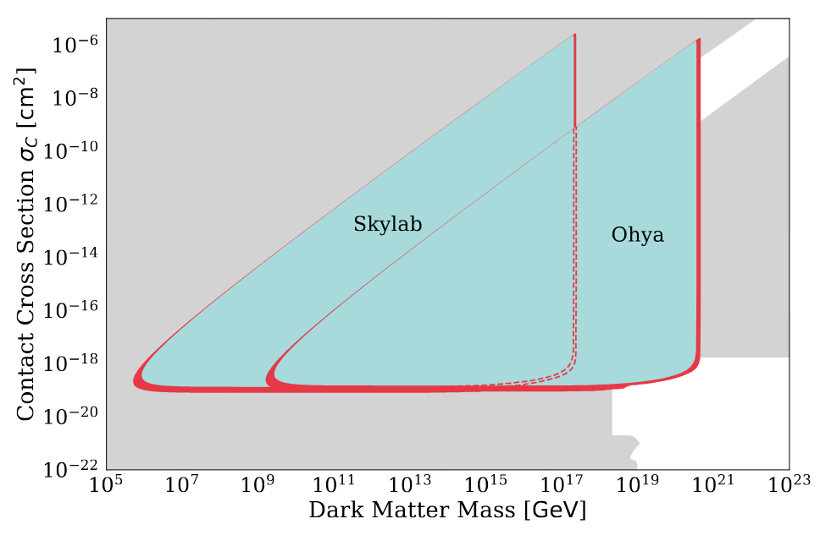
Comparison with Other Bounds
Per-nucleon
contact

Slide 31
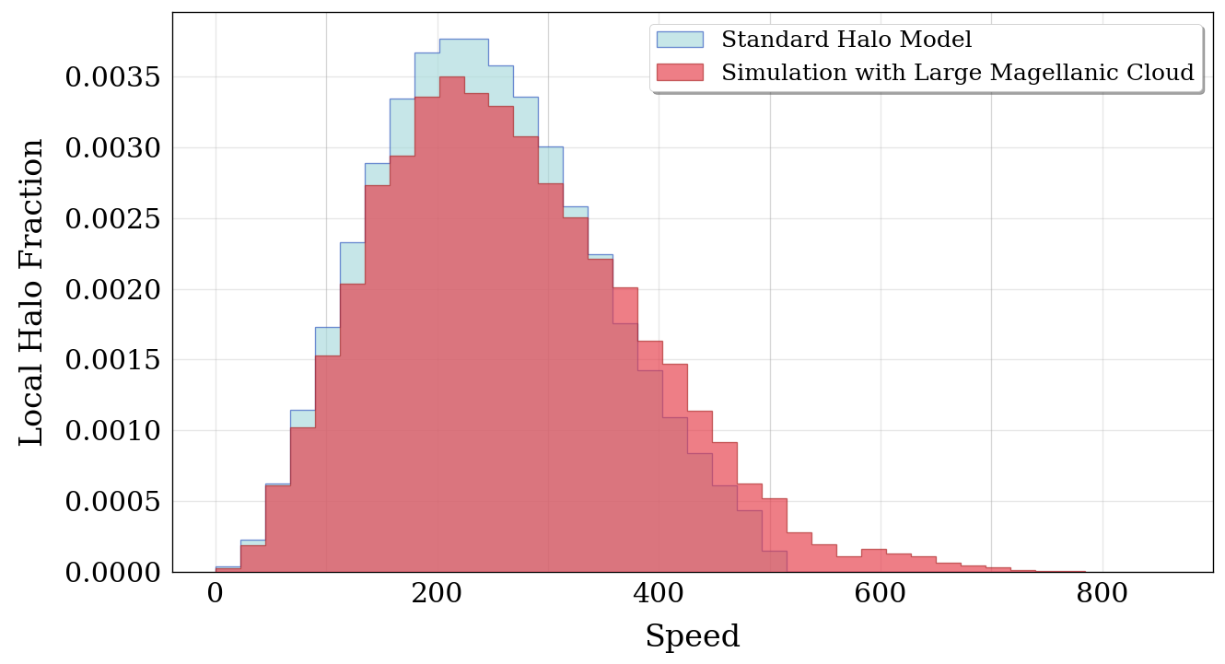
Galactic Speed Distribution

Slide 32
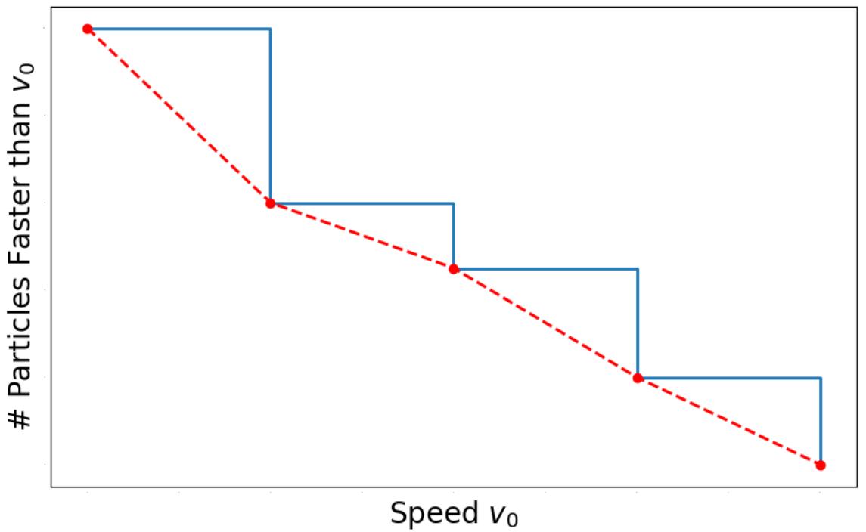
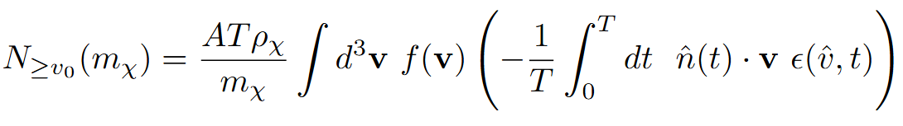
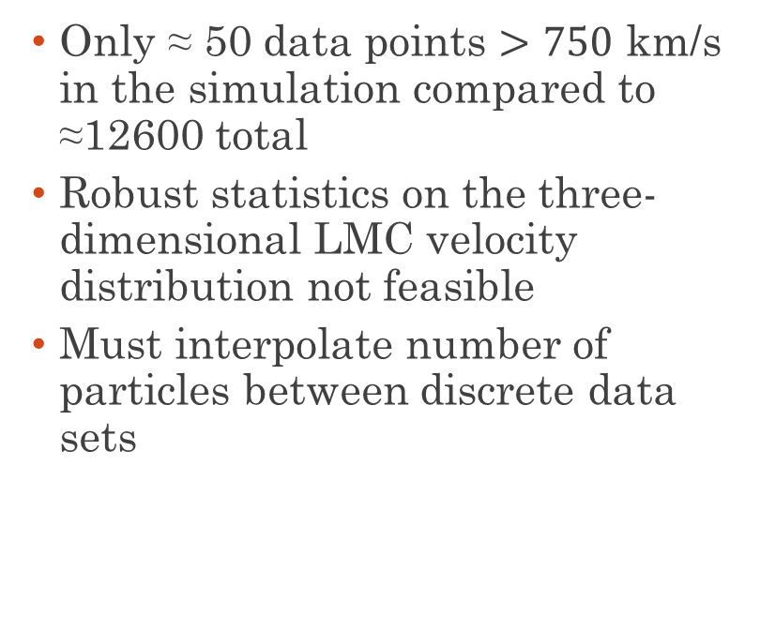
Handling Simulated Results
  Only ≈ 50 data points $>750$ km/s in the simulation compared to ≈12600 total
  Robust statistics on the three-dimensional LMC velocity distribution not feasible
  Must interpolate number of particles between discrete data sets

Slide 33
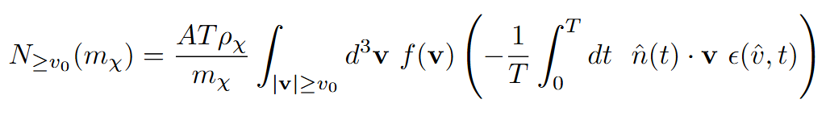
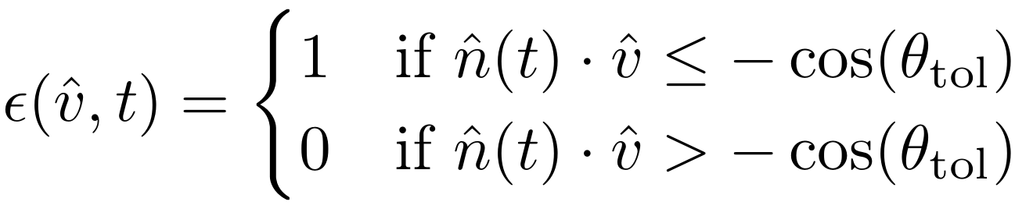
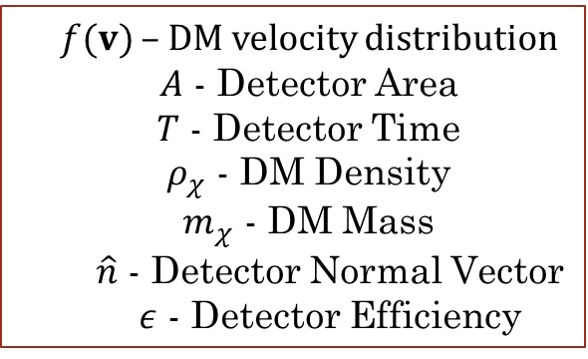
Computing the Particle Number
  Rewrite flux through a planar detector above a speed $v_{0}$
  $f(v)$ – DM velocity distribution
  $A$ - Detector Area
  $T$ - Detector Time
  $ρ_{χ}$ - DM Density
  $m_{χ}$ - DM Mass
  $\hat{n}$ - Detector Normal Vector
  $ε$ - Detector Efficiency

