Slide 1
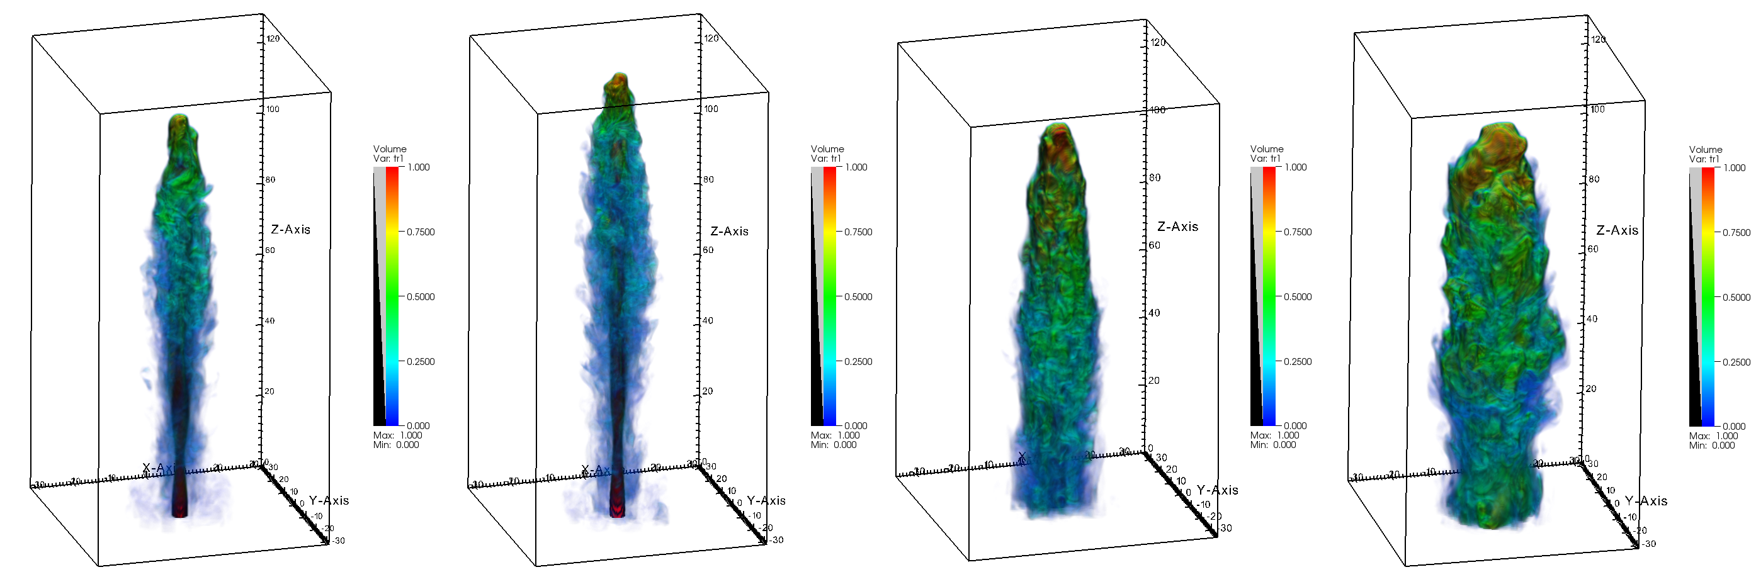



Investigating the morphology and polarisation of kiloparsec-scale AGN jets with hybrid relativistic magnetohydrodynamic simulations
www.ufs.ac.za
Izak van der Westhuizen, Reuben Immelman, Brian van Soelen and Bhargav Vaidya

Slide 2
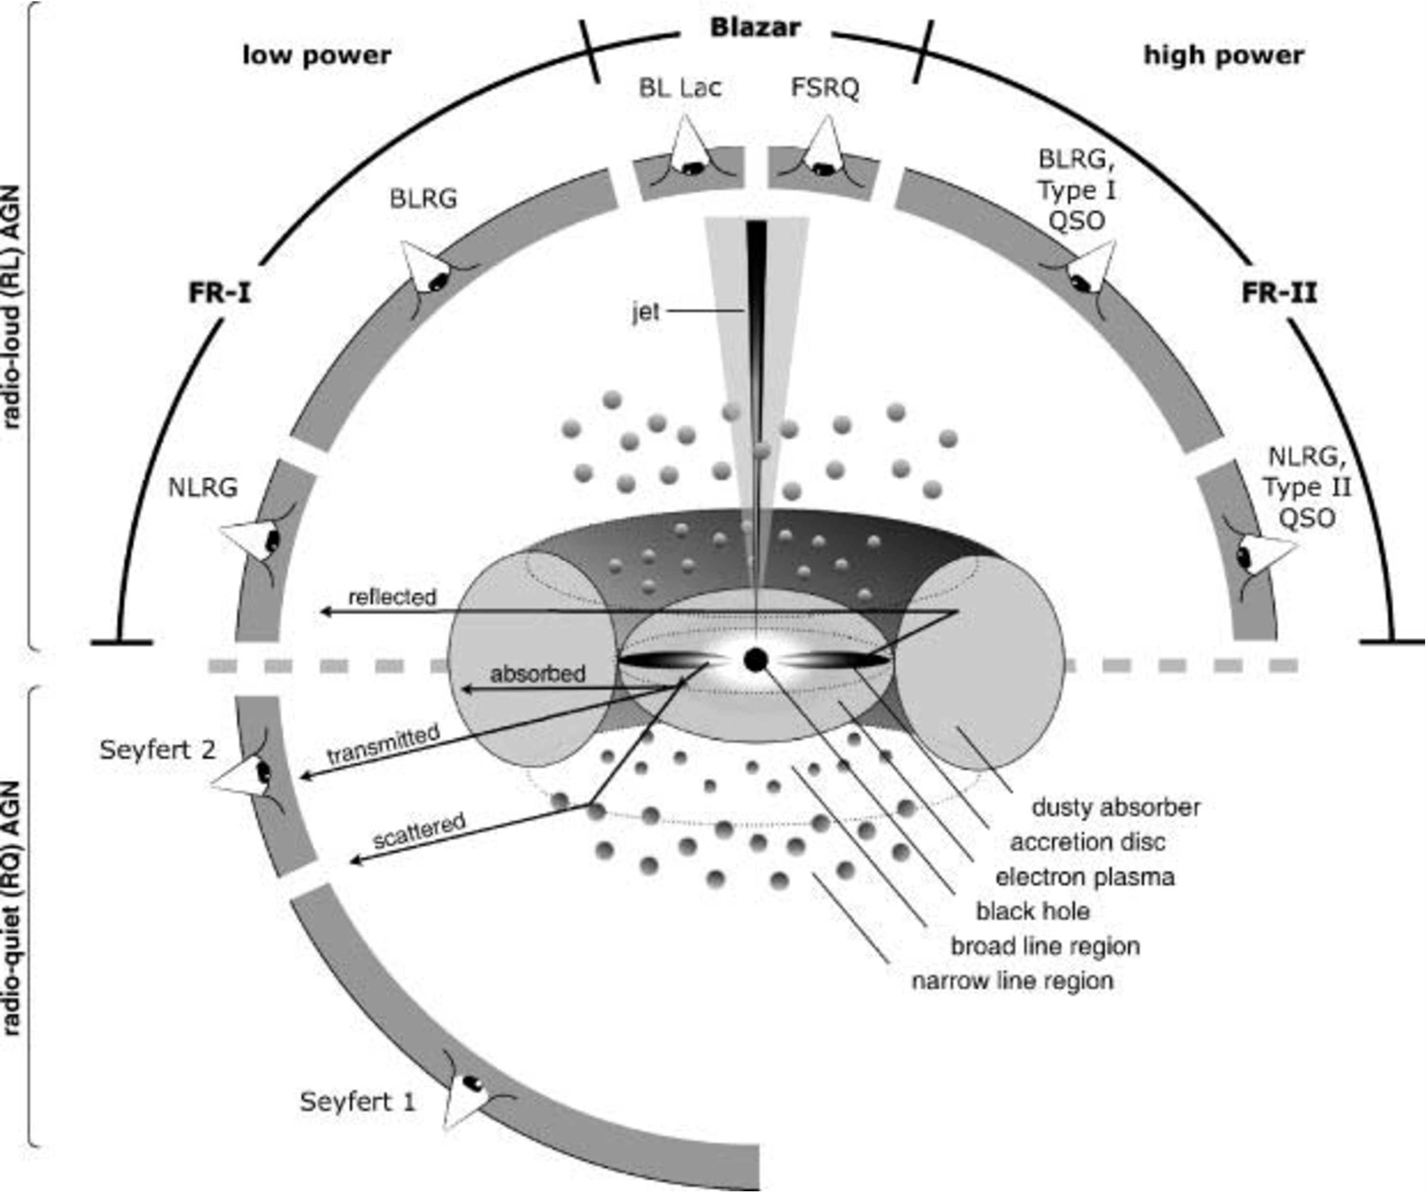
Active Galactic Nuclei
An active galactic nucleus (AGN) is the compact, highly luminous region at the center of a galaxy, powered by a supermassive black hole actively accreting gas and dust
Beckmann and Shrader, 2012, Figure 4.16

Slide 3
Active Galactic Nuclei
Radio galaxies
Jetted
(radio loud)
Radio loud
Quasars
Non-jetted
(Radio Quiet)
Blazars
Beckmann and Shrader, 2012, Figure 4.16

Slide 4
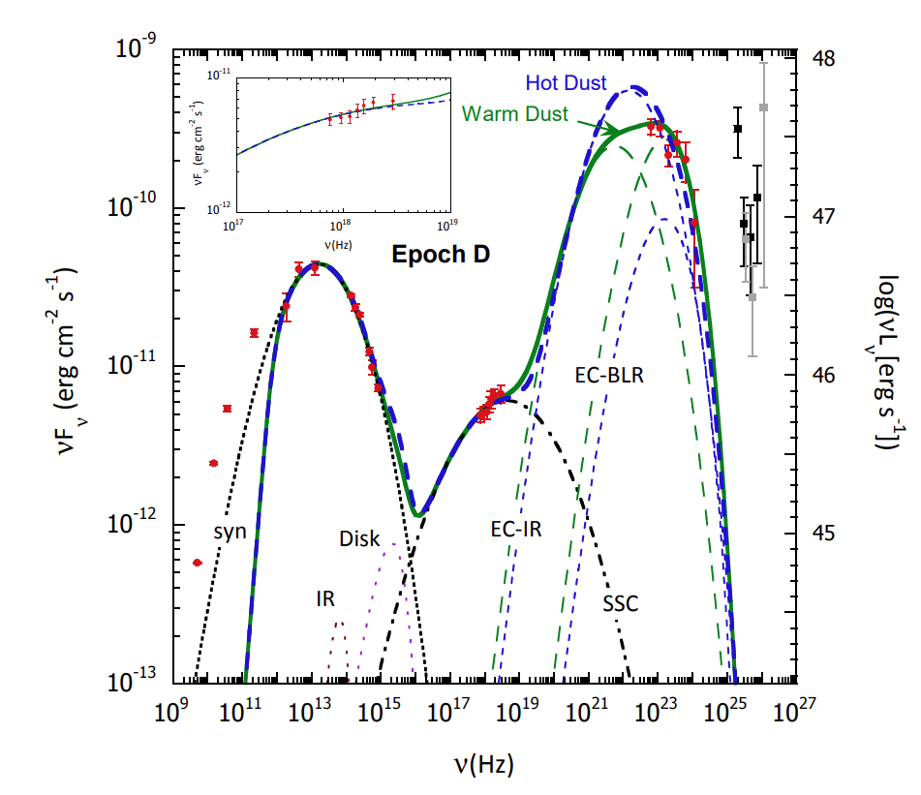
Active Galactic Nuclei
SED of 3C 279 with Leptonic emission models with contributions from different components in the AGN. Dermer, et al. 2014, ApJ, 782, 82
Beckmann and Shrader, 2012, Figure 4.16

Slide 5
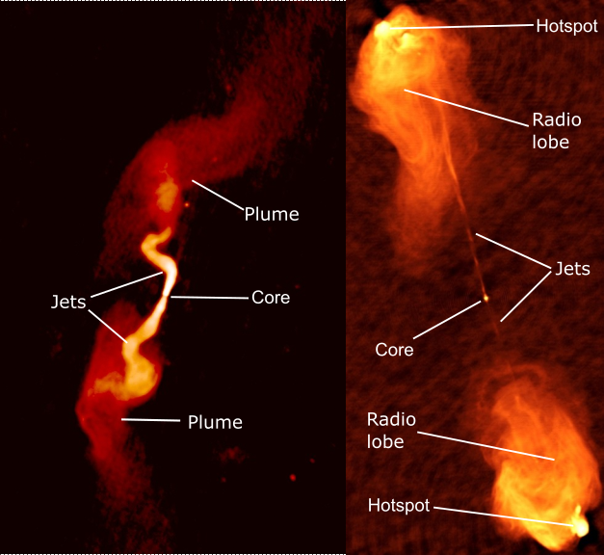
Large scale morphology
FR I
Typically two sided
Brightness generally decreases with distance from the nucleus
Lower luminosity
FR II
Jets can be single or double-sided
Jet terminates in hotspots with bright lobe
Higher luminosity
Left: 3C 31, NRAO, see Laing and Bridle(2002b).
Right: Cyg A, NRAO, see Carilli and Barthel (1996).

Slide 6
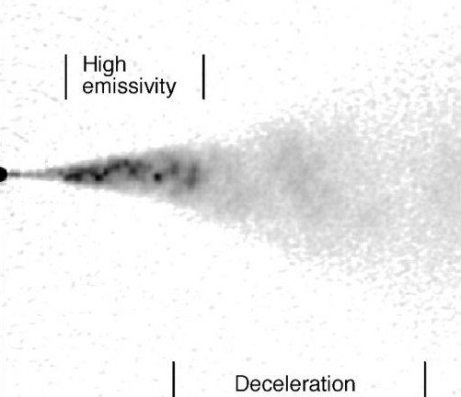
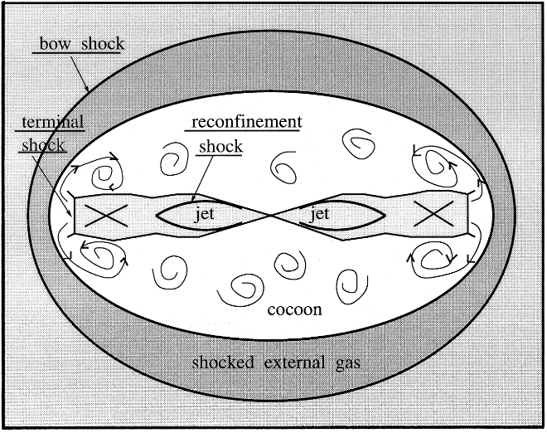
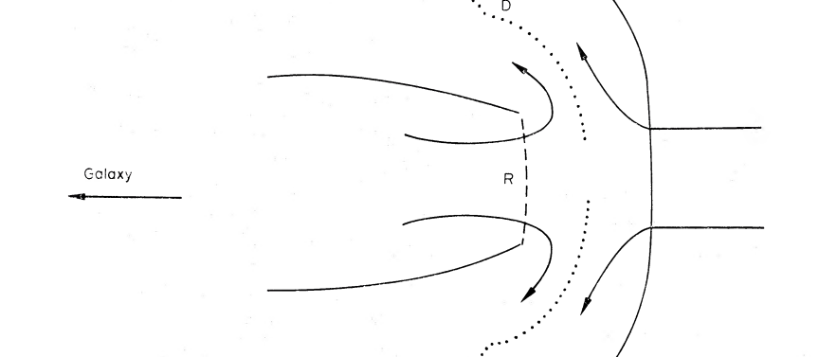
Large scale morphology
FR I
– Decelerate between parsec-kpc scales
FR II
– Remains relativistic, terminates in a shock
Diagram of the large scale structure of an FR II radio source, Komissarov and Falle (1998).
Diagram of flow at terminal shock, Blandford and Rees (1974)
Model for FR I deceleration, Laing and Bridle (2014)

Slide 7
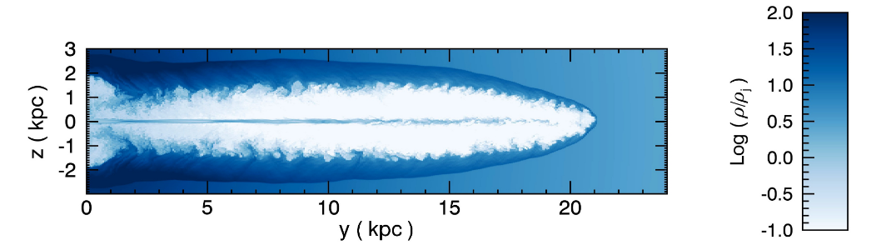
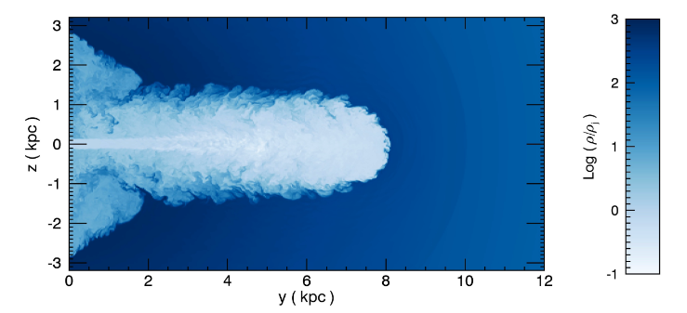
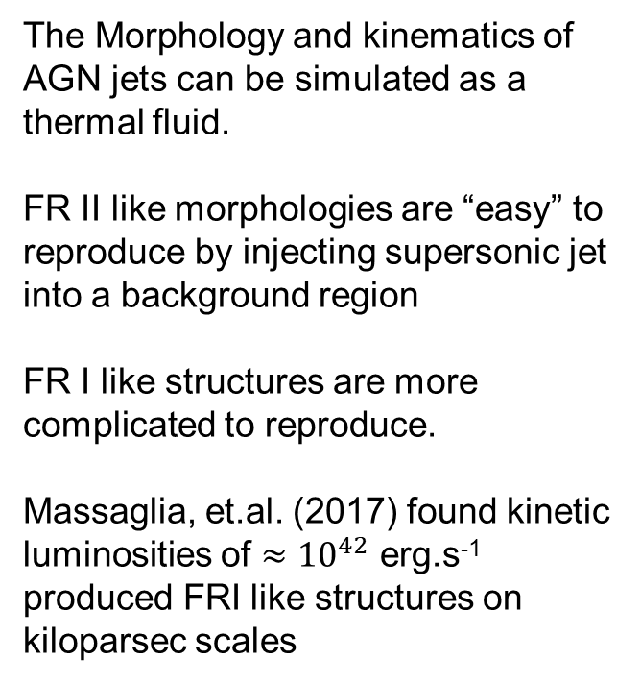
Simulating AGN jets
FR II like morphology
The Morphology and kinematics of AGN jets can be simulated as a thermal fluid.
FR II like morphologies are “easy” to reproduce by injecting supersonic jet into a background region
FR I like structures are more complicated to reproduce.
Massaglia, et.al. (2017) found kinetic luminosities of $≈{10}^{42}$ erg.s⁻¹ produced FRI like structures on kiloparsec scales
FR I like morphology
Massaglia, et.al. (2017)

Slide 8
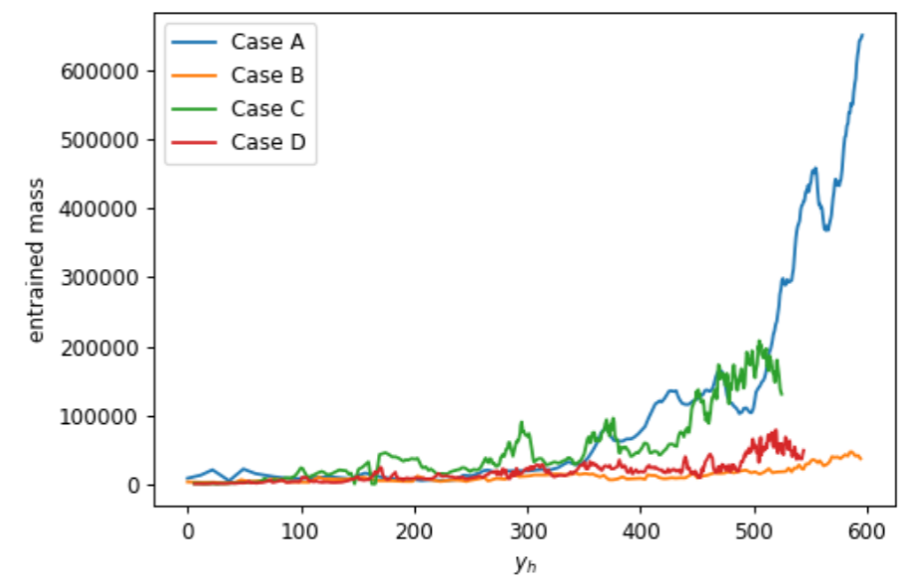
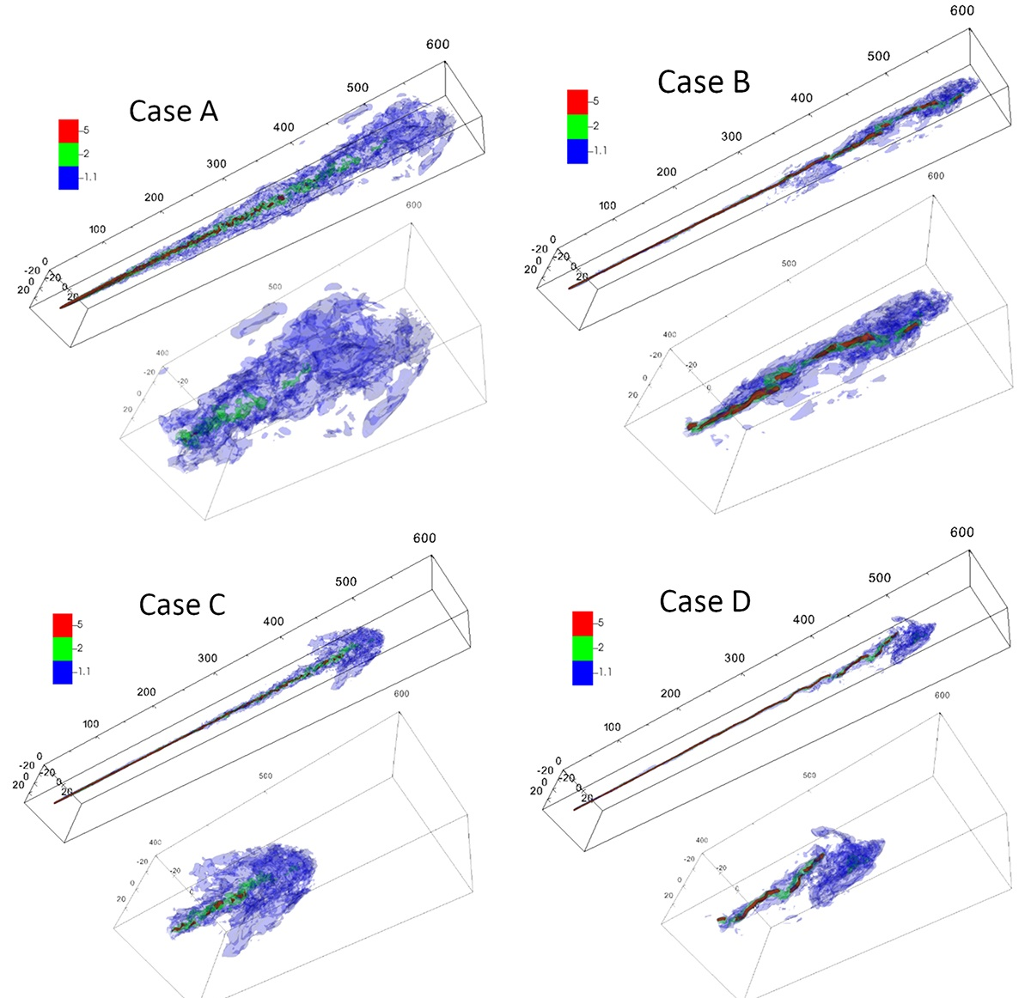
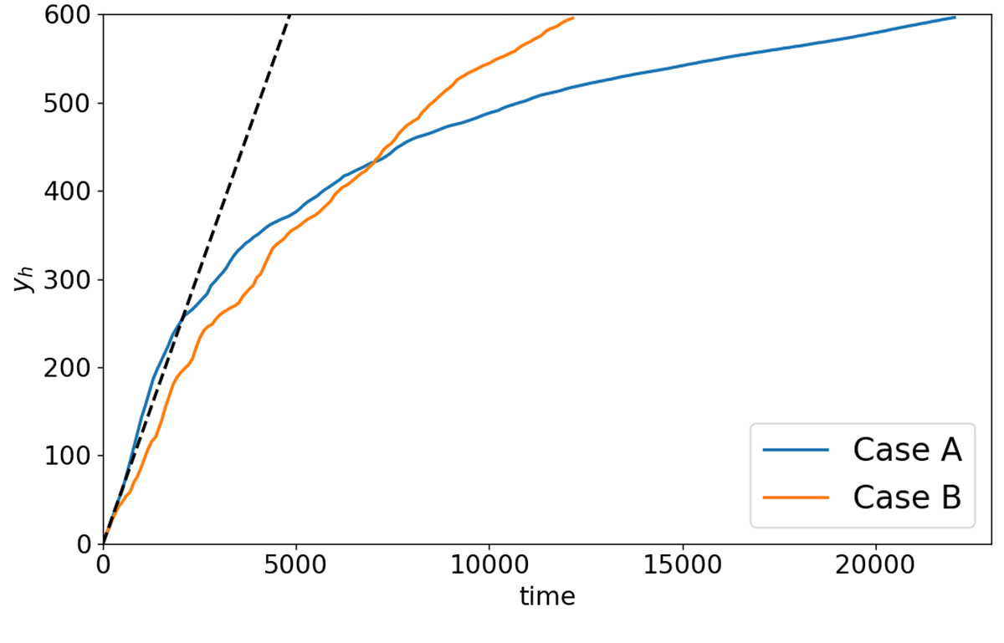
Deceleration in Jets
Another way to produce FR I type morphologies is through deceleration
This can happen through entrainment of the ambient medium
Rossi et. al. (2024)

Slide 9
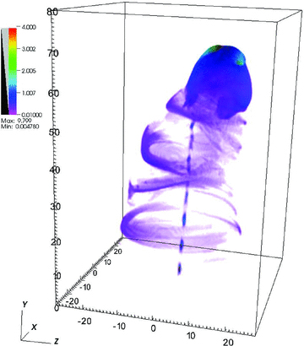
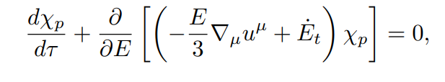
PLUTO RMHD Simulations
PLUTO v4.4 https://plutocode.ph.unito.it/
Grid based hydrodynamics code
Designed for high Mach number flows in astrophysical plasma dynamics
Opensource
- Lagrangian particles module (Bhargav Vaidya, et. al. ApJ 865:144 (21pp), 2018)
Separate particle entities suspended in fluid
Represents an ensemble of particles with a finite energy distribution
No back reaction on fluid
Follow fluid streamlines
Energy distribution is evolved with time
Adiabatic expansion
Radiative losses
Diffusive shock acceleration
Mignone et. Al., (2010)

Slide 10
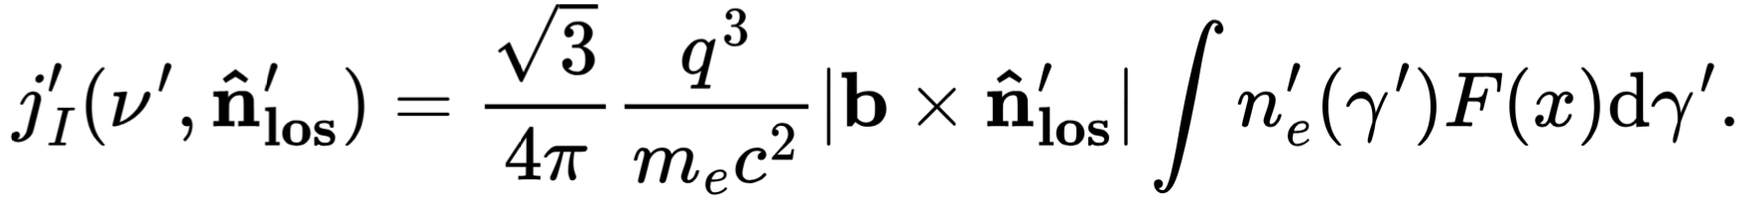
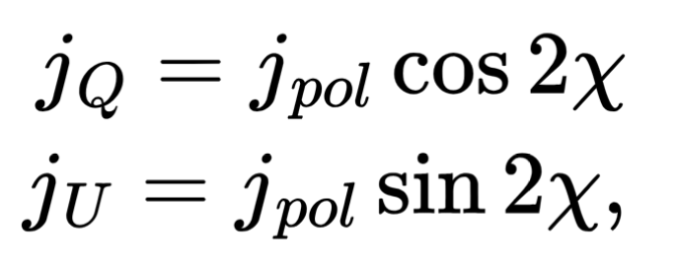
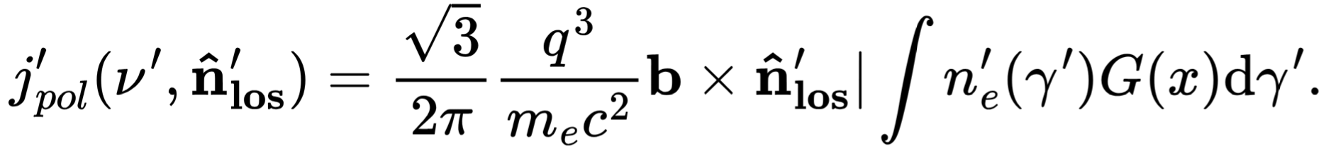
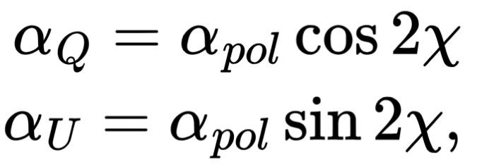
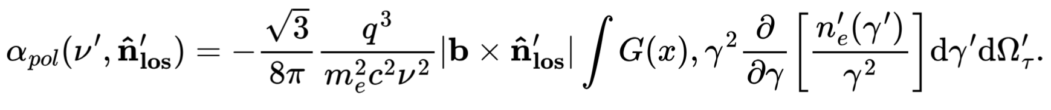
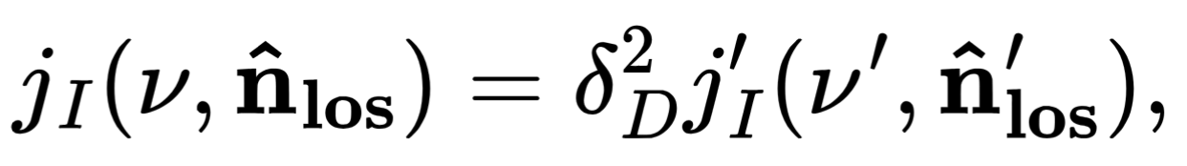
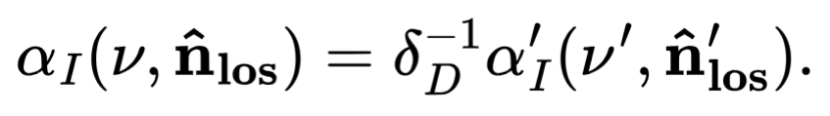
Synchrotron Emission
Model the I, Q and U Stokes parameters of the Synchrotron emission
Emission coefficients:
Absorption coefficients:
Lorentz transformations:

Slide 11


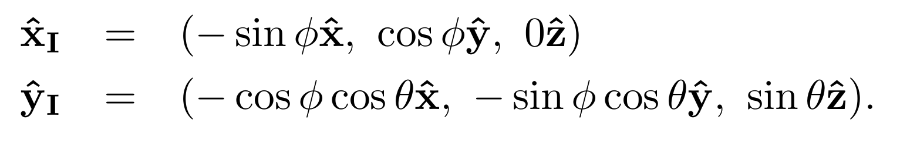



Emission: Radiative transfer
Rays
Fluid Domain
Image
Accounting for light travel time
$$Δs=cΔt$$

Slide 12
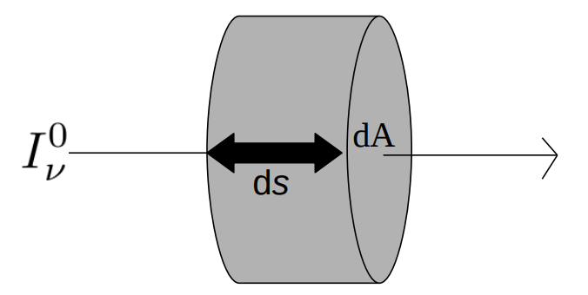
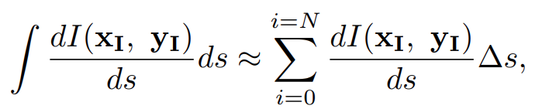

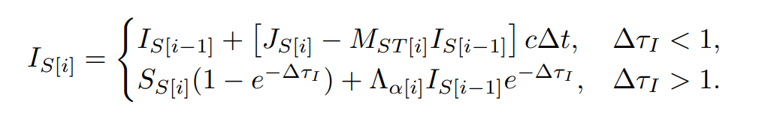
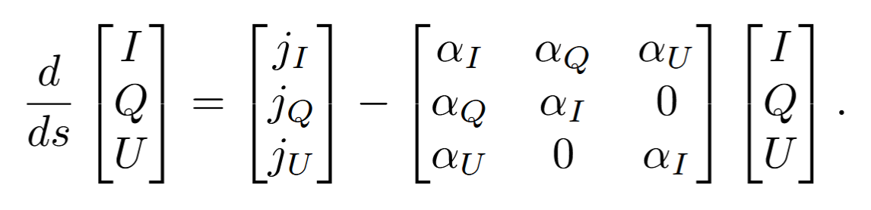

Emission: Radiative transfer
Integration of radiative transfer equation along the path of the ray
The integration is split for optically thick and thin regimes
Where,
$$S_{i}=\frac{J_{i}}{α_{i}}, τ=αΔs$$

Slide 13
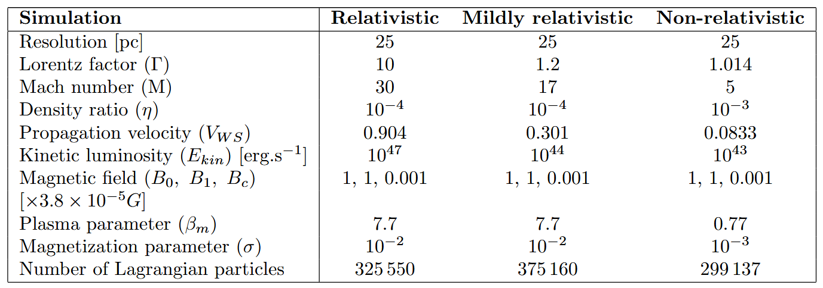
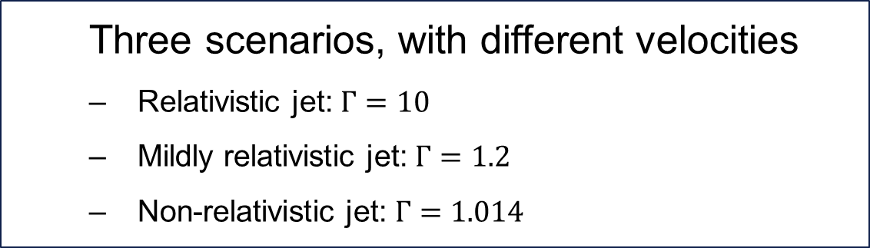
RMHD Simulations
Three scenarios, with different velocities
Relativistic jet: $Γ=10$
Mildly relativistic jet: $Γ=1.2$
Non-relativistic jet: $Γ=1.014$

Slide 14
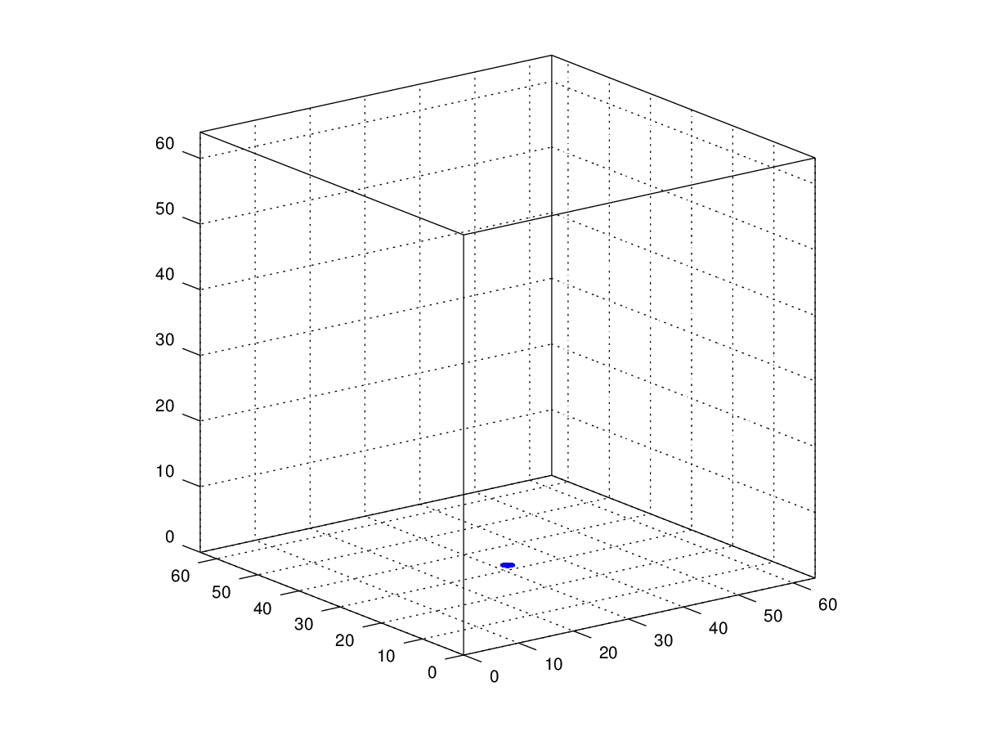
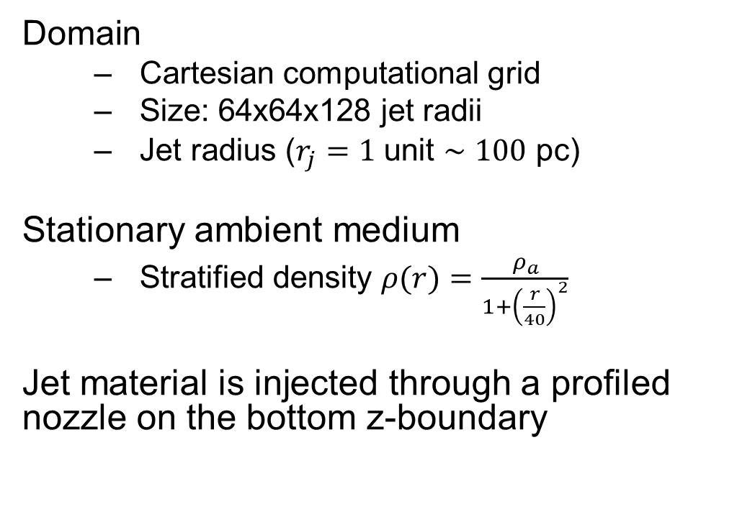
Simulations setup
Domain
Cartesian computational grid
Size: 64x64x128 jet radii
Jet radius ($r_{j}=1$ unit $∼100$ pc)
Stationary ambient medium
Stratified density $ρ(r)=\frac{ρ_{a}}{1+{\left(\frac{r}{40}\right)}^{2}}$
Jet material is injected through a profiled nozzle on the bottom z-boundary
Nozzle

Slide 15
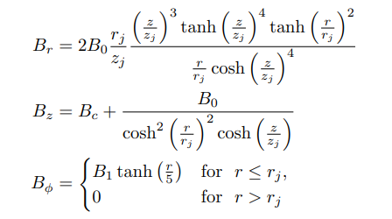
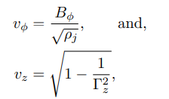
Simulations setup
Domain
Cartesian computational grid
Size: 64x64x128 jet radii
Jet radius ($r_{j}=1$ unit $∼100$ pc)
Stationary ambient medium
Stratified density $ρ(r)=\frac{ρ_{a}}{1+{\left(\frac{r}{40}\right)}^{2}}$
Jet material is injected through a profiled nozzle on the bottom z-boundary

Slide 16
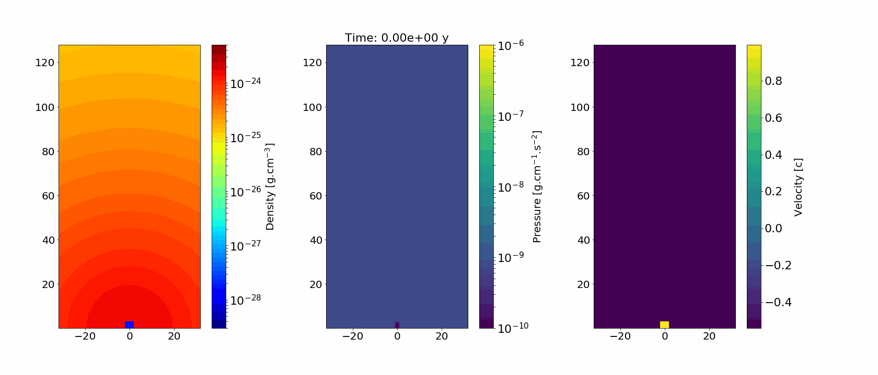


RMHD simulations
Relativistic jet
2D slices of the simulations through the xz-plane
Density
Pressure
Velocity
Mildly relativistic jet
Non-relativistic jet
Density
Pressure
Velocity
Density
Pressure
Velocity

Slide 17
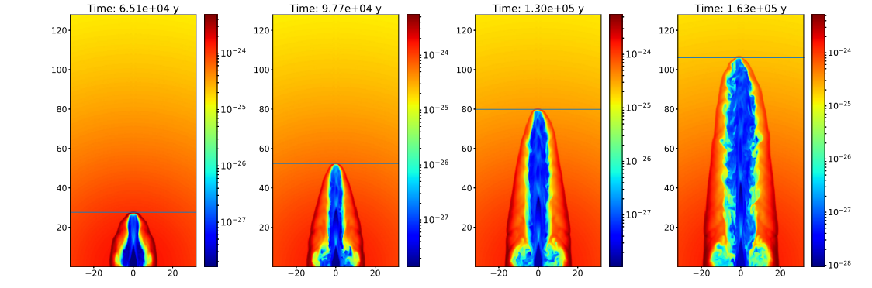
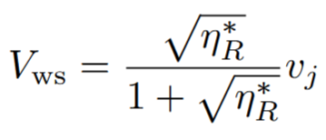
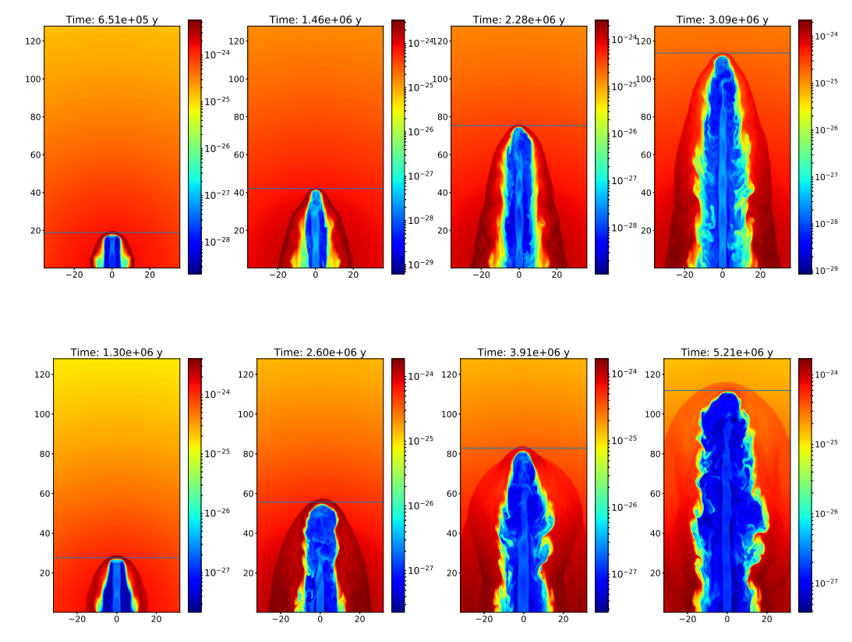
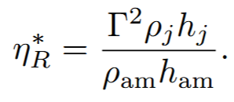
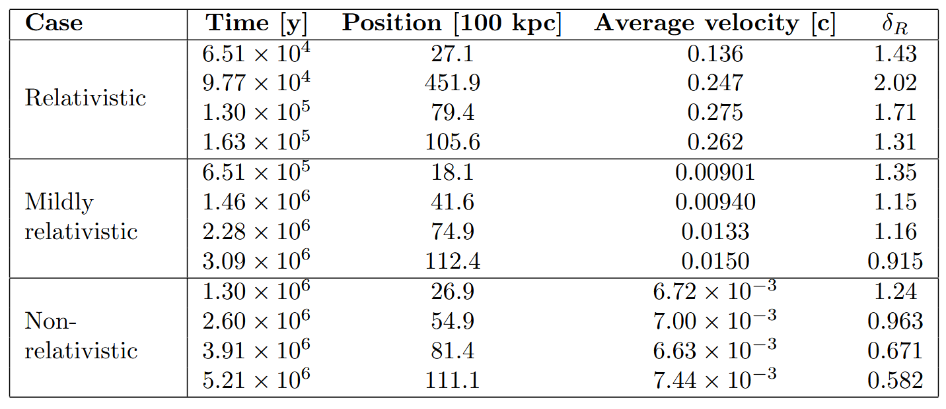
RMHD simulations evolution
Relativistic jet
Jet propagation
Mildly relativistic jet
Non-relativistic jet

Slide 18
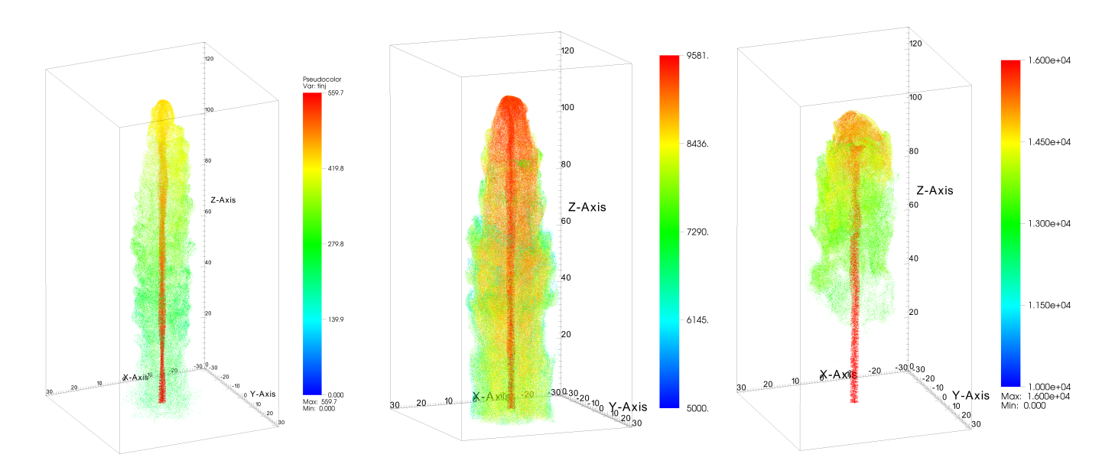
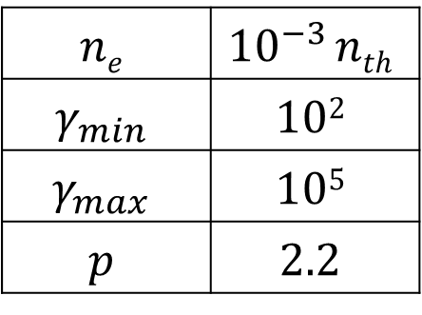
Emission modelling
Lagrangian particles were injected at random positions inside the jet inlet.
The injection was started after the jet established itself in the domain
The injection rate was scaled according to mass flux of each simulation
$$ne$$ | $${10}^{−3} nth$$
$$γ_{min}$$ | $$102$$
$$γ_{max}$$ | $$105$$
$$p$$ | $$2.2$$
Relativistic jet
Mildly relativistic jet
Non-relativistic jet

Slide 19
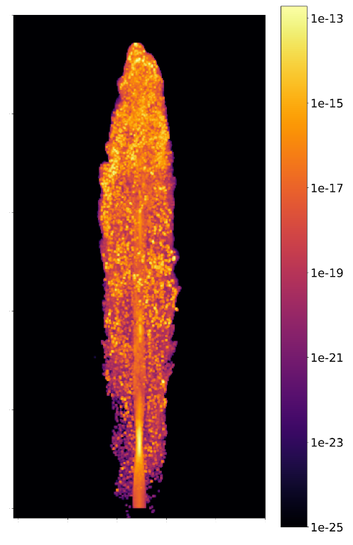
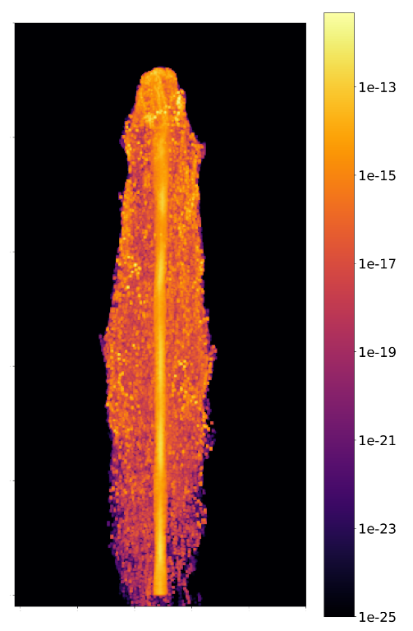
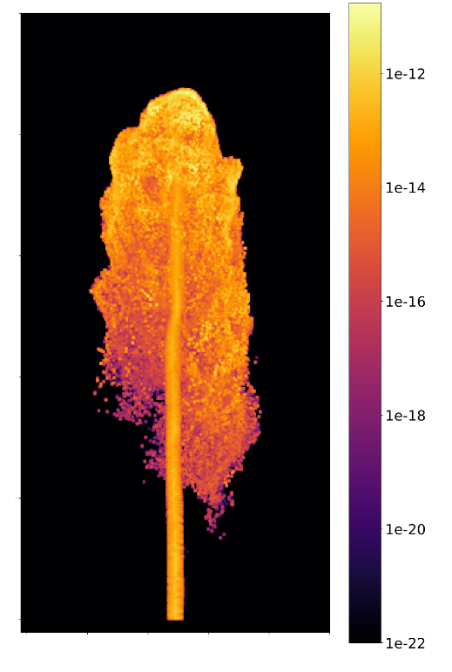

Intensity maps: 10 GHz, $θ={90}^{∘}$
Relativistic jet
Mildly relativistic jet
Non-relativistic jet
Intensity maps resemble FR II type radio galaxies for all cases

Slide 20
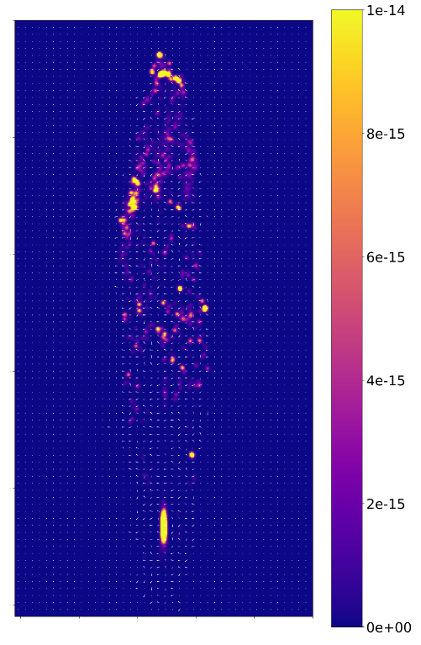
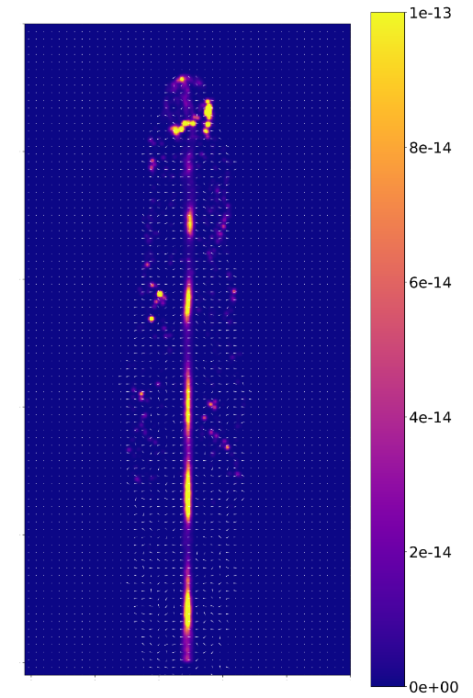
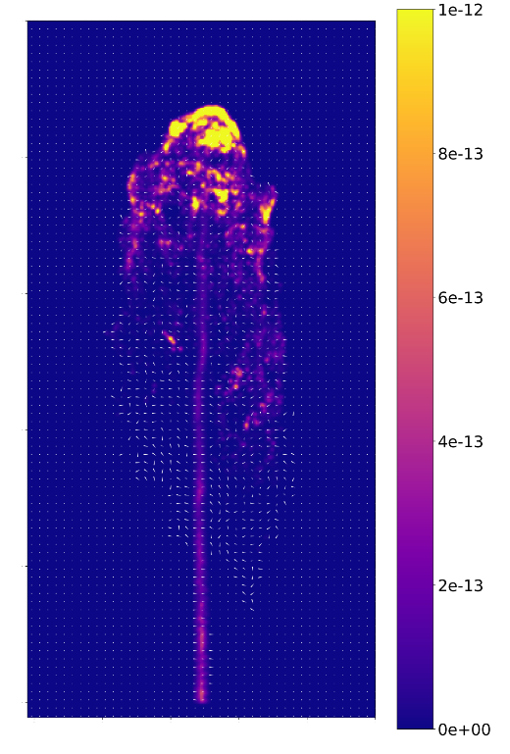

Intensity maps: 10 GHz, $θ={90}^{∘}$
Relativistic jet
Mildly relativistic jet
Non-relativistic jet
Intensity maps resemble FR II type radio galaxies for all cases
Jets
Stationary emission components

Slide 21

Intensity maps: 10 GHz, $θ={90}^{∘}$
Relativistic jet
Mildly relativistic jet
Non-relativistic jet
Intensity maps resemble FR II type radio galaxies for all cases
Jets
Stationary emission components
Lobes
Hotspots
Filaments

Slide 22
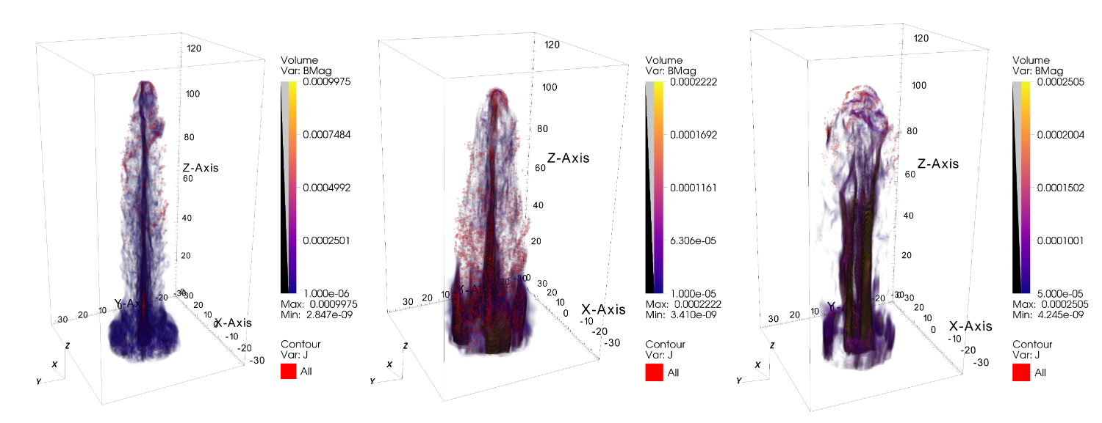

Intensity maps: 10 GHz, $θ={90}^{∘}$
Filaments and hot spots follow magnetic filaments in the lobes
Relativistic jet
Mildly relativistic jet
Non-relativistic jet

Slide 23
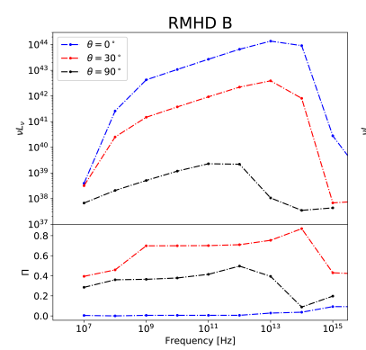


SED modelling
Relativistic model
Features are dominated by Doppler boosting
Mildly relativistic model
Magnetic field geometry is important
Non-relativistic model
Emission dominated by lobe region

Slide 24

What about FRI’s?
For FRI type structure we require deceleration
This can be achieved by a pressure mismatch

Slide 25


Decelerated jet
For FRI type structure we require deceleration
This can be achieved by a pressure mismatch
Density
Pressure
Velocity
Intensity map (log)
Intensity map (linear)
Polarization

Slide 26


Blazar emission
Barnard, et al. (2024). MNRAS, 532, https://doi.org/10.1093/mnras/stae1576
Marscher, A. P., et al. (2024). Galaxies, 12(4), 50. https://doi.org/10.3390/galaxies12040050

Slide 27

Blazar emission
Recent IXPE observations show X-ray polarization is typically higher than Optical (see e.g. Kouch, et. al., 2024)
This is consistent with the shock in jet model (see e.g. Marscher, A. P., et al. 2024).
Marscher, A. P., et al. (2024). Galaxies, 12(4), 50. https://doi.org/10.3390/galaxies12040050
Kouch, et. al., 2024

Slide 28



Parsec scale Jet model
Initial setup consists of cylindrical jet in a uniform background
Helical magnetic field :
(Meliani and Keppens, APJ, 705:1594–1606, 2009)

Slide 29

Jet cross-section

Slide 30



Lagrangian particles
Lagrangian particles were injected at random positions inside the jet inlet.
The injection was started after the jet established itself in the domain
50 Particles per time step
100 000 Particles total
Injected with a single power-law distribution
The injection was normalized to 10⁻³ the density of the thermal fluid
Spatial distribution of particles in simulation

Slide 31







$ν={10}^{9}$ Hz
$$ν={10}^{14} \text{Hz}$$
$$ν={10}^{17} \text{Hz}$$
Intensity maps
Different frequencies ($θ={30}^{∘})$
Radio ($ν={10}^{9}$ Hz):
Entire jet is bright
Optical ($ν={10}^{14} \text{Hz}$):
Recollimation shock brighter than jet
X-rays ($ν={10}^{14} \text{Hz}$):
Only at recollimation shock

Slide 32


Variability
Variability is simulated through the injection of a region of increased density and magnetic field
$$ρ$$ | $10^{3} ρ_{0}$
$$B$$ | $$10 B_{0}$$
$$R$$ | $$0.5 R_{spine}$$

Slide 33



Intensity maps and light curve $$θ=2^{∘}$$

Slide 34
Conclusions
In this study the synchrotron emission of 3D RMHD simulations of the PLUTO code.
Lagrangian particles were used to represent non-thermal electrons in the jet and used to calculate the synchrotron emission
Included synchrotron self absorption
Included relativistic effects and light travel time for any viewing angles
I,Q, U Polarization calculations
Reproduce SED’s
Reproduced some morphologies and characteristics seen in observations
Most simulations showed FR II morphology
Radio lobes with hotspots and filaments
Reproduced FRI type morphology by inducing deceleration in the jet after injection
Bright stationary emission components that correspond to recollimation shocks
Filaments and hotspots in lobes correspond to magnetic field structure in cocoon correspond to magnetic
Variability was investigated in the form of a dense region injected into the jet.
Increased in flux coincided with component propagating through recollimation shock
X-ray increase lag behind optical
Increased flux coincided with an increase in polarization, peak polarization lags behind flux in optical

Slide 35
Thank you
www.ufs.ac.za

