Slide 1




MeV cosmic-ray electrons modify the TeV pair-beam plasma instability
Mahmoud Alawashra (DESY)
Martin Pohl , Yuanyuan Yang, Heyang Long and Christopher Hirata
TeV Particle Astrophysics Valencia
Nov 6th 2025

Slide 2
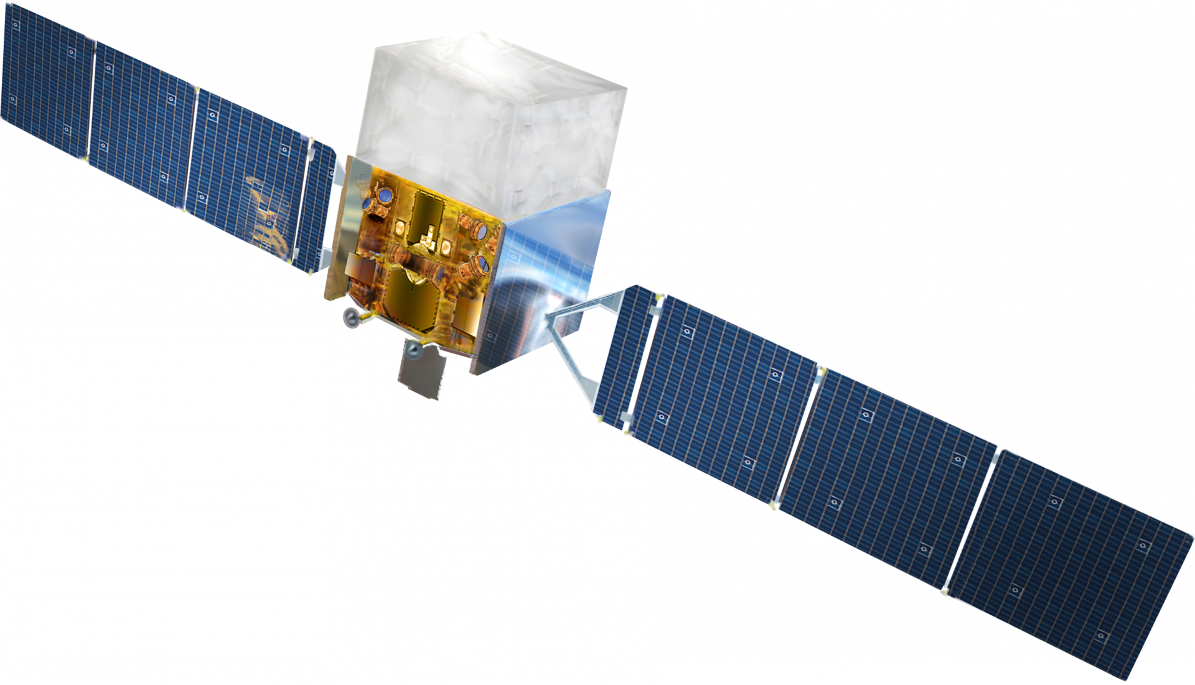

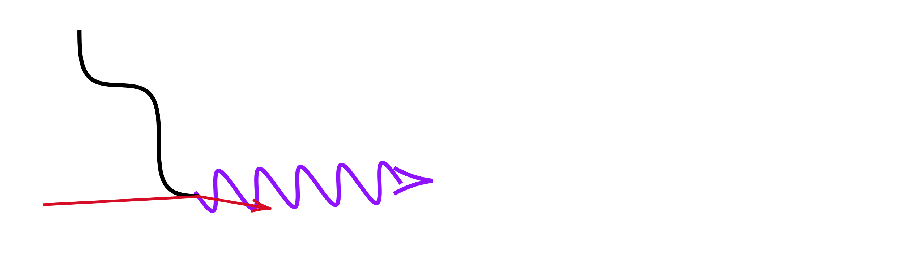





TeV gamma rays from blazars are expected to produce a detectable GeV cascade after attenuating in the cosmic voids.
Fermi-LAT
Primary
CMB
Earth
EBL
Secondary
$$e^{+}$$
GeV-$γ$
$$e^{−}$$
TeV-$γ$
AGN

Slide 3
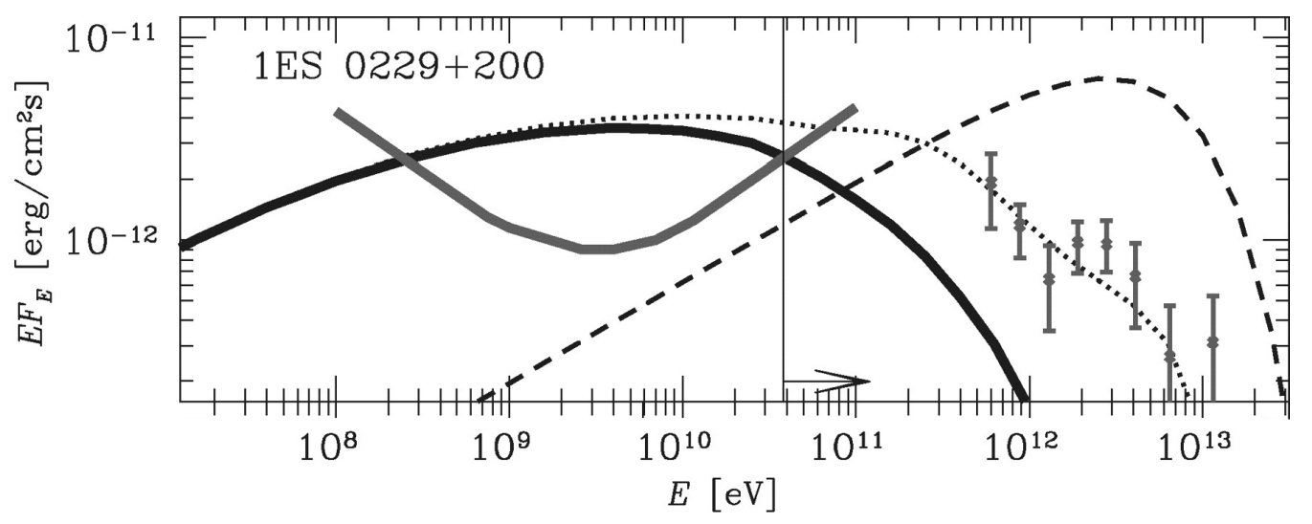
The electromagnetic cascade is missing in the observations
Fermi-LAT
Cascade emission
Fermi-LAT upper limit
Neronov and Vovk (2010)

Slide 4
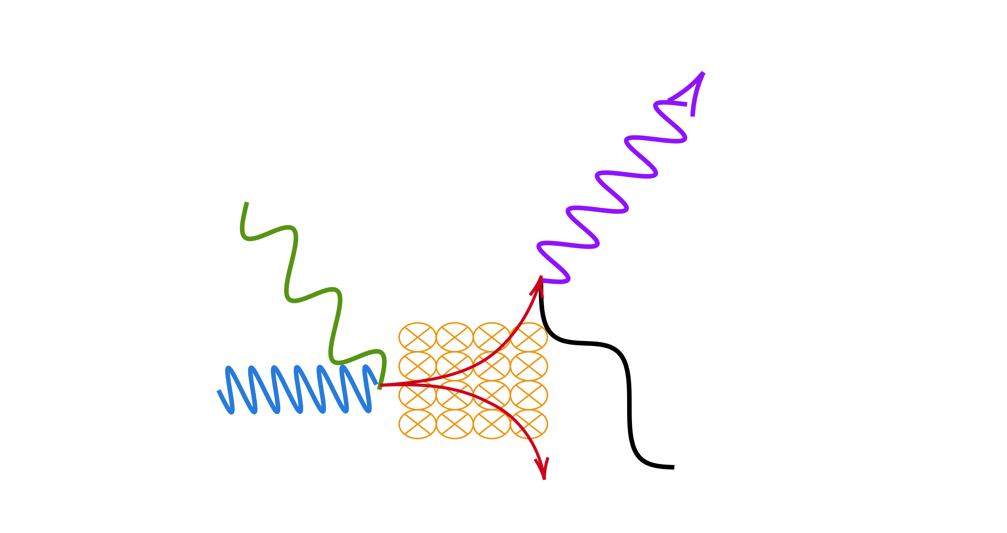





Pairs deflection by Intergalactic magnetic fields
(IGMFs)
Fermi-LAT
GeV-$γ$
Primary
Earth
EBL
$$e^{−}$$
CMB
$$e^{+}$$
$B_{IGM}$ > fG
Neronov and Vovk (2010)
TeV-$γ$
AGN

Slide 5
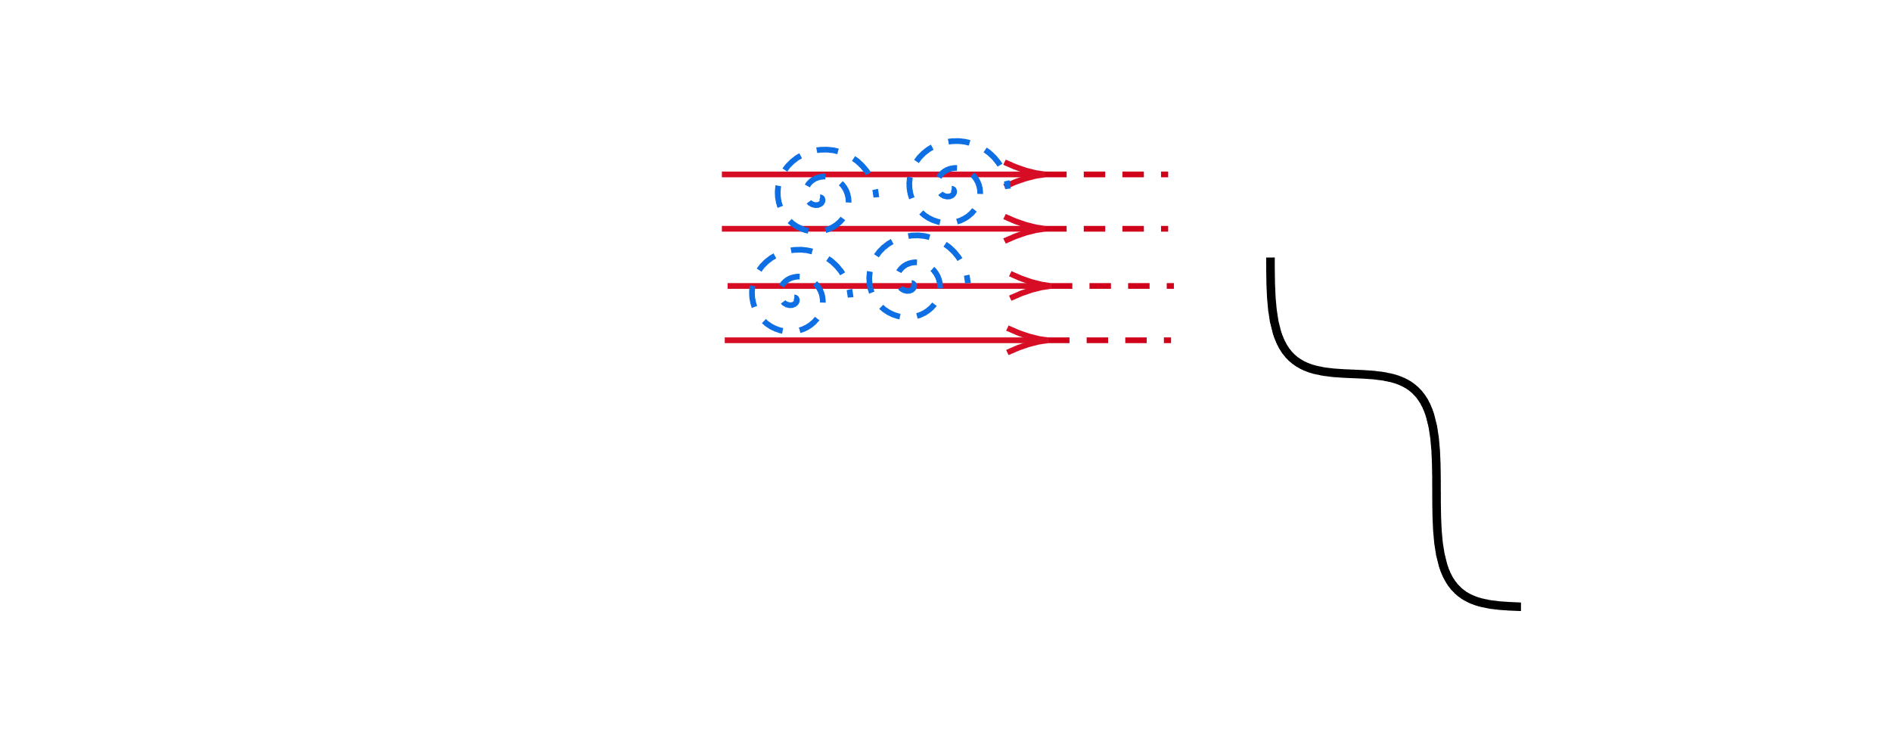



Energy loss by plasma instabilities
Broderick et al (2012)
Primary
Earth
EBL
$$e^{+}$$
$$e^{−}$$
CMB
$$\left|δE\right| ∝ exp\left(ω_{i}t\right)$$
TeV-$γ$
$ω_{i}$: Electrostatic Linear growth rate.
AGN
$$ω_{i}^{−1}≪ τ_{IC}$$

Slide 6
Previous studies of the TeV pairs instabilities
Nonlinear saturation of the instability (Schlickeiser et al. 2012 Miniati & Elyiv 2013, Broderick et al. 2014, Sironi & Giannios 2014, Supsar & Schlickeiser 2014, Chang et al. 2014, 2016, Kempf et al. 2016, Rafighi et al. 2017, Vafin et al. 2018, 2019, Shalaby et al. 2020).

Slide 7















Uncertain nonlinear saturation of the instability
$$k$$
$$e^{±}$$
$$k$$
$$e^{±}$$
$$e^{±}$$
$$e^{±}$$
$$e^{±}$$
Schlickeiser et al. 2012 Miniati & Elyiv 2013
Broderick et al. 2014
Sironi & Giannios 2014 Supsar & Schlickeiser 2014 Chang et al. 2014, 2016
Kempf et al. 2016 Rafighi et al. 2017 Vafin et al. 2018, 2019 Shalaby et al. 2020
$$e^{±}$$
$$e^{±}$$
$$e^{±}$$
$$e^{±}$$
$$e^{±}$$
$$k$$
$$k$$

Slide 8
Previous studies of the TeV pairs instabilities
Nonlinear saturation of the instability (Schlickeiser et al. 2012 Miniati & Elyiv 2013, Broderick et al. 2014, Sironi & Giannios 2014, Supsar & Schlickeiser 2014, Chang et al. 2014, 2016, Kempf et al. 2016, Rafighi et al. 2017, Vafin et al. 2018, 2019, Shalaby et al. 2020).
Instability suppression by IGMFs (Alawashra and Pohl 2022).

Slide 9
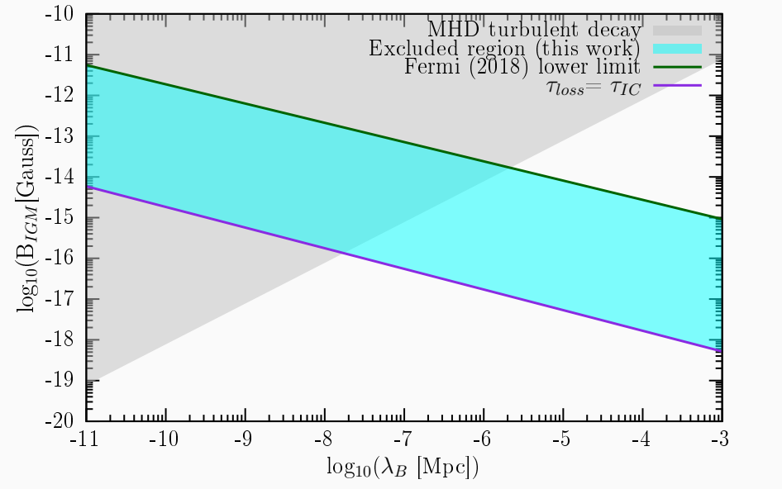
Instability suppression by the IGMFs
Alawashra and Pohl (2022) ApJ 929 67

Slide 10
Previous studies of the TeV pairs instabilities
Nonlinear saturation of the instability (Schlickeiser et al. 2012 Miniati & Elyiv 2013, Broderick et al. 2014, Sironi & Giannios 2014, Supsar & Schlickeiser 2014, Chang et al. 2014, 2016, Kempf et al. 2016, Rafighi et al. 2017, Vafin et al. 2018, 2019, Shalaby et al. 2020).
Instability suppression by IGMFs (Alawashra and Pohl 2022).
Instability feedback on the pair beam (Perry & Lyubarsky 2021, Alawashra & Pohl 2024, Dey & Sigl 2025).

Slide 11




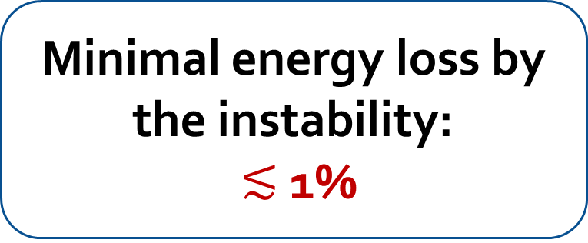










Instability feedback on the pair beam is significant
$$k$$
The oblique oscillations scatters the beam’s particles
$$k$$
$$e^{±}$$
$$e^{±}$$
$$e^{±}$$
$$e^{±}$$
$$e^{±}$$
$$e^{±}$$
$$e^{±}$$
$$e^{±}$$
$$e^{±}$$
$$e^{±}$$
Minimal energy loss by the instability: $≲$ 1%
Perry & Lyubarsky (2021) MNRAS 503 2
$$k$$
Alawashra & Pohl (2024) ApJ 964 82
$$k$$
Dey & Sigl (2025)
Astropart.Phys. 173

Slide 12
Is there something else in the IGM other than the thermal plasma that affect the pairs propagation?

Slide 13
Compton-included MeV electron cosmic rays
Even unshocked regions of the IGM have electron cosmic rays because they are illuminated by the MeV γ-ray background:
Scattered IGM electron
Thermal IGM electron
Yang, Long & Hirata (2024) ApJ 965 111

Slide 14






Compton-included cosmic rays could Landau damp the instability
$$k$$
$$e^{−}$$
$$e^{−}$$
$$e^{−}$$
$$e^{±}$$
$$k$$
$$e^{±}$$
$$e^{±}$$
$$e^{−}$$
$$e^{±}$$
$$e^{±}$$
$$e^{±}$$
$$e^{±}$$
$$e^{±}$$
$$e^{±}$$
$$e^{±}$$
$$e^{−}$$
$$e^{−}$$
$$k$$
$$k$$
Yang, Long & Hirata (2024) ApJ 965 111

Slide 15
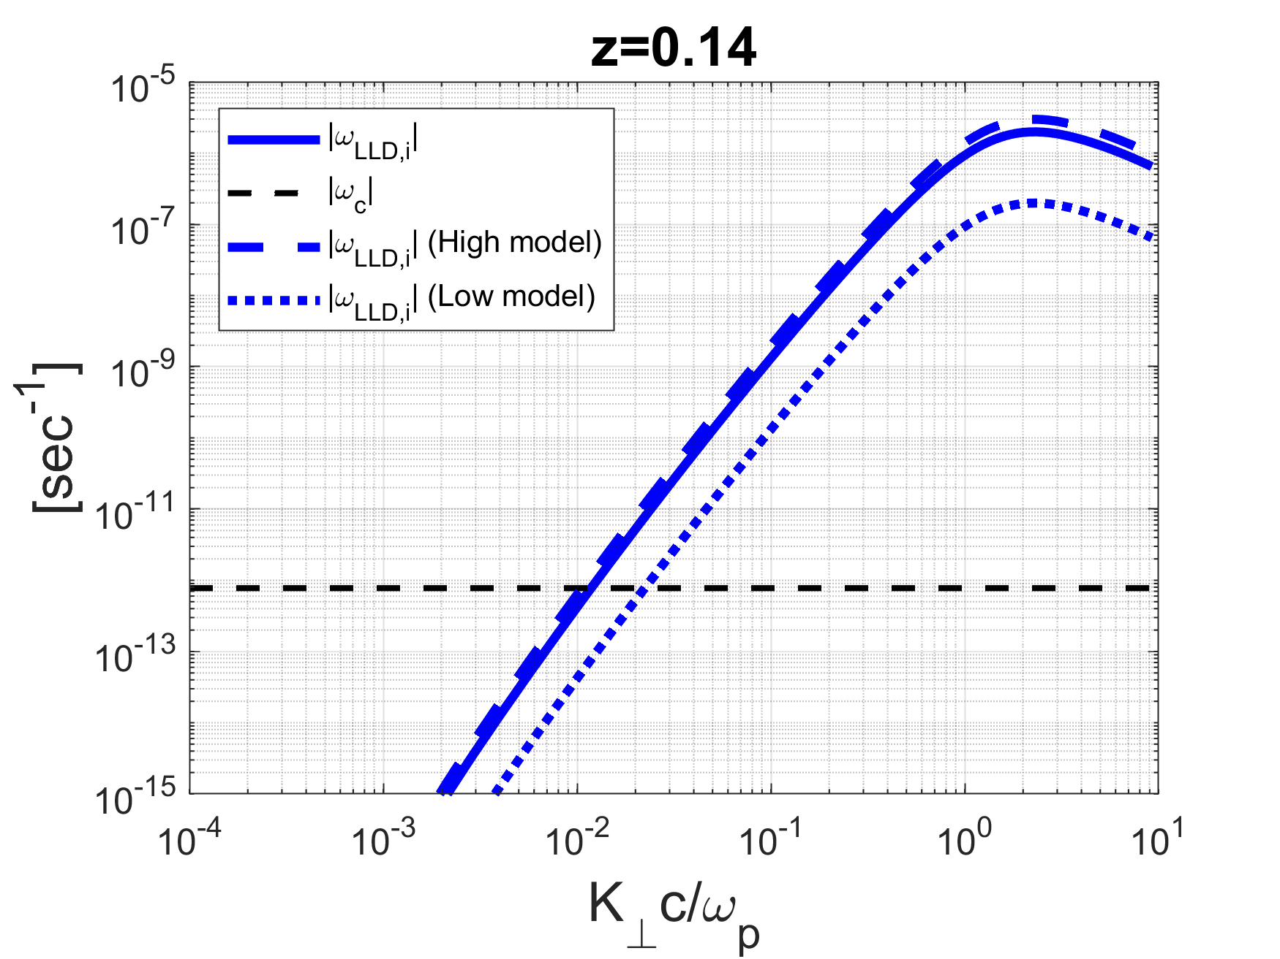
Compton-included cosmic rays could Landau damp the instability
Yang, Long & Hirata (2024) ApJ 965 111

Slide 16
What is the impact of this Linear Landau damping on the instability evolution?

Slide 17
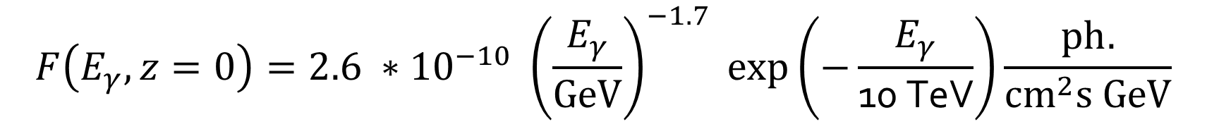

Beams induced by the blazar 1ES 0229+200
1ES 0229+200-like gamma ray source:
Using the Monte Carl0 code (CRpropa), we calculated the beams injection rates, $Q_{ee}$, at different distances in the IGM.
Alawashra, Vovk & Pohl (2025) ApJ 978 95
$$F\left(E_{γ},z=0\right)=2.6 ∗{10}^{−10} {\left(\frac{E_{γ}}{GeV}\right)}^{−1.7} exp⁡\left(−\frac{E_{γ}}{\text{10 }\text{TeV}}\right)\frac{ph.}{{cm}^{2}s GeV}$$
5 Mpc
13 Mpc
…..
125 Mpc

Slide 18
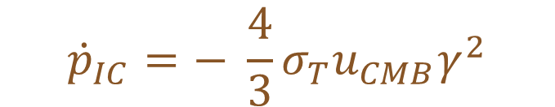
Simulation of the instability of 1ES 0229+200 induced beams
Pair Beams:
$$\frac{∂f(p,θ)}{∂t}=\frac{1}{p^{2}θ}\frac{∂}{∂θ}\left(θD_{θθ}\frac{∂f}{∂θ}\right)+\frac{1}{p^{2}}\frac{∂}{∂p}\left(−{\dot{p}}_{IC}p^{2}f\right)+Q_{ee}$$
Continuous production of pairs
Broadening feedback of the instability
$${\dot{p}}_{IC}=− \frac{4}{3}σ_{T}u_{CMB}γ^{2}$$
Pairs cooling:

Slide 19
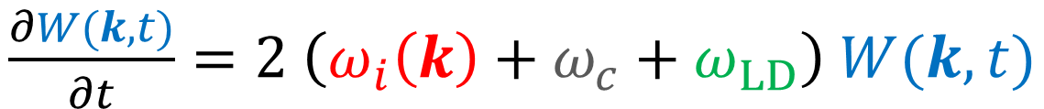
Simulation of the instability of 1ES 0229+200 induced beams
Pair Beams:
$$\frac{∂f(p,θ)}{∂t}=\frac{1}{p^{2}θ}\frac{∂}{∂θ}\left(θD_{θθ}\frac{∂f}{∂θ}\right)+\frac{1}{p^{2}}\frac{∂}{∂p}\left(−{\dot{p}}_{IC}p^{2}f\right)+Q_{ee}$$
Plasma waves:
$\frac{∂W(k,t)}{∂t}=2 \left(ω_{i}\left(k\right)+ω_{c}+ω_{LD}\right)$ $W(k,t)$
Linear growth rate
Collisional damping rate
Linear Landau damping rate

Slide 20
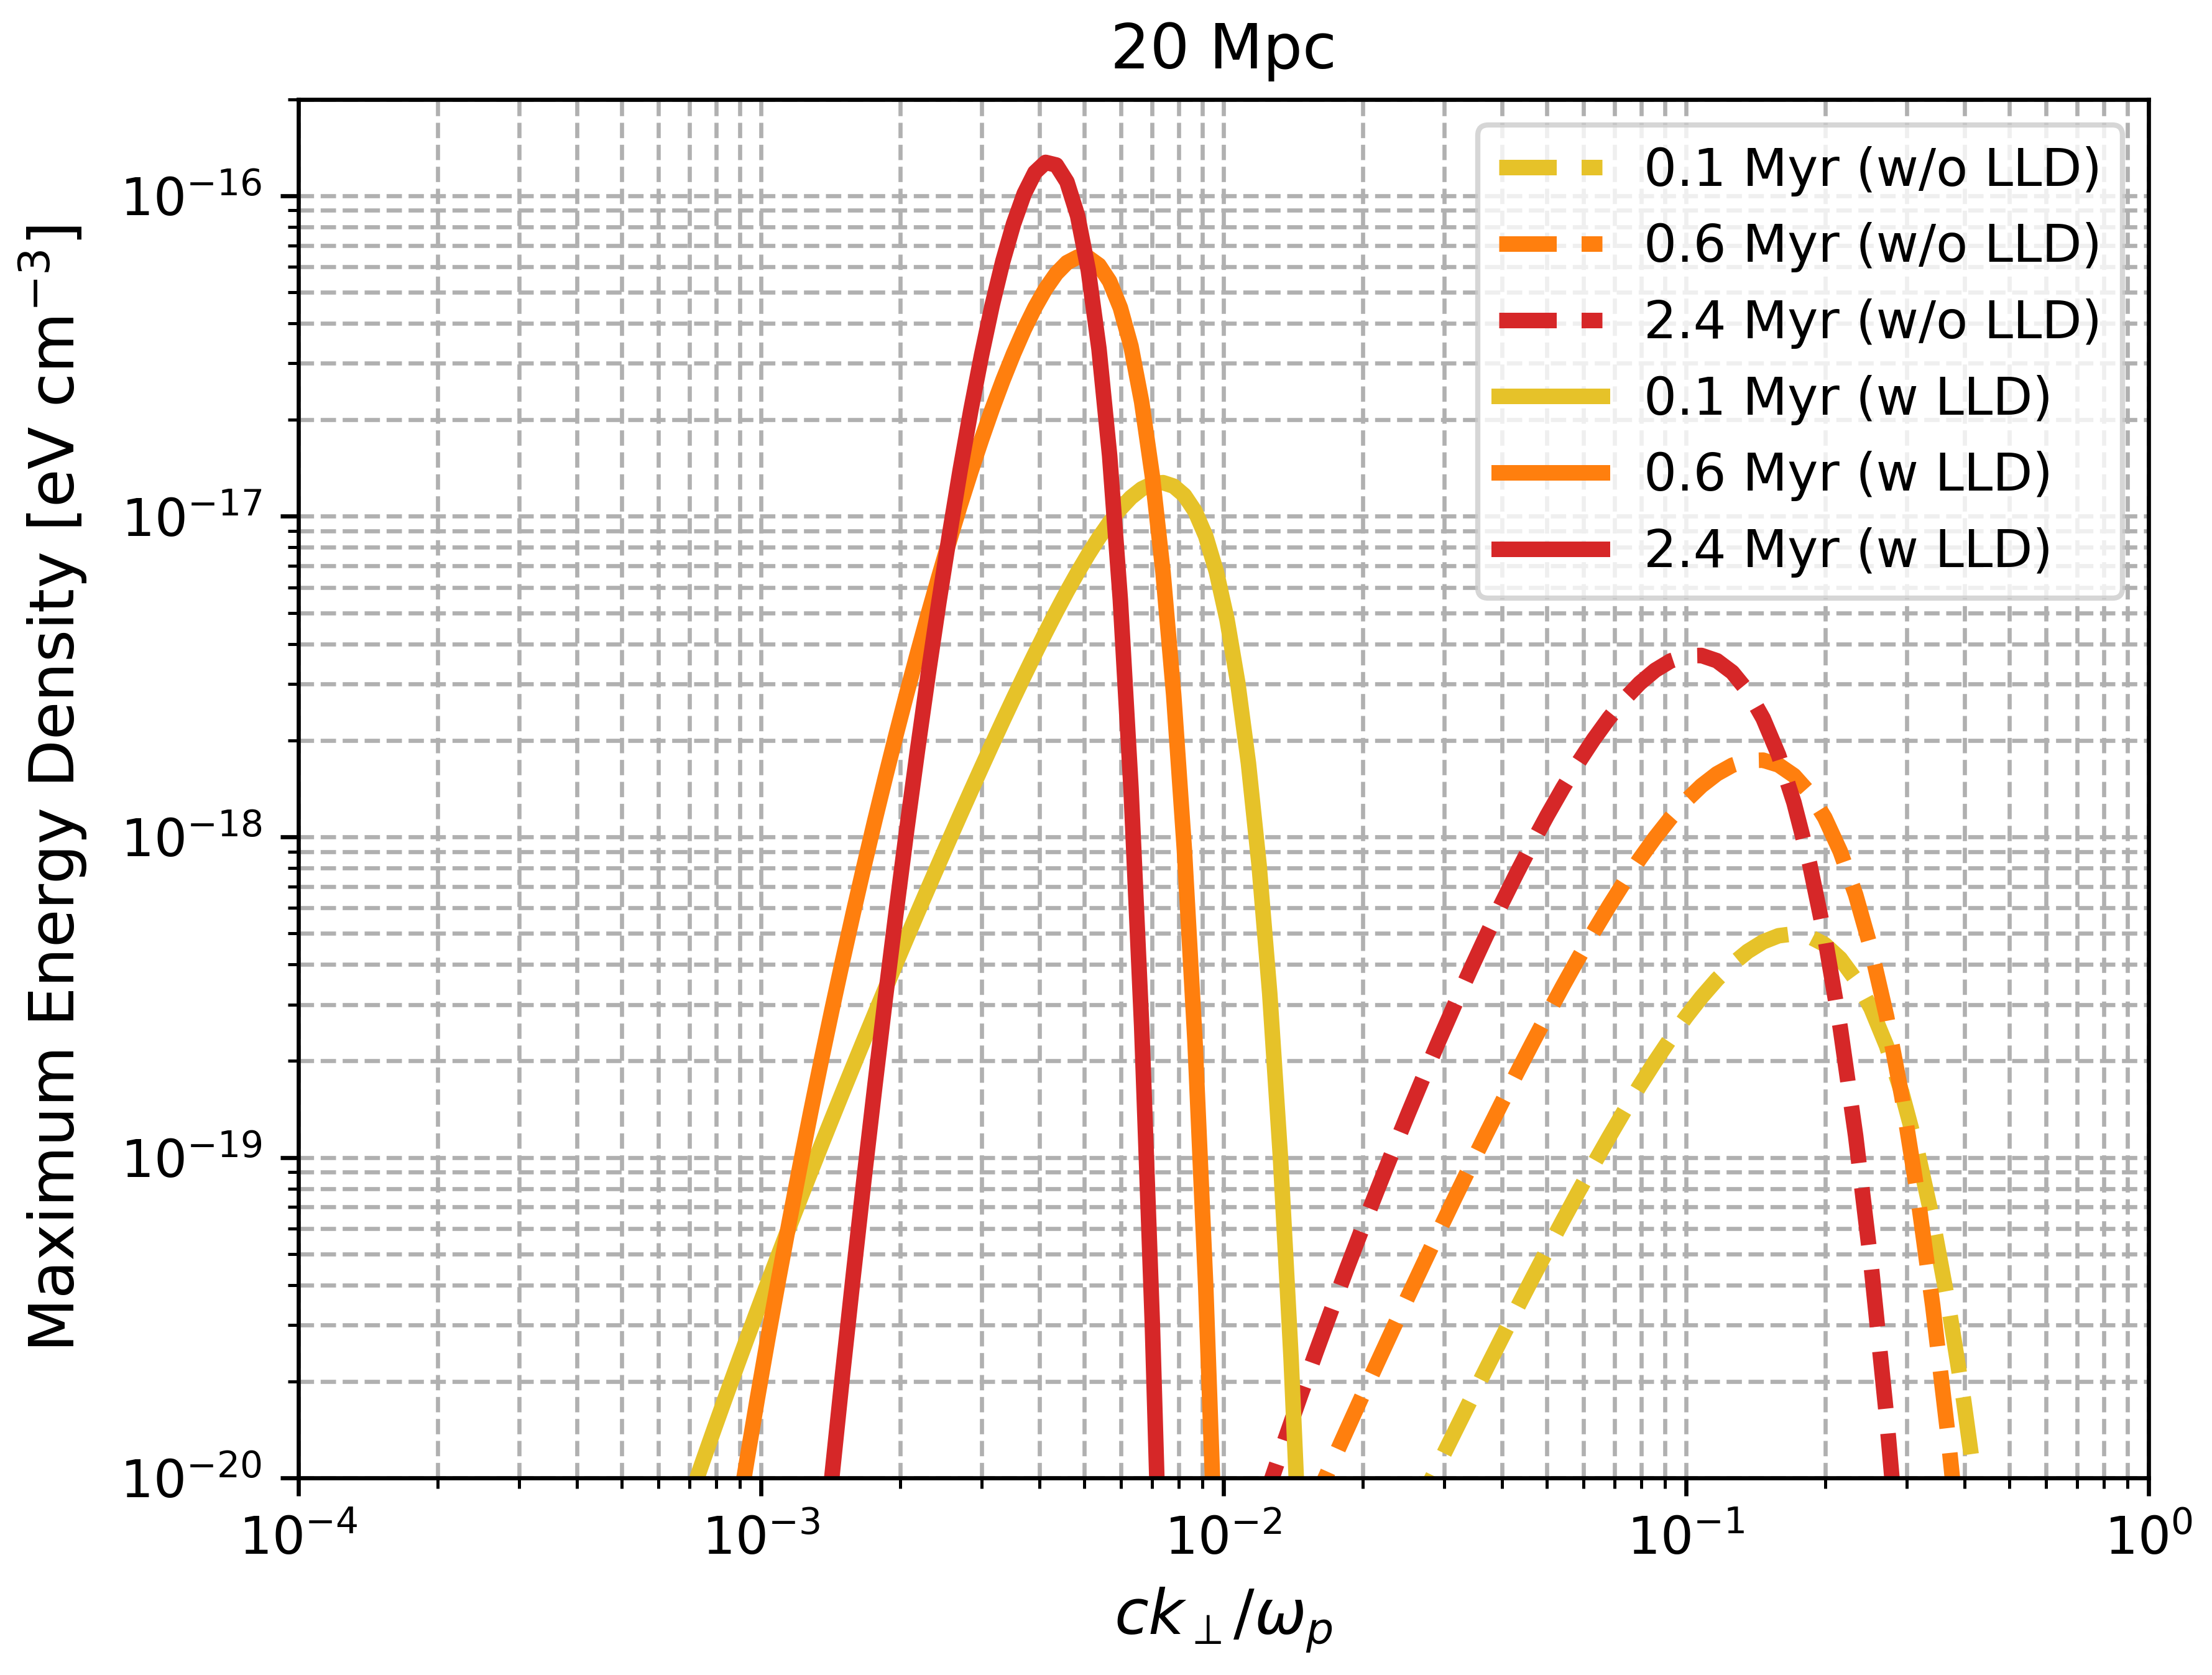
Quasi parallel modes keep growing
Alawashra et al 2025 ApJ 989 37

Slide 21
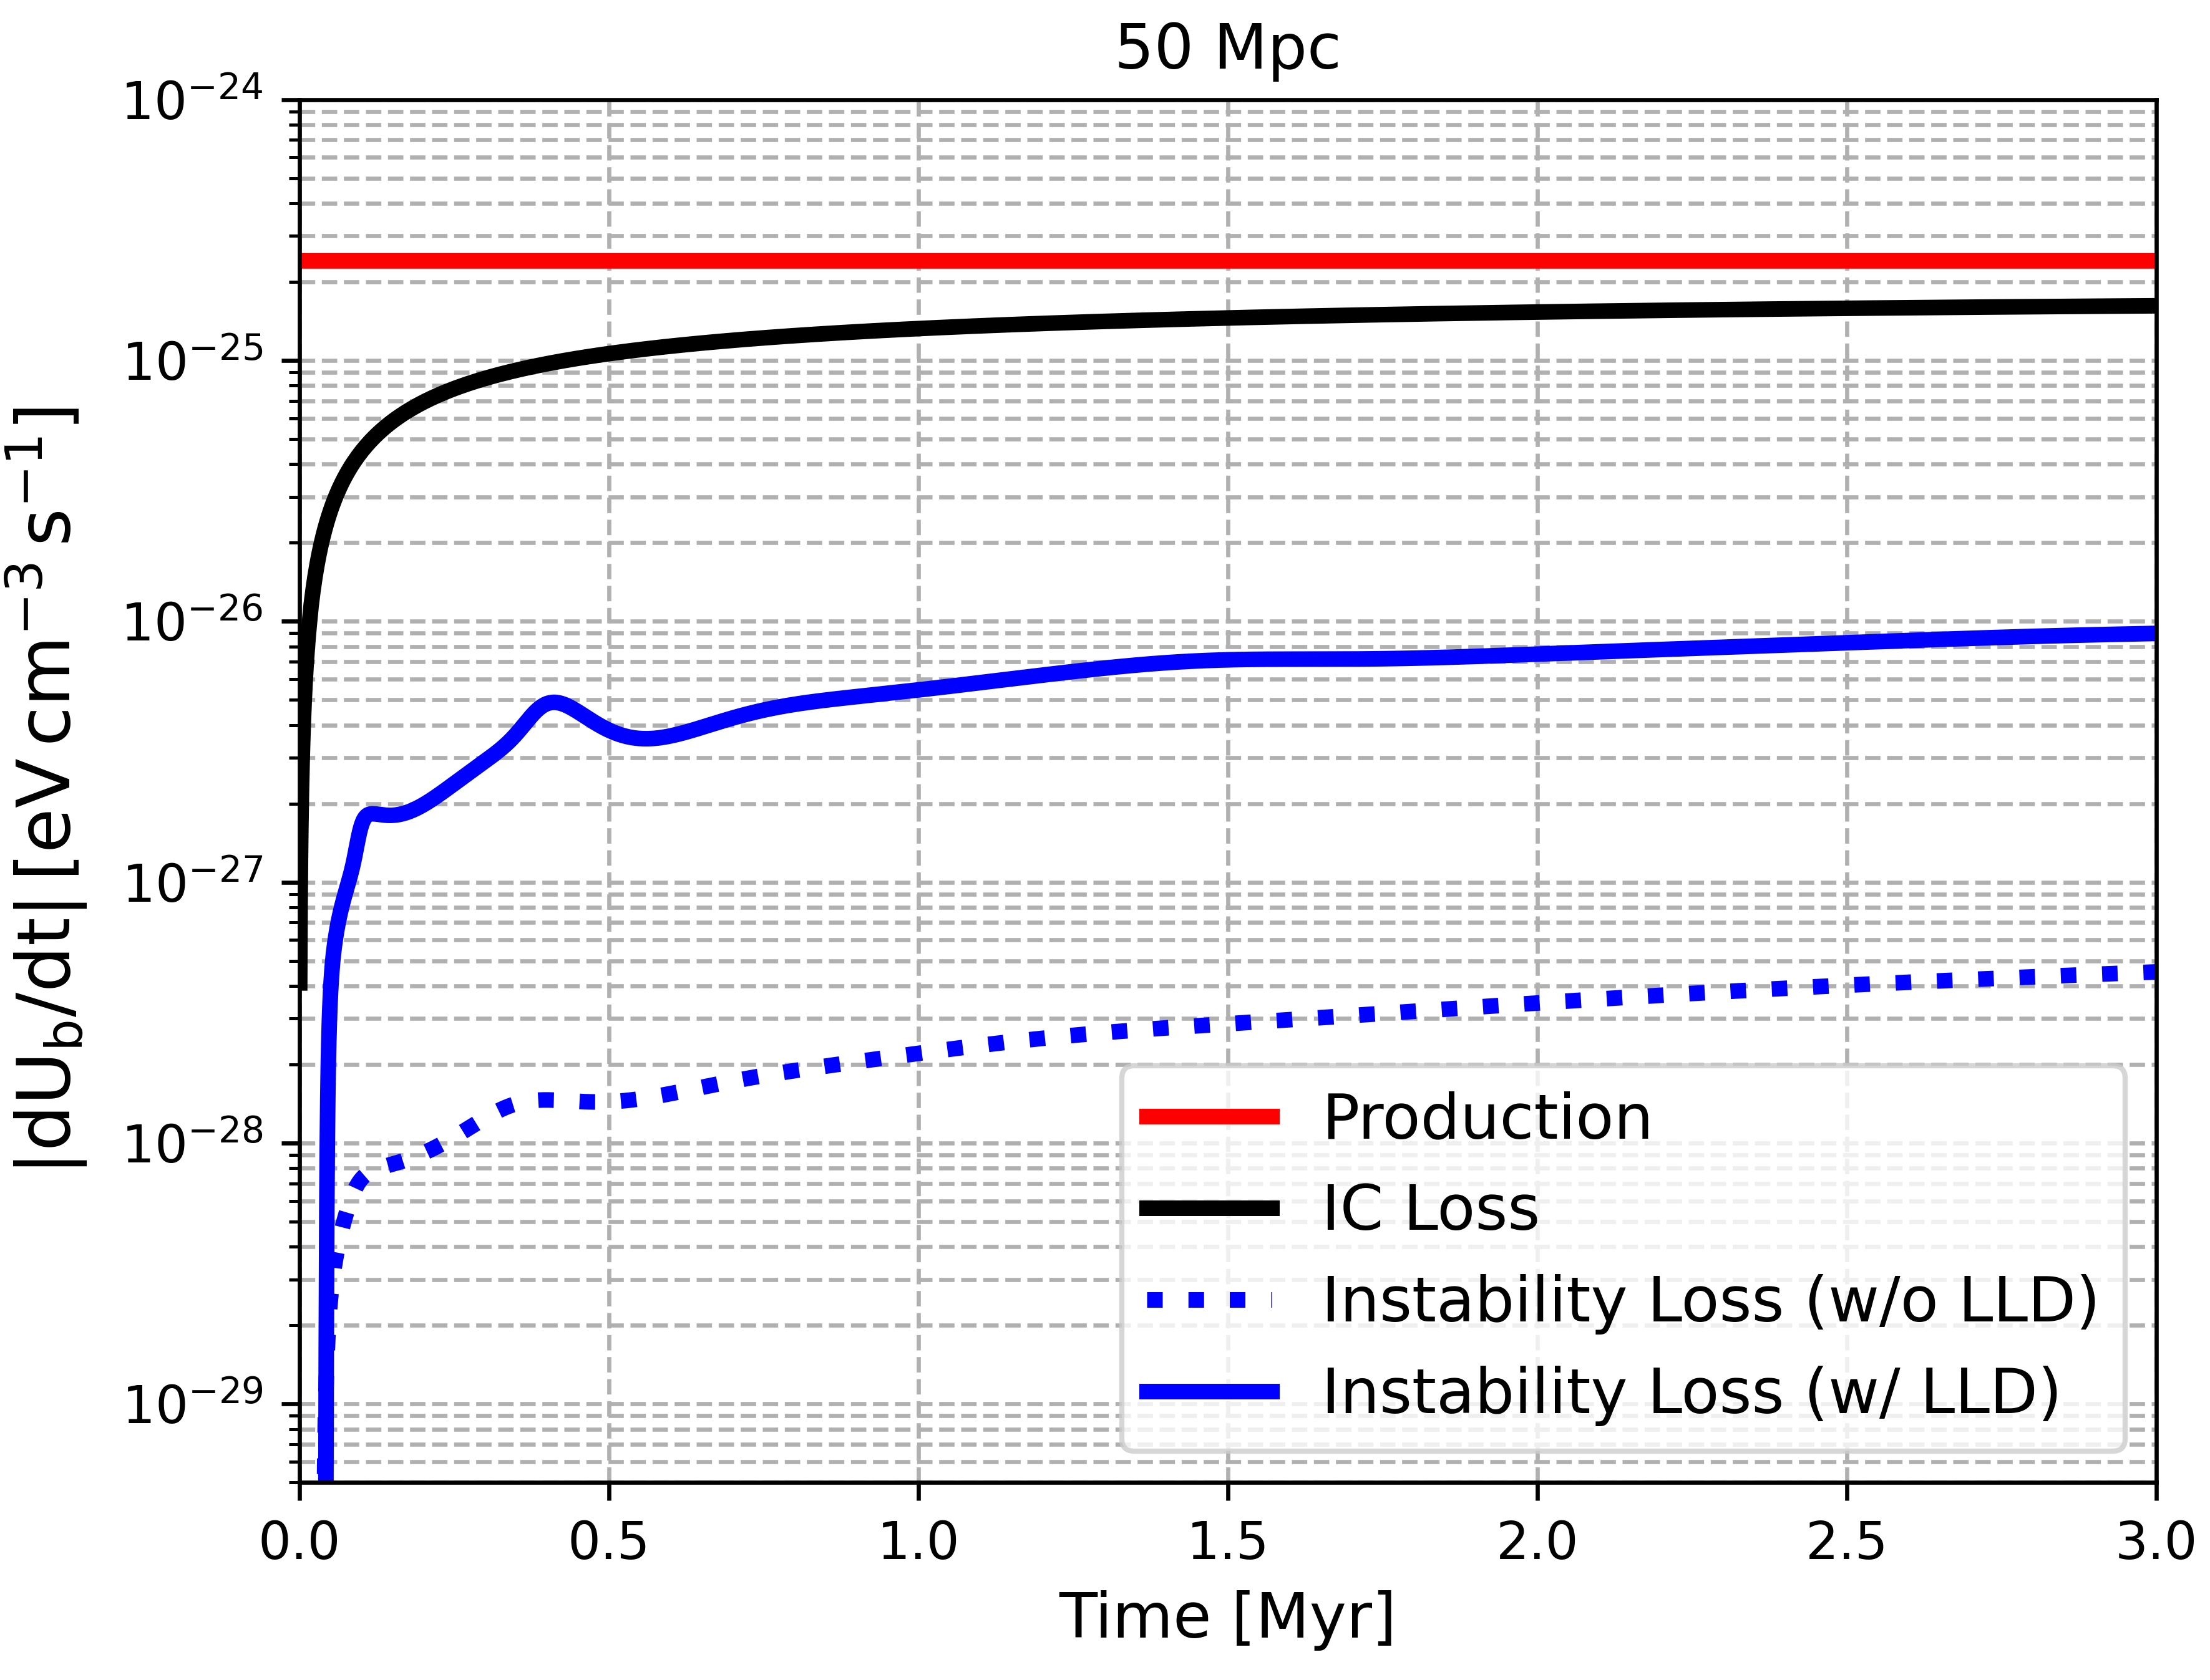
Instability loss enhanced by LLD
Alawashra et al 2025 ApJ 989 37

Slide 22
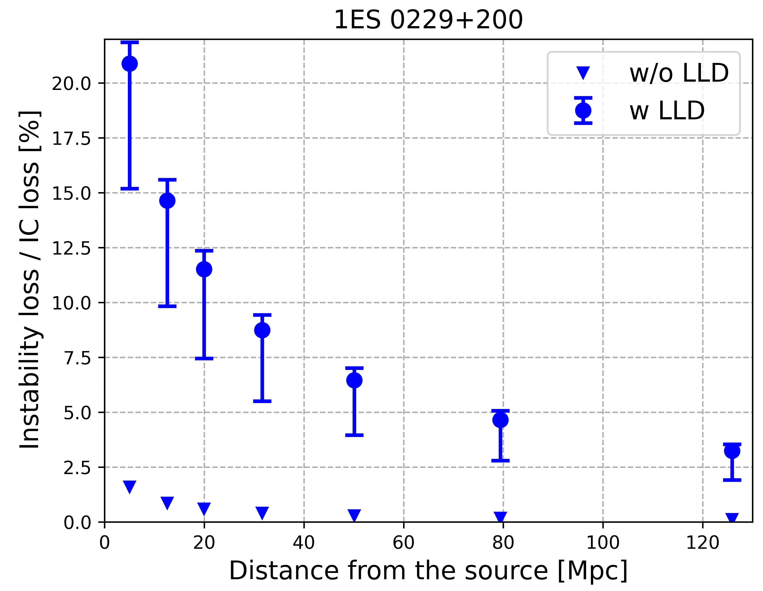
Instability loss enhanced by LLD
Alawashra et al 2025 ApJ 989 37

Slide 23
Conclusions
Including the Linear Landau damping (LLD) by the MeV cosmic rays is essential to understand the role of the instability in the blazar-induced pair beams evolution.
The LLD turn off the waves oblique to the beam direction where the parallel modes are kept growing.
This results in a higher energy loss efficiency by the instability.

Slide 24
Thank you

Slide 25
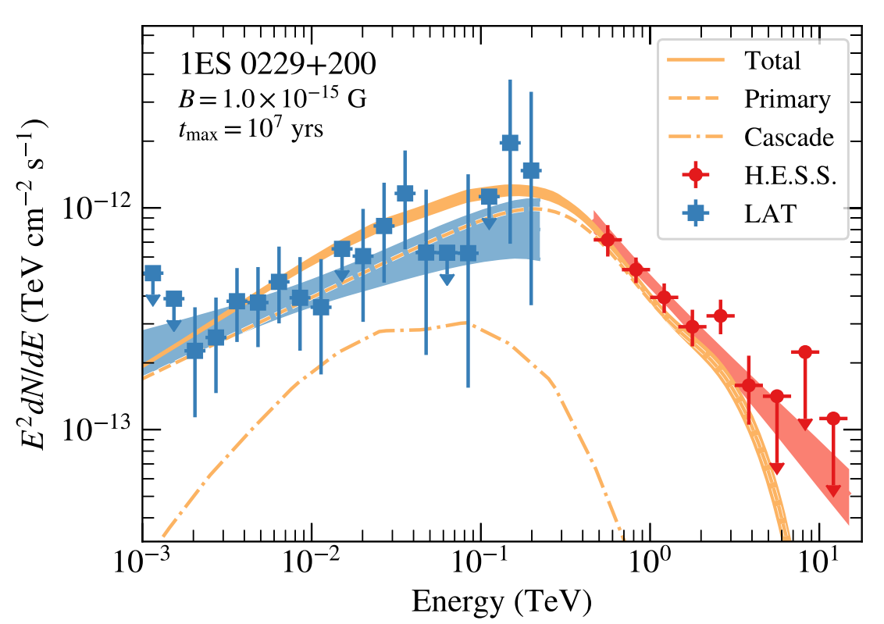
Suppression of the cascade emission by IGMFs
H.E.S.S. Collaboration (2023)

Slide 26
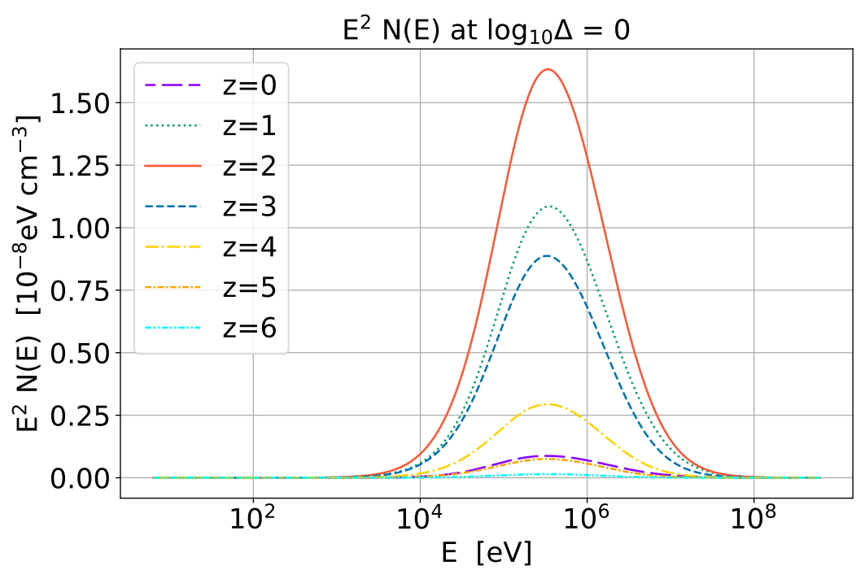
Compton-included cosmic ray spectrum
Yang, Long & Hirata (2024) ApJ 965 111

Slide 27
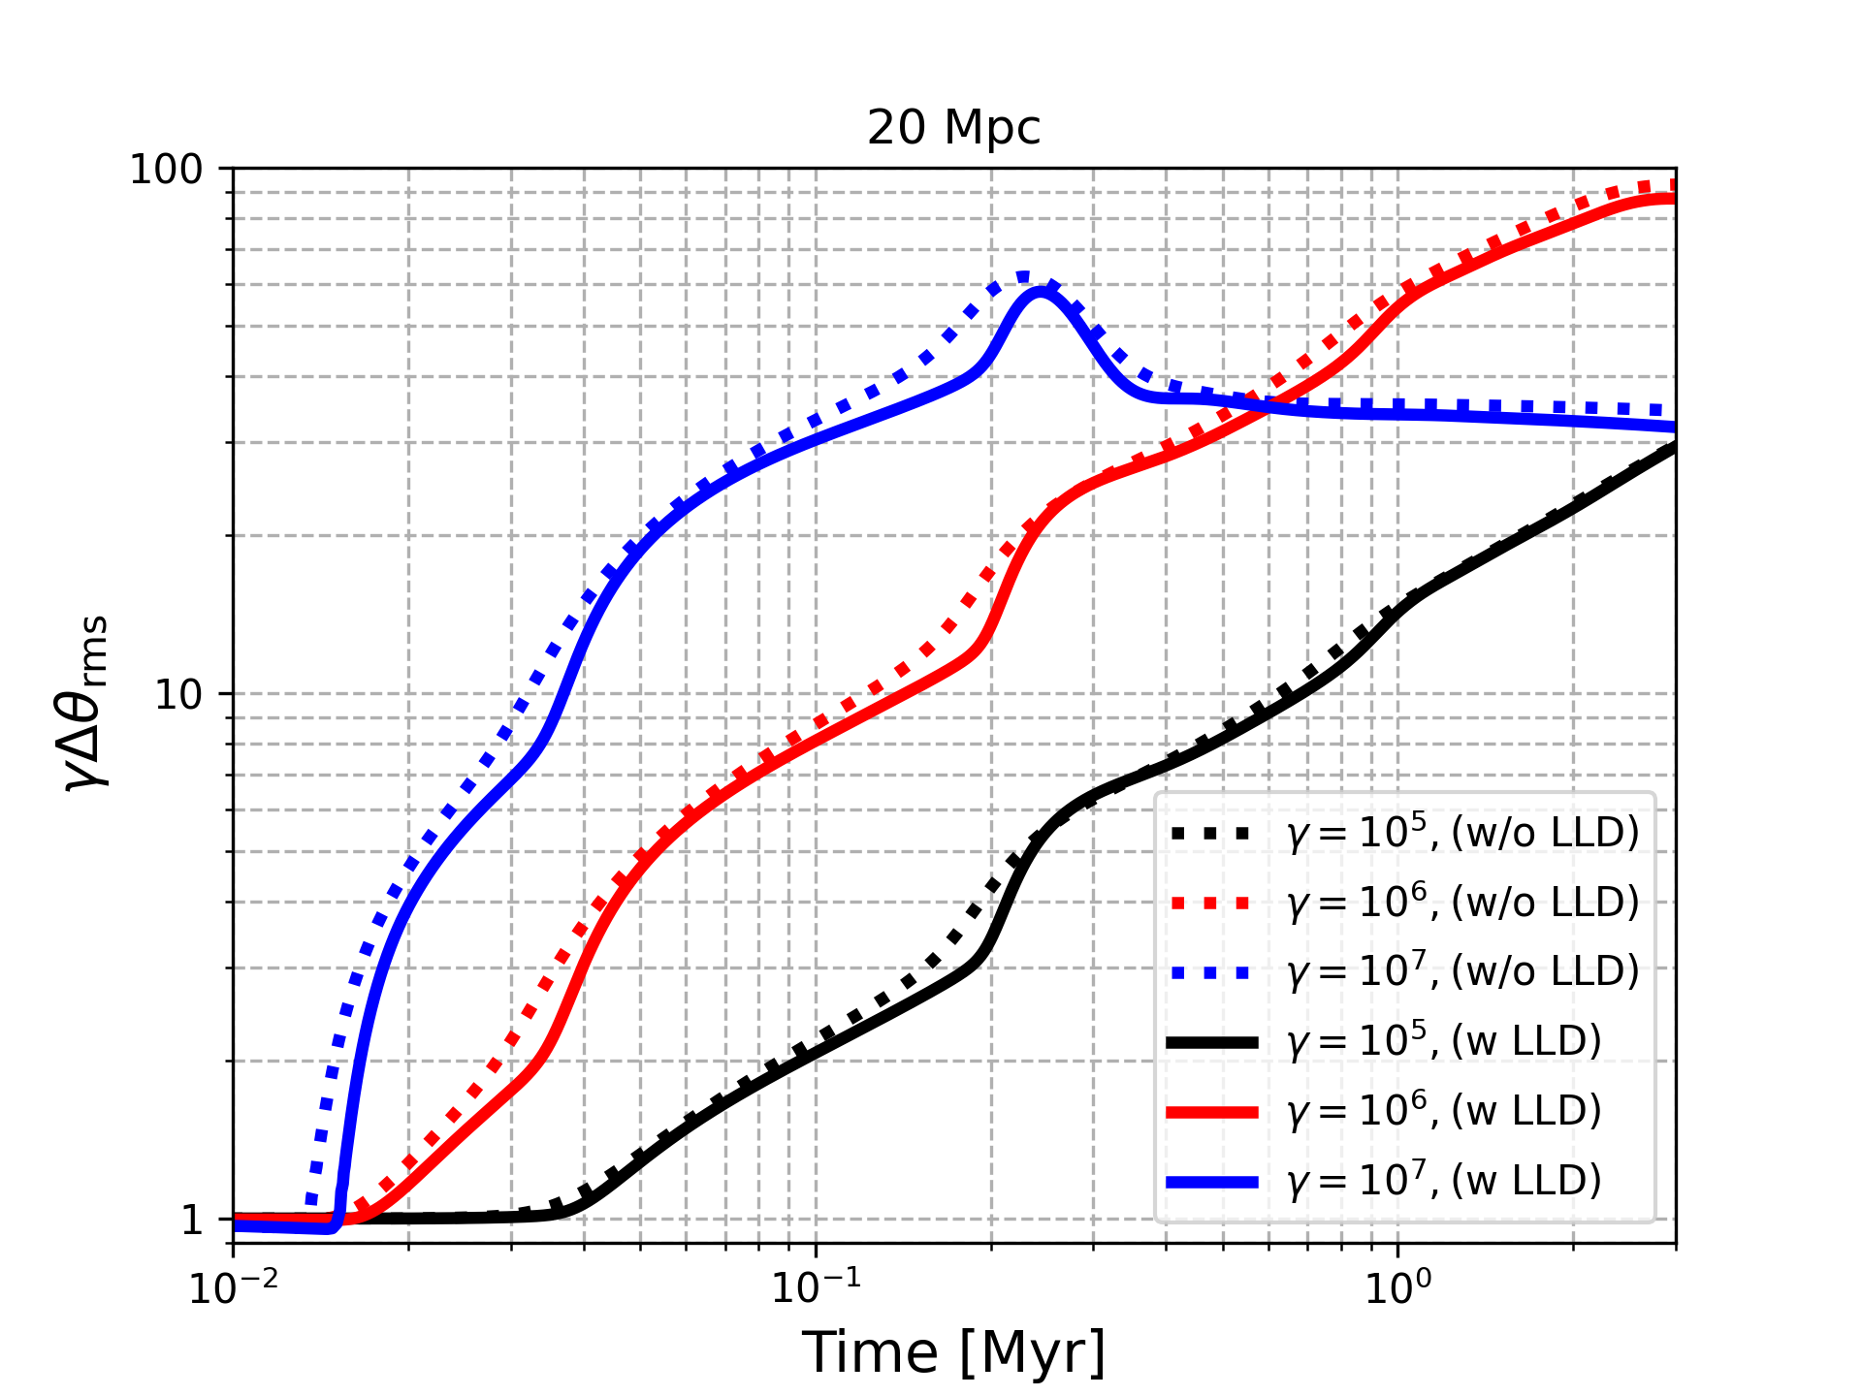
Beam broadening is only delayed

Slide 28

















What is the Impact of the Instability broadening on the GeV cascade?
GeV-$γ$
$$B_{IGM}$$
No magnetic fields or instability: forward-beamed γ-rays cascade
$$e^{±}$$
Intergalactic magnetic fields broaden the γ-rays cascade
$$e^{±}$$
$$e^{±}$$
$$e^{±}$$
GeV-$γ$
GeV-$γ$
$$∆θ \sim {10}^{−6}→{5×10}^{−4} : ∆t_{Delay}\sim 15 yr$$
Beam broadening by the feedback of the instability
$$e^{±}$$
$$k$$
$$e^{±}$$
$$∆t_{Delay}\sim ??$$
$$e^{±}$$
$$k$$
$$e^{±}$$
GeV-$γ$

Slide 29
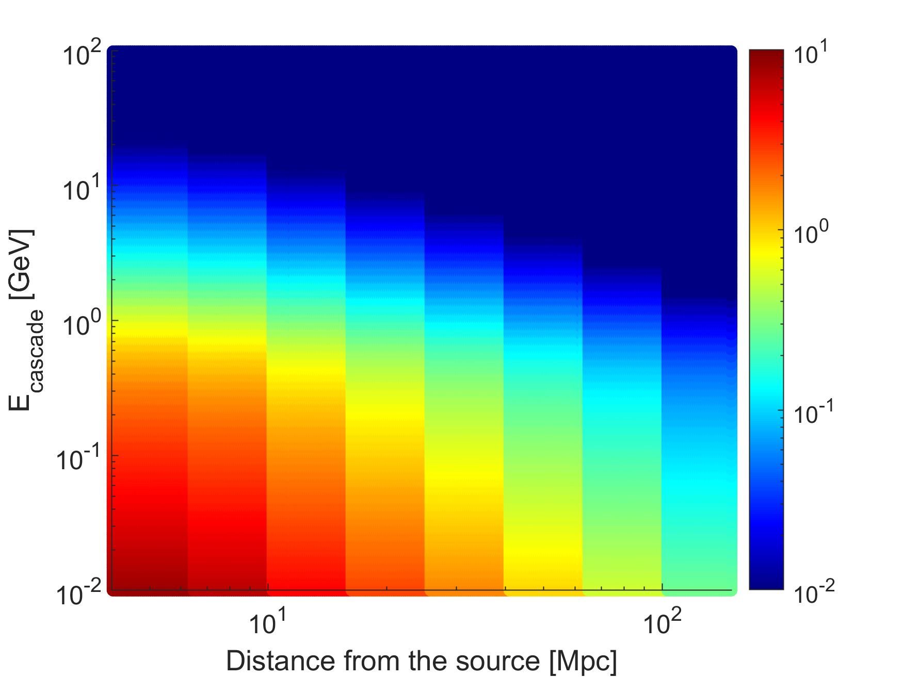
Cascade delay due to the instability broadening
Alawashra, Vovk & Pohl (2025) ApJ 978 95
Fermi-LAT Energy Range
Arrival time delay [years]

Slide 30
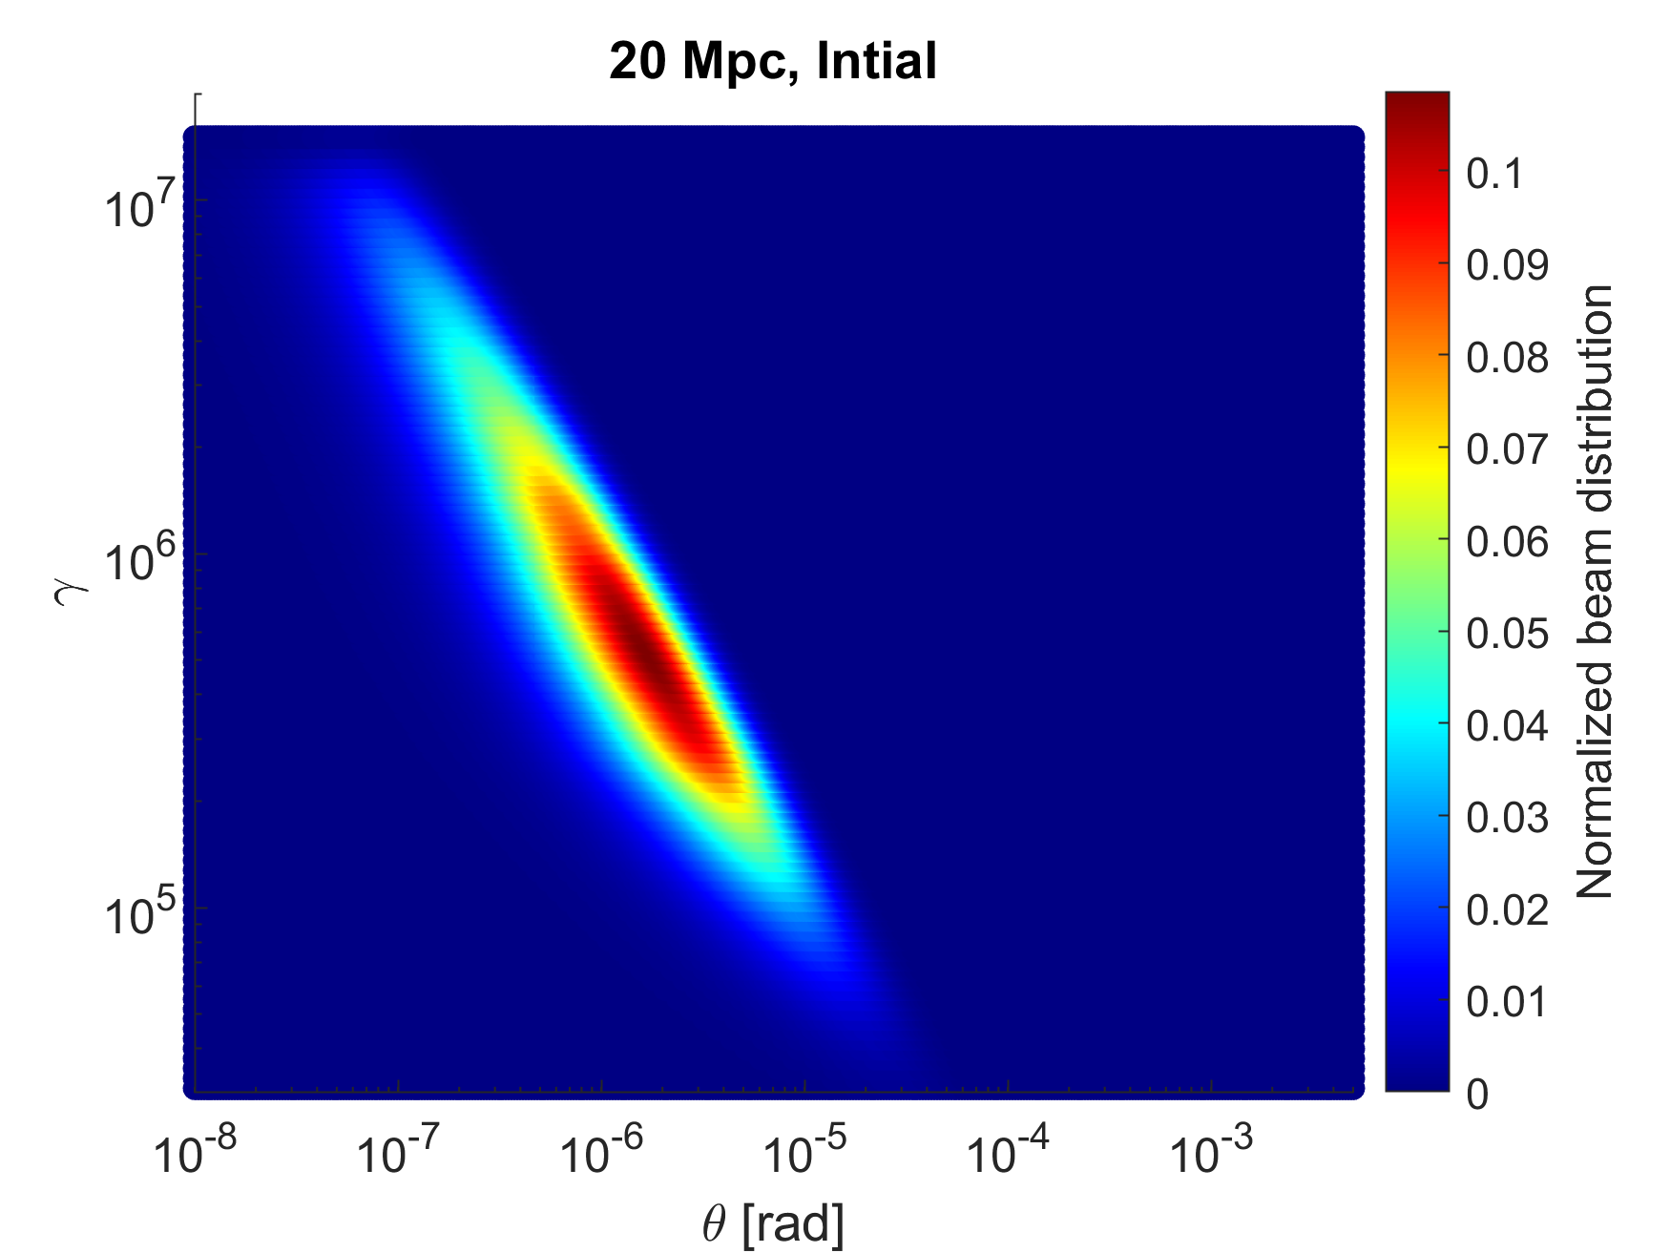
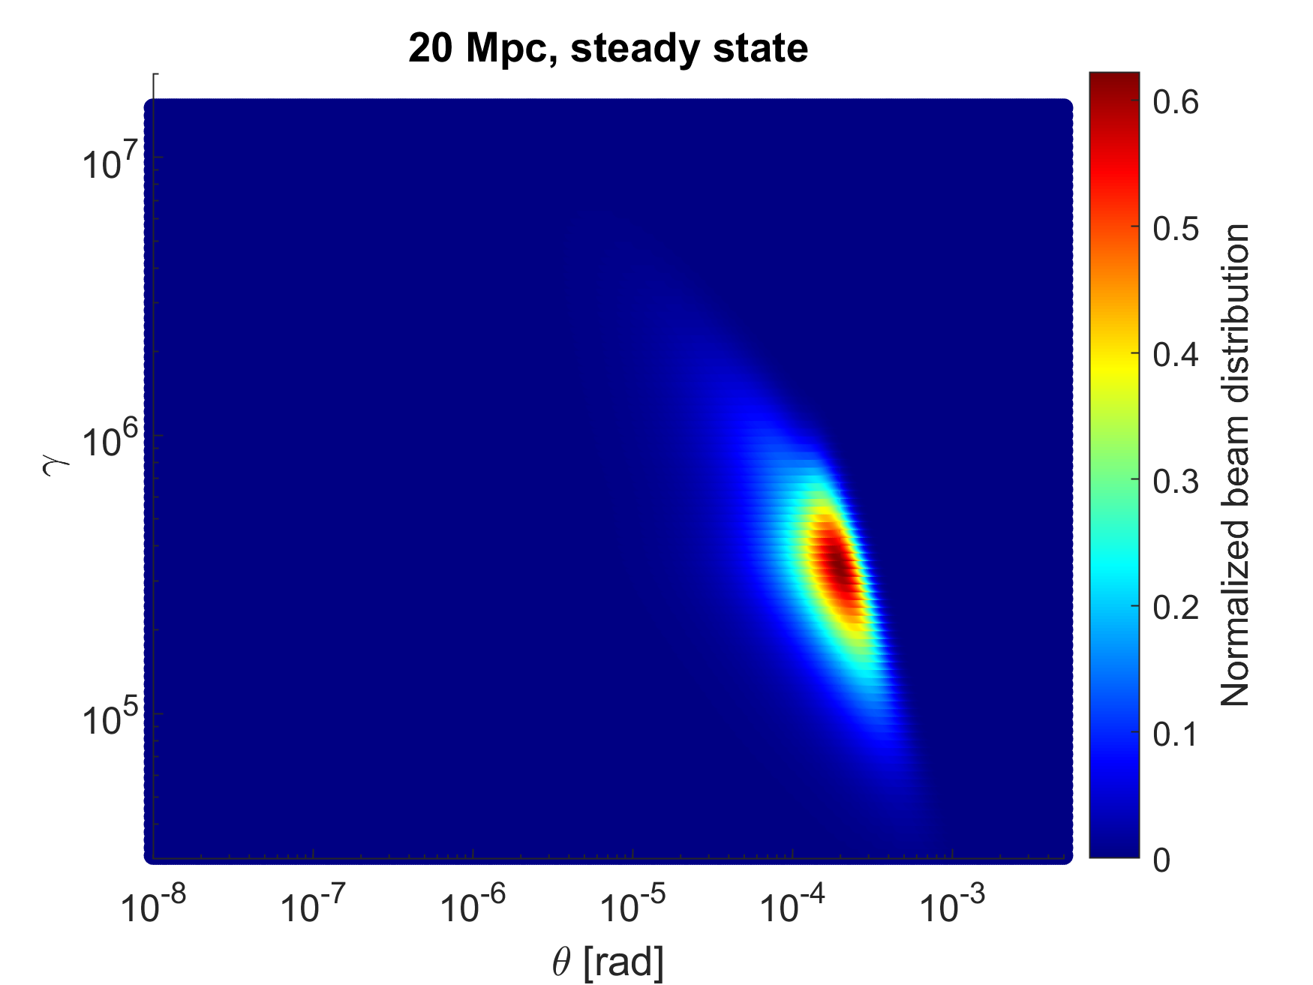

Slide 31
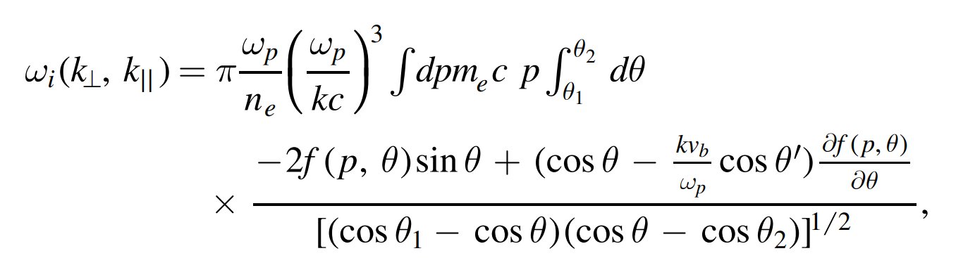

Slide 32
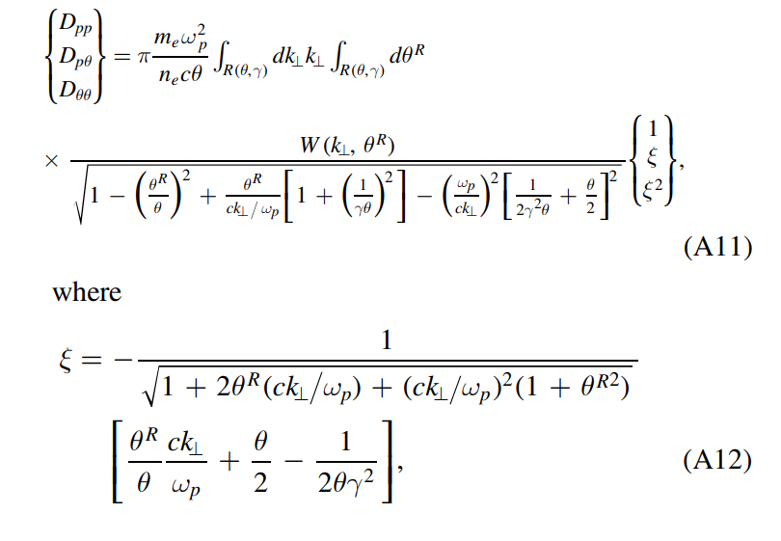

Slide 33
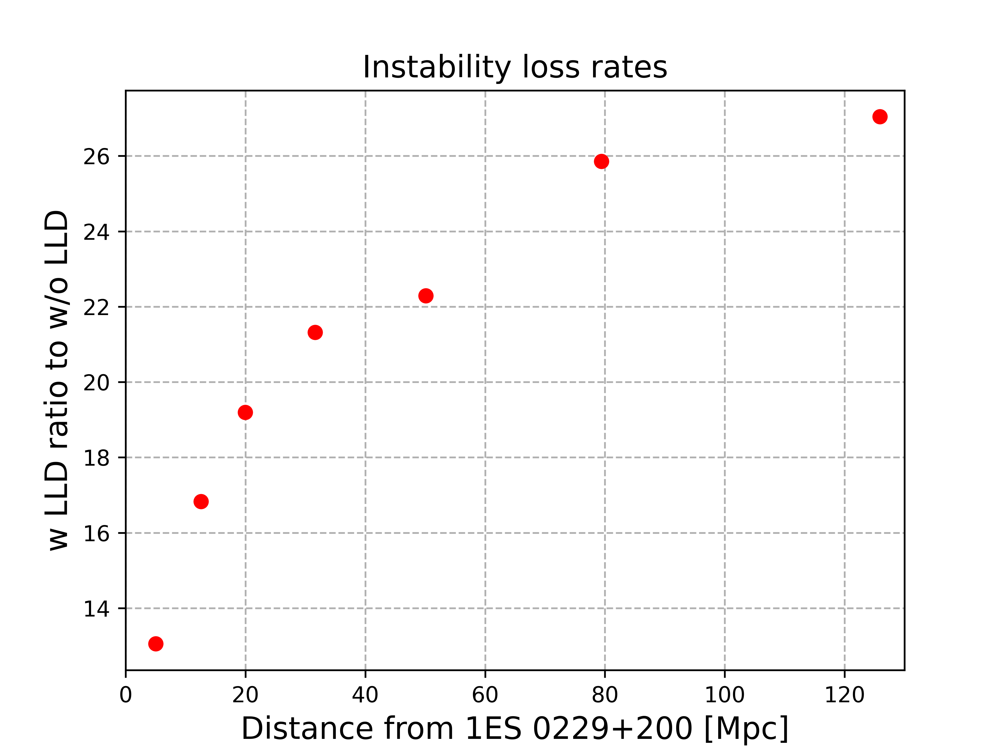
Q: Why the ratio increases with distance?

Slide 34
Q: Why the ratio increases with distance?

Slide 35
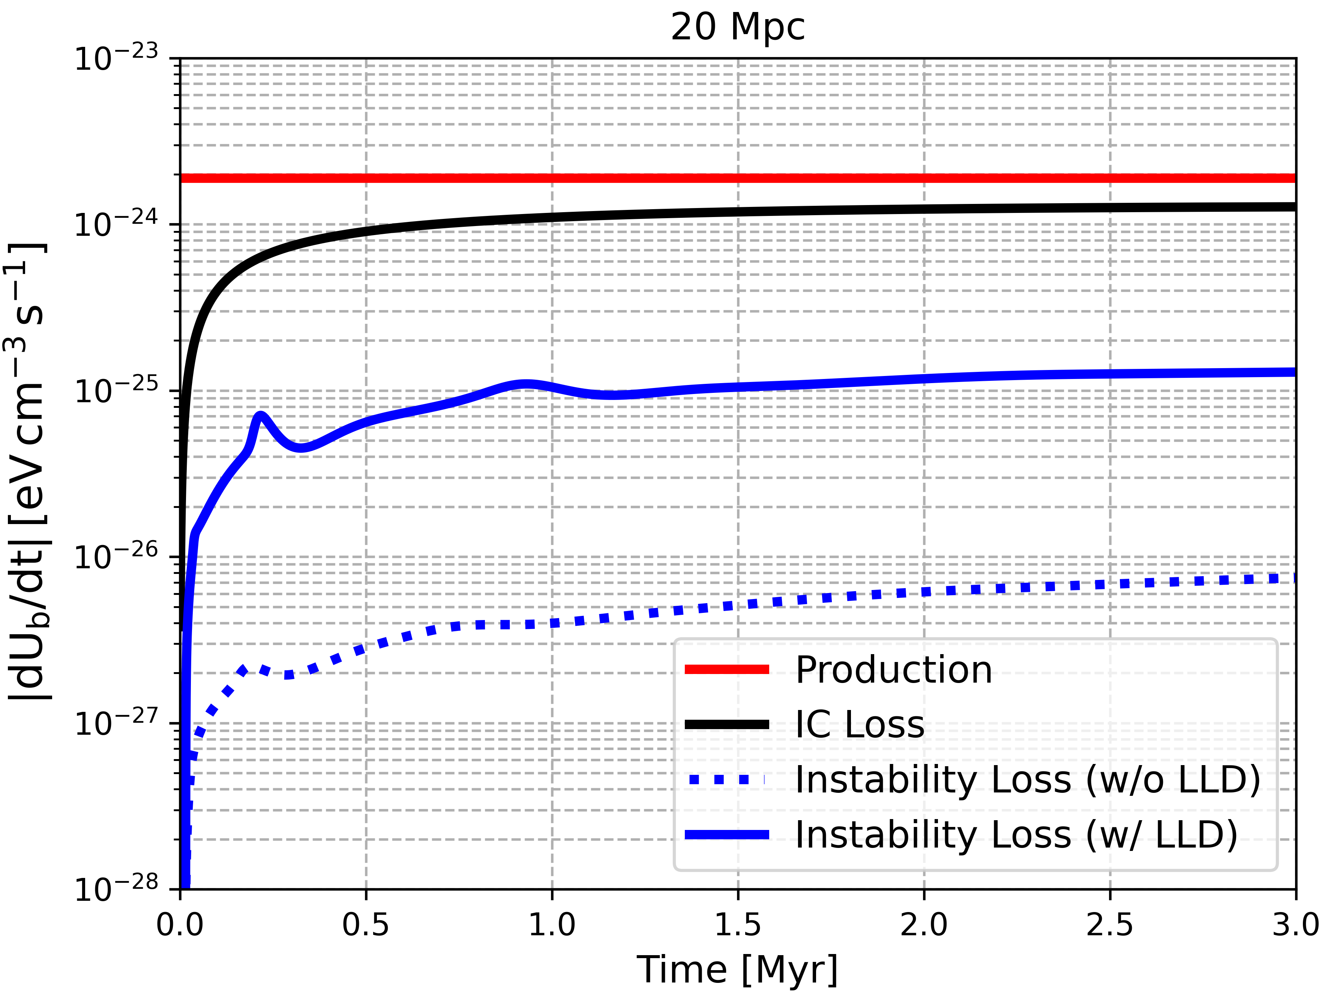
Instability loss enhanced by LLD

Slide 36
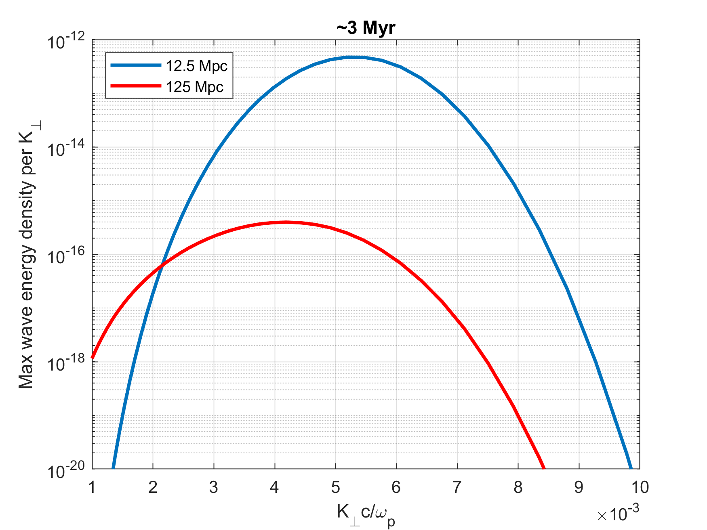
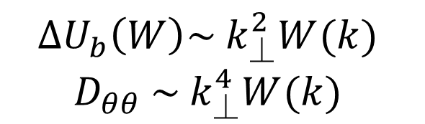
Q: Why the ratio increases with distance?
$$∆U_{b}\left(W\right)\sim { k}_{⏊}^{2}W(k)$$
$D_{θθ}$ $\sim { k}_{⏊}^{4}W(k)$

Slide 37
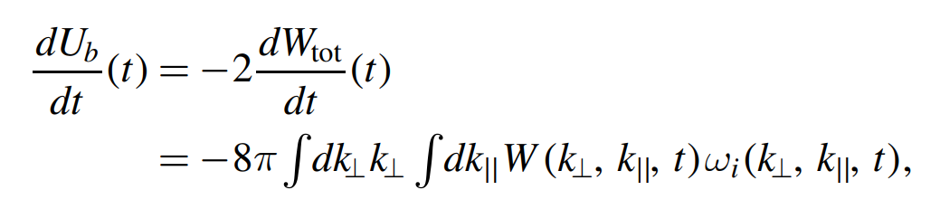
Energy loss for certain beam particles

Slide 38
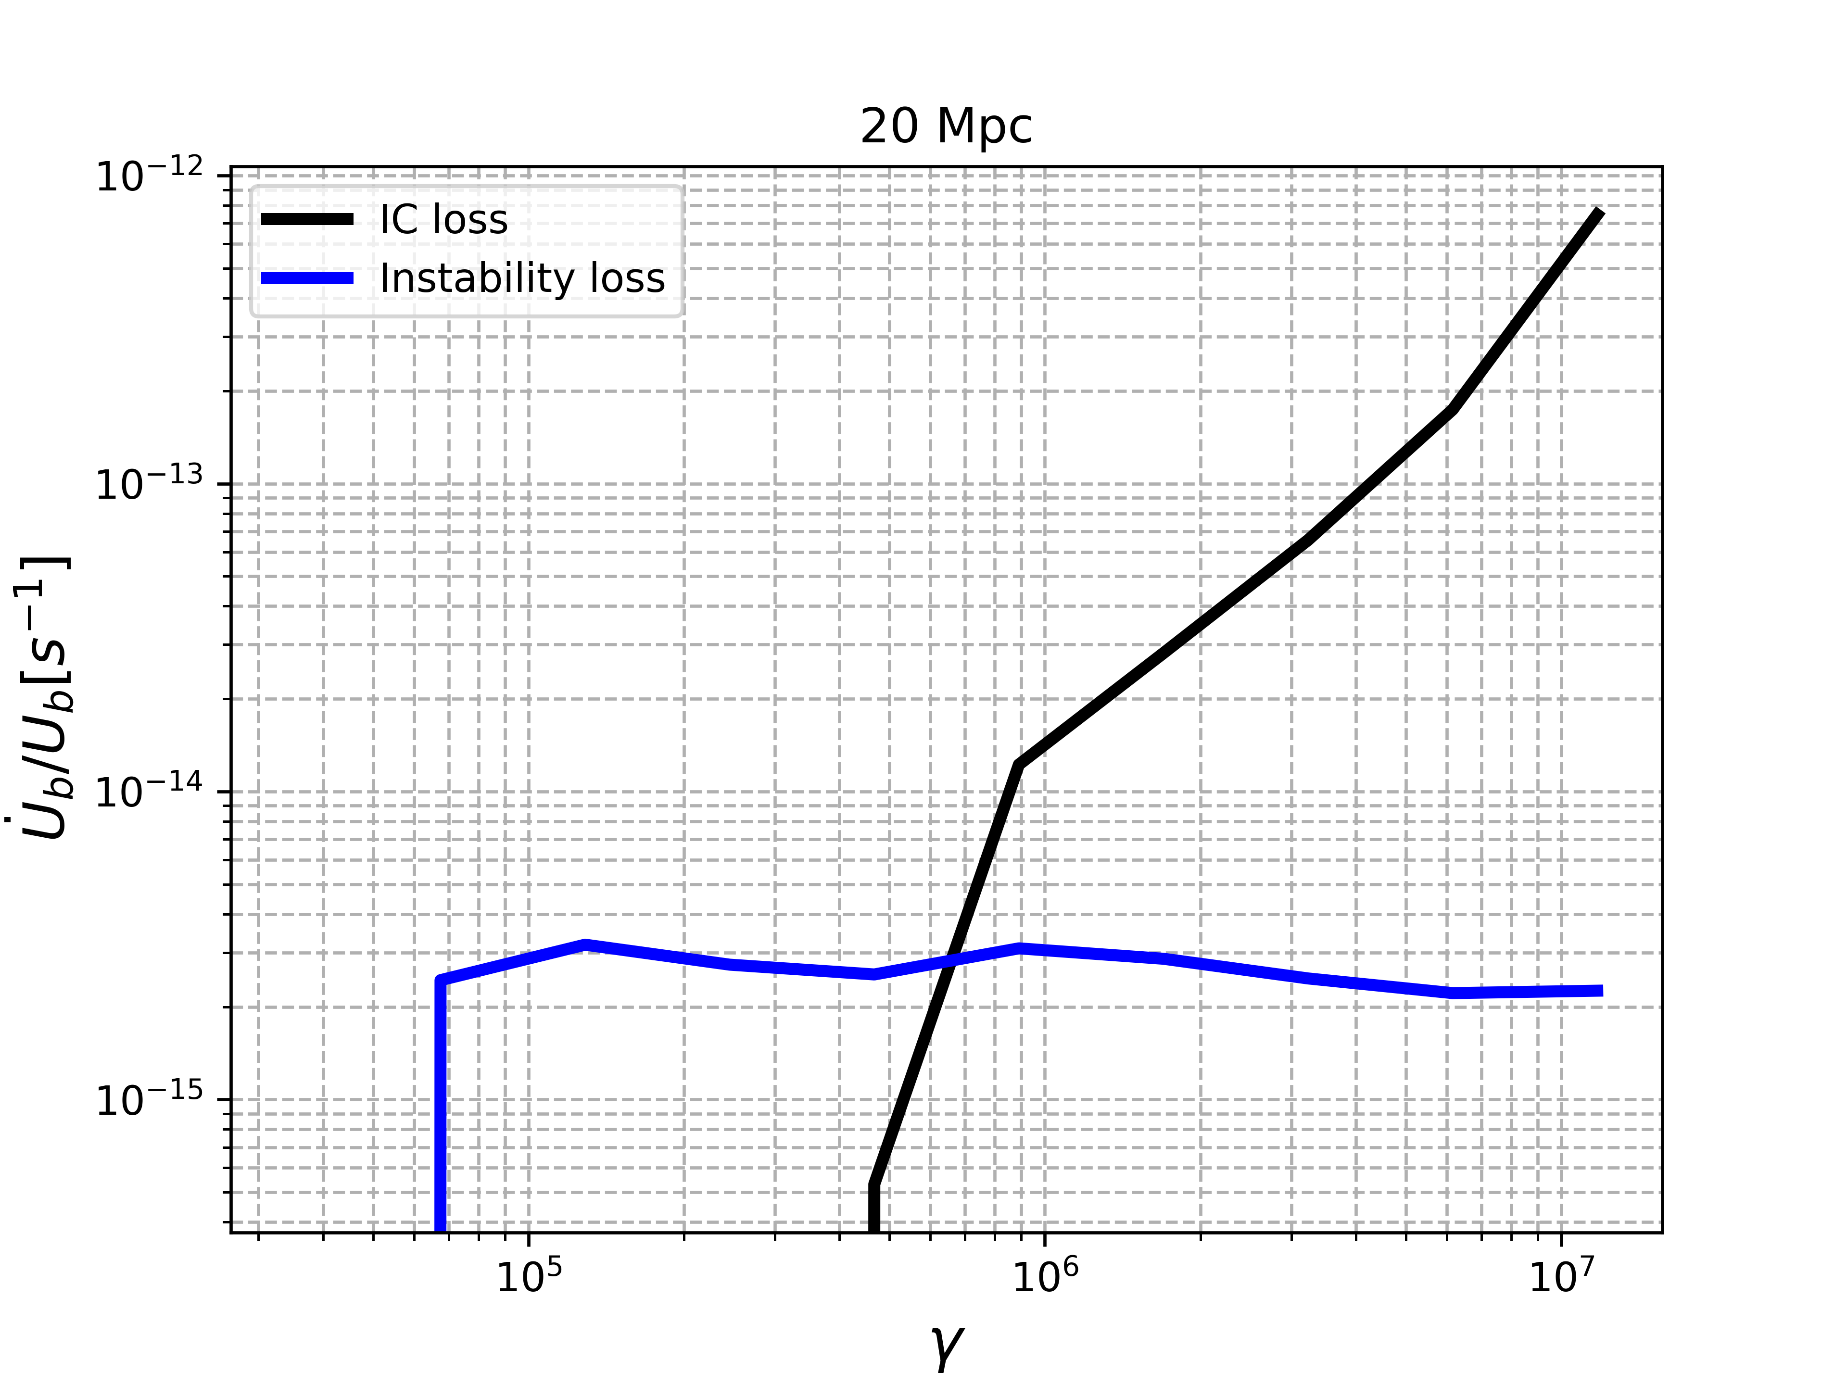
Instability loss vs IC cooling loss

Slide 39
Back up slides

Slide 40
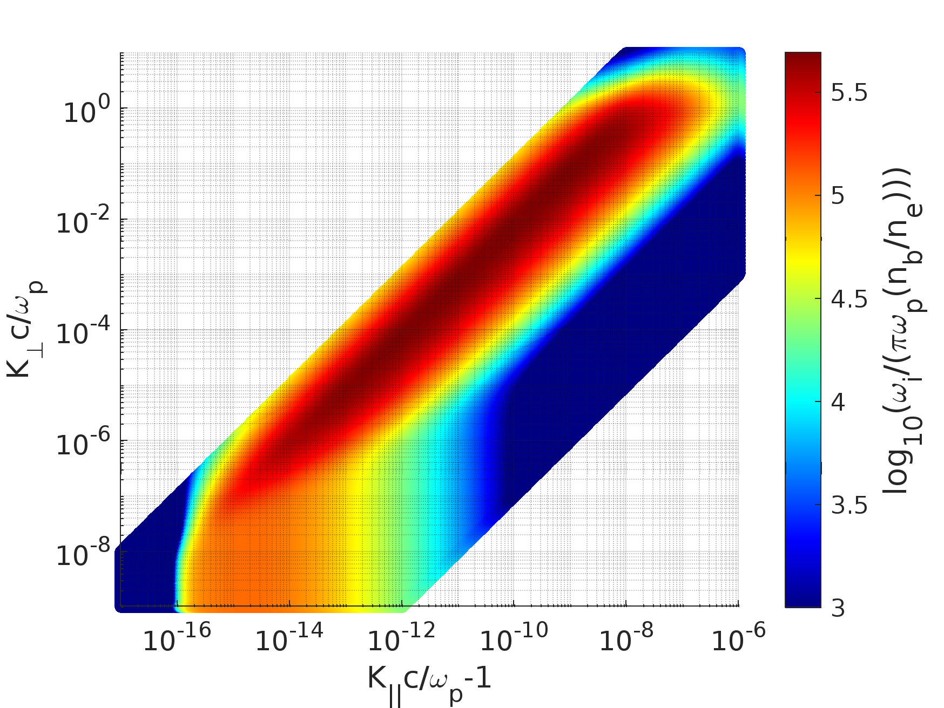

Electrostatic Linear growth rate
$$\sim {10}^{−7}−{10}^{−10} s^{−1}$$

Slide 41
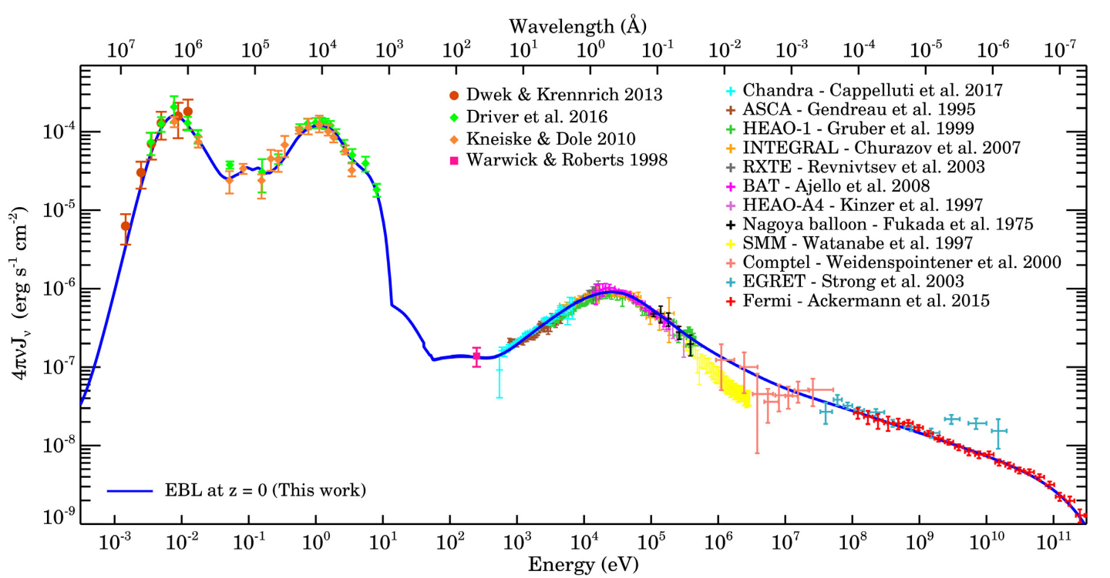

Slide 42
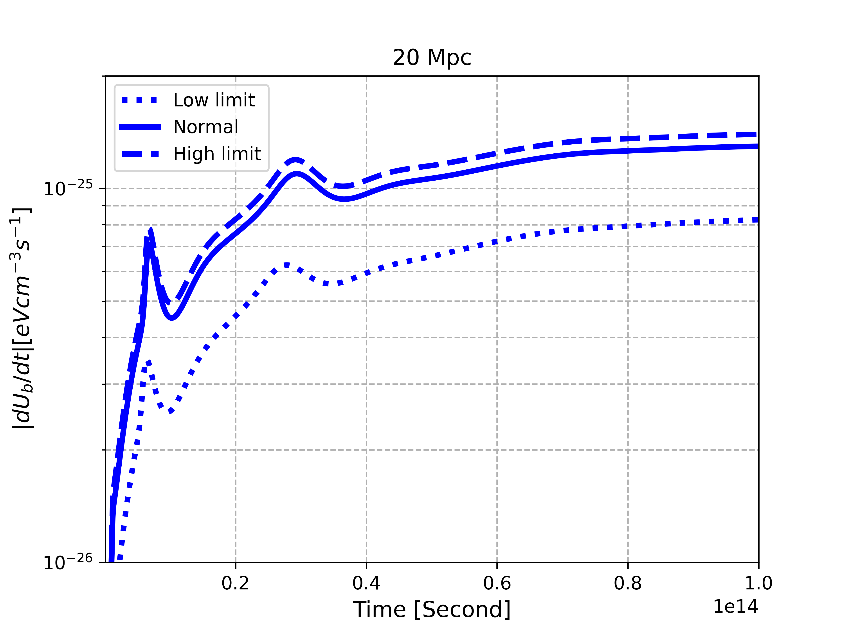
Instability loss vs IC cooling loss

Slide 43
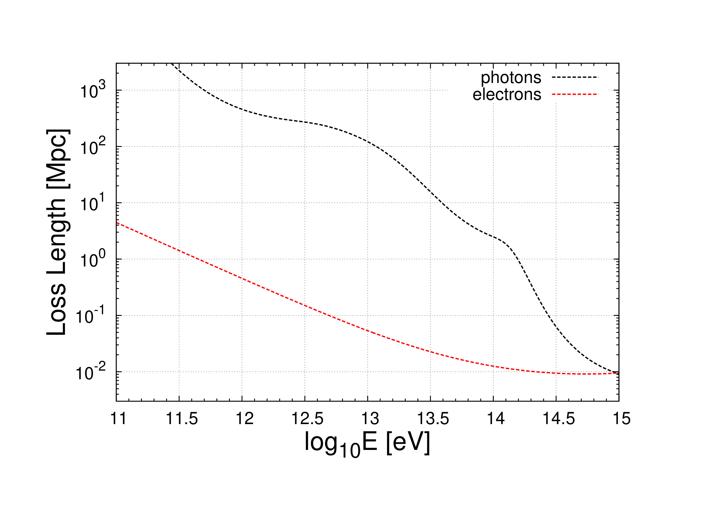
Q: Why look at the first 100 Mpc?
Andrew Taylor (private communication)

Slide 44
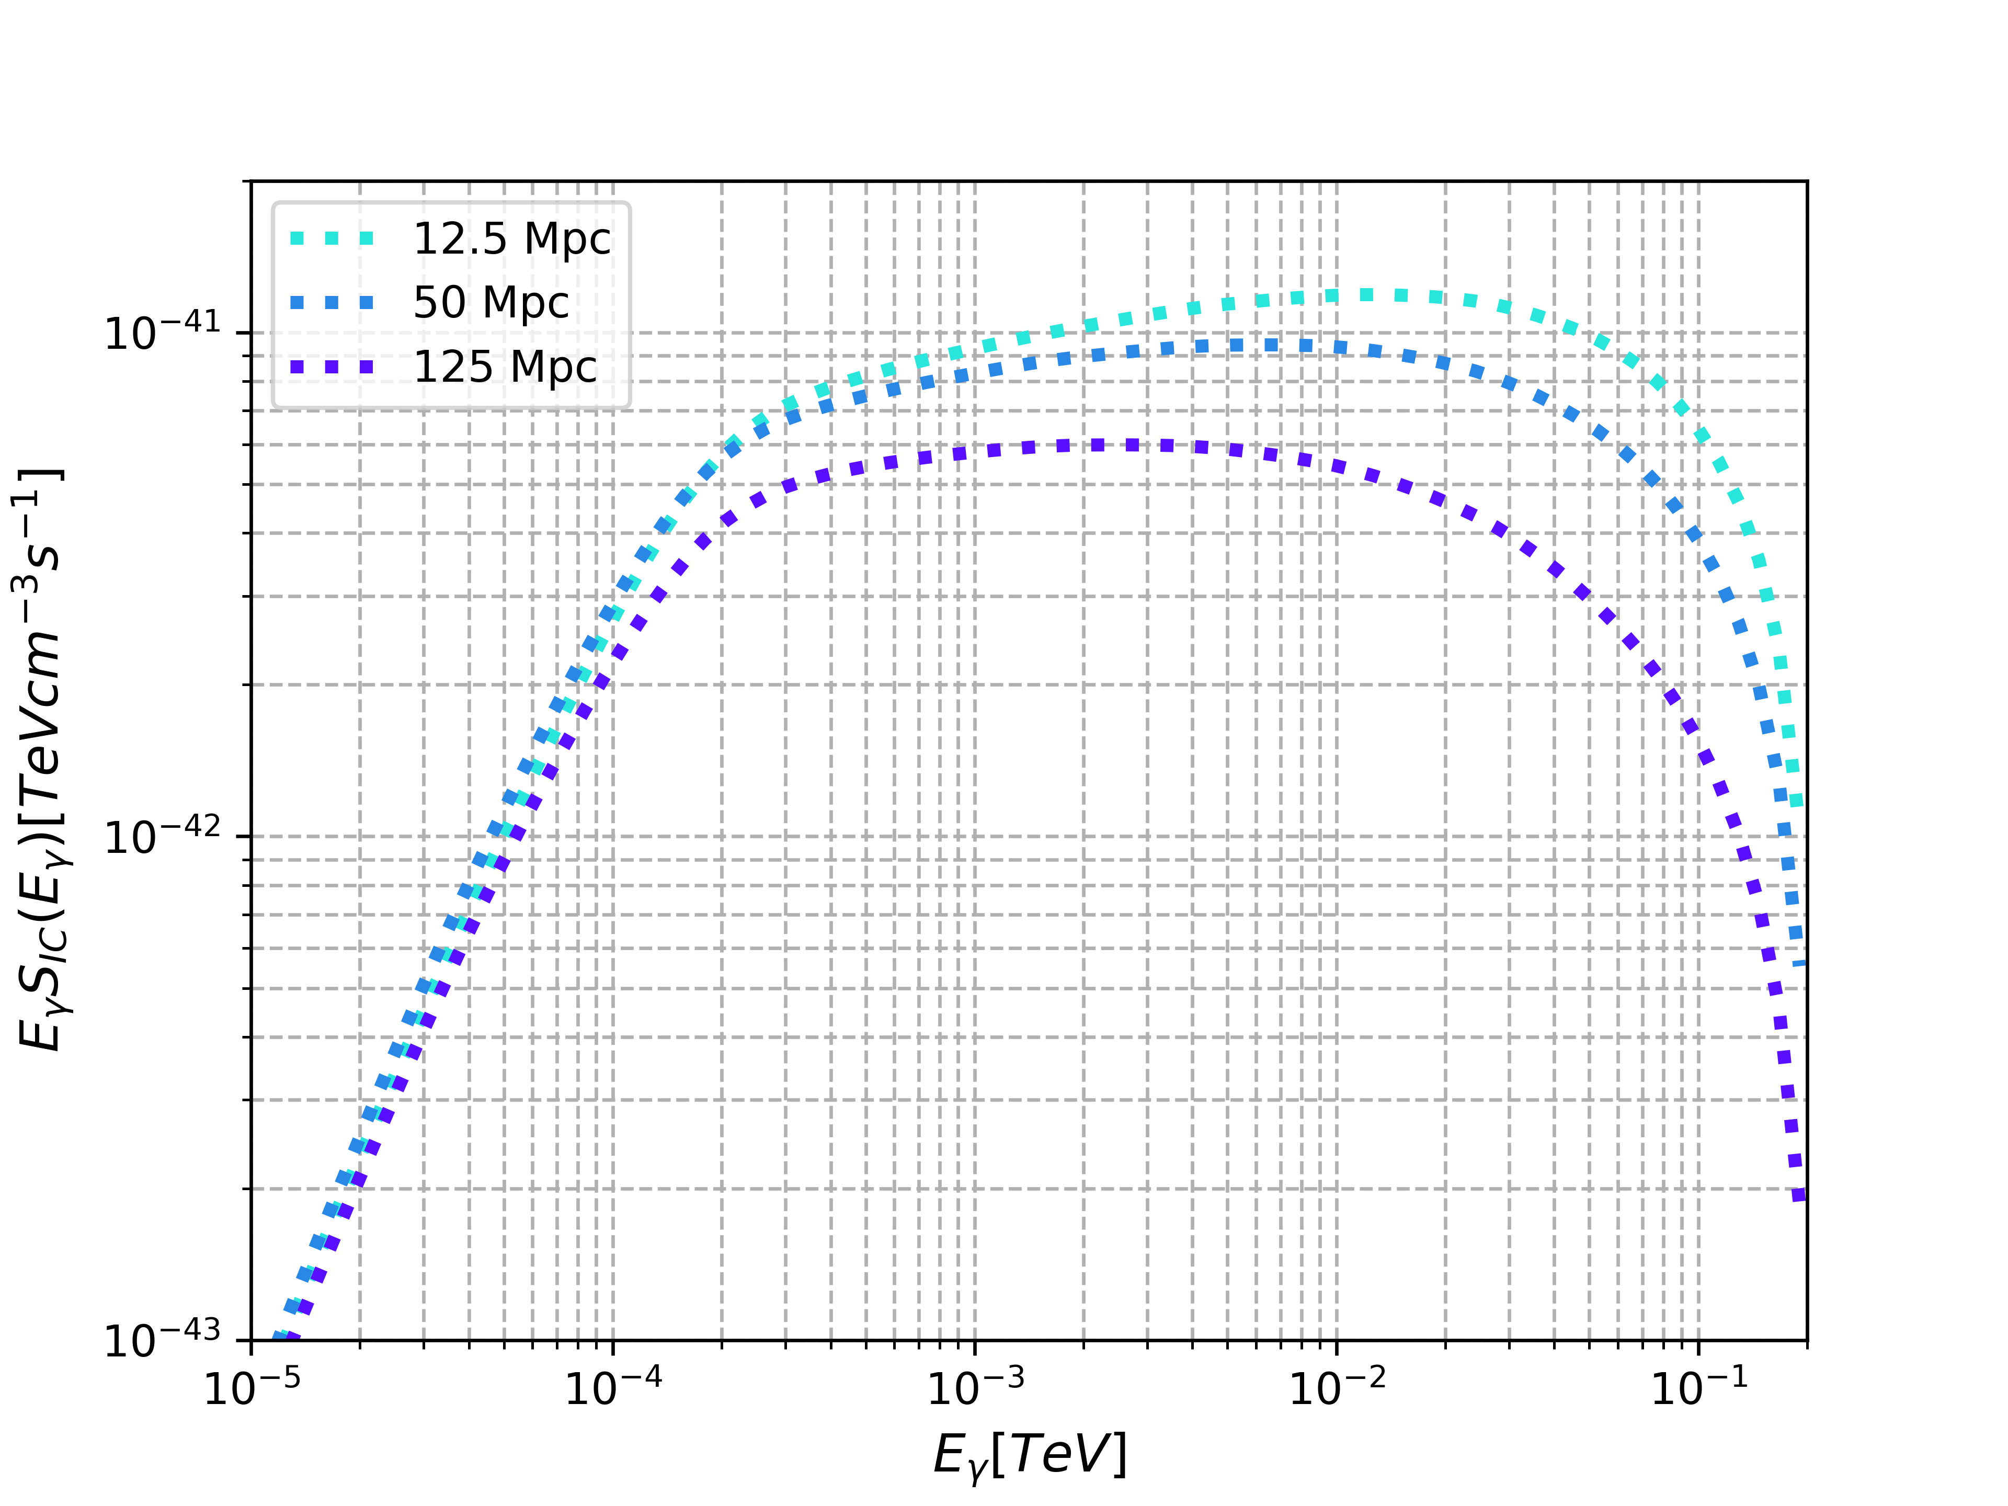
Q: Why look at the first 100 Mpc?

