Slide 1


Generic isocurvature fluctuations of scalar spectators
Saarik Kalia
TeVPA 2025
4 November 2025
Based on arXiv:2510.11803

Slide 2
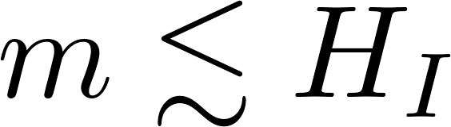
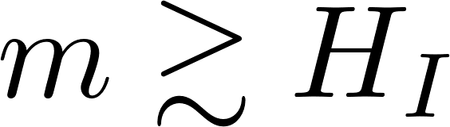
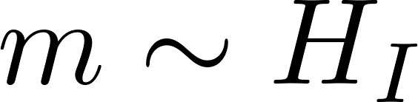

Introduction
Scalar fields acquire isocurvature fluctuations during inflation
Light field ( ) → isocurvature at all scales → constrained by CMB
Heavy field ( ) → no isocurvature
Need for blue-tilted spectrum
Interesting signatures at small scales, e.g., GWs, non-Gaussianities
Can model build, e.g., effective mass during inflation
If scalar has nontrivial potential and inflation not too long, dynamics can
generically produce blue tilt!
Dynamics yield predictive relic abundance → target in DM parameter space

Slide 3
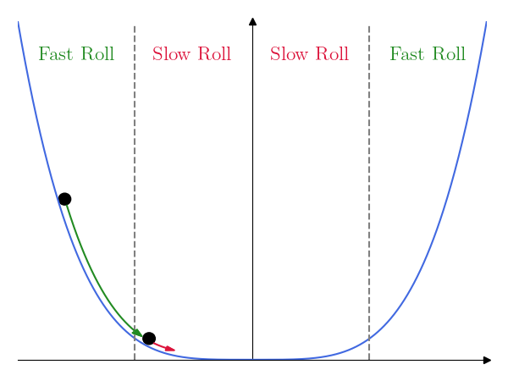
Schematic picture

Slide 4
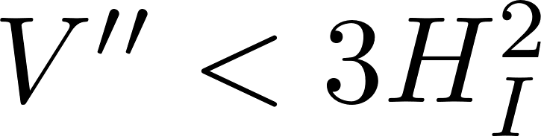
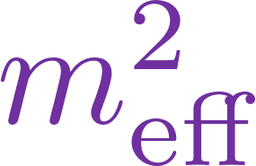
Schematic picture
Slow-roll condition:

Slide 5
Outline
Inflationary dynamics
Perturbations
Relic abundance

Slide 6
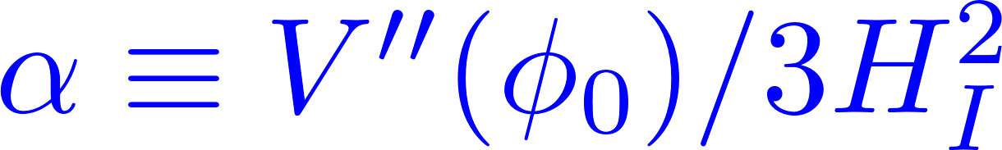
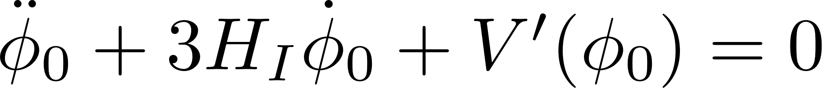
Inflationary dynamics
Suppose scalar dominated by condensate
Slow-roll parameter
Condensate satisfies

Slide 7

Inflationary dynamics (fast roll)
Suppose scalar dominated by condensate
Slow-roll parameter
Condensate satisfies
If initially , scalar oscillates and redshifts

Slide 8
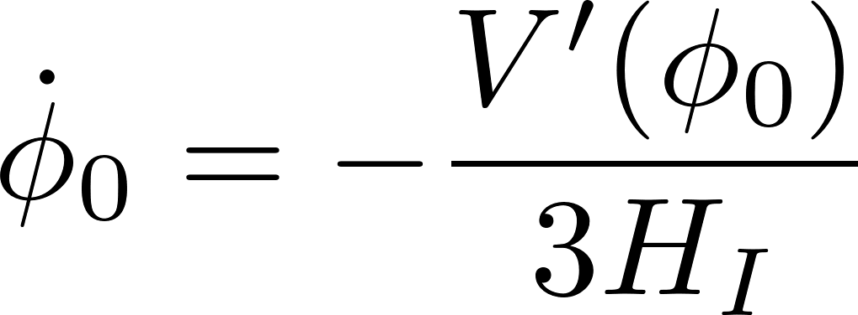
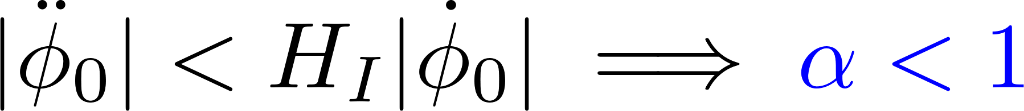

Inflationary dynamics (slow roll)
Suppose scalar dominated by condensate
Slow-roll parameter
Condensate satisfies
Slow-roll solution
Valid when
Slow roll leads to

Slide 9

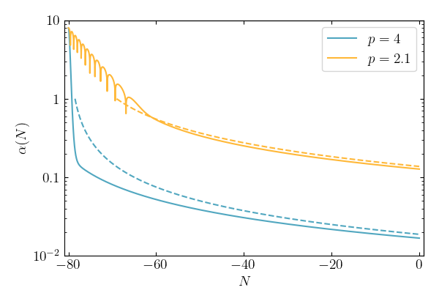
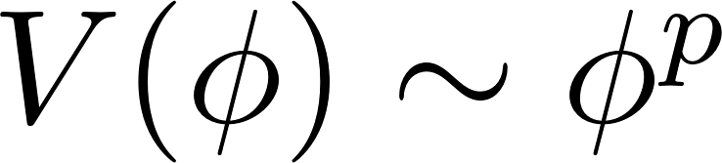
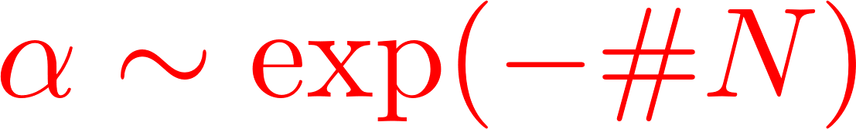
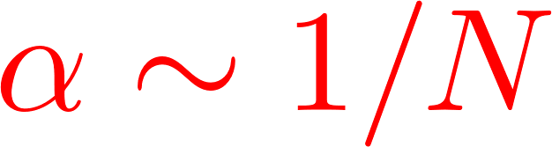

Evolution of
Coefficient generically ,
but can be large

Slide 10
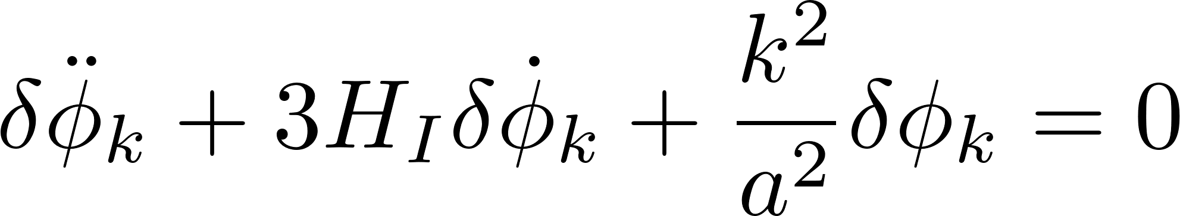
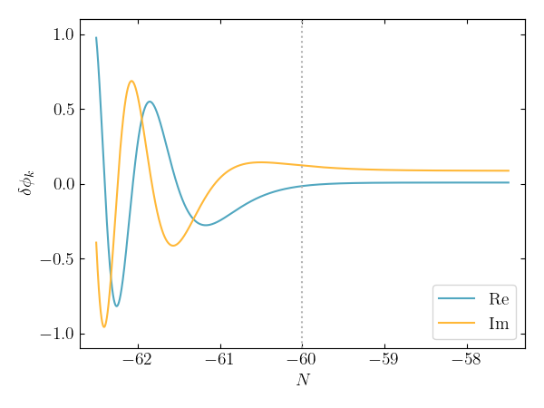
Perturbations (no potential)
Oscillate and decay
inside horizon
(Bunch-Davies)
Constant outside
horizon

Slide 11
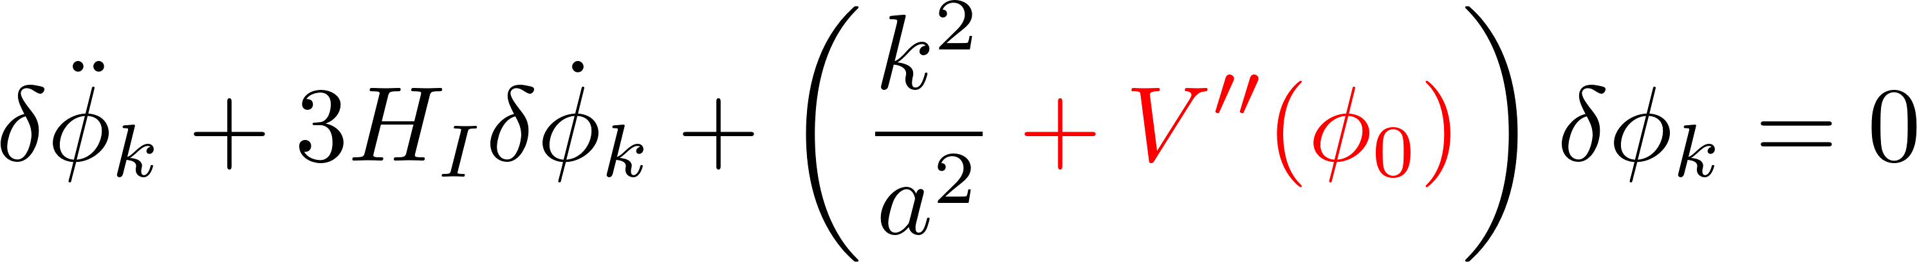
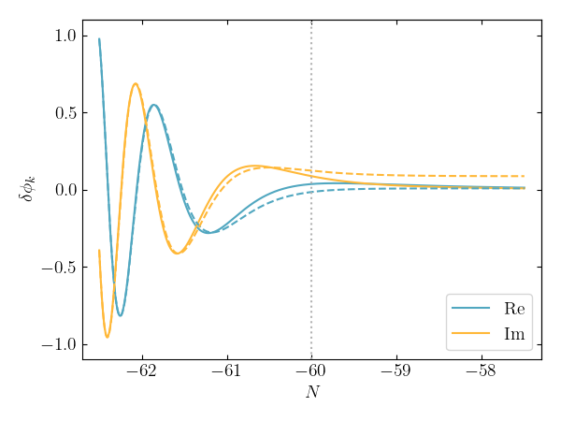
Perturbations (with potential)
Oscillate and decay
inside horizon
(Bunch-Davies)
Decays outside
horizon

Slide 12
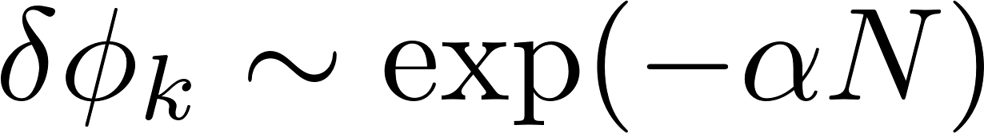
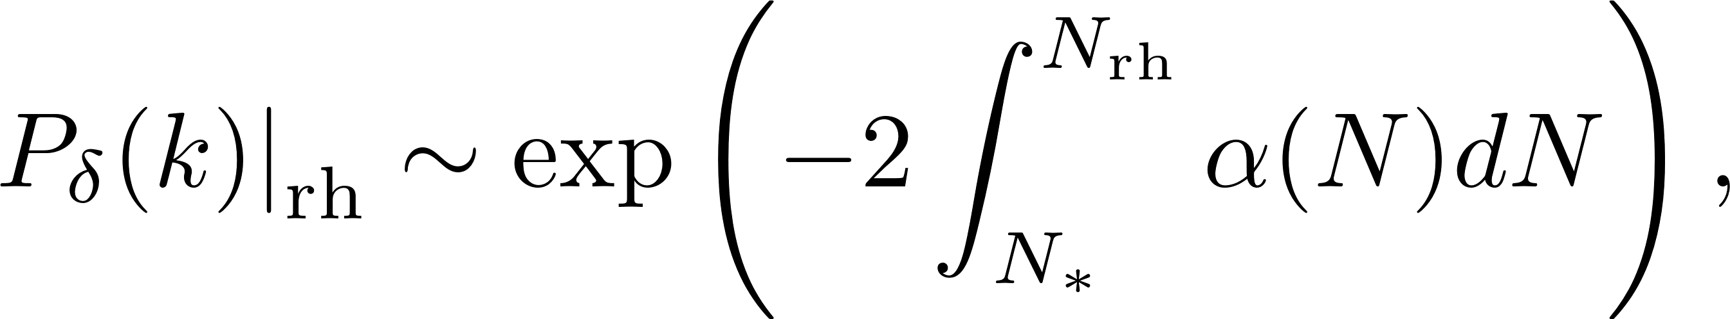

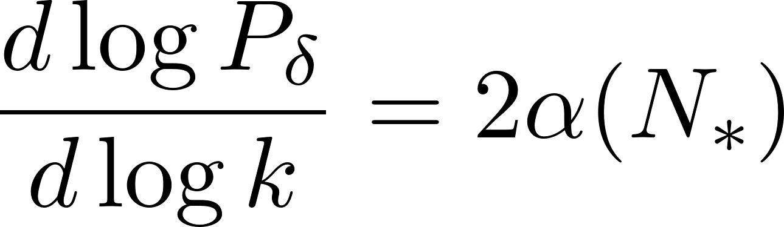
Spectral tilt
Potential causes decay outside horizon:
where denotes horizon crossing
Longer wavelength modes spend longer outside horizon → blue tilt!

Slide 13
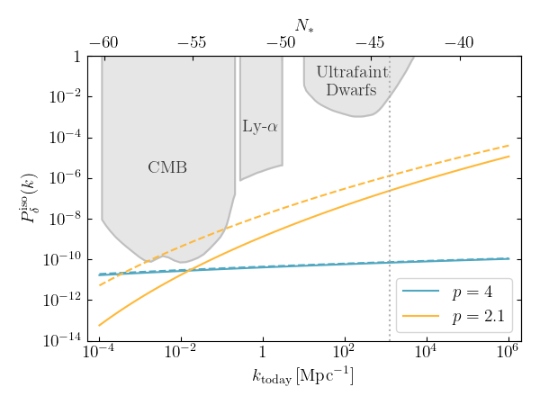
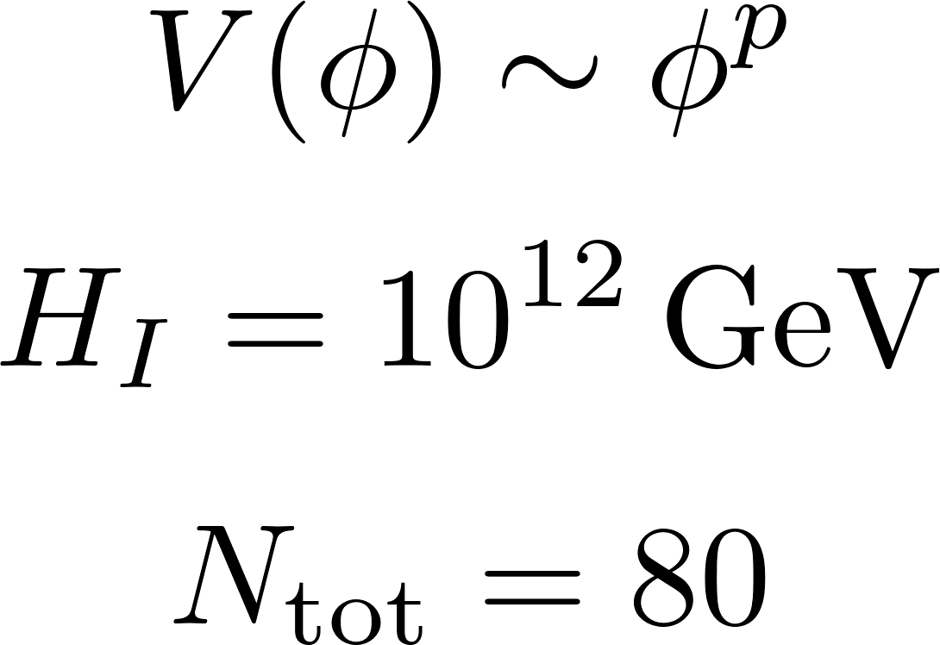

Isocurvature power spectrum
Larger ,
larger tilt!

Slide 14

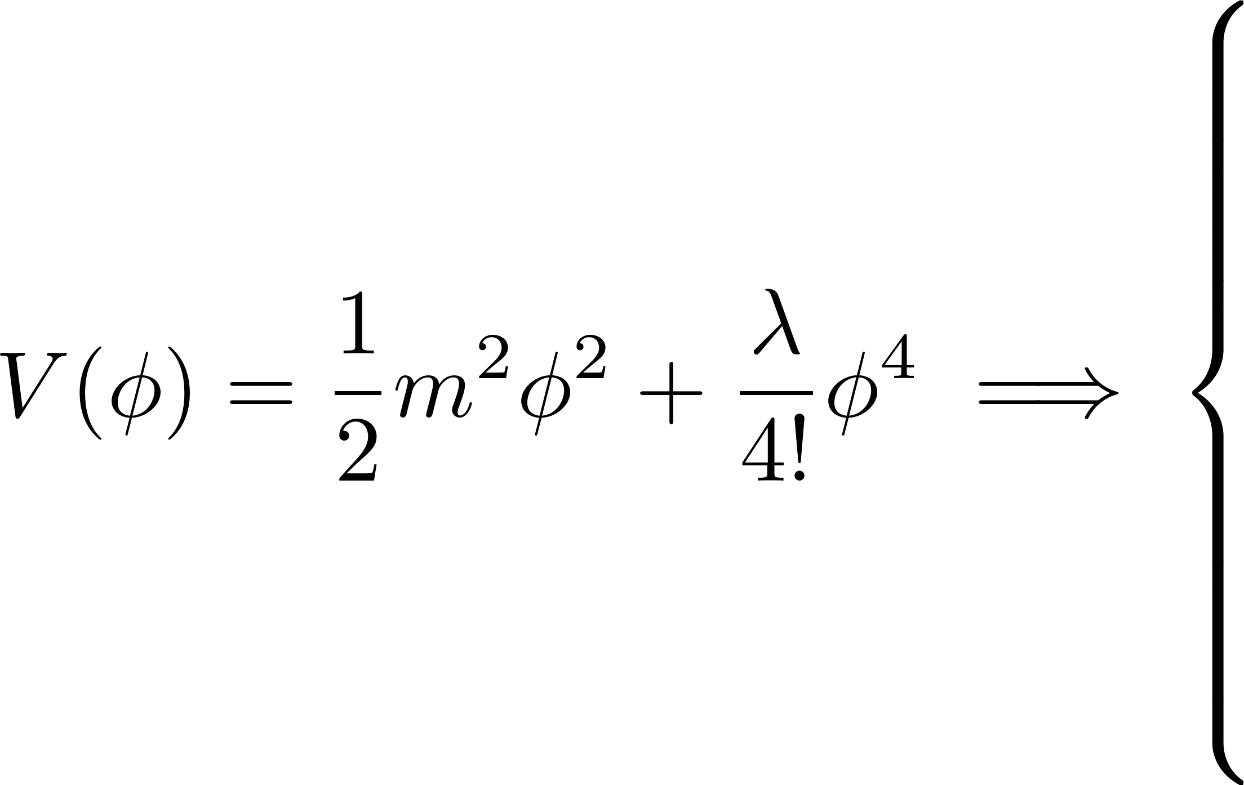
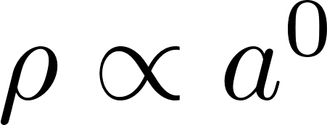
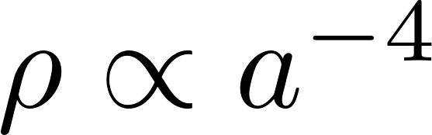
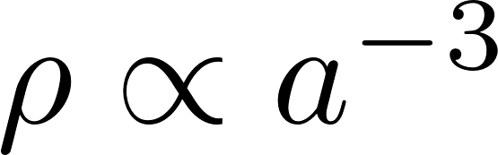
Relic abundance
If long-lived, energy density redshifts in phases:
Final abundance independent of initial conditions (for fixed
inflationary parameters)
[frozen]
[quartic]
[matter]
potential
dependent

Slide 15
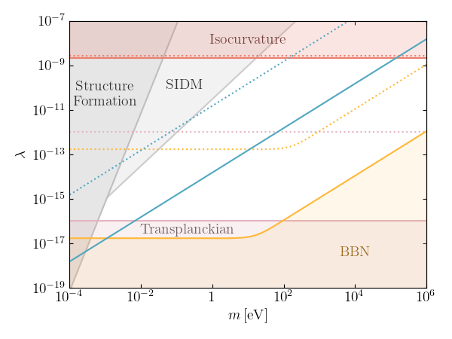
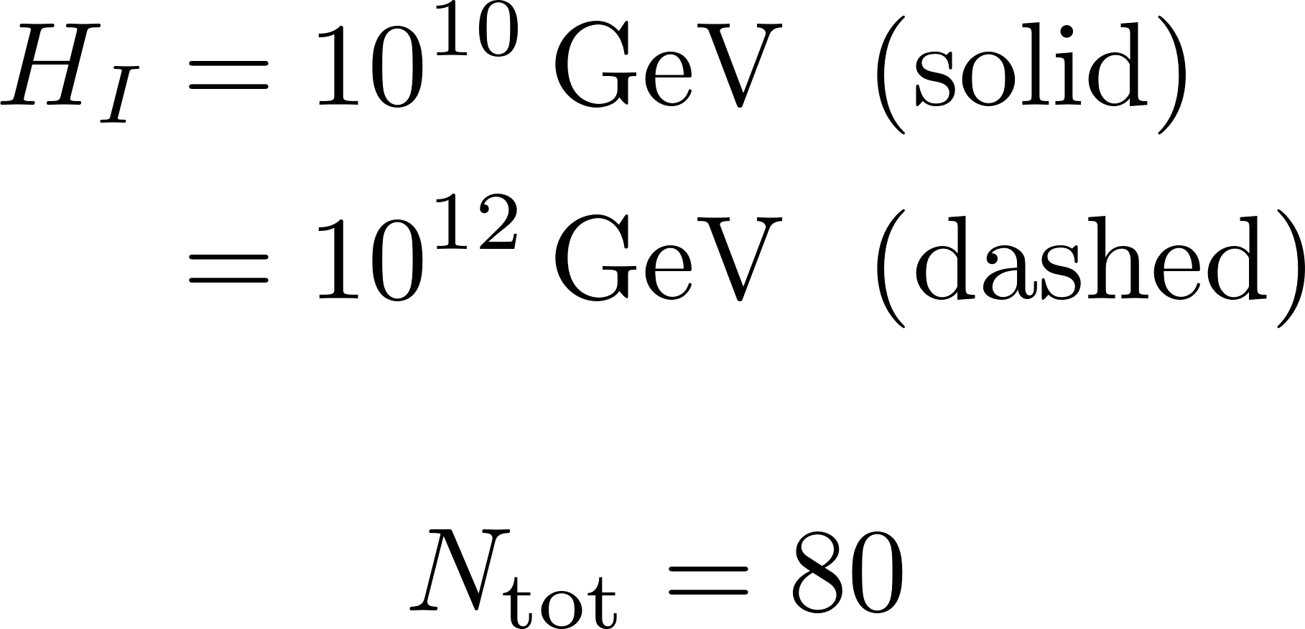
Quartic dark matter
*assumes instantaneous reheating

Slide 16
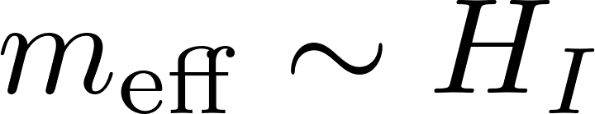
Conclusion
If scalar has potential and inflation not too long, generic blue-tilted isocurvature!
Scalar spends most of inflation near slow-roll boundary, where
Enhanced isocurvature on small scales → GWs or non-Gaussianities
If scalar long-lived, relic abundance is predictable
Quartic scalar can be all of DM with well-defined parameter space target!

Slide 17
Backup Slides

Slide 18
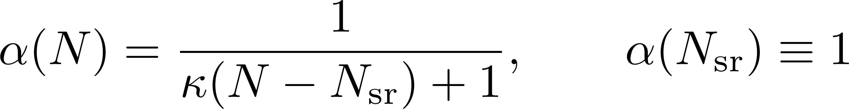
Slow-roll solution
During slow roll, condensate EOM can be written as
Solved by

Slide 19
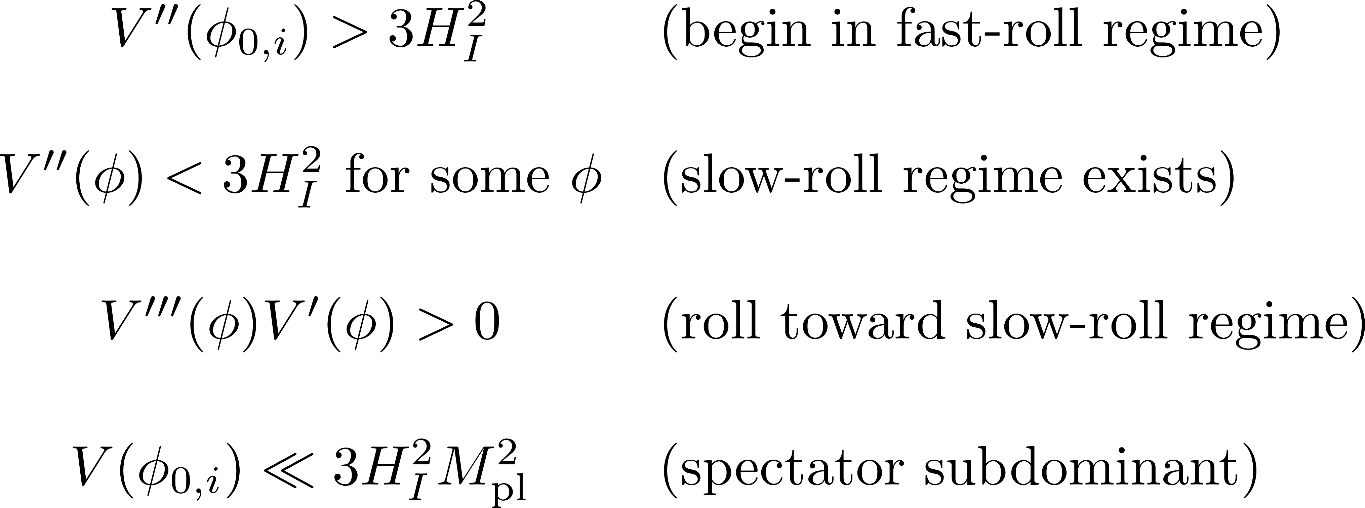
Necessary conditions

Slide 20
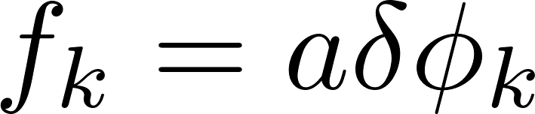
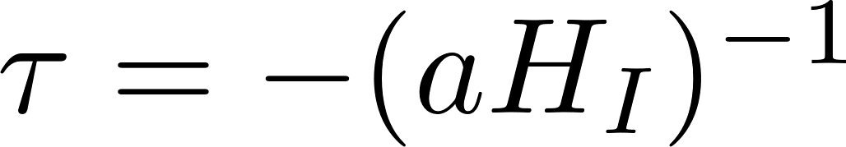
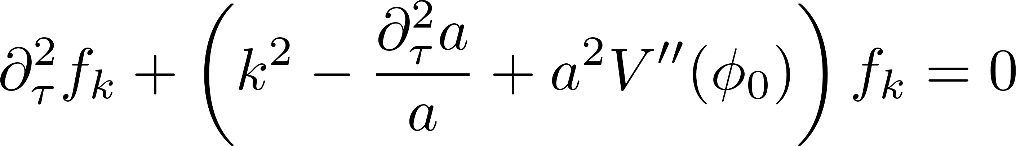
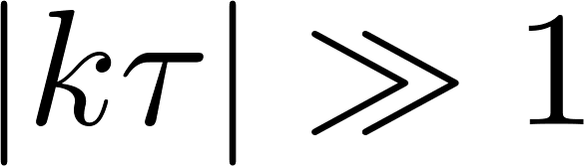

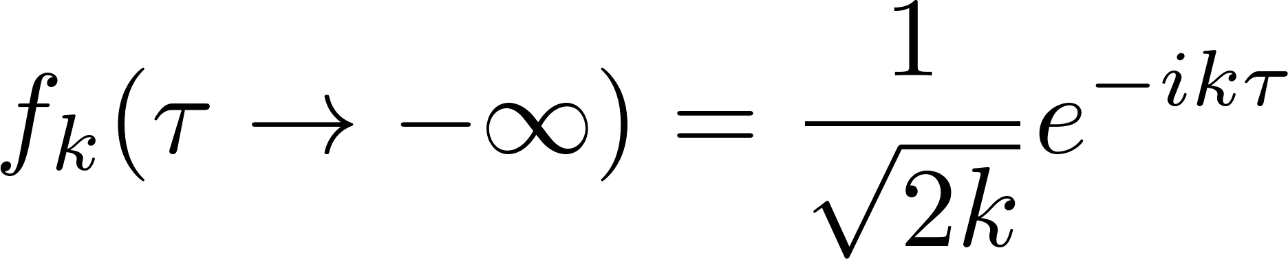
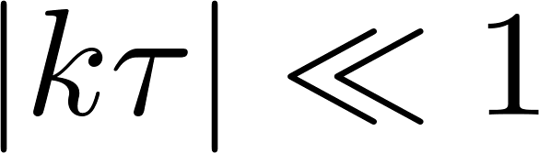
Perturbation solution
In terms of and , perturbation EOM becomes
For , harmonic oscillator of frequency
Bunch-Davies initial conditions
For ,

Slide 21
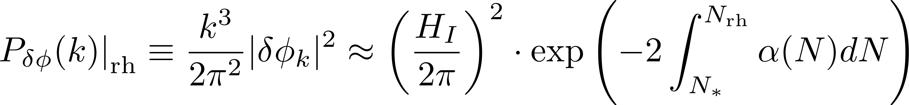
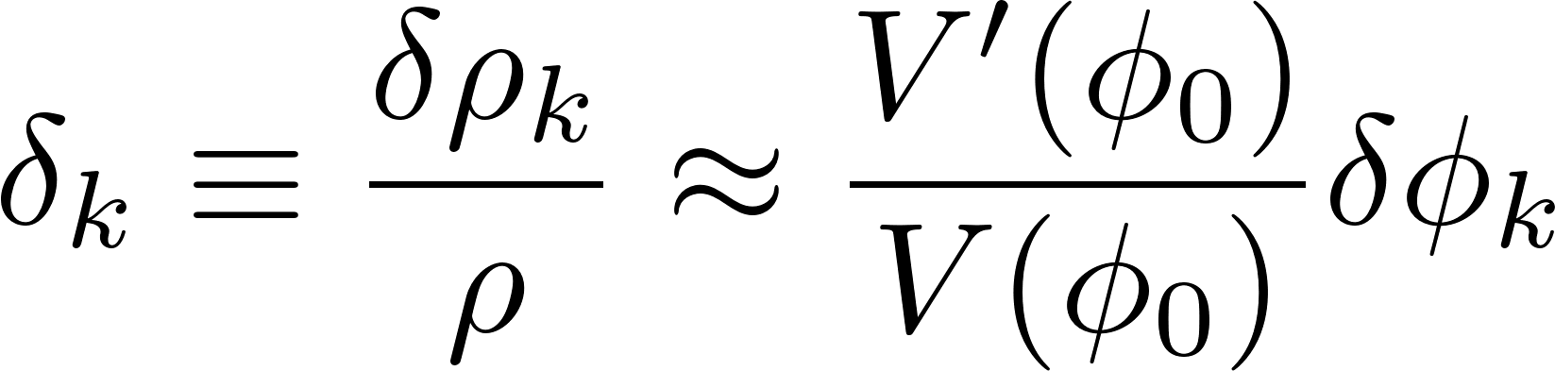
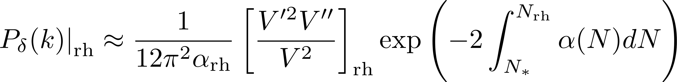
Power spectrum
Spectrum of field fluctuations (at reheating)
Related to density perturbations by
Spectrum of density perturbations (at reheating)

Slide 22
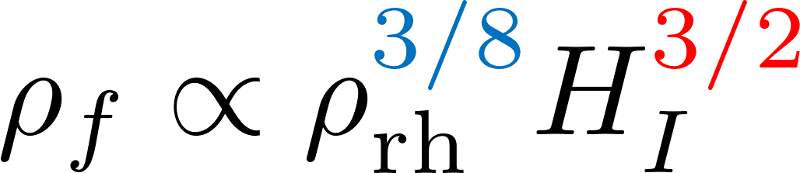
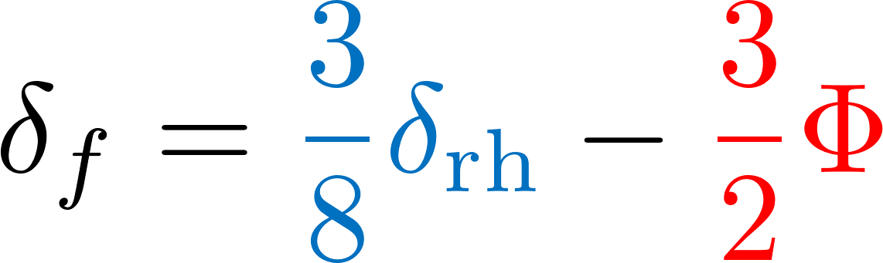
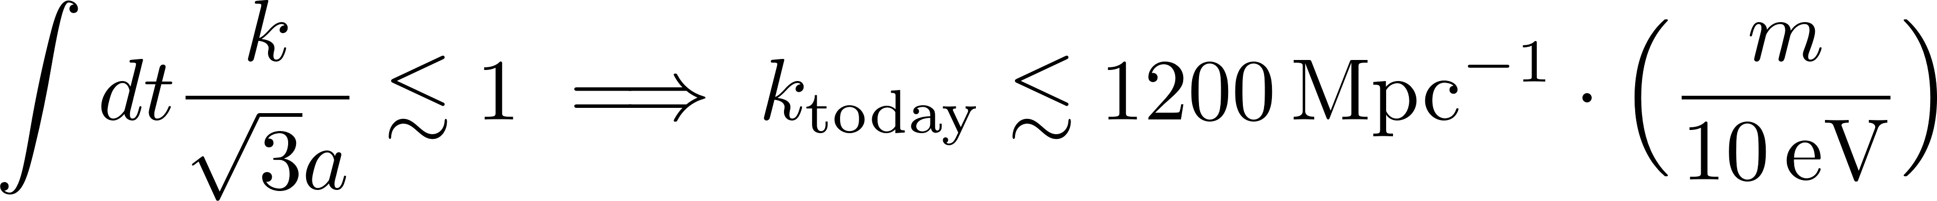
Late-time evolution
“Separate universes”: each patch undergoes same dynamics as zero mode
Relic abundance calculation gives
Final perturbations consist of isocurvature + adiabatic
Applies for long-wavelength modes

