Slide 1







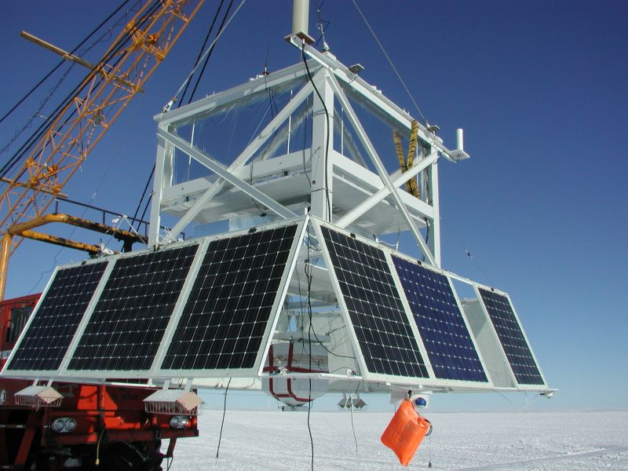
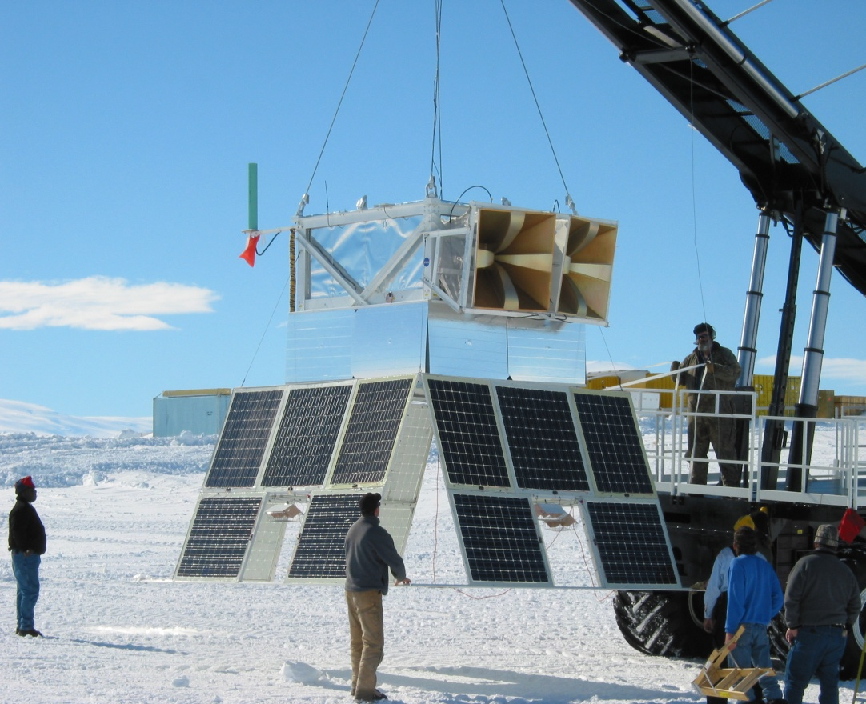
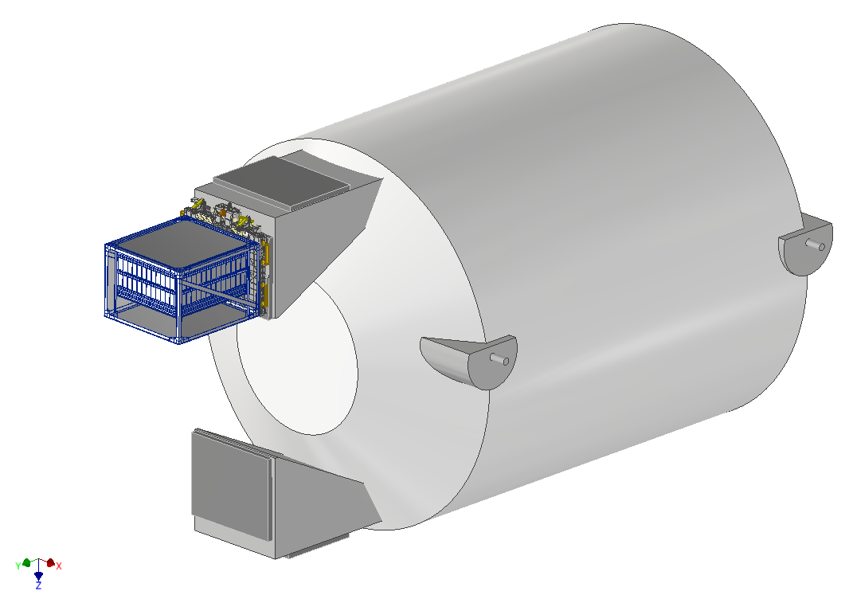
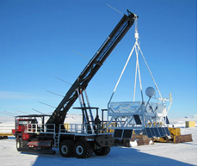
Ultra-Heavy Galactic Cosmic Ray Measurements with TIGERs
Brian Flint Rauch
November 4, 2025
TIGER: Trans-Iron Galactic Element Recorder
SuperTIGER: Super Trans-Iron Galactic Element Recorder
TIGERISS: Trans-Iron Galactic Element Recorder for the International Space Station
TIGER
2001 for 32 days & 2003 for 18 days
SuperTIGER
2012 for 55 days & 2019 for 32 days
TIGERISS Columbus-SOX Payload
September 2027 launch

Slide 2
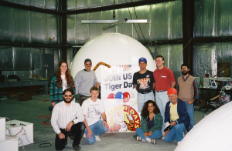
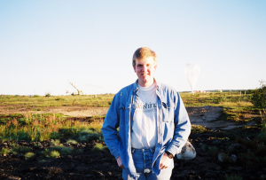
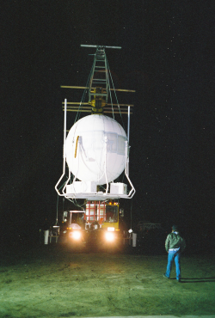
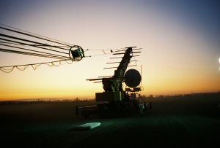
TIGER Collaboration
1995/1996: Lynn Lake, MB, Canada
Washington University in St. Louis: J.J. Beatty, W.R. Binns, D.J. Crary, D.J. Ficnec, P.L. Hink, J. Klarmann, D.J. Lawrence, B.F. Rauch
Goddard Space Flight Center: L.M. Barbier, E.R. Christian, K.E. Krombel, J.W. Mitchell, R.E. Streitmatter
University of Minnesota: C.J. Waddington
1997: Ft. Sumner, NM
TIGERISS Team Members
Washington University in St. Louis: W.R. Binns, J.R. Cummings, P.L. Hink, M.H. Israel, S.H. Sposato
California Institute of Technology: G.A. de Nolfo, R.A. Mewaldt, S.M Schindler
Goddard Space Flight Center: L.M. Barbier, E.R. Christian, J.W. Mitchell, R.E. Streitmatter
University of Minnesota: C.J. Waddington

Slide 3
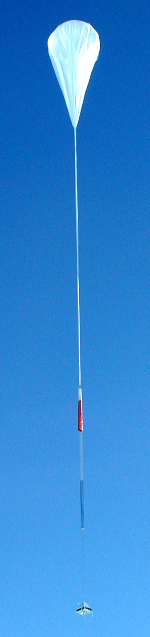
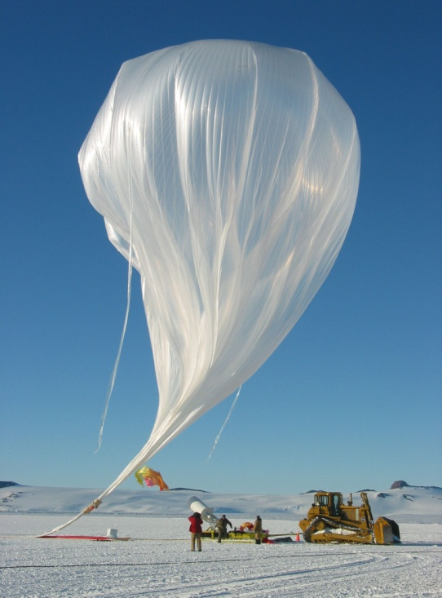
TIGER-LDB Collaboration
Washington University in St. Louis B.F. Rauch, W.R. Binns, J.R. Cummings, M.H. Israel, K. Lodders, L.M. Scott
California Institute of Technology S. Geier, R.A. Mewaldt, S.M Schindler, E.C. Stone
Goddard Space Flight Center L.M. Barbier, E.R. Christian, J.W. Mitchell, J.T. Link, G.A. de Nolfo, R.E. Streitmatter
Jet Propulsion Laboratory M.E. Wiedenbeck
University of Minnesota C.J. Waddington
Trans-
Iron
Galactic
Element
Recorder
TIGERISS team members
This work was supported by NASA under grant NNG05WC04G, and by the Graduate School of Arts and Sciences at Washington University in St. Louis with a Dean’s Dissertation Fellowship.

Slide 4
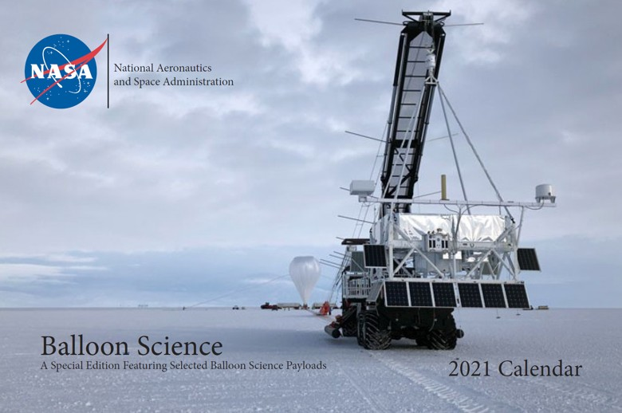
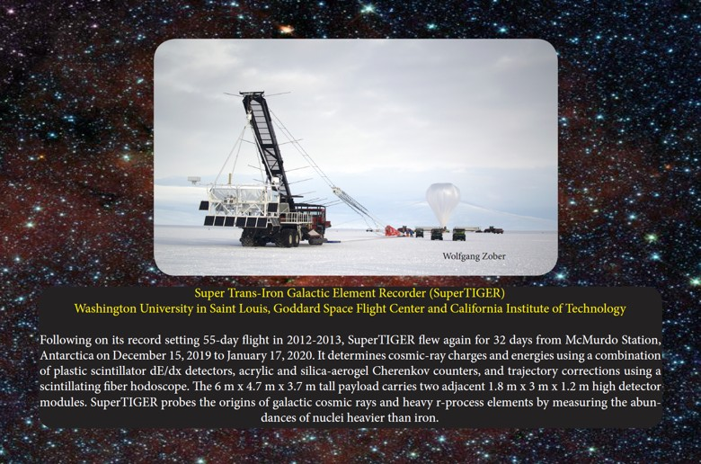
GCR Measurements with
Balloon Experiments
Economical access to near space for large payloads up to ~6,000 lbs, possible reflight.
Student involvement spanning entire project life and include many project roles.

Slide 5





SuperTIGER Collaboration
Y. Akaike^{2,5}, W.R. Binns¹, R.G. Bose¹, T.J. Brandt², D.L. Braun¹, N. Cannady^{2,5}, W.M. Daniels², P.F. Dowkontt¹, S.P. Fitzsimmons², D.J. Hahne², T. Hams², M.H. Israel¹, J.F. Krizmanic², A.W. Labrador³, R.A. Mewaldt³, J.W. Mitchell², R.P. Murphy¹, G.A. De Nolfo², S. Nutter⁶, M.A. Olevitch¹, N.E. Osborn¹, B.F. Rauch¹, K. Sakai^{2,5}, F. San Sebastian², M. Sasaki^{2,5}, G.E. Simburger¹, T. Tatoli², N.E. Walsh¹, J.E. Ward¹, M.E. Wiedenbeck⁴, W.V. Zober¹
Washington University, St. Louis, MO 63130, USA
NASA/Goddard Space Flight Center, Greenbelt, MD 20771, USA
California Institute of Technology, Pasadena, CA 91125, USA
Jet Propulsion Laboratory, California Institute of Technology, Pasadena, CA 91109, USA
Center for Research and Exploration in Space Science Technology (CRESST)
Northern Kentucky University, Newport, KY 41099, USA

Slide 6
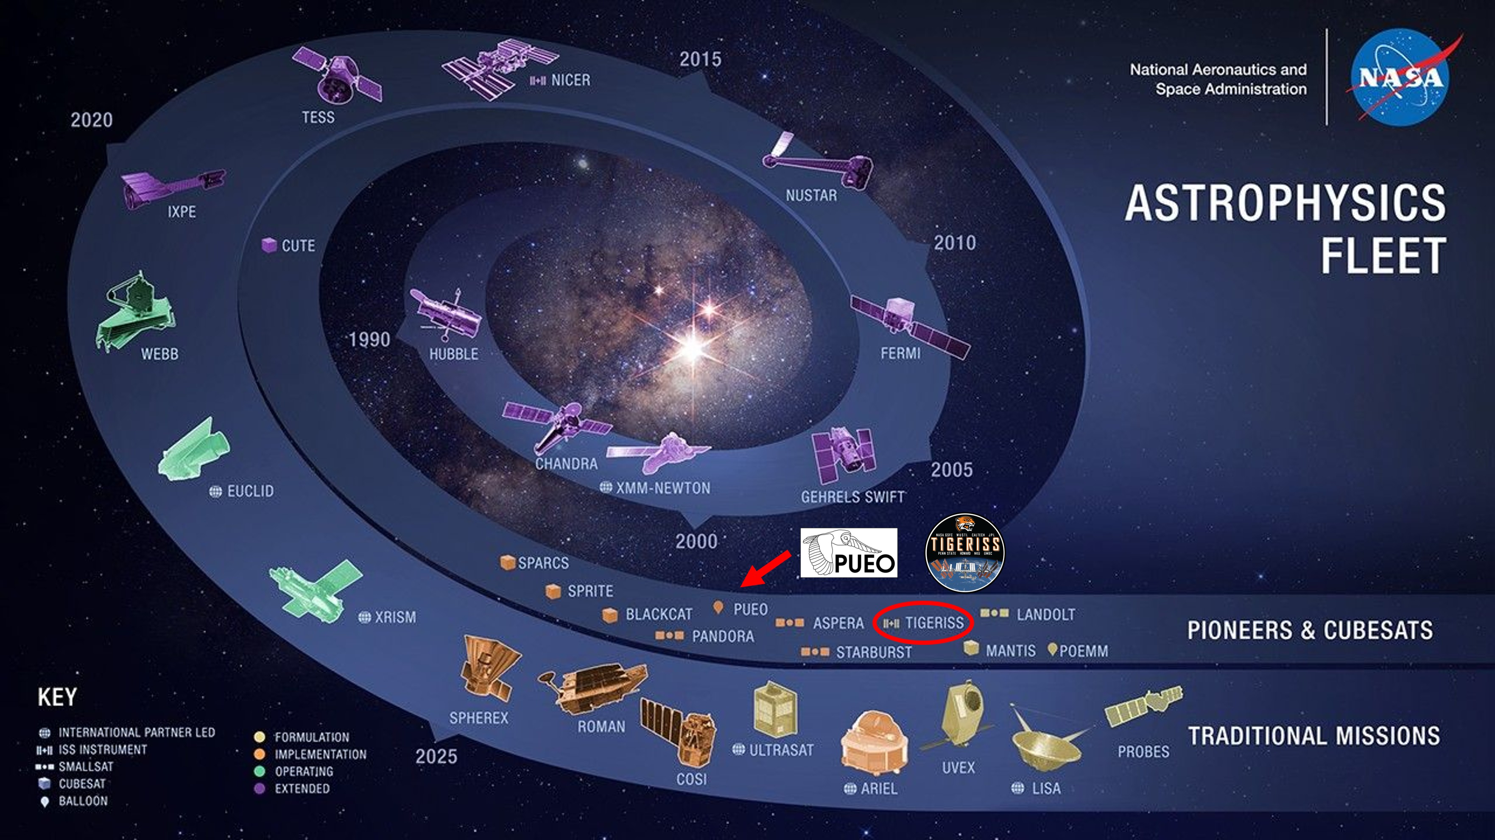
TIGERISS – ISS Pioneers Mission

Slide 7
TIGERISS Collaboration
Trans-Iron Galactic Element Recorder for the International Space Station
H. Allen,¹ R. F. Borda,² R. G. Bose,³ D. L. Braun,³ J. Calderon,⁴ Z. Campbell,⁵ N. W. Cannady,⁶ R. M. Caputo,⁶ M. Clark,⁷ J. Coldsmith,⁸ S. Coutu,¹ G. A. de Nolfo,⁹ T. Forstmeier,¹ M. Fratta,⁵ P. Ghosh,^{2, 6, 10} S. Graham,⁸ S. Jones,⁴ J. F. Krizmanic,⁶ W. Labrador,³ L. Lisalda,³ J. V. Martins,² M. P. McPherson,⁷ J. G. Mitchell,⁹ J. W. Mitchell,⁶ S. I. Mognet,¹ A. Moiseev,^{11, 6, 10} T. L. Ng,⁵ S. Nutter,⁴ N. Osborn,³ M. Pant,⁴ I. M. Pastrana,³ D. Radomski,³ B. F. Rauch,³ H. Salmani,⁷ M. Sasaki,^{11, 6, 10} G. E. Simburger,³ S. Smith,⁷ H. A. Tolentino,⁷ Y. Tufail,⁵ D. Washington,¹ T. Widmyer,⁵ L. Williams,⁸ W. V. Zober,³
1) Pennsylvania State University
2) University of Maryland, Baltimore County
3) Department of Physics and McDonnell Center for the Space Sciences, Washington University in St. Louis
4) Northern Kentucky University
5) NASA Wallops Flight Center
6) NASA Goddard Space Flight Center, Astrophysics Science Division
7) Howard University
8) NASA Goddard Space Flight Center
9) NASA Goddard Space Flight Center, Heliophysics Science Division
10) Center for Research and Exploration in Space Sciences and Technology II
11) University of Maryland, College Park

Slide 8
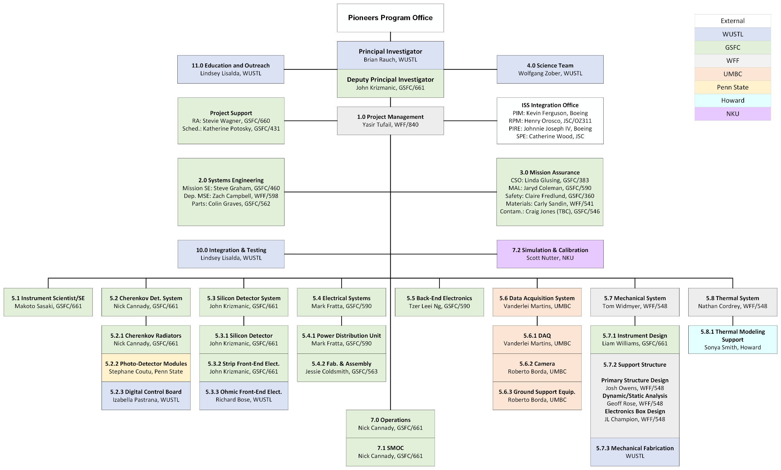
TIGERISS Collaboration Org Chart

Slide 9
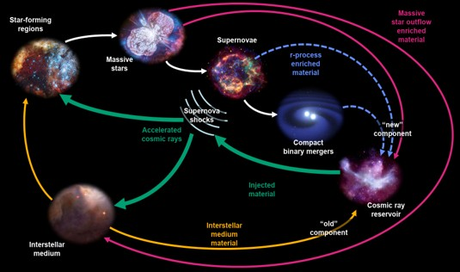
Cosmic Rays in the Grand Cycle of Matter
The overall TIGERISS mission goal is to increase our understanding of how the Galaxy produces and distributes the elements. These goals come from the NASA decadal survey’s questions:
Where is main site of r-process nucleosynthesis?
How the “injection of energy, momentum, and metals from stars” circulates matter?

Slide 10
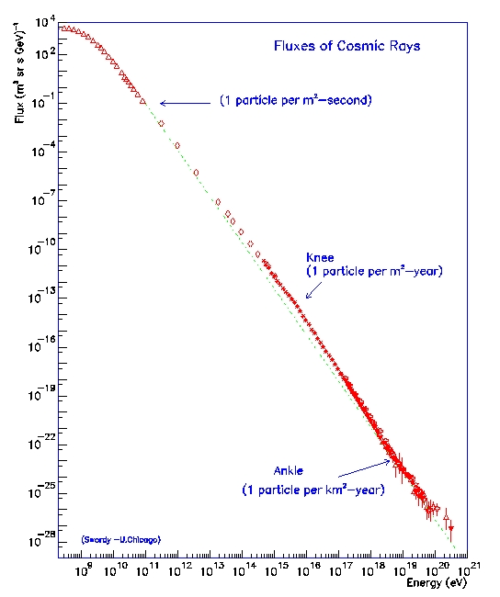
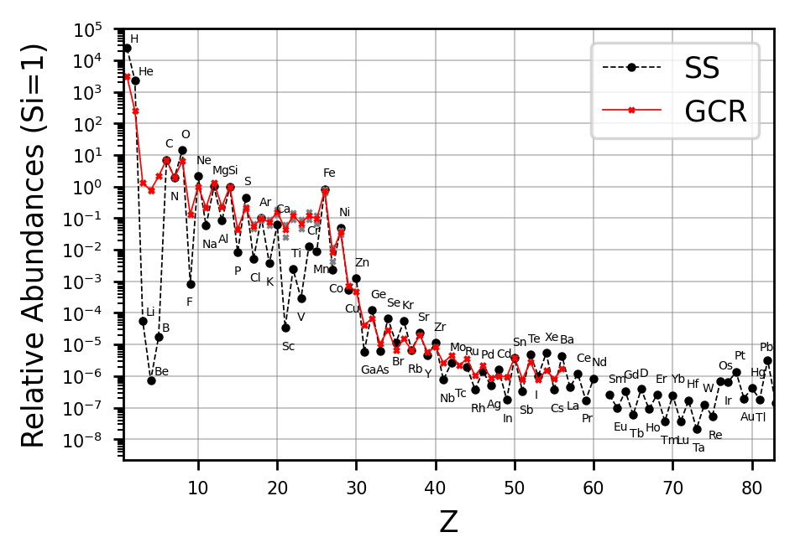

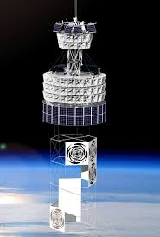
Ultra-Heavy Galactic Cosmic Rays (UHGCRs)
Extra- Galactic?
CALET
ANITA/
PUEO
SuperTIGER
TIGERISS
SuperTIGER
TIGERISS
Christoph Welling: Prospects for UHE neutrino flavor measurements with PUEO 05/11/2025, 15:15, Room 1.1+1.2, ADEIT

Slide 11
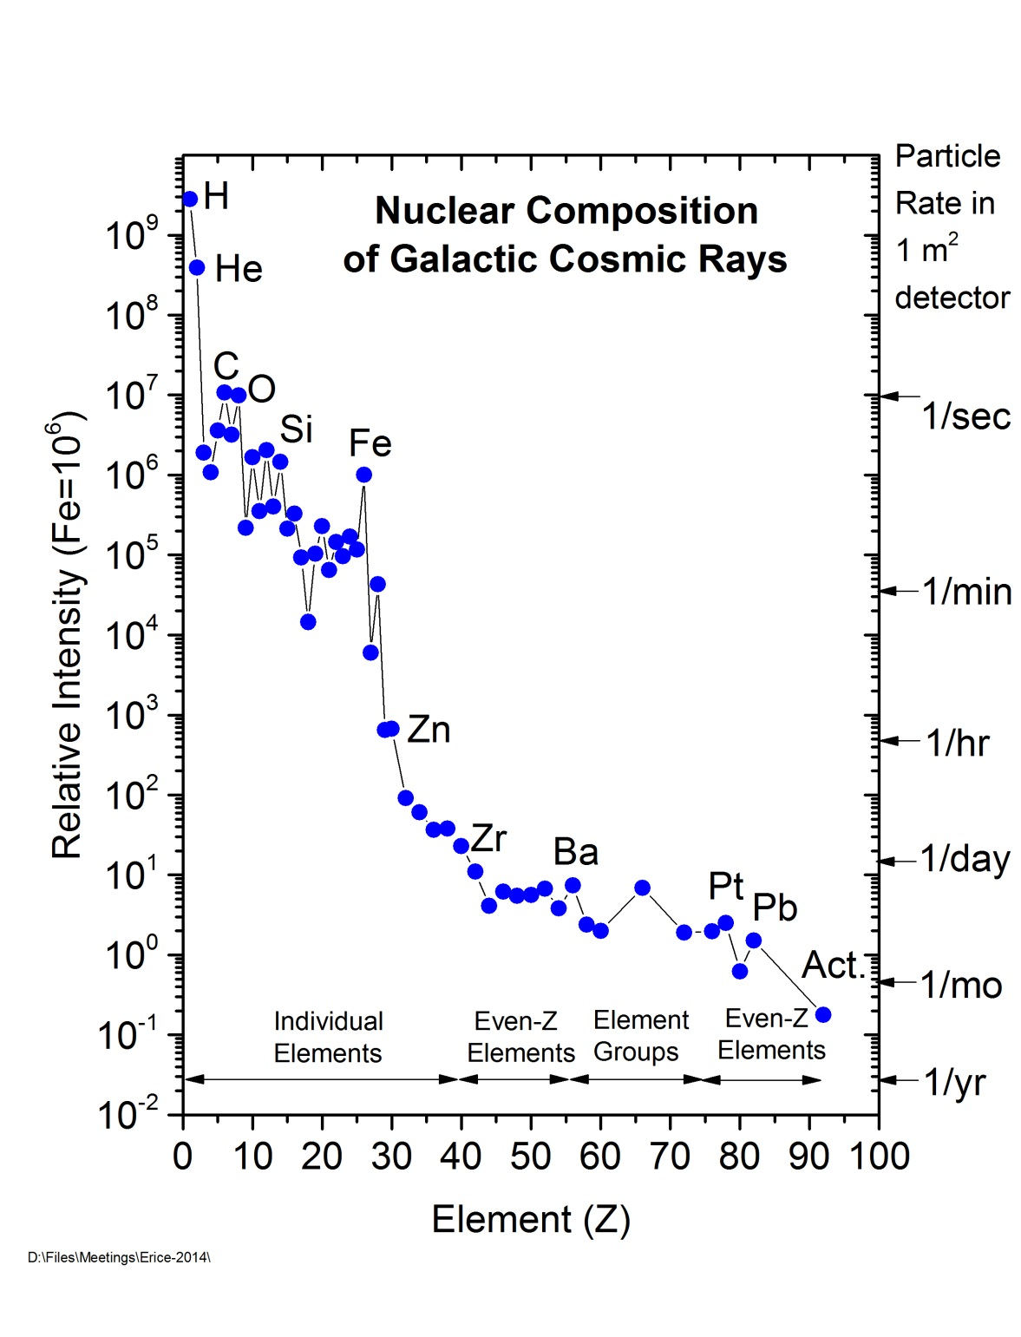

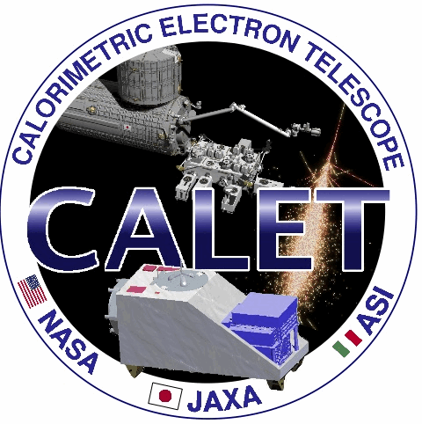
Cosmic Rays and Atomic Number
Relative abundances depend on nucleosynthetic sources
Big Bang: ₁H and ₂He
Fusion: up to ₂₆Fe
r- and s-process neutron capture: past ₂₆Fe
Cosmic-ray spallation: ₃Li, ₄Be, and ₅B
What source for s-process neutron capture versus atomic number
Massive star outflow prior to supernovae
?
What source for r-process neutron capture versus atomic number
Supernovae (SNe)
Compact binary merger (CBM), e.g., binary neutron star mergers (BNSM)
?
TIGERISS
HEAO-3-HNE
ACE-CRIS
CALET
SuperTIGER

Slide 12
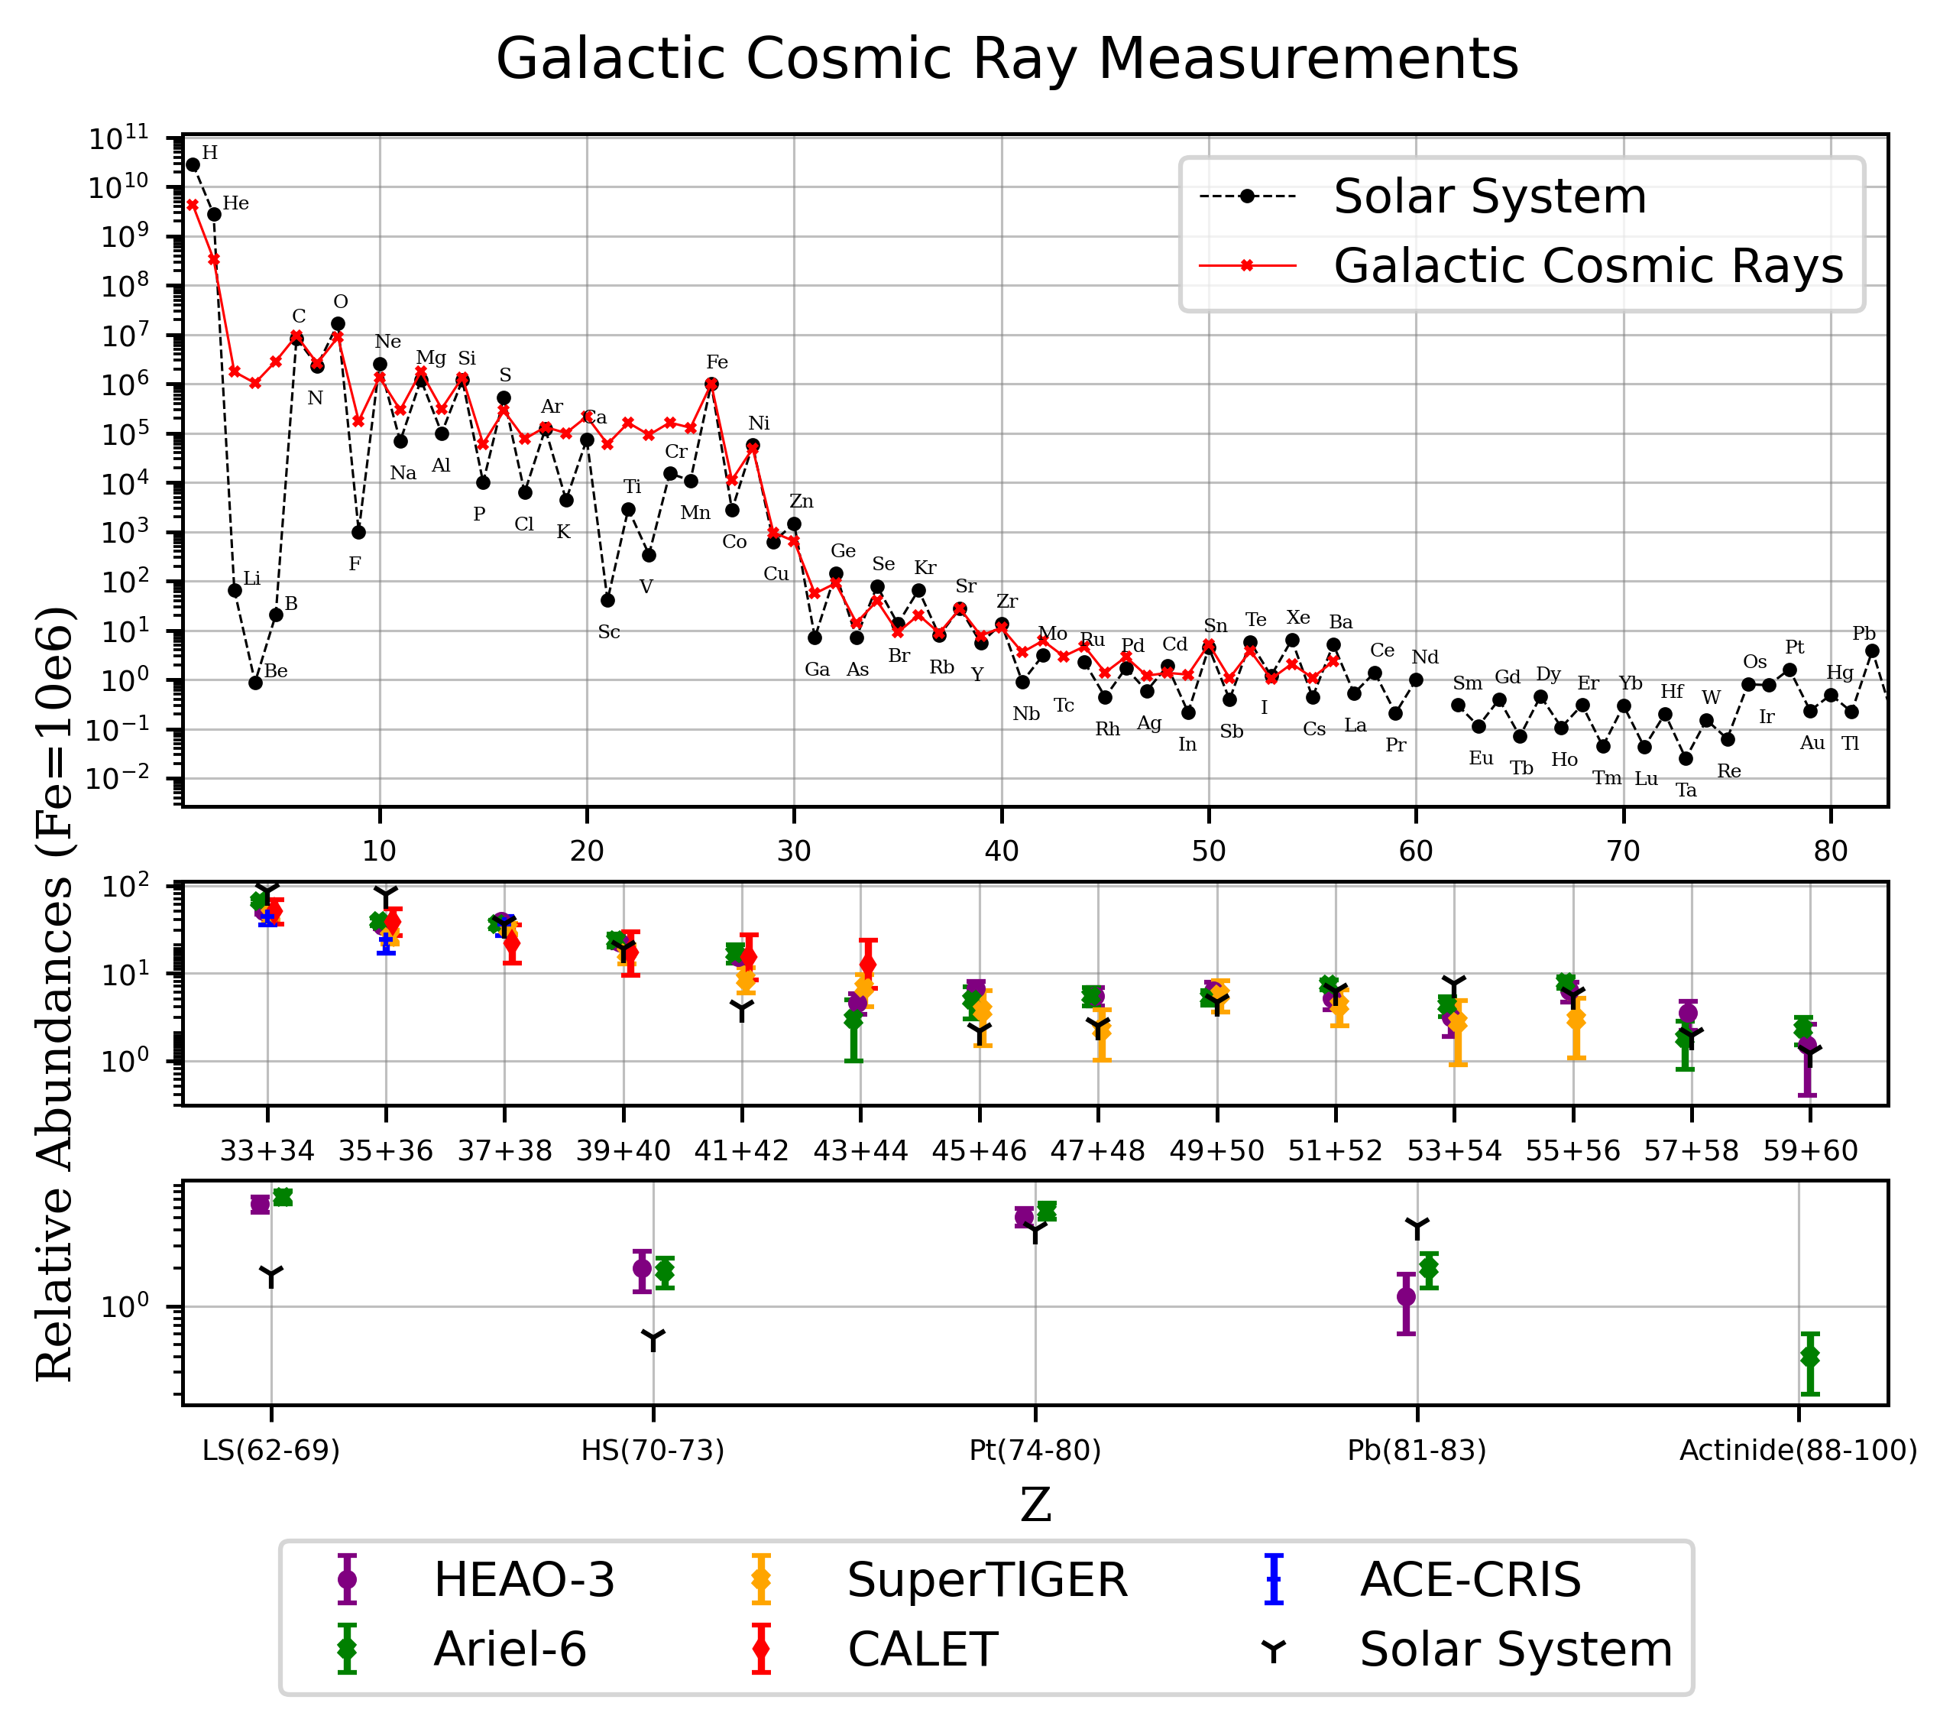
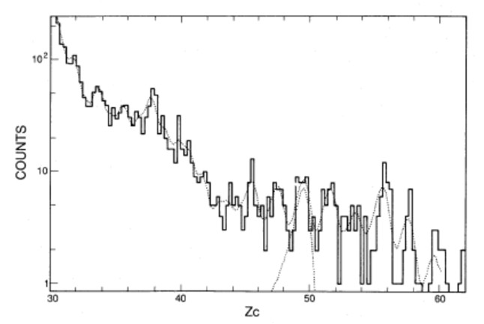
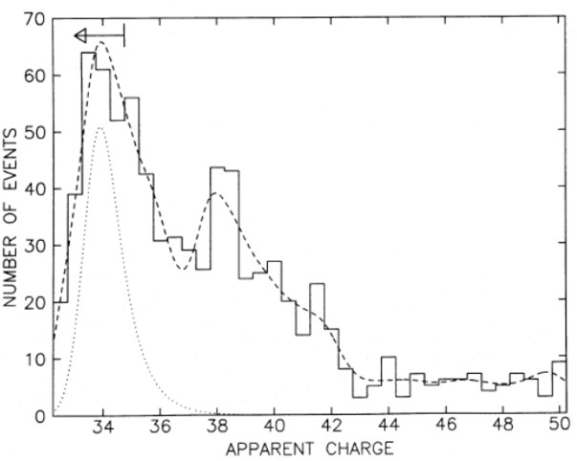
Previous Ultra-Heavy Cosmic Ray Results
HEAO-HNE
Ariel 6

Slide 13
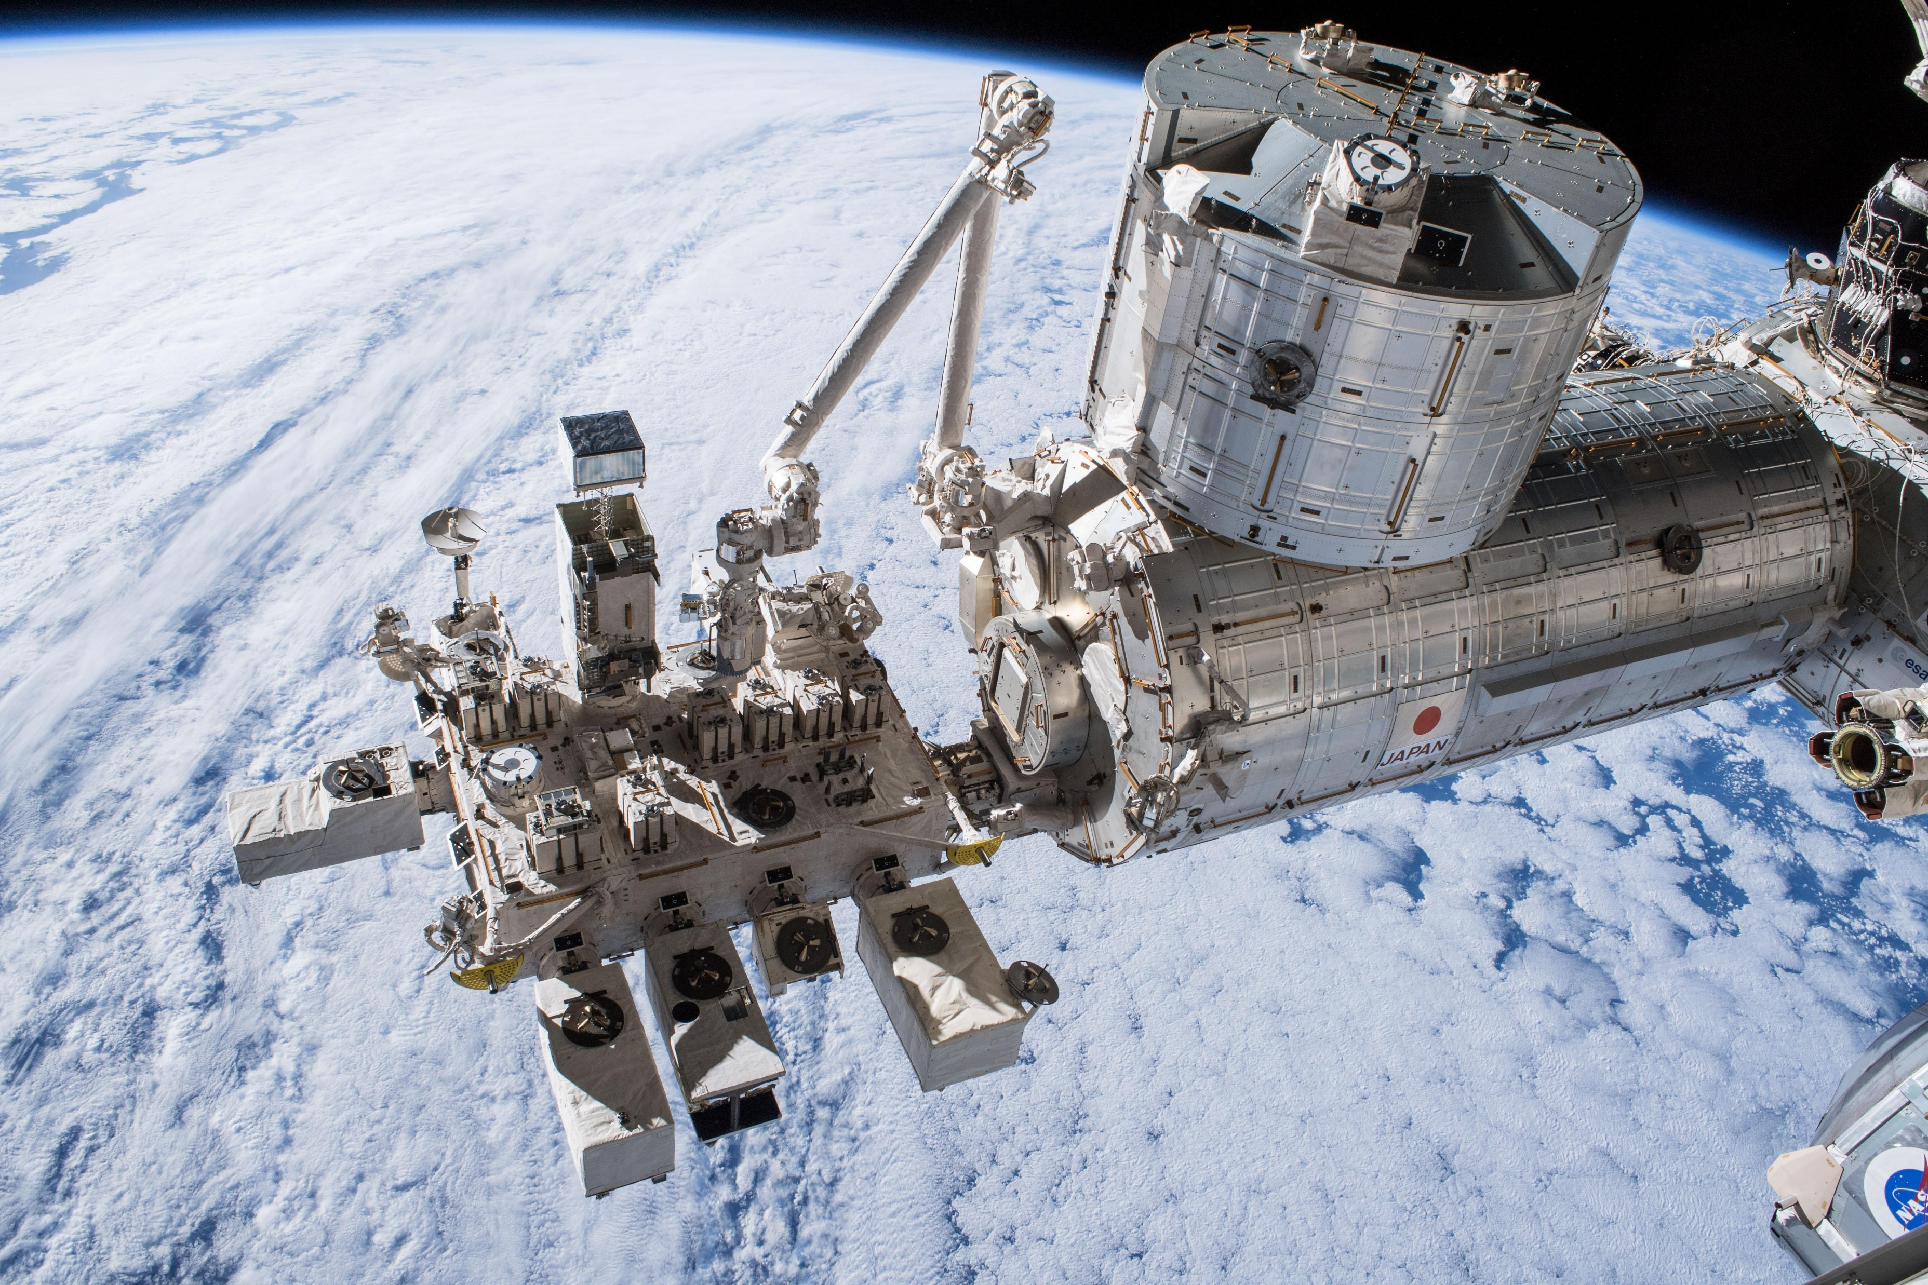
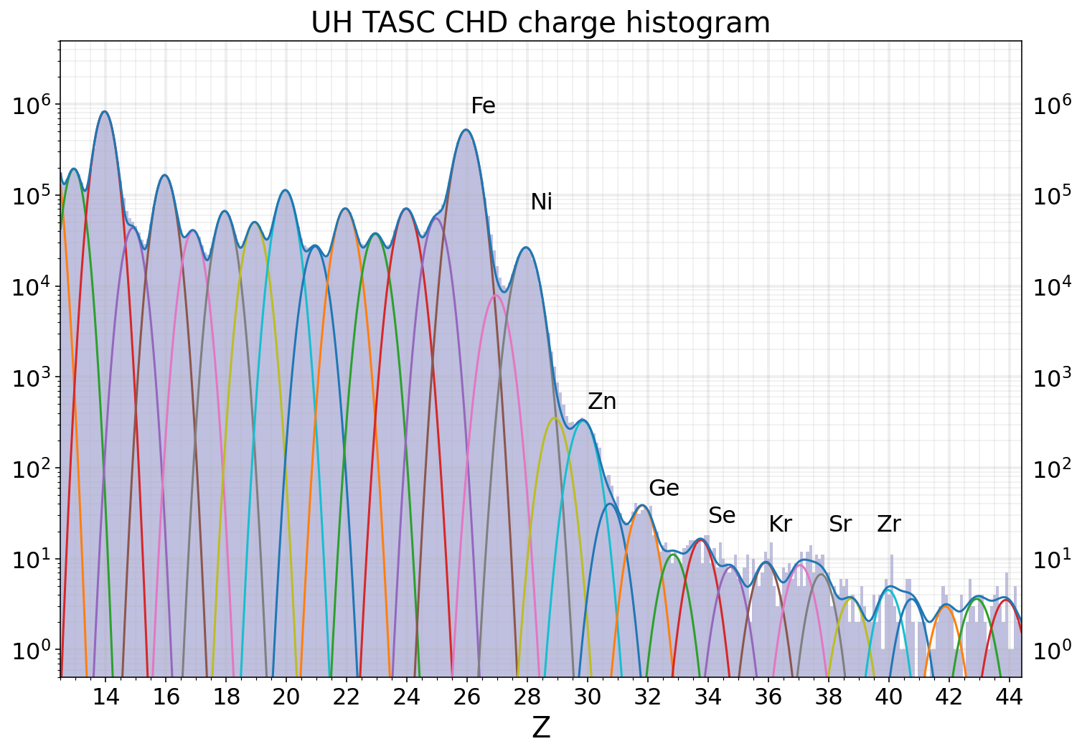
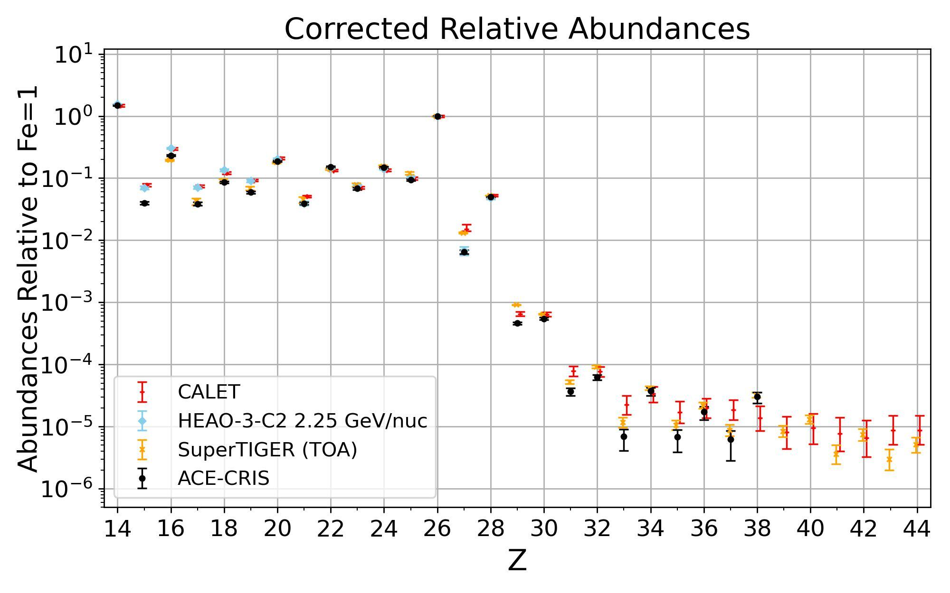

Calorimetric Electron Telescope (CALET)
Yosui Akaike: A Decade of CALET Observations: Cosmic-Ray Results from the ISS
04/11/2025 14:45 Room 2.1+2.2, ADEIT
Wolfgang Zober
Detected Abundances of Nuclei Relative to ₂₆Fe for Elements ₁₄Si through ₄₄Ru with CALET on the International Space Station
2025ApJ...988..148A
DOI 10.3847/1538-4357/ade3cc
CALET

Slide 14
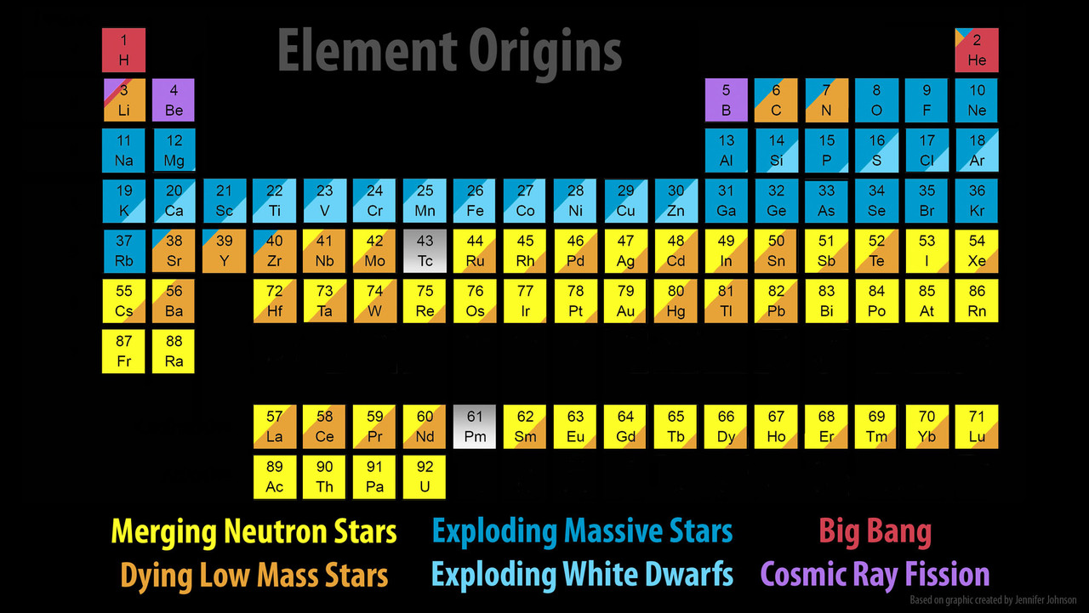
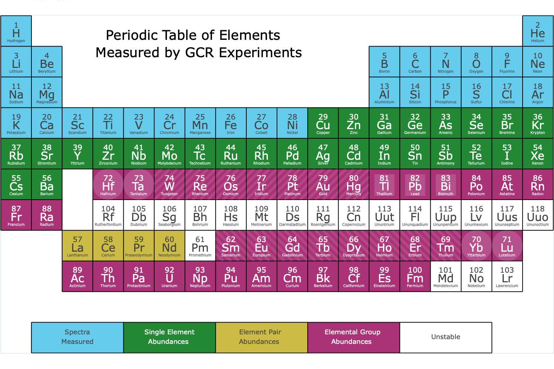
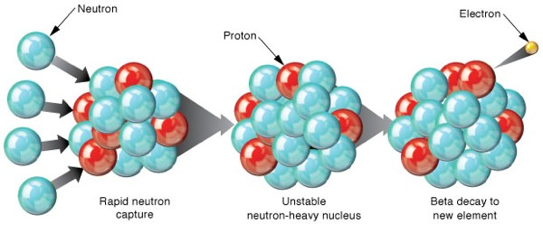
Nucleosynthesis vs. GCR Measurements
Explosive nucleosynthesis r-process AND/OR Neutron star merger r-process : signature in elemental ratios.
1 year of TIGERISS Data
₅₀Sn + ₅₆Ba (s-process: 63; r-process 19)
₅₂Te + ₅₄Xe (s-process: 12; r-process 60)
r-process neutron capture

Slide 15
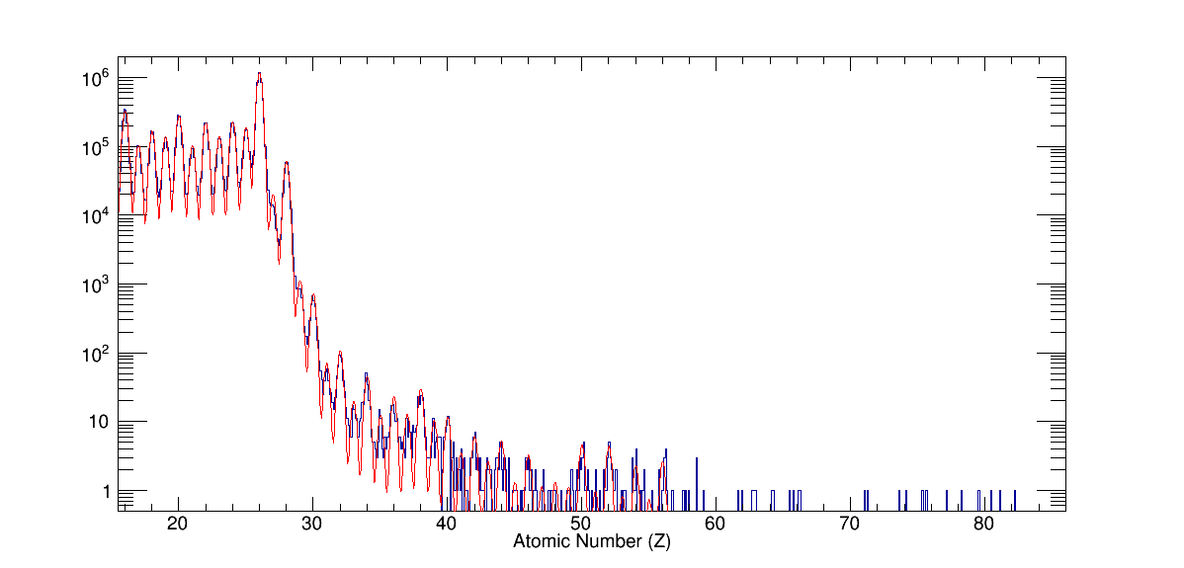
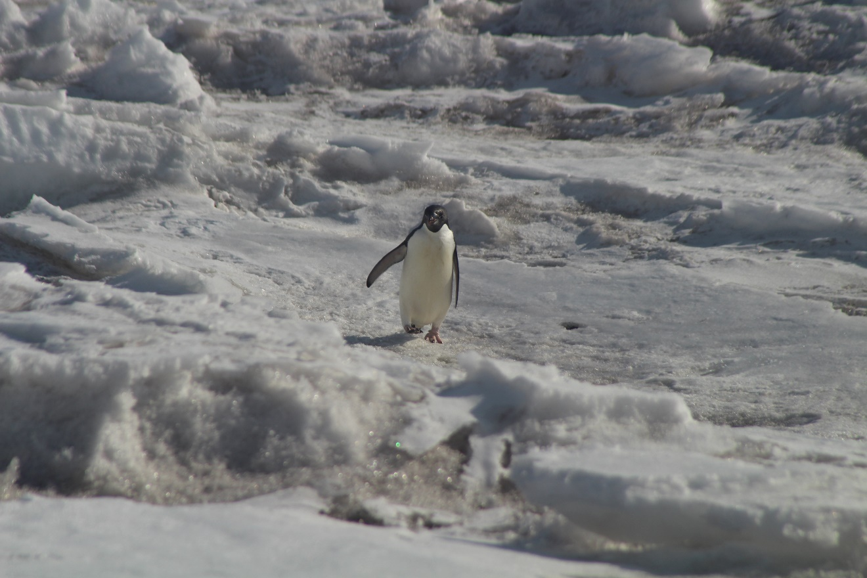
SuperTIGER Cosmic Ray Abundances
Record 55-day flight
~8 times the UHGCR data collected with the two TIGER flights
Best measurement of 30 ≤ Z ≤ 56
- Nathan Elliot Walsh, SuperTIGER Elemental Abundances for the Charge Range 41≤Z≤56, PhD thesis, Washington University in St. Louis, 2020.

Slide 16
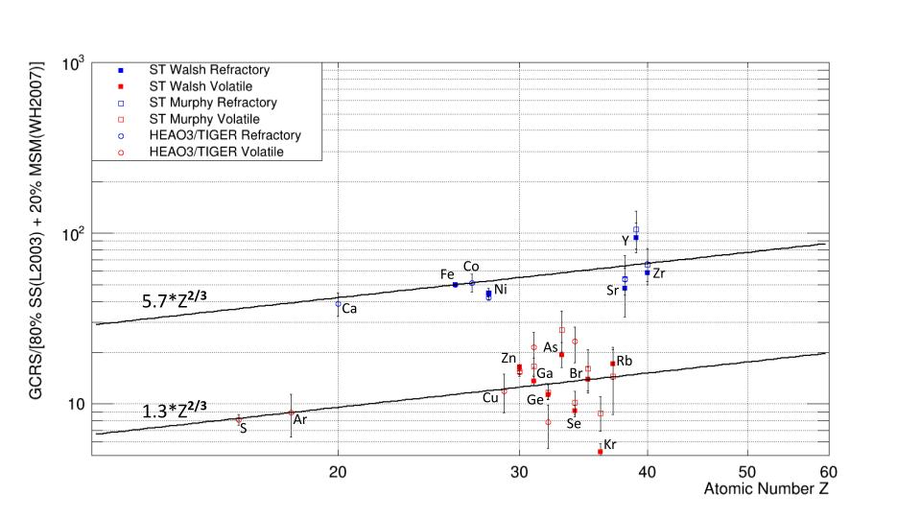
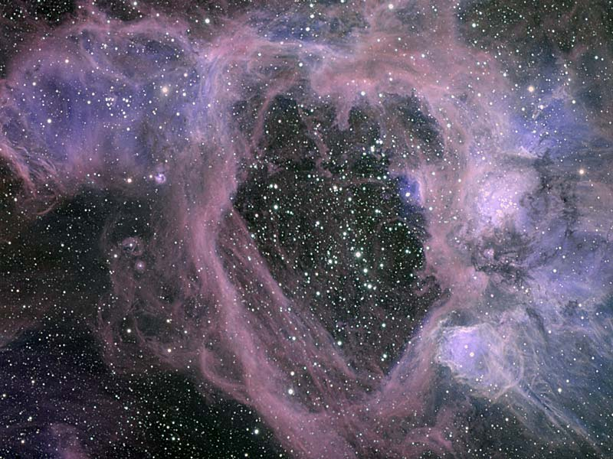
OB Association Source Model Good Z≤40
Current OB association Galactic cosmic ray source (GCRS) model predictions:
GCRS = ~80% ISM + ~20% MSM
interstellar medium (ISM) is similar in composition to Solar System (SS) material
massive star material (MSM) includes stellar wind outflow and supernova (SN) ejecta
Refractory elements more likely in dust grains than volatiles preferentially injected into the accelerator
Z^{2/3} injection dependence from grain sputtering cross sections seen for both refractories and volatiles
N44 Superbubble in LMC
Credit: Gemini Observatory, AURA, NSF
- Nathan Elliot Walsh, SuperTIGER Elemental Abundances for the Charge Range 41≤Z≤56, PhD thesis, Washington University in St. Louis, 2020.
- Rauch et al. 2009
- Murphy et al. 2016

Slide 17
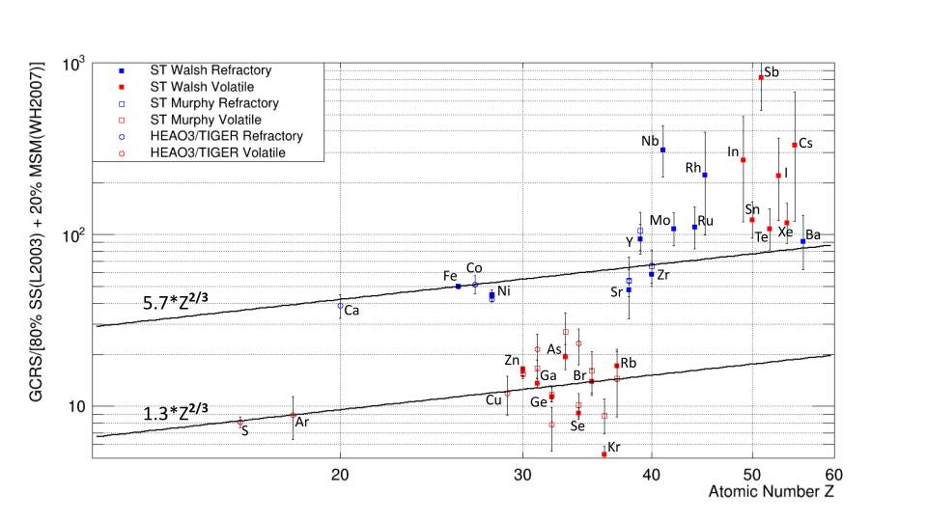
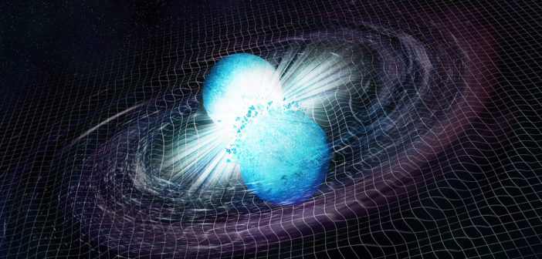
Apparent Model Breakdown for Z>40
SuperTIGER Z>40 abundances elevated over refractory line: Model is missing something
Change in acceleration mechanism?
New source component, e.g., neutron star mergers? (Observed in ejecta from GW170817 )
Artist’s illustration of the merger of two neutron stars. [NASA/CXC/M.Weiss]
- Nathan Elliot Walsh, SuperTIGER Elemental Abundances for the Charge Range 41≤Z≤56, PhD thesis, Washington University in St. Louis, 2020.

Slide 18
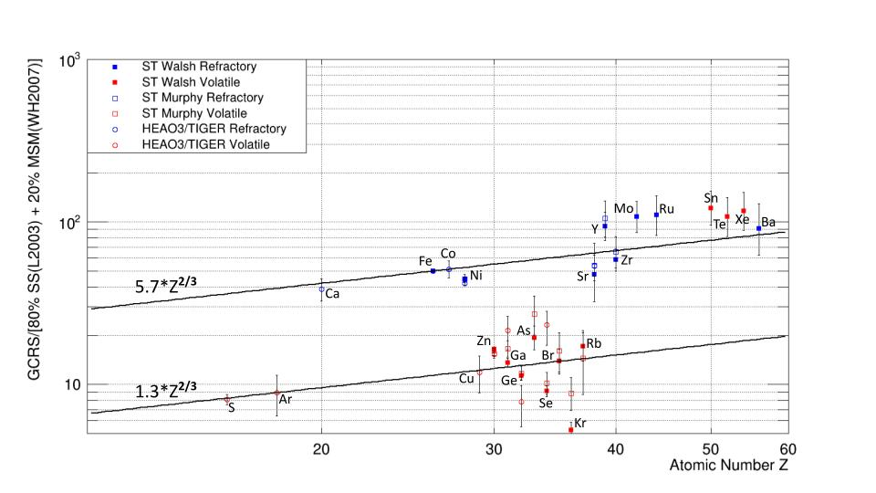
Apparent Model Breakdown for Z>40 Even Elements Only
Odd elements likely overestimated due to contamination from even-element peak spill over
Elevated volatile elements largely r-process
r- ,s-, and p-process decomposition of solar system abundances West & Heger (2013) ApJ 774:75

Slide 19
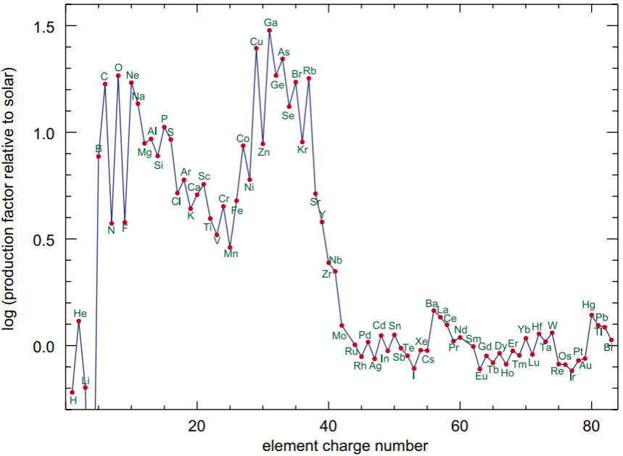
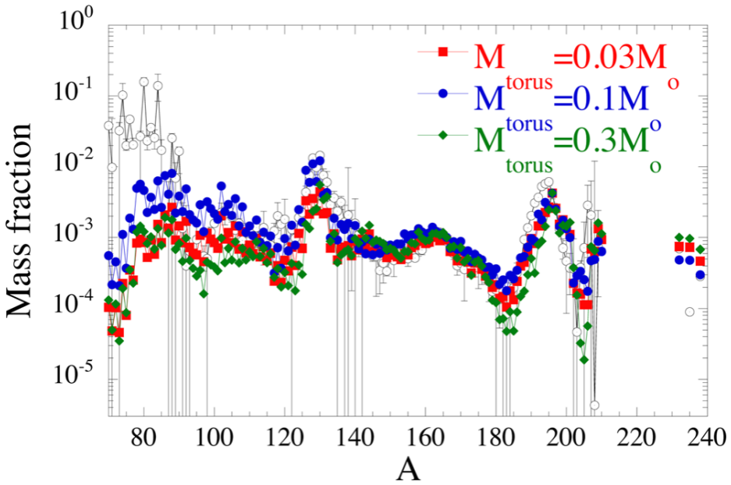
Heavy Element Production Models
How and where are the heaviest elements created?
Absolute and relative abundances of r- & s-process elements probe NSM physics and contributions to GCRs – part of a multi-messenger approach
SuperTIGER measured part of the transition region between SN and NSM production at Z~40 (A~90)
Nathan’s dissertation results paved the way for TIGERISS, which will reach ₇₈Pt-₈₂Pb region with single element resolution and further constrain NSM production models
OB association production
NSM production
Supernova (SN) production relative to solar composition Woosley & Heger (2007) PhR 442:269W
Neutron star merger (NSM) production model compared to solar composition (open circles)
Just et al. (2015) MNRAS 448:541J

Slide 20
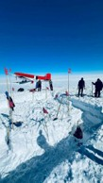

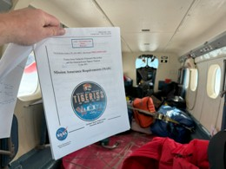
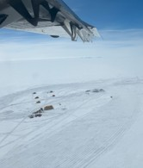
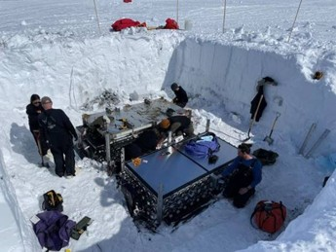
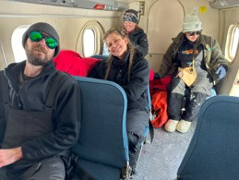
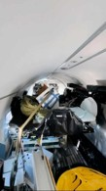
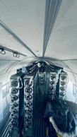
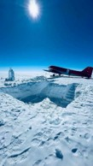
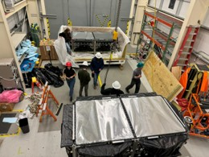
ST-2.3 Recovery

Slide 21
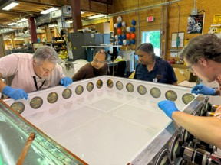
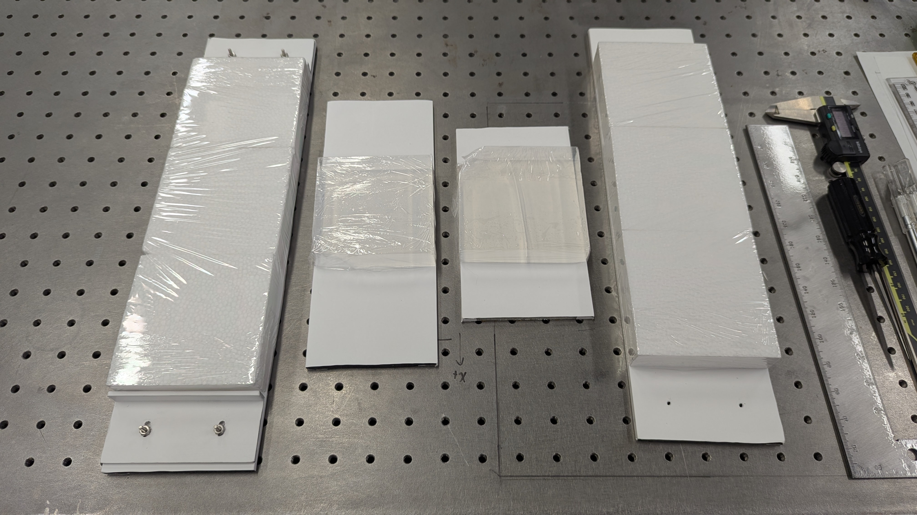
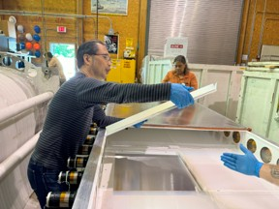
SuperTIGER vs TIGERISS Aerogel Mounting

Slide 22





TIGERISS Columbus SOX Instrument

Slide 23


TIGER Measurement Methods
Silicon strip detector (SSD) for precision charge measurement σ_{Q} < 0.24e for 5 ≲ Z ≤ 82 and SiPM Cherenkov detector readout based on CERN testing.
SSD CERN Pb Test Beam Results
dE/dx vs. Acrylic Cherenkov
0.33 to 2.12 GeV/nucleon
Acrylic Cherenkov vs. Silica Aerogel Cherenkov > 2.12 GeV/nucleon
Acrylic Cherenkov Detectors
n = 1.5
β ≥ 0.67
KE ≥ 325 MeV/nucleon
SiPM readout instead of PMTs
Silica Aerogel Cherenkov Detectors
n = 1.05
β ≥ 0.0.95
KE ≥ 2.12 GeV/nucleon
SuperTIGER data for dE/dx from scintillator detectors
σ_{Q} < 0.19e up to ₃₀Zn - measured
σ_{Q} < 0.20e up to ₅₆Ba - measured
σ_{Q} < 0.21e up to ₈₂Pb - extrapolated
TIGERISS with SSDs will do better

Slide 24

TIGERISS Predicted Observations
TIGERISS SOX model for 9x9 SSD configuration – descope from 10x9 configuration
In one-year TIGERISS will have:
Comparable statistics to SuperTIGER-1
~1/2 statistics for HEAO-3-HNE charge group measurements (Binns et al. 1989) with individual element resolution

Slide 25
TIGERISS – Summary
TIGERISS will make revolutionary measurements that will transform our understanding of galactic nucleosynthesis.
Key to answer are measurements of abundances of Ultra-Heavy Galactic Cosmic Rays: UHGCRs: Z > 28 (above Nickel)
Astro2020 Decadal Survey Questions:
“Are neutron star mergers the main site of r-process nucleosynthesis, or are there supernovae and other core collapse events that contribute significantly to the r-process budget of the universe?”
scientists “may be able to use heavy cosmic-ray abundance measurements in the Milky Way to constrain sites of r-process nucleosynthesis.”
TIGERISS will accomplish this by measuring the elemental composition from ⁵B through ⁸²Pb.

Slide 26





Acknowledgements and Disclaimer
NASA grants for CALET (NNX11AE02G, NNX16AC02G, and 80NSSC20K0399) and SuperTIGER (NNX15AC23G and 80NSSC20K0405), and a cooperative agreement for TIGERISS (80NSSC22M0299).
The ANITA, SuperTIGER and TIGERISS efforts has been supported at Washington University in St. Louis by a grant from the Peggy and Steve Fossett Foundation and by the McDonnell Center for the Space Sciences.
We thank the NASA Columbia Scientific Balloon Facility, the NASA Balloon Program Office, the NSF United States Antarctic Program, and the Antarctic Support Contract for the record long-duration balloon flight for SuperTIGER-1, the successful recovery efforts, and the 32-day SuperTIGER-2.3 flight providing scientific and technical background for TIGERISS.
The material contained in this document is based upon work supported by a National Aeronautics and Space Administration (NASA) grant or cooperative agreement. Any opinions, findings, conclusions, or recommendations expressed in this material are those of the author and do not necessarily reflect the views of NASA.
Peggy and Steve Fossett Foundation
26

