Slide 1
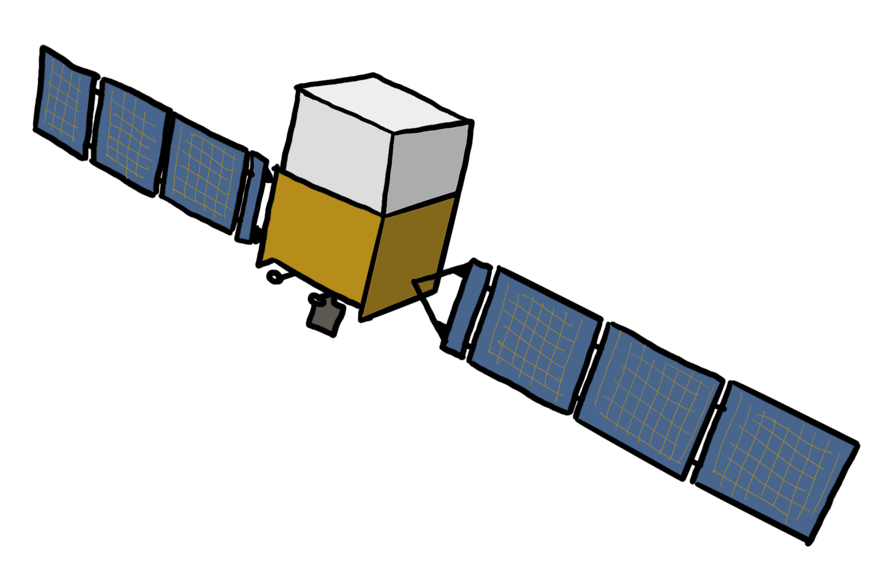

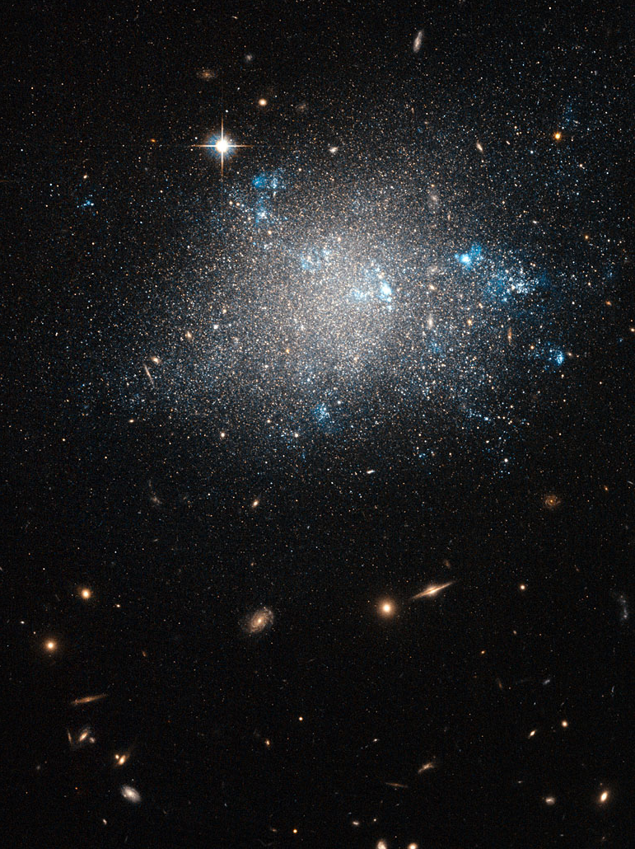





Gamma rays from the littlest galaxies
Sculptor Dwarf Galaxy ESA/Hubble
Tracing Accretion and Dark Matter in the Low-Mass Universe
Milena Crnogorčević (she/her)
Postdoctoral Fellow
Oskar Klein Centre/Stockholm University
November 5, 2025
milena.crnogorcevic@fysik.su.se
mcrnogor.github.io
@mcrnogor
Image credit: Naumann | Friedel Architekturfotografen)
Notes:
When we think of the Universe’s biggest question --- galaxy formation, black hole formation and evolution, dark matter --- our mind may turn to the largest structures in the Universe because of our observational biases. But, in fact,

Slide 2
Gamma rays from the littlest galaxies
Sculptor Dwarf Galaxy ESA/Hubble
Tracing Accretion and Dark Matter in the Low-Mass Universe
Milena Crnogorčević (she/her)
Postdoctoral Fellow
Oskar Klein Centre/Stockholm University
November 5, 2025
milena.crnogorcevic@fysik.su.se
mcrnogor.github.io
@mcrnogor
Image credit: Naumann | Friedel Architekturfotografen)
Notes:
When we think of the Universe’s biggest question --- galaxy formation, black hole formation and evolution, dark matter --- our mind may turn to the largest structures in the Universe because of our observational biases. But, in fact,

Slide 3
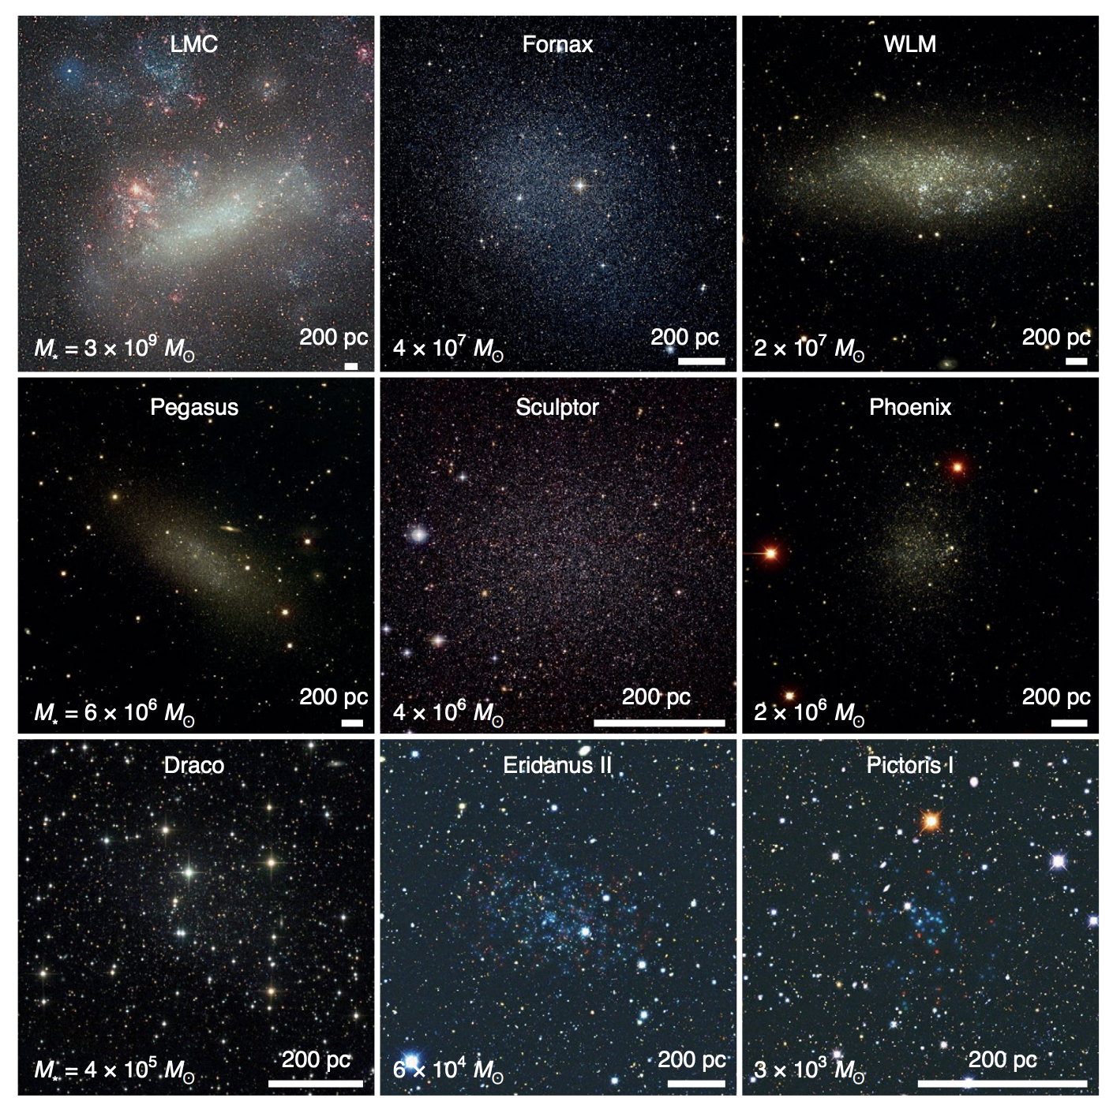
Dwarf galaxies: small but mighty
⇾ Low-mass galaxies:
tens of M_{sun} < M_{stellar} < 3 x 10⁹ M_{sun}
⇾ At the forefront of current/future observational efforts:
Near-field cosmology (Gaia, DES, Rubin/LSST)
Early Universe & Reionization (JWST)
Accretion & Feedback (Athena, AXIS, SKA, ngVLA)
Fundamental physics & dark matter (Fermi, IACTs, IceCube)
[Bullock & Boylan-Kolchin 2017]
Representative sample of the Local Group dwarf galaxies.
[1]
Notes:
Dwarf galaxies are small, but mighty
🔹 Near-field cosmology
Provide a high-resolution window into galaxy formation physics.
Gaia, DES, and Rubin/LSST are revealing a nearly complete census of the Local Group.
Let us directly test ΛCDM predictions — e.g. the missing satellites and too-big-to-fail problems.
🔹 Early Universe & Reionization
Occupy the faint end of the galaxy luminosity function.
Likely major contributors to cosmic reionization.
JWST now resolves these systems at z ≳ 6, linking local dwarfs to the first galaxies.
🔹 Accretion & Feedback
Shallow potentials make dwarfs sensitive probes of stellar and AGN feedback.
Future X-ray and radio missions (Athena, SKA, ngVLA) can trace intermediate-mass black holes and their outflows.
Test how BH–galaxy scaling relations extend into the low-mass regime.
🔹 Dark Matter Laboratories
Dynamical masses ≫ stellar masses → dominated by dark matter.
Ideal to test DM self-interaction, warm DM cutoffs, and annihilation/decay scenarios.
Provide a clean environment with minimal baryonic noise — perfect for Fermi-LAT studies.

Slide 4
Dwarf galaxies: small but mighty
⇾ Low-mass galaxies:
tens of M_{sun} < M_{stellar} < 3 x 10⁹ M_{sun}
⇾ At the forefront of current/future observational efforts:
Near-field cosmology (Gaia, DES, Rubin/LSST)
Early Universe & Reionization (JWST)
Accretion & Feedback (Athena, AXIS, SKA, ngVLA)
Fundamental physics & dark matter (Fermi, IACTs, IceCube)
[Bullock & Boylan-Kolchin 2017]
Dwarf galaxies: bridges between large scale structure, galaxy formation, & fundamental physics.
Representative sample of the Local Group dwarf galaxies.
[1]
Notes:
🔹 Near-field cosmology
Provide a high-resolution window into galaxy formation physics.
Gaia, DES, and Rubin/LSST are revealing a nearly complete census of the Local Group.
Let us directly test ΛCDM predictions — e.g. the missing satellites and too-big-to-fail problems.
🔹 Early Universe & Reionization
Occupy the faint end of the galaxy luminosity function.
Likely major contributors to cosmic reionization.
JWST now resolves these systems at z ≳ 6, linking local dwarfs to the first galaxies.
🔹 Accretion & Feedback
Shallow potentials make dwarfs sensitive probes of stellar and AGN feedback.
Future X-ray and radio missions (Athena, SKA, ngVLA) can trace intermediate-mass black holes and their outflows.
Test how BH–galaxy scaling relations extend into the low-mass regime.
🔹 Dark Matter Laboratories
Dynamical masses ≫ stellar masses → dominated by dark matter.
Ideal to test DM self-interaction, warm DM cutoffs, and annihilation/decay scenarios.
Provide a clean environment with minimal baryonic noise — perfect for Fermi-LAT studies.

Slide 5
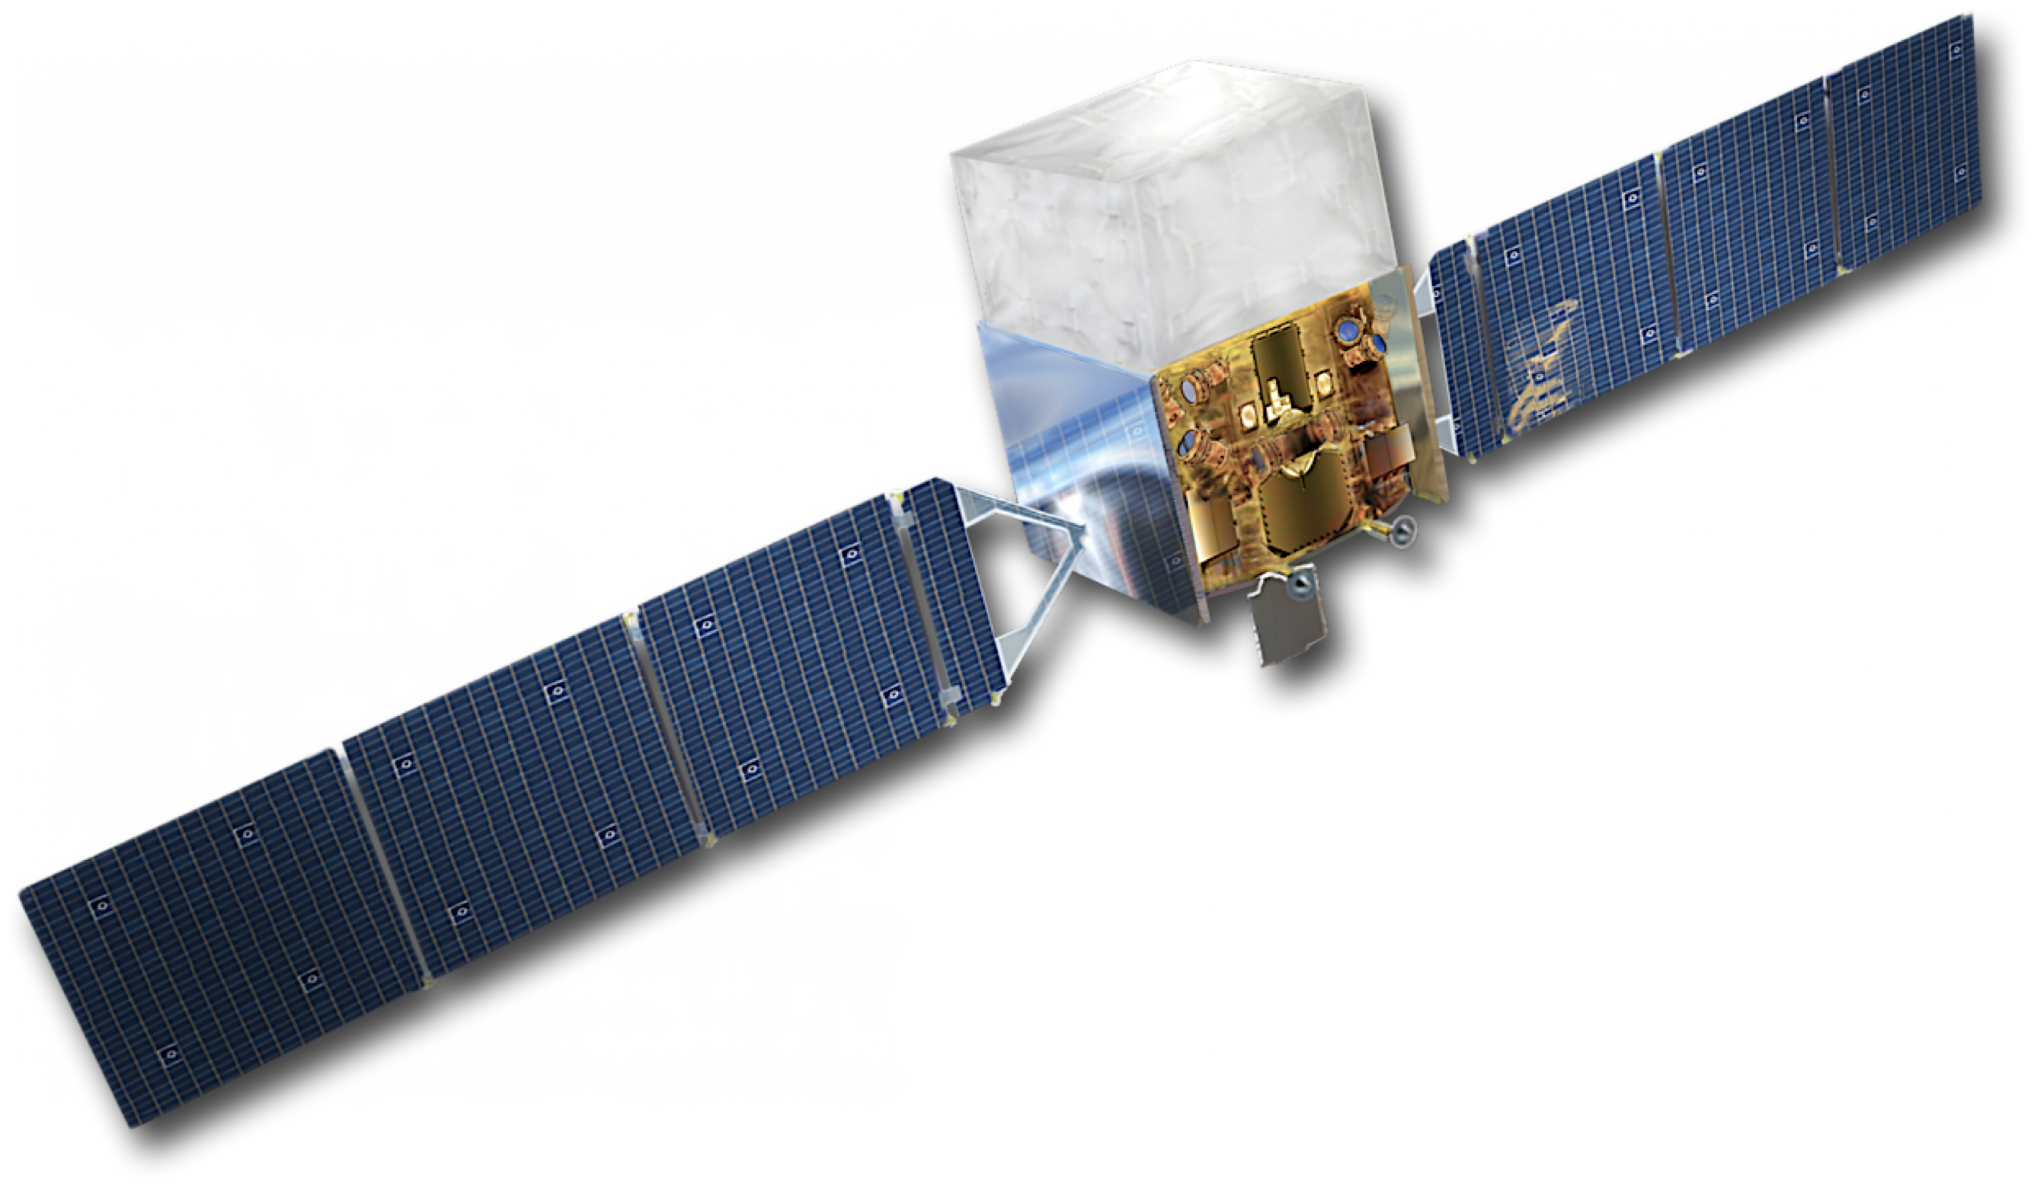
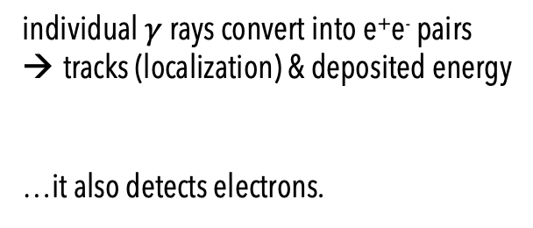
Obligatory slide on Fermi Large Area Telescope
e⁺e⁻ pair-conversion telescope
*Energy range | 20 MeV to > 300 GeV
**Field of View | 2.4 sr (~1/5 of the whole sky)
***Single photon angular resolution | < 1 deg at 1 GeV
Timing accuracy | 1 microsecond
*ideally suited for WIMP searches
**whole sky every ~3 hours
***point-source localization <0.5 arcmin
individual $γ$ rays convert into e⁺e⁻ pairs
tracks (localization) & deposited energy
…it also detects electrons.
[2]
Notes:
Just be careful about the single-photon; does not depend on the position in the sky

Slide 6
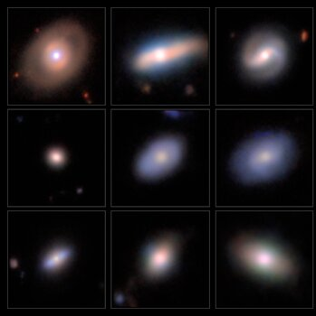
Dwarf AGN
Legacy Surveys/D. Lang (Perimeter Institute)/NAOJ/HSC Collaboration/D. de Martin (NSF NOIRLab) & M. Zamani (NSF NOIRLab)
Based on Crnogorčević+ 2025, arXiv: 2509.18239
Credit: NASA/DOE/FERMI LAT COLLABORATION; T. LINDEN
Fornax Dwarf Galaxy, ESO/Sky Survey 2
[3]
Notes:
Let’s start with the dwarfs that do show accretion activity — dwarf AGN.”

Slide 7
⇾ host intermediate-mass black holes (IMBHs), 10⁴ - 10⁶ M☉
⇾ missing link in BH mass spectrum
⇾ preserve signatures of BH seed formation
⇾ enhanced dark matter density around IMBHs (potential dark matter targets)
⇾ but, multiple potential γ-ray production mechanisms
Dwarf AGN
Legacy Surveys/D. Lang (Perimeter Institute)/NAOJ/HSC Collaboration/D. de Martin (NSF NOIRLab) & M. Zamani (NSF NOIRLab)
Based on Crnogorčević+ 2025, arXiv: 2509.18239
Credit: NASA/DOE/FERMI LAT COLLABORATION; T. LINDEN
Fornax Dwarf Galaxy, ESO/Sky Survey 2
[3]
Notes:
“These galaxies host intermediate-mass black holes — tens of thousands to a million solar masses — and act as the missing link between stellar and supermassive black holes.”
“They might preserve signatures of seed formation, and interestingly, those black holes could locally enhance the dark matter density — so we have both astrophysical and particle physics reasons to look.”

Slide 8
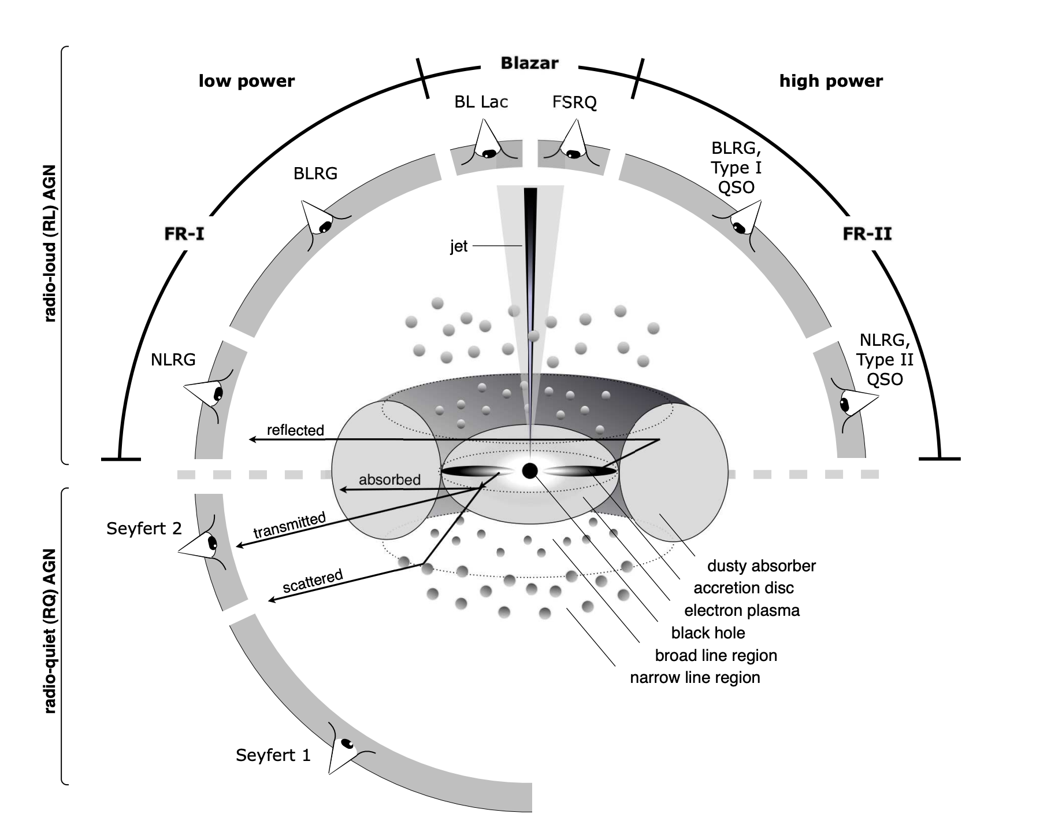
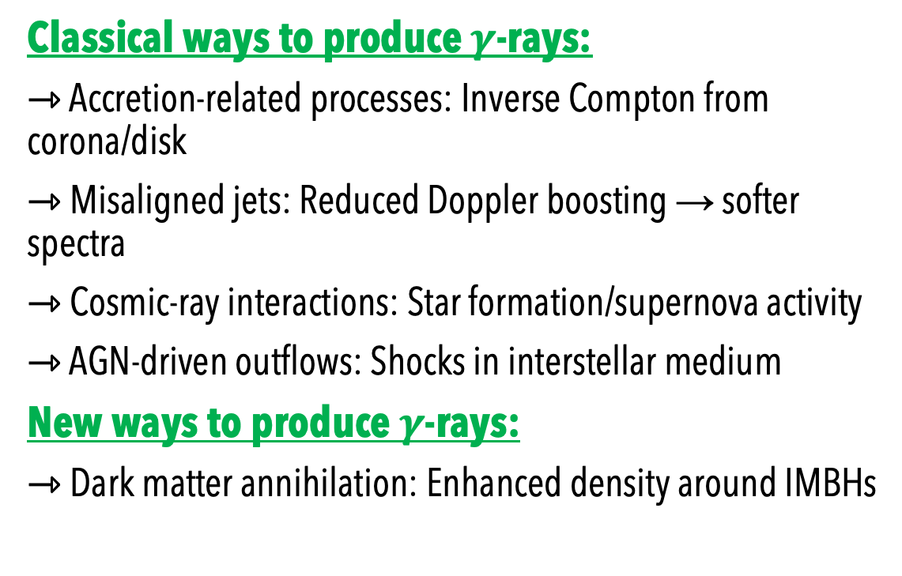
Gammas from AGNs
Classical ways to produce $γ$-rays:
⇾ Accretion-related processes: Inverse Compton from corona/disk
⇾ Misaligned jets: Reduced Doppler boosting → softer spectra
⇾ Cosmic-ray interactions: Star formation/supernova activity
⇾ AGN-driven outflows: Shocks in interstellar medium
New ways to produce $γ$-rays:
⇾ Dark matter annihilation: Enhanced density around IMBHs
[Beckmann & Shrader 2013]
[5]
Notes:
There are a few well-established ways that AGN generate gamma rays, and most of them come down to how particles get accelerated and where they interact.
Close to the black hole, you can get inverse Compton scattering — energetic electrons in the corona up-scatter disk photons into the gamma-ray range. This is usually the dominant mechanism in radio-quiet AGN.
In radio-loud AGN, especially those with jets not pointing directly at us, we still see gamma rays — just weaker and softer because there’s less Doppler boosting. So, these are your misaligned blazars — FR I or FR II types Cosmic-rays: In star-forming galaxies or regions with recent supernovae, shock waves from supernova explosions accelerate charged particles — mainly protons and electrons — to relativistic speeds via diffusive shock acceleration (the Fermi mechanism).
So the galaxy becomes filled with a population of cosmic rays: relativistic protons (and some heavier nuclei) plus electrons
Gas (proton–proton collisions): When relativistic protons hit interstellar gas nuclei (mostly hydrogen), they produce neutral pions (π⁰). These pions decay almost instantly into gamma rays:
$$p+p→π^{0}+X, π^{0}→2γ$$
Radiation fields (inverse Compton): High-energy electrons can up-scatter optical, infrared, or microwave photons to gamma-ray energies via inverse Compton scattering.
Magnetic fields (synchrotron): Those same electrons also emit radio to X-ray synchrotron radiation, so multiwavelength correlations help us tell these processes apart.

Slide 9
Gammas from AGNs
Classical ways to produce $γ$-rays:
⇾ Accretion-related processes: Inverse Compton from corona/disk
⇾ Misaligned jets: Reduced Doppler boosting → softer spectra
⇾ Cosmic-ray interactions: Star formation/supernova activity
⇾ AGN-driven outflows: Shocks in interstellar medium
New ways to produce $γ$-rays:
⇾ Dark matter annihilation: Enhanced density around IMBHs
[Beckmann & Shrader 2013]
Multiple mechanisms likely contribute: requires multiwavelength approach to disentangle
[5]
Notes:
There are a few well-established ways that AGN generate gamma rays, and most of them come down to how particles get accelerated and where they interact.
Close to the black hole, you can get inverse Compton scattering — energetic electrons in the corona up-scatter disk photons into the gamma-ray range. This is usually the dominant mechanism in radio-quiet AGN.
In radio-loud AGN, especially those with jets not pointing directly at us, we still see gamma rays — just weaker and softer because there’s less Doppler boosting. So, these are your misaligned blazars — FR I or FR II types Cosmic-rays: In star-forming galaxies or regions with recent supernovae, shock waves from supernova explosions accelerate charged particles — mainly protons and electrons — to relativistic speeds via diffusive shock acceleration (the Fermi mechanism).
So the galaxy becomes filled with a population of cosmic rays: relativistic protons (and some heavier nuclei) plus electrons
Gas (proton–proton collisions): When relativistic protons hit interstellar gas nuclei (mostly hydrogen), they produce neutral pions (π⁰). These pions decay almost instantly into gamma rays:
$$p+p→π^{0}+X, π^{0}→2γ$$
Radiation fields (inverse Compton): High-energy electrons can up-scatter optical, infrared, or microwave photons to gamma-ray energies via inverse Compton scattering.
Magnetic fields (synchrotron): Those same electrons also emit radio to X-ray synchrotron radiation, so multiwavelength correlations help us tell these processes apart.

Slide 10
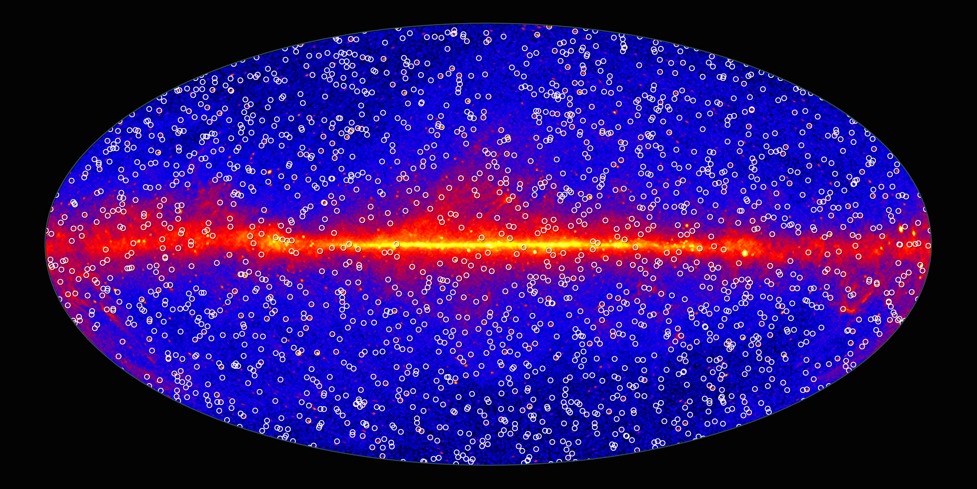
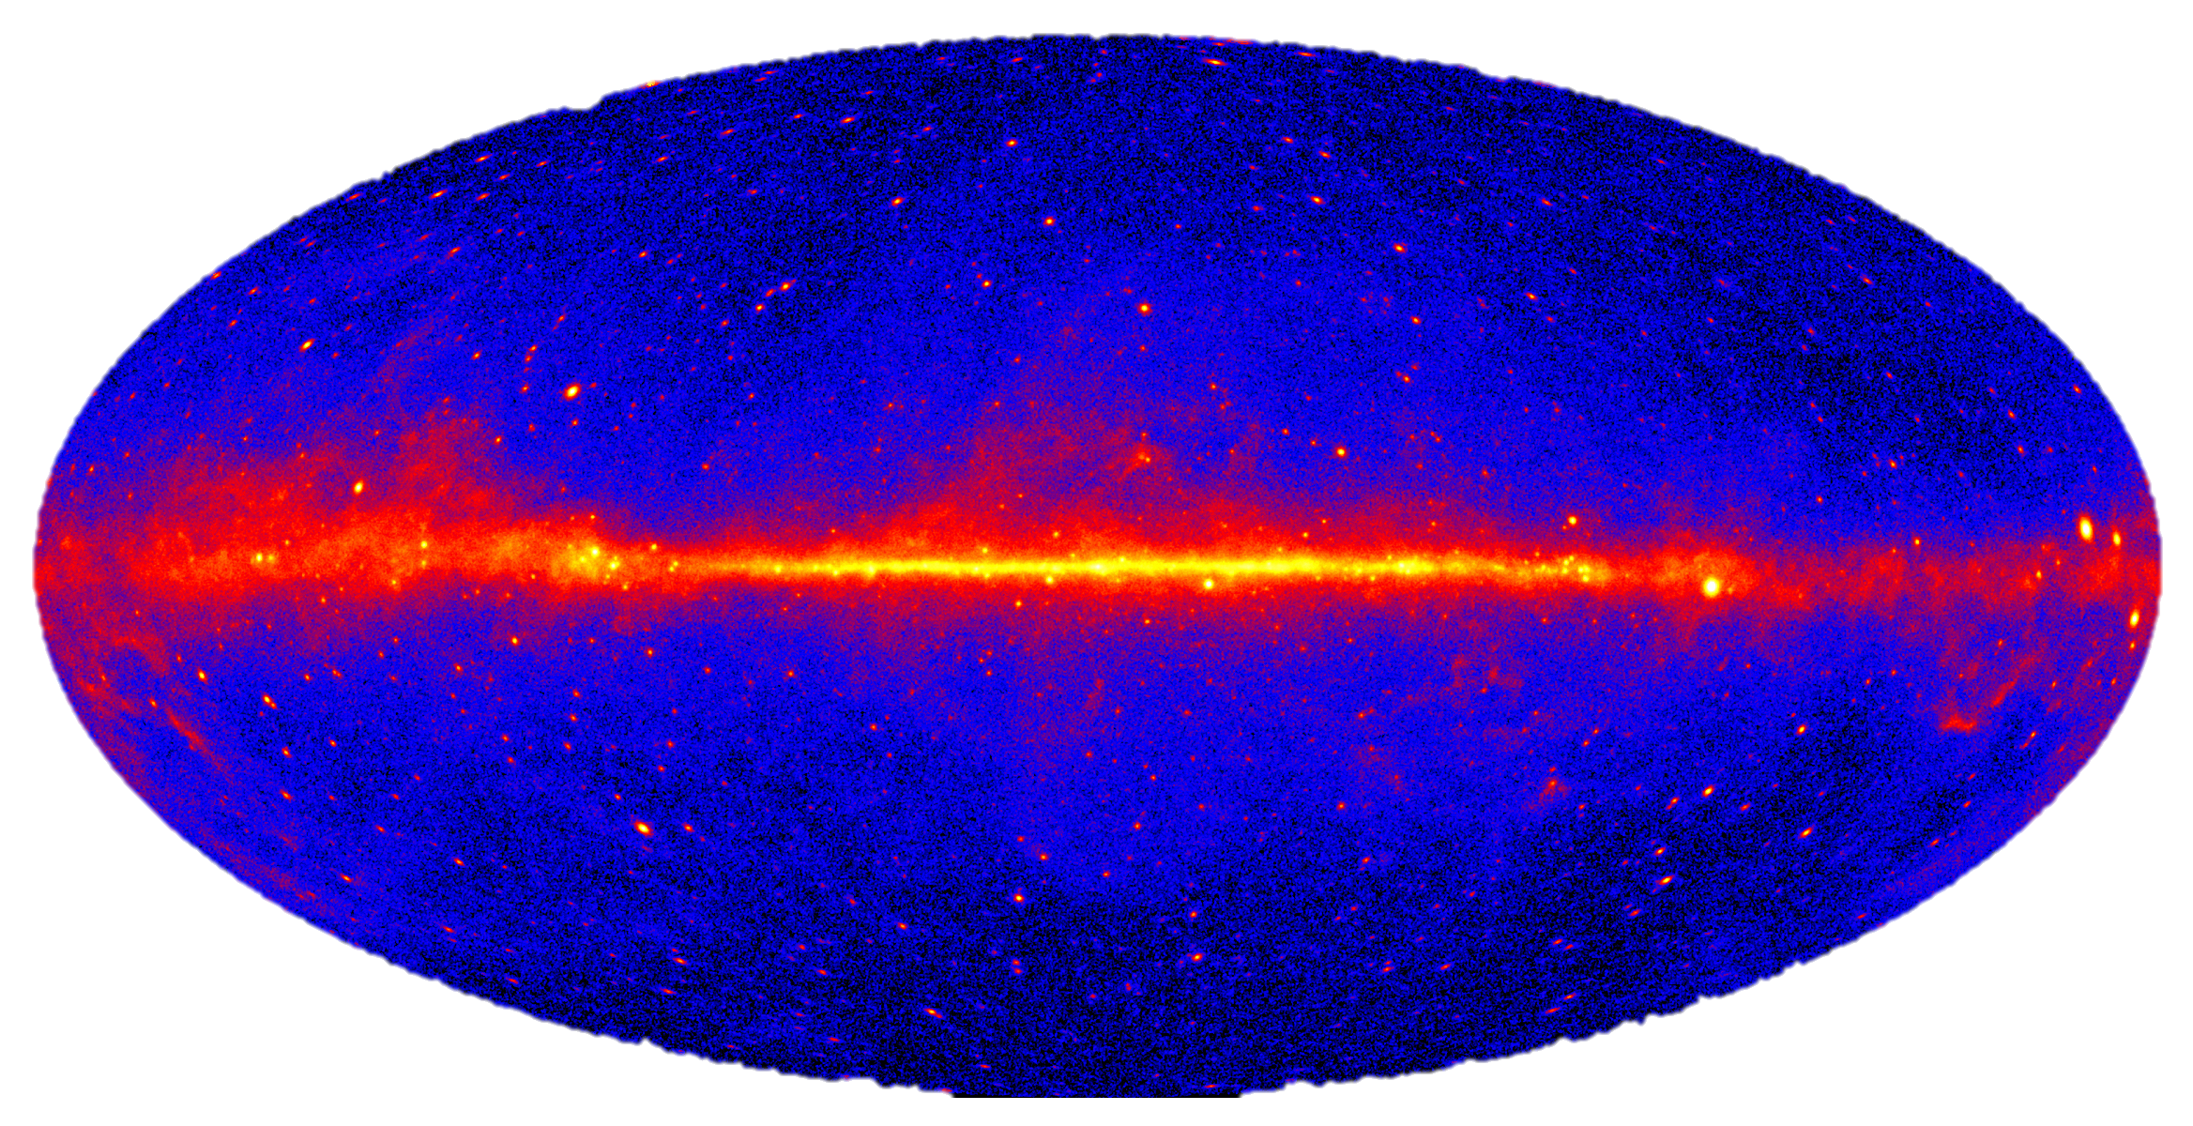
Fermi-LAT Collaboration
[4]
Notes:
This is the all sky image with Fermi LAT

Slide 11
Fermi-LAT Collaboration
[4]
Notes:
The massibve AGN dominate the gamma-ray sky --- both in flux and number

Slide 12
Some questions you may ask…
[6]

Slide 13
Some questions you may ask…
⇾ Do gamma-ray emission mechanisms observed in massive galaxy AGN scale down to IMBHs?
[6]

Slide 14
Some questions you may ask…
⇾ Do gamma-ray emission mechanisms observed in massive galaxy AGN scale down to IMBHs?
⇾ How does emission efficiency depend on e.g., black hole mass as a proxy for accretion rate?
[6]

Slide 15
Some questions you may ask…
⇾ Do gamma-ray emission mechanisms observed in massive galaxy AGN scale down to IMBHs?
⇾ How does emission efficiency depend on e.g., black hole mass as a proxy for accretion rate?
⇾ Can gamma-ray observations distinguish between competing emission models?
[6]

Slide 16
Some questions you may ask…
⇾ Do gamma-ray emission mechanisms observed in massive galaxy AGN scale down to IMBHs?
⇾ How does emission efficiency depend on e.g., black hole mass as a proxy for accretion rate?
⇾ Can gamma-ray observations distinguish between competing emission models?
⇾ Are there unique signatures in IMBH systems not seen in SMBH-hosted AGN?
[6]

Slide 17
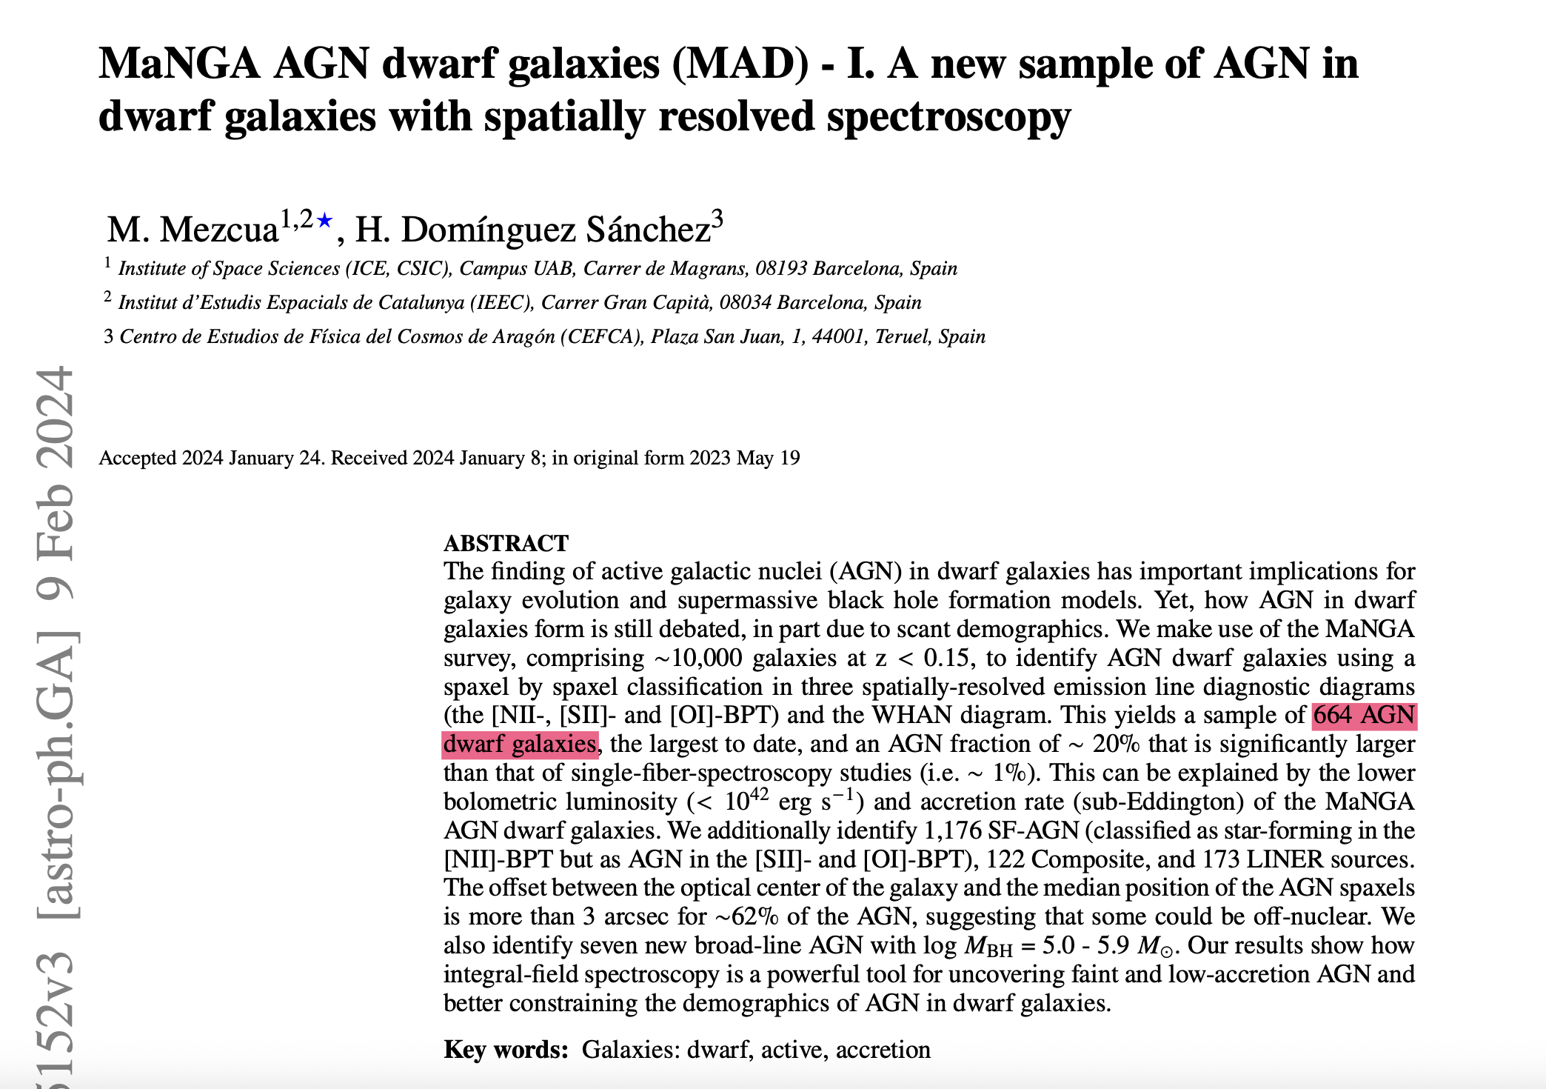
Dwarf AGN sample
[7]
Notes:
Recent Census:
MaNGA survey: 664 dwarf-AGN with 20% AGN fraction
DESI early data: 2,444 dwarf-AGN candidates
eROSITA All-Sky Survey: increasing dwarf-AGN population
X-ray selection: robust against stellar contamination that affects optical identification

Slide 18
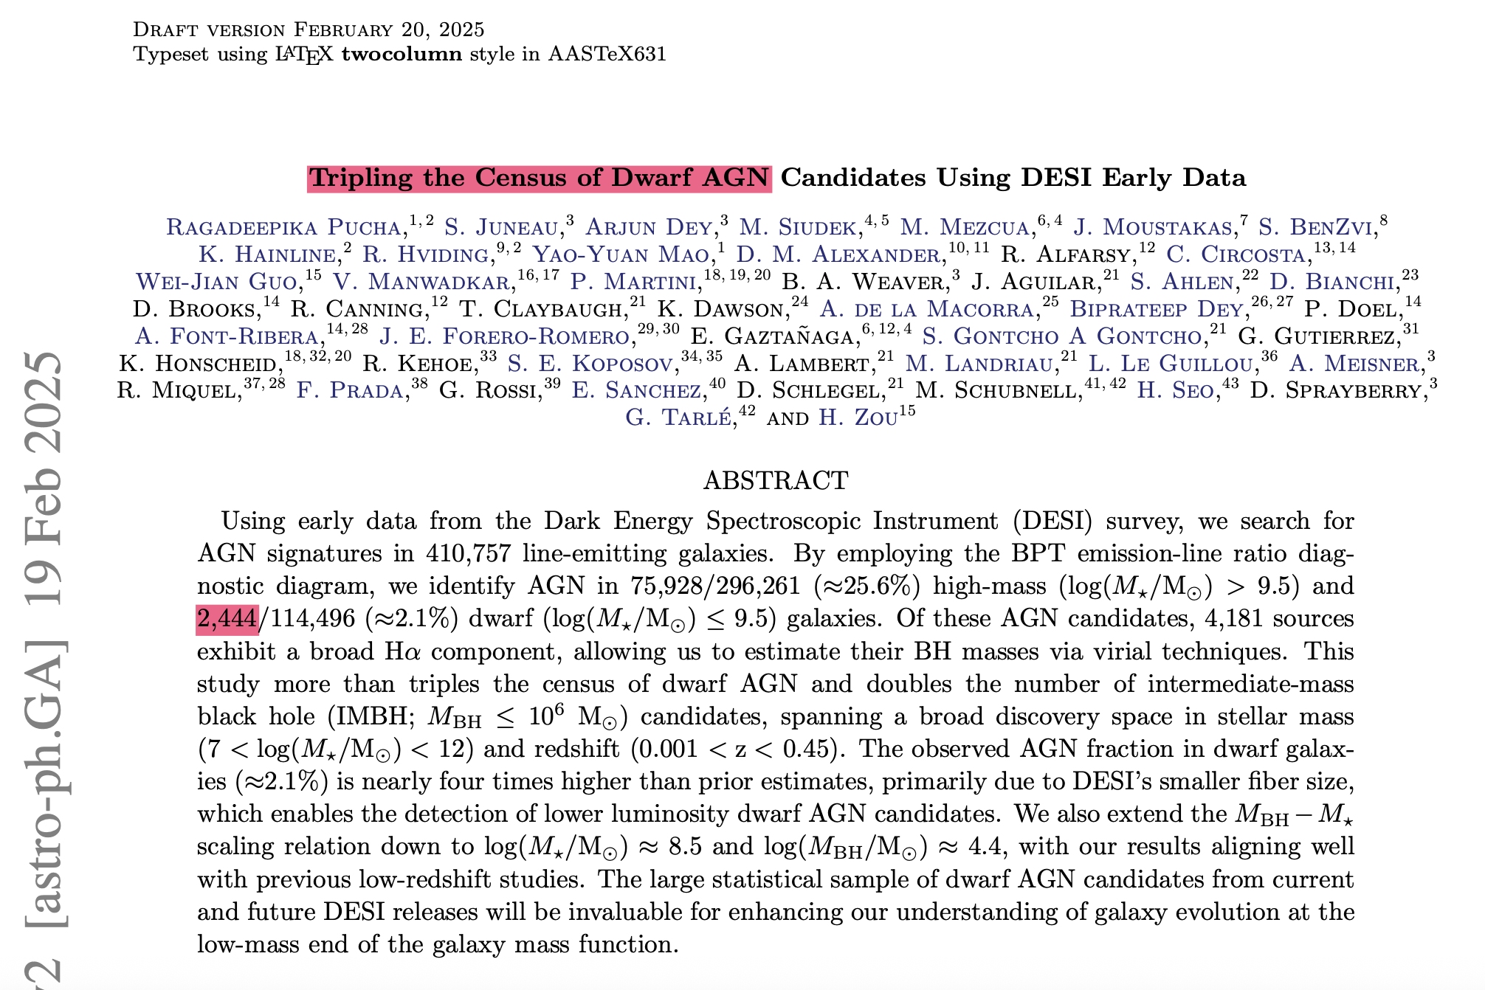
Dwarf AGN sample
[7]
Notes:
Recent Census:
MaNGA survey: 664 dwarf-AGN with 20% AGN fraction
DESI early data: 2,444 dwarf-AGN candidates
eROSITA All-Sky Survey: increasing dwarf-AGN population
X-ray selection: robust against stellar contamination that affects optical identification

Slide 19
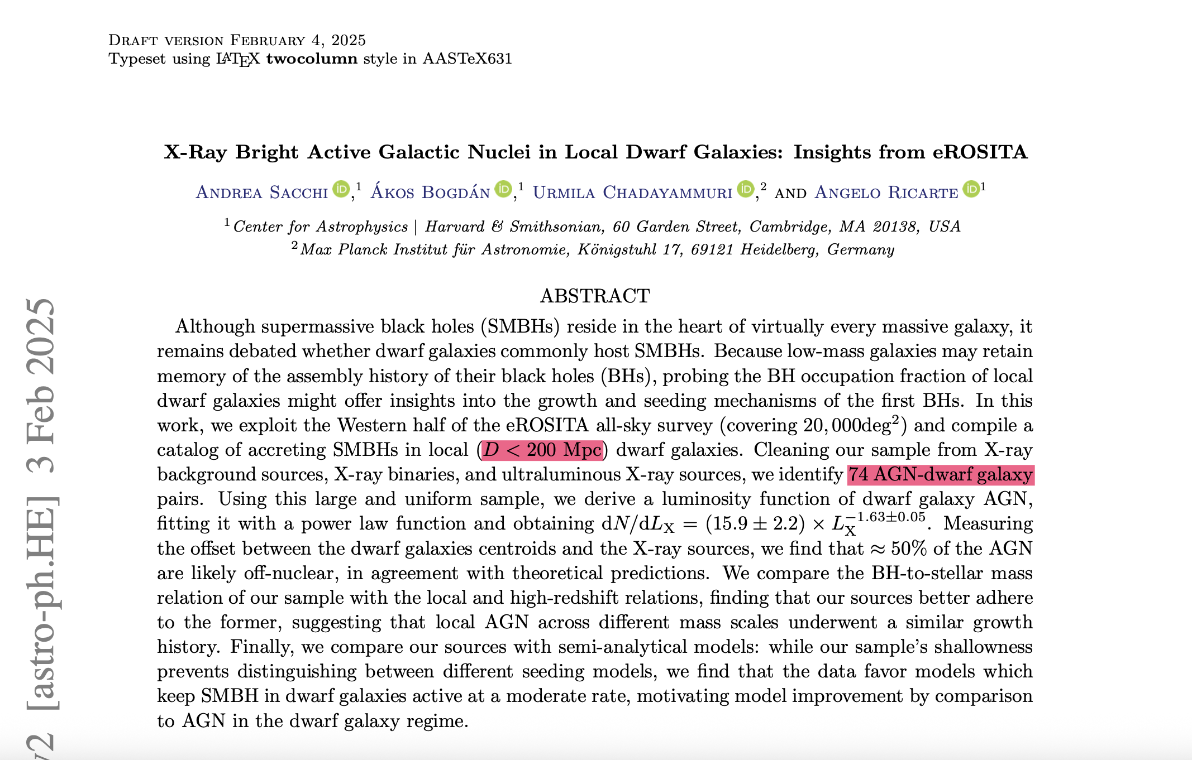
Dwarf AGN sample
[7]
Notes:
Recent Census:
MaNGA survey: 664 dwarf-AGN with 20% AGN fraction
DESI early data: 2,444 dwarf-AGN candidates
eROSITA All-Sky Survey: increasing dwarf-AGN population
X-ray selection: robust against stellar contamination that affects optical identification

Slide 20
Dwarf AGN sample
⇾ X-rays sensitive to accretion
⇾ minimizes the contamination or line emission biases
⇾ unbiased to obscuration of the AGN
⇾ closest sources (D < 200 Mpc)
⇾ available control samples
⇾ almost… all-sky
[8]
Notes:
“In this work, we focus on dwarf AGN candidates identified in the eROSITA X-ray survey, rather than relying on purely optical samples like MaNGA or DESI.
The key reason is that X-rays trace accretion directly — they’re the most unambiguous signature of black hole activity, unlike optical emission lines, which can be produced by star formation, shocks, or even diffuse ionized gas.
MaNGA and DESI are incredibly powerful for studying the stellar and ionized gas components of galaxies, but their AGN selection is fundamentally optical. That means they preferentially find bright, unobscured, emission-line AGN — and they tend to miss low-luminosity or heavily obscured accretors, especially in dwarfs, where stellar dilution is strong.
In contrast, eROSITA provides a uniform, all-sky X-ray view that is less biased by dust, star formation, or inclination effects. It’s sensitive to low Eddington-ratio accretion, and its depth and coverage make it ideal for constructing statistically meaningful samples of nearby dwarf AGN candidates.
Finally, because X-ray emission probes the same physical processes that can give rise to high-energy signatures, eROSITA naturally bridges to the gamma-ray regime, making it a perfect starting point for my analysis with Fermi-LAT.”

Slide 21
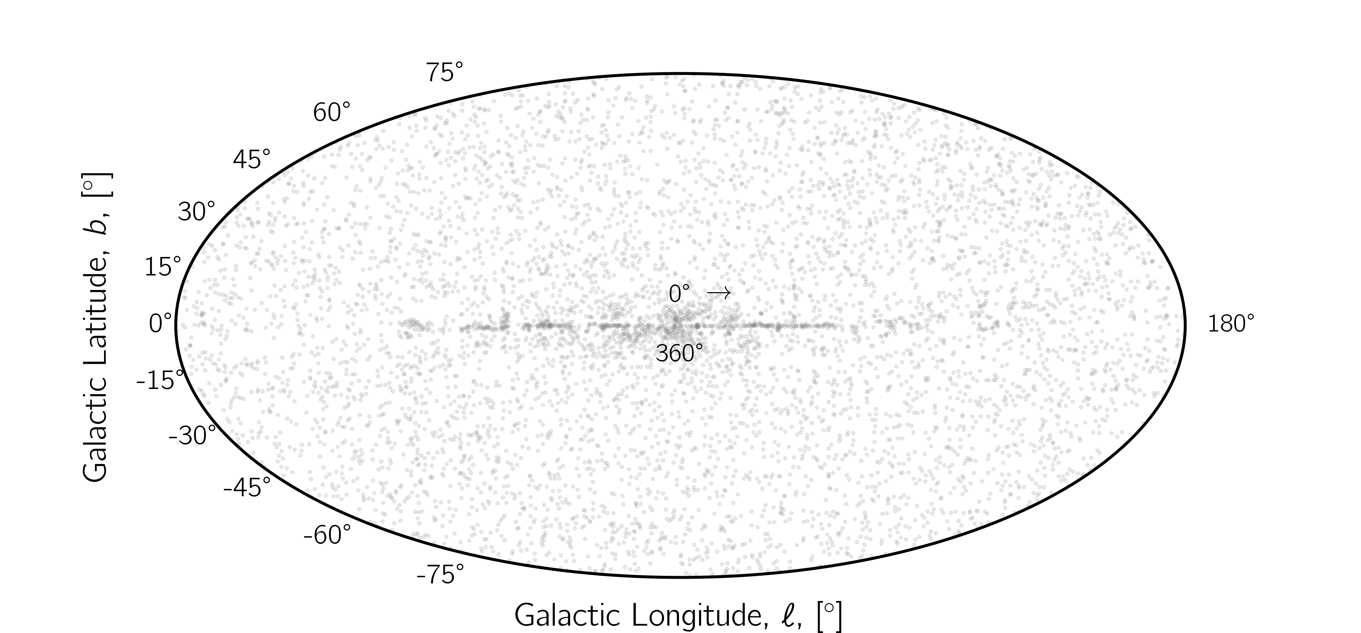
[9]

Slide 22

[9]

Slide 23
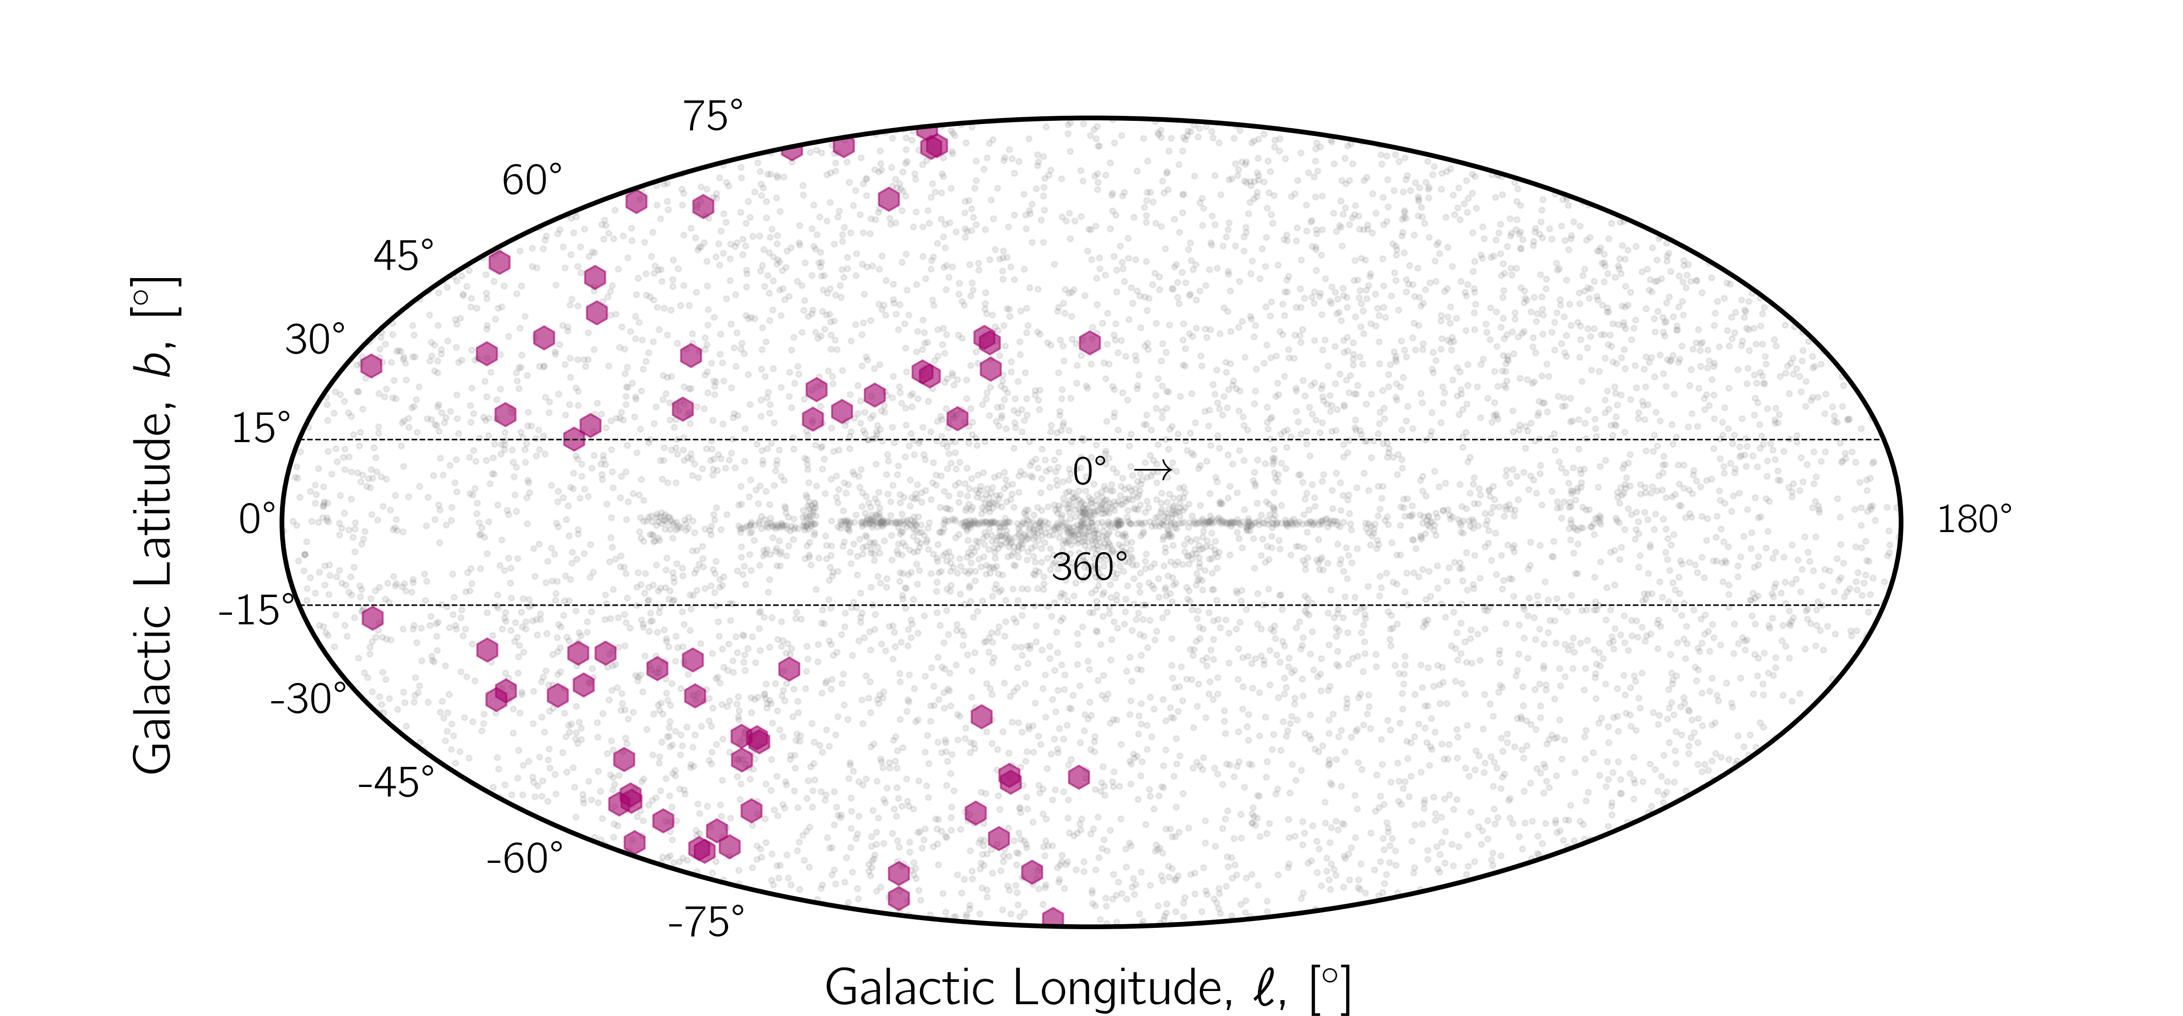
[9]

Slide 24
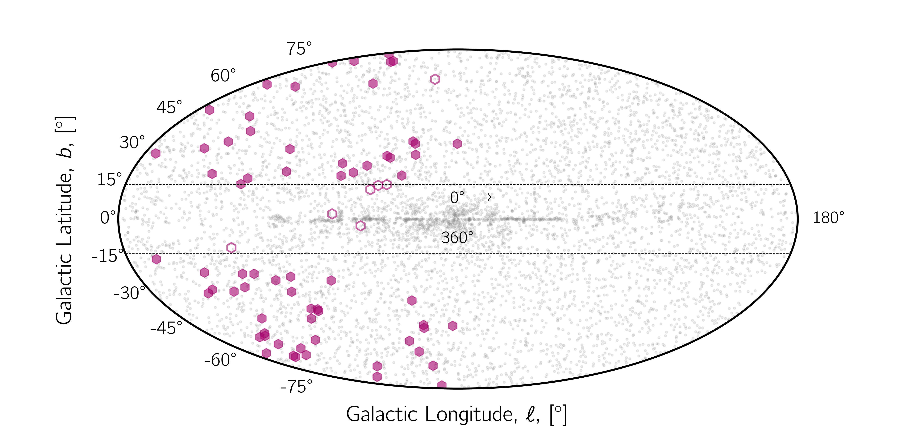
[9]

Slide 25
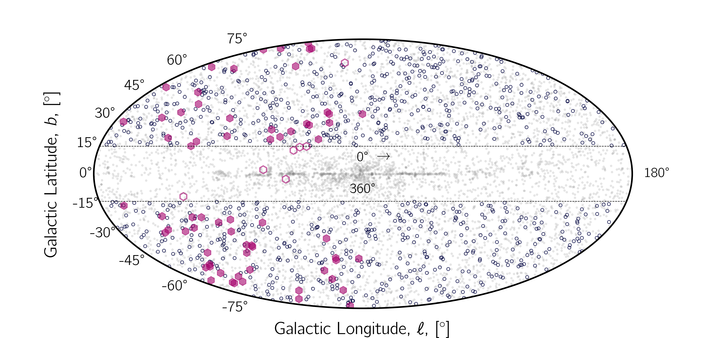
[9]

Slide 26
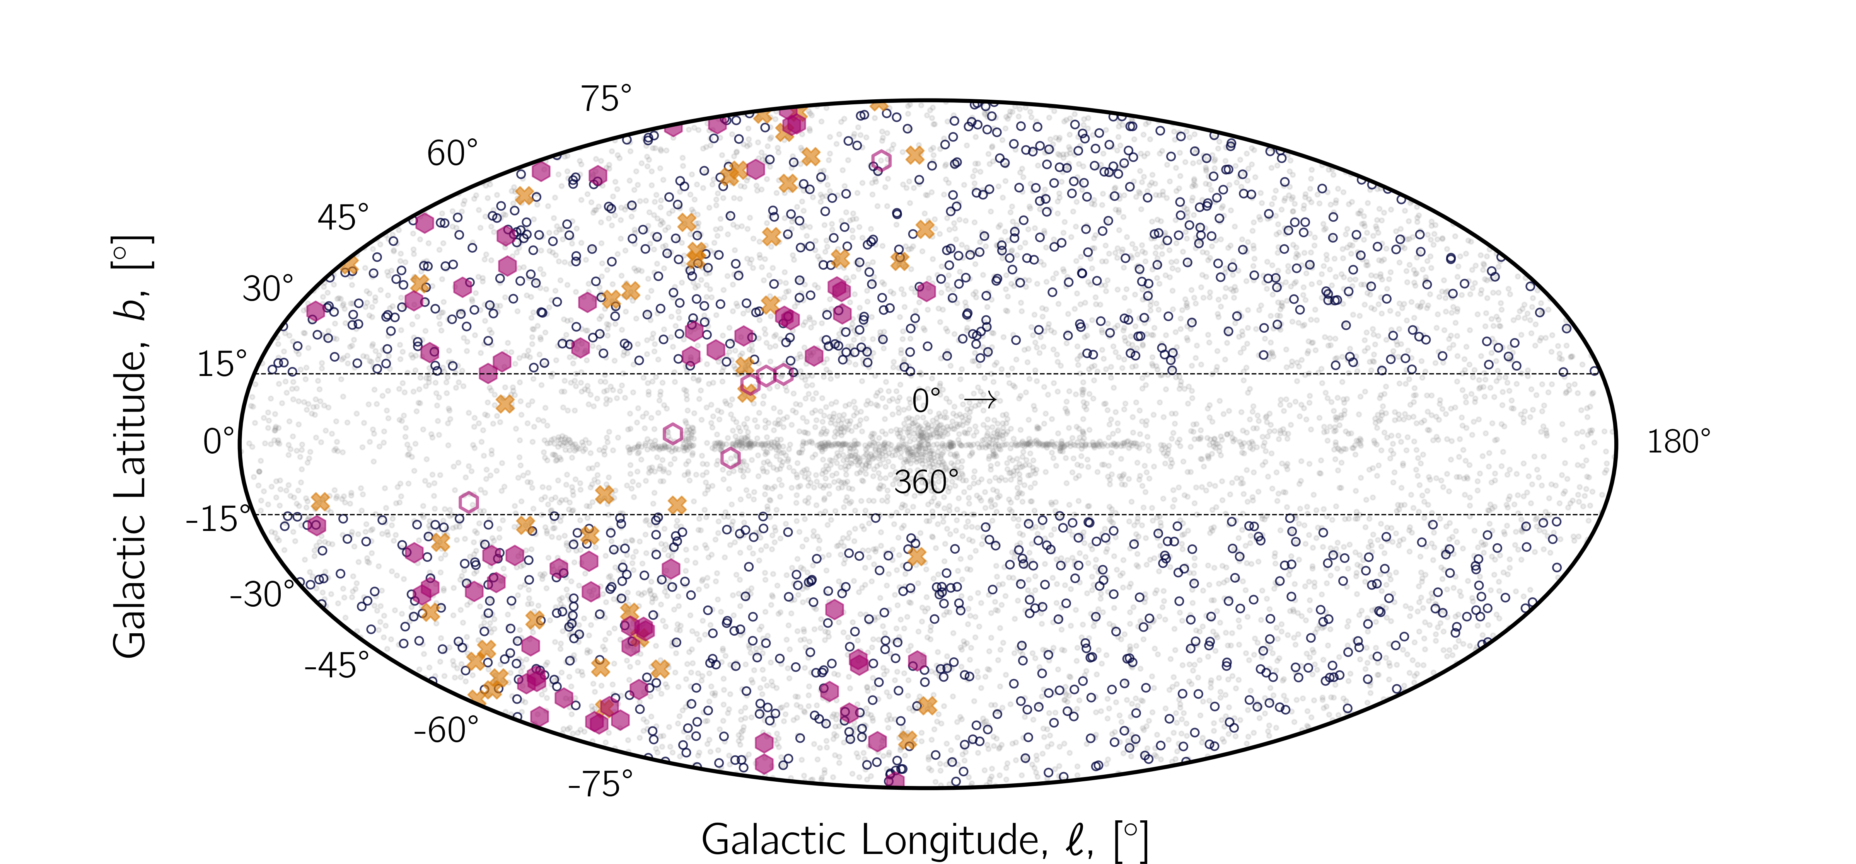
[9]

Slide 27
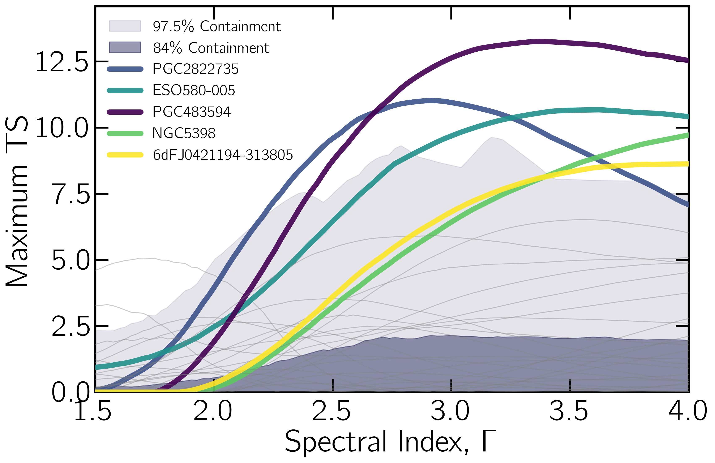
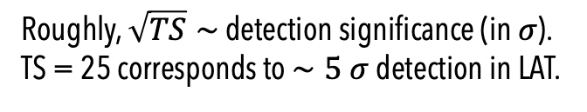

Individual Source Analysis: No Detection
15 years of Fermi-LAT Pass 8
Energy range: 500 MeV – 500 GeV
Event class: P8R3 SOURCE (evclass=128, evtype=3)
Software: Fermipy v1.2.0 + Fermitools v2.2.0
ROI: 10°×10° (model extended to 15°×15° for PSF spillover)
Background sources from 4FGL-DR4
Modeled as point source (unresolved at LAT resolution)
Binned likelihood analysis per energy bin
SED derived with fixed per-bin index Γ = 2
$$TS=2(\log{ℒ_{1}−\log{ℒ_{0}})}$$
Roughly, $\sqrt{TS}∼$ detection significance (in $σ$).
TS = 25 corresponds to $∼5 σ$ detection in LAT.
[10]
Notes:
— Measures how much better the data are explained by including a γ-ray source.

Slide 28
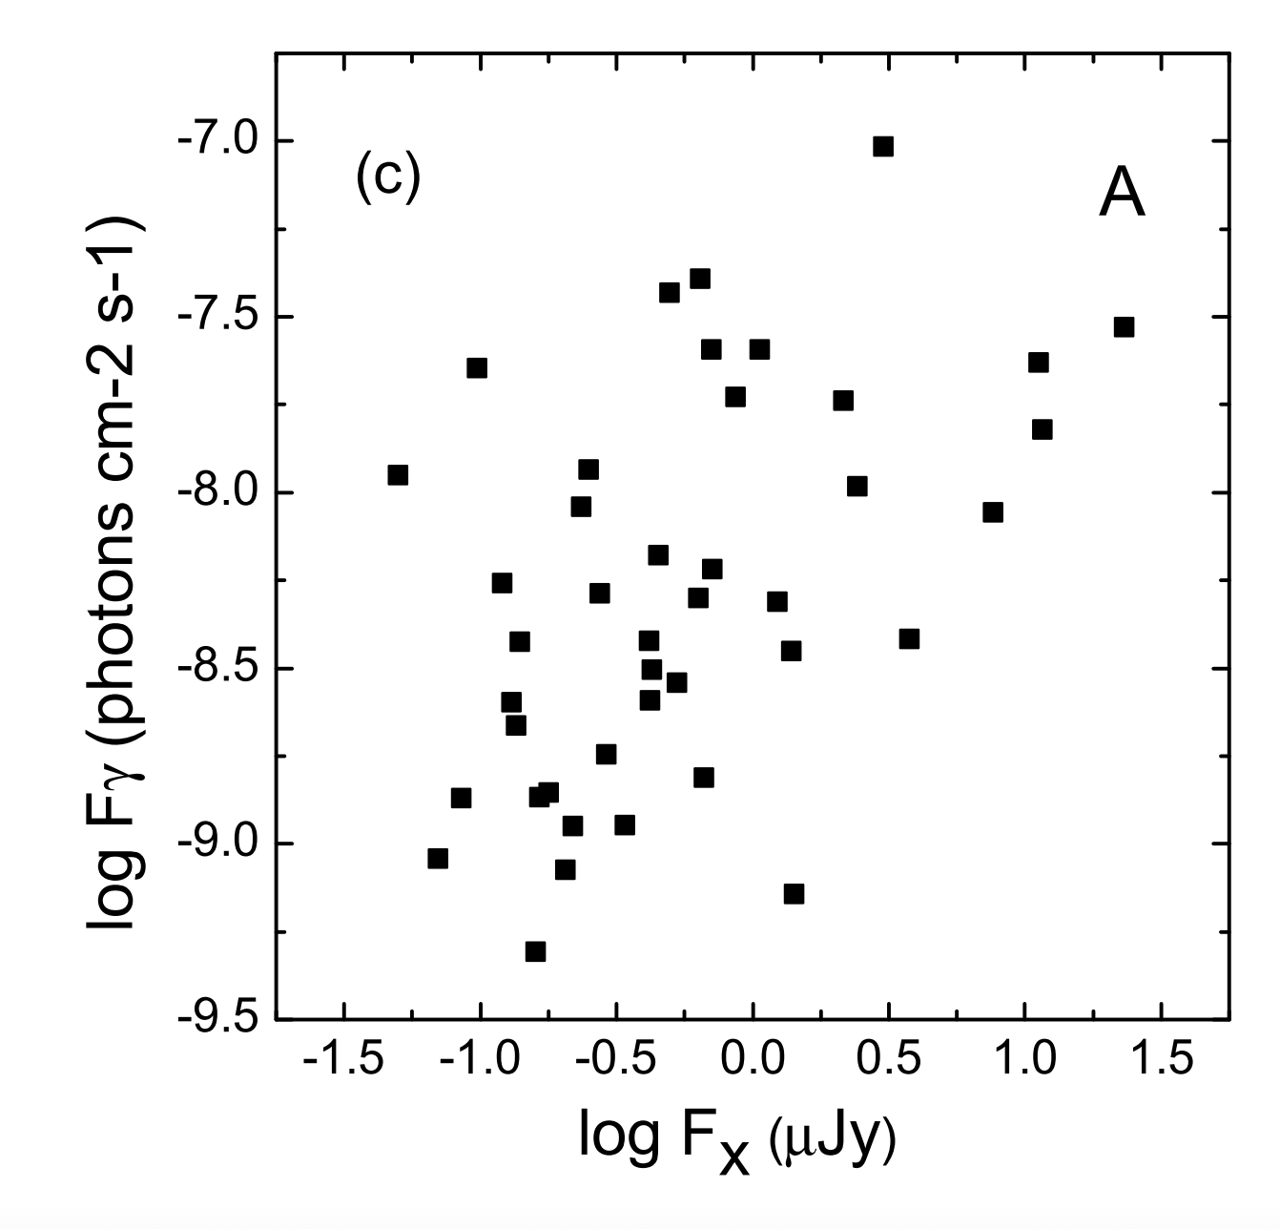

What does this no detection mean?
X-ray / $γ$-ray Scaling
Empirical BL Lac relation
$$TS=2(\log{ℒ_{1}−\log{ℒ_{0}})}$$
[Li et al. 2013]
$\log{F_{γ}=0.42\log{F_{X}−8.17}}$(& scatter based on different states)
[11]
Notes:
— Measures how much better the data are explained by including a γ-ray source.

Slide 29
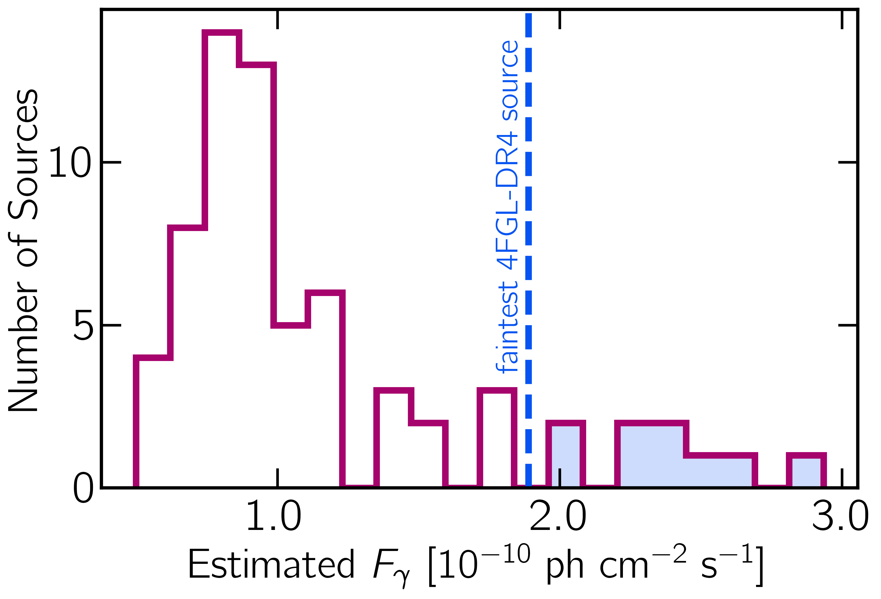
What does this no detection mean?
Most predicted fluxes fall just below LAT’s sensitivity after 15 years
X-ray / $γ$-ray Scaling
Empirical BL Lac relation
$$TS=2(\log{ℒ_{1}−\log{ℒ_{0}})}$$
[Li et al. 2013]
$\log{F_{γ}=0.42\log{F_{X}−8.17}}$(& scatter based on different states)
[11]
Notes:
— Measures how much better the data are explained by including a γ-ray source.

Slide 30
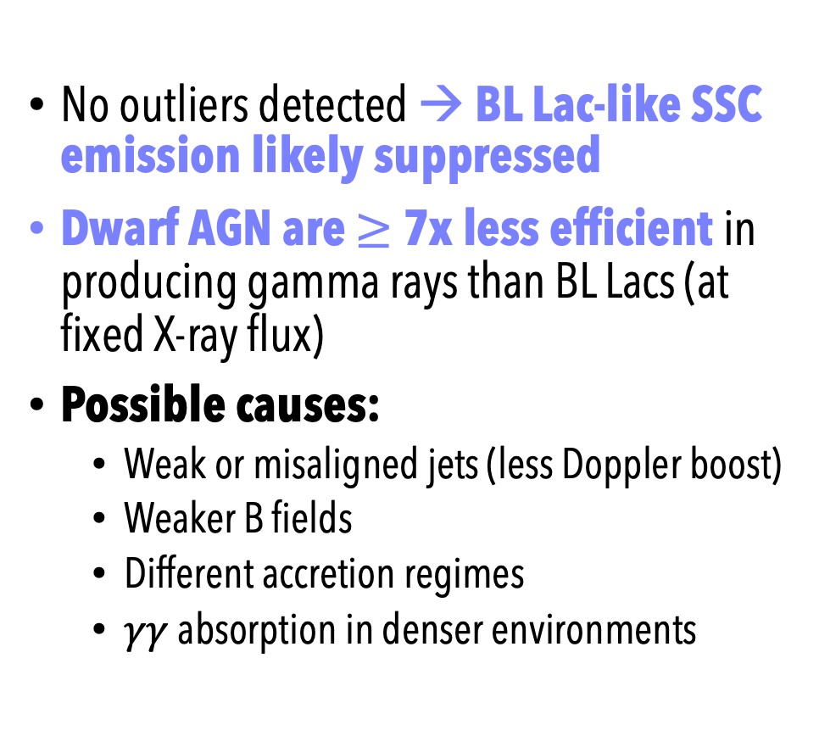
What does this no detection mean?
Most predicted fluxes fall just below LAT’s sensitivity after 15 years
No outliers detected → BL Lac-like SSC emission likely suppressed
Dwarf AGN are $≥$7x less efficient in producing gamma rays than BL Lacs (at fixed X-ray flux)
Possible causes:
Weak or misaligned jets (less Doppler boost)
Weaker B fields
Different accretion regimes
$γγ$ absorption in denser environments
$$TS=2(\log{ℒ_{1}−\log{ℒ_{0}})}$$
[12]
Notes:
“In blazars, gamma rays come primarily from the synchrotron self-Compton process — electrons in the jet up-scatter their own synchrotron photons to GeV energies. But in dwarf AGN, those conditions are much less extreme — weaker jets, lower photon densities, and little Doppler boosting — so the same mechanism is dramatically less efficient. That’s what we see in the data: roughly seven times less gamma-ray output for the same X-ray flux.”
In blazars, the jet is pointed almost directly at us. Inside that jet, you have relativistic electrons spiraling around magnetic field lines.
Step 1 – Synchrotron emission: Those electrons emit synchrotron radiation — photons ranging from radio up to X-ray energies.
Step 2 – Compton up-scattering: The same electrons then collide with the synchrotron photons they just produced, scattering them to much higher energies — into the gamma-ray regime.
(it works in blazars because they’re highly relativistic… ) Lower black hole masses → lower jet powers,
Weaker magnetic fields,
Fewer high-energy electrons, and
Less Doppler boosting (misaligned or slow jets).

Slide 31
Joint likelihood analysis

Slide 32
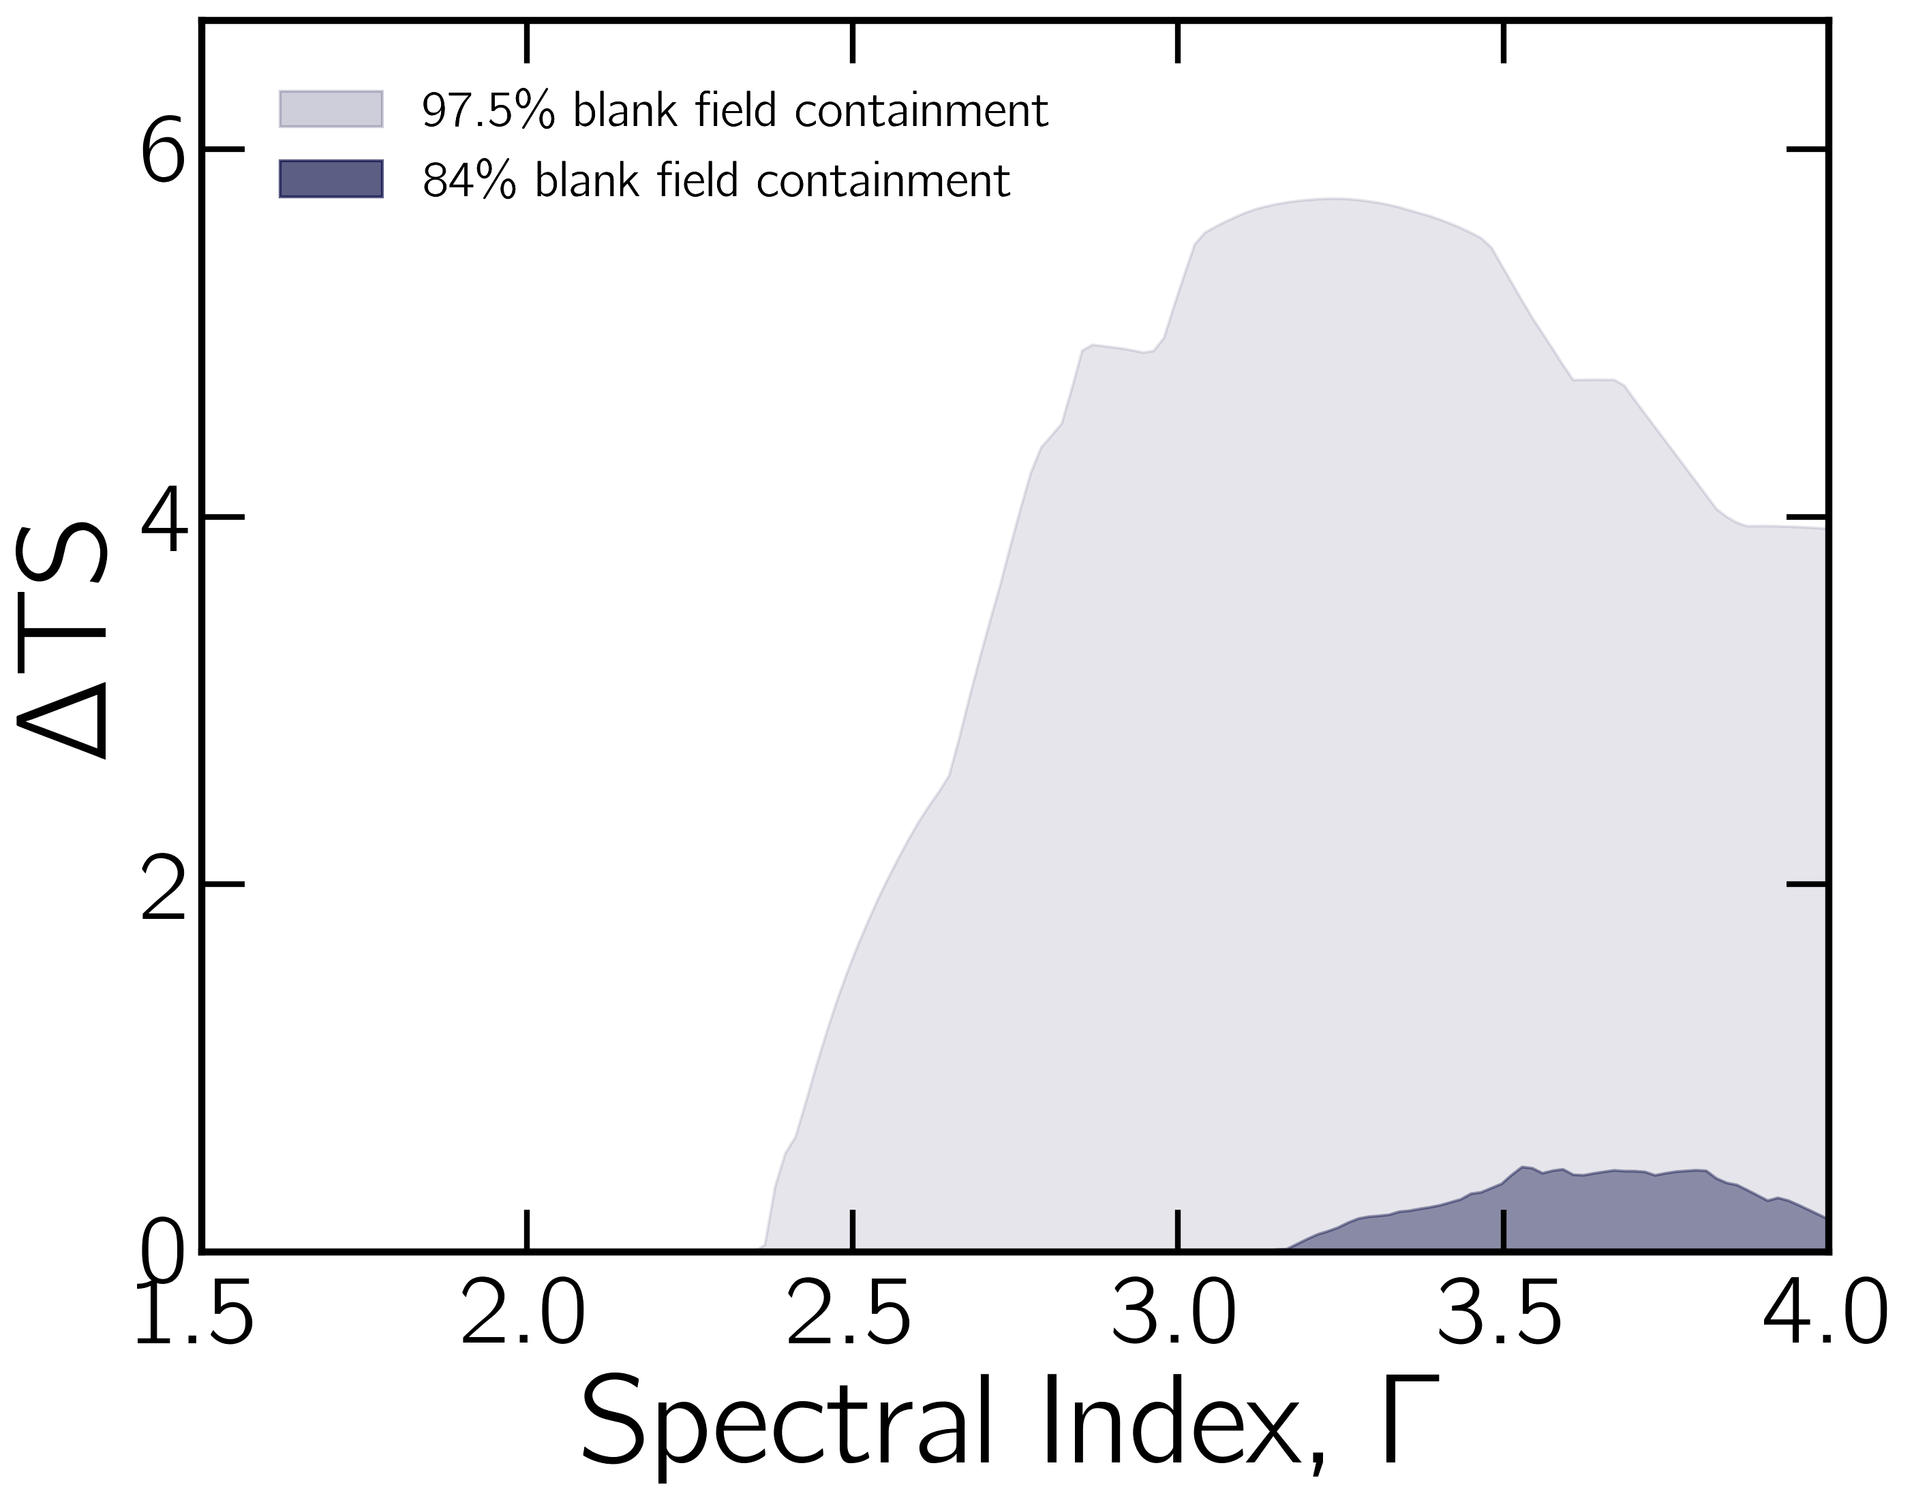
[14]

Slide 33
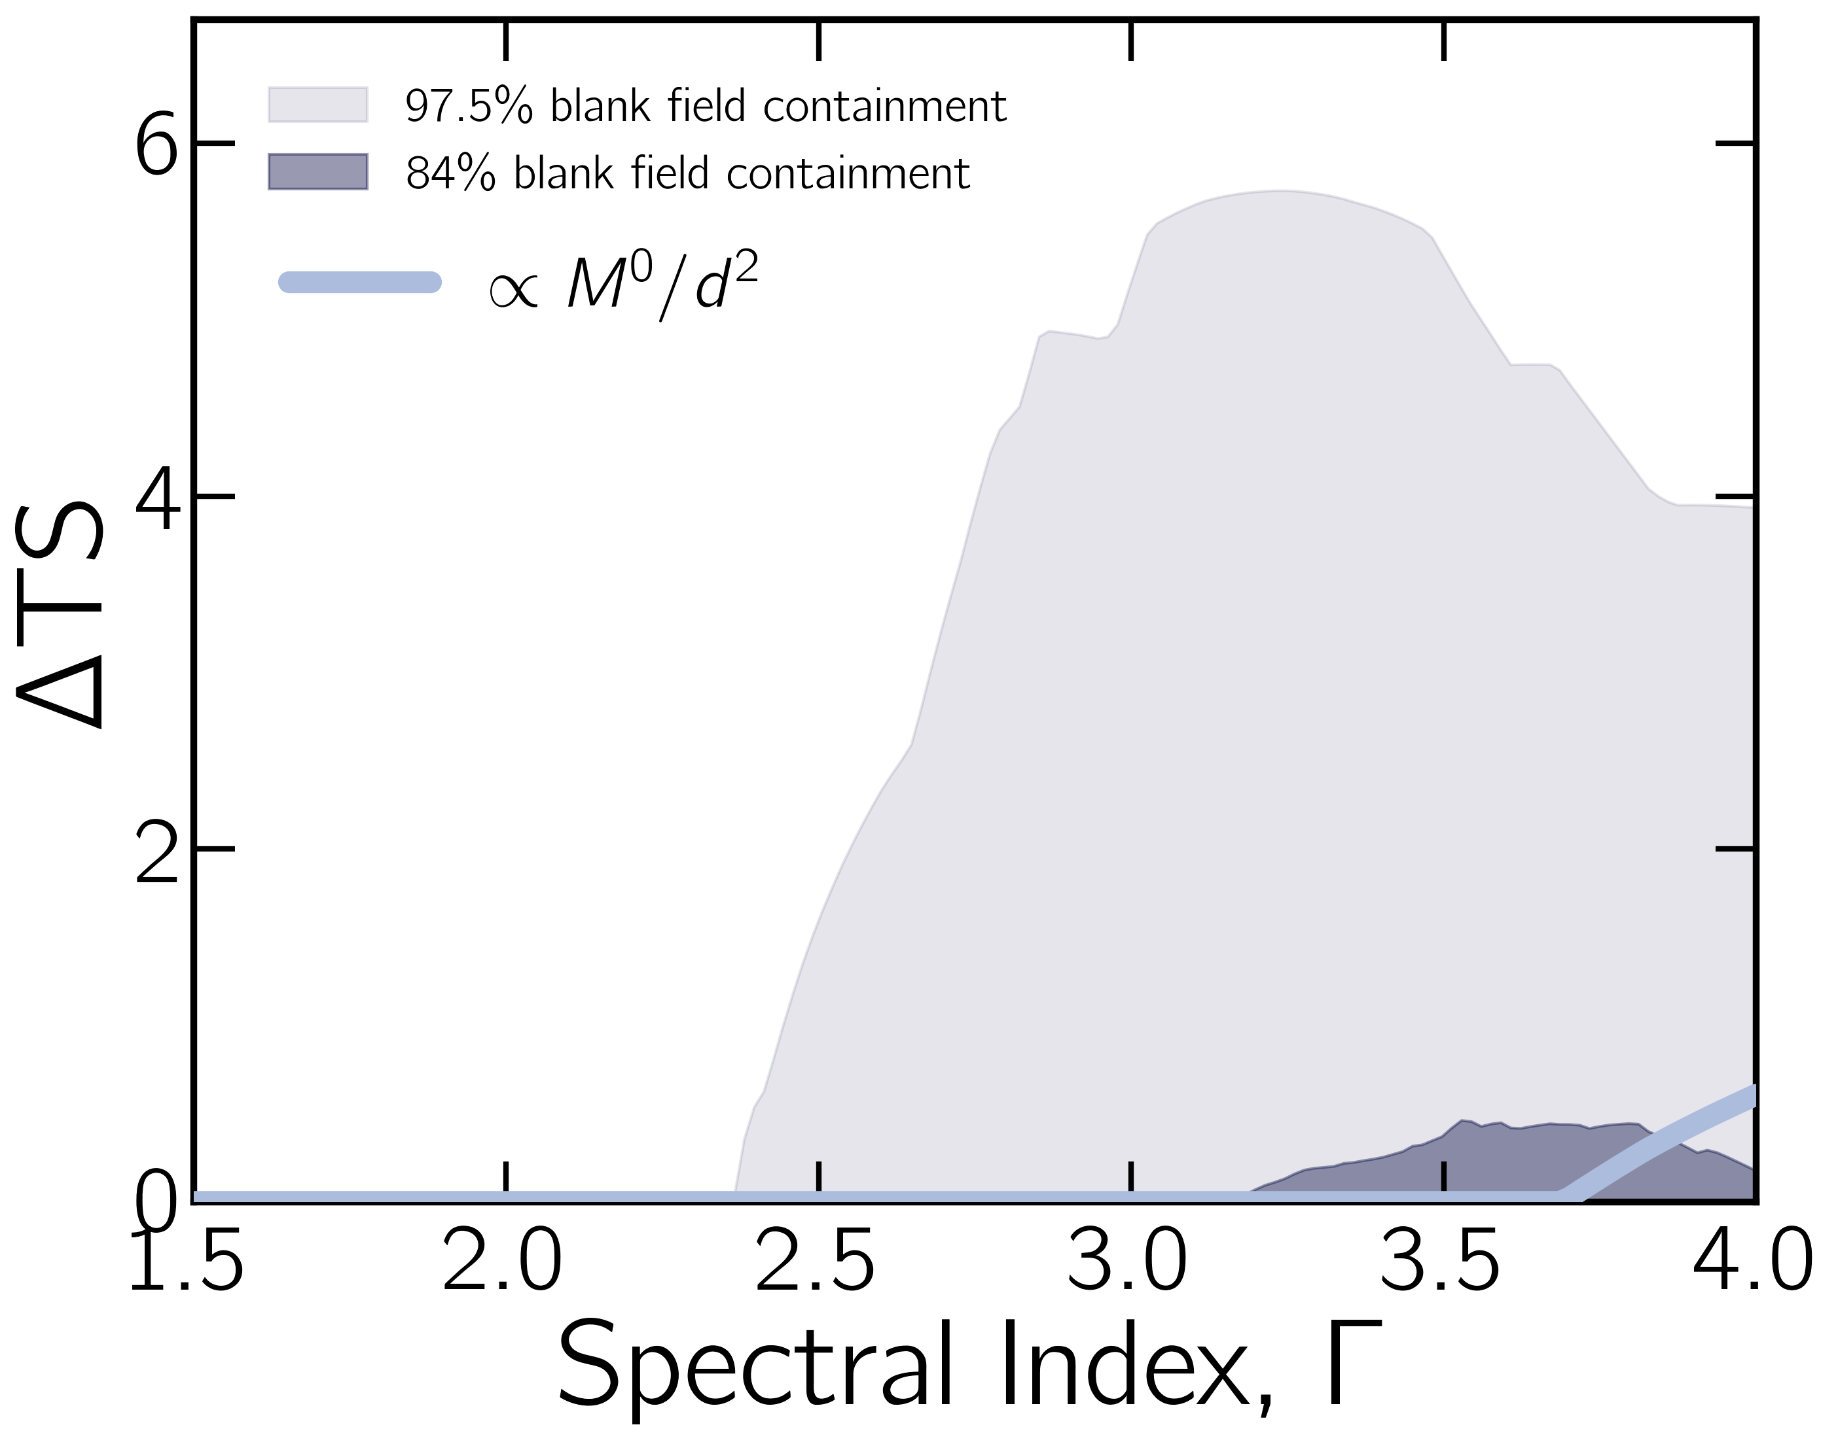
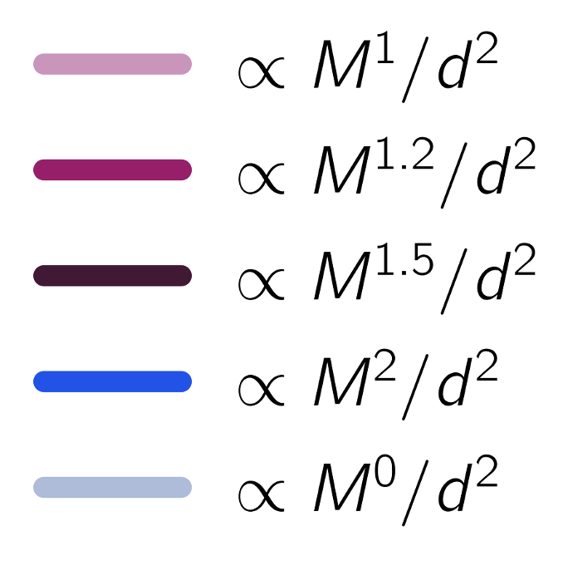
With IMBH mass derived from stellar mass–black hole mass relation (Reines & Volonteri 2015):
[14]

Slide 34
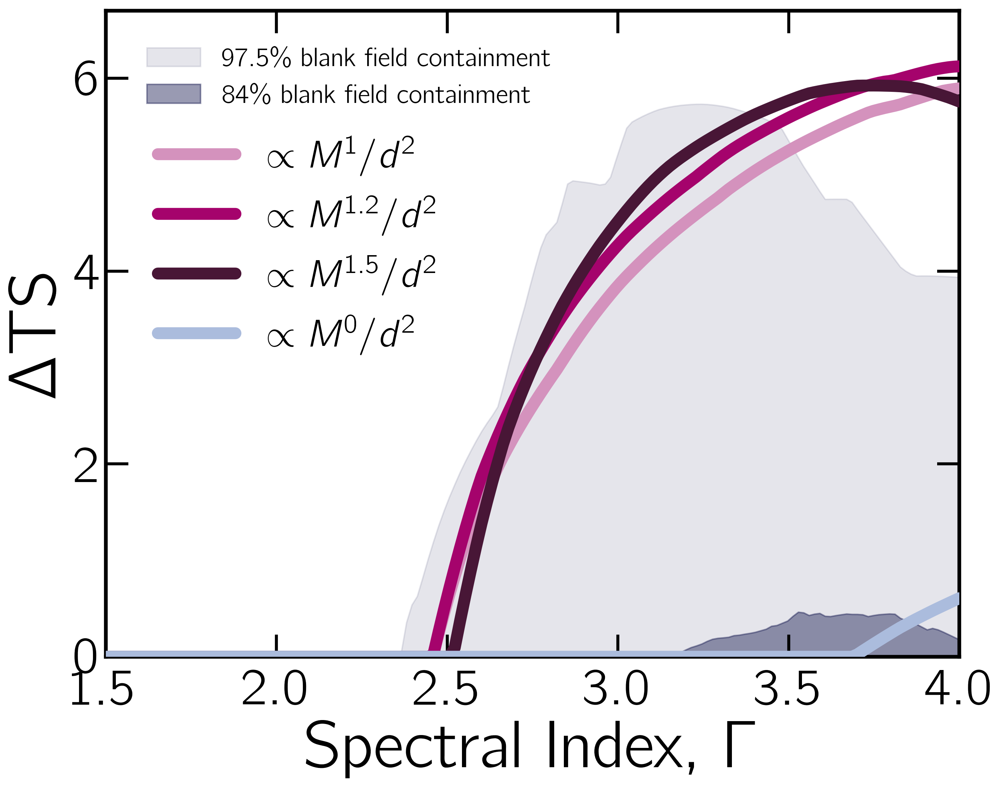
With IMBH mass derived from stellar mass–black hole mass relation (Reines & Volonteri 2015):
[14]

Slide 35
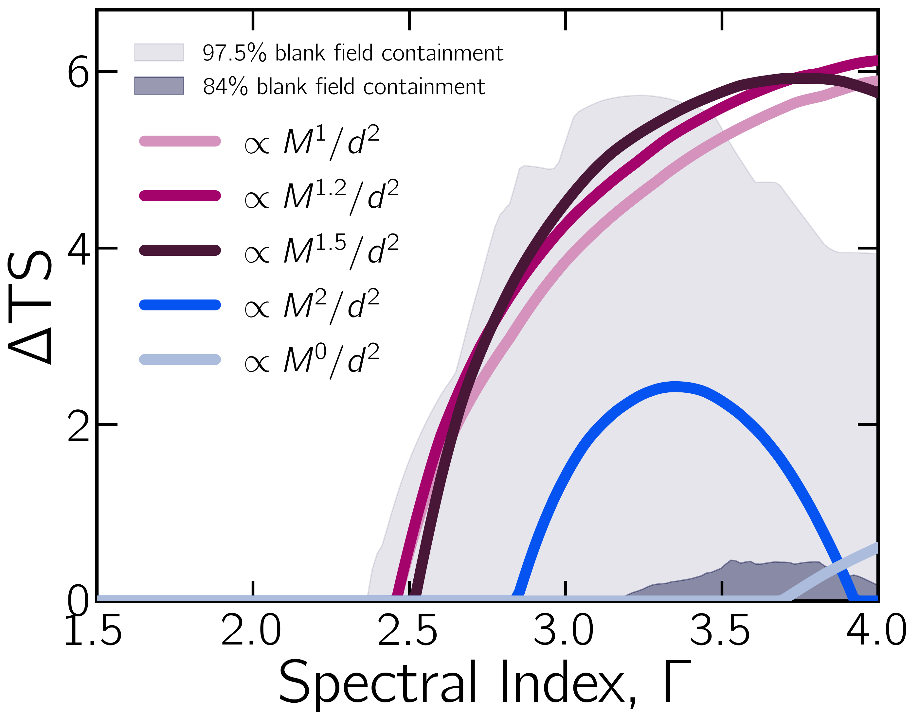
With IMBH mass derived from stellar mass–black hole mass relation (Reines & Volonteri 2015):
[14]

Slide 36
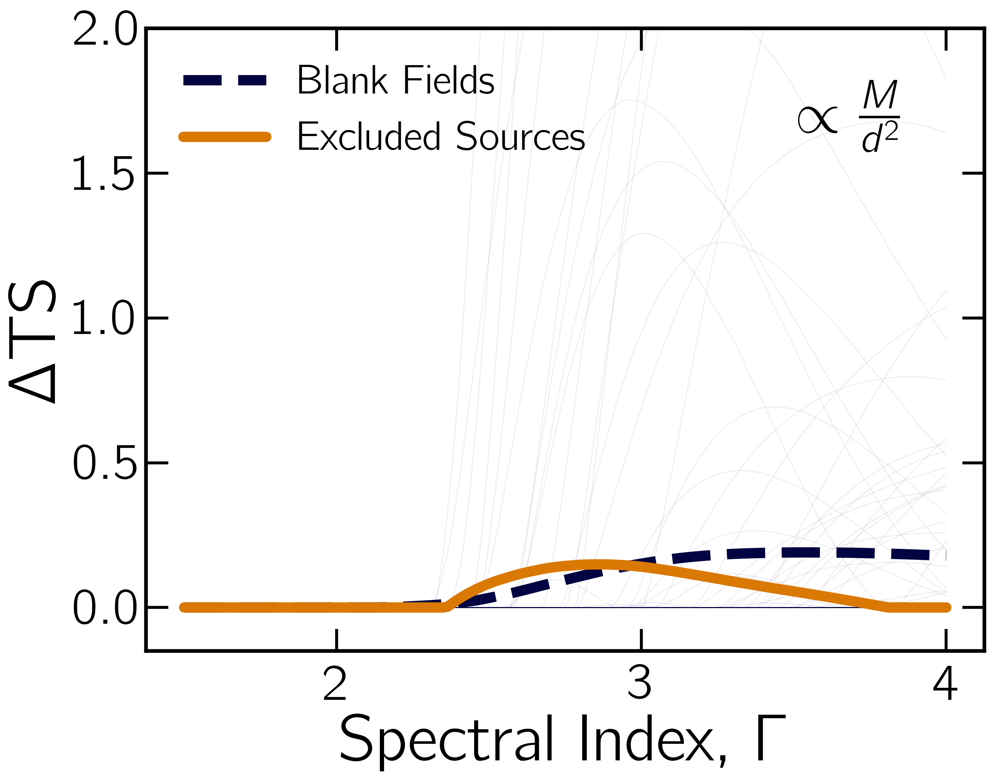
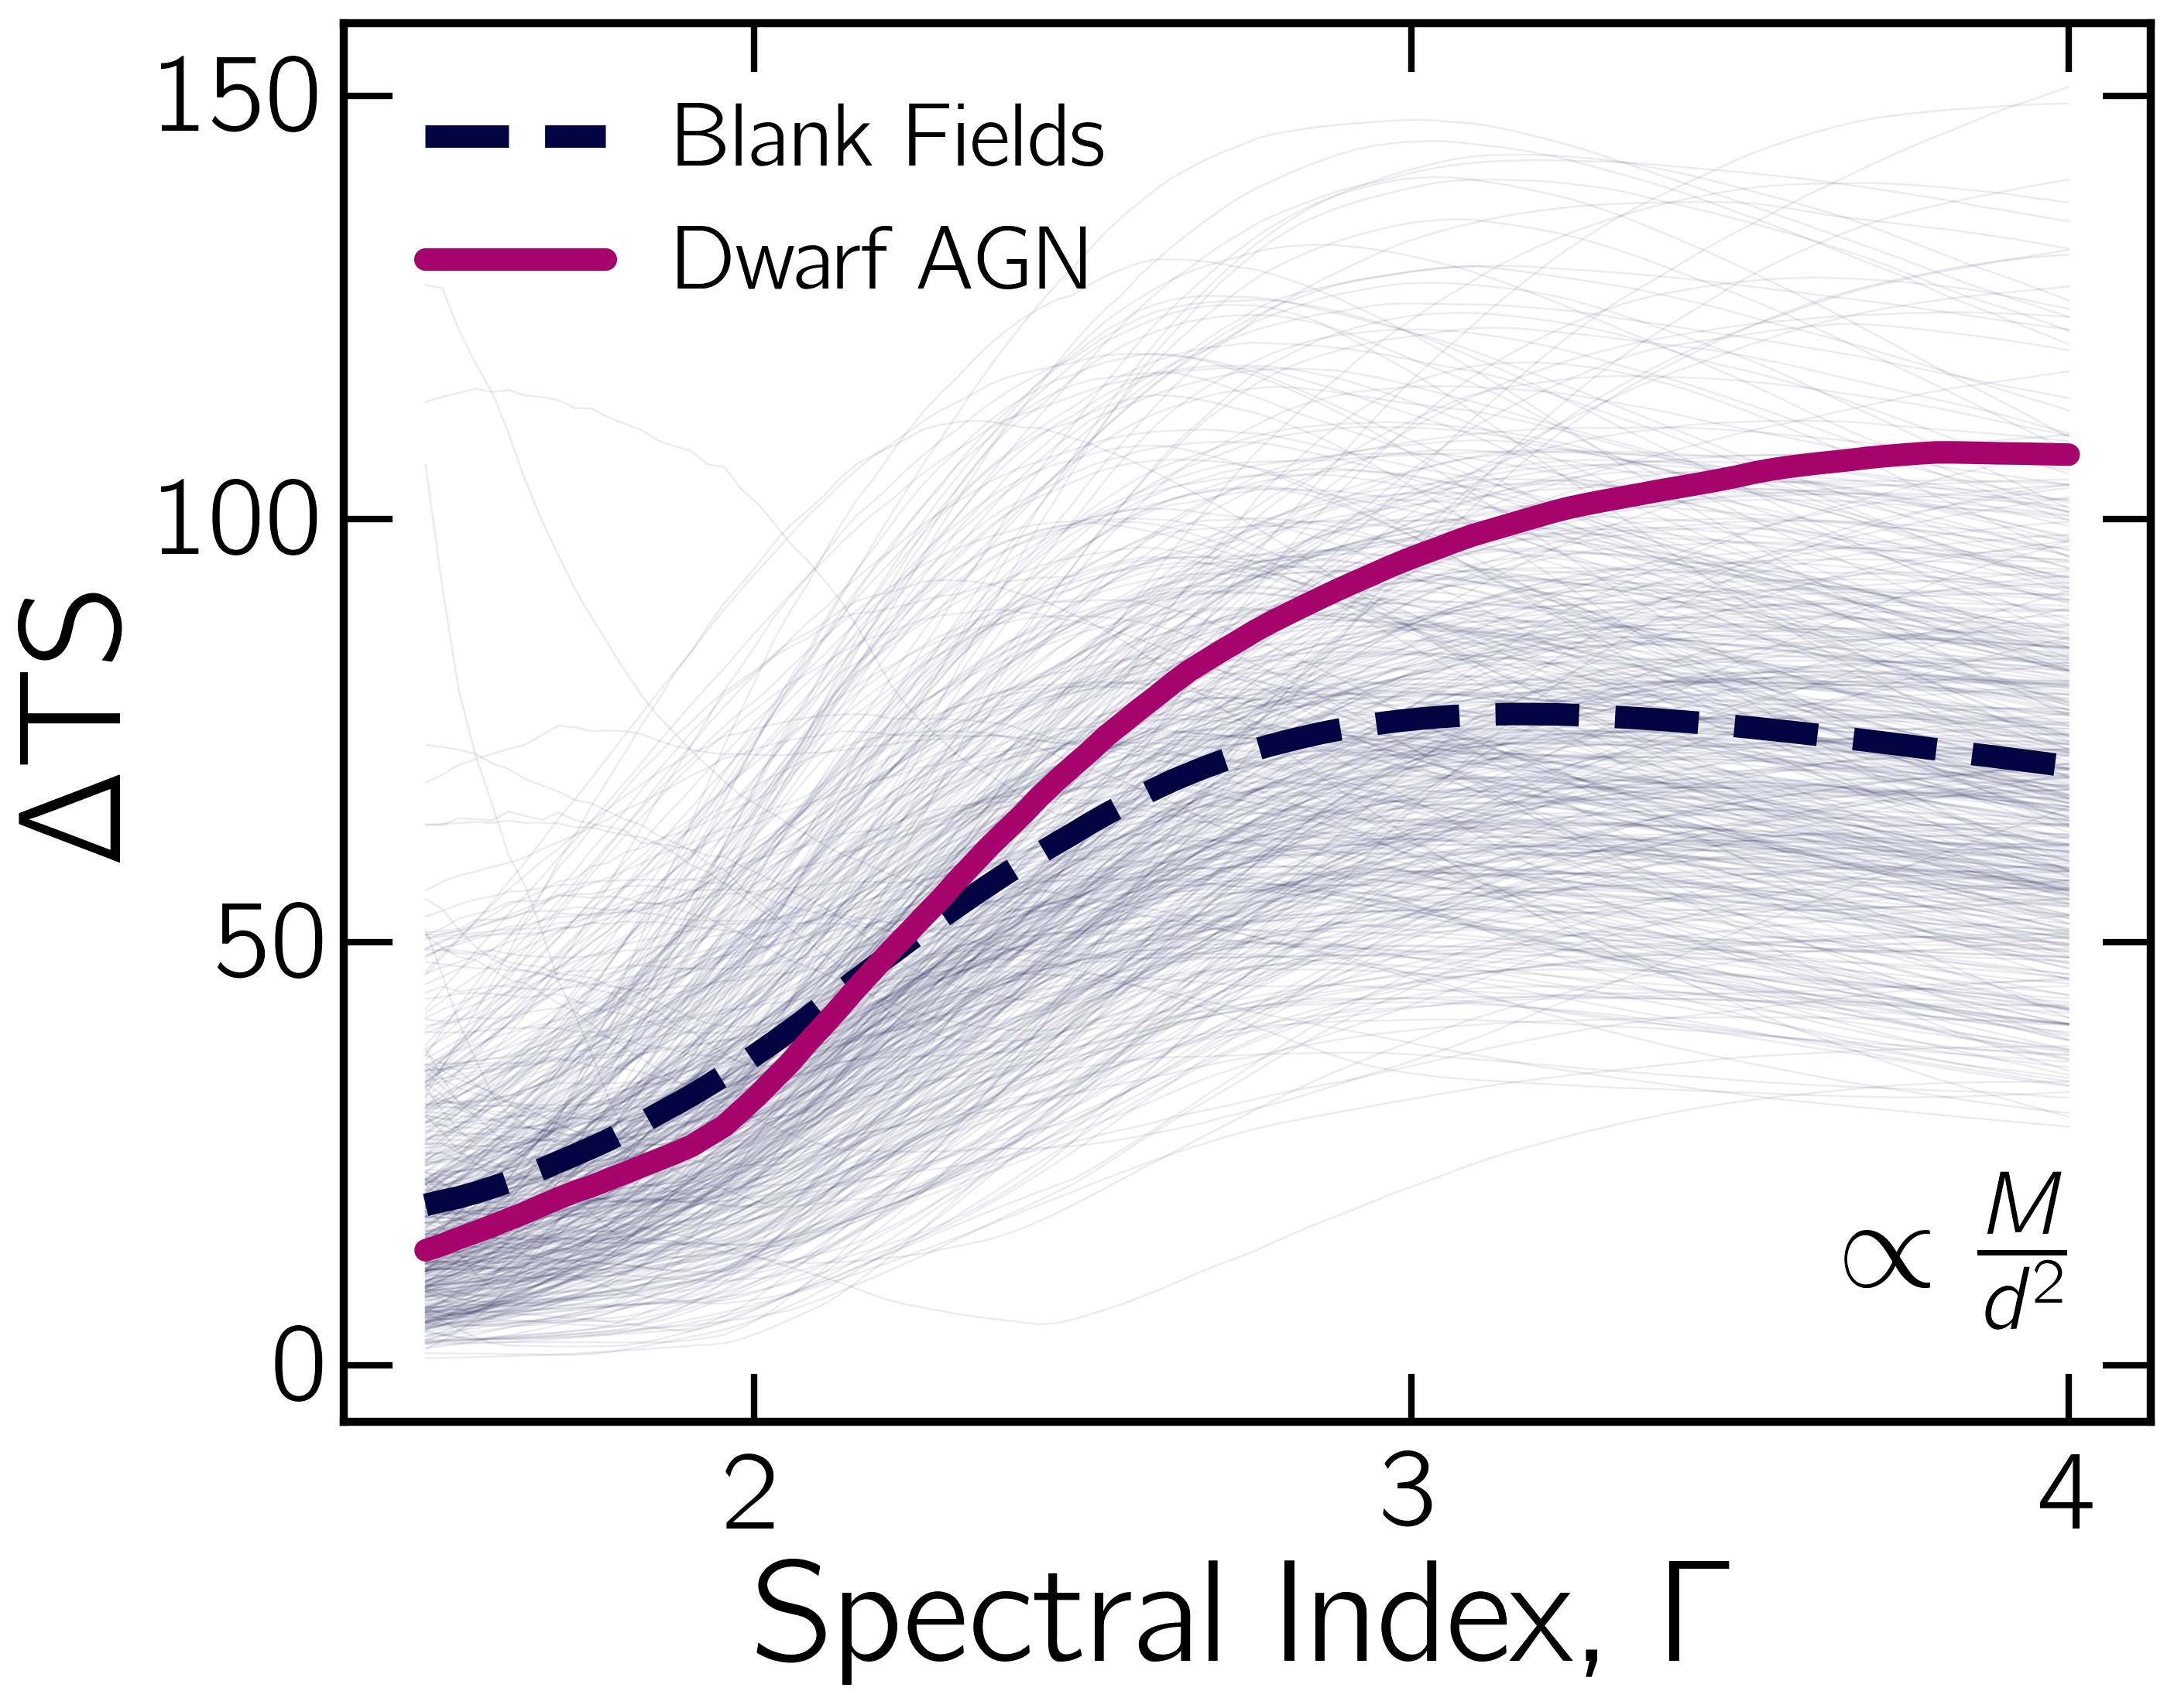
With IMBH mass derived from stellar mass–black hole mass relation (Reines & Volonteri 2015):
Interpretation:
⇾ Suggestive—but not conclusive—evidence that γ-ray emission may scale with IMBH mass
⇾ Spectrum significantly softer than typical blazars (Γ ≈ 2–2.5)
⇾ Possible explanations:
Coronal or accretion-disk Comptonization
Weak or misaligned jets
γγ absorption or host star formation contamination
⇾ Verified against 400 blank-field ensembles and excluded-source control sample
⇾ Similar soft peak appears when extended down to 100 MeV (but with inflated significance → likely systematics)
[15]

Slide 37
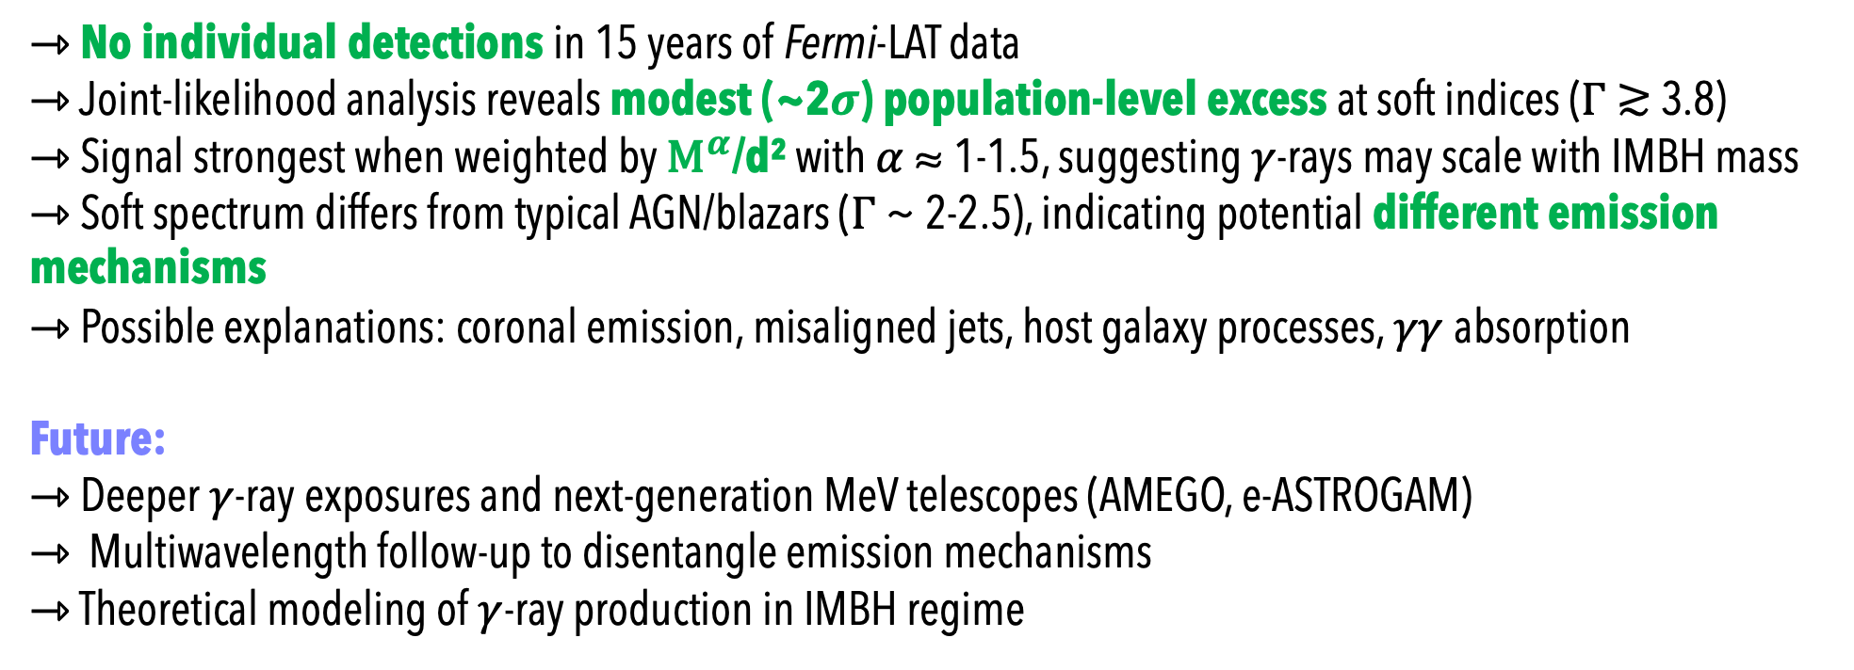
Conclusions
⇾ No individual detections in 15 years of Fermi-LAT data
⇾ Joint-likelihood analysis reveals modest (~2$σ$) population-level excess at soft indices ($Γ$≳ 3.8)
⇾ Signal strongest when weighted by ${\text{M}}^{α}$/d² with $α$ ≈ 1-1.5, suggesting $γ$-rays may scale with IMBH mass
⇾ Soft spectrum differs from typical AGN/blazars ($Γ$ ~ 2-2.5), indicating potential different emission mechanisms
⇾ Possible explanations: coronal emission, misaligned jets, host galaxy processes, $γγ$absorption
Future:
⇾ Deeper $γ$-ray exposures and next-generation MeV telescopes (AMEGO, e-ASTROGAM)
⇾ Multiwavelength follow-up to disentangle emission mechanisms
⇾ Theoretical modeling of $γ$-ray production in IMBH regime
Thank you!
[16]

Slide 38
Back-up

Slide 39
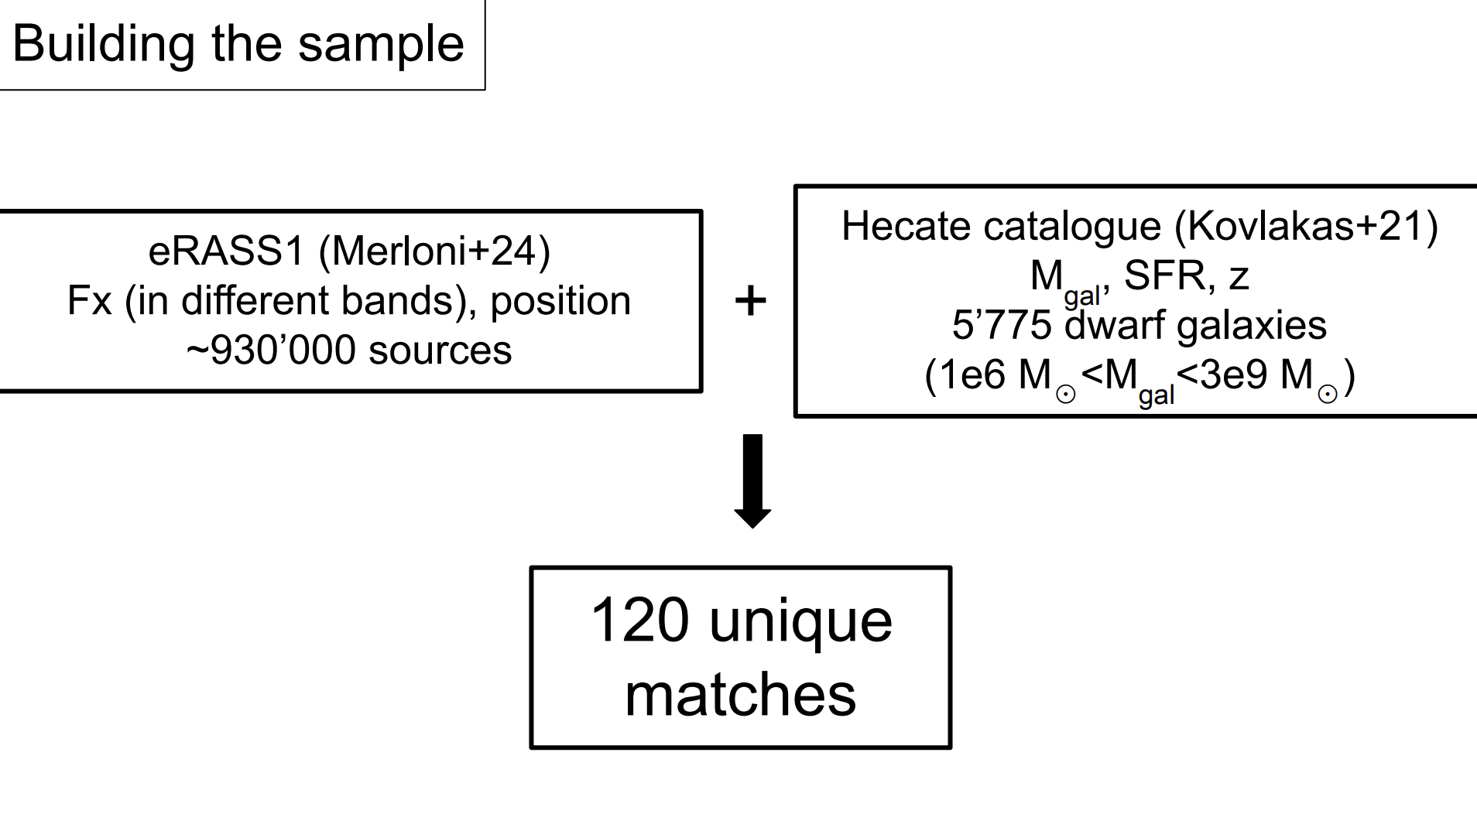

Slide 40
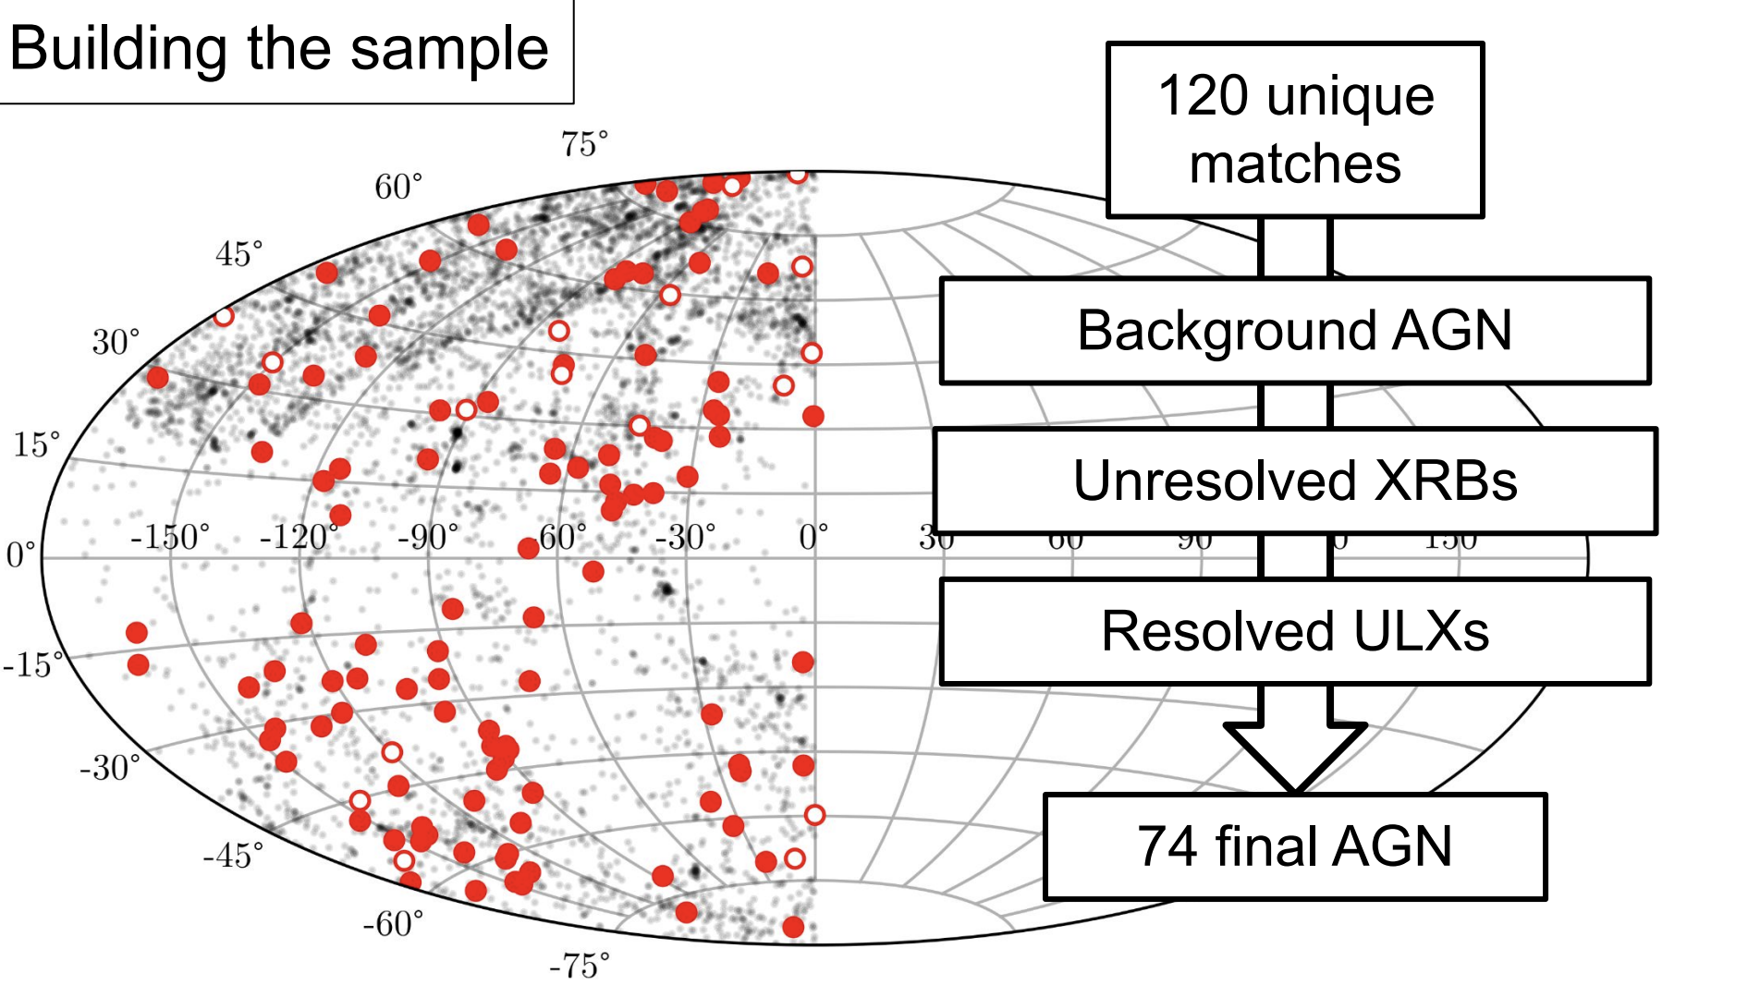
Notes:
LXRB=αMgal+βSFR (Lehmer+10)

