Slide 1



“Particle Probing AGN jet structure with RMHD simulations: implications for VHE emission” Stella S. Boula
INAF – Osservatorio di Brera
05/11/2025
TeVPa, Valencia

Slide 2
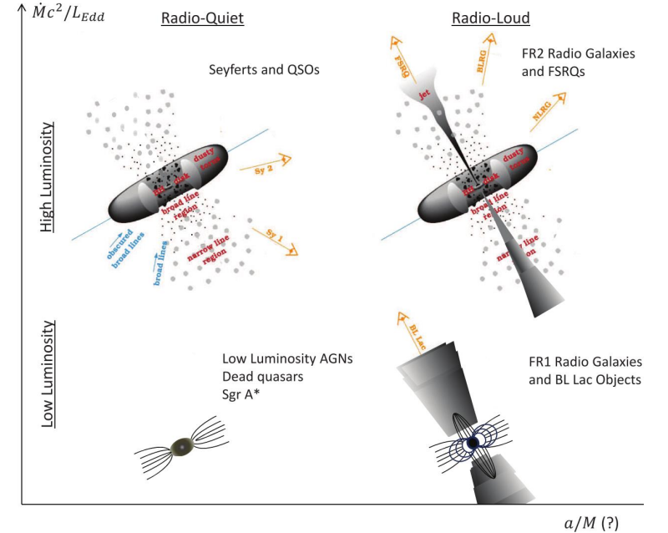
We are interested in…
Relativistic jets launched from near a supermassive black hole (10⁶–10⁹ M☉)
Beaming effects due to small viewing angle (θ ≲ 1/Γ)
Strong variability across the spectrum (from radio to TeV)
Multiwavelength polarization
Non-thermal continuum emission, often dominating over host galaxy light
Jet Lorentz factor Γ ~ 10-50
Magnetic field
B~ mG - G
Acceleration zone
R_{acc}~ 10¹⁶cm
Credit: Padovani et al.
Reviews: e.g., Madejski et al., 2016, Padovani et al., 2017, Blandford et al., 2019, Matthews et al., 2020

Slide 3
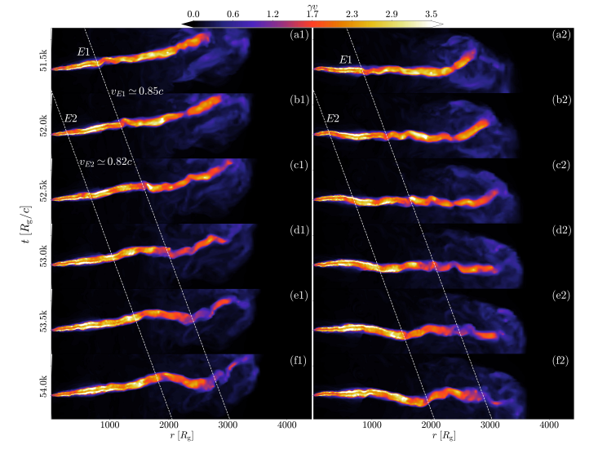
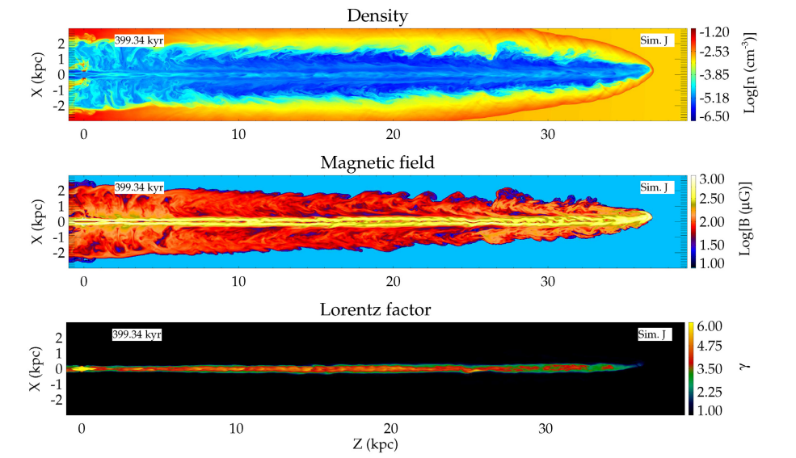
Jet Simulations
Lalakos et al., 2023
Mukherjee et al., 2020

Slide 4
What are the jet instabilities?
Kelvin-Helmholtz (KHI): Caused by shear at jet-ambient interface; prominent in hydrodynamic jets.
Current-Driven (CDI / Kink Instability): Arises in magnetized jets with strong toroidal components; distorts or disrupts the jet core.
Centrifugal (CFI): Linked to local curvature, radius, and magnetization; localized and condition-dependent.
Types of instabilities
Control jet stability, mixing and turbulence.
Affect energy dissipation, shock formation and particle acceleration.
Influence polarization, variability and emission signatures observed in AGN jets.
Why are they important?
2D captures linear growth and shock interaction.
3D is necessary for full nonlinear evolution (e.g., kink development, helical modes, turbulence onset).
only 3D can capture non axisymmetric modes (kink, KHI and CFI)
3D vs. 2D

Slide 5
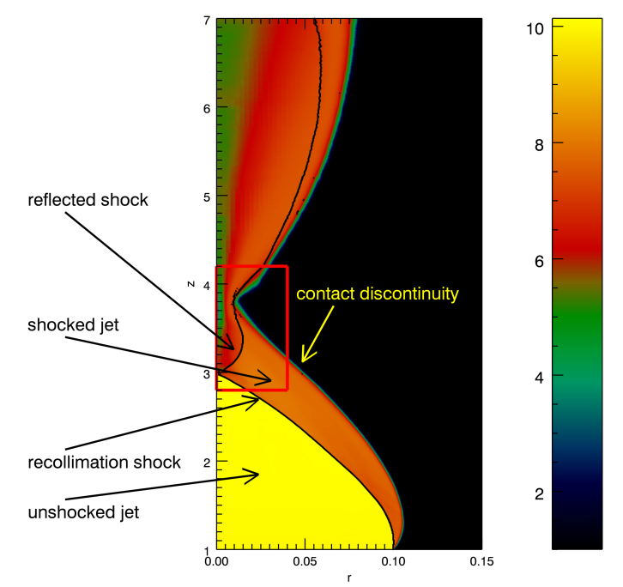
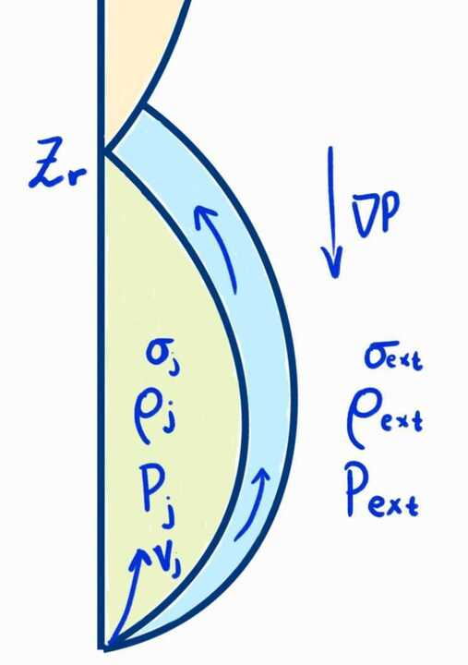
Recollimation instabilities and their role in shaping MHD jets
Research Question:
Can electrons be accelerated at the recollimation shock?
New 3D simulations of recollimated, weakly magnetized jets (post-first recollimation shock) show:
Rapidly growing instability in the flow
Development of high turbulence
Flow deceleration
Inhibition of multiple shock structure formation as seen in 2D simulations
Bodo & Tavecchio 2018
e.g. Komissarov & Falle 1997, Mizuno et al. 2015, Gourgouliatos & Komissarov 2018, Bodo & Tavecchio 2018, Costa et al. 2025, Boula et al., 2025 +++

Slide 6
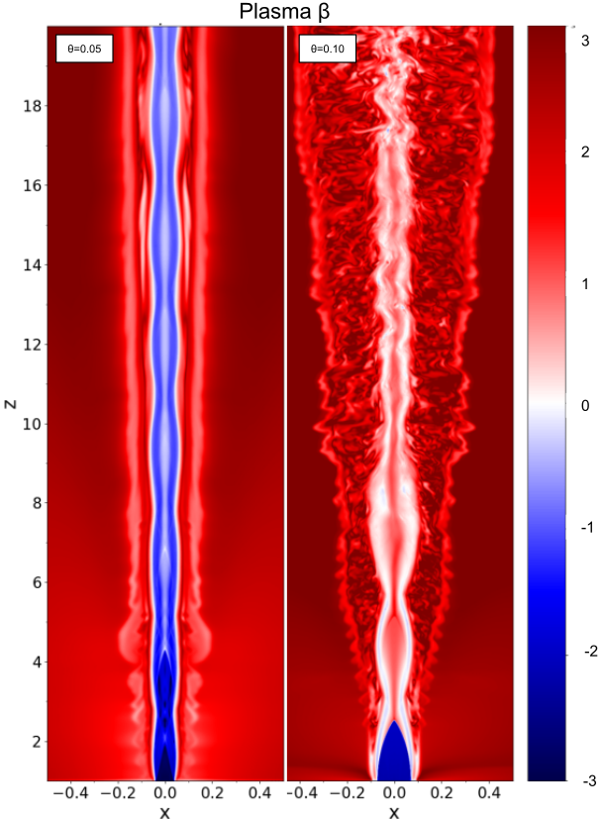
Magnetohydrodynamic (MHD) simulations
Global Dynamics Model full jet structure over parsec to kiloparsec scales: formation, collimation, propagation, and jet–environment interaction.
Shock Identification Capture macroscopic shocks: Internal shocks (from velocity variations) Recollimation shocks (from pressure mismatches) → Potential particle acceleration sites
Instability Evolution Resolve large-scale MHD instabilities (e.g., Kelvin–Helmholtz, current-driven), leading to turbulence and possible energy dissipation.
Long-Term Variability Follow the evolution of shocks and turbulence over time, providing insight into long-timescale blazar variability.
No Microphysics of Acceleration Cannot self-consistently model particle injection or non-thermal spectra. Particle energization must be assumed or informed by PIC/MC results.
Boula et al., arXiv:2510.01742
e.g., Gómez et al. 1997; Komissarov & Falle 1997;Mizuno et al. 2011; Rueda-Becerril et al. 2014; Diltz et al. 2015; Mizuno et al. 2015; Martí et al. 2016; Fromm et al. 2016; Bromberg & Tchekhovskoy 2016; Matsumoto et al. 2017; Barniol Duran et al. 2017; Martí 2019; Tavecchio et al. 2020; Kramer et al., 2024, Boula et al., 2025

Slide 7
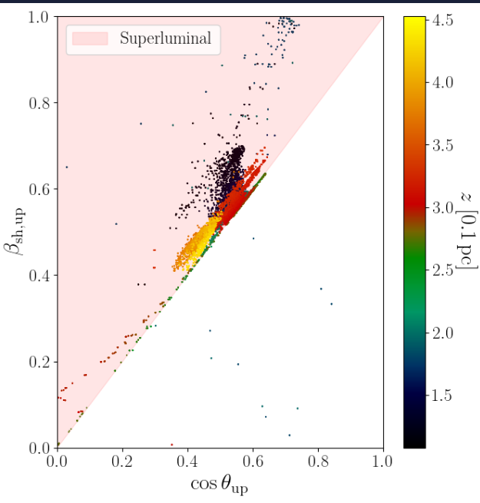
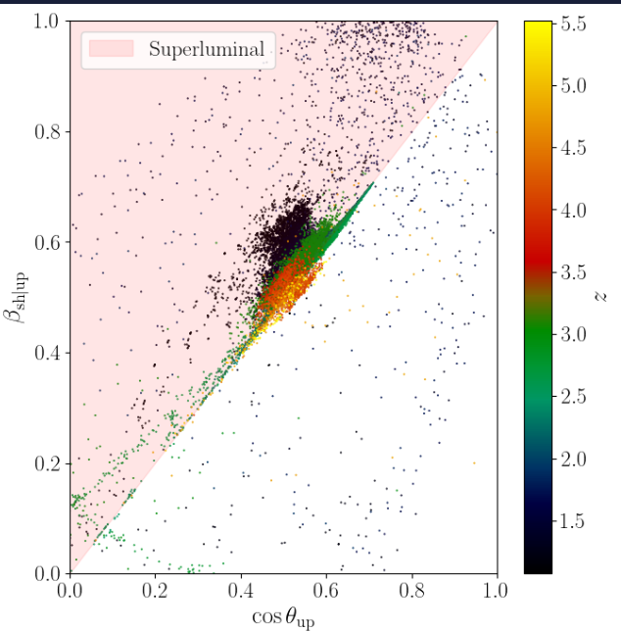
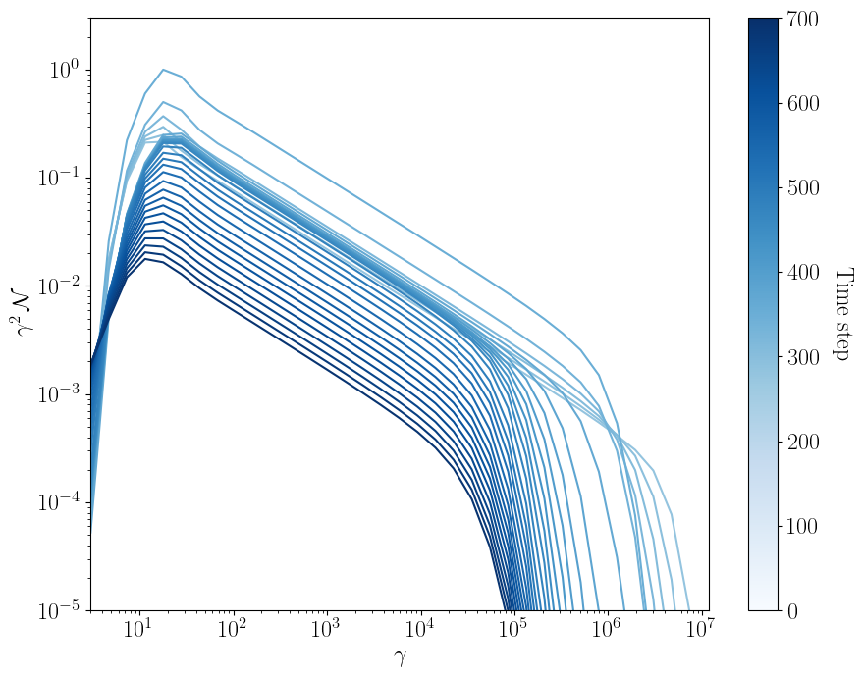
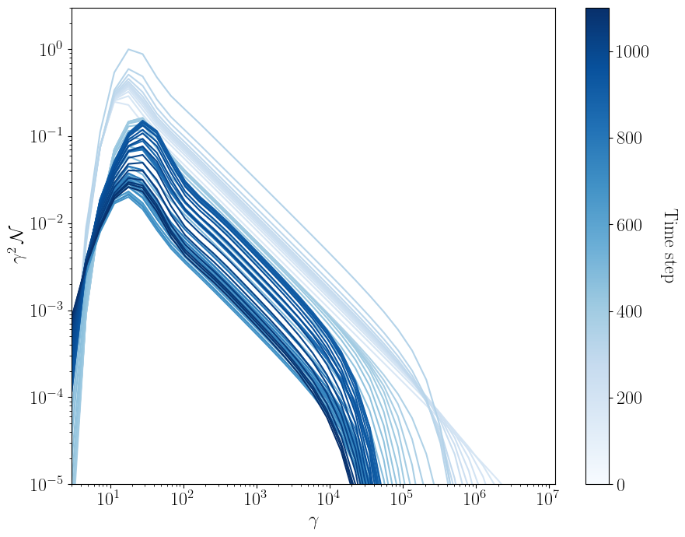
Main Findings
Shock Formation Internal shocks commonly form from bulk velocity variations in the jet. Recollimation shocks arise as the jet adjusts to external pressure. → Both are key sites for potential particle acceleration.
Turbulence & Dissipation MHD instabilities generate turbulence, enabling stochastic acceleration. Magnetic energy dissipation (e.g., via reconnection) can energize particles.
Jet Structure Reveal the large-scale location and evolution of emission regions. Essential for interpreting multi-wavelength and polarization data.
Coupling with Particle Codes RMHD + particle transport/radiation models yield synthetic SEDs and light curves. → Connects global dynamics to observed blazar variability and spectra.
From 3D simulations
t=0
t=93
The method is described in Sciaccaluga, 2025 (for the 2D)

Slide 8
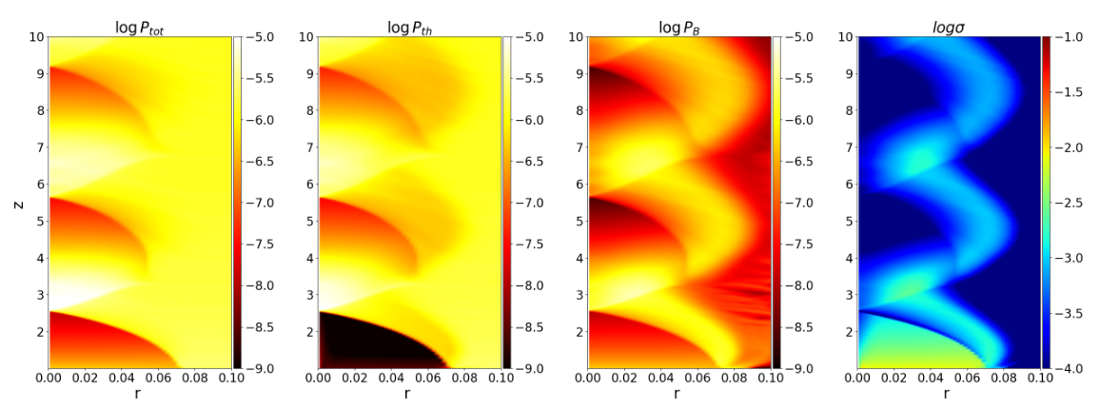
The case: σ=0.1 of a cold, light jet

Slide 9
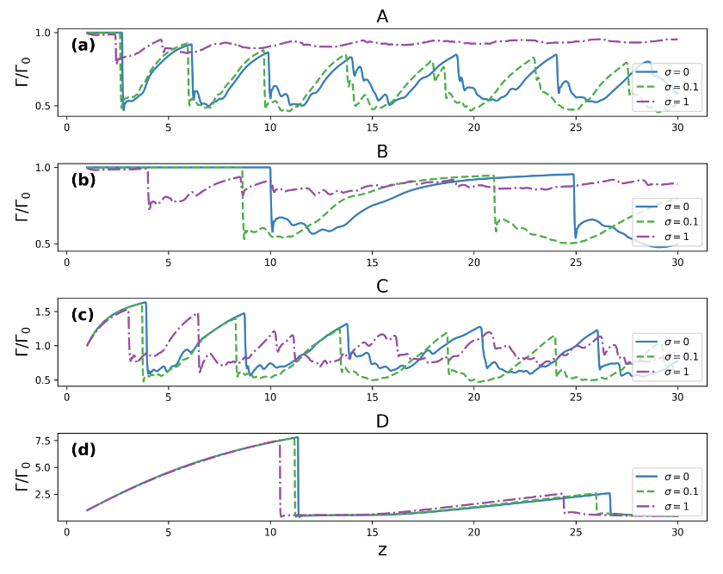
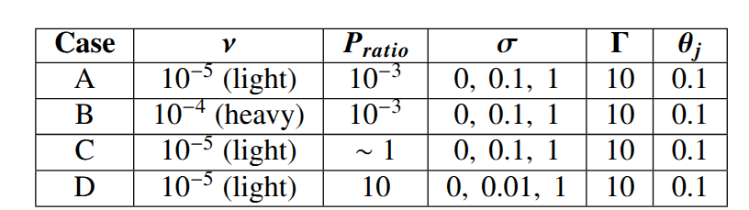
Cold, High Magnetization Jets: Almost absent recollimation shocks due to poloidal dominance.
Jet Acceleration: Less expansion results in less acceleration.
Magnetization Impact: Increased magnetization decreases recollimation points due to poloidal pressure and toroidal tension.
Pressure Ratio: Higher pressure ratios allow freer jet expansion and larger recollimation distances, preserving jet structure.
Heavy Jets: Recollimation at larger distances.

Slide 10
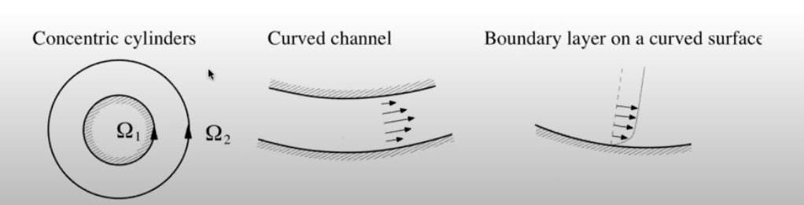

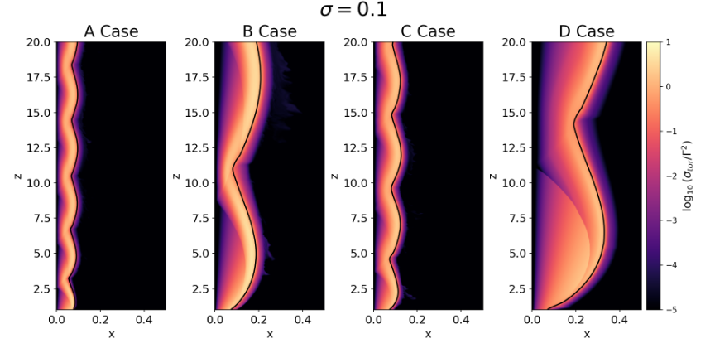
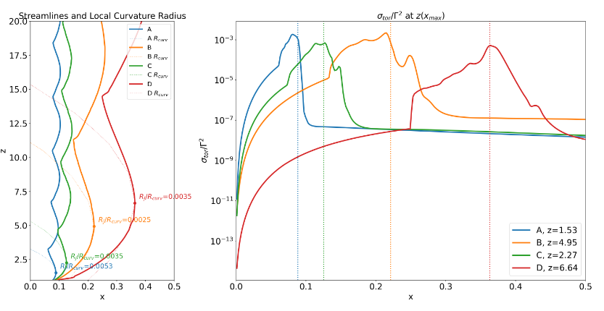
A local instability: Centrifugal instability
Credit: K. Gourgouliatos
Komissarov et. al, 2019, Vlahakis, in prep, Boula et al., arXiv:2510.01742v1, accepted in A&A

Slide 11
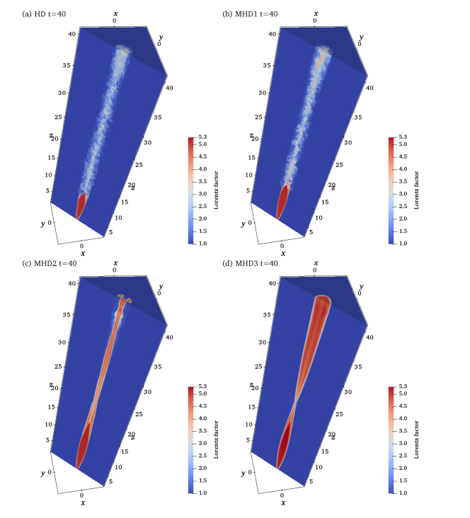

3D simulations
Matsumoto, Komissarov and Gourgouliatos, 2021

Slide 12
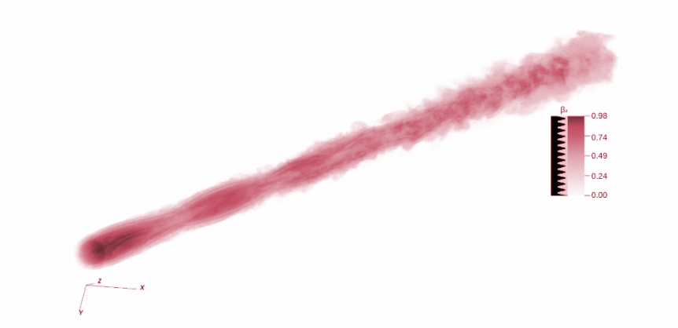
3D PLUTO simulations
Perform the 2D simulations to start the 3D from a nearly equilibrium state.
2D (cylindrical) → 3D (cartesian)
Resolution
Important for the instabilities that will be triggered

Slide 13
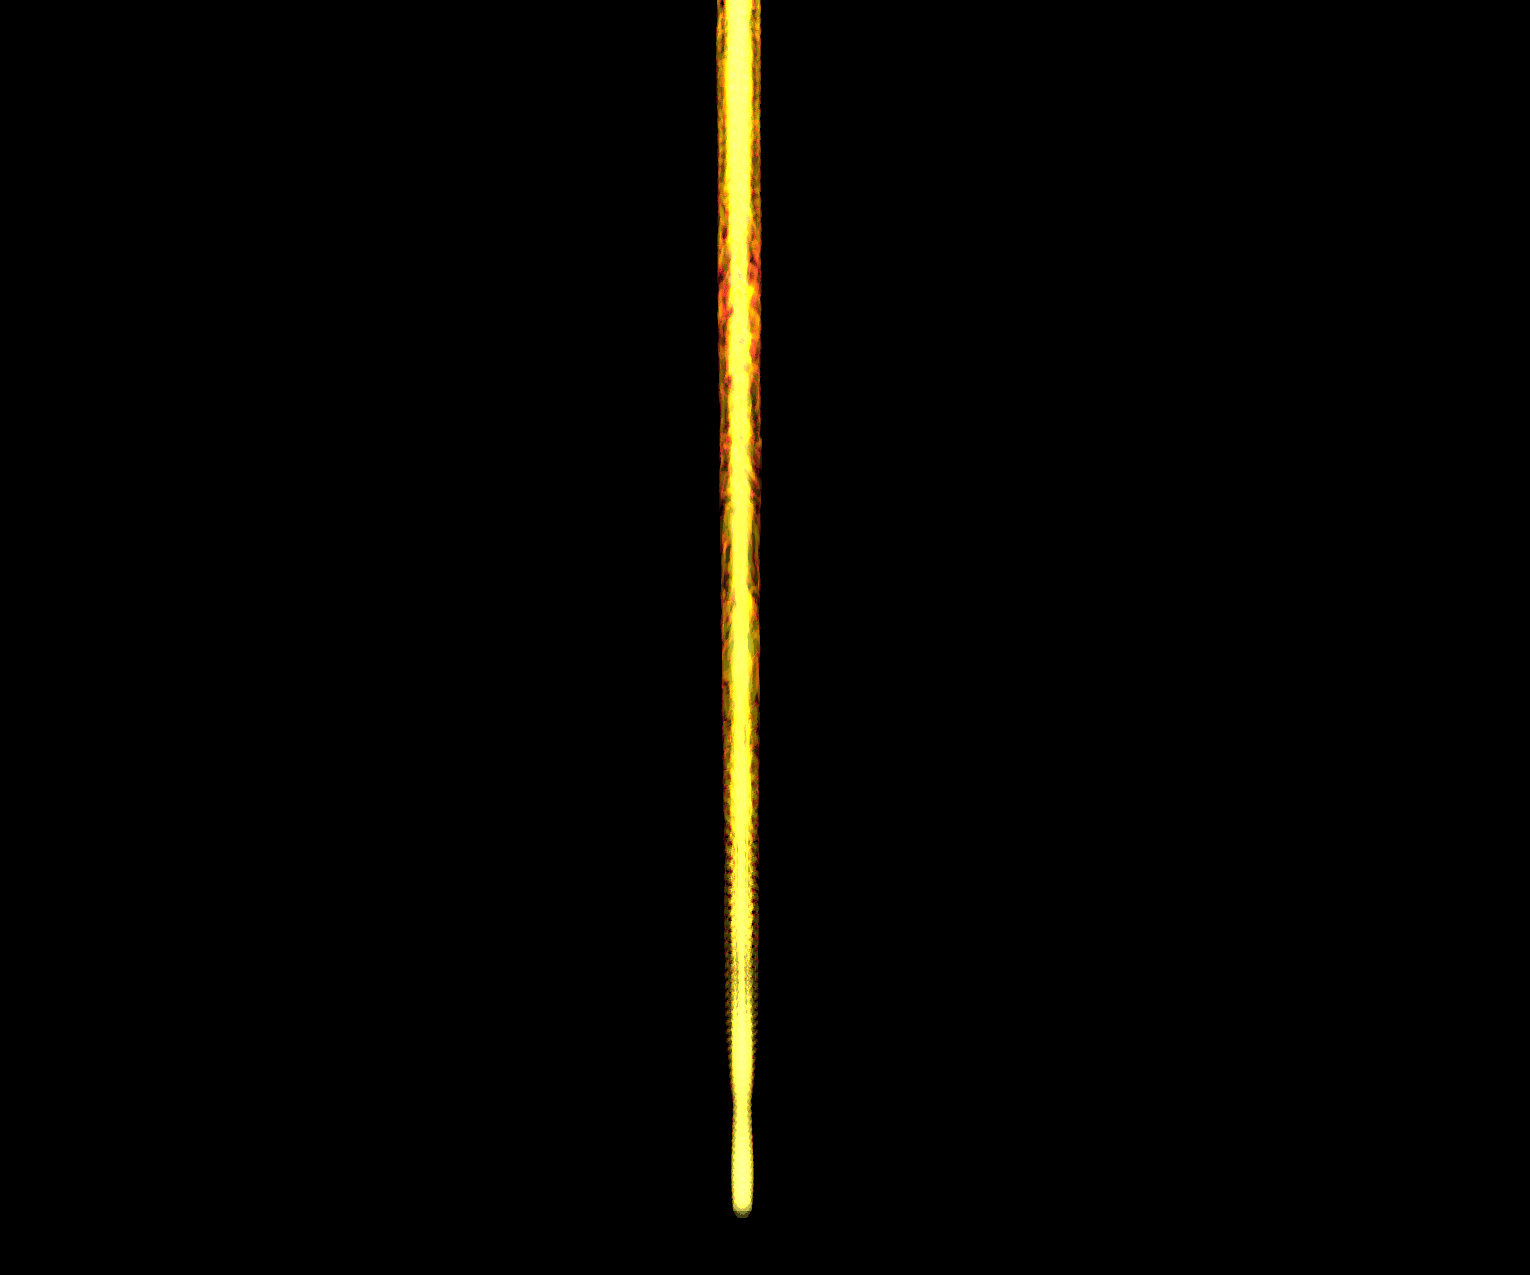

Slide 14
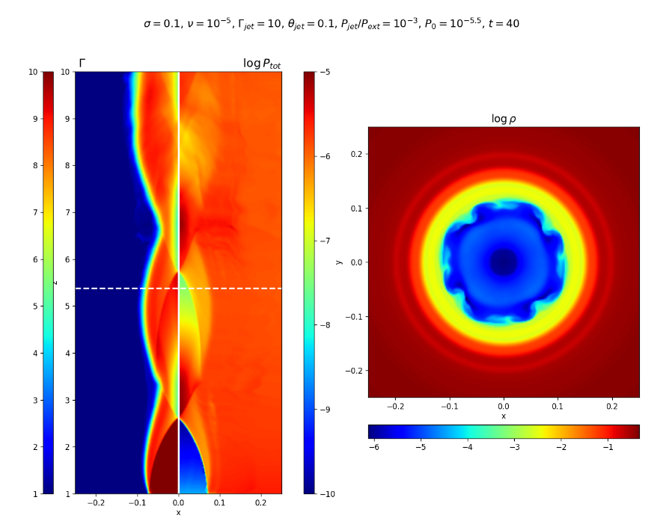
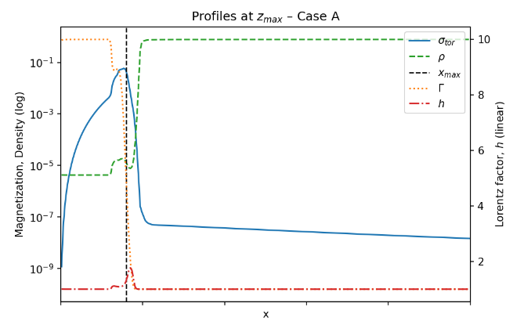
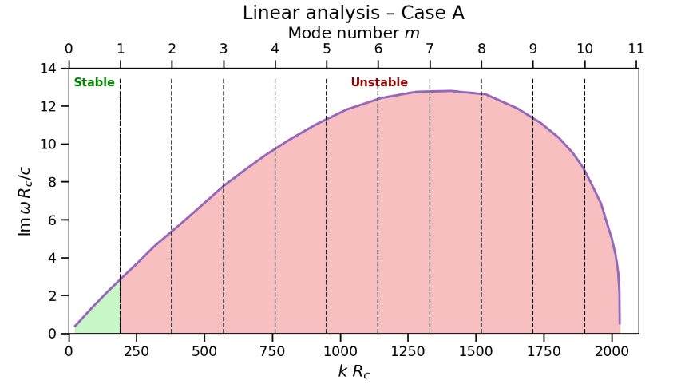
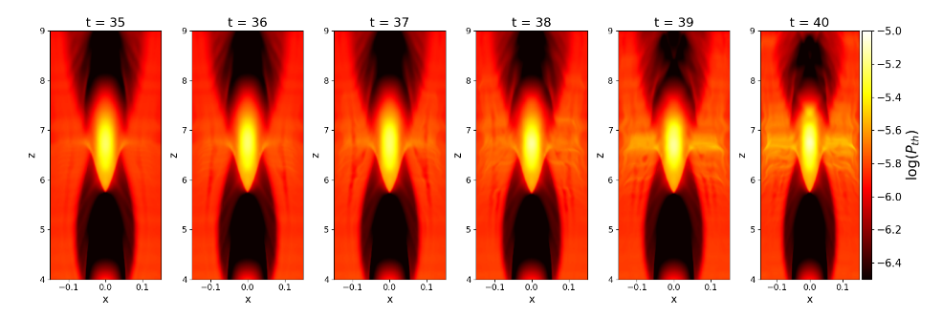
When CFI is triggered?

Slide 15
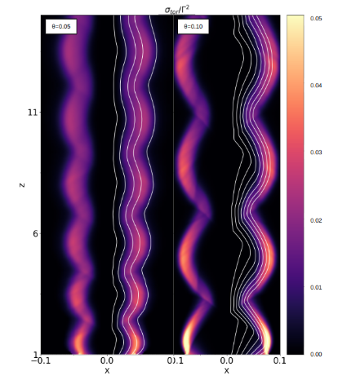
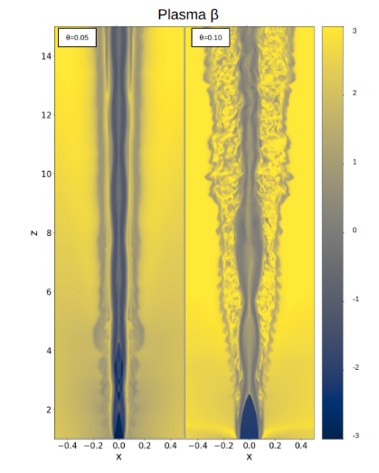
Stable vs Unstable
t=0
t=80
Comparison of for jets with σ=0.1 and opening angle θ=0.05 and 0.1 and Lorentz factor Γ=5 and 10 respectively.

Slide 16
Take home messages
2D vs. 3D: 2D simulations guide parameter choices but miss nonlinear effects—3D is essential for full understanding.
Magnetization controls jet structure: Higher magnetization leads to earlier recollimation and suppresses instabilities, especially in cold jets.
Pressure and inertia effects: High pressure ratios allow for more expansion; heavier jets recollimate further downstream.
3D dynamics reveal instabilities: Hydrodynamic jets quickly destabilize; magnetized jets remain stable longer, delaying kink onset.
CFI is local: Its growth depends on local jet properties (radius, curvature, Lorentz factor, σ), not just global parameters.
Astrophysical relevance: Results help explain AGN jet variability, knot formation and polarization signatures.

Slide 17

Thank you!
styliani.boula@inaf.it

Slide 18
Back up slides

Slide 19
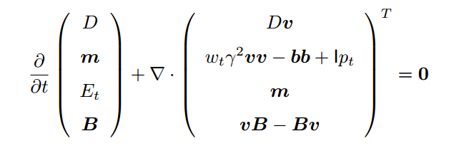
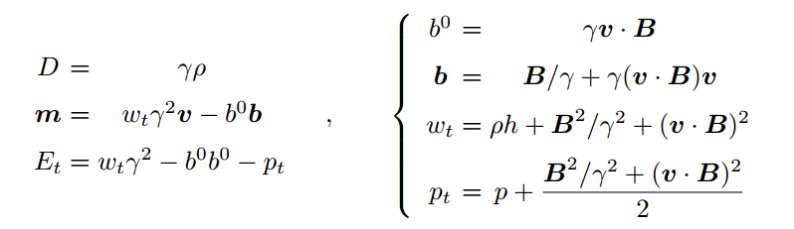
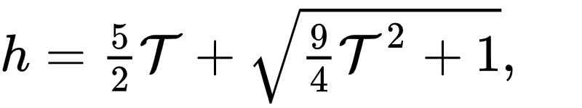
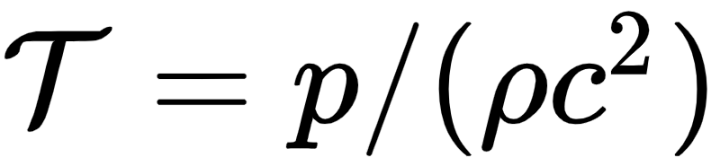
The RMHD Module
PLUTO
Explicit, Compressible Code (FV):
Shock capturing
High Mach number flows
Works in 1D, 2D, 3D
Modular Structure:
Physics modules
Time stepping
Interpolations
Riemann solvers
Supported Physics:
HD (Hydrodynamics)
MHD (Magnetohydrodynamics)
RHD (Relativistic Hydrodynamics)
RMHD (Relativistic Magnetohydrodynamics)
Geometry Support:
Cartesian
Cylindrical
Spherical
Additional Features:
Radiative losses
Mignone et al. 2005, 2007, 2019
The new code gPLUTO is out https://gitlab.com/PLUTO-code/gPLUTO

Slide 20
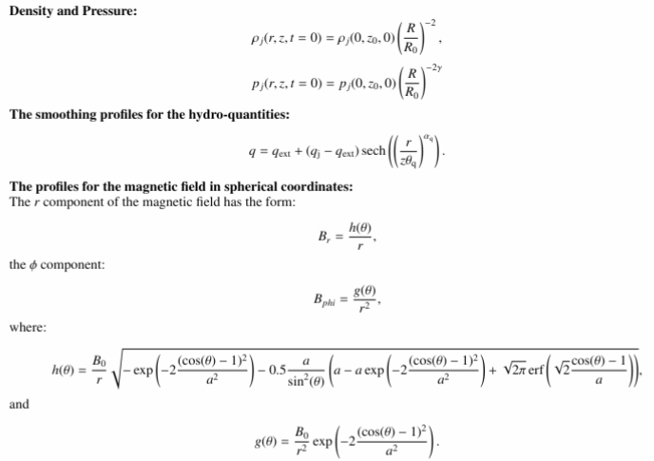

Slide 21
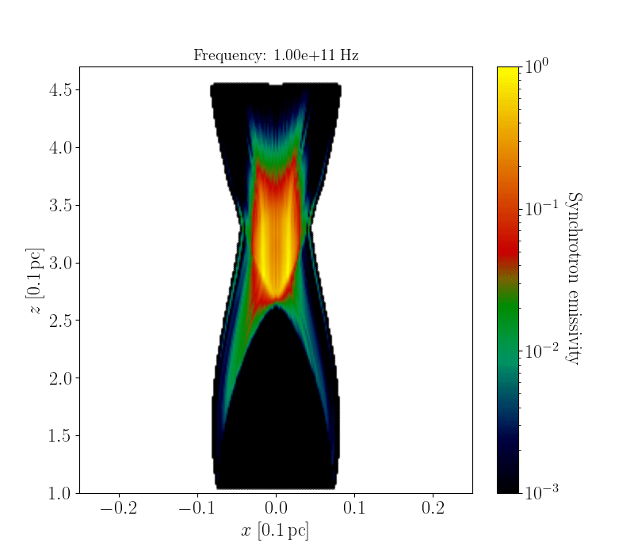



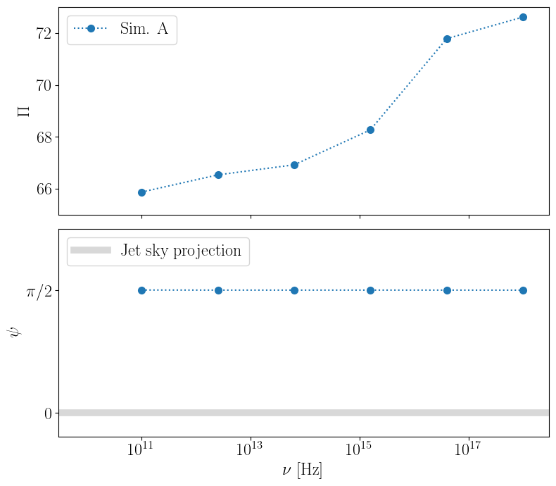
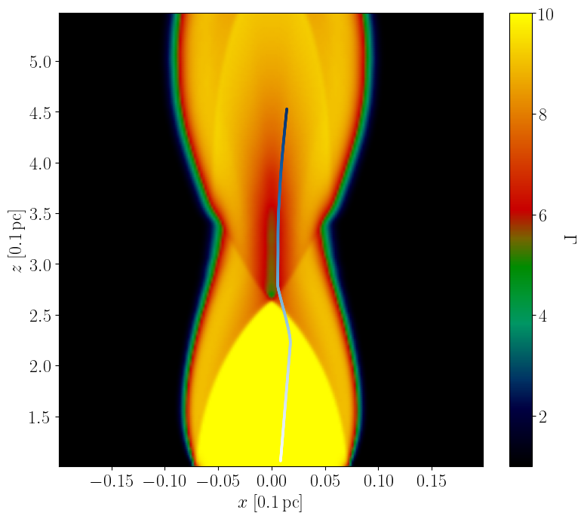
σ=0.1, t=0
Kirk 1994
Drury 1983, Keshet & Waxman 2005

Slide 22
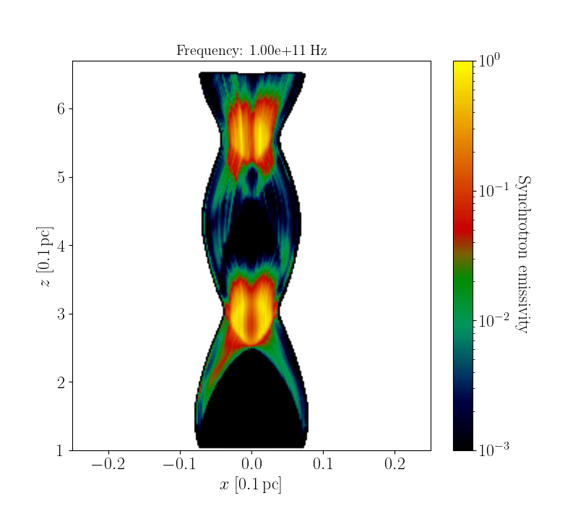
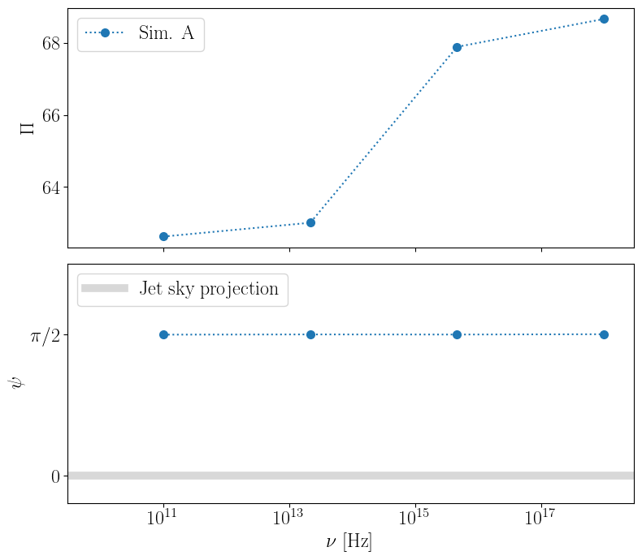
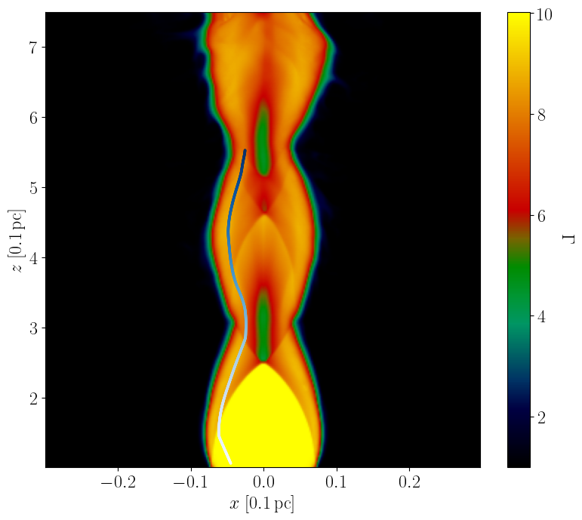
σ=0.1, t=93

Slide 23
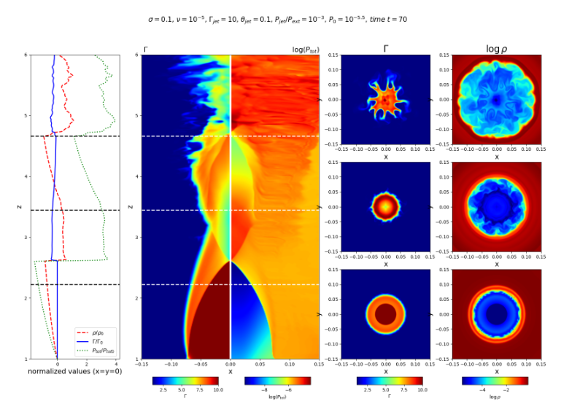

Slide 24
