Slide 1
Interacting Supernovae…
…and where to find them
R. BROSE, 03.11.2025, TeVPa, Valencia

Slide 2
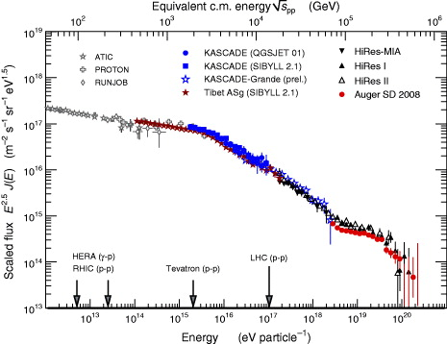
Galactic cosmic-rays
Key questions:
Can SNRs produce the right spectral shape? (And does it agree to observations?)
Can SNRs accelerate CRs to high-enough energies?
Needed Emax for single-source scenario
Bulk of energy
Figure: The cosmic ray spectrum (Blümer et al. 2019)

Slide 3
Galactic cosmic-rays
Key questions:
Can SNRs produce the right spectral shape? (And does it agree to observations?)
Can SNRs accelerate CRs to high-enough energies?
Needed Emax for single-source scenario
Bulk of energy
Figure: The cosmic ray spectrum (Blümer et al. 2019)

Slide 4
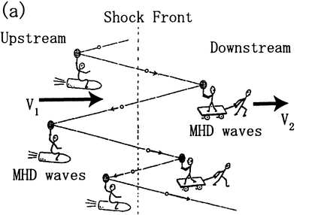
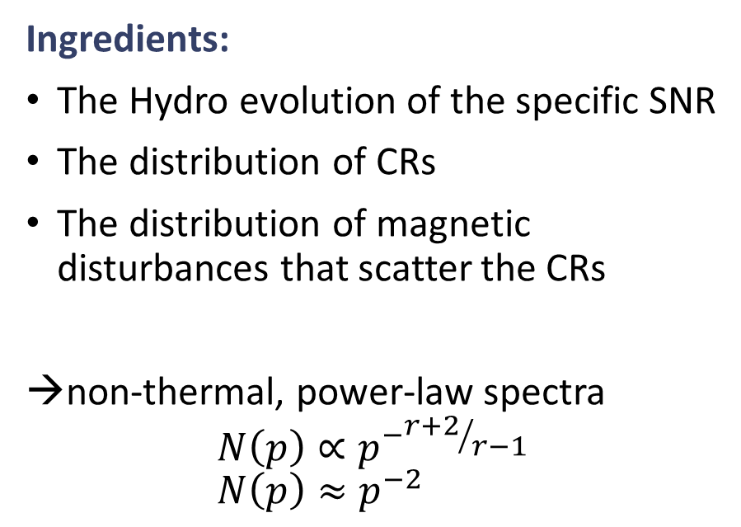
Diffusive shock acceleration
Ingredients:
The Hydro evolution of the specific SNR
The distribution of CRs
The distribution of magnetic disturbances that scatter the CRs
non-thermal, power-law spectra
$$N\left(p\right)∝p^{−{r+2}/{r−1}} \\ N\left(p\right)≈p^{−2}$$

Slide 5

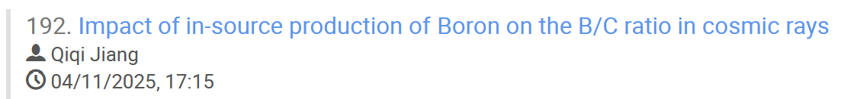
RATPaC – Radiaion Acceleration Transport PArallel Code
Powered by
Cosmic-ray transport equation
Well-tested code in development since 2012
17+ papers
225+ citations
Hydro equations
Magnetic Turbulence
Magnetic field
Standard DSA

Slide 6
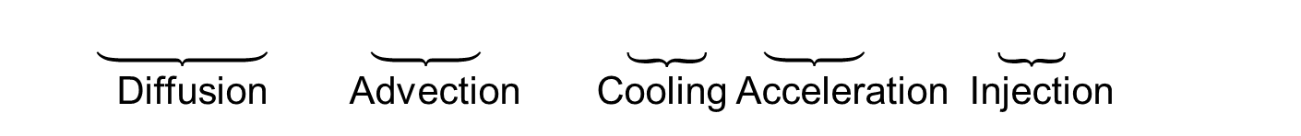
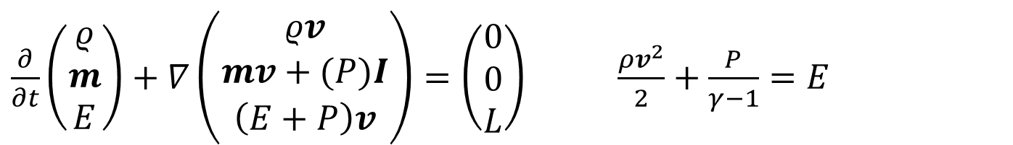
RATPaC – The Equations
$$\frac{∂N}{∂t} = ∇{ D}_{r}∇N − ∇vN − \frac{∂}{∂p}\left(N\dot{p} − \frac{v}{3}Np\right) + Q$$
The equations are solved:
- One dimensional - Spherically symmetric - Monoenergetic injection - Including Synchrotron and inverse-Compton cooling for electrons
- On a comoving, expanding grid for turbulence and CRs → no free escape boundary
Diffusion Advection Cooling Acceleration Injection
$$\frac{∂E_{W}}{∂t} = − \left(v∇_{r}E_{W}+c∇_{r}vE_{W}\right)+ k^{3}∇_{k}D_{k}∇_{k}\frac{E_{W}}{k^{3}}+2\left(Γ_{g}−Γ_{d}\right)E_{W}$$
Advection + Compression Cascading Growth + Damping
$\frac{∂}{∂t}\left(\begin{matrix}ρ \\ m \\ E\end{matrix}\right)+∇\left(\begin{matrix}ρv \\ mv+(P)I \\ \left(E+P\right)v\end{matrix}\right)=\left(\begin{matrix}0 \\ 0 \\ L\end{matrix}\right)$ $\frac{ρv^{2}}{2}+\frac{P}{γ−1}=E$

Slide 7
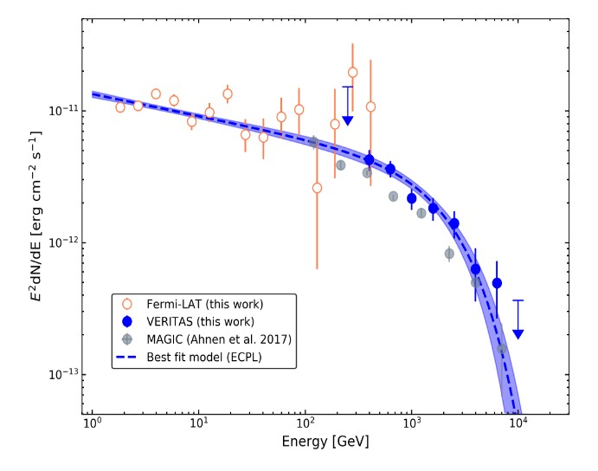
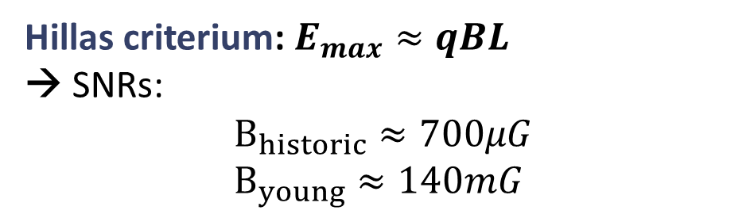
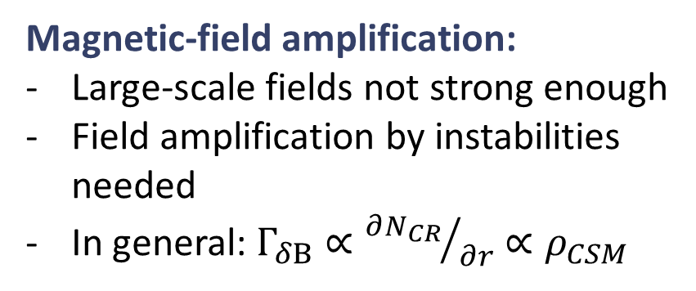
Maximum energy - General problem
Observations:
Hillas criterium: $E_{max}≈qBL$ → SNRs: $$B_{historic}≈700μG \\ B_{young}≈140mG$$
~2TeV
Magnetic-field amplification:
Large-scale fields not strong enough
Field amplification by instabilities needed
In general: $Γ_{δB}∝{∂N_{CR}}/{∂r}∝ρ_{CSM}$
Figure: Gamma-ray SED of Cas A (VERITAS 2013)

Slide 8
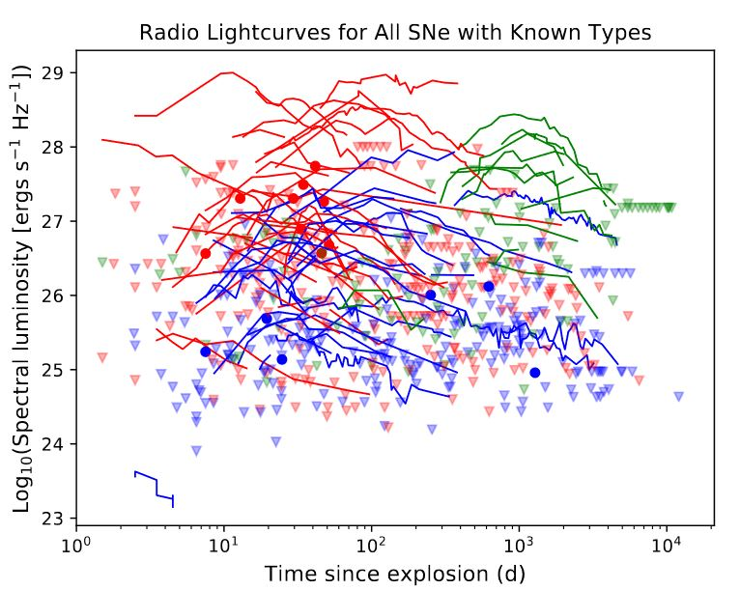
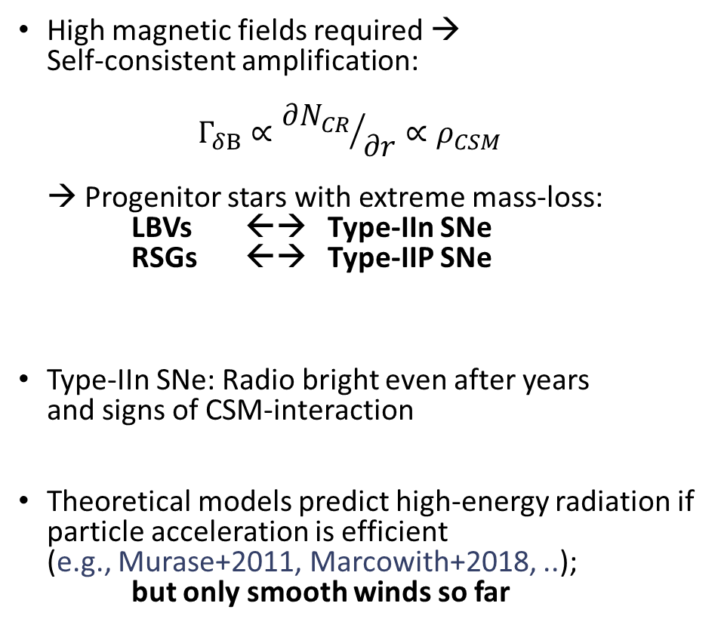
SNRs as CR Sources
High magnetic fields required → Self-consistent amplification: $Γ_{δB}∝{∂N_{CR}}/{∂r}∝ρ_{CSM}$ → Progenitor stars with extreme mass-loss: LBVs ←→ Type-IIn SNe RSGs ←→ Type-IIP SNe
Type-IIn SNe: Radio bright even after years and signs of CSM-interaction
Theoretical models predict high-energy radiation if particle acceleration is efficient (e.g., Murase+2011, Marcowith+2018, ..); but only smooth winds so far
Figure: Early-time Radio emission from SNs of various types (Bietenholz et al.2021)

Slide 9
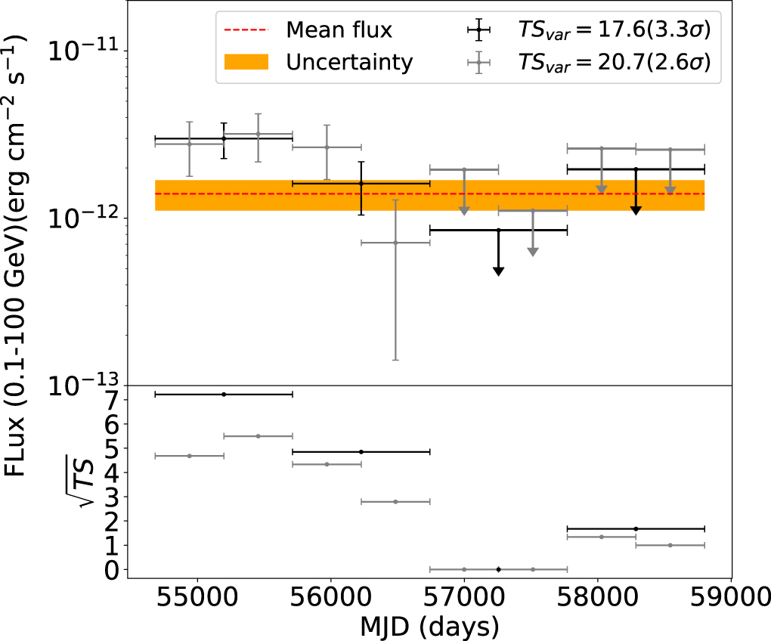
SNRs as CR Sources
H.E.S.S. Collaboration (2019) obtained upper limits on TeV emission from nearby CCSNe
Ongoing HESS ToO programme so far has no detections
Xi+(2020) detected 𝛾-rays from the location of SN 2004dj, a bright and nearby SN IIP, with FERMI-LAT
A recent variability analysis of FERMI-LAT data found evidence in support of 2 further detections (Prokhorov+2021).
Also suggestion of increasing flux from SN1987A with FERMI-LAT (Malyshev+2019)
Non detection of SN 2023ixf at ~7Mpc → E_{CR}<10⁴⁹erg (Martí-Devesa+2024)
No detections in gamma-rays!
Figure: Light curve of the gamma-ray flux from SN 2004dj (Xi et al. 2020)

Slide 10
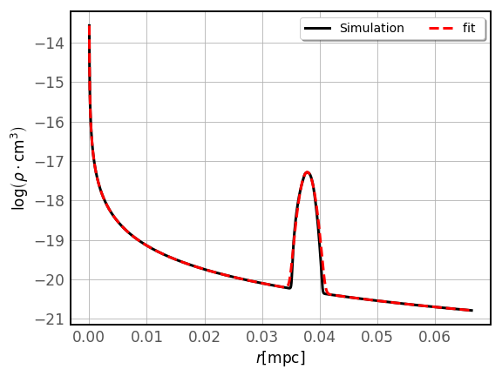
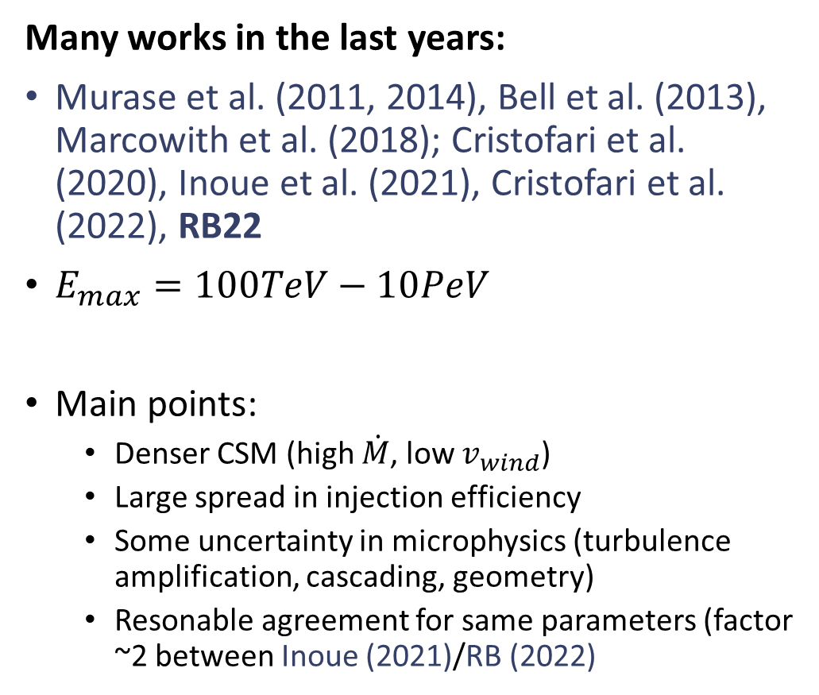
Smooth Wind Case
Many works in the last years:
Murase et al. (2011, 2014), Bell et al. (2013), Marcowith et al. (2018); Cristofari et al. (2020), Inoue et al. (2021), Cristofari et al. (2022), RB22
$E_{max}=100TeV−10PeV$
Main points:
Denser CSM (high $\dot{M}$, low $v_{wind}$)
Large spread in injection efficiency
Some uncertainty in microphysics (turbulence amplification, cascading, geometry)
Resonable agreement for same parameters (factor ~2 between Inoue (2021)/RB (2022)
Figure: CSM-structure for a LBV with a smooth wind (example plot)

Slide 11
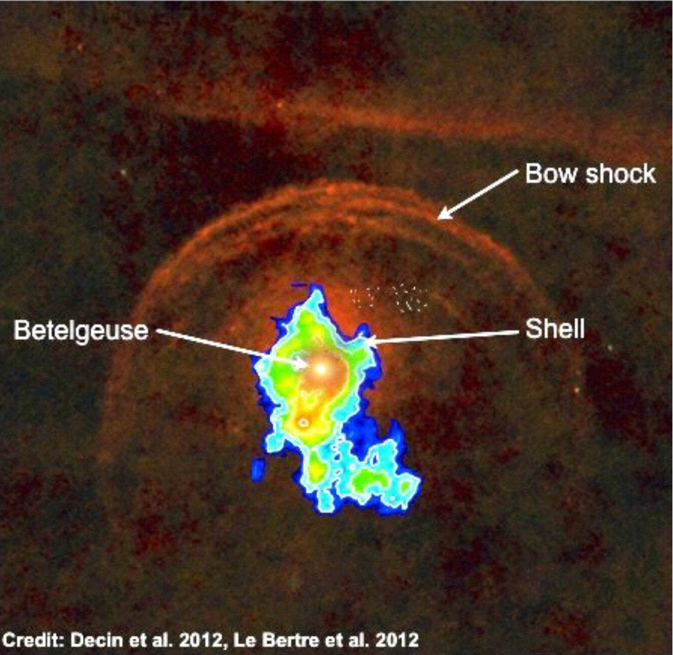
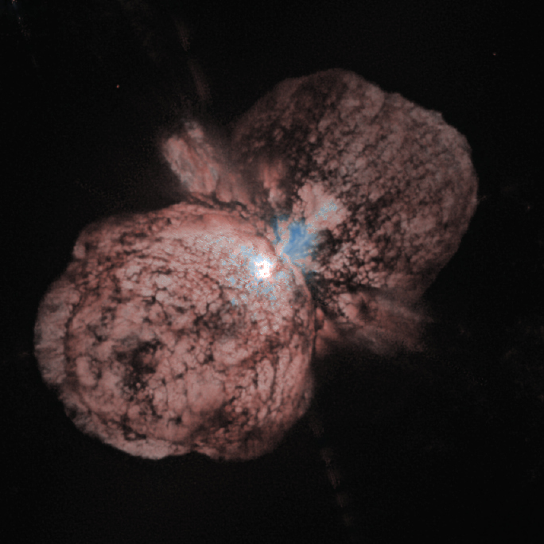
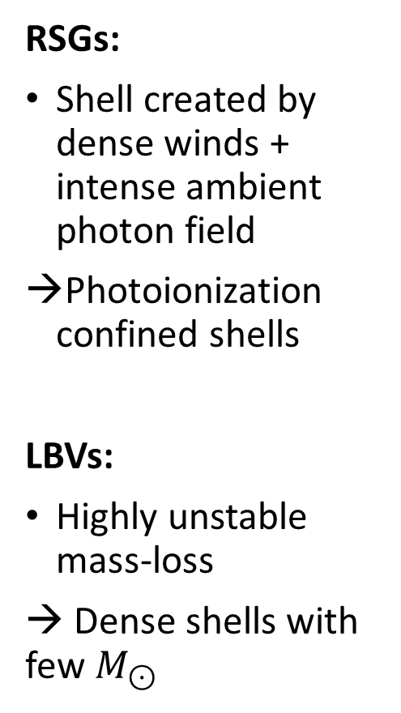
Structured CSM
RSGs:
Shell created by dense winds + intense ambient photon field
Photoionization confined shells
LBVs:
Highly unstable mass-loss
→ Dense shells with few $M_{⊙}$
Figure: Herschel view of Betelgeuse
Figure: HST view of η Carinae (NASA, STScI)

Slide 12
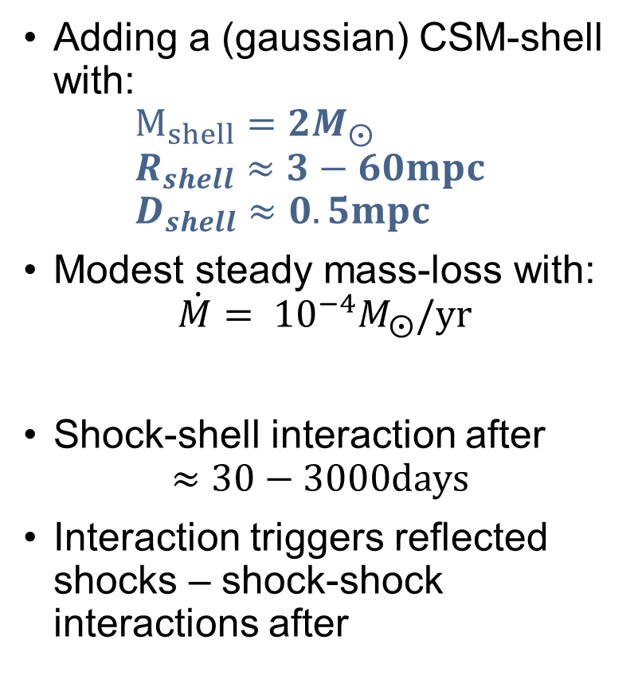
Structured CSM – Shell Setup
Adding a (gaussian) CSM-shell with: $M_{shell}={2M}_{⨀}$ $R_{shell}≈3−60mpc$ $D_{shell}≈0.5mpc$
Modest steady mass-loss with: $\dot{M}= {10}^{−4}M_{⨀}/yr$
Shock-shell interaction after $≈30−3000days$
Interaction triggers reflected shocks – shock-shock interactions after
r [pc]
Figure: CSM-structure for a LBV with a episode of high mass-loss in the past (example plot)

Slide 13
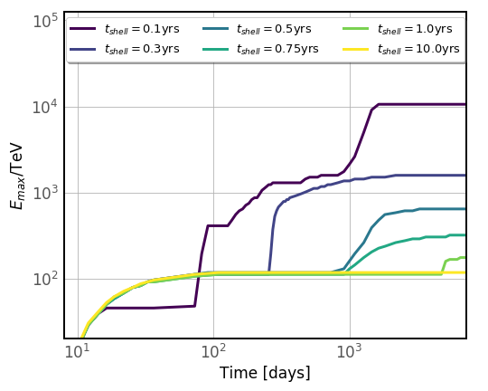
Results - Emax
FBOTs?
Shell:
Shock-shell interaction reduces E_{max} of freshly accelerated CRs
Reaccelerated shock after shell passage propagates into amplified field of previously escaped CRs → Boost to E_{max} (E_{max} limited by shock-capture time)
Type-IIn SNe can be PeVatrons! How to find them?
Figure: Maximum energy over time for Type-Iin SNe interacting with dense shells (RB+2025a).

Slide 14
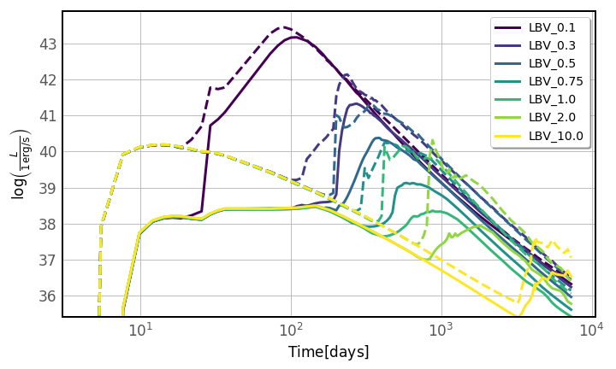
Gamma-ray Emission from Type-IIns
Peak-luminosity in gamma-rays after 100s of days
and 10x above early peak in free wind Fast-rising luminosities but shift between HE and VHE peaks
Fast decline after shock-shell interaction → short observational time-window
Substructure due to shock-shock interactions
Figure: Attenuated Gamma-ray luminosity over time (RB+2025b).
Detectable? Superluminous?
Strongly attenuated

Slide 15
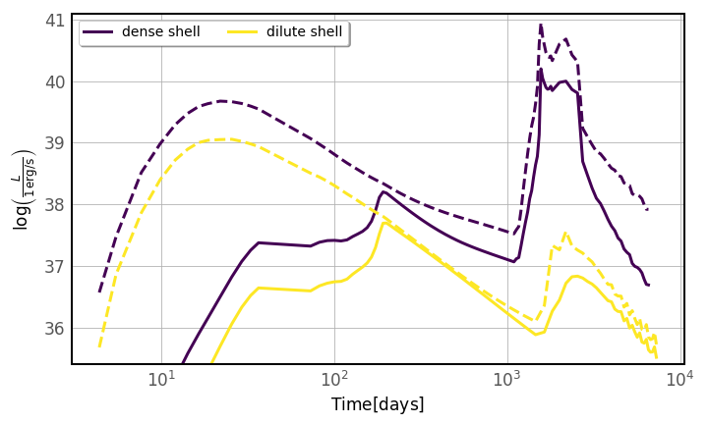
Gamma-ray Emission from Type-IIPs
Figure: Attenuated Gamma-ray luminosity over time (RB+2025b).
Peak-luminosity in gamma-rays after years
and 20x above early peak in free wind
Emission plateaus for a few years
SN2004dj

Slide 16
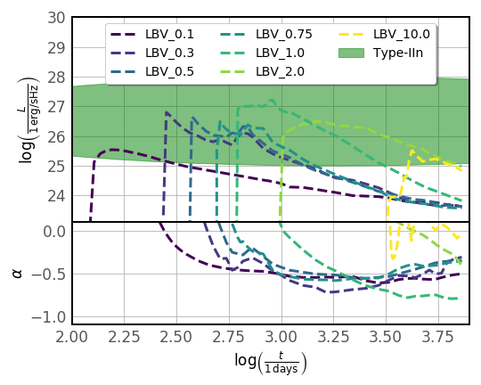
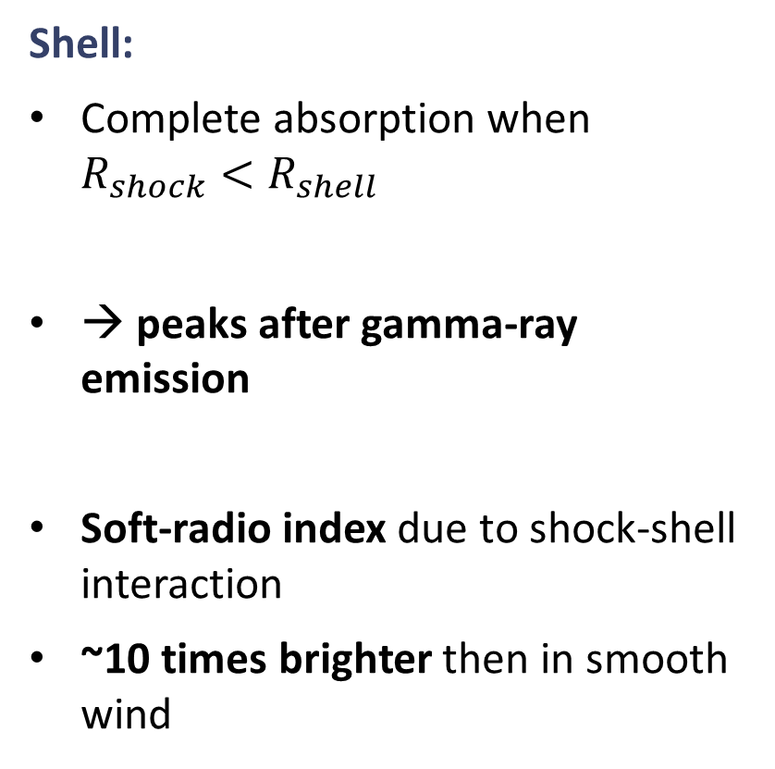
Radio Emission
Shell:
Complete absorption when $R_{shock}<R_{shell}$
→ peaks after gamma-ray emission
Soft-radio index due to shock-shell interaction
~10 times brighter then in smooth wind
Figure(top): Radio luminosity at 4GHz. Figure(right): Radio spectral-index 4GHz (RB+, submitted)

Slide 17
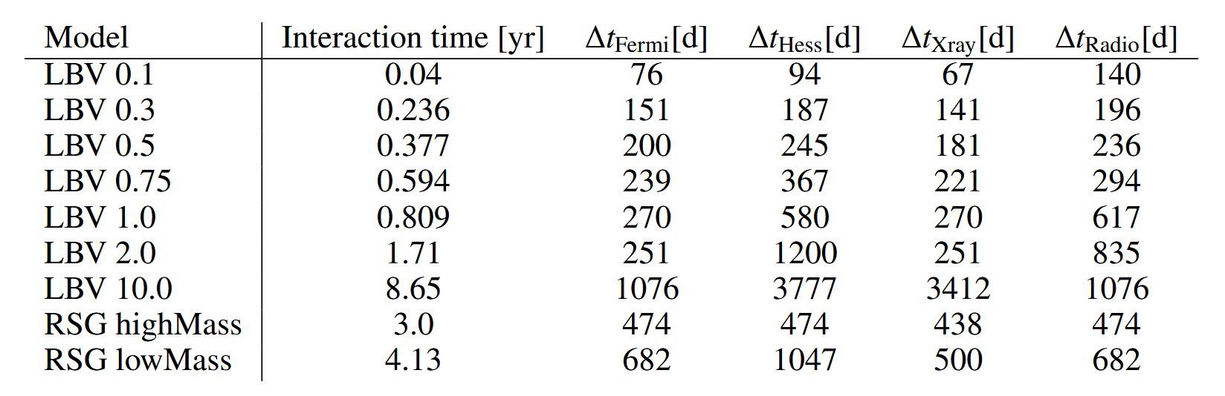
Other emission
Thermal and non-thermal emission not peaking simultaneously for different wavebands
Caused by acceleration/absorption effects
Radio peaks last but easiest to detect
X-ray ideal but usually small FoV
High-cadence optical surveys also promising
Table: Time-delay between the onset of the shell-interaction and the peak of the emission for various wavebands

Slide 18
Summary
Most SNRs (Typical Type-IIP) usually reach too low Emax
Interaction with CSM-shells boosts Emax, beyond 1PeV in exceptional cases
Interactions shift peak of gamma-ray emission to later stages (outside current observation windows)
RSG-shells cause potentially detectable emission after years (e.g. SN2004dj)
Dedicated monitoring programs needed, e.g. in radio; optical surveys potentially useful for rebrightening of Type-IIPs

Slide 19


Slide 20
Thanks for your attention!

