Slide 1
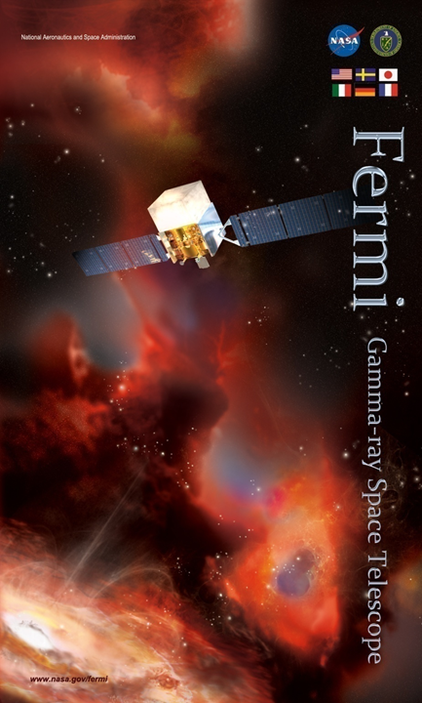
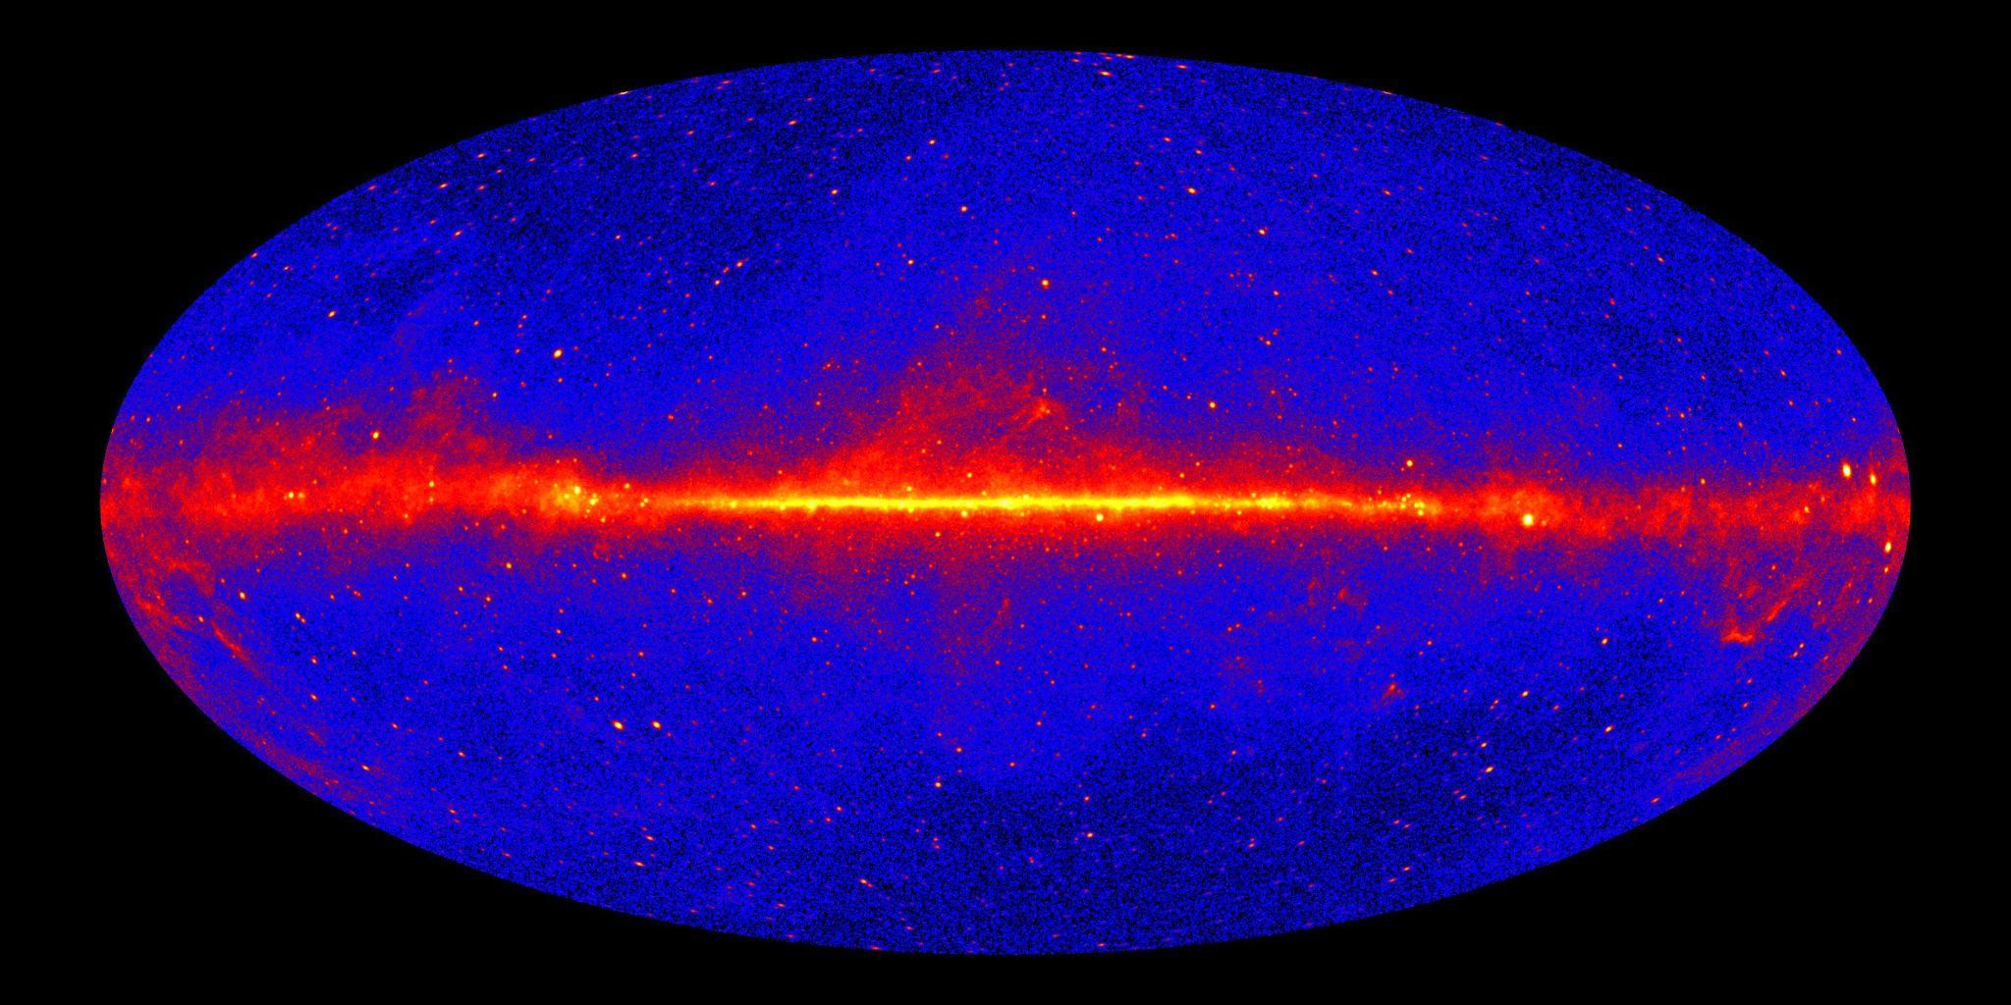
Search for the GeV Counterpart of PeVatron LHAASO J1912+1014u using Fermi-LAT and FUGIN CO Data
T. Mizuno, N. Nakahara (Hiroshima Univ.), H. Sano, K. Murase (Gifu Univ.), T. Oka (Wüerzburg Univ.), H. Suzuki (Miyazaki Univ.)
2025.11.03 @TeVPA 2025 (Valencia, Spain)
Notes:
Hi everyone
Thanks for organizers
Self introduction, title, team

Slide 2
Scientific Objectives
LHAASO reported 43 ultrahigh-energy (UHE) sources (>4 σ in >100 TeV) that are either proton or electron PeVatron candidates (Cao+24)
Multiwavelength data is crucial to examine particle type and CR spectrum. Here we search for GeV counterpart of LHAASO J1912+1014u using Fermi-LAT GeV data and high-resolution FUGIN CO data to investigate “proton PeVatron” scenario
Notes:
Here we show scientific objectives
LHAASO reported >40 UHE (sub-PeV) sources; proton or electron PeVatrons
MW data crucial
LHAASO J1912+1014u by Fermi-LAT and FUGIN data; investigate proton PeVatron scenario

Slide 3
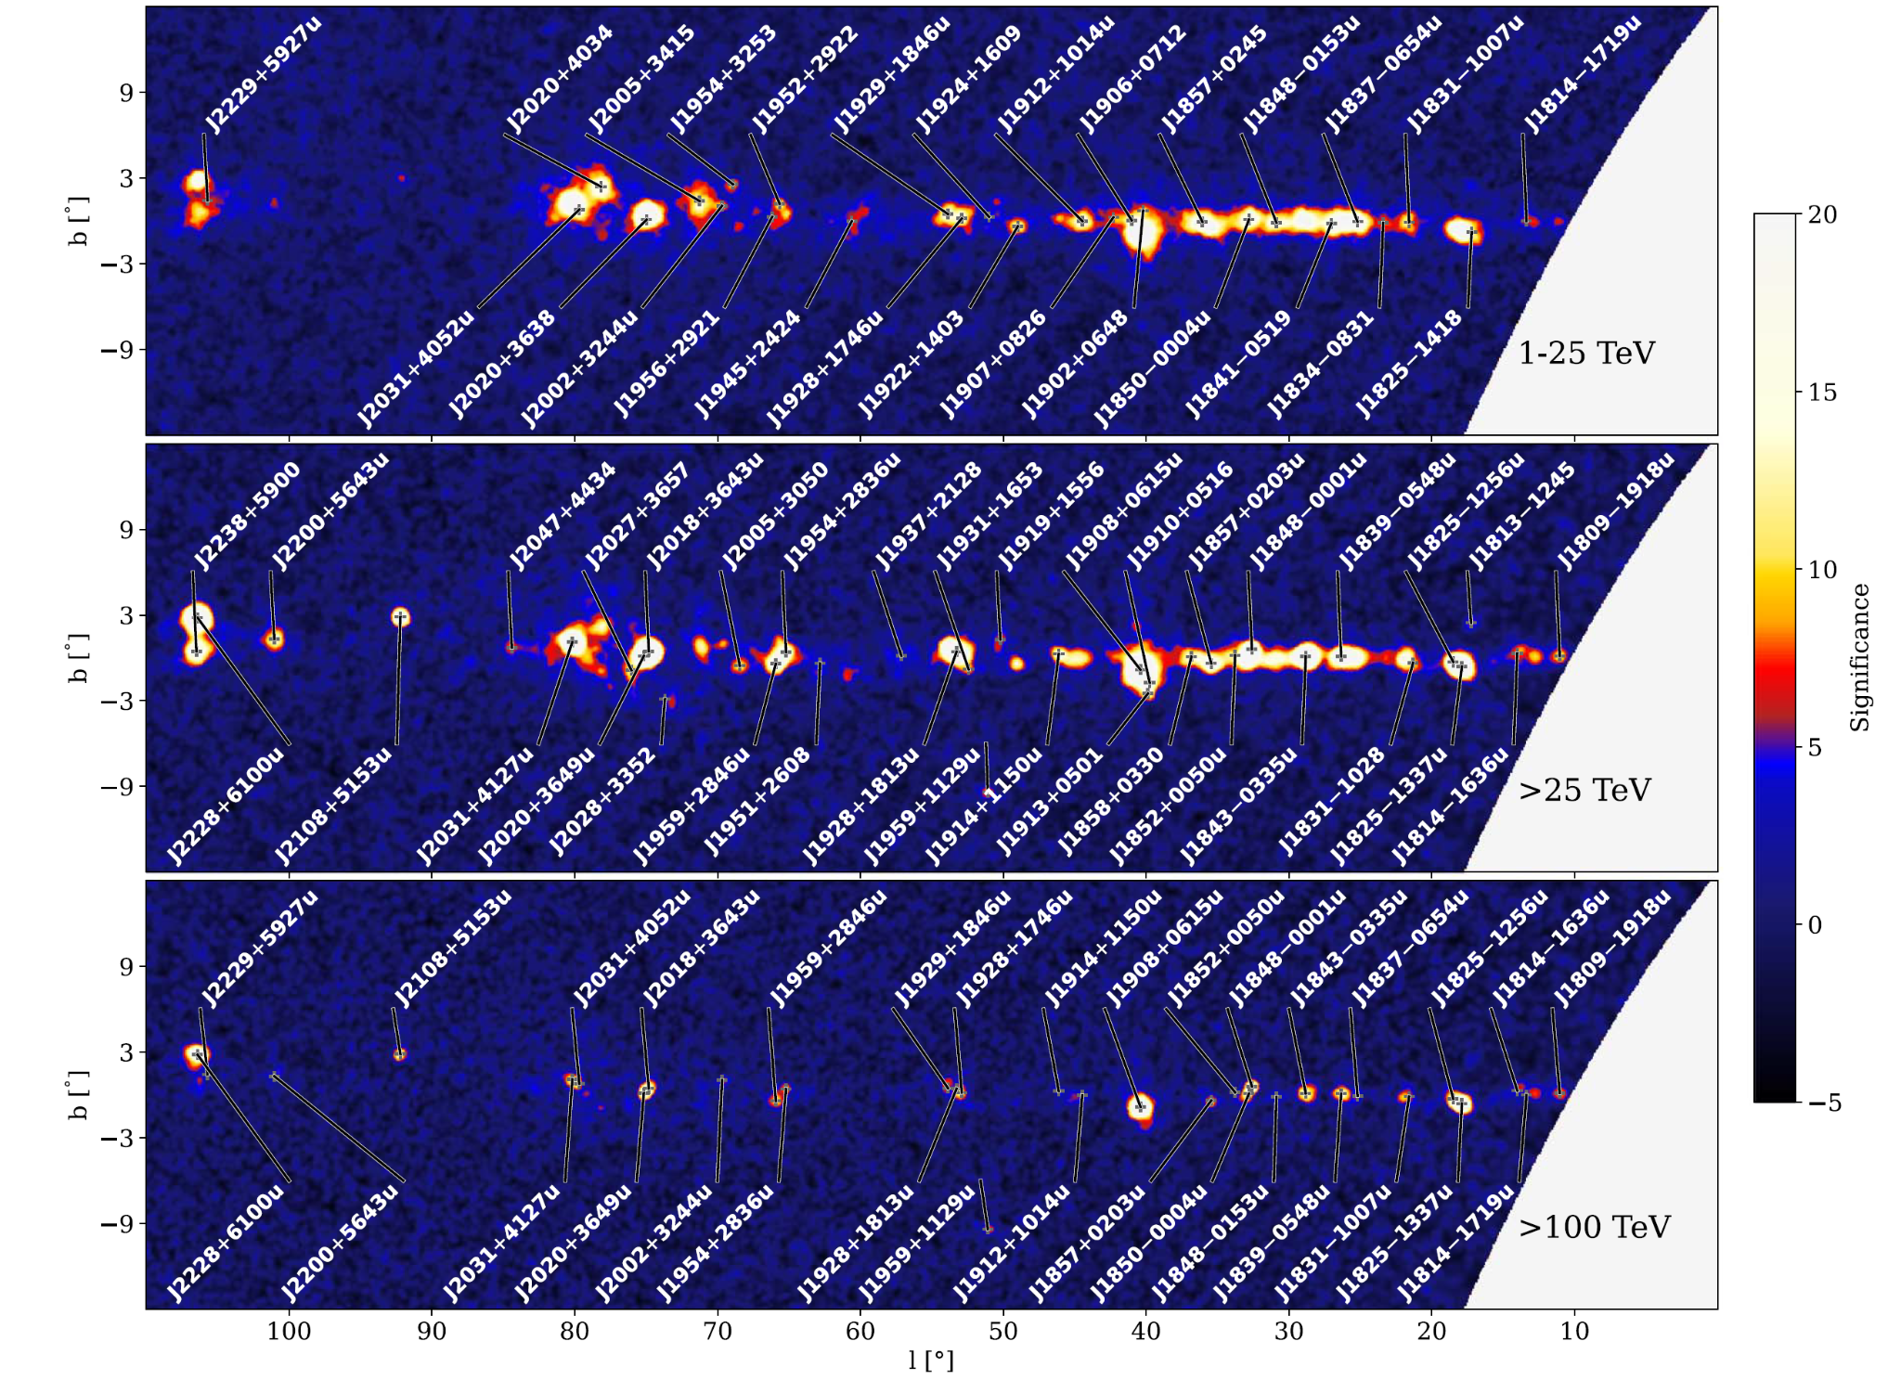
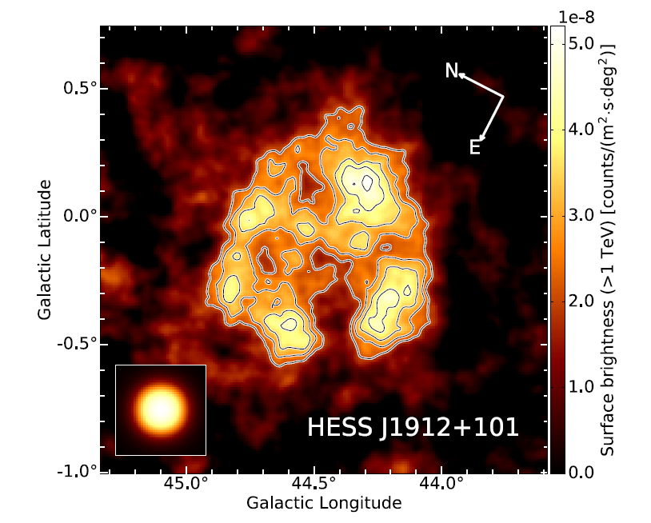
TeV Properties of the Target
LHAASO J1912+1014u is an extended UHE source with test statistics above TS₁₀₀~70 and size r₃₉~0.50 deg
It coincides in position with an extended H.E.S.S. source, HESS J1912+101 (r_{sep}=0.1 deg). Hereafter we assume they are the same object
Γ=3.26 (KM2A band), 2.68 (WCDA band) and 2.56 (H.E.S.S. band) with ΔΓ~0.1;
GeV counterpart will have Γ<2.5
H.E.S.S. 2018
Cao+24
(Some earlier works of LAT data for HESS J1912+101; e.g., Green+19, Li+23)
Notes:
Here we show TeV properties of the target
Extended UHE source
(left) reported in 1st LHAASO catalog (point to a square)
(right) coincides with a TeV source HESS J1912+101; assume they are same object
Spectral indices; GeV counterpart will have Gamma<2.5

Slide 4
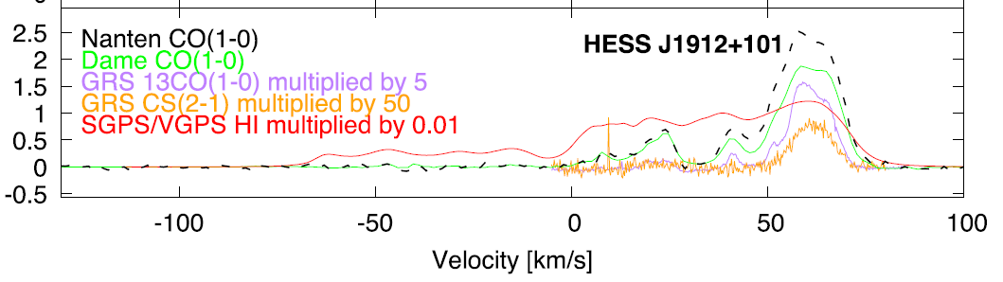
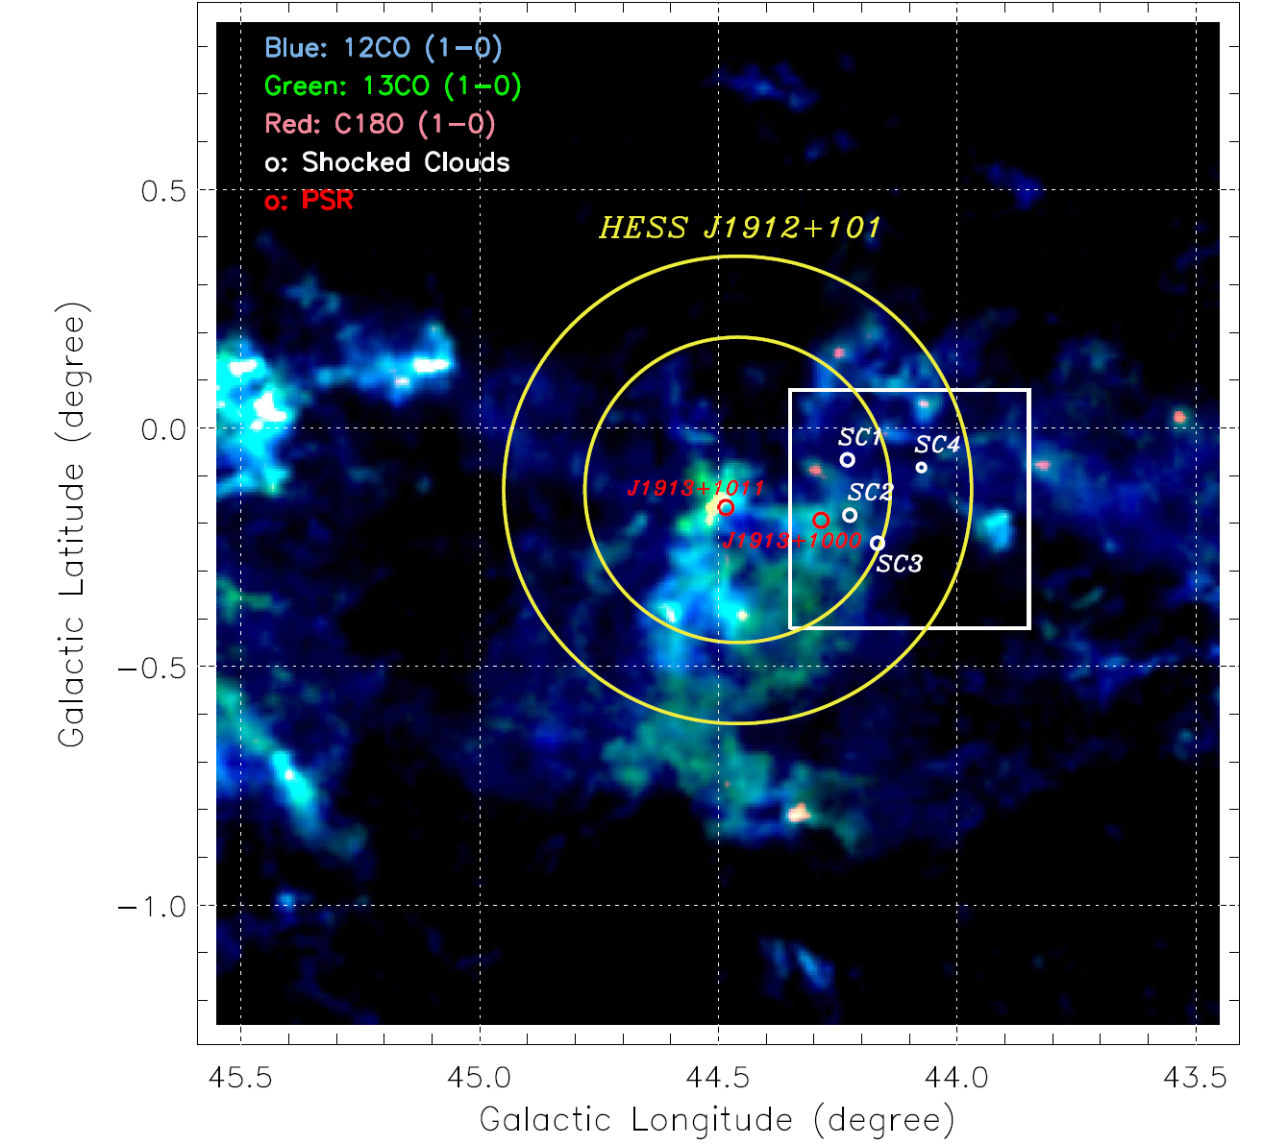
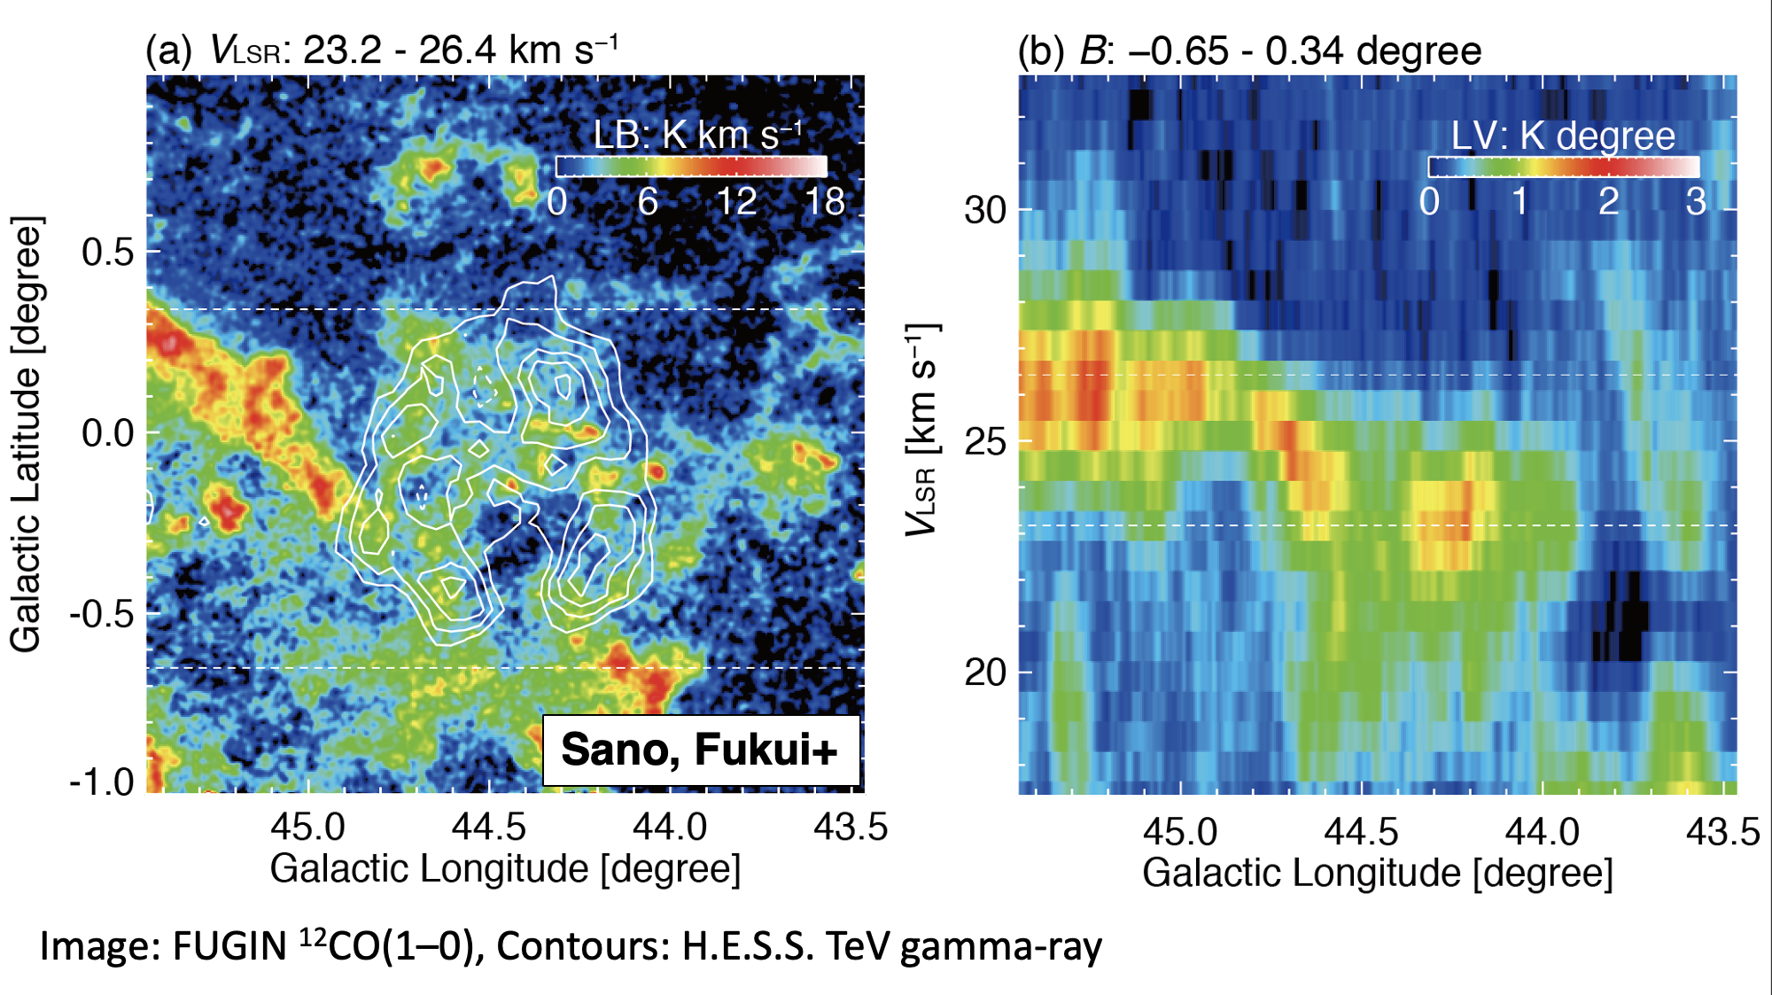
CO Data
CO data toward the source show several peaks. Su+17 proposed CO cloud with v~60 km/s corresponding to the H.E.S.S source and high-velocity shells are due to SN expansion. Sano+18 pointed out this may be due to outflow of H_{II} region along LOS and proposed alternative scenario, i.e., CO cloud with v~25 km/s is associated
Here we test three models against LAT data, (1) LHAASO WCDA Gaussian, (2) ¹²CO map of Su+17 velocity range, and (3) ¹²CO map of Sano+18 velocity range
Sano+18 Su+17
(H.E.S.S. 2018)
(Su+17) (Sano+18)
Notes:
Here we show CO data
(left) CO data show several peaks. Let’s focus on a dotted line; there are two prominent peaks
(left & middle) Su+17 proposed v~60 km/s
(left & right) Sano+18 proposed v~25 km/s
We will test three models

Slide 5
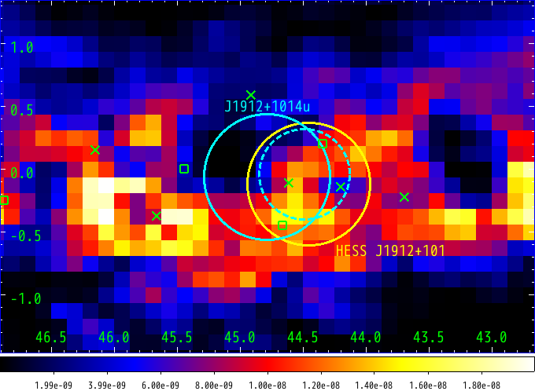
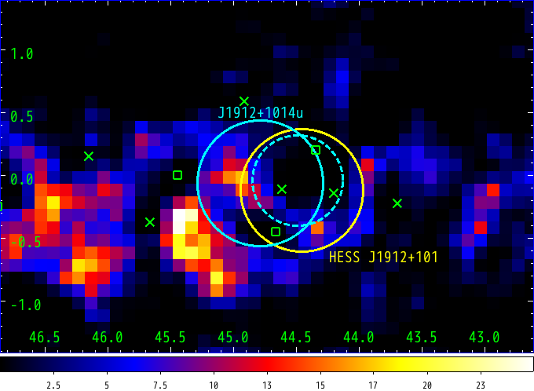
Construction of Baseline Model
We first employed standard diffuse model + 4FGL sources, and found large residual in 1-10 GeV, likely because dark gas template is not perfect
We added additional template (magenta square) to construct “baseline model”
(ISM gas not traced well by H_{I} and CO lines)
dark gas template for standard diffuse model (arbitrary unit)
TS map by initial model (1.6-12.8 GeV)
Preliminary
Gal. latitude
Gal. longitude
Notes:
Let me first describe how we constructed baseline model
Standard analysis
(right) residual next to the source (circles, square)
(left) likely because DG template not perfect (residual (square) <-> DG (square))
Additional template (isolating magenta square) to construct baseline model

Slide 6
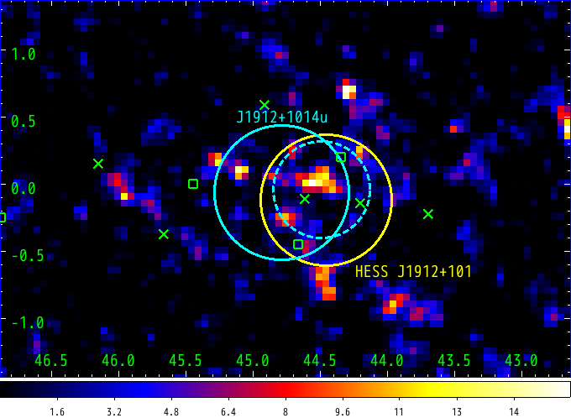
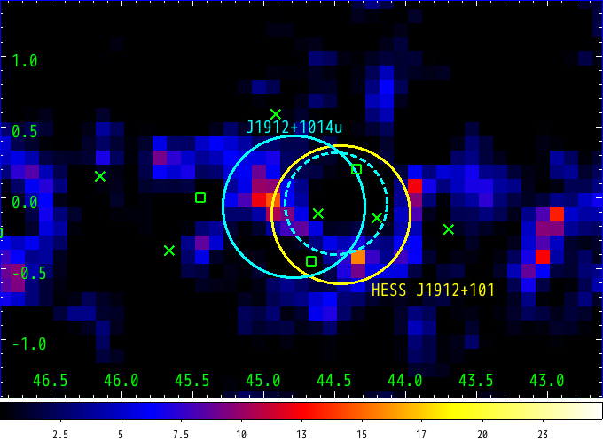
Construction of Baseline Model (Cont’d)
We first employed standard diffuse model + 4FGL sources, and found large residual in 1-10 GeV, likely because dark gas template is not perfect
We added additional template (magenta square) to construct “baseline model”
Residual reduced significantly in <10 GeV
Excess emission remain toward LHAASO/H.E.S.S. source in >10 GeV; we test 3 models
TS map w/ additional DG temp. (>12.8 GeV)
TS map w/ additional DG temp. (1.6-12.8 GeV)
Preliminary
Preliminary
Gal. latitude
Gal. latitude
Gal. longitude
Gal. longitude
Notes:
(Let me first describe how we constructed baseline model)
(right) the residual was reduced in <10 GeV; residual gone
(click*2) excess emission remain in >10 GeV; we will test 3 models

Slide 7
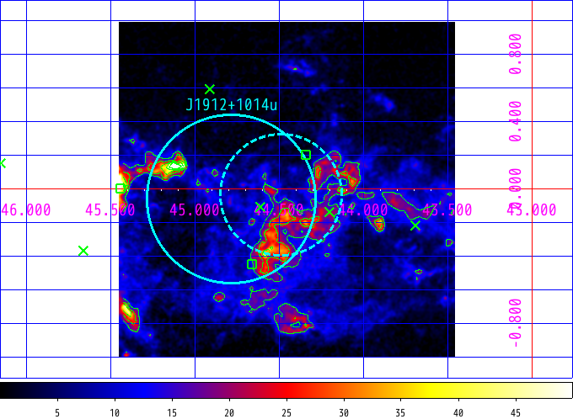
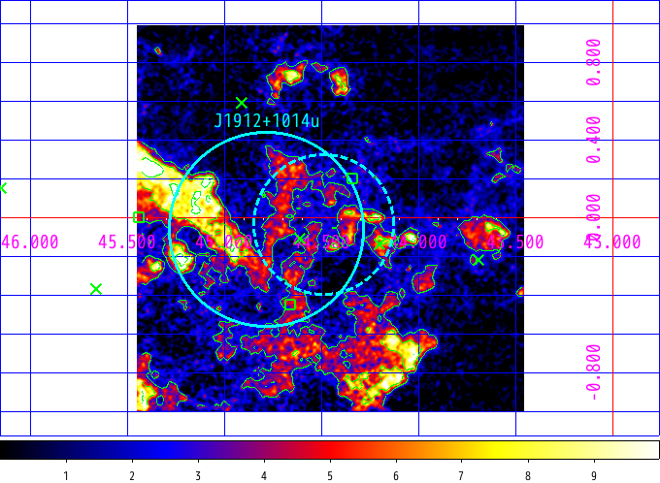
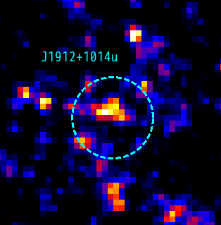
Models for Excess Emission
We prepared three models for the excess:
LHAASO WCDA Gaussian (dashed circle)
Su+17 CO map (58.6-62.2 km/s)
Sano+18 CO map (22.3-26.4 km/s)
High-resolution FUGIN data
(by Sano, Murase)
WCDA Gaussian (overlaid on TS map)
Su+17 CO map
Sano+18 CO map
Preliminary
Notes:
Here we show models for excess emission
prepared 3 models for the excess (1) WCDA Gaussian (2) Su+17 CO map (3) Sano+18 CO map
(left) zoom-up of TS & Gaussian, (middle) CO map of Su+17 v_lsr, (right) CO map of Sano+18 v_lsr; high-resolution FUGIN CO data
They will improve the fit

Slide 8
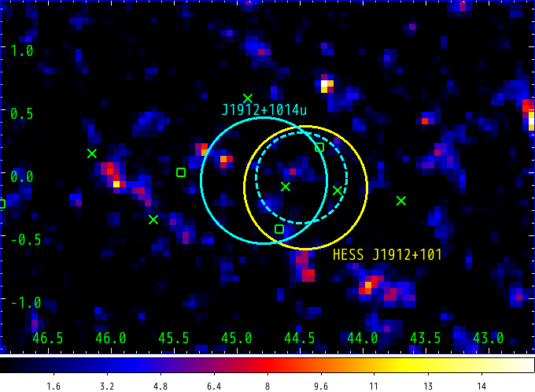
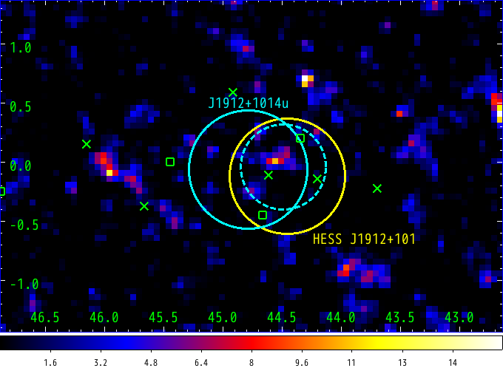
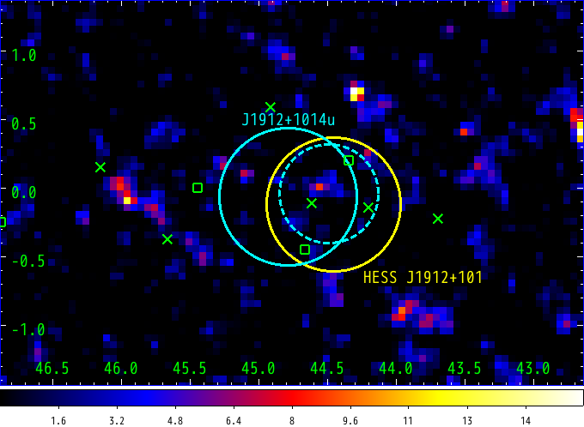
Results with Excess Emission Models
Models: (1) LHAASO WCDA Gaussian, (2) Su+17 CO map, (3) Sano+18 CO map
(Sano+18 CO map prefers different norm. for inner/outer areas; we allowed them differ)
(We also tested H.E.S.S. intensity map and KM2A Gaussian; they gave worse fits)
CO-map-based models are as good as, or better than, LHAASO Gaussian
hadronic scenario preferred (leptonic not ruled out)
TS maps (>12.8 GeV)
fit w/ Gaussian (TS=95.2)
fit w/ Su+17 CO map (TS=109.8)
fit with Sano+18 CO map (TS=99.8)
Preliminary
Preliminary
Preliminary
Gal. latitude
Gal. latitude
Gal. latitude
Gal. longitude
Gal. longitude
Gal. longitude
Notes:
Here we show results with the excess emission models
Remind two things;
Sano+18 CO map preferes difference norm. btw. inner&outer
2 other models gave worse fits
Results (TS map & TS one by one)
CO-map-based models work well
hadronic scenario preferred; leptonic scenario not ruled out (yet)

Slide 9
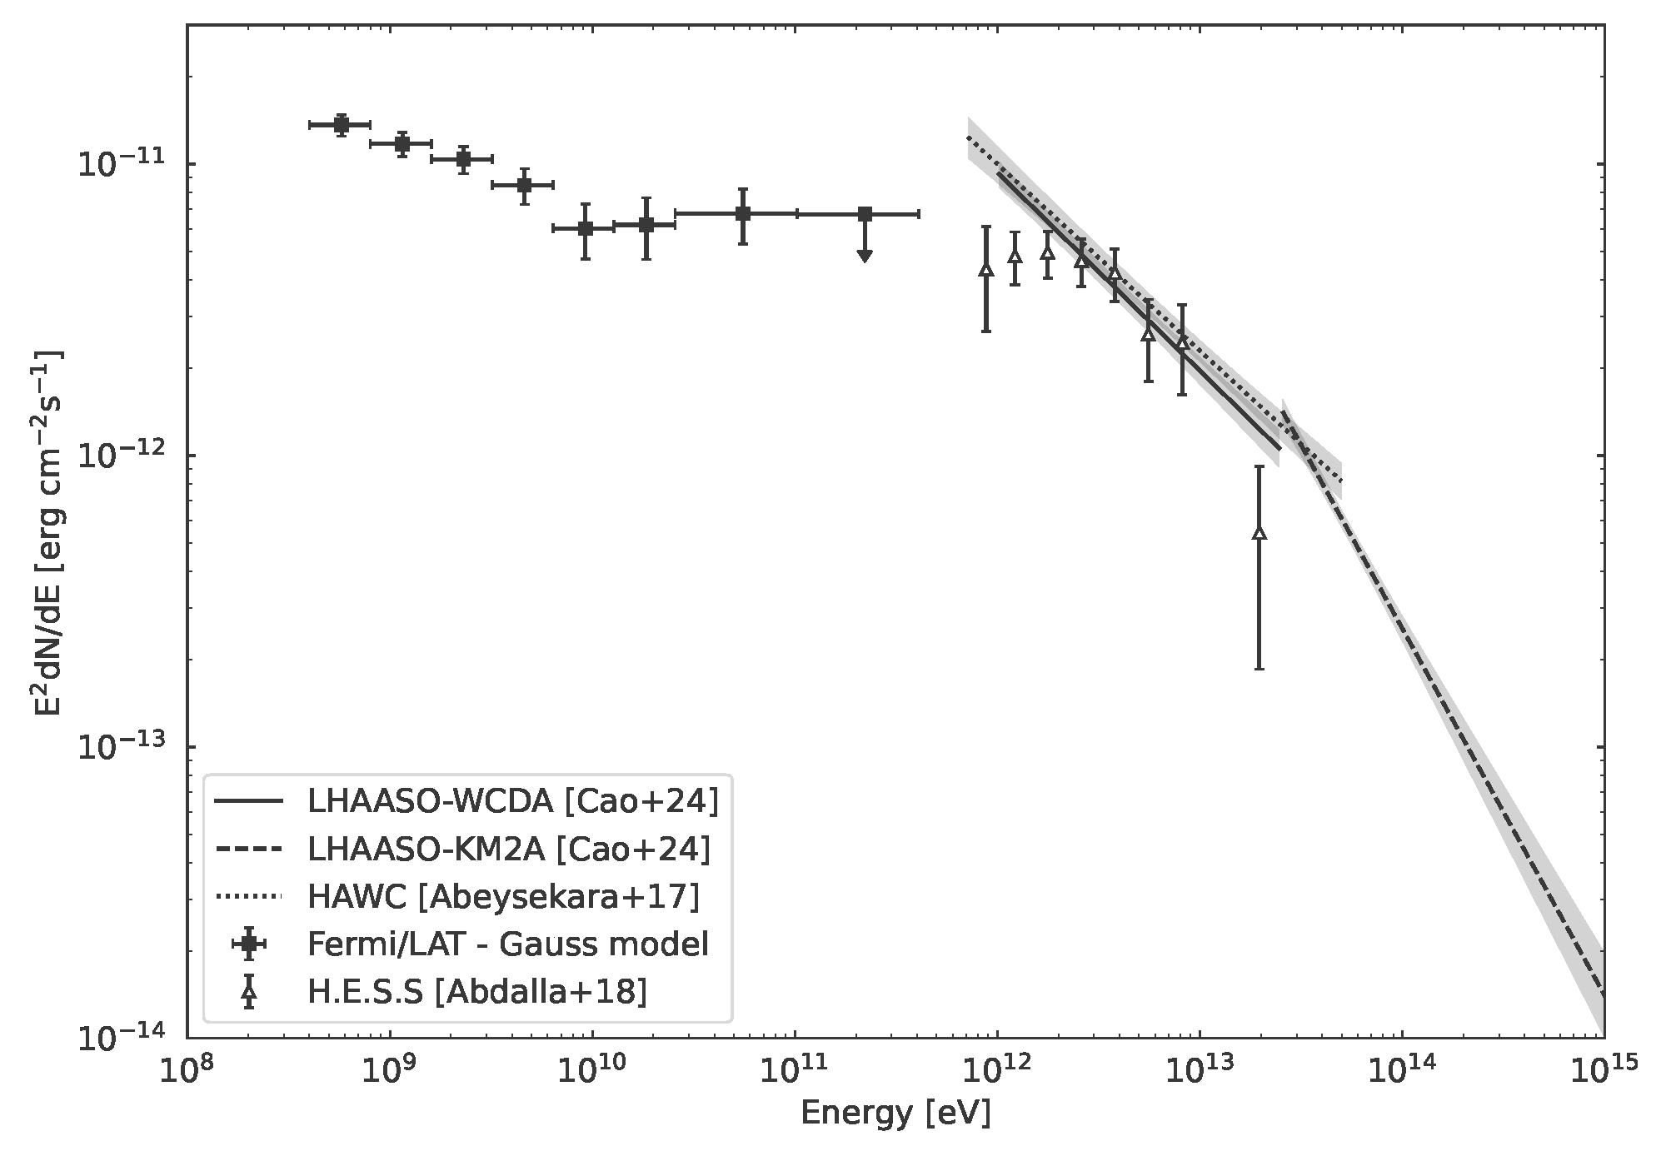
GeV/TeV Spectrum
3 models give similar spectrum that connects to TeV spectrum smoothly; SED w/ LHAASO WCDA Gaussian as an example
LAT gives Γ~2.2 and F(>0.4 GeV)~60x10⁻¹² erg/s/cm²
leptonic case (IC): α_{e}~3
hadronic case: α_{p}~2.2
Su+17 CO (d=4.6 kpc): M_{CO,H2}~4x10⁵ Msun
W_{p}(>4GeV)~5x10⁴⁹ erg
Sano+18 CO (d=1.7 kpc):
M_{CO,H2}~2x10⁴ Msun
W_{p}(>4GeV)~10⁴⁹ erg
(by Oka)
Evaluation of H_{I} contribution (e.g., Fukui+17), X-ray counterpart search, SED fitting in progress
Preliminary
Notes:
Finally, let me show the GeV/TeV spectrum
SED w/ Gaussian as an example
Plot (LAT, HESS, HAWC, LHAASO)
Gamma~2.2 and F~60E-12
Leptonic case (index)
Hadronic case (index), two possible distances (Mco, Wp)
Detailed discussion in progress

Slide 10
Summary and Prospect
We searched for GeV counterpart of LHAASO J1912+1014u that is a Galactic PeVatron and positionally coincides with HESS J1912+101
We developed a dedicated diffuse model and succeeded in reproducing excess in LAT data
CO-map-based model are as good as, or better than, gaussian model
proton PeVatron scenario is favored
LAT gives Γ~2.2 and F(>0.4 GeV)~60x10⁻¹² erg/s/cm²
If leptonic (IC), α_{e}~3
If hadronic, α_{p}~2.2 and W_{p}~10⁴⁹ erg or 5x10⁴⁹ erg (depends on distance)
Detailed modeling using multiwavelength data in progress; stay tuned
Thank you for your attention
Notes:
OK, here is the summary
Search for GeV counterpart of LHAASO J1912+1014u
Proton PeVatron scenario feasible
Implication of LAT data (index, Wp)
Detailed modeling in progress

Slide 11
References
Abdollahi et al. 2024, ApJS 260, 53 (4FGL)
Abdollahi et al. 2024, ApJS submitted (2FGES; arXiv.2411.07162)
Abeysekara et al. 2017, ApJ 843, 40 (2HWC)
Aharonian et al. 2008, A&A 484, 435
Brand&Blitz 1993, A&A 275, 67
Cao et al. 2024, ApJS 271, 25
Chang et al. 2008, ApJ 682, 1177
Fukui et al. 2017, ApJ 850, 71
H.E.S.S. Collaboration 2018, A&A 612, 8
Ranasinghe&Leahy 2023, ApJS 265, 53
Sano et al. 2018, ASJ meeting (ISM-oriented paper in prep.)
Smith et al. 2019, ApJ 871, 78 (LAT PSR catalog)
Su et al. 2017, ApJ 845, 48
Green et al. 2019, Proc. ICRC 2019; Zhang et al. 2020, ApJ 889, 12; Zeng et al. 2021, ApJ 910 78; Sun et al. 2022, A&A 659, 83; Li et al. 2023, ApJ 953, 100 (past studies of LAT data for HESS J1912+101)

Slide 12
Backup Slides (Appendix)

Slide 13
Alternative Scenario (Sano+18)
Su+17 proposed CO cloud with v~60 km/s is associated with HESS J1912+101
Sano+18 proposed alternative scenario (CO cloud with v~25 km/s) based on the following:
expanding gas motion is observed
good spatial correlation with H.E.S.S. source is observed
(ISM-oriented paper in prep.)

Slide 14
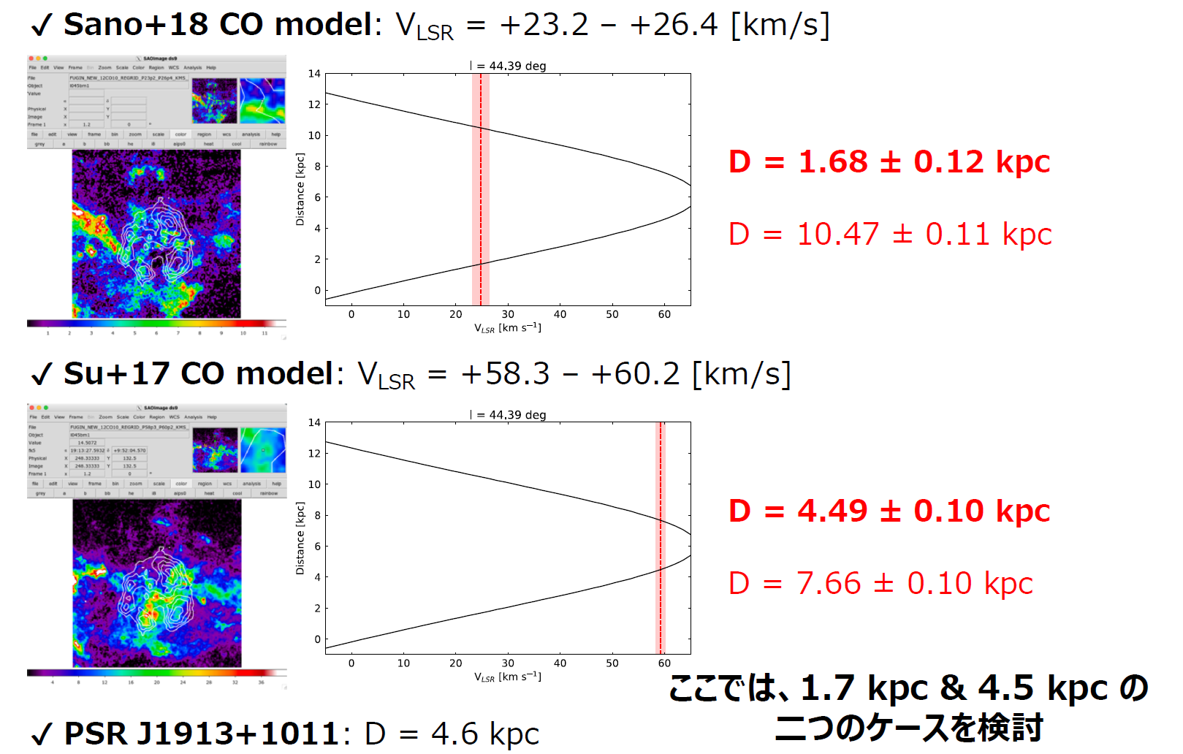
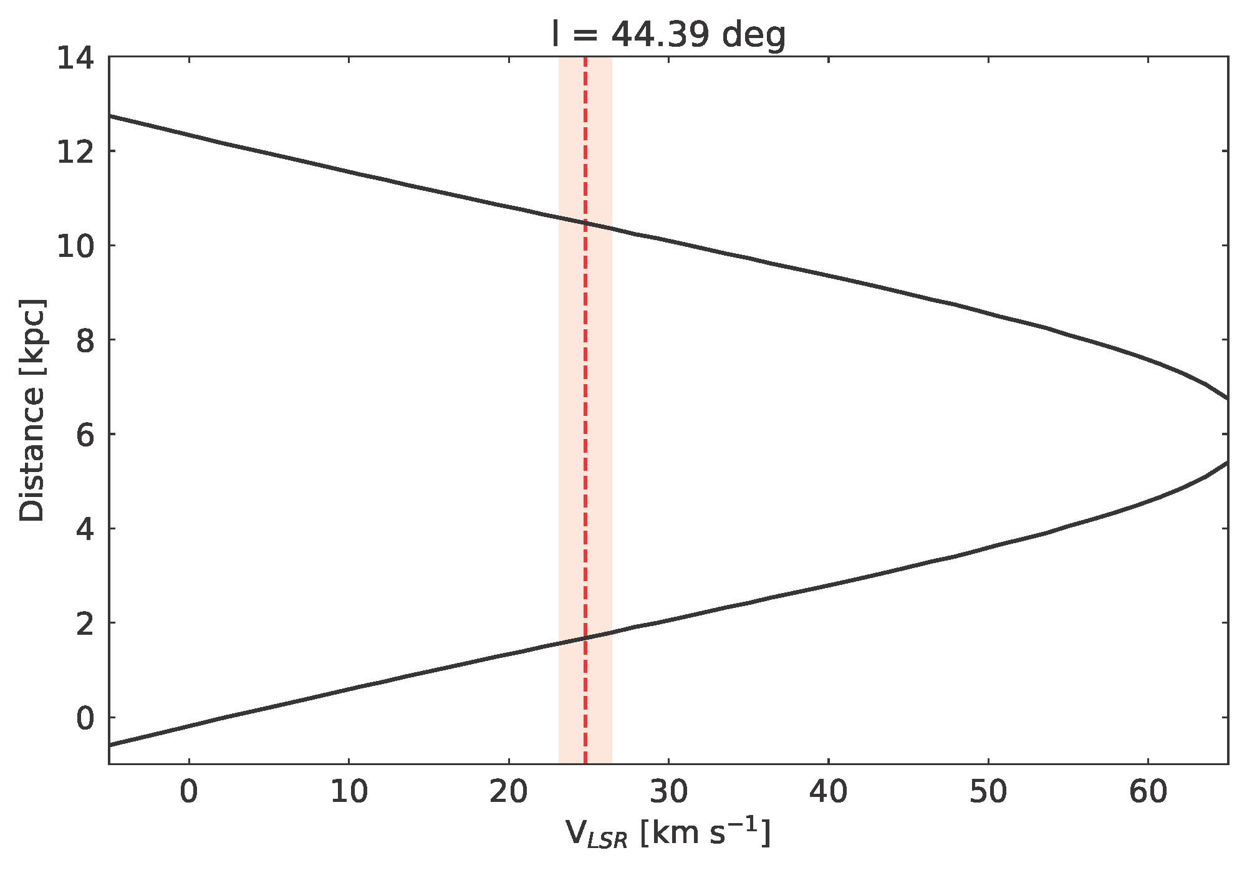
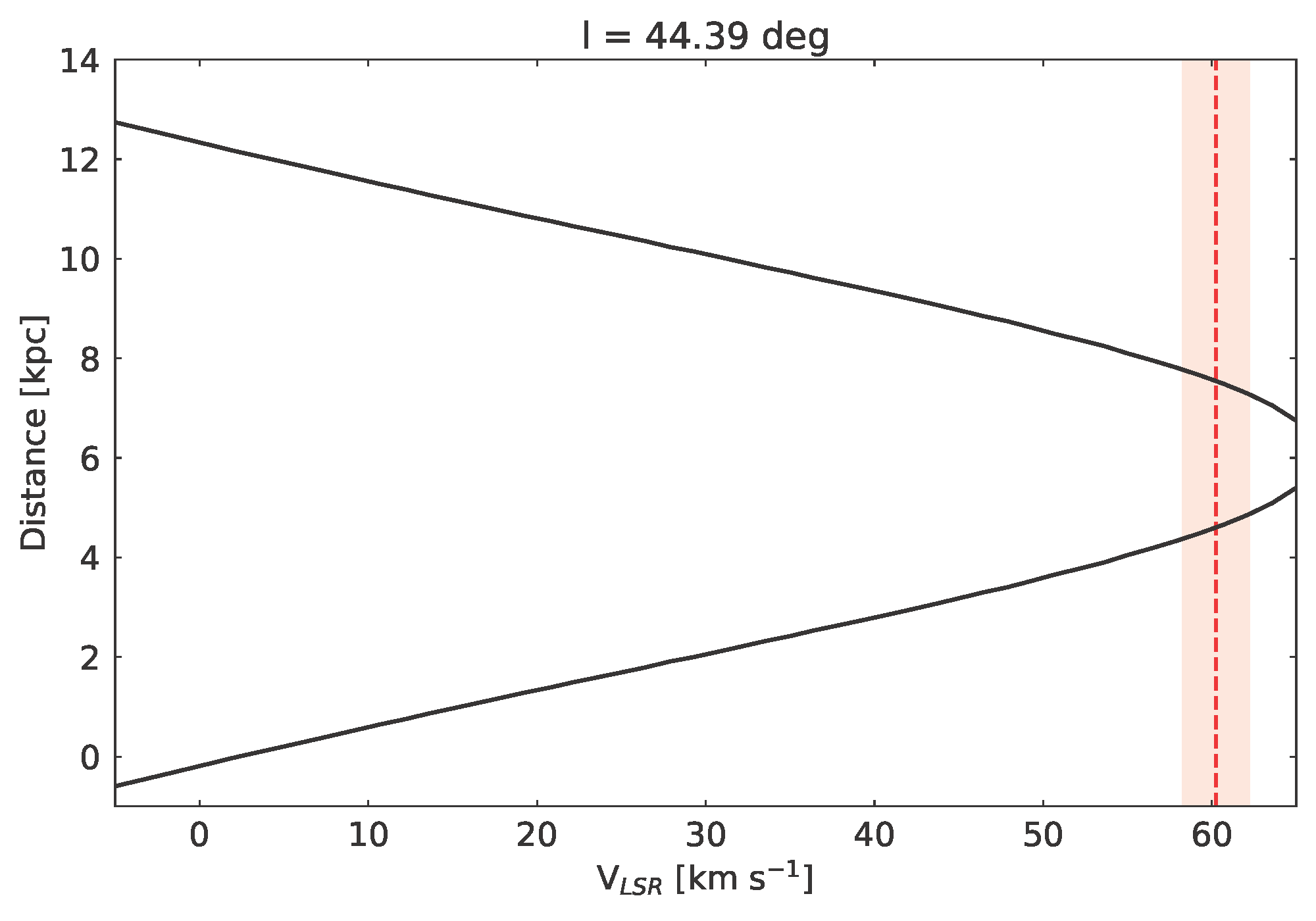
Distance to the Source
We refer to rotation curve by Brand&Blitz 1993 and adopt the distances of near side
V_{LSR} = +23.2 - 26.4 [km/s]
D=1.7 +/- 0.1 kpc
D=10.5 +/- 0.1 kpc
If the LHAASO (and LAT) source is SNR, D=1 deg corresponds to
~30 ps (t~15 kyr) for Sano+18
~80 pc (t~120 kyr) for Su+17 (D=9.5t^{0.44} pc; Ranasinghe&Leahy 23)
V_{LSR} = +58.3 - 62.2 [km/s]
D=4.6 +/- 0.2 kpc
D=7.5 +/- 0.2 kpc
(by Oka)

Slide 15
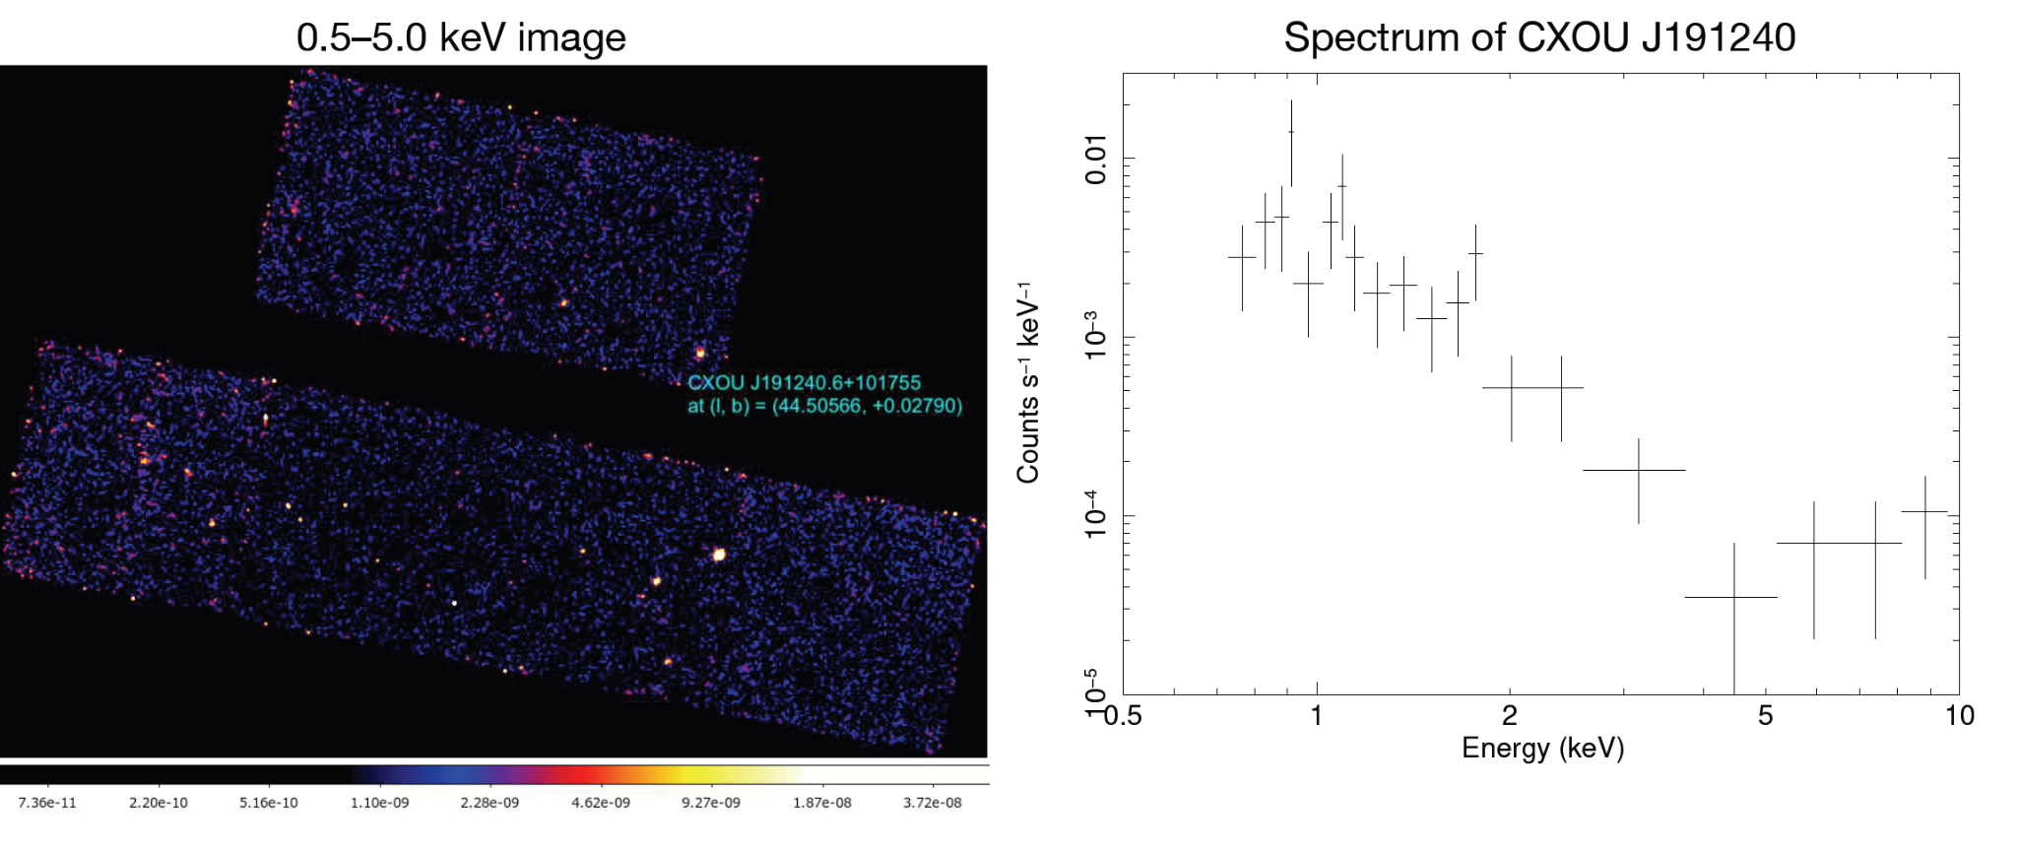
X-Ray Observations
Chandra and XMM observed the area several times to study HESS J1912+101 (some affected by stray-light of GRS 1915+105)
Position of GeV residual peak (center of HESS J1912+101) observed by Chandra
No apparent extended emission (cf. Chang+08); detailed study in progress
(by Suzuki)

Slide 16
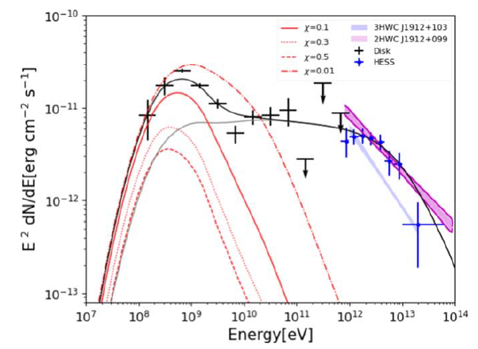
Past Studies of LAT Data
Several past studies of LAT data searching for GeV counterpart of HESS J1912+101
Most of these pioneering work used standard diffuse model and removed “c” flag sources
They obtained soft spectrum (Γ~2.5) below 10 GeV and employed two-zone model or discussed only >10 GeV
(LI+23)

Slide 17
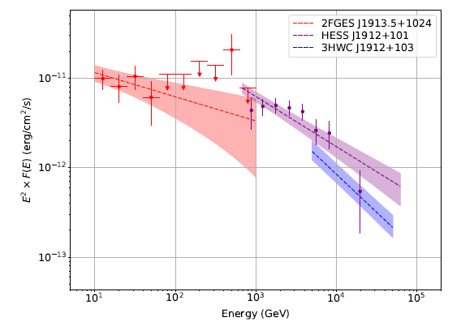
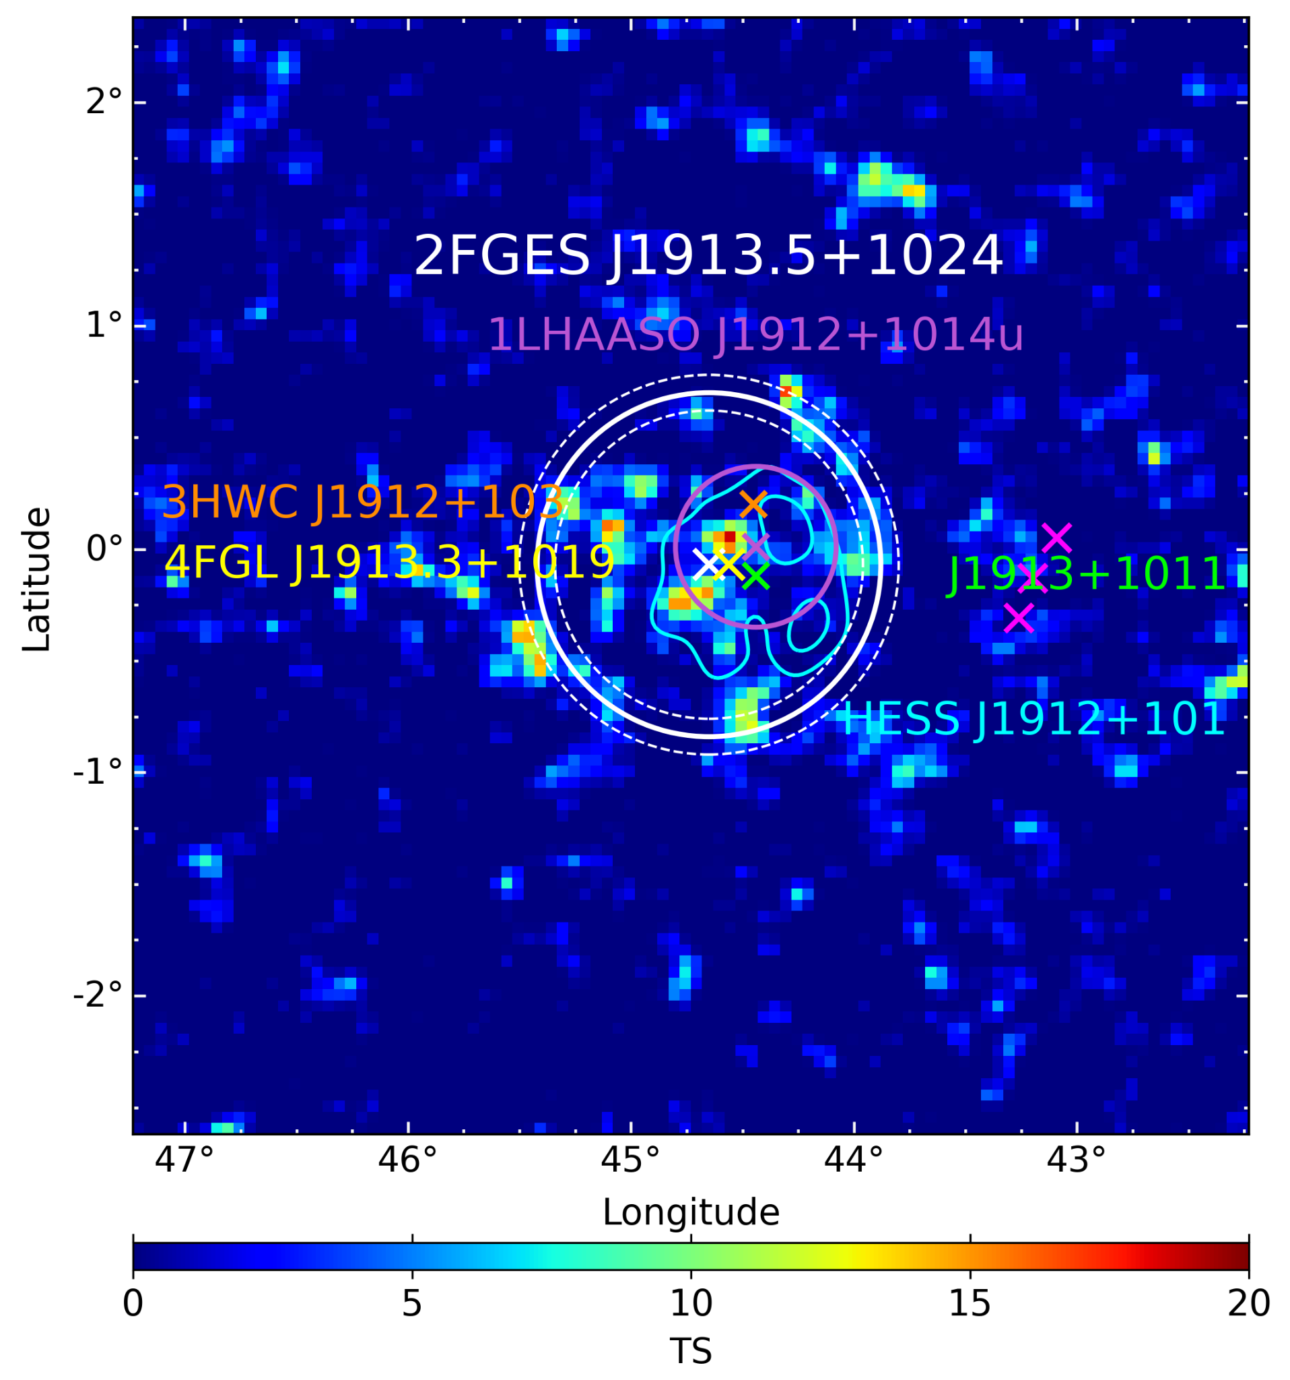
2FGES Result of the Region
2FGES, led by Soheila and Pierrick, reported extended emission toward the region (r₆₈=0.77 deg, Gamma=2.27)
Our spectrum using LHAASO gaussian (r₃₉=0.50 deg) is similar to 2FGES result
Abdollahi+24

