Slide 1
CTAO: The Upcoming VHE γ-ray Observatory
Dr. David Green, CTAO Deputy Project Scientist
david.green@cta-observatory.org

Slide 2
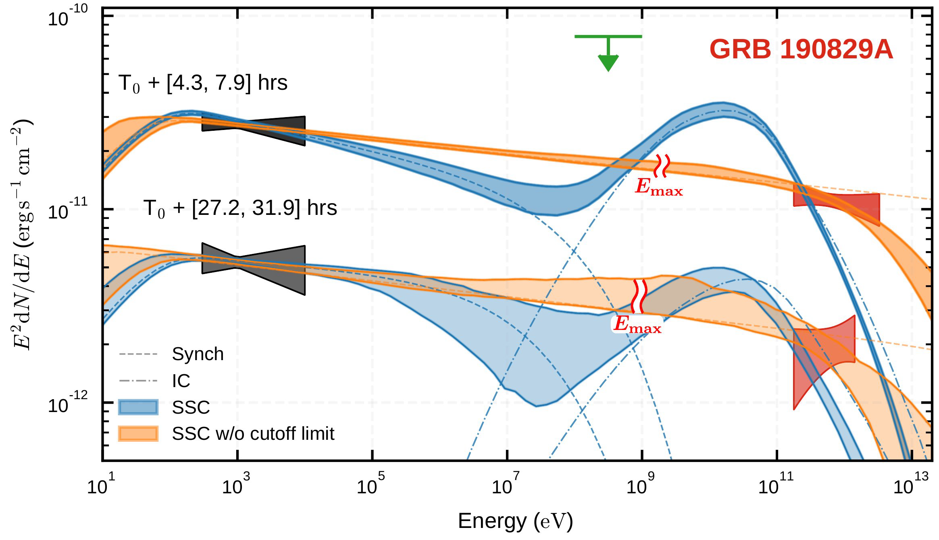
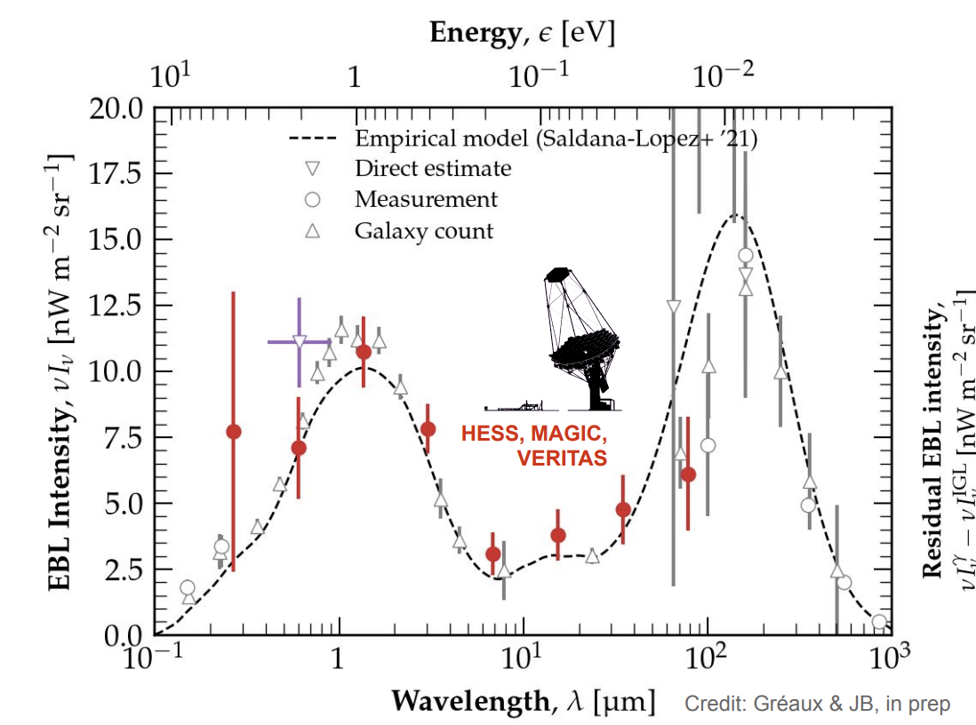
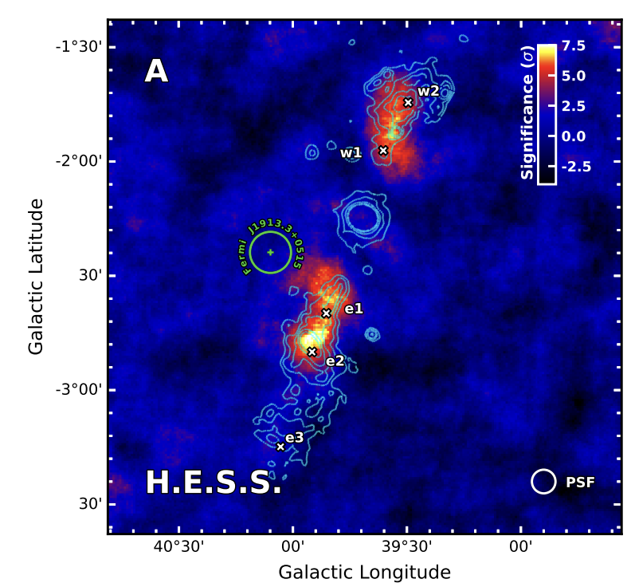
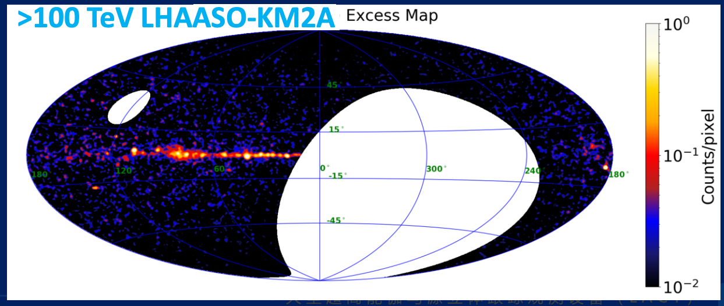
CTAO Science
I am not going to go into details on the Science for CTAO
CTAO will have lots of science potential
Will produce the largest catalog of VHE sources
Will be a cornerstone of MM+MWL Science
See Gabrijela’s talk
Sub-TeV
Transients
Cosmological Sources
Pulsars
TeV
EBL
Dark Matter
Diffuse Emission
Morphology
Surveys
Multi-TeV
PeVatrons
SFRs
SNRs
Microquasars
H.E.S.S. coll. 2021
H.E.S.S. coll. 2024

Slide 3
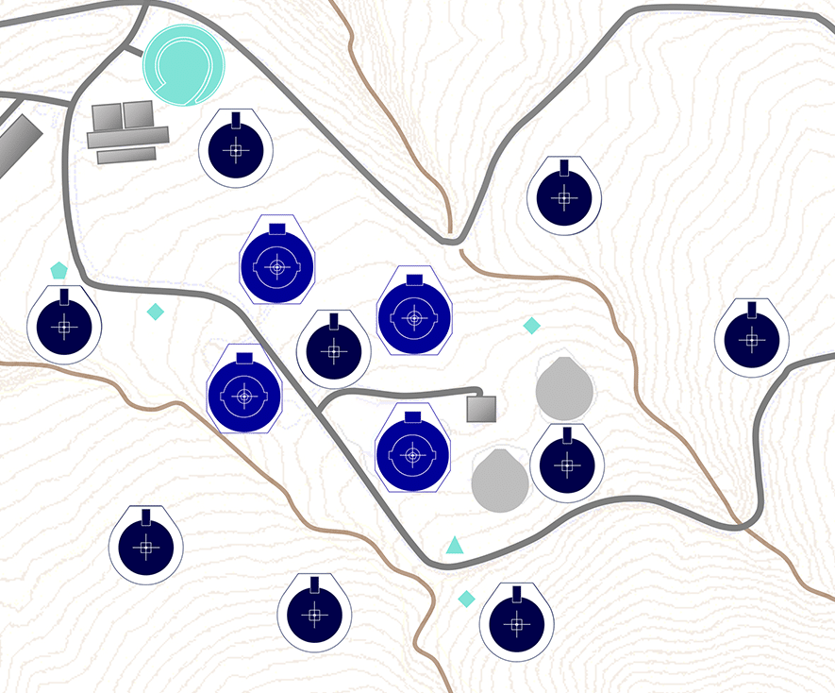
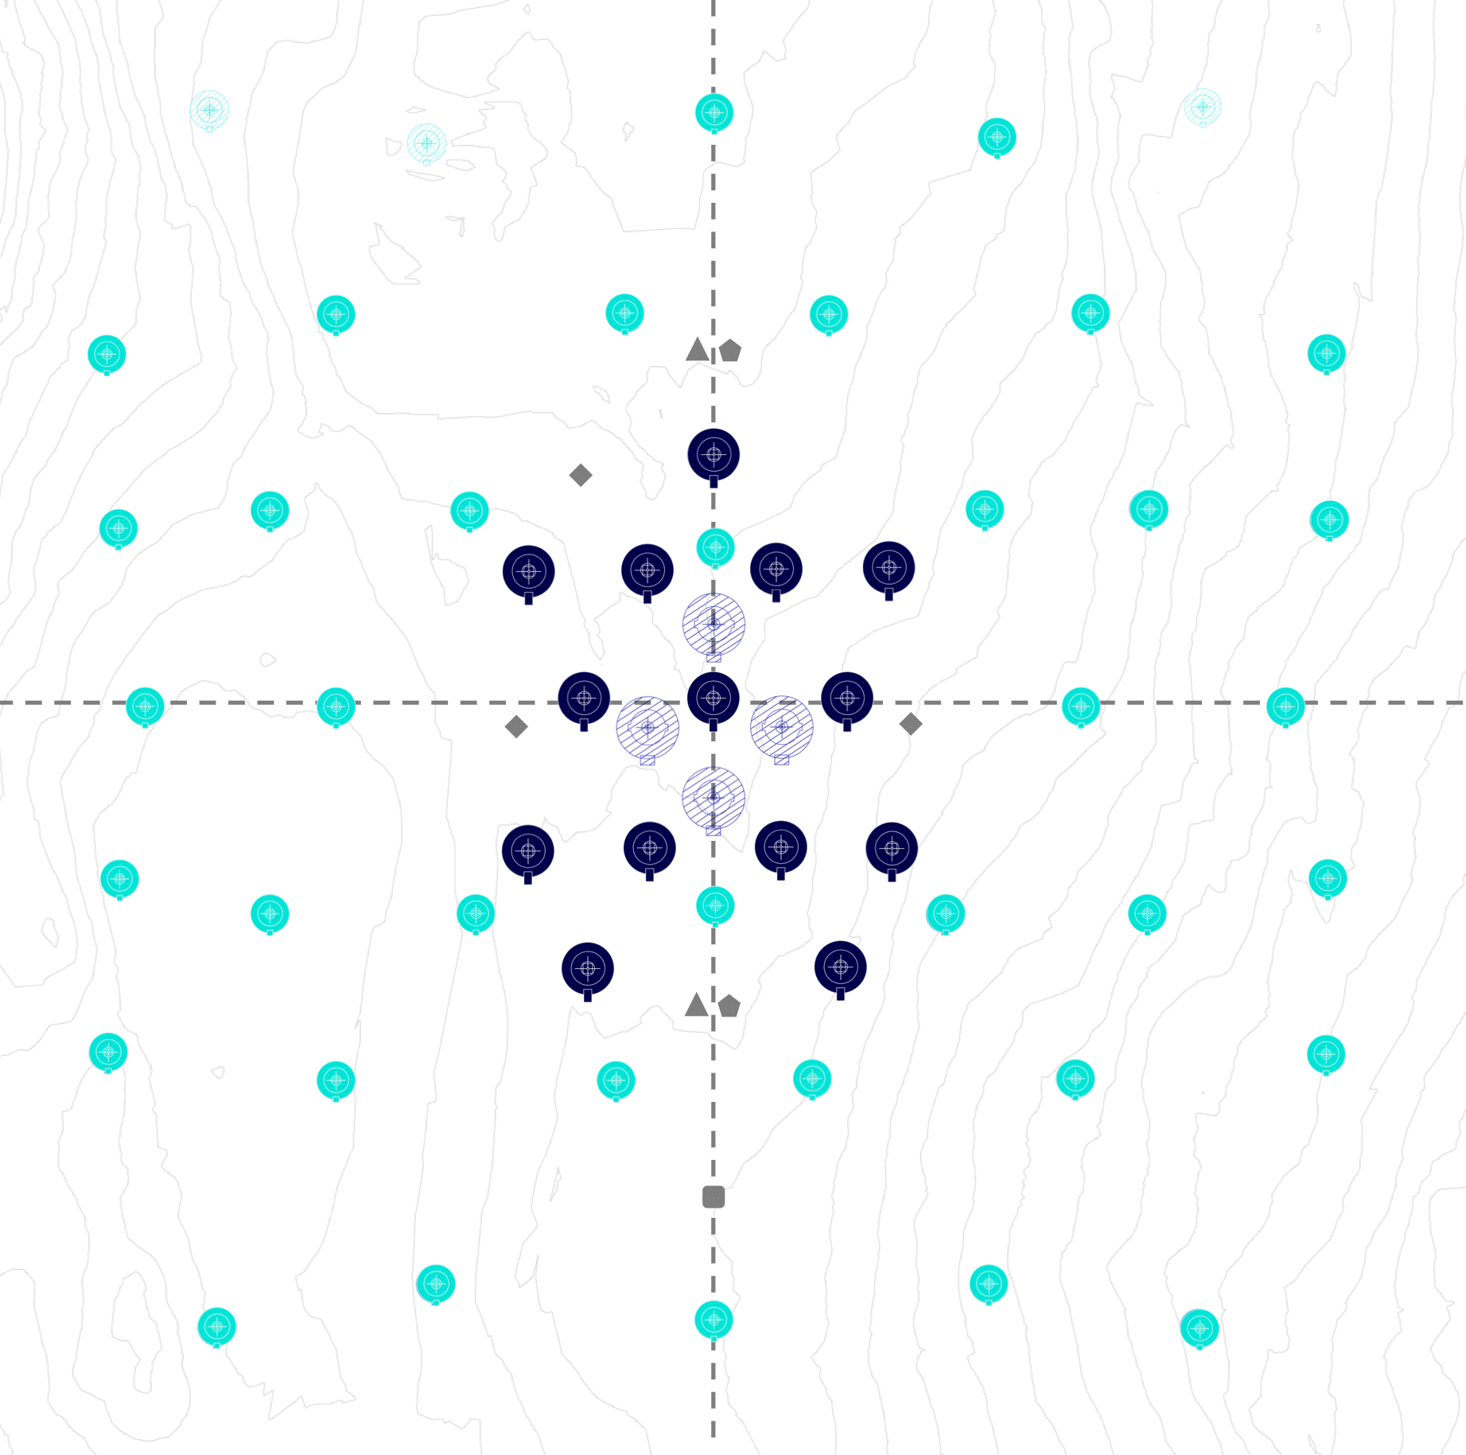
CTAO Sites
Alpha Configuration
CTAO Northern Array
CTAO Southern Array

Slide 4
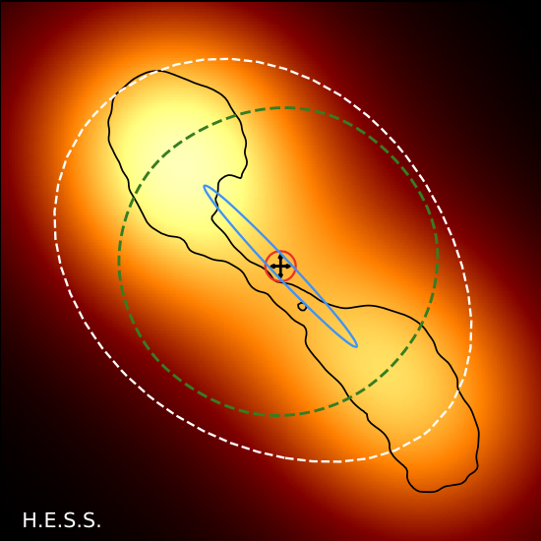
CTAO Performance
Alpha Configuration
15-30” localization
x
CTAO 2 TeV
ASTRI 10 TeV
LAT @10GeV
HAWC @10TeV
LHAASO @30 TeV
SWGO @10TeV
4

Slide 5
Types of Observing Time
An open proposal-driven observatory
Proposals will be evaluated on their scientific merit in a double-blind fashion
Data will have a proprietary period of 1 year
After which the data will be public
8% of time is for any scientist either through DDT or Open Time
HGT – Host Guarantee Time (Spain, Chile, ESO)
DDT – Director’s Discretionary Time
KSP – Key Science Projects
Integrated over 10 years

Slide 6
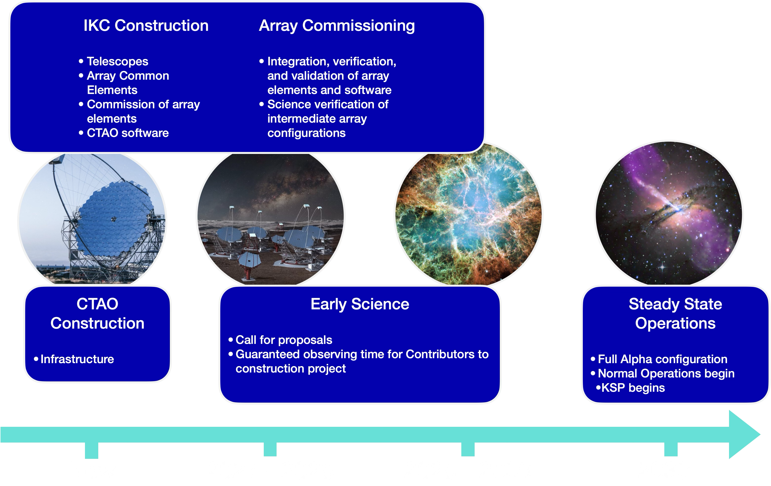
CTAO Timeline
Scientific Comm.

Slide 7
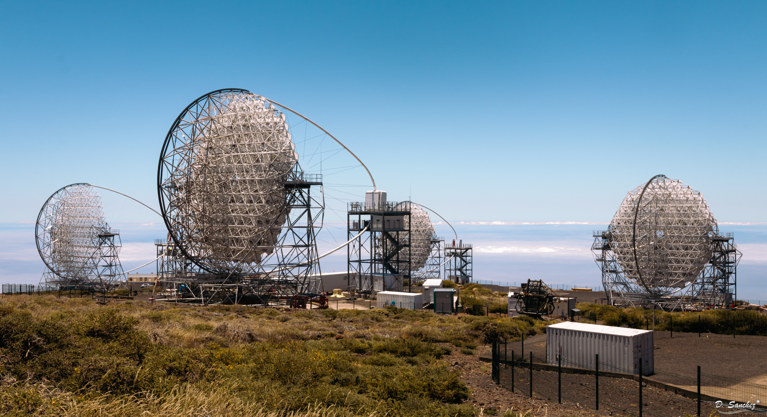
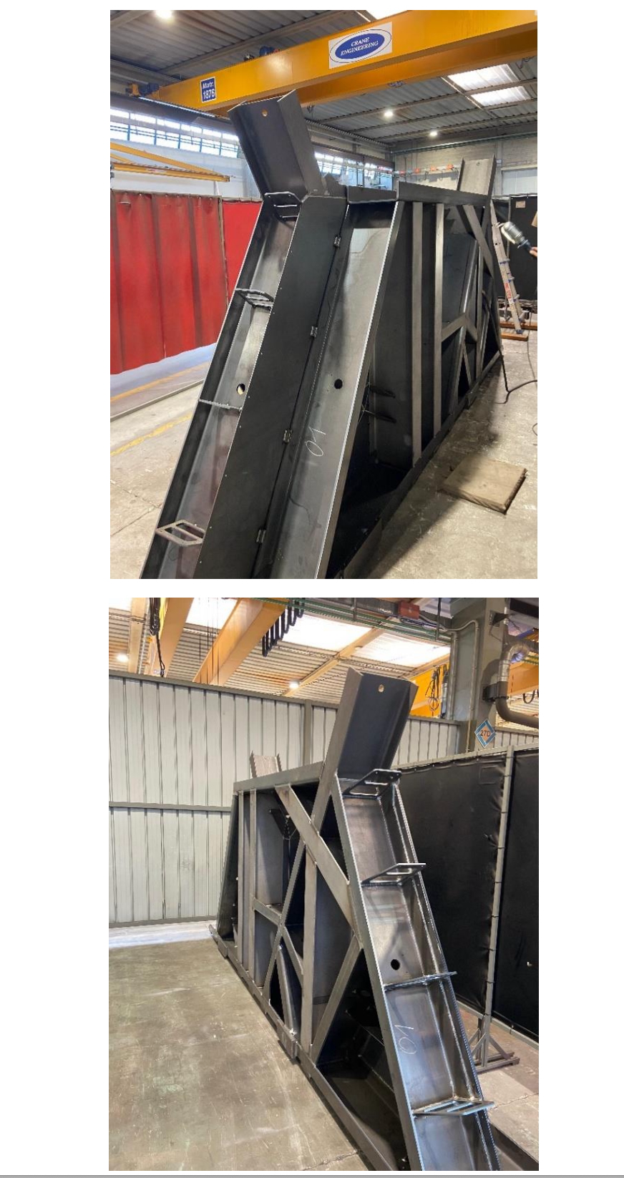
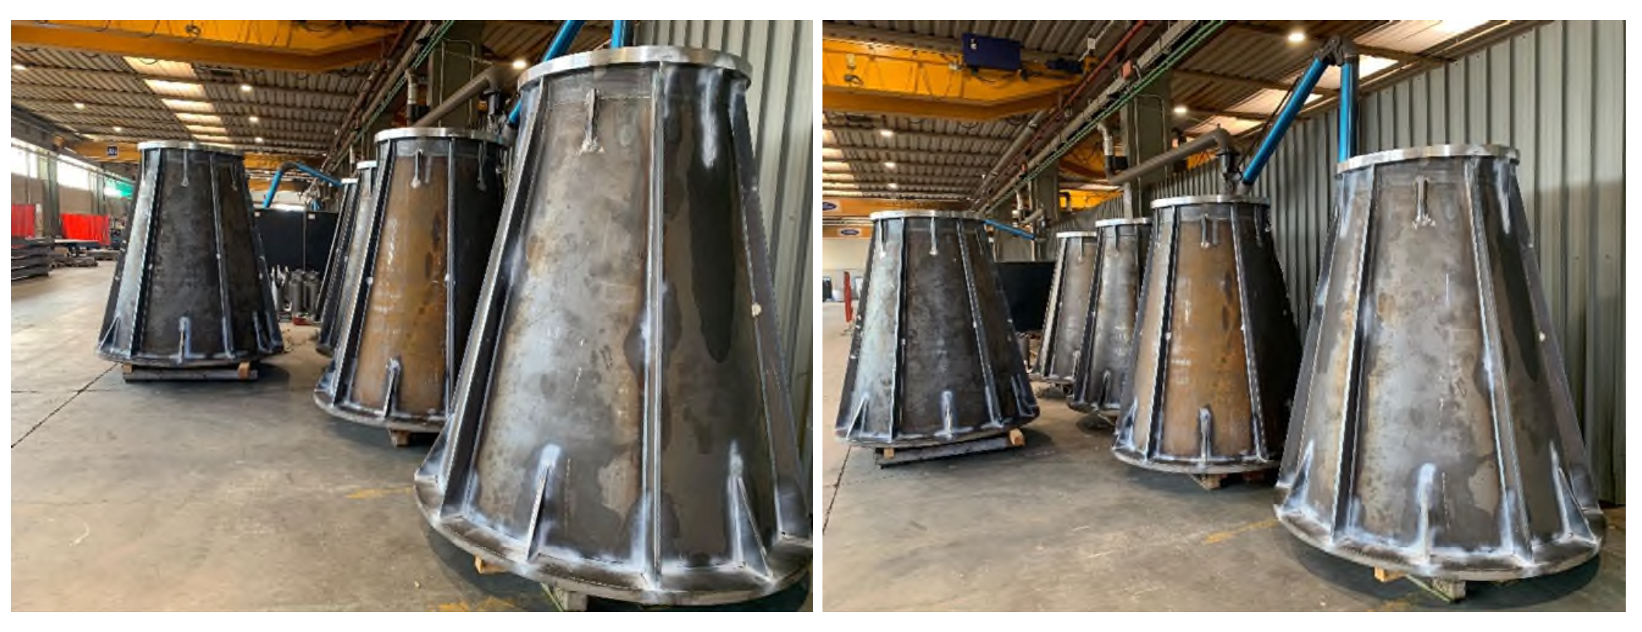
Credit: David Sanchez & CTAO-LST Collab
July 2025

Slide 8
Towards first CTAO data
Intermediate array configurations
Incremental array configurations that become progressively available to community
Array elements fully integrated with the intermediate release of software packages
Array elements include telescopes but also calibration devices and atmospheric characterization instruments
Mid-period plan (~3 years) based on the construction and acceptance schedule
Built accounting for the inputs of the in-kind contribution teams
Scientific Comm.

Slide 9
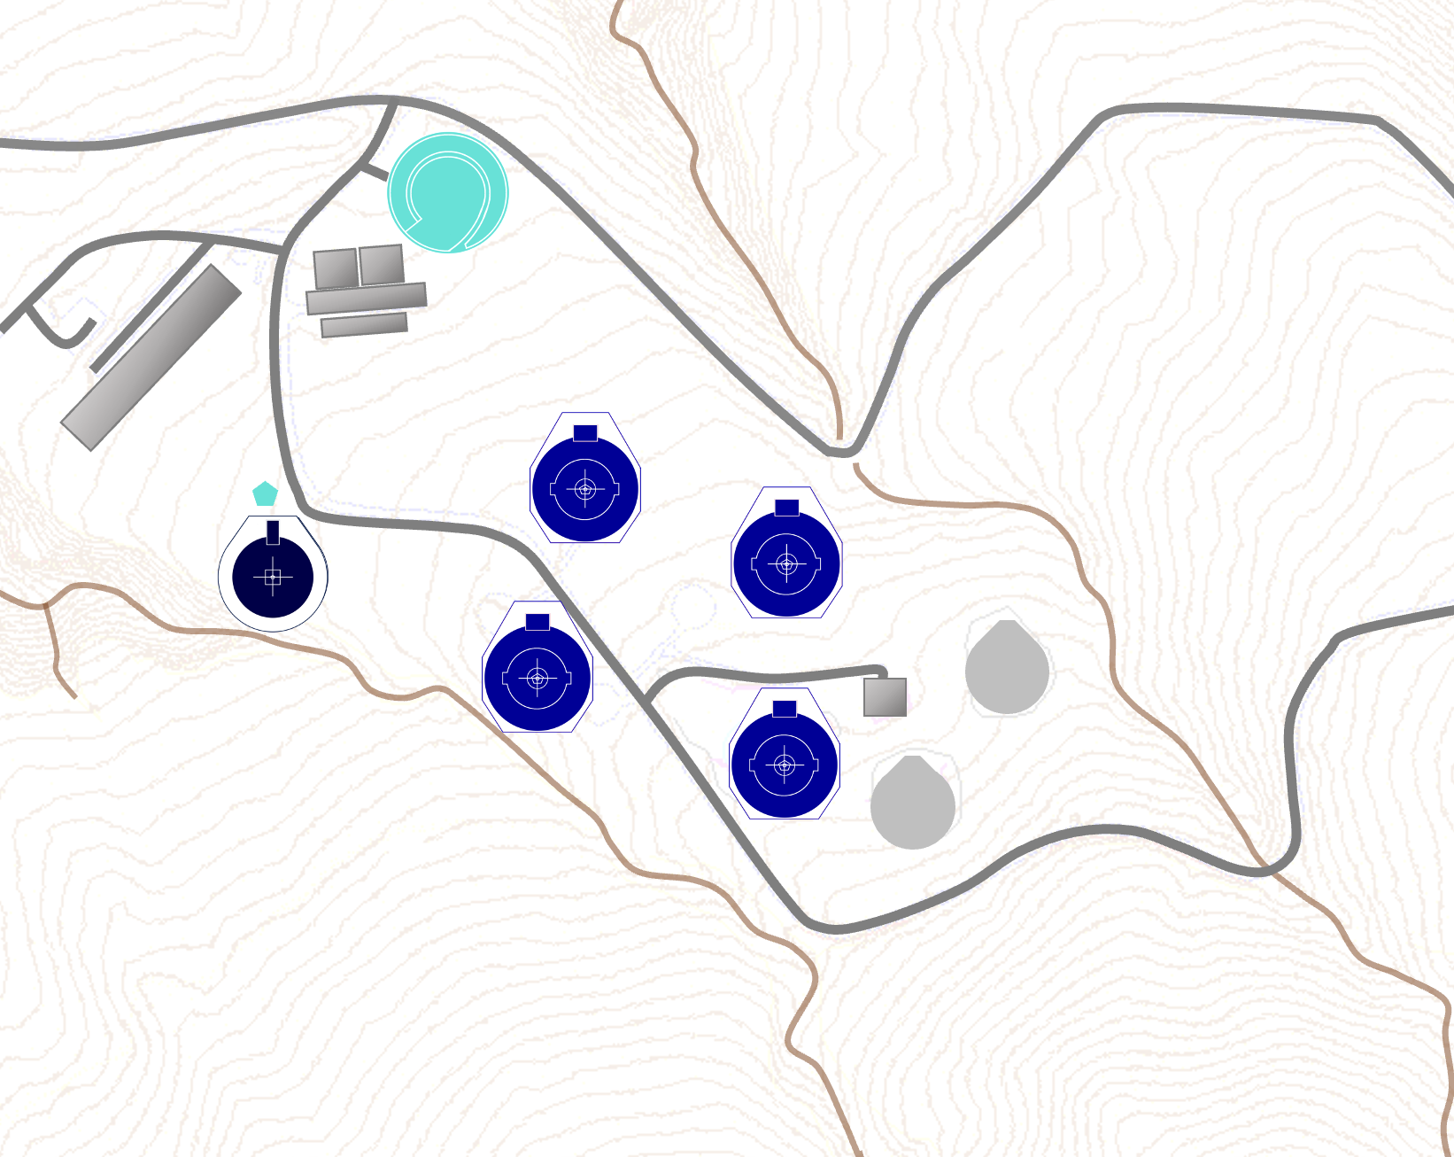
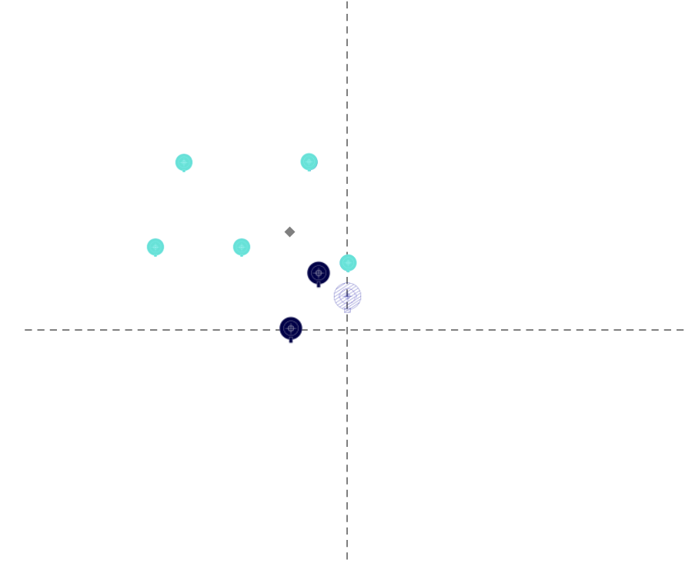
1st Intermediate Arrays
3 years from today
CTAO-North
CTAO-South
Scientific Comm.

Slide 10
1st Intermediate Arrays
Intermediate array configurations should be available in 2028
CTAO Central Office is working closely with IKC teams
CTAO-North -> 4 LST + 1 MST
CTAO-South -> 2 MST + 5 SST
More news hopefully to come soon
CTAO-North
CTAO-South
Scientific Comm.

Slide 11
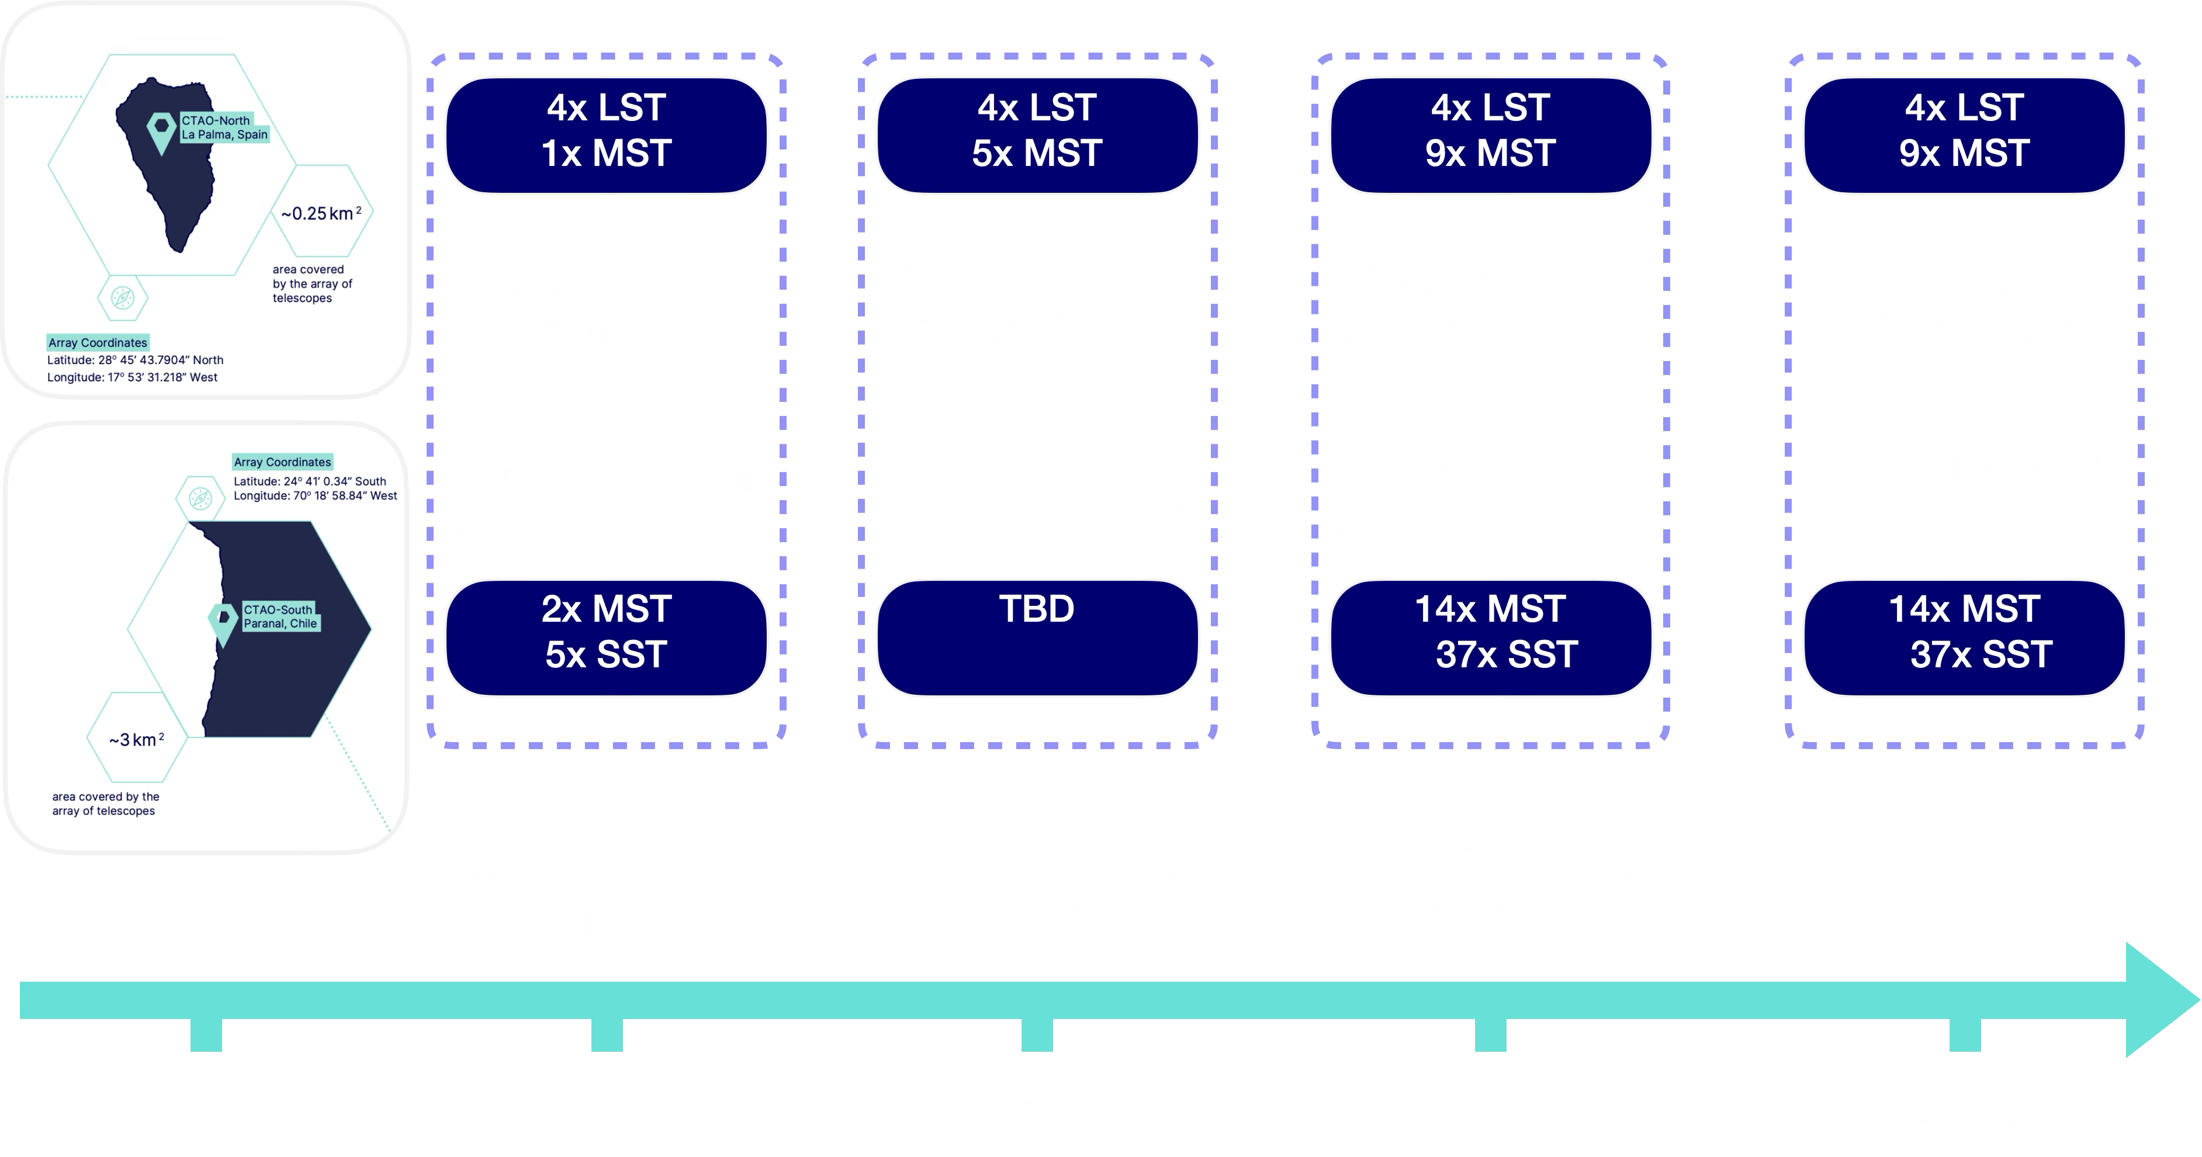
Early Science Timeline

Slide 12
Science Data Challenge
Fully open and blind!
Seven years of simulated CTAO observations provided as science-ready datasets
Goals:
Allow the scientific community to explore CTAO Scientific capabilities
Allow users to become familiar with the technicalities of the analysis as well with the CTAO SAT/Gammapy
Good opportunity to learn Gammapy
Release of Science Data Challenge Q4 2026

Slide 13

Focus of school is on Time-domain astrophysics and Galactic science
Partnering with MAGIC through ACME to reach beyond CTAO
Application deadline is November 30th!
https://school.ctao.org/ for more details

Slide 14
Conclusions
VHE gamma-ray astronomy is a key discipline within the broader field of astrophysics
CTAO will be the first proposal driven open astronomy observatory in the field of VHE astronomy
The scientific community will have the possibility to request observing time and to access the data (after a one year of proprietary period)
CTAO is set to become a cornerstone of mutli-messenger and mutli-wavelength (MM/MWL) astronomy
The construction of the CTAO project has already started! First data is coming soon.

Slide 15
Backup Slides

Slide 16
Data Levels
CTAO will offer a storage service on selected DL6 data (e.g., catalogs)
R0 Telescope Raw data
R1 Standard Raw data
DL0 Archived Raw data
DL1 Calibrated data
DL2 Reconst. Air showers
DL3 Science Ready data
DL4 Binned Science Data
DL5 Advanced Science Data
DL6 Advanced Science
Collection
Structure
Produced by:
Users with SAT
User-contributed data products
CTAO with standardized pipeline
Observatory data products for quick-look results
Preserved Data
Distributed to the Scientific Community

Slide 17
Data Categories
CAT-A data Realtime analysis
CAT-B data On-site analysis
CAT-C data Off-site analysis
Latency | Within the same observing night | Next day (before the start of the next observing night) | 1 month after observation
Goal | Issue Scientific alerts and follow-up observations | Data quality and check of CAT-A results | Delivery of best quality data for scientific analysis == used in publications
Scientific Comm.
Performance Requirements in terms of systematic uncertainties

