Slide 1
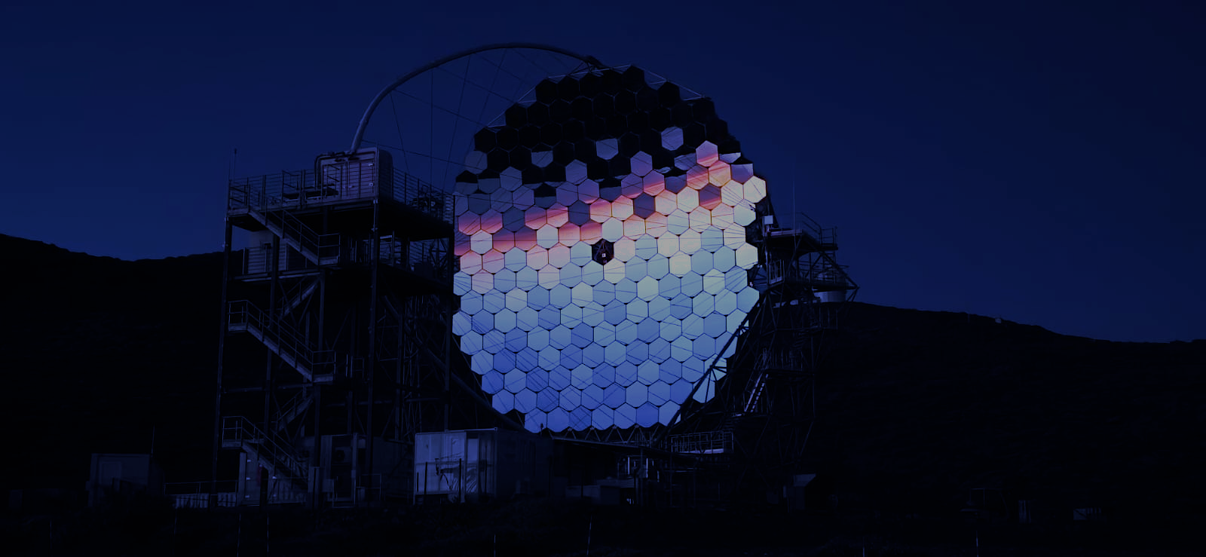





LST-1 Observations of Radio Galaxies: a study of flaring and quiescent states for NGC 1275 & IC 310
Tora T.H. Arnesen (IAC), Mireia Nievas Rosillo (IAC),
Monica Vázquez Acosta (IAC), Jorge Otero-Santos (INFN),
Daniel Morcuende (IAA), for the CTAO-LST Project
Tora Therese Høiland Arnesen, PhD student
tora.arnesen@iac.es

Slide 2
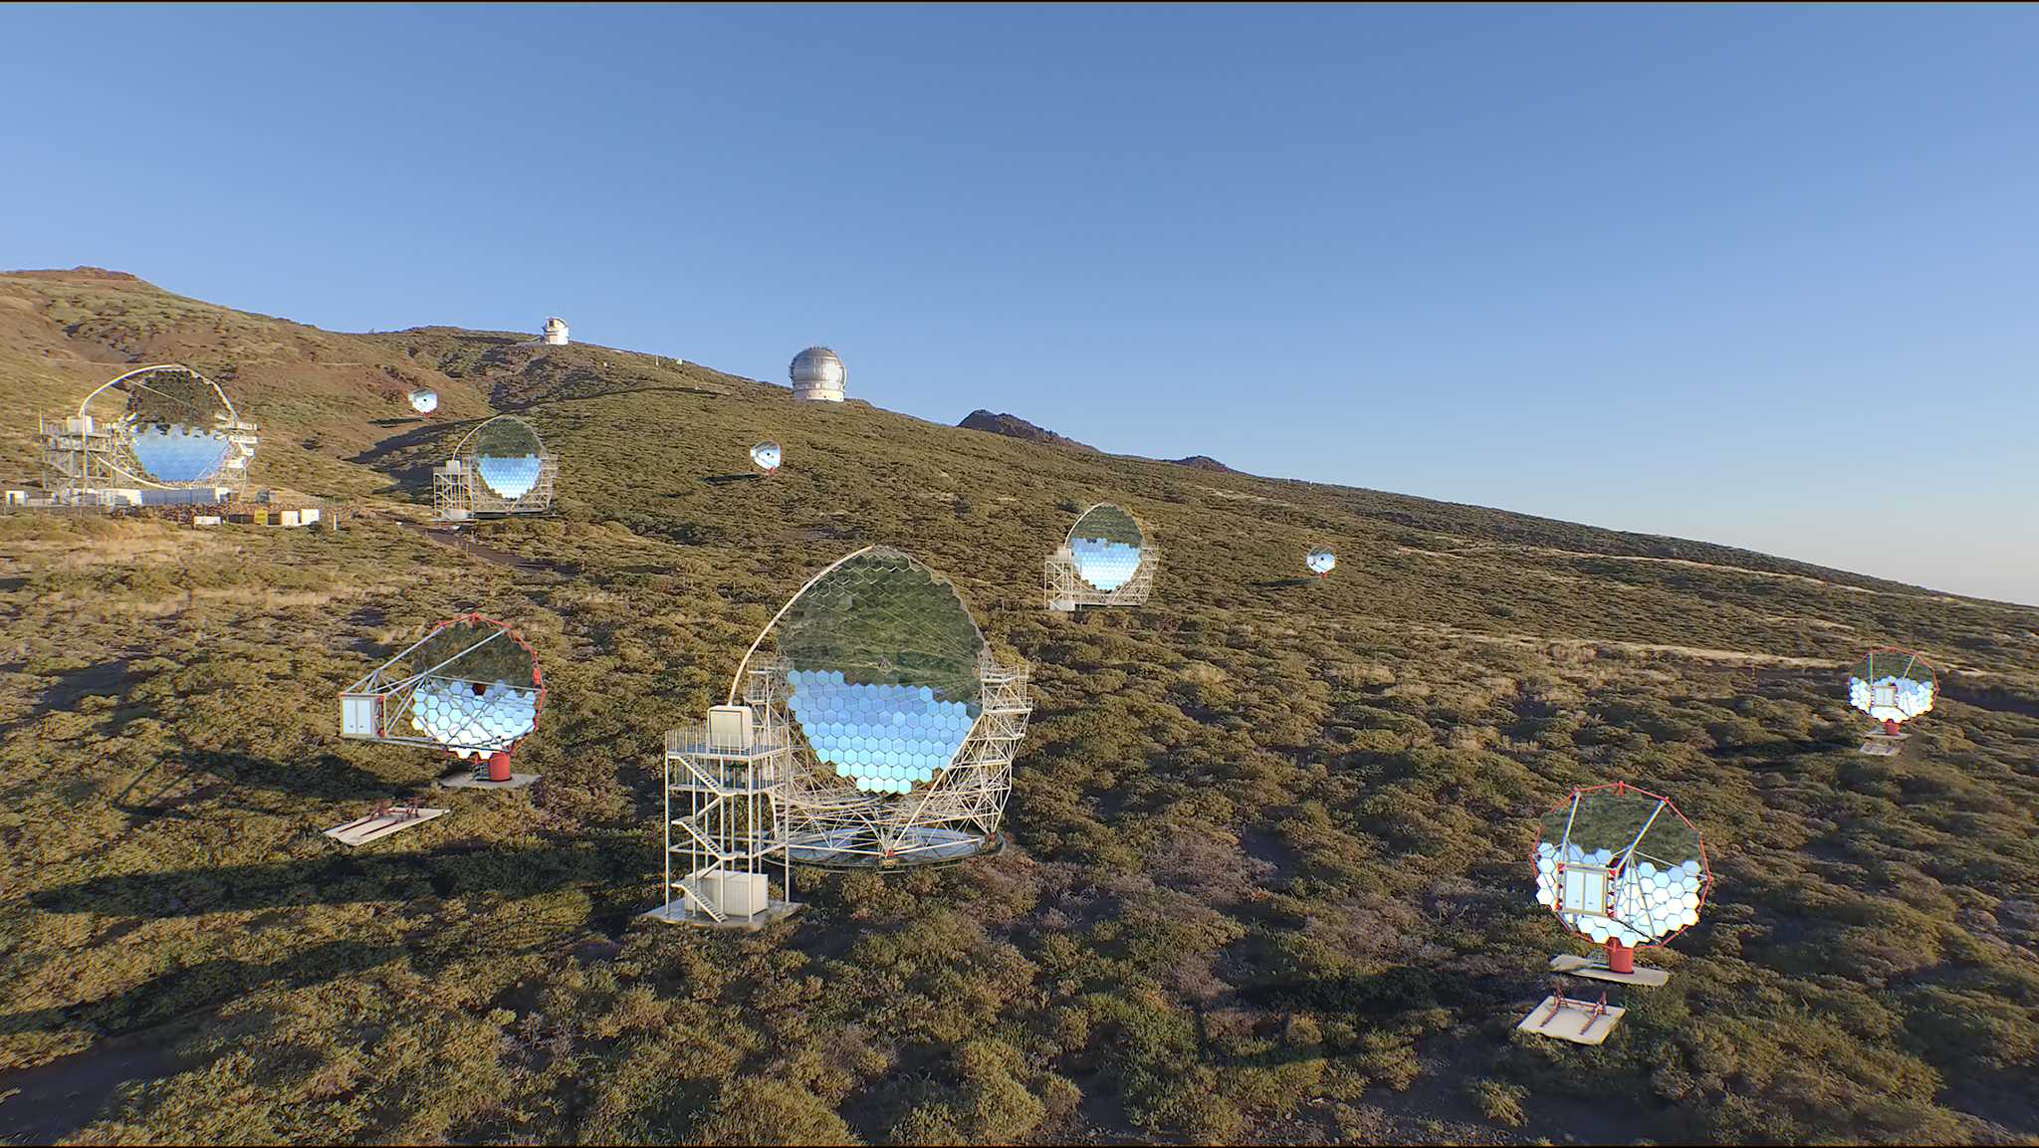
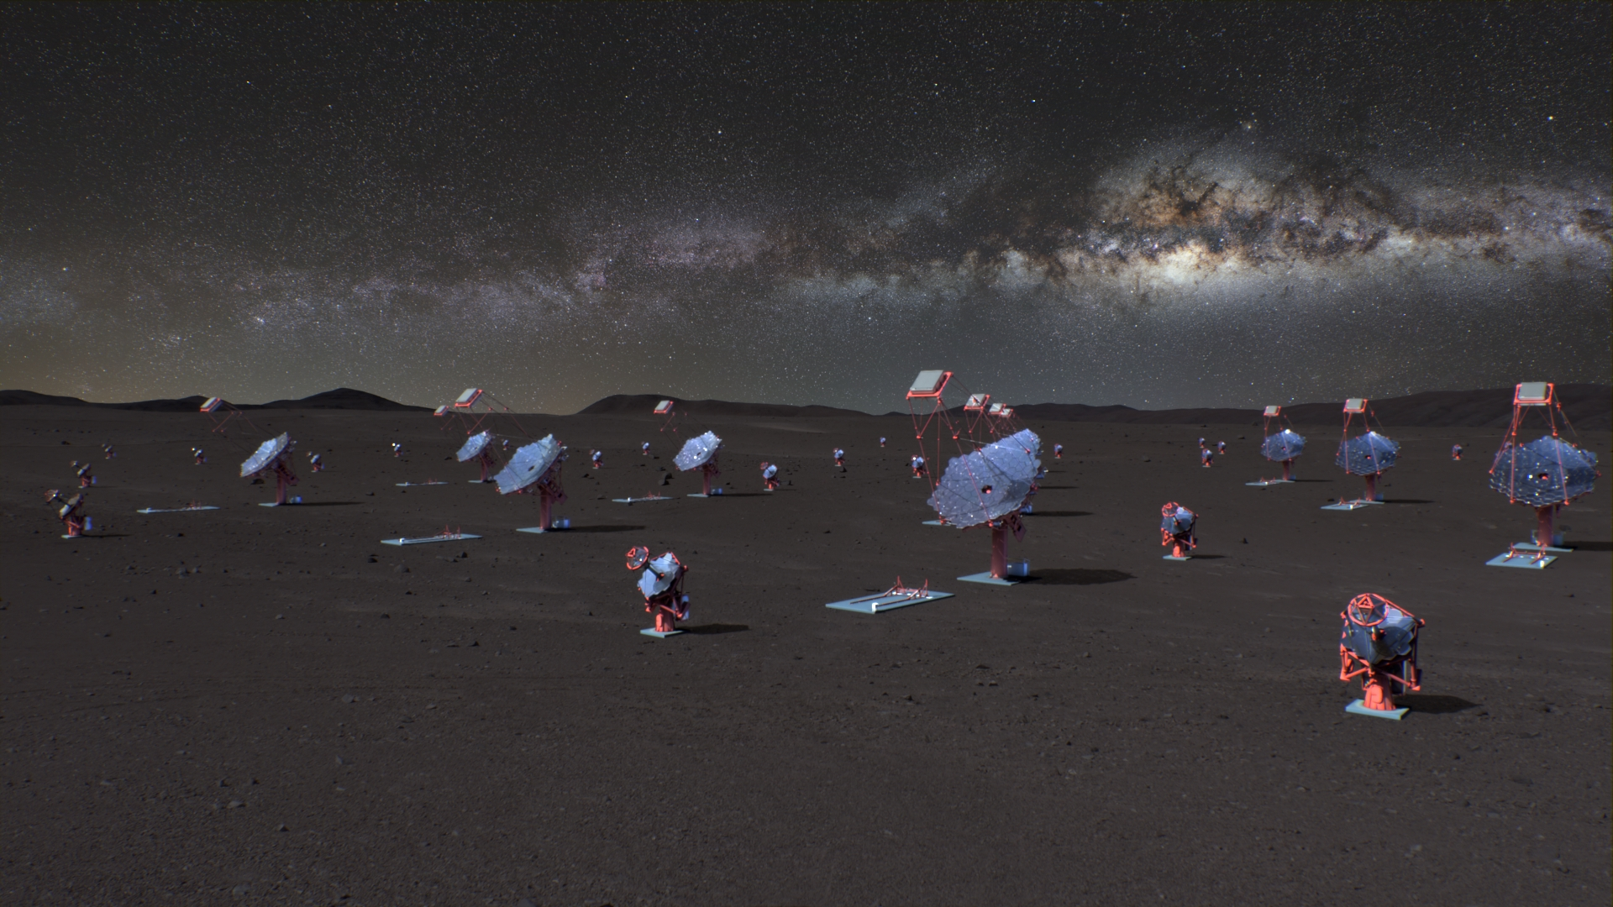
Future CTAO-North
Credit: CTAO
Future CTAO-South
Credit: CTAO

Slide 3
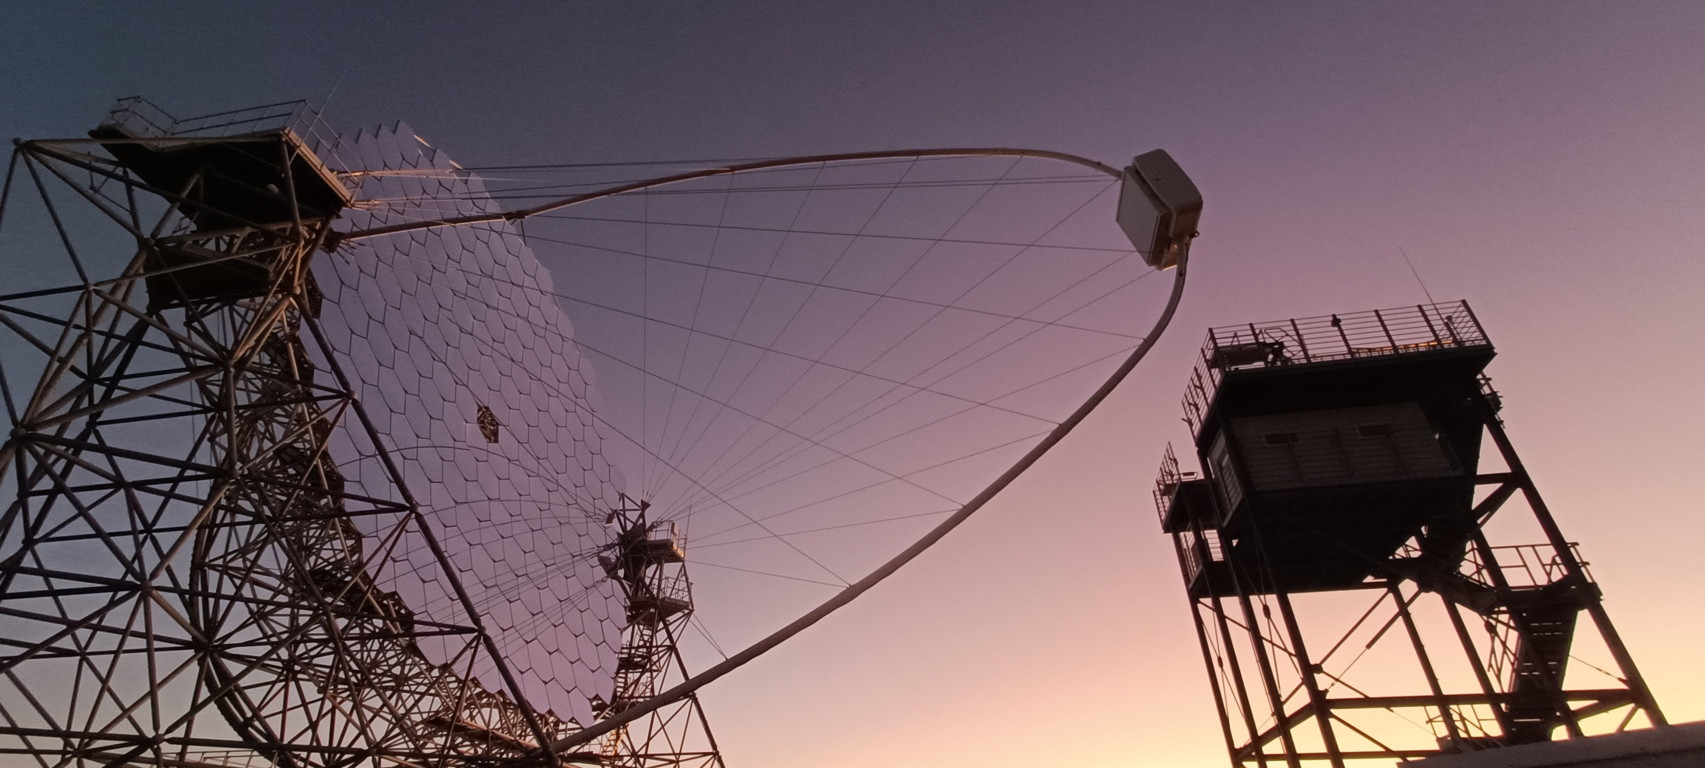
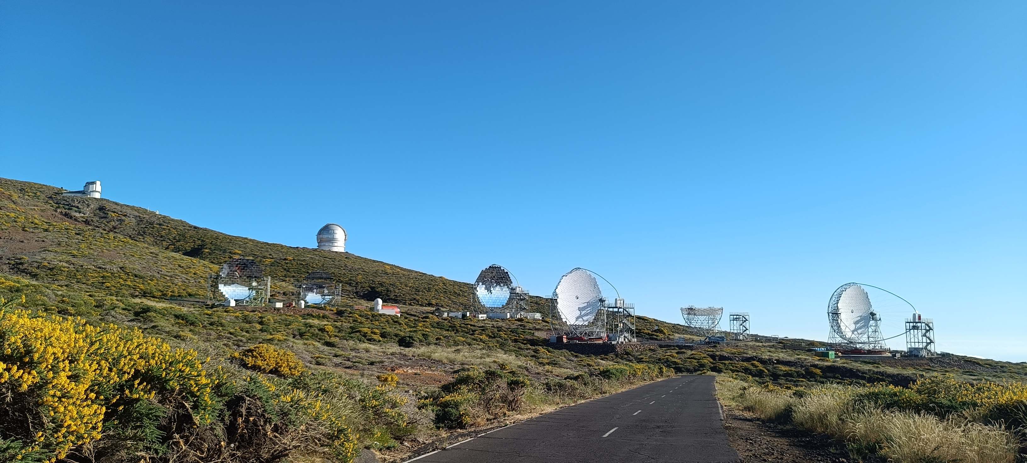
Future CTAO-North
Credit: CTAO
Current CTAO-North
Future CTAO-North
Credit: CTAO
LST-1:
in commissioning
LST-1 has taken the data presented here
LST-4
LST-3
LST-2
(MAGIC telescopes)

Slide 4
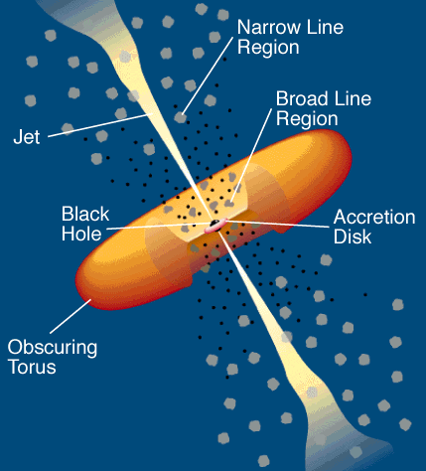
Intro Observations IC 310 NGC 1275 MWL NGC 1275
Extragalactic TeV dominated by AGNs:
mostly blazars
some notable radio galaxies
Urry and Padovani Model for Radio-Loud AGN Credit: C.M. Urry and P. Padovani

Slide 5
Intro Observations IC 310 NGC 1275 MWL NGC 1275
Extragalactic TeV dominated by AGNs:
mostly blazars
some notable radio galaxies
Blazars - near line of sight
Radio Galaxies
- near edge on, see relativistic jets radio -> TeV
- mis-aligned / de-boosted AGN
-> still bright, rapid variation, explore different sites in TeV and MWL
- multiple science applications
(e.g. Extragalactic Background Light, Axion-Like Particles, Lorentz Invariance Violation)
Urry and Padovani Model for Radio-Loud AGN Credit: C.M. Urry and P. Padovani

Slide 6
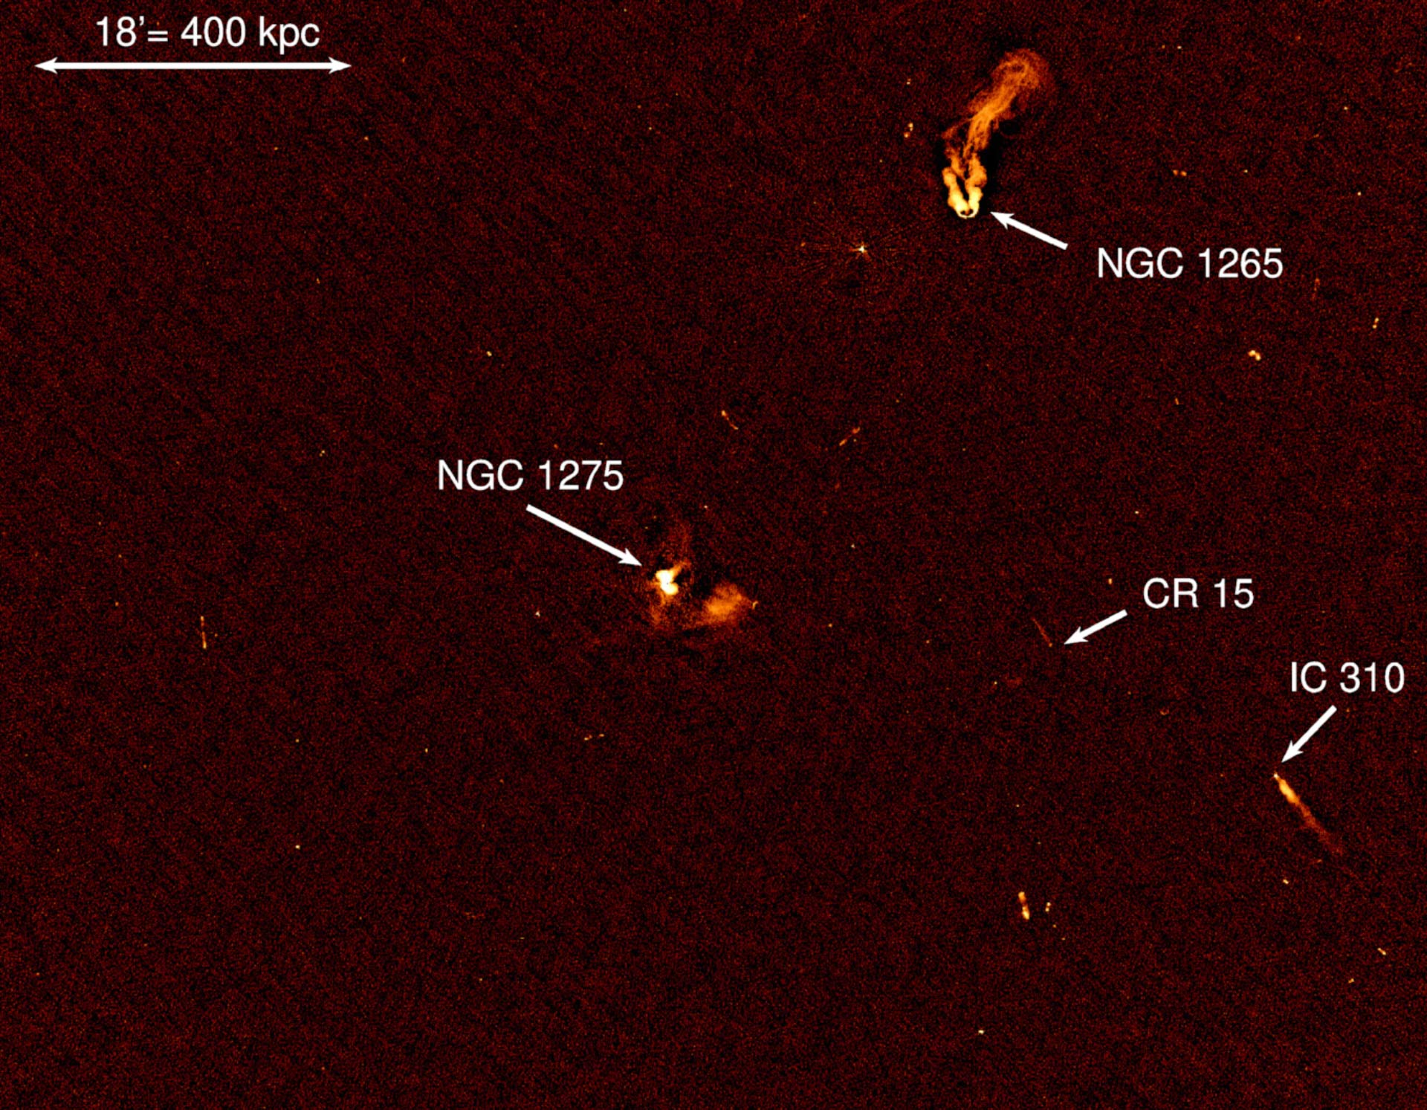
NGC 1275 & IC 310
Intro Observations IC 310 NGC 1275 MWL NGC 1275
Perseus cluster - NGC1275 central
close (z ≈ 0.017 & z ≈ 0.019)
VLA 230-470 MHz radio map (Gendron-Marsolais et al., 2020)

Slide 7
NGC 1275 & IC 310
Intro Observations IC 310 NGC 1275 MWL NGC 1275
Perseus cluster - NGC1275 central
close (z ≈ 0.017 & z ≈ 0.019)
NGC 1275 (3C 84)
Fanaroff-Riley I
generally bright VHE
2016-2017 bright flare, ~hr variability (Fermi-LAT, MAGIC, VERITAS)
2022/2023 flares (LHAASO, MACE)
VLA 230-470 MHz radio map (Gendron-Marsolais et al., 2020)

Slide 8
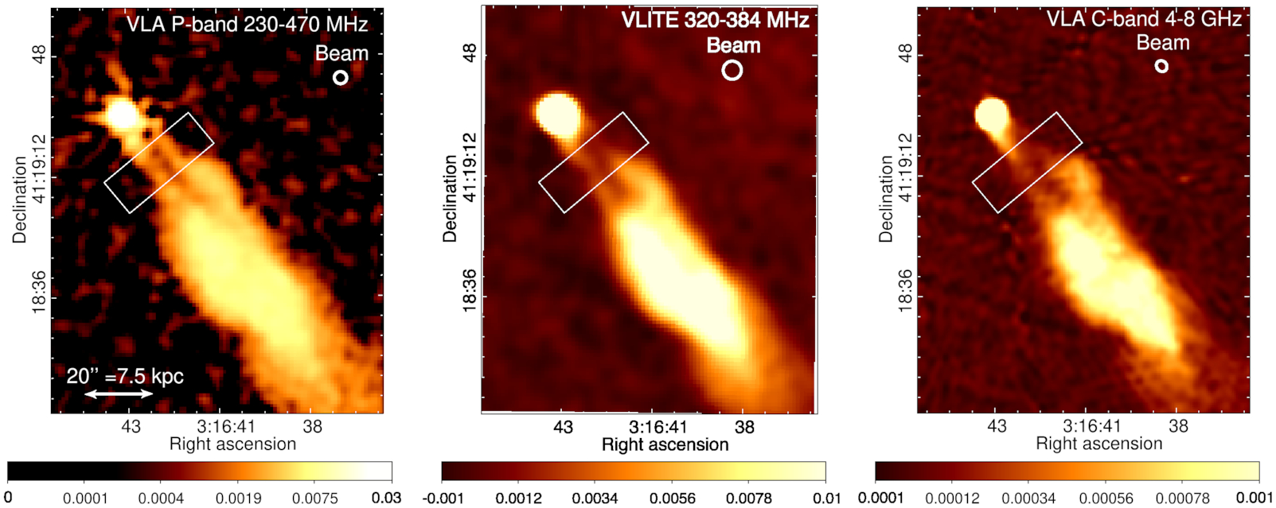
NGC 1275 & IC 310
Intro Observations IC 310 NGC 1275 MWL NGC 1275
Perseus cluster - NGC1275 central
close (z ≈ 0.017 & z ≈ 0.019)
NGC 1275 (3C 84)
Fanaroff-Riley I
generally bright TeV
2016-2017 bright flare, ~hr variability (Fermi-LAT, MAGIC, VERITAS)
2022/2023 flares (LHAASO, MACE)
IC 310
blazar-like bent-jet radio galaxy?
2012 extreme <4.8 min variability flare (MAGIC)
(Gendron-Marsolais et al., 2020)

Slide 9
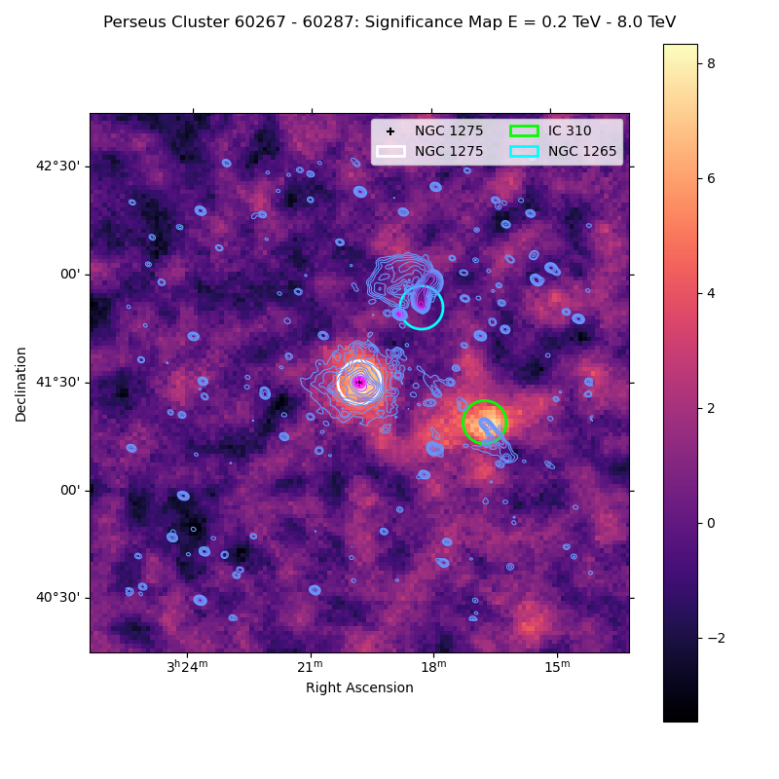
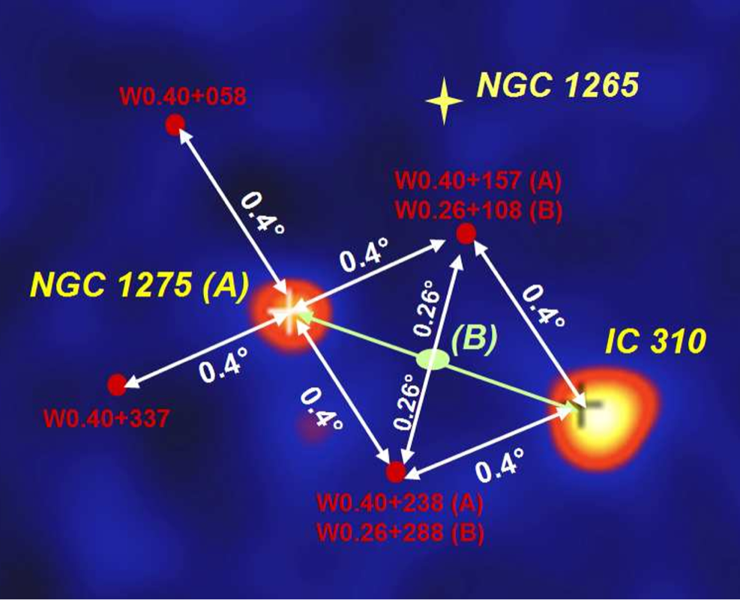
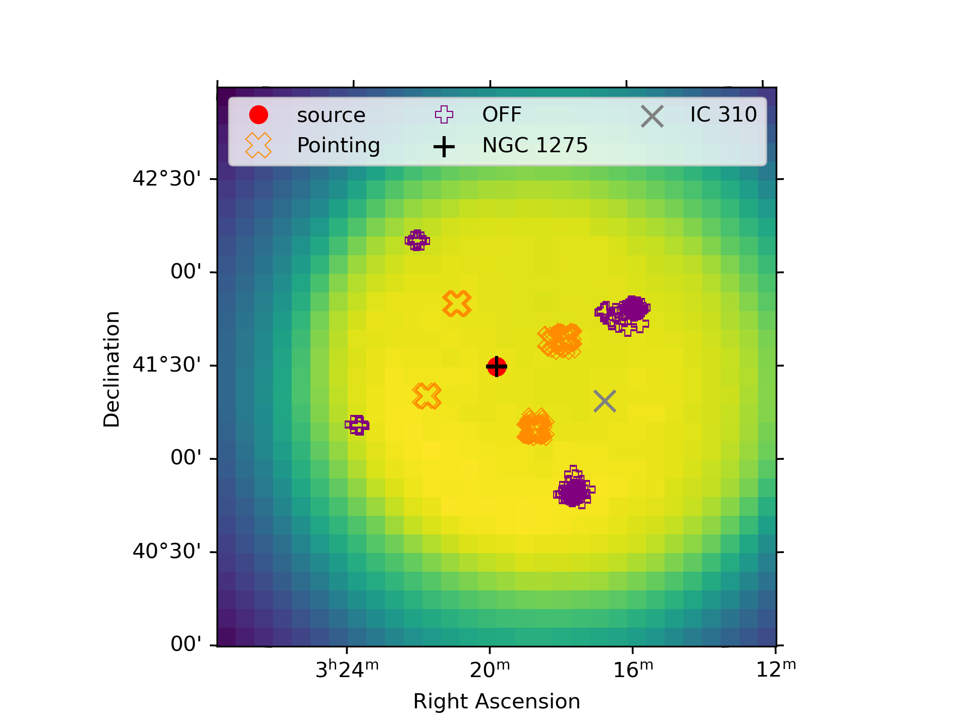
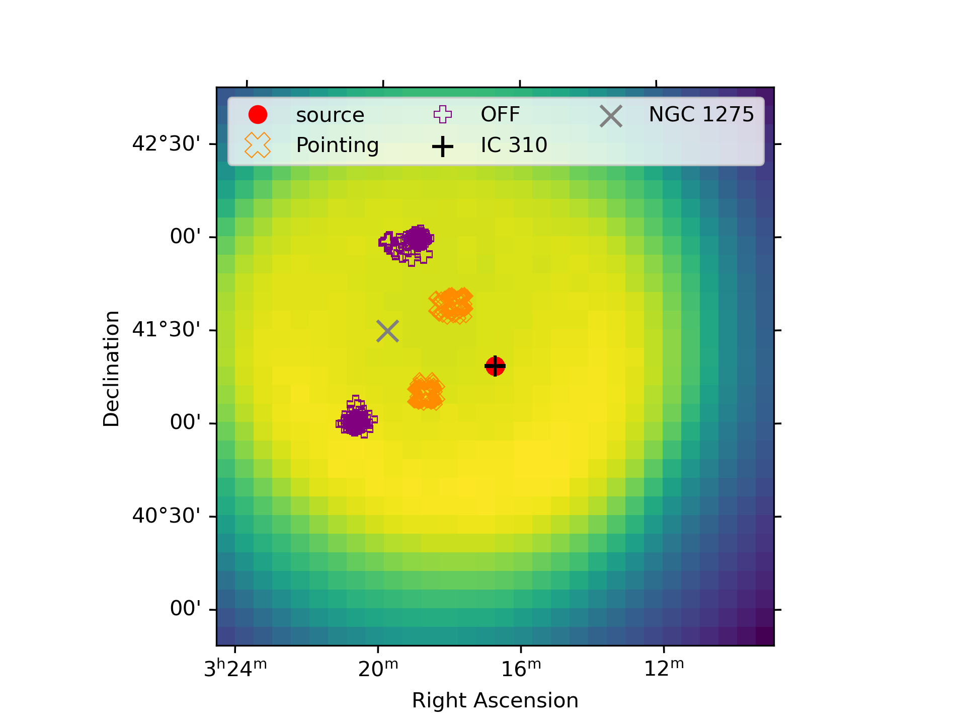
Observations
Intro Observations IC 310 NGC 1275 MWL NGC 1275
IC 310 and NGC 1275 when both visible in FoV:
dates: 20 dec 2022 – 29 jan 2025
zd < 60
NGC 1275
IC 310
2 for IC310
radio contours LOFAR 120-168 MHz https://cdsarc.cds.unistra.fr/viz-bin/cat/J/A+A/692/A12

Slide 10
Observations
Intro Observations IC 310 NGC 1275 MWL NGC 1275
IC 310 and NGC 1275 when both visible in FoV:
dates: 20 dec 2022 – 29 jan 2025
zd < 60
NGC 1275:
55 nights
49.9 hrs
IC 310:
49 nights
45.8 hrs
NGC 1275
IC 310
4 for
NGC 1275
radio contours LOFAR 120-168 MHz https://cdsarc.cds.unistra.fr/viz-bin/cat/J/A+A/692/A12

Slide 11
Observations
Intro Observations IC 310 NGC 1275 MWL NGC 1275
IC 310 and NGC 1275 when both visible in FoV:
dates: 20 dec 2022 – 29 jan 2025
zd < 60
NGC 1275:
55 nights
49.9 hrs
IC 310:
49 nights
45.8 hrs
NGC 1275
IC 310
2 for IC310
radio contours LOFAR 120-168 MHz https://cdsarc.cds.unistra.fr/viz-bin/cat/J/A+A/692/A12

Slide 12
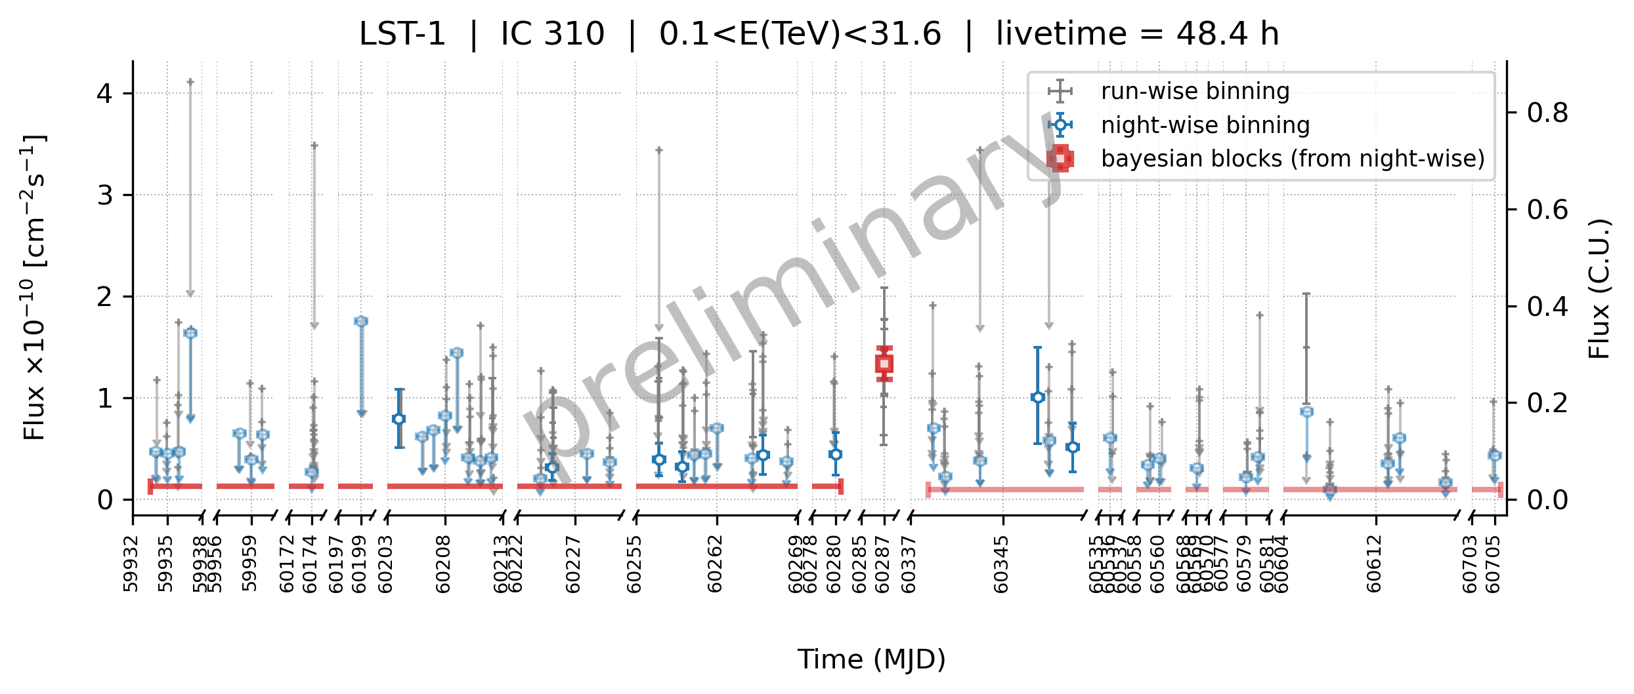
IC 310
Intro Observations IC 310 NGC 1275 MWL NGC 1275
dec 2022
8 dec 2023
feb 2025

Slide 13
IC 310
Intro Observations IC 310 NGC 1275 MWL NGC 1275
1.72 hr: 6.6σ
block 0
block 1: flare
block 2
dec 2022
8 dec 2023
feb 2025

Slide 14
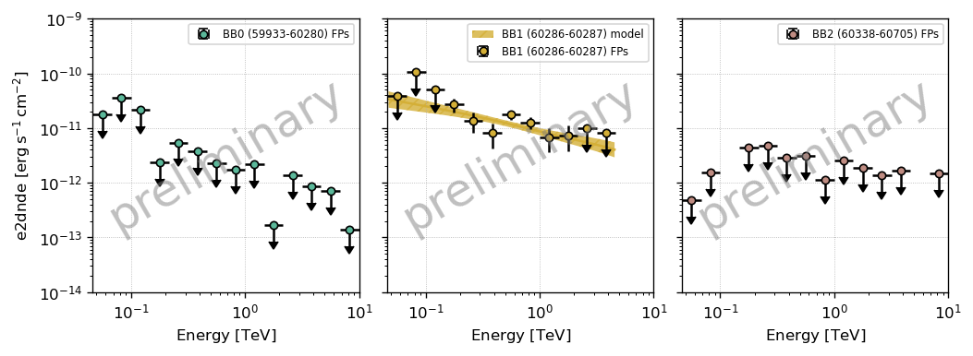
block 0
block 1: flare
block 2
1.72 hr: 6.6σ
block 0
block 1: flare
block 2
dec 2022
8 dec 2023
feb 2025

Slide 15
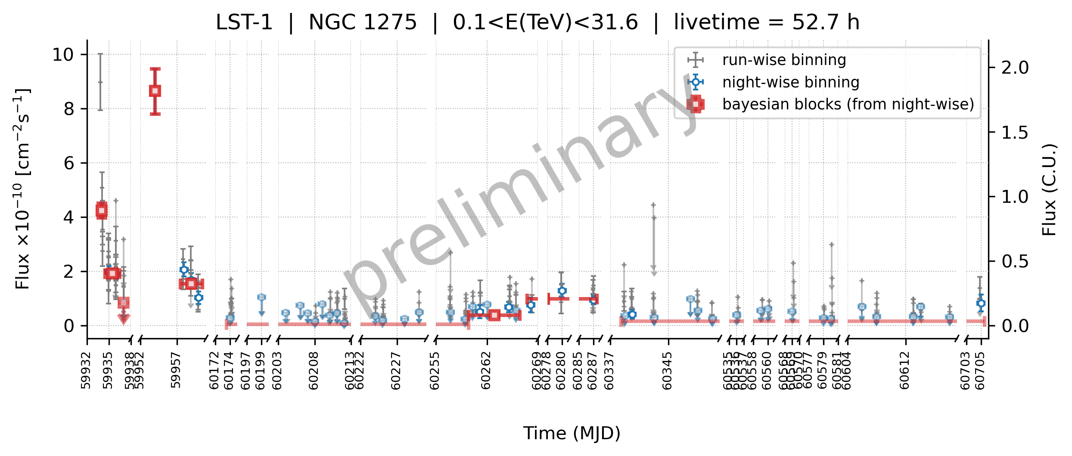
NGC 1275
Intro Observations IC 310 NGC 1275 MWL NGC 1275
BB7 - 7σ
19 nov – 8 dec 2023
BB8 - ☹
jan 2024 - feb 2025
BB5 - ☹
aug-nov 2023

Slide 16
NGC 1275
Intro Observations IC 310 NGC 1275 MWL NGC 1275
BB0 - 11σ
Dec flare peak
20 dec 2022
-> also intra-night variability!
BB1 - 12σ
Dec flare
21-22 dec 2022
BB2
Dec flare end
23 dec 2022

Slide 17
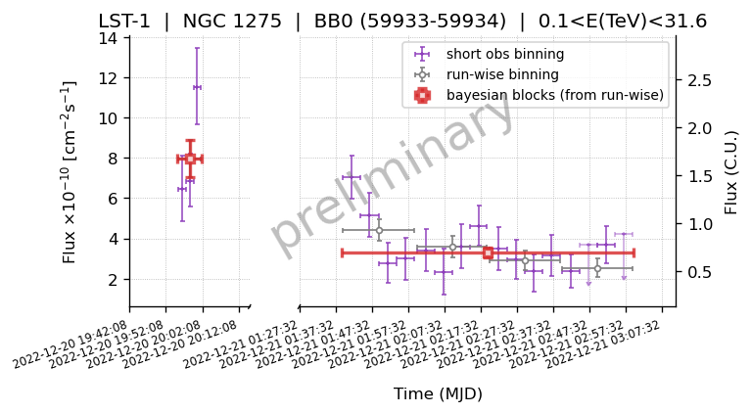
NGC 1275
Intro Observations IC 310 NGC 1275 MWL NGC 1275
BB0 - 11σ
Dec flare peak
20 dec 2022
BB0.0 - 8σ
6 mins
(short: 2 min)
BB0.1 - 10σ
1.24 hrs
(short: 5 min)

Slide 18
NGC 1275
Intro Observations IC 310 NGC 1275 MWL NGC 1275
BB3 - 11σ
Jan flare peak
9 jan 2023
BB4 - 8σ
Jan flare
13-15 jan 2023

Slide 19
NGC 1275
Intro Observations IC 310 NGC 1275 MWL NGC 1275
BB6 - 3σ
12 – 17 nov 2023
BB7 - 7σ
19 nov – 8 dec 2023
BB8
jan 2024 - feb 2025
BB5
aug-nov 2023

Slide 20
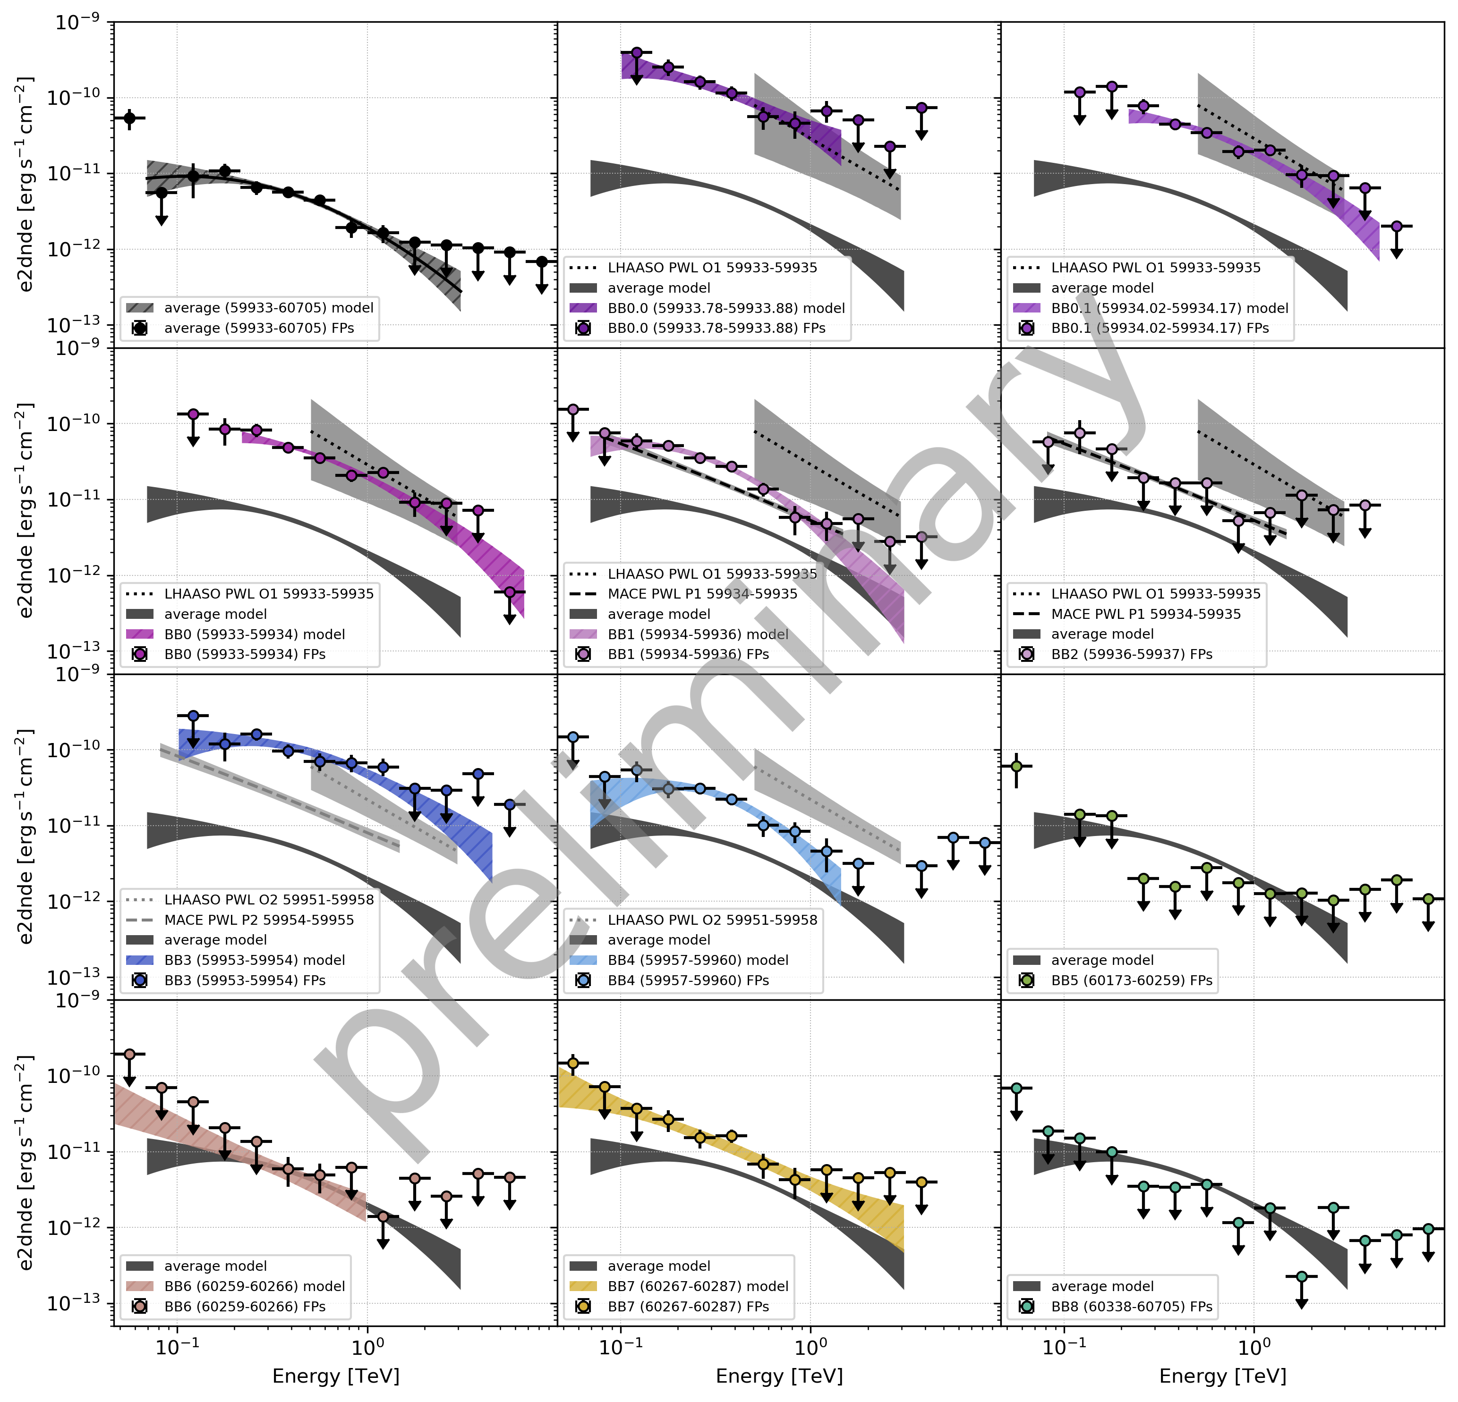
NGC 1275
average

Slide 21







NGC 1275
LHAASO . . .

Slide 22



NGC 1275
MACE - - -

Slide 23
NGC 1275
intra-night
BB0.0
BB0.1
flare dec 2022
BB0

Slide 24
NGC 1275
flare dec 2022
BB0
BB1
BB2

Slide 25
NGC 1275
flare jan 2023
BB3
BB4

Slide 26
NGC 1275
quiescent
low states
quiescent

Slide 27
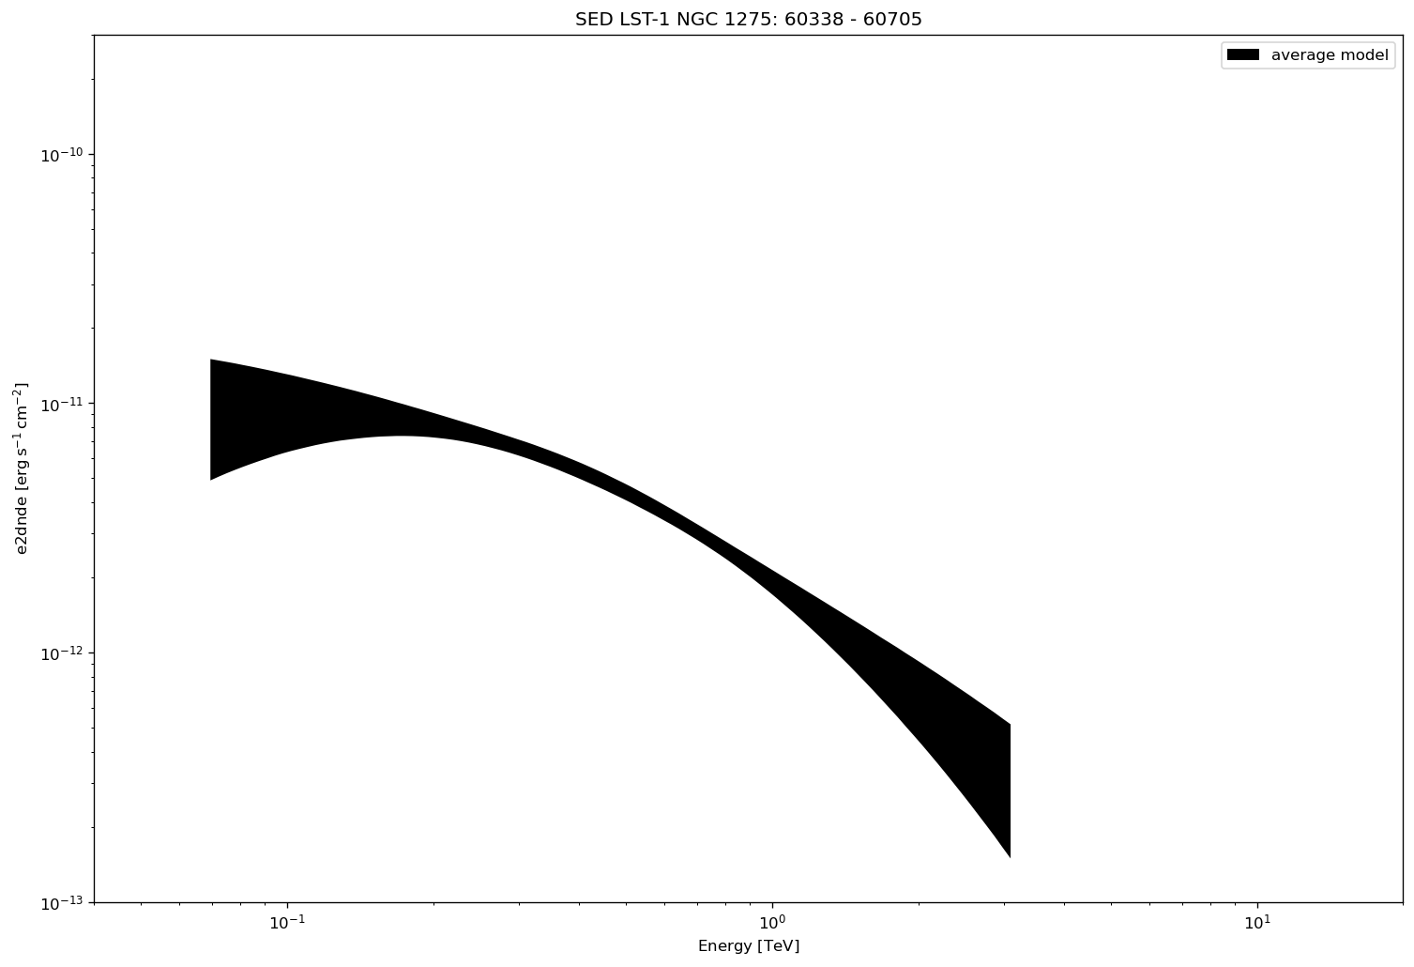
NGC 1275
preliminary
average

Slide 28
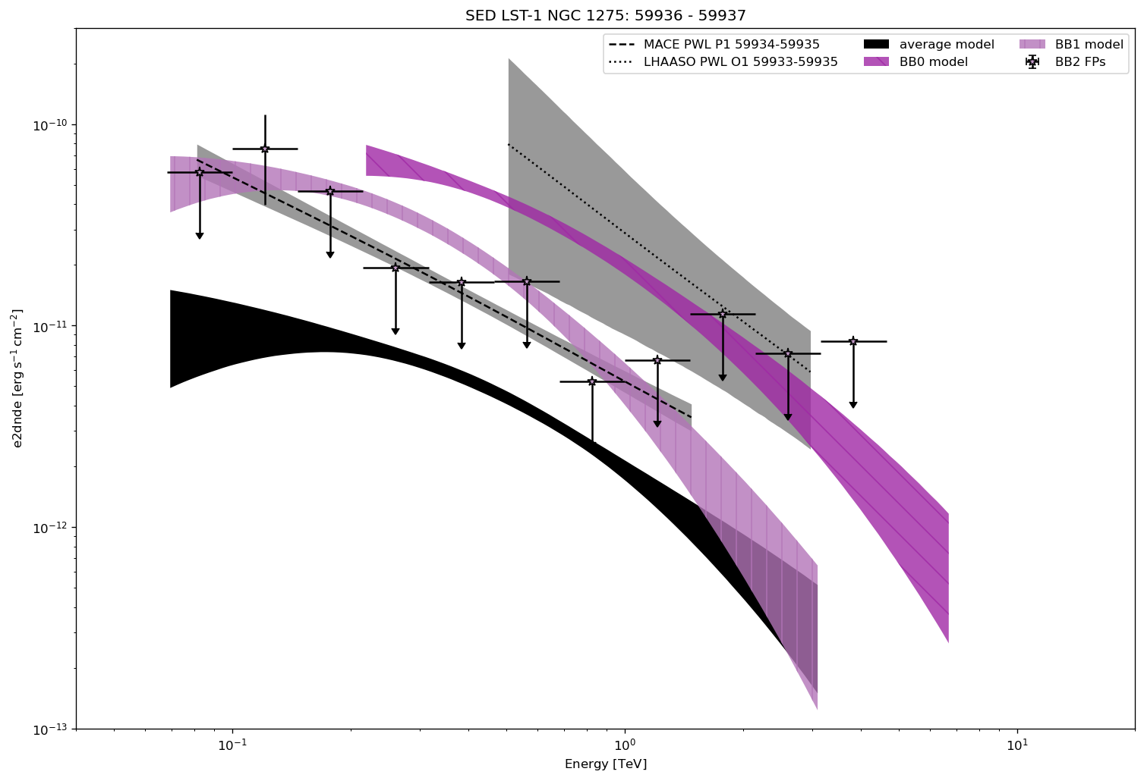
NGC 1275
preliminary
+ flare
dec 2022

Slide 29
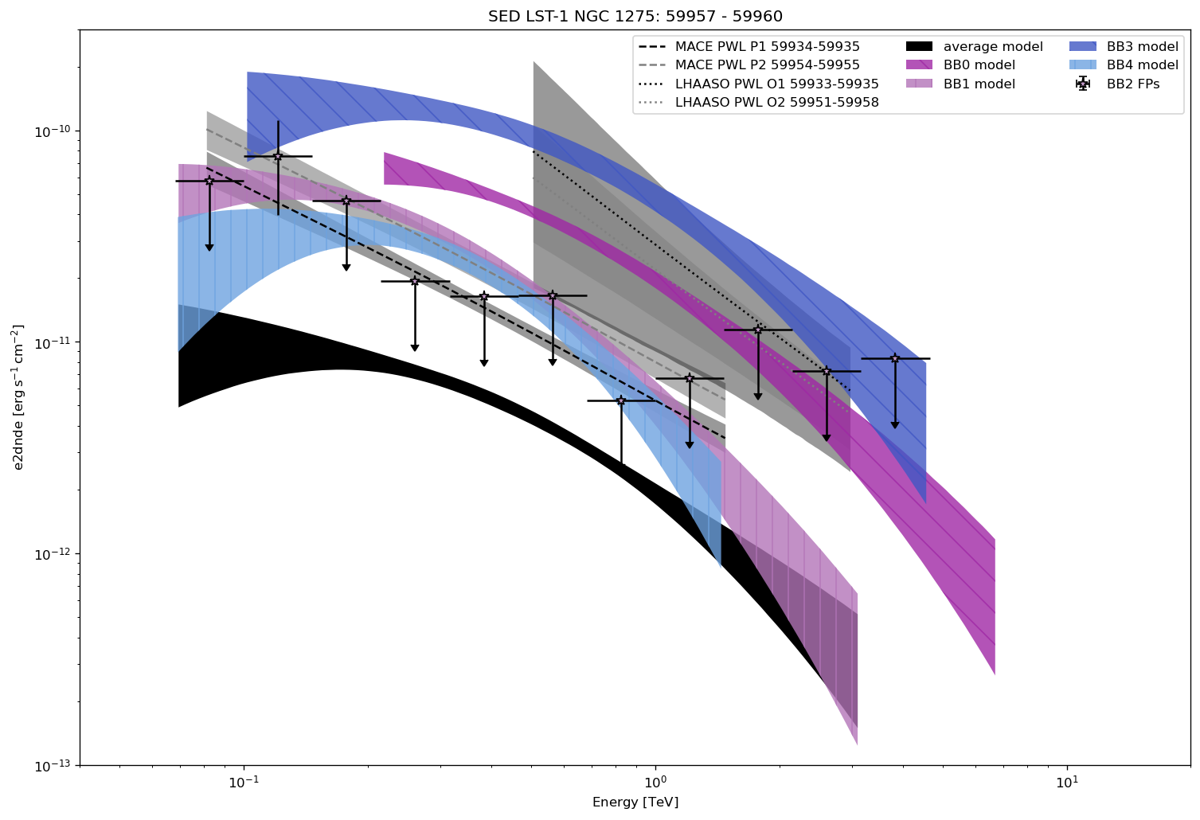
NGC 1275
preliminary
+ flare
jan 2023
note: moon

Slide 30
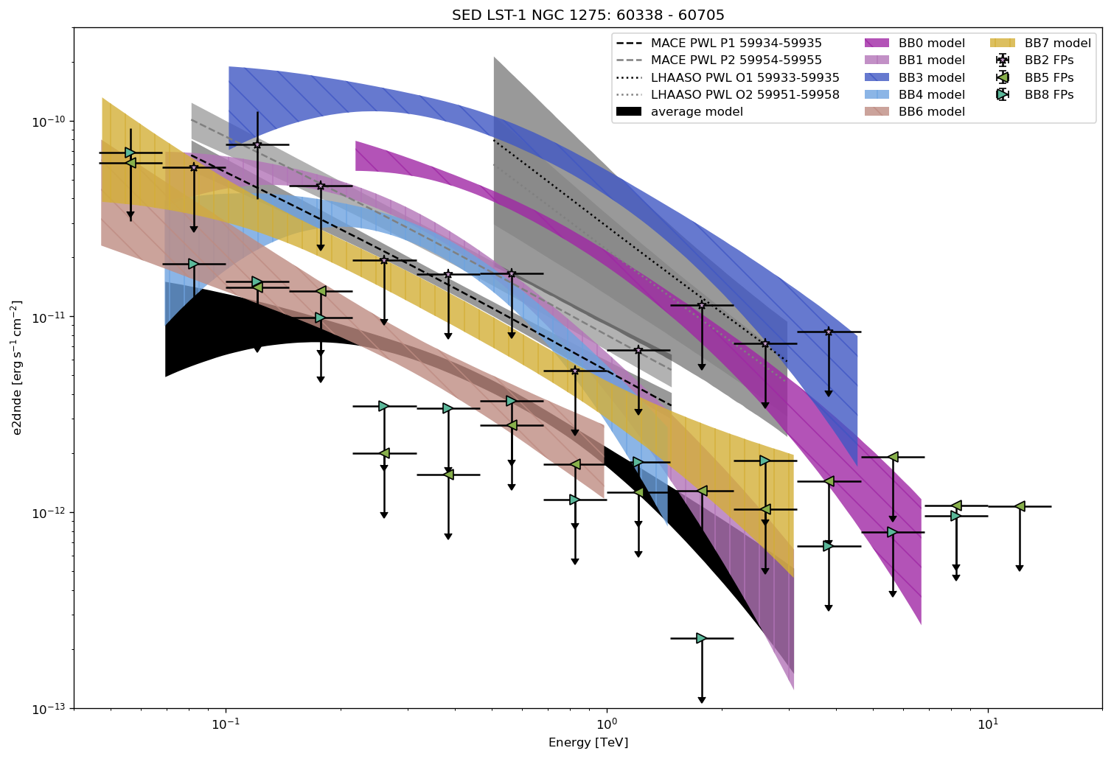
NGC 1275
preliminary
+ low &
quiescent

Slide 31
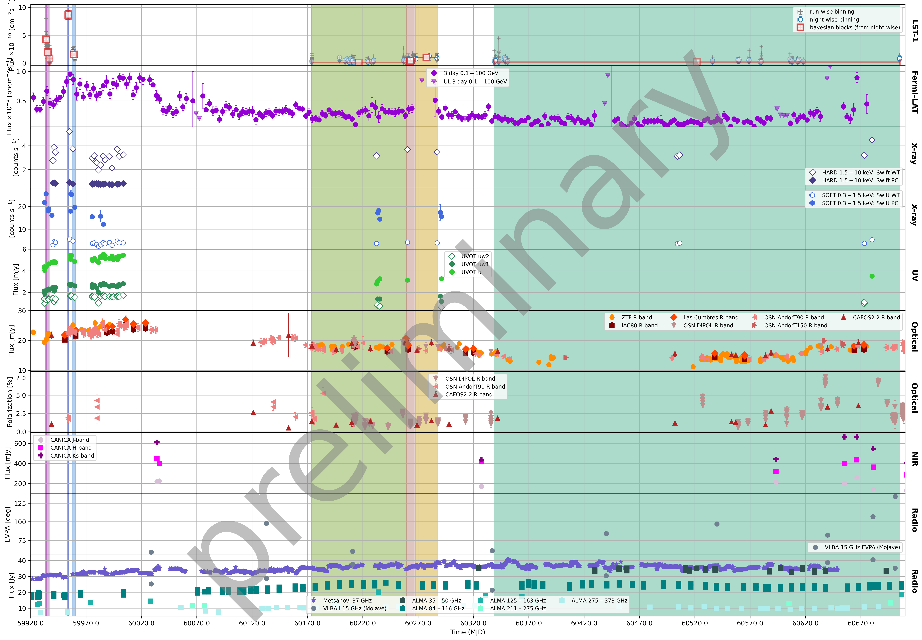
NGC 1275 MWL LC
LST-1
Fermi-LAT
Swift-XRT (hard)
Swift-XRT (soft)
Swift-UVOT
Optical
Optical pol.
NIR
Radio EVPA
Radio

Slide 32
NGC 1275 MWL LC
LST-1
Fermi-LAT
Swift-XRT (hard)
Swift-XRT (soft)
Swift-UVOT
Optical
see some
increased
flux near flares
Optical pol.
NIR
Radio EVPA
Radio

Slide 33
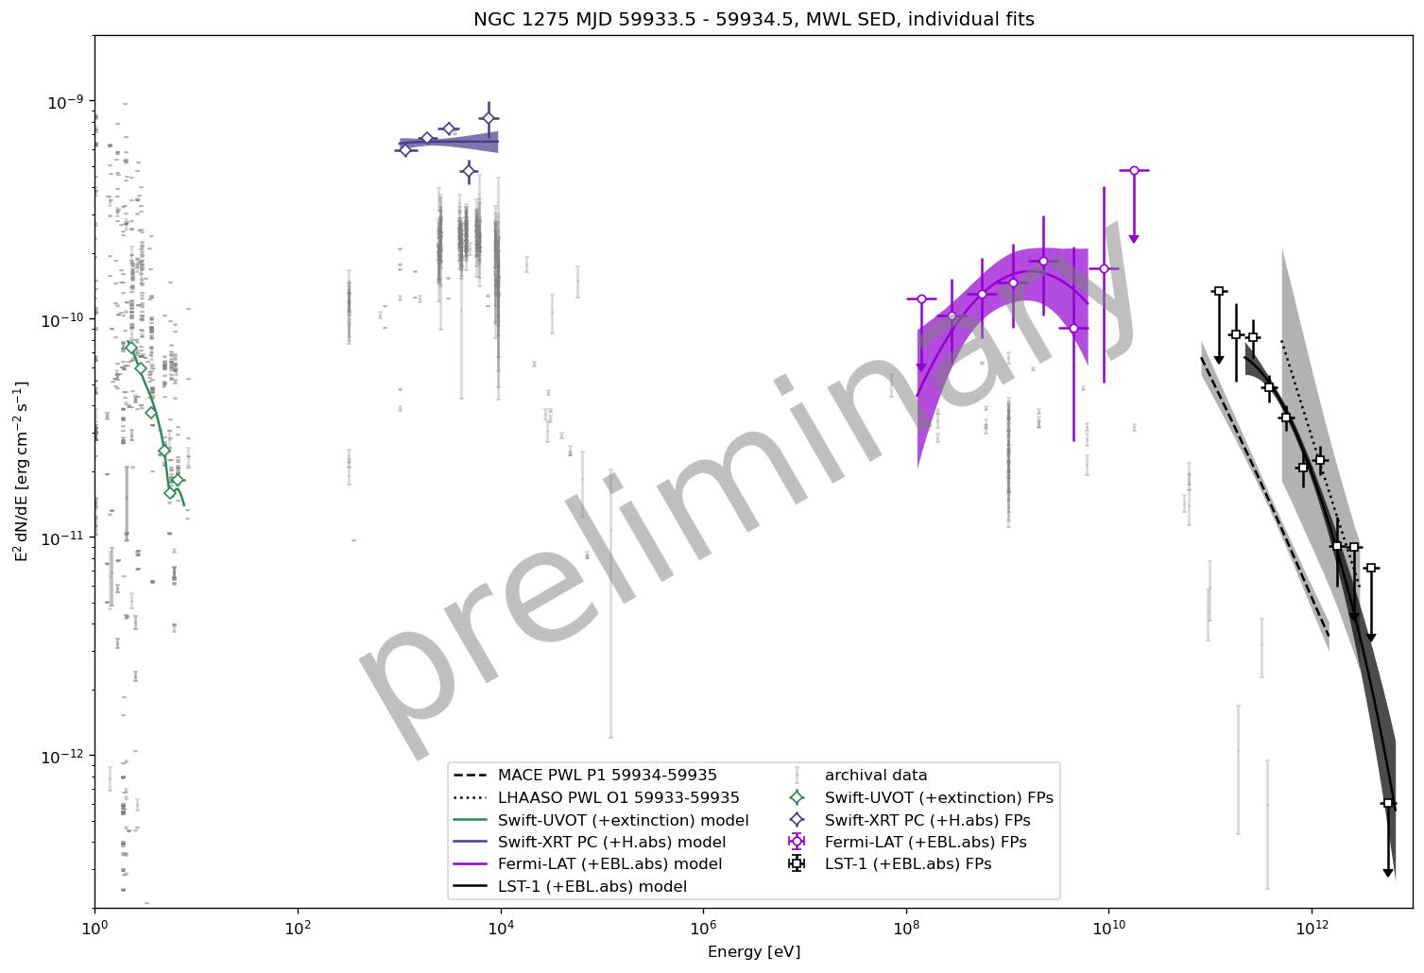
NGC 1275 MWL SED 20 dec 2022
Intro Observations IC 310 NGC 1275 MWL NGC 1275
Swift-XRT
appear increased flux compared to archival data in X- and 𝛄
Fermi-LAT
LHAASO
59933-59935
Swift-UVOT
MACE
59934-59935
LST-1

Slide 34
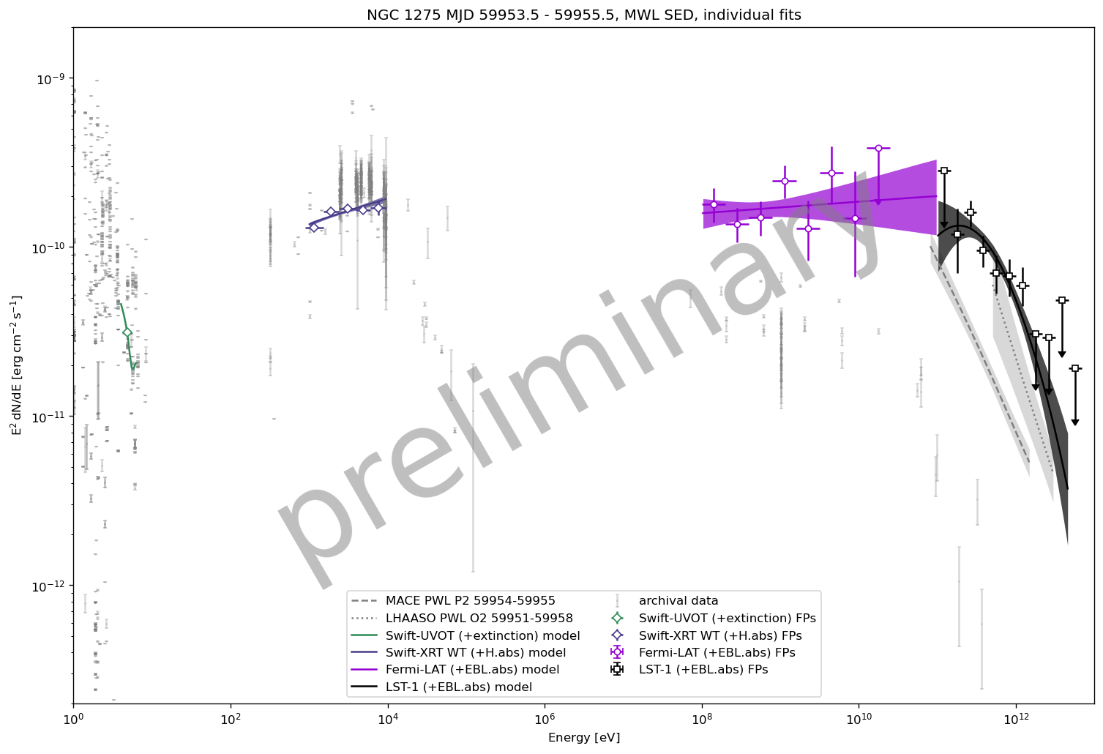
Intro Observations IC 310 NGC 1275 MWL NGC 1275
NGC 1275 MWL SED 9-10 jan 2023
x-ray lower, but taken 1 day after LST-1
Fermi-LAT
Swift-XRT
LST-1
MACE
59954-59955
Swift-UVOT
LHAASO
59951-59958

Slide 35
Conclusions
Conclusions
LST-1 have detected flares and quiescent states of two radio galaxies in the Perseus cluster with previous notable TeV activity
Detected and explored dec 2022 & jan 2023 flares and long term low and quiescent states for NGC 1275
flares comparable LHAASO & MACE, show evolution across several time blocks
exploration of MWL data appear to show some flux variation at similar times as that seen by LST-1
Plan to round out MWL analysis and prepare a paper for publication
Later work 3D analysis and modelling Perseus cluster

Slide 36
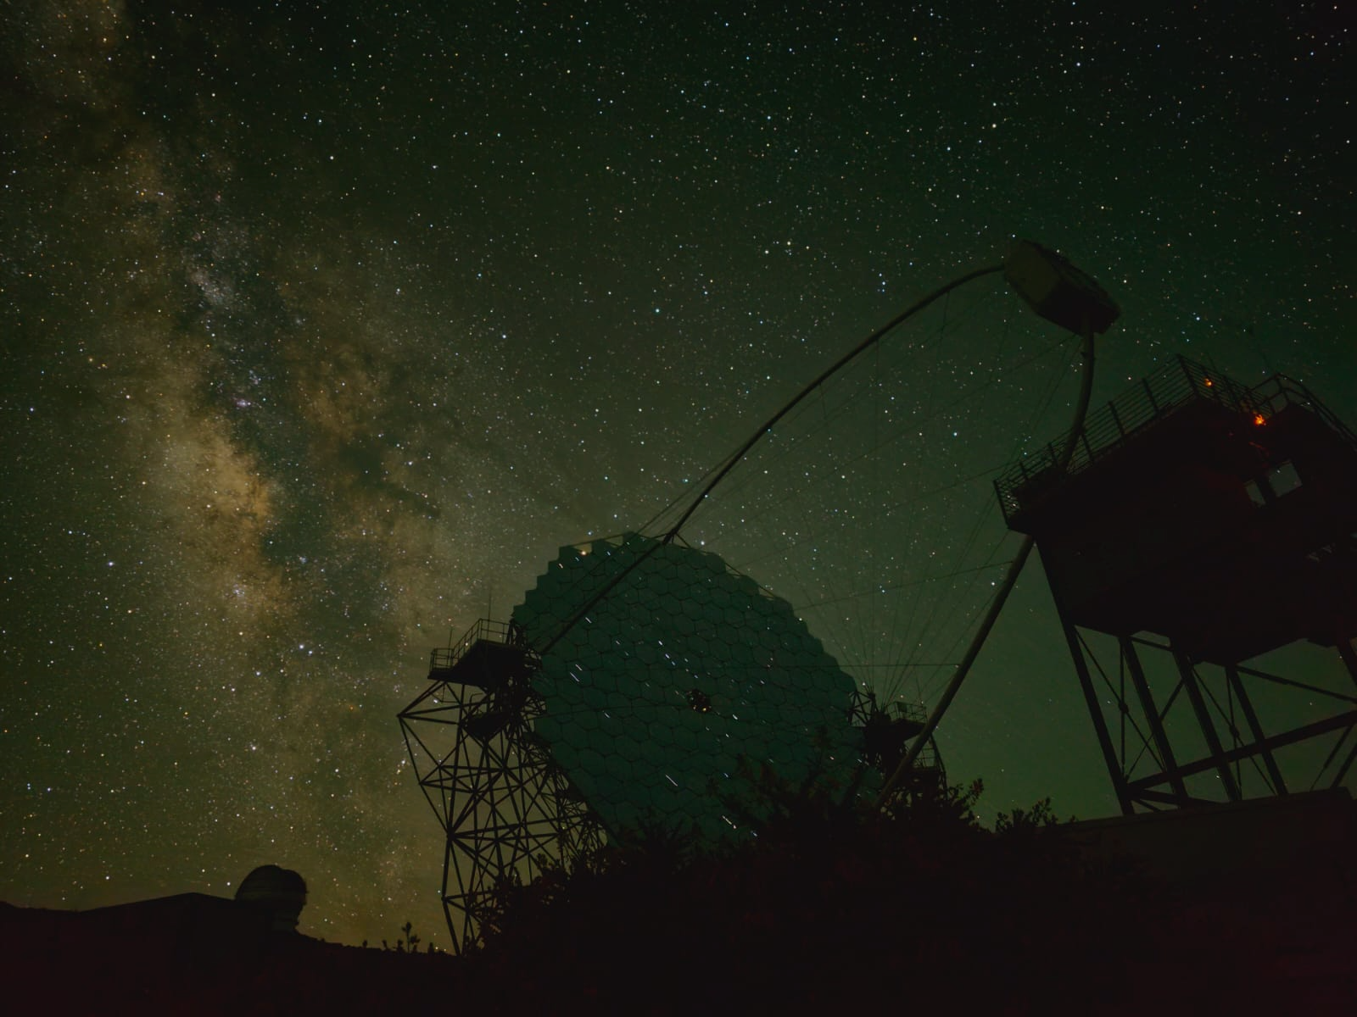
Thank you
www.ctao.org

Slide 37
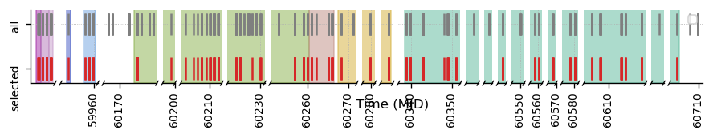
Data Selection
Observations
des
jan
nov
2022
2023
2024
2025

Slide 38
Observations
Intro Observations IC 310 NGC 1275 MWL NGC 1275
dates: 20 dec 2022 – 29 jan 2025
zd < 60
2 for IC310

Slide 39
Observations
Observations
dates: 20 dec 2022 – 29 jan 2025
zd < 60
NGC 1275:
55 nights of 67
190 runs of 303
49.9 hrs of 82
4 for
NGC 1275

Slide 40
Observations
Observations
dates: 20 dec 2022 – 29 jan 2025
zd < 60
NGC 1275:
55 nights of 67
190 runs of 303
49.9 hrs of 82
IC 310:
49 nights of 66
170 runs of 282
45.8 hrs of 78
2 for IC310

Slide 41
NGC 1275
NGC 1275
BB0 - 11σ
Dec flare peak
20 dec 2022
BB3 - 11σ
Jan flare peak
9 jan 2023
-> also intra-night variability!
BB1 - 12σ
Dec flare
21-22 dec 2022
BB4 - 8σ
Jan flare
13-15 jan 2023
BB6 - 3σ
12 – 17 nov 2023
BB2 - ☹
Dec flare end
23 dec 2022
BB7 - 7σ
19 nov – 8 dec 2023
BB8 - ☹
jan 2024 - feb 2025
BB5 - ☹
aug-nov 2023

