Slide 1
Quantum Optimization via Iterative Learning and Composition of Hardwares
Sebastián V. Romero
Kipu Quantum GmbH & EHU

Slide 2
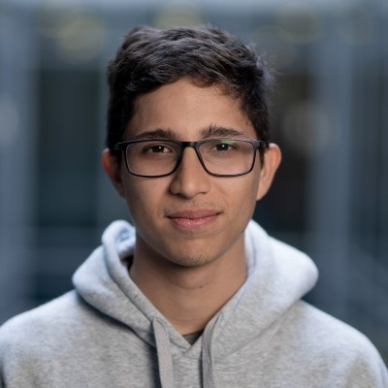
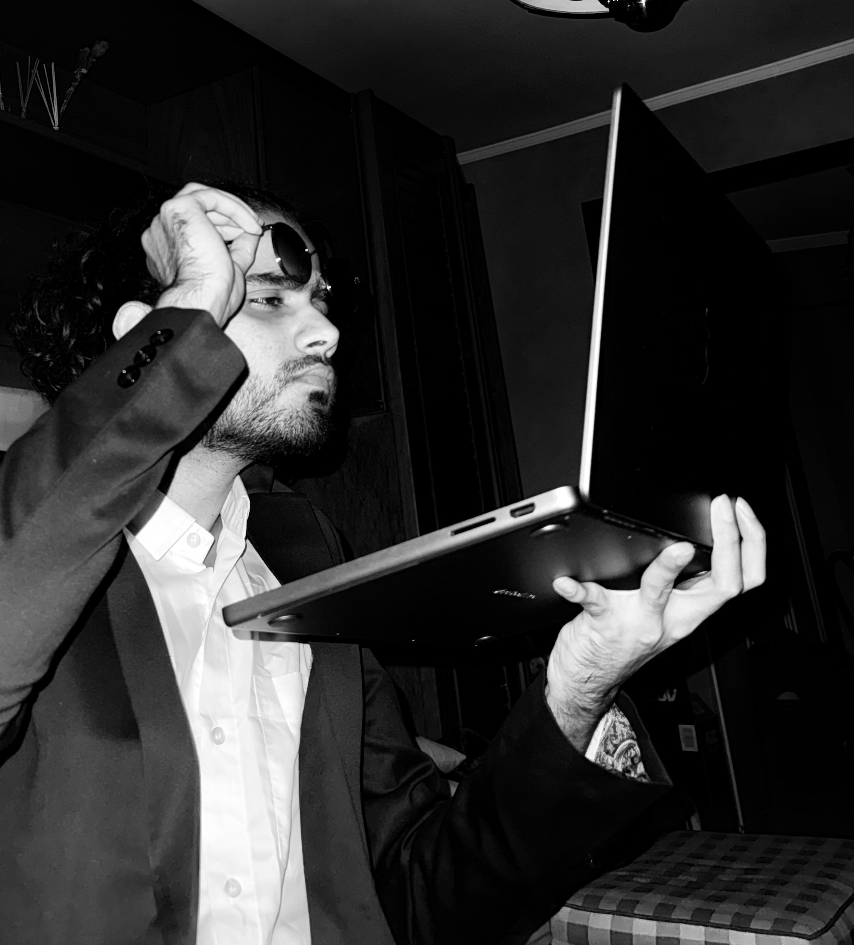
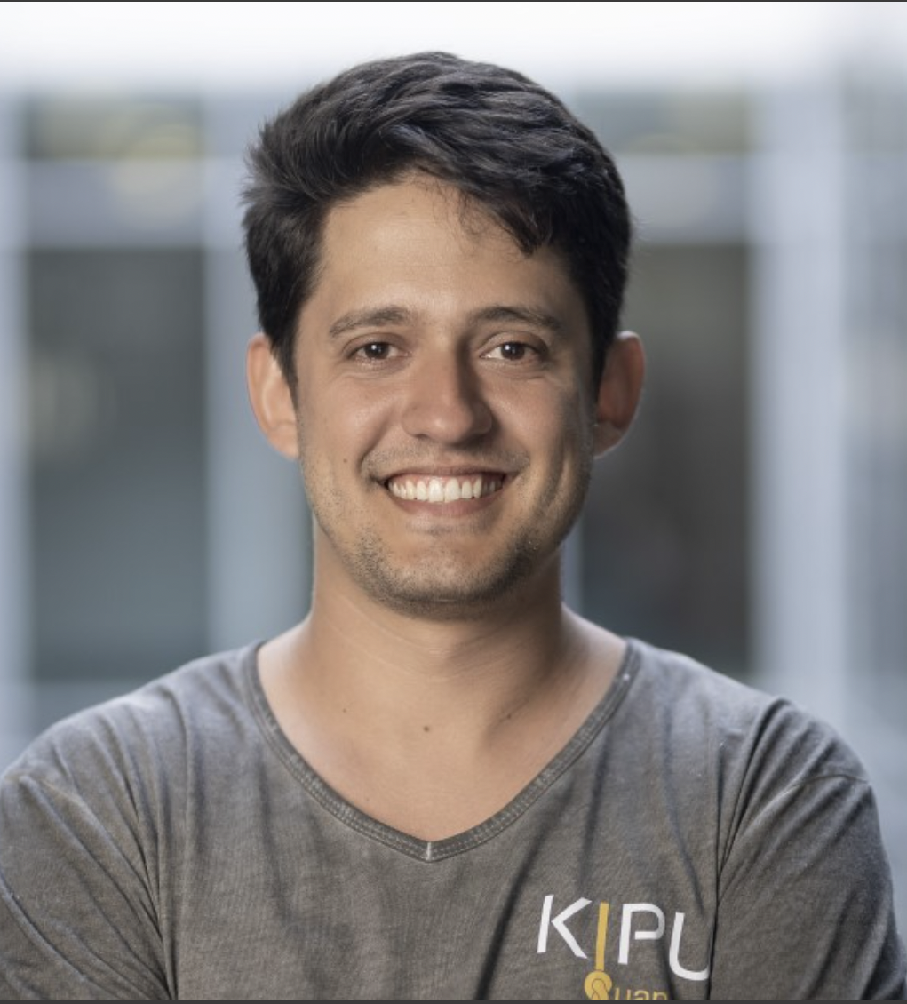
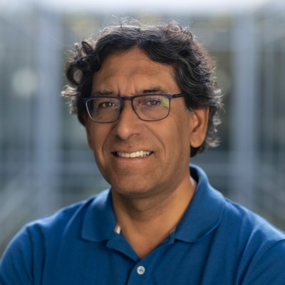
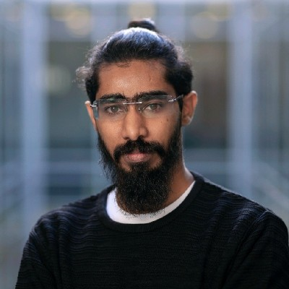
List of contributors
Team
Behind a great idea, there is always a great family!
Alejandro Gomez Cadavid
Pranav Chandarana
Anton Simen
Enrique Solano
Narendra N. Hegade
Kipu Quantum GmbH EHU
Kipu Quantum GmbH EHU
Kipu Quantum GmbH EHU
Kipu Quantum GmbH
Kipu Quantum GmbH
… and many more behind-the-scenes contributors

Slide 3

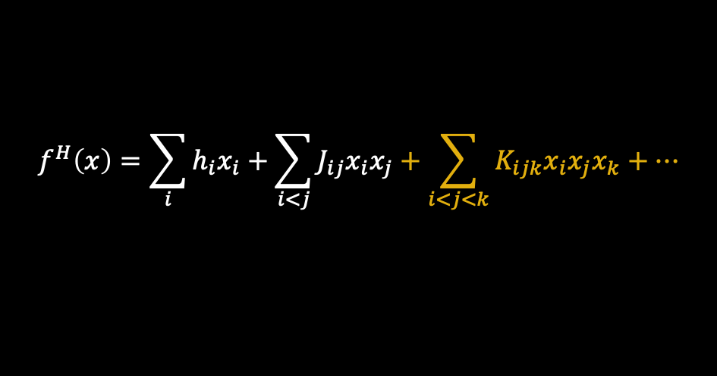
Why higher-order optimization?
Introduction
$$f^{H}\left(x\right)=\sum_{i}{h_{i}x_{i}}+\sum_{i<j}{J_{ij}x_{i}x_{j}}+\sum_{i<j<k}{K_{ijk}x_{i}x_{j}x_{k}}+…$$
Potential use cases
Beyond QUBO …
By means of entanglement, feature with no classical analogue, quantum has shown speedups in optimization.
Several problems find a native representation as a HUBO:
MAX k-SAT, vehicle routing problem (VRP).
Dynamic portfolio optimization.
Factorization.
Protein folding.
Moreover, higher-order problems face several challenges
Relaxation methods might fail due to non-convexity.
Extra variables required to map HUBO-to-QUBO.
It turns an unconstrained → constrained problem.
Simen et al. arXiv:2504.15367

Slide 4
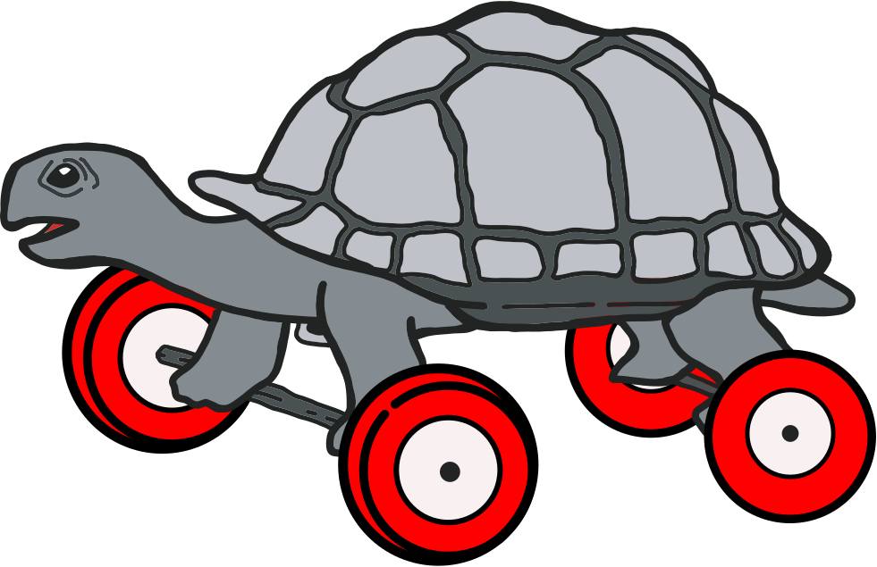

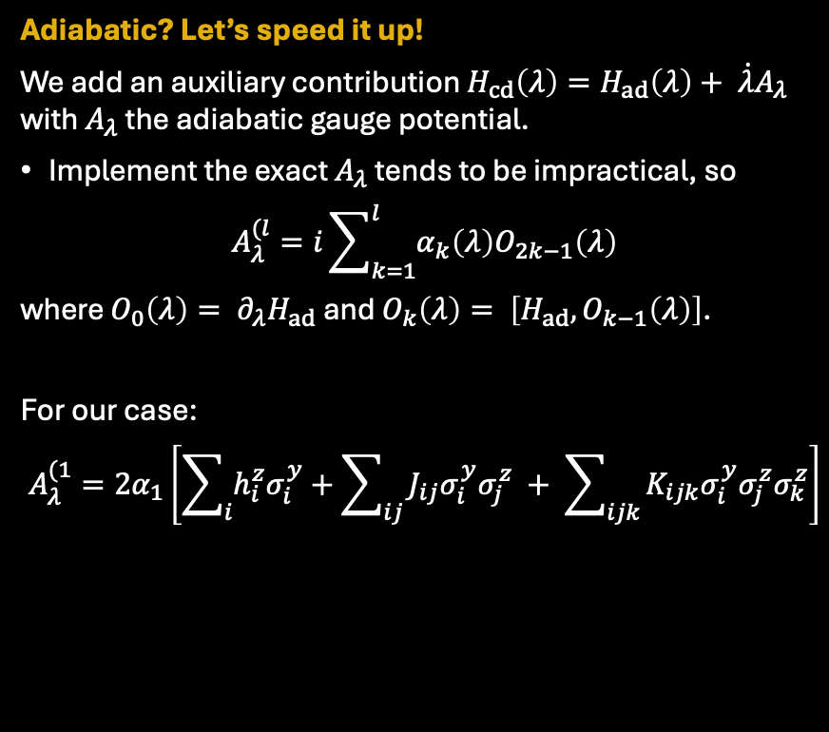
Digitized counterdiabatic quantum optimization (DCQO)
INTRODUCTion
DCQO paradigm as basis of BF-DCQO
Rely on the adiabatic theorem
An initial state evolves under the adiabatic protocol $H_{ad}\left(λ\right)=\left(1−λ\right)H_{i}+ λH_{f}$, where we consider a $p$-spin glass up to three-body terms
Initial:
$H_{i}= \sum_{j}{(h_{j}^{x}σ_{j}^{x}+h_{j}^{b}σ_{j}^{z})}$.
Final:
$H_{f}=\sum_{i}{h_{i}^{z}σ_{i}^{z}}+ \sum_{ij }{J_{ij}σ_{i}^{z}σ_{j}^{z}}+ \sum_{ijk}{K_{ijk}σ_{i}^{z}σ_{j}^{z}σ_{k}^{z}}$.
If we initially set $h_{j}^{x}=−1$ and $h_{j}^{b}=0→H_{i}=−\sum_{j}{σ_{j}^{x}}$
Initial state: GS of $H_{i}$: ${\left|\left.+\right\rangle \right.}^{⊗N}={\left(\frac{\left|\left.0\right\rangle +\left|\left.1\right\rangle \right.\right.}{\sqrt{2}}\right)}^{⊗N}$.
Adiabatic? Let’s speed it up!
We add an auxiliary contribution $H_{cd}\left(λ\right)=H_{ad}\left(λ\right)+ \dot{λ}A_{λ}$ with $A_{λ}$ the adiabatic gauge potential.
Implement the exact $A_{λ}$ tends to be impractical, so
$$A_{λ}^{(l}=i\sum_{k=1}^{l}{α_{k}\left(λ\right)O_{2k−1}\left(λ\right)}$$
where $O_{0}\left(λ\right)= ∂_{λ}H_{ad}$ and $O_{k}\left(λ\right)= \left[H_{ad}, O_{k−1}\left(λ\right)\right]$.
For our case:
$$A_{λ}^{(1}=2α_{1}\left[\sum_{i}{h_{i}^{z}σ_{i}^{y}}+\sum_{ij}{J_{ij}σ_{i}^{y}σ_{j}^{z}} + \sum_{ijk}{K_{ijk}σ_{i}^{y}σ_{j}^{z}σ_{k}^{z}}\right]$$
Demirplak, Rice. J. Phys. Chem. A, 107, 46, 9937–9945 (2003)
Chen et al. Phys. Rev. Lett. 104, 063002 (2010)
Guéry-Odelin et al. Rev. Mod. Phys. 91, 045001 (2019)

Slide 5
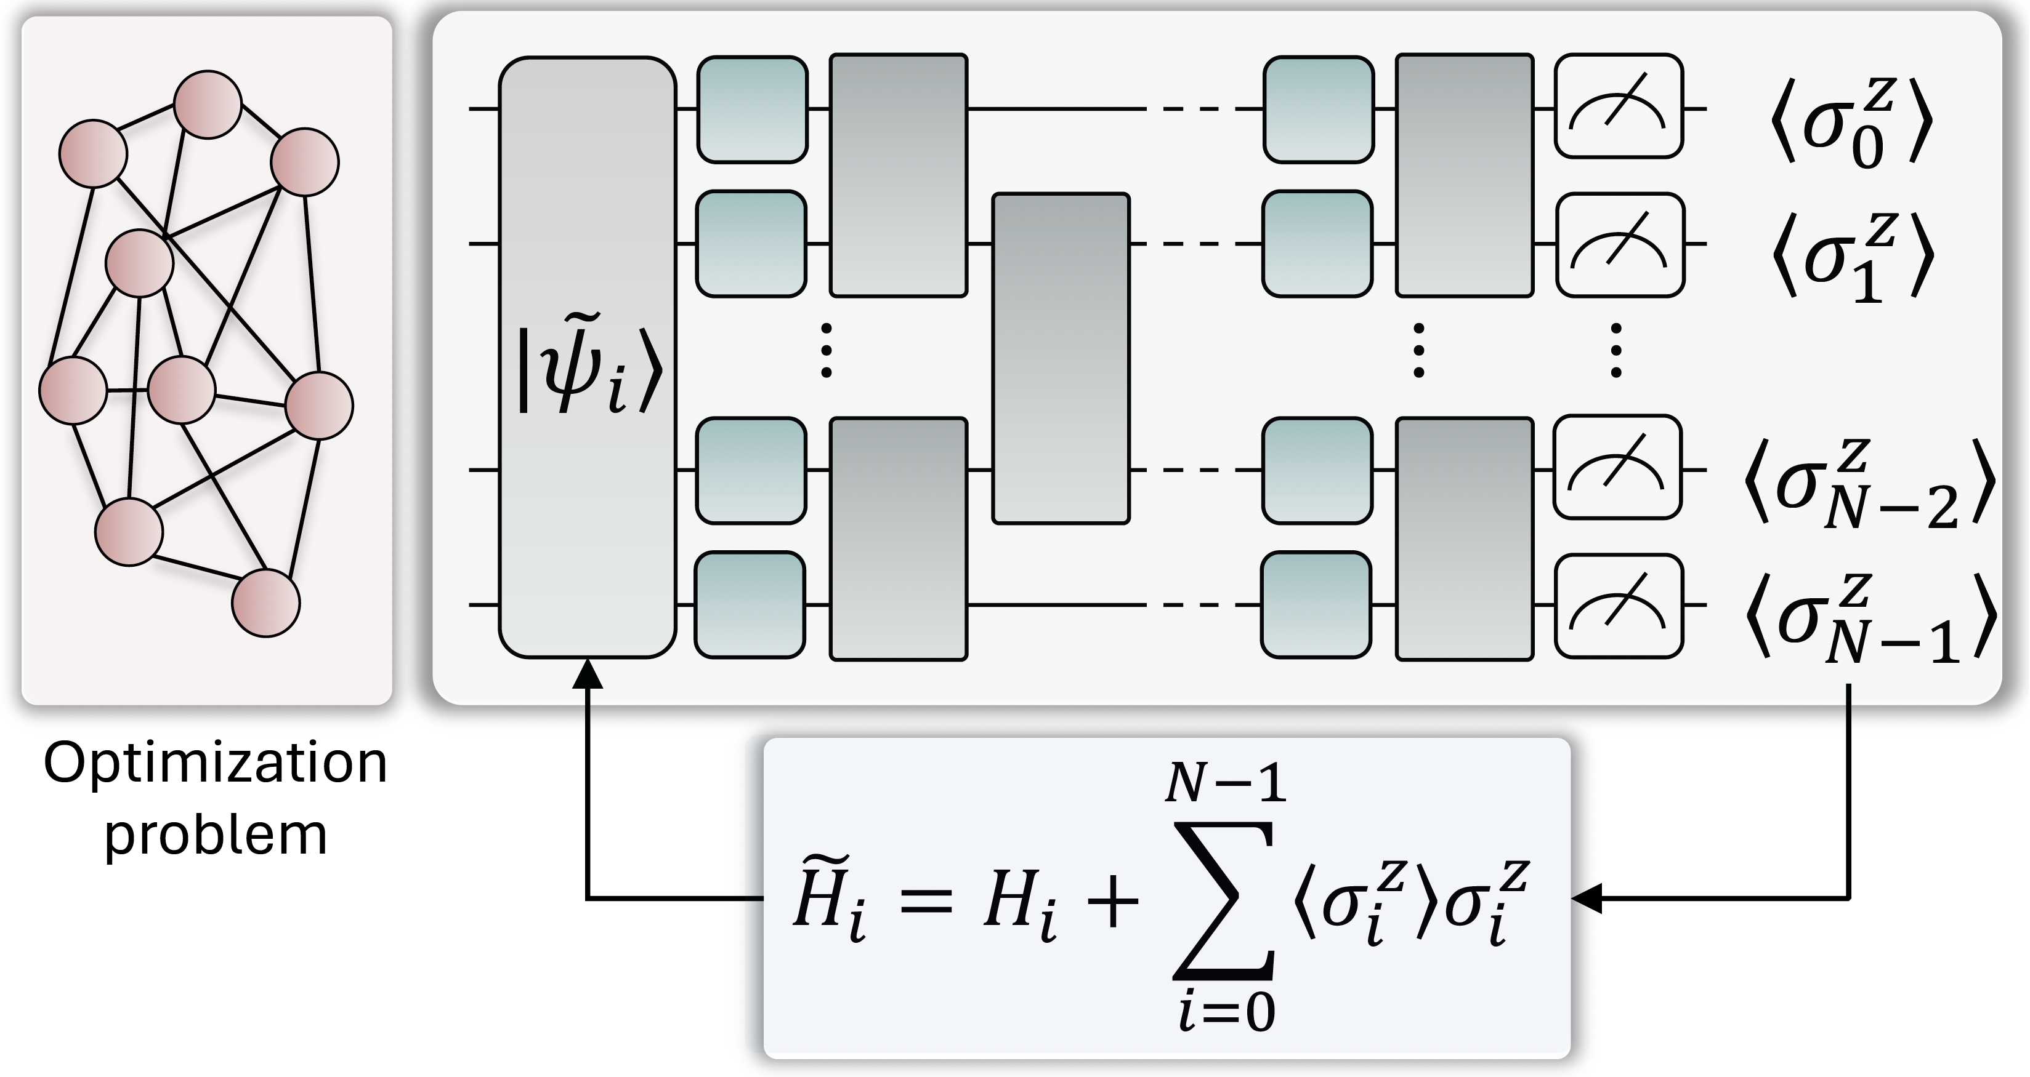
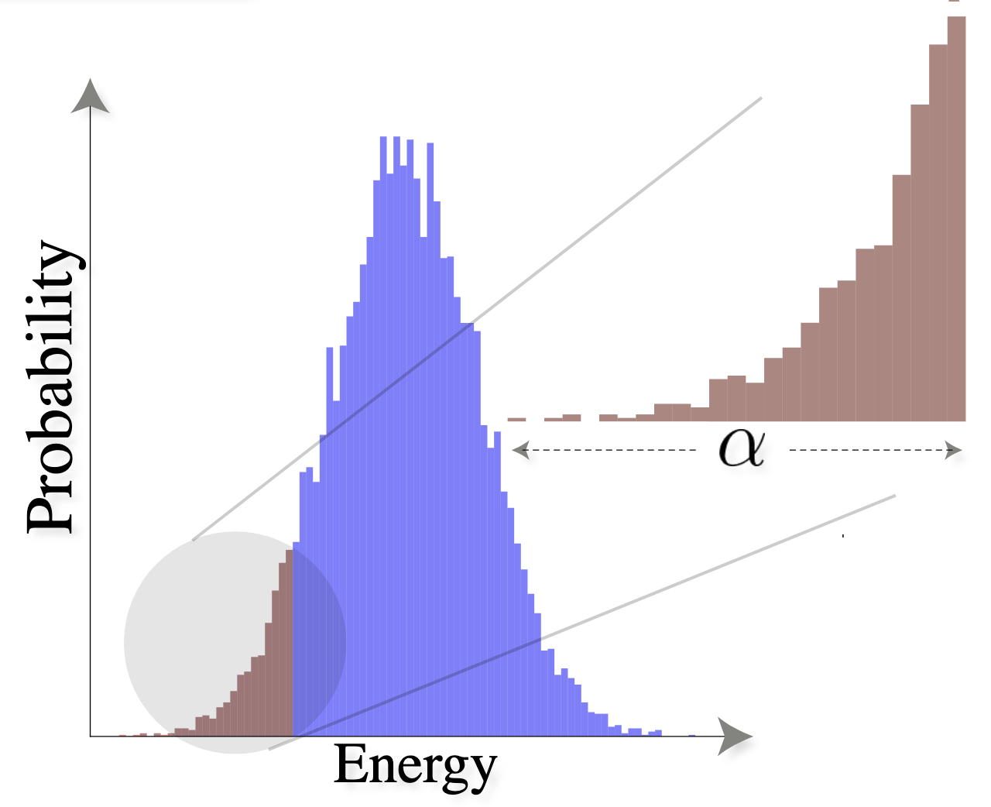
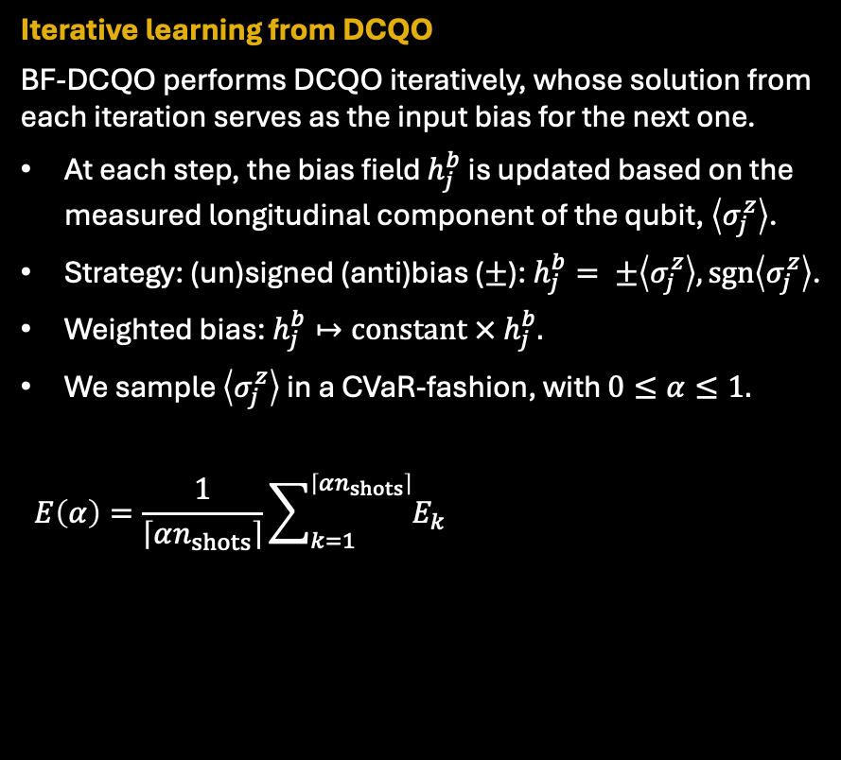

Bias-field updating
INTRODUCtion
Building upon DCQO paradigm
Iterative learning from DCQO
BF-DCQO performs DCQO iteratively, whose solution from each iteration serves as the input bias for the next one.
At each step, the bias field $h_{j}^{b}$is updated based on the measured longitudinal component of the qubit, $\left\langle σ_{j}^{z}\right\rangle$.
Strategy: (un)signed (anti)bias ($±$): $h_{j}^{b}= ±\left\langle σ_{j}^{z}\right\rangle , sgn\left\langle σ_{j}^{z}\right\rangle$.
Weighted bias: $h_{j}^{b}↦constant × h_{j}^{b}.$
We sample $\left\langle σ_{j}^{z}\right\rangle$ in a CVaR-fashion, with $0≤α≤1.$
$$E\left(α\right)=\frac{1}{\left\lceil αn_{shots}\right\rceil }\sum_{k=1}^{\left\lceil αn_{shots}\right\rceil }{E_{k}}$$
Relevant metrics
Approximation ratio: $AR=E\left(α=1\right)/E_{0}$.
Distance to solution: $DS=1−min E_{k}/E_{0}$.
Cadavid et al. PRResearch 7, L022010 (2025)
SVR et al. Commun Phys 8, 348 (2025)

Slide 6
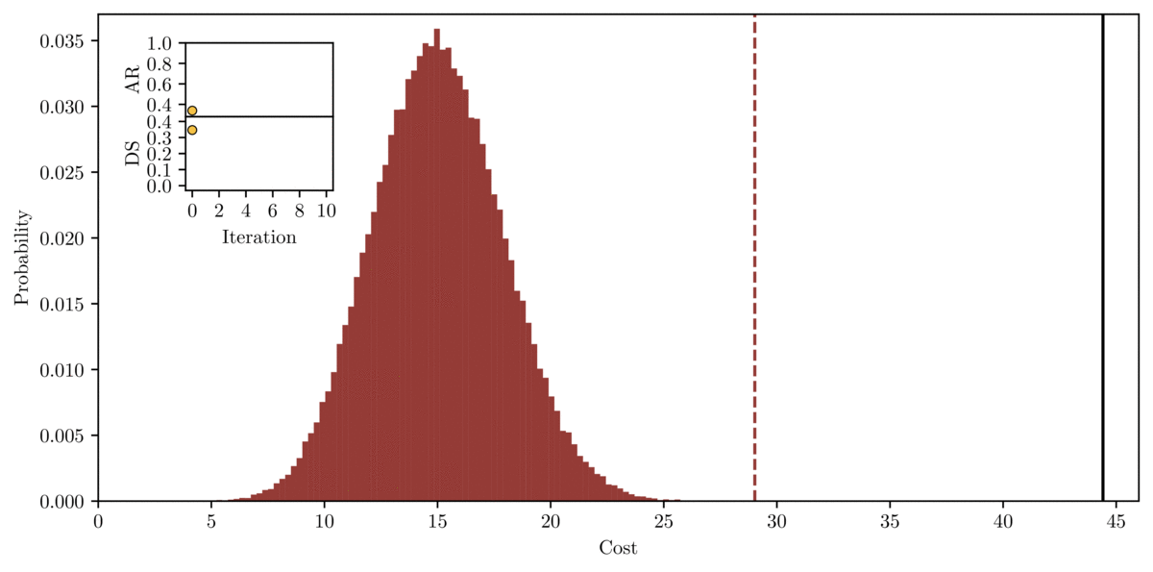
Bias-field updating
INTRODUCtion
Building upon DCQO paradigm
156-qubit NN MAX W-3-SAT Hamiltonian (IBM Fez)
Iterative learning from DCQO
BF-DCQO performs DCQO iteratively, whose solution from each iteration serves as the input bias for the next one.
At each step, the bias field $h_{j}^{b}$is updated based on the measured longitudinal component of the qubit, $\left\langle σ_{j}^{z}\right\rangle$.
Strategy: (un)signed (anti)bias ($±$): $h_{j}^{b}= ±\left\langle σ_{j}^{z}\right\rangle , sgn\left\langle σ_{j}^{z}\right\rangle$.
Weighted bias: $h_{j}^{b}↦constant × h_{j}^{b}.$
We sample $\left\langle σ_{j}^{z}\right\rangle$ in a CVaR-fashion, with $0≤α≤1.$
$$E\left(α\right)=\frac{1}{\left\lceil αn_{shots}\right\rceil }\sum_{k=1}^{\left\lceil αn_{shots}\right\rceil }{E_{k}}$$
Relevant metrics
Approximation ratio: $AR=E\left(α=1\right)/E_{0}$.
Distance to solution: $DS=1−min E_{k}/E_{0}$.
Cadavid et al. PRResearch 7, L022010 (2025)
SVR et al. Commun Phys 8, 348 (2025)

Slide 7

Sequential quantum computing (SQC)
Composition of Hardwares
superconducting
photonic
annealing
trapped ions
rare-earth
neutral atoms
NV centers
quantum dots
QPU 1 → QPU 2 → QPU 3 → ...
How to selectively compose quantum hardwares?
Superconducting qubits, trapped ions, neutral atoms, etc.; offer distinct advantages and face unique limitations.
Given that no platform has emerged as the leading one yet, SQC aims to:
Overcome individual limitations.
Combine complementary strengths.
The output of one hardware is fed into a subsequent one. For example, via state initialization.
We experimentally validate SQC by combining quantum annealing (QA) and superconducting qubit hardware:
QA: fast sampling rates, constrained Hamiltonian.
Superconducting: low connectivity, universality.
SVR et al. arXiv:2506.20655

Slide 8

Sequential quantum computing (SQC)
Composition of Hardwares
superconducting
photonic
annealing
trapped ions
rare-earth
Sidon-28 coefficients
neutral atoms
NV centers
quantum dots
QPU 1 → QPU 2 → QPU 3 → ...
Graph coloring
How to transfer the outcomes?
Following the same logic as in BF-DCQO:
Solve the problem using low-sampled QA in D-Wave.
This generates a decent but not so high-quality initial distribution (lavender).
A HUBO-to-QUBO mapping is required → extra qubits are needed.
Implement DCQO in IBM (superconducting qubits).
Initial state is prepared through the bias fields from the QA distribution and then DCQO is run (amber).
We compare against their individual parts (QA and BF-DCQO) with more resources (blue and purple).
SQC can provide faster and better solutions.
156 one-body terms
176 two-body terms
244 three-body terms
Three two-body layers
Six three-body layers
Approach | Number of shots | AR | Best AR | Best energy | Qubits
Standalone QA (large) | 290000 (26.1 s) | 96.63% | 98.89% | -184.78 | 678
Standalone BF-DCQO | 50000 (5.0 s) | 90.10% | 97.52% | -182.21 | 156
Standalone QA (low) | 3000 (0.6 s) | 90.70% | 98.51% | -184.07 | 678
SQC | 8000 (1.1 s) | 94.95% | 100% | -186.86 | 678/156
SVR et al. arXiv:2506.20655

Slide 9
Sequential quantum computing (SQC)
Composition of Hardwares
superconducting
photonic
annealing
trapped ions
Better results in 13 out of 18 instances of the same kind
rare-earth
neutral atoms
NV centers
Instance | QA_{large} (%) | BF-DCQO (%) | QA_{low} (%) | SQC (%)
1 | 98.89 | 97.52 | 98.51 | 100
2 | 98.51 | 98.51 | 98.62 | 98.96
3 | 98.01 | 98.28 | 97.86 | 98.74
4 | 98.37 | 99.11 | 98.37 | 99.65
5 | 99.04 | 99.20 | 98.27 | 99.92
6 | 98.14 | 98.89 | 98.81 | 99.25
7 | 99.36 | 98.05 | 98.65 | 99.76
8 | 97.51 | 99.42 | 97.90 | 99.96
9 | 99.58 | 99.51 | 99.05 | 99.96
10 | 99.22 | 96.55 | 97.76 | 99.43
11 | 99.27 | 97.69 | 97.34 | 99.50
12 | 99.22 | 98.40 | 98 | 99.47
13 | 97.85 | 100 | 98.58 | 100
14 | 98.87 | 99.22 | 96.31 | 98.45
15 | 99.24 | 98.86 | 99.20 | 99.20
16 | 99.69 | 96.45 | 98.56 | 98.87
17 | 99.41 | 97.02 | 98.22 | 98.77
18 | 99.12 | 96.06 | 97.82 | 98.59
quantum dots
QPU 1 → QPU 2 → QPU 3 → ...
How to transfer the outcomes?
Following the same logic as in BF-DCQO:
Solve the problem using low-sampled QA in D-Wave.
This generates a decent but not so high-quality initial distribution (lavender).
A HUBO-to-QUBO mapping is required → extra qubits are needed.
Implement DCQO in IBM (superconducting qubits).
Initial state is prepared through the bias fields from the QA distribution and then DCQO is run (amber).
We compare against their individual parts (QA and BF-DCQO) with more resources (blue and purple).
SQC can provide faster and better solutions.
SVR et al. arXiv:2506.20655

Slide 10
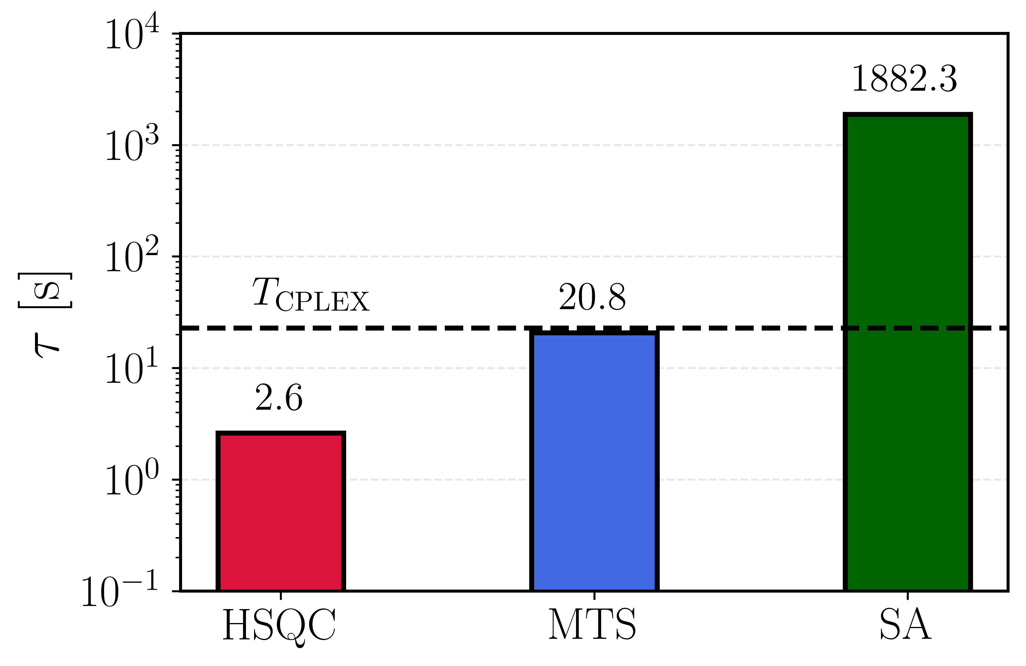
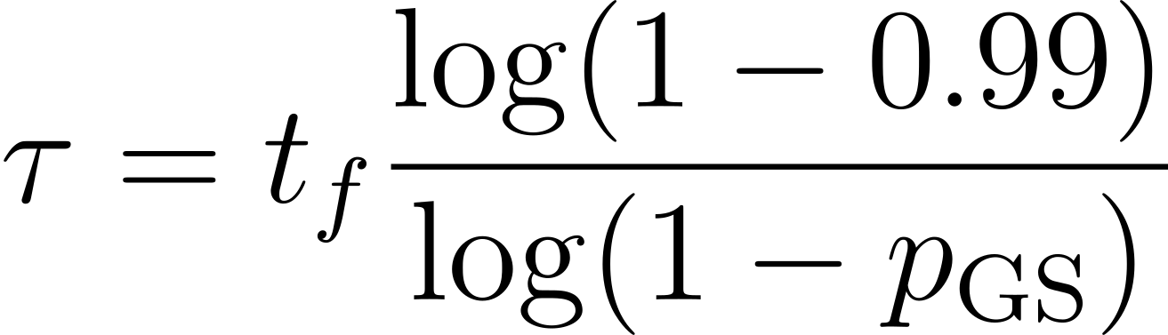

Hybrid sequential quantum computing (HSQC)
Combine classical with quantum
quantum
classical
classical
quantum
quantum
classical
classical
Speedups via hybrid workflows
quantum
How to selectively compose solvers?
With the same spirit of SQC, we propose HSQC:
We validate it using quantum results as a source to accelerate classical solvers (quantum accelerators).
Classical: memetic tabu search (MTS), simulated annealing (SA), CPLEX.
Quantum: BF-DCQO on IBM, QA on D-Wave (using different annealing times and their hybrid solvers).
We design two schemes:
SA with low resources → BF-DCQO → MTS.
SA with low resources → BF-DCQO → SA.
156 one-body terms
125 two-body terms
616 three-body terms
SWAP strategy: building upon heavy hex architecture, include more terms at minimum cost
 | MTS |  |  | HSQC
G_{max} | p_{gs} | t_{f} [s] | τ [s] | p_{gs} | t_{f} [s] | τ [s]
75 | 0.01 | 0.068 | 31.385 | 0.070 | 0.068 | 5.452
100 | 0.02 | 0.091 | 20.758 | 0.120 | 0.091 | 4.386
200 | 0.02 | 0.181 | 41.342 | 0.410 | 0.181 | 2.688
500 | 0.08 | 0.452 | 24.981 | 0.750 | 0.452 | 2.608
HSQC (SA + BF-DCQO + MTS) is faster than:
MTS
SA
CPLEX
Chandarana et al. arXiv:2510.05851

Slide 11

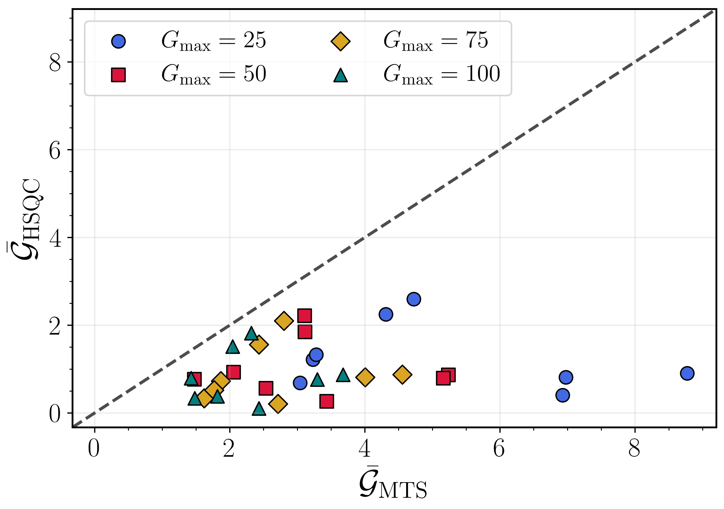
Hybrid sequential quantum computing (HSQC)
Combine classical with quantum
GS | BF-DCQO | Gen | Minimum energy E_min |  | Mean best energy Ē_best |  | Optimality gap 𝓖 (%)
 |  |  | MTS | HSQC | MTS | HSQC | MTS | HSQC
-218.10 | -215.52 | 25 | -204.02 | -216.52 | -198.97 | -216.13 | 6.46 | 0.72
-218.10 | -215.52 | 50 | -214.85 | -216.55 | -206.68 | -216.20 | 1.49 | 0.71
-218.10 | -215.52 | 75 | -216.29 | -216.33 | -208.16 | -216.19 | 0.83 | 0.81
-218.10 | -215.52 | 100 | -214.79 | -216.52 | -210.08 | -216.20 | 1.52 | 0.72
quantum
classical
classical
quantum
quantum
classical
classical
Speedups via hybrid workflows
quantum
How to selectively compose solvers?
With the same spirit of SQC, we propose HSQC:
We validate it using quantum results as a source to accelerate classical solvers (quantum accelerators).
Classical: memetic tabu search (MTS), simulated annealing (SA), CPLEX.
Quantum: BF-DCQO on IBM, QA on D-Wave (using different annealing times and their hybrid solvers).
We design two schemes:
SA with low resources → BF-DCQO → MTS.
SA with low resources → BF-DCQO → SA.
Optimality gap (the lower, the better)
Chandarana et al. arXiv:2510.05851
Data points below the dashed line: HSQC is better

Slide 12

Concluding remarks
Concluding remarks
and what’s next?
Know more about us!
Our novel sequential workflows in a nutshell
Large-scale HUBO instances are solved using IBM (156q), D-Wave quantum annealers and hybrid solvers (~1400q) and classical solvers (SA and MTS).
We introduce SQC, a paradigm that aims to overcome individual limitations and combine complementary strengths combining different QPUs.
Superior performance is shown against the standalone parts.
We extend SQC to include classical routines, landing into HSQC.
Speedups are possible by combining of classical and quantum routines.
Both routines emerge as suitable methods for large-scale higher-order optimization using current and near-term quantum hardware.
To design new pipelines for quantum simulations of many-body physics, quantum chemistry and quantum machine learning is left as future work.
arXiv:2506.20655
arXiv:2510.05851

Slide 13



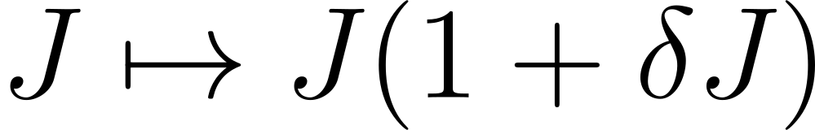
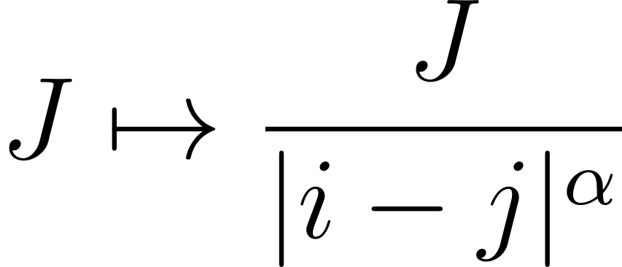

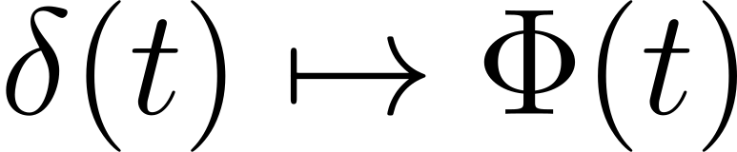
Interested about quantum batteries?
addendum
Check our poster!
Quantum chaos can be used to scramble an initial state faster
We study it as a potential resource to accelerate QB charging protocols.
Given the importance of entanglement, we propose a minimal maximally ergodic model as a QB.
Potential candidates: trapped ions, Rydberg atoms, superconducting qubits, waveguide QED setups, etc.
(at early times)
SVR, Ding, Chen, Ban. JHEP 5, 21 (2025)
SVR, Chen, Ban. In preparation. arXiv:2511.XXXXX. (2025)

Slide 14
Moltes gràcies!
Sebastián V. Romero
Kipu Quantum GmbH & EHU E-mail: sebastianv.romero@kipu-quantum.com

