Slide 1


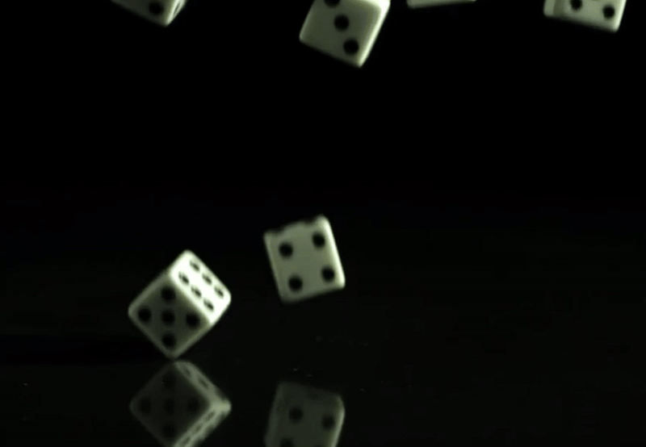
Quantum Nonlocality
vs
Quantum Randomness Certification
Qiongyi He
Peking University
2025.10.20. ICE-10 Valencia Spain

Slide 2
1
Background
2
1SDI and DI Randomness Certification
CONTENTS
3
Experimental Realization
4
Conclusion

Slide 3
1
Background

Slide 4
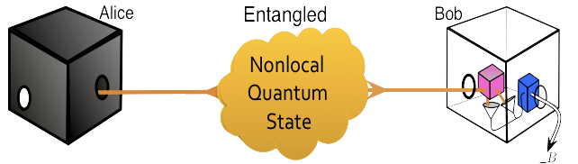
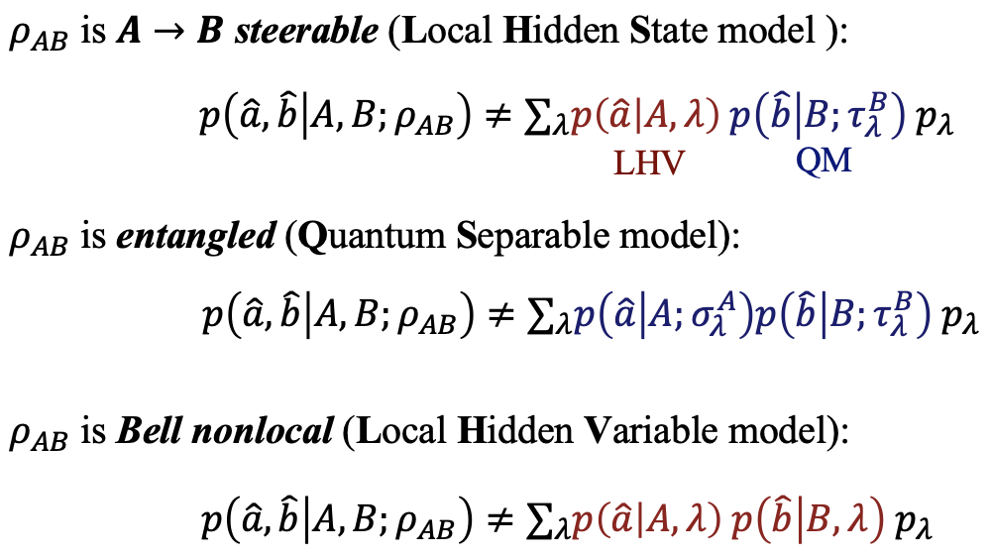
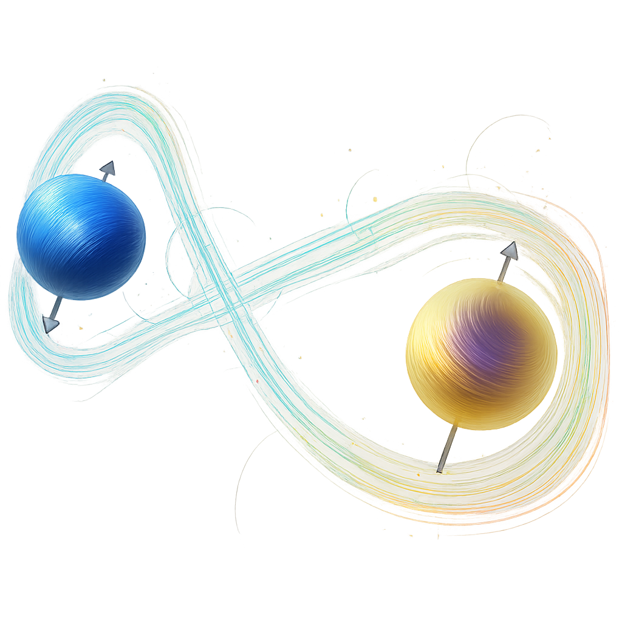
Background: Quantum Nonlocality
Device dependent
inseparability
measure A
affect B
One-sided device independent
（白箱：constrained by QM,信任假定)
steering
􏰁
Device independent
Bell
nonlocality
Review references:
[1] Rev. Mod. Phys. 81, 1727 (2009).
[2] Rep. Prog. Phys. 80, 024001 (2017).
[3] Rev. Mod. Phys. 92, 015001 (2020).
[4] Fundamental Research 1, 99–101 (2021).
[5] PRX Quantum 3, 030102 (2022).
（黑箱：不需做任何信任假定)
Quantum inseparability:
Quantum steering:
Bell nonlocality:

Slide 5

Background: Quantum Nonlocality vs Randomness Certification
1SDI & DI Randomness Certification in Multipartite and High-Dimensional Systems
measure A
affect B
inseparable
1-Sided-Device Independent
Quantum steering
Bell
nonlocal
Device Independent

Slide 6
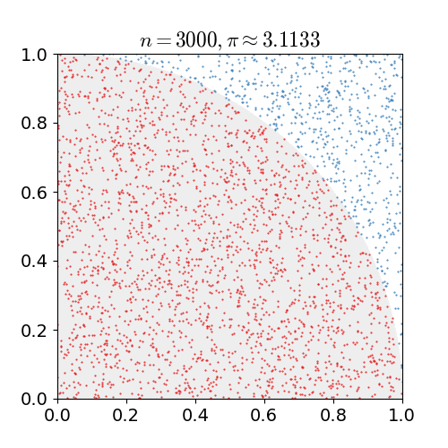
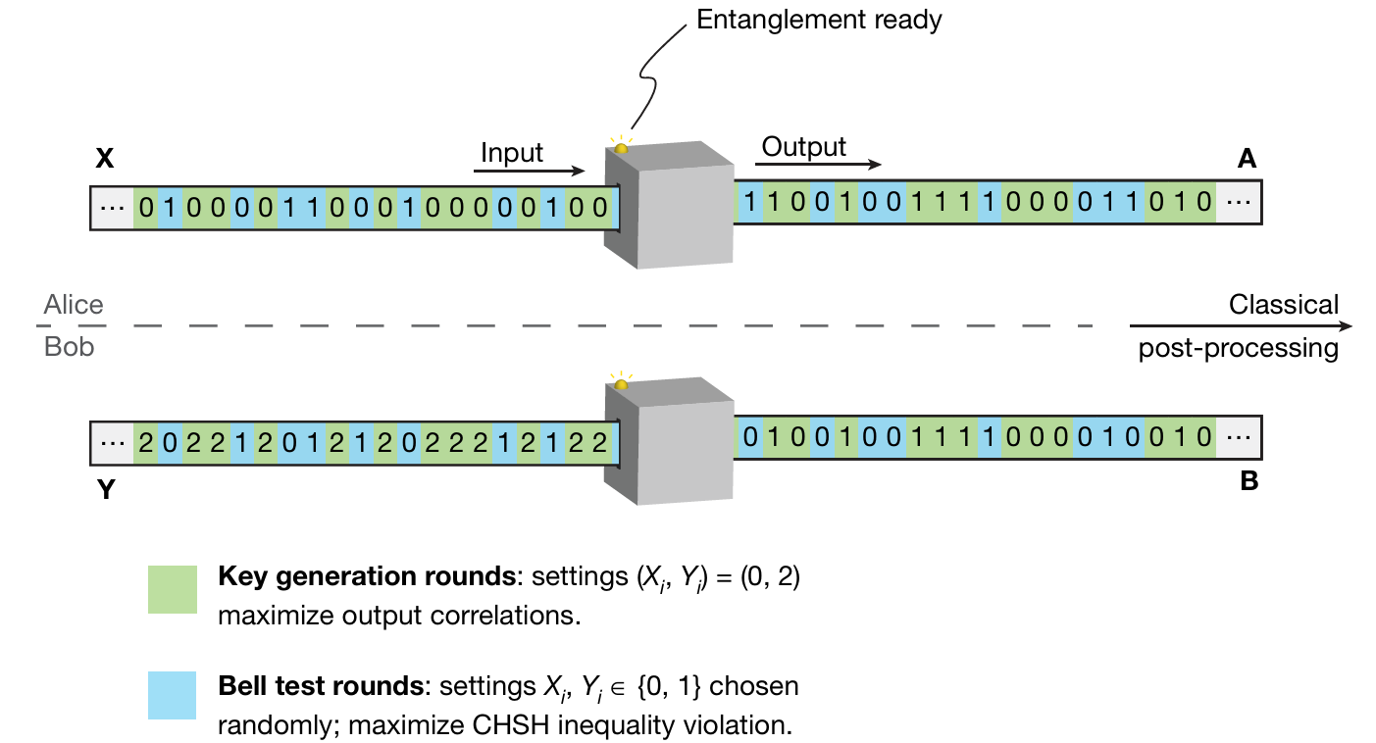
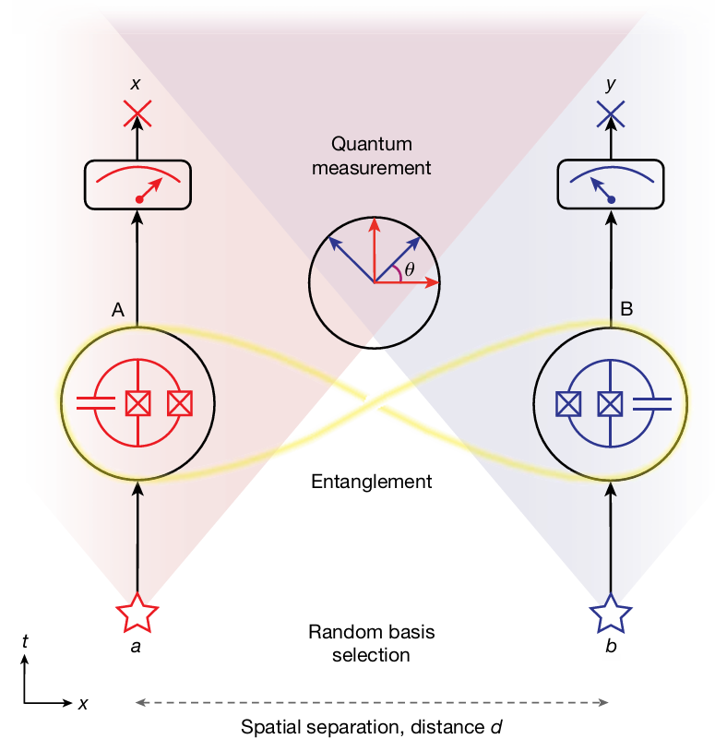
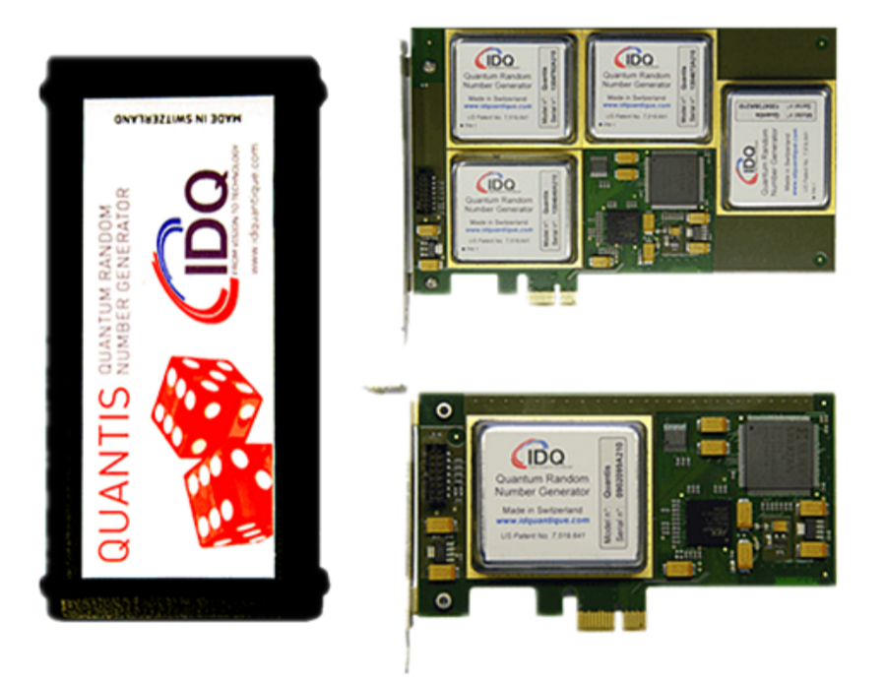
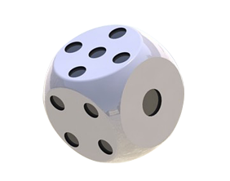
Background: Random numbers and their applications
Simulation
Quantum Key Distribution
Nature 607, 682–686 (2022).
Bell Test
Quantum Cryptography
Simulation
Fundamental Science
Commercial
Products
Nature 617, 265–270 (2023).
www.idquantique.com

Slide 7
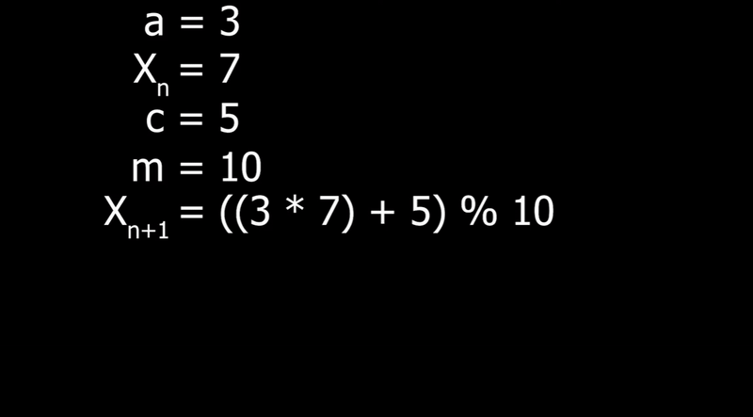
Background: Random numbers and their applications
Pseudorandom number generators (PRNGs)
PRNG | TRNG
Predictable | Unpredictable
Reproducible | Non-reproducible
Periodic | Time-independent
Deterministic | Probabilistic
Algorithm-based | Physical-process-based
E.g., Linear Congruential Generator
https://www.youtube.com/watch?v=kRCmR4qr-hQ
[Ref] Applied cryptography. CRC press, Boca Raton, 1996.

Slide 8
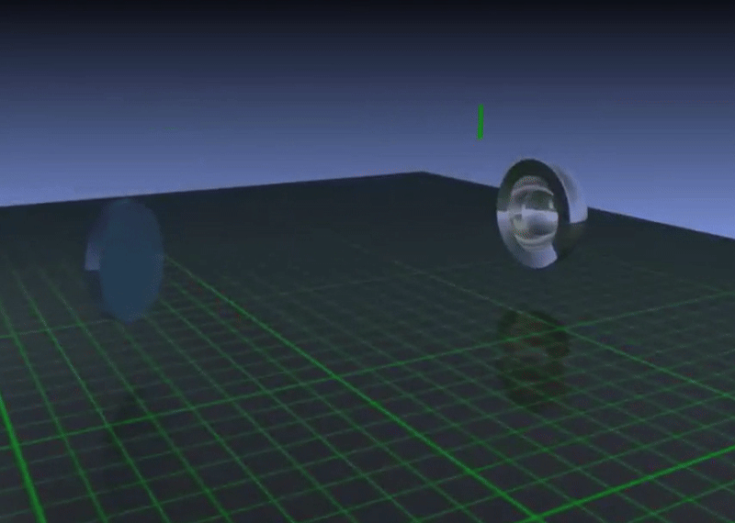

Background: Random numbers and their applications
True random number generators (TRNGs)
PRNG | TRNG
Predictable | Unpredictable
Reproducible | Non-reproducible
Periodic | Time-independent
Deterministic | Probabilistic
Algorithm-based | Physical-process-based
Born’s rule
$$Pr\left(i\right)={\left|\left\langle λ_{i} | Ψ\right\rangle \right|}^{2}$$
[Ref] Applied cryptography. CRC press, Boca Raton, 1996.
https://www.youtube.com/watch?v=1DAHRPU3BEM

Slide 9
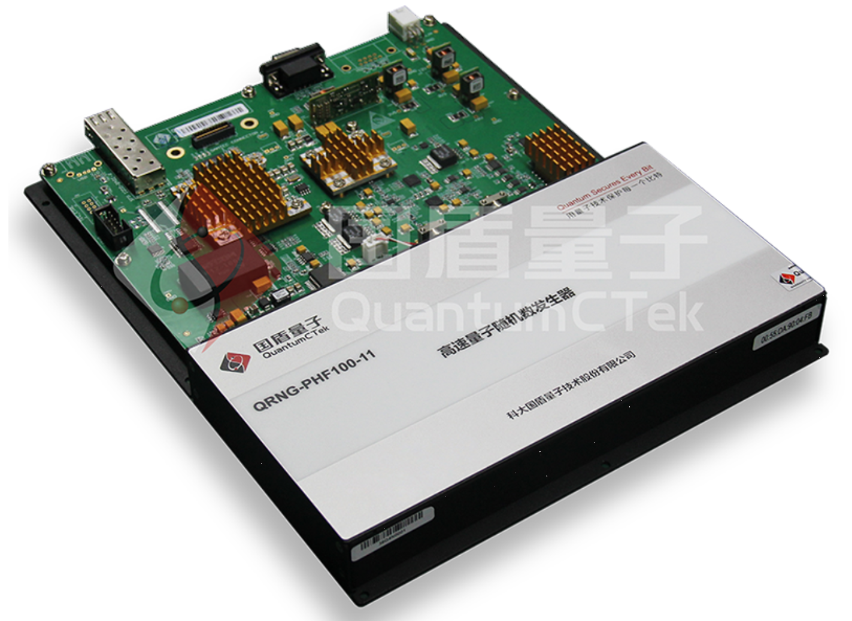

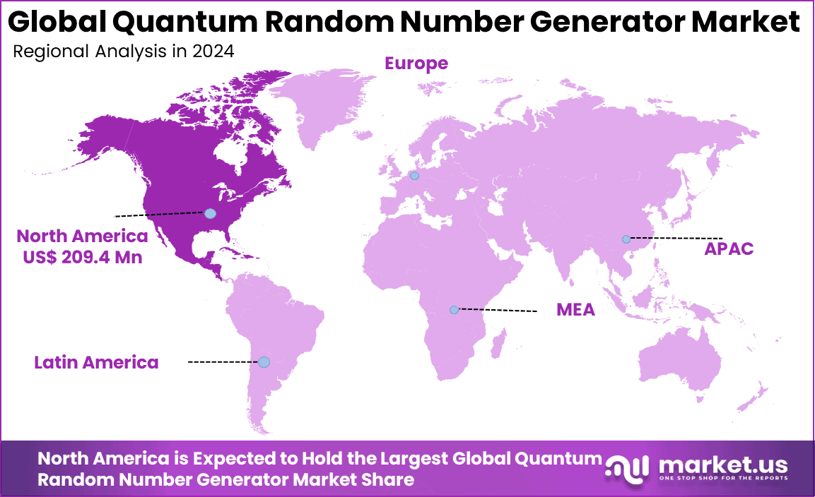
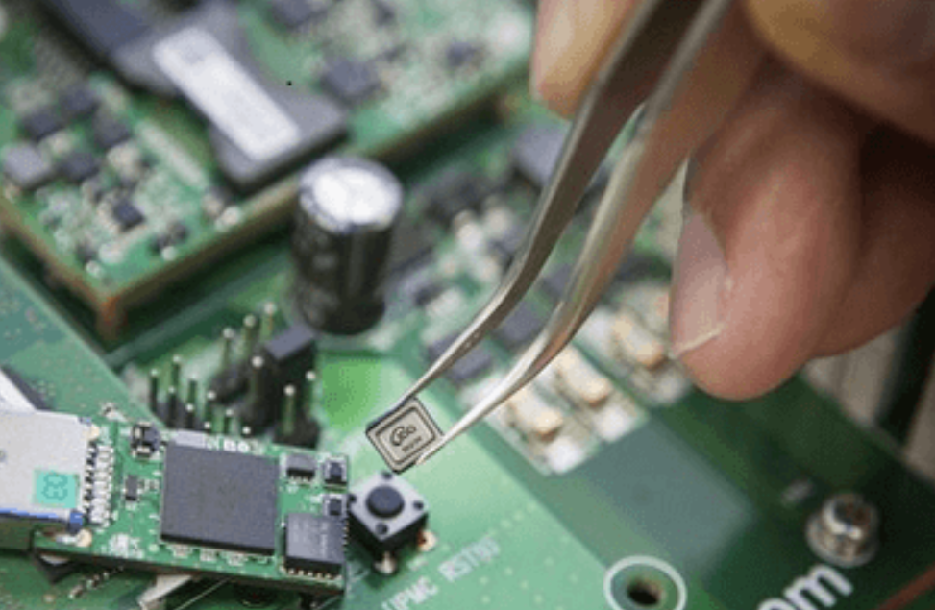
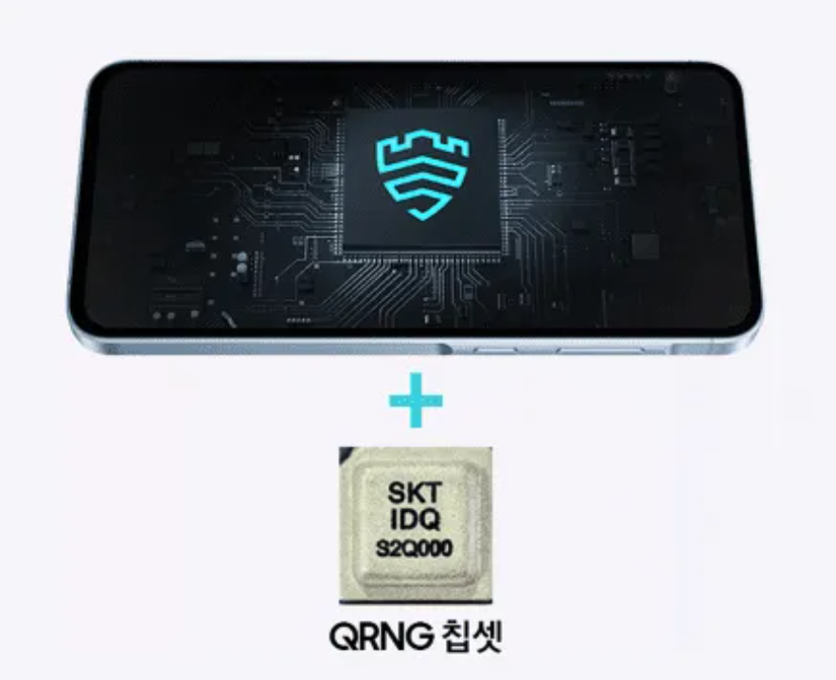
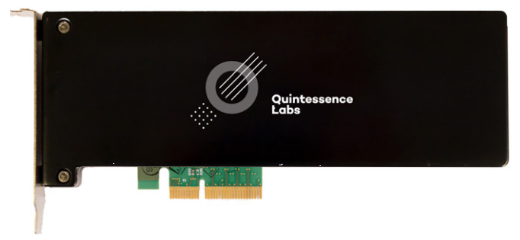

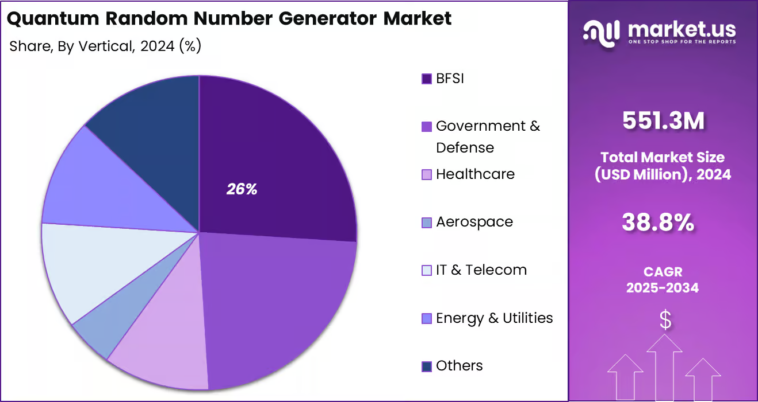
Background: Random numbers and their applications
www.idquantique.com
www.quantum-info.com
www.quintessencelabs.com
www.sammobile.com
https://market.us/report/quantum-random-number-generator-market/

Slide 10
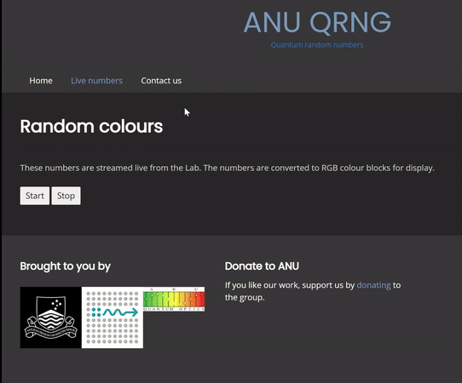




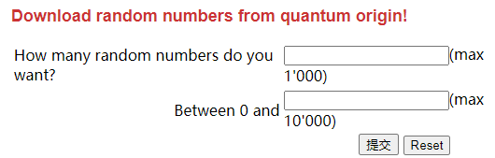
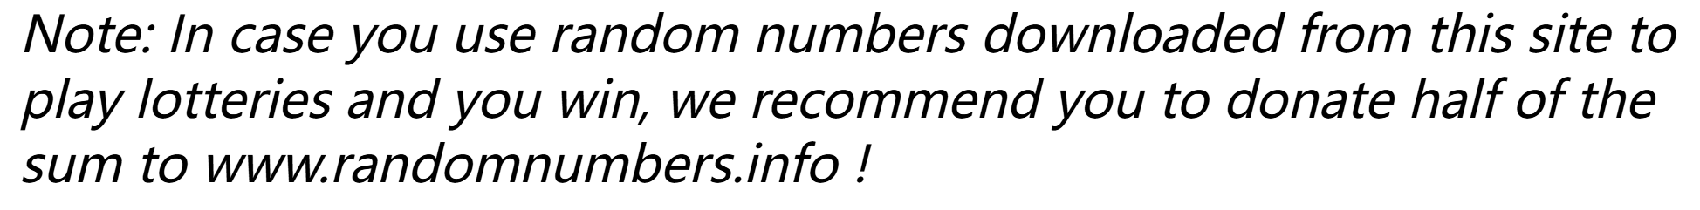
Background: Random numbers and their applications
Discrete variable system
Continuous variable system
www.randomnumbers.info
https://qrng.anu.edu.au/

Slide 11
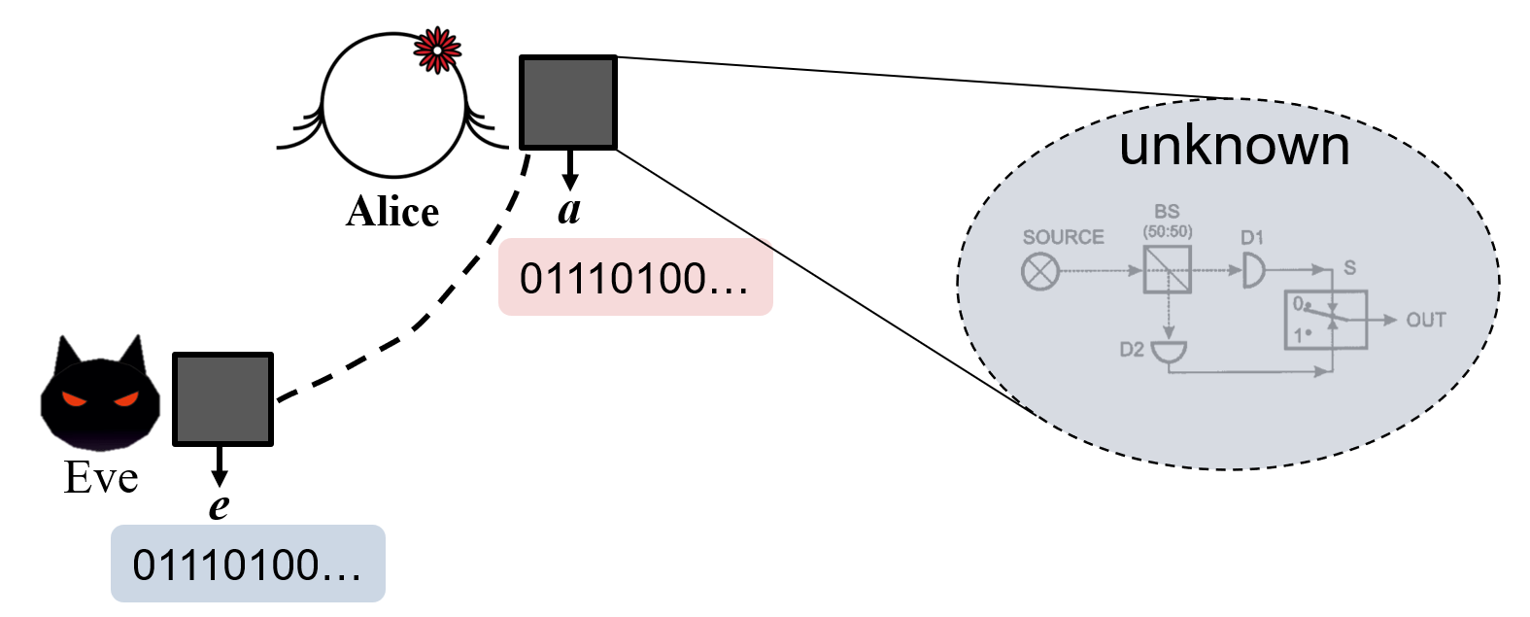

Background: Device-Independent random number generator
maximally entangled
Randomness: Eve’s ability to guess Alice’s outcomes
Device-Dependent
The sequence can pass the randomness tests.
Rely on the characterization of the devices.
maximally entangled
Perfectly predictable by Eve!
Entanglement ensures the security of measurement outcomes
Alice
Entanglement
DI： Bell nonlocality
1SDI：Quantum steering
maximal
EPR Steering
$$Eve$$
Bell nonlocality
$$Bob$$
Monogamy of quantum nonlocality
When the states of Alice and Bob are entangled, then Eve’s state must not be maximally entangled with Alice’s state, which means Eve cannot guess Alice’s results with 100%, i.e., existing randomness.

Slide 12
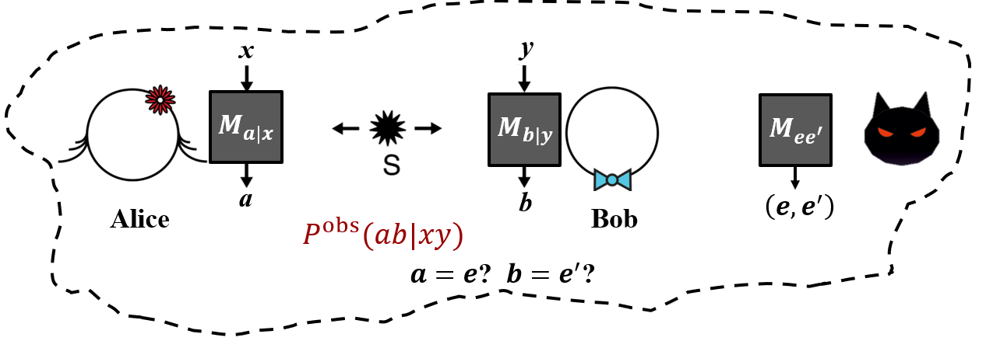
Background: Device-Independent random number generator
Device-Independent (DI)
Ask to the two devices giving a Bell inequality violation.
Bound the randomness of the outputs from the violation, i.e., prevent the case that Eve perfectly predict Alice and Bob’s outcomes
如果满足LHV模型，Eve一定可以找到经典的攻击策略完美猜测AB的测量结果
[Ref] “Hacking commercial quantum cryptography systems by tailored bright illumination” Nat. Photon. 4, 686–689 (2010);

Slide 13

Background: Device-Independent random number generator
For the CHSH Bell inequality, each trial consumes exactly 2 random bits and produces at most 2 bits of randomness
Consumption $≥$ Generation
Spot-Checking Protocol
A trusted third party determines randomly with a small probability $q$ whether a trial is a spot-checking trial.
Spot-checking trial: Alice and Bob perform the Bell test, consuming random bits.
Generation trial: Fix inputs $\left(x,y \right)=\left(x^{∗},y^{∗}\right)$. —— allows for the randomness expansion
Assumption：Eve cannot learn in advance whether or not a trial is a spot-checking trial!
[Ref] “Universal security for randomness expansion from the spot-checking protocol” SIAM J. Comput. 46, 1304 (2017).

Slide 14
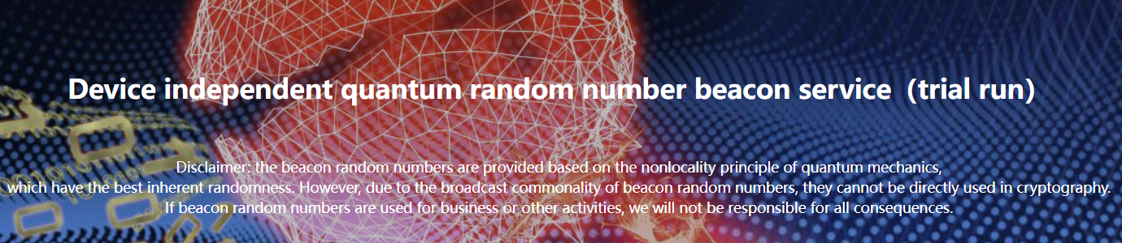
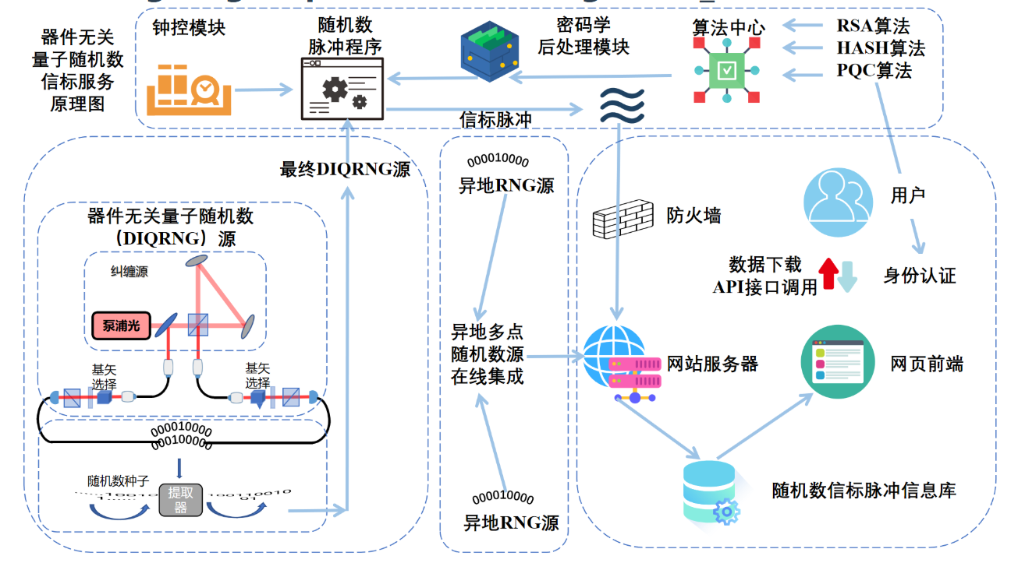
Background: Device-Independent random number generator
https://randomnessbeacon.com Jinan Institute of Quantum Technology; University of Science and Technology of China (USTC)

Slide 15
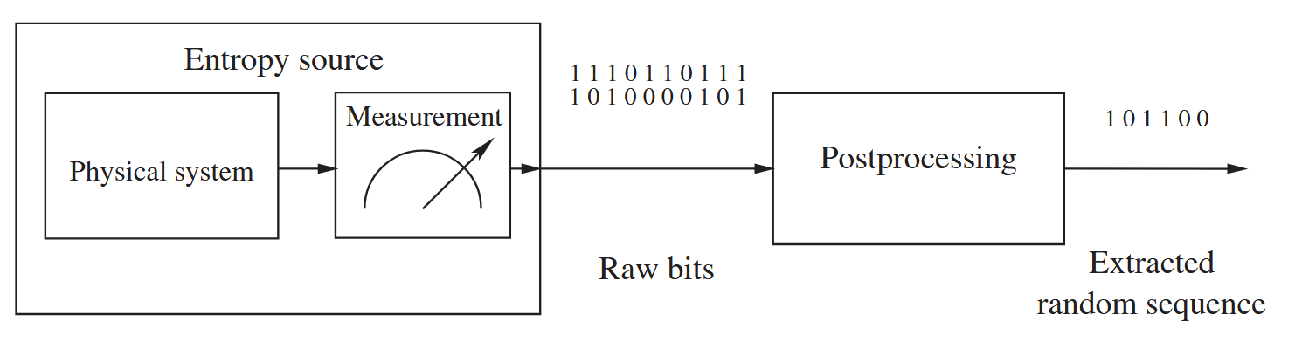
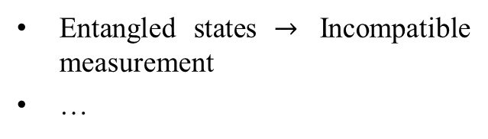
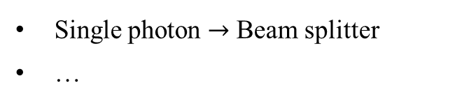
Background: Block diagram of typical TRNGs
Step 1: Randomness certification
Step 2: Random numbers extraction
Device-Dependent
Device-Independent
Single photon $→$ Beam splitter
…
i.i.d. case：SDPs、…
non-i.i.d. case：Entropy Accumulation Theorem (EAT)、…
Entangled states $→$ Incompatible measurement
…
Toeplitz-hashing extractor
…
[Ref] M. Herrero-Collantes and J. C. Garcia-Escartin, Rev. Mod. Phys. 89, 015004 (2017); X. Ma, et al., Phys. Rev. A 87, 062327 (2013).

Slide 16
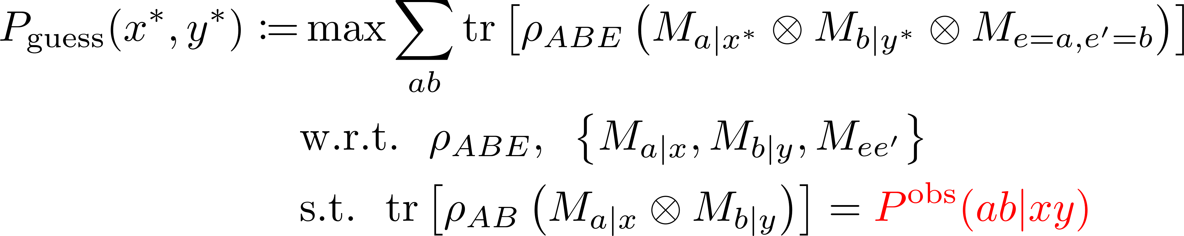
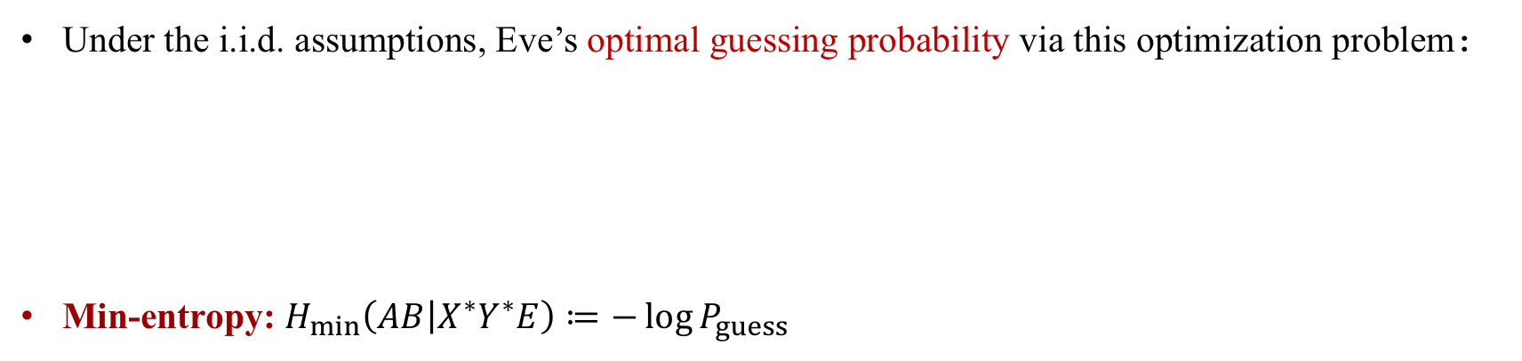
Background: Randomness certification
DI scenario
Under the i.i.d. assumptions, Eve’s optimal guessing probability via this optimization problem：
Min-entropy: $H_{min}\left(AB | X^{∗}Y^{∗}E\right)≔−\log{P_{guess}}$
$$H_{min}\left(AB | X^{∗}Y^{∗}E\right)≤\lim_{n→∞}H_{min}^{ε}\left(AB|XYE\right)/n$$
[non-i.i.d case]
[Ref] J. D. Bancal, et al., New J. Phys. 16, 033011 (2014); P. J. Brown, et al., IEEE Trans. Inf. Theory 66, 2964-2987 (2020).

Slide 17
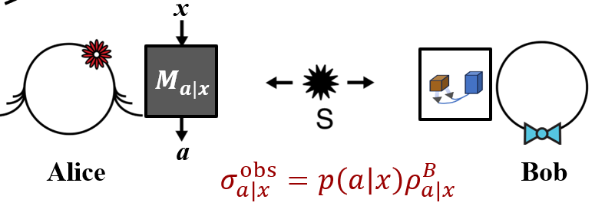
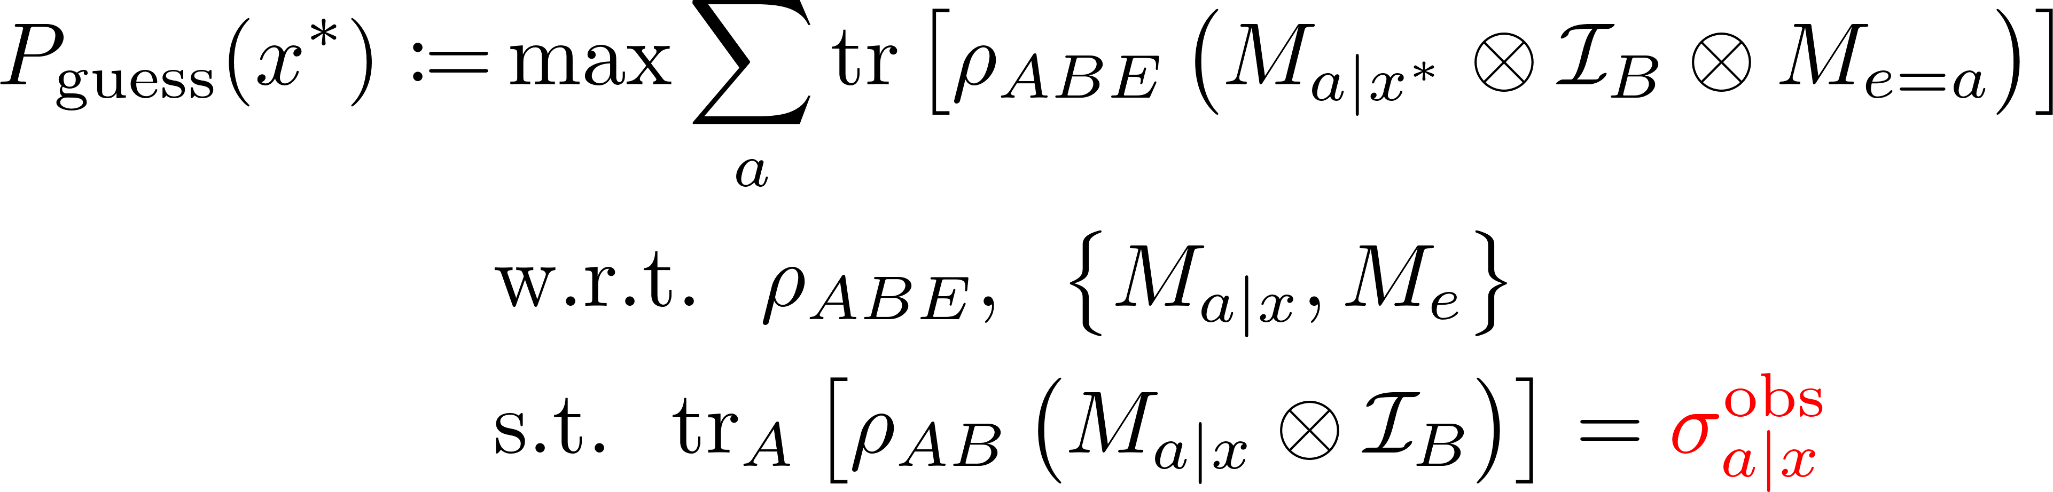
Background: Randomness certification
1SDI scenario
Random numbers generated from the untrusted device held by Alice
Guessing probability defined in a similar way:
“Assemblage”
the observed statistics becomes the set of Bob’s conditional states, called Assemblage
Characterize Bob’s device.
Tolerate a higher level of noise and loss.
This optimization problem is equivalent to an Semidefinite programming (SDP) in bipartite case!
[Ref] E. Passaro, et al, New J. Phys. 17, 113010 (2015).

Slide 18
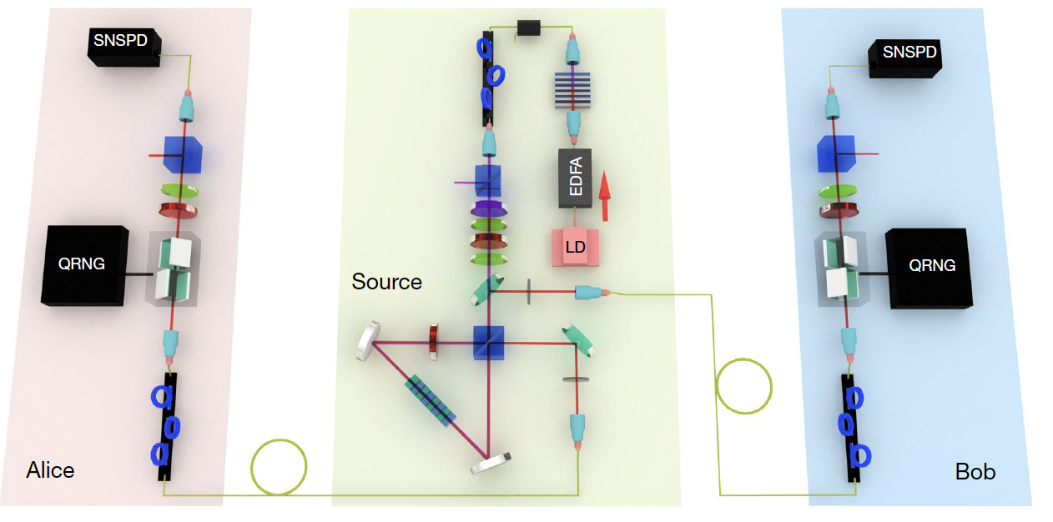
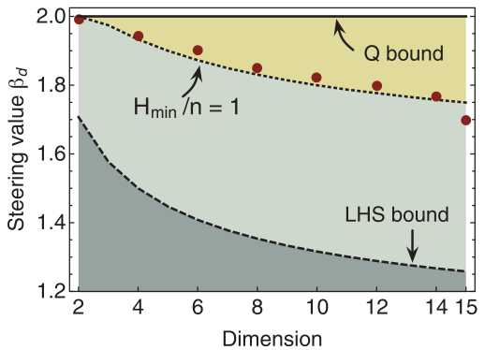
Background: Randomness expansion in bipartite scenario
DI – CHSH inequality
1SDI – High-dimensional steering
Nature 562, 548–552 (2018).
Science 360, 285-291 (2018).
Challenge: Existing schemes are limited to two users —
how to generate randomness among multiple users?

Slide 19
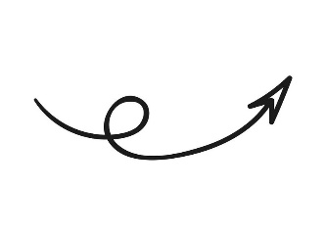



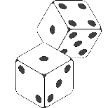
Background: Quantum nonlocality vs Randomness
Based on the same statistics (e.g. the joint probability distribution)
Relation?
Nonlocality
Randomness
EPR, Phys. Rev. (1935)
J. Bell, Physics (1964)
CHSH, PRL (1969)
H. M. Wiseman, et al., PRL (2007)
N. Brunner, et al., RMP (2014)
R. Uola, et al., RMP (2020)
Y. Xiang, et al., Fund. Res. 1, 99 (2021)
Y. Xiang, et al., PRX Quantum 3, 030102 (2022)
R. Colbeck, PhD thesis (2006)
S. Pironio, et al., Nature (2010)
A. Acín, et al., PRL (2012)
A. Acín, et al., Nature (2016)
X. Ma, et al., npj QI (2016)
M. Herrero-Collantes, et al., RMP (2017)

Slide 20
Background: Quantum nonlocality vs Randomness
Related discussion [Standard spot-checking protocol]
Even weakly entangled states can certify maximal randomness.
[DI：A. Acín, et al., PRL (2012); 1SDI：P. Skrzypczyk, et al., PRL (2018)]
Bell nonlocality is not sufficient for certifying randomness (NS adversary).
[E. Woodhead, PhD thesis (2014)]
Maximal nonlocality does not imply maximal randomness (NS adversary).
[A. Acín, et al., PRL (2015)]
A trade-off between nonlocality and randomness.
[L. Wooltorton, et al., PRL (2022)]
Maximal nonlocality fails to certify randomness (Quantum adversary).
[R. Ramanathan, et al., arXiv:2408.03665]
Relation?
Challenge: How to understand the relationship between quantum nonlocality and randomness?

Slide 21
2
1SDI and DI Randomness Certification

Slide 22
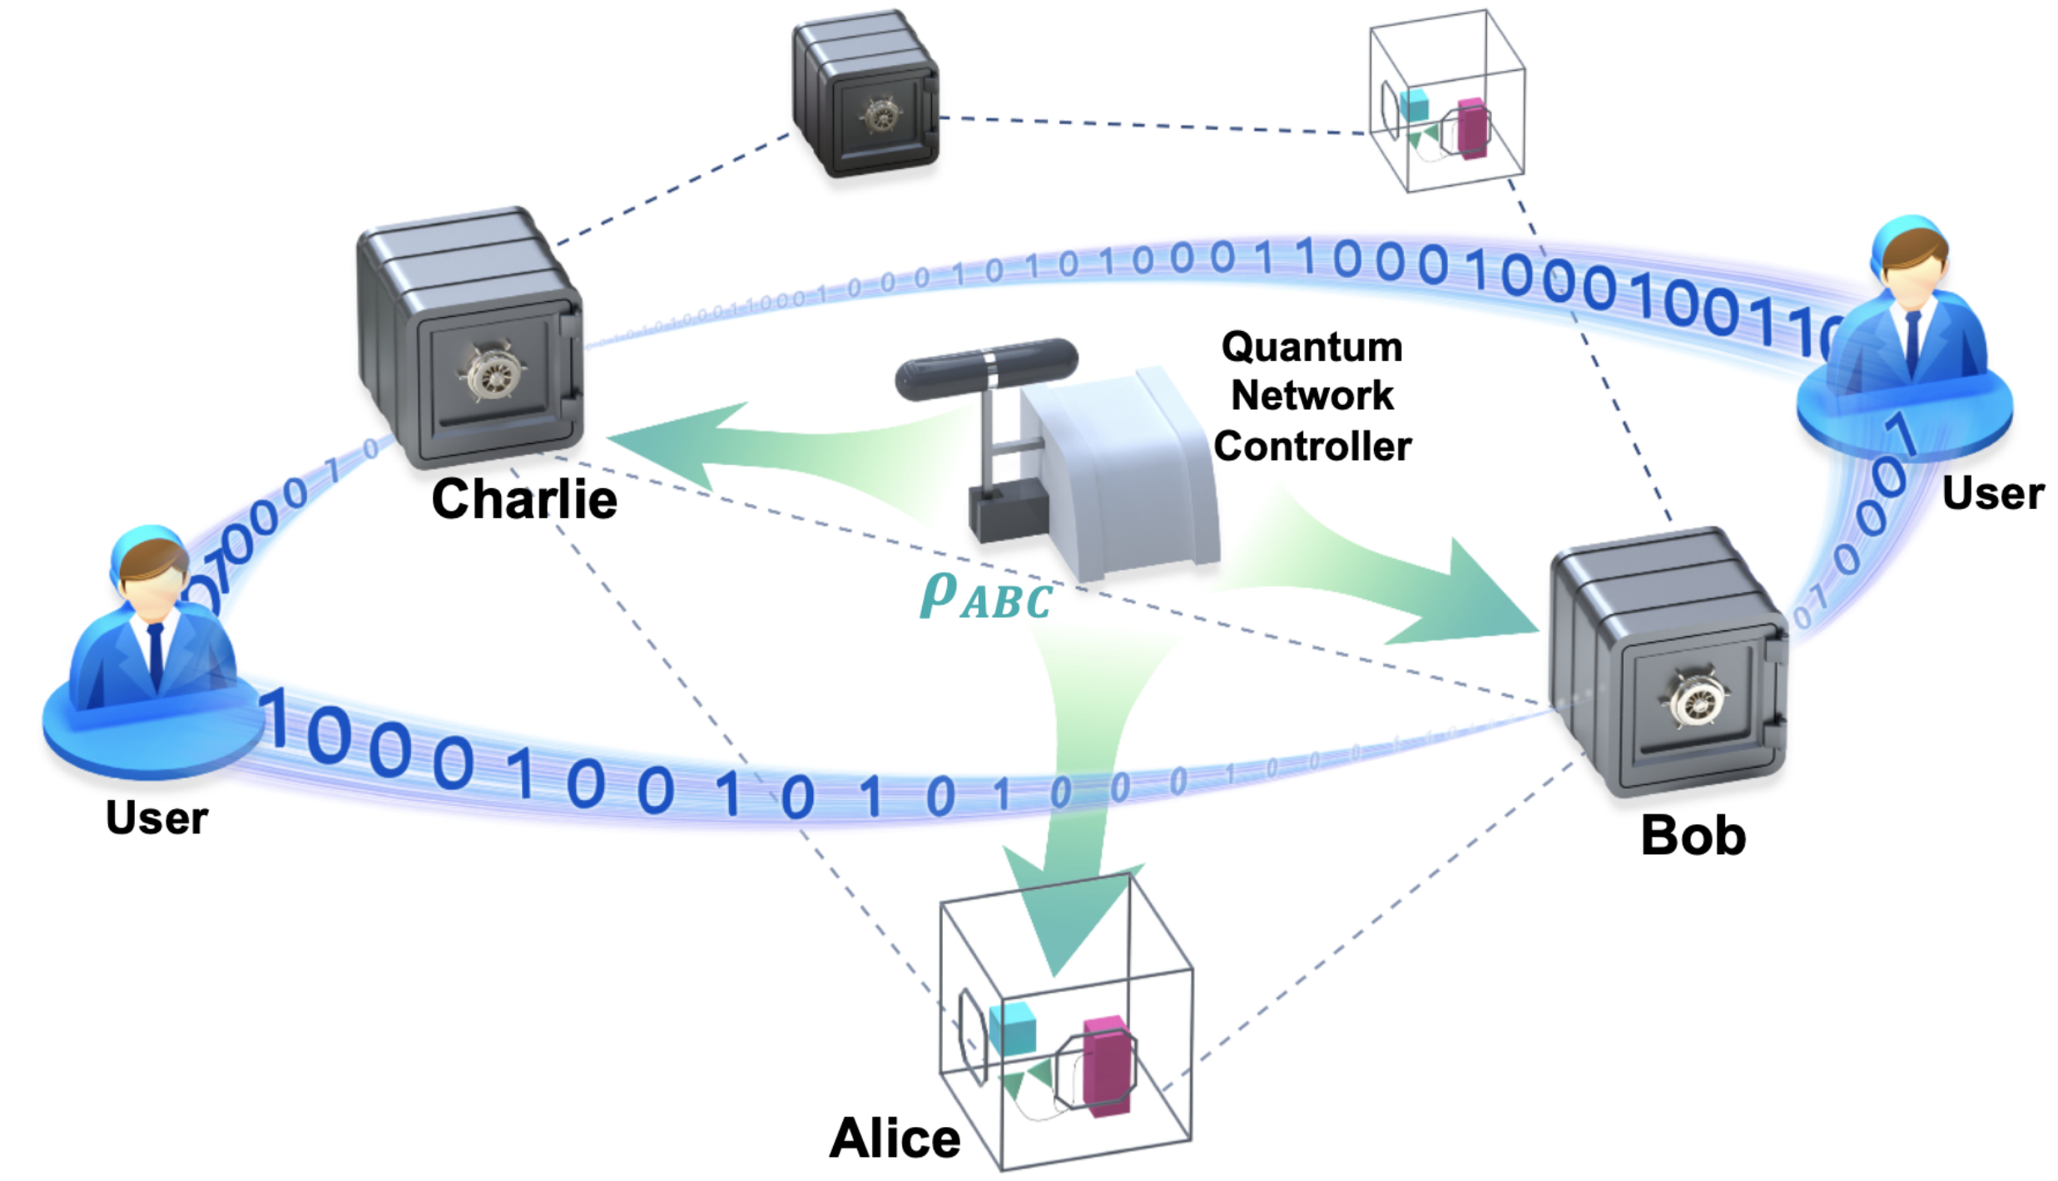
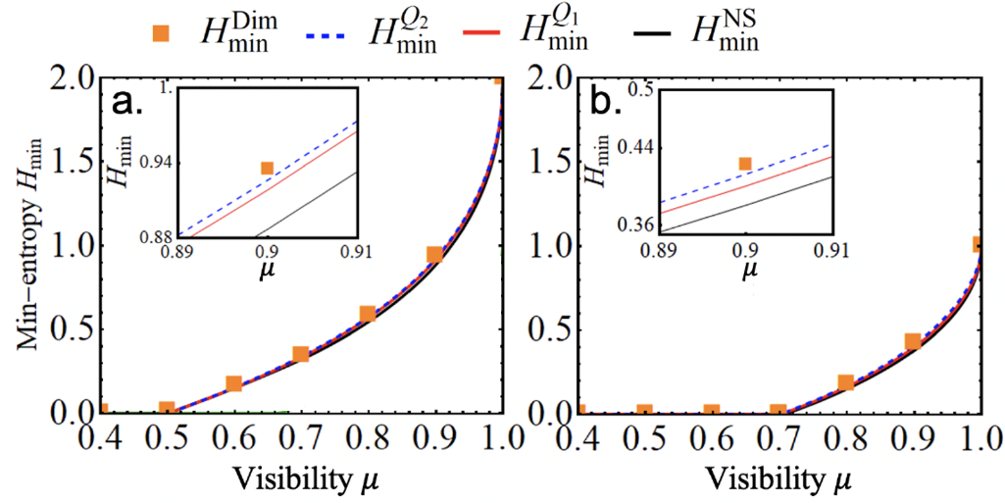
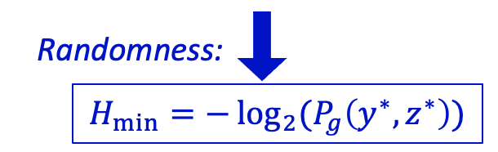
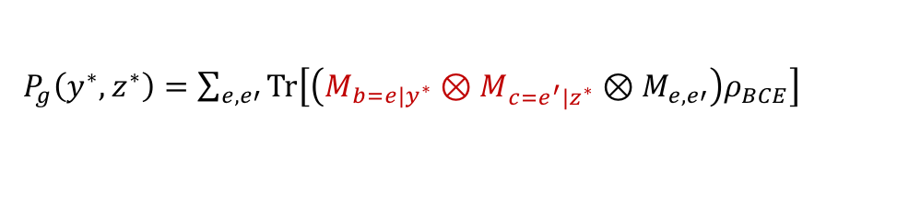

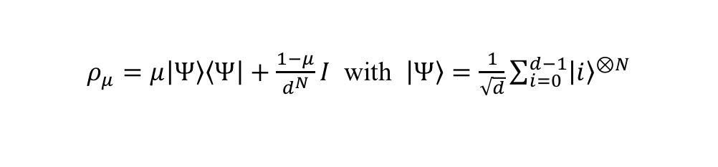
1. Randomness Certification based on Multipartite Steering
PRL 132, 080201 (2024).
$N$ parties with $N−1$ untrusted parties
Example 1: d-dimension GHZ + noise
$ρ_{μ}=μ\left|Ψ\right\rangle \left\langle Ψ\right|+\frac{1−μ}{d^{N}}I$ with $\left|Ψ\right\rangle =\frac{1}{\sqrt{d}}\sum_{i=0}^{d−1}{{\left|i\right\rangle }^{⊗N}}$
untrusted
联合
untrusted
单独
？
Eve
trusted
$P_{g}\left(y^{∗},z^{∗}\right)=\sum_{e,e′}{Tr\left[\left(M_{b=e|y^{∗}}⊗M_{c=e^{′}|z^{∗}}⊗M_{e,e′}\right)ρ_{BCE}\right]}$
Bob & Charlie together Only Bob or Charlie
Applicable to arbitrary dimensional systems
Certify Higher randomness, robust to noise

Slide 23
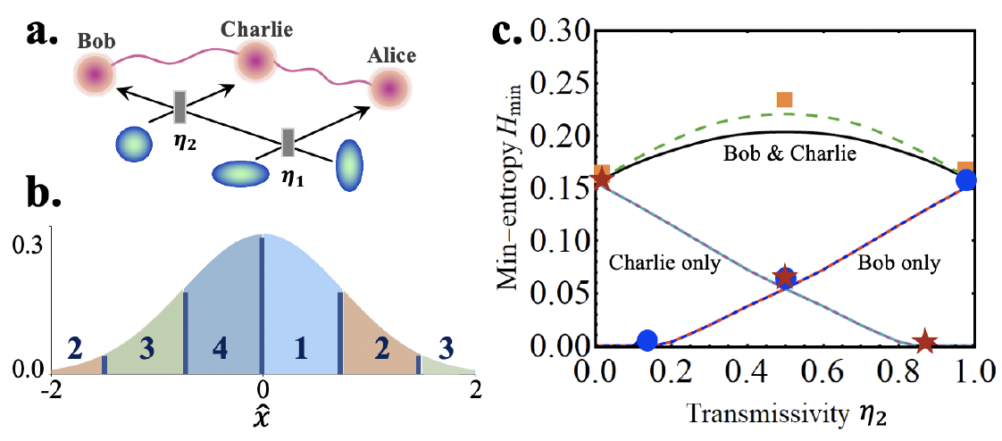
1. Randomness Certification based on Multipartite Steering
$N$ parties with $N−1$ untrusted parties
Example 2: three-mode Gaussian state
untrusted
联合随机性更高
单方
untrusted
？
Eve
trusted
$P_{g}\left(y^{∗},z^{∗}\right)=\sum_{e,e′}{Tr\left[\left(M_{b=e|y^{∗}}⊗M_{c=e^{′}|z^{∗}}⊗M_{e,e′}\right)ρ_{BCE}\right]}$
Applicable to arbitrary dimensional systems
Certify Higher randomness, robust to noise

Slide 24
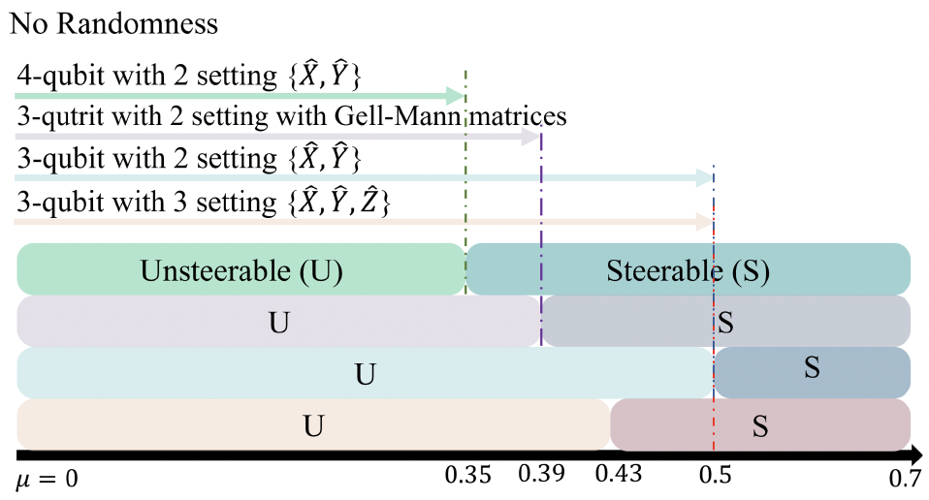
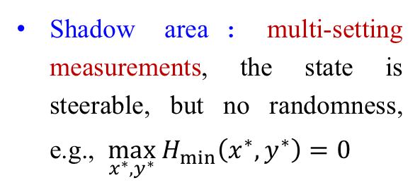
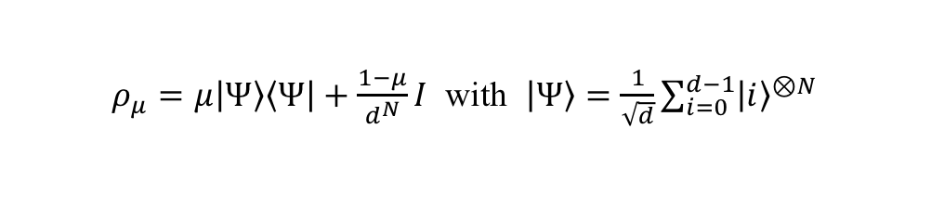
1. Randomness Certification based on Multipartite Steering
Dose the quantum nonlocality always guarantee nonzero quantum randomness? No!
Example: d-dimension GHZ + noise
$ρ_{μ}=μ\left|Ψ\right\rangle \left\langle Ψ\right|+\frac{1−μ}{d^{N}}I$ with $\left|Ψ\right\rangle =\frac{1}{\sqrt{d}}\sum_{i=0}^{d−1}{{\left|i\right\rangle }^{⊗N}}$
When two measurement settings are performed on the untrusted parties, multipartite steering is sufficient and necessary for certifying randomness.
Shadow area：multi-setting measurements, the state is steerable, but no randomness, e.g., $\max_{x^{∗},y^{∗}} H_{min}\left(x^{∗},y^{∗}\right)=0$

Slide 25
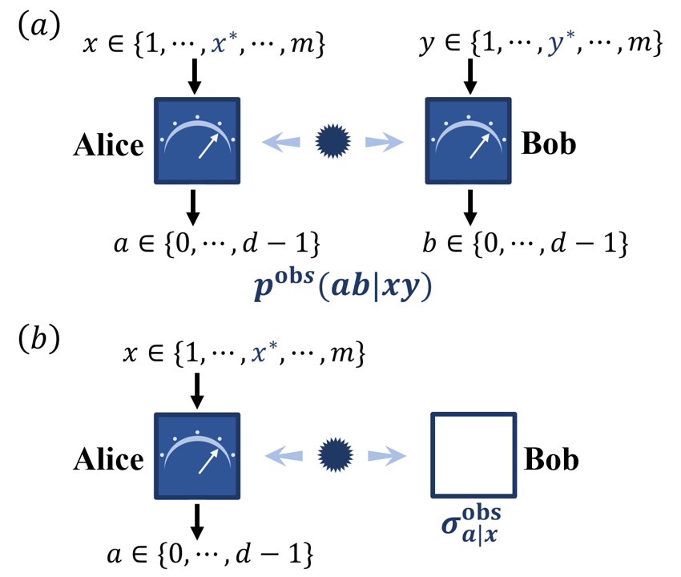









Problem Statements
What are the necessary and sufficient conditions for 1SDI and DI randomness certification?
How to identify the minimal quantum resources required?
$$x$$
DI
$$y$$
$$x$$
1SDI
$$a$$
$$b$$
$$a$$
PRL 135, 060201 (2025).

Slide 26
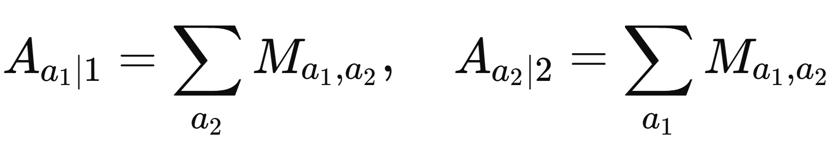
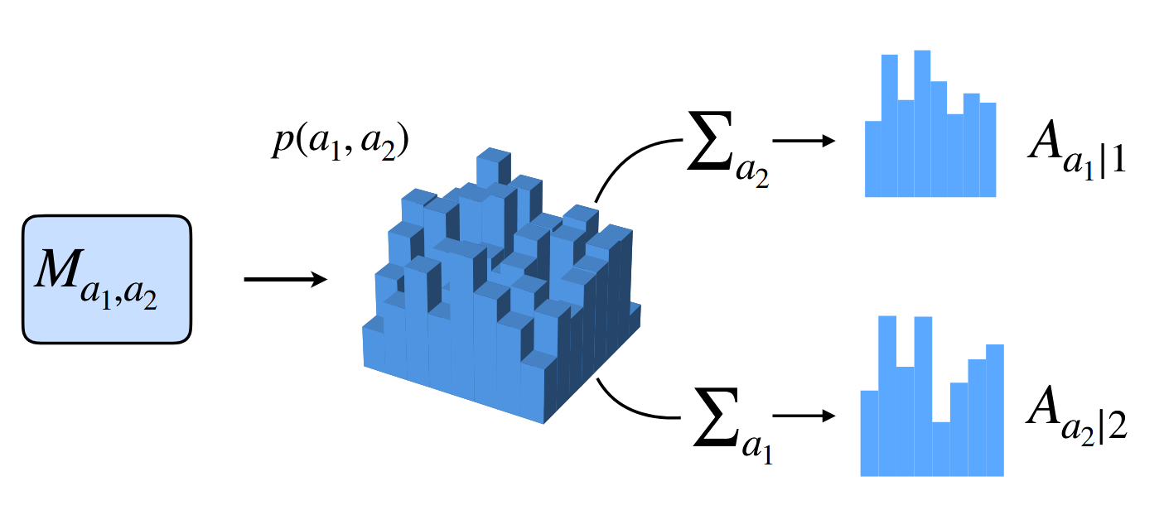
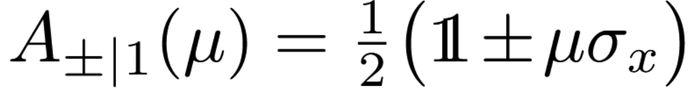
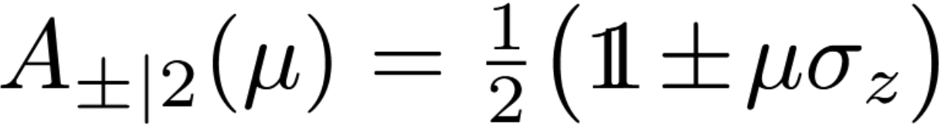
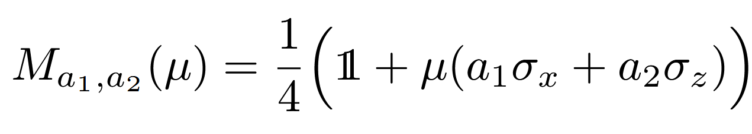

Compatible measurements
Multiple measurements can be jointly simulated at the statistics level
Definition 1: Two POVMs $\left\{A_{a_{1}|1}\right\}$ and $\left\{A_{a_{2}|2}\right\}$ are compatible (i.e., jointly measurable) if there exists a joint measurement $\left\{M_{a_{1},a_{2}}\right\}$ that can simulate both measurements at the statistics level:
e.g., Noisy Pauli measurements
$μ=1$, they are incompatible.
$μ∈[0,1/\sqrt{2}]$, they are compatible:
[Ref] O. Gühne, et al., Rev. Mod. Phys. 95, 011003 (2023).

Slide 27









Compatible measurements
Multiple measurements can exhibit a variety of compatibility structures
Definition 2: The compatibility structure of a set of POVMs can be represented by a hypergraph:
Vertex $↔$ Measurement;
Hyperedge $↔$ Compatible measurements.
e.g., a set of measurements$\left\{x^{∗},1, 2, …,m−1\right\}$
$$m−1$$
Measurements $\{x^{∗},1\}$ are compatible.
Measurements $\{x^{∗},2\}$ are compatible.
$⋮$
The central measurement $x^{∗}$ is individually compatible with the measurements at branch sites.
5
$$⋅⋅⋅$$
1
$$x^{∗}$$
$$4$$
2
3
[Ref] O. Gühne, et al., Rev. Mod. Phys. 95, 011003 (2023); M. Quintino, et al, Phys. Rev. Lett., 123, 180401 (2019).

Slide 28
Quantum nonlocality vs Compatible measurements
Measurement incompatibility is a necessary for demonstrating Bell nonlocality and quantum steering.
Bell nonlocality
Incompatible measurements
Quantum Steering
One-to-One Mapping
Theorem 1. The assemblage $\left\{σ_{a|x}\right\}$, with $σ_{a|x}={tr}_{A}\left(ρ_{AB}M_{a|x}⊗I\right)$, is unsteerable for any state $ρ_{AB}$ acting on $ℂ^{d}⊗ℂ^{d}$ if and only if the set of POVMs $\left\{M_{a|x}\right\}$ acting on $ℂ^{d}$ is jointly measurable.
M. T. Quintino, et al., PRL 113, 160402 (2014); R. Uola, et al., PRL 113, 160403 (2014);
“One-to-One Mapping between Steering and Joint Measurability Problems” PRL 115, 230402 (2015).

Slide 29




2. Necessary and Sufficient Condition for Randomness Certification
Result 1: Given an assemblage $\left\{σ_{a|x}^{obs}\right\}$ and any $x^{∗}$, the guessing probability satisfies $P_{g}^{S}\left(x^{∗}\right)=1$ iff the assemblage lies within the set:
PRL 135, 060201 (2025).
$𝒞_{A}$: Compatibility structure of Alice’s measurements.
1SDI
$$x^{∗}$$
Unsteerable assemblage
Steerable assemblage
$$R_{x^{∗}}^{S}$$

Slide 30



2. Necessary and Sufficient Condition for Randomness Certification
Result 2: For a given behavior $\left\{p^{obs}(ab|xy)\right\}$ and any $x^{∗},y^{∗}$, we have $P_{g}^{NL}\left(x^{∗},y^{∗}\right)=1$ iff the behavior lies within the set:
$ℛ_{x^{∗},y^{∗}}^{NL}≔\left\{p\left(ab | xy\right)\left|p\left(ab | xy\right)∈𝒬,𝒞_{A}⊇K_{1,m−1}\left(x^{∗}\right),𝒞_{B}⊇K_{1,m−1}\left(y^{∗}\right)\right.\right\}.$
DI
$$x^{∗}$$
$$y^{∗}$$

Slide 31





2. Necessary and Sufficient Condition for Randomness Certification
How to determine if the observed statistics lies within the sets ​$ℛ_{x^{∗}}^{S},ℛ_{x^{∗},y^{∗}}^{NL}$?
1SDI
DI
If feasible $→$ $σ_{a|x}^{obs}∈ℛ_{x^{∗}}^{S}$
If infeasible$→$ $σ_{a|x}^{obs}∉ℛ_{x^{∗}}^{S}$
“Chained”
Result 2: Violation of any chained inequality $→ p^{obs}∉ℛ_{x^{∗},y^{∗}}^{NL}$.
$$⋮$$

Slide 32
3
Experimental realization

Slide 33



Experimental Realization
Continuous variable system
Discrete variable system
1SDI – over 2 km optical fiber transmission
DI – high-dimensional path-encoded systems
（with Shanxi Uni.）
（with USTC）
Experiment
Experiment
7.06 Mbits/s
Theory
Theory
Random number generation in fiber-based systems
Revealing and verifying the impossibility of randomness certification for certain violations
Light: Sci.& Appl. 14, 25 (2025).
Phys. Rev. Lett. 134, 090201 (2025).

Slide 34
4
Conclusion

Slide 35
Conclusion
Randomness Certification in Multipartite and High-Dimensional Systems
1SDI
Randomness certification in quantum networks. PRL 132, 080201 (2024).
Experimental collaboration：Randomness generation in CV system. Light: Sci & Appl. 14, 25 (2025).
Relation?
DI
Experimental collaboration：Randomness certification in DV system. PRL 134, 090201 (2025).
1SDI & DI
Necessary and sufficient conditions for randomness certification with practical detection methods. PRL 135, 060201 (2025).

Slide 36








Acknowledgments
李逸, Li Yi
Collaborators on “Randomness” projects:
Our group @ PKU, Beijing
Otfried Gühne
@ Siegen, Germany
于晓东@山东大学
Jordi Tura
@ Leiden, the Netherlands
项玉@ 西安交大
Collaborators on experiments:
苏晓龙@山西大学
柳必恒@中科大
胡晓敏@中科大
Welcome to visit our group at Peking!

Slide 37


Our current research interests
Gaussian
non-Gaussian
(1st and 2nd-order correlations)
(higher-order correlations!)
bipartition
multipartition
high dimension

Slide 38
Our current research interests (2021-2025)
PRL 135, 140201 (2025).
PRL 134, 210202 (2025).
PRL 131, 070201 (2023).
PRL 128, 200401 (2022).
PRL 127, 087203 (2021).
PRX Quantum 4, 020324 (2023).
PRX Quantum 3, 030102 (2022).
Nat. Commun. 12, 2712 (2021).
PRA 112, 022434 (2025).
PRA 108, 012435 (2023).
Quantum 8, 1236 (2024).
QST 9, 015021; 025001 (2024).
arXiv: 2405.03261; 2409.17891;
2501.14595; 2501.01088; 2509.02743
PRL 130, 253201 (2023).
Sci. Bull. 68, 1366 (2023).
PRL 133, 233604 (2024).
PRA 110, 023702 (2024).
PRA 110, 053507 (2024).
PRL 134, 090201 (2025).
PRL 135, 060201 (2025).
PRL135, 160202 (2025).
PRL 132, 080201 (2024).
Light: Sci. & Appl.14, 25 (2025).
Light: Sci. & Appl. 14, 164 (2025).
Laser Photonics Rev. 2300103 (2023). Quantum 9, 1809 (2025).
PRA 111, 043515 (2025).
PRA 109, 052604 (2024);108, 053327 (2023);
npj Quantum Inf. 8, 21 (2022).
arXiv: 2505.05270; 2509.15747.
PRL 132, 220202 (2024).
arXiv: 2409.07909
PRL 132, 126602 (2024).
PRA 110, 053507 (2024).
arxiv: 2407.08525; 2502.04639.

Slide 39



Entanglement meets Ultrafast Optics
Interaction between free electron and photons
Strong-field ionization driven by quantum light
Classical light
photoelectron momentum distribution
Squeezed light
Sci. Bull. 68, 1366–1371 (2023).
Phys. Rev. Lett. 130, 253201 (2023).

Slide 40

Thanks for your attention!
Welcome to visit Peking University!
qiongyihe@pku.edu.cn

Slide 41






Randomness Certification based on Multipartite Steering
$N$ parties with $N−1$ untrusted parties
Randomness Certification:
Alice
$$x^{∗},y^{∗}$$
Bob
$N=2$
$N≥3$
？
Eve
窃听者
Charlie
Equivalent to an SDP!
Postquantum steering $→$ Optimization problem is infeasible!
Y. Li, Y. Xiang, X.-D. Yu, H. C. Nguyen, O. Gühne and Q. He, PRL 132, 080201 (2024).

Slide 42


Randomness Certification based on Multipartite Steering
$N$ parties with $N−1$ untrusted parties
$N≥3$
Postquantum steering $→$ Optimization problem is infeasible!
Upper bound: generalized NPA hierarchy.
Lower bound: searching for solutions in Hilbert space with ﬁxed dimension.
Y. Li, Y. Xiang, X.-D. Yu, H. C. Nguyen, O. Gühne and Q. He, PRL 132, 080201 (2024).

Slide 43


2. Necessary and Sufficient Condition for Randomness Certification
PRL 135, 060201 (2025).
Result 1: Given an assemblage $\left\{σ_{a|x}^{obs}\right\}$ and any $x^{∗}$, the guessing probability satisfies $P_{g}^{S}\left(x^{∗}\right)=1$ iff the assemblage lies within the set:
Key idea:
Unsteerable assemblage
Steerable assemblage
$𝒞_{A}$: Compatibility structure of Alice’s measurements.
$$R_{x^{∗}}^{S}$$
$$x^{∗}$$
In bipartite scenarios, all no-signaling assemblage admits quantum realizations[1]:
$\left\{σ_{a|x}\left|\begin{matrix}σ_{a|x}={Tr}_{A}\left[\left(M_{a|x}⊗𝕀^{B}\right)ρ_{AB}\right], \\ M_{a|x},ρ_{AB}≽0, \sum_{a}{M_{a|x}=𝕀^{A}}\end{matrix}\right. \right\}$ $⇔$ $\left\{σ_{a|x}\left|\sum_{a}{σ_{a|x}}=\sum_{a}{σ_{a|x^{′}}}, ∀x,x′\right.,σ_{a|x}≽0,\right\}$.
Valid quantum state & POVM
Non-signaling conditions
[1] E. Schrödinger, et al., (1936); E. T. Jaynes, (1957); N. Gisin, (1989); L. P. Hughston, et al., (1993).

Slide 44


















2. Necessary and Sufficient Condition for Randomness Certification
Key idea:
$$x$$
(a)
In bipartite scenarios, all no-signaling assemblage admits quantum realizations.
Assemblages generated in case (a) can be decomposed:
Constructing Eve’s strategy (b)：
Alice
Bob
$$a$$
$$σ_{a|x}^{obs}$$
$$𝒞_{A}⊇$$
$$x^{∗}$$
Bipartite scenarios
$σ_{a|x}^{obs}=\sum_{e}{ξ_{a|x}^{e}}$ with ${\left\{ξ_{a|x}^{e}\right\}}_{a,x}∈𝒩𝒮$ for each $e$.
$$⇔$$
(b)
$$x$$
$$x=x^{∗} ?$$
√
×
Eve
Alice
Bob
$$⊗$$
$$σ_{a|x}^{obs}$$
$$a$$
$$⇔$$
Phys. Rev. Lett. 132, 080201 (2024).
$$P_{guess}\left(x^{∗},σ_{a|x}^{obs}\right)=1$$

Slide 45




Quantum nonlocality vs Randomness
Result 1: For a given behavior $\left\{p^{obs}(ab|xy)\right\}$ and any $x^{∗},y^{∗}$, we have $P_{g}^{NL}\left(x^{∗},y^{∗}\right)=1$ iff the behavior lies within the set:
Key idea:
$ℛ_{x^{∗},y^{∗}}^{NL}≔\left\{p\left(ab | xy\right)\left|p\left(ab | xy\right)∈𝒬,𝒞_{A}⊇K_{1,m−1}\left(x^{∗}\right),𝒞_{B}⊇K_{1,m−1}\left(y^{∗}\right)\right.\right\}.$
$$x^{∗}$$
$$y^{∗}$$
Any behavior in Quantum set can be rewritten as：
Based on Proposition 1, we can always construct a quantum strategy for Eve giving unit guessing probability!
$$p^{obs}\left(ab | xy\right)=Tr\left[\left(M_{a|x}⊗M_{b|y}\right)ρ_{AB}\right]$$
$=Tr\left[M_{a|x}σ_{b|y}\right]$
$=Tr\left[M_{b|y}σ_{a|x}\right]$
Y. Li, Y. Xiang, J. Tura and Q. He, arXiv: 2409.14991.

Slide 46


Quantum nonlocality vs Randomness
Result 3: A bipartite state $ρ_{AB}$ can be used to certify $P_{g}^{S}\left(x^{∗}\right)<1$ iff it can demonstrate steerability under two measurement settings.
Applications：
For a bipartite state with
The assemblages are unsteerable if Alice performs two projective measurements [1].
$P_{guess}\left(x^{∗}\right)=1$ when Alice performs projective measurements.
Y. Li, Y. Xiang, J. Tura and Q. He, arXiv: 2409.14991.
[1] D. J. Saunders, et al., NP, 6, 845 (2010); J. Bowles, et al., PRA 93, 022121 (2016); Y. Xiao, et al., PRL 118, 140404 (2017)

Slide 47

Background: Generation rate of DI QRNGs
 | Time | # of input bits | # of output bits | Adversary
Pironio et al., Nature, 2010 | ~1 month | $$6032$$ | $$42$$ | 经典
Liu et al., PRL 2017 | 111 hours | $$8×{10}^{10}$$ | $$4.6×{10}^{7}$$ | 量子
Bierhorst et al., Nature, 2018 | 10 mins | $$1.2×{10}^{8}$$ | $$1024$$ | 经典
Liu et al., Nature, 2018 | 96 hours | $$1.4×{10}^{11}$$ | $$6.2×{10}^{7}$$ | 量子
Shen et al., PRL, 2018 | 43 mins | $$3.5×{10}^{8}$$ | $$6.2×{10}^{5}$$ | 量子
Zhang et al., PRL, 2020 | ~ 5 mins | $$4.8×{10}^{7}$$ | $$512$$ | 量子
Shalm et al., NP, 2021 | 91 hours | $$9.5×{10}^{8}$$ | $$1.2×{10}^{9}$$ | 经典
Liu et al., NP, 2021 | 19.2 hours | $$6.8×{10}^{8}$$ | $$9.4×{10}^{8}$$ | 量子
From a slide of Yanbao Zhang’s talk (https://www.youtube.com/watch?v=VI0uA8aSUCo)

Slide 48


Randomness Certification based on Multipartite Steering
Numerical Results
Randomness on Alice & Bob
2 bits
(Maximum)
Upper bound（See-saw）
Lower bound（generalized NPA hierarchy）
Global measurement
[A. Máttar, et al., QST 2, 015011 (2017)]
Y. Li, Y. Xiang, X.-D. Yu, H. C. Nguyen, O. Gühne and Q. He, PRL 132, 080201 (2024).

