Slide 1
The response of stellar systems to SIDM halo evolution
Annika Peter
The Ohio State University
Focused largely on Zeng+ 2412.14621
with side dishes of other papers

Slide 2
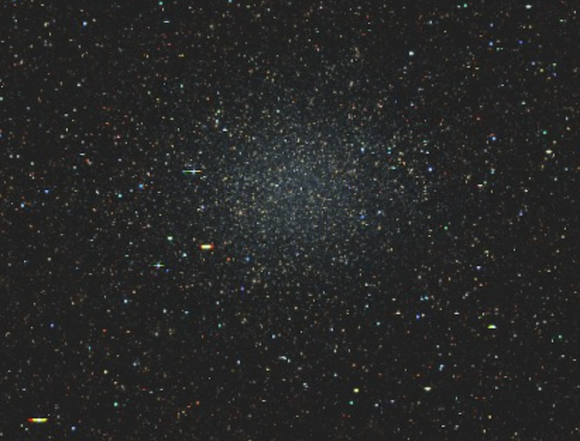
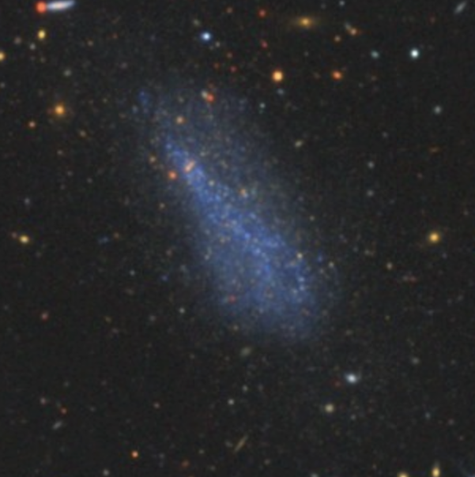
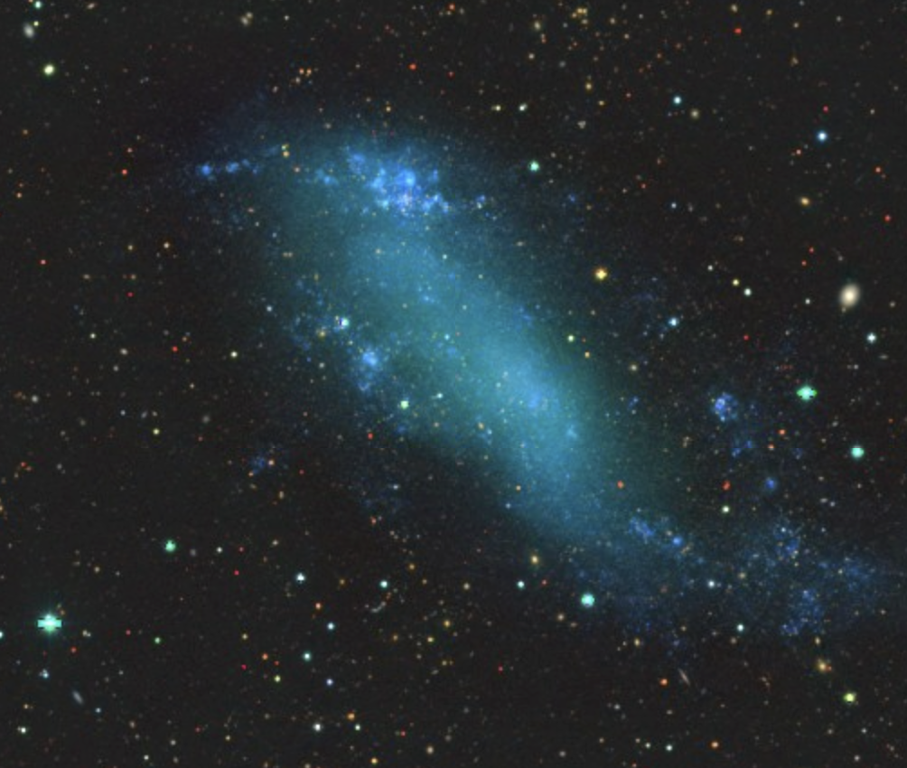

Using the structural properties of galaxies to constrain dark matter
Sculptor
$Σ_{\left\{∗, gas,your favorite waveband\right\}}\left(\vec{R}\right)$
  Often summarized w/parametrized fits and an effective radius
  Colors/color profiles
${\vec{v}}_{\left\{LOS of stars or gas\right\}}(\vec{R})$
  (often summarized w/v_{circ}( R) or $σ_{∗}\left(R\right))$
$Z_{\left\{∗,gas\right\}}(\vec{R})$
DESI Legacy Imaging Surveys
DDO 6
IC 2574
Notes:
We will hear more tomorrow from Jorge

Slide 3
Example: velocity function for MW satellites
Isotropic, velocity-independent self-interacting dark matter
Semi-empirical model (similar in spirit to what Francis-Yan and Soumyodipta presented yesterday)
*identical stellar mass functions*
Completeness corrections
Models
Kim & Peter 2021

Slide 4
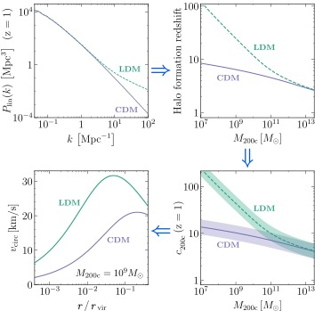

Example: correlation between R_{e} and $σ_{∗}$ (MW satellites)
Esteban, Peter, Kim 2024

Slide 5
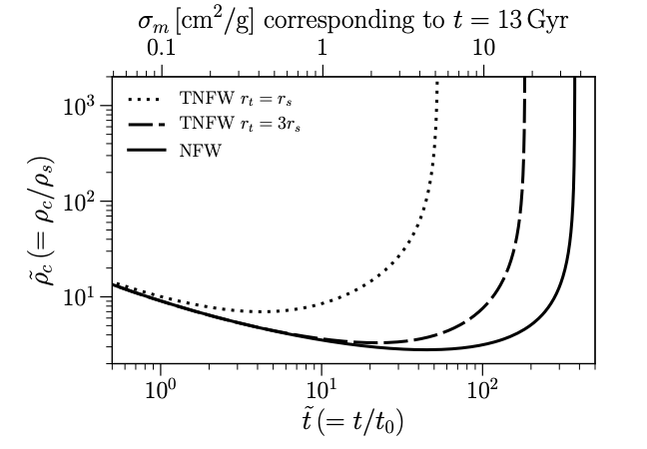
We are all very excited about core collapse
How can we learn about core collapse from visible baryons?
Nishikawa, Boddy, Kaplinghat 2020

Slide 6
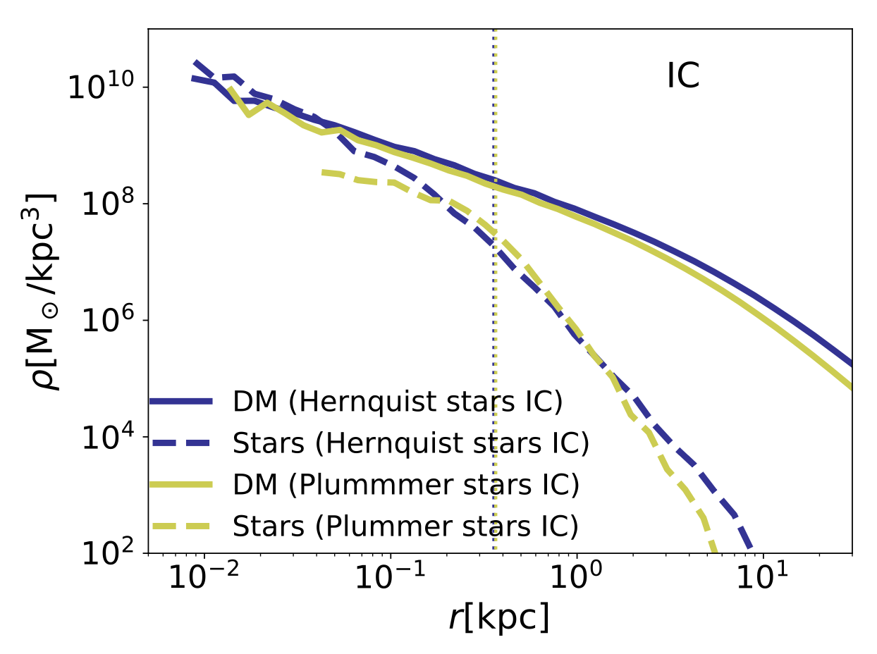
Staged simulations
Zeng+ 2412.14621
Fornax-mass dwarf (inspiration was the “galaxies without dark matter”), initialized with properties consistent w/M*-M_{h} and size-mass relations
Stars are dynamically important
10⁷ particles, star and DM particles have the same mass
Galaxy is either isolated, or on one of four, ever more eccentric, orbits in a group-scale system
Full evaporation modeling!
https://www.youtube.com/watch?v=4kOeuhtVzhc
Notes:
Carton is now a postdoc at TAMU. We drew inspiration from Jorge’s papers from ~15 years go. Used both Hernquist and Plummer ICs for the stars (note issue w/initial conditions for Plummer) because massive dwarfs and lower mass ones can have different stellar distributions

Slide 7
Simulation parameters determined by convergence tests*
Mace+ 2025a
Notes:
*means that we tested these for isolated halos, but we don’t know what works for subhalos, and Frank has given us reasons to be cautious.

Slide 8

Takeaways:

Slide 9
1. Galaxy size tracks core collapse*

Slide 10
1. Galaxy size tracks core collapse*
*Except when it doesn’t

Slide 11
2. Evaporation matters
Depends on cross section model, orbits, etc. especially on the evaporation end.

Slide 12
3. …BUT galaxies follow tracks

Slide 13
4. Only cuspy galaxies with initially small M/L can yield dark matter-free galaxies for any length of time
Plummer
Hernquist
Can form DM-free galaxies w/Plummer stellar profiles under some conditions, but it’s a transient state.

Slide 14
Open questions
What is the interplay between core collapse and the physics of star formation and feedback?
Can dark matter affect the multiplicity of stellar systems? (Jorge P)
How to compare field vs. satellite objects?

