Slide 1

Creating empirical dark matter halo profiles with Symbolic Regression
Tariq Yasin
tariq.yasin@physics.ox.ac.uk
University of Oxford
w/ Alicia Martin, Deaglan Bartlett, Harry Desmond, Pedro Ferreira

Slide 2
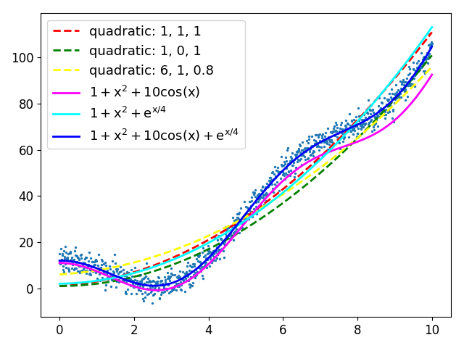
Symbolic Regression overview
Numerical regression: y = 6 + 1x + 0.8x²
Symbolic regression: y = 1 + x² + 10cos(x) + e^{x/4}
Discover functions describing a dataset rather than parameters of predefined function

Slide 3
Symbolic Regression overview
Numerical regression: y = 6 + 1x + 0.8x²
Symbolic regression: y = 1 + x² + 10cos(x) + e^{x/4}
Discover functions describing a dataset rather than parameters of predefined function

Slide 4
Symbolic Regression overview
Numerical regression: y = 6 + 1x + 0.8x²
Symbolic regression: y = 1 + x² + 10cos(x) + e^{x/4}
Discover functions describing a dataset rather than parameters of predefined function
Difficulties:
Larger search space makes convergence harder
Optimisation methods of numerical regression not applicable
Advantages:
Much more general (reduces confirmation bias)
Easy to prevent overfitting
Highly interpretable

Slide 5
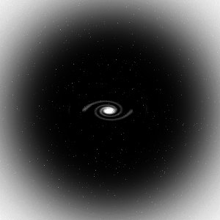
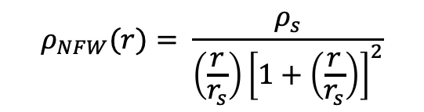
Dark matter haloes
Dark matter forms massive clumps called “haloes”
Normal matter falls to centre – forming galaxies
Approximately spherical
Standard dark matter model:
$$ρ_{NFW}(r)= \frac{ρ_{s}}{\left(\frac{r}{r_{s}}\right){\left[1+\left(\frac{r}{r_{s}}\right)\right]}^{2}}$$
Notes:
In the modern picture of structure forma- tion, galaxies form at the center of extended, overdense ‘ha- los’ of dark matter, which originate from small fluctuations in the density of matter in the early Universe

Slide 6
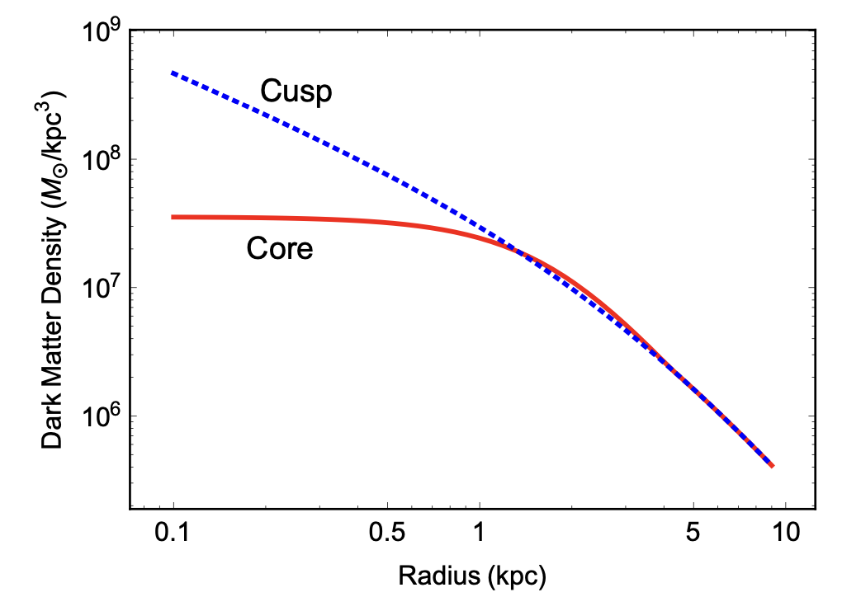
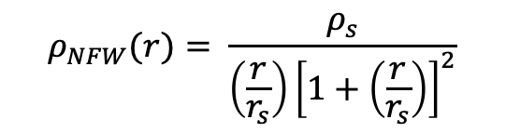
Testing dark matter
Dark matter forms halos ~ spherical clumps
Usual approach: fit theoretical profiles to dynamics/lensing data.
Problems:
Which dark matter model?
Impact of normal matter
Cores – evidence NFW inadequate
$$ρ_{NFW}(r)= \frac{ρ_{s}}{\left(\frac{r}{r_{s}}\right){\left[1+\left(\frac{r}{r_{s}}\right)\right]}^{2}}$$
Galaxy DD0 154 – Tulin and Yu (2017)

Slide 7
Symbolic regression for DM halo profiles
Aims:
Learn equations of fundamental physics
Learn new empirical laws
DM profiles with maximum empirical accuracy

Slide 8
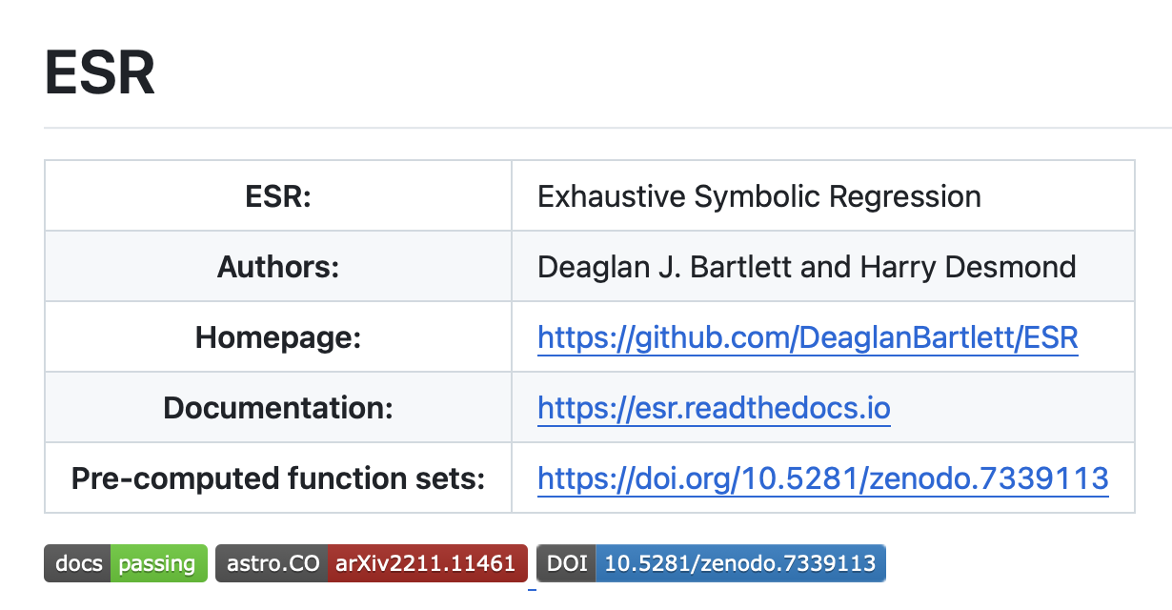
Exhaustive Symbolic Regression (ESR)
Learns analytic expressions which fit data accurately
Interpretable
Clear extrapolation
Generating functions
D.J. Bartlett, H. Desmond, P. Ferreira , Exhaustive Symbolic Regression,2023, arXiv:2211.11461, 2022
Notes:
By searching for simple, analytic descriptions of the data, the advantage of SR algorithms over traditional machine learn- ing methods is their interpretability and clear (although not necessarily accurate) extrapolation behaviour when employed on data outside the range of the training set. A potentially more important, yet more optimistic, goal of SR is to uncover “physical laws” from data, which are necessarily analytic

Slide 9
Exhaustive Symbolic Regression (ESR)
Learns analytic expressions which fit data accurately
Interpretable
Clear extrapolation
Two main steps to Symbolic Regression
Generating functions
Selecting the best functions
Notes:
By searching for simple, analytic descriptions of the data, the advantage of SR algorithms over traditional machine learn- ing methods is their interpretability and clear (although not necessarily accurate) extrapolation behaviour when employed on data outside the range of the training set. A potentially more important, yet more optimistic, goal of SR is to uncover “physical laws” from data, which are necessarily analytic

Slide 10
Generating functions
Complexity 6
$$+$$
$$f\left(x\right)=ax+ \log{x}$$
$$×$$
$$log$$
$$a$$
$$x$$
$$x$$
Parameters: $a, x$
Unary: log, exp, inv, sqrt, square, cube
Binary: $+$, $×$, pow
ESR explicitly considers every possible combination of operators

Slide 11

Selecting the best function
Accuracy
Simplicity
Minimum Description Length
Description length: Fewest units of information are needed to communicate the data
$$L\left(D\right)=L\left(H\right)+L(D|H)$$
penalises complex hypotheses
residuals: how well the function fits the data
Functional part
Parameter part

Slide 12
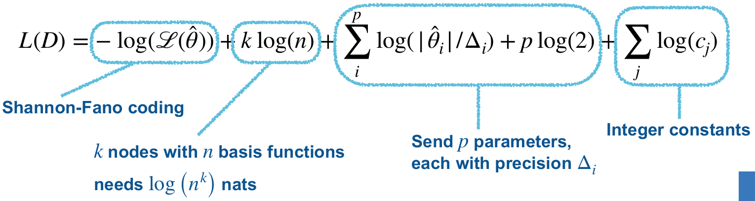
Selecting the best function
Accuracy
Simplicity
Minimum Description Length
Description length: Fewest units of information are needed to communicate the data
$$L\left(D\right)=L\left(H\right)+L(D|H)$$

Slide 13
Which data constrains dark matter halo profiles?
Galaxy dynamics
Lensing

Slide 14
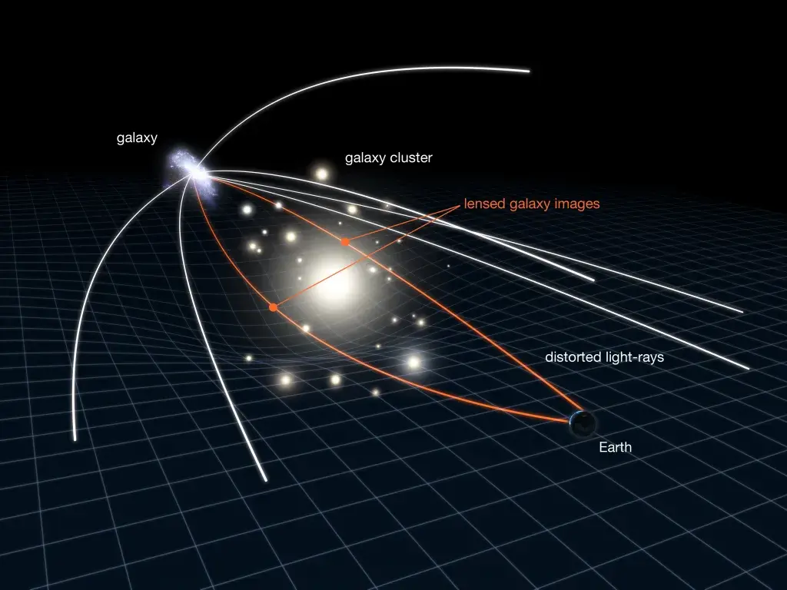
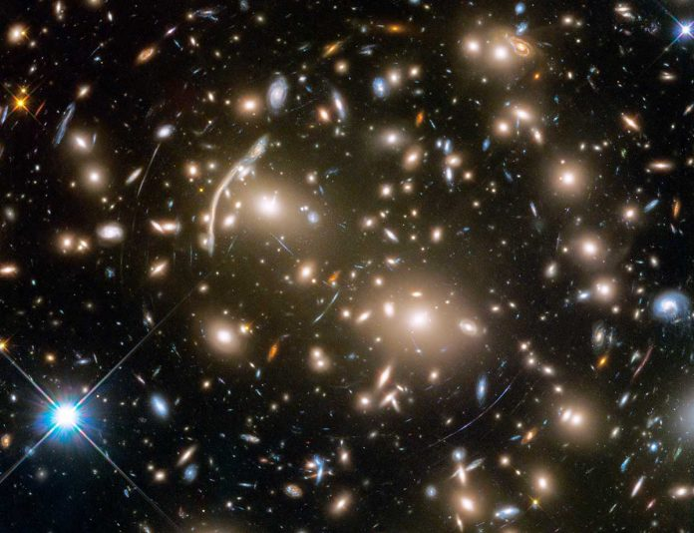
Measure dark matter distribution with gravitational lensing
Light from background galaxies bent by gravity
Amount of bending scales with foreground mass

Slide 15
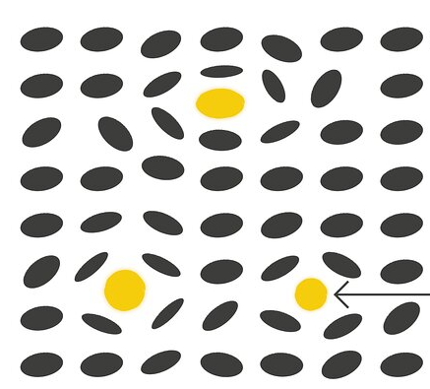


Weak lensing data
Background galaxies
Observable: Excess surface density (ESD)
HSC lensing data around 150 X-ray selected galaxy clusters (Umetsu 2019)
Convert galaxy shapes data to ESD
Lensing clusters
Notes:
It might be interesting to apply
The tiny distortions in background galaxy shapes, sizes, and fluxes due to the deflection by mass in more nearby objects,
Due to its sensitivity to all mass, the detorsion of the galaxy shape, the shear, it provides a more direct measurement of the total mass distribution that can be used to study the dark matter
Shear measurements can be converted to a excess surface density – that quantifies the difference between the mass density within a radius R and the mass density at radius R.
I’m going to show an example, more of a proof of concept, of applying the same method to weak lensing data from the HSC around an X-ray clusters.

Slide 16
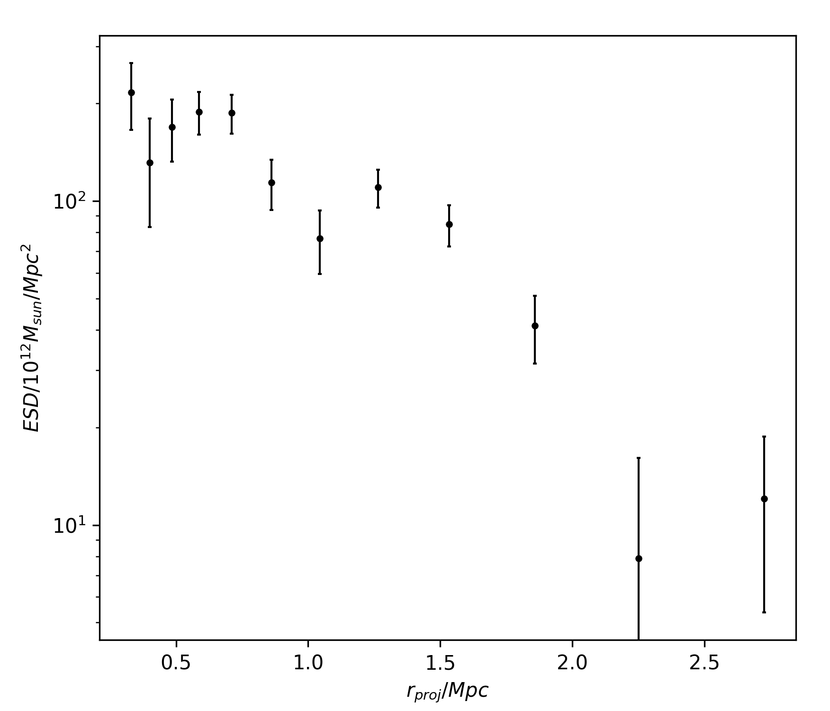
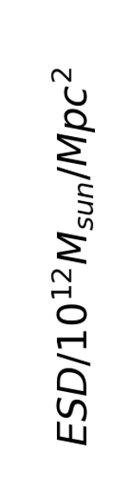

Weak lensing data
Observable: Excess surface density (ESD)
HSC lensing data around 150 X-ray selected galaxy clusters
Convert galaxy shapes data to ESD

Slide 17
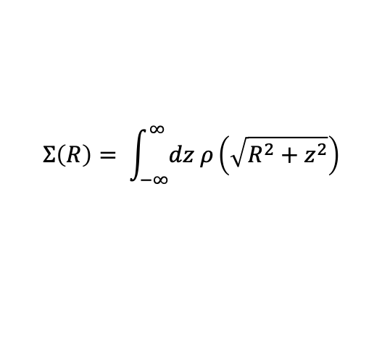

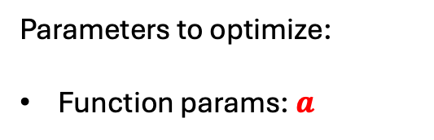
Weak lensing: forward model
Generating functions
DM halo density profiles
Excess surface density (ESD)
$$ρ_{DM}\left(r\right)=ar+\log{r}$$
$$Σ\left(R\right)= \int_{−∞}^{∞}{dz ρ\left(\sqrt{R^{2}+z^{2}}\right)}$$
Parameters to optimize:
Function params:$a$

Slide 18









Local and global parameters
2 global parameters
1 local, 1 global parameter
2 local parameters
Cluster 1
$$ρ_{DM}\left(r\right)=a r+b\log{r}$$
$$ρ_{DM1}\left(r\right)=a r+b1\log{r}$$
$$ρ_{DM1}\left(r\right)=a1 r+b1\log{r}$$
Cluster 2
$$ρ_{DM}\left(r\right)=a r+b\log{r}$$
$$ρ_{DM2}\left(r\right)=a r+b2\log{r}$$
$$ρ_{DM2}\left(r\right)=a2 r+b2\log{r}$$
.....
.....
.....
.....
Cluster 150
$$ρ_{DM}\left(r\right)=a r+b\log{r}$$
$$ρ_{DM150}\left(r\right)=a r+b150\log{r}$$
$$ρ_{DM150}\left(r\right)=a150 r+b150\log{r}$$
For mix of local and global: optimise all local independently at each step of global optimisation
Notes:
Need to see how much I need to cut this section

Slide 19
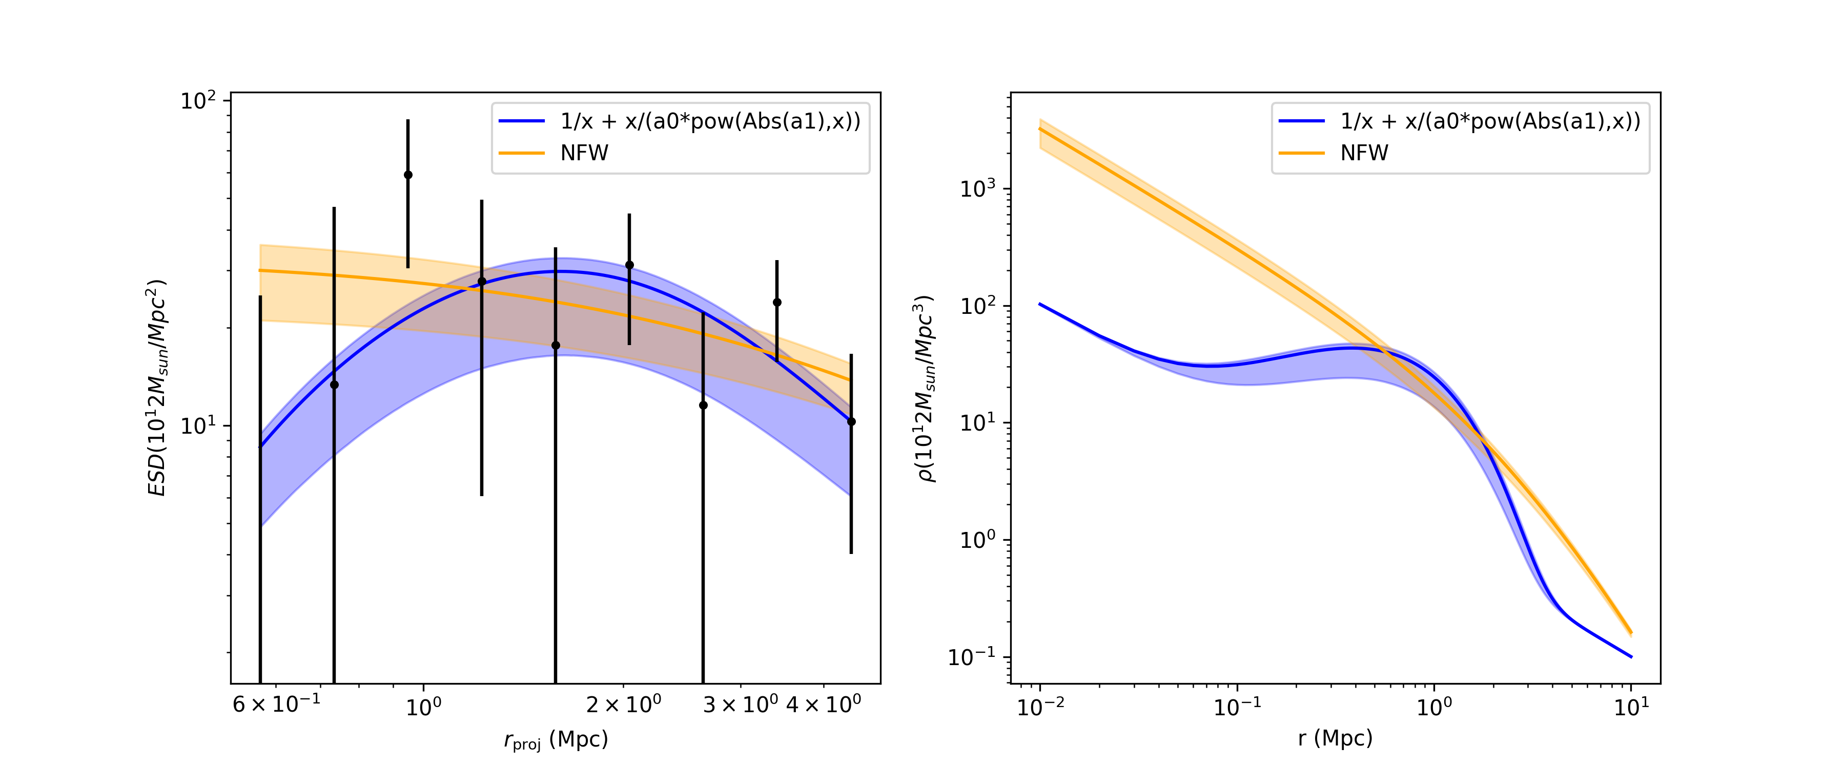
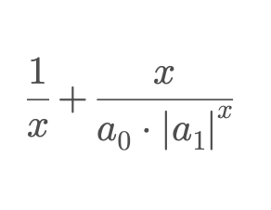

Weak lensing fits
ESD profile
Density profiles
Notes:
Put both axis in log?

Slide 20
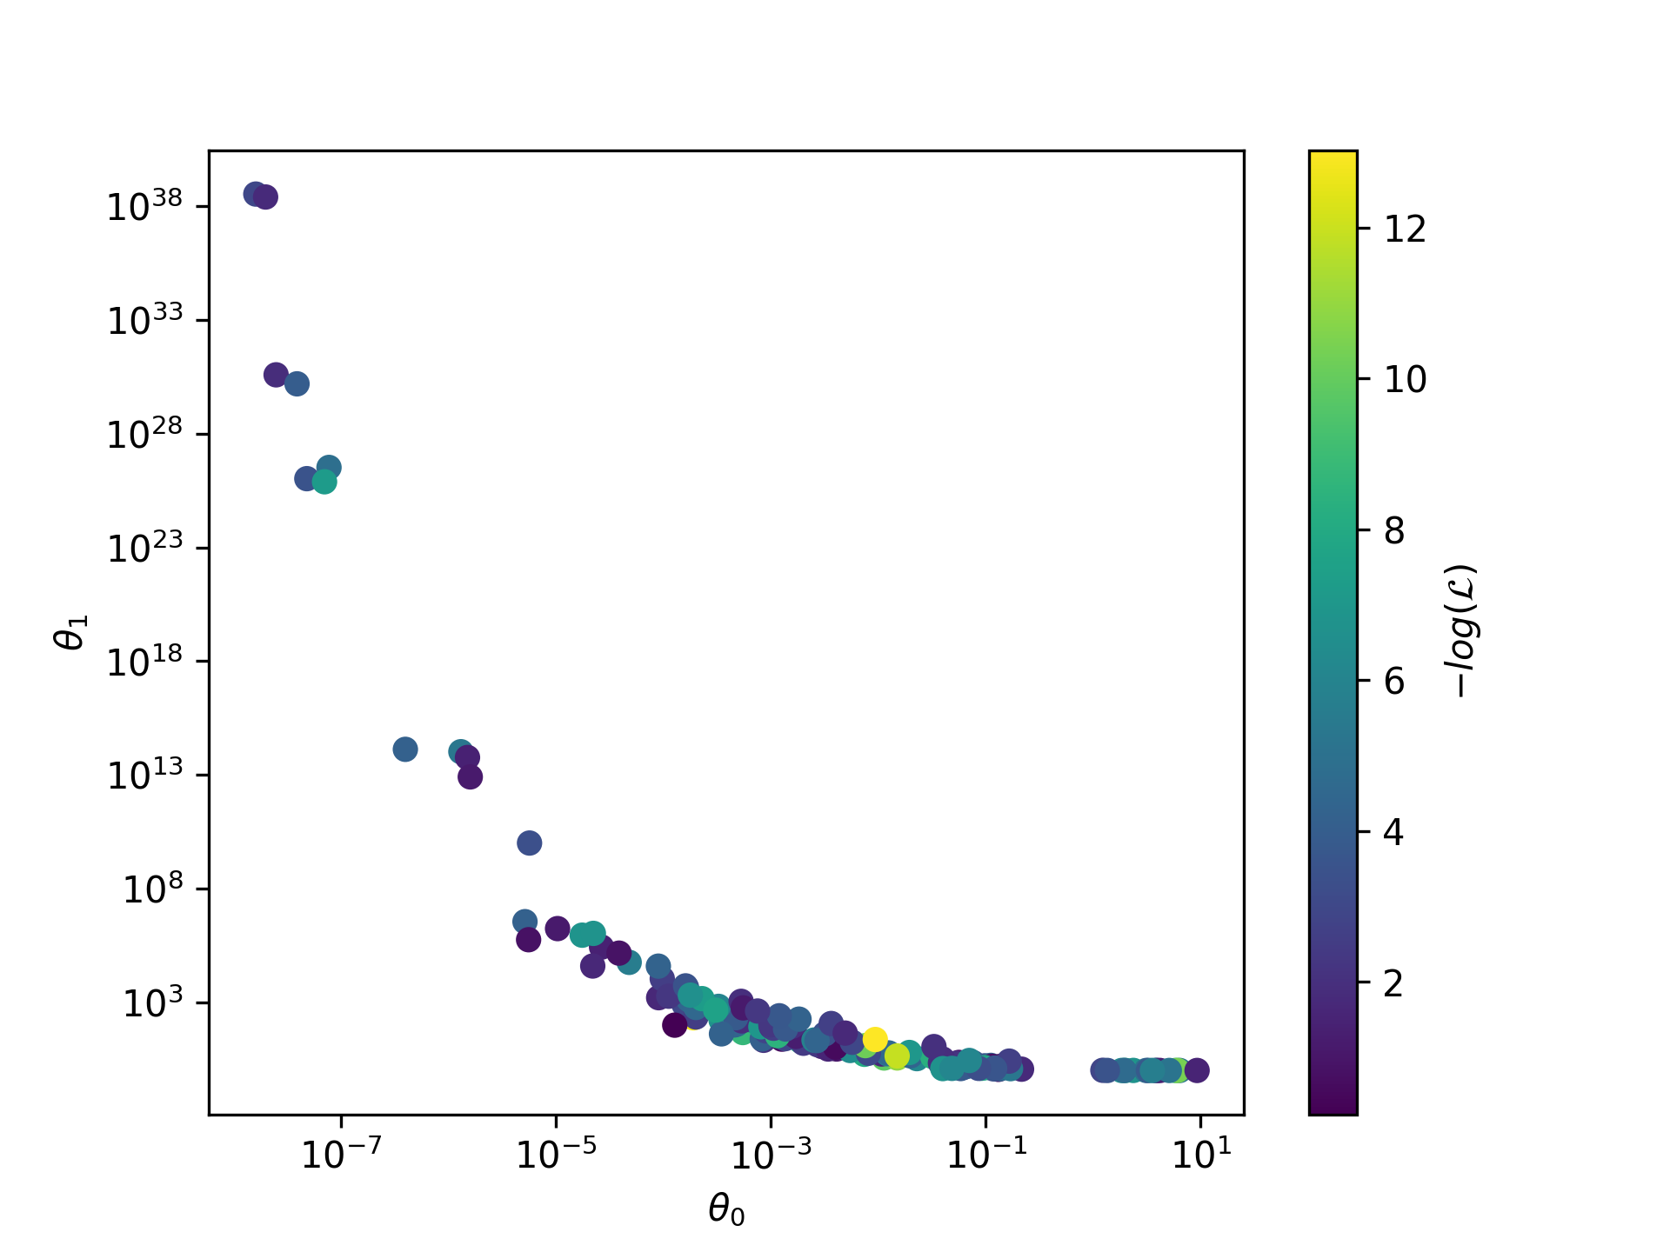
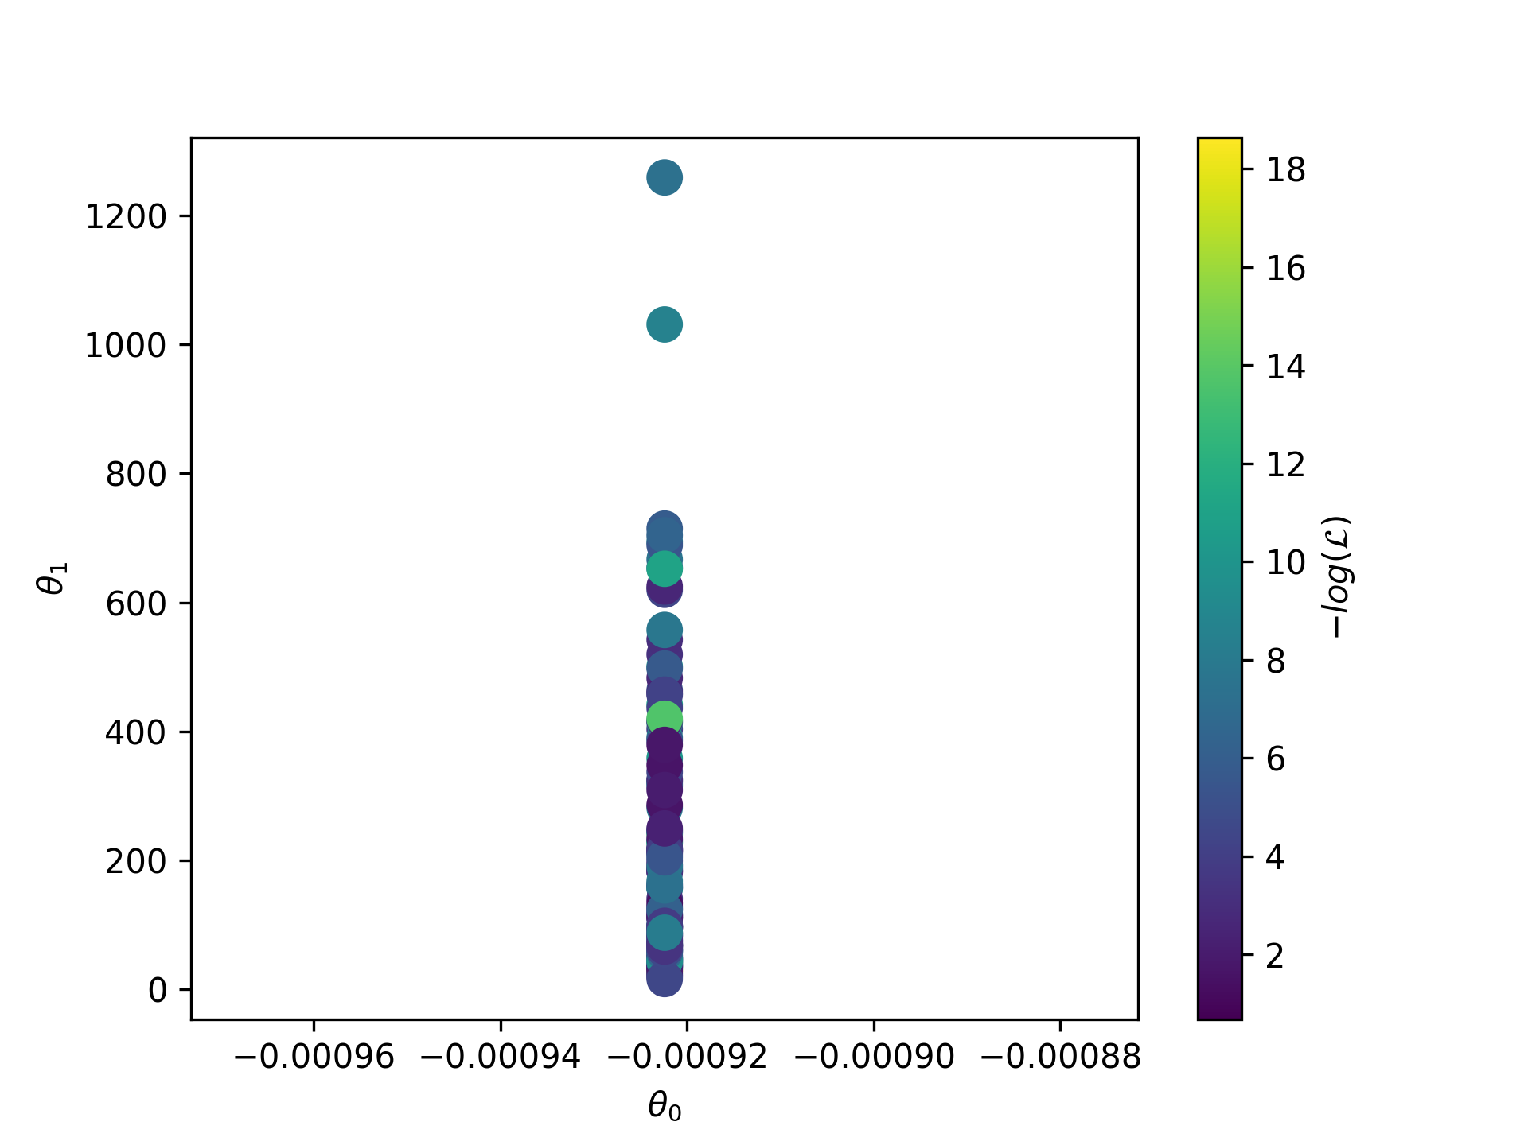
Optimised parameters for
2 local parameters
1 local, 1 global parameter
Parameter 2
Parameter 2
Parameter 1
Parameter 1
DL = 853 nats
DL = 911 nats
Notes:
Put both axis in log?

Slide 21
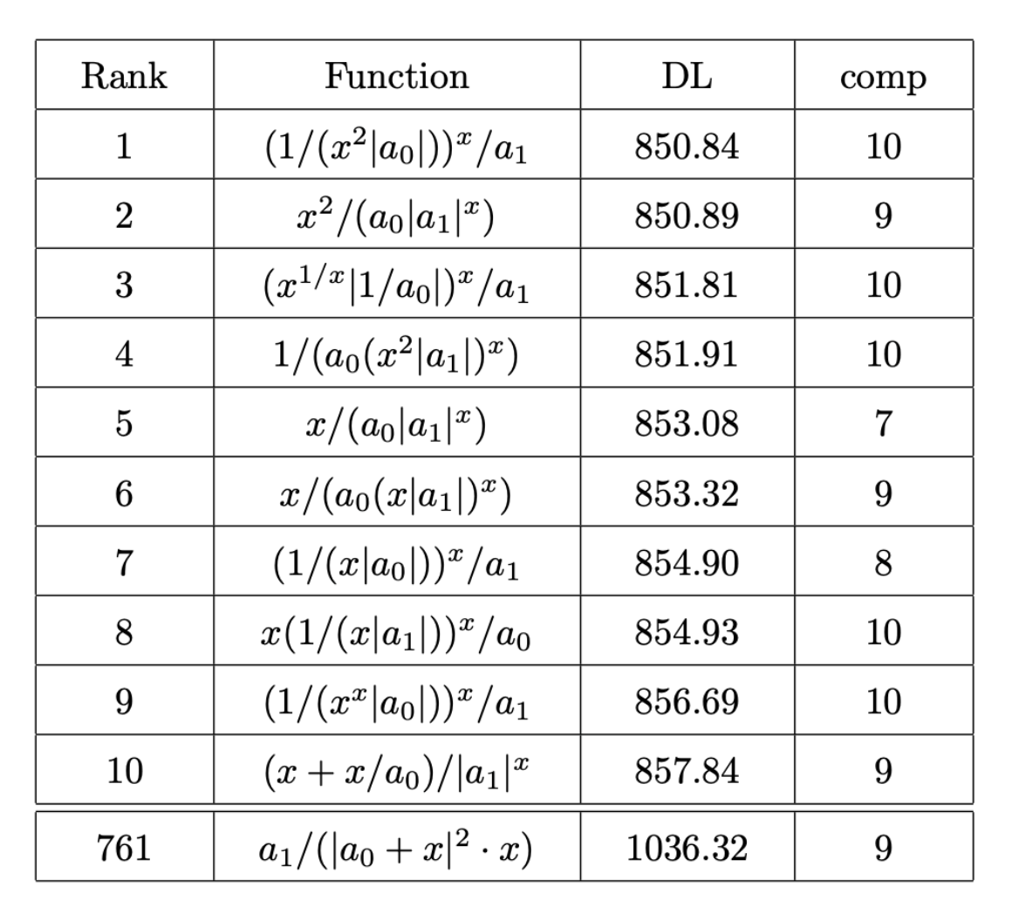
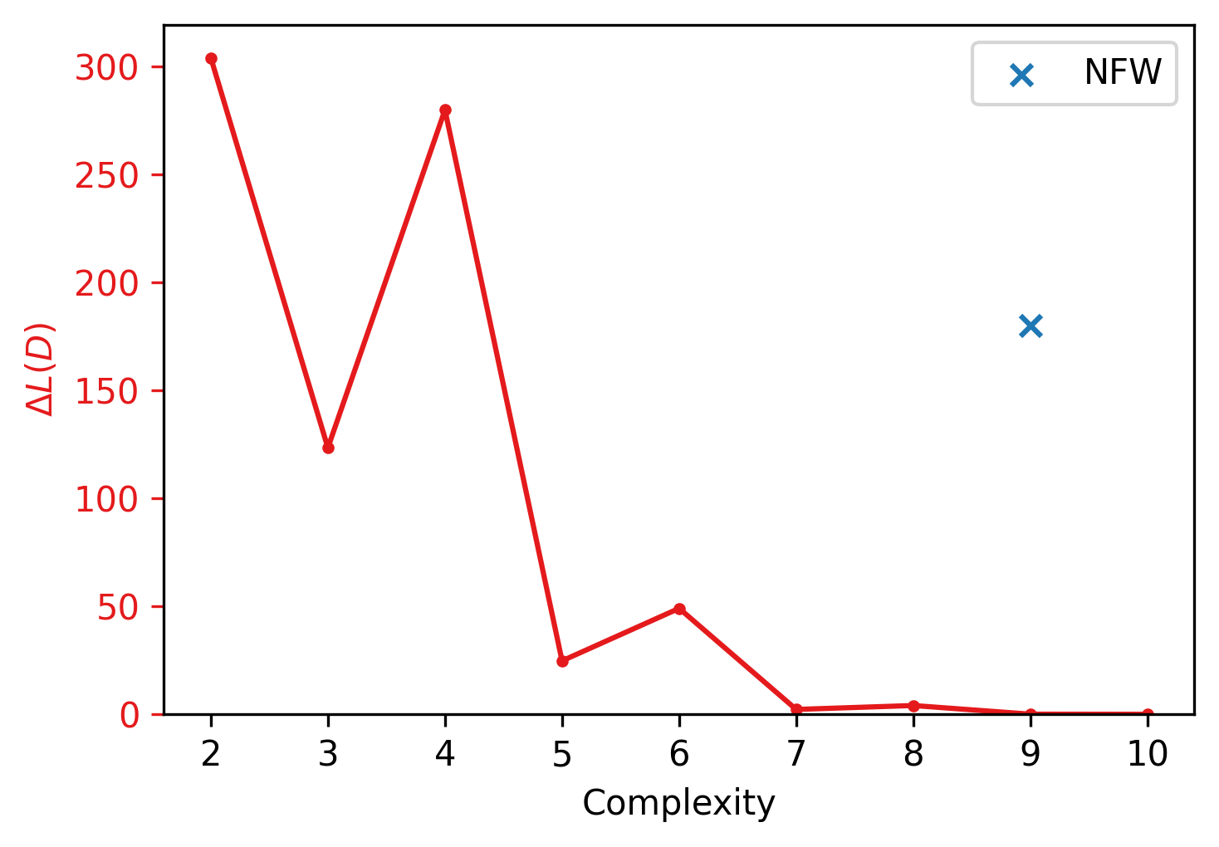
Results
NFW
Notes:
Need to see how much I need to cut this section

Slide 22
Results
NFW
Kamada et. al 2016 hybrid ISO/NFW profile 912.33 16
Notes:
Need to see how much I need to cut this section

Slide 23
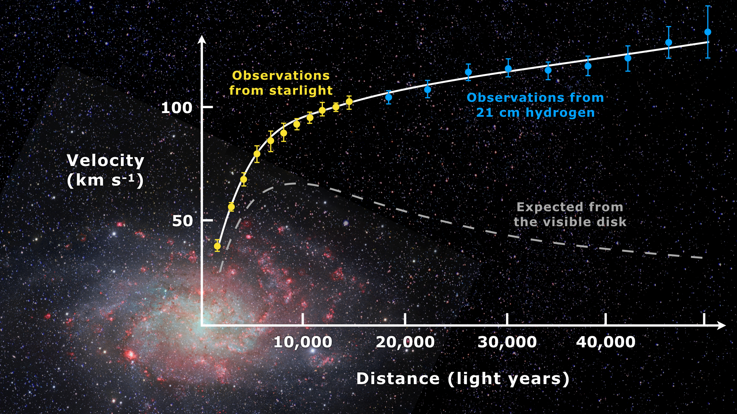

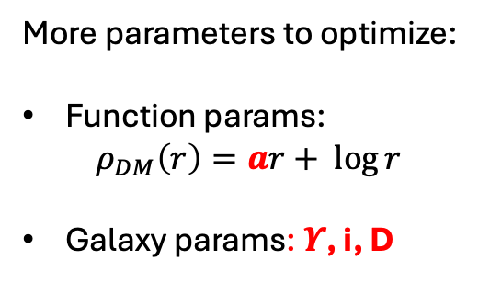

Ongoing work: galaxy dynamics
DM halo density profiles
$$ρ_{DM}\left(r\right)=ar+ \log{r}$$
Observable: Rotational velocity ${vobs}^{ }$
$$v_{Normal}^{2}\left(r\right)=D\sin\left(i\right)\left({Υ_{disc}v}_{disc}^{2}\left(r\right)\text{ + }{Υ_{bulge}v}_{bulge}^{2}\left(r\right)\text{ + }{Υ_{gas}v}_{gas}^{2}\left(r\right)\right)$$
$${vobs}^{2}\left(r\right)=v_{DM}^{2}\left(r\right)+v_{Normal}^{2}\left(r\right)$$
More parameters to optimize:
Function params:
$$ρ_{DM}\left(r\right)=ar+ \log{r}$$
Galaxy params: $Υ$, i, D

Slide 24
Conclusions
Applied Exhaustive Symbolic Regression algorithm to dark matter profiles
Found superior functions to NFW for HSC clusters
Now applying to Hubble CLASH WL data + SPARC
Introduction

