Slide 1
Is the dark substructure in lens J0946+1006 a core-collapsed SIDM subhalo?
Quinn E. Minor
CUNY Borough of Manhattan Community College
American Museum of Natural History

Slide 2
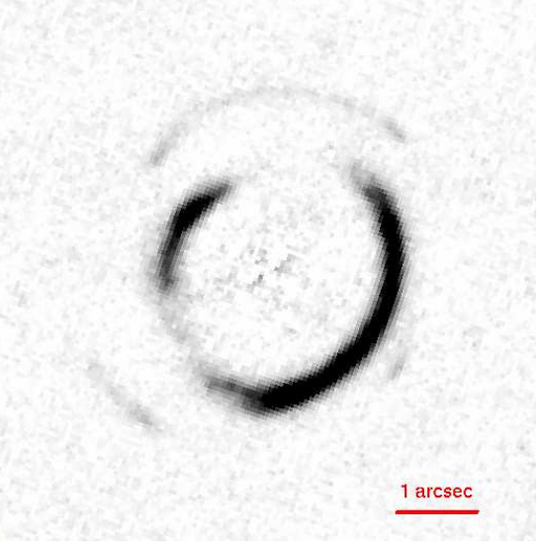
Lens SDSSJ0946+1005
Nicknamed “Jackpot” due to having two strongly lensed source galaxies…now a third! (Collett & Smith 2020)
The first lensing galaxy for which an individual “dark” substructure was detected (Vegetti et al. 2010)
z_{lens}=0.222, z_{src1}=0.609
HST ACS/F814W image (Gavazzi et al. 2008)

Slide 3
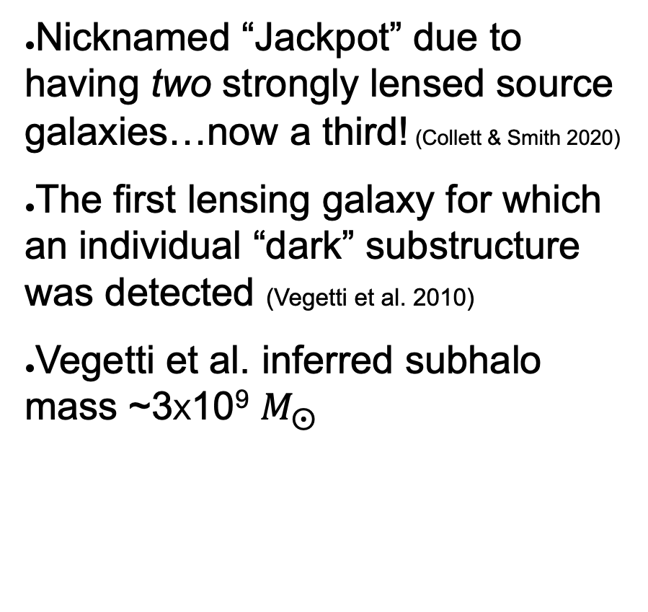
Lens SDSSJ0946+1005
Nicknamed “Jackpot” due to having two strongly lensed source galaxies…now a third! (Collett & Smith 2020)
The first lensing galaxy for which an individual “dark” substructure was detected (Vegetti et al. 2010)
Vegetti et al. inferred subhalo mass ~3X10⁹ $M_{⨀}$
z_{lens}=0.222, z_{src1}=0.609
HST ACS/F814W image (Gavazzi et al. 2008)

Slide 4
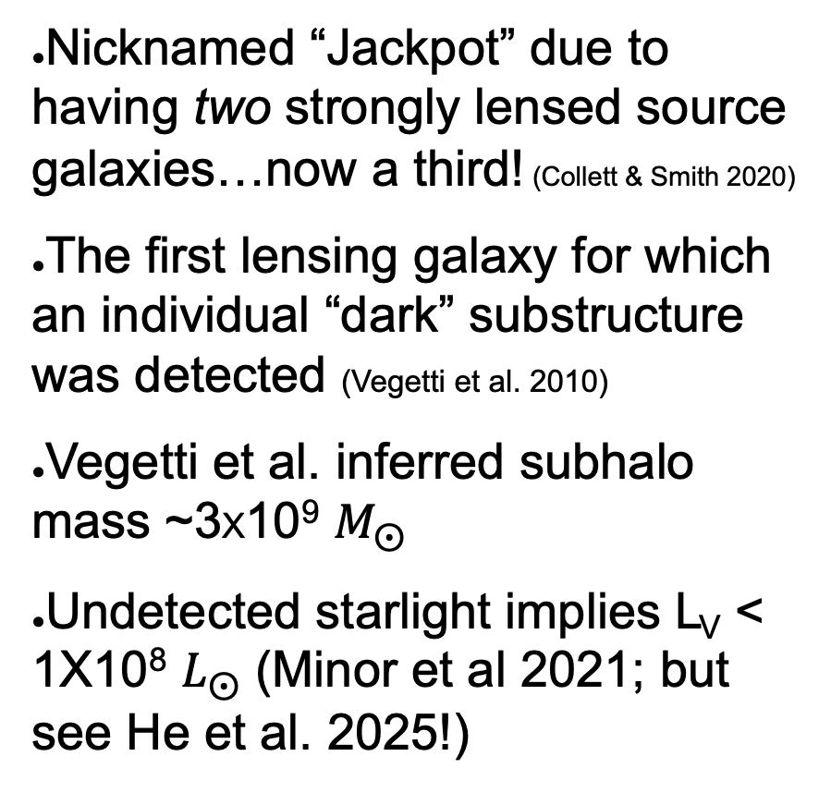
Lens SDSSJ0946+1005
Nicknamed “Jackpot” due to having two strongly lensed source galaxies…now a third! (Collett & Smith 2020)
The first lensing galaxy for which an individual “dark” substructure was detected (Vegetti et al. 2010)
Vegetti et al. inferred subhalo mass ~3X10⁹ $M_{⨀}$
Undetected starlight implies L_{V} < 1X10⁸ $L_{⨀}$ (Minor et al 2021; but see He et al. 2025!)
z_{lens}=0.222, z_{src1}=0.609
HST ACS/F814W image (Gavazzi et al. 2008)

Slide 5
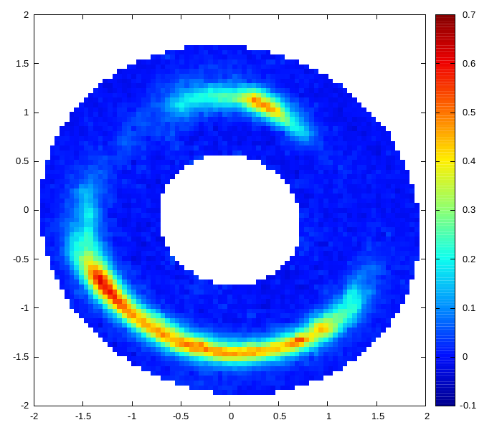
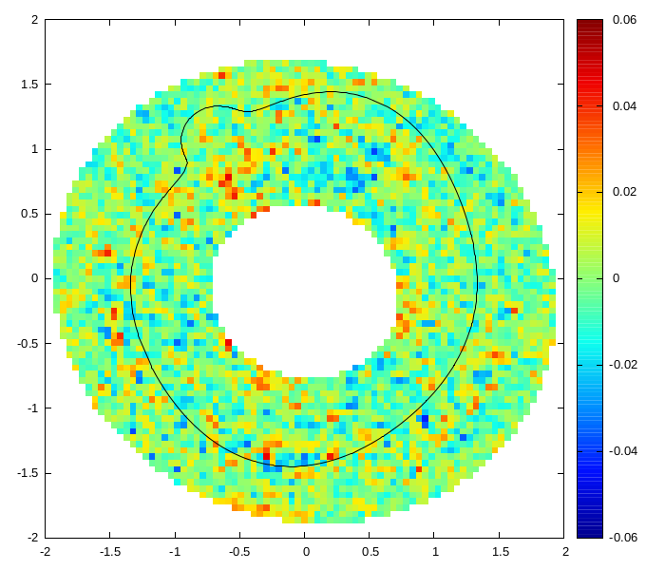
Best-fit model from 2021
y (arcsec)
Reconstructed source
x (arcsec)
Masked HST/ACS image
Subhalo detected in same location as Vegetti et al. 2010
Residuals

Slide 6
- Inferred subhalo concentration is well above those allowed for field halos in DM-only simulations
- Also higher than c₂₀₀ formally defined for subhalos (Moline et al 2017)

Slide 7

What can be learned from lensing perturbations?
Projected mass within perturbation radius of subhalo can be robustly determined (if subhalo position, host galaxy parameters are well constrained; Minor et al. 2017)
Minor et al. (2021)

Slide 8
What can be learned from lensing perturbations?
Perturbation radius defined by critical curve
Projected mass within perturbation radius of subhalo can be robustly determined (if subhalo position, host galaxy parameters are well constrained; Minor et al. 2017)
The subhalo’s robust mass within 1 kpc is ~ 2-3X10⁹ M_{sun} if main lens is assumed to be elliptical
Minor et al. (2021)

Slide 9
More recent lensing analyses have “filled out” the region around constant M_{2D}(1kpc)
Enzi et al. (2024)

Slide 10
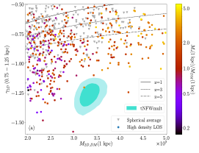
Subhalos in Illustris-TNG100 simulation: are any of them dense and dark enough?
Subhalos that achieve steep enough slopes have high baryon fractions (>0.5), indicating adiabatic contraction & tidal stripping is required

Slide 11
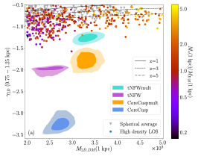
Subhalos in Illustris-TNG100 simulation: are any of them dense and dark enough?
Subhalos that achieve steep enough slopes have high baryon fractions (>0.5), indicating adiabatic contraction & tidal stripping is required
New constraints

Slide 12
Subhalos in Illustris-TNG100 simulation: are any of them dense and dark enough?
Subhalos that achieve steep enough slopes have high baryon fractions (>0.5), indicating adiabatic contraction & tidal stripping is required
More recently, Despali et al (2024) redid this with TNG50; more subhalos with steep slopes, but M*/M_{DM} still way too high
Despali et al (2024)

Slide 13
Subhalos in Illustris-TNG100 simulation: are any of them dense and dark enough?
Subhalos that achieve steep enough slopes have high baryon fractions (>0.5), indicating adiabatic contraction & tidal stripping is required
More recently, Despali et al (2024) redid this with TNG50; more subhalos with steep slopes, but M*/M_{DM} still way too high
New constraints
Despali et al (2024)

Slide 14
But wait…is the subhalo even real?
Ballard et al. (2023) showed that a good fit can be obtained without a subhalo…if the source is allowed to be “noisy” enough

Slide 15
But wait…is the subhalo even real?
Ballard et al. (2023) showed that a good fit can be obtained without a subhalo…if the source is allowed to be “noisy” enough
They also showed subhalo concentration is more consistent with CDM (with multipoles added)

Slide 16
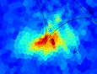




Supersampling of image pixels
Supersampling: image pixels are split into subpixels, ray-traced to source plane, and surface brightness found by interpolation
Image pixel (3x3 splitting)

Slide 17
Supersampling of image pixels
Supersampling: image pixels are split into subpixels, ray-traced to source plane, and surface brightness found by interpolation
Subpixel SB’s are then averaged to get the image pixel surface brightness (before PSF convolution)
Image pixel (3x3 splitting)

Slide 18
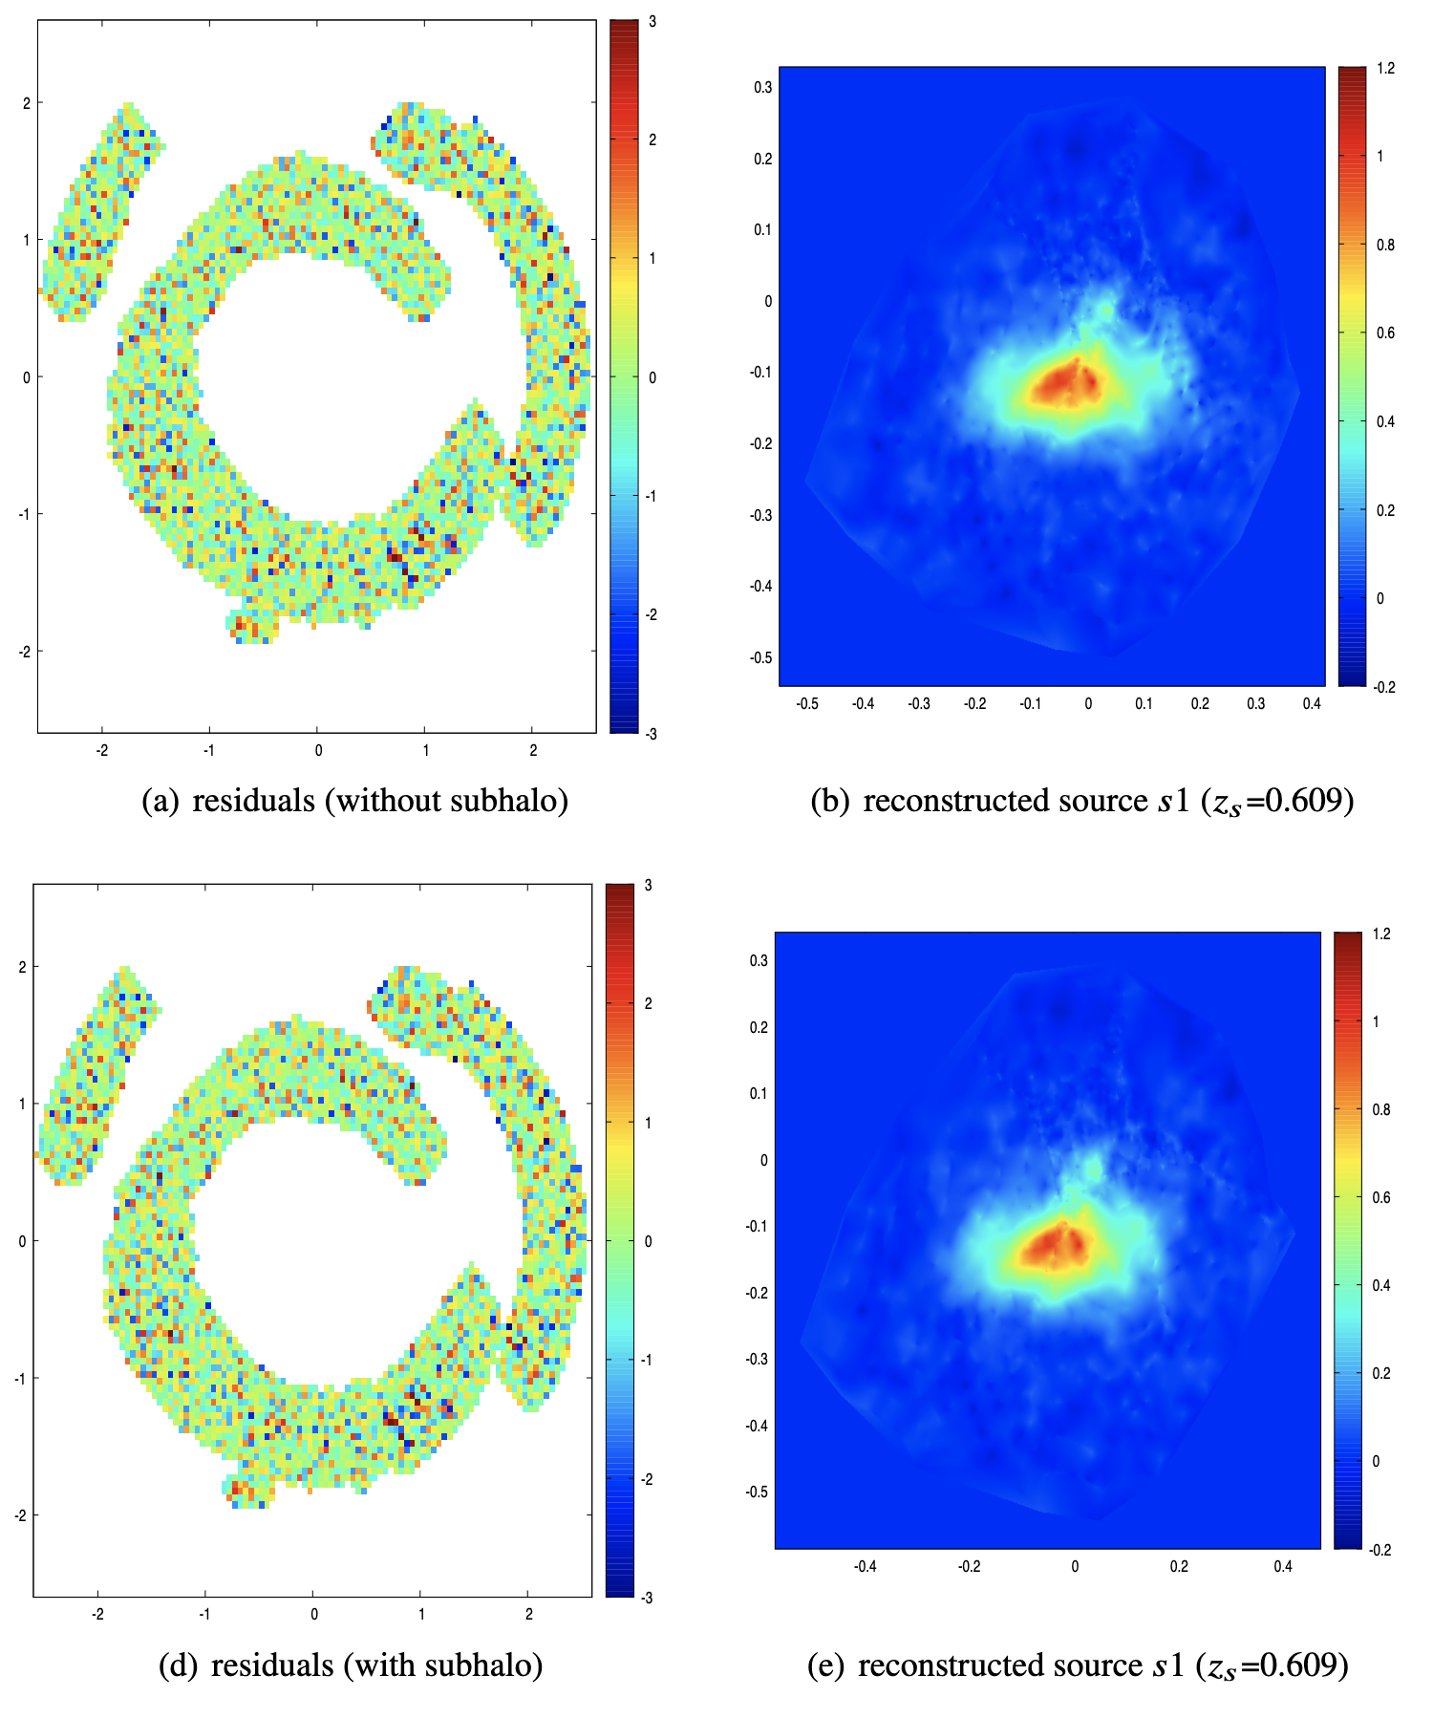
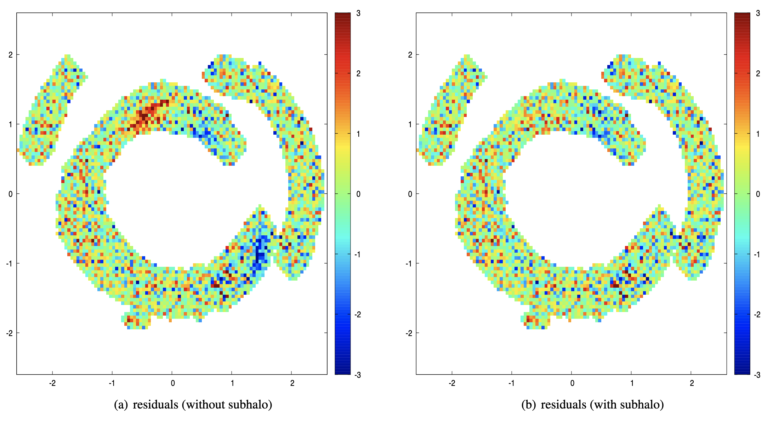
If supersampling is not used, noise-level residuals can be achieved without a substructure
If supersampling is turned on, strong residuals appear near purported substructure and its counterimage
Image pixel (3x3 splitting)

Slide 19
If supersampling is not used, noise-level residuals can be achieved without a substructure
If supersampling is turned on, strong residuals appear near purported substructure and its counterimage
In the fit with subhalo included, residuals remain below noise level in those regions

Slide 20
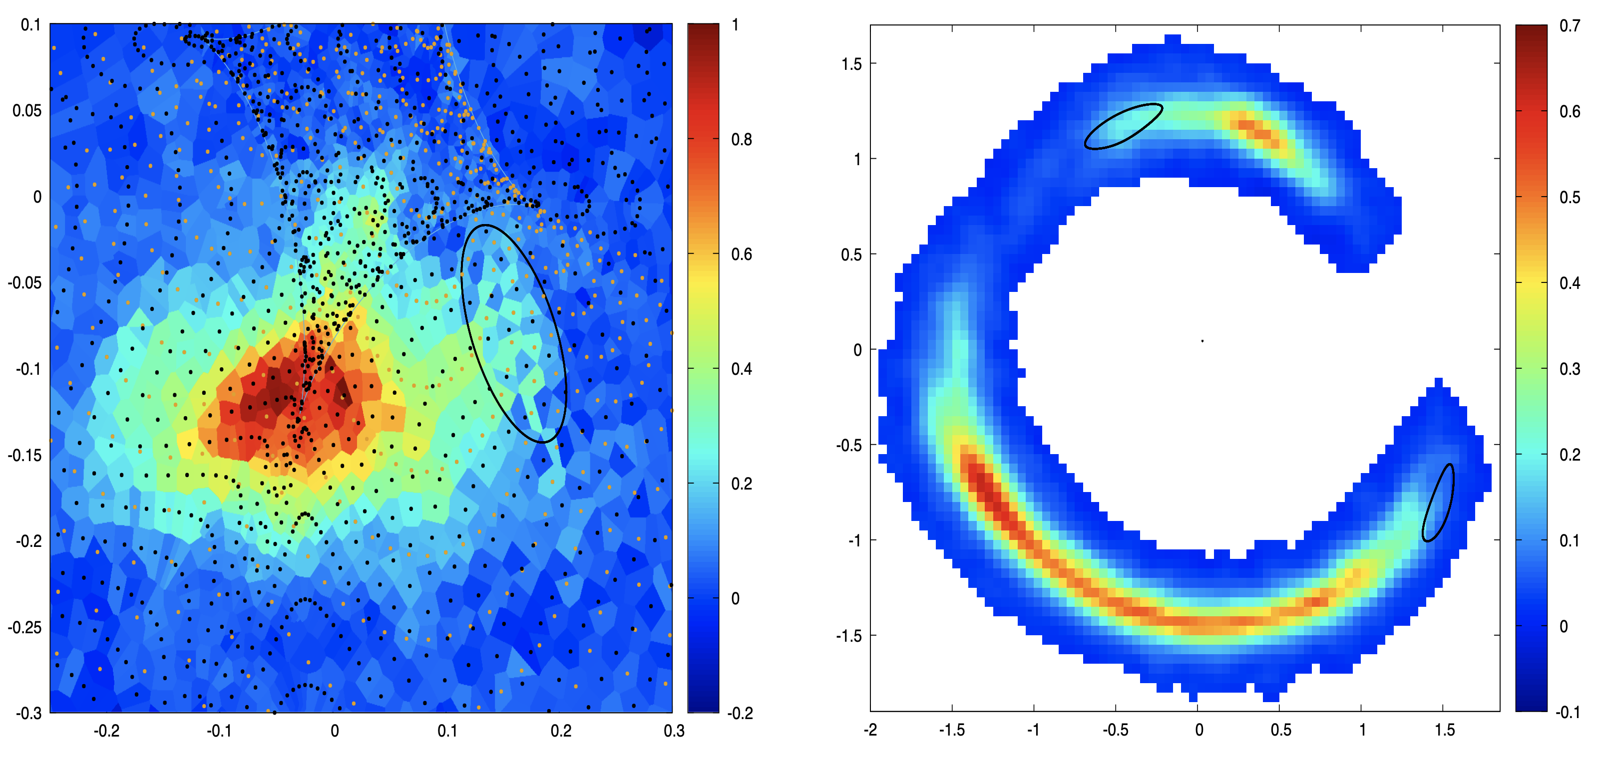
The “checkerboarding effect”: bright pixels map to top image, the other pixels map to bottom image

Slide 21
The “checkerboarding effect”: bright pixels map to top image, the other pixels map to bottom image
Supersampling does not allow this solution, since subpixels are interpolated and averaged together

Slide 22
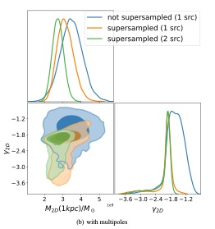
Supersampling also reduces the allowed parameter space, by eliminating inconsistent solutions (modeling both sources also helps).

Slide 23
Density slope constraint is model-dependent
The 2d density slope around 1kpc is highly dependent on the subhalo model

Slide 24
Density slope constraint is model-dependent
The 2d density slope around 1kpc is highly dependent on the subhalo model
The "corecusp” model with variable inner slope prefers much steeper slope (down to -4)
The inference could be biased by imperfect foreground subtraction

Slide 25
Can Self-Interacting Dark Matter explain this substructure?
In principle, yes: core collapse can increase central density, produce density slopes ~ -3 (e.g. Turner et al 2021, Gad-Nasr et al 2023)
Nadler et al. (2023)

Slide 26
Can Self-Interacting Dark Matter explain this substructure?
In principle, yes: core collapse can increase central density, produce density slopes ~ -3 (e.g. Turner et al 2021, Gad-Nasr et al 2023)
Nadler et al (2023) performed cosmological N-body simulation, found a couple “matches”
Simulating a larger galaxy group will likely produce more subhalos with required M_{2D}
Nadler et al. (2023)

Slide 27
Comparison to analog SIDM core-collapsed subhalos
Li et al (2025) simulated SIDM halos using semi-analytic modeling (Kaplinghat et al. 2014, Robertson et al 2021)

Slide 28
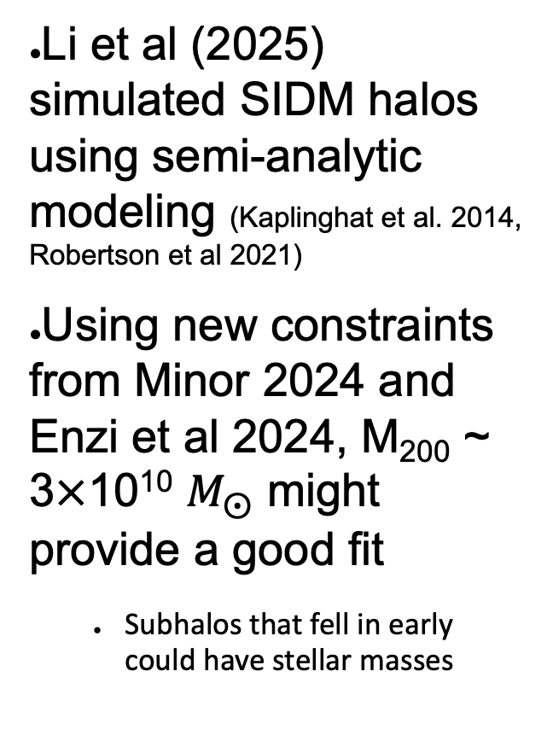
Comparison to analog SIDM core-collapsed subhalos
Li et al (2025) simulated SIDM halos using semi-analytic modeling (Kaplinghat et al. 2014, Robertson et al 2021)
Using new constraints from Minor 2024 and Enzi et al 2024, M₂₀₀ ~ 3$×$10¹⁰ $M_{⨀}$ might provide a good fit
Subhalos that fell in early could have stellar masses

Slide 29
Reasons we (the lens modelers) could be fooling ourselves
The isophotes show a complicated angular structure, indicating recent interaction with neighboring galaxy
The substructure’s position may allow for more degeneracy with overall angular structure (Hsueh et al 2017, Nightingale et al 2022)

Slide 30
Reasons we (the lens modelers) could be fooling ourselves
The isophotes show a complicated angular structure, indicating recent interaction with neighboring galaxy
The substructure’s position may allow for more degeneracy with overall angular structure (Hsueh et al 2017, Nightingale et al 2022)
Could stellar light from the substructure be “mixed in” with the main lensing galaxy light? (He et al, in prep)
Even if the perturber is indeed highly concentrated, could it be a rogue black hole?
JWST observations will most likely allow us to answer these questions

Slide 31
Conclusion
The Jackpot substructure certainly appears to be real
When both lensed sources are modeled and supersampling is used, its projected mass within 1kpc ~ 2-3X10⁹ M_{sun}
The 2D log-slope constraint at 1kpc depends on the density profile; for tNFW model, is steeper than -1.7 at 95% CL
SIDM core collapse models can indeed produce high enough central densities/slopes, but some lensing systematics remain
JWST data would be enormously helpful in resolving this debate (possible detection of starlight & 3rd source, higher S/N arcs)

