Slide 1
Universal laws of subhalos arising from unbiased accretion
Jiaxin Han （韩家信）
Shanghai Jiao Tong University

Slide 2
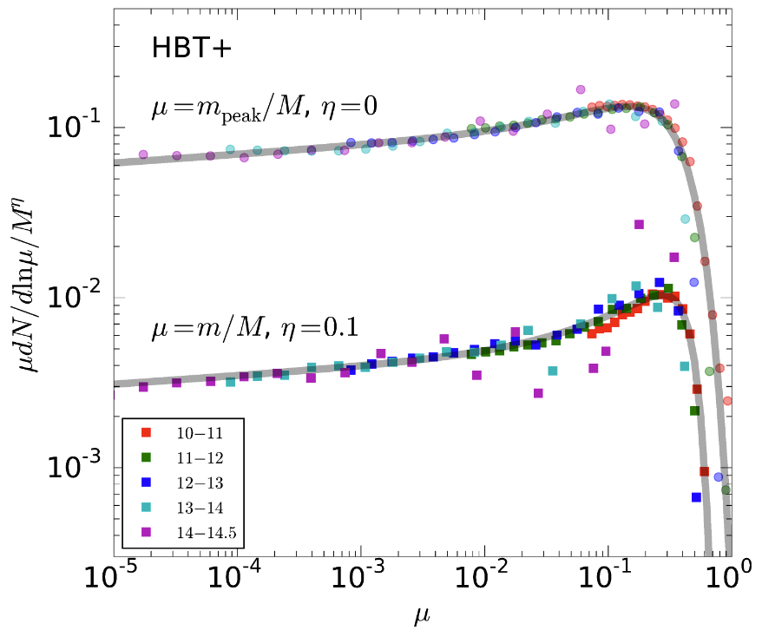
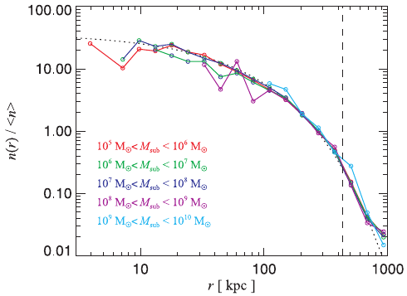
Universal laws on subhalo distribution
Han+ 18
Can we understand these laws?
-Yes, unbiased accretion
Subhalo mass functions
(Double) Schechter form
Largely independent on host halo mass
Probably also universal across redshift, cosmology, hierarchy？
Subhalo radial distribution
Mass independent
Flatter than NFW
NFW
What do we learn from them?
- Origin, dynamics, mass loss, disruption, hierarchy, cosmology & dark matter
Springel+08

Slide 3
Unbiased accretion
Halos and diffuse matter are accreted indiscriminatively
Subhalo progenitors fall in on similar orbits as matter
Halo
Subhalo progenitors fall in in proportion to matter
Subhalo spatial distribution
Subhalo mass distribution
Han et al. 2016

Slide 4
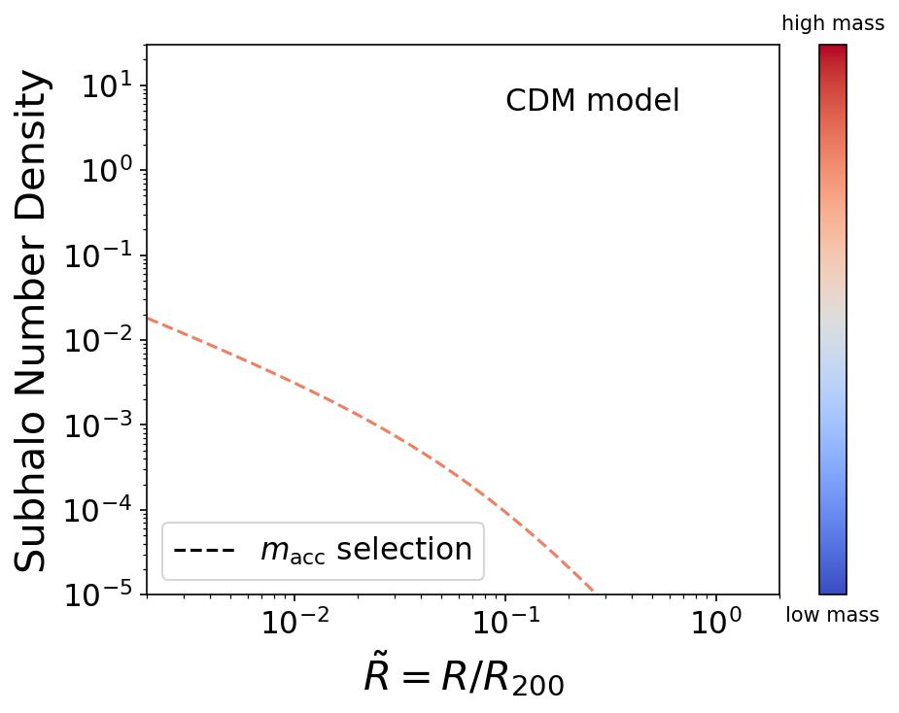


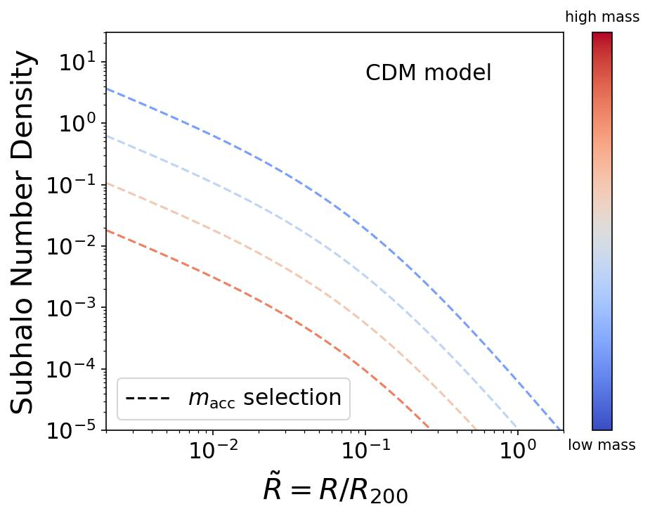
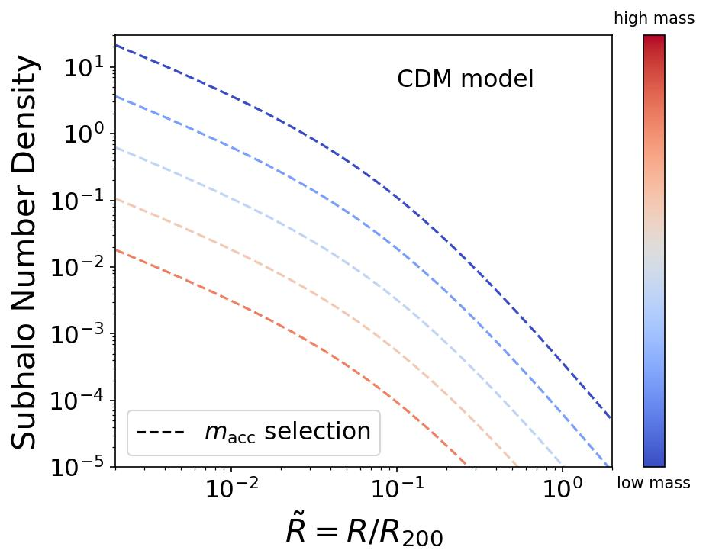

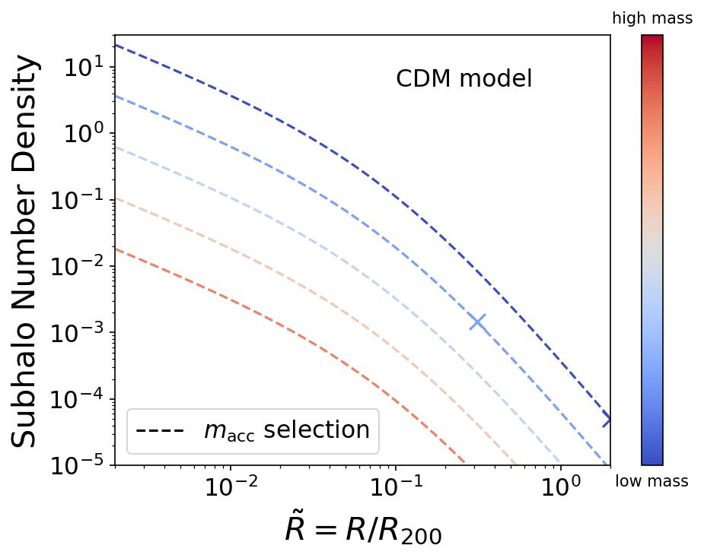

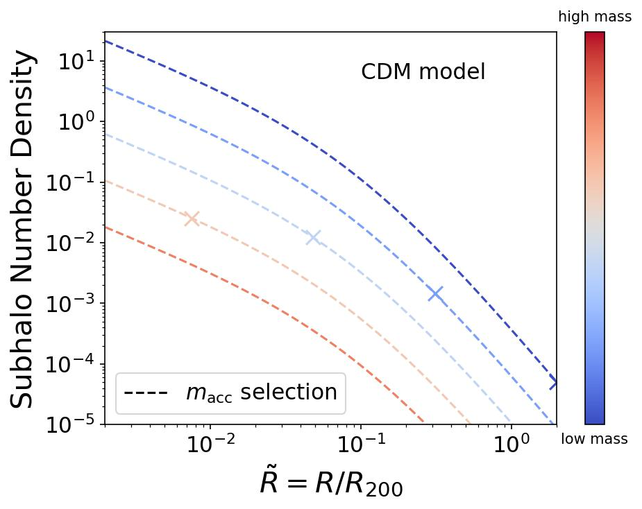
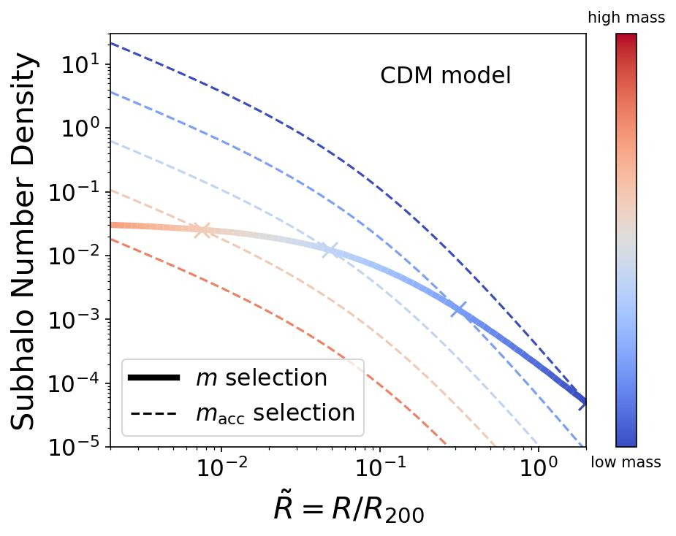
Modelling subhalo radial distribution
Unbiased accretion: subhalos at fixed infall mass follow host density profile (NFW)
Simulations usually measure subhalo distribution at fixed final mass
Tidal stripping:
same final mass map to different infall mass at different radius
Han et al. 2016

Slide 5
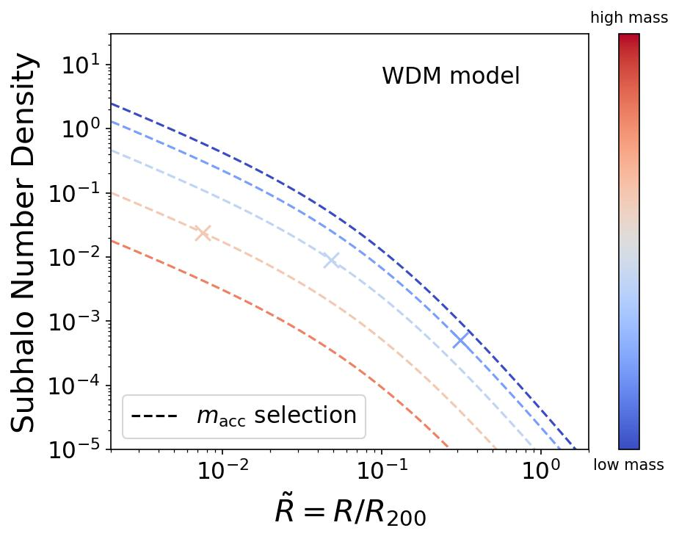
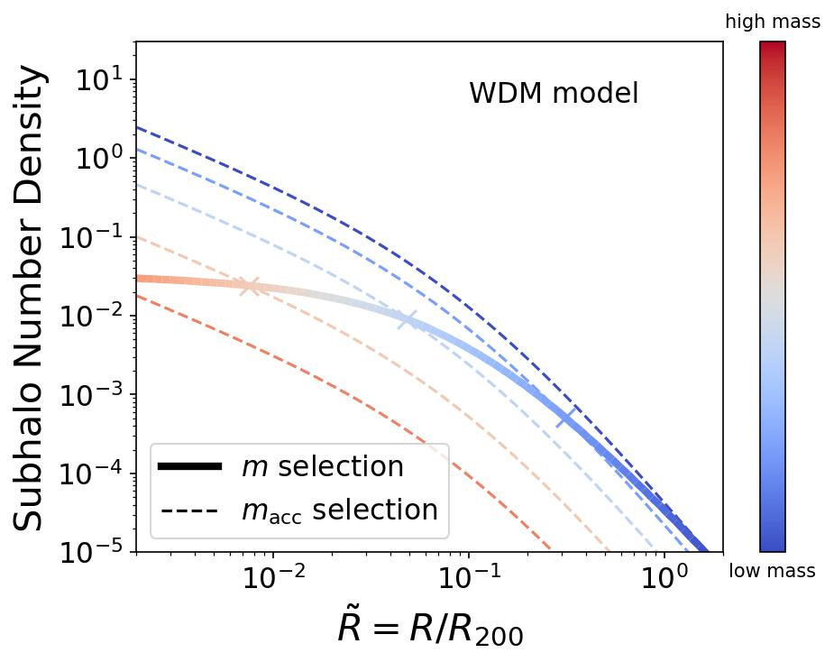
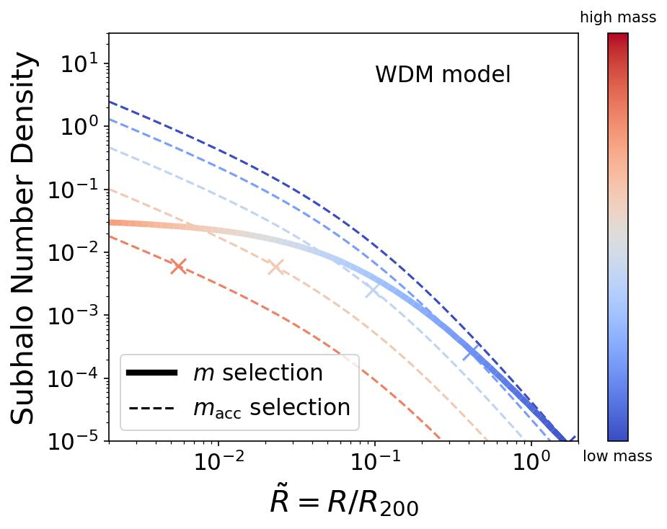
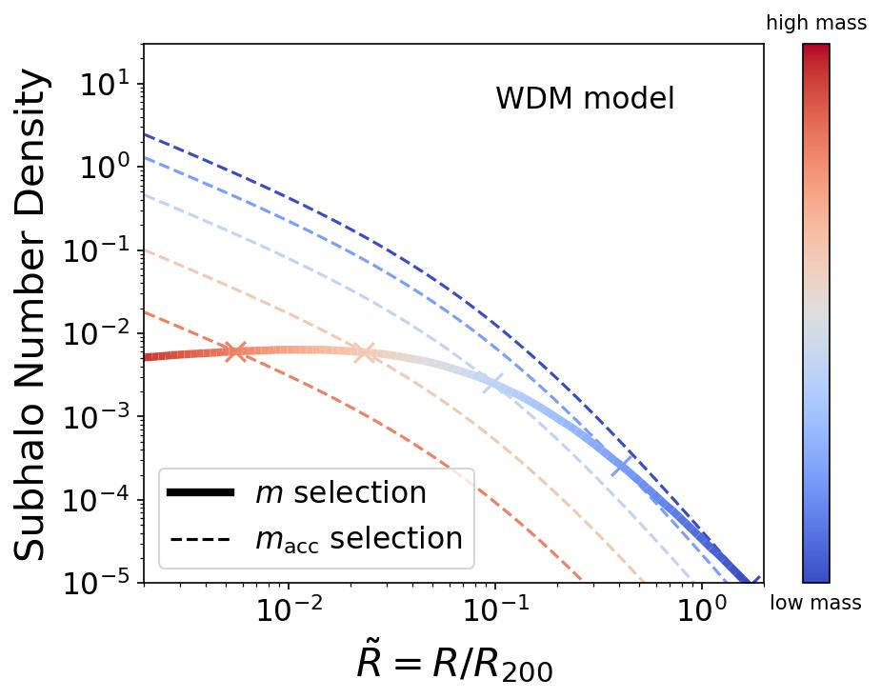
Extending to Warm Dark Matter
WDM has suppressed small scale power
Suppressed mass function at low mass end
Lower concentration at low mass end → stronger tidal stripping
He, Han et al. 2023
shallower
steeper

Slide 6
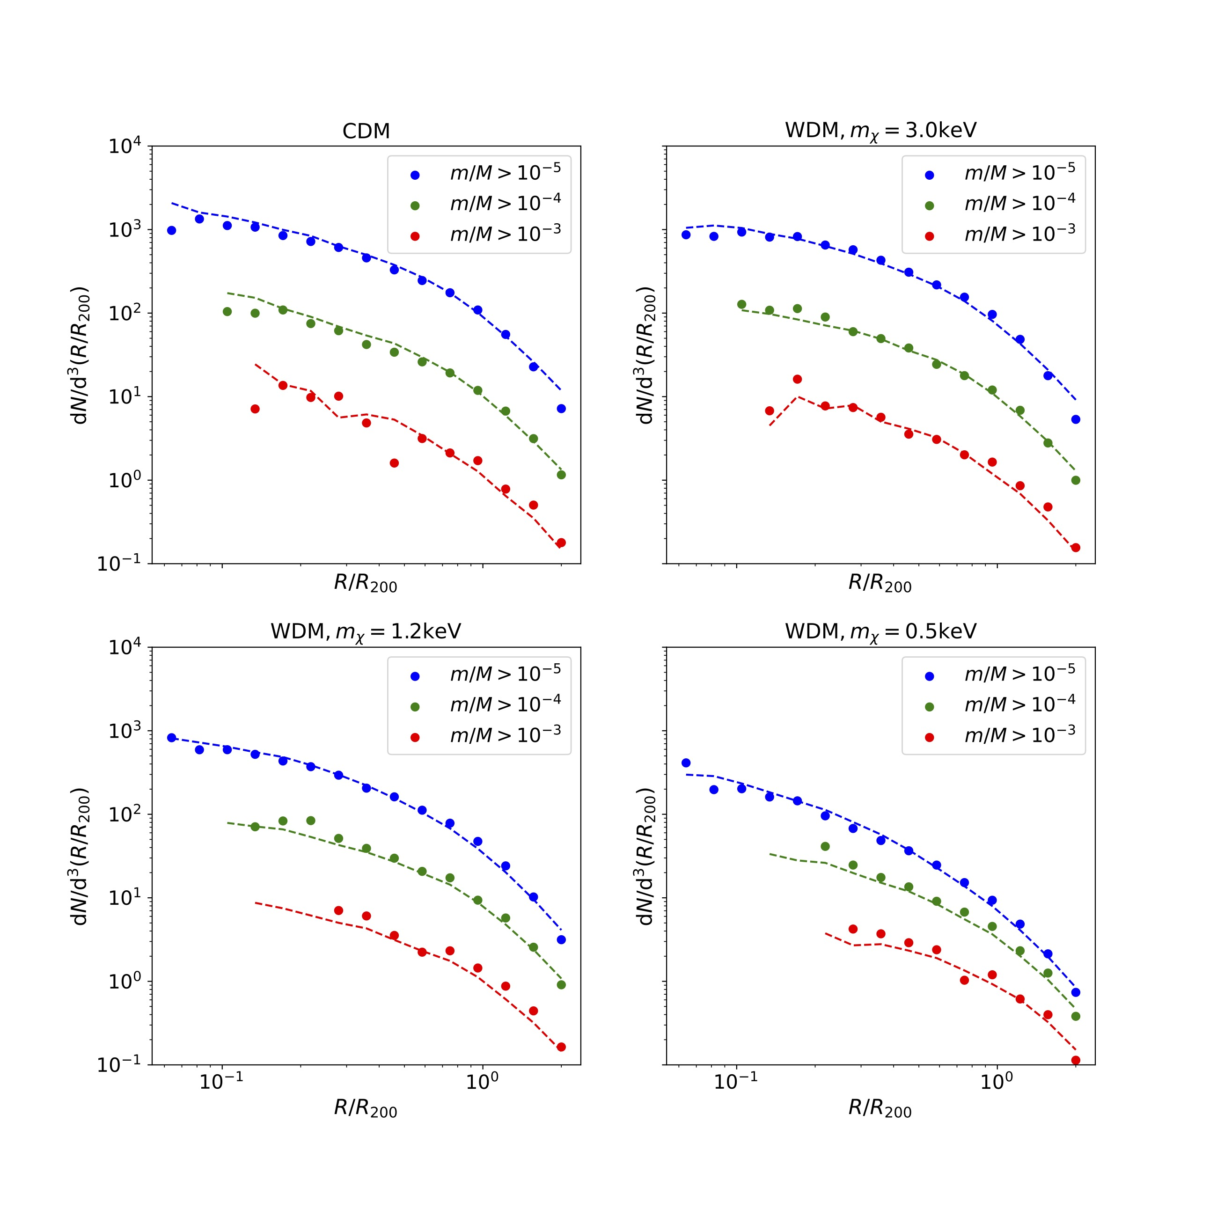
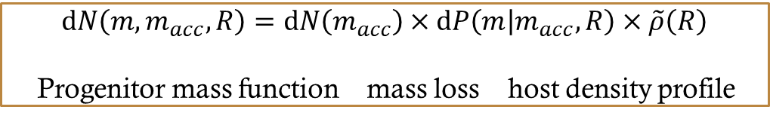
Universal subhalo radial and mass distribution
Analytical model:
Predicts final mass function from progenitor mass function
Python sampler:
SubGen, SubGen2 on github
To generate subhalo samples for any halo in CDM/WDM
He, Han et al. 2023
$$dN\left(m, m_{acc}, R\right)=dN\left(m_{acc}\right)×dP\left(m | m_{acc}, R\right)×\tilde{ρ}\left(R\right)$$
Progenitor mass function mass loss host density profile

Slide 7
Unbiased accretion
Halos and diffuse matter are accreted indiscriminately
Subhalo progenitors fall in on similar orbits as matter
Halo
Subhalo progenitors fall in in proportion to matter
Halo merger rate proportional to halo growth rate

Slide 8
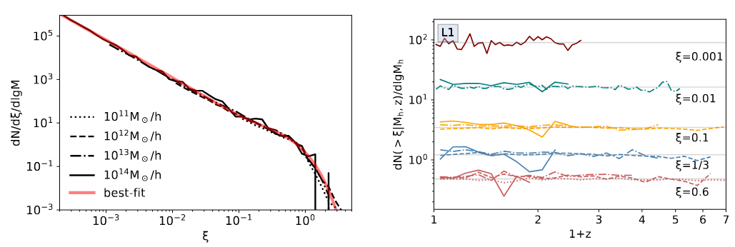

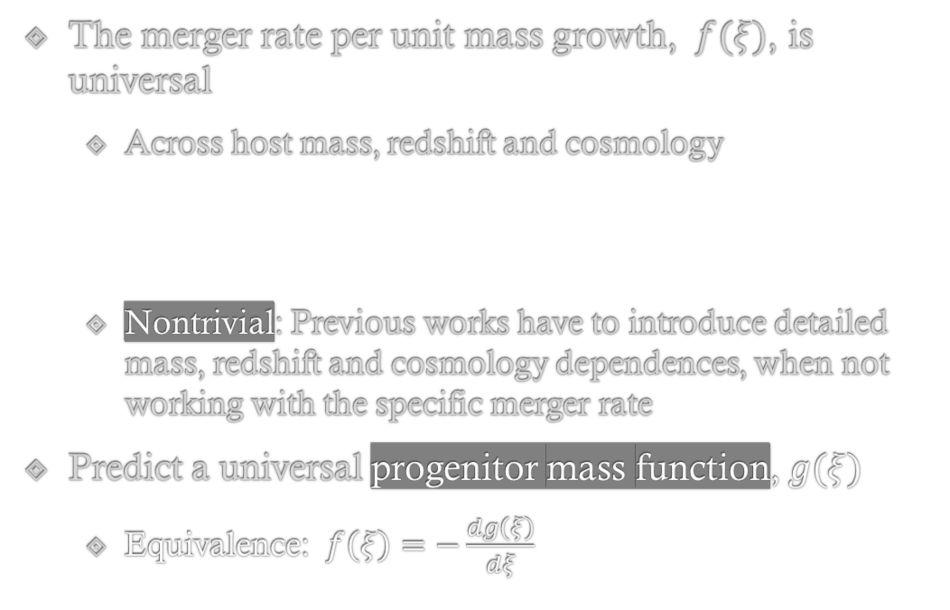

Universal specific halo merger rate
The merger rate per unit mass growth, $f(ξ)$, is universal
Across host mass, redshift and cosmology
Nontrivial: Previous works have to introduce detailed mass, redshift and cosmology dependences, when not working with the specific merger rate
Predict a universal progenitor mass function, $g(ξ)$
Equivalence: $f\left(ξ\right)=−\frac{dg\left(ξ\right)}{dξ}$
$$ξ=m/M$$
Dong, Zhao, Han+ 2022

Slide 9
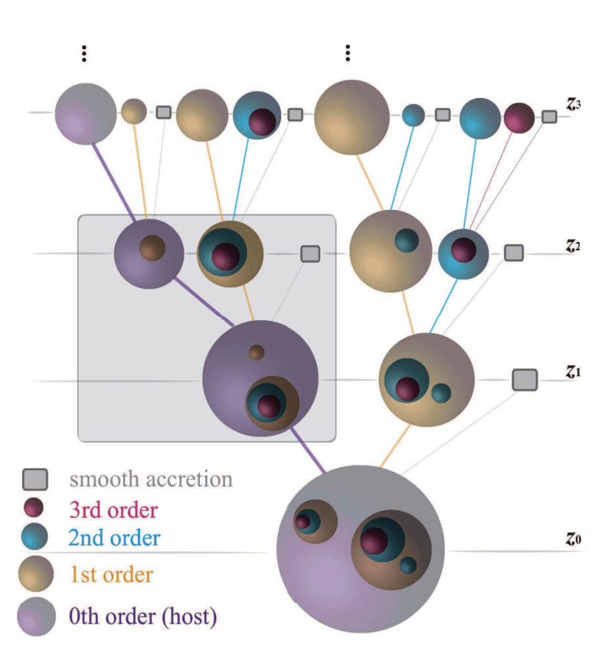
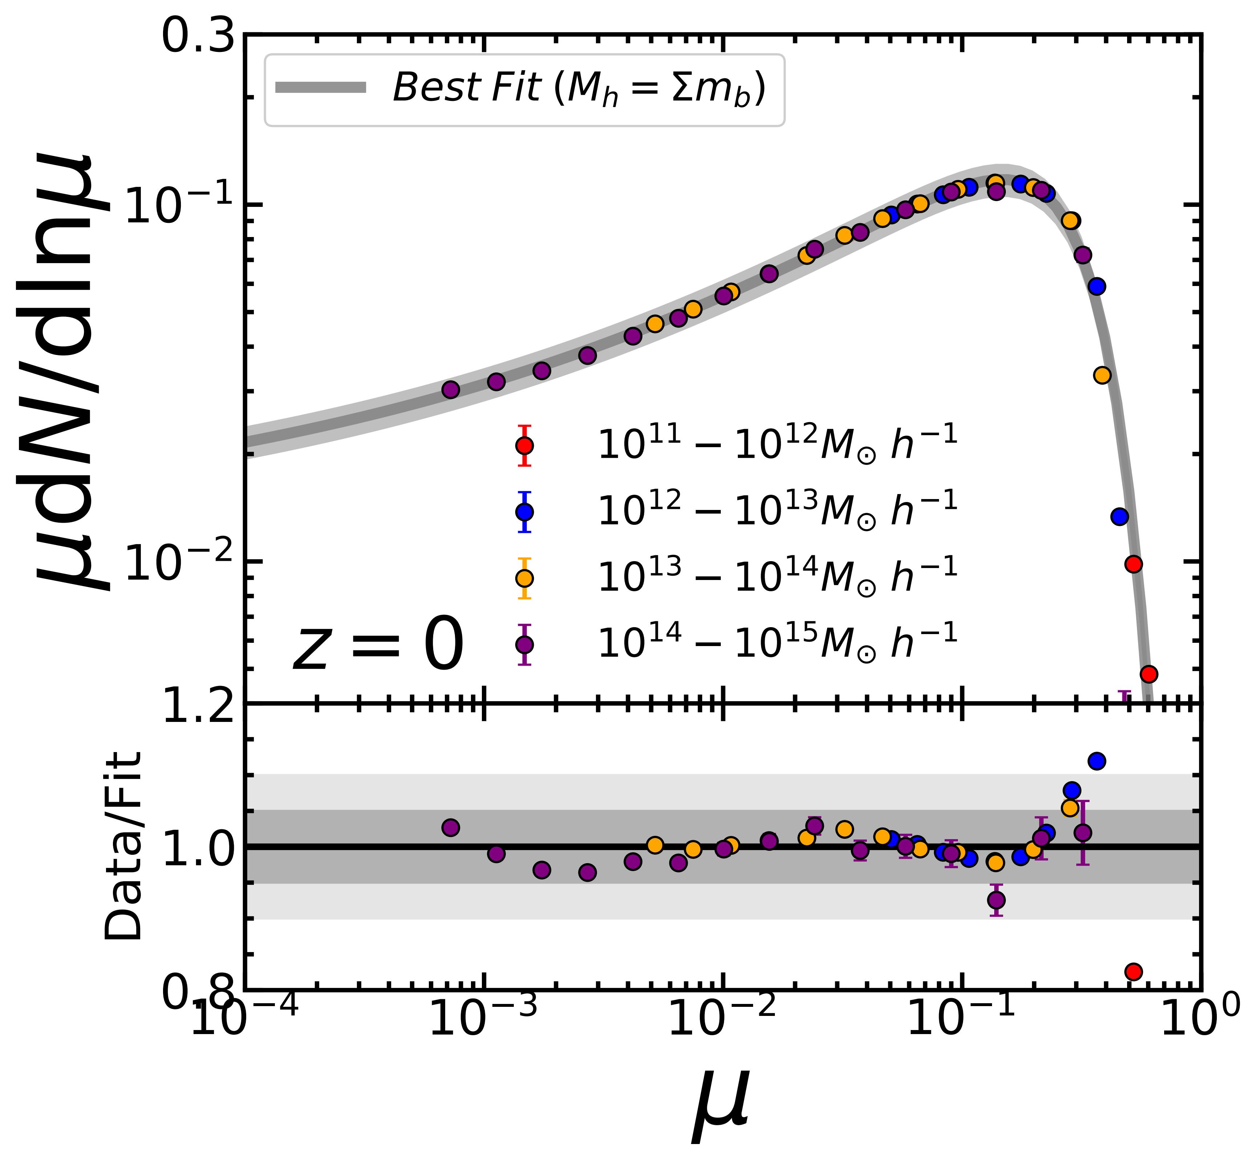
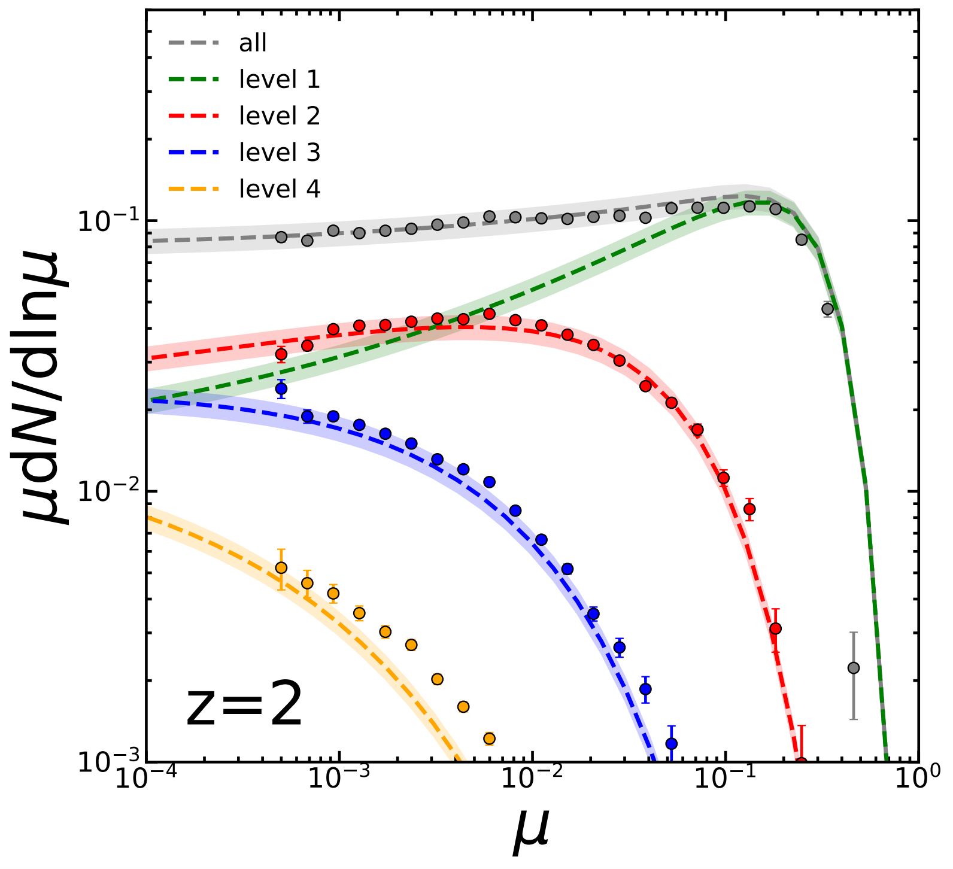
Universal PMF across levels
Hierarchical merger leads to different levels of progenitors (and subhalos)
Level-$n$ PMF = $n$-th convolution of Level-1 PMF
Level 1
Level 3
Level 2
Level 1
Level 0 (host)
Merger rate only models the PMF of level-1 subhalos
Jiang, Han+2025

Slide 10
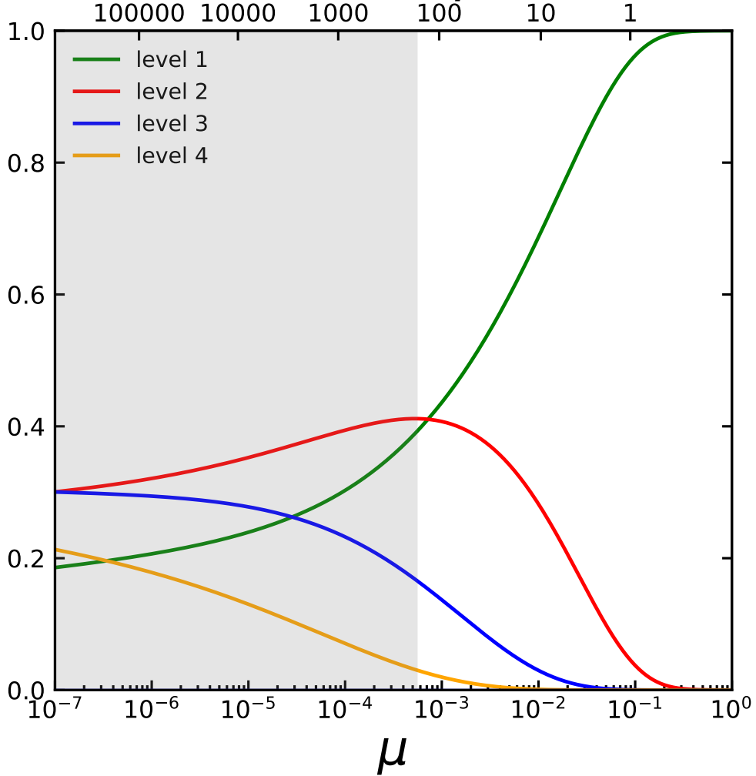



The hierarchy composition of subhalos
$$N(>μ)$$
Pre-processing is important!
Only 40% of the top 100 progenitors originate from direct mergers with main halos.
Fraction ($>μ$)
$$≡m_{acc}/M_{h}$$

Slide 11
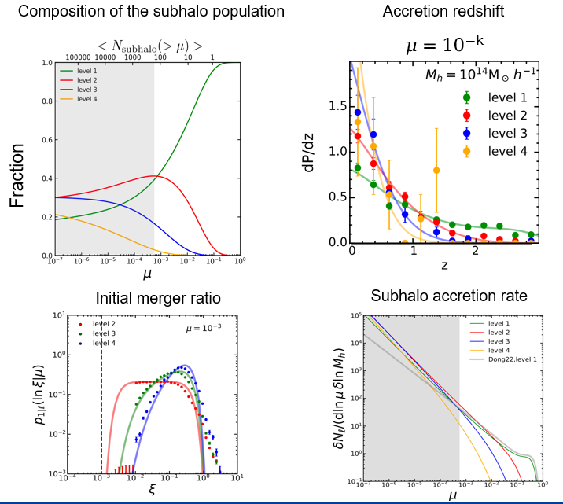
Higher level progenitors dominate at progressively lower mass.
Majority of high-level ones are first accreted in major mergers.
High-level subhalos are acquired more recently.
...

Slide 12
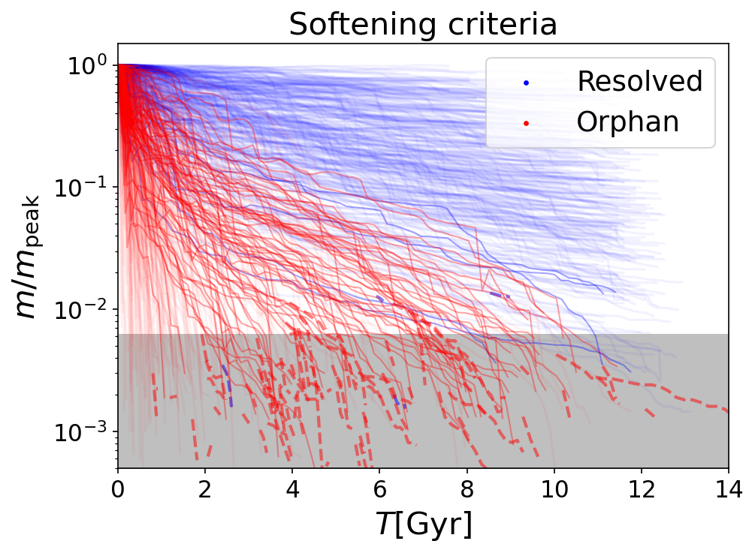
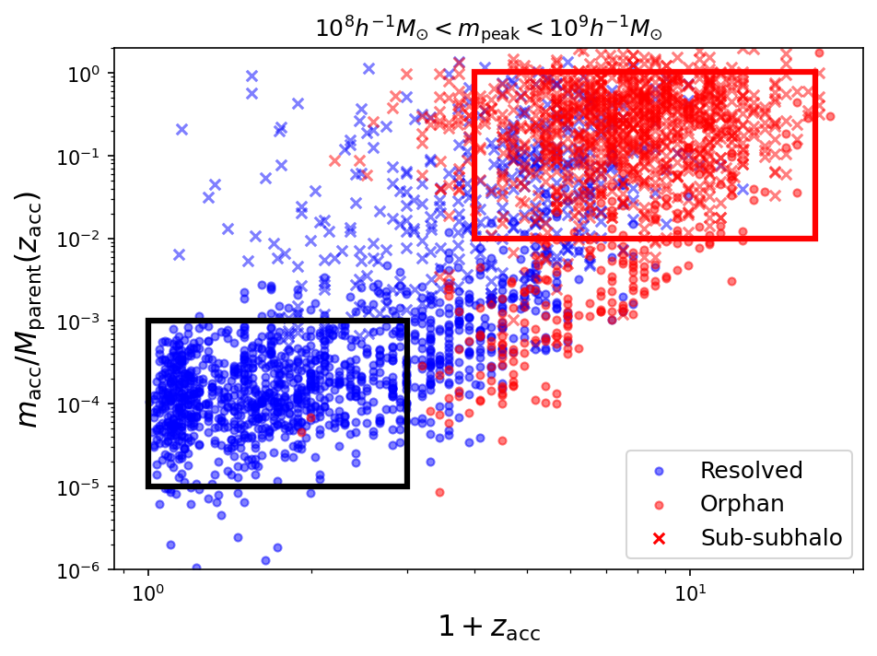
Artificial Disruption
He, Han & Li 2025
Theories predict cuspy subhalos to never disrupt, while ~50% subhalos appear disrupted in simulations.
Are simulations severely suffering from Artificial Disruption? No.
Different mass loss curves
Different physical (hierarchical) origins!

Slide 13
Summary
(sub)halos and diffuse matter are accreted onto halos in an “unbiased” way
Similar dynamics
Leads to radial distribution of subhalos following host profile at fixed infall mass
Tidal stripping leads to a modification to the profile at fixed final mass
WDM subhalos are distributed differently due to different infall mass function and mass loss rate
Proportional accretion rate
Universal specific merger rate
Universal subhalo peak mass function at any level
High level subhalos dominate the low mass subhalo population
“Disrupted” subhalos in cosmological simulations can be understood arising from their hierarchical origin

Slide 14
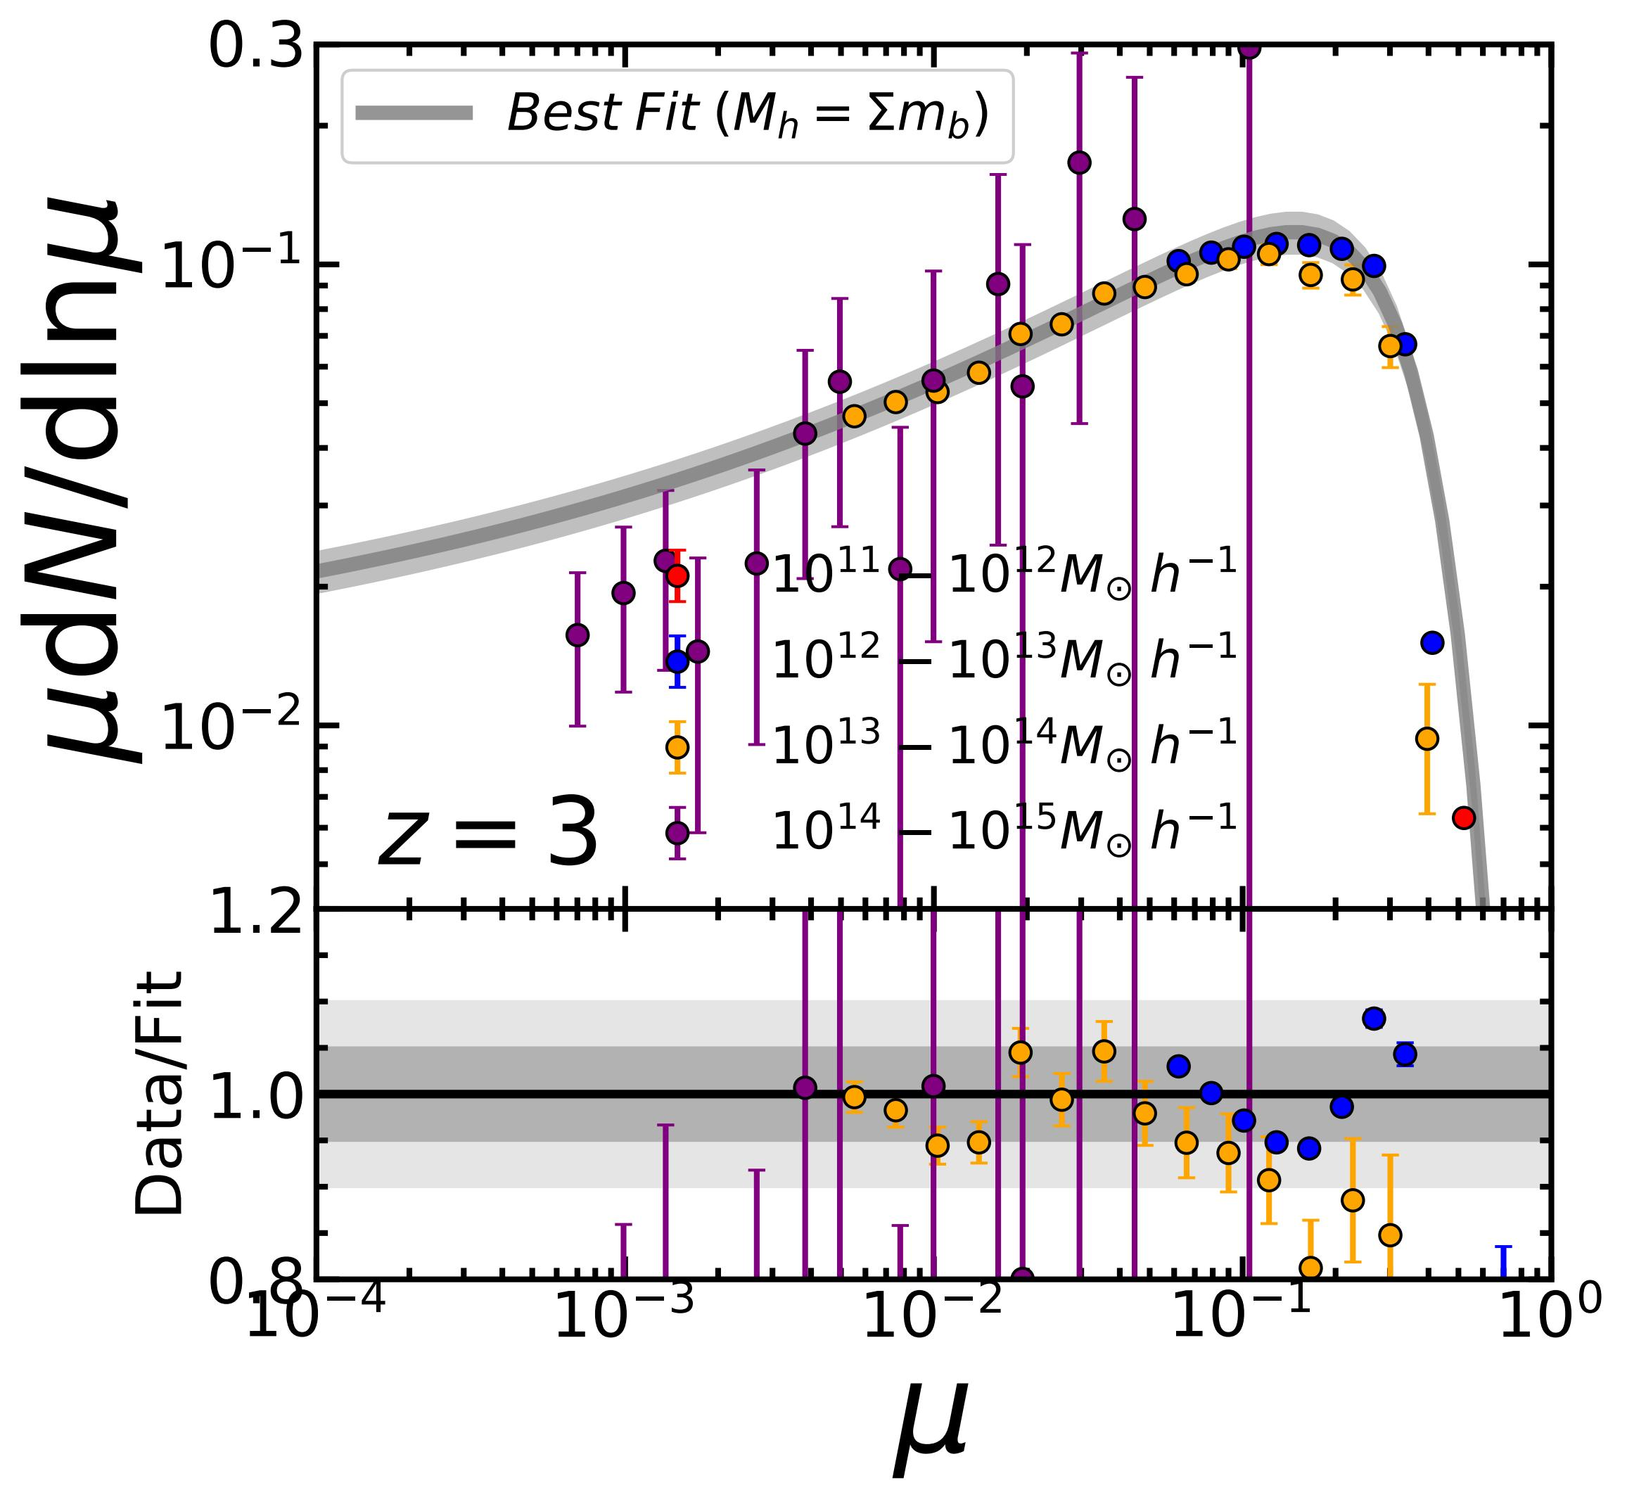
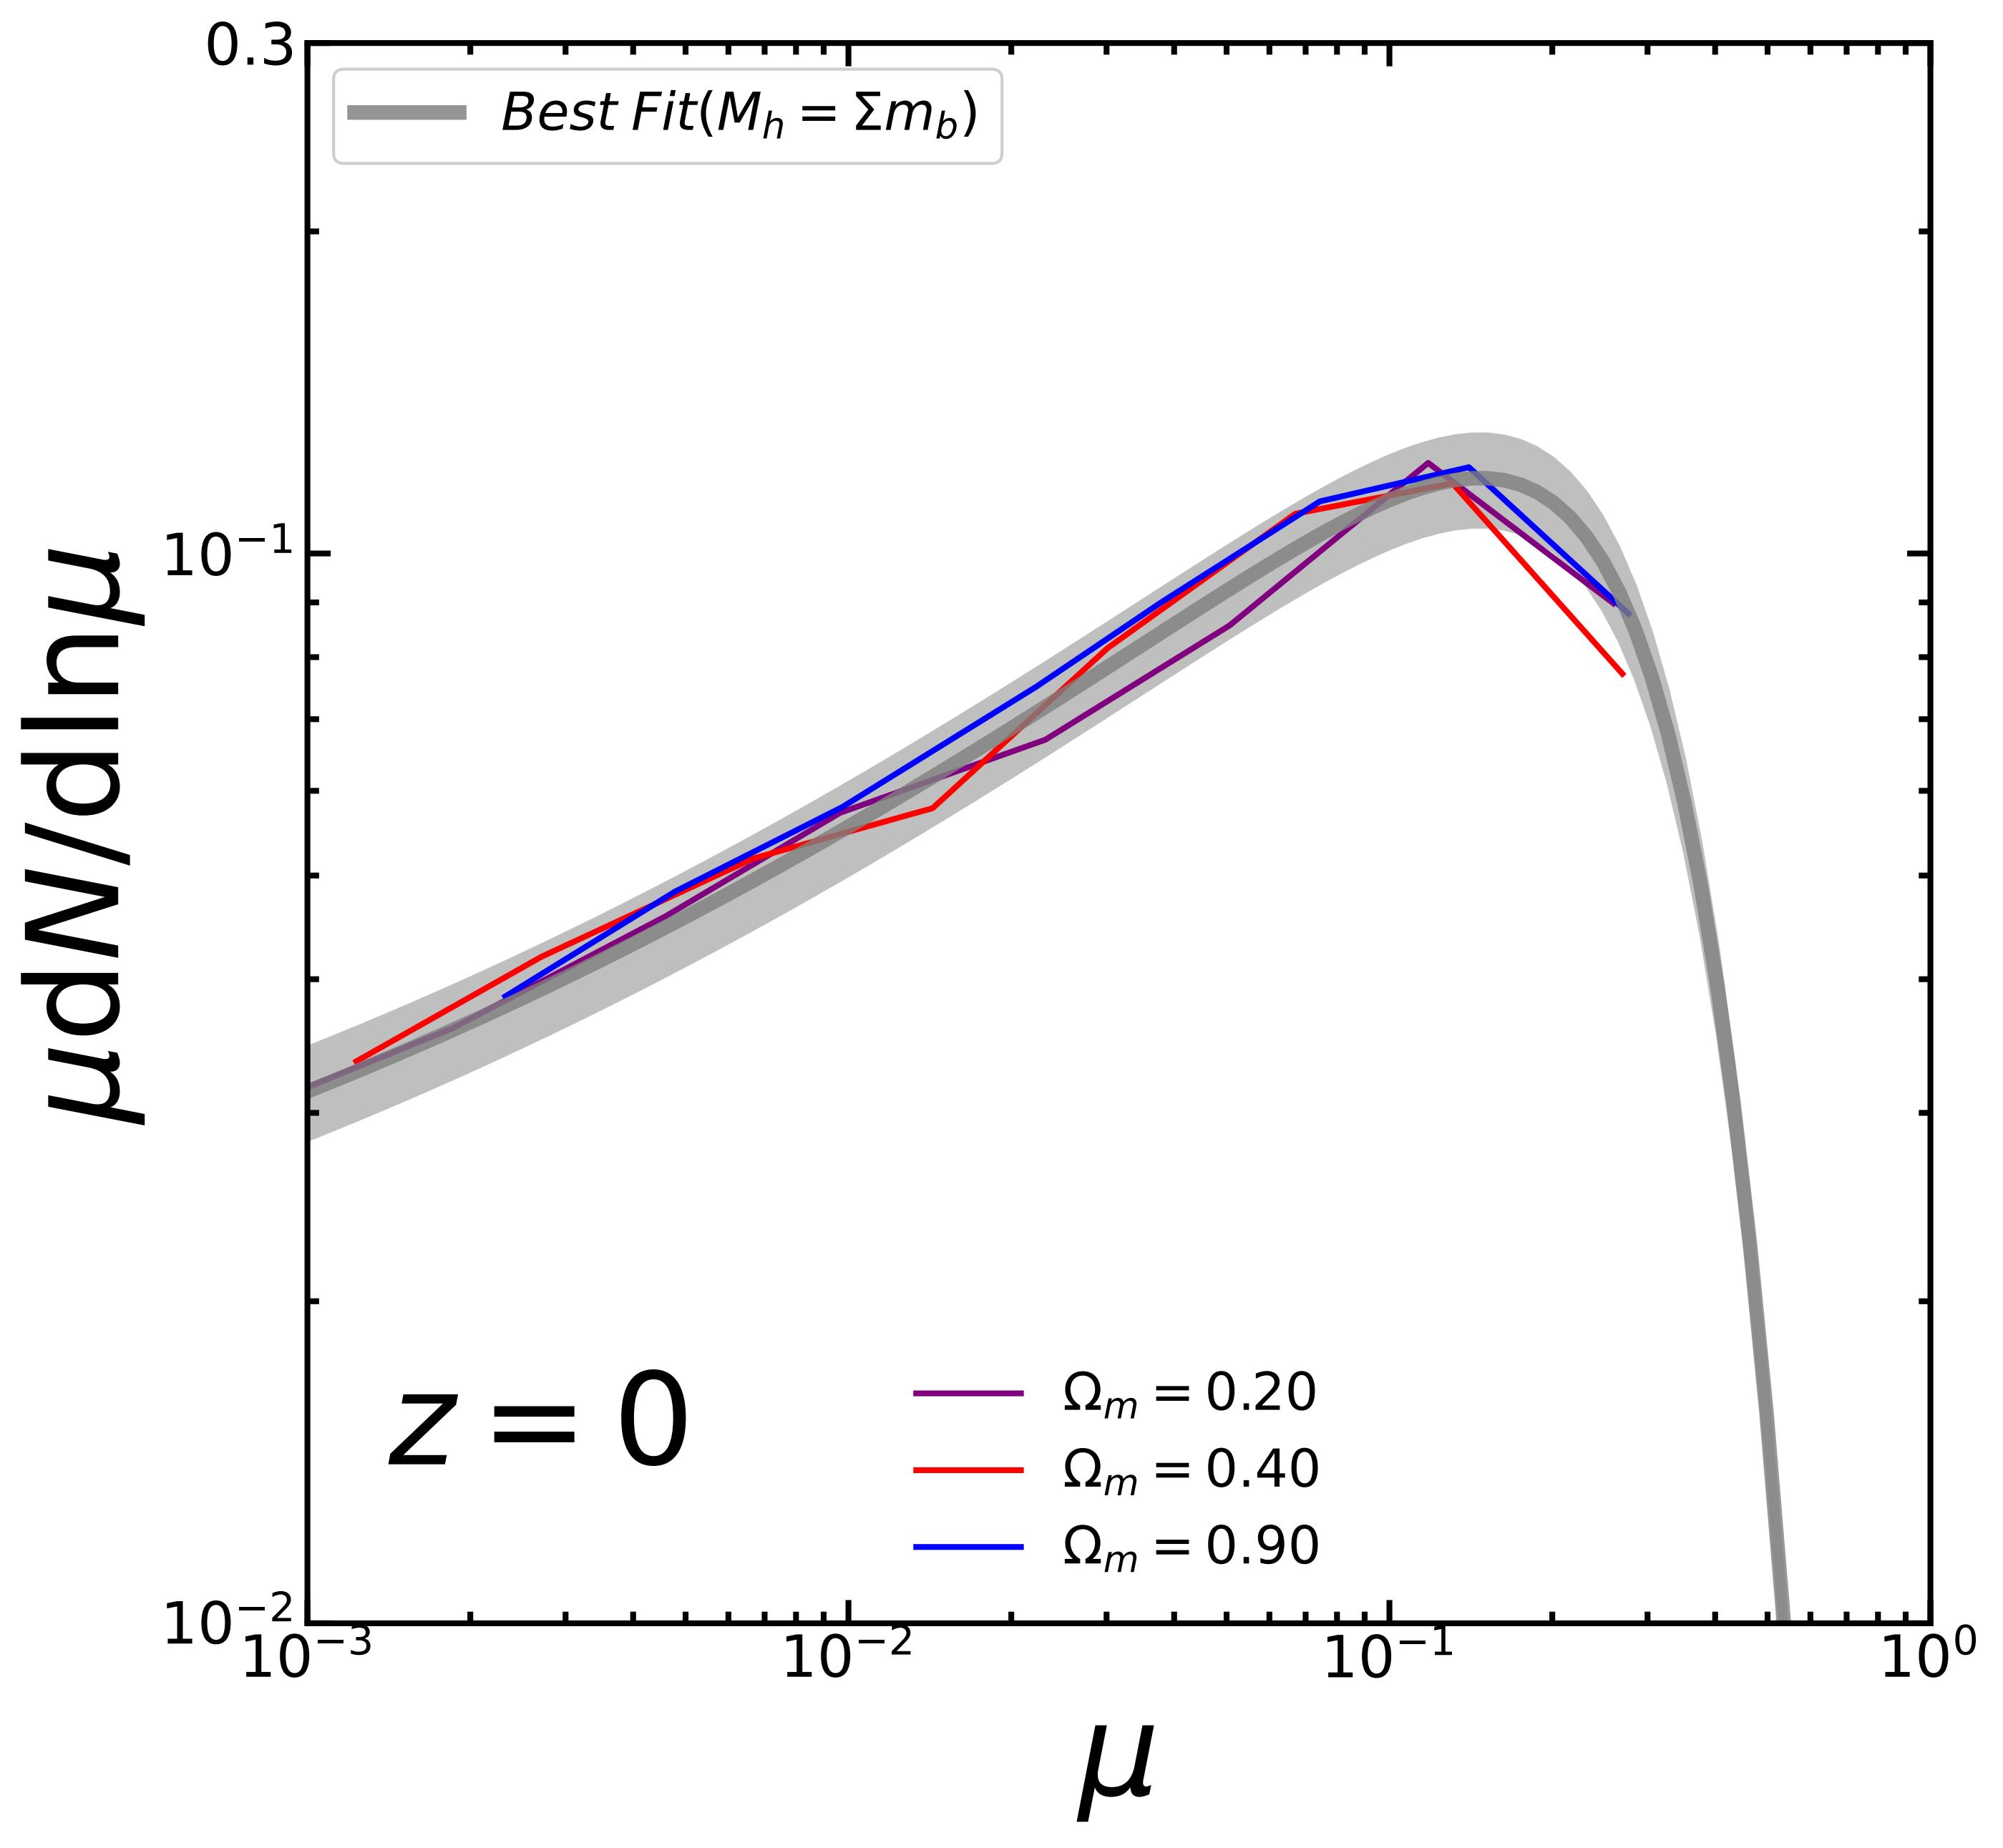
Universal Subhalo Peak Mass Function
The progenitor mass function (or Peak MF) has to be universal as well
Verified to 10% in simulations across mass, redshift and cosmology
Well fit by the same double-Schechter function
Jiang, Han+2025

Slide 15
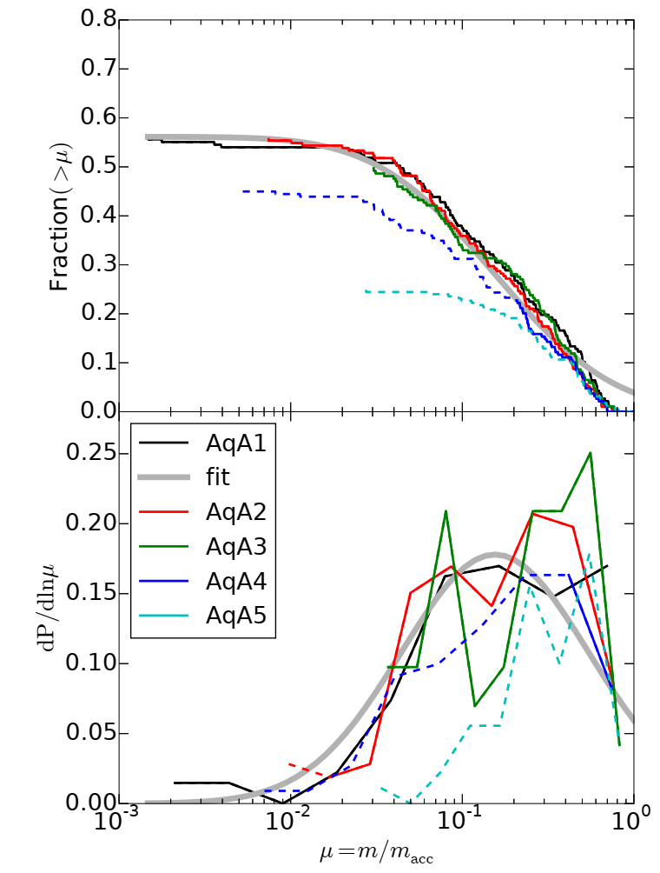
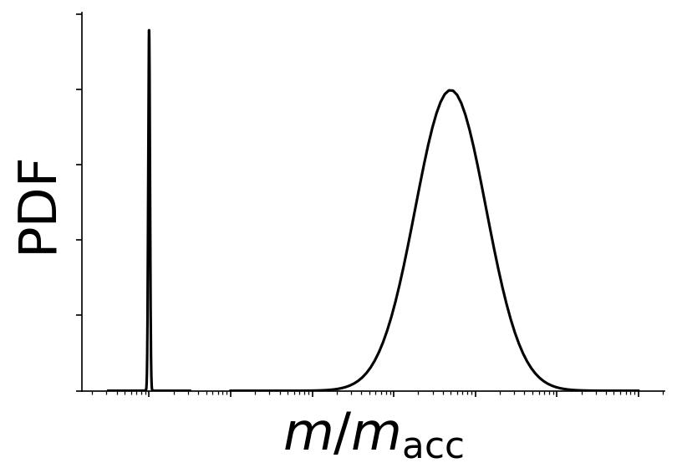
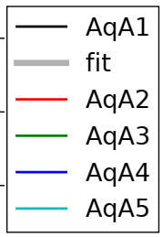

Tidal Stripping and Disruption
Mass loss
Mean: $\frac{m}{m_{acc}}∝r^{−β}$, Lognormal scatter
Disruption: ~45% subhalos remain disrupted at the highest resolution
Converges with increasing resolution, Physical?
Recent theoretical studies suggest CDM subhalos never disrupt (e.g., van den Bosch et al. 2018, Errani & Penarrubia 2021). Artificial?
Bound mass ratio
~ 50%
~ 55%
0
~ 45% disrupted

Slide 16
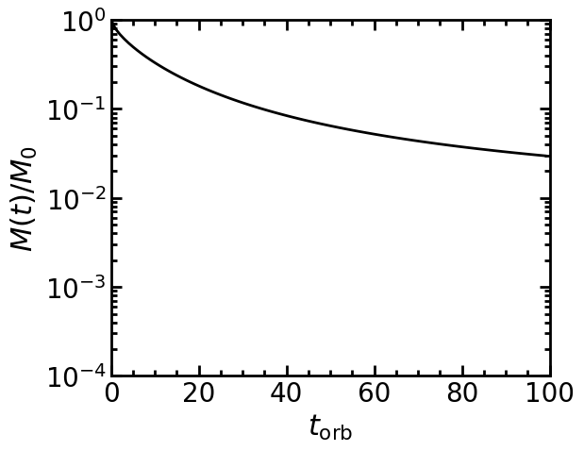
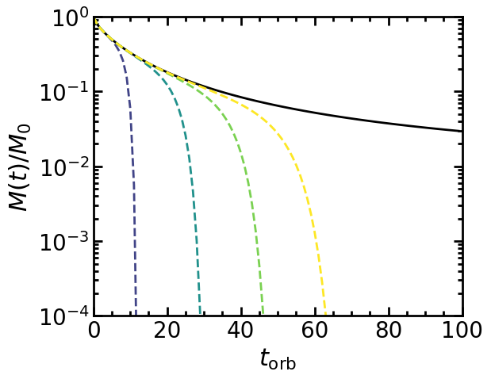

Artificial Disruption
Theoretical studies predict that CDM subhalos should not disrupt
Tidal limit ~ $f(r_{peri})$
Lower resolution leads to artificial disruption
Errani et al. 2021, Stucker et al. 2023
van den Bosch et al. 2018

Slide 17
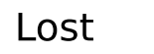
Origins of surviving vs disrupted subhalos
Previous studies on artificial disruption pertains only to the surviving condition, and they indeed remain resolved!
Disrupted | Surviving
High redshift | Low redshift
Major merger | Minor merger
High level sub | Level-1 sub
Rapid host growth | Slow host growth
He, JH+, 2025

