Slide 1
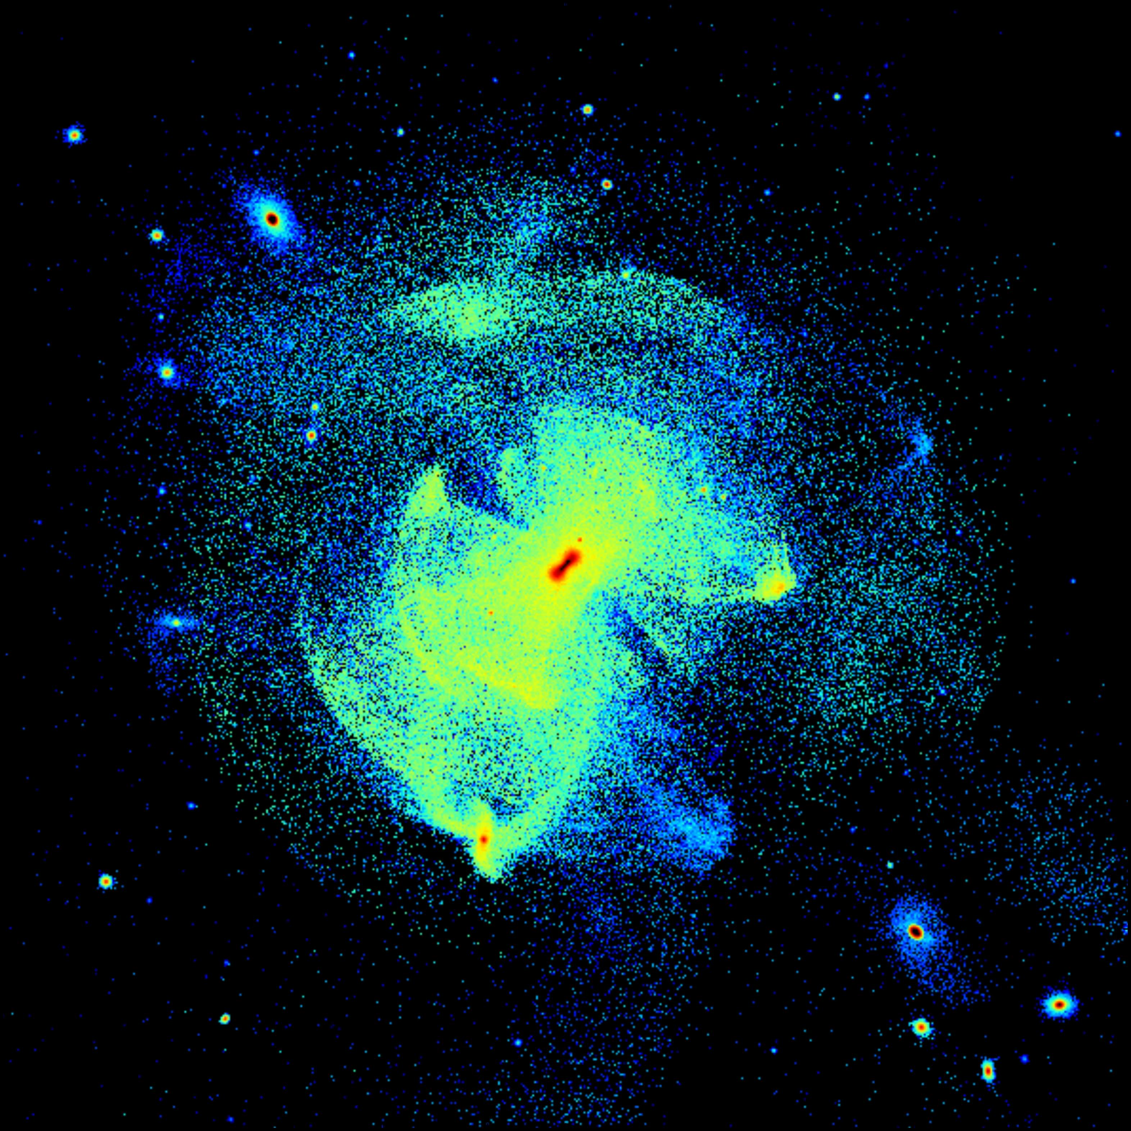


Probing SIDM with Galactic halos
Azadeh Fattahi
ICC, Durham
Oskar Klein Centre
Stockholm University
Small Scale Structure & SIDM
Valencia – June 2025

Slide 2
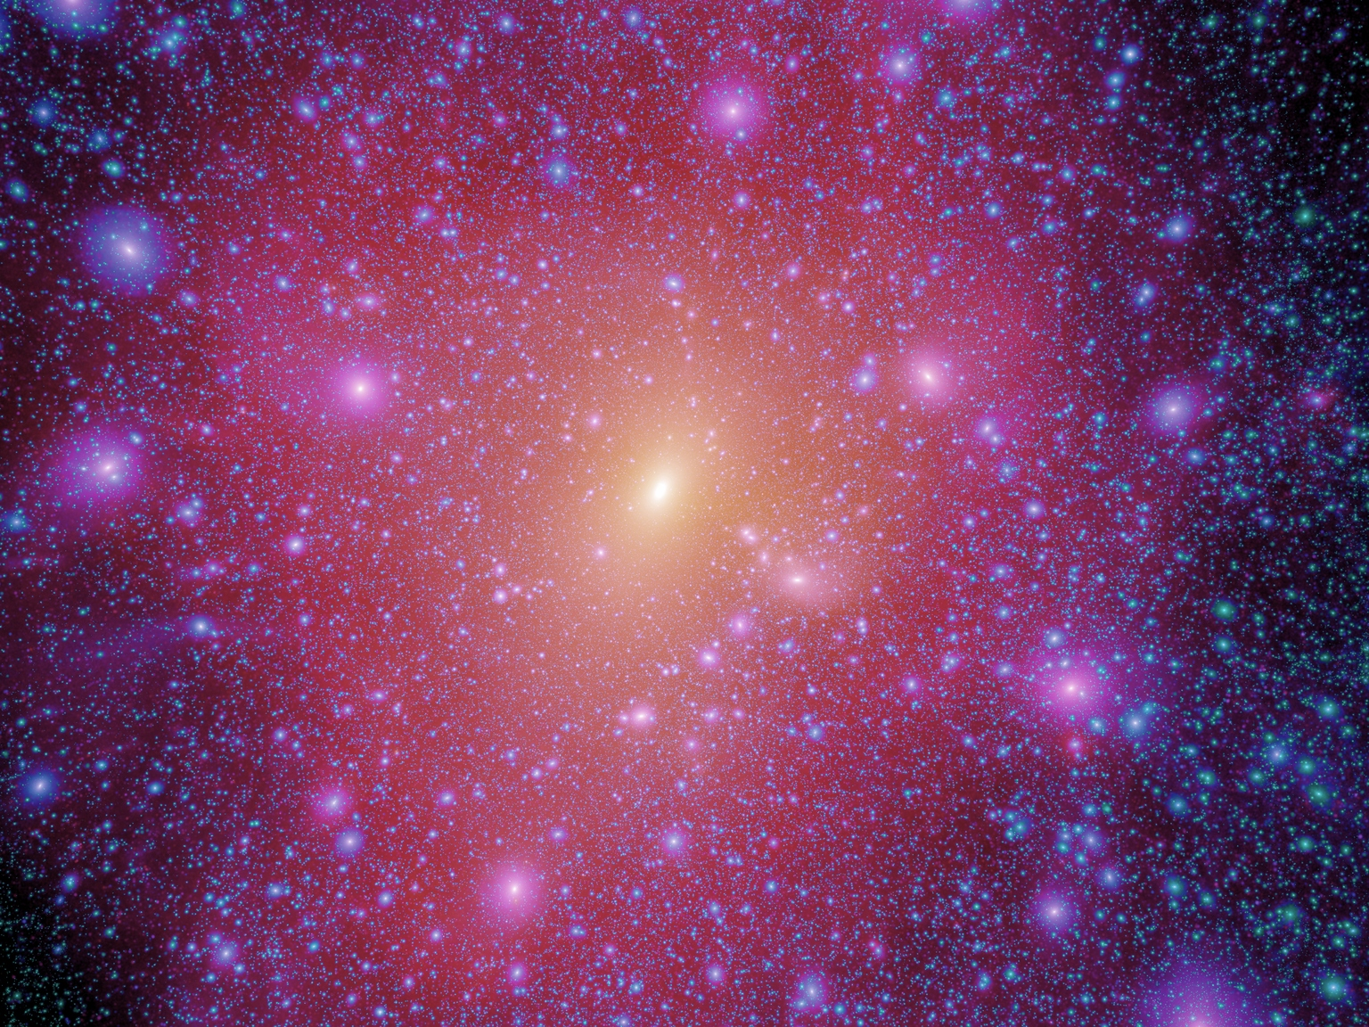
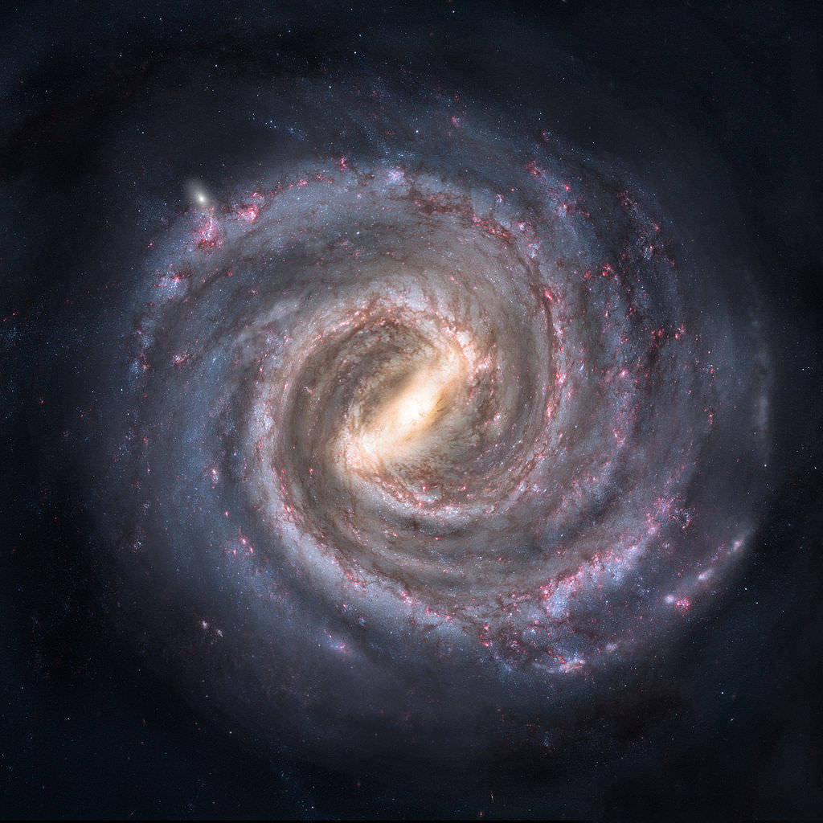
Galactic dark matter halo in the standard model of cosmology
Aquarius project – Springel+2008

Slide 3
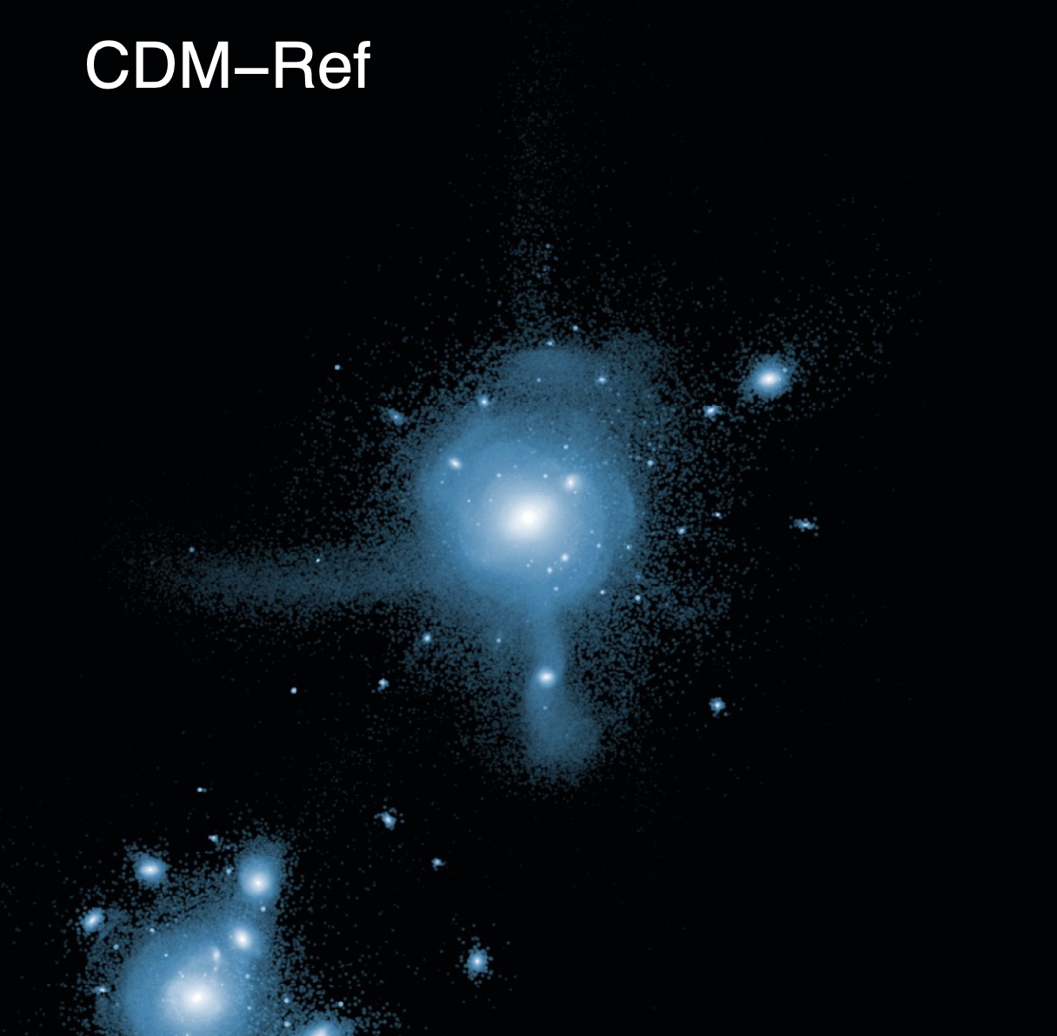
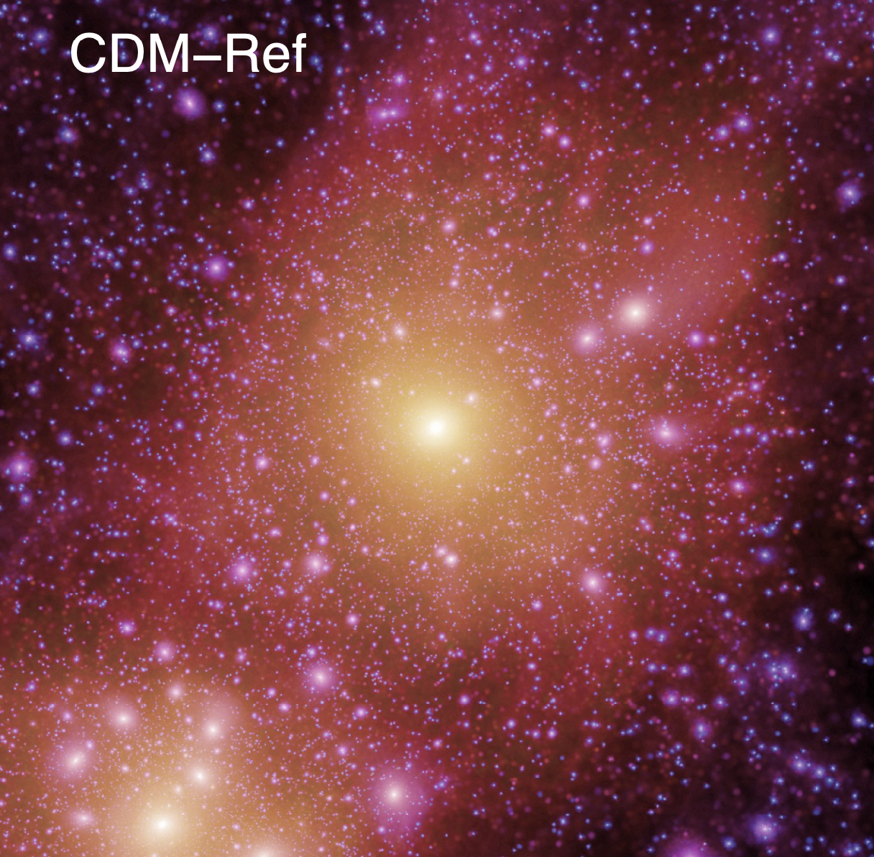
Disrupted (dwarf) galaxies and the formation of Galactic halos
stars
DM
APOSTLE Local Group simulations
(AF+2016, Sawala+2016)
Image: M. Lovell

Slide 4
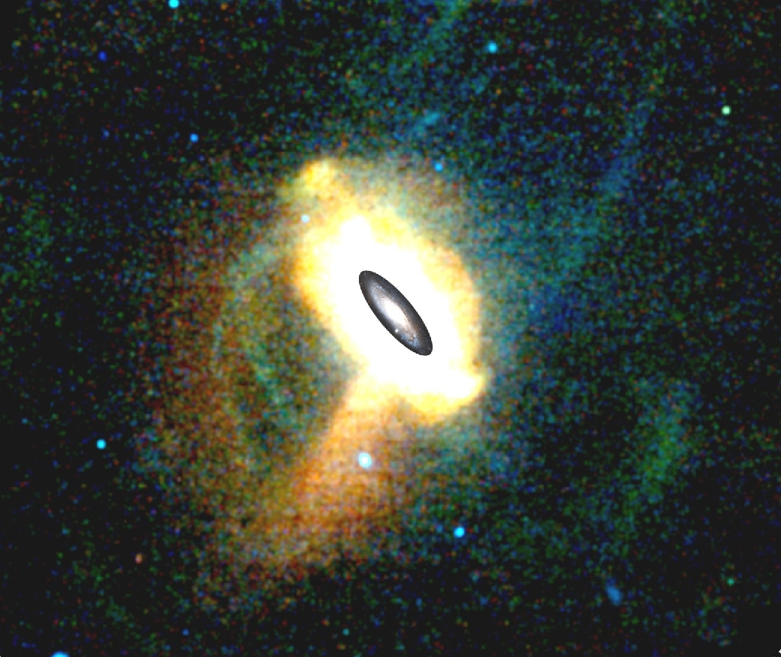
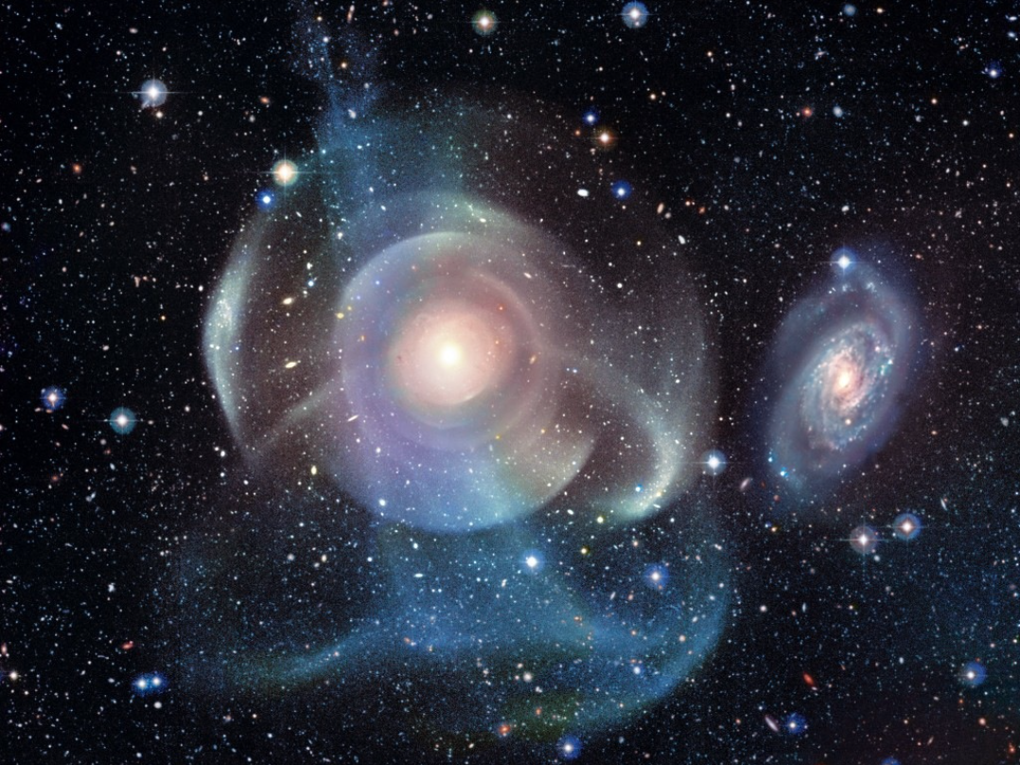
Disrupted (dwarf) galaxies and the formation of stellar halos
Andromeda Galaxy
NGC 474
PAndAS survey
Duc/Cuillandre/CFHT/Cole

Slide 5
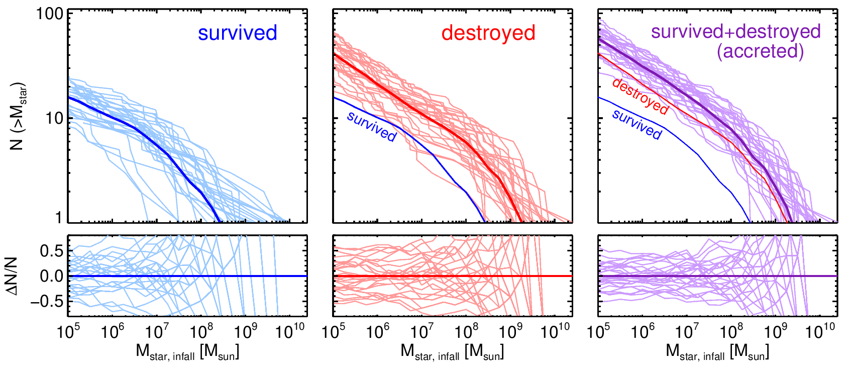
Disrupted (dwarf) galaxies and the formation of Galactic halos
in CDM
Mass spectrum of destroyed dwarf galaxies (halo progenitors) in Milky Way-mass CDM haloes
based on 30 Auriga cosmological simulations
A few tens of dwarf galaxies contribute towards the formation of Galactic halos
The mass budget is dominated by the few more massive objects
Dynamical friction drags these massive ones towards the centre, and radializes the orbits
(see, Deason+2016, Monachesi+2019, AF+2020, Amorisco+2017 )
AF et al. 2020
100
N (>M)
10
1
Notes:
Galactic -> Milky Way
galactic halos/stellar halos --> accreted component

Slide 6
How do things differ when looking into alternative dark matter models, such as self-interacting (SIDM), that affect low mass dark matter halos?
Victor Forouhar-Moreno - arXiv: 2407.05899
Fergus Henstridge + Alis Deason , Alex Riley,

Slide 7
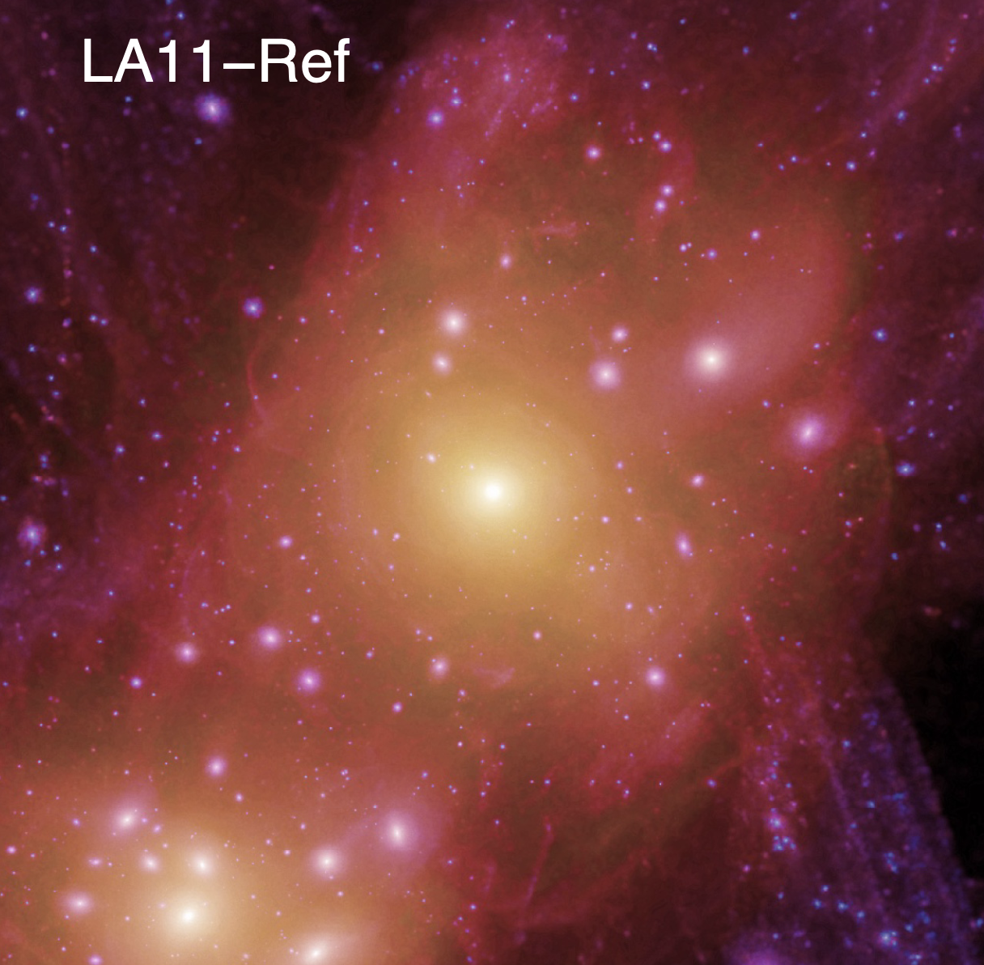
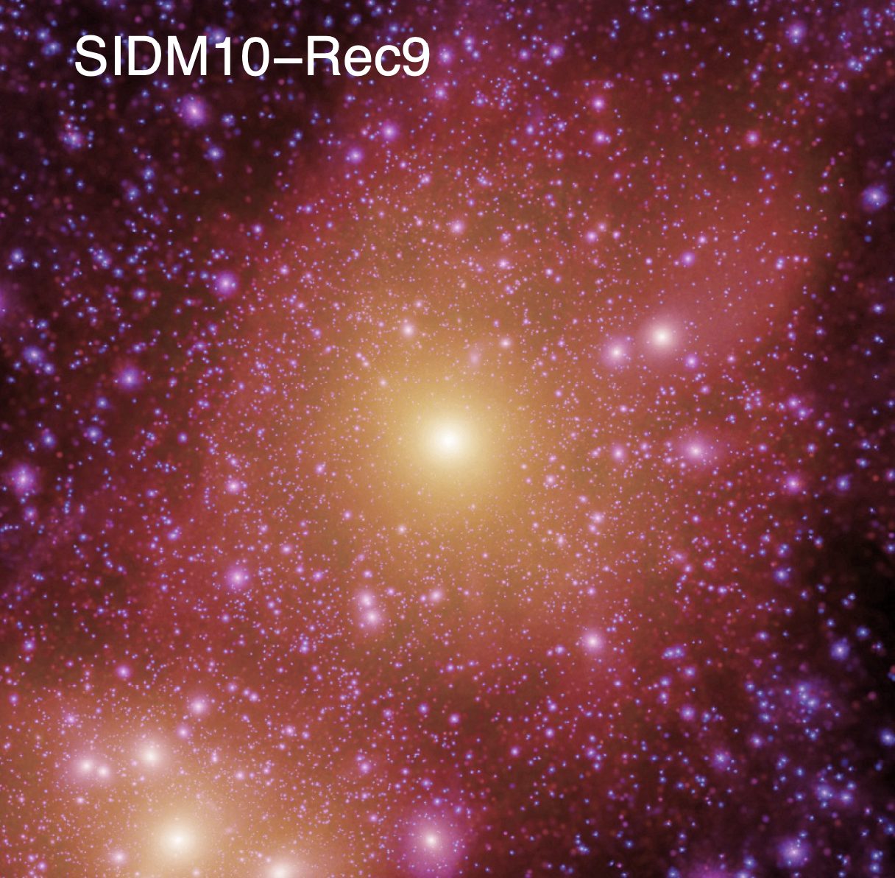
Alternative dark matter models: warm and self-interacting
WDM
Suppression of power at small scales -> lower abundance of low mass halos/subhalos
Delay in formation time of the lower mass halos -> Lower concentration of DM halos
SIDM
No change in the abundance of field low mass halos
(self)interaction between DM particles thermalizes the inner regions of halos -> shallow DM density profiles in the centre
WDM
CDM
SIDM-10

Slide 8
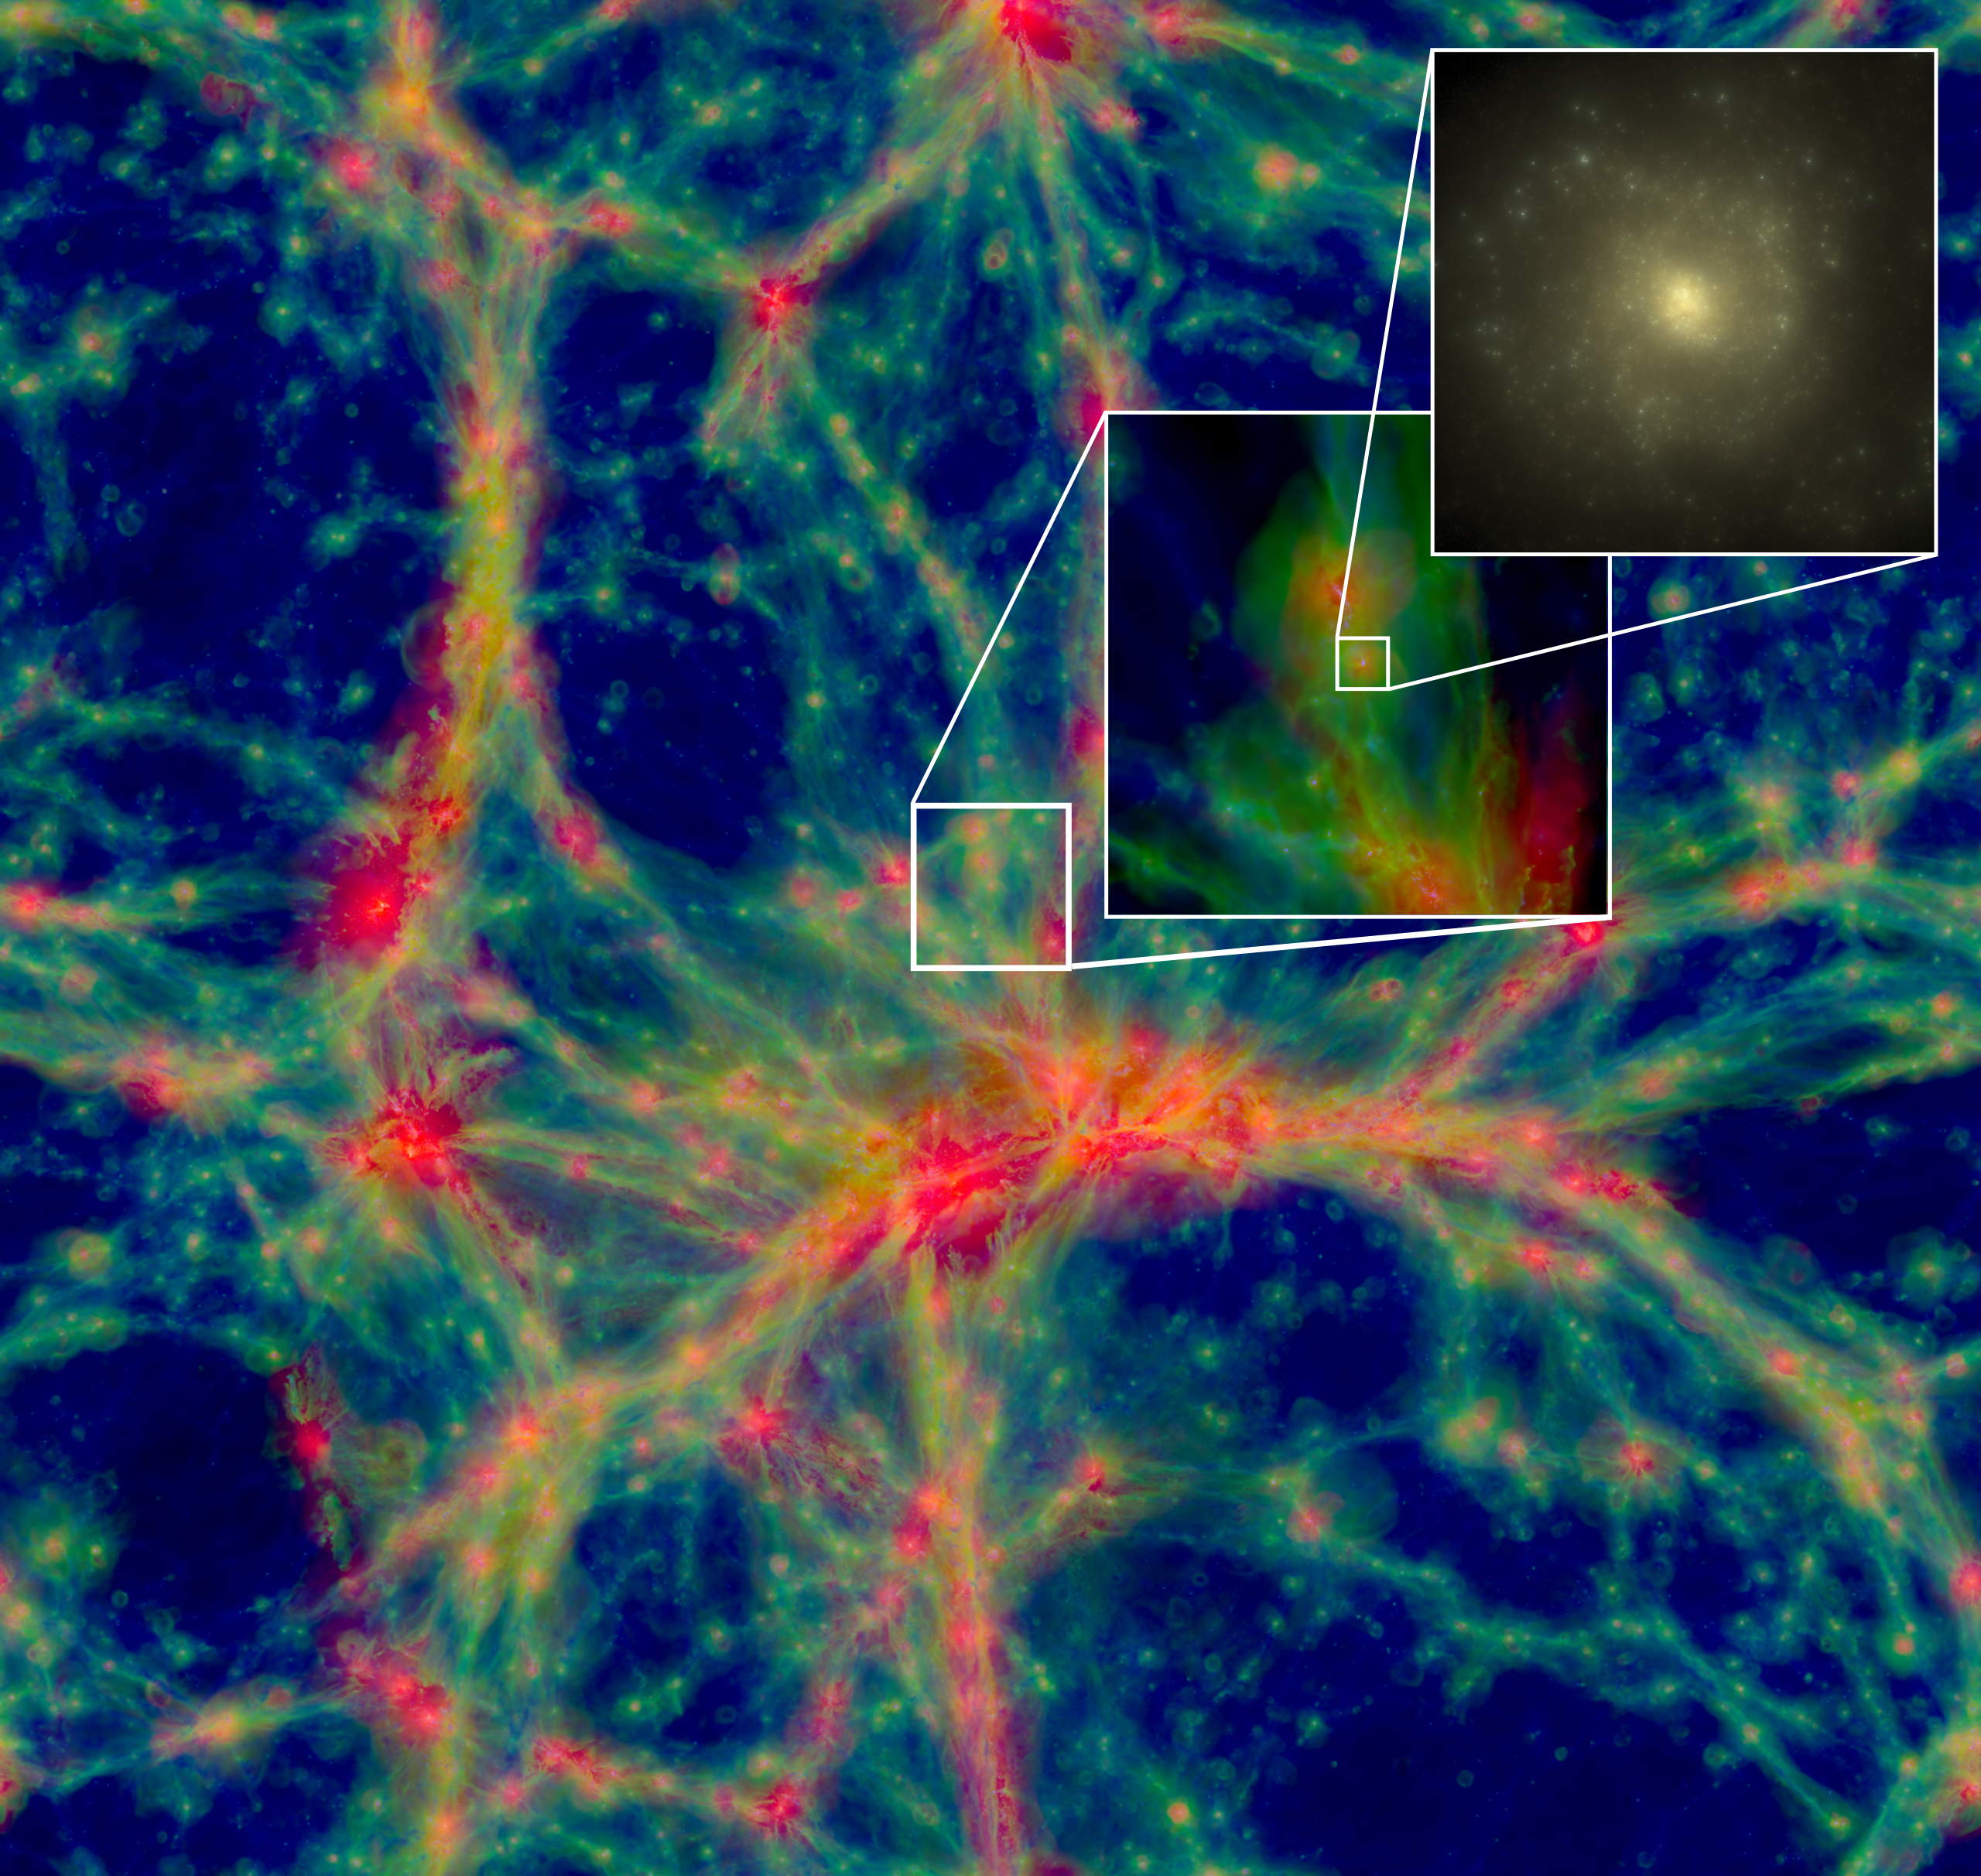
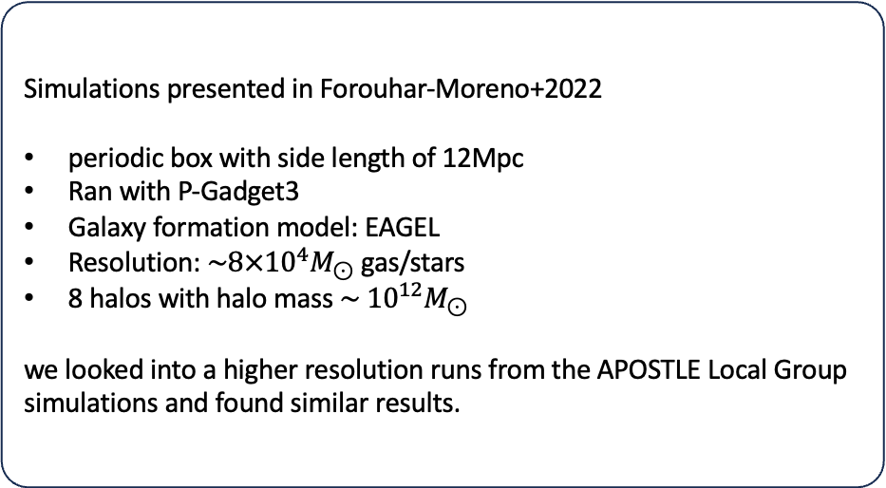
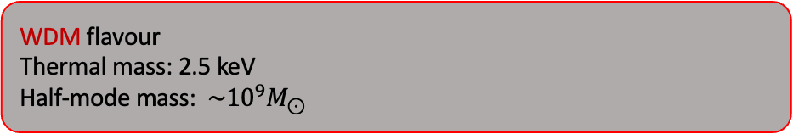
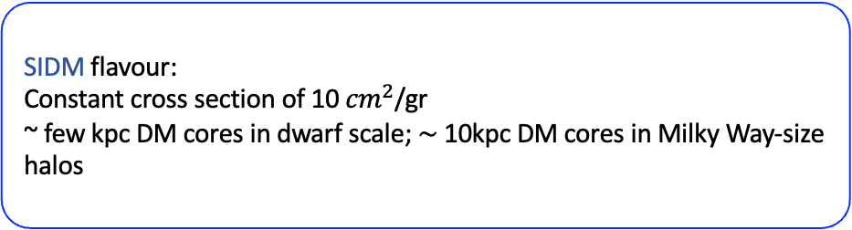
Simulations
Simulations presented in Forouhar-Moreno+2022
periodic box with side length of 12Mpc
Ran with P-Gadget3
Galaxy formation model: EAGEL
Resolution: ${\sim 8×10}^{4}M_{⊙}$gas/stars
8 halos with halo mass $\sim {10}^{12}M_{⊙}$
we looked into a higher resolution runs from the APOSTLE Local Group simulations and found similar results.
WDM flavour
Thermal mass: 2.5 keV
Half-mode mass: ${\sim 10}^{9}M_{⊙}$
SIDM flavour:
Constant cross section of 10 ${cm}^{2}$/gr
~ few kpc DM cores in dwarf scale; $\sim$10kpc DM cores in Milky Way-size halos

Slide 9
Disrupted dwarf galaxies (halo progenitors) in various DM models
CDM
WDM
SIDM
Mass spectrum of disrupted objects (halo progenitors)
There are fewer disrupted objects in WDM
There are more disrupted objects in SIDM
Peak mass before infalling to the MW-mass halos
Forouhar-Moreno, AF, Deason et al. 2024

Slide 10
Density profiles of halos in various DM models
DM halos:
WDM and CDM are similar
SIDM is flatter in the centre
Stellar halos:
WDM is very similar to CDM
SIDM is shallower than CDM
Dark Matter
CDM
WDM
SIDM
Accreted
stars

Slide 11
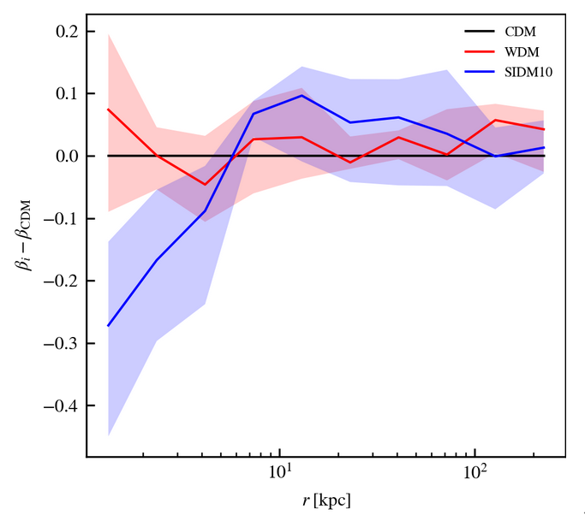
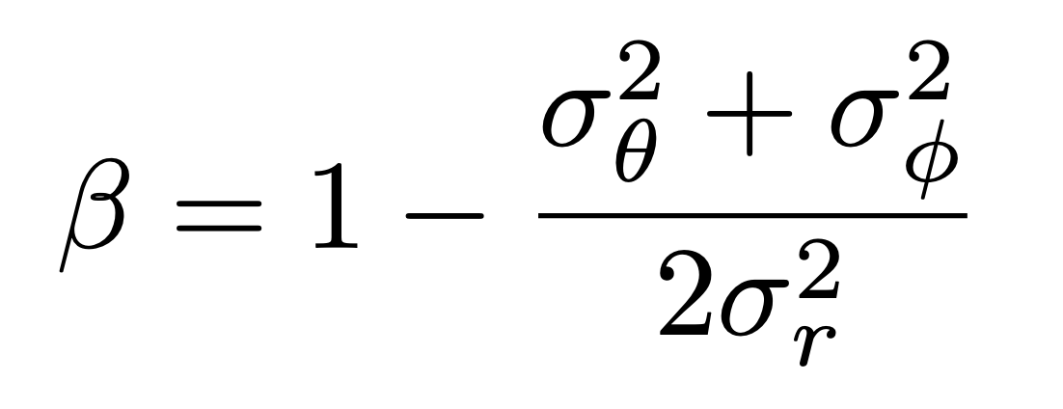
Kinematics of stellar halos in various DM models
Velocity anisotropy profile of stellar halos (relative to CDM)
WDM
The inner regions of SIDM Galactic halos are less radial than CDM
SIDM

Slide 12
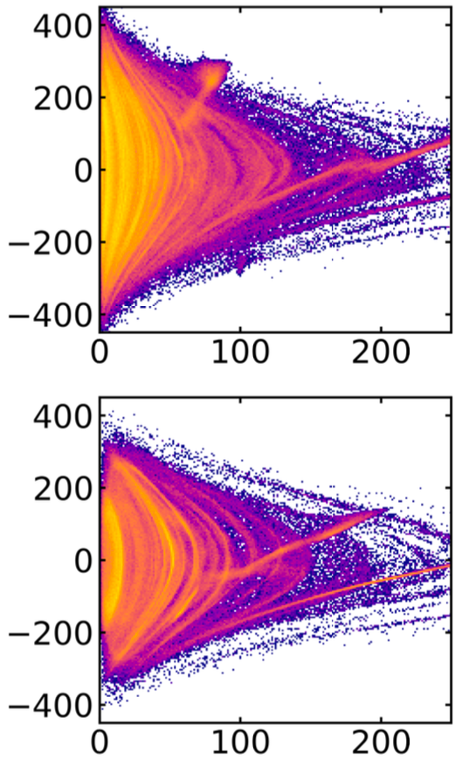
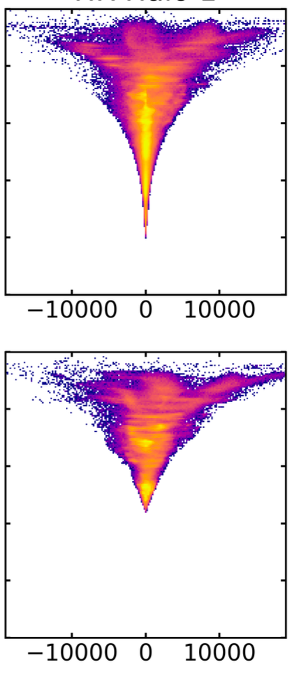
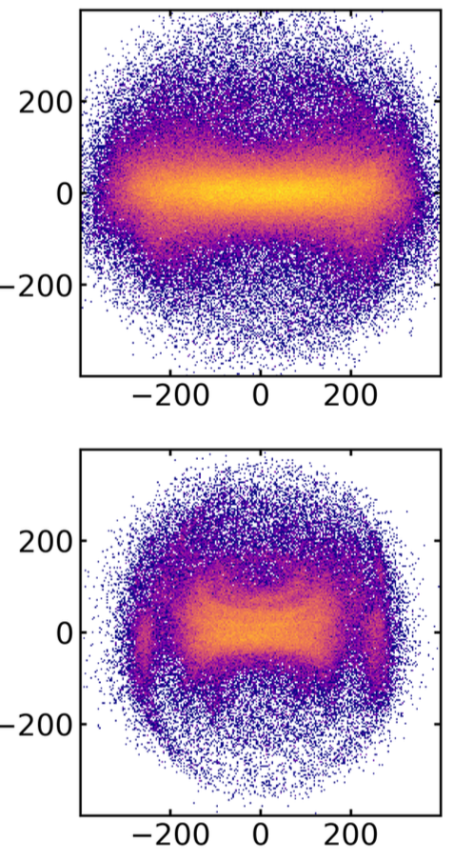


Kinematics of stellar halos in various DM models
Based on APOSTLE high res runs
CDM
Energy
$V_{φ}$(km/s)
V_{r} (km/s)
Energy
$V_{φ}$(km/s)
SIDM
r (kpc)
L_{z}
V_{r} (km/s)

Slide 13
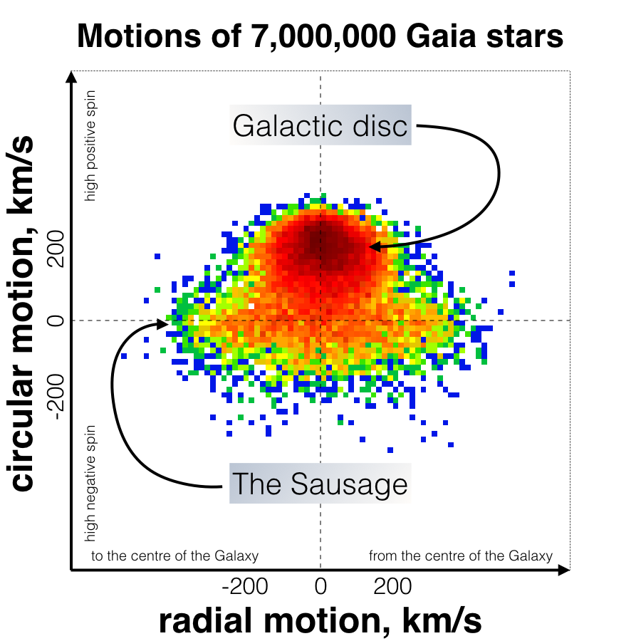


Kinematics of stellar halos in various DM models
Based on APOSTLE high res runs
$V_{φ}$(km/s)
$V_{φ}$(km/s)
V_{r} (km/s)

Slide 14



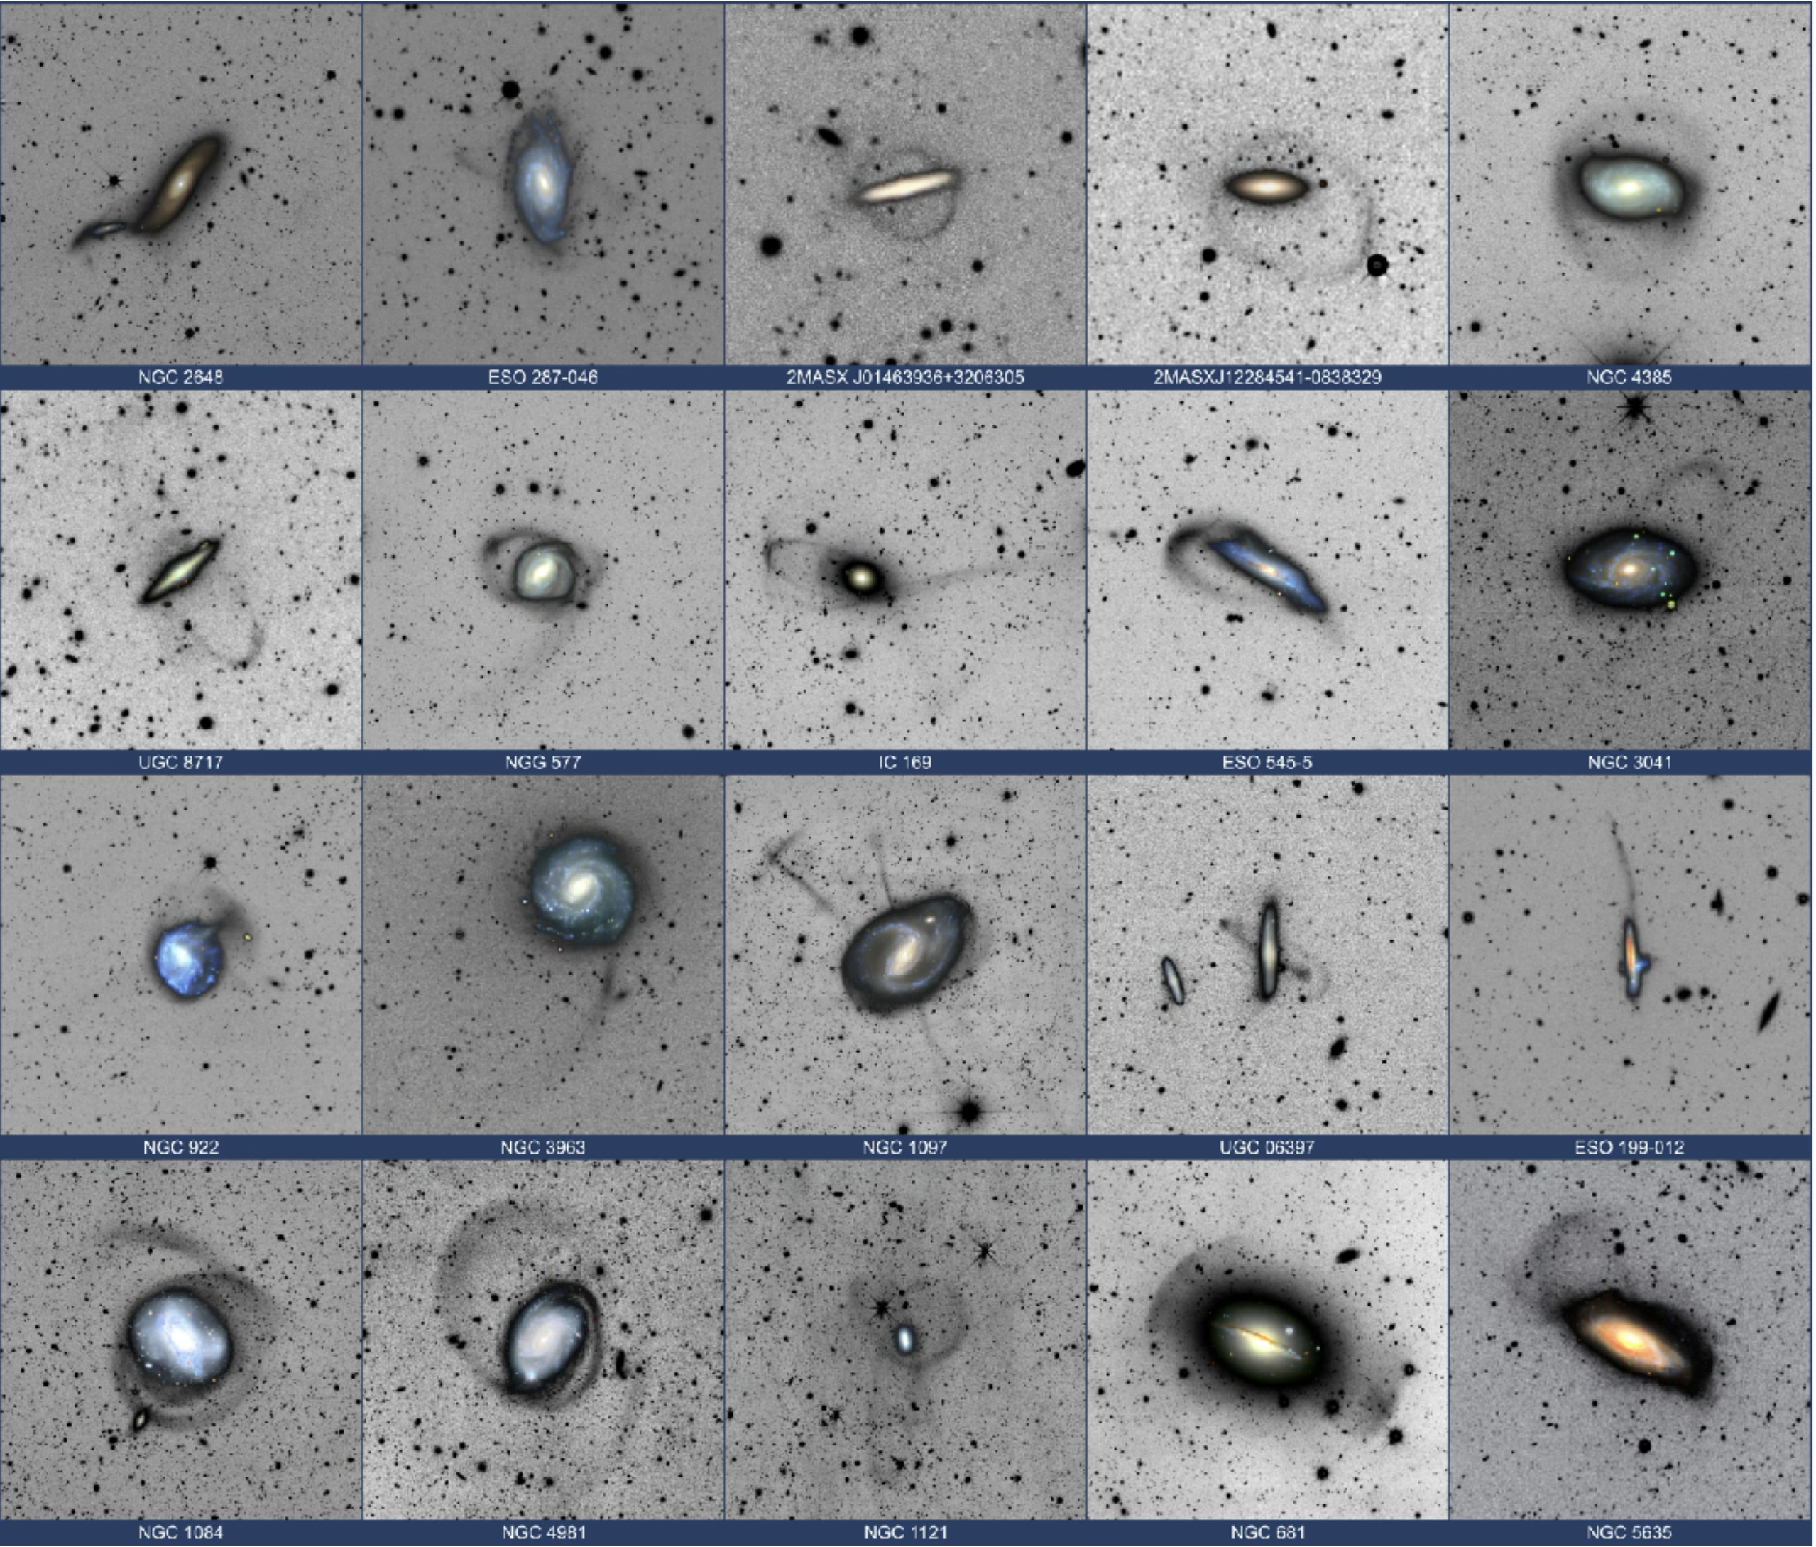
ESA F2 MISSION (selected in Nov 2022, full adoption in 2026, launch around 2030)
Lead by Spain - PI: Rafael Guzmán
Science goal:
Observing the low-surface brightness (sub)structures around Milky Way-like halos for probing galaxy formation and dark matter physics on small scales.
Observing strategy:
Survey: > 80 MW-like galaxies
Total Observing time: 150 hrs/gal
SBlim ≤ 31 mag arcsec⁻²
Credit: Martinez-Delgado

Slide 15
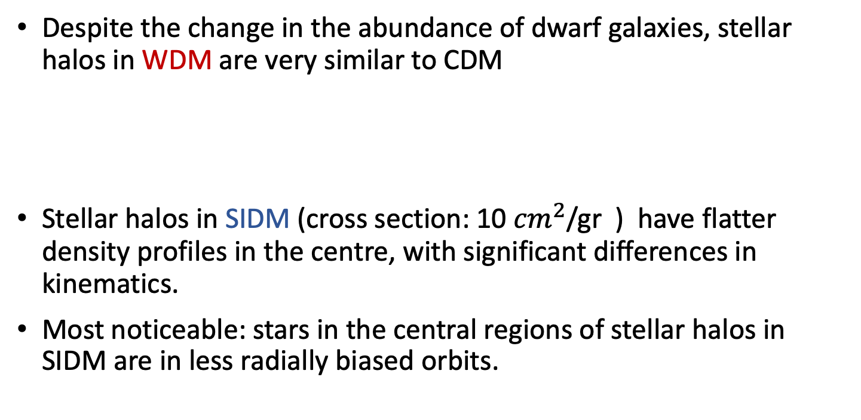
Key takeaway points on
Galactic halos in CDM, (WDM) & SIDM
Despite the change in the abundance of dwarf galaxies, stellar halos in WDM are very similar to CDM
Stellar halos in SIDM (cross section: 10 ${cm}^{2}$/gr ) have flatter density profiles in the centre, with significant differences in kinematics.
Most noticeable: stars in the central regions of stellar halos in SIDM are in less radially biased orbits.

Slide 16
Disruption of dwarf galaxies in various DM models
V_{peak} < 50 km/s
V_{peak} > 50 km/s

Slide 17
Kinematics of stellar halos in various DM models
Galaxy 1
Galaxy 2
Galaxy 3

Slide 18
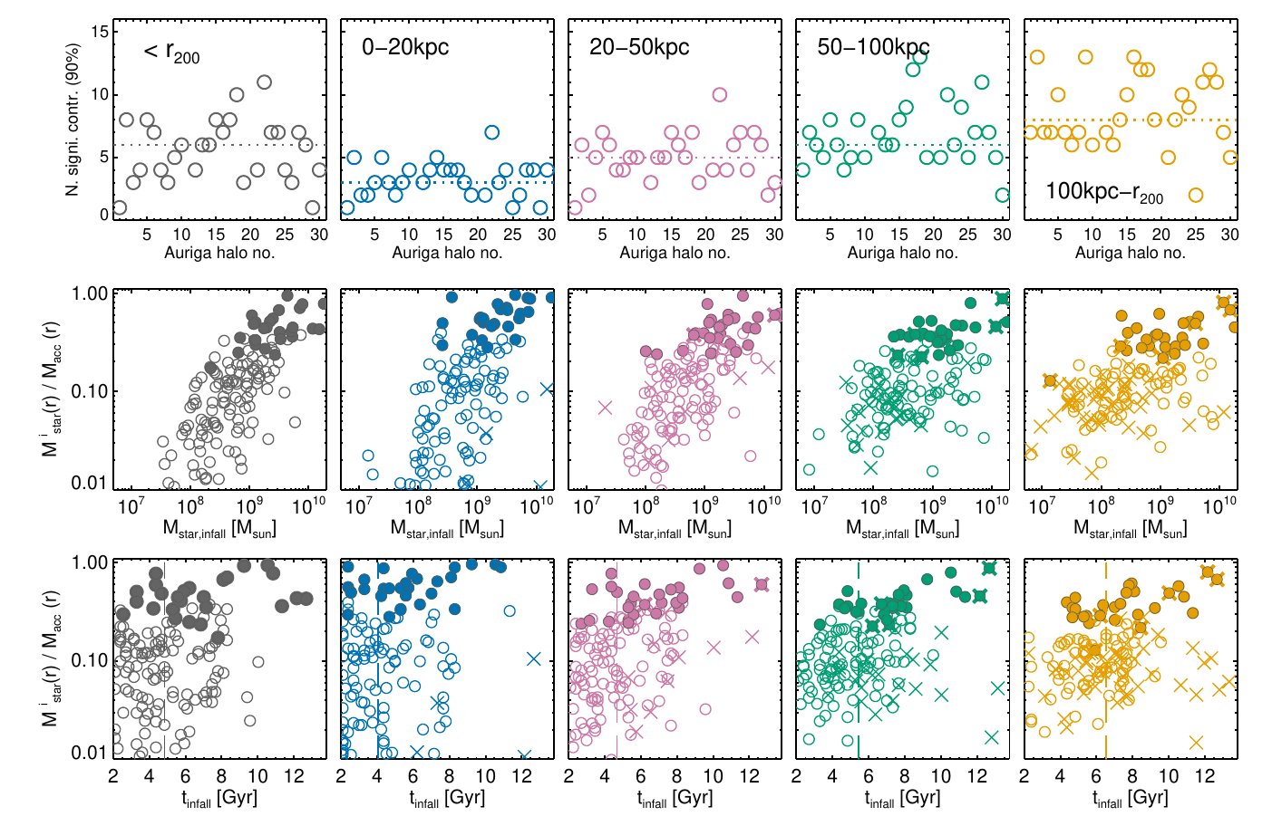
The formation of Galactic halos from disrupted dwarf galaxies
Number of “significant progenitors” (forming 90% of the stellar halo mass) at various radii:
the inner regions are formed by very few dwarf galaxies, thar are relatively bright
(see, also, Deason et al. 2015, Monachesi et al. 2019, …)
AF+2020

Slide 19
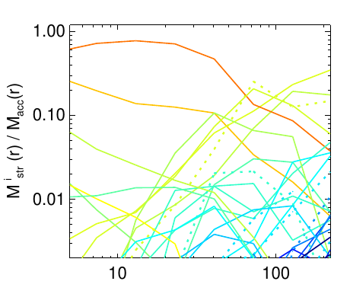
The formation of Galactic halos from disrupted dwarf galaxies
Tracing back accreted stars to their progenitors
Low mass progenitors
High mass progenitors
Mass contributed from various progenitors spherical shells
One example:
AF+2020
r_{GC} [kpc]

Slide 20
Kinematics of the inner stellar halo: Gaia-Enceladus-Sausage
Belokurov et al. 2018:
stars: [Fe/H] < -1 , b > 25 deg
Velocity space of stars shows two prominent features
Galactic disk rotating with ~ 200 km/s
halo component with highly orbital anisotropy, β ~ 0.85

Slide 21
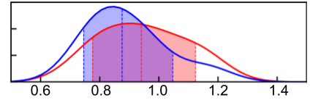
Disrupted dwarf galaxies (halo progenitors) in various DM models
Mass spectrum of disrupted objects (halo progenitors)
There are fewer disrupted objects in WDM
There are more disrupted objects in SIDM
CDM
WDM
SIDM
Accreted stellar halo mass ( <R₂₀₀) relative to CDM
Peak mass before infalling to the MW-mass halos
M_{acc, XDM} / M_{acc, CDM}
Forouhar-Moreno, AF, et al. (2024)

Slide 22
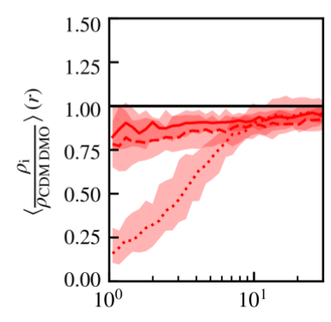
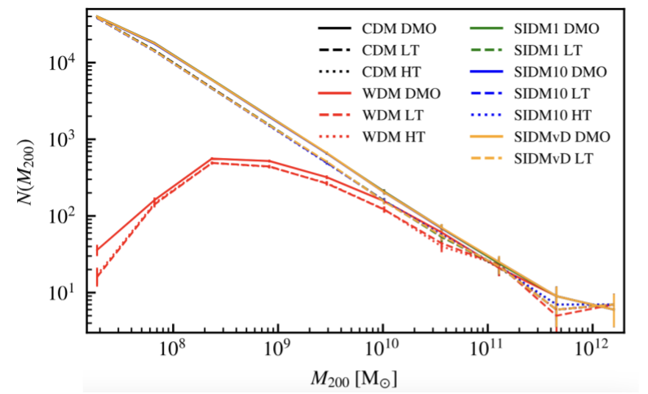
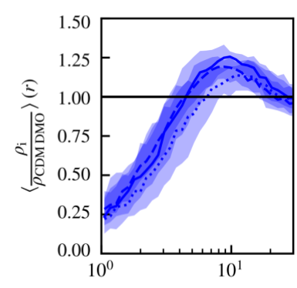
Low mass halos in WDM and SIDM
WDM
Dark matter halo mass function
CDM+SIDM
WDM
SIDM
r (kpc)

