Slide 1
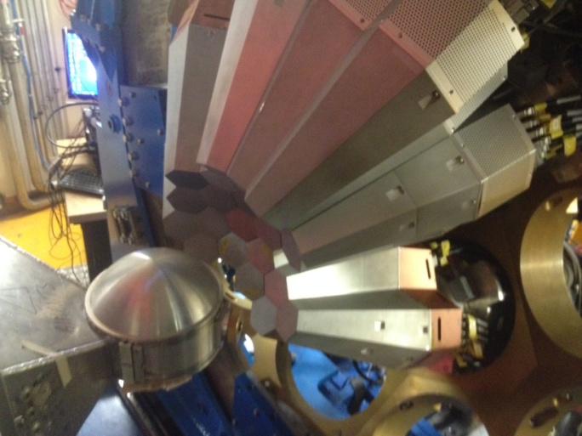


Position Sensitive γ-ray Detectors from tracking to imaging arrays
Andres Gadea (IFIC-CSIC, Spain)
Maria Doncel (Stockholm University)
GeHP Position Sensitivity and the Tracking array concept development started on mid 90’ in Europe and USA.
Goal was to maximize the solid angle coverage by GeHP in the arrays without loosing P/T performance.
Arrays based on Planar (CUBE, DEGAS) and Coaxial (MARS, AGATA, GRETA) detectors, have been proposed and few are under construction.
Notes:
Introduction
Overview of the system
Physics outcomes from this meeting important
define physics case
experimental constraints
range of experiments
key experiments demonstrator/full array
meeting
Key design parameters Before too late
120/180 decision

Slide 2

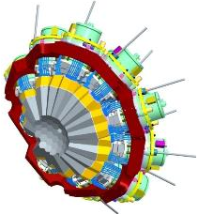
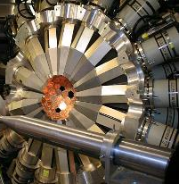
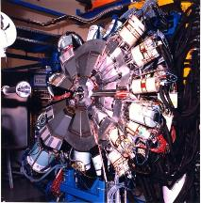
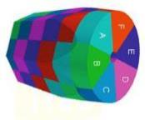
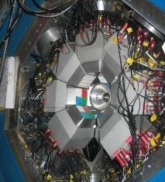
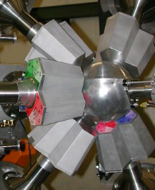
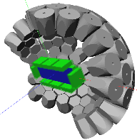
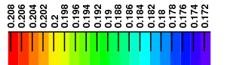

HR γ-Spectroscopy Instrumentation for Nuclear Structure
Late 90’s Large γ−Arrays
European Tracking Arrays based on
Position Sensitive Ge Detectors
GAMMASPHERE
EUROBALL
AGATA
ε ∼ 10 — 5 %
( M_{γ}=1 − M_{γ}=30)
Compact γ−Arrays optimized Doppler correction, low Mγ
ε ∼ 35 — 24 %
( M_{γ}=1 − M_{γ}=30)
EXOGAM
MINIBALL
DEGAS
R&D phase
ε ∼ 17 − 20% (M_{γ}=1) extended sources ~2π → clearance for other detectors
ε ∼ 20 % M_{γ}=1

Slide 3
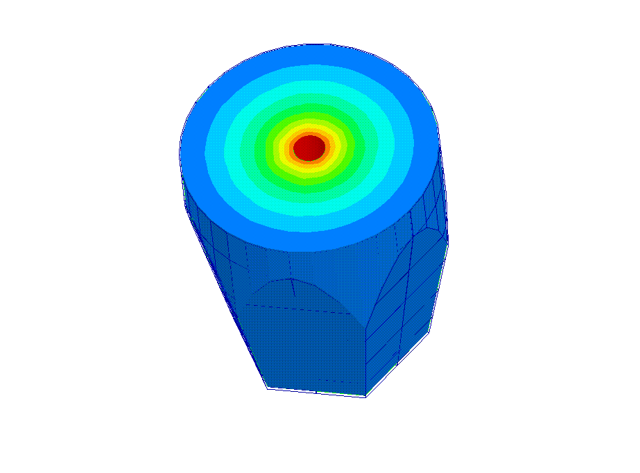
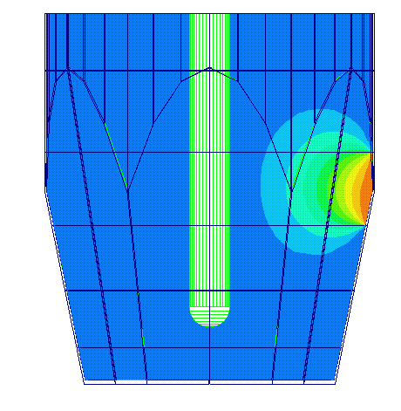
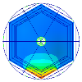
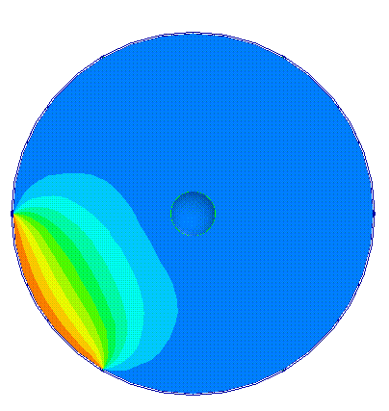
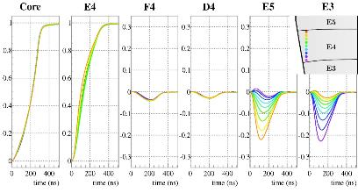
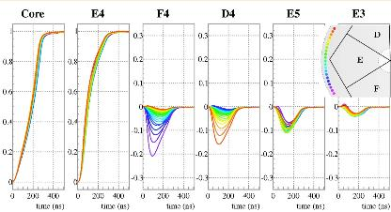
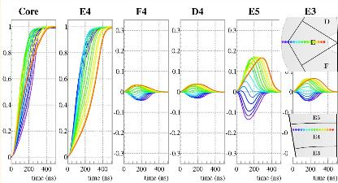
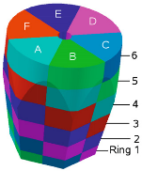
Position Sensitive Detector for γ-rays
Real potential
Weighting potential
Induced current by the moving charge in the sensing contact → weighting potential Ramo’s Theorem.
4000 V
2000 V
0 V
1 V
0.5 V
0 V
E. Gatti, et al. NIM 193 (82) 651
Depth
Azimuthal
Radial
Figures courtesy of
M.Ginsz, et al., IPHC Strasbourg

Slide 4

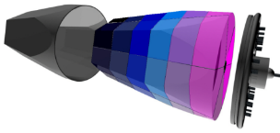
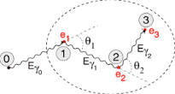
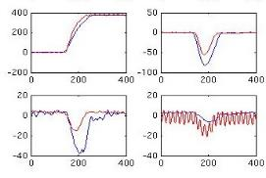

Gamma Tracking Array Concept
Event building time-stamped data
Highly segmented
HPGe detectors
Global level
Local level
•
•
•
Energies, times,
interaction points
•
•
Reconstruction of γ-rays from the hits
γ
•
•
•
(x,y,z,E,t)_{i}
Synchronized digital electronics to digitize (14 bit, 100 MS/s) and process the 37 signals generated by crystals
Pulse Shape Analysis of the recorded waves
Analysis & correlation with other detectors
Readout Raw Data (10 kB/evt/crystal)
HARDWARE
SOFTWARE

Slide 5

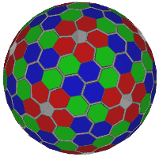
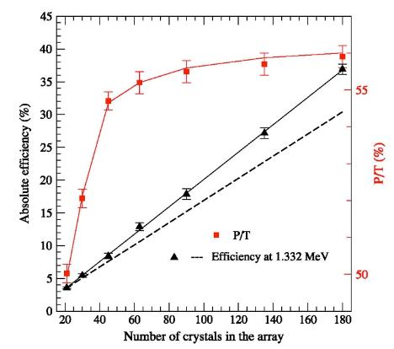
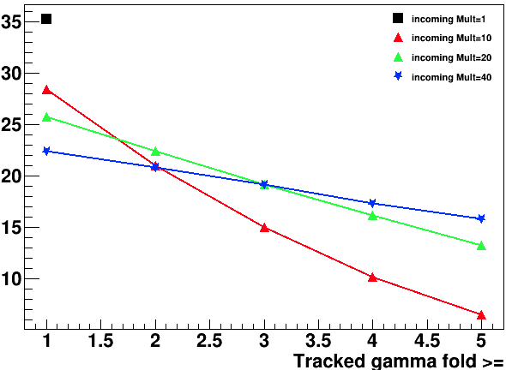
AGATA 4π Performance simulations
Efficiency and P/T Monte Carlo simulations for the
180 Capsules set-up with Tracking
A. Korichi et al., NIM A 872 (2017) 80
Linear Scaling from known efficiencies
Simulation
These expectations require the PSA improvements regarding multiple interactions in one segment.
For 1 MeV
Efficiency %
~1MeV γ-rays
Efficiency depends as well on the γ-ray multiplicity
Recent Upgraded Simulations by M.Labiche (STFC)
CSNSM-Orsay, STFC-Daresbury

Slide 6
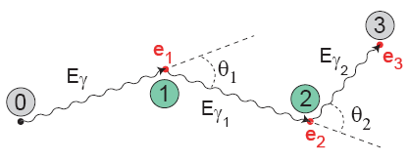
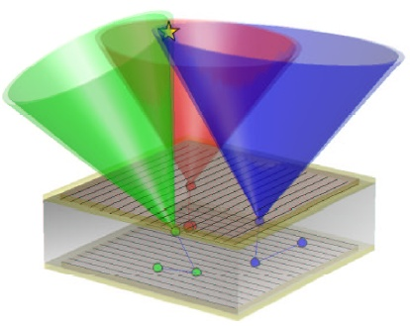
Tracking & imaging concepts
Tracking:
Reconstruct the path of γ rays to improve P/T and background reduction.
Requirements:
Good energy and position resolution.
High granularity.
Imaging:
Reconstruct the origin of the γ ray in the implantation plane for the isomeric decay.
Requirements:
Good energy and position resolution.
High granularity.
Large separation between Ge in the stacks
(increase average distance between interactions)
Notes:
6

Slide 7
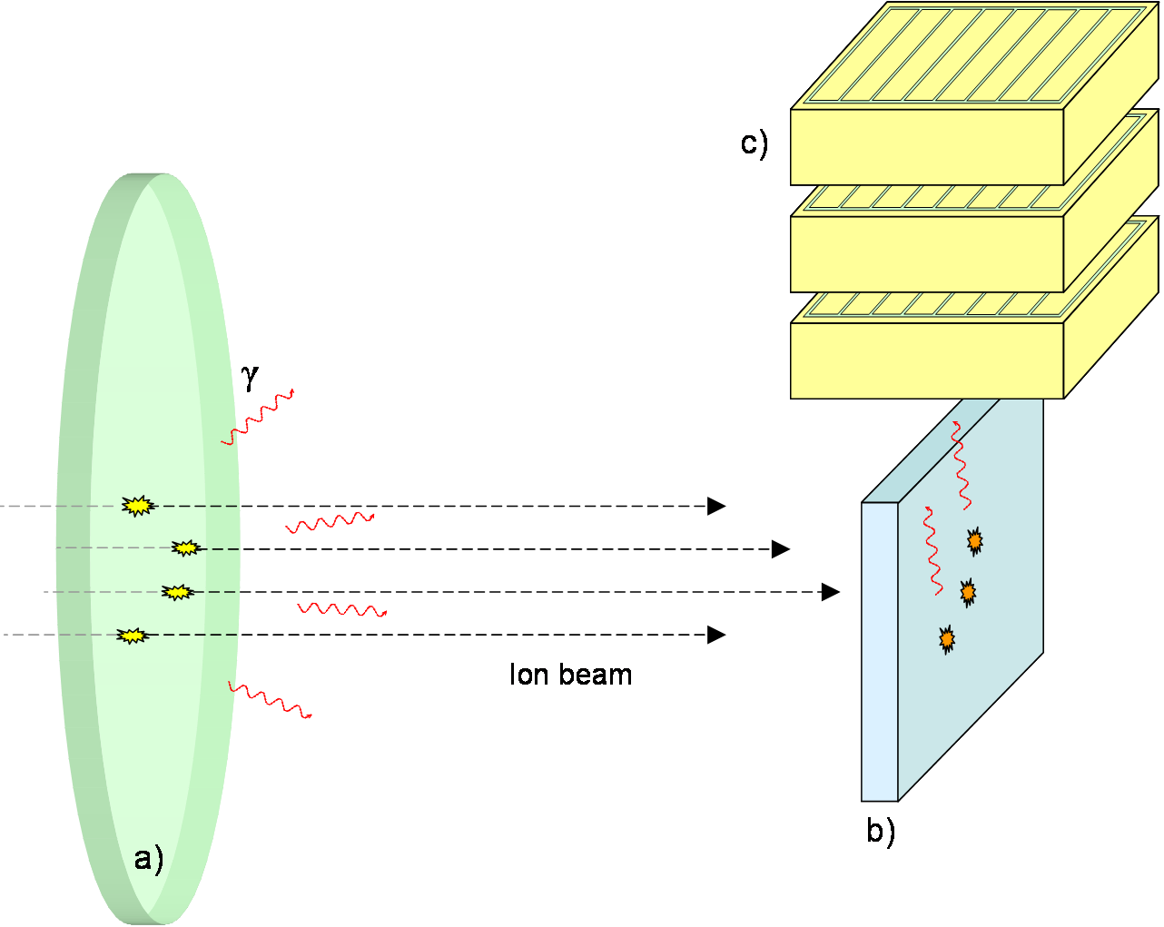
Background suppression for tagging of γ−rays in isomeric and radioactive decays
Improve the correlation between the implantation and the decay for long-lived isomers
Reconstruct the initial energy from Compton escape events and increase the absolute efficiency
Identify gamma events from the background sources
Suppress the Compton background

Slide 8
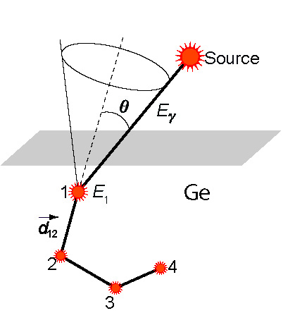
Thinking on imaging…
“Ideal” Compton Imaging
“Real” Compton Imaging
ϕ
Coaxial detector
&
Planar detector
Position resolution FWHM ≈ 4-5 mm
Position resolution FWHM ≈ 1-2 mm
F. Recchia et al., NIMA 604 (2009) 555 P-A Söderström,., et al. NIMA 638 (2011) 96
A. Khaplanov et al., NIMA 592 (2008) 325
Ge array configuration including planar detectors?

Slide 9
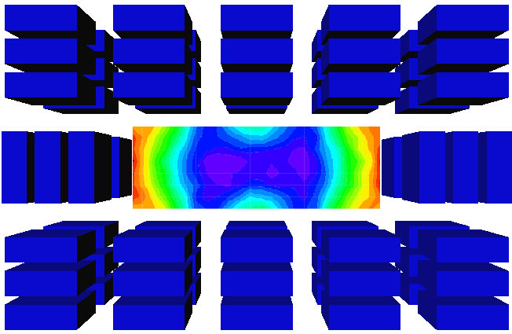
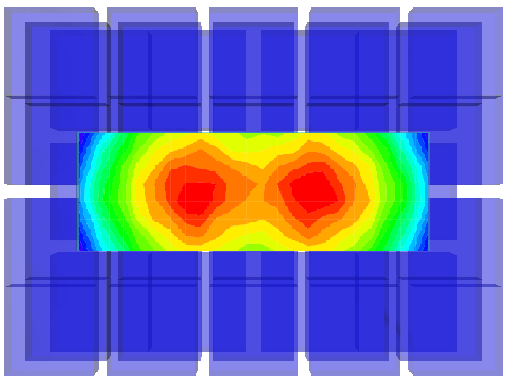


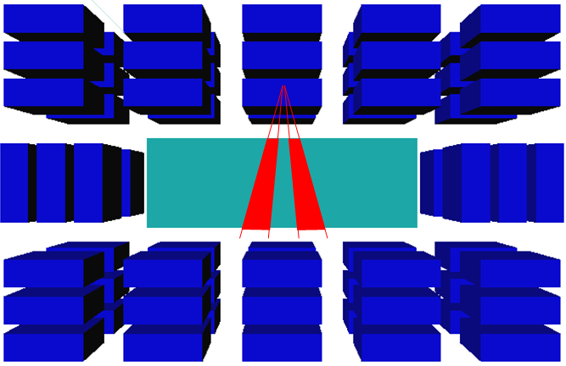
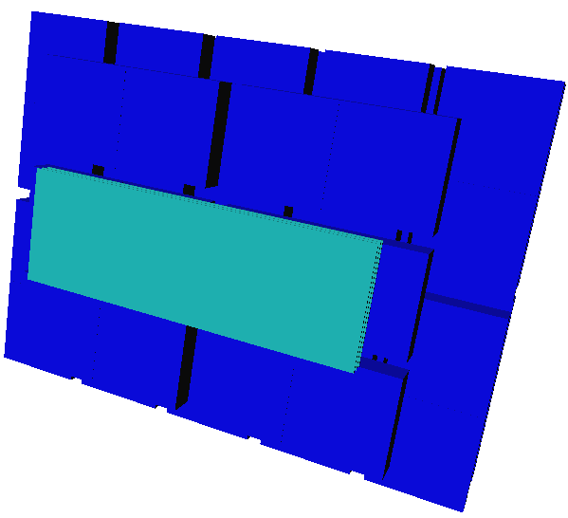
ε_{p}
Realistic γ-ray Imaging Capability
Wall
ε_{p} ≈ 7 %
ε_{p} ≈ 7 %
~4mm
Eγ = 1.3 MeV
<5% of the area
>15% of the area
Notes:
9

Slide 10
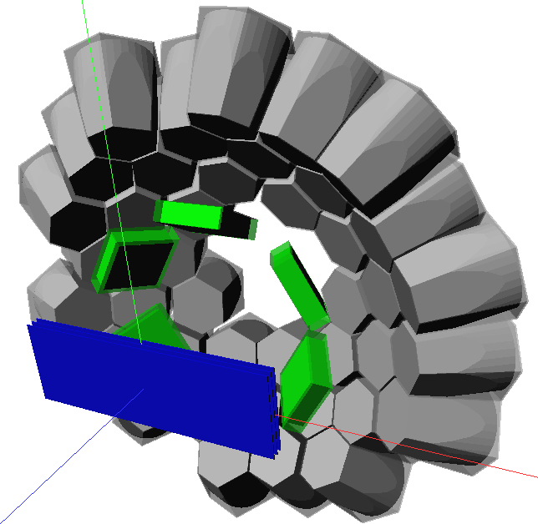
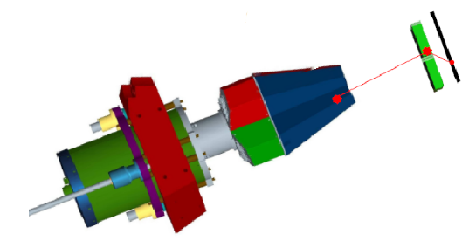
DEGAS (beyond 3rd phase) AGATA type+planar Ge telescope array?
Idea: AGATA-planar telescope
Composed system: AGATA + planar array takes advantage of the high AGATA efficiency and of the position resolution of planar detectors, about 1-2 mm compared to the 5 mm of AGATA.
Requires R&D
12 cm
23.5 cm
40 AGATA tapered coaxial HPGe crystals
(9 cm long) + 6 planar HPGe detectors (7*7*2 cm³)
+ Si implantator detector (AIDA)

Slide 11
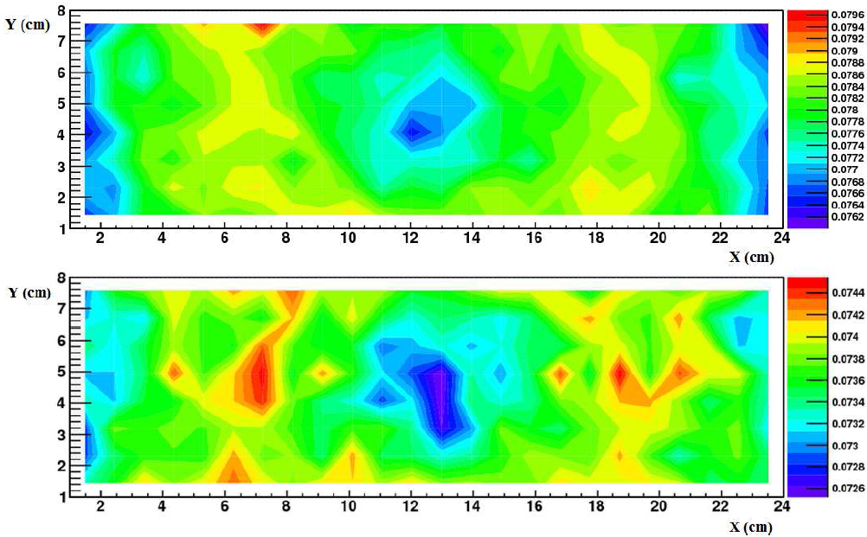
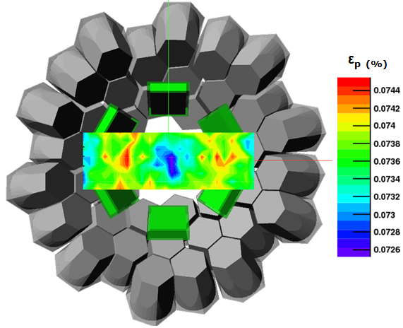
Test geometry for DEGAS
AGATA at GSI
AGATA + PLANAR’s
In basic capabilities (ε_{p} and P/T)
the system is not improved but
we gain imaging capabilities…

Slide 12
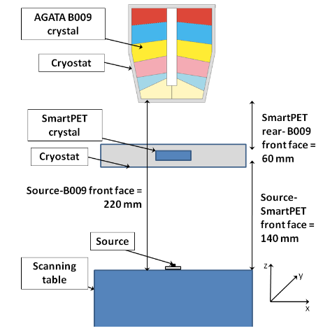
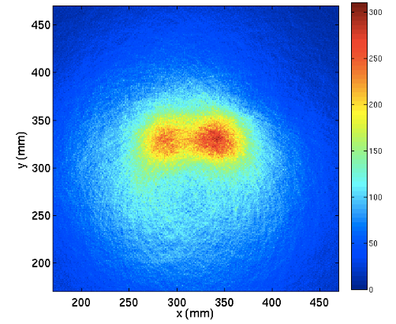
Test measurements
S. Moon et al., J. of Instrum. 6 C12048 (2011)
Test without PSA analysis for the AGATA detector
Sum of image matrices for source at two locations with a separation of 60 mm.
Notes:
12

Slide 13
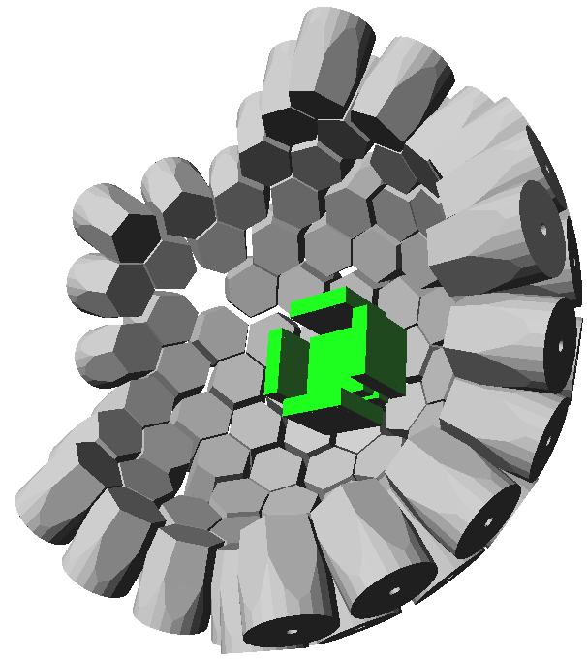

New Possibility: DSSD-Ge implantation detector
Planar position sensitive HPGe detector for combined implantation, beta decay and gamma detection
Prototype developed for NSCL beams Ge amorphous contacts (R&D)
Beta decay efficiency ~40% for a single GeHP planar | ~ 90/60% with/without considering neighbouring pixels. Improvements on the tracking (imaging) of γ-rays
N. Larson et al., Nucl. Instr. And Meth. A 727 (2013) 59-64
Notes:
13

Slide 14
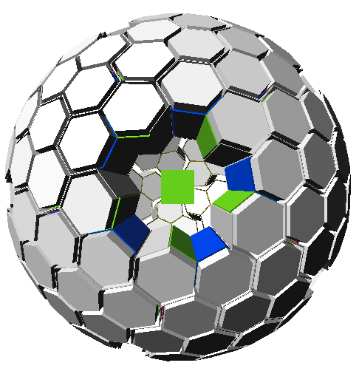

DEGAS + planar Ge implantation detector
35 EUROBALL 3-clusters coupled with 20 AGATA triple clusters + DSSD-Ge planar (8*8*2 cm³) with AIDA?
Notes:
14

Slide 15
New Possibility: DSSD-Ge implantation detector
Optimal solution is to use the Planar DSSD GeHP detector as implanter or in close geometry with the Si implanter AIDA.
Issue: usually Planar DSSD GeHP detectors have one of the contacts made with Li and therefore the detectors can be annealed without destroying completely the contact.
Attempts to use alternative amorphous Ge contacts has not bean successful because these contact are not stable with time.
New detector technology development program started by the AGATA collaboration in the framework of ENSAR2 PSeGe JRA
Also R&D on novel Ge-detector geometries for ultimate position resolution and efficiency included in ENSAR2 PSeGe JRA
HPGe DSSD p-type Lithium segmented contact. Investigation of p-type contacts
Notes:
15

Slide 16
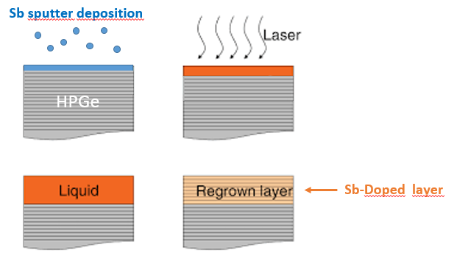
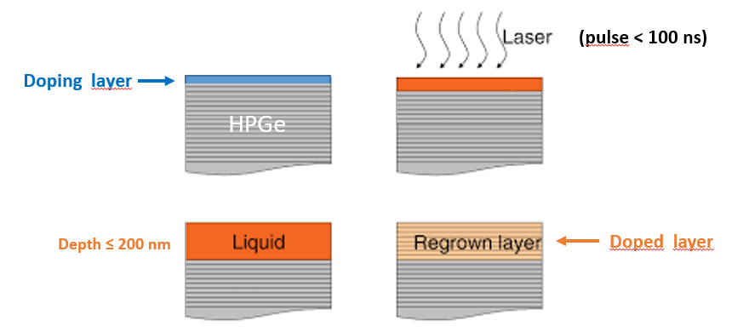
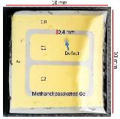
Development of HPGe detector production technologies
Towards the AGATA 4π array
Developments in contact technology performed in the framework of ENSAR2 (PSeGe) and N3G with PLM techniques at the University of Padova, INFN-LNL and IFIC-Valencia
PULSED LASER MELTING TECHNIQUE
pulse < 100 ns
Doping layer
Doped layer
150 nm
PhD Thesis of Stefano Bertoldo: Uni. Valencia and Uni. Padova.
S. Bertoldo et al., The European Physical Journal A 57 (2021) 177
G. Maggioni et al., The European Physical Journal A 54 (2018) 1
S. Bertoldo, D. De Salvador, G.L. Maggioni, D. R. Napoli, W. Raniero, A.Gadea

Slide 17
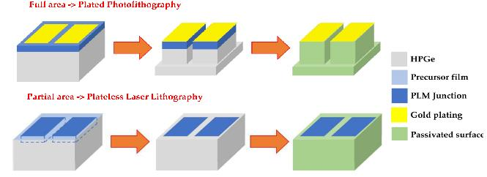
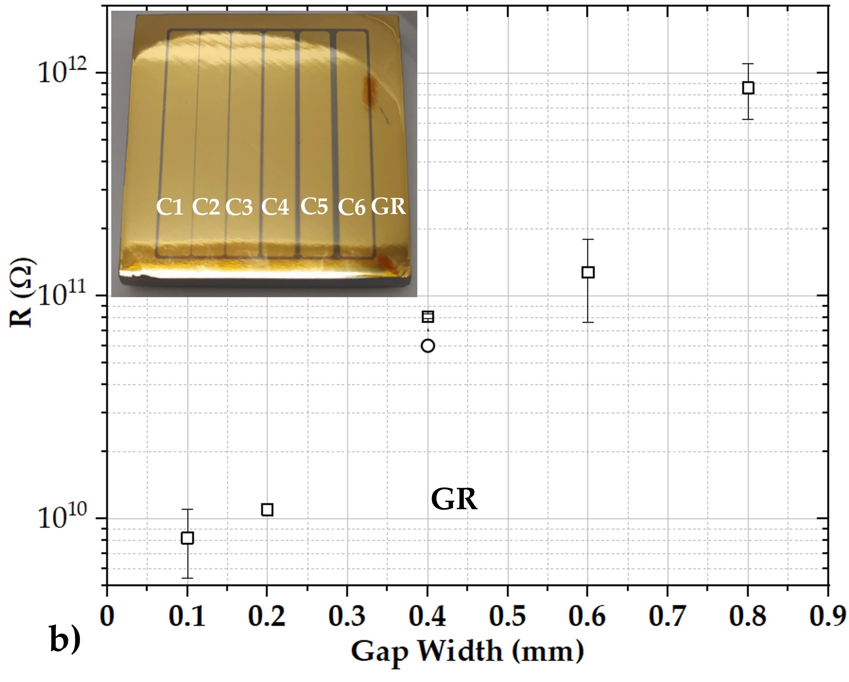
Some results on HPGe detector production technologies for thick planar detectors
Towards the AGATA 4π array
Development of surface treatments, segmentation techniques and passivation
PhD Thesis of Stefano Bertoldo: Uni. Valencia and Uni. Padova.
S. Bertoldo, D. De Salvador, G.L. Maggioni, D. R. Napoli, W. Raniero, A.Gadea

Slide 18
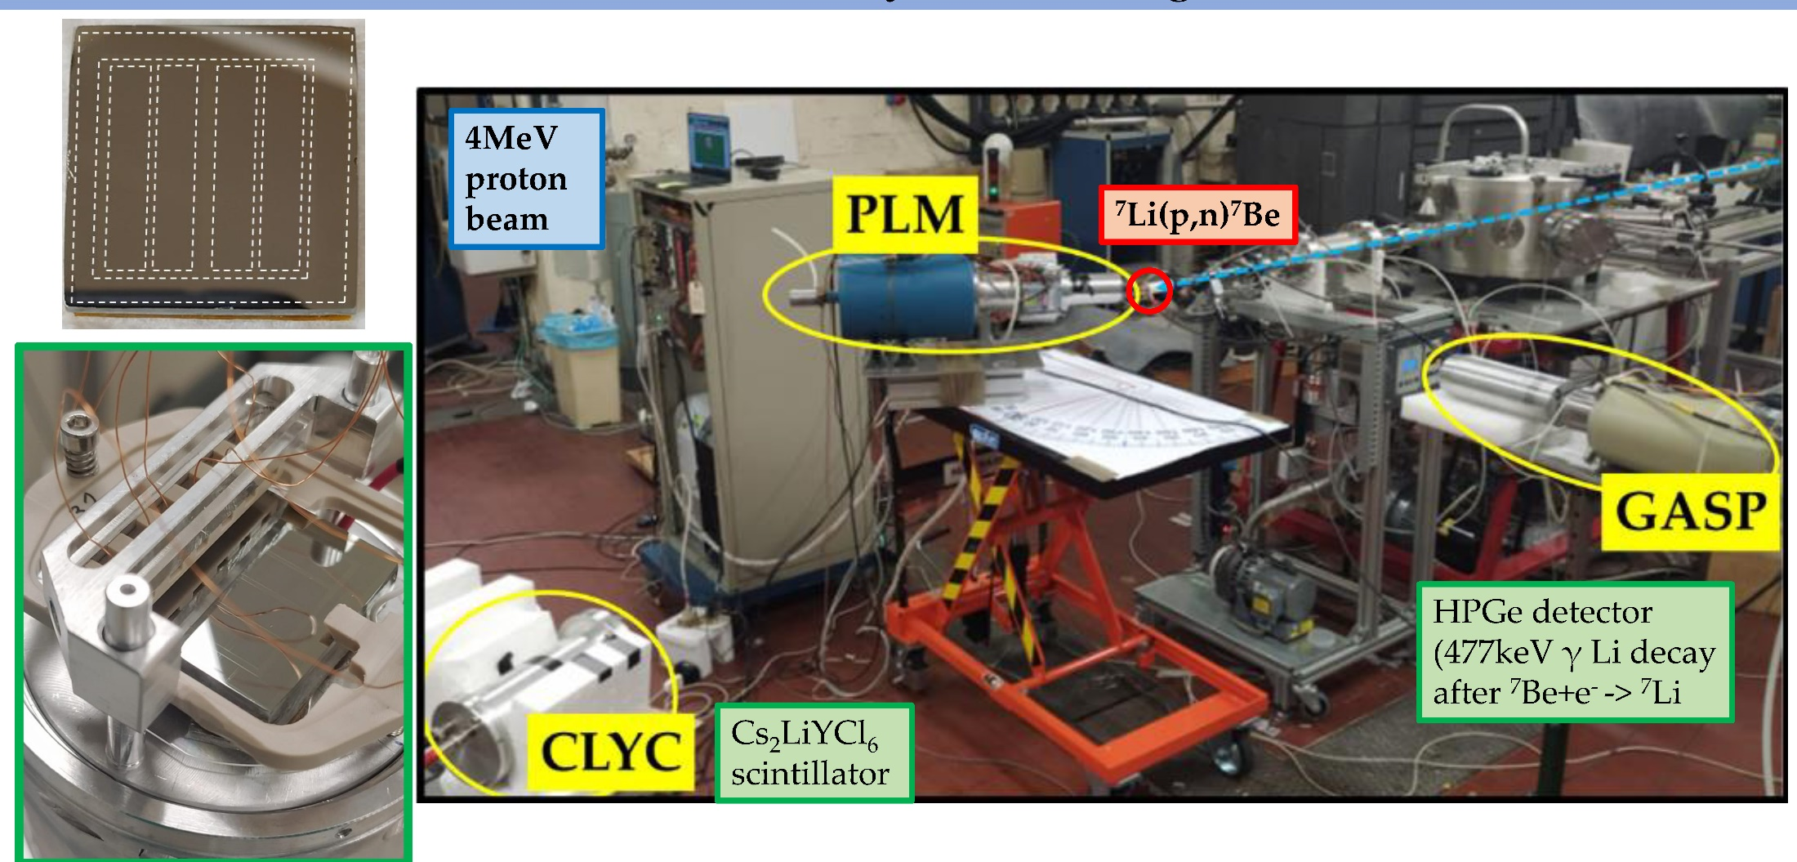
Neutron-damage test at CN linear accelerator in INFN-LNL
8.6mm thick p-type 4 segments, Sb junctions
Towards the AGATA 4π array
PhD Thesis of Stefano Bertoldo: Uni. Valencia and Uni. Padova.
S. Bertoldo, D. De Salvador, G.L. Maggioni, D. R. Napoli, W. Raniero, A.Gadea

Slide 19
Achieved Energy resolution
Sb/p-type/Al Square
Side=28mm
Depth=10mm
Guard ring+ central contact
PhD Thesis of Stefano Bertoldo:
Uni. Valencia and Uni. Padova.
S. Bertoldo, D. De Salvador, G.L. Maggioni, D. R. Napoli, W. Raniero, A.Gadea

Slide 20
Outlook:
The use of tracking detector arrays maximize your solid angle coverage without losing sensitivity. The possibility to incorporate higher position resolution detectors for the g-rays will allow to perform a limited imaging event by event.
Imaging reduces the background, increases P/T and allows higher implantation rates
Detectors should be places as close as possible from the implanter and thus require annealing to repair radiation damage.
New contact technologies are under development that will allow p-type segmented contacts to survive annealing. These developments require new funding that our collaboration is seeking.
Once the contacts are developed we will investigate the effects of radiation damage by implantation of heavy ions as well.

