Slide 1
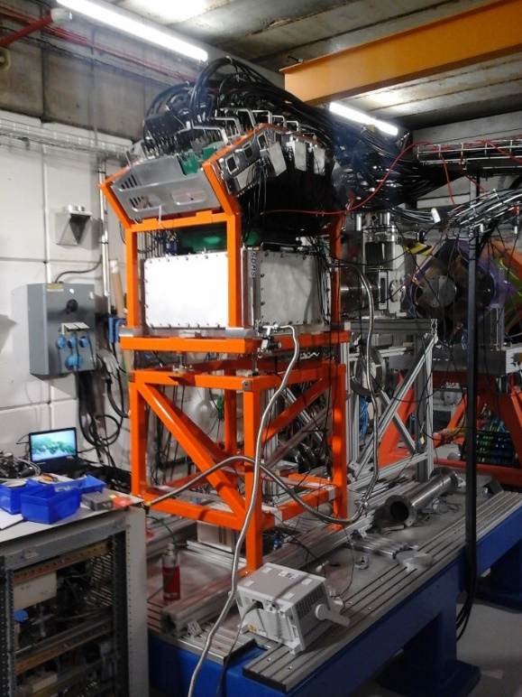
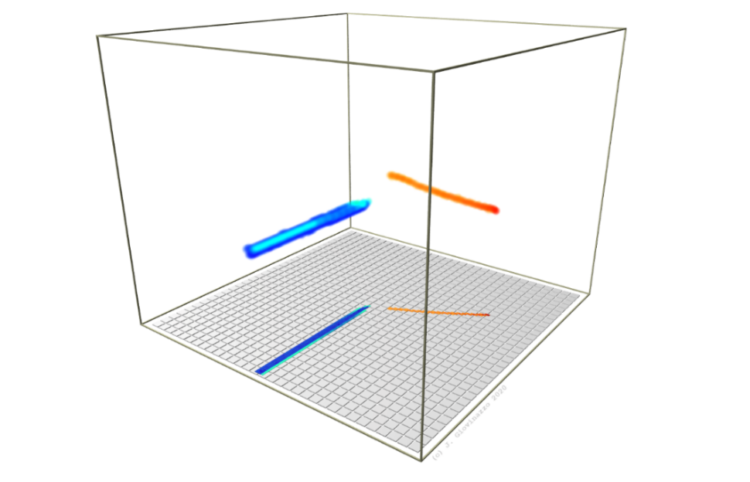


Active Stoppers for Decay Experiments Workshop
March 2025 – Valencia, Spain
proton decay studies with ACTAR TPC
J. Giovinazzo – LP2iB (former CENBG) – Bordeaux
⬥ proton decays physics cases
⬥ time projection chambers / ACTAR TPC
⬥ recent results at GANIL
⬥ signal processing, simulation and analysis
⬥ improvements & perspectives
if time allows…

Slide 2
Active Stoppers for Decay Experiments Workshop
March 2025 – Valencia, Spain
proton decay studies with ACTAR TPC
J. Giovinazzo – LP2iB (former CENBG) – Bordeaux
⬥ proton decays physics cases
⬥ time projection chambers / ACTAR TPC
⬥ recent results at GANIL
⬥ signal processing, simulation and analysis
⬥ improvements & perspectives
Active Stoppers and ancillary detectors
in fragmentation facilities
Electronics and DACQ
Sustainable operation (waveform processing,
noise filtering, AI-based optimizations)
Decay experiments with Active Stoppers
New technologies and materials
if time allows…

Slide 3
physics from beta-delayed proton decay
J. Giovinazzo (LP2iB – CNRS IN2P2 / Univ. Bordeaux)
2025/03 Active Stoppers for Decay Experiments – proton decay studies with ACTAR TPC

Slide 4




β-xp: decay spectroscopy
many physics cases
• masses
• isospin symmetry
• weak interaction
• nuclear structure
• deformation
• nuclear astrophysics
• level densities
• excited states lifetimes
• 2-proton decay
• …
beta decay
Fermi / Gamow Teller
daughter nucleus de-excitation
• gamma transitions
• (multi-)proton emission
$${}_{N}^{A}{Xa}$$
F
J. Giovinazzo (LP2iB – CNRS IN2P2 / Univ. Bordeaux)
2025/03 Active Stoppers for Decay Experiments – proton decay studies with ACTAR TPC
IAS
β⁺ / EC
p
detailed decay spectroscopy
→ address several topics
simultaneously
very exotic stuff…
→ exploration: fragmentation
→ details/precision: ISOL
Q_{EC}
p
γ
2p?
GT
${}_{N+1}^{A−2}{Xd}$ $(+2p)$
γ
${}_{N+1}^{A−1}{Xc}$ $(+p)$
S_{2p}(Xb)
$${}_{N+1}^{A}{Xb}$$

Slide 5




β-p: Fermi decay
Isobaric Multiplet Mass Equation (IMME, Wigner, 1957)
charge independent strong nuclear interaction + Coulomb
M(T_{Z}) = a + b×T_{Z} + c×T_{Z}²
T = 2
β(F)-p: IMME (masses)
isospin mixing
β (F)
less exotic (known)
⁵²Ni
T = 2
T = 2
T = 2
T = 2
p
T = 1
⁵²Cr
⁵¹Fe
T = 1
T = 1
⁵²Co
(+p)
$${}_{N}^{A}{Xa}$$
J. Giovinazzo (LP2iB – CNRS IN2P2 / Univ. Bordeaux)
2025/03 Active Stoppers for Decay Experiments – proton decay studies with ACTAR TPC
F
T = 0
⁵²Mn
IAS
⁵²Fe
T_{Z} = −2
T_{Z} = −1
T_{Z} = 0
T_{Z} = +1
T_{Z} = +2
β⁺ / EC
p
Q_{EC}
p
worst mass precision !!!
does not compete with
precision (trap) measurements
but the first access to mass for
the most exotic nuclei
(→ when produced in fragmentation)
γ
2p?
GT
${}_{N+1}^{A−2}{Xd}$ $(+2p)$
γ
${}_{N+1}^{A−1}{Xc}$ $(+p)$
S_{2p}(Xb)
$${}_{N+1}^{A}{Xb}$$

Slide 6
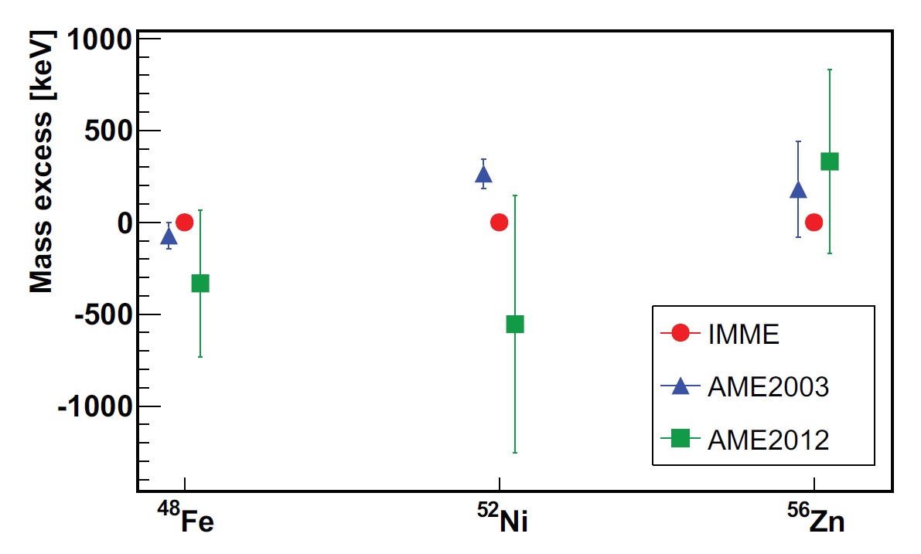
β-p: Fermi decay
experiment @ GANIL / LISE3
comparison of masses
from IMME (exp.) with A.M.E.
⁵⁶Zn
⁵⁶Cu
⁵²Ni
⁵⁶Ni
β(F)-p: IMME (masses)
isospin mixing
⁵²Co
⁵⁶Co
several cases in A ∼ 50 mass region
in C. Dossat et al.,
Nucl. Phys. A 792 (2007)
+ Coulomb displacement energy
(if less than 3 param. of the IMME)
⁴⁸Fe
⁵²Fe
⁵⁶Fe
⁴⁸Mn
⁵²Mn
⁴⁸Cr
⁵²Cr
$${}_{N}^{A}{Xa}$$
⁴⁸V
F
J. Giovinazzo (LP2iB – CNRS IN2P2 / Univ. Bordeaux)
2025/03 Active Stoppers for Decay Experiments – proton decay studies with ACTAR TPC
⁴⁸Ti
IAS
β⁺ / EC
S.E.A. Orrigo et al., PRC 93 (2016)
p
Q_{EC}
p
γ
2p?
GT
not comparable to
trap measurements !!!
γ
${}_{N+1}^{A−2}{Xd}$ $(+2p)$
${}_{N+1}^{A−1}{Xc}$ $(+p)$
S_{2p}(Xb)
$${}_{N+1}^{A}{Xb}$$

Slide 7
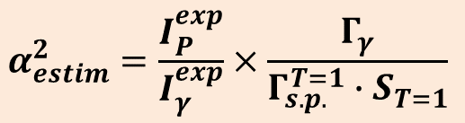
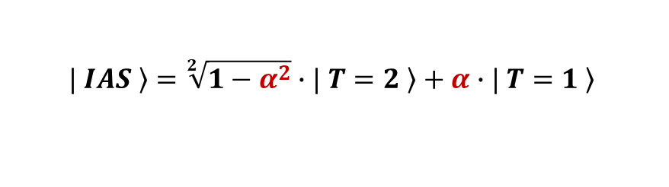
β-p: Fermi decay
proton emission from IAS is forbidden (isospin)
→ isospin mixing
→ test of INC terms in nucl. interaction (collab. N. Smirnova)
example: T_{Z} = −2 (simple 2-states mixing)
β(F)-p: IMME (masses)
isospin mixing
$\left.| IAS \right\rangle =\sqrt[2]{1−α^{2}}∙\left.| T=2 \right\rangle +α∙\left.| T=1 \right\rangle$
$$α_{estim}^{2}=\frac{I_{P}^{exp}}{I_{γ}^{exp}}×\frac{Γ_{γ}}{Γ_{s.p.}^{T=1}∙S_{T=1}}$$
$${}_{N}^{A}{Xa}$$
F
J. Giovinazzo (LP2iB – CNRS IN2P2 / Univ. Bordeaux)
2025/03 Active Stoppers for Decay Experiments – proton decay studies with ACTAR TPC
IAS
β⁺ / EC
p
Q_{EC}
p
γ
2p?
GT
${}_{N+1}^{A−2}{Xd}$ $(+2p)$
γ
${}_{N+1}^{A−1}{Xc}$ $(+p)$
S_{2p}(Xb)
$${}_{N+1}^{A}{Xb}$$

Slide 8
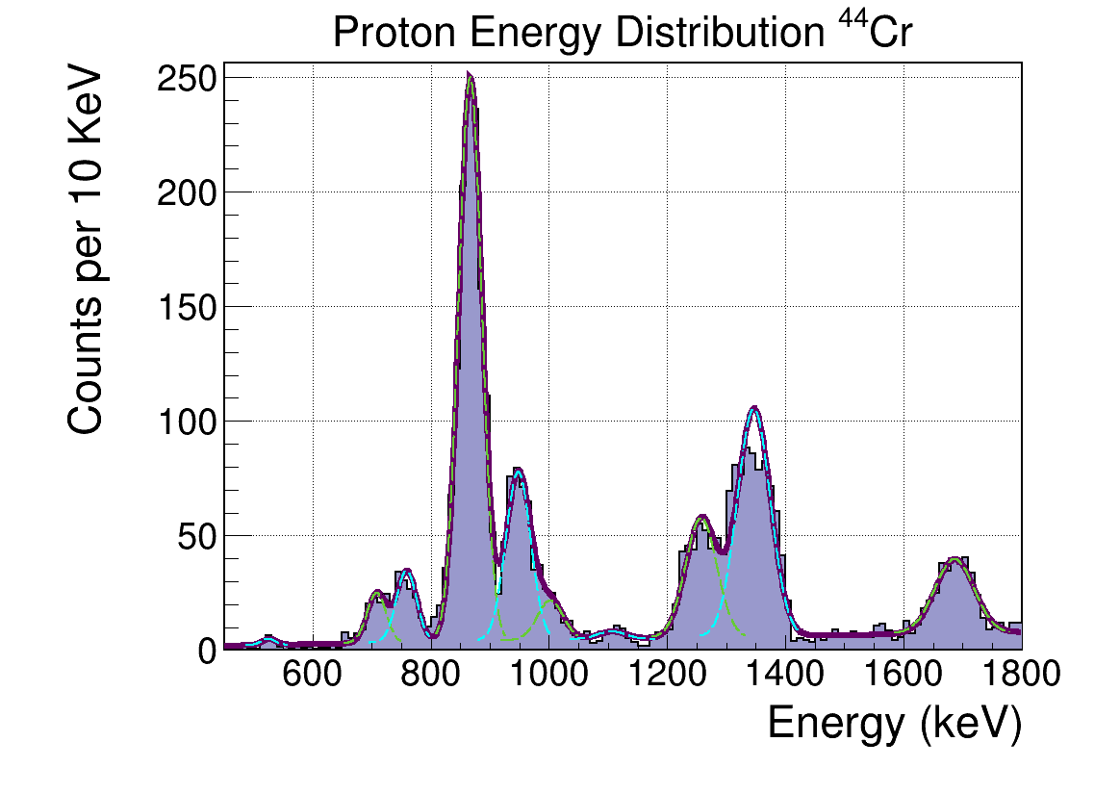
β-p: Fermi decay
proton emission from IAS is forbidden (isospin)
→ isospin mixing
→ test of INC terms in nucl. interaction (collab. N. Smirnova)
example: case of ⁴⁴Cr (T_{Z} = −2)
• position of IAS known from gamma
(E666 / LISE, P. Ascher et al.)
• wrong assignment of the proton transition
(beta pile-up, small transition not resolved)
→ overestimated isospin mixing
→ transition resolved
(E791 + ACTAR TPC, A. Ortega Moral et al.)
β(F)-p: IMME (masses)
isospin mixing
$\left.| IAS \right\rangle =\sqrt[2]{1−α^{2}}∙\left.| T=2 \right\rangle +α∙\left.| T=1 \right\rangle$
$${}_{N}^{A}{Xa}$$
F
J. Giovinazzo (LP2iB – CNRS IN2P2 / Univ. Bordeaux)
2025/03 Active Stoppers for Decay Experiments – proton decay studies with ACTAR TPC
IAS
β⁺ / EC
p
Q_{EC}
p
γ
2p?
GT
${}_{N+1}^{A−2}{Xd}$ $(+2p)$
γ
${}_{N+1}^{A−1}{Xc}$ $(+p)$
S_{2p}(Xb)
$${}_{N+1}^{A}{Xb}$$

Slide 9
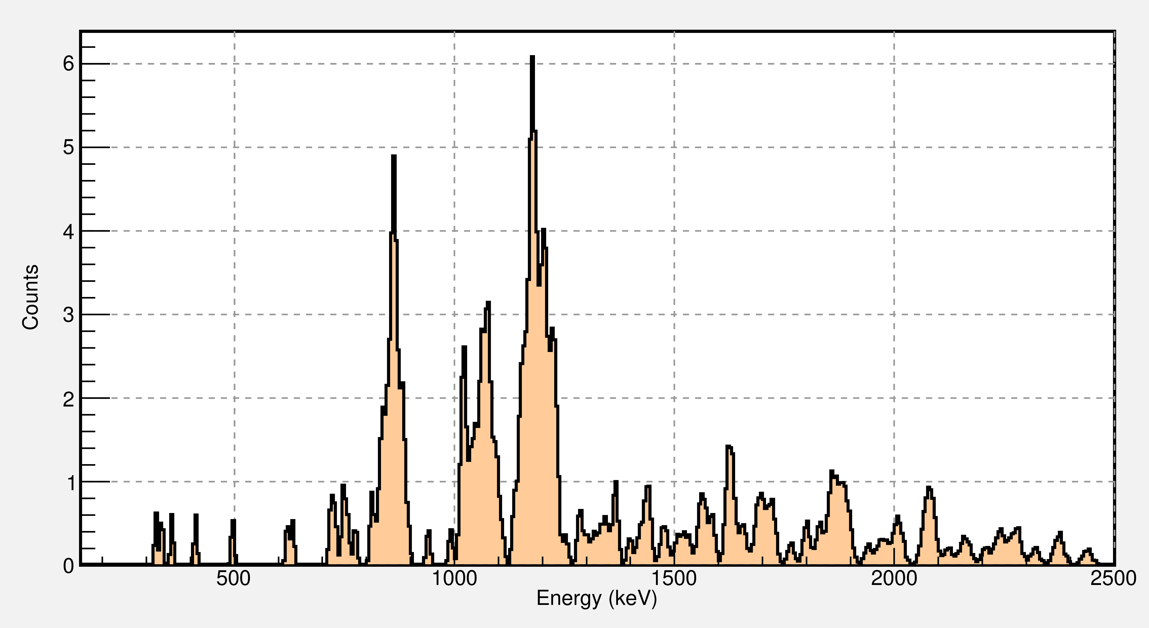
β-p: astrophysics
states close to the proton emission threshold
decay of ³⁵Ca → proton capture ³⁴Cl(p,γ)³⁵Ar
gamma / proton widths in ³⁴Ar
decay of ⁴⁶Mn → proton capture ⁴⁵V(p,γ)⁴⁶Cr
→ type II supernovae
U. Huelva / GANIL coll.
p / γ: nuclear astrophysics
resonances close to S_{P}
$${}_{N}^{A}{Xa}$$
at fragmentation facilities
→ impl. in silicon: killed by beta background
→ TPC: ok, but need for complementary
gamma detection
F
J. Giovinazzo (LP2iB – CNRS IN2P2 / Univ. Bordeaux)
2025/03 Active Stoppers for Decay Experiments – proton decay studies with ACTAR TPC
IAS
β⁺ / EC
p
Q_{EC}
p
γ
2p?
⁴⁶Mn
(LISE + ACTAR TPC)
A. Ortega Moral PhD
GT
${}_{N+1}^{A−2}{Xd}$ $(+2p)$
γ
${}_{N+1}^{A−1}{Xc}$ $(+p)$
S_{2p}(Xb)
preliminary
$${}_{N+1}^{A}{Xb}$$

Slide 10
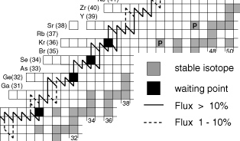
β-p: astrophysics
p / γ: nuclear astrophysics
resonances close to S_{P}
$${}_{N}^{A}{Xa}$$
F
J. Giovinazzo (LP2iB – CNRS IN2P2 / Univ. Bordeaux)
2025/03 Active Stoppers for Decay Experiments – proton decay studies with ACTAR TPC
IAS
β⁺ / EC
region Z < 50
→ rp-process
(waiting points, e.g. ⁶⁹Br)
→ short half-lives
p
Q_{EC}
p
γ
2p?
GT
${}_{N+1}^{A−2}{Xd}$ $(+2p)$
γ
${}_{N+1}^{A−1}{Xc}$ $(+p)$
S_{2p}(Xb)
$${}_{N+1}^{A}{Xb}$$

Slide 11
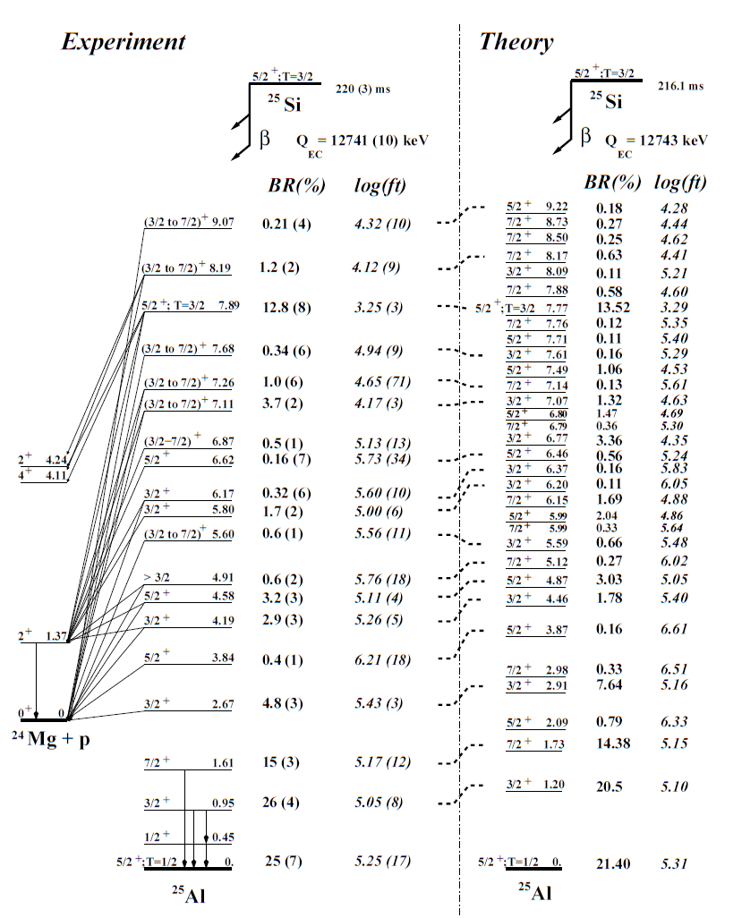
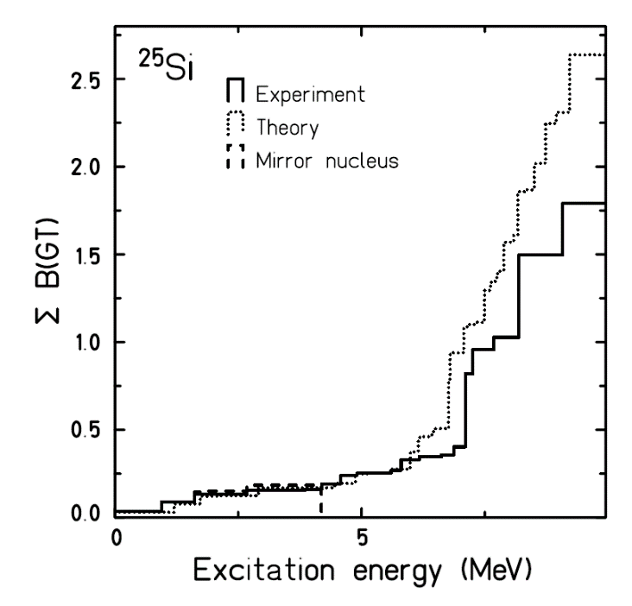
β-p: Gamow-Teller strength distribution
B(GT) in light nuclei
decay of ²⁵Si @ GANIL (in-flight)
β(GT)-p: nuclear structure
deformation
$${}_{N}^{A}{Xa}$$
F
J. Giovinazzo (LP2iB – CNRS IN2P2 / Univ. Bordeaux)
2025/03 Active Stoppers for Decay Experiments – proton decay studies with ACTAR TPC
IAS
β⁺ / EC
p
Q_{EC}
p
γ
2p?
comparison
with shell model
GT
${}_{N+1}^{A−2}{Xd}$ $(+2p)$
γ
${}_{N+1}^{A−1}{Xc}$ $(+p)$
S_{2p}(Xb)
$${}_{N+1}^{A}{Xb}$$

Slide 12
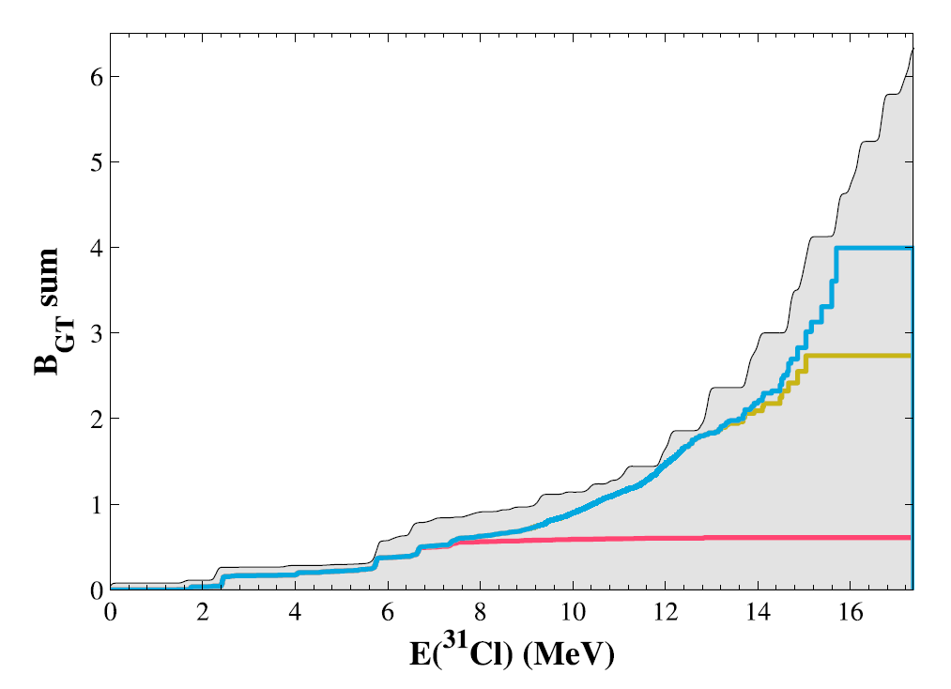
β-p: Gamow-Teller strength distribution
B(GT) in light nuclei
decay of ³¹Ar @ ISOLDE
from 1p+2p+3p
β(GT)-p: nuclear structure
deformation
from 1p+2p
from 1p
Koldste et al., Phys. Lett. B (2014)
$${}_{N}^{A}{Xa}$$
F
J. Giovinazzo (LP2iB – CNRS IN2P2 / Univ. Bordeaux)
2025/03 Active Stoppers for Decay Experiments – proton decay studies with ACTAR TPC
IAS
β⁺ / EC
p
Q_{EC}
p
γ
2p?
p
B(GT) ← β-p,2p,3p
ISOLDE & Si-Cube
in ³¹Ar (Koldste et al., PRC 2014)
GT
${}_{N+1}^{A−2}{Xd}$ $(+2p)$
γ
${}_{N+1}^{A−1}{Xc}$ $(+p)$
S_{2p}(Xb)
$${}_{N+1}^{A}{Xb}$$

Slide 13
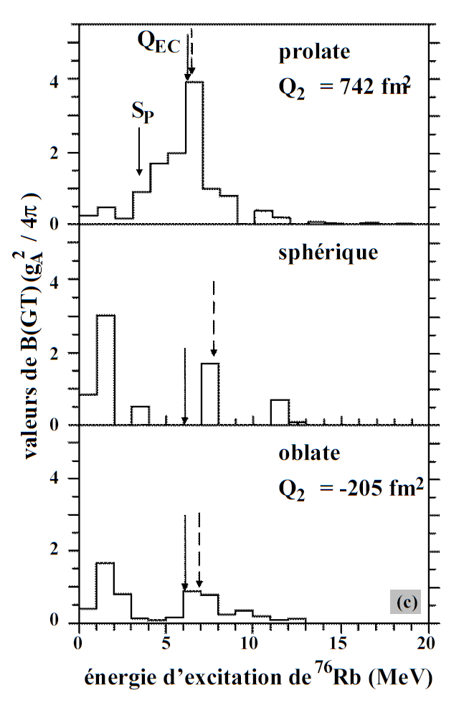
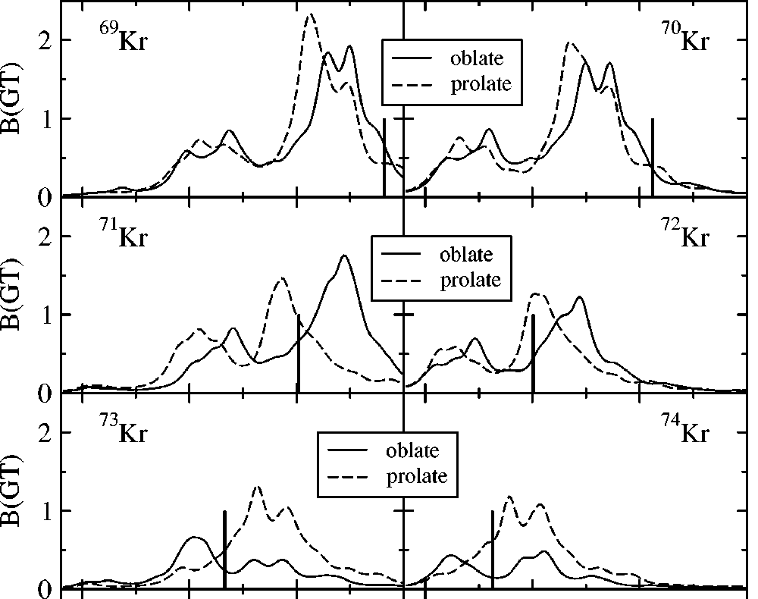
β-p: Gamow-Teller decay
influence of deformation
on B(GT) distribution
β(GT)-p: nuclear structure
deformation
I. Hamamoto et al., Z. Phys. A353 (1995)c
$${}_{N}^{A}{Xa}$$
F
J. Giovinazzo (LP2iB – CNRS IN2P2 / Univ. Bordeaux)
2025/03 Active Stoppers for Decay Experiments – proton decay studies with ACTAR TPC
IAS
β⁺ / EC
p
Q_{EC}
p
γ
2p?
GT
${}_{N+1}^{A−2}{Xd}$ $(+2p)$
γ
${}_{N+1}^{A−1}{Xc}$ $(+p)$
S_{2p}(Xb)
P. Sarriguren et al., Phys. Rev. C64 (2001)
$${}_{N+1}^{A}{Xb}$$

Slide 14
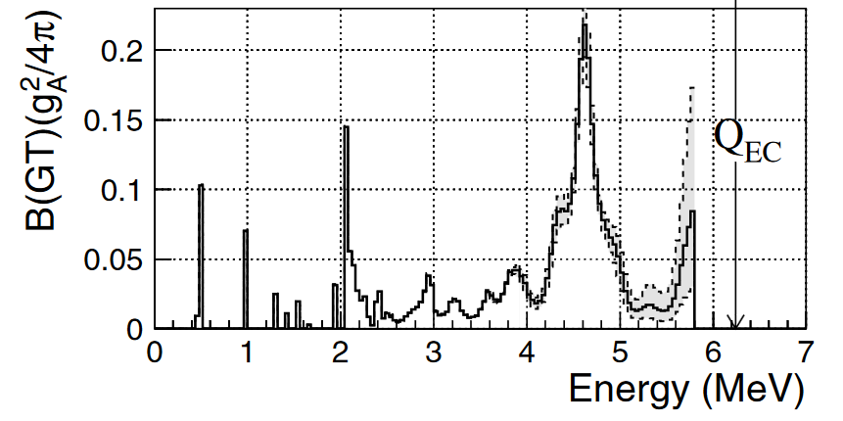
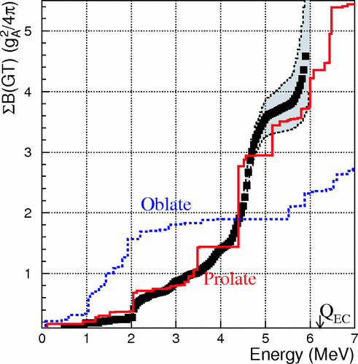
β-p: Gamow-Teller decay
⁷⁶Sr J.G. (PhD 1997)
⁷²Kr I. Piqueras et al., EPJA 2003
⁷⁰Kr A. Vitez-Sveiczer et al., PLB 2022
…
S_{P}
β(GT)-p: nuclear structure
deformation
gamma
proton
$${}_{N}^{A}{Xa}$$
F
J. Giovinazzo (LP2iB – CNRS IN2P2 / Univ. Bordeaux)
2025/03 Active Stoppers for Decay Experiments – proton decay studies with ACTAR TPC
⁷⁶Sr
IAS
β⁺ / EC
p
Q_{EC}
p
γ
2p?
GT
${}_{N+1}^{A−2}{Xd}$ $(+2p)$
γ
${}_{N+1}^{A−1}{Xc}$ $(+p)$
S_{2p}(Xb)
$${}_{N+1}^{A}{Xb}$$
E. Nacher et al., PRL 92 (2004)

Slide 15




β−2proton emission
sequential emission complete decay scheme
(levels of intermediate nucleus, B(GT),…)
direct emission search for correlation pattern
comparison with ground-state 2P
E₂
E₁ + E₂ = const
sequential
2p (²He) emission
E₁
$${}_{N}^{A}{Xa}$$
F
J. Giovinazzo (LP2iB – CNRS IN2P2 / Univ. Bordeaux)
2025/03 Active Stoppers for Decay Experiments – proton decay studies with ACTAR TPC
IAS
E₂
E₁ + E₂ = const
β⁺ / EC
p
Q_{EC}
p
γ
2p?
GT
${}_{N+1}^{A−2}{Xd}$ $(+2p)$
direct
γ
${}_{N+1}^{A−1}{Xc}$ $(+p)$
S_{2p}(Xb)
E₁
$${}_{N+1}^{A}{Xb}$$

Slide 16
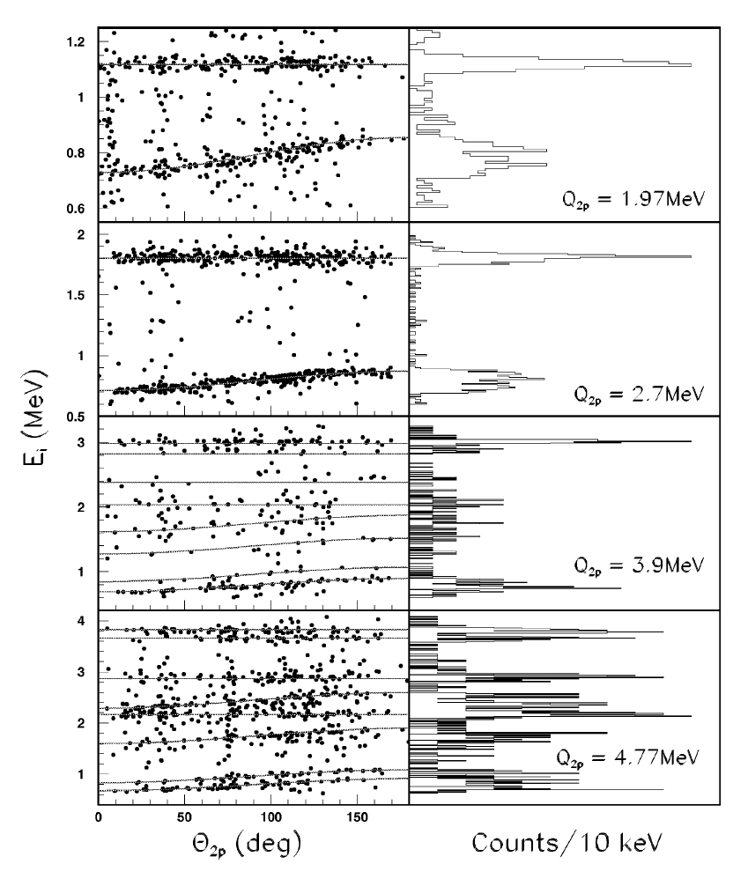
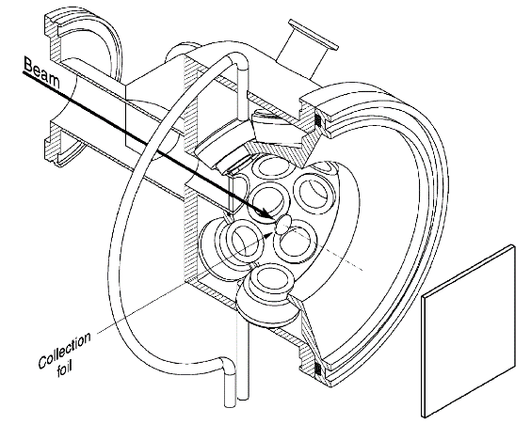
β−2proton emission
β-2P direct emission never observed
(only sequential decay)
few % direct 2P expected
(B.A. Brown, PRL 1990, calc. from IAS decay, ²²Al)
→ 2 energy peaks
→ kinematic shift of the 2nd proton
Fynbo et al., N.P. A (2000)
2p (²He) emission
$${}_{N}^{A}{Xa}$$
F
J. Giovinazzo (LP2iB – CNRS IN2P2 / Univ. Bordeaux)
2025/03 Active Stoppers for Decay Experiments – proton decay studies with ACTAR TPC
IAS
β⁺ / EC
p
Q_{EC}
p
γ
2p?
GT
${}_{N+1}^{A−2}{Xd}$ $(+2p)$
γ
${}_{N+1}^{A−1}{Xc}$ $(+p)$
S_{2p}(Xb)
$${}_{N+1}^{A}{Xb}$$
³¹Ar beta-2p decay (ISOLDE)

Slide 17
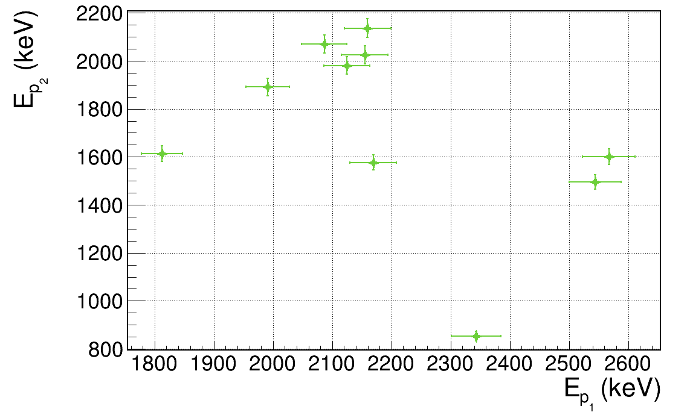
β−2proton emission
best candidates for β-2P direct emission ?
→ from IAS: 1p forbidden, 2p allowed: T_{Z} < −3/2
→ e.g.: ³⁵Ca, ³⁹Ti, ⁴³Cr, …
I_{β→IAS} ∼ 5% ; R_{2P/1P} ∼ 2% → >10⁴ counts for signature
>10⁵ counts for correlations
E791 (LISE+ACTAR TPC)
(A. Ortega Moral et al.)
few events compatible with
β-2p direct emission
→ ⁴³Cr (and ⁴⁶Fe?)
$${}_{N}^{A}{Xa}$$
F
2p (²He) emission
IAS
β⁺ / EC
p
Q_{EC}
p
γ
2p?
GT
${}_{N+1}^{A−2}{Xd}$ $(+2p)$
J. Giovinazzo – DESIR workshop – 27/02-01/03/2024
γ
${}_{N+1}^{A−1}{Xc}$ $(+p)$
S_{2p}(Xb)
$${}_{N+1}^{A}{Xb}$$

Slide 18
ISOL vs fragmentation
J. Giovinazzo (LP2iB – CNRS IN2P2 / Univ. Bordeaux)
2025/03 Active Stoppers for Decay Experiments – proton decay studies with ACTAR TPC

Slide 19
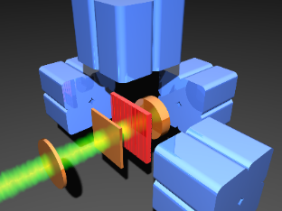
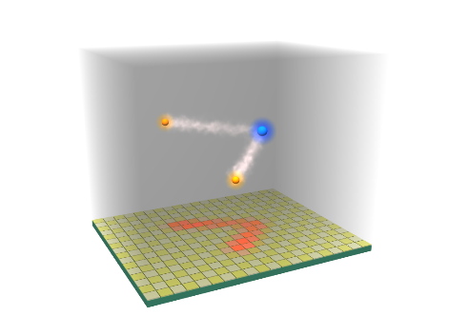
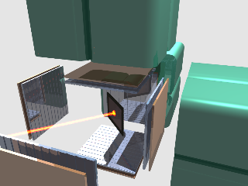
ISOL versus fragmentation
(+ total absorption spectrometers – not discussed here)
there are specialists in the place !
existing
devices
silicon
or
T.P.C.
Si-tele + Ge
projectile fragmentation
reaction
(thin target)
fragments
spectrometer
thick stopper
active
fragmentation
+
J. Giovinazzo (LP2iB – CNRS IN2P2 / Univ. Bordeaux)
2025/03 Active Stoppers for Decay Experiments – proton decay studies with ACTAR TPC
10∼50 ns
decay TPC
additional
detectors
+
50∼100 ms
spallation or
other reaction
(thick target)
extraction
source
mass separation
(+ purification)
thin catcher
or tape drive
ISOL
Si-cube + Ge
(10∼100 ms)

Slide 20
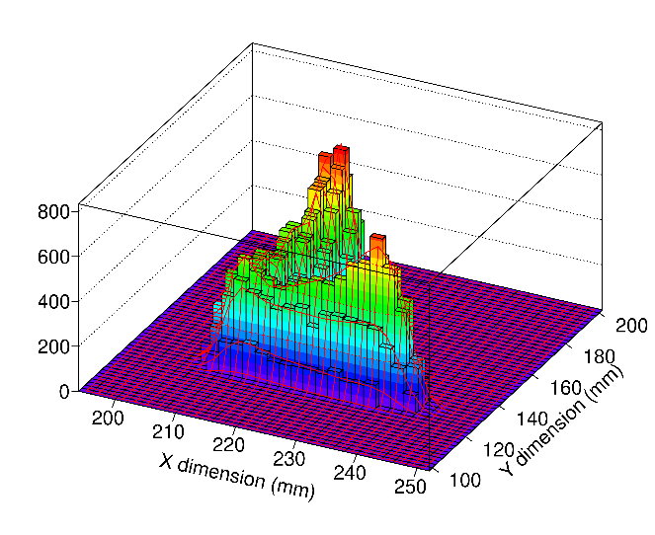
ISOL versus fragmentation: beta-proton detection capabilities
existing
devices
energy
threshold
energy
resolution
beta
detection
multi
proton
∼
p

beta
pile-up
only sum
energy
Si-tele + Ge
β
p
fragmentation
J. Giovinazzo (LP2iB – CNRS IN2P2 / Univ. Bordeaux)
2025/03 Active Stoppers for Decay Experiments – proton decay studies with ACTAR TPC
∼
energy
& angles
(tracks)

transparent
to beta
decay TPC
ε∼100%
ISOL
β
p
Si-cube + Ge


separated strips / pixels
ε_{1P}∼70%
ε_{2P}∼50%
p

Slide 21
ISOL versus fragmentation
existing
devices
beam
purity
detection
multi
proton
IMME
isospin
B(GT)
distrib.
astro.
(low E prot.)
beta
-2P
gamma
proton
∼

∼
∼



Si-tele + Ge
fragmentation
cocktail beam
multiple isotopes
J. Giovinazzo (LP2iB – CNRS IN2P2 / Univ. Bordeaux)
2025/03 Active Stoppers for Decay Experiments – proton decay studies with ACTAR TPC



∼



decay TPC
99.9…%
single isotopes







ISOL
Si-cube + Ge

Slide 22
ISOL versus fragmentation
existing
devices
beam
purity
detection
multi
proton
IMME
isospin
B(GT)
distrib.
astro.
(low E prot.)
beta
-2P
gamma
proton
∼

∼
∼



Si-tele + Ge
fragmentation
cocktail beam
multiple isotopes
?
J. Giovinazzo (LP2iB – CNRS IN2P2 / Univ. Bordeaux)
2025/03 Active Stoppers for Decay Experiments – proton decay studies with ACTAR TPC
∼
requires gamma
detection


∼



decay TPC
99.9…%
single isotopes







ISOL
Si-cube + Ge

Slide 23
ISOL versus fragmentation
existing
devices
beam
purity
detection
multi
proton
IMME
isospin
B(GT)
distrib.
astro.
(low E prot.)
beta
-2P
gamma
proton
∼

∼
∼



Si-tele + Ge
fragmentation
cocktail beam
multiple isotopes
?
J. Giovinazzo (LP2iB – CNRS IN2P2 / Univ. Bordeaux)
2025/03 Active Stoppers for Decay Experiments – proton decay studies with ACTAR TPC
∼
requires gamma
detection


∼



decay TPC
short half-lives
limitation (∼100 ms)
99.9…%
single isotopes







ISOL
Si-cube + Ge

Slide 24
proton(s) radioactivity
J. Giovinazzo (LP2iB – CNRS IN2P2 / Univ. Bordeaux)
2025/03 Active Stoppers for Decay Experiments – proton decay studies with ACTAR TPC

Slide 25
proton(s) radioactivity
proton charge → Coulomb barrier
if larger than proton separation energy
→ metastable state
then tunnel effect
→ 1-proton radioactivity
beyond the
proton
drip-line
J. Giovinazzo (LP2iB – CNRS IN2P2 / Univ. Bordeaux)
2025/03 Active Stoppers for Decay Experiments – proton decay studies with ACTAR TPC
energy
p
A+1,Z+1
A,Z
(+p)

Slide 26
proton(s) radioactivity
drip-line + Coulomb + pairing
→ 2-proton radioactivity
proton charge → Coulomb barrier
if larger than proton separation energy
→ metastable state
then tunnel effect
→ 1-proton radioactivity
emitted protons:
- strongly correlated inside the nucleus
- unbound sub-system outside
even-Z isotope
1 proton emission forbidden
(so called “true” 2P radioactivity)
J. Giovinazzo (LP2iB – CNRS IN2P2 / Univ. Bordeaux)
2025/03 Active Stoppers for Decay Experiments – proton decay studies with ACTAR TPC
radius
energy
pairing effect
2P decay
Δ
energy
p
energy
Δ
2p
A+1,Z+1
A+2,Z+2
A+1,Z+1
(+p)
A,Z
(+p)
A,Z
(+2p)
(Z is even)

Slide 27
proton(s) radioactivity: examples
proton decay of the
10⁺ isomer in ⁵⁴Ni
2-proton radioactivity
of ⁴⁸Ni (and ⁴⁵Fe)
T_{1/2} ∼ 150 ns
T_{1/2} ∼ 1-2 ms
J. Giovinazzo (LP2iB – CNRS IN2P2 / Univ. Bordeaux)
2025/03 Active Stoppers for Decay Experiments – proton decay studies with ACTAR TPC
production at fragmentation facilities
implantation + decay in active stopper

Slide 28
proton(s) radioactivity: examples
proton decay of the
10⁺ isomer in ⁵⁴Ni
2-proton radioactivity
of ⁴⁸Ni (and ⁴⁵Fe)
T_{1/2} ∼ 150 ns
T_{1/2} ∼ 1-2 ms
J. Giovinazzo (LP2iB – CNRS IN2P2 / Univ. Bordeaux)
2025/03 Active Stoppers for Decay Experiments – proton decay studies with ACTAR TPC
production at fragmentation facilities
implantation + decay in active stopper
+
need for tracking device
GANIL / LISE3
+ ACTAR TPC (2019)
GANIL / LISE3
+ ACTAR TPC (2021)

Slide 29
ACTAR TPC tracking detector
J. Giovinazzo (LP2iB – CNRS IN2P2 / Univ. Bordeaux)
2025/03 Active Stoppers for Decay Experiments – proton decay studies with ACTAR TPC

Slide 30
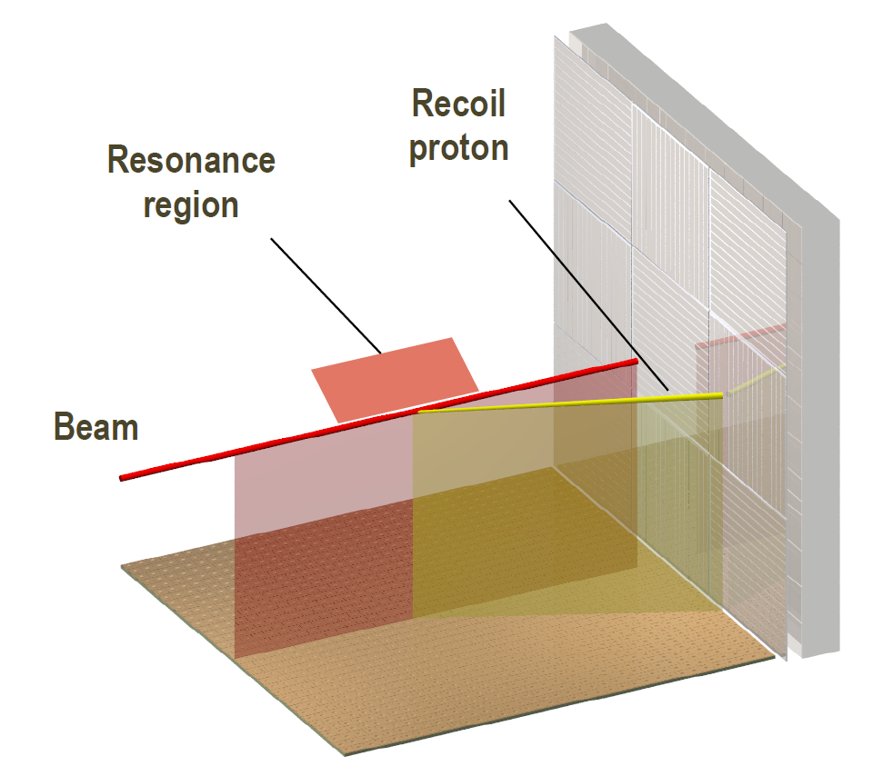
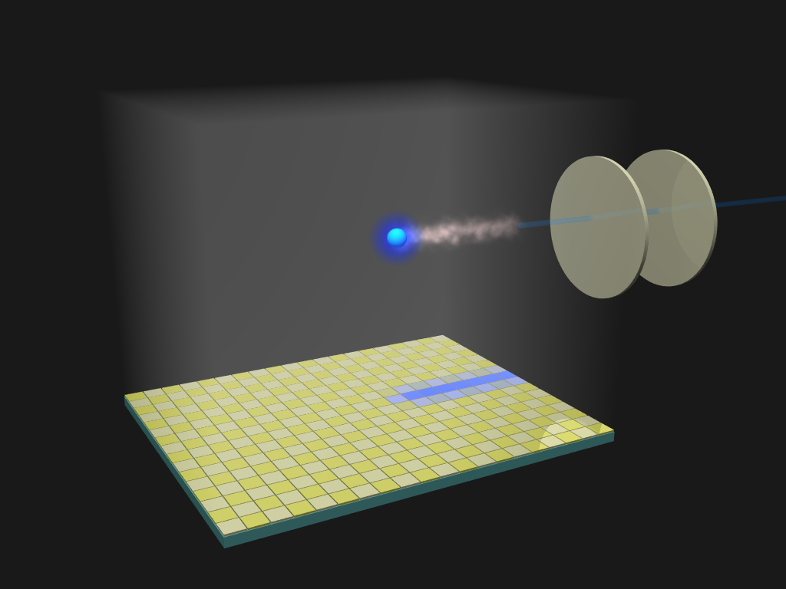

ACTAR TPC, a versatile detector for nuclear physics
collaboration (core)
GANIL + Bordeaux
U. Santiago de C.
U. Regina, U. Leuven
designed as “active target”…
high efficiency, thick target, vertex, tracking,
good energy resolution…
inverse kinematic reactions
unbound resonances, highly excited states
transfer & charge exchange reactions
3D tracks
reconstruction
capabilities
J. Giovinazzo (LP2iB – CNRS IN2P2 / Univ. Bordeaux)
2025/03 Active Stoppers for Decay Experiments – proton decay studies with ACTAR TPC
…and implantation/decay TPC
high efficiency, transp. to beta, low threshold
multi-particle tracking…
charged particles / exotic decay modes
beta-delayed (multi-)proton
particle decay of excited states

Slide 31
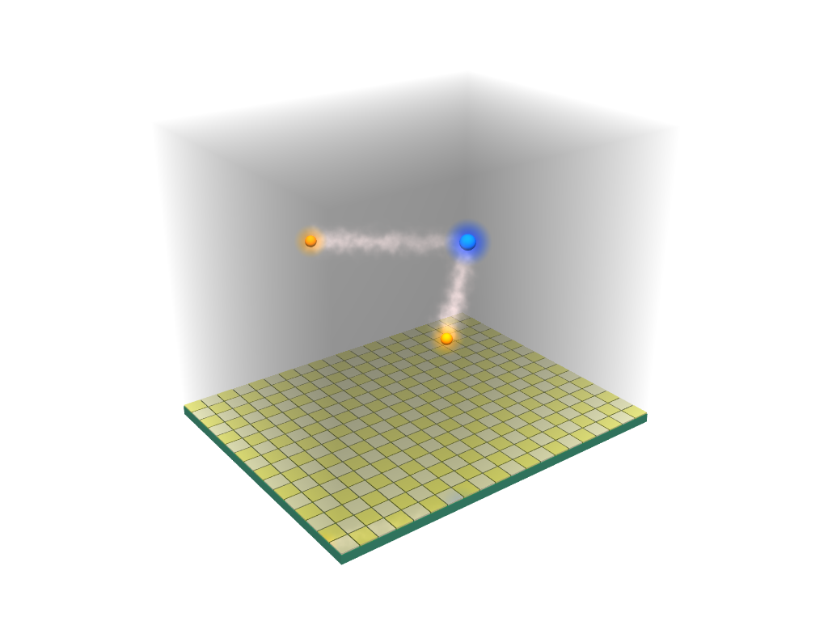
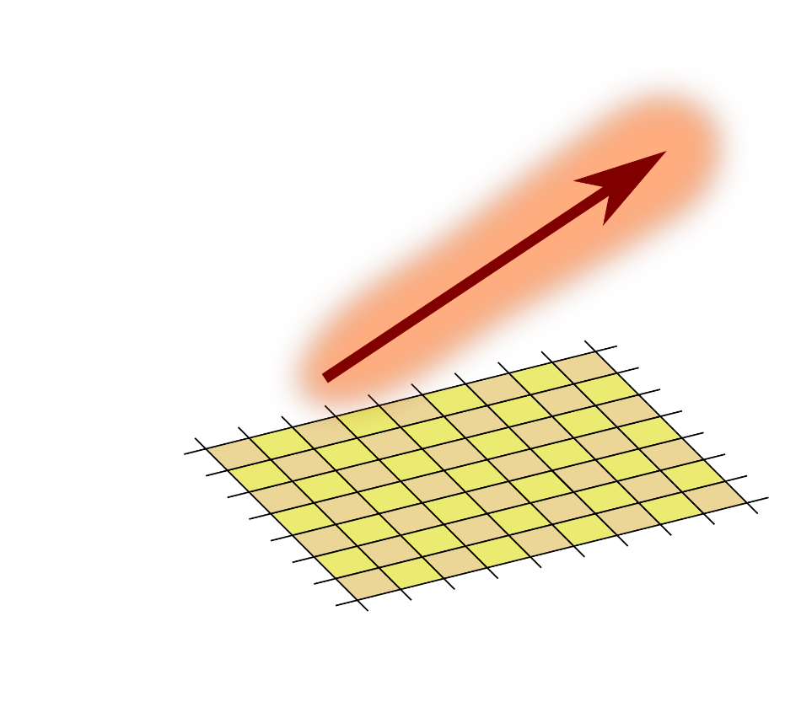
ACTAR TPC, a 4D detector: tracking and energy
pads plane
(signal collection)
2D digitization
ΔE(x,y,z) ⇐⇒ ΔE[x_{i},y_{j}](z)
particle
track
gas
ionization
J. Giovinazzo (LP2iB – CNRS IN2P2 / Univ. Bordeaux)
2025/03 Active Stoppers for Decay Experiments – proton decay studies with ACTAR TPC
pads plane
(signal collection)

Slide 32
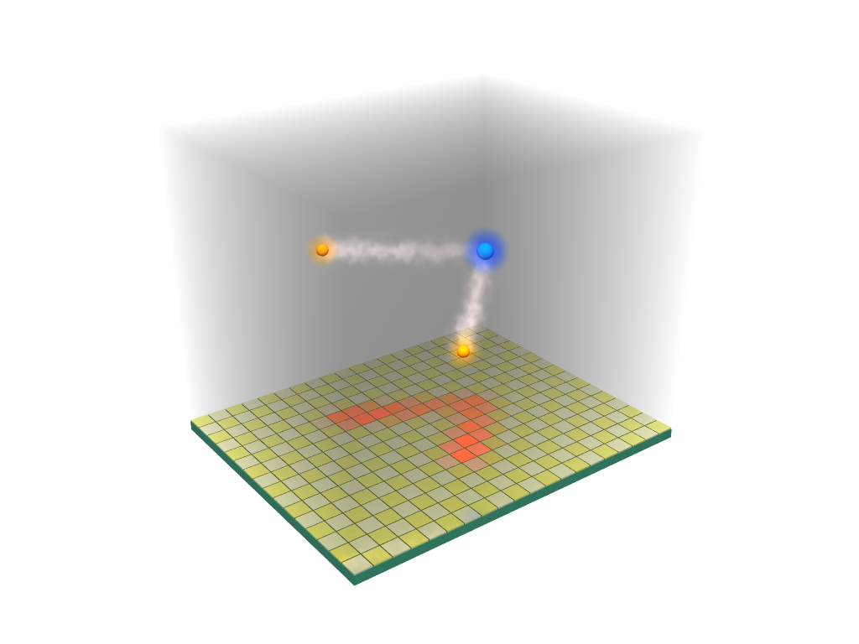
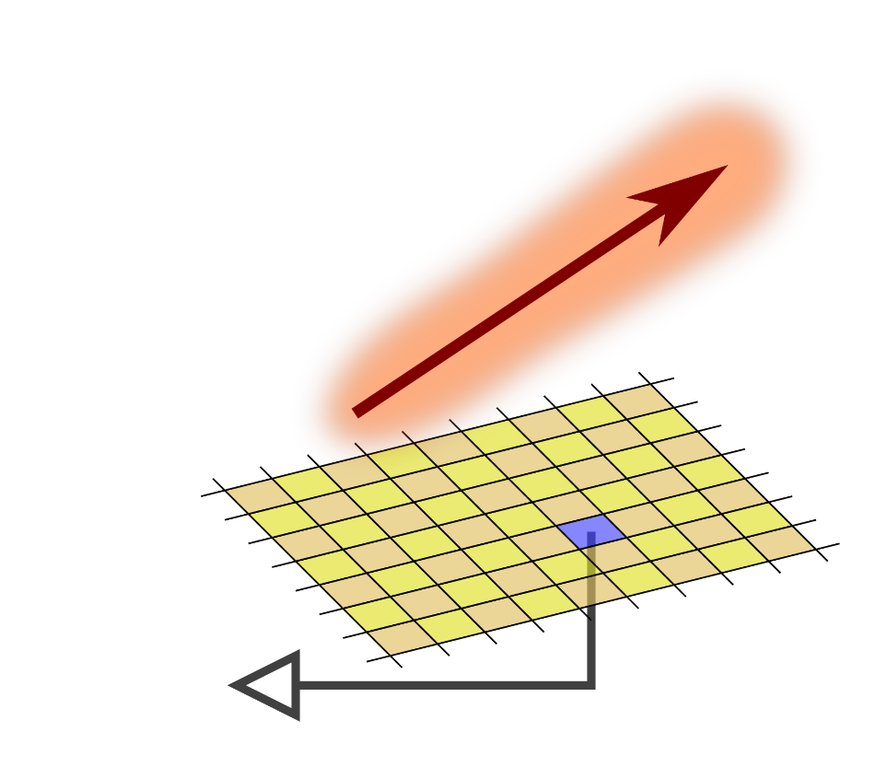
ACTAR TPC, a 4D detector: tracking and energy
pads plane TPC principle
(signal collection)
2D digitization z ⇔ t
ΔE(x,y,z) ⇐⇒ ΔE[x_{i},y_{j}](z) ⇐⇒ ΔE[x_{i},y_{j}](t)
particle
track
gas
ionization
J. Giovinazzo (LP2iB – CNRS IN2P2 / Univ. Bordeaux)
2025/03 Active Stoppers for Decay Experiments – proton decay studies with ACTAR TPC
ionization
drift
(velocity,,
dispersion)
pads plane
(signal collection)
pad
signal

Slide 33
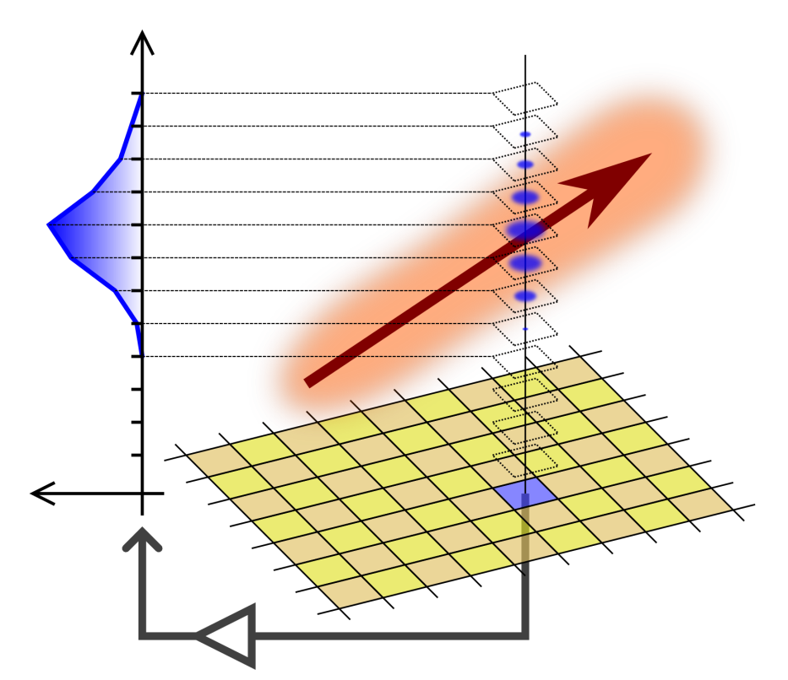
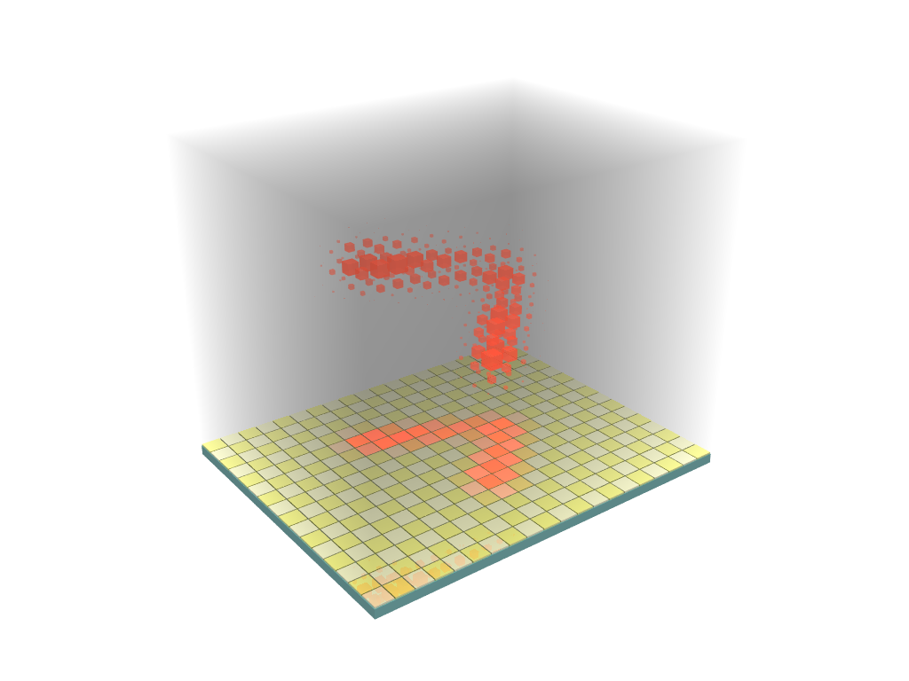

ACTAR TPC, a 4D detector: tracking and energy
pads plane TPC principle time sampling
(signal collection) of signal
2D digitization z ⇔ t 3D digitization
ΔE(x,y,z) ⇐⇒ ΔE[x_{i},y_{j}](z) ⇐⇒ ΔE[x_{i},y_{j}](t) ⇐⇒ ΔE[x_{i},y_{j},t_{k}]
particle
track
gas
ionization
ideal situation
reality is not that
simple…
time sampling
of collected signal
J. Giovinazzo (LP2iB – CNRS IN2P2 / Univ. Bordeaux)
2025/03 Active Stoppers for Decay Experiments – proton decay studies with ACTAR TPC
ionization
drift
(velocity,,
dispersion)
3D reconstruction of
ionizations charges along
the particles trajectories
pad
signal
pads plane
(signal collection)
GET electronics

Slide 34
ACTAR TPC, a 4D detector: tracking and energy
ideal case:
• current preamplifier on each channel !
• not easy from electronics point of view
• noisy…
GET electronics based on an existing chip
(AFTER from T2K exp.)
J. Giovinazzo (LP2iB – CNRS IN2P2 / Univ. Bordeaux)
2025/03 Active Stoppers for Decay Experiments – proton decay studies with ACTAR TPC

Slide 35
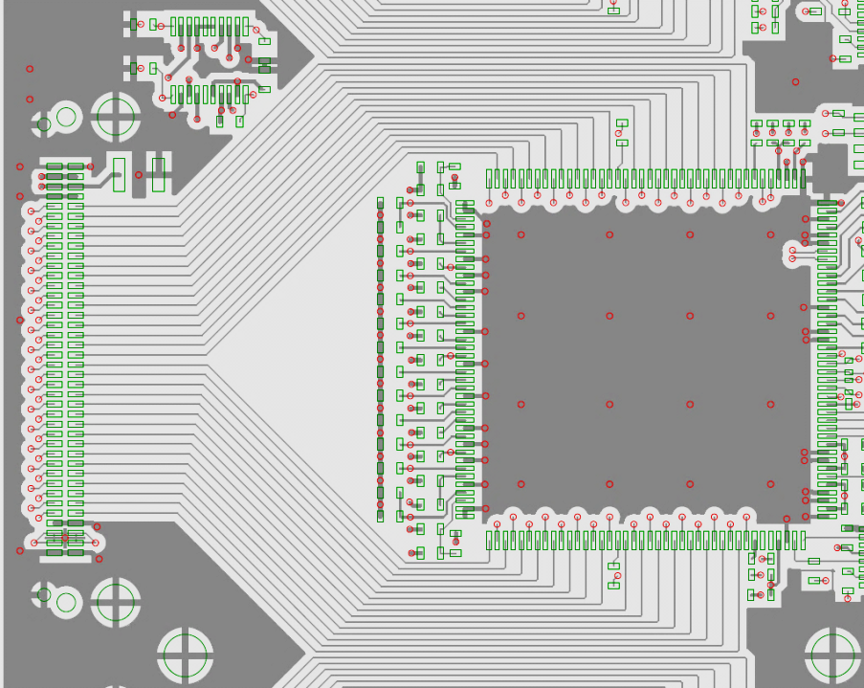
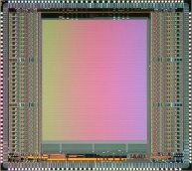
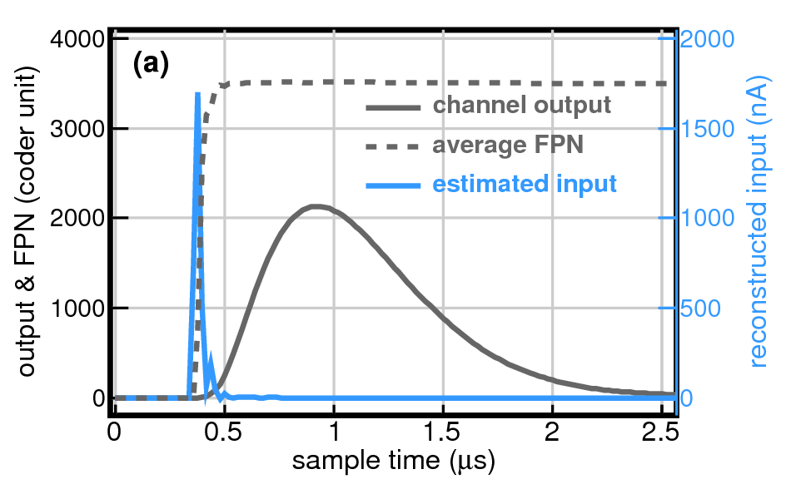
ACTAR TPC, a 4D detector: tracking and energy
ideal case:
• current preamplifier on each channel !
• not easy from electronics point of view
• noisy…
GET electronics based on an existing chip
(AFTER from T2K exp.)
channel processing (AGET)
multiplicity
hit pattern
discri.
shaper
analog memory
ADC
TPC
pad signal
CSA
charge preamplifier + shaper
→ loss of charge initial distribution
amplitude (A) and timing (T) information
J. Giovinazzo (LP2iB – CNRS IN2P2 / Univ. Bordeaux)
2025/03 Active Stoppers for Decay Experiments – proton decay studies with ACTAR TPC
A
T

Slide 36
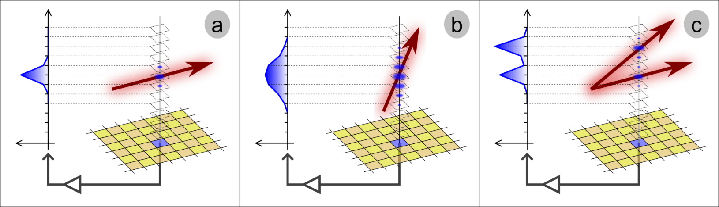
ACTAR TPC, a 4D detector: tracking and energy
ideal case:
• current preamplifier on each channel !
• not easy from electronics point of view
• noisy…
GET electronics based on an existing chip
(AFTER from T2K exp.)
channel processing (AGET)
multiplicity
hit pattern
discri.
shaper
analog memory
ADC
TPC
pad signal
CSA
charge preamplifier + shaper
→ loss of charge initial distribution
amplitude (A) and timing (T) information
→ decay events in any direction…
J. Giovinazzo (LP2iB – CNRS IN2P2 / Univ. Bordeaux)
2025/03 Active Stoppers for Decay Experiments – proton decay studies with ACTAR TPC
A
T

Slide 37
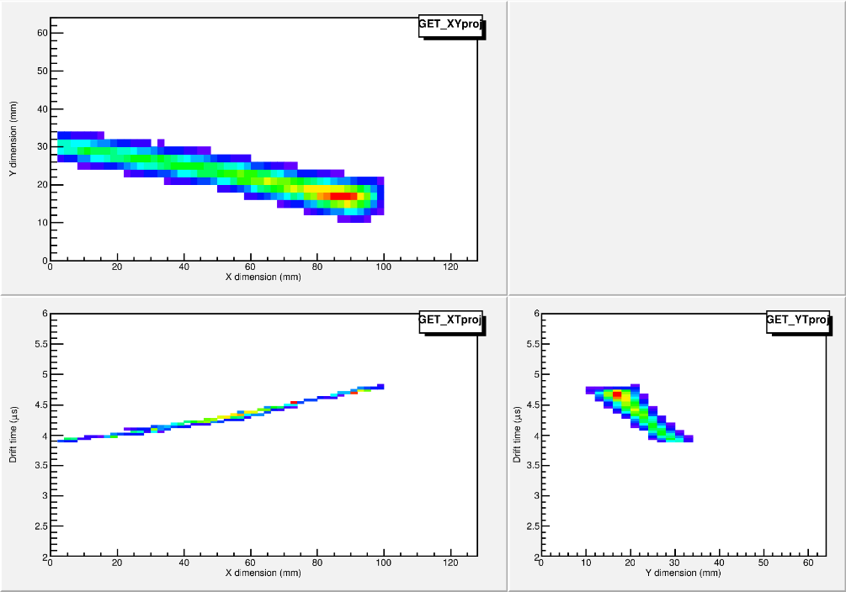
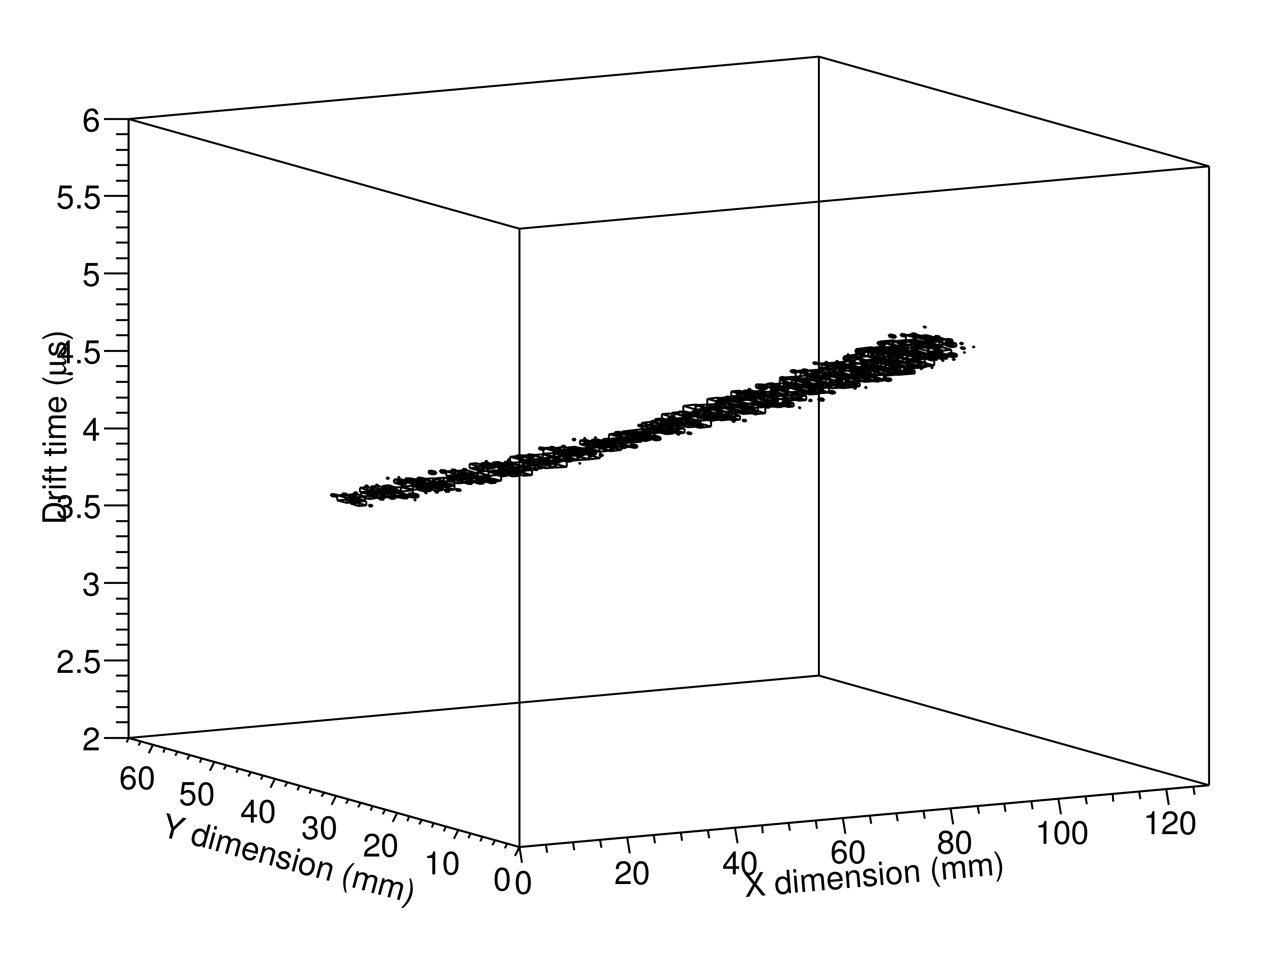
ACTAR TPC, a 4D detector: tracking and energy
“standard” analysis
signal amplitude + CFD timing
2D (X,Y) A & T
→ 2 × 16k = 32k data
J. Giovinazzo (LP2iB – CNRS IN2P2 / Univ. Bordeaux)
2025/03 Active Stoppers for Decay Experiments – proton decay studies with ACTAR TPC

Slide 38
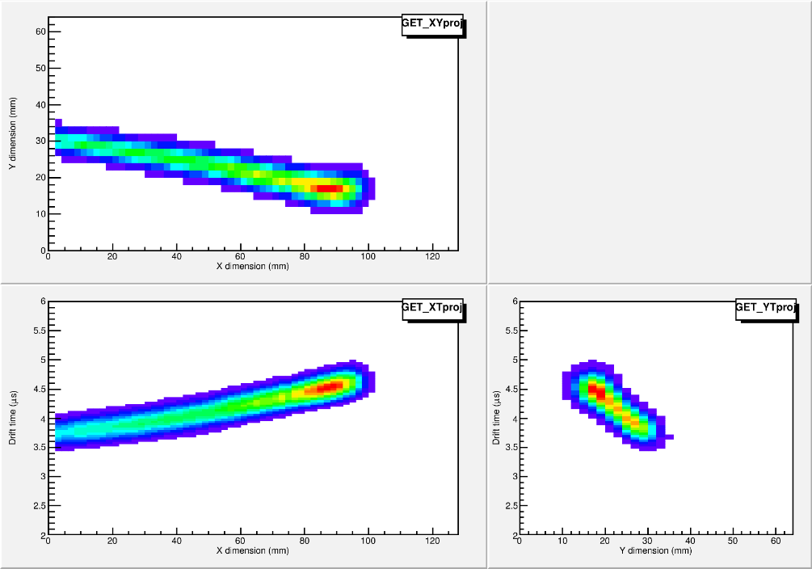
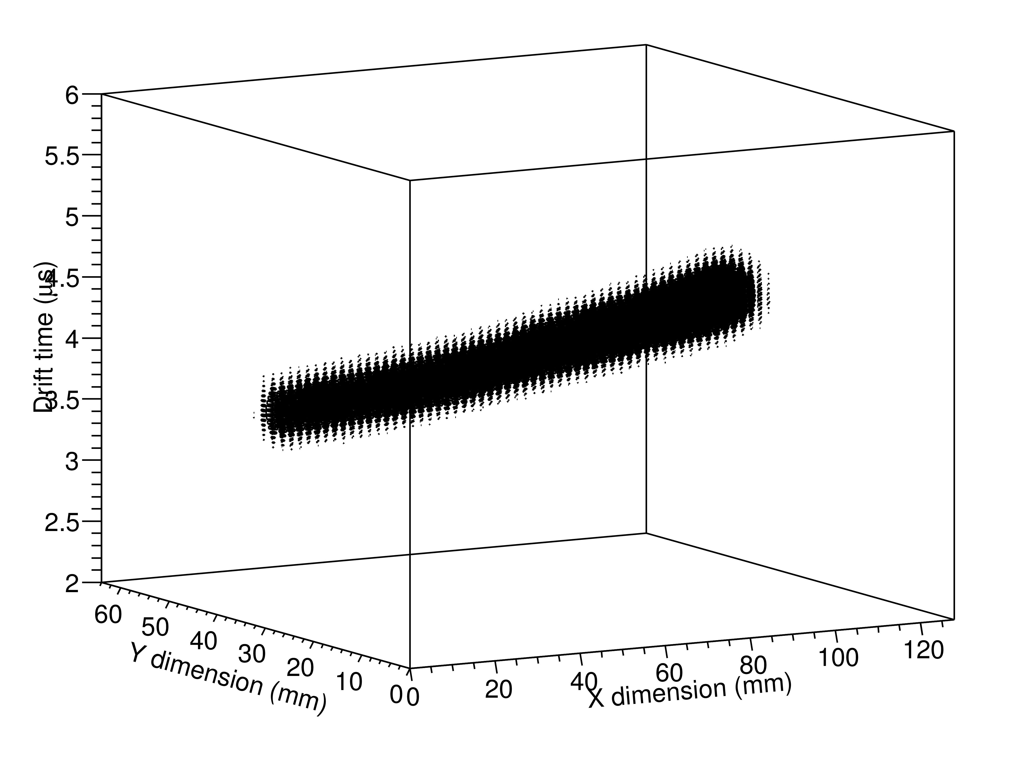
ACTAR TPC, a 4D detector: tracking and energy
“standard” analysis
signal amplitude + CFD timing
2D (X,Y) A & T
→ 2 × 16k = 32k data
deconvolution analysis
→ response functions for each channel
full 3D (X,Y,T) signal distribution (from FFT)
→ 512 × 16k = 8000k data
JG, NIM A 2020
J. Giovinazzo (LP2iB – CNRS IN2P2 / Univ. Bordeaux)
2025/03 Active Stoppers for Decay Experiments – proton decay studies with ACTAR TPC
analysis / computing cost
×200 !!

Slide 39
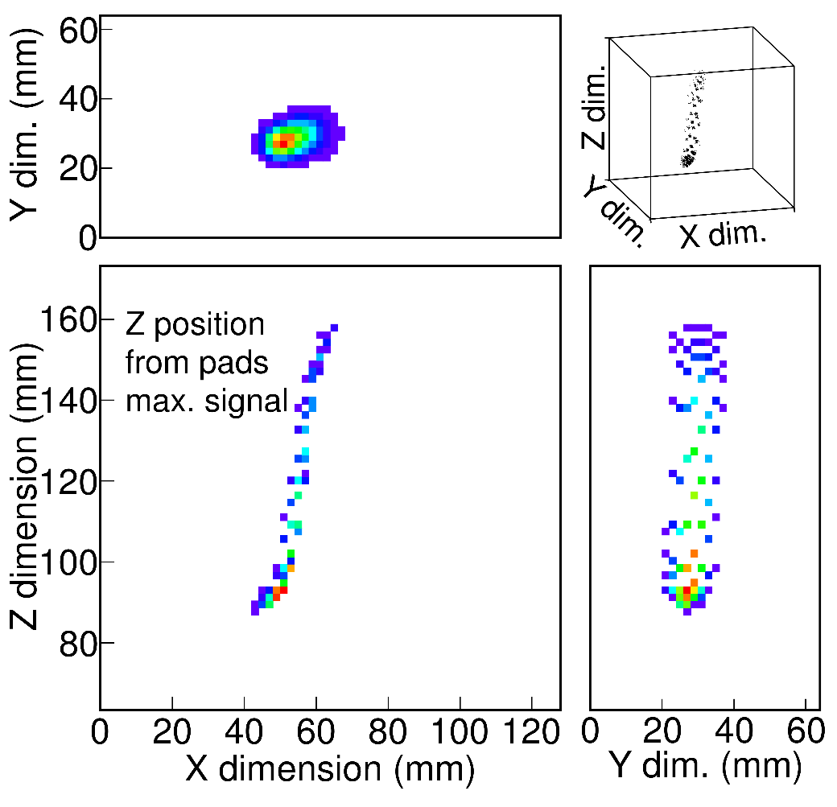
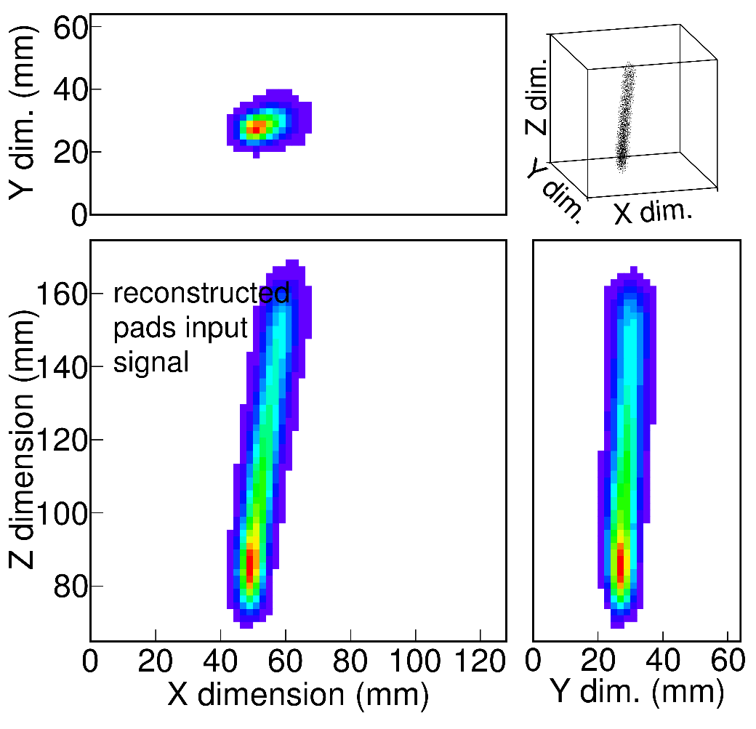
ACTAR TPC, a 4D detector: tracking and energy
“standard” analysis
signal amplitude + CFD timing
2D (X,Y) A & T
→ 2 × 16k = 32k data
deconvolution analysis
→ response functions for each channel
full 3D (X,Y,T) signal distribution (from FFT)
→ 512 × 16k = 8000k data
problem at large
vertical angles
JG, NIM A 2020
J. Giovinazzo (LP2iB – CNRS IN2P2 / Univ. Bordeaux)
2025/03 Active Stoppers for Decay Experiments – proton decay studies with ACTAR TPC
incorrect
track
length

Slide 40
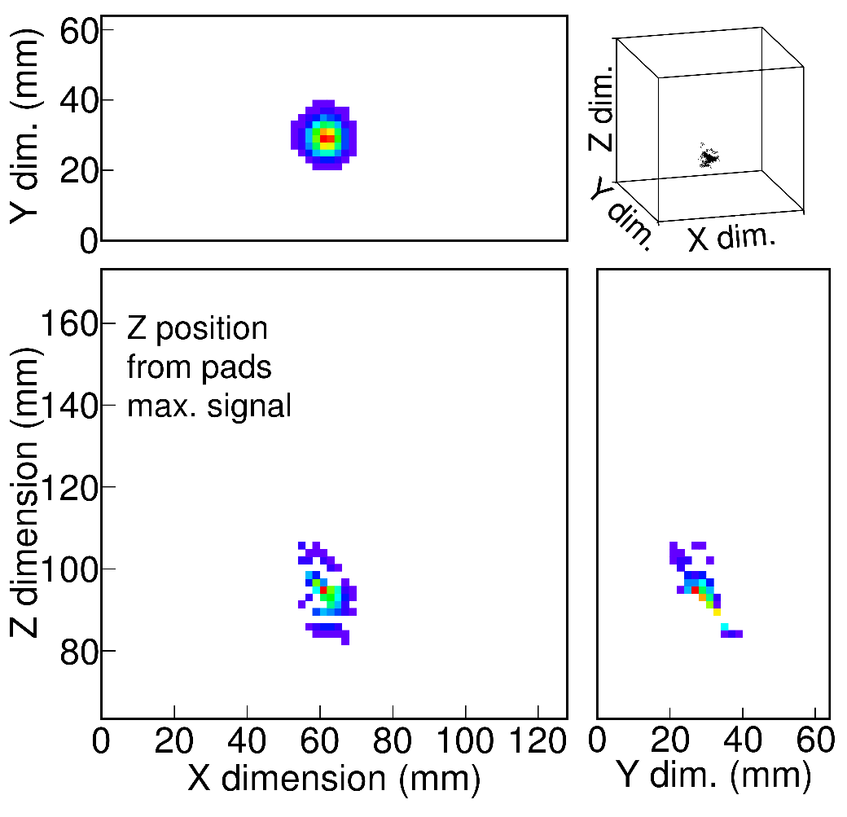
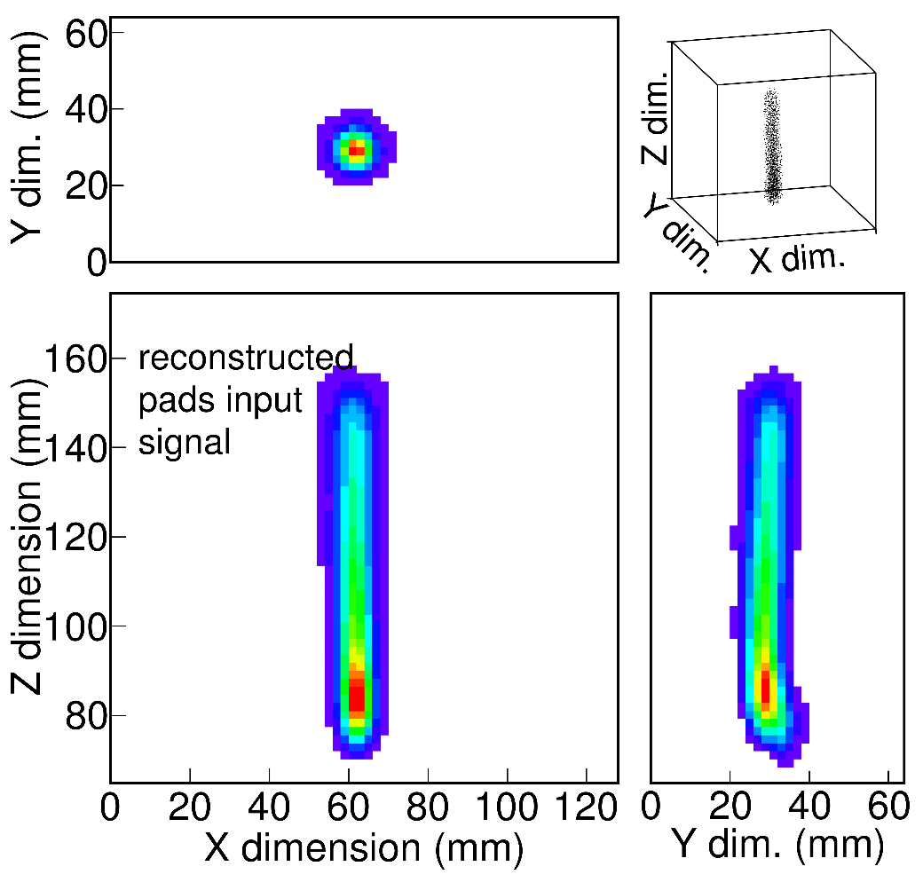
ACTAR TPC, a 4D detector: tracking and energy
“standard” analysis
signal amplitude + CFD timing
2D (X,Y) A & T
→ 2 × 16k = 32k data
deconvolution analysis
→ response functions for each channel
full 3D (X,Y,T) signal distribution (from FFT)
→ 512 × 16k = 8000k data
problem at large
vertical angles
JG, NIM A 2020
J. Giovinazzo (LP2iB – CNRS IN2P2 / Univ. Bordeaux)
2025/03 Active Stoppers for Decay Experiments – proton decay studies with ACTAR TPC

Slide 41
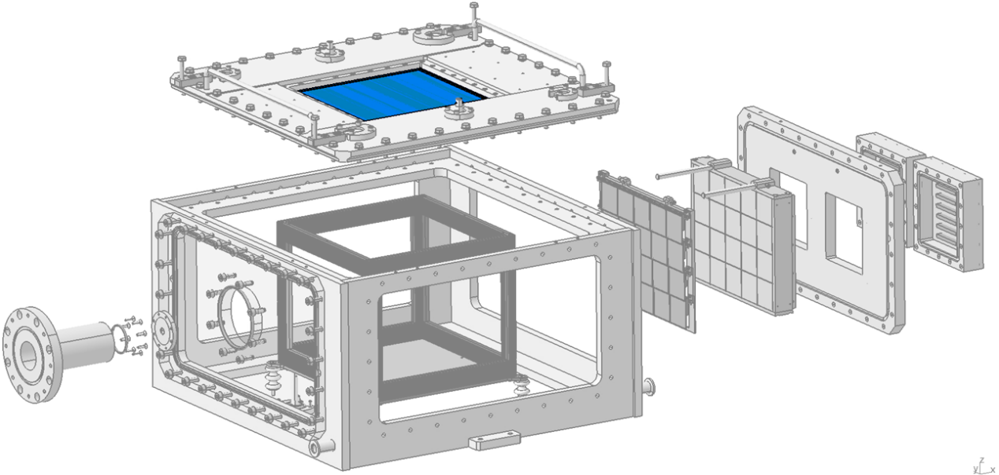
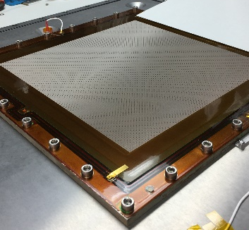
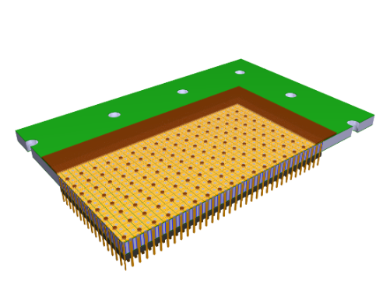
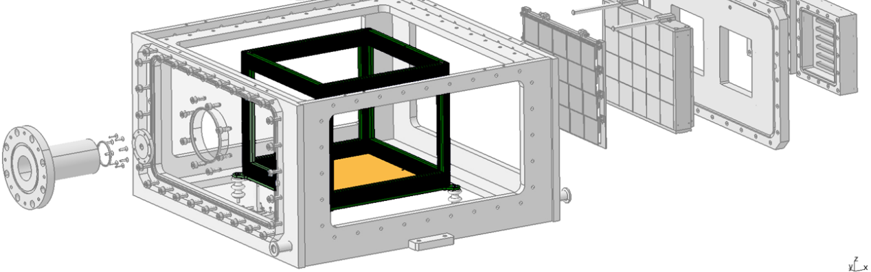
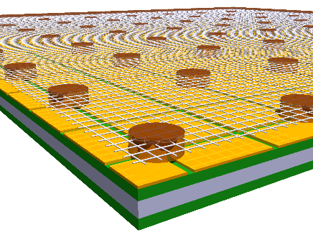
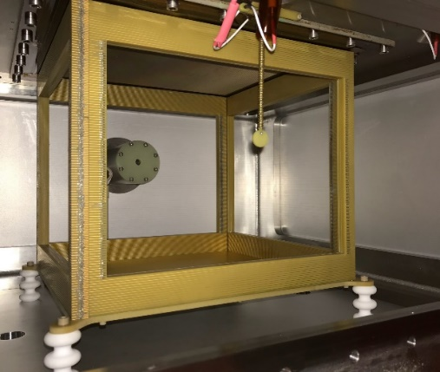
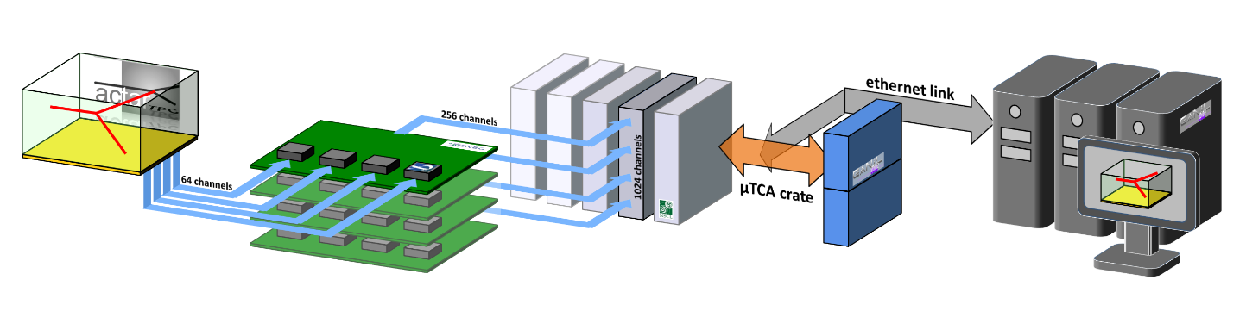
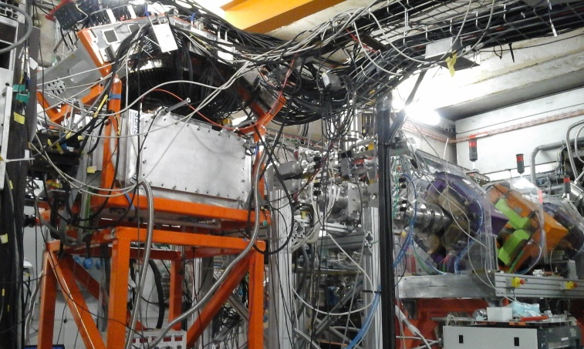

the ACTAR TPC device
collection plane (pads)
metal-core or
multi-layer PCB
16384 pads
(128×128; 2×2 mm²)
image P. Gangnant, GANIL
“micromegas”
amplification
drift cage (active volume)
J. Giovinazzo (LP2iB – CNRS IN2P2 / Univ. Bordeaux)
2025/03 Active Stoppers for Decay Experiments – proton decay studies with ACTAR TPC
+ flexible PCB connection
to readout electronics
readout electronics
photo O. Poleshchuk (2017)
detector
CoBo modules
control / acquisition
AsAd boards
image JG / CENBG (2015)
AGET chip
signal sampling
512 @ 1-100 MHz
MuTAnT
clocks distribution
and data concentration

Slide 42

the ACTAR TPC device
decay experiments (GANIL/LISE3)
2019: proton radioactivity of ^{54m}Ni and isospin symmetry (^{54m}Fe)
2021: 2-proton radioactivity of ⁴⁸Ni & other exotic decays
collection plane (pads)
16384 pads
(128×128; 2×2 mm²)
metal-core or
multi-layer PCB
image P. Gangnant, GANIL
JG (2012)
drift cage (active volume)
“micromegas” amplification
J. Giovinazzo (LP2iB – CNRS IN2P2 / Univ. Bordeaux)
2025/03 Active Stoppers for Decay Experiments – proton decay studies with ACTAR TPC
+ flexible PCB connection to readout electronics
readout electronics
photo O. Poleshchuk (2017)
detector
CoBo modules
control / acquisition
AsAd boards
image JG / CENBG (2015)
AGET chip
signal sampling
512 @ 1-100 MHz
MuTAnT
clocks distribution
and data concentration
ACTAR TPC @ GANIL / LISE3 (2021)

Slide 43
ACTAR TPC decay experiments at GANIL
J. Giovinazzo (LP2iB – CNRS IN2P2 / Univ. Bordeaux)
2025/03 Active Stoppers for Decay Experiments – proton decay studies with ACTAR TPC

Slide 44

proton decay of the 10⁺ isomer in ⁵⁴Ni
S_{n}
mirror nuclei ⁵⁴Fe and ⁵⁴Ni
comparison of 10⁺ isomers
→ near N = Z = 28 shell closures
→ test isospin symmetry (breaking)
very few cases for such comparison…
→ test coupling to the continuum
⁵⁴Fe isotope
stable ground state
decay of isomer: known from gamma spectroscopy
⁵⁴Ni isotope
unstable (proton rich)
→ low proton separation energy
decay of isomer
→ short half-life
only accessible at fragmentation facilities (+ separator)
→ partially known from gamma spectroscopy (GSI /RISING)
→ above proton emission threshold
T_{1/2} = 152(4) ns
S_{p}
J. Giovinazzo (LP2iB – CNRS IN2P2 / Univ. Bordeaux)
2025/03 Active Stoppers for Decay Experiments – proton decay studies with ACTAR TPC
unstable
stable

Slide 45
proton decay of the 10⁺ isomer in ⁵⁴Ni
⁵⁴Ni isomer decay
→ above proton emission threshold
but very high angular momentum
1.3 MeV proton (ℓ = 5) deduced from gamma coincidence (RISING)
2.6 MeV proton (ℓ = 7) may exist (not observed)
possible 2P branch (extremely small)
T_{1/2} = 152(4) ns
need for the full
decay scheme
D. Rudolph et al. Phys. Rev. C 78 (2008)
J. Giovinazzo (LP2iB – CNRS IN2P2 / Univ. Bordeaux)
2025/03 Active Stoppers for Decay Experiments – proton decay studies with ACTAR TPC

Slide 46

proton decay of the 10⁺ isomer in ⁵⁴Ni
⁵⁴Ni isomer decay
→ above proton emission threshold
but very high angular momentum
1.3 MeV proton (ℓ = 5) deduced from gamma coincidence (RISING)
2.6 MeV proton (ℓ = 7) may exist (not observed)
possible 2P branch (extremely small)
T_{1/2} = 152(4) ns
need for the full
decay scheme
D. Rudolph et al. Phys. Rev. C 78 (2008)
J. Giovinazzo (LP2iB – CNRS IN2P2 / Univ. Bordeaux)
2025/03 Active Stoppers for Decay Experiments – proton decay studies with ACTAR TPC
cyclotrons
target
need for tracking
detectors
separator
protons detection
• about 0.1% of ions produced in isomeric state
• few MeV proton signal on top of 1 GeV ion signal !
→ no standard implantation/decay in a silicon detector
→ tracking in a gas detector (ACTAR TPC)
protons emitted out of the ion track
can be observed !
detector
proton
ion
detector

Slide 47



decay of the 10⁺ isomer in ⁵⁴Ni: GANIL/LISE experiment (E690)
standard fragmentation production
75 MeV/A ⁵⁸Ni²⁶⁺ stable beam, 200 µm nat. Ni target
LISE3 fragment separator
(A,Z) separation, standard ToF – ΔE (Si) ident.
⁵⁴Ni
target
about 0.1% of ions
produced in isomeric state
cyclotrons
separator
J. Giovinazzo (LP2iB – CNRS IN2P2 / Univ. Bordeaux)
2025/03 Active Stoppers for Decay Experiments – proton decay studies with ACTAR TPC
detector
proton
ion
detector
ACTAR TPC @ LISE

Slide 48

extracting experimental information
• selection of ⁵⁴Ni and isomer decay events
• identify and separate ion and proton signal
(degraded pad plane)
• drift velocity estimate
TPC principle: ( X , Y , T ) → ( X , Y , Z = v_{d}∙T ) → track length
from protons signal
• 3D proton tracks fit
trajectory points
+ Bragg peak model
+ signal dispersion
track length → energy
proton start / ion stop time offset → decay time
track length
time offset
J. Giovinazzo (LP2iB – CNRS IN2P2 / Univ. Bordeaux)
2025/03 Active Stoppers for Decay Experiments – proton decay studies with ACTAR TPC
t
y
x
JG et al. NIM A (2022)

Slide 49


4D imaging of proton radioactivity
original detection/analysis technique
possibilities for short lived decays !
J. Giovinazzo (LP2iB – CNRS IN2P2 / Univ. Bordeaux)
2025/03 Active Stoppers for Decay Experiments – proton decay studies with ACTAR TPC
E(T_{1/2}) ⊗ G(σ_{T})
rad. decay exp. resol.
track length ↔ proton energy
JG et al. NIM A (2022)

Slide 50

4D imaging of proton radioactivity
different detection
efficiency for
1.2 and 2.5 MeV
full simulation
branching ratio
1.25 MeV ℓ = 5
2.55 MeV ℓ = 7
J. Giovinazzo (LP2iB – CNRS IN2P2 / Univ. Bordeaux)
2025/03 Active Stoppers for Decay Experiments – proton decay studies with ACTAR TPC
observation of protons with
very high angular momenta
(also case of ^{53m}Co – same exp.
with ℓ = 7 and ℓ = 9)
E(T_{1/2}) ⊗ G(σ_{T})
rad. decay exp. resol.
track length ↔ proton energy
L.G. Sarmiento et al., Nature Comm. (2023)
JG et al. Nature Comm. (2021)
JG et al. NIM A (2022)

Slide 51
4D imaging of proton radioactivity
different detection
efficiency for
1.2 and 2.5 MeV
full simulation
branching ratio
1.25 MeV ℓ = 5
2.55 MeV ℓ = 7
J. Giovinazzo (LP2iB – CNRS IN2P2 / Univ. Bordeaux)
2025/03 Active Stoppers for Decay Experiments – proton decay studies with ACTAR TPC
complete decay scheme
allows for a detailed analysis
→ test of isospin non-conserving
terms of the interaction
→ constraints on effective isoscalar
and isovector effective charges
from B(E4)
E(T_{1/2}) ⊗ G(σ_{T})
rad. decay exp. resol.
track length ↔ proton energy
D. Rudolph et al. Phys. Lett. B (2022)
L.G. Sarmiento et al., Nature Comm. (2023)
JG et al. Nature Comm. (2021)
JG et al. NIM A (2022)

Slide 52
2-proton radioactivity
→ drip-line and masses (beyond the « drip-line »)
transition Q-values
→ nuclear structure
energies, half-life, levels configuration
→ pairing
correlations in energy and angle of emitted protons
→ tunnel effect
theoretical descriptions
nuclear
structure
coupling to
continuum
adapted from
M. Pfützner et al. 2023
J. Giovinazzo (LP2iB – CNRS IN2P2 / Univ. Bordeaux)
2025/03 Active Stoppers for Decay Experiments – proton decay studies with ACTAR TPC
3-body
nature
complex process for theoretical
interpretations / predictions
ideally, taking into account:
• the 3-body decay dynamics
• the nuclear structure (wave functions)
• the coupling to the continuum

Slide 53


2-proton radioactivity
observation: silicon exp.
→ standard detectors
→ limited info.
(T_{1/2}, Q_{2P}, BR)
p
p
implantation / decay experiments
at fragmentation facilities
→ short half-lives
→ active stopper
J. Giovinazzo (LP2iB – CNRS IN2P2 / Univ. Bordeaux)
2025/03 Active Stoppers for Decay Experiments – proton decay studies with ACTAR TPC
correlations: TPC exp.
→ tracking devices
→ individual protons
information

Slide 54
2-proton radioactivity
experimental information: observation (silicon) / correlations (TPC)
• ⁴⁵Fe: first indirect evidence
(J.G. et al. GANIL 2002,M. Pfützner et al. GSI 2002)
first direct observation (J.G. et al. GANIL 2007)
angular distribution (K. Miernik et al., MSU 2009)
more events, energy sharing (A. Ortega Moral et al., GANIL 2021)
• ⁵⁴Zn: observation (B. Blank et al. 2005)
few p-p correlations (P. Ascher et al., GANIL 2011)
• ⁴⁸Ni: indication (B. Blank et al. GANIL 2005)
few p-p correlations (K. Miernik et al., MSU 2007)
few more correlations (A. Ortega Moral et al., GANIL 2021)
Warsaw group exp. at FRIB (2024) – more stat…
• ⁶⁷Kr: observation (J.G. et al. RIKEN 2015)
→ half-life problem…
→ deformation / decay mechanism ?
p
p
J. Giovinazzo (LP2iB – CNRS IN2P2 / Univ. Bordeaux)
2025/03 Active Stoppers for Decay Experiments – proton decay studies with ACTAR TPC
previous models
fail…

Slide 55


2-proton radioactivity
recent theoretical approaches
- hybrid model
(B.A. Brown)
- Gamow Coupled Channels (GCC)
(S. Wang & W. Nazarewicz)
pure f²
configuration
shell model
amplitudes
struct.
cont.
3-body
3-body
dynamics
need for tracking
detectors
J. Giovinazzo (LP2iB – CNRS IN2P2 / Univ. Bordeaux)
2025/03 Active Stoppers for Decay Experiments – proton decay studies with ACTAR TPC
struct.
cont.
3-body
proton-proton correlations predictions
→ angular distributions
→ energy sharing
experimental
validation !!!

Slide 56



⁴⁸Ni decay at GANIL / LISE3 with ACTAR TPC
long beam time, high intensity…
full acceptance of the spectrometer (→ ident. problems)
implantation (optimized for ⁴⁸Ni) in ACTAR TPC
⁴⁸Ni
J. Giovinazzo (LP2iB – CNRS IN2P2 / Univ. Bordeaux)
2025/03 Active Stoppers for Decay Experiments – proton decay studies with ACTAR TPC
⁴⁵Fe
…but very small statistics
identified stopped 2p /total
in ACTAR decays
⁴⁵Fe 80 13(+?) 6(+9) / 7(+?)
⁴⁸Ni 11 6 3 / 5
only few 2P decay events (⁴⁸Ni & ⁴⁵Fe)
courtesy of A. Ortega Moral

Slide 57



half-life and Q-value
all models fail to reproduce the half-lives with last measured Q-values
→ 3-body model:
dominant contribution of p_{3/2} occupancy while expected f_{7/2} (almost 100% for ⁴⁸Ni)
(it was ok for ⁴⁵Fe with Q_{2P} from silicon experiments)
→ GCC framework:
increased V_{pp} favoured for ⁴⁸Ni, not for ⁴⁵Fe – but anyway no agreement…
but… systematic trend: Q_{2P} values from TPC experiments smaller
than from silicon experiments
this problem needs
to be clarified !!
J. Giovinazzo (LP2iB – CNRS IN2P2 / Univ. Bordeaux)
2025/03 Active Stoppers for Decay Experiments – proton decay studies with ACTAR TPC
A. Ortega Moral, S. Wang et al., in preparation
⁴⁵Fe
⁴⁸Ni

Slide 58


angular correlations
very low statistics…
same conclusions as in Miernik et al.
best agreement with ∼24% of p²
no significant change
3-body
but similar trend for both models
→ confirmation of the persistence
of the shell closure
favours standard value of V_{pp}
fairly good agreement with exp.
(χ² similar to 3-body)
GCC
favours standard value of V_{pp}
(opposite conclusion than for T_{1/2})
J. Giovinazzo (LP2iB – CNRS IN2P2 / Univ. Bordeaux)
2025/03 Active Stoppers for Decay Experiments – proton decay studies with ACTAR TPC
A. Ortega Moral, S. Wang et al., in preparation
⁴⁵Fe
⁴⁸Ni

Slide 59


energy sharing
⁴⁵Fe
all models (since prediction in the 1960’s…) suggest
a more favourable equal energy sharing
from barrier penetration considerations
(non-trivial… ²He / p+p tunnelling)
distribution from calculations larger
than experimental ones
3-body model in agreement with data
from K. Miernik et al. (2007)
with O-TPC → poor energy resolution
GCC calculation: no sensitivity to V_{pp}
(not folded with exp. resol. → worse…)
A. Ortega Moral, S. Wang et al., in preparation
J. Giovinazzo (LP2iB – CNRS IN2P2 / Univ. Bordeaux)
2025/03 Active Stoppers for Decay Experiments – proton decay studies with ACTAR TPC
what could influence the distribution width ?
mainly (only ?) the barrier height
□ requires significantly lower Q_{2P}
→ contradiction with T_{1/2} and exp. TPC/Silicon discrepancy
□ proton pair emitted with angular momentum L_{pp} > 0
(centrifugal barrier) what reason ?...

Slide 60


2-proton radioactivity…
• we (I…) thought a consistent description of all aspects ( ) would give a comprehensive picture
• when angular and energy correlations enter the game, we cannot get a satisfying description of
experimental observable:
→ contradictory conclusions/trends in models for half-lives and angular distributions
• open question of the energy sharing and the Q-value
→ (in principle…) experimental data does not lie… but the systematic difference between TPC
and silicon experiments (despite large uncertainties) must be clarified
→ comparison with theory suggests the opposite direction
J. Giovinazzo (LP2iB – CNRS IN2P2 / Univ. Bordeaux)
2025/03 Active Stoppers for Decay Experiments – proton decay studies with ACTAR TPC
this is (not) the end !... for experiment & theory
side product: β-xp data
• decay of ⁴⁴Cr → isospin symmetry
• decay of ⁴⁶Mn → astrophysics (low energy protons)
• decay of ⁴³Cr → search for direct 2p branch

Slide 61

what next ?
the long
journey
from
raw data
to
physics
results
time
out
J. Giovinazzo (LP2iB – CNRS IN2P2 / Univ. Bordeaux)
2025/03 Active Stoppers for Decay Experiments – proton decay studies with ACTAR TPC

Slide 62
from raw data to physics results
J. Giovinazzo (LP2iB – CNRS IN2P2 / Univ. Bordeaux)
2025/03 Active Stoppers for Decay Experiments – proton decay studies with ACTAR TPC

Slide 63


from raw data to tracks information
raw data
bugs in electronics (CoBo)
channels signal
corrections
corrected
data
J. Giovinazzo (LP2iB – CNRS IN2P2 / Univ. Bordeaux)
2025/03 Active Stoppers for Decay Experiments – proton decay studies with ACTAR TPC
“standard” corrections
JG, NIM A 2016
detector
CoBo
DACQ
AsAd
image JG / CENBG (2015)
MuTAnT

Slide 64




from raw data to tracks information
raw data
channels signal
corrections
time
corrected
data
time alignment
gain matching
calibrated
data
amplitude
J. Giovinazzo (LP2iB – CNRS IN2P2 / Univ. Bordeaux)
2025/03 Active Stoppers for Decay Experiments – proton decay studies with ACTAR TPC
JG et al., NIM A 2016
JG et al., NIM A 2021
time alignment
(electronics)
signal collection
(detector)
electronic
channels
detector
CoBo
DACQ
AsAd
image JG / CENBG (2015)
MuTAnT

Slide 65

from raw data to tracks information
saturation correction
raw data
channels signal
corrections
corrected
data
time alignment
gain matching
calibrated
data
JG et al., NIM A 2021
correction of saturated
with unsaturated
template signals
(from same channel)
J. Giovinazzo (LP2iB – CNRS IN2P2 / Univ. Bordeaux)
2025/03 Active Stoppers for Decay Experiments – proton decay studies with ACTAR TPC
final signal
corrections
corrected
signal
detector
CoBo
DACQ
AsAd
image JG / CENBG (2015)
MuTAnT

Slide 66

from raw data to tracks information
mesh induced signal correction
raw data
channels signal
corrections
corrected
data
time alignment
gain matching
JG et al., NIM A 2020
calibrated
data
J. Giovinazzo (LP2iB – CNRS IN2P2 / Univ. Bordeaux)
2025/03 Active Stoppers for Decay Experiments – proton decay studies with ACTAR TPC
final signal
corrections
corrected
signal
correction of signal induced
on all pads from pad-plane
mesh (micromegas)
amplification (avalanche)
detector
CoBo
DACQ
AsAd
image JG / CENBG (2015)
MuTAnT

Slide 67




from raw data to tracks information
raw data
decay
event
corrected
data
signal in ACTAR TPC
active volume only
calibrated
data
J. Giovinazzo (LP2iB – CNRS IN2P2 / Univ. Bordeaux)
2025/03 Active Stoppers for Decay Experiments – proton decay studies with ACTAR TPC
corrected
signal
energy loss
time-of-flight
ext. trigger
events selection
ion impl.
event
beam line
detector

Slide 68



from raw data to tracks information
raw data
simple track fitting
beam along X axis
- Y(X), T/Z(X) directions
- charge profile model
→ stopping point estimate
corrected
data
calibrated
data
J. Giovinazzo (LP2iB – CNRS IN2P2 / Univ. Bordeaux)
2025/03 Active Stoppers for Decay Experiments – proton decay studies with ACTAR TPC
corrected
signal
events selection
(identification not
discussed here)
ion impl.
event
beam line
detector

Slide 69

from raw data to tracks information
$$\vec{P_{0}}$$
raw data
simple track fitting
beam along X axis
- Y(X), T/Z(X) directions
- charge profile model
→ stopping point estimate
defined from
correlation
with decay events
corrected
data
calibrated
data
J. Giovinazzo (LP2iB – CNRS IN2P2 / Univ. Bordeaux)
2025/03 Active Stoppers for Decay Experiments – proton decay studies with ACTAR TPC
corrected
signal
events selection
(identification not
discussed here)
ion impl.
event
beam line
detector

Slide 70





from raw data to tracks information
raw data
typology / topology analysis
→ 1p, 2p, 3p, α, junk…
decay
event
corrected
data
• princ. comp. analysis (signal)
• multi param. conditions
(max./mean ampl./charge,
pads mult, length,…)
• Hough transform
• …
y
x
calibrated
data
J. Giovinazzo (LP2iB – CNRS IN2P2 / Univ. Bordeaux)
2025/03 Active Stoppers for Decay Experiments – proton decay studies with ACTAR TPC
corrected
signal
alpha
light
particles
very complex, still “artisanal”
• difficult automation
• need for tools development
- machine learning type ?
- high efficiency required !
events selection
protons
beam line
detector

Slide 71





from raw data to tracks information
(2)
raw data
drift velocity estimate
Δt ↔ Δz
(1)
decay
event
corrected
data
(3)
$$l=\sqrt{{∆x}^{2}+{∆y}^{2}+{\left(∆t∙v_{d}\right)}^{2}}$$
t
beta-proton(s)
from E791
y
x
calibrated
data
proton 2
J. Giovinazzo (LP2iB – CNRS IN2P2 / Univ. Bordeaux)
2025/03 Active Stoppers for Decay Experiments – proton decay studies with ACTAR TPC
corrected
signal
(1)
proton 1
protons from
^{54m}Ni (E690)
events selection
(2)
(3)
Δt = t_{max} – t_{min}
tools such as GARFIELD not
precise enough at low electric fields
beam line
detector

Slide 72

from raw data to tracks information
raw data
parasitic signal suppression
decay
event
noise or beta signal → spoil track fitting
corrected
data
calibrated
data
y
x
J. Giovinazzo (LP2iB – CNRS IN2P2 / Univ. Bordeaux)
2025/03 Active Stoppers for Decay Experiments – proton decay studies with ACTAR TPC
corrected
signal
t
t
x
y
events selection
beam line
detector

Slide 73




from raw data to tracks information
raw data
tracks fitting 2D (A+T) / 3D (full)
decay
event
corrected
data
• trajectory definition
start and stop 3D points
(+ additional control points)
• Bragg peak model
projected along the trajectory
amplitude factor & length fraction
• dispersion along drift
$σ_{XY/T}\left(t\right)=σ_{0,XY/T}+σ_{1,XY/T}∙\sqrt{z\left(t\right)}$
• energy deposit from recoil nucleus
from fit:
→ track length (≡ energy), angles (x-p)
fitted total charge
$$A$$
calibrated
data
$$λ_{L}=\frac{L}{L_{0}}$$
J. Giovinazzo (LP2iB – CNRS IN2P2 / Univ. Bordeaux)
2025/03 Active Stoppers for Decay Experiments – proton decay studies with ACTAR TPC
corrected
signal
events selection
beam line
detector

Slide 74
from raw data to tracks information
raw data
tracks fitting 2D (A+T) / 3D (full)
decay
event
corrected
data
• trajectory definition
start and stop 3D points
(+ additional control points)
• Bragg peak model
projected along the trajectory
amplitude factor & length fraction
• dispersion along drift
$σ_{XY/T}\left(t\right)=σ_{0,XY/T}+σ_{1,XY/T}∙\sqrt{z\left(t\right)}$
• energy deposit from recoil nucleus
from fit:
→ track length (≡ energy), angles (x-p)
fitted total charge
+ large number of parameters
+ data size (full3D fits)
+ standard minimizer (MINUIT)
= very slow processing
$$A$$
calibrated
data
$$λ_{L}=\frac{L}{L_{0}}$$
J. Giovinazzo (LP2iB – CNRS IN2P2 / Univ. Bordeaux)
2025/03 Active Stoppers for Decay Experiments – proton decay studies with ACTAR TPC
corrected
signal
events selection
beam line
detector

Slide 75

from tracks to physics
identified (A,Z) implantations
raw data
decay
event
corrected
data
calibrated
data
J. Giovinazzo (LP2iB – CNRS IN2P2 / Univ. Bordeaux)
2025/03 Active Stoppers for Decay Experiments – proton decay studies with ACTAR TPC
corrected
signal
events selection
ion impl.
event
beam line
detector

Slide 76


from tracks to physics
identified (A,Z) implantations
correlated to decay events
raw data
decay
event
corrected
data
calibrated
data
J. Giovinazzo (LP2iB – CNRS IN2P2 / Univ. Bordeaux)
2025/03 Active Stoppers for Decay Experiments – proton decay studies with ACTAR TPC
corrected
signal
events selection
ion impl.
event
beam line
detector

Slide 77

from tracks to physics
final distributions for physics
→ decay energy (track length)
→ decay time curve (decay – impl. time diff.)
raw data
decay
event
corrected
data
calibrated
data
J. Giovinazzo (LP2iB – CNRS IN2P2 / Univ. Bordeaux)
2025/03 Active Stoppers for Decay Experiments – proton decay studies with ACTAR TPC
experimental
information
corrected
signal
events selection
ion impl.
event
beam line
detector

Slide 78
from tracks to physics
final distributions for physics
→ decay energy (track length)
→ decay time curve (decay – impl. time diff.)
raw data
decay
event
corrected
data
decay branching ratios
→ still need for efficiency corrections !
→ simulations
(escape probability, analysis biases,…)
calibrated
data
J. Giovinazzo (LP2iB – CNRS IN2P2 / Univ. Bordeaux)
2025/03 Active Stoppers for Decay Experiments – proton decay studies with ACTAR TPC
experimental
information
physics
corrected
signal
events selection
simulation
ion impl.
event
beam line
detector

Slide 79

simulations for detection efficiency
tracks fitting procedures control & validation (dispersion, recoil…) – not discussed here
evaluation of missed events fraction
→ protons escaping from active volume (E690 & E791)
→ protons hidden by implantation signal (E690, short half-life)
→ analysis conditions (threshold, cuts,…)
$$ε_{Y}\left(E_{p}\right)∝\int{n_{Y}\left({\vec{P}}_{Y}\right)∙ε_{p}\left({\vec{P}}_{Y},E_{p}\right)∙d{\vec{P}}_{Y}}$$
J. Giovinazzo (LP2iB – CNRS IN2P2 / Univ. Bordeaux)
2025/03 Active Stoppers for Decay Experiments – proton decay studies with ACTAR TPC

Slide 80





simulations for detection efficiency
tracks fitting procedures control & validation (dispersion, recoil…) – not discussed here
evaluation of missed events fraction
→ protons escaping from active volume (E690 & E791)
→ protons hidden by implantation signal (E690, short half-life)
→ analysis conditions (threshold, cuts,…)
simulation processes
• event generator
based on nucleus ($Y$) implantation distribution
• tracking (Geant4) – emitted particles
gas pressure, geometry
• signal drift and collection
dispersion, gain, fluctuations
• signal processing (from electronics)
shaping, amplification, noise
→ many parameters: systematic uncertainties
(+ exp. analysis conditions)
dispersion
$$ε_{Y}\left(E_{p}\right)∝\int{n_{Y}\left({\vec{P}}_{Y}\right)∙ε_{p}\left({\vec{P}}_{Y},E_{p}\right)∙d{\vec{P}}_{Y}}$$
J. Giovinazzo (LP2iB – CNRS IN2P2 / Univ. Bordeaux)
2025/03 Active Stoppers for Decay Experiments – proton decay studies with ACTAR TPC
response
function
$$ε_{p}\left(x,E_{p}\right)$$
parameters based on
experimental data

Slide 81
conclusion and perspectives
○ many opportunities for TPC active stoppers for implantation/decay
experiments at fragmentation facilities (RIKEN, … FAIR, FRIB…)
J. Giovinazzo (LP2iB – CNRS IN2P2 / Univ. Bordeaux)
2025/03 Active Stoppers for Decay Experiments – proton decay studies with ACTAR TPC

Slide 82
conclusion and perspectives
○ many opportunities for TPC active stoppers for implantation/decay
experiments at fragmentation facilities (RIKEN, … FAIR, FRIB…)
○ interesting benefit of associating a gamma detection
for beta-delayed proton decays
→ currently considered by collaboration
at Santiago de Compostella
CSi detectors around ACTAR TPC active volume
J. Giovinazzo (LP2iB – CNRS IN2P2 / Univ. Bordeaux)
2025/03 Active Stoppers for Decay Experiments – proton decay studies with ACTAR TPC
image A. Ortega Moral, PhD thesis 2023

Slide 83
conclusion and perspectives
○ many opportunities for TPC active stoppers for implantation/decay
experiments at fragmentation facilities (RIKEN, … FAIR, FRIB…)
○ interesting benefit of associating a gamma detection
for beta-delayed proton decays
→ currently considered by collaboration
at Santiago de Compostella
CSi detectors around ACTAR TPC active volume
○ quite complex data analysis of ACTAR TPC data
→ no “standardized” analysis packages (yet ?)
○ analysis tools improvements needed
→ efficient tools for events selection & sorting
(machine learning, decision trees, neural networks…)
→ tracks fitting procedure (full 3D processing time)
J. Giovinazzo (LP2iB – CNRS IN2P2 / Univ. Bordeaux)
2025/03 Active Stoppers for Decay Experiments – proton decay studies with ACTAR TPC

Slide 84
thank you for your attention
J. Giovinazzo (LP2iB – CNRS IN2P2 / Univ. Bordeaux)
2025/03 Active Stoppers for Decay Experiments – proton decay studies with ACTAR TPC
thanks to
the ACTAR TPC collaboration
the E690 collaboration (^{54m}Ni/GANIL)
the E791 collaboration (⁴⁸Ni and others/GANIL)
the LISE3 team

Slide 85
J. Giovinazzo (LP2iB – CNRS IN2P2 / Univ. Bordeaux)
2025/03 Active Stoppers for Decay Experiments – proton decay studies with ACTAR TPC

Slide 86
backups
J. Giovinazzo (LP2iB – CNRS IN2P2 / Univ. Bordeaux)
2025/03 Active Stoppers for Decay Experiments – proton decay studies with ACTAR TPC

Slide 87



final result: protons from ACTAR TPC and gammas from RISING
ACTAR TPC exp.: $R\left(\frac{P1}{P1+P2}\right)=57.33±1.90$ %
RISING campaign: $R\left(\frac{γ}{γ+P1}\right)=64.0±2. 0$ %
Global: $I_{p1}=28.4±1.3 \%$
$I_{p2}=21.1±1.6 \%$
$I_{γ}=50.5±2.3 \%$
→ comparison with theory (shell model)
proton decay half-life: $Γ=\left(C^{2}S\right)∙Γ_{SP}$
(B.A. Brown, NuShellX, with GFPX1A and KB3G interactions)
calculations in the fp shell + high ℓ orbitals:
→ 1 proton in 0h_{11/2} (ℓ = 5) or 0j_{13/2} and 0j_{15/2} (ℓ = 7)
→ T_{1/2} governed by very weak components of the wave functions (∼10⁻⁶)
fairly good agreement for the 2.55 MeV transition to the 7/2⁻ state
not satisfying for the 1.22 MeV transition to the 9/2⁻ state
(mixing with a 2nd 10+ state, less truncated space…)

Slide 88

⁵⁴Fe and ⁵⁴Ni mirror symmetry
complete decay scheme allows for a detailed analysis
→ test of isospin non-conserving
terms of the interaction
→ constraints on effective isoscalar
and isovector effective charges
from B(E4)

Slide 89


⁵⁴Fe and ⁵⁴Ni mirror symmetry
(D. Rudolph, with code ANTOINE)
very good agreement with experiment can be achieved
for mirror energy differences
but some inconsistencies in the mass region
→ not satisfying V_{Cp} parametrization
p-orbital occupation numbers very different
for A = 54, A = 56 and A = 58
→ deduced effective charges: large discrepancies in B(E4)
for neighbor nuclei ⁵²Mn, ⁵³Fe and ⁵²Fe
different INC terms
study of isospin non-conserving terms
D. Rudolph et al. Phys. Lett. B (2022)
D. Rudolph et al. Phys. Lett. B (2022)
different SM
interactions

Slide 90

isomer proton radioactivity conclusion
new type of measurement (short lived proton decay)
→ 3D tracking + decay time
→ complete decay pattern of ^{54m}Ni with ℓ = 5 and ℓ = 7 proton branches
similar measurement for ^{53m}Co with ℓ = 7 and ℓ = 9
first observed proton radioactivity, 1970
L.G. Sarmiento, T. Roger,
accepted Nature Comm. (2023)

Slide 91
2-proton radioactivity: theoretical interpretations
• models based on nuclear structure
R-matrix formalism, shell model wave functions, p-p resonance (I. Barker & B.A. Brown)
shell-model embedded in the continuum (SMEC, M. Ploszajczak)
→ no dynamics, limited comparison: T_{1/2}(Q_{2P})
• 3-body model
core+p+p system (L.V. Grigorenko)
→ emission dynamics (angular & energy correlations), no intrinsic structure prediction
→ good agreement for ⁴⁵Fe correlation patterns
• recent approaches
- hybrid model (B.A. Brown)
- Gamow Coupled Channels (GCC) (S. Wang & W. Nazarewicz)
struct.
cont.
3-body
struct.
cont.
3-body
angular
& energy
correlations
struct.
cont.
3-body

Slide 92

the problem of ⁶⁷Kr half-life
struct.
cont.
calculation experiment(s)
⁴⁵Fe $1.8$ - $5.9$ ms $3,6±0,4$ ms OK
⁴⁸Ni $0.4$ - $1.3$ ms $4.1±0,4$ms ∼OK
⁵⁴Zn $0.6$ - $1.7$ ms ${1.98}_{−0.41}^{+0.73}$ ms ∼OK
⁶⁷Kr $300$ - $900$ ms $21 ±12$ ms !?
3-body model (L.V. Grigorenko)
good dynamics
T_{1/2} for (s²,) p² and f² config.
3-body
B.A. Brown, B. Blank,
J.G, PRC 2019
“Shell model
corrected half-lives”
A = A(f²) + A(p²) → T_{1/2}(2P)
“hybrid” model
shell-model (B.A. Brown)
2-proton amplitudes
for (s²,) p² and f² config
factor
20 to 40 off !!!
B.A. Brown et al., PRC 2019

Slide 93


the problem of ⁶⁷Kr half-life
struct.
cont.
calculation experiment(s)
⁴⁵Fe $1.8$ - $5.9$ ms $3,6±0,4$ ms OK
⁴⁸Ni $0.4$ - $1.3$ ms $4.1±0,4$ms ∼OK
⁵⁴Zn $0.6$ - $1.7$ ms ${1.98}_{−0.41}^{+0.73}$ ms ∼OK
⁶⁷Kr $300$ - $900$ ms $21 ±12$ ms !?
3-body model (L.V. Grigorenko)
good dynamics
T_{1/2} for (s²,) p² and f² config.
3-body
B.A. Brown, B. Blank,
J.G, PRC 2019
“Shell model
corrected half-lives”
A = A(f²) + A(p²) → T_{1/2}(2P)
“hybrid” model
shell-model (B.A. Brown)
2-proton amplitudes
for (s²,) p² and f² config
factor
20 to 40 off !!!
B.A. Brown et al., PRC 2019
L. Grigorenko et al.
PRC 95 (2017) 021601(R)
2 proposed hypothesis
• transition between direct and sequential 2P emission
(L.V. Grigorenko, 2017)
→ different energy sharing
• nuclear deformation
Gamow Coupled Channels formalism (GCC)
(S. Wang & W. Nazarewicz, 2018)
→ angular distribution prediction
?
⁶⁷Kr
struct.
cont.
3-body
R. Bengtsson & P. Möller (nature, 2007)

Slide 94

need for new measurements (2018 status)
GCC…
3-body model
not available for ⁴⁸Ni
extrapolation from ⁴⁵Fe & ⁵⁴Zn
spherical
pure f²
configuration
⁴⁸Ni
GANIL
2021
not up to date
(limited nucleus size)
consistent structure
and dynamics description
good agreement
in the case of ⁴⁵Fe…
deformed
energy
sharing
2P / seq. emission
angular
correlations
⁶⁷Kr
RIKEN
future
0
0.5
1
E_{P1}/Q_{2P}

Slide 95

signal distortion: charge pre-amplifier + shaper
charge deposit on a single pad
J. Giovinazzo (LP2iB – CNRS IN2P2 / Univ. Bordeaux)
2025/03 Active Stoppers for Decay Experiments – proton decay studies with ACTAR TPC
$$i\left(t\right)$$
$$i\left(t\right)$$
$$i\left(t\right)$$
sampled signal after CSA and shaper… (based on AFTER chip for T2K)
$$s\left(t\right)$$
$$s\left(t\right)$$
$$s\left(t\right)$$
information is “washed out” by AGet shaping

Slide 96




signal reconstruction: deconvolution
analog signal
J. Giovinazzo (LP2iB – CNRS IN2P2 / Univ. Bordeaux)
2025/03 Active Stoppers for Decay Experiments – proton decay studies with ACTAR TPC
$$q_{e}\left(t\right)$$
shaping
$$v_{s}\left(t\right)=q_{e}\left(t\right)⊗h\left(t\right)$$
digitisation
$${\tilde{v}}_{s}^{Δt}\left[i\right]$$
$${\tilde{q}}_{e}^{Δt}\left[i\right]$$
convolution
de-convolution
de-convolution requires each channel response function
use of FFT – need for filtering

