Slide 1
Active Stopper Concepts employing Scintillators
Active stoppers for Decay Experiments
J. Gerl, GSI
March 2025
Universitat de València, Spain

Slide 2
Content
Active stopper requirements
Why using scintillators
Advanced concepts

Slide 3
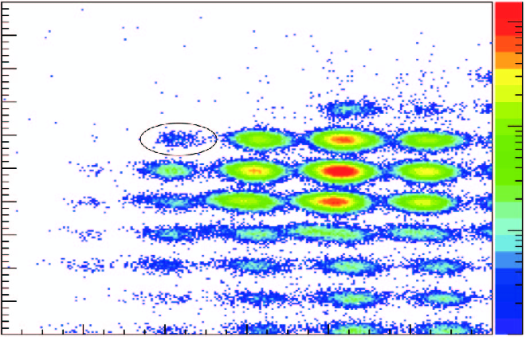
Active stopper for fragmentation facilities
Aim of an active stopper
stop wanted isotopes in the active volume
provide 3D coordinates of implantation position
provide decent time of implantation
provide rough energy information
measure subsequent β or α decay of an isotope
provide 3D coordinates of decay position
provide precise time of decay
provide decent energy information
correlate implantation and decay event
correlate particle decay with coincident γ decay
γ detectors
Fragment Separator
active
stopper
degrader
γ detectors

Slide 4
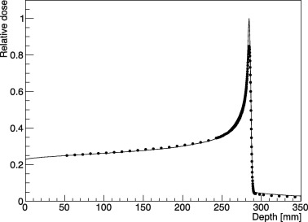
The implantation process
1 punch through, 100 MeV range
well localized track,
chance of secondary reactions
2 implantation, 1000 MeV range,
well localized stopping volume,
chance of secondary reactions
3 prompt flash, 1 MeV range
active volume hit by x-rays, γ-rays, Δ-electrons
heavy ion
1
2
3

Slide 5
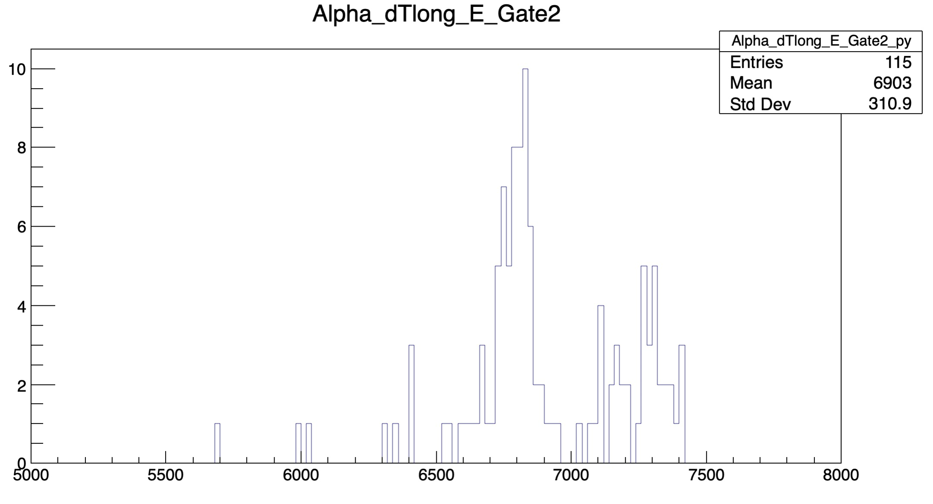
The decay process
β-decay
E: MeV range, wide distribution
τ: ≥ µs
long range, random path
α-decay
E: MeV range, discrete lines
τ: ≥ µs
short range, straight path
²²⁴Ac
1
2
3
²¹⁹Rn

Slide 6
The harsh environment
Fragment separator background
unwanted nuclear species
light charged particles
x-rays, γ-rays
Electronic noise
electromagnetic interference
detector noise
electronic noise and oscillations
Fragment Separator
EMI

Slide 7
Implanter requirements
stopping capability for any ion with Z ≥ 6, A ≥ 10 and E ≤ 200 MeV/u
ion detection efficiency as large as possible: > 90%
ion energy resolution enabling distinction of implants and punch-throughs: <10%
ion time resolution enabling decay time measurements: < µs
recovery time after implantation < 0.1ꞏτ_{min} : ≈ 100 ns
(active volume / voxel size) < (decay time ꞏ implantation rate):10³…10⁴ voxels
decay particle efficiency as large as possible: > 90%
α energy resolution enabling spectroscopy: ≈ 100 keV @ 5 MeV
β energy threshold low enough to avoid substantial efficiency losses: < 100 keV
β time resolution adequate for fast timing γ and n measurements: < 400 ps
active implantation cross section fitting to implant distribution: 6 ꞏ 6 cm² … 24 ꞏ 8 cm²
total size of implanter set-up compact enough for γ arrays: < 8ꞏ8ꞏ10 cm³ … 26ꞏ10ꞏ10 cm³
minimal material budget to minimize γ absorbtion and scattering: <10% @ 100 keV

Slide 8
What Si DSSSDs can achieve
stopping capability for any ion with Z ≥ 6, A ≥ 10 and E ≤ 200 MeV/u
ion detection efficiency as large as possible: > 90%
ion energy resolution enabling distinction of implants and punch-throughs: <10%
ion time resolution enabling decay time measurements: < µs ≈ µs
recovery time after implantation < 0.1ꞏτ_{min} : ≈ 100 ns > 10 µs
adequate granularity (V_{active} / V_{voxel}) < (τ ꞏ R_{implantation}): 10³…10⁴ voxels
decay particle efficiency as large as possible: > 90% ≤ 30%
α energy resolution enabling spectroscopy: ≈ 100 keV @ 5 MeV
β energy threshold low enough to avoid substantial efficiency losses: < 100 keV ≈ 100 keV
β time resolution adequate for fast timing γ and n measurements: < 400 ps > 2 ns
active implantation cross section fitting to implant distribution: 6 ꞏ 6 cm² … 24 ꞏ 8 cm²
total size of implanter set-up compact enough for γ arrays: < 8ꞏ8ꞏ10 cm³ … 26ꞏ10ꞏ10 cm³
minimal material budget to minimize γ absorbtion and scattering: <10% @ 100 keV

Slide 9
What scintillator detectors may achieve
stopping capability for any ion with Z ≥ 6, A ≥ 10 and E ≤ 200 MeV/u
ion detection efficiency as large as possible: > 90%
ion energy resolution enabling distinction of implants and punch-throughs: <10%
ion time resolution enabling decay time measurements: < µs
recovery time after implantation < 0.1ꞏτ_{min} : ≈ 100 ns
adequate granularity (V_{active} / V_{voxel}) < (τ ꞏ R_{implantation}): 10³…10⁴ voxels
decay particle efficiency as large as possible: > 90% to be shown
α energy resolution enabling spectroscopy: ≈ 100 keV @ 5 MeV to be checked
β energy threshold low enough to avoid substantial efficiency losses: < 100 keV
β time resolution adequate for fast timing γ and n measurements: < 400 ps
active implantation cross section fitting to implant distribution: 6 ꞏ 6 cm² … 24 ꞏ 8 cm²
total size of implanter set-up compact enough for γ arrays: < 8ꞏ8ꞏ10 cm³ … 26ꞏ10ꞏ10 cm³
minimal material budget to minimize γ absorbtion and scattering: <10% @ 100 keV

Slide 10
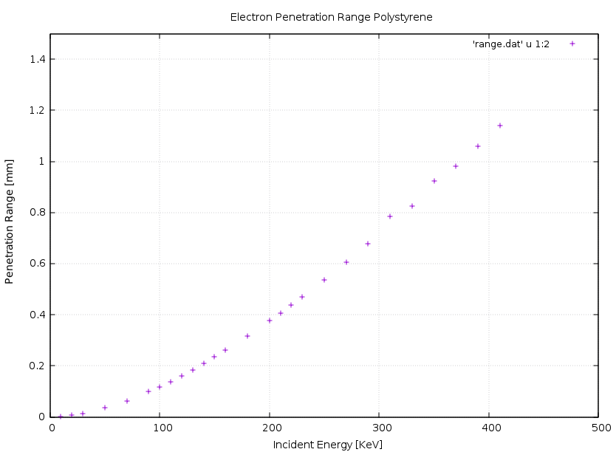
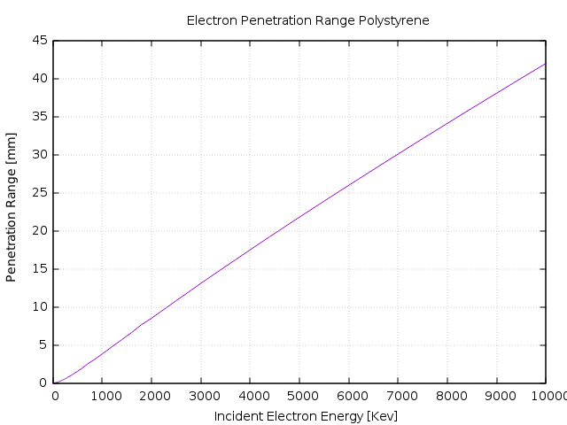
Penetration range of β-particles in plastic
βs with E ≤ 500 keV are stopped within 1.5 mm plastic material.
With 3 mm thick plastic sheets (equivalent to 1 mm Si), >90% of βs will deposit ≥ 100 keV energy.
This leads to a voxel size of 3ꞏ3ꞏ3 mm³ corresponding to > 10⁴ voxels for a 8ꞏ8 cm² detector cross section.

Slide 11
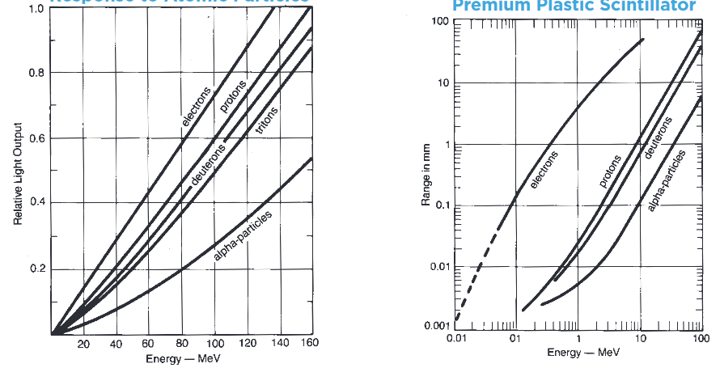
Properties of plastic scintillators
Strong quenching of αs
Even stronger quenching of nuclear isotopes
Range of αs < 0.1 mm

Slide 12
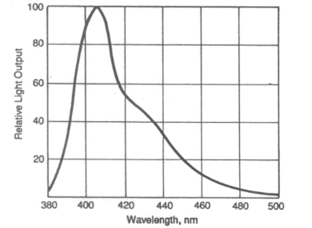
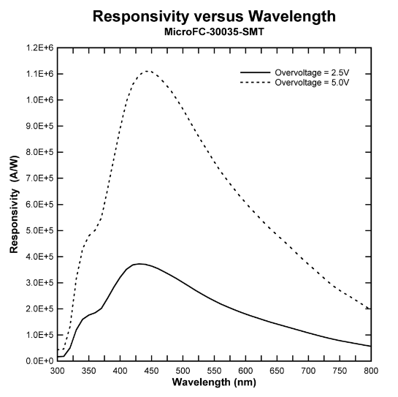
Properties of plastic scintillators
BC404
Light yield (photons/MeV) | 11000
Rise time (ns) | 0.7
Decay time (ns) | 1.8
λ(max. emission) (nm) | 408
Attenuation length (cm) | 160
Density (g/cm²) | 1.02
Perfectly matching with SiPMs
no afterglow
radiation hard

Slide 13
Inorganic scintillators in comparison to plastic
Pros
higher density → smaller stopping volume for βs, smaller stopping thickness for nuclei
higher light yield → better energy resolution → improved α spectroscopy
Cons (depending on choice)
larger γ absorption → γ detection efficiency reduction
longer decay times → „diluted“ rise times → worse time resolution
afterglow → longer recovery times
higher light attenuation → limited light readout options
mechanically demanding → limited crystal size, less robust
expensive → higher detector cost
Interesting choices
YSO, GAGG, La-GPS, CLYC, CeBr₃…

Slide 14
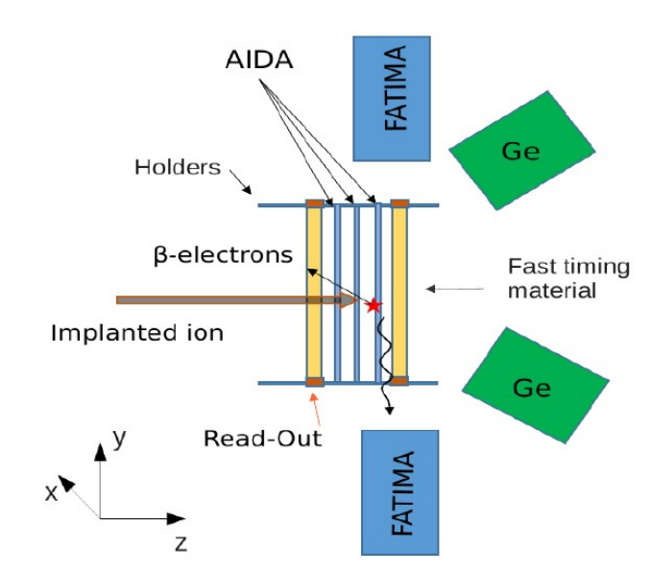
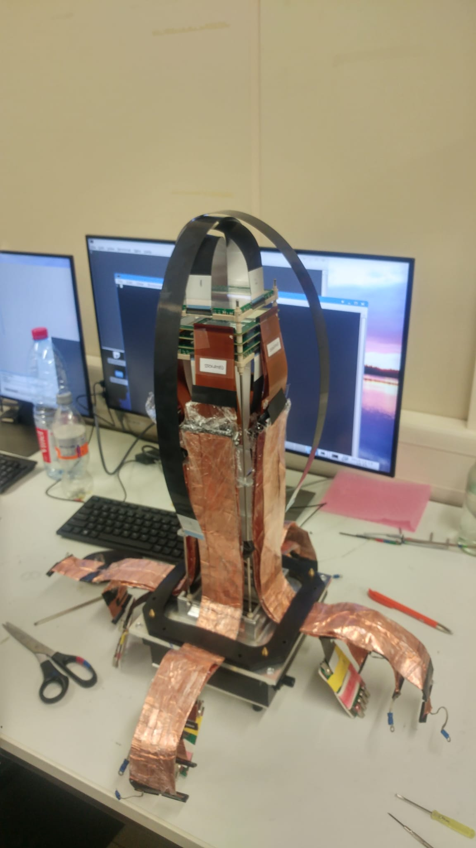
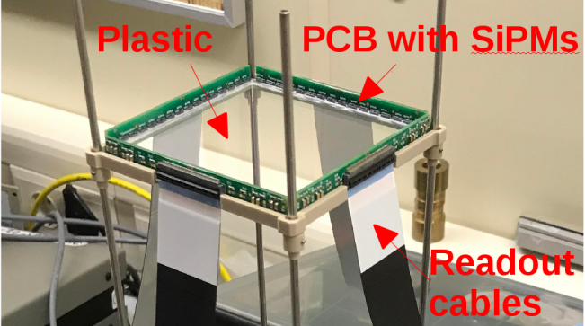
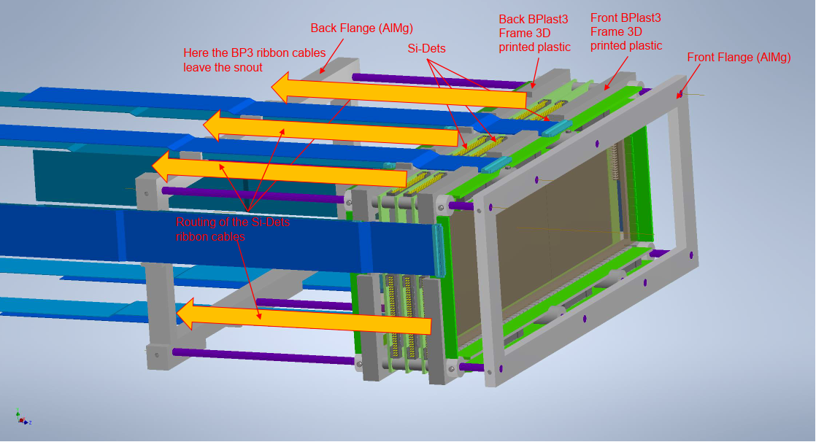
Non-segmented plate scintillator
NUSTAR/DESPEC → AIDA DSSSD + bPlast scintillator
bPlast
Properties
material | BC-400, BC-404
active volume | 80ꞏ80ꞏ3 mm³, 75ꞏ240ꞏ3 mm³
light readout | OnSemi SiPM C-series

Slide 15
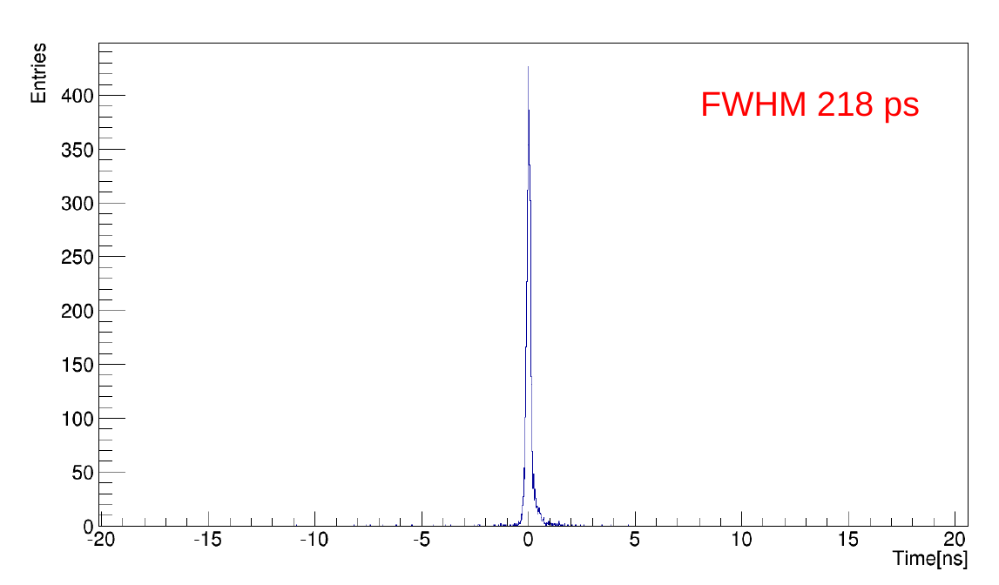
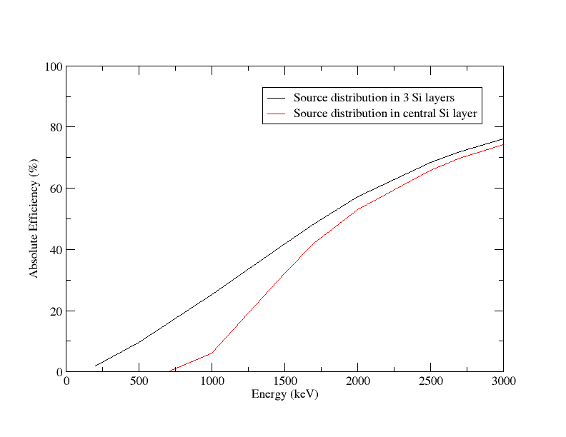
AIDA + bPlast
AIDA + bPlast β coincidence efficiency for fast timing experiments (simulated)
Position resolution
-Implants: ≈ 6 mm
(t distribution ANN)
-Compton e⁻: ≈ 6mm
(E center-of-gravity)
Time resolution
-Implants: ≈ 30 ps
-β,α: ???
intrinsic bPlast time resolution (multiple SiPM combinations) employing ²²Na γ source in clean lab environment…
works well for high-energy βs
For further details see talk by Carole Chatel

Slide 16
Non-segmented plate scintillator
Pros
excellent time resolution → fast timing capability
50…100 ns recovery time, no afterglow → fast decay capability
low material budget → little γ absorption
mechanically robust, cheap
Cons
edge light detection → < 10% photons detectable → limited position resolution → <10⁴ voxels
low density→ long tracks and escapes at higher β energies → reduced ion-β correlation eff.
Comments
Well suited as fast timing add-on for AIDA
Suitable as stand-alone implanter for α decays (energy resolution to be checked)
Suitable as stand-alone implanter when stacked for τ < 5 s or low implant/background rates

Slide 17
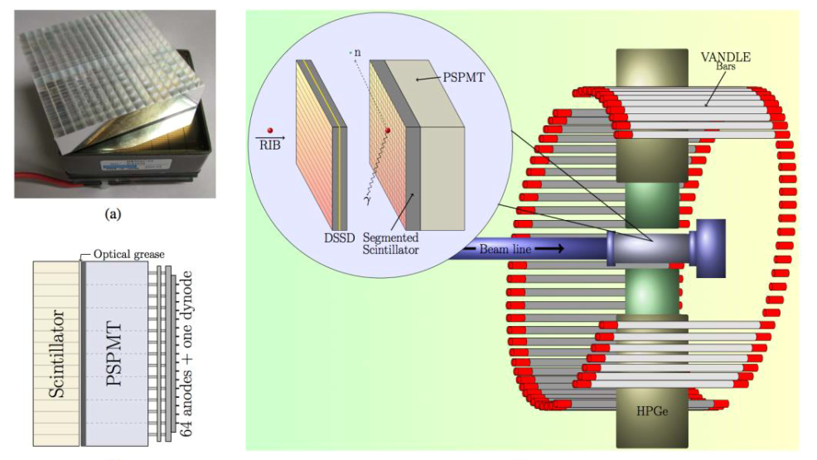
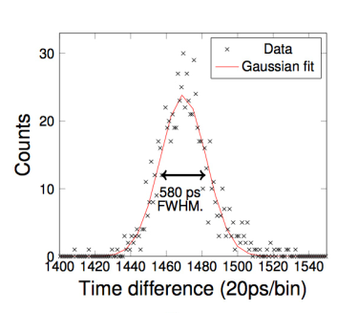
2D segmented scintillator
VANDLE FRIB
16x16 pixel plastic
48x48x10 mm³ active volume
diffuser plate
8x8 pixel PSPMT
PSPMT dynode for timing
R. Grzywacz et al.
against 418 ps ref. det.

Slide 18
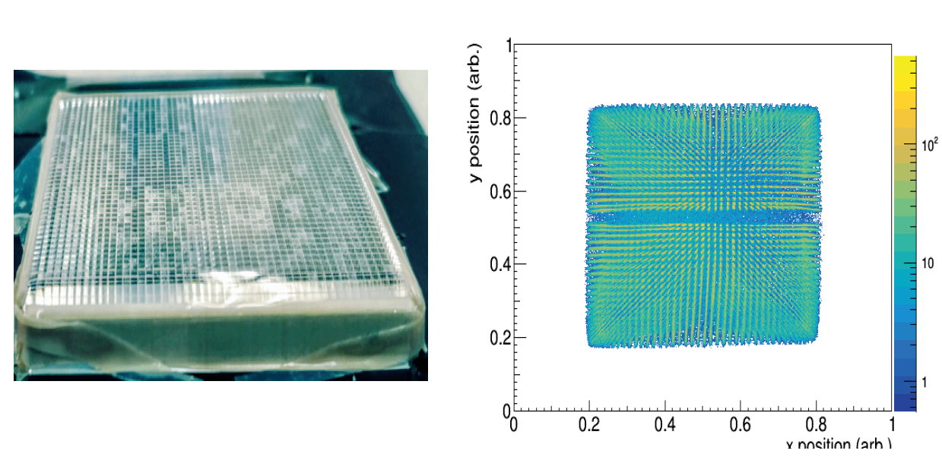
2D segmented scintillator
BRIKEN RIBF
48x48 pixel YSO
48x48x5 mm³ active volume
glass diffuser plate
8x8 pixel PSPMT
PSPMT dynode for timing
>65% beta efficency
R. Grzywacz et al.
For further details see talk by Quanbo Zeng

Slide 19
2D segmented scintillator
Pros
excellent β detection efficiency
good time resolution → fast timing capability (for neutrons)
good energy resolution → α spectroscopy capability
Excellent position resolution (with inorganic scintillators)
Cons
inorganic scintillators → strong γ absorption (for equatorial angles)
plastic → long tracks and escapes at higher β energies → reduced ion-β correlation eff.
long recovery time
Comments
Comes with a variety of scintillators adoptable to specific experiments
Well suited for implant-decay correlations if γ absorption is acceptable

Slide 20
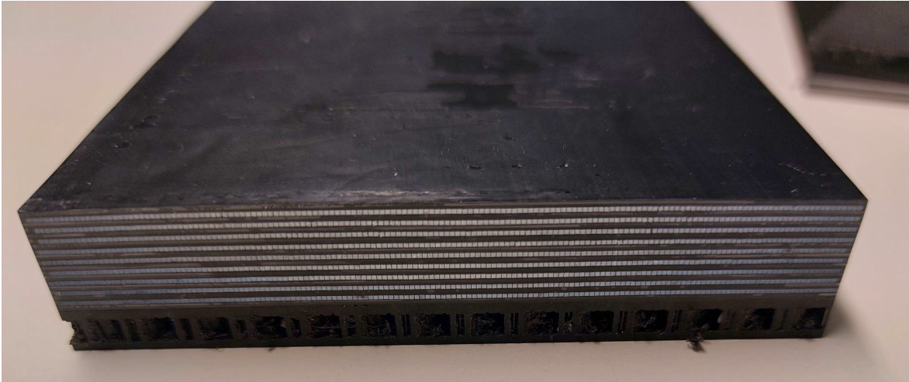
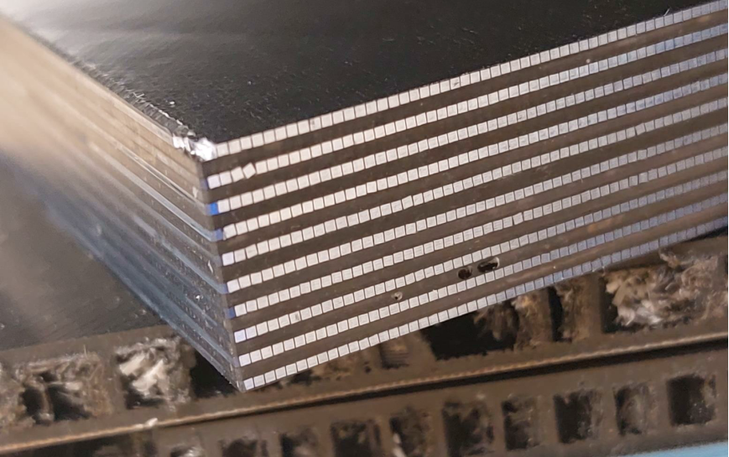
3D segmented scintillator
NUSTAR/DESPEC – FIMP (GSI Darmstadt , JSI Ljubljana, IMP Lanzhou)
SiPM 4x4 mm²
3x20 SiPM
3x20 SiPM
3x19 SiPM
heavy ion
to be
implanted
side view
front view
3x19 SiPM
Fibers:
St. Gobain cross section 0.5x0.5 mm²
scintillating core 0.4x0.4 mm²
cladding 0.05 mm
Each SiPM reads 4x8 fibers
Fibers are read on both ends
with interleaved SiPMs
→ 2x2x2 mm³ voxels (granularity 9600)
Expected specs:
-Efficiency: >80% at E_{β} ≥ 500 keV
-Time resolution: <500 ps at E_{β} ≥ 500 keV
-Energy resolution: <20% at E_{β} = 1000 keV

Slide 21
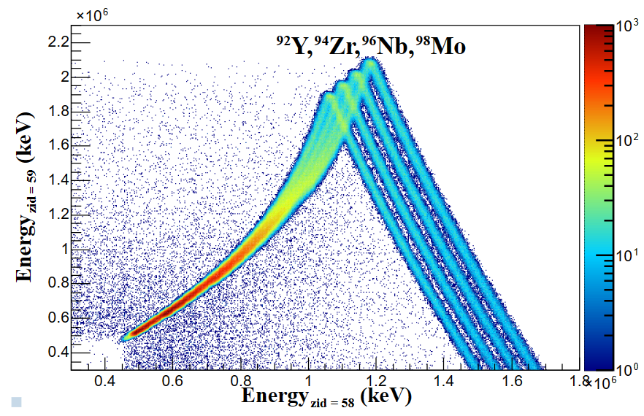
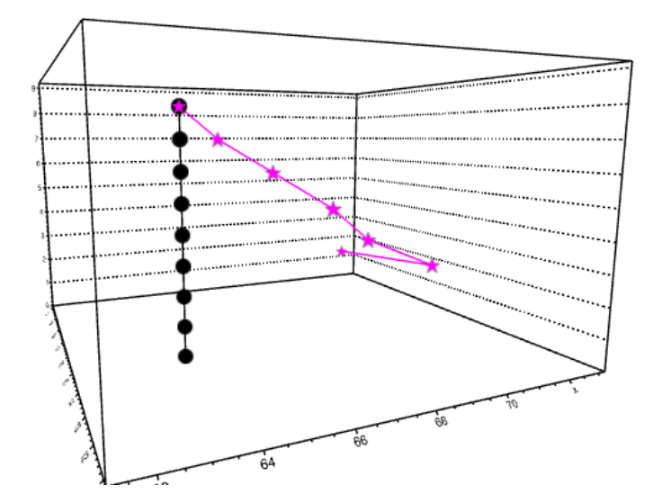
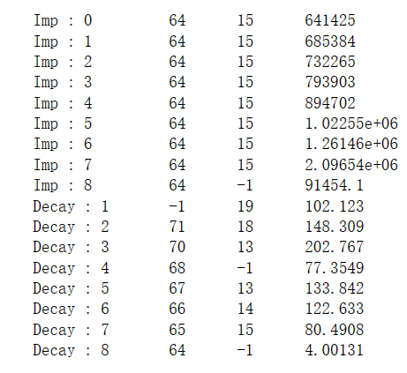
3D segmented scintillator
Geant simulation: Implant – β decay
x
z
E_{xyz}(keV)
E ≤ 200 MeV/u
β
element ID
z
y
ion
x
H. Hao, G. Li
IMP Lanzhou
FIMP enables charged particle tracking: implant, sec. fragm., fission, α, β, p, d, t,…

Slide 22
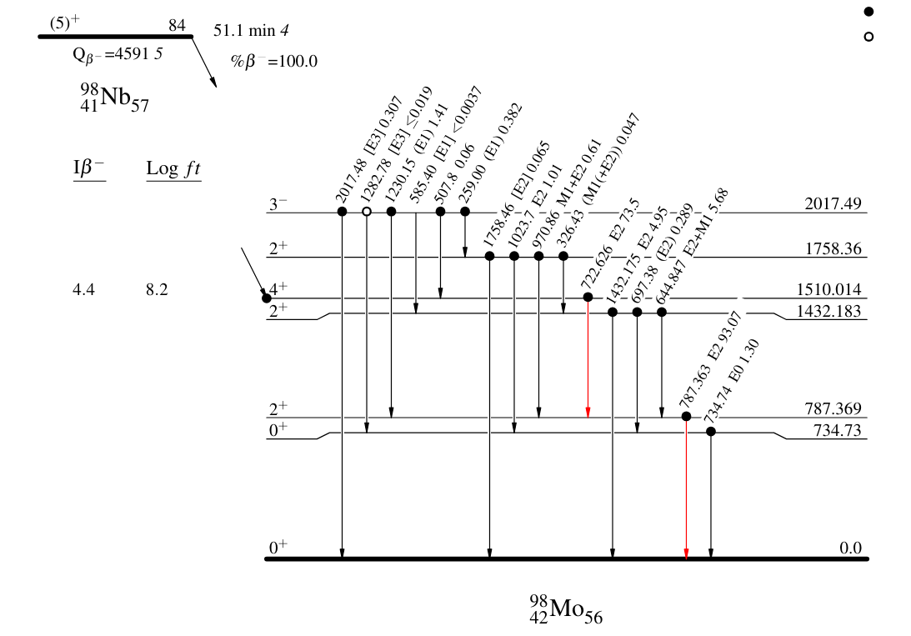
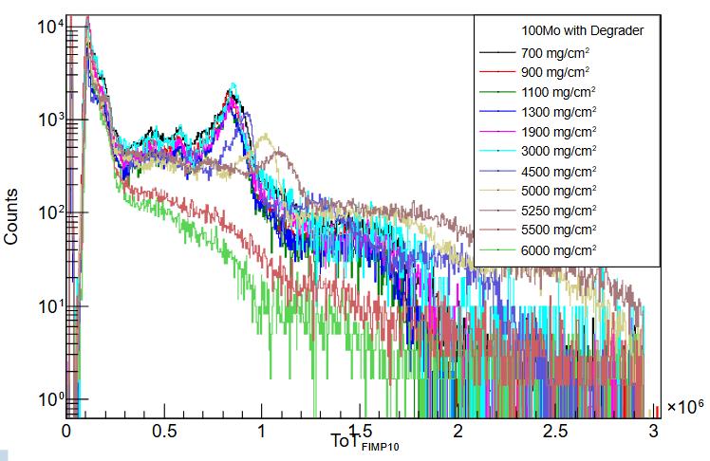
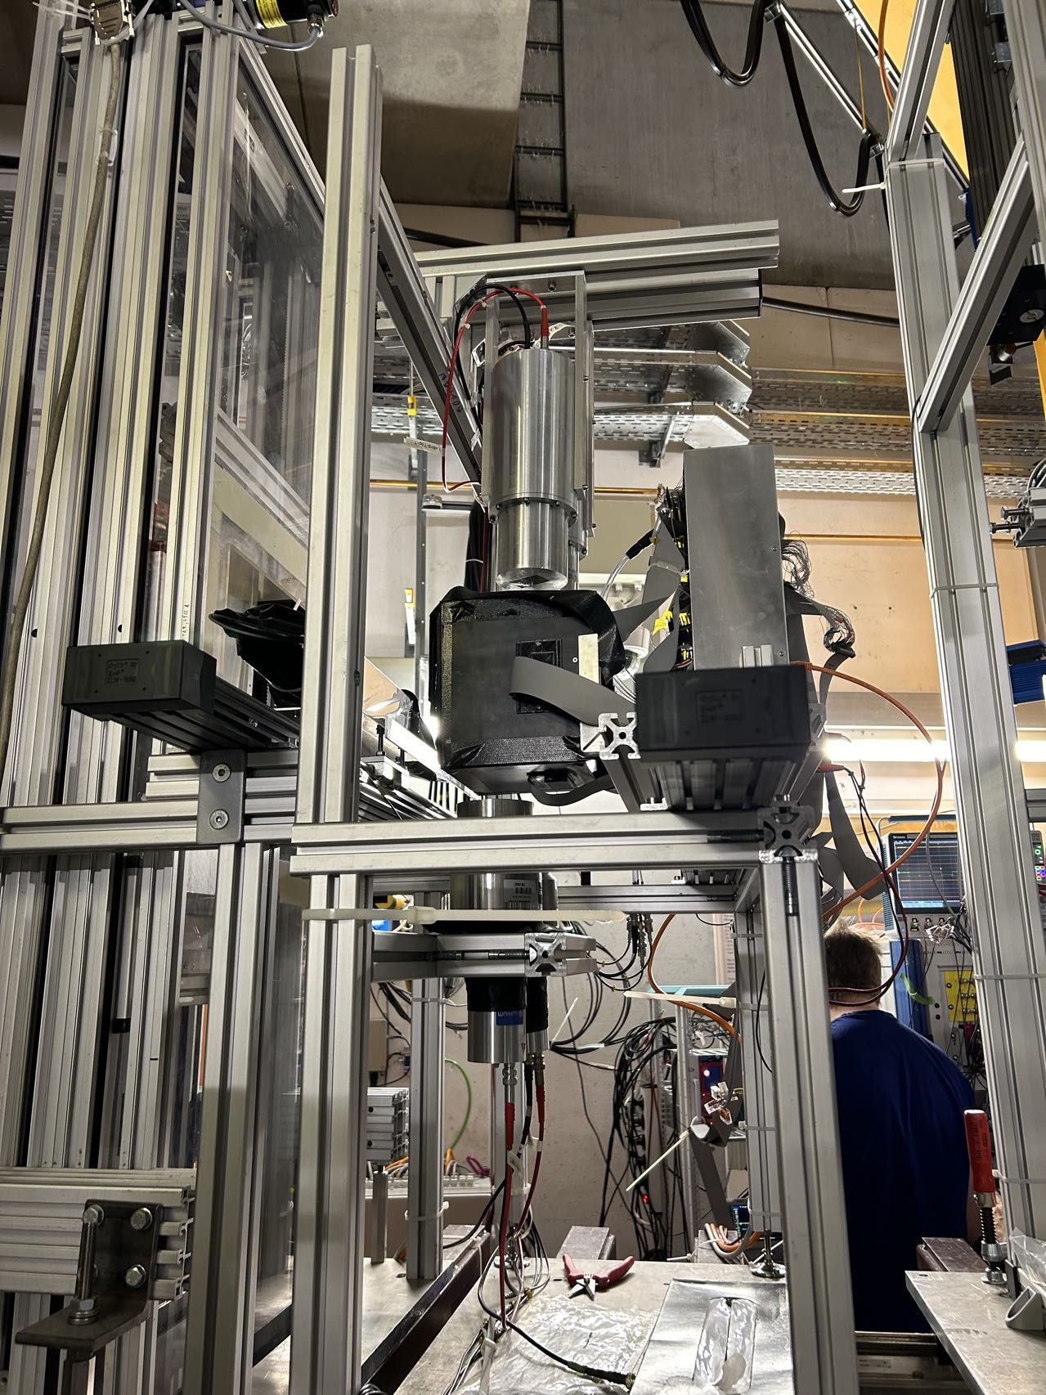
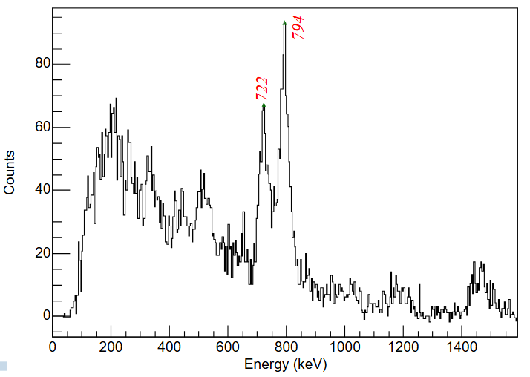
3D segmented scintillator
FIMP Box
degrader
SC41
SC42
γ
SC43
punch-through
flash
FRS
implant
¹⁰⁰Mo
γ
4 LaBr3
ch10
implantation process
For further details see talks by
Jelena Vesic and Klemen Zagar
β-γ decay process

Slide 23
3D segmented scintillator
Pros
excellent time resolution → fast timing capability
universal charged partcle tracking → valuable novel analysis possibilities
50…100 ns recovery time, no afterglow → fast decay capability
low material budget → little γ absorption
Cons
edge light detection → < 10% photons detectable → limited energy resolution
low density→ long tracks → complex tracking analysis (AI/ML)
Comments
Universal implanter with tracking capability
Under development → Final detector properties not yet known…

Slide 24
Conclusions
Available implantation decay systems are limited in their properties
On-going R&D work aims to overcome these limitations with scintillator-based systems
Scintillator-based implanter are complementing Si DSSSD stack systems
Fast-timing requirements demand Scintillator-based systems
Latest developments will enable charged particle tracking, which provides possibilities for isotope identification, background event suppression and enhanced efficiency.

