Slide 1
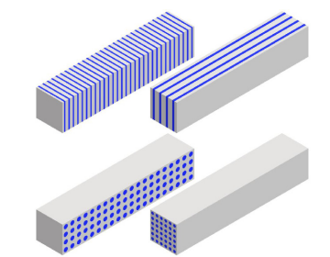
A novel active stopper based on hetero-structured BGO scintillators functionalized with 2D-perovskites and chalcogenide semiconductors
Teresa Kurtukian-Nieto
IEM-CSIC, Madrid
Workshop Active stoppers for decay experiments
March 24-26 2025
Parc Científic de la Universitat de València

Slide 2
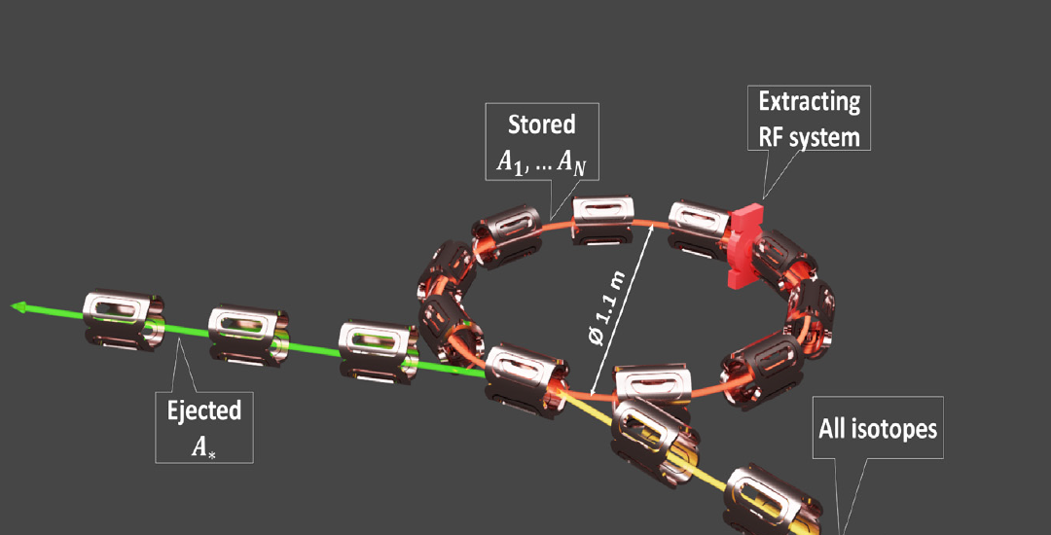
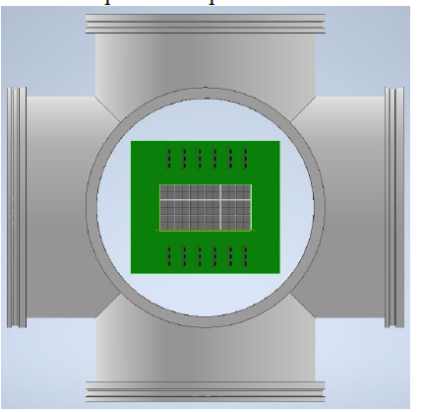
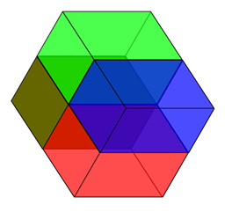

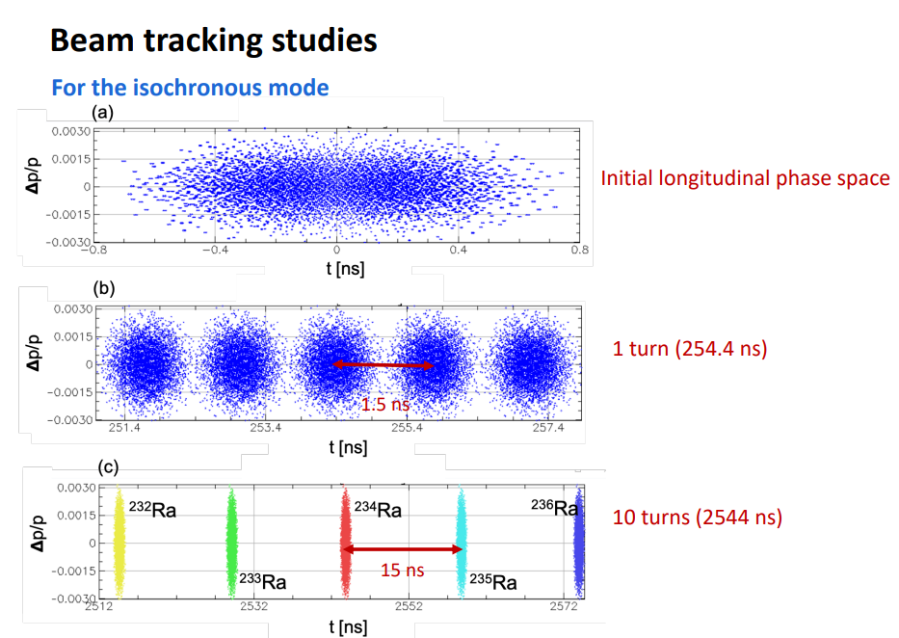
Why WE ARE INTERESTED IN THIS TECHNOLOGY?
ISOLDE
Superconducting
Recoil
Separator

Slide 3
Why WE ARE INTERESTED IN THIS TECHNOLOGY?
• ISRS focal plane active stopper :
radiation-hardness
good time resolution
high-efficiency and enough energy resolution
high-granularity
Edge-technology scintillators?
• Traditional technologies could address these needs but with significantly increased complexity in readout systems and price

Slide 4
FAST RESPONSE : Scintillators

Slide 5
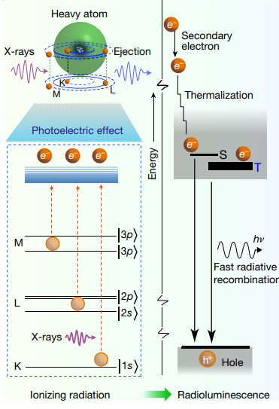
FAST RESPONSE : Scintillation at the nanoscale

Slide 6
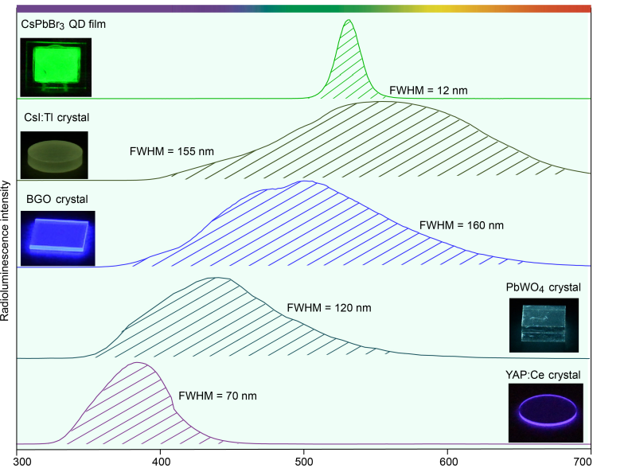

Slide 7
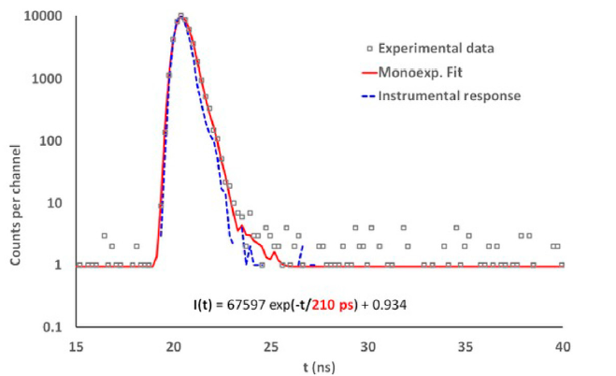
In nano systems, ultra fast emissions may occur: multiexciton generation(MEG)
Decay time spectra of ZnO(Ga) ZnO nanoscintillators under irradiation by X-rays
Procházková L, Tomáš G, Václav C, Vítězslav J, Martin N. Fabrication of
Highly Efficient ZnO Nanoscintillators. Opt Mater (2015) 47:67–71. doi:10.
1016/j.optmat.2015.07.001

Slide 8
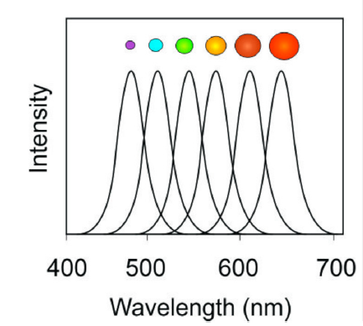
Emission spectrum as a function of nanocrystal size
Fontes A. Quantum Dots in Biomedical Researchs. In: Biomedical
Engineering - Technical Applications in Medicine. London,
United Kingdom: IntechOpen. (2012). Available at: https://www.
intechopen.com/chapters/38785.

Slide 13
What scintillator material to use?

Slide 14
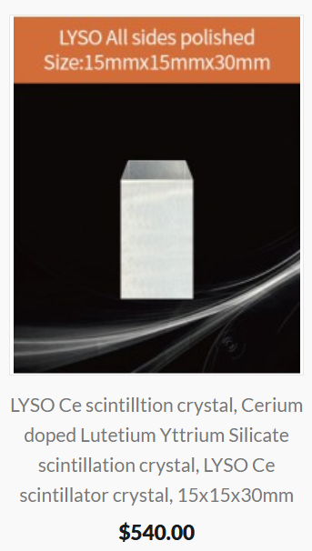
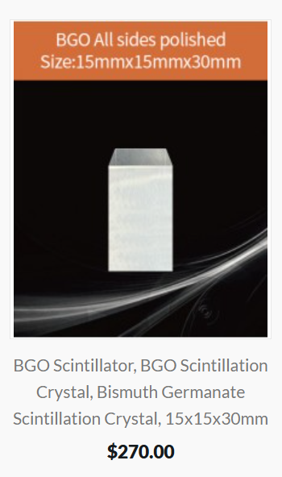
What scintillator material to use?

Slide 15
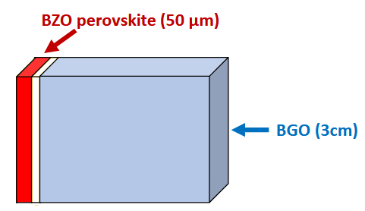
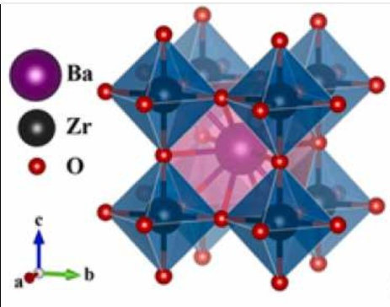
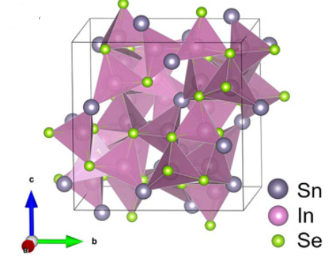
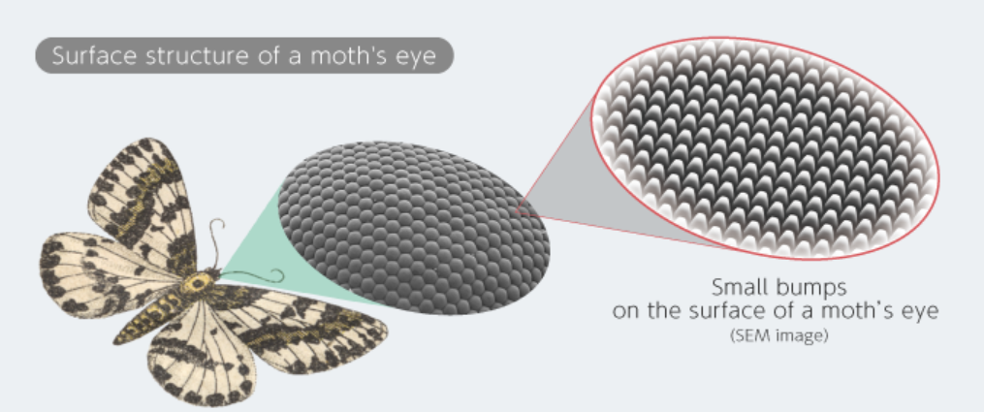
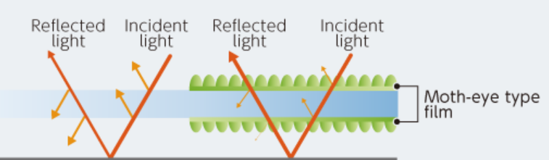
Pure BaZrO3 Perovskites and
A₄SnX₄ (X=S, Se, Te and A=In, Cu, Cd, Zn, Ag) chalcogenide semiconductors

Slide 16

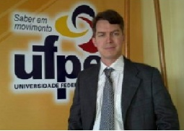

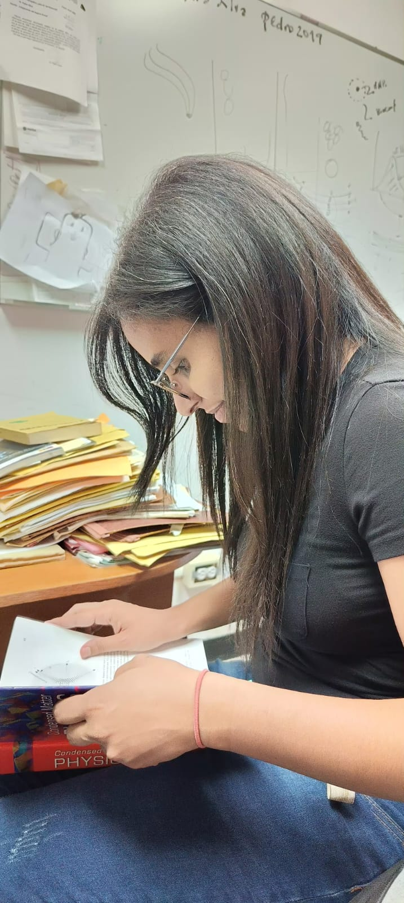
Pure and rare-earth-doped BaZrO3 Perovskites and A4SnX4 (X=S, Se, Te and A=In, Cu, Cd, Zn, Ag) chalcogenide semiconductors
Universidad Federal de Pelotas (UFPel), Pelotas, Brasil, “Advanced Crystal Growth and Photonics”
Instituto Venezolano de Investigaciones Científicas (IVIC), Caracas, Venezuela.
1. Prof. Dr. Mario Lucio Moreira (UFPel)
Professor at the Institute of Physics and
Mathematics(IFM-UFPel)
2. Prof. Dr. Pedro José Silva Mujica
(IVIC y UFPel)
Researcher at the Physics Center (IVIC)
Visiting Professor at the Institute of
Physics and Mathematics(IFM-UFPel)
4. Lic. Lennys Martínez, (IVIC)
PhD Student
3. Msc. Daniele Gonçalves Mesquita (UFPel)
PhD Student in 6 moths internship at CSIC y UCM
Development of Scintillation Detectors from Low-Dimensional Materials.
Various types of scintillating nanomaterials will be explored:
Pure and rare-earth-doped BaZrO3 Perovskites
Barium Fluoride (BaF₂)
A4SnX4 (X=S, Se, Te and A=In, Cu, Cd, Zn, Ag) supplied by IVIC, Venezuela. The performance will be studied in terms of light yield, temporal characteristics, and radiation resistance.

Slide 17


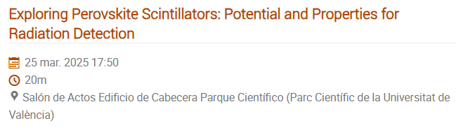


Exploring Perovskite Scintillators: Potential and Properties for Radiation Detection
Daniele Gonçalves Mesquita

Slide 18
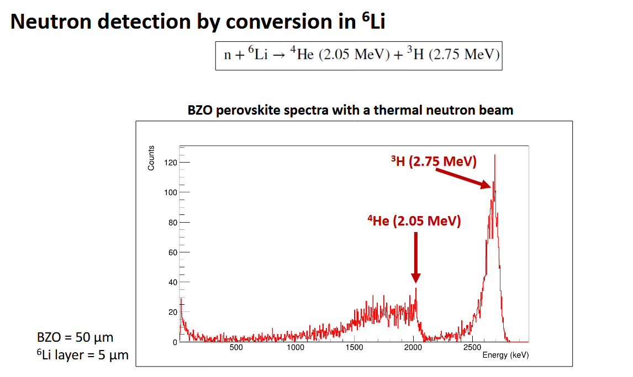
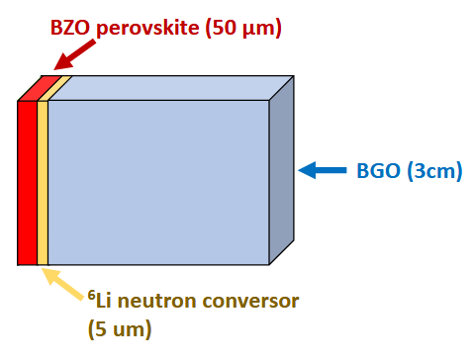

Slide 19
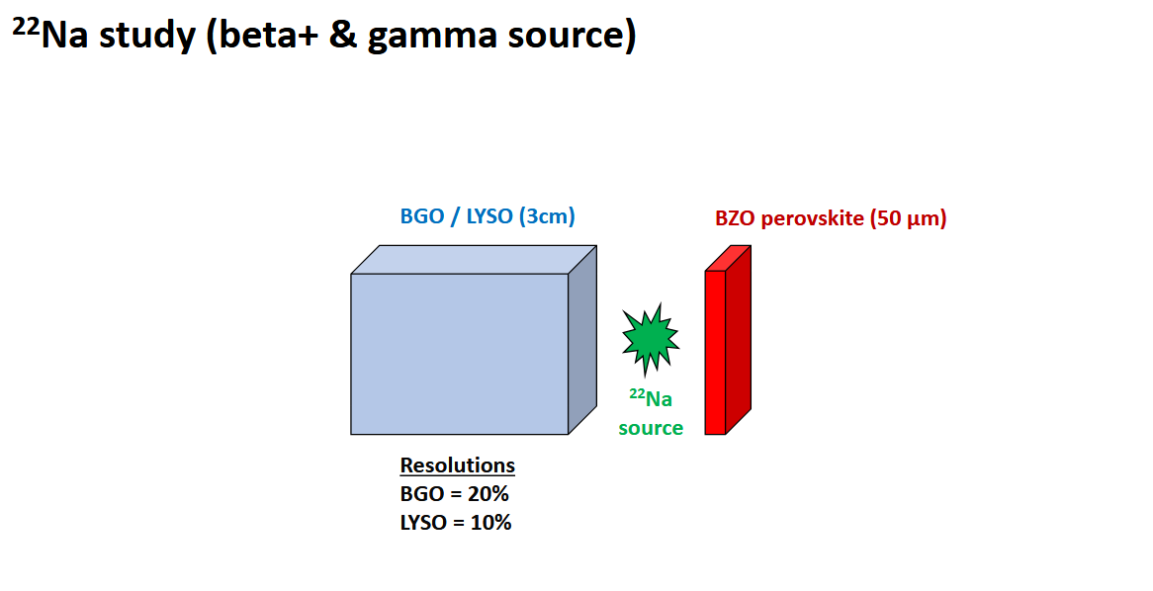

Slide 20
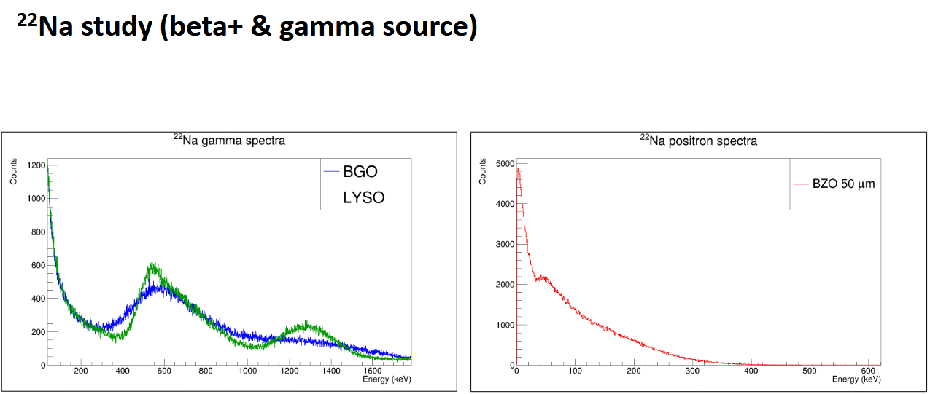
Juan Francisco González Linares (IEM )

Slide 21
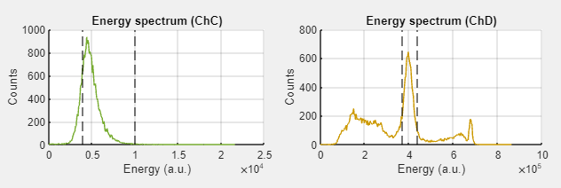
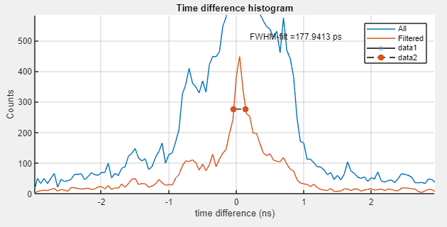
Timing coincidence
Na-22 Source
Detectors:
BaZrO₃ thin film in Polyvinyl sheet substrate
(50 μm)
x
LYSO single crystal (4x4x20mm)
Daniele Gonçalves Mesquita UPEL, Brasil

Slide 22
FUTURE? QUANTUM DOT BASED CHROMATIC CALORIMETRY

Slide 23
HOW DOES IT WORK?

Slide 24
HOW DOES IT WORK?

Slide 25
HOW DOES IT WORK?

Slide 27
Thank you

Slide 28
While not having this technology….

Slide 29
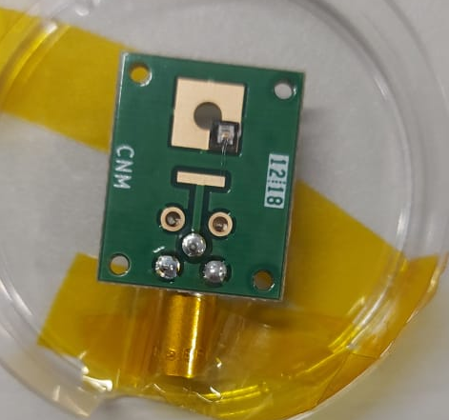
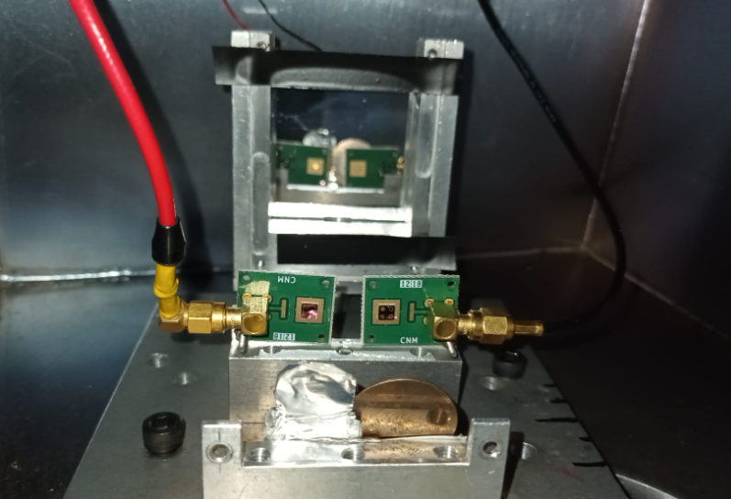
SiC developed at IMB CSIC
SiC epi growth on 4H-SiC substrate Epi 0: standard n-buffer, N(N)≥1e18/ccm , thickness 0.5 um Epi 1: n-layer, N(N)=1-3e14/ccm,
Conductivity Type N-type Dopant Nitrogen Crystal Orientation (0001) Off-Orientation 4° towards <11-20> Micropipe density ≤ 2cm-2 Si-face CMP epi-ready polished C-face Optical polished

Slide 30
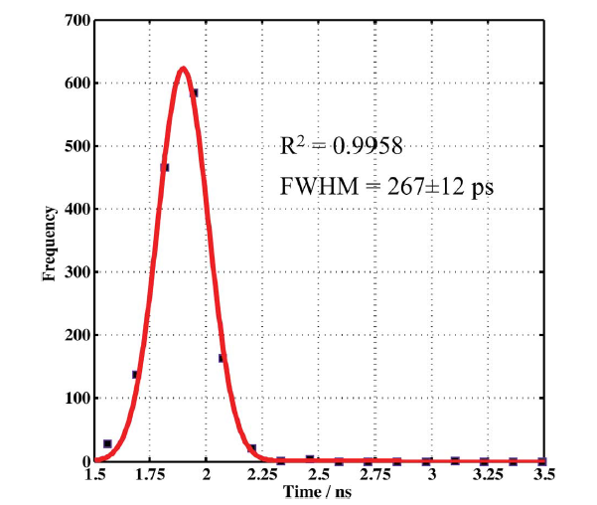
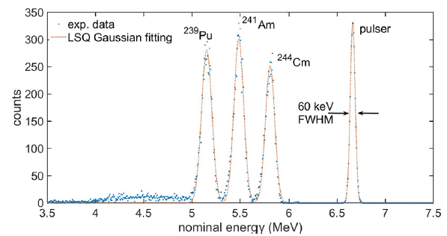
SiC developed at IMB CSIC and PM Italy

Slide 31
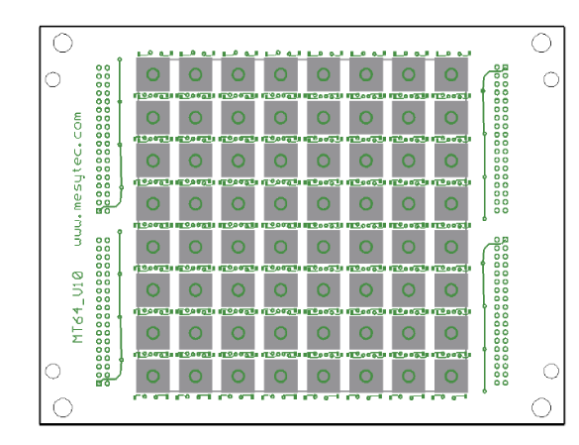
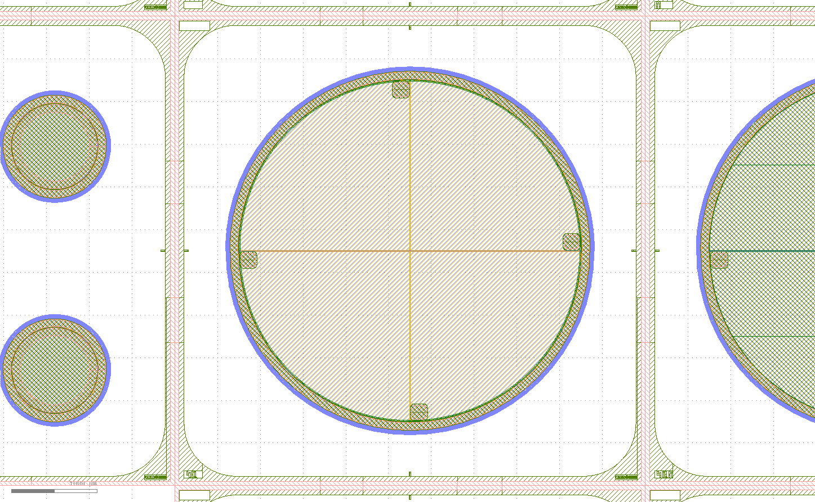
SiC developed at IMB CSIC
5500um
The dice is 5500 um x 5500um
Active diameter is 4000um
The quadrant has a radius of 2000um
4000um
diodes of 50μm
diodes of 100 μm

Slide 32
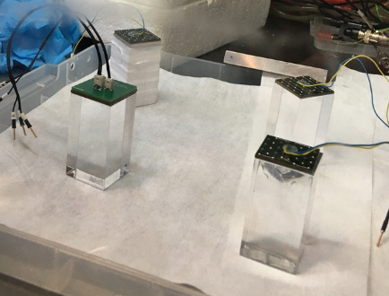
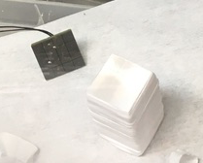
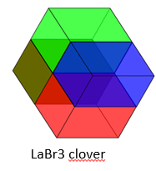
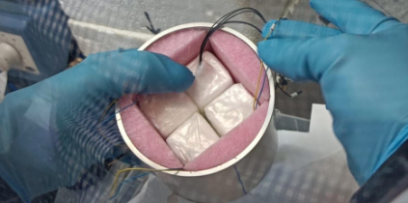
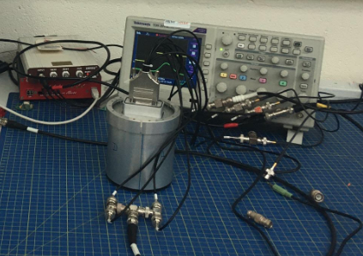
Focal plane detectors:
LaBr3 clover developed at U. West Scotland

Slide 33
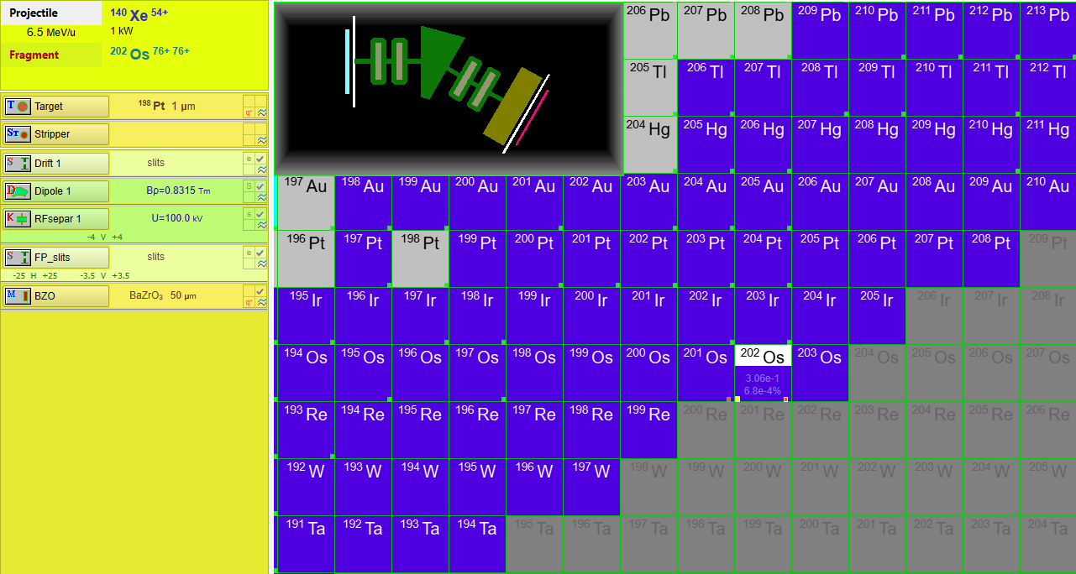
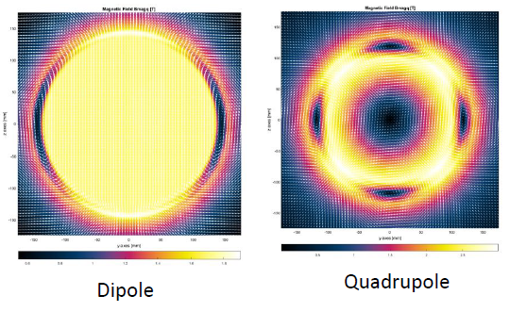
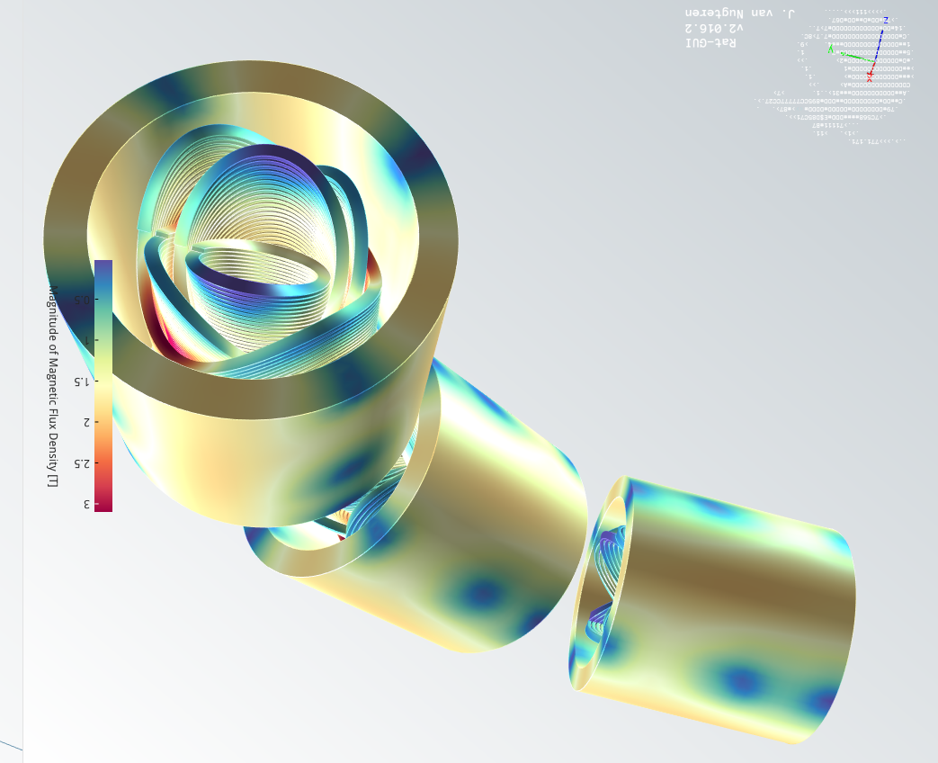
Ion test bench: small spectrometer

Slide 34
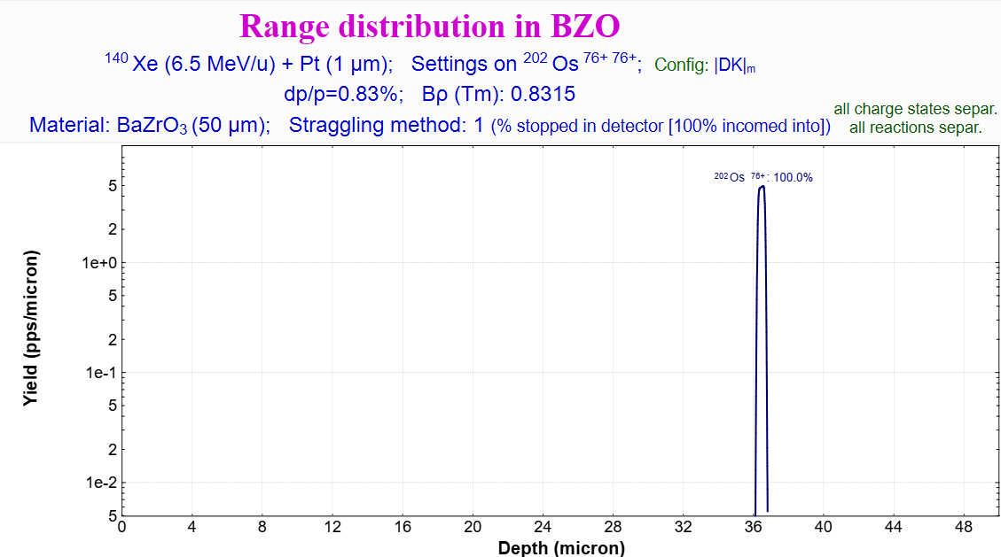

Slide 35
