Slide 1



Multiple-cavities interferometric analysis for dark matter axions search based on RF signal cross-correlation processing
José Reina-Valero (1), Iván Martí-Vidal (2), Benito Gimeno (1), Alejandro Díaz-Morcillo (3), Juan Monzó (3), Antonio Lozano (3), Pablo Navarro (3), José Ramón Navarro-Madrid (3)
Instituto de Física Corpuscular (IFIC), CSIC – University of Valencia, 46980 Paterna (Valencia), Spain
(2) Department of Astronomy and Astrophysics, University of Valencia, 46100 Burjassot (Valencia), Spain
(3) Department of Information and Communications Technologies, Technical University of Cartagena, 30203 Cartagena, Spain

Slide 2
INDE
Motivation
2. Theoretical Formulation
3. Numerical Results
3.1. SNR Improvement
3.2. Directionality and Annual Modulation
4. Conclusions and Future Prospects

Slide 3
INDEX
Motivation
2. Theoretical Formulation
3. Numerical Results
3.1. SNR Improvement
3.2. Directionality and Annual Modulation
4. Conclusions and Future Prospects

Slide 4
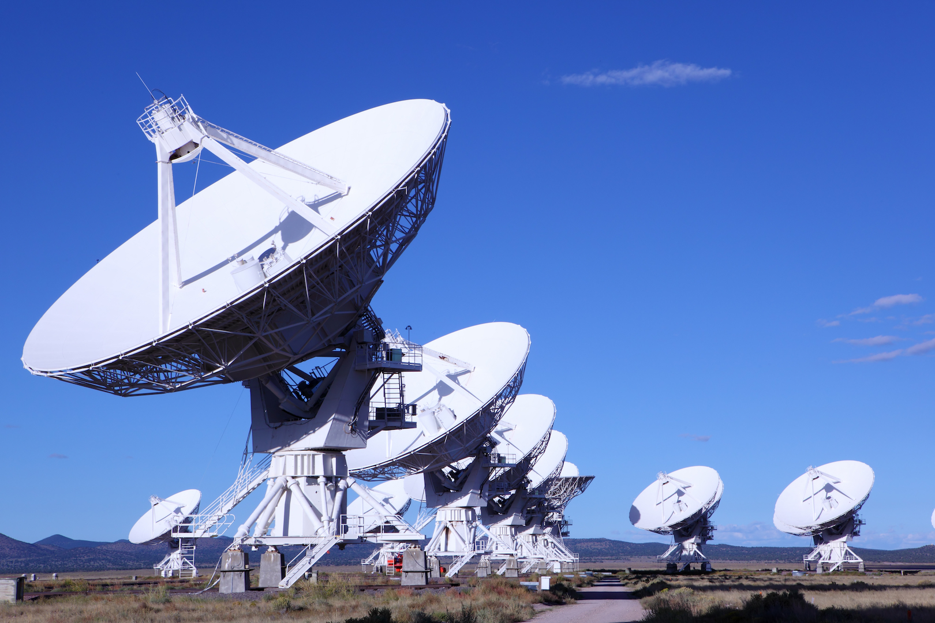
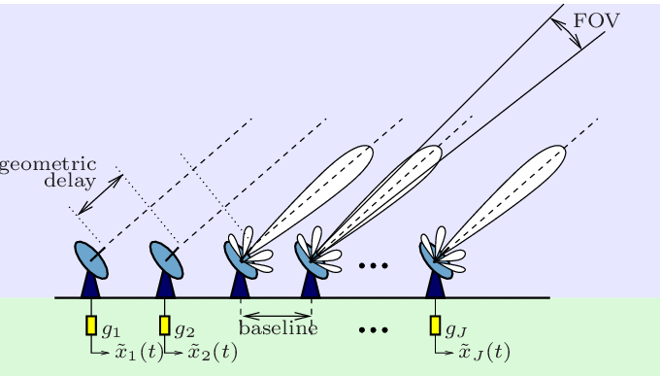
Motivation
Apply correlation techniques (well-known in radioastronomy) to study systems with low SNR, like in the axion case.

Slide 5
INDEX
Motivation
2. Theoretical Formulation
3. Numerical Results
3.1. SNR Improvement
3.2. Directionality and Annual Modulation
4. Conclusions and Future Prospects

Slide 6
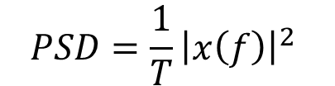
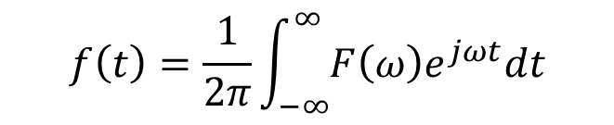

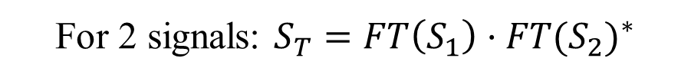
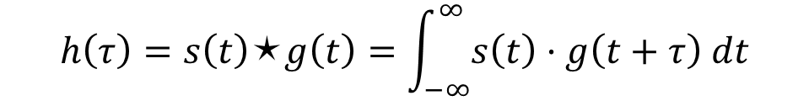

Theoretical Formulation: Correlation in Fourier domain
$$F\left(ω\right)=FT\left(f\left(t\right)\right)=\int_{−∞}^{∞}{f(t)e^{−jωt}dt}$$
$$f\left(t\right)=\frac{1}{2π}\int_{−∞}^{∞}{F\left(ω\right)e^{jωt}dt}$$
$$h\left(τ\right)=s\left(t\right)⬆g\left(t\right)=\int_{−∞}^{∞}{s\left(t\right)·g\left(t+τ\right) dt}$$
Correlation:
Power Spectral Density:
$$FT\left(h\left(τ\right)\right)=FT\left(s\left(t\right)⬆g\left(t\right)\right)=FT\left(s\left(t\right)\right)·{FT(g\left(t\right))}^{∗}$$
$$PSD=\frac{1}{T}{\left|x\left(f\right)\right|}^{2}$$
$T=$observation time
For 2 signals: $S_{T}=FT\left(S_{1}\right)·{FT(S_{2})}^{∗}$
For 3 signals: $S_{T}=FT\left(S_{1}\right)·{FT(S_{2})}^{∗}+FT\left(S_{2}\right)·{FT(S_{3})}^{∗}+FT\left(S_{3}\right)·{FT(S_{1})}^{∗}$

Slide 7


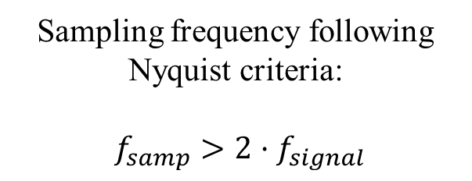
Theoretical Formulation: Correlation Procedure
$$∆t$$
Sampling frequency following Nyquist criteria:
$f_{samp}>2·f_{signal}$
Coherent signal
A
FT (A)
Gaussian
Noise
A⬆B
Add
$$∆t$$
Coherent signal
B
FT (B)
Gaussian
Noise
Repeat (T)

Slide 8
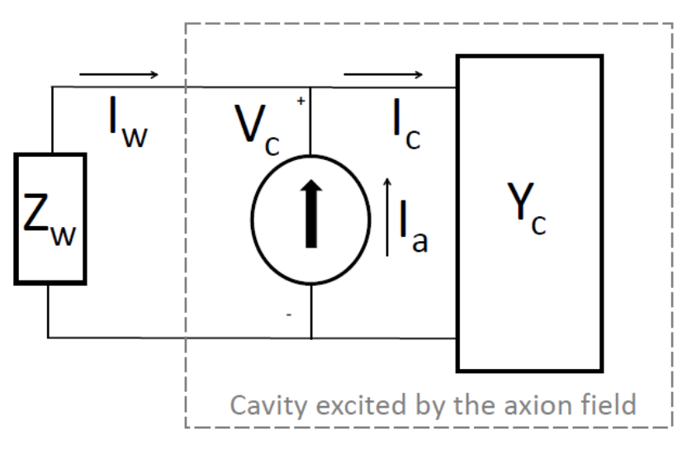
Theoretical Formulation: BI-RME 3D Method
BI-RME 3D method allows us to obtain the detected voltage from the axion-photon decay inside the cavity.
BI-RME 3D
equivalent to
Experimental setup
Equivalent circuit for the axion detection via haloscope

Slide 9
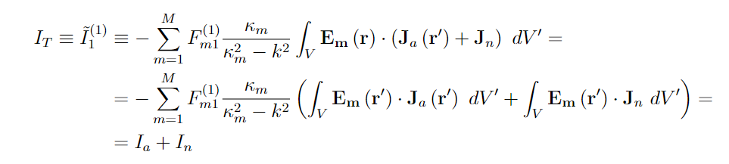
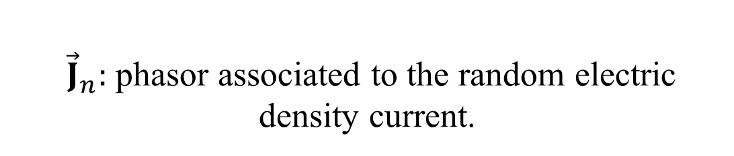
Theoretical Formulation: Noisy Resonant Cavity in BI-RME3D
${\vec{J}}_{n}:$ phasor associated to the random electric density current.
Realistic spectrum of cavity noise

Slide 10
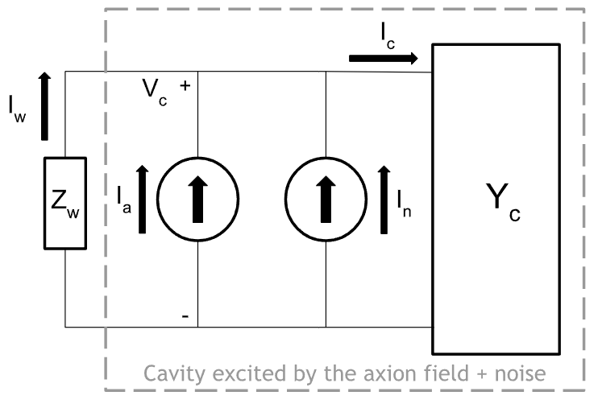
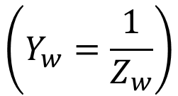
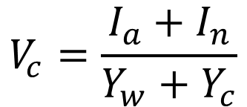

Theoretical Formulation: Cavity Noise in BI-RME3D
$$V_{c}=\frac{I_{a}+I_{n}}{Y_{w}+Y_{c}}$$
$$\left(Y_{w}=\frac{1}{Z_{w}}\right)$$
$$\left(Y_{c}=G_{c}+jX_{c}\right)$$
Equivalent circuit for the axion + Gaussian noise detection via haloscope

Slide 11
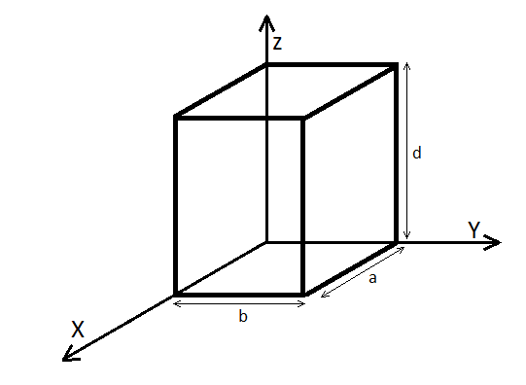
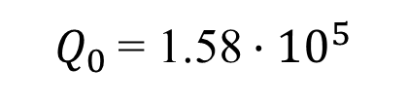
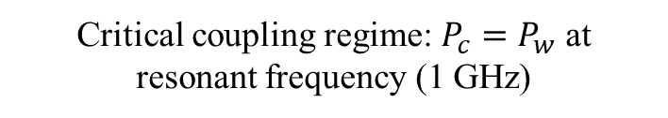

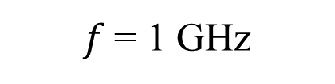

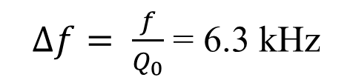
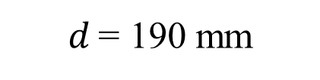

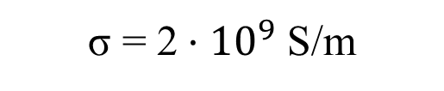
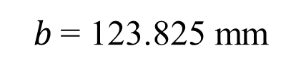

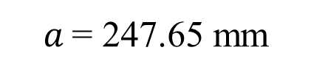
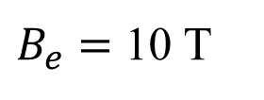
Theoretical Formulation: Electromagnetic modeling of the cavity
We are going to study a rectangular cavity with the next features (at cryogenic temperature):
Mode ${TE}_{101}$
$f$ = 1 GHz
$a$ = 247.65 mm
σ = 2 $·{10}^{9}$ S/m
$$V_{c}$$
$Q_{0}$ = 1.58 $·{10}^{5}$
$$V_{c}$$
$b$ = 123.825 mm
$d$ = 190 mm
$∆f= \frac{f}{Q_{0}}$ = 6.3 kHz
$$\vec{B_{e}}$$
$B_{e}=$ 10 T
Critical coupling regime: $P_{c}=P_{w}$ at resonant frequency (1 GHz)

Slide 12
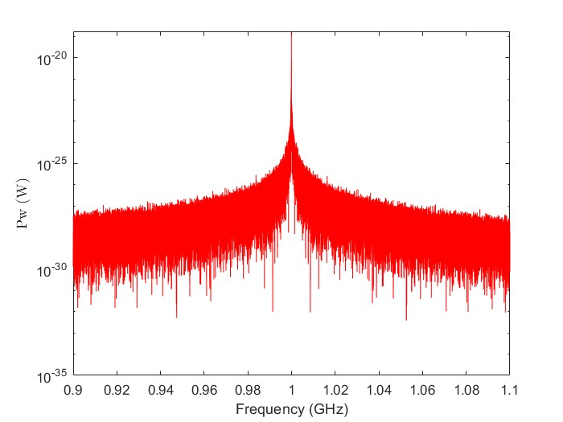
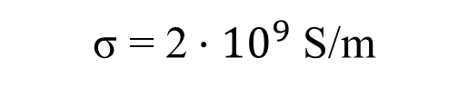


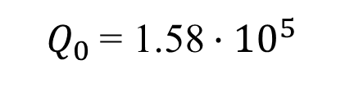
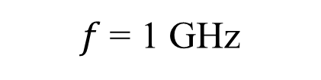
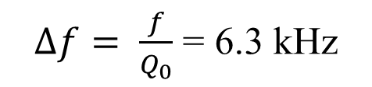
Theoretical Formulation: Cavity Noise in BI-RME3D (without axion)
Maximum normalized to
$P_{w}=P_{c}=k_{b}T∆f=$ 3.492 $·{10}^{−19}$ W
$f$ = 1 GHz
σ = 2 $·{10}^{9}$ S/m
$Q_{0}$ = 1.58 $·{10}^{5}$
$∆f= \frac{f}{Q_{0}}$ = 6.3 kHz
$T$ = 4 K
ONLY cavity Gaussian noise

Slide 13
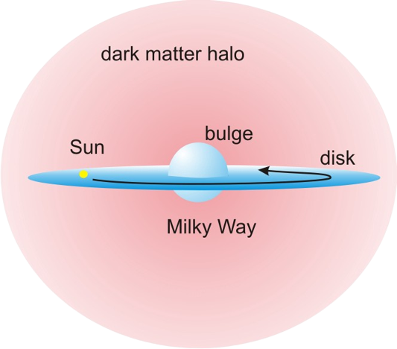






Theoretical Formulation: Axionic halo description in laboratory coordinates
$${\vec{v}}_{lab}={\vec{v}}_{LSR}+{\vec{v}}_{pec}+{\vec{v}}_{⨁}+{\vec{v}}_{rot}$$
$λ_{lab}$ = latitude
$t$ = time (day of the year)
$${\vec{v}}_{lab}\left(λ_{lab},t\right)=R_{lab}\left(λ_{lab},t\right)×R_{gal}·\left(\vec{v_{⨀}}+\vec{v_{⨁}}\right)+\vec{v_{rot}}$$
Matrix multiplication
$$\left({\vec{v}}_{⨀}={\vec{v}}_{LSR}+{\vec{v}}_{pec}\right)$$
$R_{gal}$: Galactic
Equatorial
$R_{lab}$: Equatorial
LAB

Slide 14
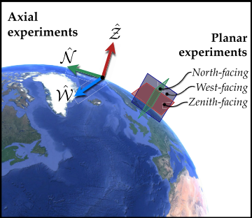









Theoretical Formulation: Axionic halo description in laboratory coordinates
N (North): X axis
$ω_{d}=$2π / (0.9973 days)
W (West): Y axis
Z (Zenith): Z axis
$t_{d}$ = 0.721 days
$λ_{lab}$ = latitude
$ω_{y}$ = 2π / (365 days)
$φ_{lab}=$ longitude
$t_{y}$ = March 20
$t$ = time (day of the year)
$${\vec{v}}_{lab}\left(t\right)=\left(\begin{matrix}−σ_{1}\sin\left(λ_{lab}\right)\cos\left(τ_{d}\right)−σ_{2}\sin\left(λ_{lab}\right)\sin\left(τ_{d}\right)+σ_{3}\cos\left(λ_{lab}\right) \\ σ_{1}\sin\left(τ_{d}\right)−σ_{2}\cos\left(τ_{d}\right)−v_{rot}\cos\left(λ_{lab}\right) \\ σ_{1}\cos\left(λ_{lab}\right)\cos\left(τ_{d}\right)+σ_{2}\cos\left(λ_{lab}\right)\sin\left(τ_{d}\right)+σ_{3}\sin\left(λ_{lab}\right)\end{matrix}\right)$$
$$τ_{d}=ω_{d}\left(t−t_{d}\right)+φ_{lab}$$
$σ_{n}≡$ n row of $R_{gal}$ times n component of the velocities summation $\vec{v_{⨀}}+\vec{v_{⨁}}\left(τ_{y}\right)$
$$τ_{y}=ω_{y}\left(t−t_{y}\right)$$

Slide 15
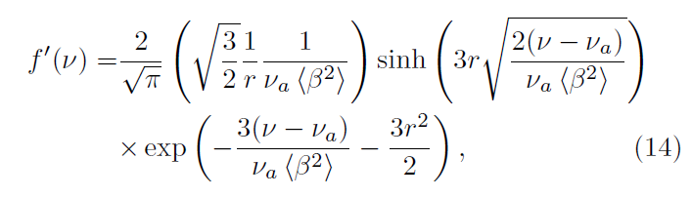
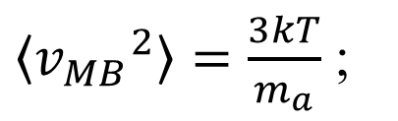
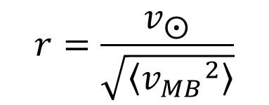


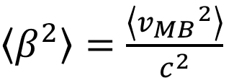
Theoretical Formulation: Maxwell-Boltzmann Bandwidth of the axion
$\left\langle {v_{MB}}^{2}\right\rangle =\frac{3kT}{m_{a}}$ ;
$\left\langle β^{2}\right\rangle =\frac{\left\langle {v_{MB}}^{2}\right\rangle }{c^{2}}$
$$r=\frac{v_{⨀}}{\sqrt{\left\langle {v_{MB}}^{2}\right\rangle }}$$
Frequency spectrum of the axion
($v_{s}$: Sun’s speed)
Intrinsic movement
(Maxwell-Boltzmann)
$$+$$
LAB frame velocity
Shifted Maxwell-Boltzmann

Slide 16
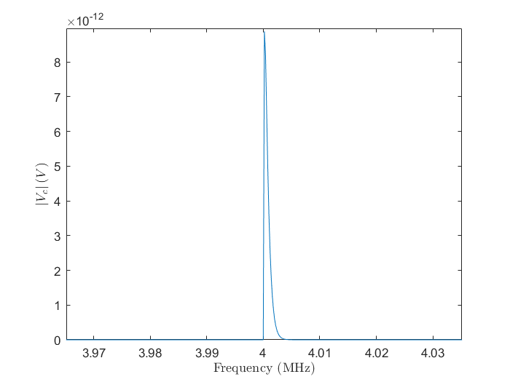
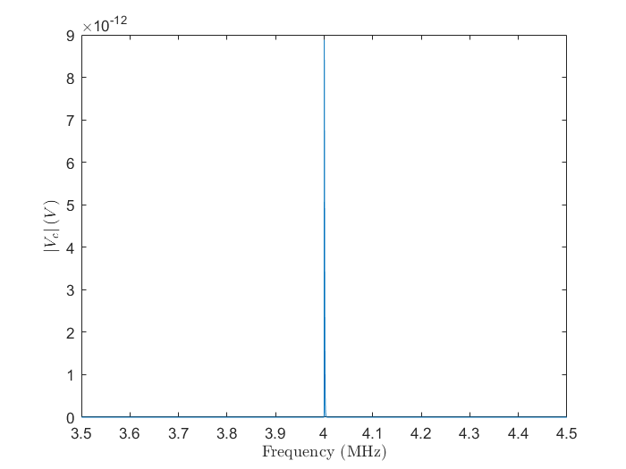
Theoretical Formulation: Maxwellian Bandwidth of the axion
Signal lowered to 4 MHz via local oscillator

Slide 17



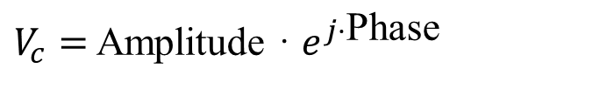

Theoretical Formulation: Study of the detected voltage
Connecting a coaxial probe to the cavity:
$$\left({\vec{k}}_{DB}·\vec{r}=\frac{2π}{λ_{DB}}{\hat{u}}_{k}·\vec{r}=\frac{\vec{p}}{ℏ}·\vec{r}=\frac{m_{a}γ{\vec{v}}_{lab}}{ℏ}·\vec{r}≈m_{a}\frac{{\vec{v}}_{lab}}{ℏ}·\vec{r}\right)$$
Introducing the electric field expression of the mode:
$$V_{c}$$
$$V_{c}$$
$$\vec{B_{e}}$$
We can obtain an analytical expresión for $V_{c}$ of the form:
$V_{c}=$ Amplitude · $e^{j·\text{Phase}}$

Slide 18
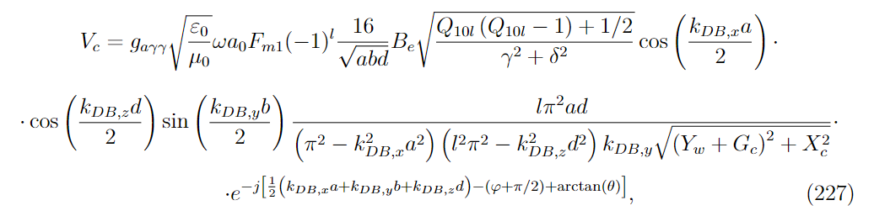
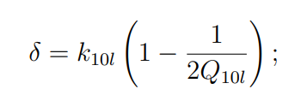
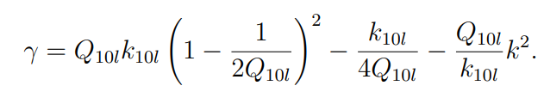
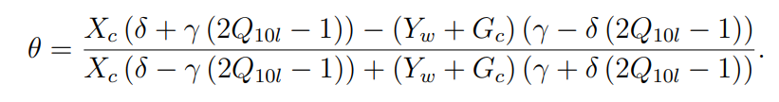

Theoretical Formulation: Study of the detected voltage
k = $ω$/c ;

Slide 19






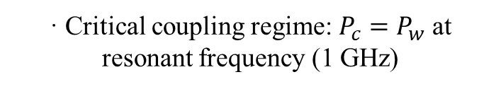




Theoretical Formulation: Electromagnetic modeling for Directional study
C1: d = 0.19 m ($l$ = 1)
3 cavities
$$V_{c}$$
$$V_{c}$$
C2: d = 2.07 m ($l$ = 11)
Mode ${TE}_{10l}$
$$\vec{B_{e}}$$
$$\vec{B_{e}}$$
C3: d = 3.95 m ($l$ = 21)
Most sensible system for directionality
· Critical coupling regime: $P_{c}=P_{w}$ at resonant frequency (1 GHz)
$$a\left(\vec{r}, t\right)= a_{0}\cos\left(ωt+ {\vec{k}}_{DB}·\vec{r}+φ\right)$$
· $B_{e}=$ 10 T
· Lowered to 4 MHz through a LO

Slide 20
INDEX
Motivation
2. Theoretical Formulation
3. Numerical Results
3.1. SNR Improvement
3.2. Directionality and Annual Modulation
4. Conclusions and Future Prospects

Slide 21


Numerical Results: 1 cavity
Autocorrelation
x
Correlator
$$\vec{B_{e}}$$
A⬆A
$$\vec{B_{e}}$$
z
Cavity A
y

Slide 22
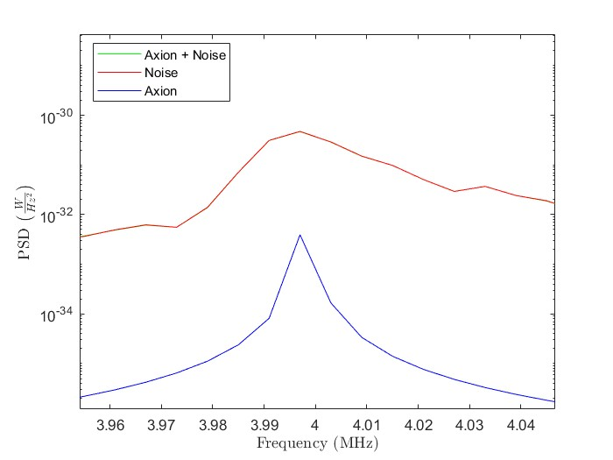
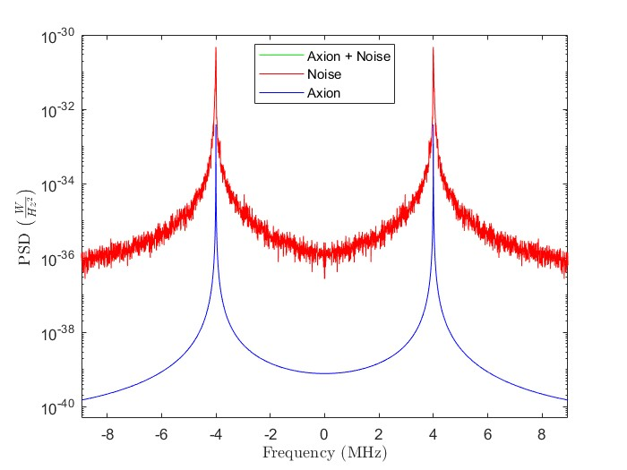

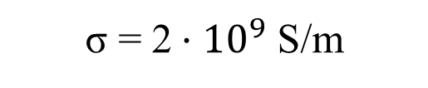

Numerical Results: 1 cavity
Autocorrelation
σ = 2 $·{10}^{9}$ S/m
$Q_{0}$= 1.58 $·{10}^{5}$
T = 10 mK
Iterations: ${10}^{1}$

Slide 23
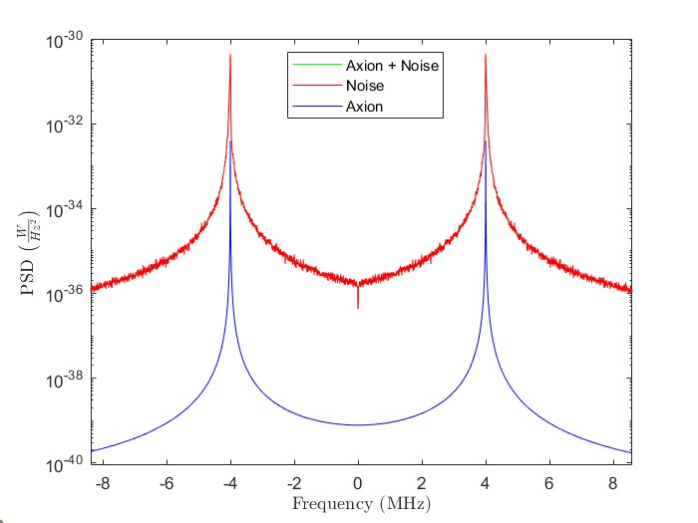
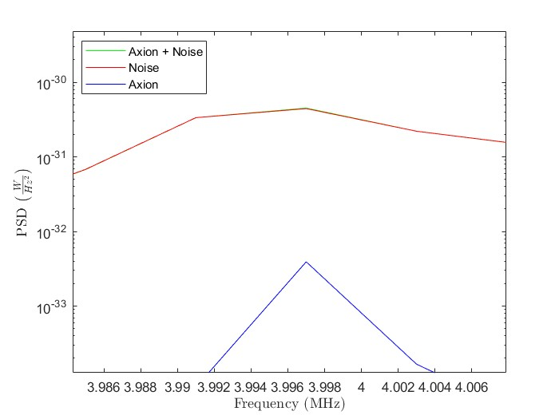


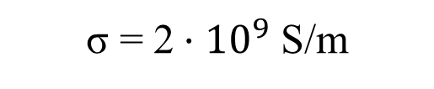
Numerical Results: 1 cavity
Autocorrelation
σ = 2 $·{10}^{9}$ S/m
$Q_{0}$= 1.58 $·{10}^{5}$
T = 10 mK
Iterations: ${10}^{2}$

Slide 24
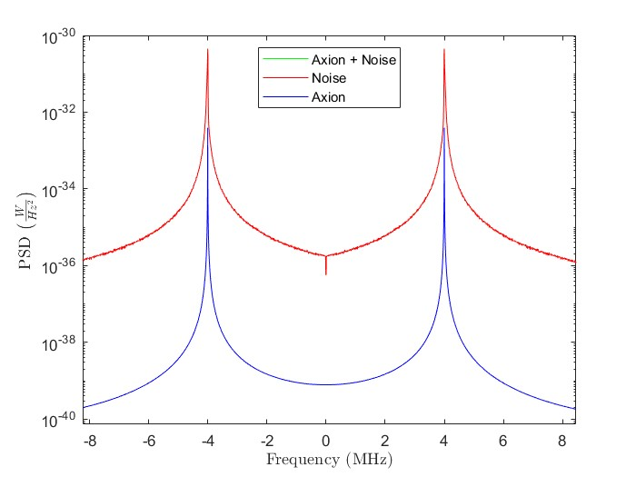
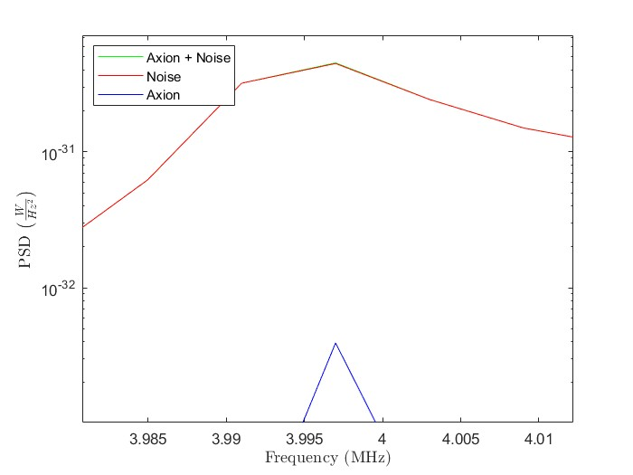

Numerical Results: 1 cavity
Autocorrelation
σ = 2 $·{10}^{9}$ S/m
$Q_{0}$= 1.58 $·{10}^{5}$
T = 10 mK
Iterations: ${10}^{3}$

Slide 25



Numerical Results: 1 cavity
Autocorrelation
σ = 2 $·{10}^{9}$ S/m
$Q_{0}$= 1.58 $·{10}^{5}$
T = 10 mK
Iterations: ${10}^{4}$

Slide 26



Numerical Results: 1 cavity
Autocorrelation
σ = 2 $·{10}^{9}$ S/m
$Q_{0}$= 1.58 $·{10}^{5}$
T = 10 mK
Iterations: ${10}^{5}$

Slide 27




Numerical Results: 2 cavities
Cross - Correlation
x
$$\vec{B_{e}}$$
$$\vec{B_{e}}$$
Correlator
z
Cavity A
y
A⬆B
x
$$\vec{B_{e}}$$
$$\vec{B_{e}}$$
z
Cavity B
y

Slide 28



Numerical Results: 2 cavities
Cross - Correlation
σ = 2 $·{10}^{9}$ S/m
$Q_{0}$= 1.58 $·{10}^{5}$
T = 10 mK
Iterations: ${10}^{3}$

Slide 29



Numerical Results: 2 cavities
Cross - Correlation
σ = 2 $·{10}^{9}$ S/m
$Q_{0}$= 1.58 $·{10}^{5}$
T = 10 mK
Iterations: ${10}^{4}$

Slide 30


Numerical Results: 2 cavities
Cross - Correlation
σ = 2 $·{10}^{9}$ S/m
$Q_{0}$= 1.58 $·{10}^{5}$
T = 10 mK
Iterations: ${10}^{5}$

Slide 31


Numerical Results: 2 cavities
Cross - Correlation
σ = 2 $·{10}^{9}$ S/m
$Q_{0}$= 1.58 $·{10}^{5}$
T = 300 mK
Iterations: ${10}^{4}$

Slide 32


Numerical Results: 2 cavities
Cross - Correlation
σ = 2 $·{10}^{9}$ S/m
$Q_{0}$= 1.58 $·{10}^{5}$
T = 300 mK
Iterations: ${10}^{5}$

Slide 33






Numerical Results: 3 cavities
Cross - Correlation
x
$$\vec{B_{e}}$$
$$\vec{B_{e}}$$
Correlator
z
y
Cavity A
A⬆B
+
B⬆C
+
C⬆A
x
$$\vec{B_{e}}$$
$$\vec{B_{e}}$$
z
y
Cavity B
x
$$\vec{B_{e}}$$
$$\vec{B_{e}}$$
z
y
Cavity C

Slide 34


Numerical Results: 3 cavities
Cross - Correlation
σ = 2 $·{10}^{9}$ S/m
$Q_{0}$= 1.58 $·{10}^{5}$
T = 300 mK
Iterations: ${10}^{5}$

Slide 35

Numerical Results: Standard deviation of the Noise for different temperatures

Slide 36


Numerical Results: SNR Evolution for N cavities oriented into the same direction
1 GHz signal converted to 4 MHz through a LO, with resonant noise at 10 mK
$SNR∝\sqrt{t}$ behaviour as expected

Slide 37

Numerical Results: SNR Evolution
1 GHz signal converted to 4 MHz through a LO, with resonant noise at 10 mK
Good agreement with reference
“Cross-correlation signal processing for axion and WISP dark matter searches”, Ben T. Mc Allister et al., IEEE Transactions on Ultrasonics, Ferroelectrics and Frequency control 66, 2019

Slide 38




Numerical Results: SNR Evolution
$${SNR}_{n}=2\sqrt{\frac{n(n−1)}{2}} \sqrt{m} {SNR}_{1}$$
n: Number of cavities
m: Number of times averaged $∝T$
$$\frac{{SNR}_{n}}{{SNR}_{n−1}}=\sqrt{\frac{n(n−1)}{(n−1)(n−2)}}$$
Good agreement!

Slide 39
INDEX
Motivation
2. Theoretical Formulation
3. Numerical Results
3.1. SNR Improvement
3.2. Directionality and Annual Modulation
4. Conclusions and Future Prospects

Slide 40

Numerical Results: Cavities at different positions on the Earth
The first setup was developed by allocating several cavities at different latitudes on Earth
North Pole
Valencia
Equator

Slide 41


Numerical Results: Cavities C1 at different positions on Earth
No velocity
No velocity
Valencia
Valencia
Equator
Equator
North Pole
North Pole
Voltage at resonance = 9.84 · ${10}^{−11}$ V

Slide 42


Numerical Results: Cavities C2 at different places on Earth
No velocity
No velocity
Valencia
Valencia
Equator
Equator
North Pole
North Pole
Voltage at resonance = 3.04 · ${10}^{−11}$ V

Slide 43


Numerical Results: Cavities C3 at different places on Earth
No velocity
No velocity
Valencia
Valencia
Equator
Equator
North Pole
North Pole
Voltage at resonance = 1.21 · ${10}^{−11}$ V

Slide 44


Numerical Results: Phase-shift between different cavities
Valencia - Eq
Valencia - Eq
North Pole - Eq
North Pole - Eq
C1
C3

Slide 45


Numerical Results: Phase-shift between different cavities
All cavities towards the same direction
Valencia
Equator
3 different positions
North Pole
Other possibility is three cavities in the same location oriented into three orthogonal directions
(More practical point of view for a realistic experiment)

Slide 46

Numerical Results: Directional experiment setup
z
Zenith
z
Zenith
z
Zenith
Thus, we will study the next setup:
Zenith – North – West Oriented cavities
y
West
By orienting cavities towards different directions we potentiate one different ${\vec{k}}_{DB}$ component in each one
x
North
x
North
x
North

Slide 47


Numerical Results: Velocity components behaviour in Valencia
$$λ_{lab}=39.47°$$
$$φ_{lab}=−0.38°$$
Maximum phase-shifts between signals of our directional setup are reached on days in which the difference between velocity components is high

Slide 48
Numerical Results: Velocity components behaviour in Valencia
$$λ_{lab}=39.47°$$
$$φ_{lab}=−0.38°$$
Maximum phase-shifts between signals of our directional setup are reached on days in which the difference between velocity components is high
DAY 127

Slide 49

Numerical Results: Phase-shift of the detected voltage in C3 between different cavities (in the day 127)
Zenith - North
West - North

Slide 50
Numerical Results: Velocity components behaviour in Valencia
$$λ_{lab}=39.47°$$
$$φ_{lab}=−0.38°$$
Maximum phase-shifts between signals of our directional setup are reached on days in which the difference between velocity components is high
DAY 308

Slide 51

Numerical Results: Phase-shift in C3 between different cavities (day 308)
Zenith - North
West - North

Slide 52
Numerical Results: Annual Modulation axion signal
Increasing to 6 cavities:
z
Zenith
z
Zenith
z
Zenith
z
Zenith
z
Zenith
z
Zenith
y
West
x
North
x
North
x
North
x
North
x
North
x
North

Slide 53


Numerical Results: Annual Modulation of C1 axion signal
Noisy Data = Axion + Noise

Slide 54



Numerical Results: Annual Modulation of C3 axion signal
Noisy Data = Axion + Noise
We are able to detect the annual modulation of the signal in the imaginary part for the C3 cavity

Slide 55

Numerical Results: Annual Modulation of C3 axion signal
We see a clear advantage of studying modulation in imaginary part, since:
Real part variation (cosine): 2nd order perturbation
Imaginary part variation (sine): 1st order perturbation
If you want to study annual modulation
Observe imaginary part

Slide 56
INDEX
Motivation
2. Theoretical Formulation
3. Numerical Results
3.1. SNR Improvement
3.2. Directionality and Annual Modulation
4. Conclusions and Future Prospects

Slide 57
Conclusions and future prospects
To sum up all the results obtained, we studied two aspects of the correlation technique applied to the axion detection:
Interferometric analysis of axion detection improvement by means of a multi-cavity system Pre – detection information
Analysis of axion detection with a directional-sensible multi-cavity experiment Post – detection information
Next step: Hypothesis test (how high should SNR be to consider the annual variation a signal)

Slide 58

THANKS FOR YOUR ATTENTION
jose.reina@uv.es

Slide 59
Acknowledgments
This work has the support of "Plan de Recuperación, Transformación y Resiliencia (PRTR) 2022 (ASFAE/2022/013)”, funded by Conselleria d’Innovació, Universitats, Ciència i Societat Digital from Generalitat Valenciana, and NextGenerationEU from European Union.

Slide 60
BACK-UP
SLIDES

Slide 61

Numerical Results: Annual Modulation of C1 axion signal
Correlation Real Component Maximum Annual Variation for C1 cavity (shortest one) and for two experiments with the mentioned setup:
1st: No phase correction of the results.
2nd: Day-by-day phase correction of the three signals

Slide 62

Numerical Results: Annual Modulation of C3 axion signal
Correlation Real Component Maximum Annual Variation for C3 cavity (longest one) and for two experiments with the mentioned setup:
1st: No phase correction of the results.
2nd: Day-by-day phase correction of the three signals

Slide 63




Calculation Procedure: Study of Directionality
Let us assume now that we have two signals with the next structure:
$$s_{1}(t)=A\cos\left(ω_{0}t+φ_{1}\right)$$
$$s_{2}(t)=A\cos\left(ω_{0}t+φ_{2}\right)$$
$$R_{s_{1}s_{2}}(τ)=\frac{A^{2}}{2}\cos\left(ω_{0}τ+φ_{2}−φ_{1}\right)$$
Cross-correlation:
$$\lim_{T→+∞}{}$$
Cross-correlation Fourier transform:
$$FT\left(R_{s_{1}s_{2}}\right)=\frac{A^{2}}{4}\left[e^{−i\left(φ_{1}−φ_{2}\right)}δ\left(ω−ω_{0}\right)+e^{−i\left(φ_{2}−φ_{1}\right)}δ\left(ω+ω_{0}\right)\right]$$

Slide 64
Numerical Results: Annual Modulation axion signal
What purpose may this serve?
Test of whether the observed signal comes from the sky or is a systematic of the experiment Hypothesis test (Next step)
Check if our velocities model is correct
Post-detection information

