Slide 1
The CADEx experiment: progress on the technology demonstration of the superconducting Kinetic Inductance Detectors (KIDs)
V. Rollano*, A. Gomez, A. Pascual, M.C. de Ory, D. Rodriguez,
D. Granados, J. Martín-Pintado,
on behalf of the CADEx colaboration
*vrollano@cab.inta-csic.es
Centro de Astrobiología (CSIC-INTA), Spain
IMDEA Nanociencia
November 19th

Slide 2
Motivation
Superconducting Lumped Element Resonators (LERs)
Implementation
Results
  Setting the operational frequency band
  Dark cryogenic characterization
  Radiation absorption characterization: responsivity to W-band
Summary

Slide 3
Motivation
Superconducting Lumped Element Resonators (LERs)
Implementation
Results
  Setting the operational frequency band
  Dark cryogenic characterization
  Radiation absorption characterization: responsivity to W-band
Summary

Slide 4

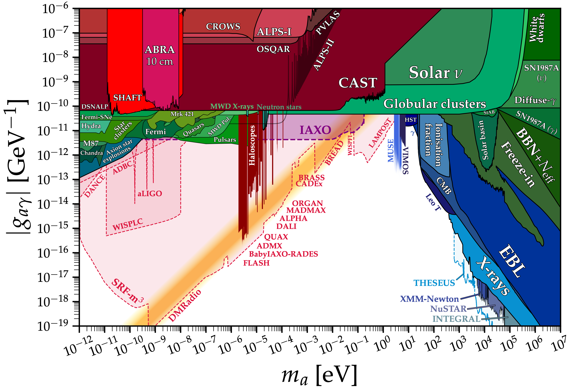

Motivation
Novel detection system:
Haloscope + KIDs
Looking for axions in the mm/submm/Far- IR desert

Slide 5
Motivation
Superconducting Lumped Element Resonators (LERs)
Implementation
Results
  Setting the operational frequency band
  Dark cryogenic characterization
  Radiation absorption characterization: responsivity to W-band
Summary

Slide 6
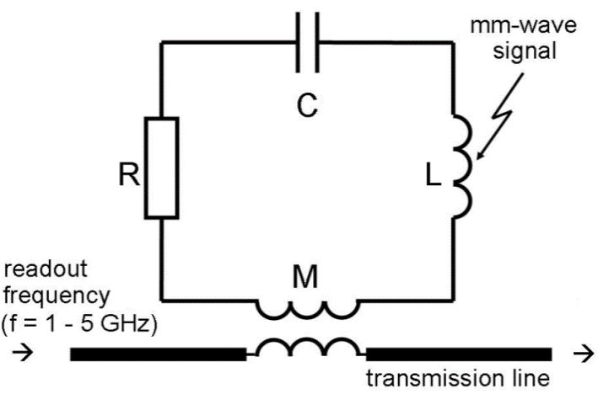
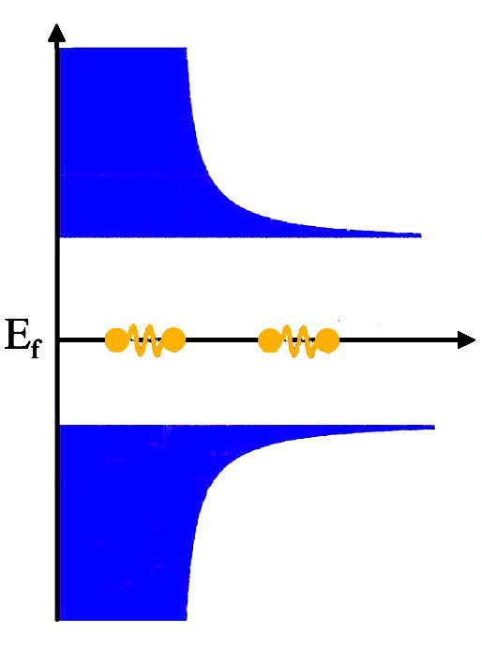
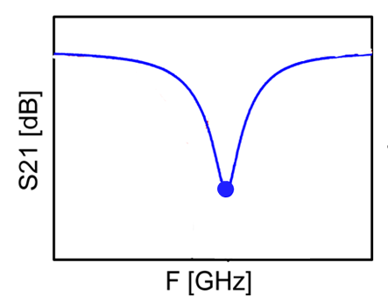
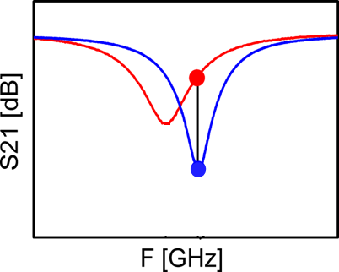
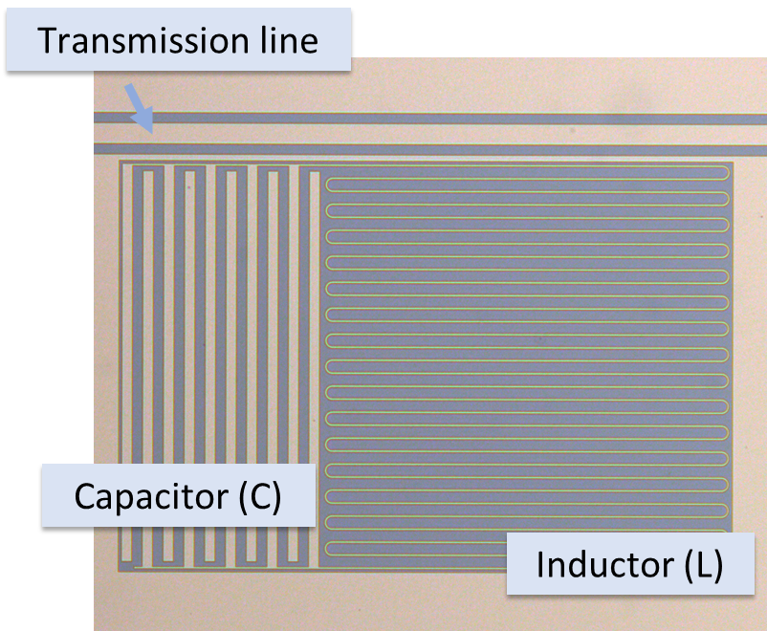





Superconducting Lumped Element Resonators (LERs)
LERs as Kinetic Inductance Detectors (KIDs)
Superconducting detectors for mm/submm astronomy
$$N_{QP}∼0$$
$$f_{0}$$
$$n_{s}∼max$$
$$2Δ≈3.5 k_{B}T_{c}$$
$$f_{0}=\frac{1}{2π\sqrt{LC}}$$

Slide 7




Superconducting Lumped Element Resonators (LERs)
LERs as Kinetic Inductance Detectors (KIDs)
Superconducting detectors for mm/submm astronomy
$$N_{QP}↑:L_{K}↑$$
$$E_{photon}>2Δ_{gap}$$
$$f_{0}$$
$$n_{s}↓ :R_{s}↑$$
$$f_{0}=\frac{1}{2π\sqrt{LC}}$$
$$f^{′}=\frac{1}{2π\sqrt{L′C}}$$

Slide 8
Superconducting Lumped Element Resonators (LERs)
WHY LERs?
  High quality factor → Low losses
  Low noise → High sensitivity
  Frequency-multiplexable
  Frequency and geometry tunability

Slide 9
Motivation
Superconducting Lumped Element Resonators (LERs)
Implementation
Results
  Setting the operational frequency band
  Dark cryogenic characterization
  Radiation absorption characterization: responsivity to W-band
Summary
Notes:
-This is the outline of my talk.
- I will start by briefly introducing the concept of a superconducting lumped element resonator (LER).
-Then, I will explain the development process, including design, fabrication and characterization.
- afterwards, I will discuss some notable results of my thesis. Both, in the field of astronomy detectors and quantum processors.
At the end, I’ll finish with a quick summary of my presentation.

Slide 10
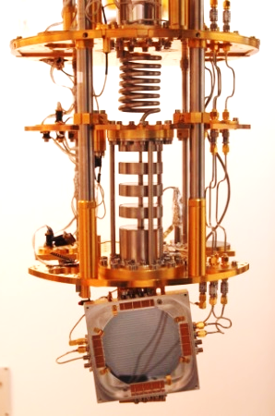
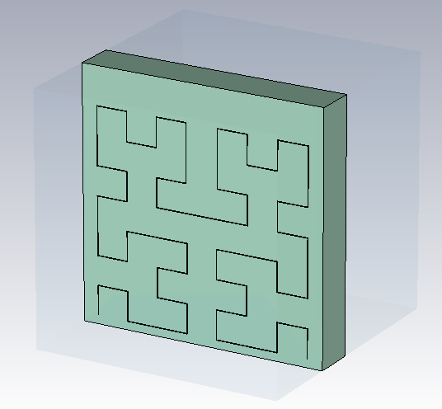
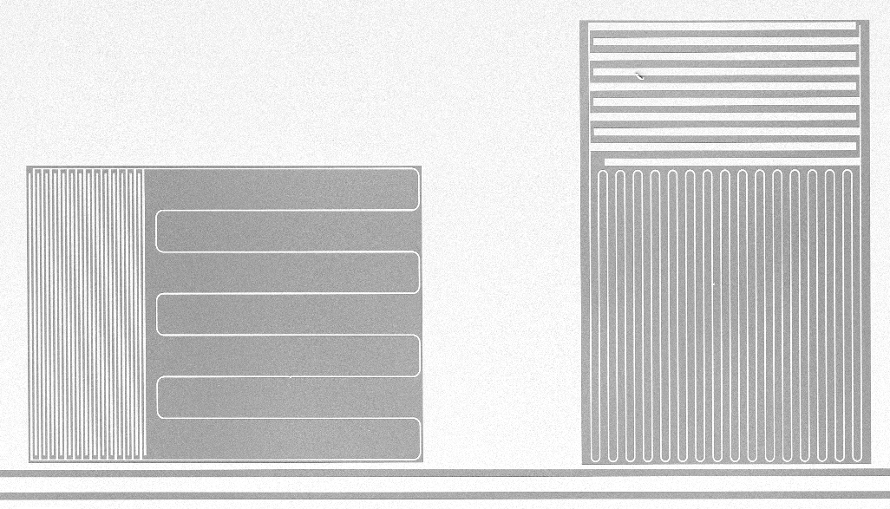
Implementation
DESIGN
CHARACTERIZATION
FABRICATION
Notes:
- Firts, we design the resonator geometry

Slide 11
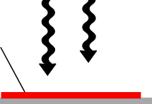
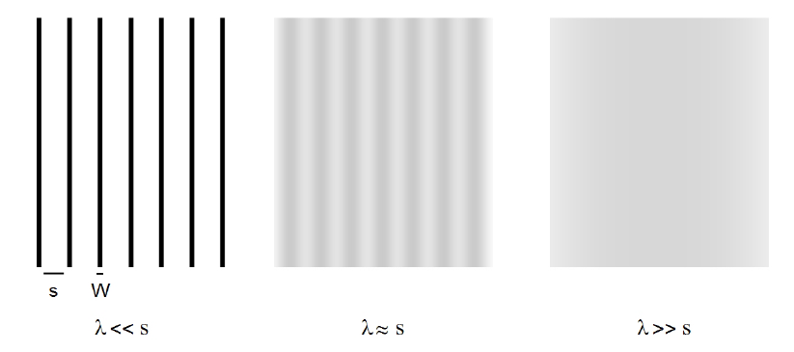
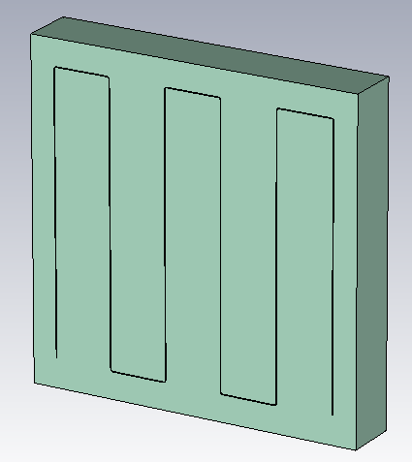
Implementation
Tuning operational frequency band: Pixel Geometry
LEKID → Inductor = Absorber
Matching impedance:
Z₀ =Z_{eff}
Free Space
Z₀=377 Ω/sq
Hybrid quantum system on a chip
Zeff
λ/20 > s
Solid absorber:
Geometry → Polarization sensitivity
Notes:
The other promissing application is use these LERs as Kinetic Inductance Detectors (KIDs), for astronomy.
KIDs are a very promising type of superconducting detectors in which every pixel, couple to a single transmission line consist of a microresonator at a specific resonant frequency.
They working princpiple is that the incidence of photons with energy higher tan the superconducting energy gap → breaks cooper pairs on the superconductor → producing a change in the kinetic inductance, and, therefore, a mesurable change in the resonance.
(Physically, this is because a smaller number of carriers must have a greater velocity than a larger number of carriers in order to achieve the same current).

Slide 12
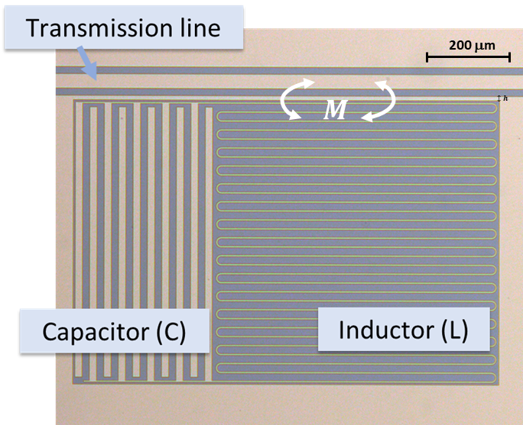

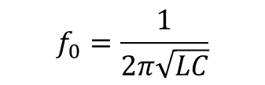




Implementation
LER Parameters
Microwave Electromagnetic Simulations
Resonance frequency $f_{0}$
$$f_{0}=\frac{1}{2π\sqrt{LC}}$$
Quality factor Q
$$Q=f_{0}\frac{Average energy stored}{Energy loss/second}=\frac{f_{0}}{2κ}$$
$$κ$$
$$\frac{1}{Q_{T}}=\frac{1}{Q_{int}}+\frac{1}{Q_{coupling}}$$
Internal quality factor
Coupling quality factor
Impedance Z
$$Z=\sqrt{\frac{L}{C}}$$

Slide 13
Implementation
DESIGN
CHARACTERIZATION
FABRICATION

Slide 14
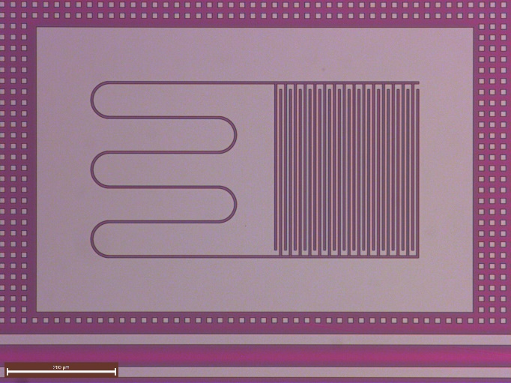
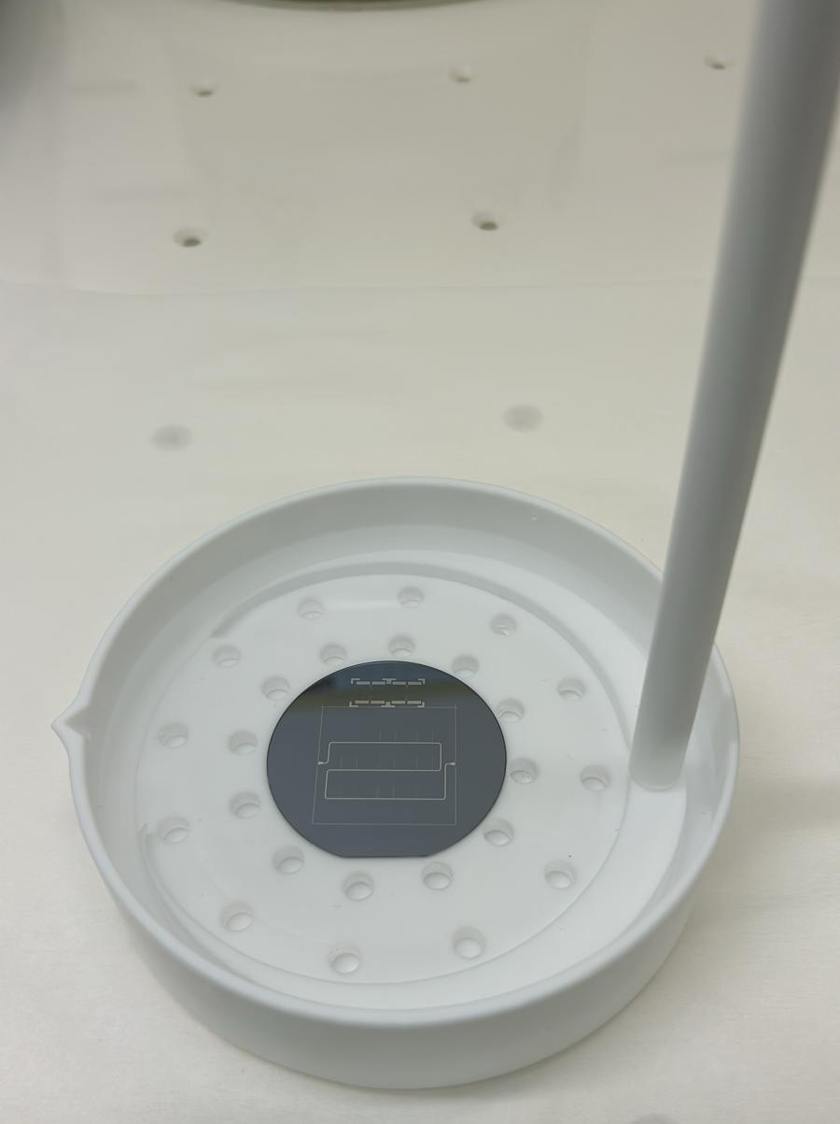
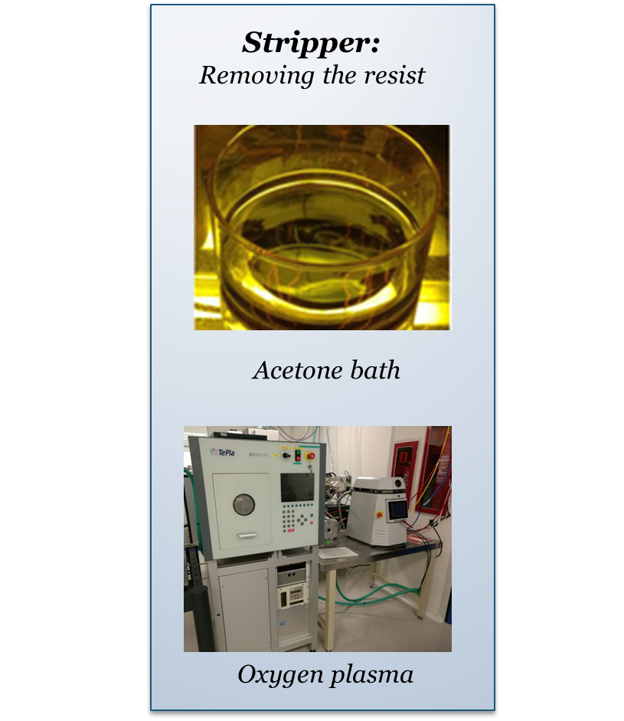
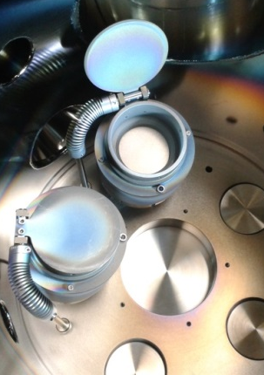
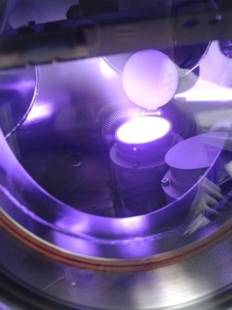
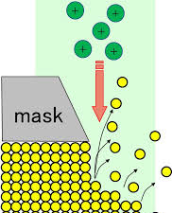
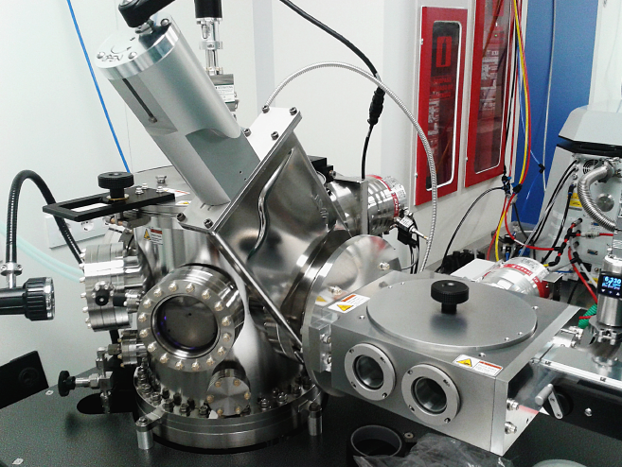
Implementation
LERs nanofabrication in Clean Room
Superconducting layer: Ti/Al
Resist
ISO 4
Substrate
Sputtering / Electron beam evaporator:
Deposition of superconducting films
Nano and micro lithography
Etching:
Wet etching, ion milling and RIE
Stripper:
Removing the resist
Laser writer
Acetone bath
Focus ion beam
Oxygen plasma

Slide 15
Implementation
DESIGN
CHARACTERIZATION
FABRICATION

Slide 16
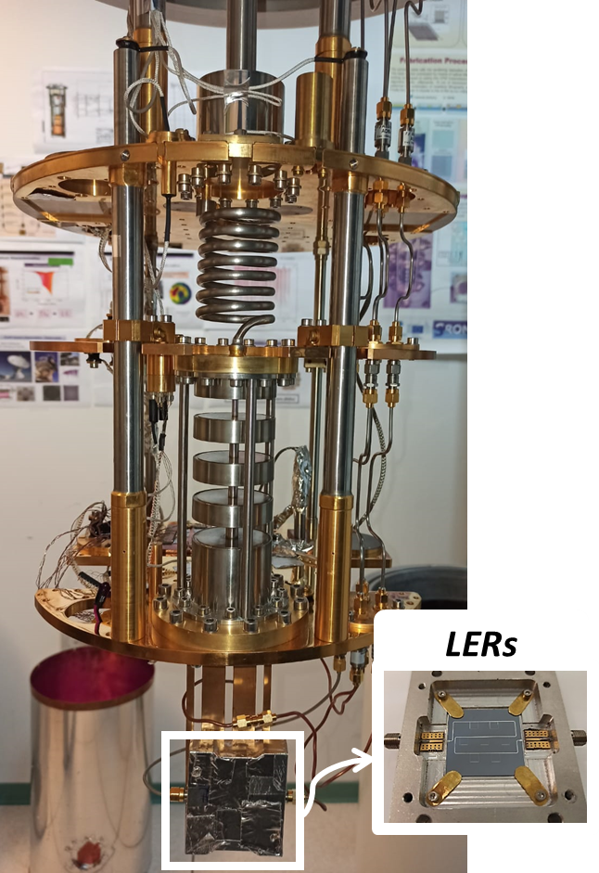
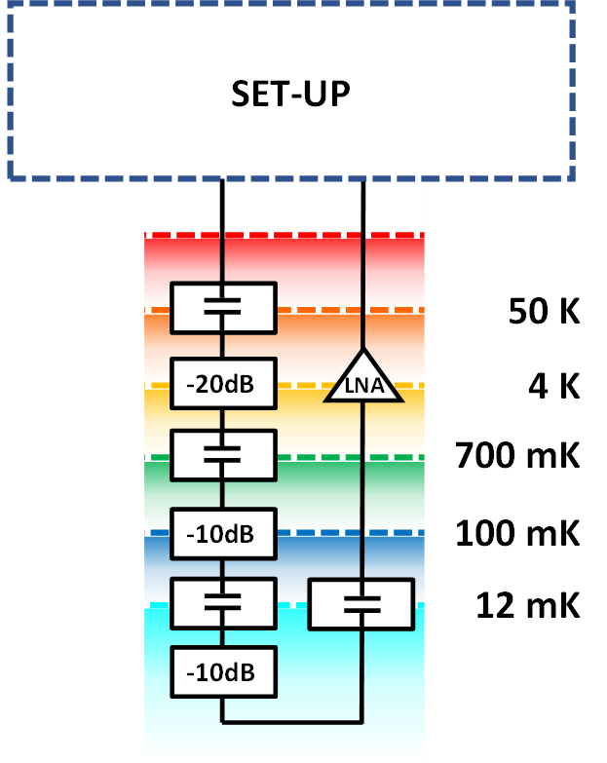
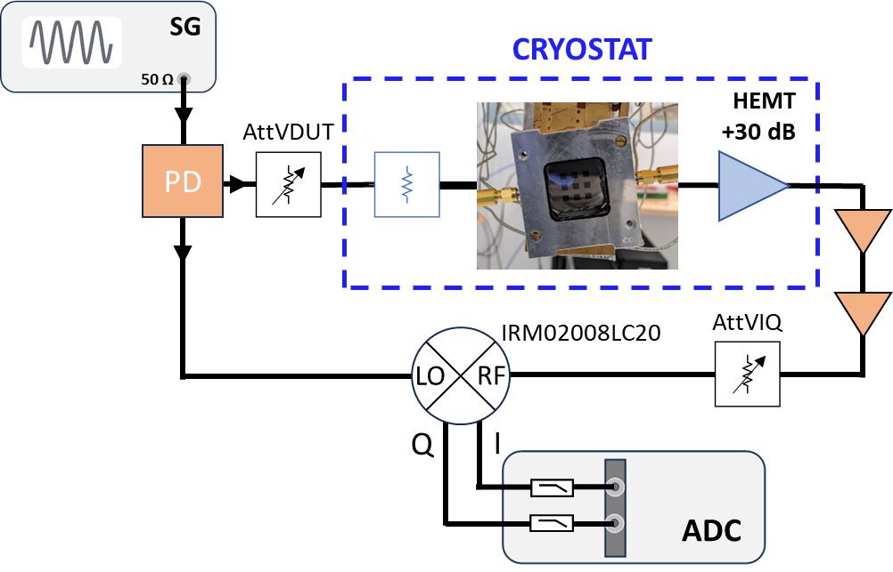
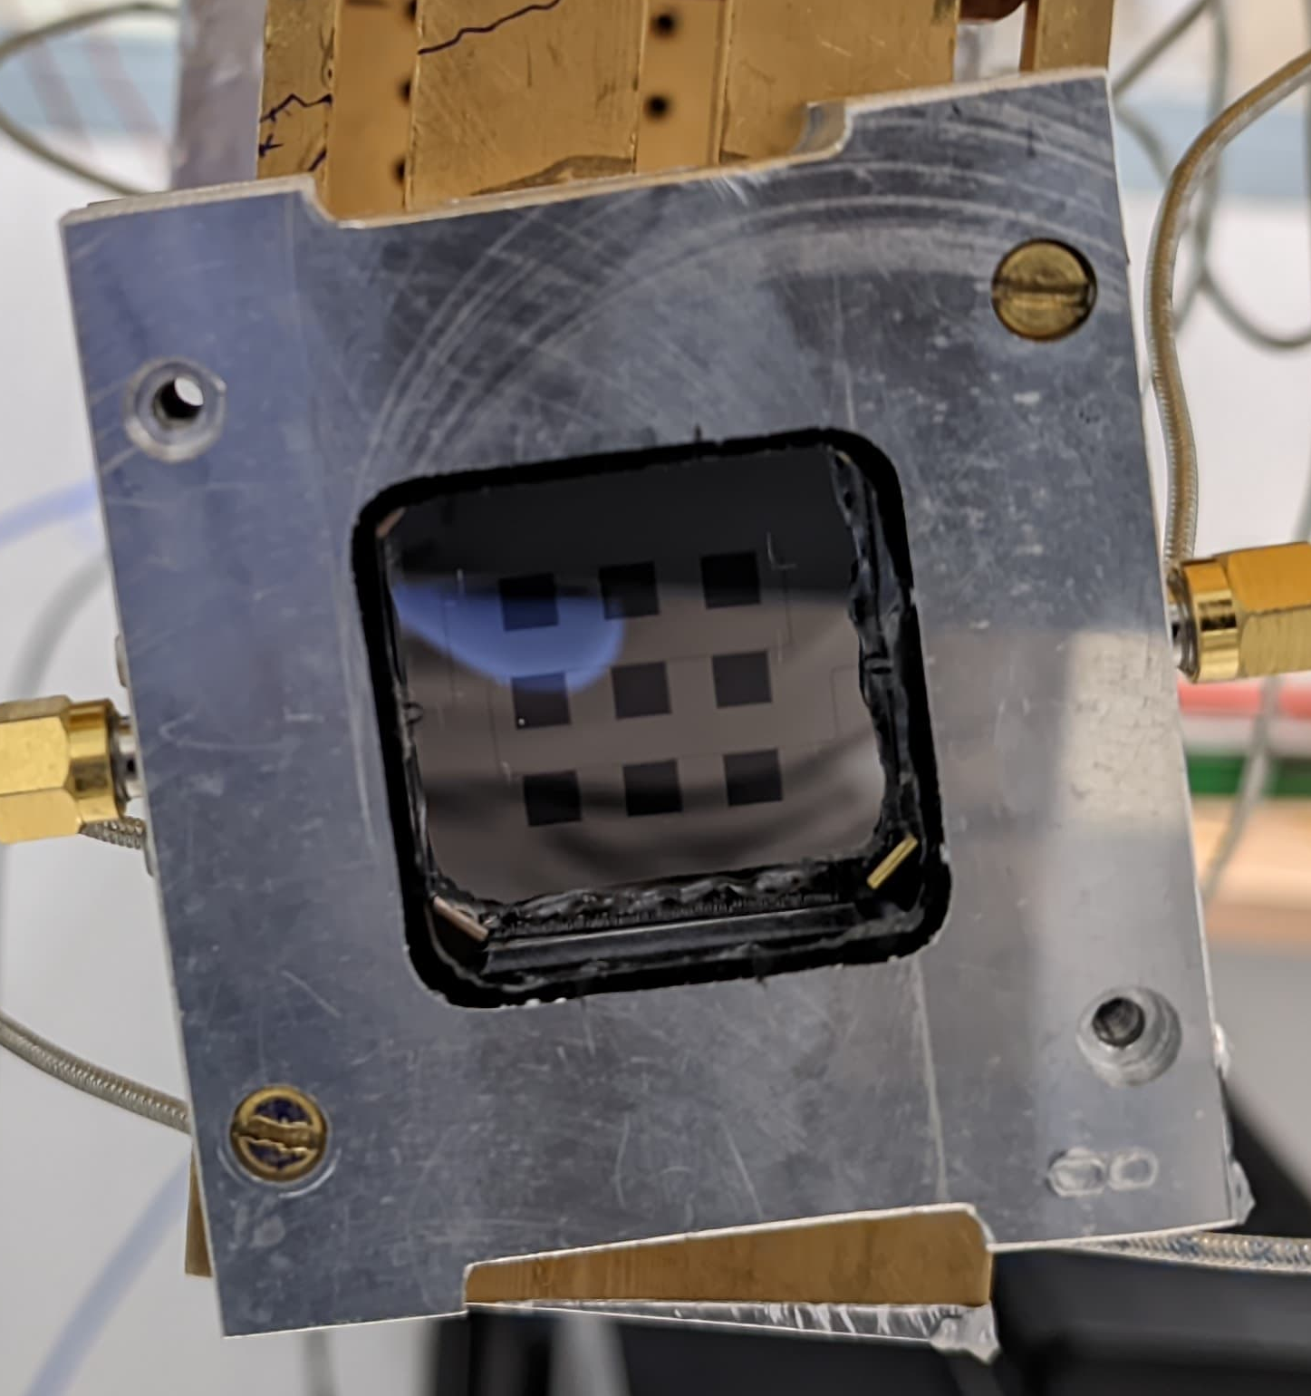

Characterization
He³/He⁴ Dilution Refrigerator
Radio-Frequency Characterization set-up
$$T∼8 mK$$

Slide 17
Motivation
Superconducting Lumped Element Resonators (LERs)
Implementation
Results
  Setting the operational frequency band
  Dark cryogenic characterization
  Radiation absorption characterization: responsivity to W-band
Summary

Slide 18
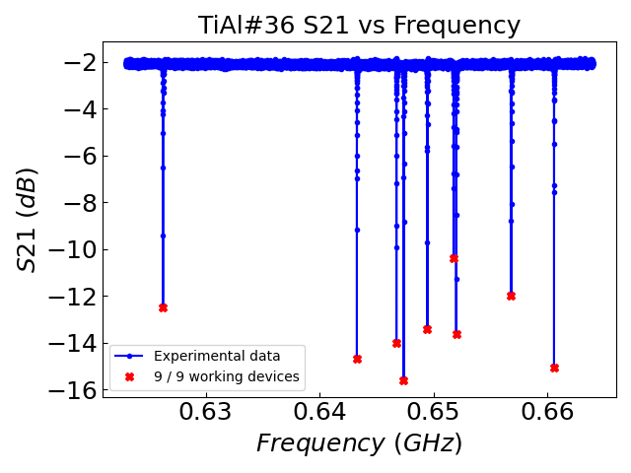
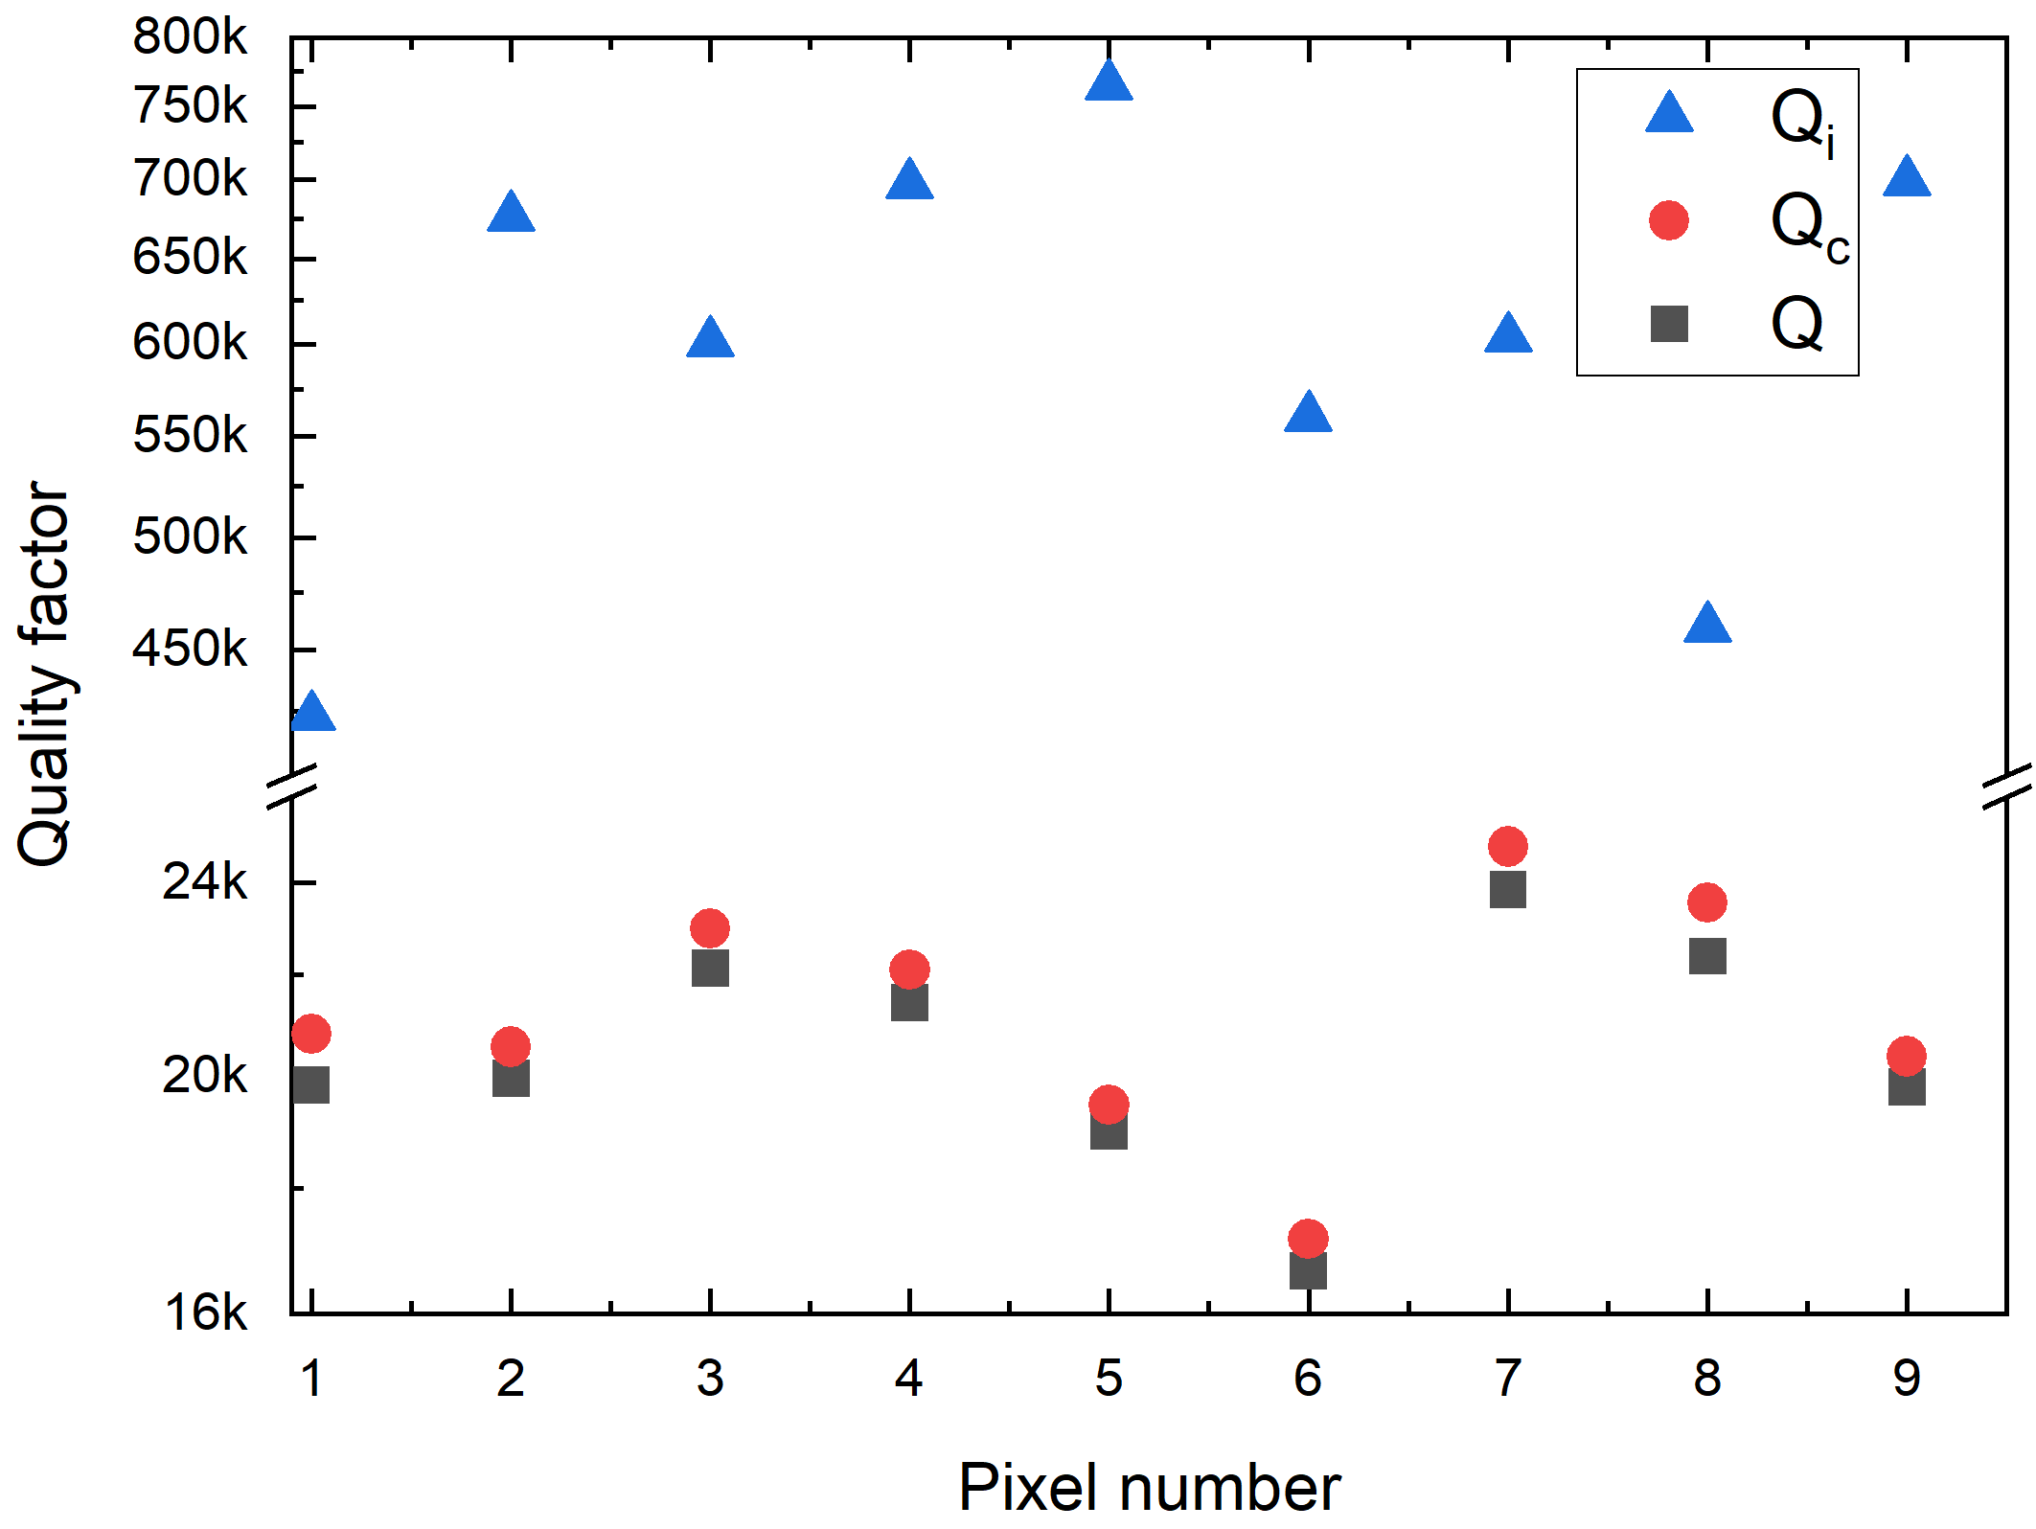
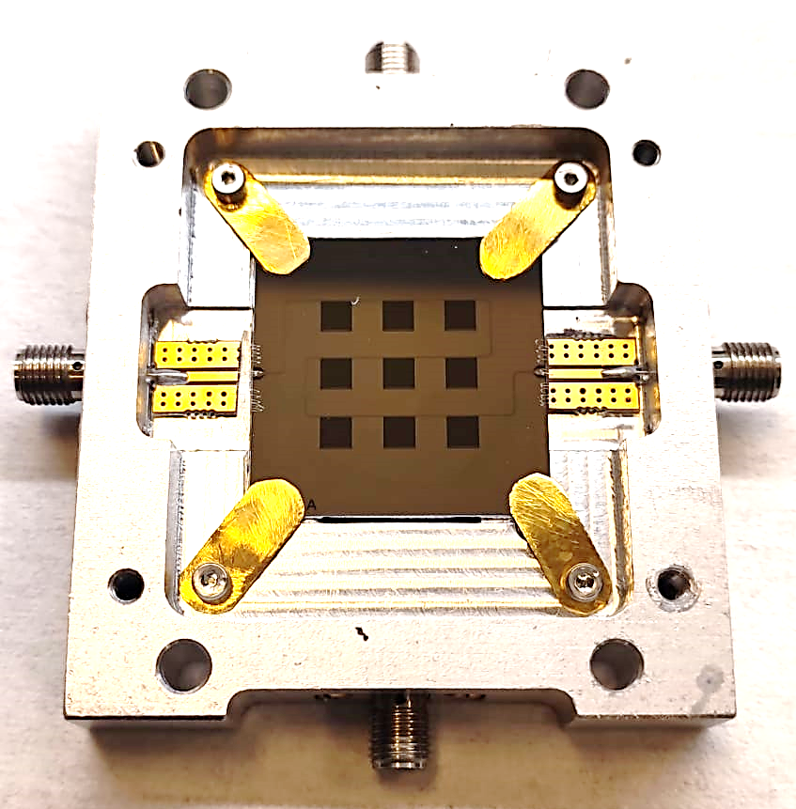
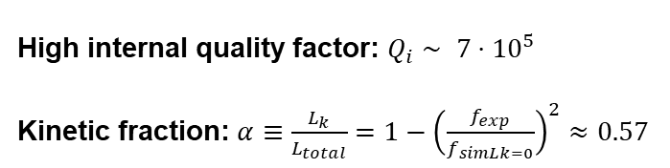

Results
Dark cryogenic characterization
9 pixels demostrator
$$\left|S_{21}\right| (dB)$$
High internal quality factor: $Q_{i}∼ 7⋅{10}^{5}$
Kinetic fraction: $α≡\frac{L_{k}}{L_{total}}=1−{\left(\frac{f_{exp}}{f_{simLk=0}}\right)}^{2}≈0.57$
High superconducting film quality
High nanofabrication yield
M. C. de Ory et al. , IEEE TMTT (2024)

Slide 19
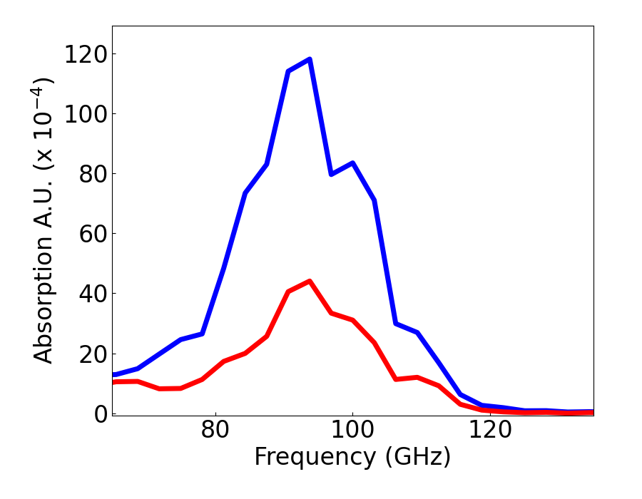
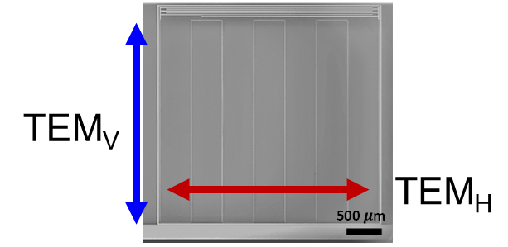






Results
Setting the operational frequency band to the W-band
  Proximity Effect: Titanium/Aluminum bilayers
  Impedance Matching
LEKID → Inductor is the effective optical absorbing área → Geometry constrains
15 nm Al (Tc $≈$ 1.2 K )
Ti/Al: $T_{c}≈780 mK$ $fcut @ 60 GHz$
15 nm Ti (Tc $≈$ 0.4 K )
  W-band : 75-110 GHz → Ti/Al suitable
T=100 mK
2$Δ_{gap}(Ti/Al)$
$↑$ Ti Thickness
2$Δ_{gap}(Al)$
A. Catalano et al., A&A (2015)

Slide 20
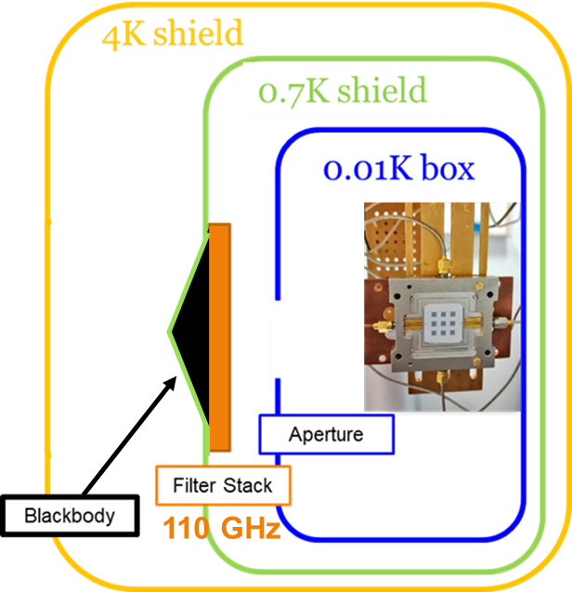
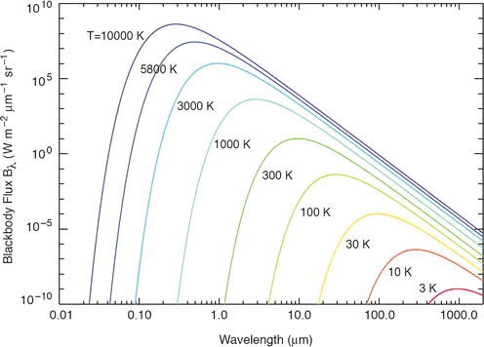
Results
Radiation absorption characterization
responsivity to W-band
Blackbody temperature controls optical loading
T_{BB} (1 K– 7K) : Optical Power Load
Filter Stack
Notes:
-

Slide 21
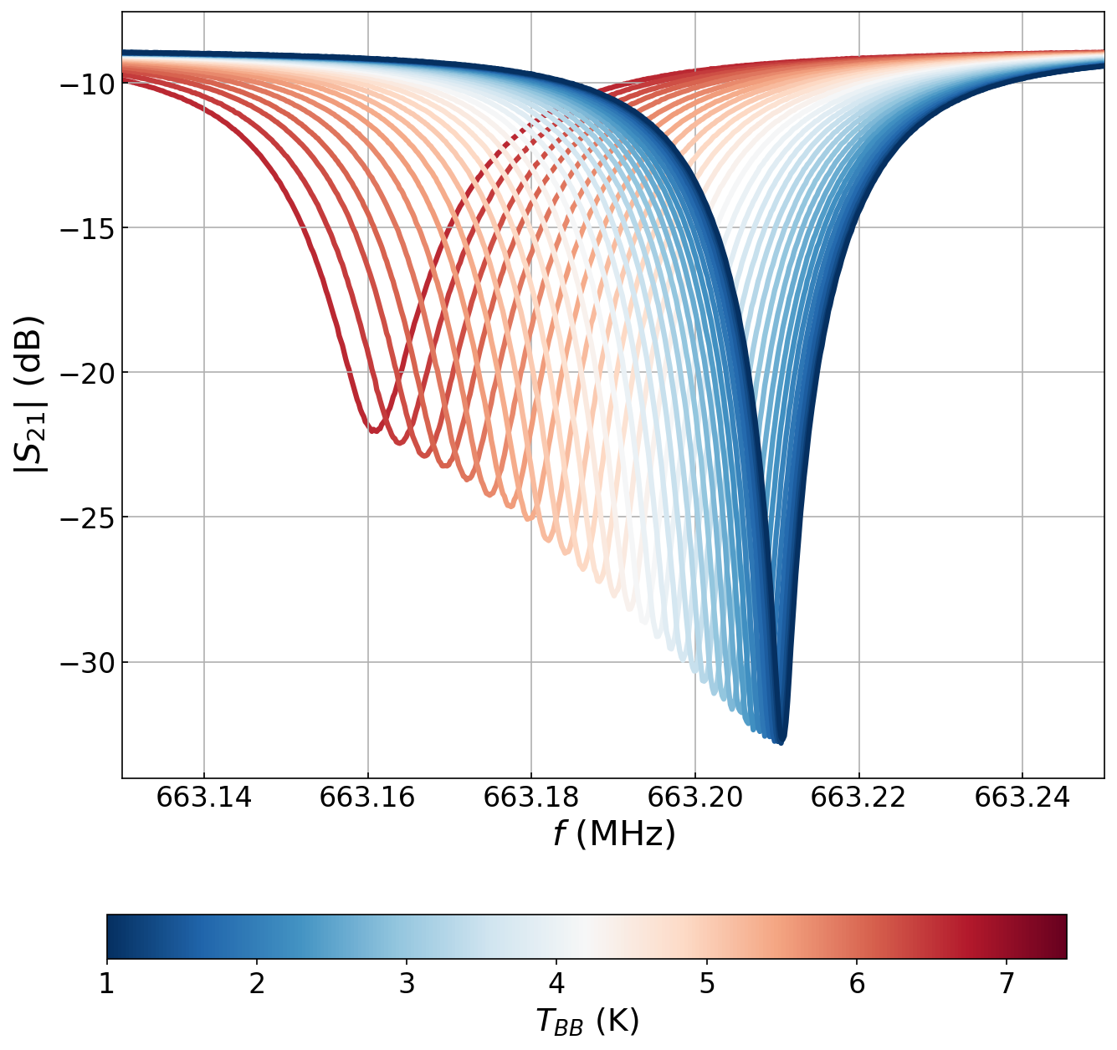
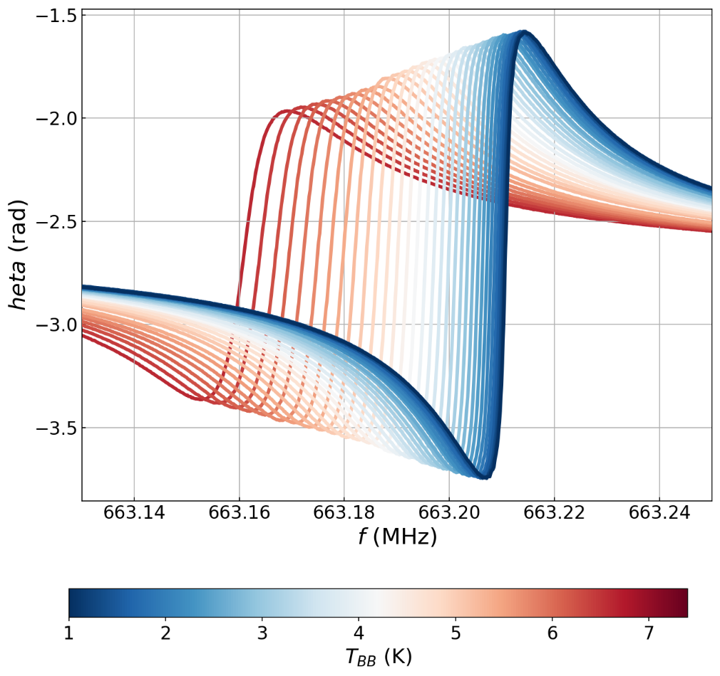
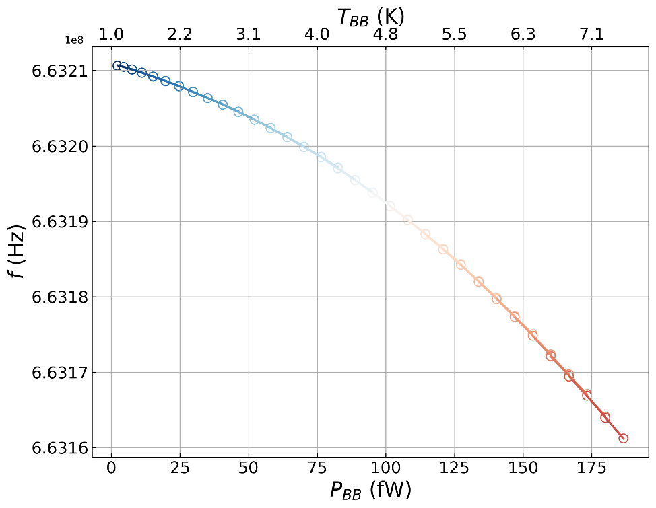
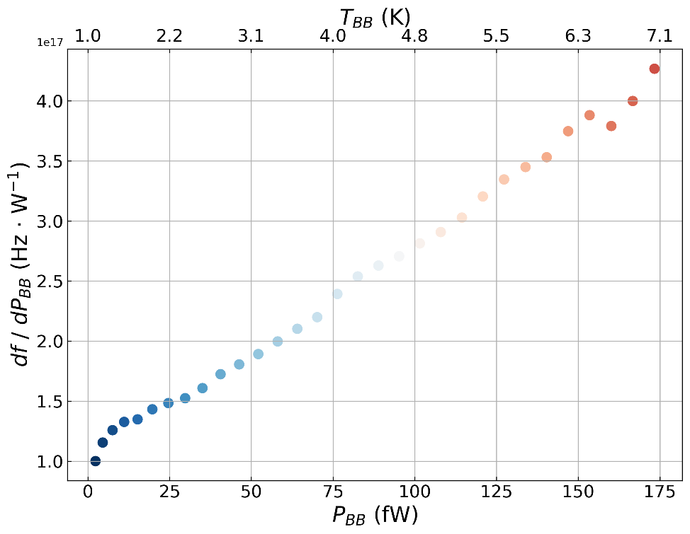

Results
Radiation absorption characterization
responsivity to W-band
$θ$(rad)
Notes:
-

Slide 22
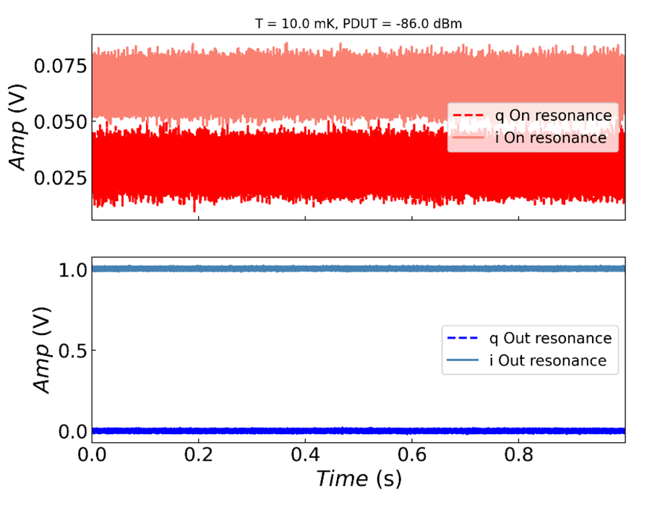
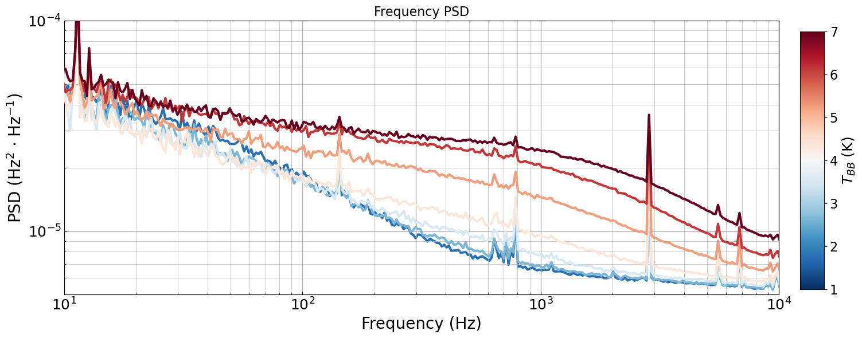
Results
Radiation absorption characterization
responsivity to W-band
FFT
Frequency noise response
Two Level Systems Noise
Notes:
-

Slide 23
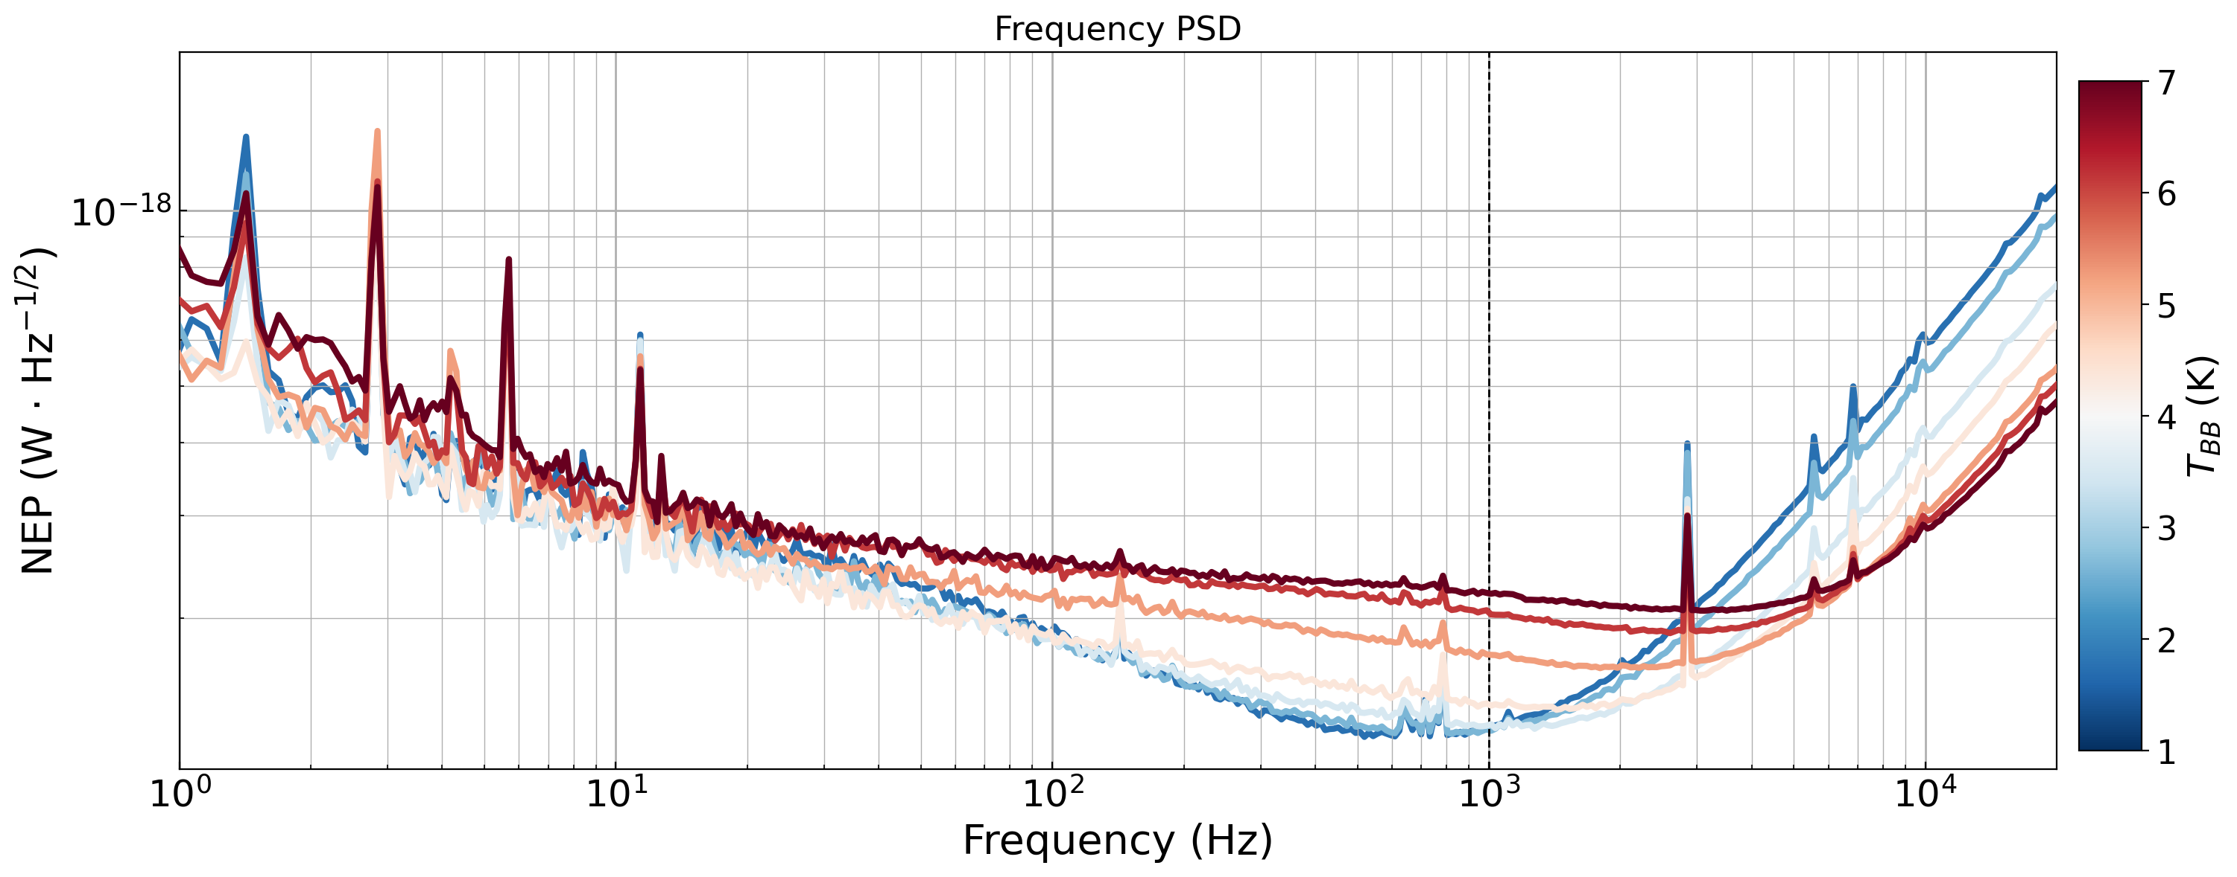
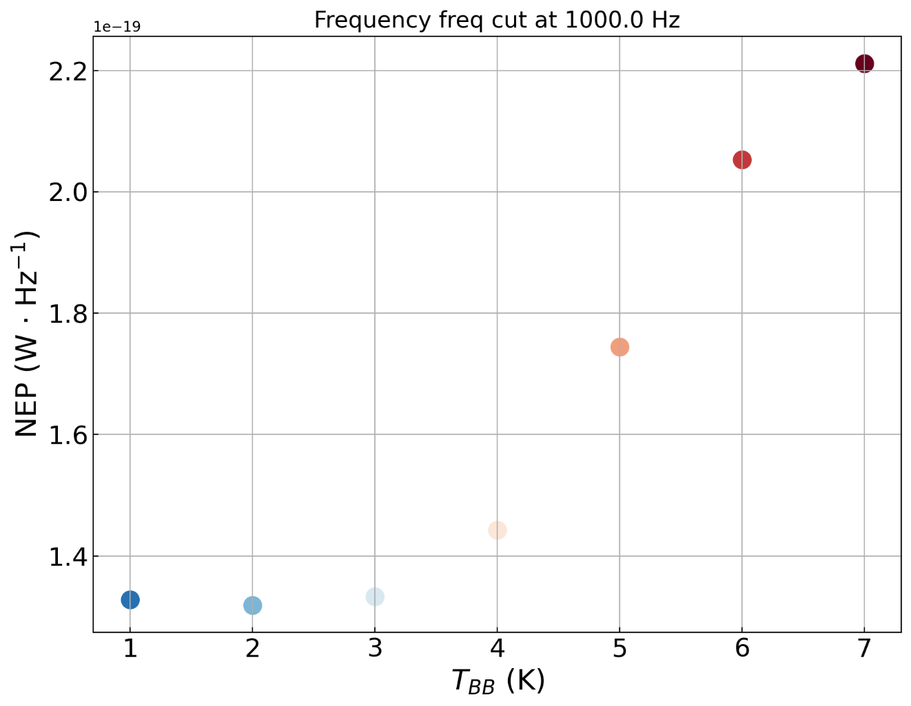
Results
Radiation absorption characterization
responsivity to W-band
Frequency Noise Equivalent Power
Background limited
Two Level Systems Limit
$NEP_{δf}\left(1.0 K, 1 kHz\right)∼1.3⋅{10}^{−19} W/\sqrt{Hz}$

Slide 24
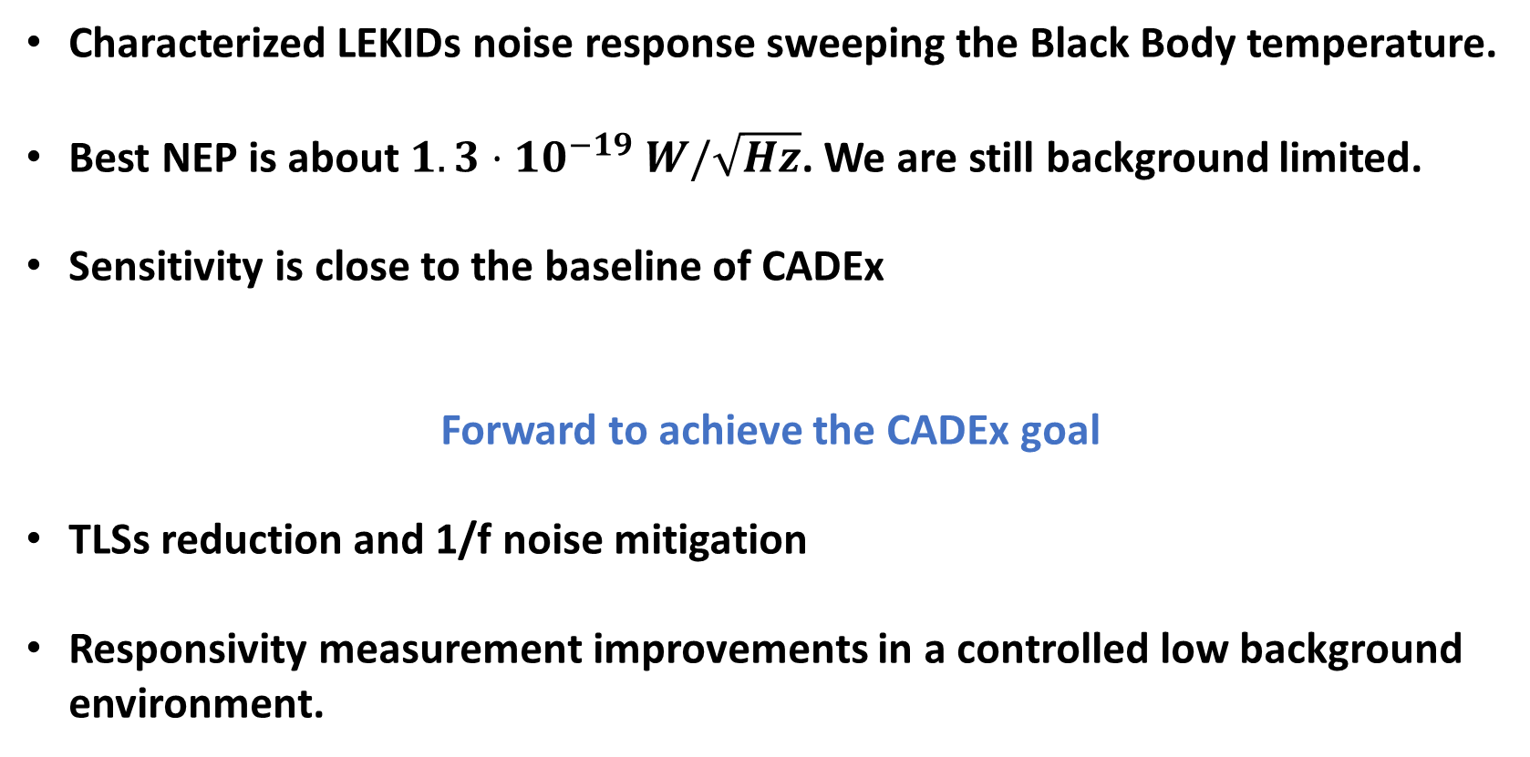
Summary
Characterized LEKIDs noise response sweeping the Black Body temperature.
Best NEP is about $1.3⋅{10}^{−19} W/\sqrt{Hz}$. We are still background limited.
Sensitivity is close to the baseline of CADEx
Forward to achieve the CADEx goal
TLSs reduction and 1/f noise mitigation
Responsivity measurement improvements in a controlled low background environment.

Slide 28



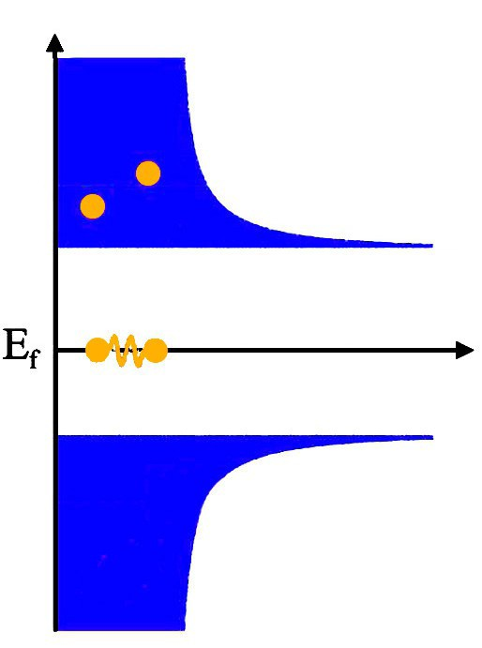


Kinetic Inductance Detectors (KIDs)
PHOTON → E_{photon}>2Δ_{gap}
Quasiparticle density
n_{qp}~0
Quasiparticle density
n'_{qp} >n_{qp}
Change in…
SUPERCONDUCTING PROPERTY
$$E>2Δ$$
Hybrid quantum system on a chip
KINETIC INDUCTANCE
2Δ
2Δ
?
$$L_{k}=\frac{m_{e}}{n_{s}te^{2}}$$
Cooper pairs density
n_{s}
Cooper pairs density
n'_{s} <n_{s}
Absorbed photon
n_{s}
L_{K}
Notes:
The other promissing application is use these LERs as Kinetic Inductance Detectors (KIDs), for astronomy.
KIDs are a very promising type of superconducting detectors in which every pixel, couple to a single transmission line consist of a microresonator at a specific resonant frequency.
They working princpiple is that the incidence of photons with energy higher tan the superconducting energy gap → breaks cooper pairs on the superconductor → producing a change in the kinetic inductance, and, therefore, a mesurable change in the resonance.
(Physically, this is because a smaller number of carriers must have a greater velocity than a larger number of carriers in order to achieve the same current).

Slide 29
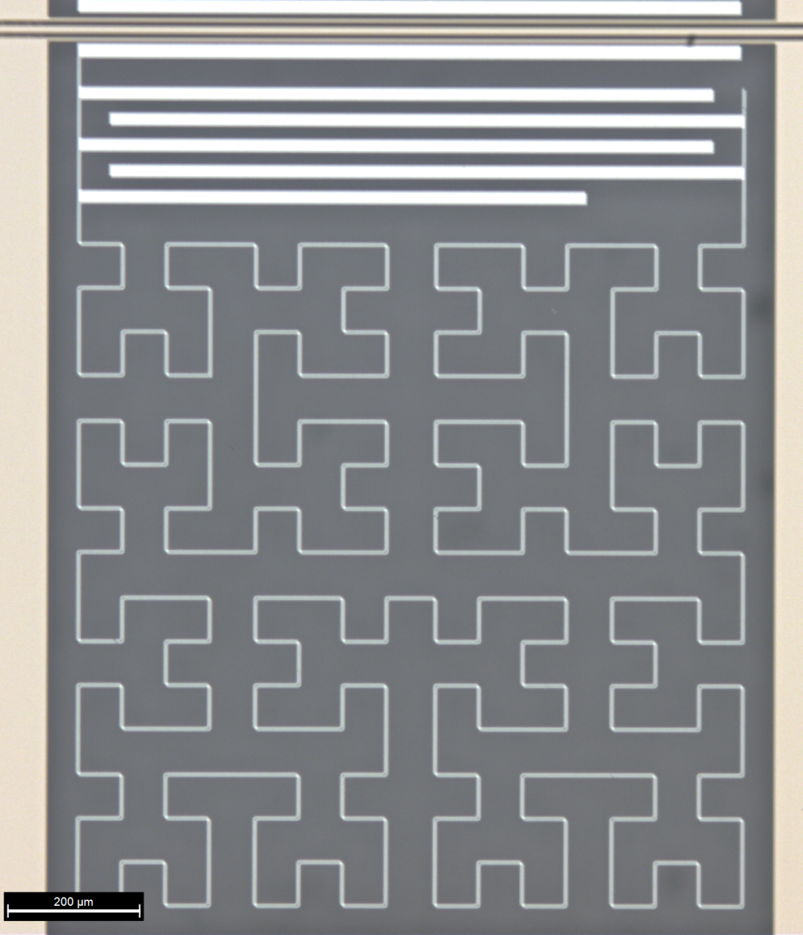

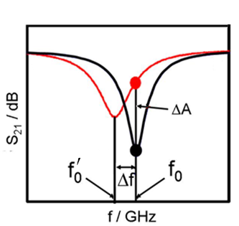
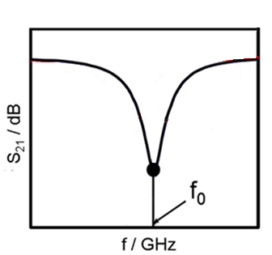


Kinetic Inductance Detectors (KIDs)
Capacitor
n_{CP}
Hybrid quantum system on a chip
L=L_{g}+L_{k}
L_{K}
We can detect
incident power
by monitoring
the shift in f₀
Inductor
Day et al., Nature (2003)
Notes:
The other promissing application is use these LERs as Kinetic Inductance Detectors (KIDs), for astronomy.
KIDs are a very promising type of superconducting detectors in which every pixel, couple to a single transmission line consist of a microresonator at a specific resonant frequency.
They working princpiple is that the incidence of photons with energy higher tan the superconducting energy gap → breaks cooper pairs on the superconductor → producing a change in the kinetic inductance, and, therefore, a mesurable change in the resonance.
(Physically, this is because a smaller number of carriers must have a greater velocity than a larger number of carriers in order to achieve the same current).

Slide 30
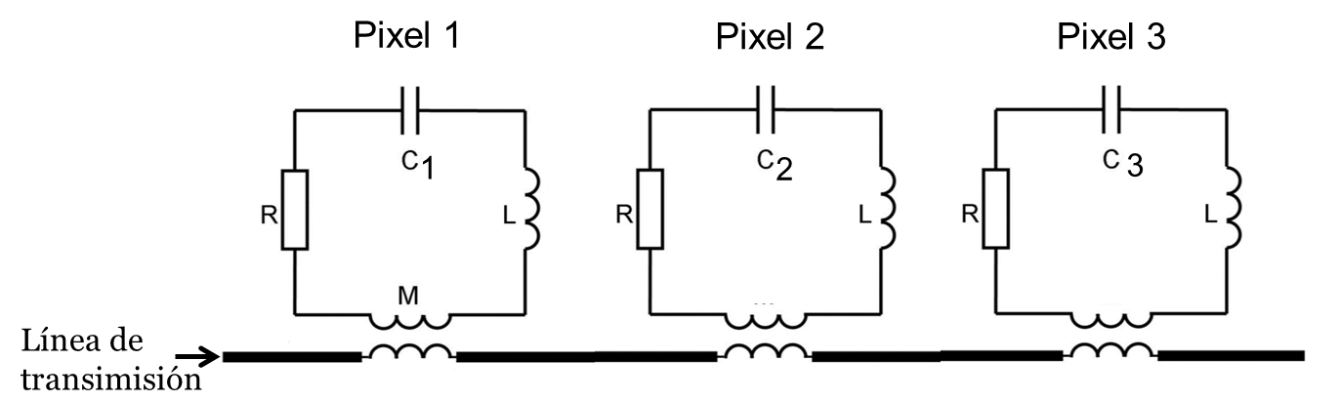







Kinetic Inductance Detectors (KIDs)
Multiplexing → 1 wire > 1000 LERs
Multiples LERs coupled to a single transmission line
Transmission line
KIDs:
1 read-out wire
>1000 pixels
$$l_{C}$$
Notes:
-They present the great advantage that they are intrinsically multiplexable, as we can couple many resonators with it characteristic resonance frequency, couple to the same transmission read out line, allowing for compact resonators geometries.
-For example, changing the capacitor finger length, we can chan the capacitance, and so that the resonance frequency from one LER to another.
-$B:total capacitor width;L_{c}:finger length$

