Slide 1
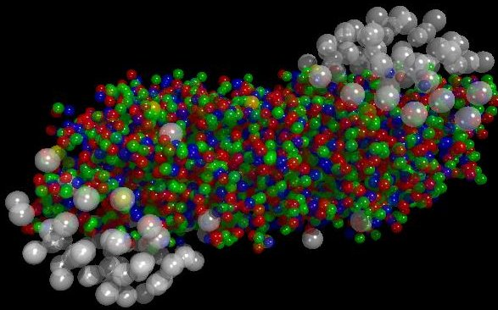
Heavy Ion Collisions
The quest for the
Quark Gluon Plasma
Elena G. Ferreiro
Universidade de Santiago de Compostela & IGFAE

Slide 2
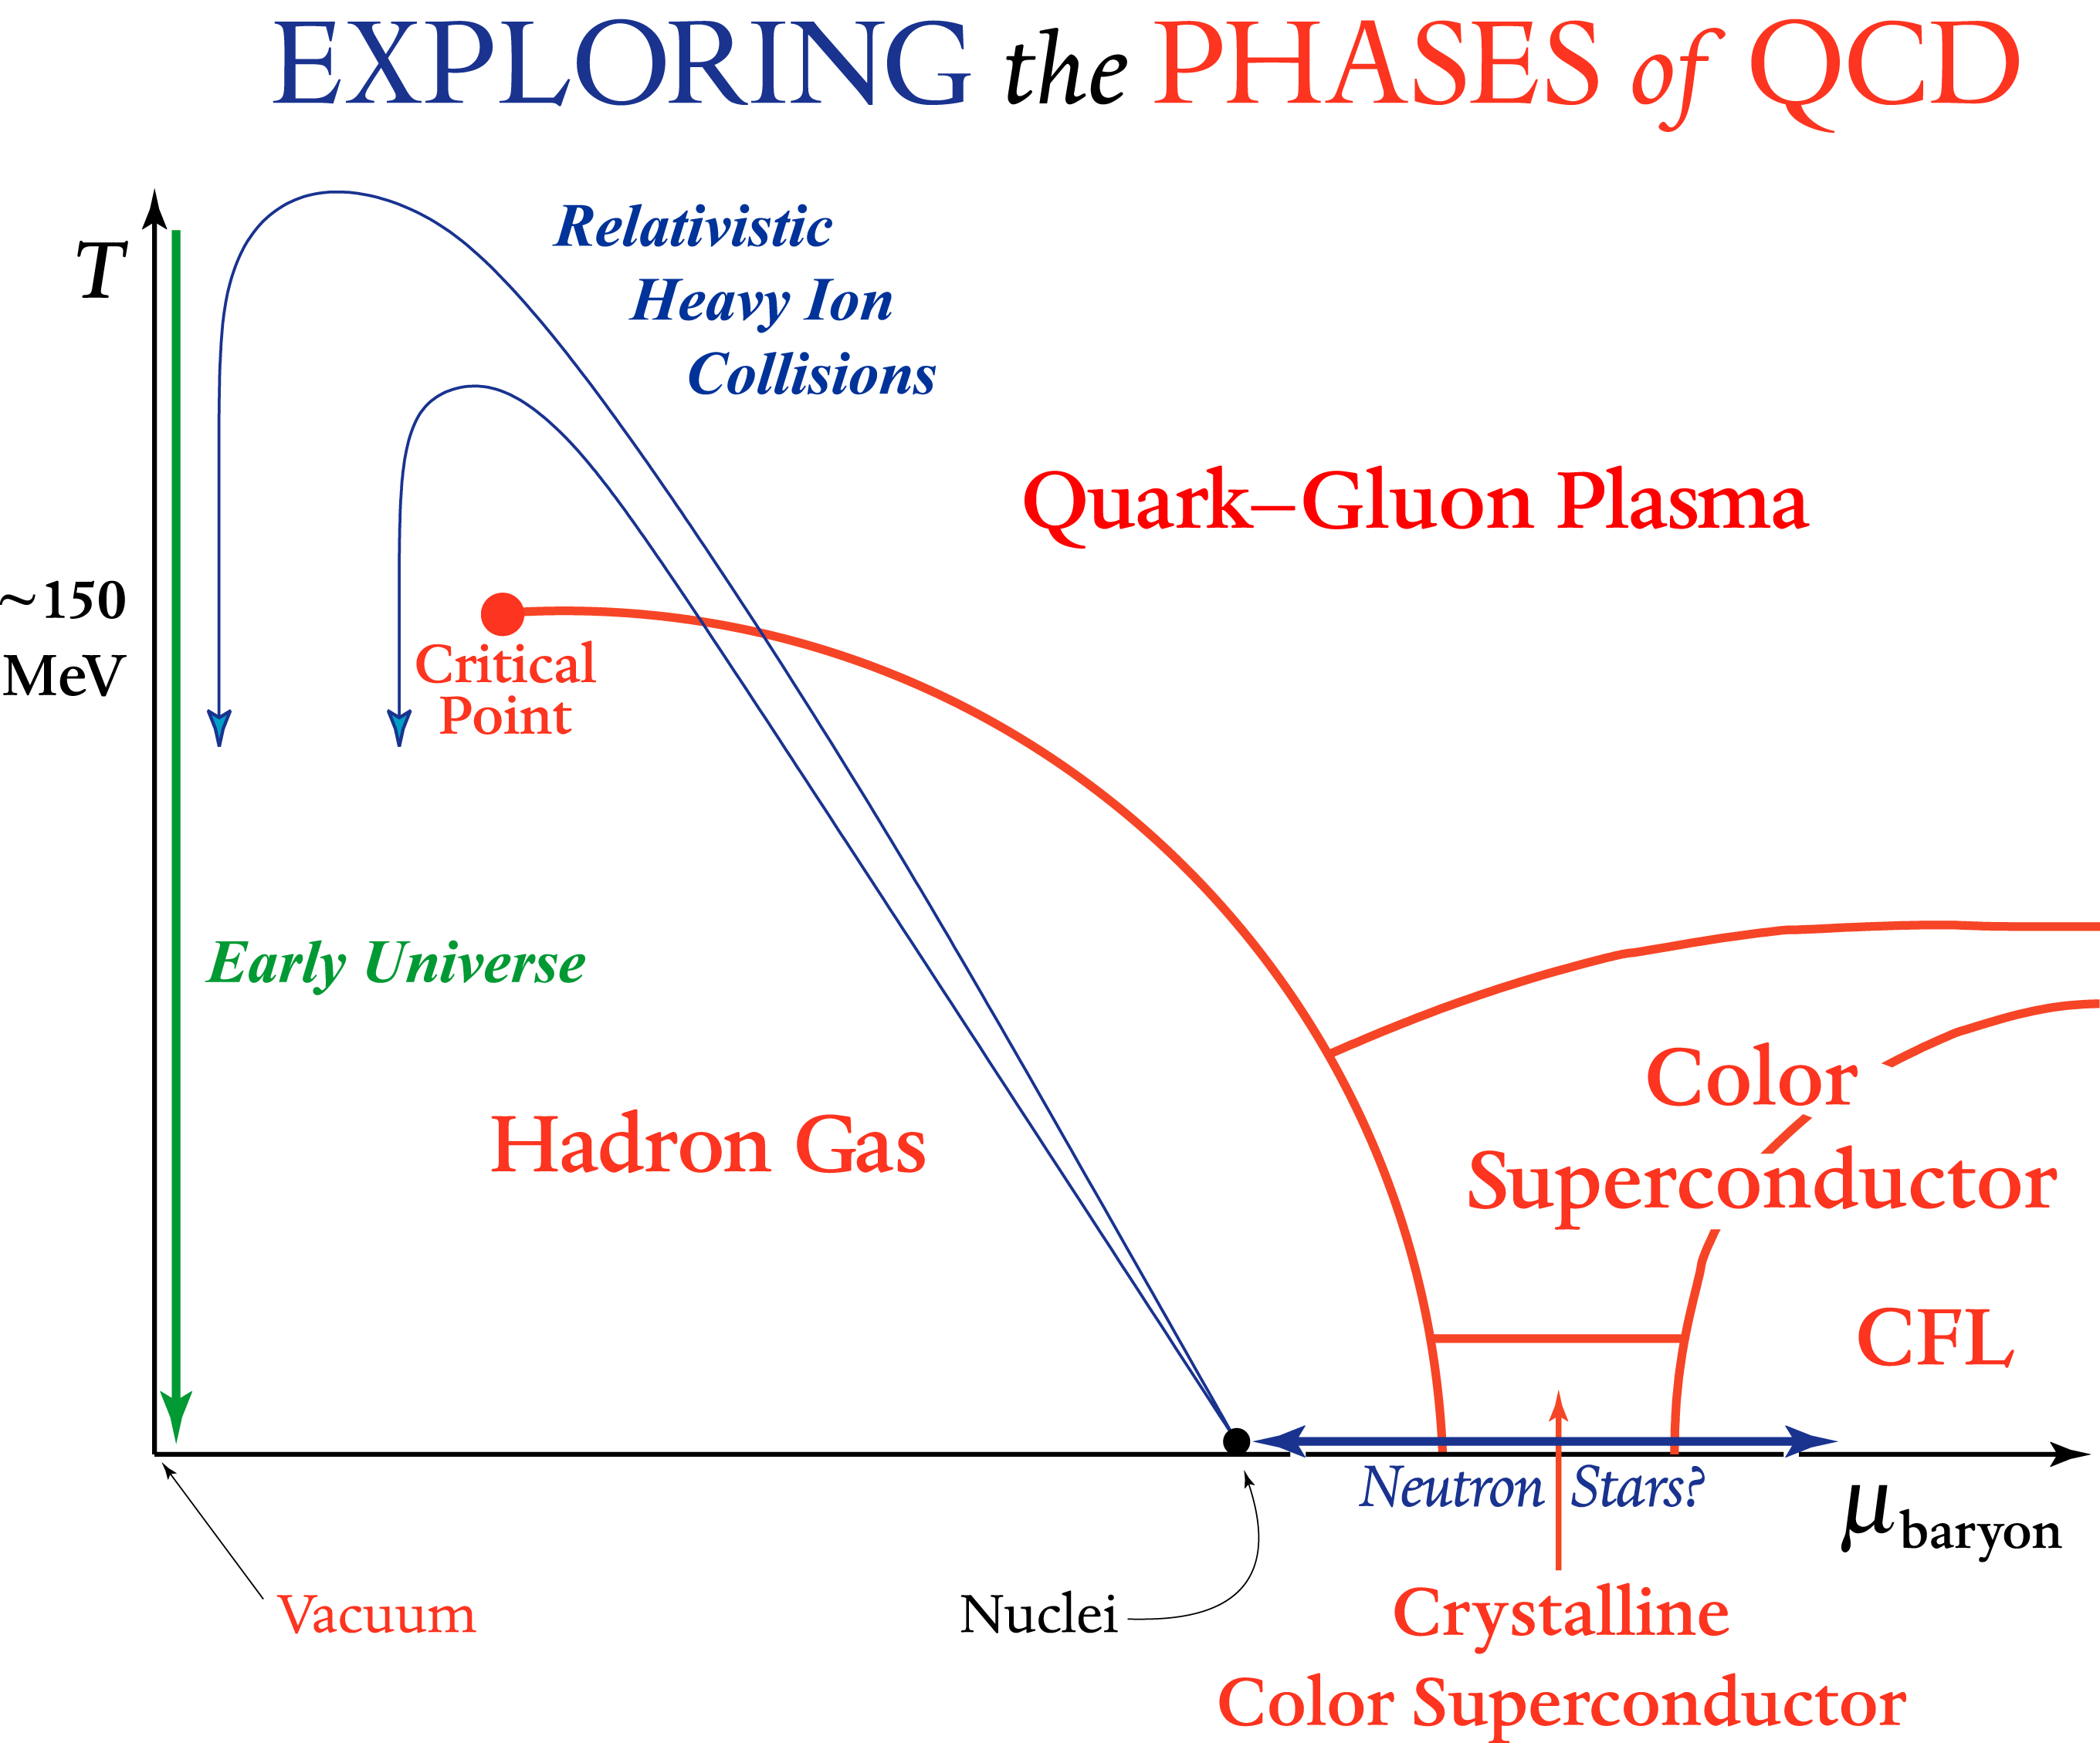
Goal of HIC experiments: Study hot and dense QCD matter
Starting point: Quantum Chromodynamics (QCD)
Fundamental question: How do collective phenomena and macroscopic properties emerge from the interactions of elementary particle physics?
Heavy Ion Physics addresses this question in the regime of the highest temperatures and densities accessible in laboratories: QGP search
Screening of long range confining
potential at high T or density
Where?:
in the Universe 10⁻⁵ s after the Big-Bang
in the core of neutron stars
in ultra-relativistic heavy ion collisions
D.o.F. increases x10 reaching 80% of the non-interacting gas limit
LHC √s≈5500 GeV
V(r)
RHIC √s≈200 GeV
SPS √s≈20 GeV
Notes:
HIC goal is the understanding of confinement through the study of systems with high parton densities. Using asymptotic freedom, high densities lead to quasi-free partons: Quark Gluon Plasma

Slide 3
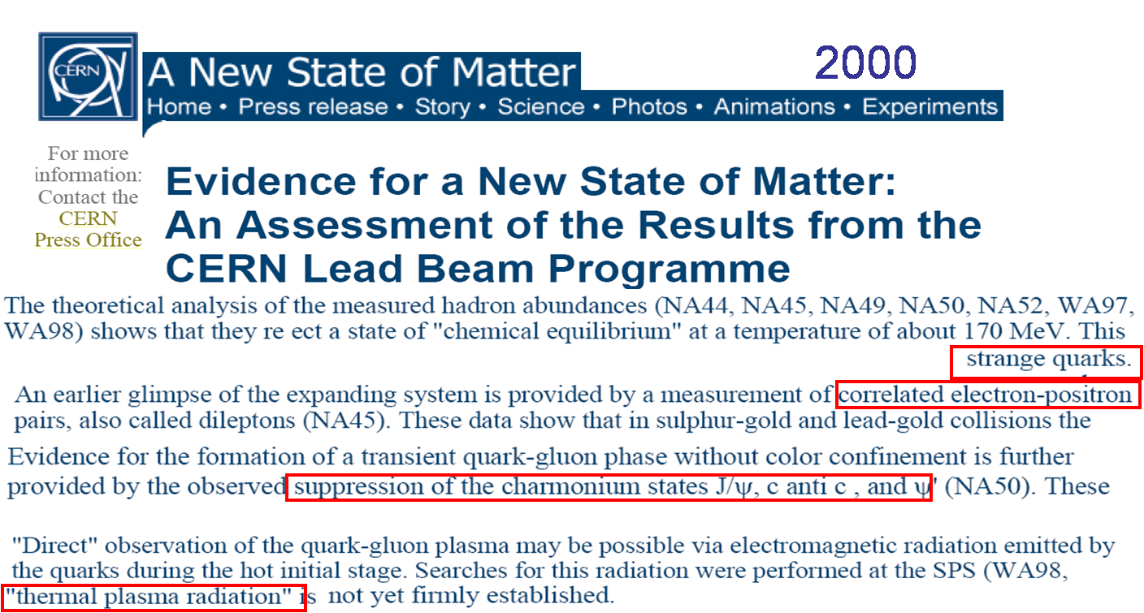
HIC experimental programs: Past, present and future
• Past programs: SIS/LBL, AGS/BNL, SPS/CERN (‘86-2003): Pb+Pb @ 17.4 GeV
Evidence for a new state of matter

Slide 4


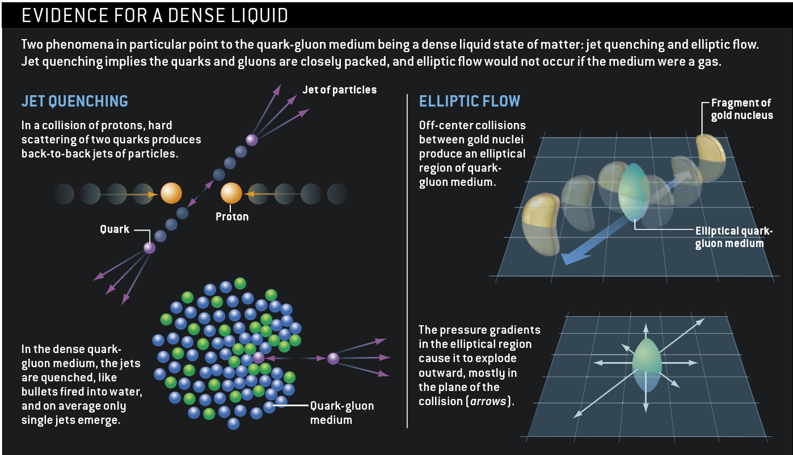
HIC experimental programs: Past, present and future
• Past programs: SIS/LBL, AGS/BNL, SPS/CERN (‘86-2003): Pb+Pb @ 17.4 GeV
Evidence for a new state of matter
• Present programs:
RHIC/BNL (2000-On): Au+Au @ 200 GeV (also d+Au, Cu+Cu & lower energies)
Evidence for a strongly interacting state of matter: a “perfect fluid” sQGP
2006

Slide 5

HIC experimental programs: Past, present and future
• Past programs: SIS/LBL, AGS/BNL, SPS/CERN (‘86-2003): Pb+Pb @ 17.4 GeV
Evidence for a new state of matter
• Present programs:
RHIC/BNL (2000-On): Au+Au @ 200 GeV (also d+Au, Cu+Cu & lower energies)
Evidence for a strongly interacting state of matter: a “perfect fluid” sQGP
2006
LHC/CERN (2010-On): Pb+Pb @ 2.76 TeV (also p+Pb @ 5 TeV)
Confirmation & quantitative description of the thermal properties of the QGP
CERN Courier, Jun 6, 2011
ALICE enters new territory in heavy-ion collisions
The first run with colliding beams of lead ions in the LHC has already provided the ALICE experiment with a taste of hot dense matter at higher energies than ever before.

Slide 6
HIC experimental programs: Past, present and future
• Past programs: SIS/LBL, AGS/BNL, SPS/CERN (‘86-2003): Pb+Pb @ 17.4 GeV
Evidence for a new state of matter
• Present programs:
RHIC/BNL (2000-On): Au+Au @ 200 GeV (also d+Au, Cu+Cu & lower energies)
Evidence for a strongly interacting state of matter: a “perfect fluid” sQGP
2006
LHC/CERN (2010-On): Pb+Pb @ 2.76 TeV (also p+Pb @ 5 TeV)
Confirmation & quantitative description of the thermal properties of the QGP
CERN Courier, Jun 6, 2011
• Future programs:
LHC/CERN: Pb+Pb @ 5.5 TeV in 2015-2017 (Run-2), with upgraded detectors (LS1, ALICE). Preparing the detector upgrade for higher luminosity LHC run during LS2 (2018) for Run-3 (2019-2022).
RHIC/BNL: p+Au, d+Au, ³He+Au, Au+Au @ 200 GeV in 2014-2016. LS (2017).
5-20 GeV Au+Au (BES-2) (2018-2019).

Slide 7
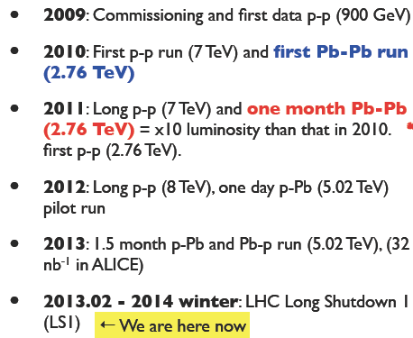
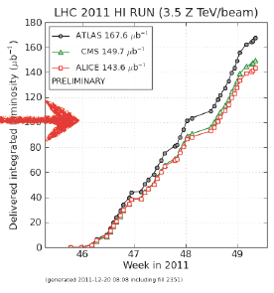
HIC experimental program: LHC run history
Similar quantities ATLAS & CMS
• 1 dedicated experiment: ALICE (U. Santiago)
CMS and ATLAS also involved
• 2013: p+Pb collisions @ 5 TeV (LHCb also joining!)

Slide 8
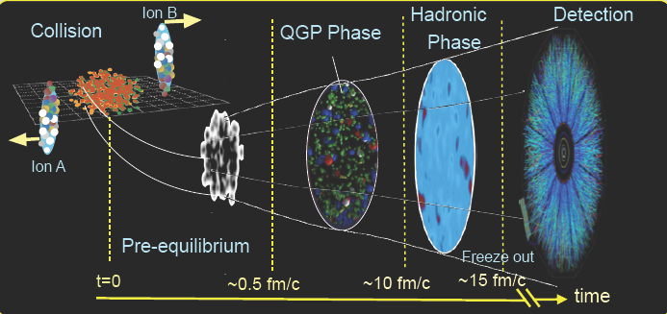
Space-time picture of heavy ion collisions: Observables
Bulk Observables: p ~ <pt>,T
~ 99% of detected particles
Multiplicities
Thermal dileptons & direct photons
Asymmetries, correlations, fluctuations
Collective behavior of the medium
Initial conditions: T, ε, μ
Thermalization and hydrodynamics
Hard Probes: p >> <pt>,T
~ 1% of detected particles
Fast quarks and gluons
Jet quenching
Quarkonia dissociation
Medium tomography & diagnosis
Interpretation requires “vacuum”
(p+p) and “cold nuclear” (p+Pb)
data at the same energy

Slide 9
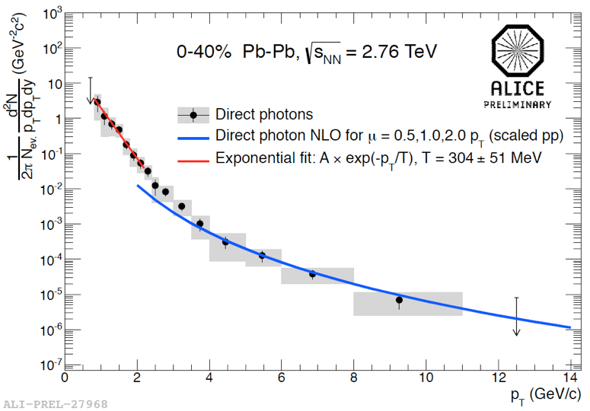
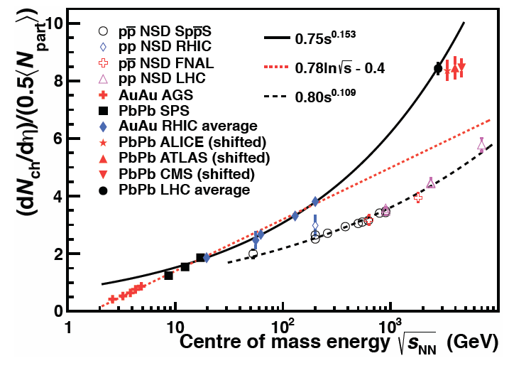

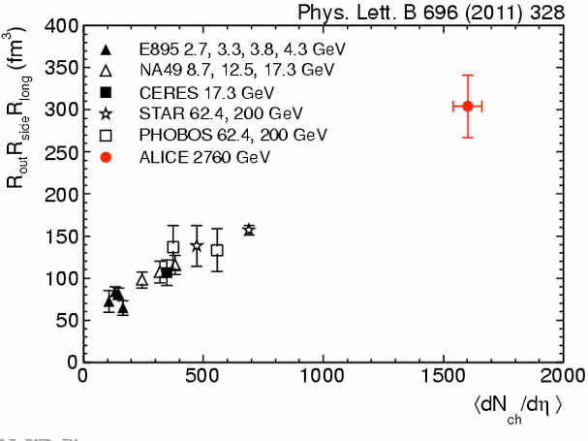
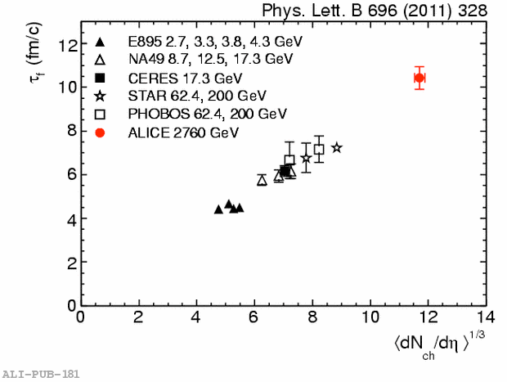


Excess of soft thermal photons
Hotter, denser, bigger and lasting
Multiplicity density: 2.1x RHIC
ε = 1/(πR²τ₀) dE_{t}/dη
dE_{t}=dN • <m_{t}>
• T = 304±51 MeV, 40% higher RHIC
• Energy density~ 3 x RHIC
• Freeze-out volume: 300 fm³ ~ 2 x RHIC
• Lifetime: 10 fm/c ~ 40% longer than RHIC
Pion HBT interferometry
Pion HBT interferometry
Notes:
In the most central PbPb collisions at the LHC, the charged-particle density at mid-rapidity amounts to dN/dη ≈ 1600, which is about 2.1 times more per nucleon pair participating in the collision than at RHIC. Since the particles are also, on average, more energetic at the LHC, the transverse-energy density is about 2.5 times higher. This allows a rough estimate of the energy density of the medium that is produced. Assuming the same equilibration time of the plasma at RHIC and the LHC, the ene
rgy density has increased at the LHC by at least a factor of three, corresponding to an increase in temperature of more than 30% (CERN Courier June 2011 p17).
The thermal photons appear in the low-energy region of the direct-photon spectrum (p^{g}_{T} <2 GeV/c) as an excess above the yield expected from next-to-leading order QCD and have an exponential shape (figure 2). The inverse slope of this exponential measured by ALICE gives a value for the temperature, T = 304±51 MeV, about 40% higher than at RHIC.
In hydrodynamic models, this parameter corresponds to an effective temperature averaged over the time evolution of the reaction. The measured values suggest initial temperatures that are well above the critical temperature of 150–160 MeV.
The ALICE collaboration has measured the size of the pion-emitting system in central lead–ion collisions at the LHC at a centre-of-mass energy of 2.76 TeV per nucleon pair. The radii of the pion source were deduced from the shape of the Bose-Einstein peak in the two-pion correlation functions.
In hadron and ion collisions, Bose-Einstein quantum statistics leads to enhanced production of bosons that are close together in phase space, and thus to an excess of pairs at low relative momentum. The width of the excess region is inversely proportional to the system size at decoupling, i.e. at the point when the majority of the particles stop interacting.
An important finding at the Relativistic Heavy Ion Collider (RHIC) at Brookhaven was that the QCD matter created there behaved like a fluid, with strong collective motions that are well described by hydrodynamic equations. The collective flow makes the size of the system appear smaller with increasing momentum of the pair. This behaviour is also clearly visible for the radii measured at the LHC in the ALICE experiment. Figure 1 shows the results for measurements of the radius of the pion source in three dimensions: along the beam axis, R_{long}; along the transverse momentum (k_{T}) of the pair, R_{out}; and in a direction perpendicular to these two, R_{side}.
The similarity between the values for R_{out} and R_{side} indicates a short duration for the emission, hence an "explosive" emission. The time when the emission reaches its maximum – measured with respect to the first encounter – can be derived from the dependence of the longitudinal radius on the transverse momentum, R_{long}(k_{T}). ALICE has found this to be 10–11 fm/c, which is significantly longer than it is at RHIC. Moreover, the product of the three radii at low pair-momentum – the best estimate of the homogeneity volume of the system at decoupling – is twice as large as at RHIC (figure 2).
Fig. 2.
These results, taken together with those obtained from the study of the multiplicity and the azimuthal anisotropy, indicate that the fireball formed in nuclear collisions at the LHC is hotter, lives longer and expands to a larger size than at lower energies. Further analyses, in particular including the full dependence of these observables on centrality, will provide more insights into the properties of the system – such as initial velocities, the equation of state and the fluid viscosity – and strongly constrain the theoretical modelling of heavy-ion collisions.
In the same way that astronomers determine the space–time structure of extended sources using Hanbury-Brown–Twiss optical intensity interferometry, heavy-ion physicists use 3D momentum correlation-functions of identical bosons to determine the size of the medium produced (the freeze-out volume) and its lifetime. In line with predictions from hydrodynamics, the volume increases between RHIC and the LHC by a factor of two and the system lifetime increases by 30% (CERN Courier May 2011 p6).
Perfect quantum liquids are characterized by a low shear-viscosity to entropy ratio, η/s, for which a lower limit of h/4πk_{B} is postulated. This property is directly related to the ability of the medium to transform spatial anisotropy of the initial energy density into momentum-space anisotropy. Experimentally, the momentum-space anisotropy is quantified by the Fourier decomposition of the distribution in azimuthal angle of the produced particles with respect to the reaction plane. The second Fourier coefficient, v₂, is commonly denoted as elliptic flow. With respect to RHIC, v₂ is found to increase in mid-central collisions by 30% (CERN Courier April 2011 p7). Calculations based on hydrodynamical models show that the v₂ measured at the LHC is consistent with a low η/s, close to or challenging the postulated limit.
Further knowledge on the collective behaviour of the medium has been obtained from the spectral analysis of pions, kaons and protons. The so-called blast-wave fit can be used to determine the common radial expansion velocity, <β_{r}>. The velocity measured by ALICE comes to about 0.65 and has increased by 10% with respect to RHIC.
In di-hadron azimuthal correlations, elliptic flow manifests as cosine-shaped modulations that extend over large rapidity ranges. At the LHC, for central collisions, more complicated structures become prominent. These can be quantified by higher-order Fourier coefficients. Hydrodynamical models can then relate them to fluctuations of the initial density distribution of the interacting nucleons. Wavy structures that were formerly discussed at RHIC, such as Mach-cones and soft ridges, have now found a simpler explanation. By selecting events with larger than average higher-order Fourier coefficients, it is possible to select and study certain initial-state configurations. "Event shape engineering" has therefore been born.
As discussed above, using hydrodynamical models, the basic parameters of the medium can be extrapolated in a continuous manner between the energies of RHIC and the LHC and they turn out to show a moderate increase. Although this might not seem to be a spectacular discovery, its importance for the field should not be underestimated: it marks a transition from data-driven discoveries to precision measurements that constrain model parameters.

Slide 10

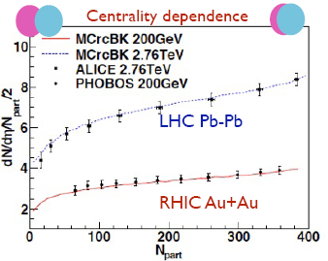
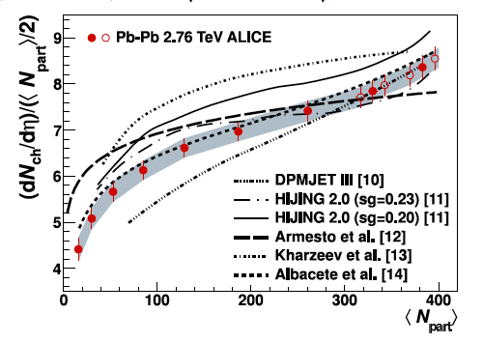

Multiplicities: Coherence effects
Both RHIC and LHC multiplicities are a lot smaller than predicted by simple superposition of proton+proton collisions: Coherence effects are important
Strong coherence/saturation in particle production:
CGC, percolation, strong gluon shadowing
=> Reduction in the effective number of colour sources
Behaviour compatible with factorization between energy and centrality dependences, as suggested by saturation

Slide 11
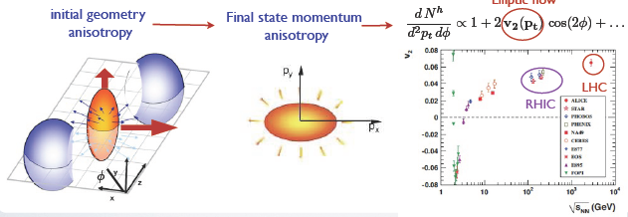
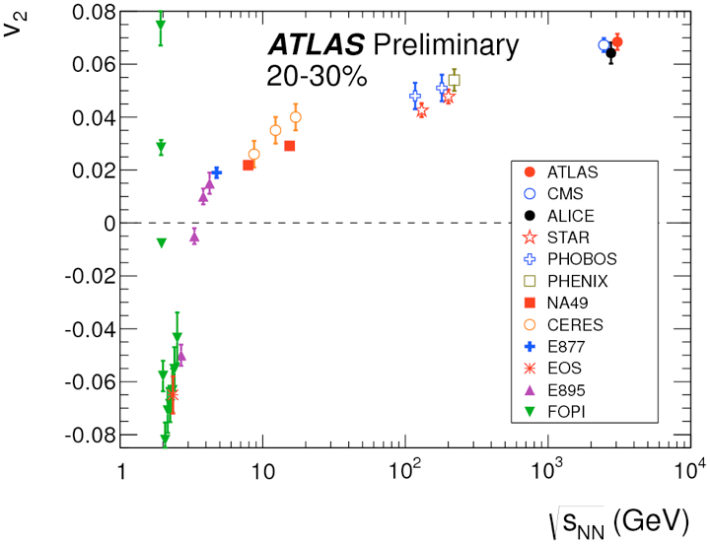

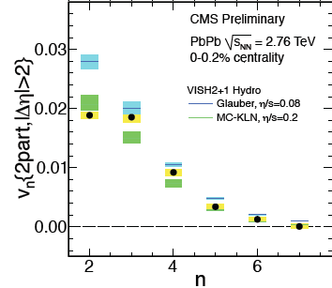
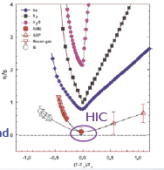
RHIC and LHC matter flow!
• Matter behaves like a fluid whose expansion is driven by pressure gradients
LHC
RHIC
• Perfect fluid: Smallest viscosity/entropy ever measured, close to ADS/CFT lower bound
Hydro+EoS+initial conditions+hadronization works
η/s = h/4πk_{B}
Further constraint on initial conditions and η/s:
Higher harmonics v_{n}
Notes:
Off-centre nuclear collisions, with a finite impact parameter, create a strongly asymmetric "almond-shaped" fireball. However, experiments cannot measure the spatial dimensions of the interaction (except in special cases, for example in the production of pions, see CERN Courier May 2011 p6). Instead, they measure the momentum distributions of the emitted particles. A correlation between the measured azimuthal momentum distribution of particles emitted from the decaying fireball and the initial spatial asymmetry can arise only from multiple interactions between the constituents of the created matter; in other words it tells us about how the matter flows, which is related to its equation of state and its thermodynamic transport properties.
The measured azimuthal distribution of particles in momentum space can be decomposed into Fourier coefficients. The second Fourier coefficient (v₂), called elliptic flow, is particularly sensitive to the internal friction or viscosity of the fluid, or more precisely, η/s, the ratio of the shear viscosity (η) to entropy (s) of the system. For a good fluid such as water, the η/s ratio is small. A "thick" liquid, such as honey, has large values of η/s. Comparison of the elliptic flow measured in heavy-ion collisions at RHIC with theoretical models suggests that the hot matter created in the collision flows like a fluid with little friction, with η/s close to its lower limit – the theoretical limit for a perfect fluid limit – given by η/s = ħ/4πk_{B}, where ħ is Planck’s constant and k_{B} is the Boltzmann constant.
-------------------------------------------------
ALICE gets with the flow
Elliptic flow
With data from the first heavy-ion run at the LHC, the ALICE collaboration has made the first observation of elliptic flow of charged particles in lead-lead collisions at 2.76 TeV per nucleon pair.
Flow is an interesting observable because it provides information on the equation of state and the transport properties of matter created in a heavy-ion collision. The azimuthal anisotropy in particle production is the clearest experimental signature of collective flow; it is caused by multiple interactions between the constituents of the created matter and the initial asymmetries in the spatial geometry of a non-central collision. The second Fourier coefficient of this azimuthal asymmetry is known as elliptic flow.
The magnitude of the elliptic flow depends strongly on the friction in the created matter, which is characterized by the ratio of shear viscosity to entropy ratio: η/s. A good fluid, such as water, has a small value of η/s and supports flow patterns such as waves in the ocean. By contrast, in a poor fluid, such as honey, flow patterns disappear quickly. Measurements of elliptic flow at the Relativistic Heavy Ion Collider (RHIC) at Brookhaven already revealed the fascinating fact that the hot and dense matter created in the collision there flows as a good fluid with almost no friction.
Surprisingly enough, the first theoretical calculation of η/s in heavy-ion collisions did not come from lattice QCD or transport theory – but from string theory. First calculations showed that in a strongly coupled N = 4 supersymmetric Yang Mills theory with a large number of colours, η/s can be calculated using a gauge gravity duality. The famous anti-de Sitter/conformal field theory (AdS/CFT) conjecture yields a ratio of η/s = h/4πk_{B}, which was argued to be a lower bound for any relativistic thermal field theory.
At RHIC, a precise determination of the friction in the partonic fluid is complicated by uncertainties in the initial conditions of the collision, the relative contributions from the hadronic and partonic phase, and the unknown temperature dependence of η/s. Because this temperature dependence is unknown, it was not even clear if the elliptic flow would increase or decrease when going from RHIC to the LHC. A measurement of elliptic flow at the LHC was therefore one of the most anticipated results.
The measurements at 2.76 TeV by ALICE show that the elliptic flow of charged particles increases by about 30% compared with flow measured at the highest RHIC energy of 0.2 TeV. This result indicates that the hot and dense matter created in these collisions still behaves like a fluid with almost zero friction, providing strong constraints on the temperature dependence of η/s.
This first measurement also shows that elliptic flow – and thus the properties of the created matter – can be studied with unprecedented precision at the LHC. This is because of the increase in particle multiplicity compared with RHIC and the increase in the elliptic flow itself.

Slide 12
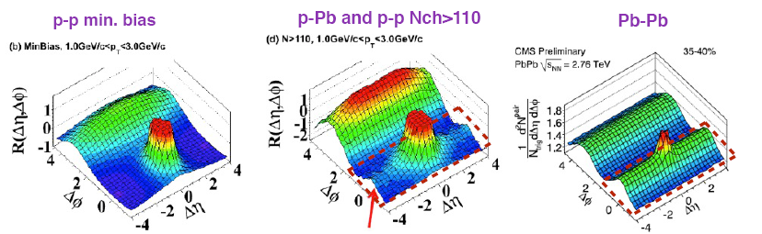
Long range rapidity correlations: The ridge
Ridge structure in Δϕ - Δη angular correlations, where Δϕ and Δη are the azimuthal angle and pseudorapidity differences of two produced hadrons
Ridge structures along Δη appear on the same side (near side, Δϕ ∼ 0) and on the away side (Δϕ ∼π), with or without a high p_{T} trigger.
Observed in Au+Au @ RHIC, and in Pb+Pb, high mult. p+Pb & p+p collisions @ LHC
Different theoretical models of the ridge: hydrodynamic flows, local hot spots, initial-state fluctuations, parton cascades, glasma flux tubes, glasma turbulence fields, the momentum kick model, pQCD modeling, etc..
Long range y-correlations natural due to initial state coherence: string models, CGC,..
Notes:
Measurements of two-particle correlations in high-energy nuclear collisions at the RHIC and LHC have provided a wealth of information that can be utilized to deduce the dynamics of the collision process and the properties of the produced dense hot medium. One of the most striking features is a "ridge" structure in Δϕ - Δη angular correlations, where Δϕ and Δη are the azimuthal angle and pseudorapidity differences of two produced hadrons, respectively. Ridge structures along Δη appear on the same side (near side, Δϕ ∼ 0) and on the away side (Δϕ ∼π), with or without a high p_{T} trigger. The "ridge" structure appearing on the same side is relatively narrow in Δϕ but quite extended in Δη. Same-side Ridge structures have been observed in high energy Au+Au and Cu+Cu collisions at the RHIC, and in p+p and Pb+Pb collisions at the LHC.
The general occurrence of ridge correlations for a variety of collision conditions and in several different phase- space regions has stimulated many theoretical discussions. The existence of long-range correlations between produced particles with large pseudorapidity differences poses an interesting theoretical puzzle. It appears timely to gather together physicists working on this interesting topic to examine what the experimental measurements reveal and what the theoretical descriptions entail. For such a purpose, the Ridge Workshop will be organized according to the following structure:
(A) The Inclusive Ridge (or minimum-pt-bias ridge, with no high pt selection, and no v_{n} subtraction):
In near side, abrupt rise of ridge yield as a function of centrality.
In away side, yield in excess of pQCD correlation predictions for high-multiplcity central collisions.
(p_{T1}, p_{T2}) correlations and their centrality dependence.
Connections of fit model elements to physics mechanisms.
The above interesting ridge properties have been observed at RHIC, what about LHC?
Why do the p_{T} of the associated ridge particles peak at a particular p_{T} range in pp collisions (CMS)?
If v₂ background is somehow subtracted, how are the correlation structures affected?
(B) The High-p_{T} Ridge (with a high-p_{T} trigger, and v₂ subtraction):
In near side, ridge yield gradually rises in variation with centrality.
Three-particle correlations, in-plane and out-of-plane two-particle correlations.
What is the amplitude of the ridge as a function of trigger p_{T} or associated particle p_{T}?
What happens for RHIC data if v₂, v₃, v₄,... background are subtracted? Would there be a ridge at all after the subtraction?
What do these correlations tell us? To what extend do the experimental v_{n} quantities explain all of the above experimental two-body correlation features (including the ridge)?
What are the properties of particles in the ridge: p_{T}, flavor composition, etc.?
To what degree are the different ridges the same between RHIC and LHC?
We need data here from both RHIC and LHC.
(C) Theoretical Descriptions
To what extent do mini-jets contribute to the global v_{n}, two-body correlations, with and without a high p_{T} trigger?
Different theoretical models of the ridge: hydrodynamic flows, local hot spots, initial-state fluctuations, parton cascades, glasma flux tubes, glasma turbulence fields, the momentum kick model, pQCD modeling, etc..
How does the inclusive (or minimum-pt-bias) ridge related to the high p_{T} ridge?
v_{n} for large n and analogies with the cosmic background radiation.
Is v_{n} the same when measured at different rapidities in the same event?
To what degree do theoretical considerations depend upon the transverse graininess of the initial conditions? Is there an intrinsic and quantum limitation of theoretical consideration if the initial conditions are too grainy?
More generally, what are the intrinsic limitations and model assumptions of various computations of ridge properties?
We need data here from both RHIC and LHC.
(D) The pp Ridge
What is the current experimental situation?
To what degree can the ridge be associated with intrinsic correlation in the emission process? With final state interactions or nascent flow?
What is the relation between the pp ridge at LHC and the AA ridge at RHIC?
(E) The Intrinsic Strength of Long-Range Rapidity Correlations:
How does the long range correlation depend upon centrality, beam energy etc.?
In pp or LHC AA Measurements? How to think about it?
Multiplicity Fluctuations.
If the ridge is associated with an underlying flux tube structure, then there are computable implications concerning the multiplicity fluctuations. Does this work for LHC and RHIC data?
(F) Summaries:
Theory: What have been ruled out and what are possibilities. How do we refine our knowledge?
Experiment: What needs to be done in future experiments to resolve the underlying physics.
There is a registration fee of $70 to attend this workshop, due in cash or by check drawn on a U.S. bank. Sorry -- we cannot accept credit cards

Slide 13
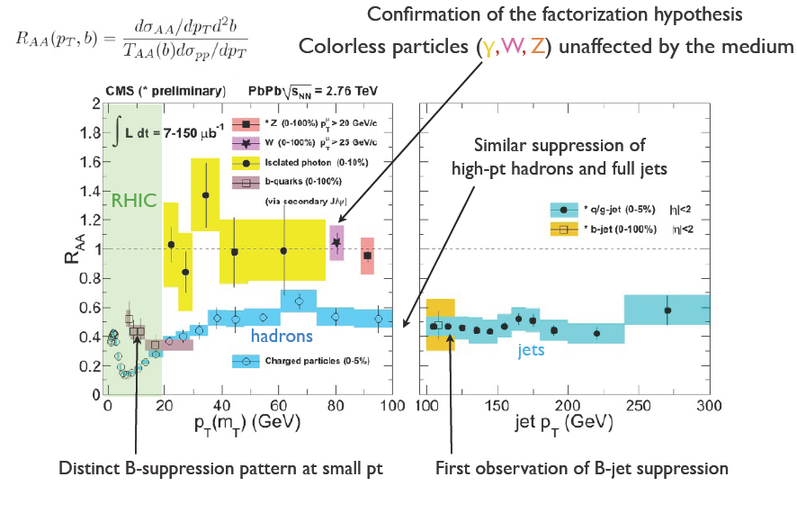
Hard Probes: Jets

Slide 14
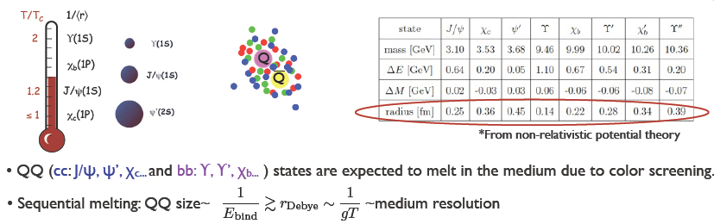
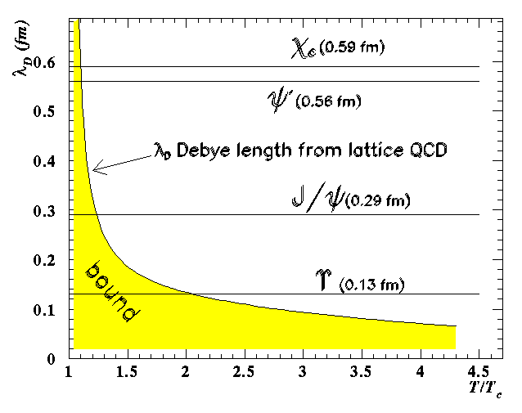

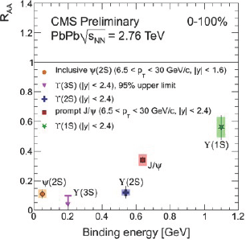
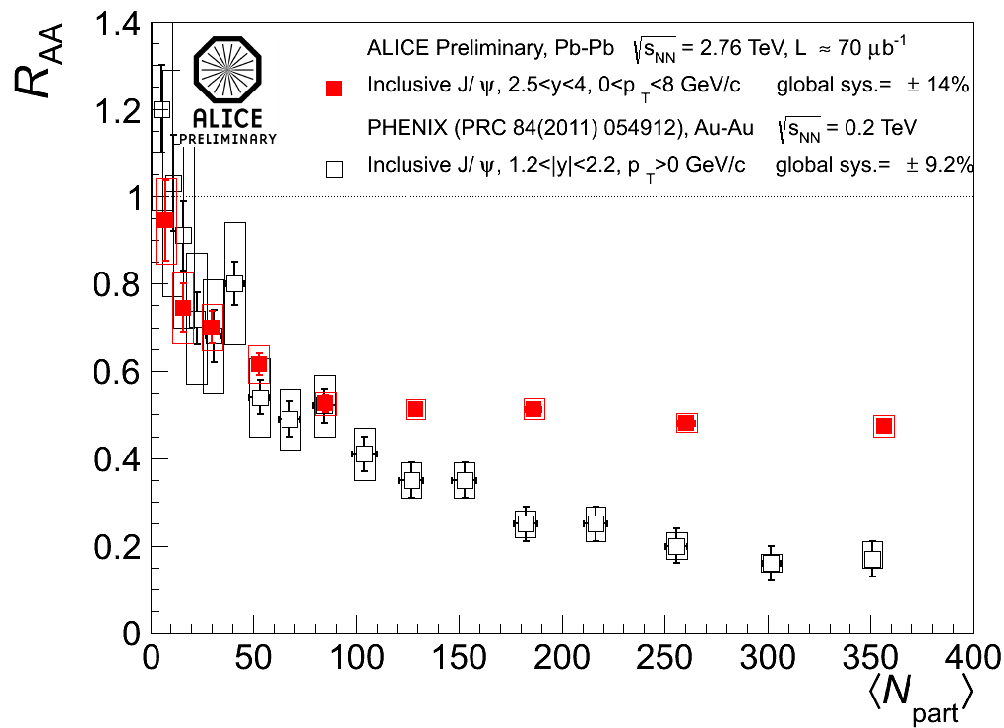
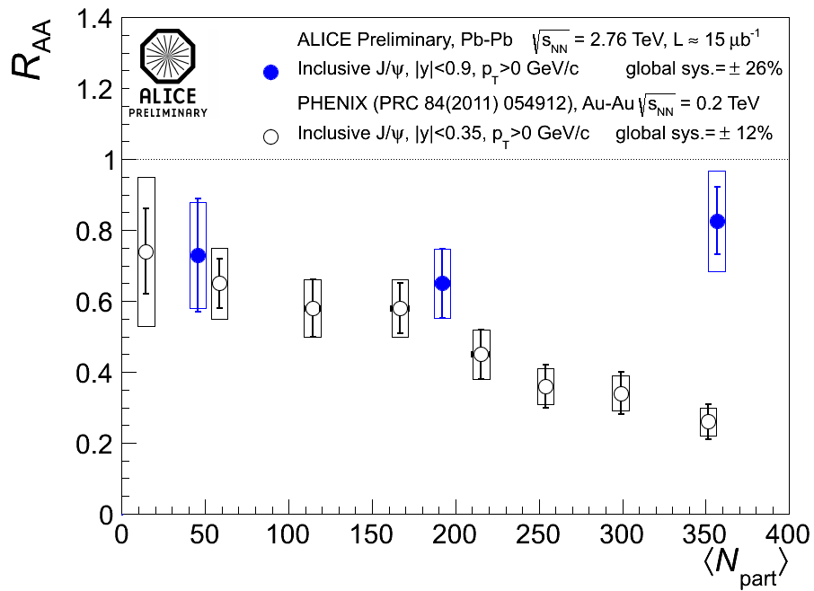
Hard Probes: Quarkonia melting and the QGP thermometer
Such a a picture starts emerging from data!!
BUT…
Stronger suppression
@ RHIC than @ LHC

Slide 15
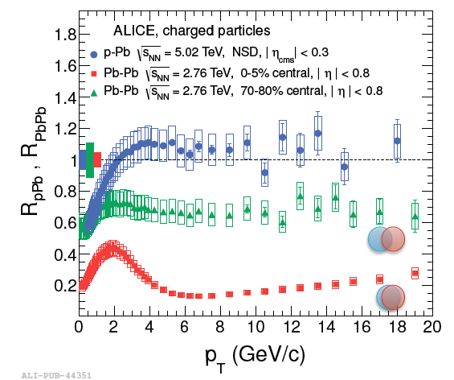
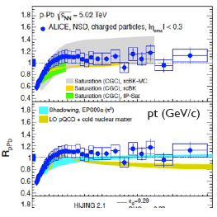
Highlights from p+Pb results: nuclear modification factor
• pPb collisions provide crucial benchmark on “cold nuclear matter effects”: Constraint nPDF’s
• QCD discovery potential: High density (coherent) QCD: Saturation and CGC
• pPb RAA compatible with gluon shadowing (nPDF. NLO+DGLAP) & saturation(CGC)
• RAA ~ 1 in pPb: suppression in Pb-Pb central is a final state effect.

Slide 16
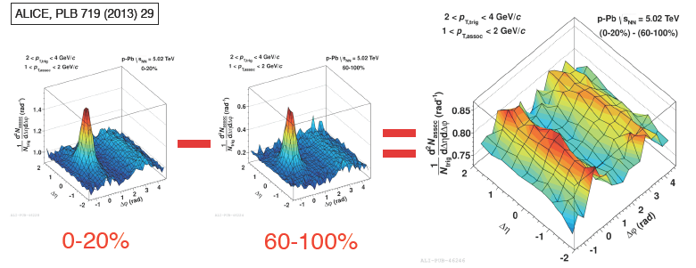
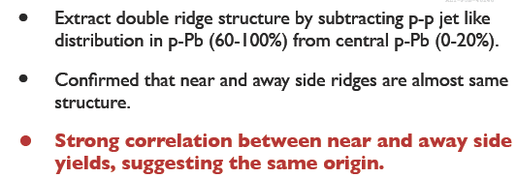
Highlights from p+Pb results: Double ridge structure

Slide 17
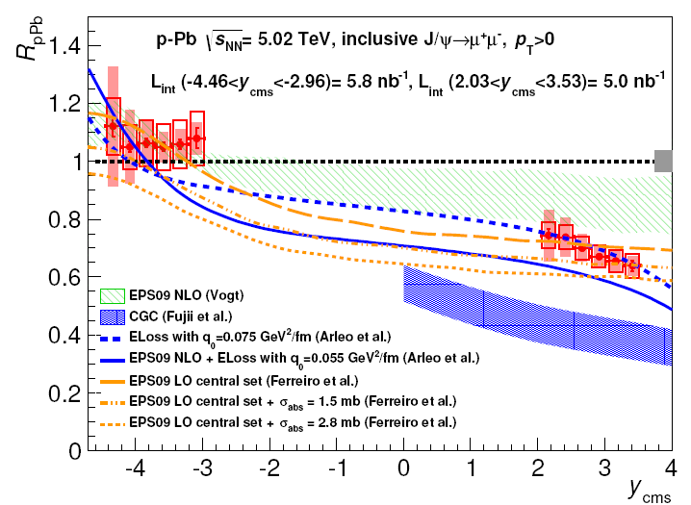
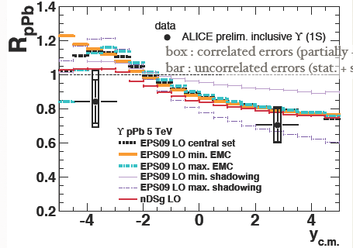
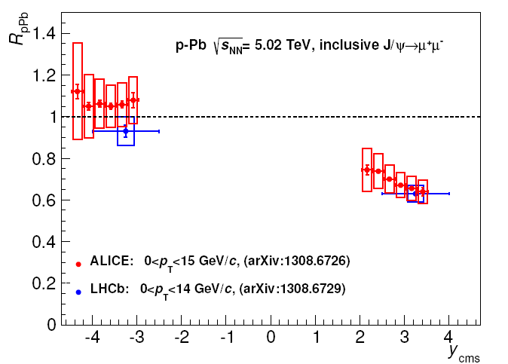
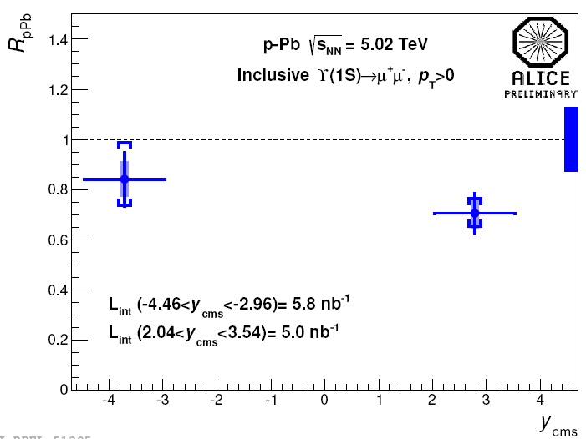
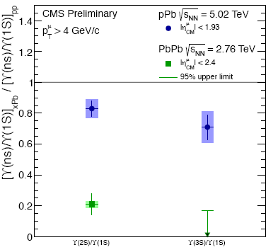
Highlights from p+Pb results: J/Ψ and ϒ suppression
J/Ψ R_{pPb}:
Shadowing &/or shadowing+energy loss
in agreement with data
CGC overestimates suppression
ϒ R_{pPb}:
agreement with shadowing
pPb vs PbPb: larger double ratios in pPb➡suggest additional (&/or stronger) final effects in PbPb that affect more the excited states than the ground state state

Slide 18
Theory developments and final comments
• Color Glass Condensate, saturation in high energy QCD. Thermalization in HIC & initial conditions. Cold nuclear matter effects: Albacete (UGR) ; Armesto, Ferreiro, Pajares, Salgado (USC)
• pQCD: Full theory of in-medium jets. Armesto, Salgado et al (USC); Casalderrey, Tywoniuk (UB); Perez-Ramos (UV)
• QCD Phase diagram. Effective theories. Lattice QCD at finite baryochemical potential. Behaviour of the system in the vicinity of the phase transition. Manuel, Tolos, Torres Rincon (CSIC); Ruiz Arriola, Salcedo (UGR); Dobado, LLanes Estrada (UCM)
• Holography: String theory -- HIC via ADS/CFT correspondence: Albacete (UGR); Casalderrey, Mateos (UB); Megias (UAB), Lansdteiner, Pena-Benitez (IFT), Mas, Edelstein (USC)
• In medium propagation of QQbar-states: Casalderrey (UB) , Ferreiro (USC)), Tolo (CSIC)
• P and CP violation in the hadronic and QGP phases Espriu, Planells (UB)
• So far the LHC has confirmed RHIC main results (new state of matter!), pushed the high-density/temperature frontier even further and opened up a new era in the field based on high-quality data and precision phenomenology.
• Well established long-term plans.
Final goal: detailed characterization of QCD thermal matter.

