Slide 1
Accelerator technology for Higss Factory
C. Oliver, F. Toral (CIEMAT)
Jornada Red Futuros Colisionadores – 2nd July 2024

Slide 2
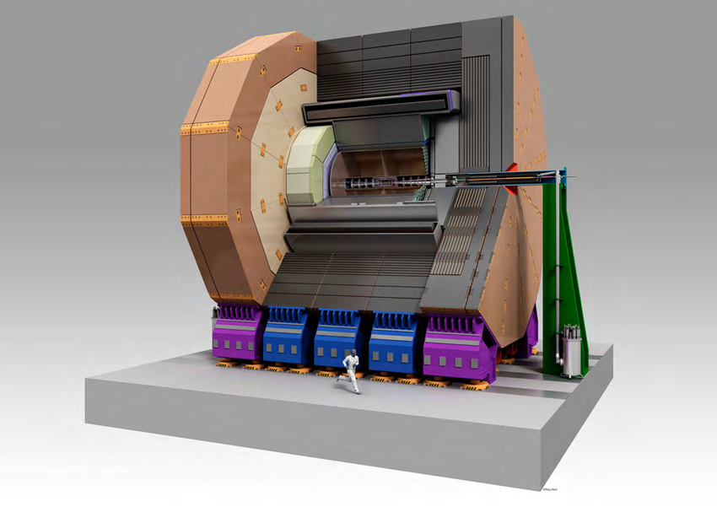
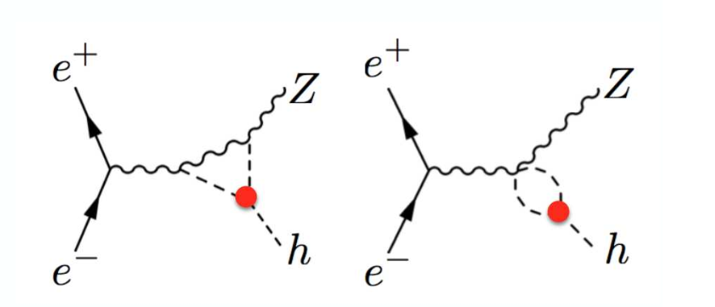
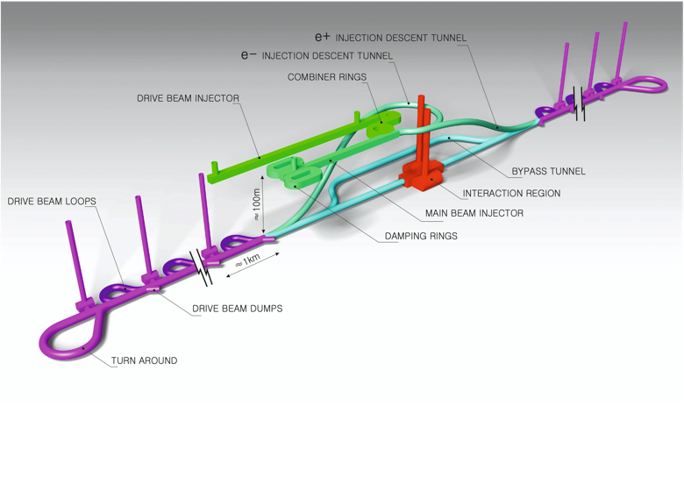
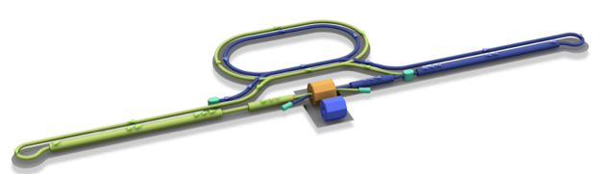
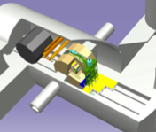
What is this talk NOT about?
No physics
No detectors
Neither accelerator overviews nor a comparison…
Interaction point
Damping Ring
e+ Source
e- Source
e- Main Linac
Beam dump
Physics Detectors
Bunches of ~10¹⁰ e+/e-
e+ Main Liinac
… but it is about CIEMAT contribution to accelerator technology for potential future colliders

Slide 3
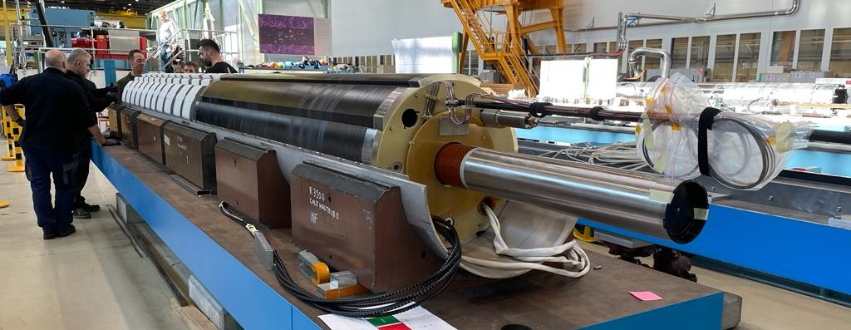
Ongoing activities on accelerator technology for future colliders at CIEMAT
C. Oliver, F. Toral (CIEMAT)
Jornada Red Futuros Colisionadores – 2nd July 2024

Slide 4
Outline
PRISMAC program
Facilities
CIEMAT contribution to:
HL-LHC
FCC
ILC
CLIC
Conclusions
18 short and long nested superconducting (SC) orbit correctors
16 T dipole in common coil configuration
Conduction cooled SC magnet package
Dipole with longitudinally variable field (permanent magnet) and RF structures

Slide 5



Collaboration with CERN: PRISMAC program
PRISMAC PROGRAM : A CIEMAT-CDTI Collaboration for Research on High Field Magnets, Supported by SGI/MCI & CERN

Slide 6
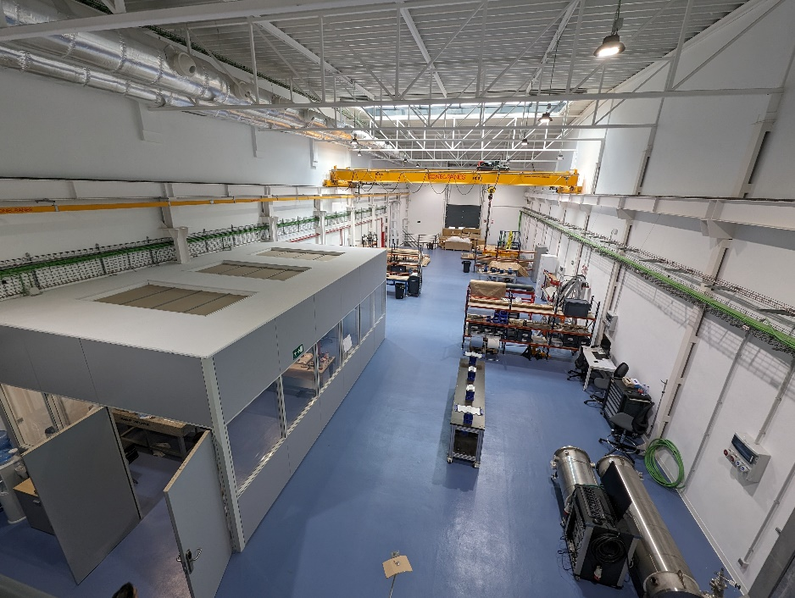
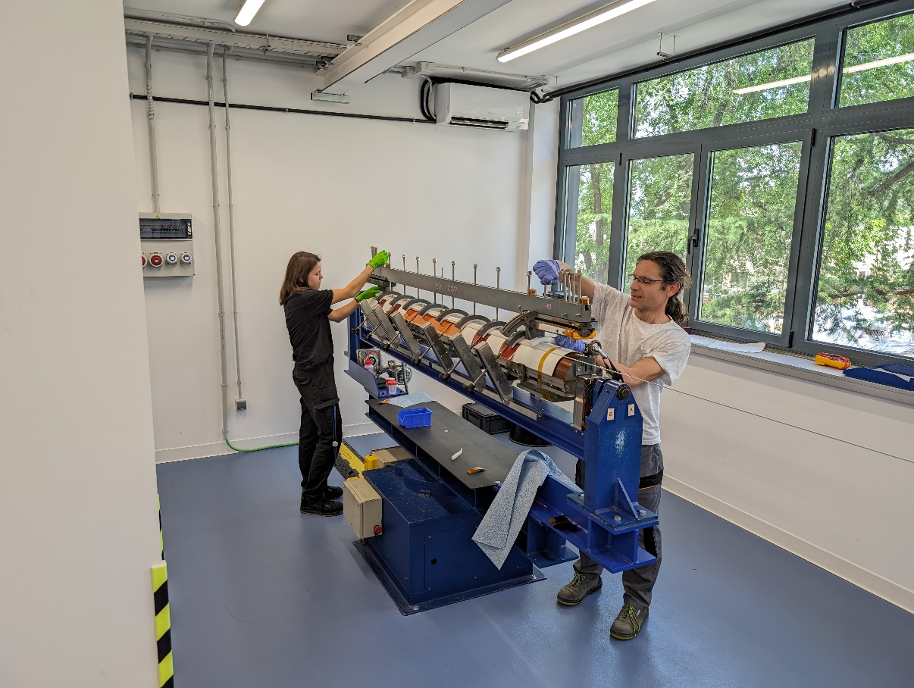
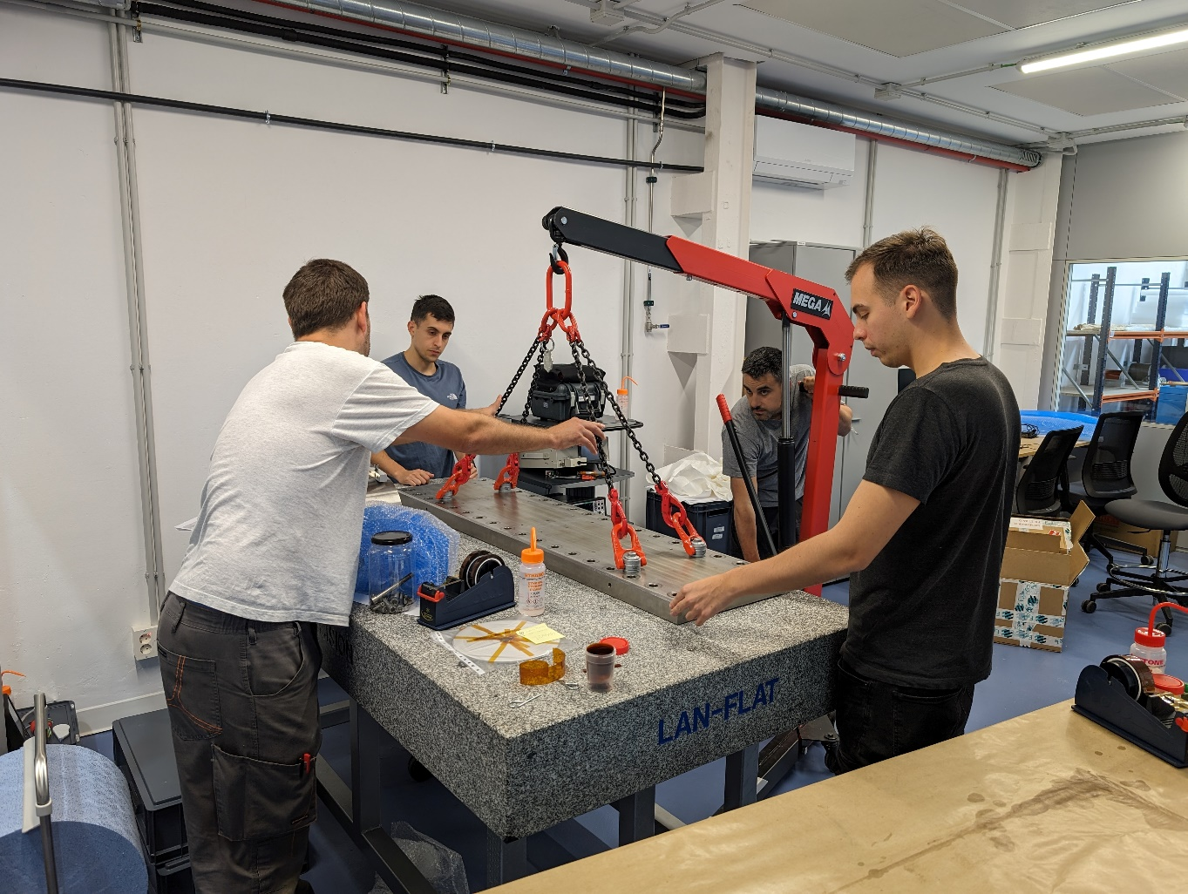
Facilities: magnet laboratory
We are working on the commissioning of a new laboratory for prototyping magnets up to 2 m long and 10 ton. Overall surface about 900 m².
Underground: mechanical workshop, laser cutting machine, storage
Ground floor: winding area, reaction furnace, dimensional control room, collaring press, magnetic measurement bench, assembly
First floor: offices

Slide 7
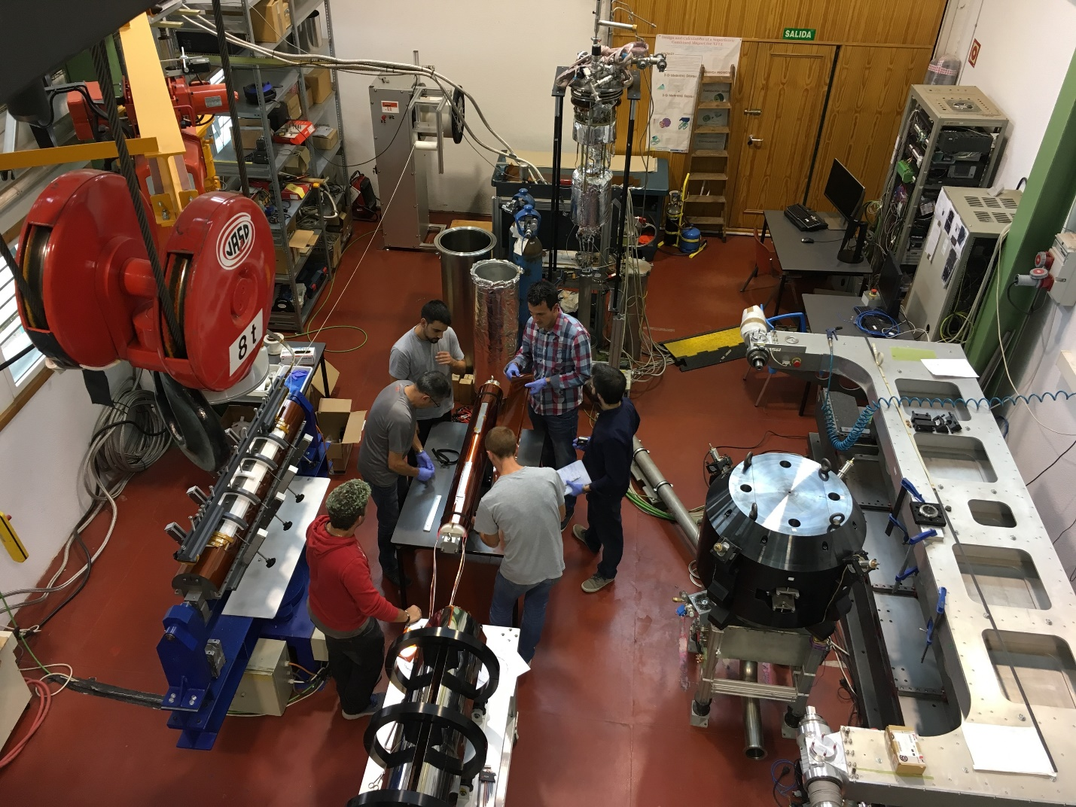
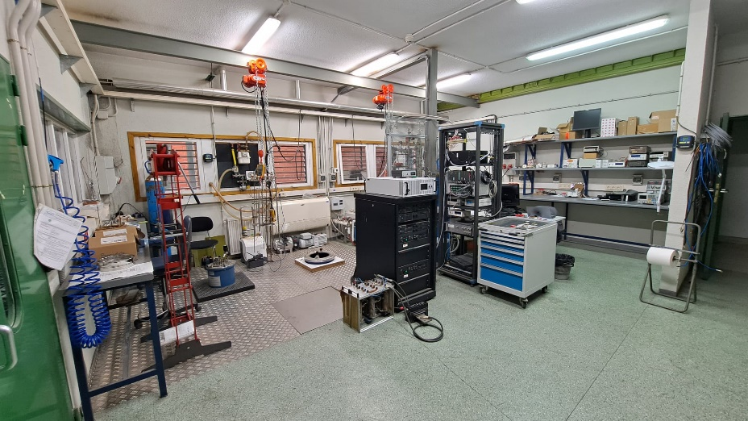
Facilities: superconductivity laboratory
Assembly hall with 3 cryocoolers
2 vertical cryostats for liquid helium
We can test magnets both in vertical cryostats or using cryocoolers. The superconductivity laboratory is at CEDEX premises (Julián Camarillo, Madrid).

Slide 8
CIEMAT contribution to HL-LHC

Slide 9
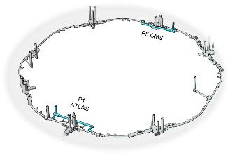
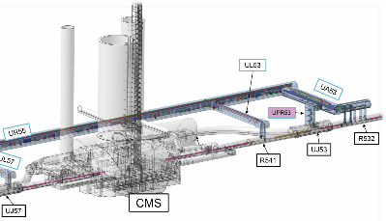
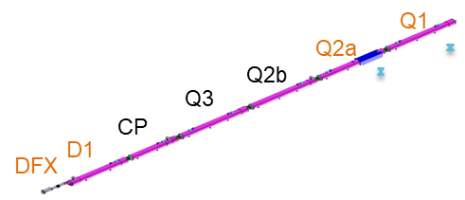
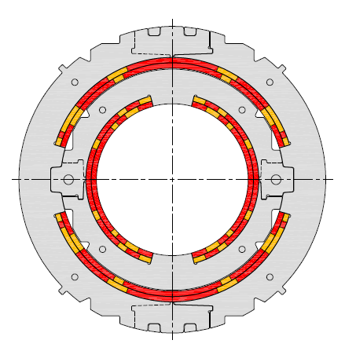
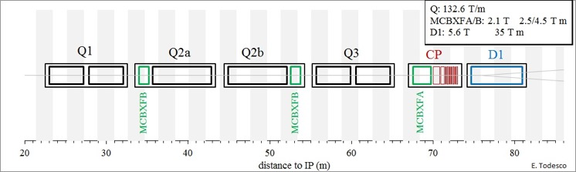
CIEMAT contribution to HL-LHC: MCBXF
MCBXF is an orbit corrector magnet located in the Inner Triplet, the closest group of magnets to the interaction points. Inner Triplet will be upgraded for HL-LHC.
View of LHC and IP5 with location of IT magnets
Inner Triplet Corrector Package
Vertical dipole field
(2.1 T)
Combined
dipole field
(Variable orientation)
MCBXFB
(2.5 T∙m)
MCBXFA
(4.5 T∙m)
Horizontal
dipole field (2.1 T)

Slide 10
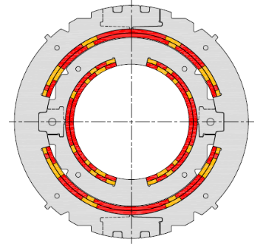
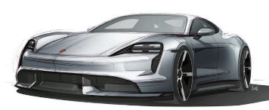
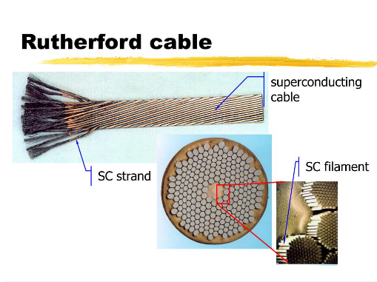
Magnet layout
CIEMAT contribution to HL-LHC: MCBXF
MCBXF Technical specifications
Magnet configuration | Combined dipole (Operation in X-Y square)
Integrated field | 4.5 (A) / 2.5 (B) Tm
Minimum free aperture | 150 mm
Nominal current | < 2000 A
Radiation resistance | 35 MGy
Physical length | < 2.5 (A) / 1.505 (B) m
Working temperature | 1.9 K
Iron geometry | D1 (A) / MQXF (B) iron holes
Field quality | < 10 units (1E-4)
Fringe field | < 40 mT (Out of the Cryostat)
First nested superconducting accelerator magnet with mechanical torque locking
Up to 147 kNm/m ¡¡~140 times the electric Porsche Taycan Turbo S motor torque!!
Coil fabrication techniques not previously used due to the high number of turns.
Courtesy L. Bottura (CERN)

Slide 11
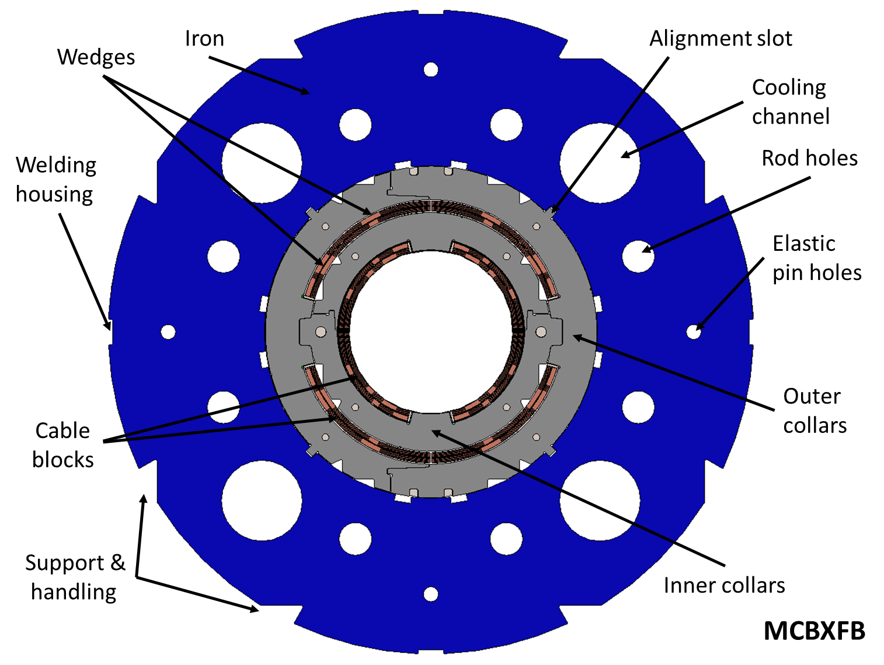
CIEMAT contribution to HL-LHC: MCBXF
MCBXFB: Short magnets
Two prototypes (MCBXFBP1, MCBXFBP2) at CIEMAT facilities
Series of 12 magnets
MCBXFA: Long magnets
Prototype (MCBXFAP1) at CIEMAT facilities
Series of 6 magnets
Courtesy of J.A. García Matos
Deliverable: “bare” magnet
Collared coils within yoke, longitudinal and transverse loading system
Integration in cold mass at CERN
Powering Tests done in CERN
Nested H/V dipoles
150 mm single aperture
Nb-Ti technology
Integrated field: 4.5 T.m (A), 2.5 T.m (B)
Two lengths with the same cross section:
Type A (2.5 m long)
Type B (1.5 m long)

Slide 12
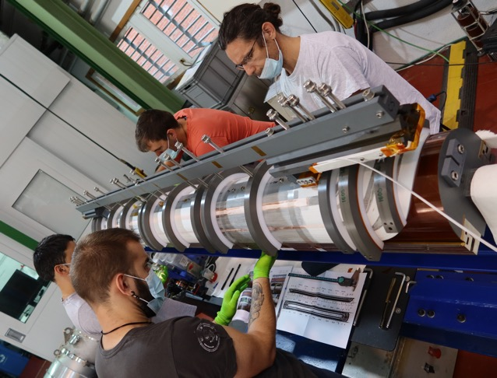
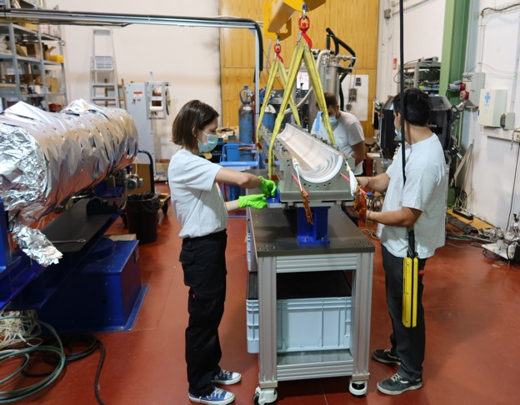
CIEMAT contribution to HL-LHC: MCBXF
Nested correctors MCBXF: coil production at CIEMAT
NbTi Rutherford cable insulated with braided glassfiber
Double pancake coils: binder
Impregnated with CTD 101K resin
Two lengths: 1.5 and 2.5 m
Binder mould assembly
Impregnation mould assembly

Slide 13
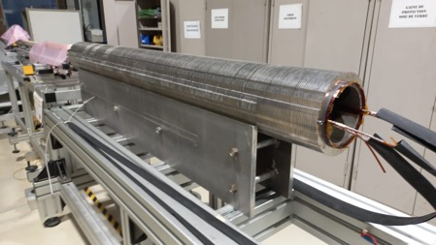
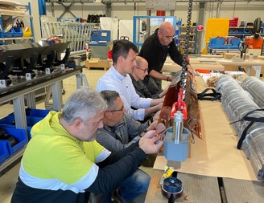
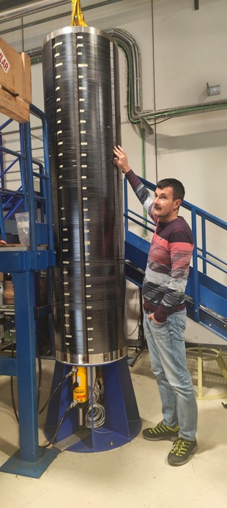
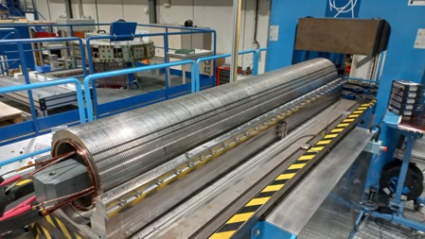
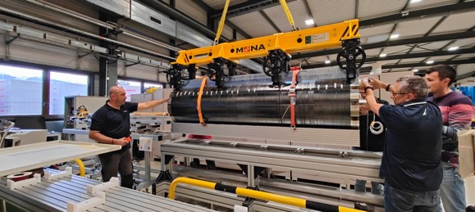
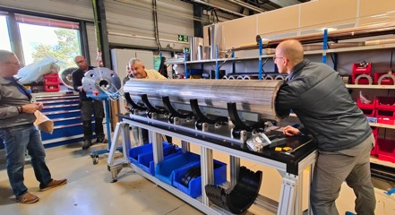
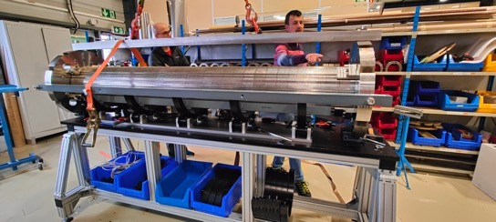
HL-LHC: Nested corrector magnet assembly at CERN
Mag. Measurements of the Inner Dipole
Inner Dipole Assembly
Outer Dipole in press
Magnet ready to be transported to Test Station
Dipoles, endplates and iron laminations
Outer Dipole in assembled
Both Dipoles with End Plates
Assembled in collaboration with CERN (927 laboratory)

Slide 14
CIEMAT contribution to FCC

Slide 15
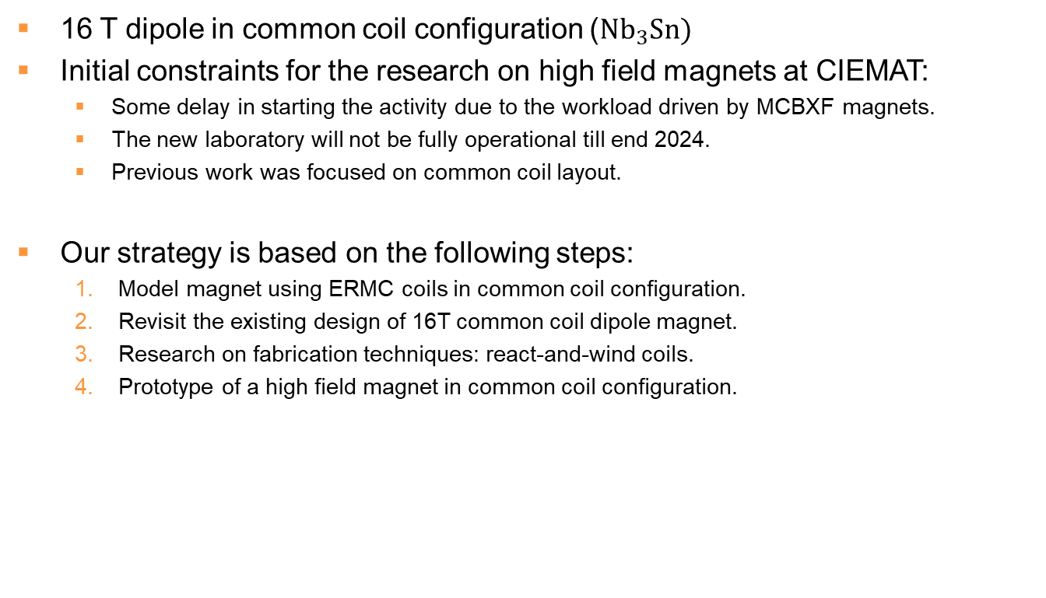
CIEMAT contribution to FCC:
R&D on High Field Magnet
16 T dipole in common coil configuration ($Nb_{3}Sn)$
Initial constraints for the research on high field magnets at CIEMAT:
Some delay in starting the activity due to the workload driven by MCBXF magnets.
The new laboratory will not be fully operational till end 2024.
Previous work was focused on common coil layout.
Our strategy is based on the following steps:
Model magnet using ERMC coils in common coil configuration.
Revisit the existing design of 16T common coil dipole magnet.
Research on fabrication techniques: react-and-wind coils.
Prototype of a high field magnet in common coil configuration.

Slide 16
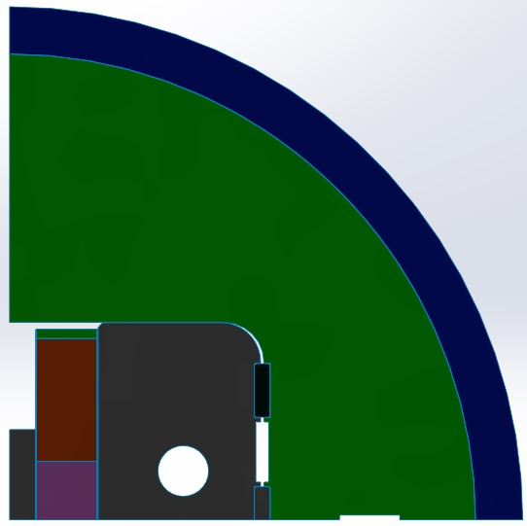
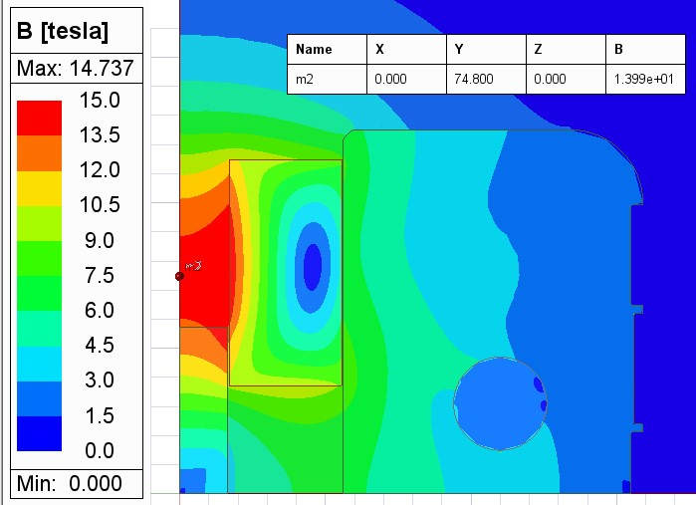
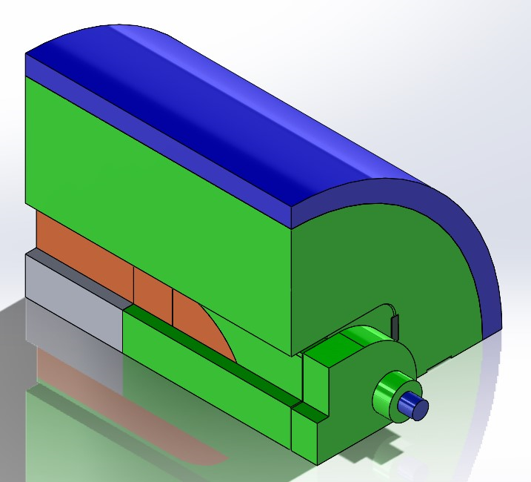
ISAAC: Model magnet using RMC coils
Motivation:
The main challenge of high field common-coil dipoles is mechanics
We can test different support structures with existing coils
ISAAC: Investigating Superconducting Assembly to Address Common coil mechanics

Slide 17
Model magnet using RMC coils
Motivation:
The main challenge of high field common-coil dipoles is mechanics.
No need to produce Nb₃Sn coils at CIEMAT laboratory.
Strategy:
Calculation of a model magnet in common coil configuration using existing RMC coils: magnetic, mechanical, protection.
Engineering design: 3D model, fabrication drawings, tooling.
Fabrication of components.
Assembly at CERN (927 workshop): training on bladder and key technology. Most of assembly tooling is available.
Test at CERN (SM18).

Slide 18
Revisit the existing design of 16T dipole
Motivation:
16 T is too challenging for our first high field magnet.
Adapt the design to the procured cables.
Strategy:
Define the input parameters: properties of procured cables, main dimensions, main field objective.
Calculations: electromagnetic, mechanical, protection.
Engineering design: 3D model, fabrication drawings.
React and wind coils
Motivation:
Possible cost-effective solution of series production of high field magnets.
Common coil layout is the only one compatible with this technique.
Strategy:
Analysis of past experiences.
Calculation of a model coil and evaluation of the feasibility of a model magnet.
Engineering design: 3D model, fabrication drawings, tooling.
Fabrication.
Test at CERN (SM18).

Slide 19
CIEMAT contribution to ILC

Slide 20
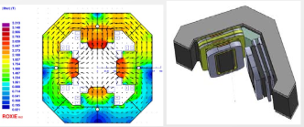
ILC: conduction cooled magnets (MagNext)
SC Quadrupole package at the center of the cryomodule (B) of the SRF string for beam acceleration
Quadrupole magnet combined with dipole corrector and BPM (IFIC)
Conduction cooled to avoid the need of a He cryostat
National MAGNEXT Project: design, fabrication and characterization of conduction-cooled coils with large temperature margin (in collaboration with KEK).

Slide 21
CIEMAT contribution to CLIC

Slide 22
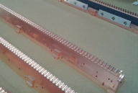
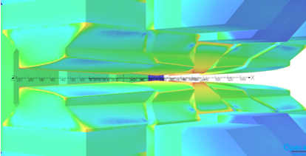
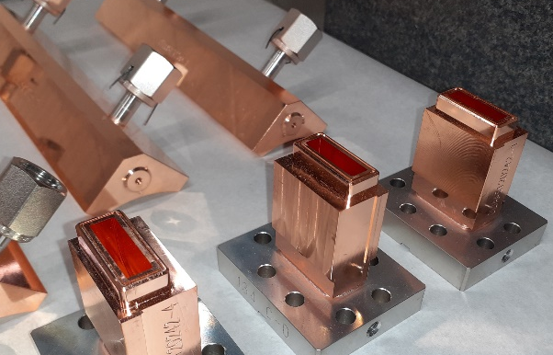
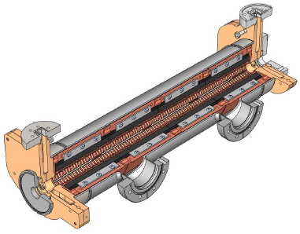
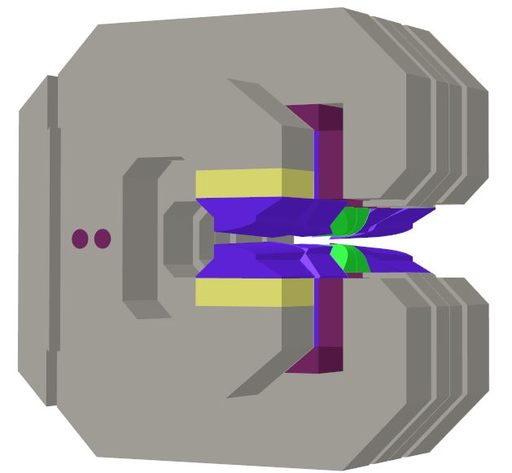
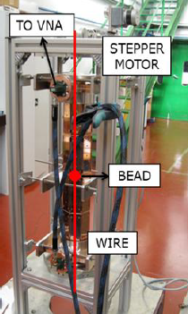
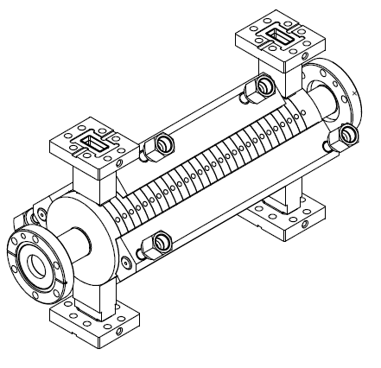
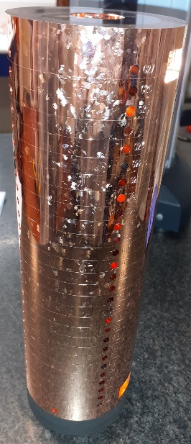


CIEMAT CONTRIBUTION TO CLIC
Variable high field magnets
RF structure manufacturing
Manufacturing of Power Extraction and Transfer Structures (PETS)

Slide 23
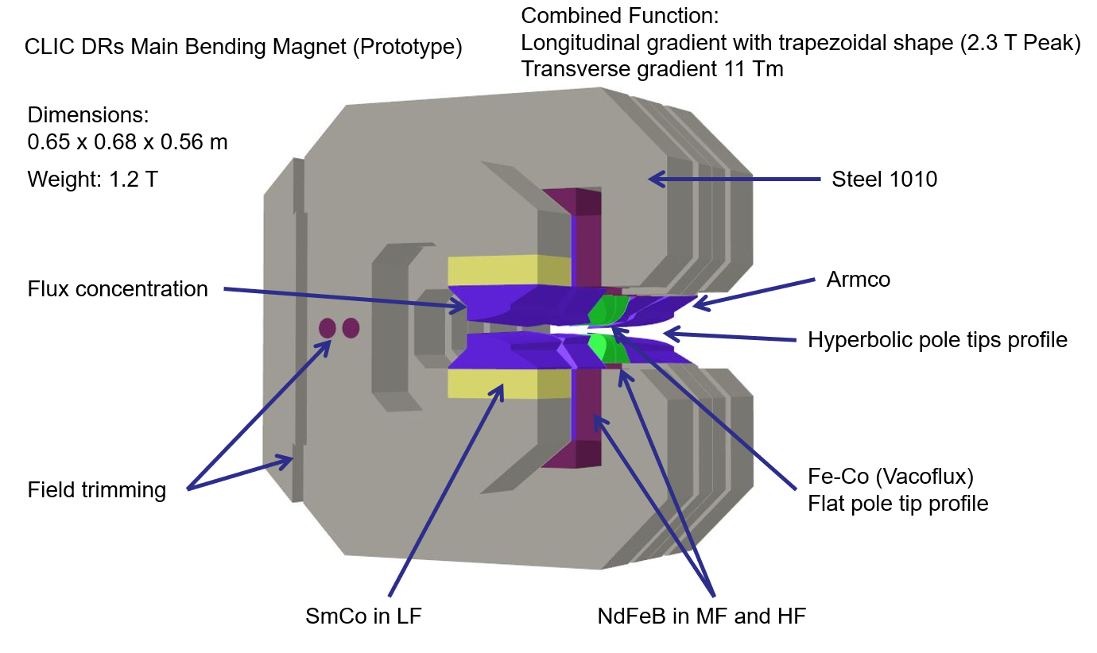
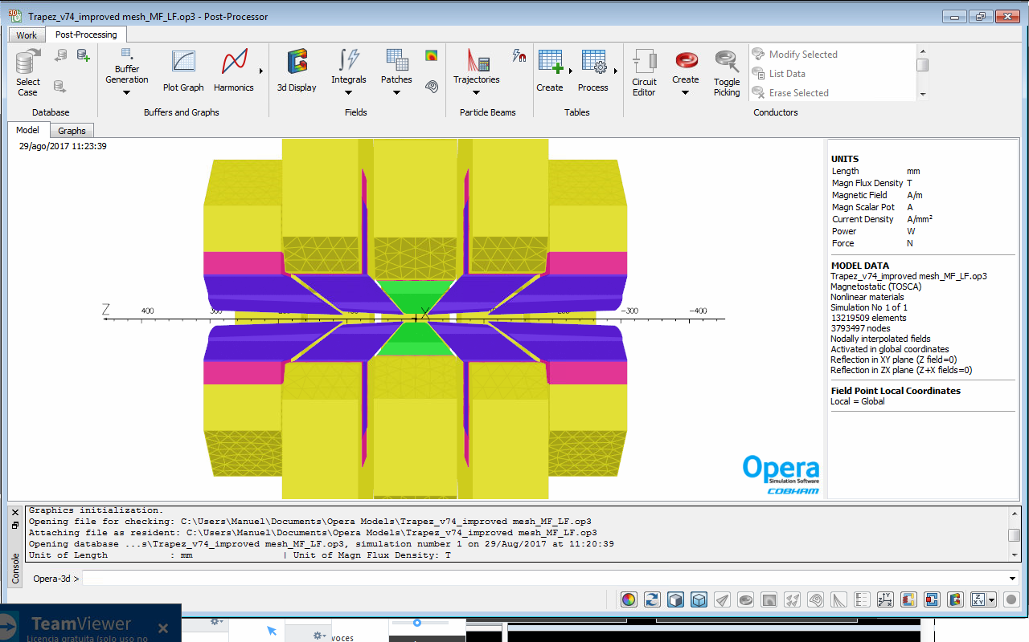
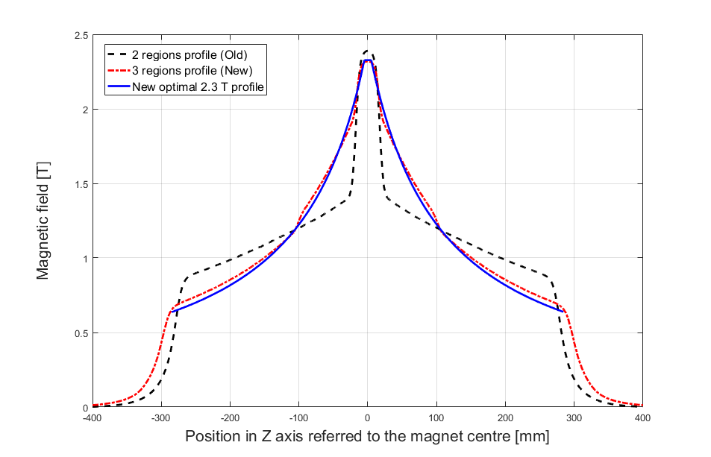
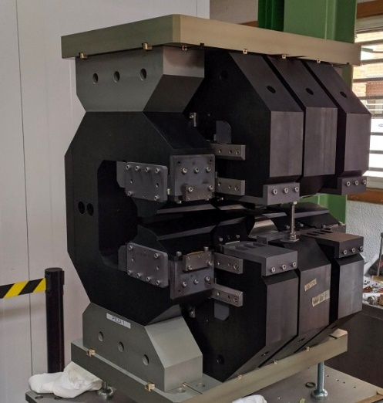
CLIC: permanent magnets
Development of dipole magnets with variable longitudinally field based on permanent magnets: low-emittance damping rings.

Slide 24
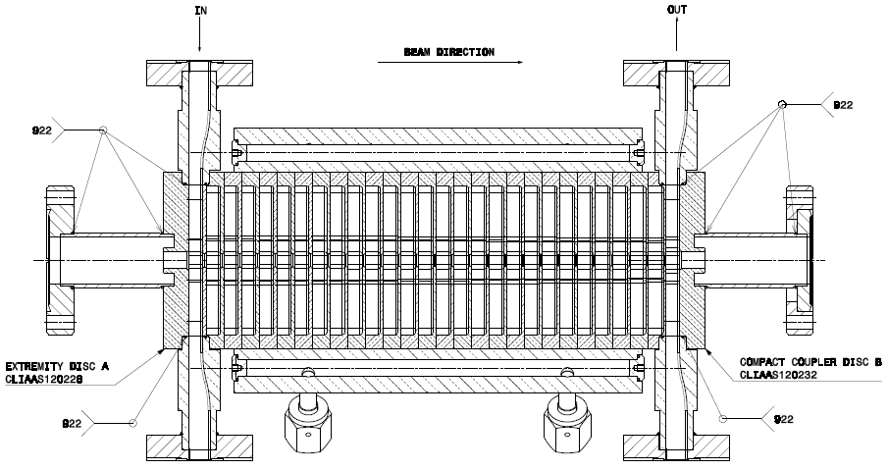
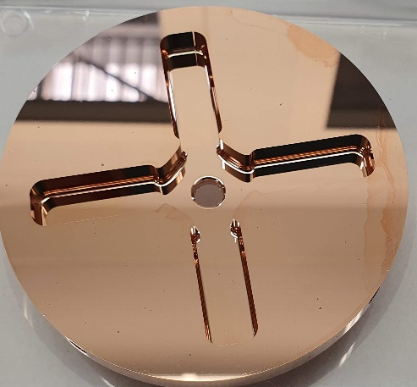
CLIC: RF structures
TD26CC
Disks manufactured by Spanish Industry (EGILE)
Tolerances fully achieved
Pending RF tests at CERN

Slide 25
Conclusions
All the ongoing projects on accelerator developments for future colliders drive substantial innovative aspects for our group.
High temperature superconductors are not included in the ongoing projects, but we are in conversations with the Spanish funding agency CDTI to start this activity.
We are working on different technologies for three future collider proposals: FCChh, ILC and CLIC.
Spanish (CIEMAT) accelerator contribution to future colliders should not be exclusively “magnets”
Very close contact with Spanish industry.

