Slide 1
Linear colliders
Outline
LC general considerations
Key project studies: ILC and CLIC, briefly C³ and HALHF
Schedules, Costs, Power and Sustainability
LC upgrades and the overall collider landscape
ESPP planning
Steinar Stapnes – CERN
Spain/CERN 1.7.2024

Slide 2
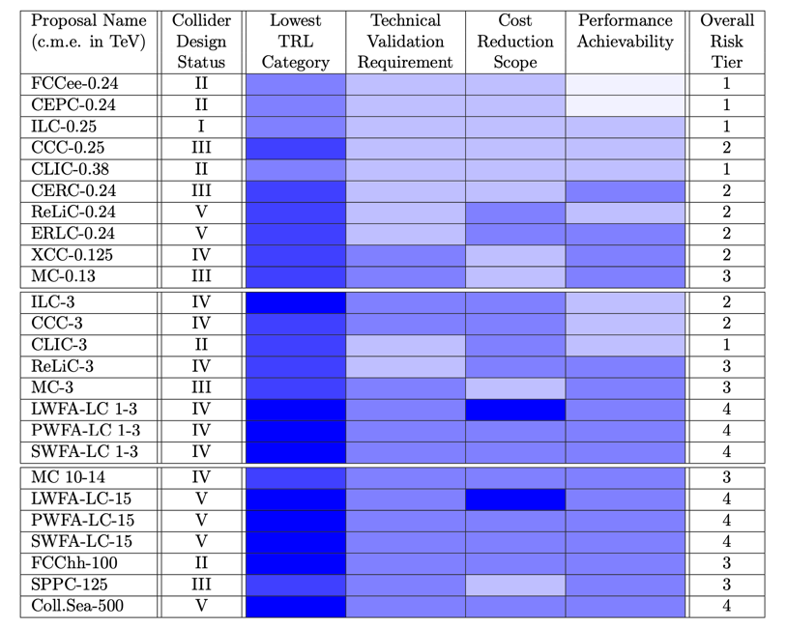
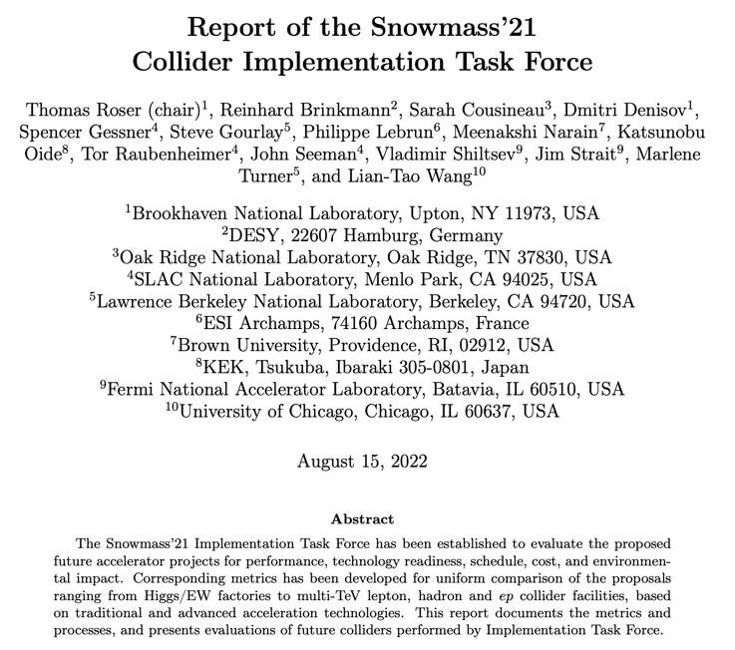
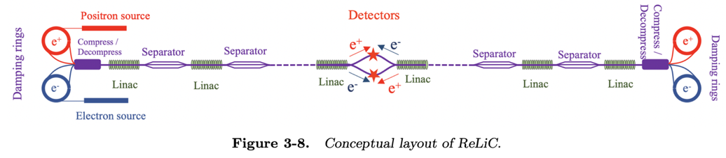
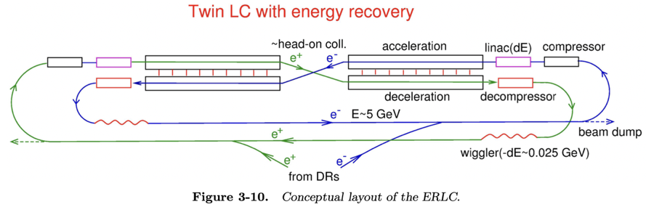
Strategies
ESPP update 2018-19:
Higgs factory next – project studies
FCC feasibility study
R&D on technologies and projects
Many Linear Collider studies and concepts discussed.
In this talk I will concentrate on the mature ILC and CLIC studies, and briefly mention the rapidly developing C³ study and a new concept making use of plasma acceleration, HALHF.
Other concepts, e.g. energy recovery, are also being worked on:
Snowmass 2021-23 provided(s) an opportunity for formulating new ideas, updated reports, overviews and summaries – for the US and worldwide
https://arxiv.org/pdf/2208.06030.pdf

Slide 3
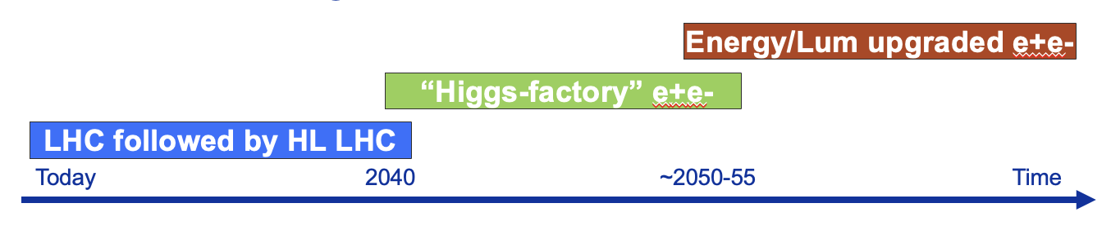
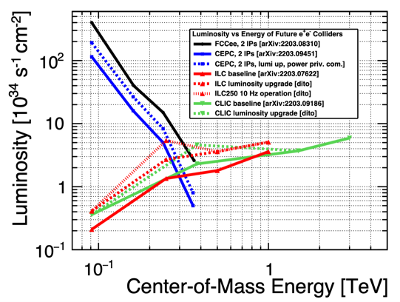
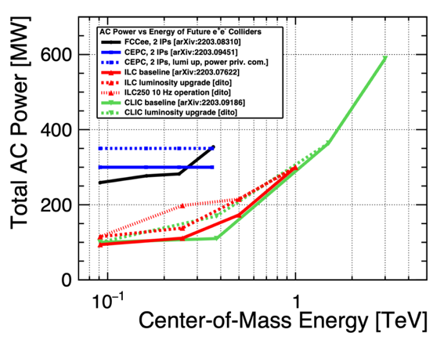
e
LC general considerations
Increased luminosity with energy, e.g. 1-3 x 10³⁴ cm⁻²s⁻¹ for Higgs factories at 250 GeV, 6 x 10³⁴ at 3 TeV
Higher energies “easy” – 3 TeV studied (CLIC), but many TeVs challenging:
Power proportional to luminosity
Consider up to 50km
Higher energy means smaller beams and increasingly important beam-beam effects

Slide 4
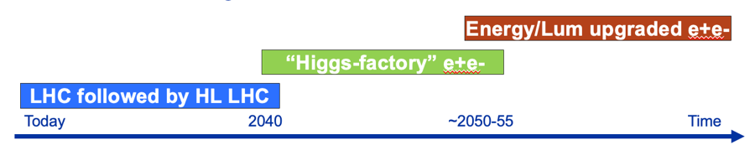
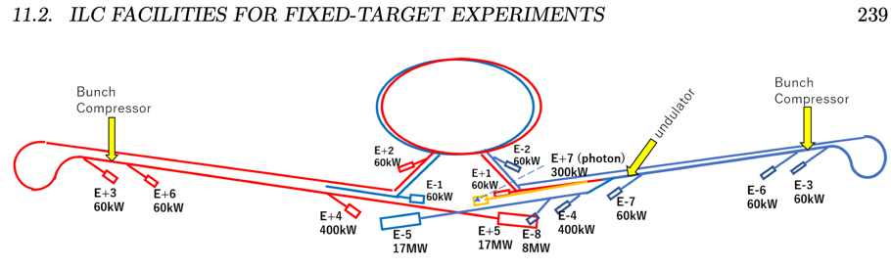
e
LC physics opportunities
arXiv:2206.08326
A wide programme:
ILCX – e.g. beam-dump experiments, dark sector physics, light dark matter, strong QED (ILCX workshop)
Higher energies: Improved Higgs, extended models, top well above threshold with polarization, new physics searches and measurements
Z running also possible
e+e- colliders show very comparable performance for standard Higgs program, despite quite different assumed integrated luminosities => longitudinal beam polarization an important factor for LCs
several couplings at few-0.1% level: Z, W, g, b, τ
some more at ~1%: γ, c

Slide 5
Some key LC projects – brief

Slide 6
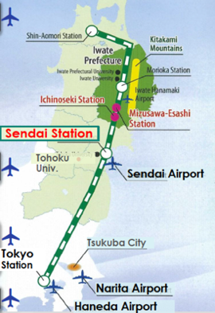
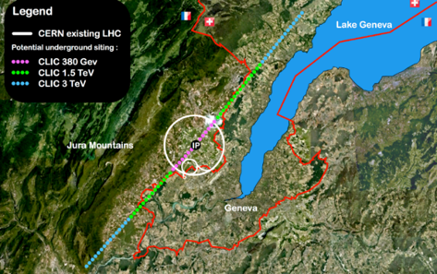
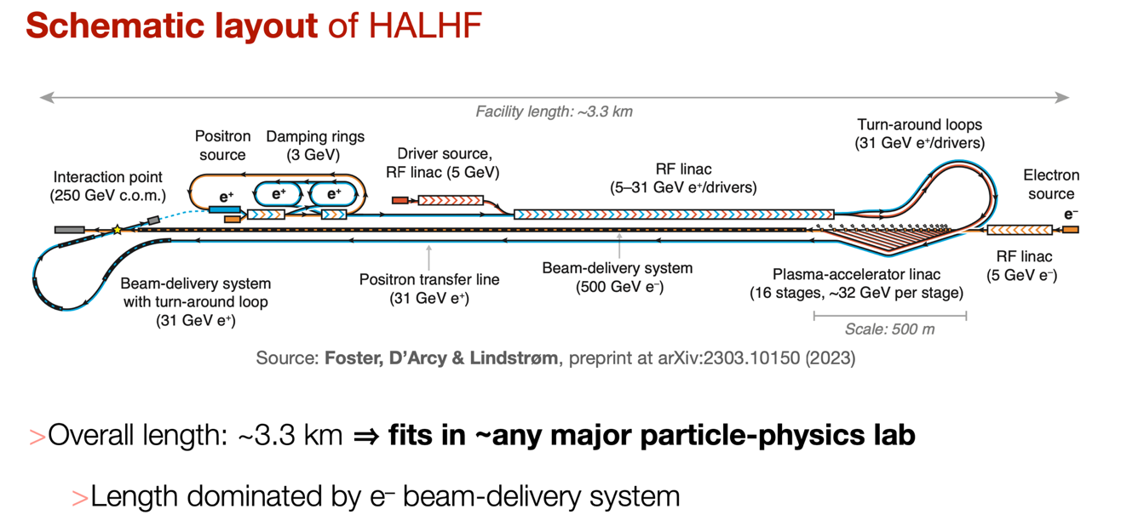
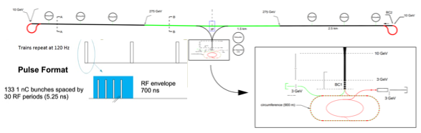
LC projects discussed below
ILC in Japan
CLIC at CERN
Initially e+e- collisions at least at 250 GeV
Linear colliders: 11 (Higgs) -> 50 (max) km for higher energies later
Four different RF solutions drive the designs
Can be built anywhere …
C3 - US based study (initially)
HALHF – anywhere

Slide 7
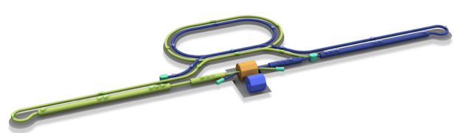
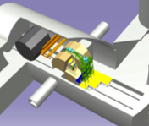
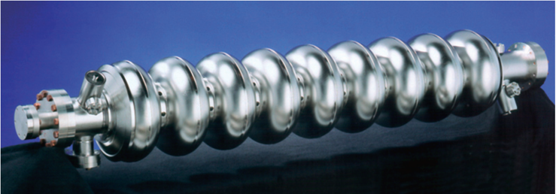
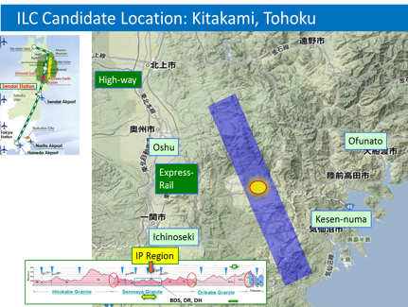
The ILC250 accelerator facility
Interaction point
Damping Ring
e+ Source
e- Main Linac
e- Source
Beam dump
Physics Detectors
Bunches of ~10¹⁰ e+/e-
e+ Main Liinac
Item | Parameters
C.M. Energy | 250 GeV
Length | 20km
Luminosity | 1.35 x10³⁴ cm⁻²s⁻¹
Repetition | 5 Hz
Beam Pulse Period | 0.73 ms
Beam Current | 5.8 mA (in pulse)
Beam size (y) at FF | 7.7 nm＠250GeV
SRF Cavity G. Q₀ | 31.5 MV/m (35 MV/m) Q₀ = 1x10 ¹⁰
Parameters and plans for luminosity and energy upgrades are available, interesting and relevant SCRF R&D also for such upgrades (Snowmass input)

Slide 8
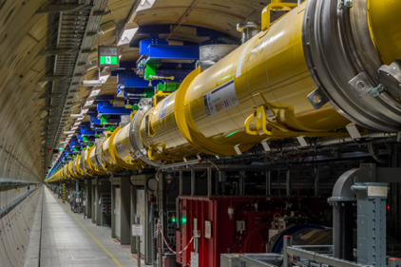
Key systems and challenges
The ILC is a very mature design, with a comprehensive TDR
Next steps involve technical developments and industrial prototyping with final specs as needed for an Engineering Design and in preparation of pre-series and construction
Creating particles Sources
polarized elections/positrons
High quality beam Damping ring
low emittance beams
Acceleration Main linac
superconducting radio frequency (SRF)
Collide them Final focus
nano-meter beams
Go to Beam dumps
Notes:
Add ATF figure

Slide 9
The ILC IDT organization – initiated at the ICFA meeting at SLAC February 2020
2020-21: The IDT – created by ICFA and hosted by KEK – was set up to move ILC towards construction. The worldwide structure of the WGs: https://linearcollider.org/team/
A set of key activities were identified in a Preparation Phase Programme.
2022-23: A subset of the technical activities of the full ILC preparation phase programme have been identified as critical (next slide). These are being addresses by a ~4 year programme called ITN – the ILC Technology Network. Moving forward with this work is being supported by the MEXT (ministry) providing crucial increased funding.
As of today: With funding from 1.4.2023 ITN is now starting. An agreement KEK and CERN and several European lab activities have been/are being set up. In the US the P5 process is ongoing, the hope is that ITN planning and interests can turn into important ITN involvements in due time.

Slide 10
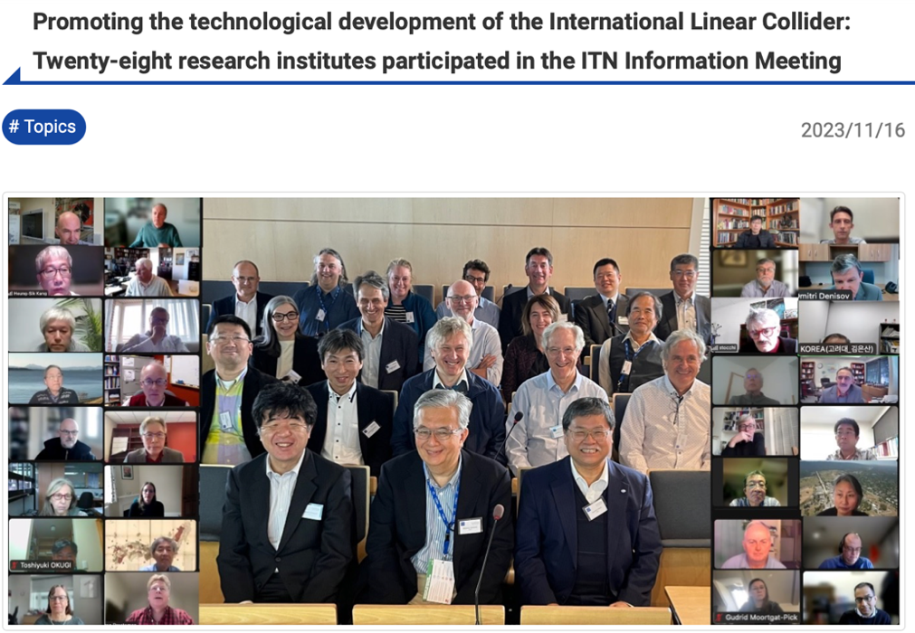
The ITN
WPP | 1 | Cavity production
WPP | 2 | CM design
WPP | 3 | Crab cavity
WPP | 4 | E- source
WPP | 6 | Undulator target
WPP | 7 | Undulator focusing
WPP | 8 | E-driven target
WPP | 9 | E-driven focusing
WPP | 10 | E-driven capture
WPP | 11 | Target replacement
WPP | 12 | DR System design
WPP | 14 | DR Injection/extraction
WPP | 15 | Final focus
WPP | 16 | Final doublet
WPP | 17 | Main dump
Building the ITN activities:
Planning in the IDT WG2 – significant interests and expertise already represented
Information meeting at CERN 16-17.10 jointly organized by KEK and the IDT
Interest matrix for the ITN work-packages, being consolidated
The next step: Further technical discussion to define deliverables, followed by agreement who among the laboratories will deliver what
For ILC, several important contributions from Spain: ML Quads, cold BPMs, studies in ATF, etc

Slide 11
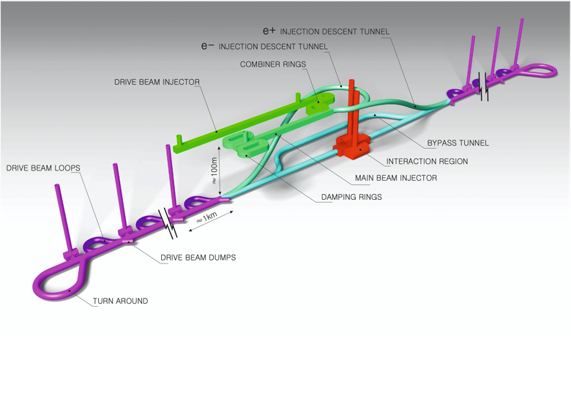
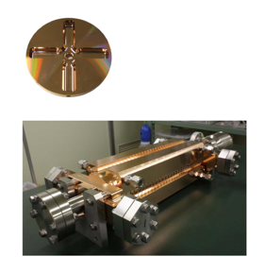
The Compact Linear Collider (CLIC)
Timeline: Electron-positron linear collider at CERN for the era beyond HL-LHC
Compact: Novel and unique two-beam accelerating technique with high-gradient room temperature RF cavities (~20’500 structures at 380 GeV), ~11km in its initial phase
Expandable: Staged programme with collision energies from 380 GeV (Higgs/top) up to 3 TeV (Energy Frontier)
CDR in 2012 with focus on 3 TeV. Updated project overview documents in 2018 (Project Implementation Plan) with focus 380 GeV for Higgs and top.
Accelerating structure prototype for CLIC: 12 GHz (L~25 cm), 100 MV/m

Slide 12
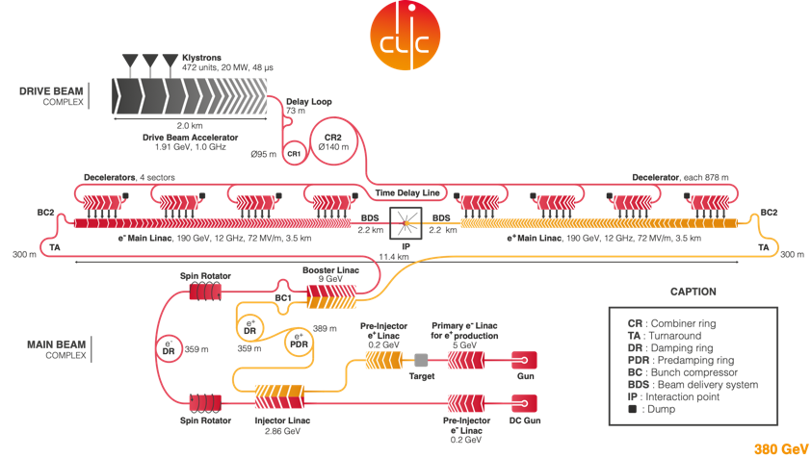
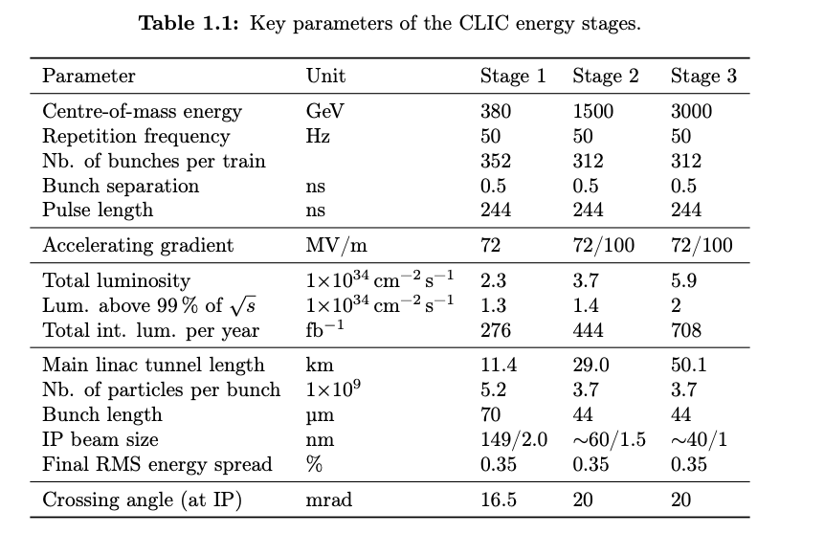
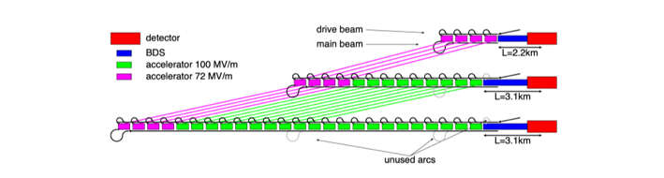
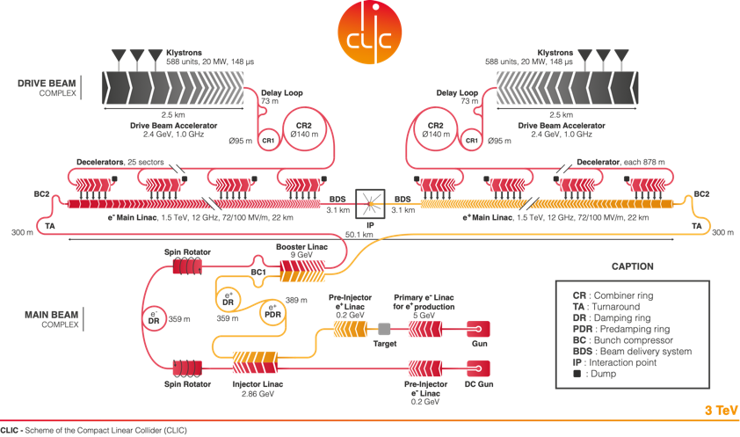
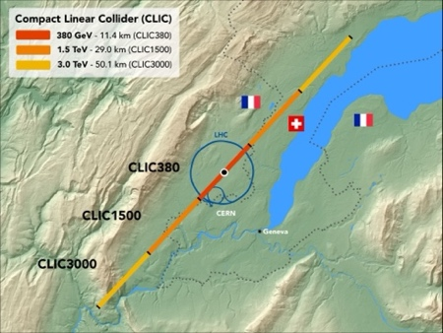
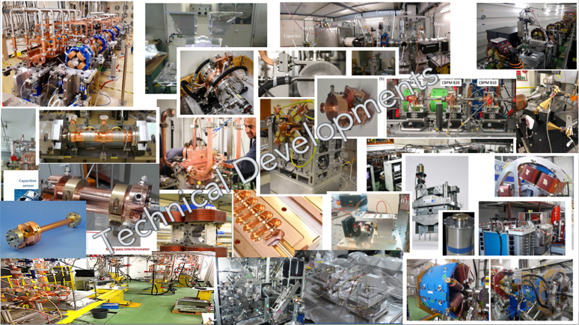
CLIC to 3 TeV
Extend by extending main linacs, increase drivebeam pulse-length and power, and a second drivebeam to get to 3 TeV
The CLIC accelerator studies are mature:
Optimised design for cost and power
Many tests in CTF3, FELs, light-sources and test-stands
Technical developments of “all” key elements
Important Spanish contributions, e.g. fast kicker, magnets, RF systems incl. cavities, detector and physics

Slide 13
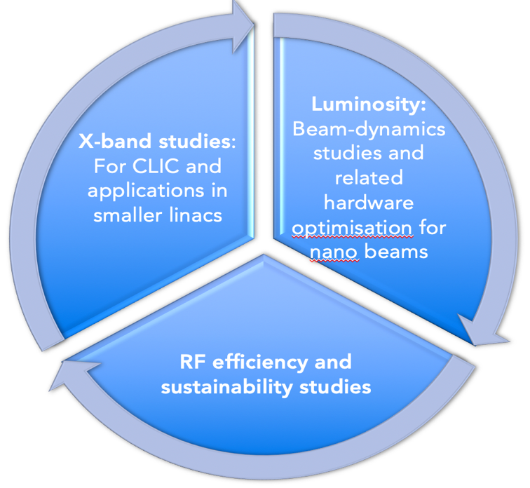
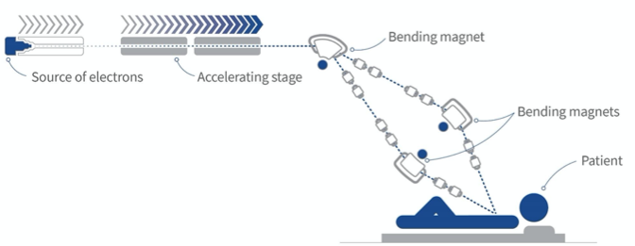
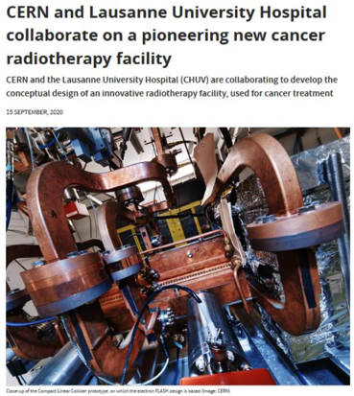
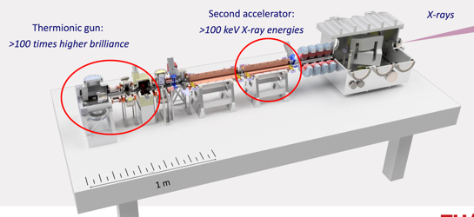
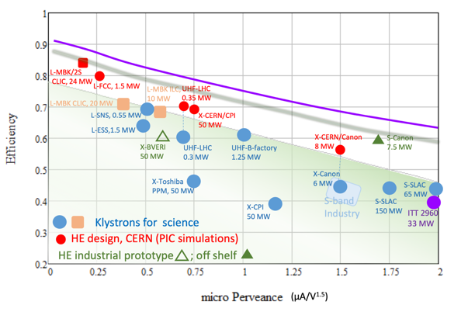
On-going CLIC studies towards next ESPP update
Project Readiness Report as a step toward a TDR
Assuming ESPP in ~ 2026, Project Approval ~ 2028, Project (tunnel) construction can start in ~ 2030.
The X-band technology readiness for the 380 GeV CLIC initial phase - manufacturability and developments driven by use in small compact accelerators for industrial experience
Optimizing the luminosity at 380 GeV at 2.3 x 10³⁴ cm⁻² s⁻¹– already implemented for Snowmass paper, further work to provide margins will continue (HW and SW)
Project summary for Snowmass: https://arxiv.org/pdf/2203.09186.pdf
Improving the power efficiency for both the initial phase (already in Snowmass report) and at high energies, including more general sustainability studies (in many cases done together with ILC – see later)

Slide 14
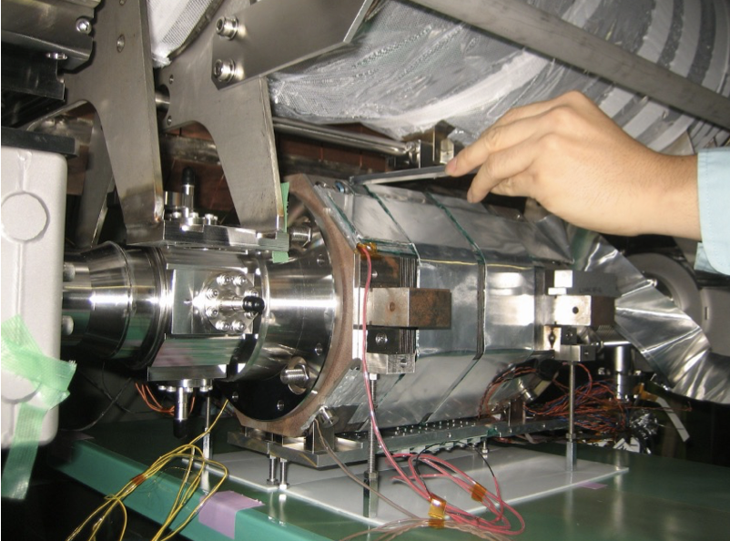
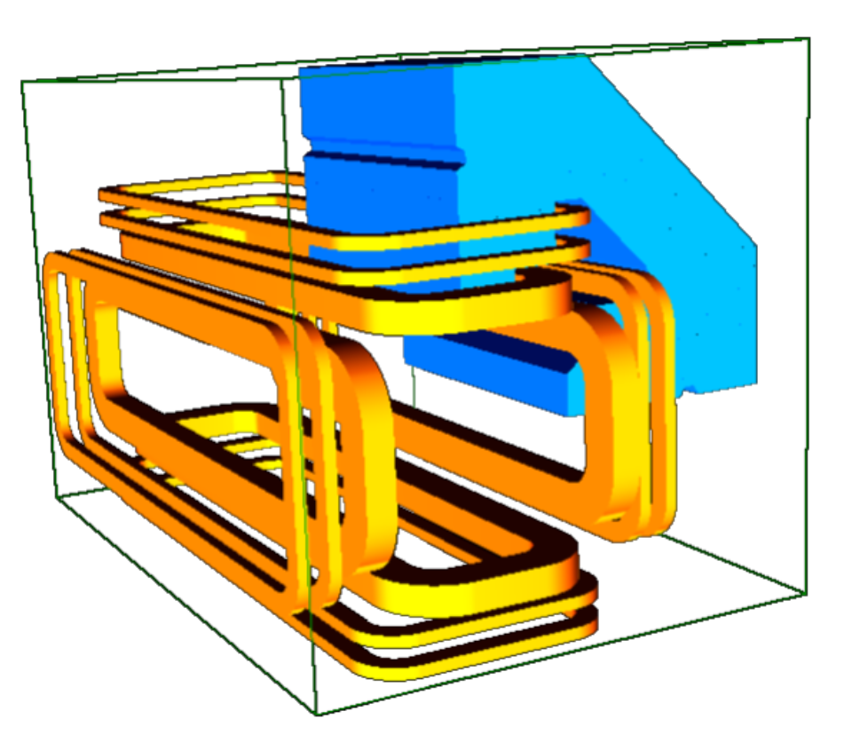
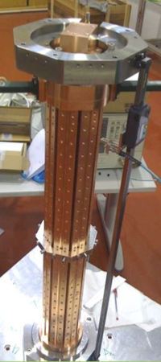
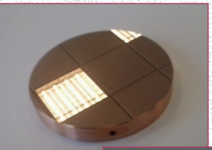
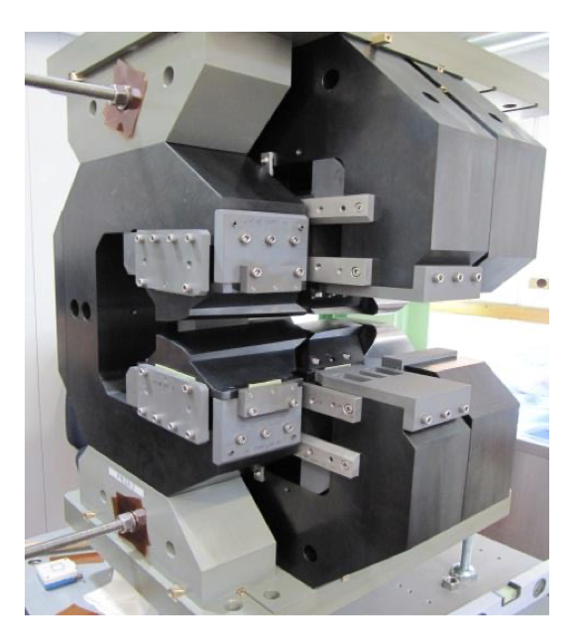
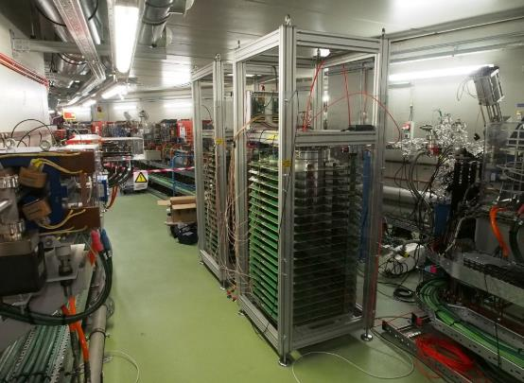
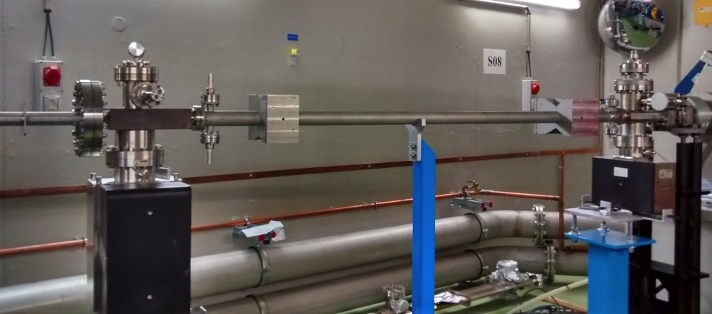
Some examples of
Spanish LC R&D
- see next talk -
Inductive Adder #2
Inductive Adder #1
Striplines

Slide 15

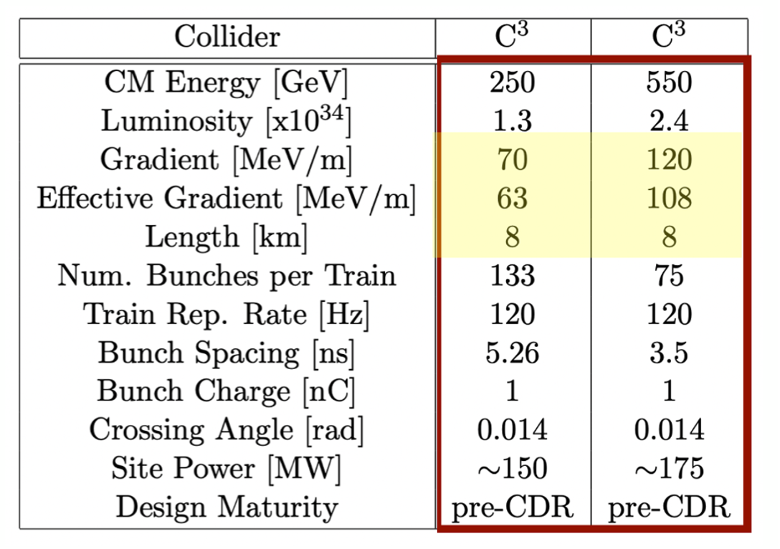
Accelerator Complex
8 km footprint for 250/550 GeV CoM ⟹ 70/120 MeV/m
Large portions of accelerator complex compatible between LC technologies
Beam delivery / IP modified from ILC (1.5 km for 550 GeV CoM), compatible w/ ILC-like detector
Damping rings and injectors to be optimized with CLIC as baseline
Snowmass paper: https://arxiv.org/pdf/2203.07646.pdf
C³ Parameters

Slide 16
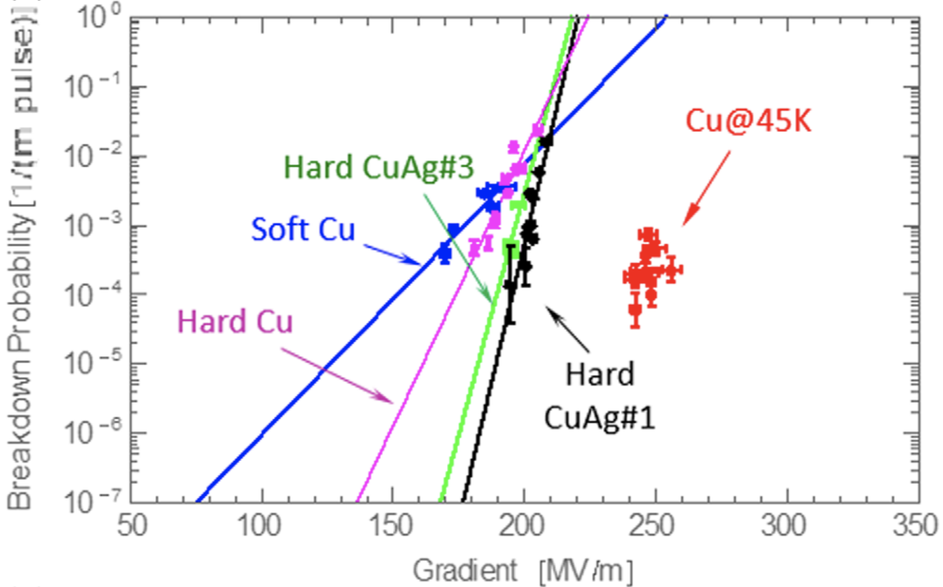
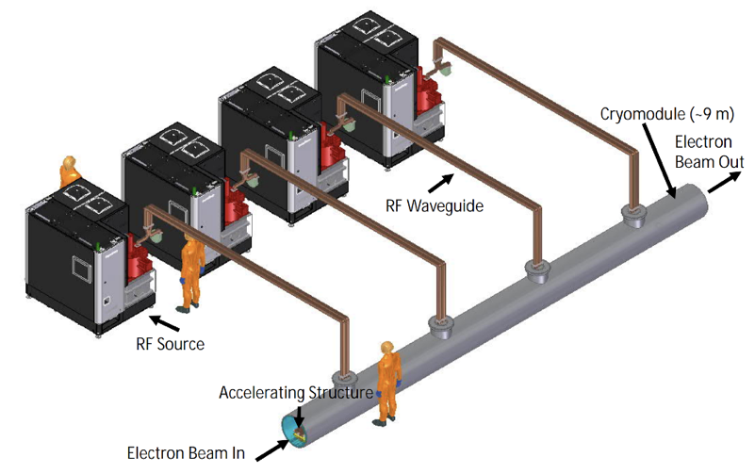
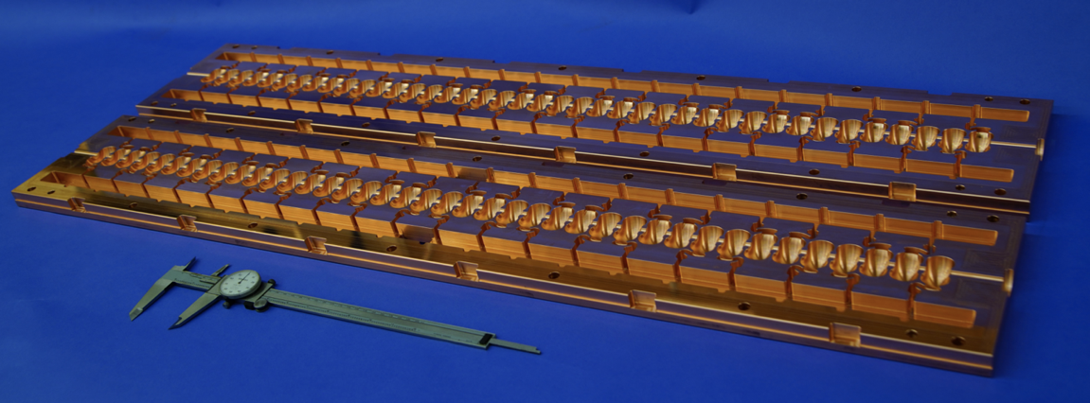
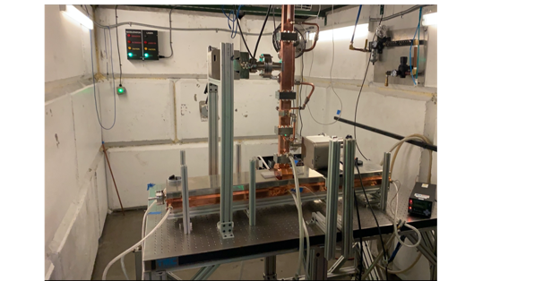
Cryo-Copper: Enabling High-Gradient Operation
Cryogenic temperature (LN₂ at 80k) elevates gradient performance
Increased material strength is key factor
Increase electrical conductivity reduces pulsed heating in the material
C³ Main Linac Cryomodule
9 m (600 MeV/ 1 GeV)
Cahill, A. D., et al. PRAB 21.10 (2018): 102002.
C³ Prototype One Meter Structure
High power Test at Radiabeam

Slide 17
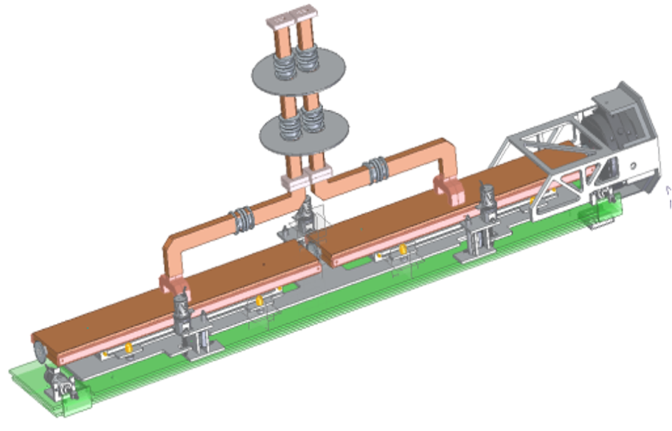
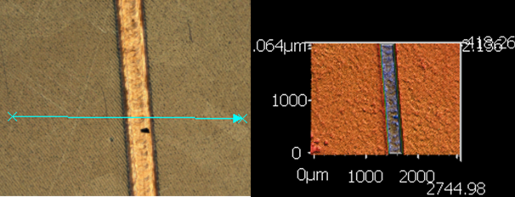

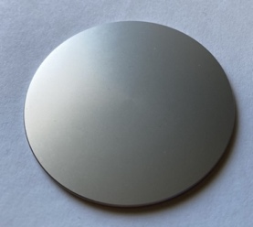
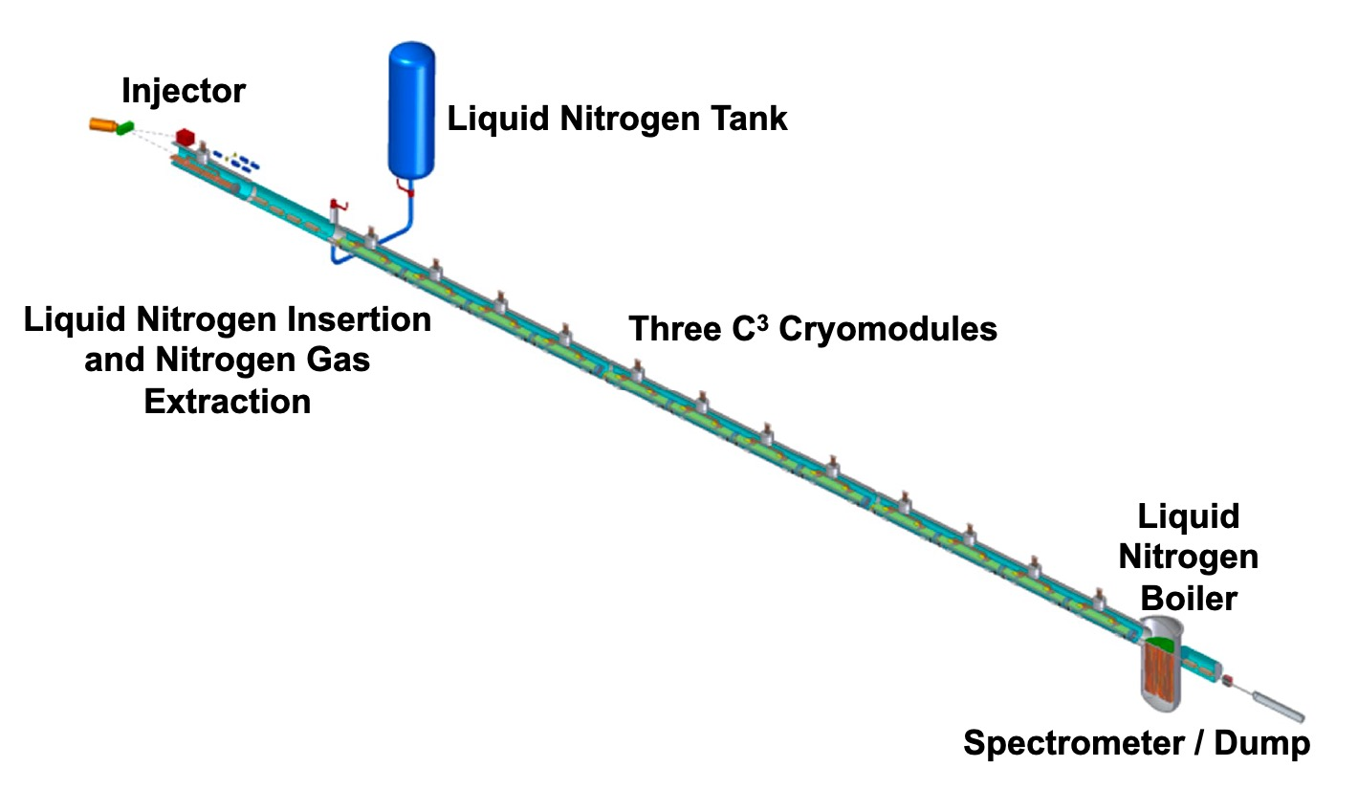
Other important technological developments - and towards a demonstrator
Integrated Damping with NiChrome Coating
Preliminary Alignment and Positioning
Demonstrate fully engineered cryomodule
~50 m scale facility
3 GeV energy reach
Answer technical questions needed for CDR

Slide 18

HALHF: A Hybrid, Asymmetric, Linear Higgs Factory
New concept, aiming for pre-CDR end 2024:
500 GeV for electrons with plasma acceleration
31 GeV positrons with RF based linac, used also to provide electron drivebeam for the plasma acceleration
Reach 250 GeV collision energy, luminosity 10³⁴
Paper: https://arxiv.org/pdf/2303.10150.pdf
Asymmetric technologies, energies and bunch charges
Small footprint, lower cost (half again?)
Several key plasma acc. challenges:
Multi-staging, emittances, energy spread, stabilities, spin polarisation preservation, efficiencies, rep rate, plasma cell cooling and more
Conventional beam(s) challenges:
Positron production, damping rings, RF linac, beam delivery system
Experimental challenges with asymmetric beams

Slide 19
Some key implementation figures/plots

Slide 20
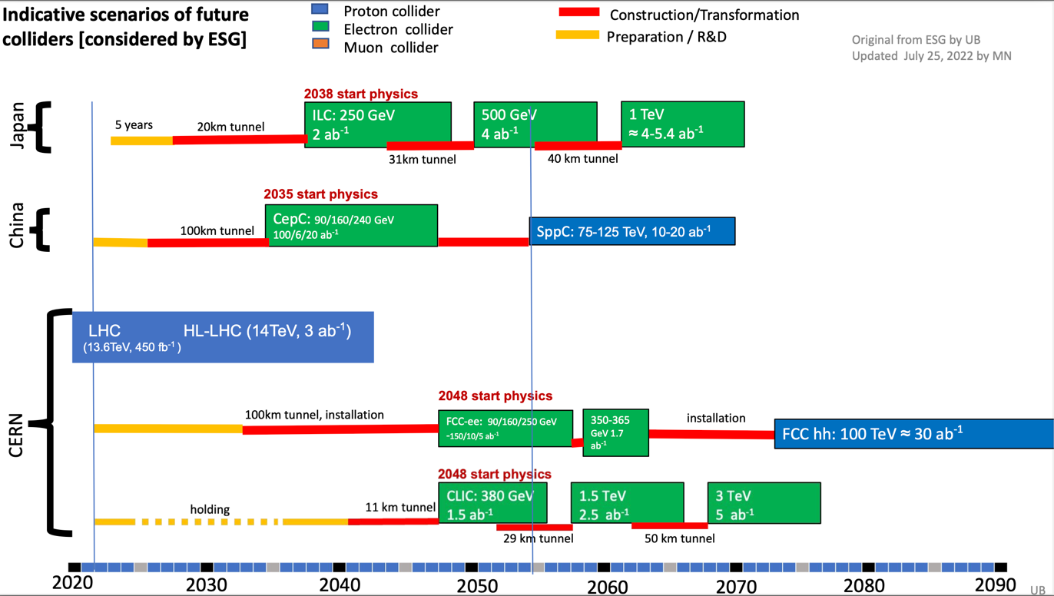
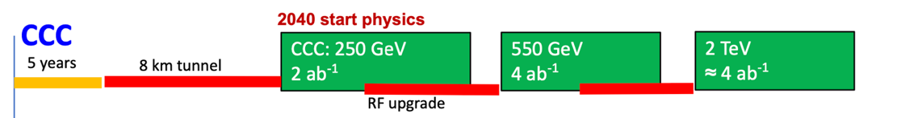

Timelines in Snowmass Energy Frontier summary
Comments:
Timelines are technologically limited – except the CERN projects that are linked to completion of the HL-LHC
From Meenakshi Narain EF summary Snowmass

Slide 21



Personnel estimate and cost – Higgs factories
One FTEy estimated to 200kUS$
Detailed PBS/WBS based reviewed number exists for ILC and CLIC, but not consistently updated to 2023 including currency changes and inflation – nevertheless good agreement
This estimate from the Snowmass process includes personnel costs (usually kept separate, e.g. ILC and CLIC)
Notes:
Remove FCC

Slide 22

Power and energy
Power at 250-380 GeV in the 100-150 MW range for the projects above, reaching ~500 MW at 3 TeV for CLIC
With a running scenario on the right this corresponds to 0.6-0.8 TWh annually
CERN is currently consuming 1.2 – 1.3 TWh annually
CERN “standard” running scenario used to convert to annual energy use
Includes studies of overall designs optimisation to reduce power, SRF cavities (grad,Q), cryo efficiency, RF power system (klystrons, modulators, components), RF to beam efficiencies, permanent magnets, operation when power is abundant, heat recovery, nanobeam and more.
Recent overview (LINK)

Slide 23




Sustainability: towards a Life Cycle Assessment (LCA) for LCs
What is the carbon intensity of energy in ~2050 (operation):
50% nuclear and 50% renewable give ~10-15g/kWh
France summer-months are today ~40g/kWh
ILC has a green implementation concept including compensation and contracting renewable energy
Reductions predicted (LINK)
LCA report for Civil Engineering: LINK
Addressing the Civil Engineering impact
Around 11-12 kton/km main linac (CLIC DB and ILC)

Slide 24

Towards Carbon Accounting with LCA
Work in progress – this example is closest to the CLIC drive-beam parameters, detectors and computing (and travels) not considered
This (blue) is for 11 km of tunnel, scales with length (CE study prev. page)
Next working on machine parts (orange), here assumed hardware = civil engineering impact
More power (here 0.7 TWh) or more carbon (here 12g/kWh) will increase this quickly

Slide 25
Preparing for the ESPP update

Slide 26
An adaptable e+e- LC facility for the world
A LC facility can be extended in length for higher energies, using the same or improved versions of the same technology, e.g. as suggested for ILC, CLIC, C3 and HALHF.
It is also possible and realistic to change to more performant (usually higher gradient) technologies in an upgrade, e.g. from ILC to CLIC or C3, maybe even plasma
Starting point for fast implementation: ILC has the most mature linac technology for large scale implementation, that is also well established in all regions and in industry - it is based on a 20-21km long and ~6-10m wide tunnel
The physics at higher energies – Higgs sector and extended models with increased reach and precision, top in detail well above threshold, searches and hopefully new physics – will open for a very exciting long term e+e- programme (see next slide)
Such a programme can run in parallel with future hadron and/or muon colliders that can be developed, optimised and implemented as their key technologies mature

Slide 27

A physics-driven, polarised operating scenario for a Linear Collider
250 GeV, ~2ab-1:
precision Higgs mass and total ZH cross-section
Higgs -> invisible (Dark Sector portal)
basic ffbar and WW program
optional: WW threshold scan
Z pole, few billion Z’s: EWPOs 10-100x better than today
350 GeV, 200 fb-1:
precision top mass from threshold scan
500…600 GeV, 4 ab-1:
Higgs self-coupling in ZHH
top quark ew couplings
top Yukawa coupling incl CP structure
improved Higgs, WW and ffbar
probe Higgsinos up to ~300 GeV
probe Heavy Neutral Leptons up to ~600 GeV
800…1000 GeV, 8 ab-1:
Higgs self-coupling in VBF
further improvements in tt, ff, WW, ….
probe Higgsinos up to ~500 GeV
probe Heavy Neutral Leptons up to ~1000 GeV
searches, searches, searches, …
Based on classic ILC/CLIC luminosity assumptions limited by self-allowed power budget
From Jenny List/M.Peskin

Slide 28
Towards the ESPP update reports
CLIC
Energy scales: 380 GeV and 2 TeV with one drivebeam, consider also 100 Hz running at 250 GeV
Several updates on parameters - no major changes (injectors, damping rings, drive-beam) based on new results and prototyping
Technology results updates including more on use of them in other projects
Update costing and power (for example power for 2 TeV needs update)
LCAs
More on next steps (prep phase)
ILC
ILC cost update - among others industrial SRF update
CE update locally (is already reasonably up to date in Japan)
Various technology updates including ITN work
Schedule updates
LCAs

Slide 29


Linear Collider Inputs to the EPPSU - current ideas - will be discussed at the LCWS meeting next week in Tokyo -
Expect each LC project (ILC, CLIC, C3, HALHF, …) to make "Project Submissions”
project overviews with accelerator bias
Joint LC Submission (physics focus)
physics at a LC from 90 GeV to multi-TeV (use references to existing documents, but highlight specifically
need for >= 500 GeV and polarised beams
new results since Snowmass
a joint strategic vision for a Linear Collider Facility incl. upgrades, beyond collider etc — at any location in the world
Expect some Detector Concepts (ILD, SiD, …) to make a “Detector Concept Submissions”
“LC facility at CERN” submission (i.e. starting with ILC as outlined )
Adapted from Jenny List

Slide 30
Thanks – most of the slides/information from: The Snowmass Implementation Task Force (names on page 2, chair T.Roser) S.Michizono, B.List, IDT and ILC colleagues CLIC team J.List, A.Robson E.Nanni and the C³ team The HALHF team M.Narain J.List ARUP more ….

